Slide 1
Measurement and Computation of Nb₃Sn Rutherford Cables Strength Under Multi-Axial Loading Conditions
G. Vallone¹, E. Anderssen¹, B. Bordini², J.F. Croteau¹,
M. D’Addazio¹, P. Ferracin¹, F. Niccoli³
¹Lawrence Berkeley National Laboratory,
²CERN, ³Università della Calabria
General MDP Meeting
06 December 2023

Slide 2
Outline
Introduction
  An Empirical Orthotropic Failure Criterion
  Multiscale Modeling of Coil Strength Limits
Measurements
      1D Loading
      2D Loading
Conclusion

Slide 3
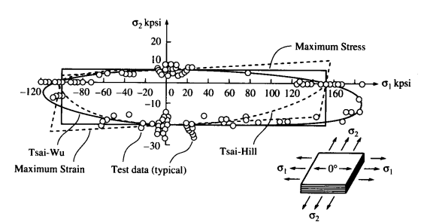
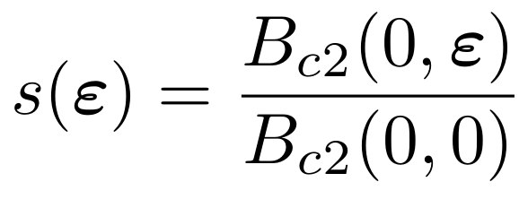
Coils – Failure Criteria – State-of-art
What can we define as ‘strength’ in superconducting coils?
    Anything that would reduce performance (e.g. critical current reduction)
    Actual failure of some part of the composite (e.g filament cracking, debonding)
  Reversible effects can be predicted with the exponential strain function
  Current ‘state-of-art’ failure criteria:
    Non-interacting: Transverse/Azimuthal stress < 150/175 MPa
      From measurements on transversally loaded cables
    Interacting: Von Mises equivalent stress < 150:200 MPa
      From comparison between models and magnet performance
    Both should not be applicable to composite materials

Slide 4
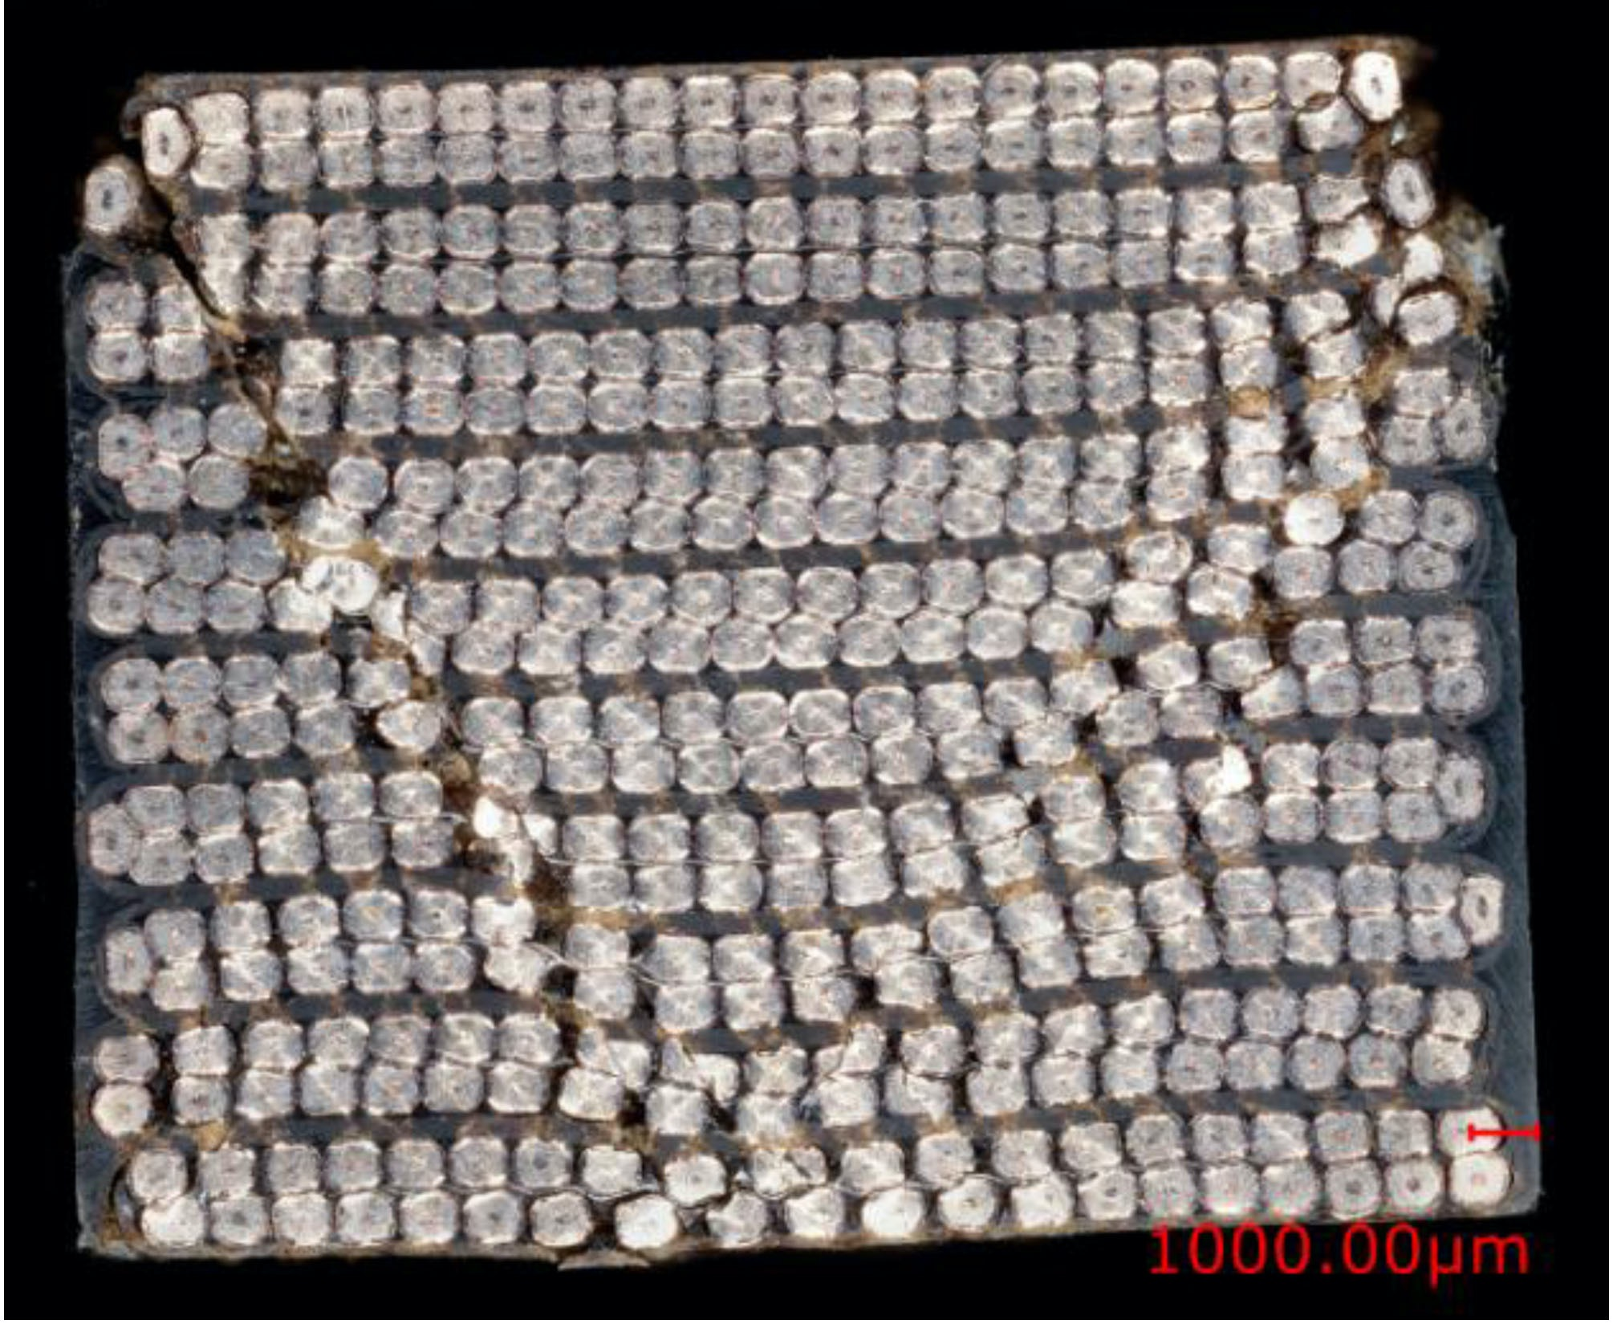
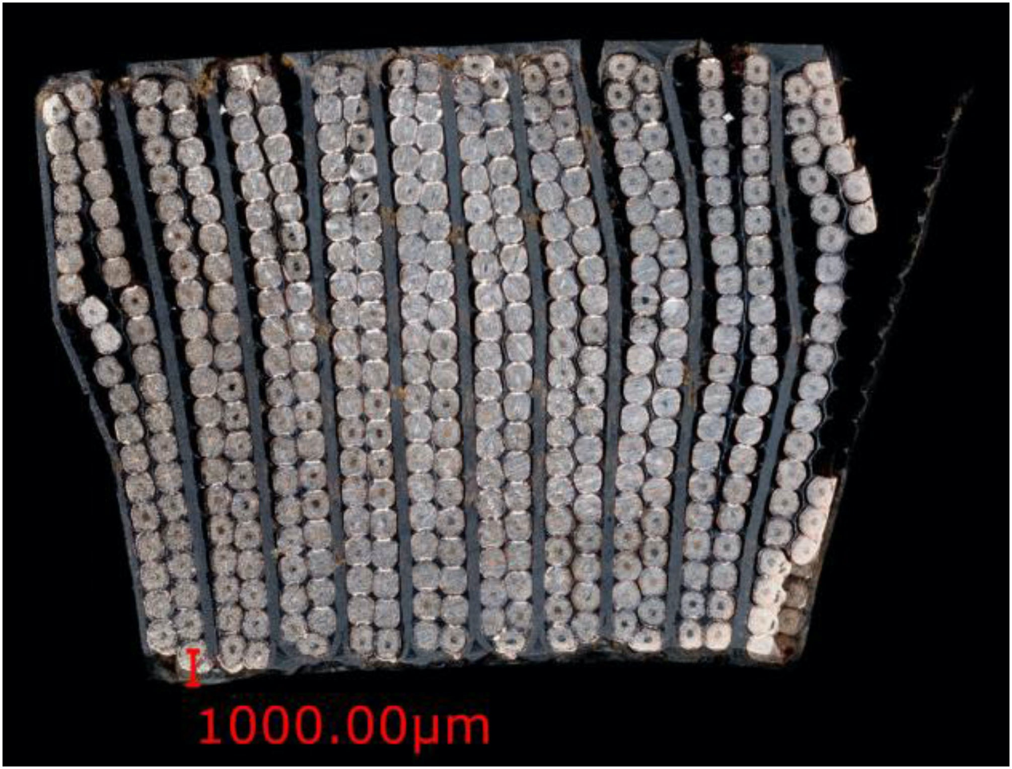
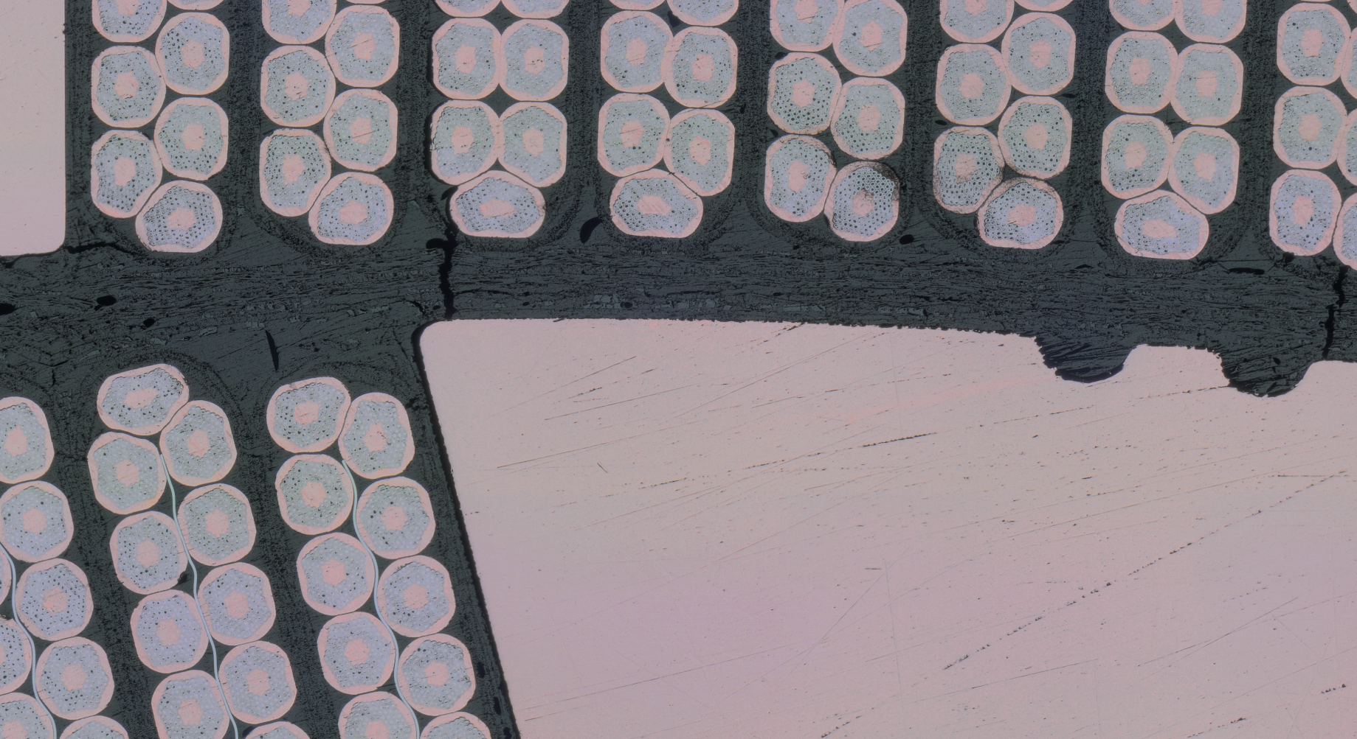
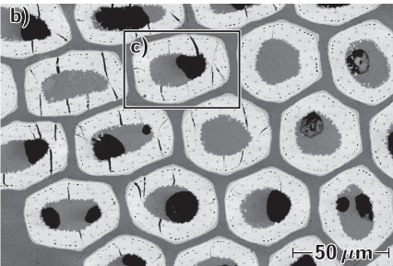
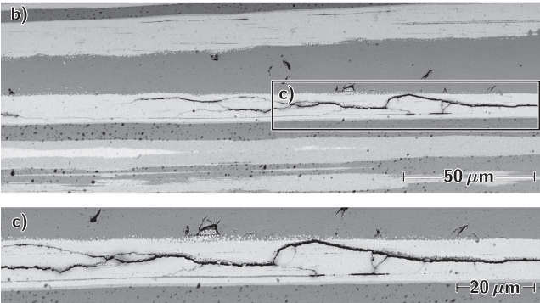
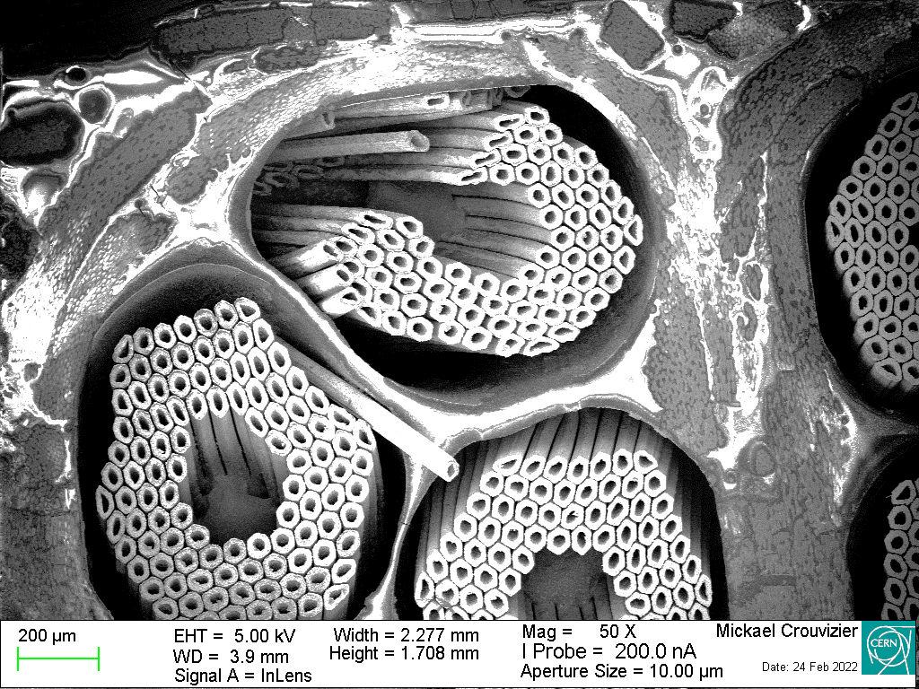
An Overview of Coil Failure Modes
Shear/Mixed
Delamination/Debonding
Insulation Failure
‘Radial’ Filament Cracks
Longitudinal Filament Cracks
‘Chopped’
Filaments
Pictures from various works of M. Crouvizier, P. Ebermann, C. Fichera, S. Sgobba et al.

Slide 5
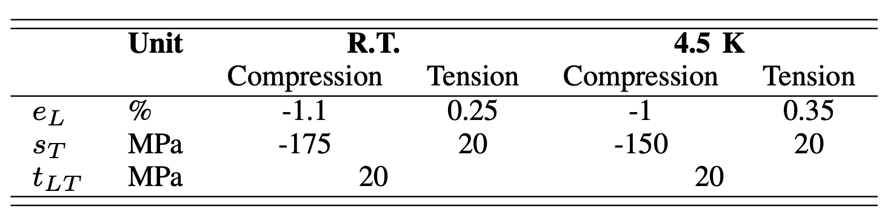
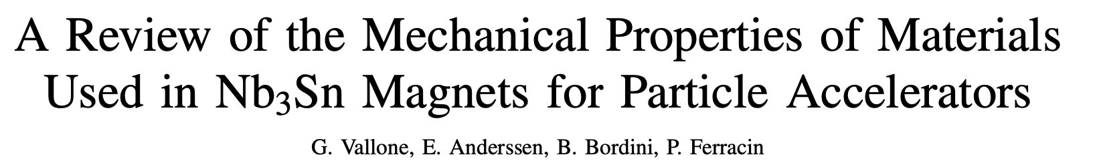
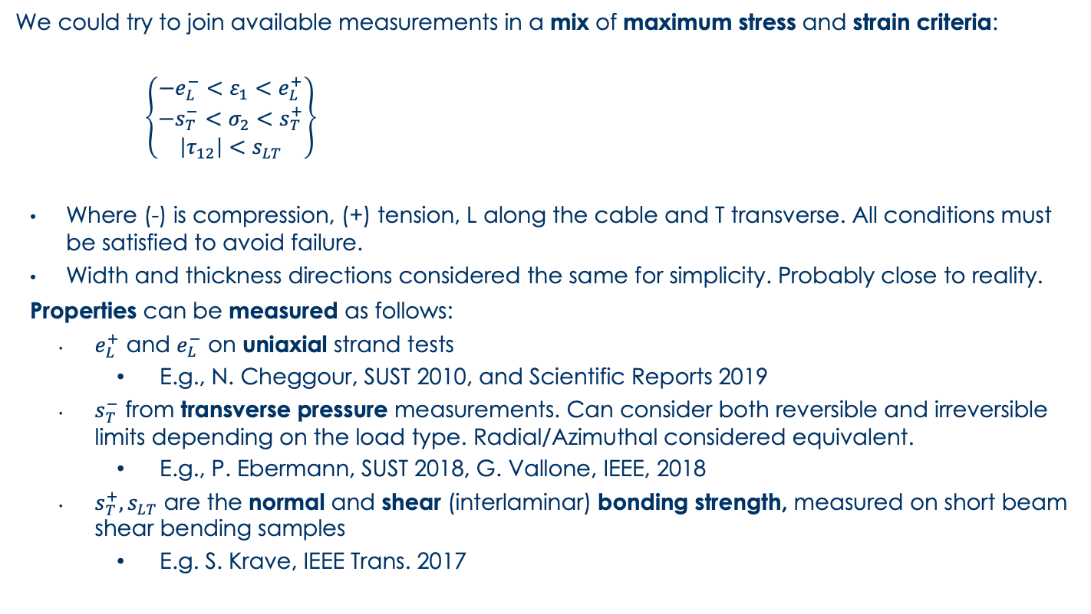
An Orthotropic Failure Criterion
  We could try to join available measurements in a mix of maximum stress and strain criteria:
      $\left\{\begin{matrix}−e_{L}^{−}<ε_{1}<e_{L}^{+} \\ −s_{T}^{−}<σ_{2}<s_{T}^{+} \\ \left|τ_{12}\right|<s_{LT}\end{matrix}\right\}$
    Where (-) is compression, (+) tension, L along the cable and T transverse. All conditions must be satisfied to avoid failure.
    Width and thickness directions considered the same for simplicity. Probably close to reality.
    Properties can be measured as follows:
      $e_{L}^{+}$ and $e_{L}^{−}$ on uniaxial strand tests
        E.g., N. Cheggour, SUST 2010, and Scientific Reports 2019
      $s_{T}^{−}$ from transverse pressure measurements. Can consider both reversible and irreversible limits depending on the load type. Radial/Azimuthal considered equivalent.
        E.g., P. Ebermann, SUST 2018, G. Vallone, IEEE, 2018
      $s_{T}^{+}, s_{LT}$ are the normal and shear (interlaminar) bonding strength, measured on short beam shear bending samples
        E.g. S. Krave, IEEE Trans. 2017

Slide 6
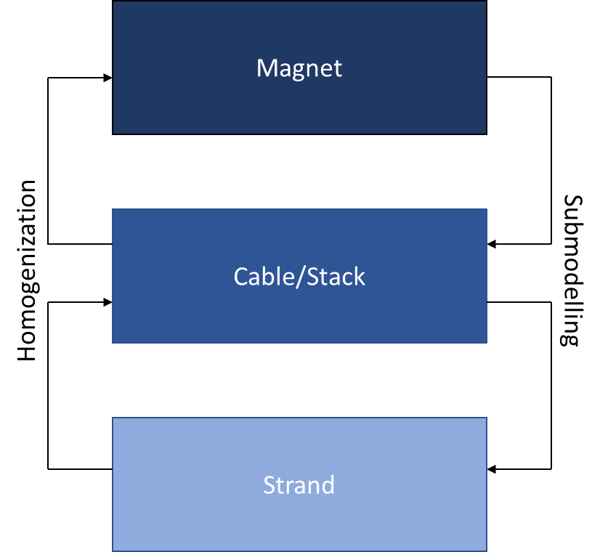
FE Coil Models
In 2022, we proposed a multi-scale approach to predict stiffness and strength of coils. The main ingredients required are:
Modelling strategy
    ‘Block’ models are the most (only?) reasonable assumption for a 3D magnet model
Constitutive equations (material model)
    Connect stress/strain inside the simplified model
Strength limits
    Depending on the modelling strategy, the definition of these limits might be different

Slide 7
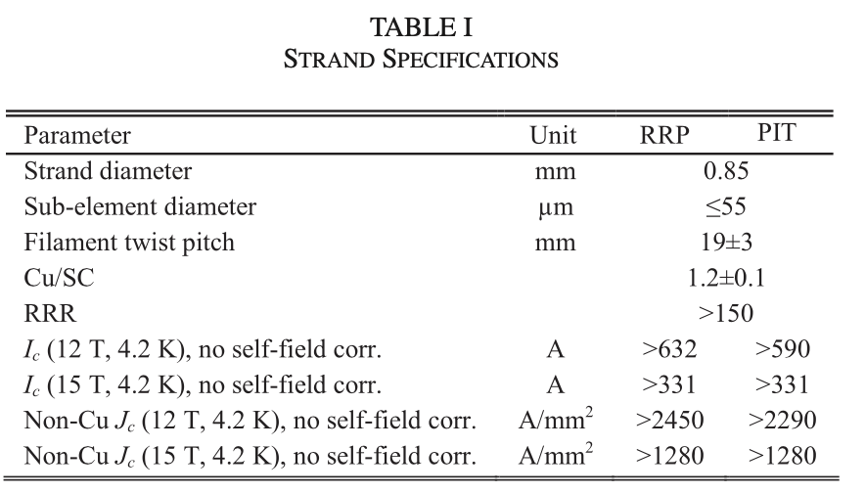
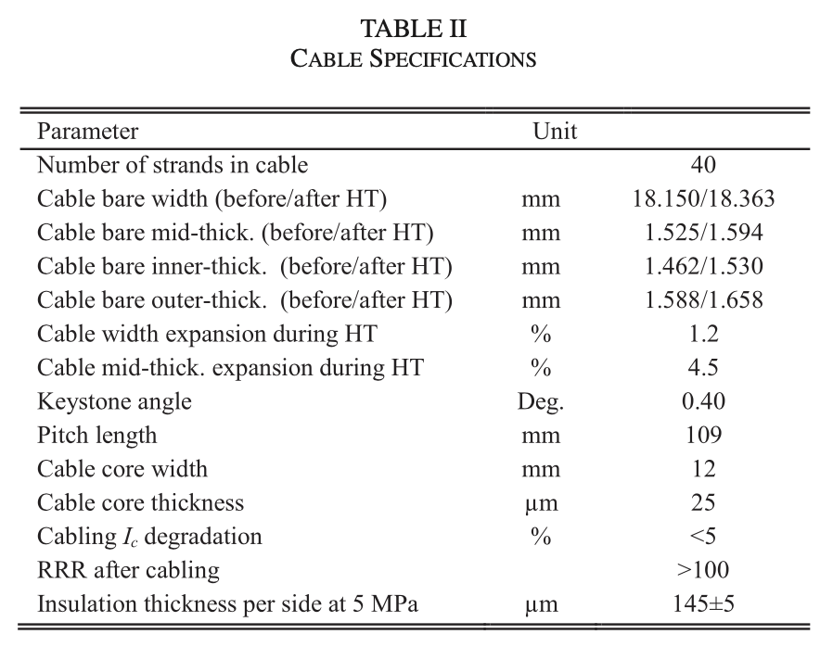
Strand/Cable Parameters
  Tables provide MQXF strand and cable specifications
  MQXF strand (RRP 108/127) used for testing and modeling

Slide 8
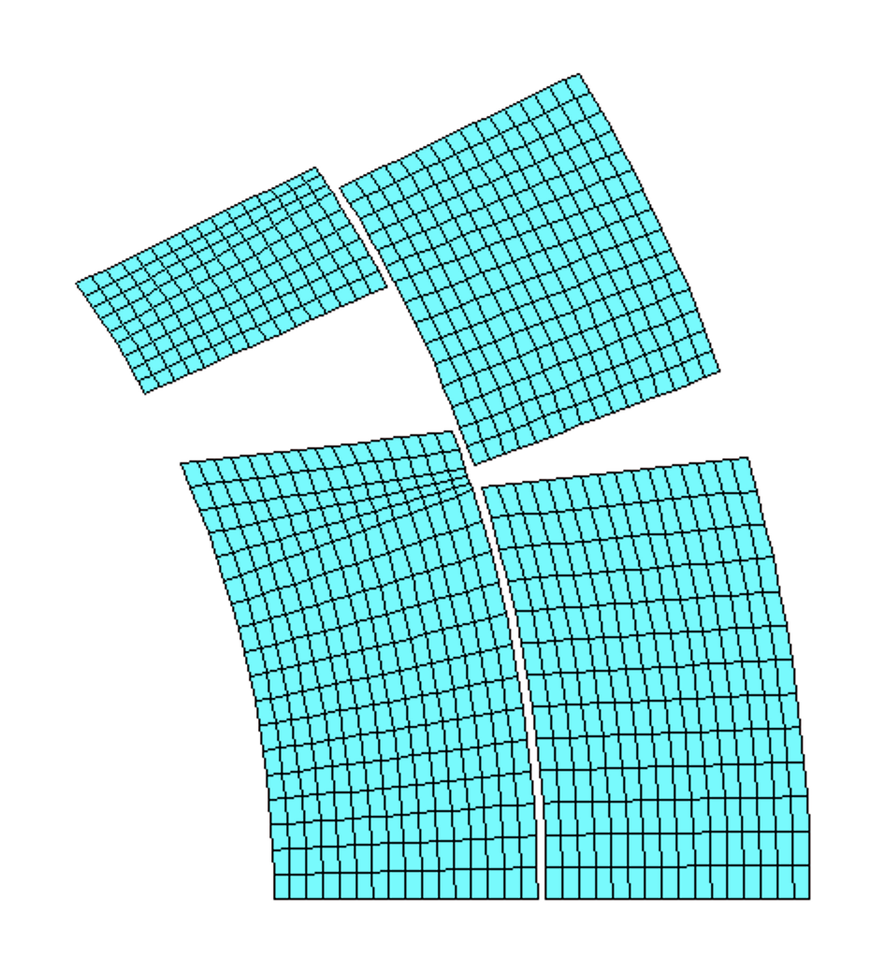
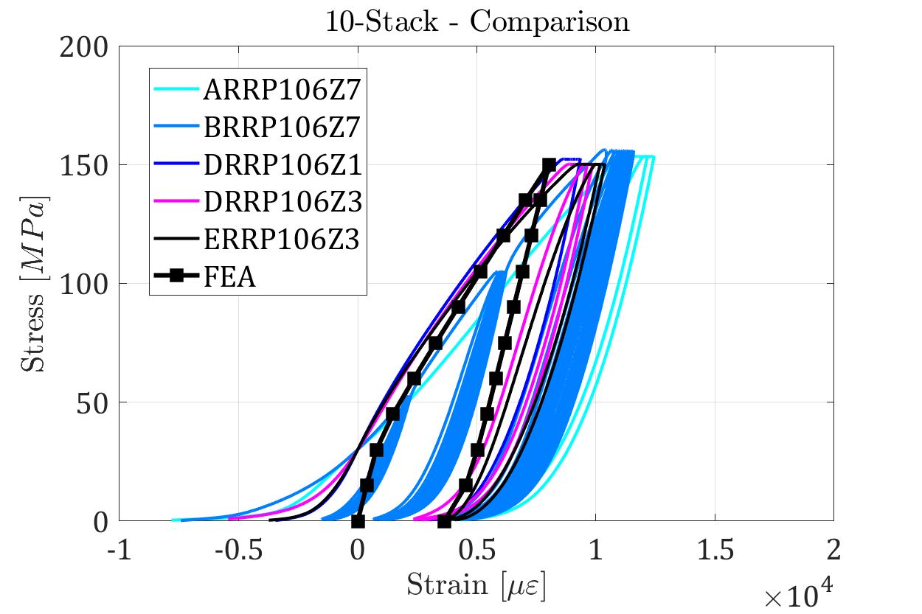
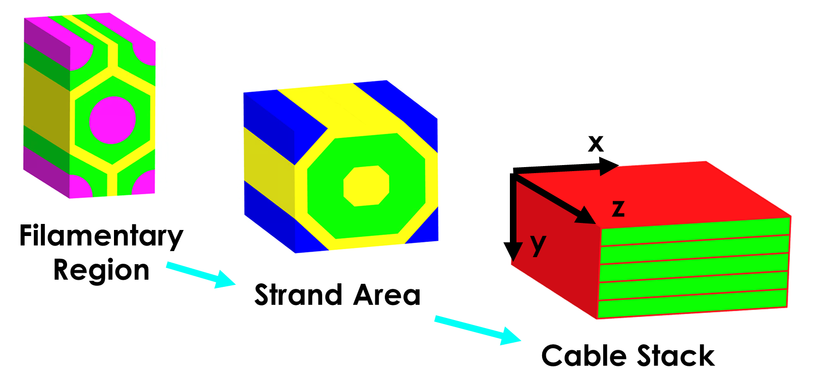
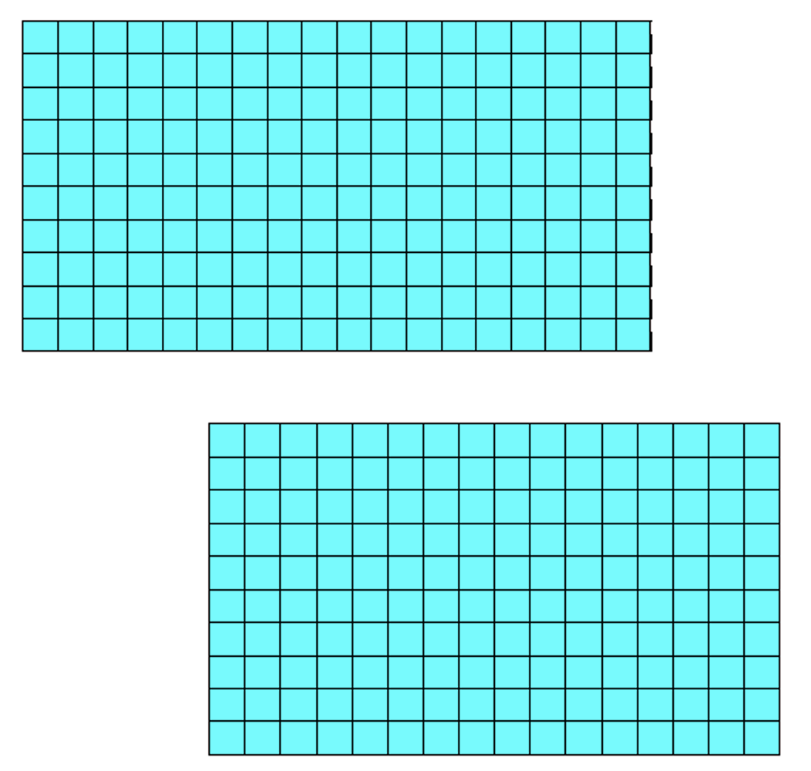
Cable Stack Model
Multiscale (RVE) modeling to extract coil properties:
      7 virtual ‘experiments’: uniaxial loading (x3), shear loading (x3), thermal contraction in free conditions
      Material properties extracted from literature
  Can be implemented in 2D block models using orthotropic properties + Von Mises yield criterion + simple hardening models
    Can match the stiffness of different cable geometries
      It also matches closely the measurements on magnets (MQXF)

Slide 9
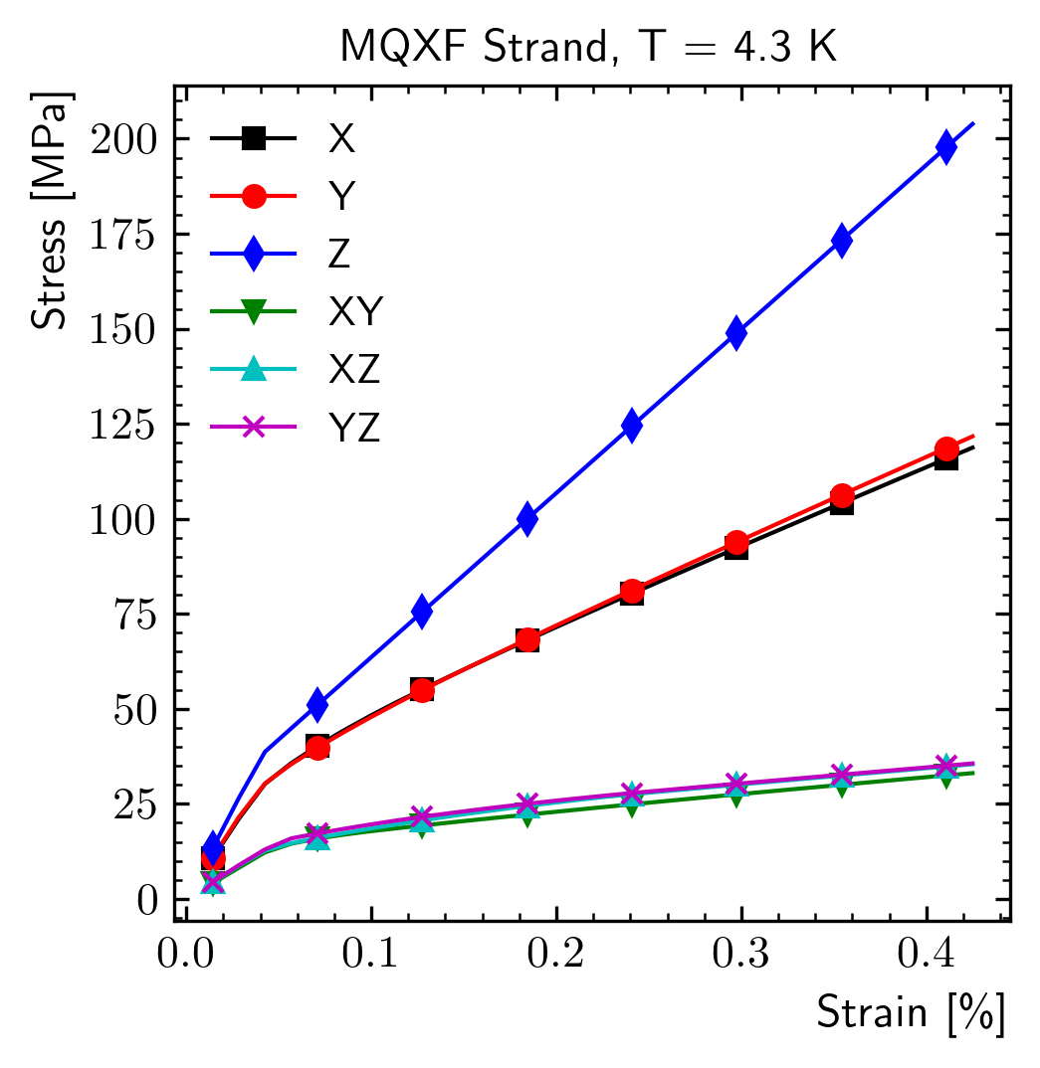
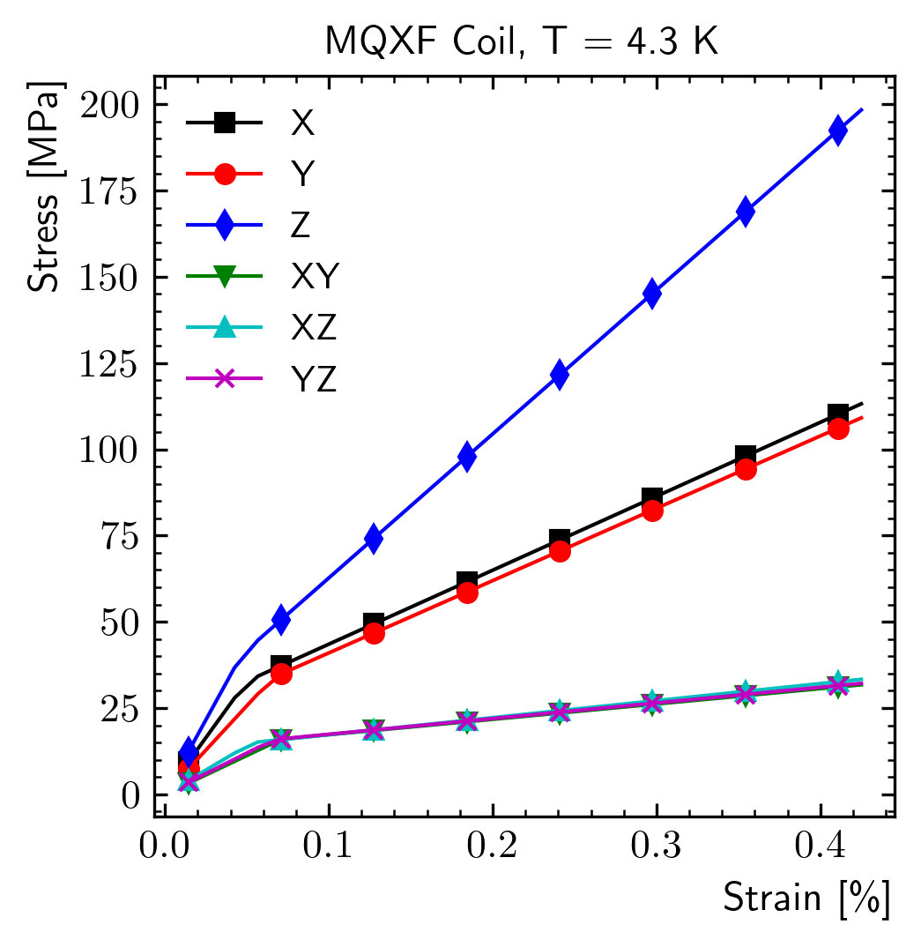
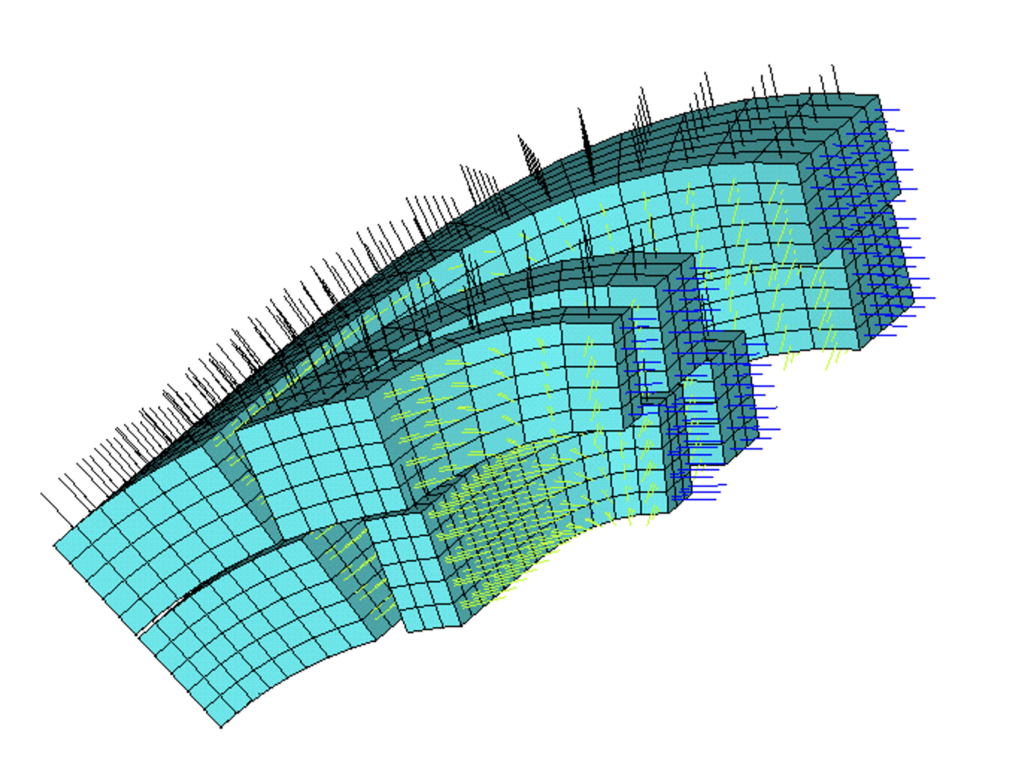
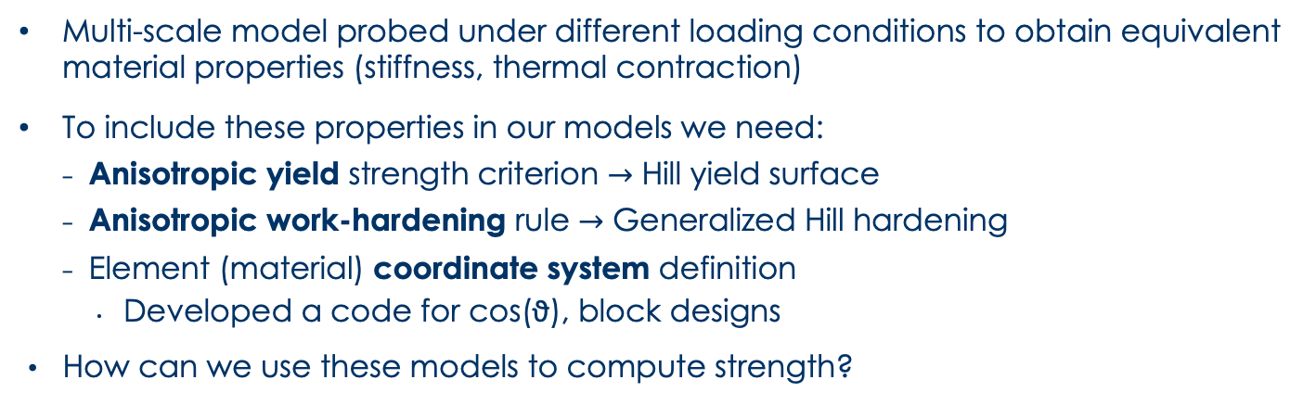
3D RVE Model
Multi-scale model probed under different loading conditions to obtain equivalent material properties (stiffness, thermal contraction)
To include these properties in our models we need:
    Anisotropic yield strength criterion $→$ Hill yield surface
    Anisotropic work-hardening rule $→$ Generalized Hill hardening
    Element (material) coordinate system definition
      Developed a code for cos(ϑ), block designs
  How can we use these models to compute strength?

Slide 10
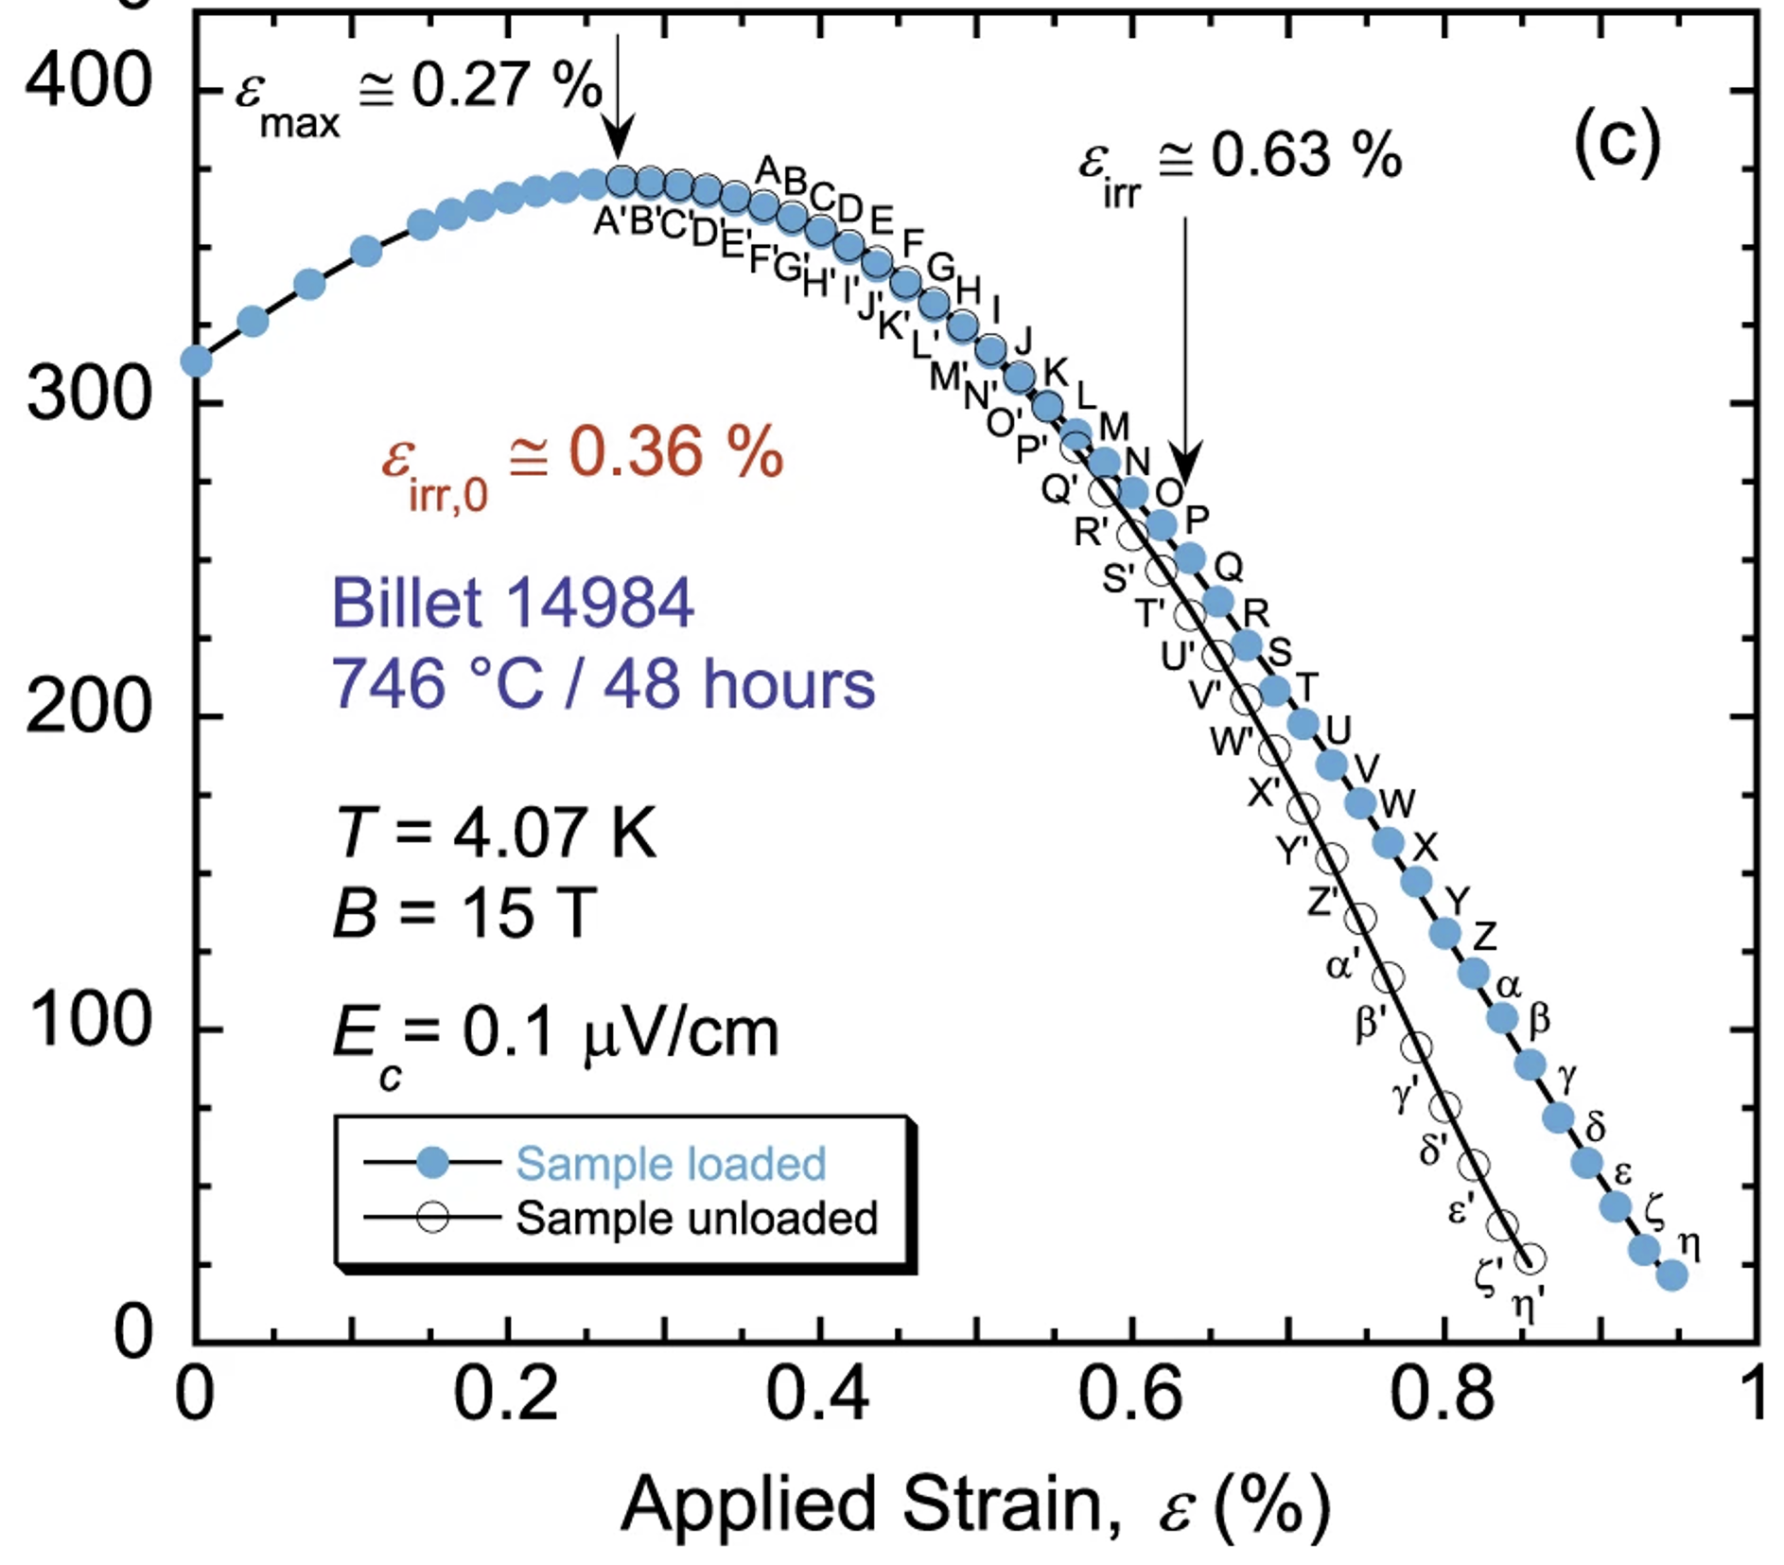
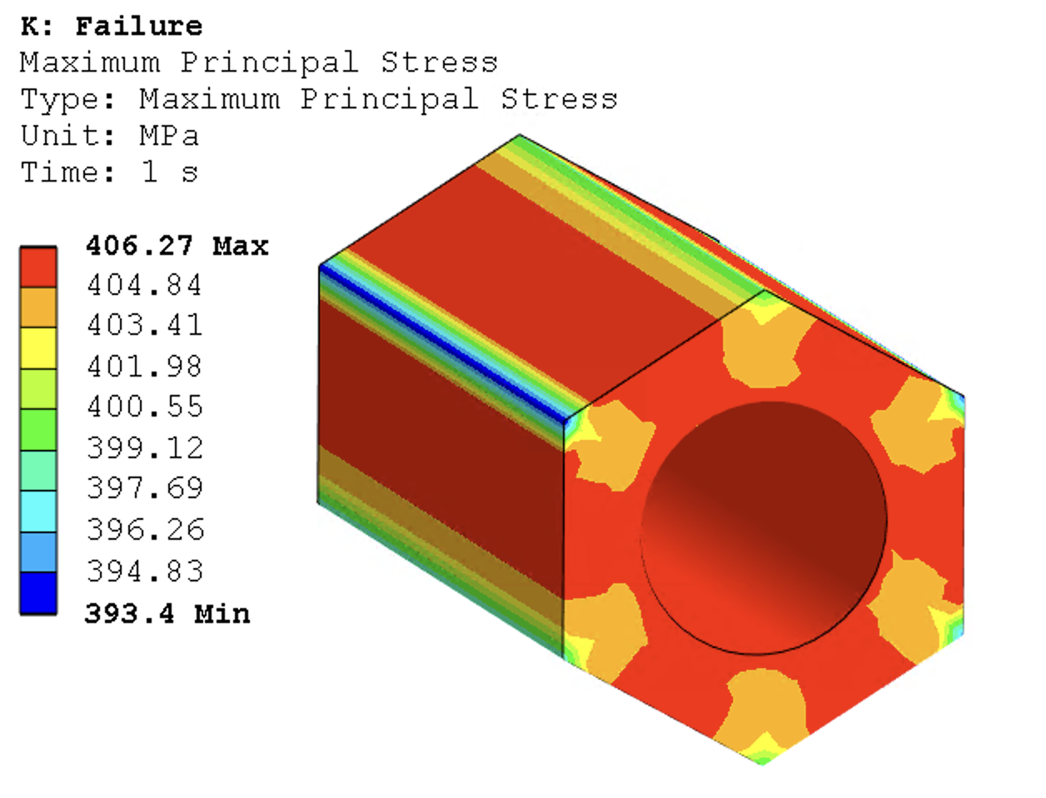
Strand Strength – Longitudinal Loads
Measurements on uniaxially loaded strands show irreversible degradation starting from an intrinsic strain of 0.35% (at 4 K)
In a filament RVE model, this means a first principal stress of 350/400 MPa
    We can assume that this is the stress at which a typical defect propagates into a crack, and use this information to compute the limits in all directions
Plot from N. Cheggour, Scientific Reports, 2019

Slide 11
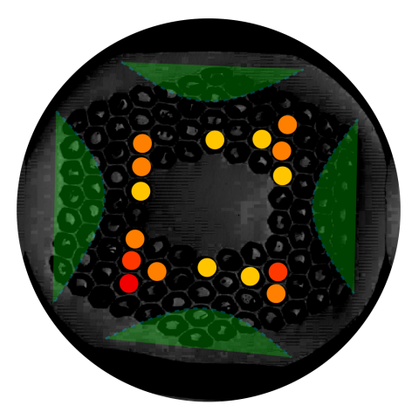
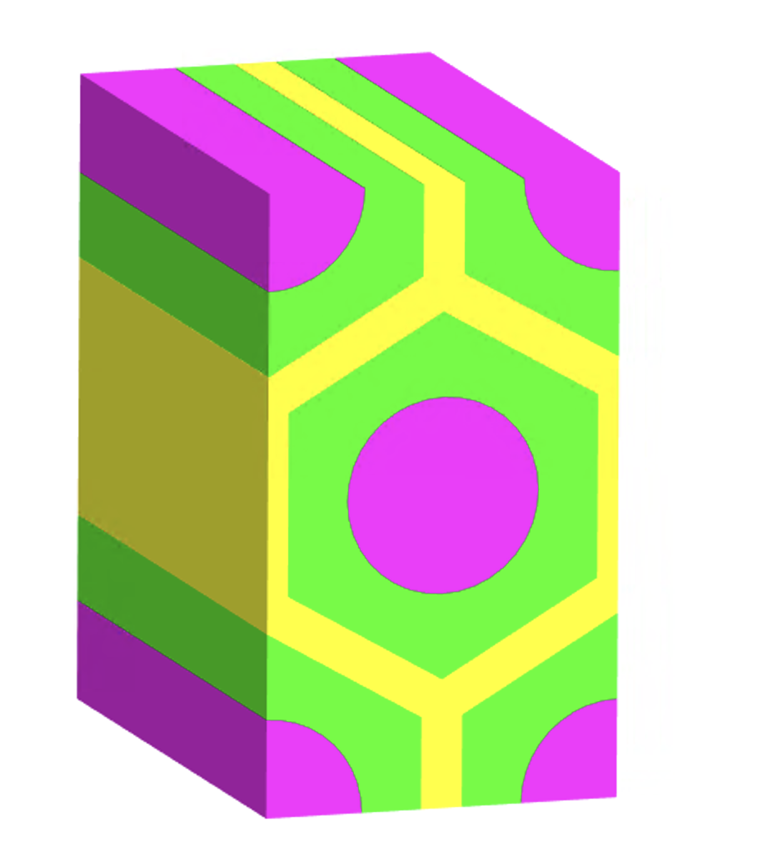
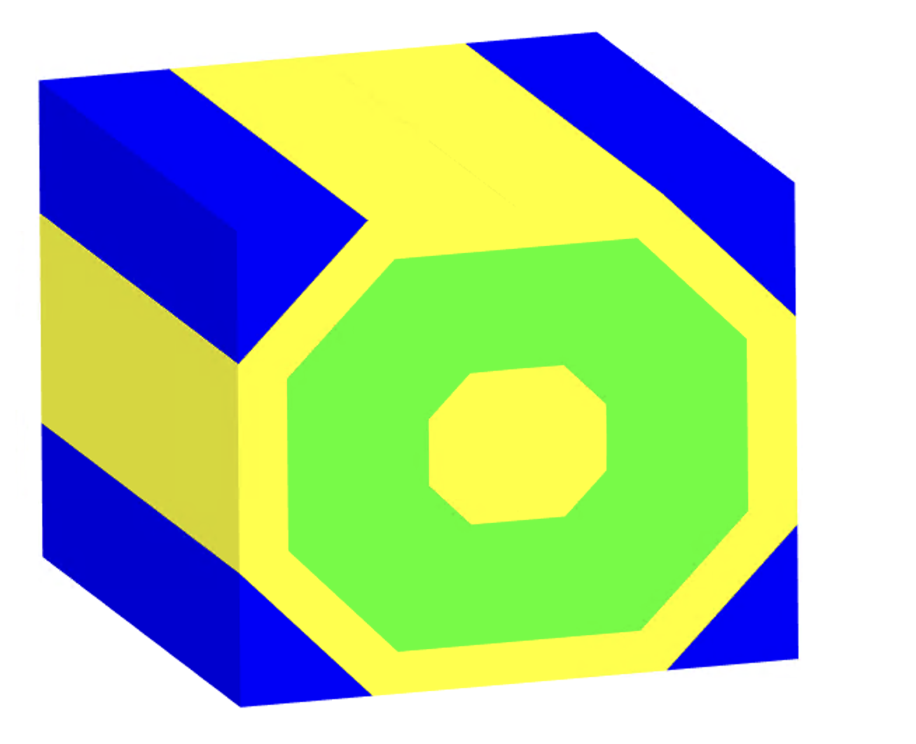
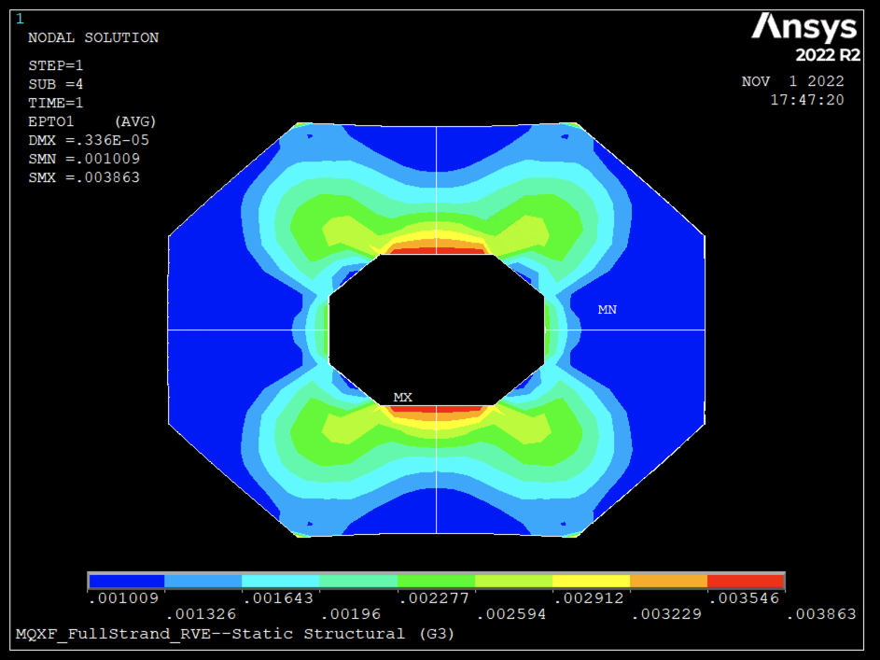
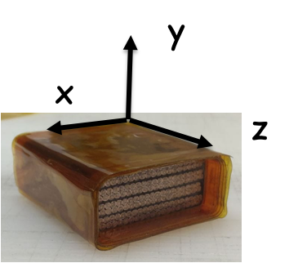
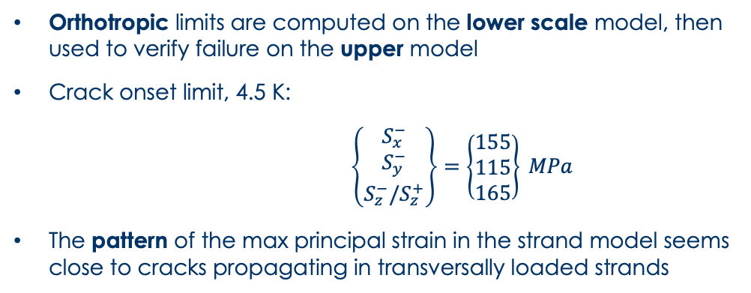
Strength Computation – 1D Loading
K. Puthran et al., 2022
Orthotropic limits are computed on the lower scale model, then used to verify failure on the upper model
Crack onset limit, 4.5 K:
$\left\{\begin{matrix}S_{x}^{−} \\ S_{y}^{−} \\ S_{z}^{−}/S_{z}^{+}\end{matrix}\right\}=\left\{\begin{matrix}155 \\ 115 \\ 165\end{matrix}\right\} MPa$
The pattern of the max principal strain in the strand model seems close to cracks propagating in transversally loaded strands

Slide 12
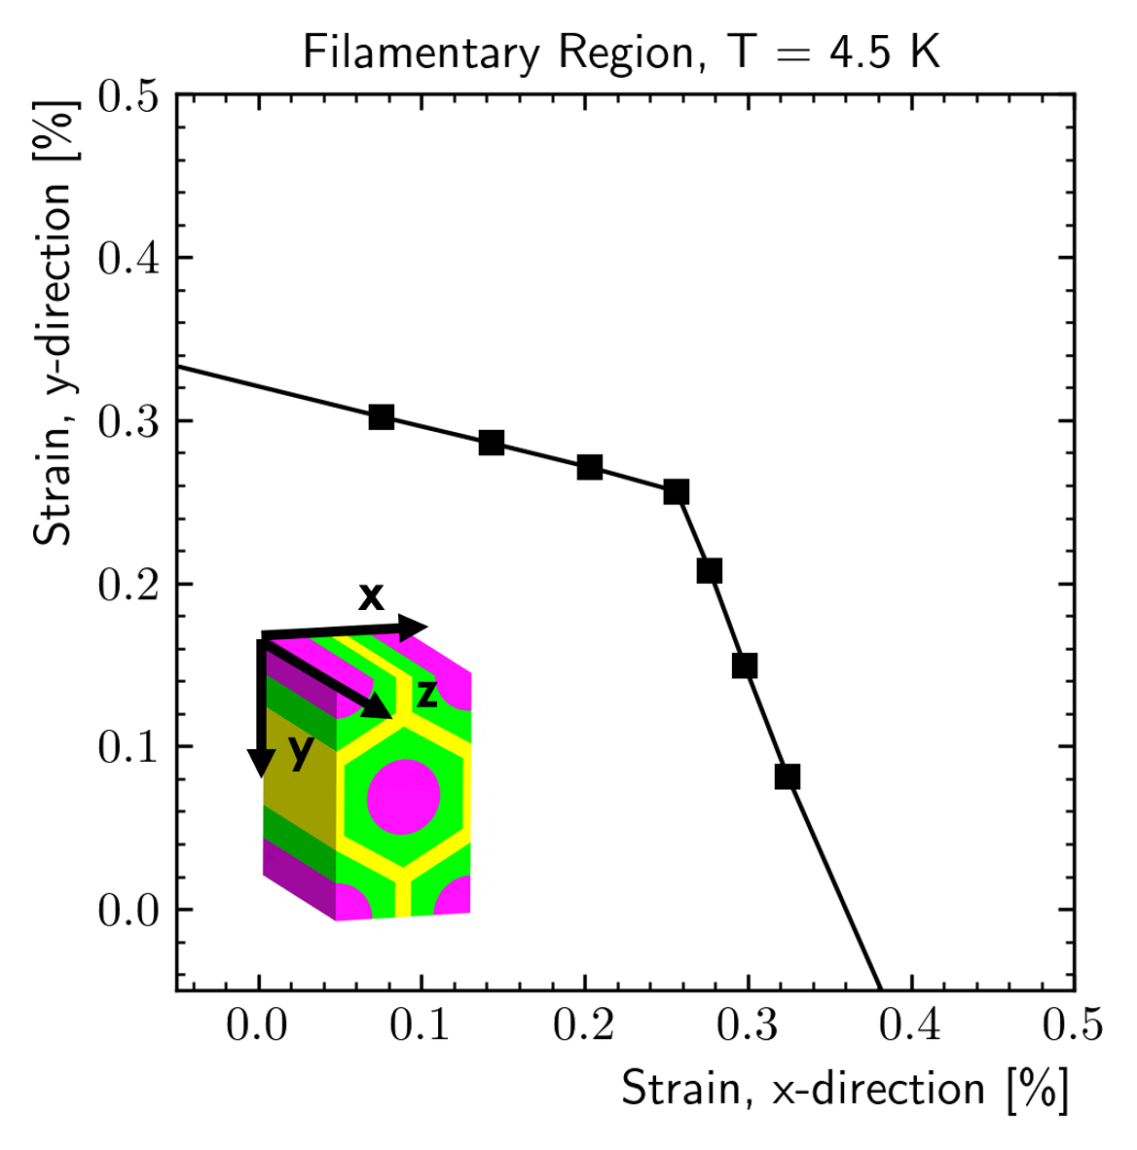
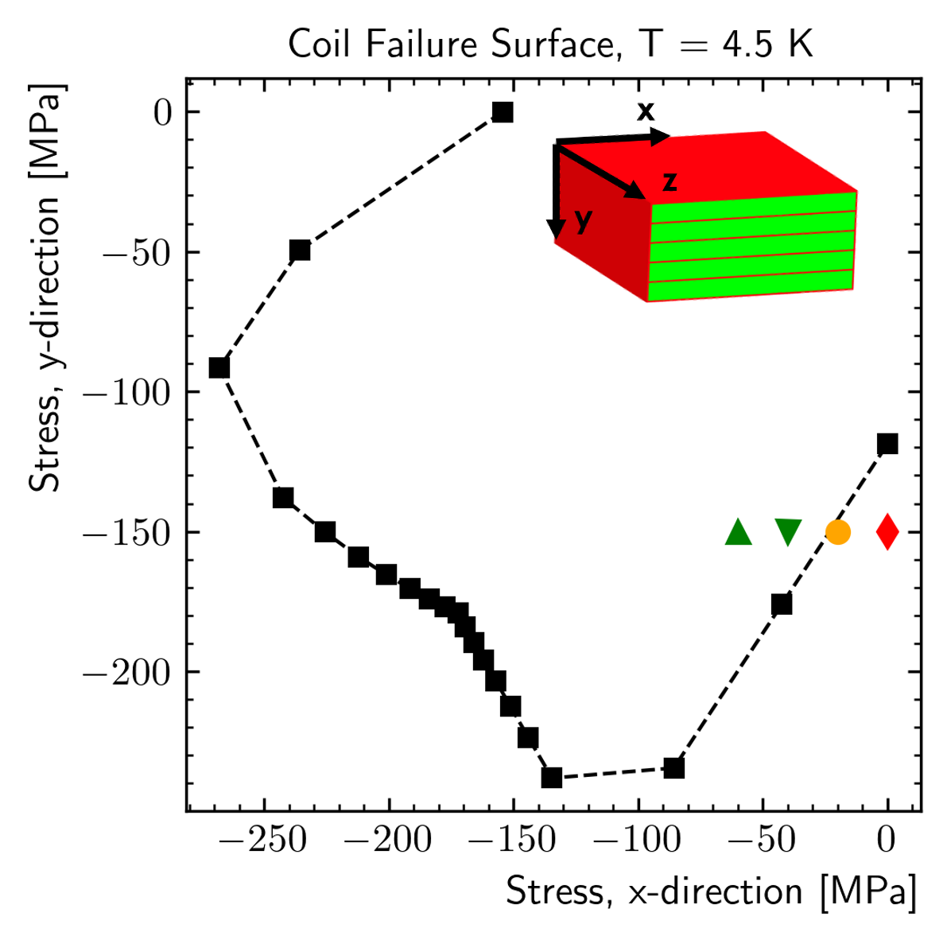
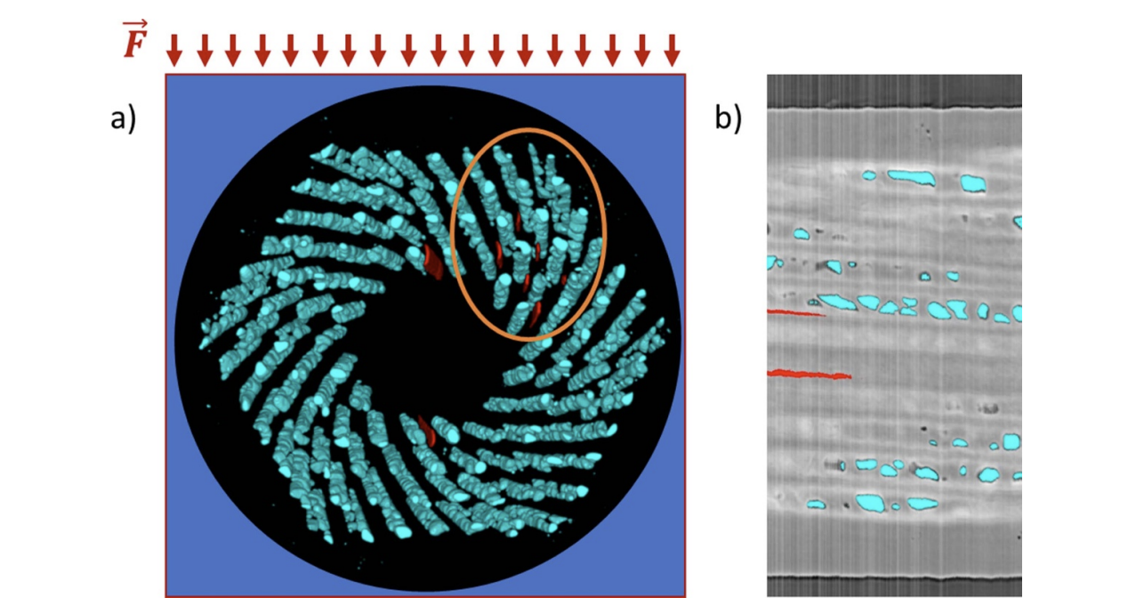
Strength Computation – 2D Loading
No failures
inside this line
T. Bagni et al., 2022
Significant computed strength increase under 2D loading:
      According to this model, the filaments inside the strand could survive a transverse pressure of more than 200 MPa with 𝜎_{x}=100 MPa
      This seems consistent with measurements on ‘strand in groove’ that showed no filaments failed at 𝜎_{y}>200 MPa
  ‘Hydrostatic’ loads are less dangerous
    Using Von Mises criterion might not be completely wrong

Slide 13
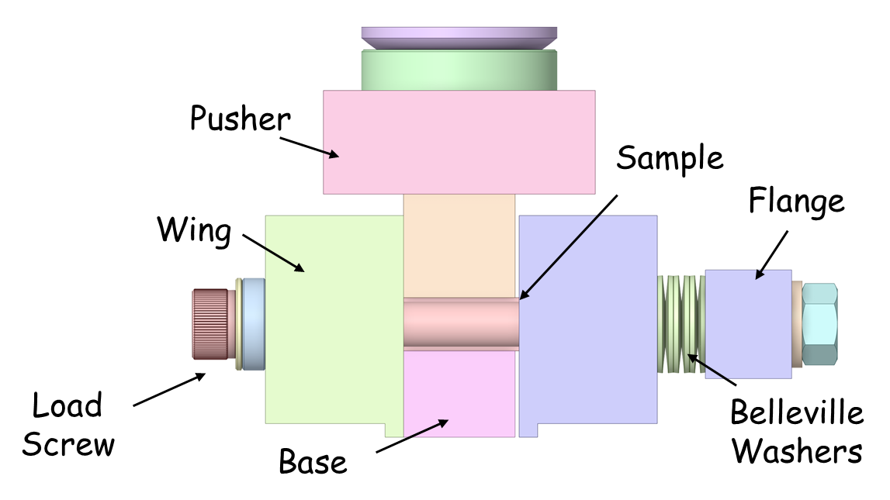
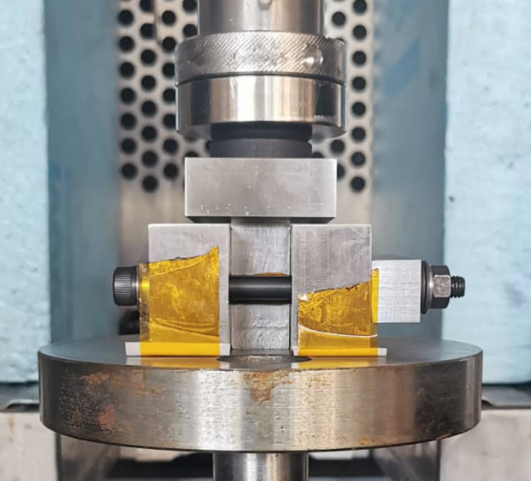
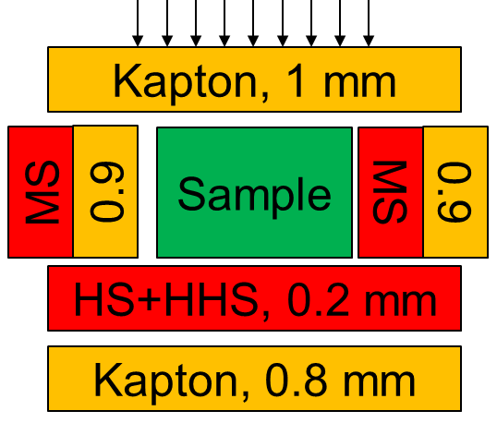
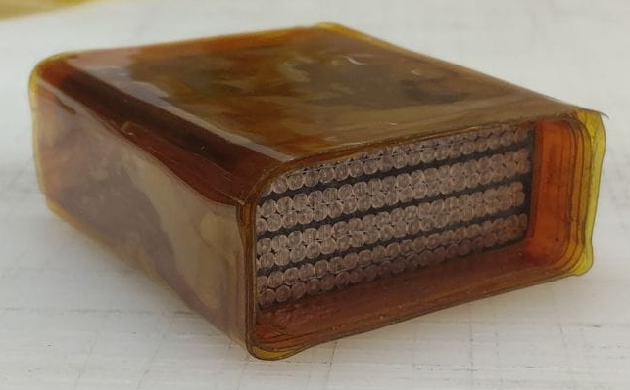
Strand Strength – Measurement Set-Up
  Stack holder designed to apply a bi-directional load
    Bellville springs to control/‘measure’ the applied prestress
      1/2/3 springs in parallel: 20/40/60 MPa on a 4 stack
      Additional springs in series can help to control bolting process, but seemed unnecessary
      Different springs can be used to change the stress level
    Fuji used to control the uniformity of the applied loads
      MS on sample short edge, HS+HHS on long edge
      Additional Fuji below the wings of the sample holder

Slide 14
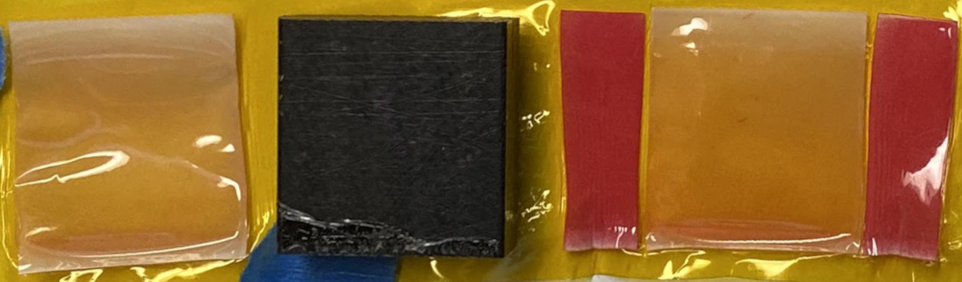
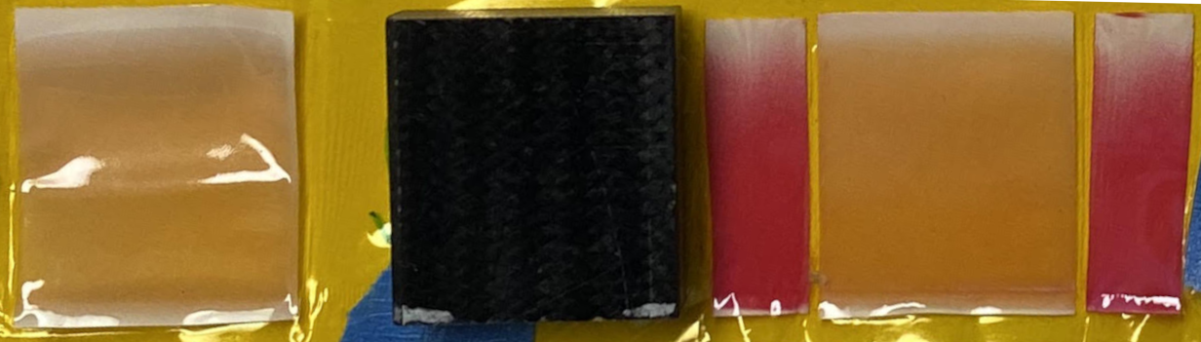
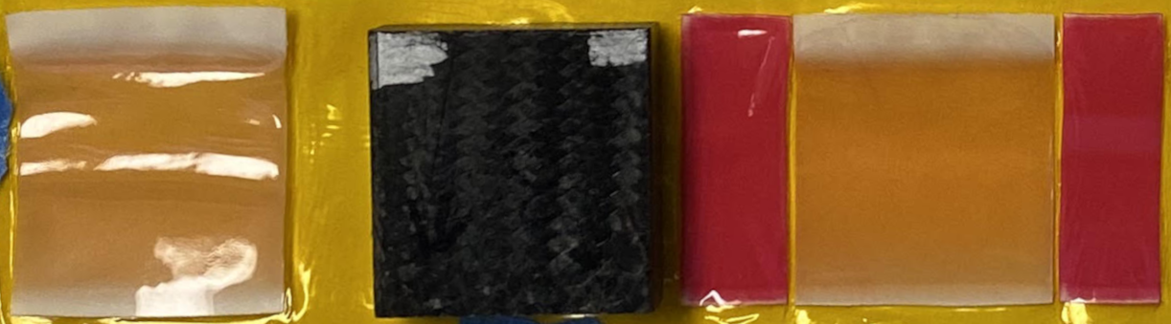
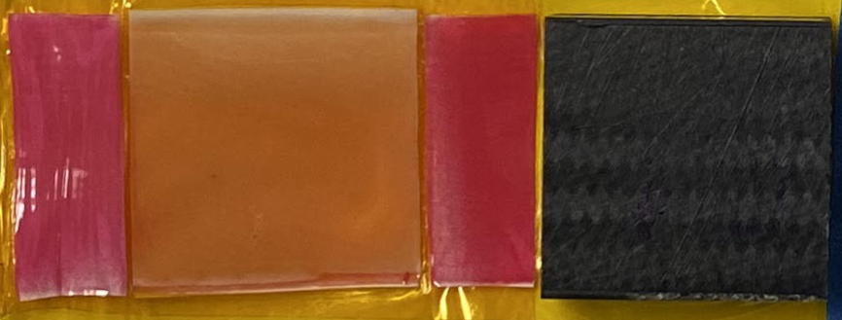
Fuji Paper – 2D Testing
The test device manages to apply a very uniform pressure on the sides
  Very good uniformity of the load applied by the wings
  No marks on the ‘ground’ Fuji paper
    ~All the load is going through the sample

Slide 15
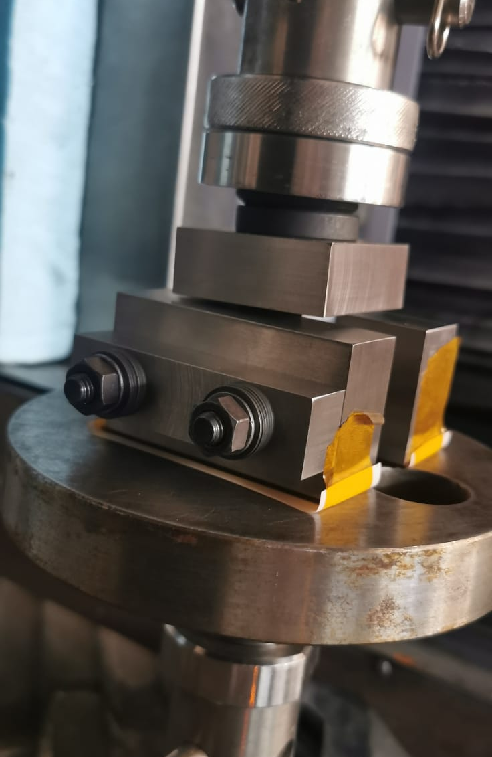

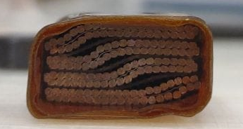
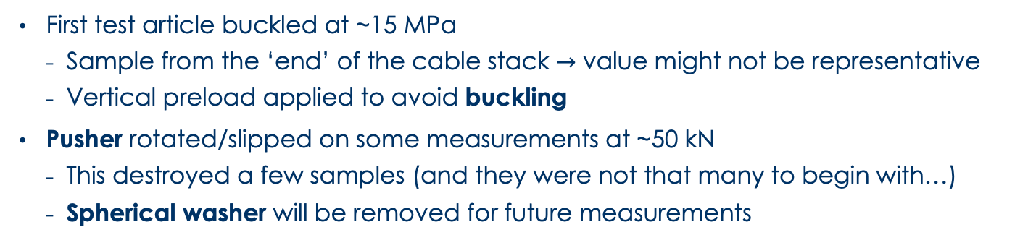
Measurement Set-Up – Some Issues
  First test article buckled at ~15 MPa
    Sample from the ‘end’ of the cable stack $→$ value might not be representative
    Vertical preload applied to avoid buckling
  Pusher rotated/slipped on some measurements at ~50 kN
    This destroyed a few samples (and they were not that many to begin with…)
    Spherical washer will be removed for future measurements

Slide 16
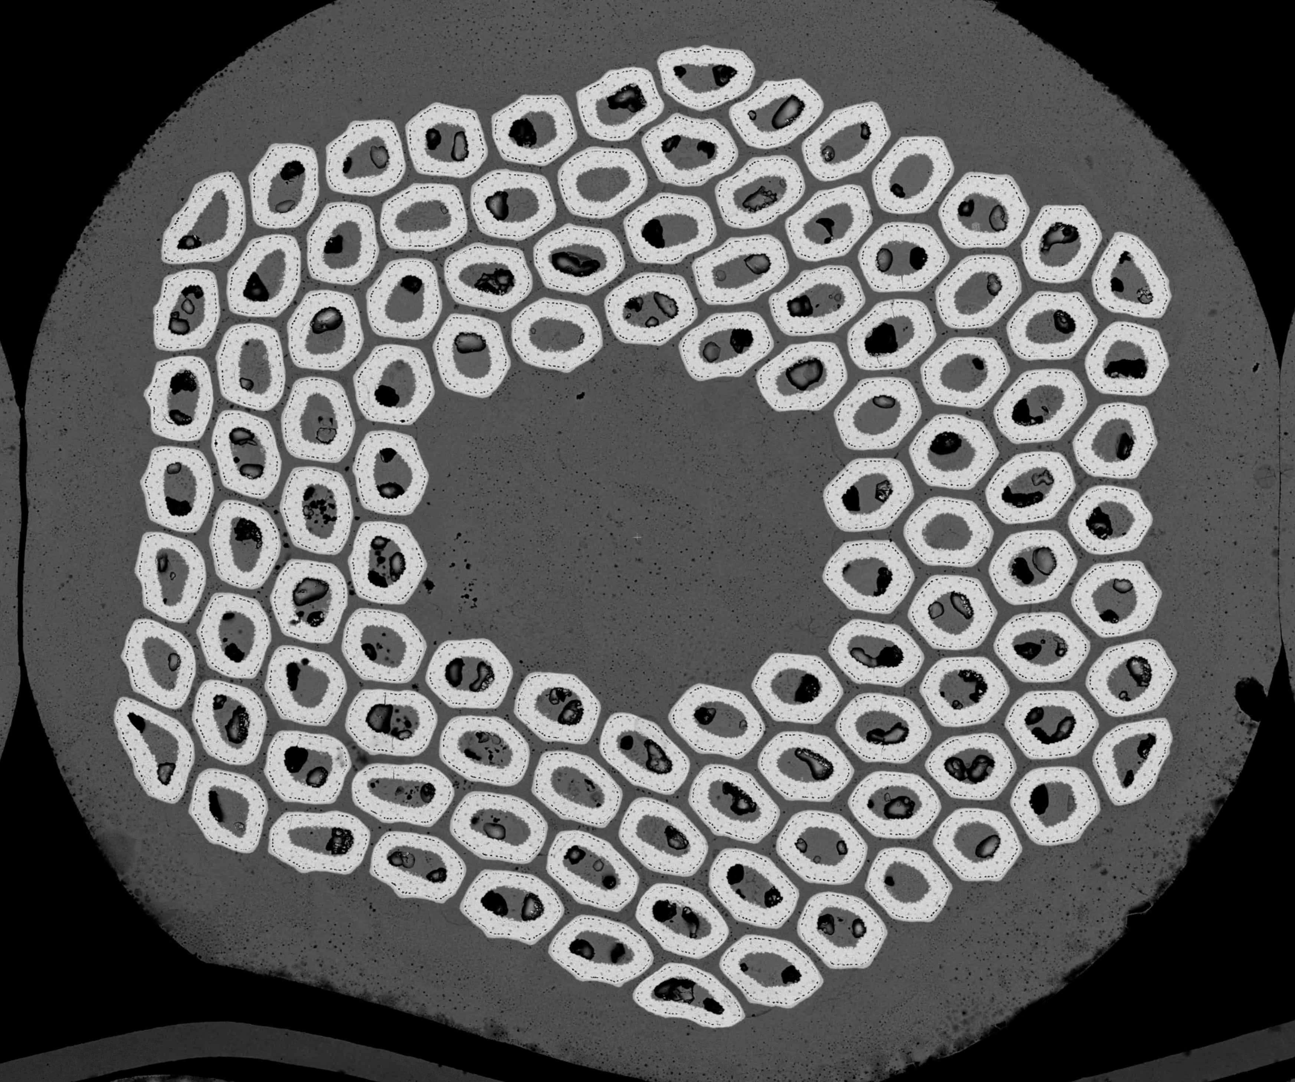
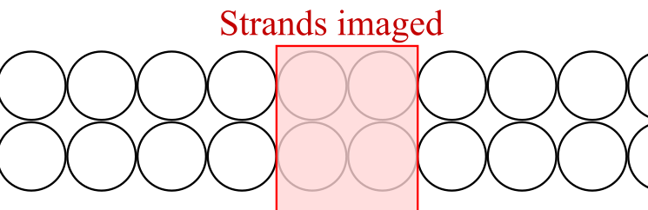
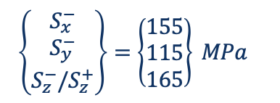
Strength Measurement – 1D Loading
  Initial run with 1D loading (y-direction) to verify our sample, test and imagining set-up
  Sample polished with vibratory polishing, coated with Au/Pd, then analyzed with SEM
    Many cracks to count… ML developed to help
    Only central portion of the stack investigated (time…)
  Result consistent with literature findings:
    Cracks start to appear at ~120 MPa
    Numerical model results are not far from reality!

Slide 17
Strength Measurement – 2D Loading
0 MPa

Slide 18
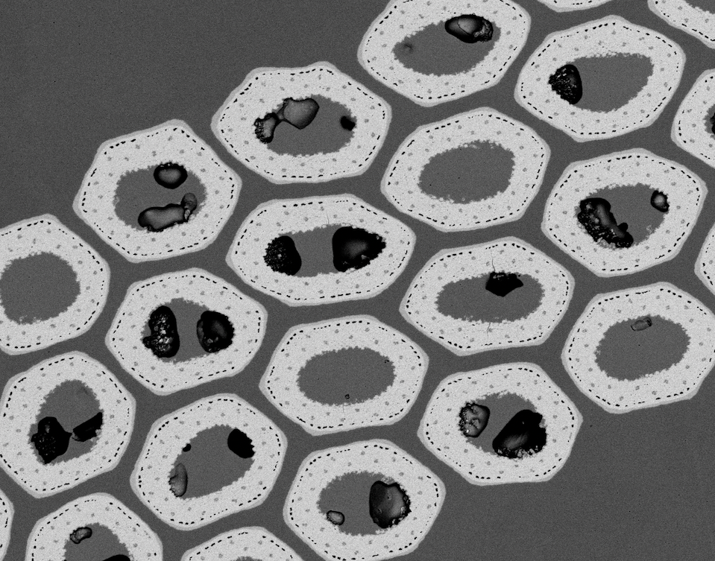
Strength Measurement – 2D Loading
0 MPa
20 MPa

Slide 19
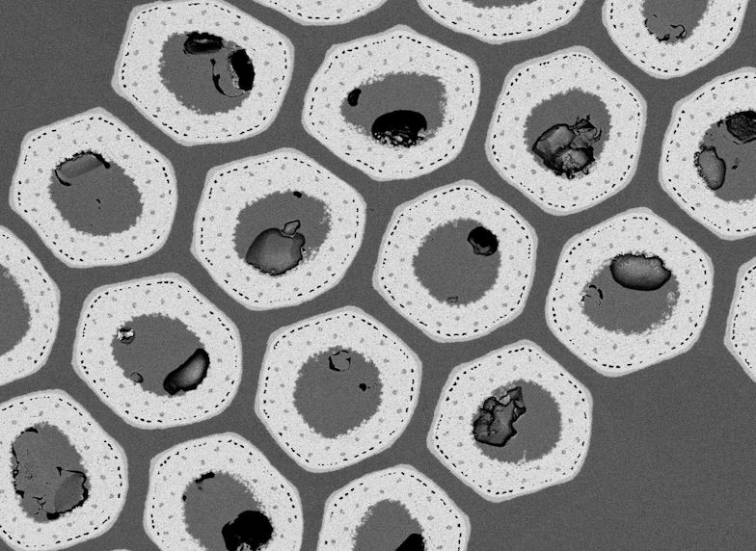
Strength Measurement – 2D Loading
0 MPa
20 MPa
40 MPa

Slide 20
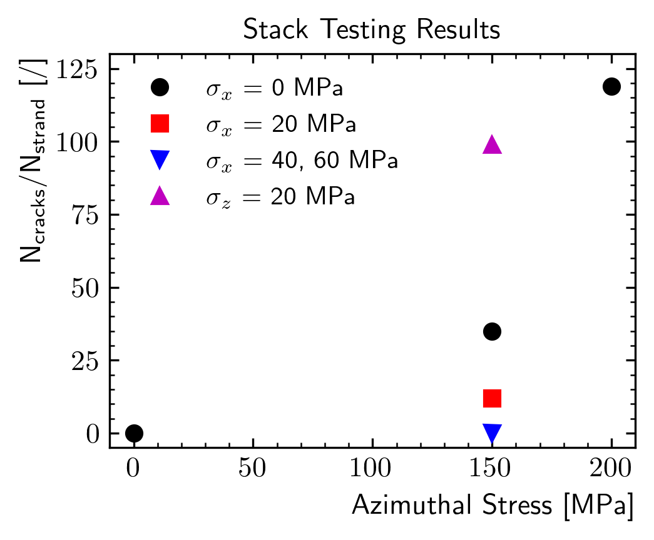
Strength Measurement – 2D Loading
No failures
inside this line
y
  Significant interaction between azimuthal and horizontal stress
    Many cracks for no horizontal prestress
    Less cracks with 20 MPa
    NO CRACKS with 40 and 60 MPa!
      Seems consistent with model predictions!
  The longitudinal prestress (z) increases the number of cracks
    More data needed!
x
z

Slide 21



Conclusion
Two approaches proposed to define a coil structural limit:
    Non-interactive criterion from measurements
    Non-interactive/interactive criteria from multiscale modeling
      Model results suggest that limits for ‘hydrostatic’ loading conditions might be significantly higher
  Measurements of cable stacks under transversal pressure:
  Cracks appear at around 120 MPa under 1D loading
  Cracks disappeared, as predicted, when the horizontal prestress was increased
These results might change the ‘optimal’ magnet design:
    e.g. Coil design, preload conditions, etc.
  Future work:
    Gather more data probing the failure surfaces $S(σ_{x},σ_{y},σ_{z})$ at room temperature and at cold
    Compute margin for different magnet designs

Slide 22

For More Details
This work was presented at MT28
  Paper submitted and accepted for IEEE Transactions on Applied Superconductivity

