Slide 1
CCT5 Progress Update
06/20/2018
US Magnet Development Program
Lawrence Berkeley National Laboratory

Slide 2
2-Layer CCT Nb₃Sn Plan
(CCT Technology Development)
 | CCT3 | CCT4 | CCT5
Bore size [mm] | 90 | 90 | 90
Groove design | constant width | 1.25 mm gap at pole | 1.65 mm gap at pole
Conductor | RRP 54/61 Ta doped | RRP 54/61 Ta doped | RRP 108/127 Ti doped
HT Temp [C] | 650 | 660 | 665
Potting configuration | full magnet | full magnet | individual layers
Epoxy | CTD-101K | CTD-101K | FSU Mix 61
Layer-to-layer interface | bonded | mold released | bend & shim
Conductor damage
Field quality
Cost and scalability
Training
New Processes have to be developed for CCT5
* Focus for CCT5 is understanding the causes of training in CCT magnets

Slide 3
Discussion Topics
Latest 10-turn heat treatment and potting results
Voltage tap flags and instrumentation plan
Bend and shim progress (see Lucas’ presentation)
CCT5 Progress

Slide 4
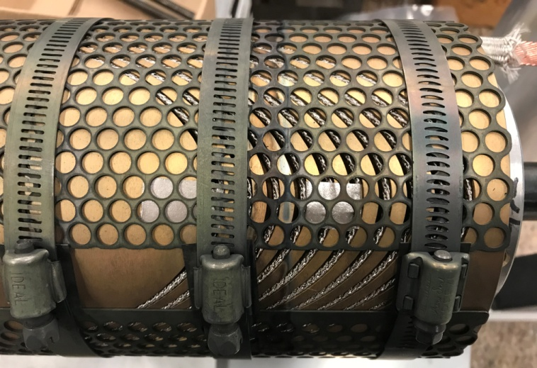
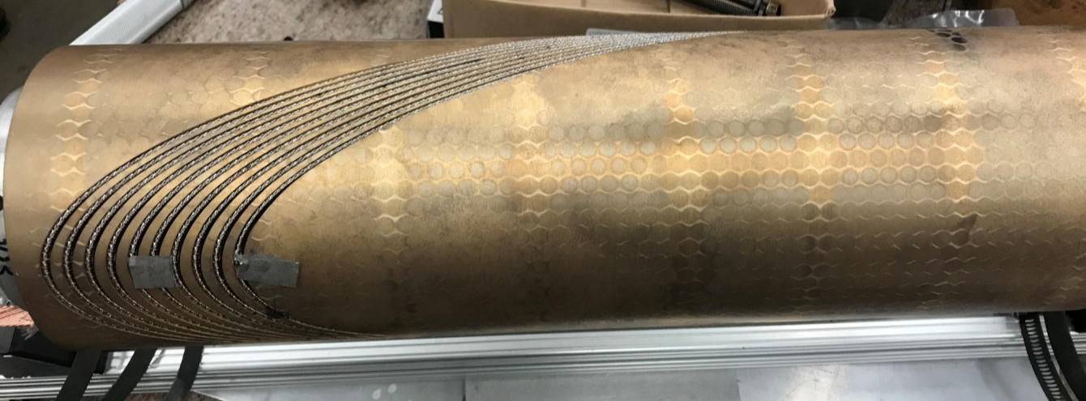
10-Turn Heat Treatment
Groove dimensions match final design for CCT5 mandrels
  Groove depth was reduced to 11.0 mm
  Extra space added at pole after measurements with previous 10-turn coils (1.65 mm gap)
Copper wires were not used to compress cable during heat treatment
Cable stays within the outer surface of the mandrel except at a couple of spots
Distortion measured after heat treatment was minimal

Slide 5
Potting Test
10-turn coil was impregnated with mix 61 epoxy in preparation for CCT5
Plan was to not deviate too far from our usual potting procedures to avoid delaying CCT5 test
Use common techniques and materials from vacuum bag process but use a mechanical seal instead of vacuum bag
  Peel ply to minimize epoxy on surface of mandrel
  Flow media for epoxy flow
  Use Nylon vacuum bag
  Use shrink tape to compress the compress the bag and flow media layer tightly onto the mandrel
End plugs are used as with CCT3/4

Slide 6
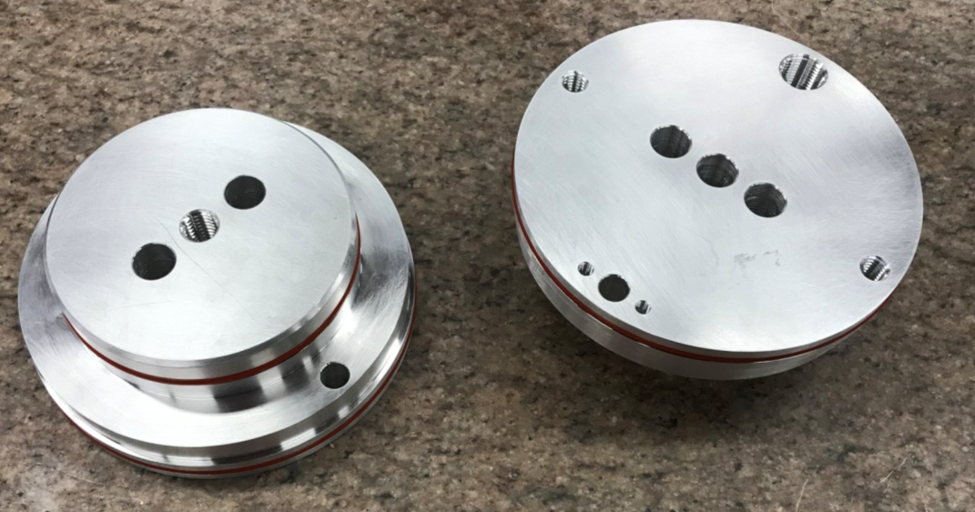
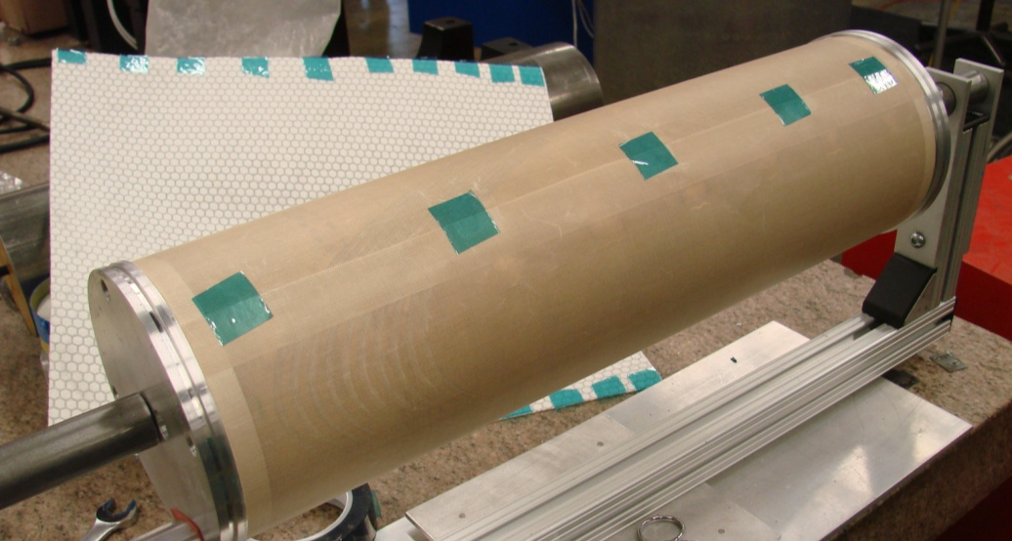
Potting Tools
O-ring Seals
Holes for heaters
Holes for Leads
Peel-Ply
(Teflon Coated Fiberglass)

Slide 7
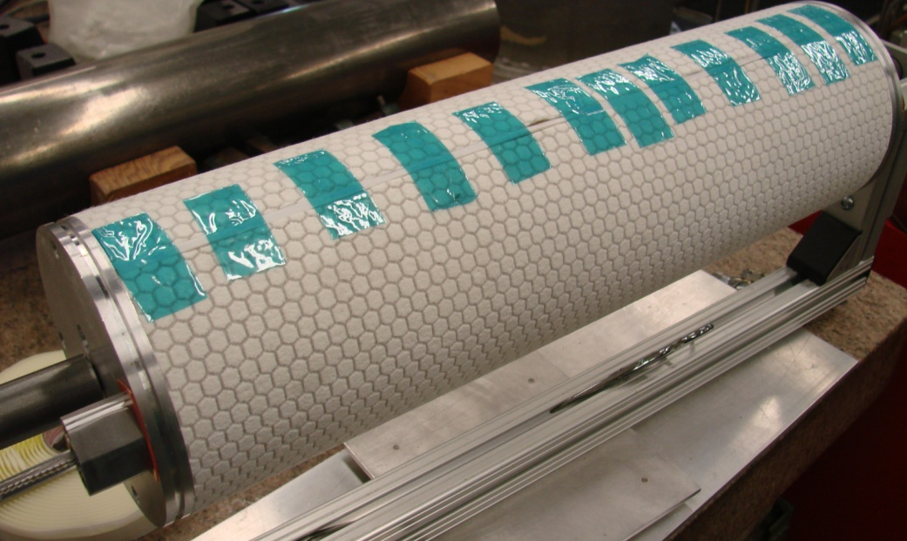
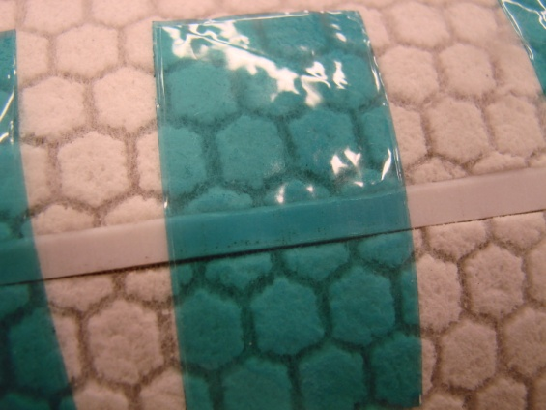
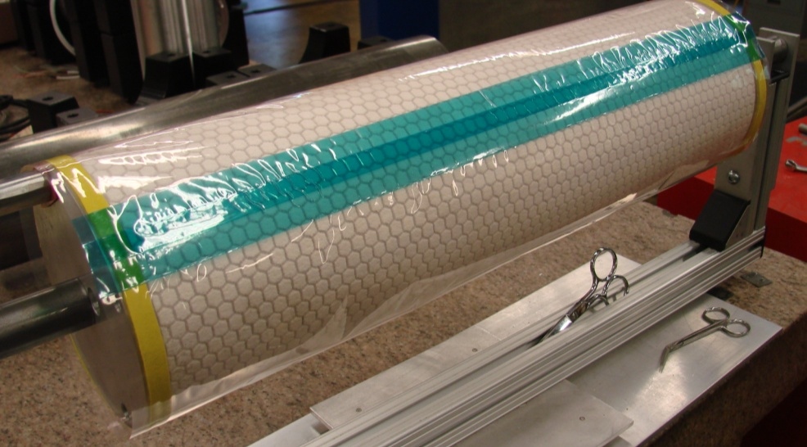
Potting Tools
Teflon strip to separate seam after potting
Flow Media
Vacuum Bag
(Seam Sealed with Tape)
Sealing tape for seal to end plug

Slide 8
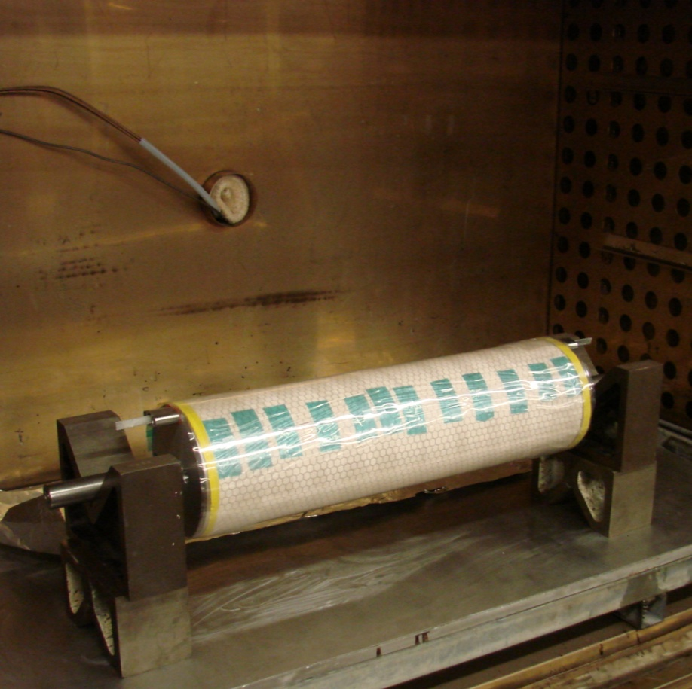
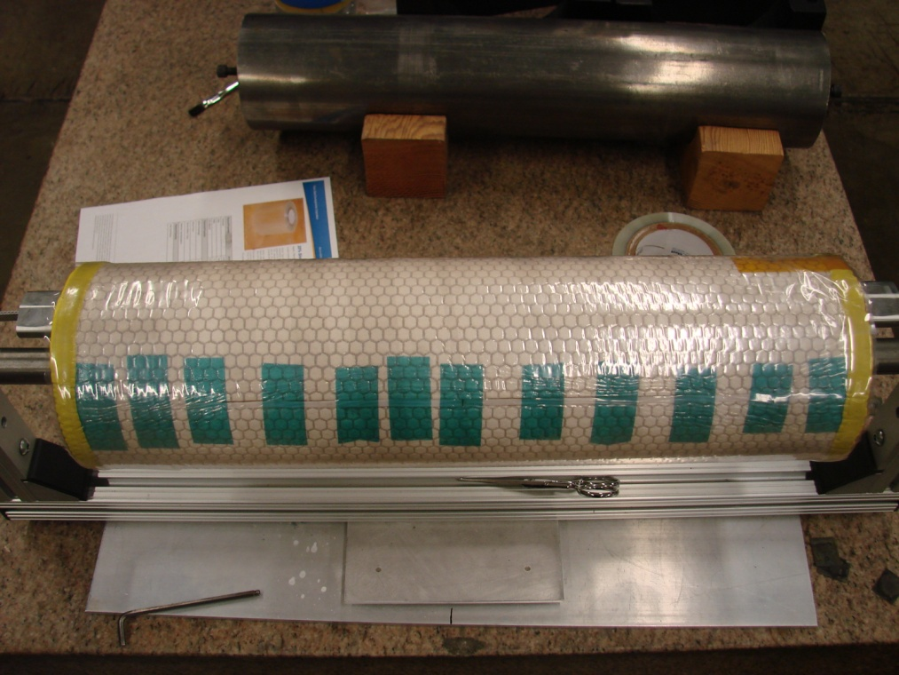
Potting Process
Coil is wrapped with shrink tape and heated in oven
Coil after removing from oven

Slide 9
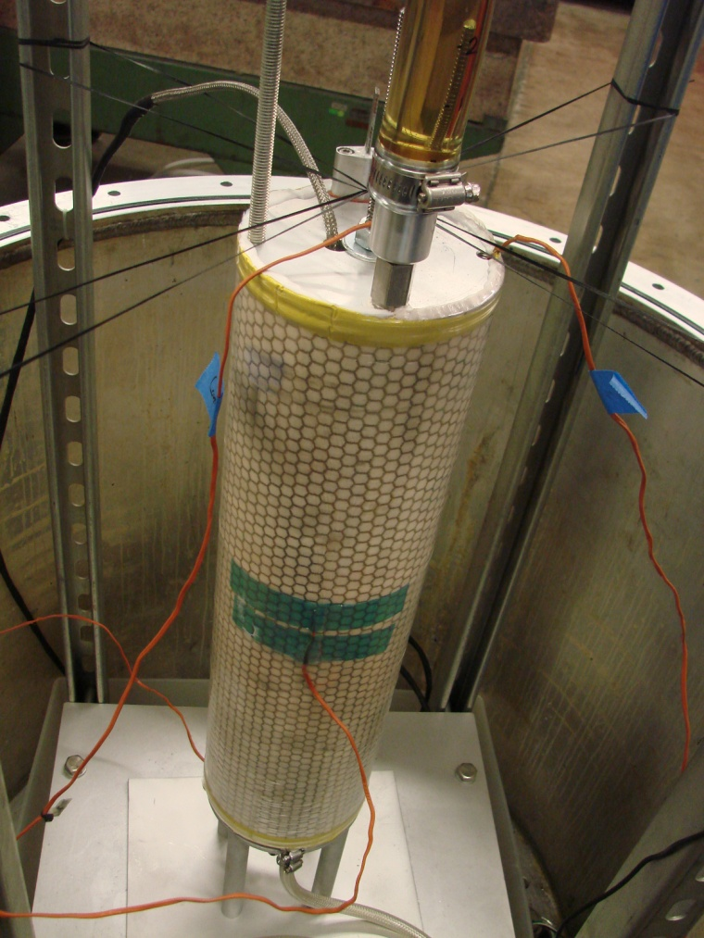
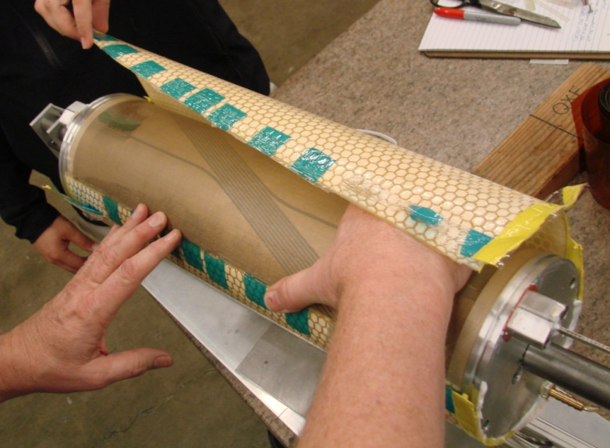
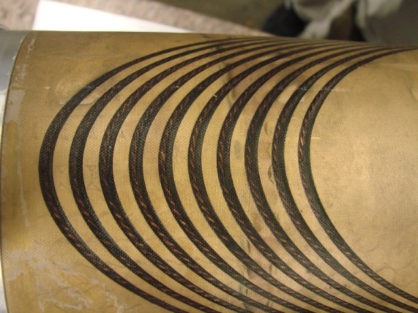
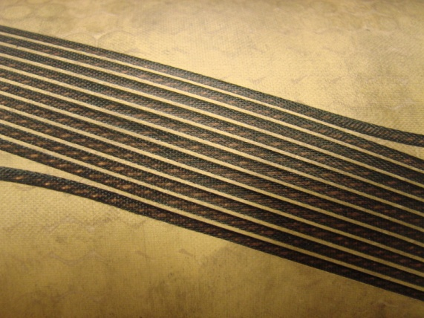
Potting Process
Coil Potting
Coil after removing flow media and Peel Ply

Slide 10
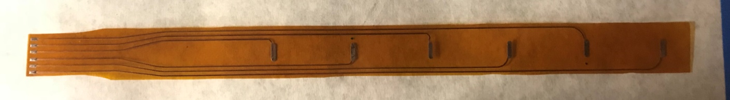
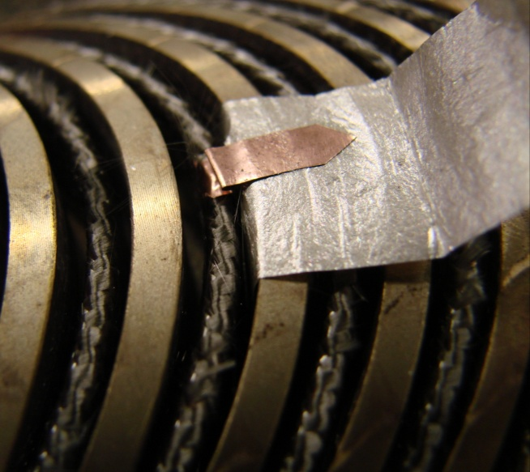
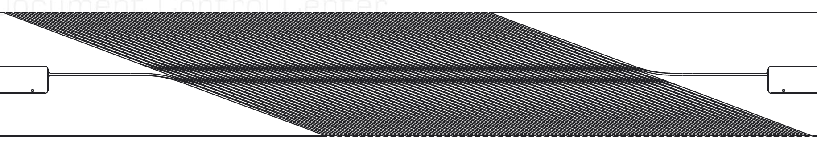
Coil Voltage Tap Plan
Inner layer voltage taps
  Voltage taps at every five turns on the pole (12 total)
  One voltage tap at each end next to the splice joint (2 total)
Outer layer voltage taps
  Voltage taps at every fifteen turns on the pole (4 total)
  One voltage tap at each end next to the splice joint (2 total)
V-Tap Trace
V-Tap Flags
Layer 1 V-Tap Locations

Slide 11
Other Instrumentation
Acoustic Sensors
  Ends of layer 1 and layer 2
  Inner surface of layer 1
Outer heaters and associated voltage taps
Outer layer thermometers in the grooves
Strain gages on outer shell

Slide 12
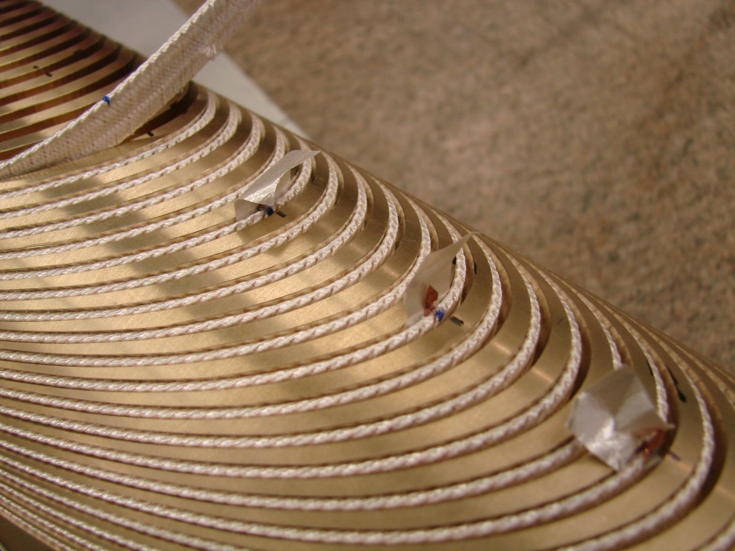
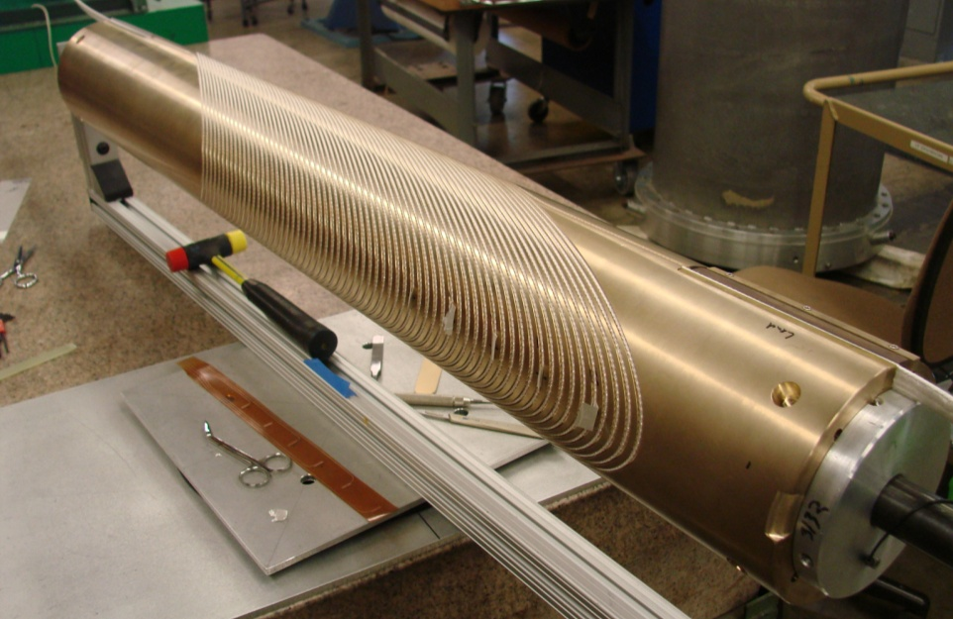
CCT5 Mandrel Winding
Winding of Layer 1 and Layer 2 is complete
Improvements in Winding methods leads to better winding uniformity
  Winding is done with two technicians
  One technician applies tension to the cable
  Leads to improvement in cable positioning within the channel (avoids areas where the cable can be proud of the outer mandrel surface)

Slide 13
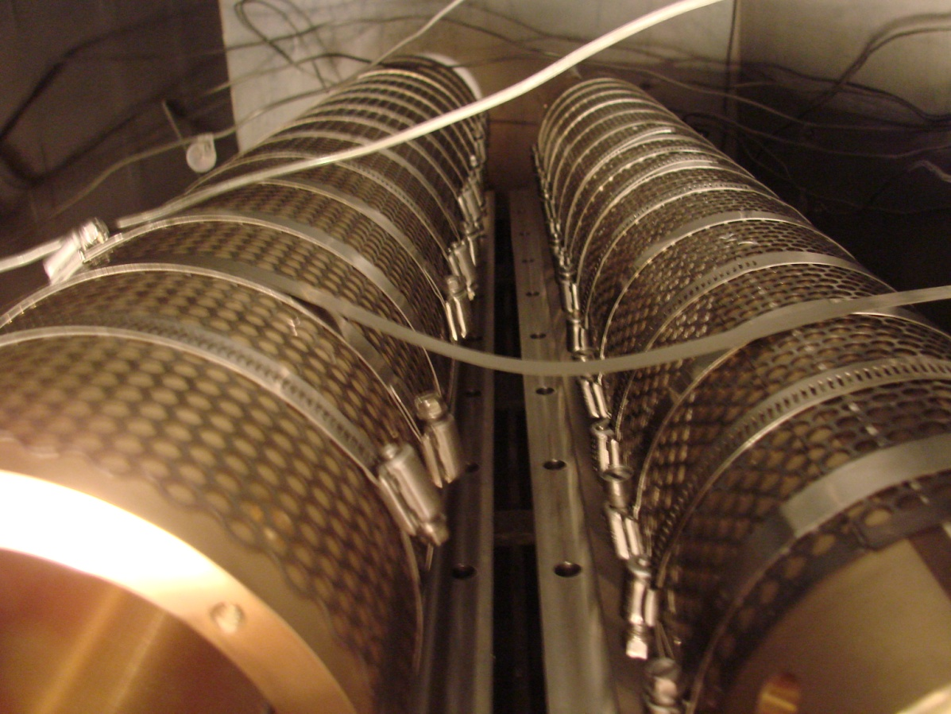
CCT5 Coil Heat Treatment
Heat treatment for both layers will finish at the end of this week (6/22)

Slide 14
CCT5 Next Steps
Coil and shell instrumentation
Potting of coils (tooling is ready)
Coil assembly using bend and shim process
Magnet test expected in August

