Slide 1
Mark Palmer, Brookhaven National Laboratory
Presentation to the Magnet Development Program General Meeting
January 17, 2024

Slide 2
P5 Panel
P5 Panel
Shoji Asai (University of Tokyo)
Amalia Ballarino (CERN)
Tulika Bose (Wisconsin–Madison)
Kyle Cranmer (Wisconsin–Madison)
Francis-Yan Cyr-Racine (New Mexico)
Sarah Demers (Yale)
Cameron Geddes (LBNL)
Yuri Gershtein (Rutgers)
Karsten Heeger (Yale) - Deputy Chair
Beate Heinemann (DESY)
JoAnne Hewett (SLAC) - HEPAP chair, ex officio until May 2023
Patrick Huber (Virginia Tech)
Kendall Mahn (Michigan State)
Rachel Mandelbaum (Carnegie Mellon)
Jelena Maricic (Hawaii)
Petra Merkel (Fermilab)
Christopher Monahan (William & Mary)
Hitoshi Murayama (Berkeley) - Chair
Peter Onyisi (Texas Austin)
Mark Palmer (BNL)
Tor Raubenheimer (SLAC/Stanford)
Mayly Sanchez (Florida State)
Richard Schnee (South Dakota School of Mines & Technology)
Sally Seidel (New Mexico) – interim HEPAP chair, ex officio since June 2023
Seon-Hee Seo (IBS Center for Underground Physics until Sep, Fermilab since Sep)
Jesse Thaler (MIT)
Christos Touramanis (Liverpool)
Abigail Vieregg (Chicago)
Amanda Weinstein (Iowa State)
Lindley Winslow (MIT)
Tien-Tien Yu (Oregon)
Robert Zwaska (Fermilab)
Blue: international members

Slide 3
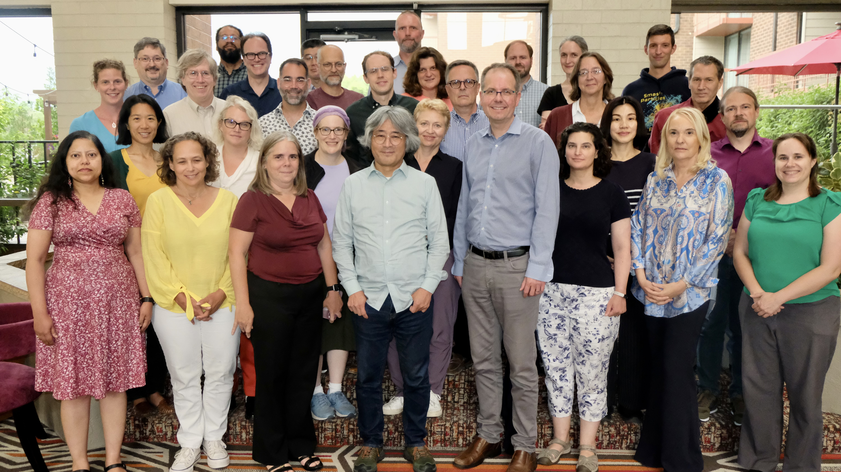
P5 Panel
Great panel!

Slide 4
1
Introduction

Slide 5
A Brief Overview of the Process
Proposed efforts far exceeded the
plausible budget scenarios
Critical to carefully evaluate project costs
  Concerns about potential cost growth
  Sub-committee on Costs, Risks & Schedule
  Chaired by Jay Marx

Slide 6
Some Context
US Budget Cycle:
  3-year process
  Will need until roughly FY26 to fully implement changes
Present budget
  Authorization in the CHIPS & Science Act has not resulted in corresponding budget appropriations!
  Significant constraints and likely more limited ramp-up of new initiatives
DOE Planning
  DOE-HEP internal planning process is now underway
  Updates to plans expected later in the year

Slide 7
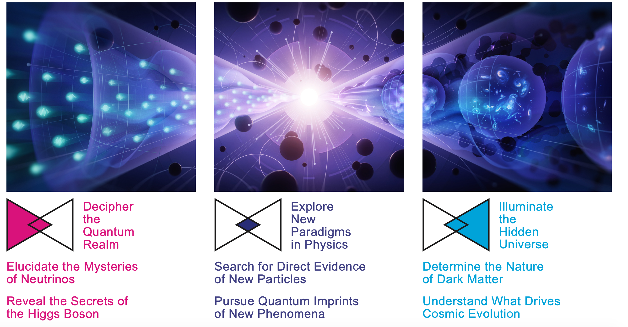
Thrusts tied to Collider Program are highlighted in blue boxes

Slide 8
Prioritization Principles
In the process of prioritization, we considered scientific opportunities, budgetary realism, and a balanced portfolio as major decision drivers.
Large projects (>$250M)
• Paradigm-changing discovery potential
• World-leading
• Unique in the world
Medium projects ($50–250M)
• Excellent discovery potential or development of major tools
• World-class
• Competitive
Small projects (<$50M)
• Discovery potential, well-defined measurements, or outstanding technology development
• World-class
• Excellent training grounds

Slide 9
2
The Recommended
Particle Physics
Program

Slide 10
2 The Recommended Particle Physics Program
2.1 Overview
A particle physics program that tackles the most important questions in each of the science drivers maximizes its potential for groundbreaking scientific discovery. Executing such a program requires a balanced portfolio of large, medium, and small projects, coupled with substantial investments in forward-looking R&D and the development of a skilled workforce for the nation.
Building upon the foundations laid by the previous P5, our recommended program completes ongoing projects and capitalizes on their momentum. A suite of new initiatives at a range of scales includes major projects that will shape the scientific landscape over the next two decades. The prioritized time sequencing of recommended projects and R&D, summarized in Figure 1, reflects our current understanding of the scientific landscape and its associated uncertainties.
The overall program is carefully constructed to be compatible with the baseline budget scenario provided by DOE. To achieve that, we recommend continuing specific projects, strategically advancing some to the construction phase, and delaying others. As shown in Figure 1, in some cases individual phases or elements of large-scale projects had to be prioritized separately. The process and criteria by which the recommended initiatives were selected are laid out in section 1.5.
Unfortunately no time to show the whole narrative… I jump to the recommendations

Slide 11
2 The Recommended Particle Physics Program
2.2 Recommendations
To drive US particle physics forward and maintain strong global leadership, we advocate a comprehensive and balanced program that strategically addresses the three science themes and their six interwoven drivers. The numerical order of the recommendations listed below is not meant to reflect their relative priority; instead it is used to group them thematically. The lists under the recommendations are not prioritized, except for the list of major projects under Recommendation 2. Each recommendation is stated in boldface, followed by concise, lettered explanations of how the recommendation can be realized. The impact of alternative budget scenarios on the different elements of the program is discussed in section 2.6.
A Full List of Recommendations is provided at the end of the report. That list includes Area Recommendations (section 6) in addition to those here.

Slide 12
Recommendation 1
Not Rank-Ordered
As the highest priority independent of the budget scenarios, complete construction projects and support operations of ongoing experiments and research to enable maximum science. We reaffirm the previous P5 recommendations on major initiatives:
HL-LHC (including ATLAS and CMS detectors, as well as Accelerator Upgrade Project) to start addressing why the Higgs boson condensed in the universe (reveal the secrets of the Higgs boson, section 3.2), to search for direct evidence for new particles (section 5.1), to pursue quantum imprints of new phenomena (section 5.2), and to determine the nature of dark matter (section 4.1).
The first phase of DUNE and PIP-II to determine the mass ordering among neutrinos, a fundamental property and a crucial input to cosmology and nuclear science (elucidate the mysteries of neutrinos, section 3.1).
The Vera C. Rubin Observatory to carry out the LSST, and the LSST Dark Energy Science Collaboration, to understand what drives cosmic evolution (section 4.2).

Slide 13
Recommendation 1
Not Rank-Ordered
In addition, we recommend continued support for the following ongoing experiments at the
medium scale (project costs > $50M for DOE and > $4M for NSF), including completion
of construction, operations, and research:
NOvA, SBN, T2K, and IceCube (elucidate the mysteries of neutrinos, section 3.1).
DarkSide-20k, LZ, SuperCDMS, and XENONnT (determine the nature of dark matter, section 4.1).
DESI (understand what drives cosmic evolution, section 4.2).
Belle II, LHCb, and Mu2e (pursue quantum imprints of new phenomena, section 5.2).
The agencies should work closely with each major project to carefully manage the costs
and schedule to ensure that the US program has a broad and balanced portfolio.

Slide 14
Recommendation 2
Construct a portfolio of major projects that collectively study nearly all fundamental constituents of our universe and their interactions, as well as how those interactions determine both the cosmic past and future.
These projects have the potential to transcend and transform our current paradigms. They inspire collaboration and international cooperation in advancing the frontiers of human knowledge. Plan and start the following major initiatives in order of priority from highest to lowest:

Slide 15
Recommendation 2
Rank-Ordered
CMB-S4, which looks back at the earliest moments of the universe to probe physics at the highest energy scales. It is critical to install telescopes at and observe from both the South Pole and Chile sites to achieve the science goals (section 4.2).
Re-envisioned second phase of DUNE with an early implementation of an enhanced 2.1 MW beam—ACE-MIRT—a third far detector, and an upgraded near-detector complex as the definitive long-baseline neutrino oscillation experiment of its kind (section 3.1).
An off-shore Higgs factory, realized in collaboration with international partners, in order to reveal the secrets of the Higgs boson. The current designs of FCC-ee and ILC meet our scientific requirements. The US should actively engage in feasibility and design studies. Once a specific project is deemed feasible and well-defined (see also Recommendation 6), the US should aim for a contribution at funding levels commensurate to that of the US involvement in the LHC and HL-LHC, while maintaining a healthy US on-shore program in particle physics (section 3.2).
An ultimate Generation 3 (G3) dark matter direct detection experiment reaching the neutrino fog, in coordination with international partners and preferably sited in the US (section 4.1).
IceCube-Gen2 for study of neutrino properties using non-beam neutrinos complementary to DUNE and for indirect detection of dark matter covering higher mass ranges using neutrinos as a tool (section 4.1).

Slide 16
Recommendation 2
The prioritization principles behind these recommendations can be found in sections 1.6
and 8.1.
IceCube-Gen2 also has a strong science case in multi-messenger astrophysics together with gravitational wave observatories. We recommend that NSF expand its efforts in multi-messenger astrophysics, a unique program in the NSF Division of Physics, with US involvement in the Cherenkov Telescope Array (CTA; recommendation 3c), a next-generation gravitational wave observatory, and IceCube-Gen2.

Slide 17
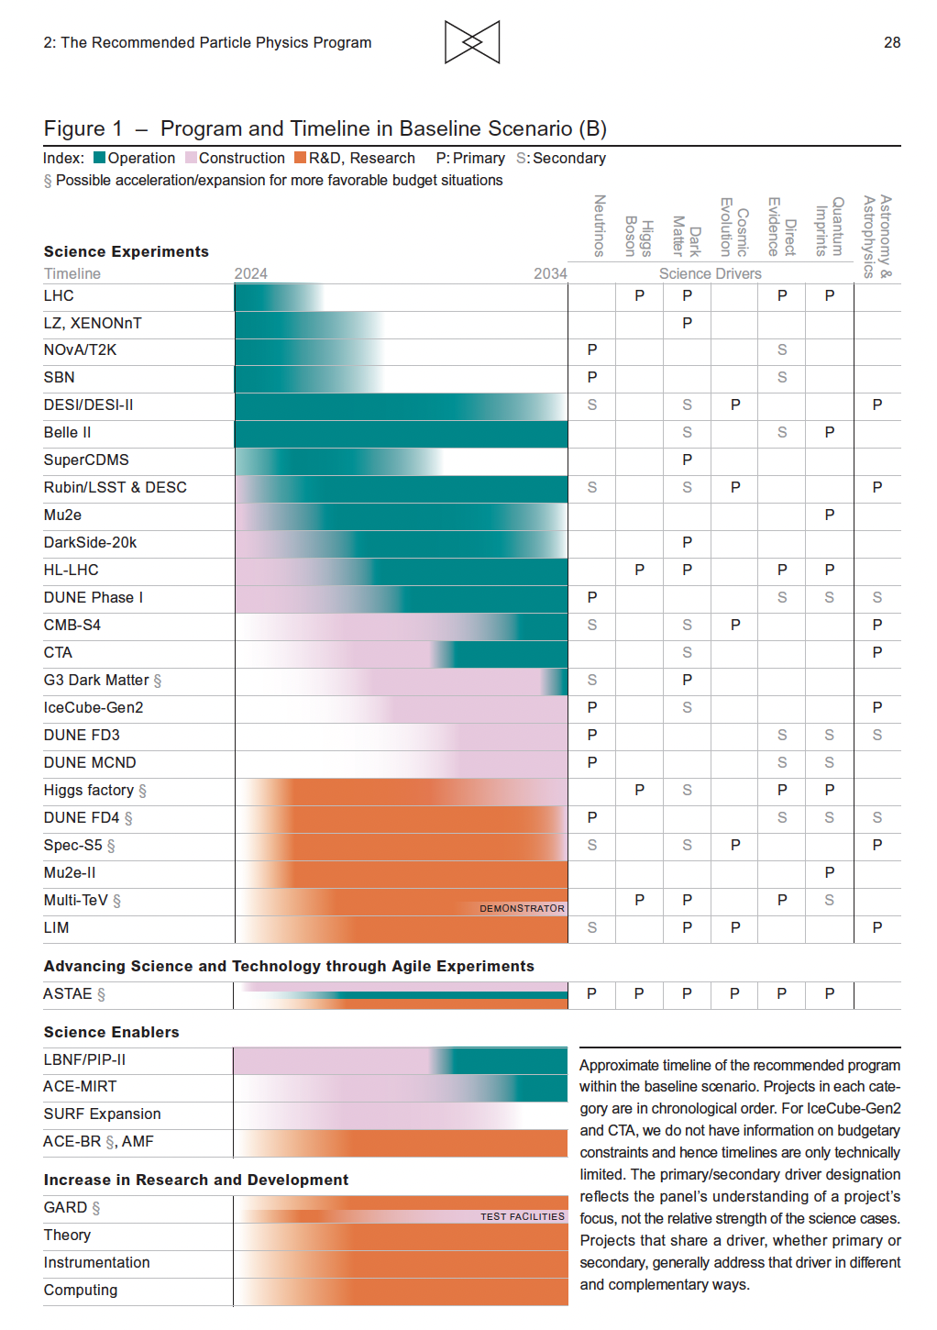

Slide 18
Recommendation 3
Not Rank-Ordered
Create an improved balance between small-, medium-, and large-scale projects to open new scientific opportunities and maximize their results, enhance workforce development, promote creativity, and compete on the world stage.
In order to achieve this balance across all project sizes we recommend the following:
Implement a new small-project portfolio at DOE, Advancing Science and Technology through Agile Experiments (ASTAE), across science themes in particle physics with a competitive program and recurring funding opportunity announcements. This program should start with the construction of experiments from the Dark Matter New Initiatives (DMNI) by DOE-HEP (section 6.2).
Continue Mid-Scale Research Infrastructure (MSRI) and Major Research Instrumentation (MRI) programs as a critical component of the NSF research and project portfolio.
Support DESI-II for cosmic evolution, LHCb upgrade II and Belle II upgrade for quantum imprints, and US contributions to the global CTA Observatory for dark matter (sections 4.2, 5.2, and 4.1).
The Belle II recommendation includes contributions towards the SuperKEKB accelerator.

Slide 19
Recommendation 4
Support a comprehensive effort to develop the resources—theoretical, computational, and technological—essential to our 20-year vision for the field. This includes an aggressive R&D program that, while technologically challenging, could yield revolutionary accelerator designs that chart a realistic path to a 10 TeV pCM collider.
Investing in the future of the field to fulfill this vision requires the following:

Slide 20
Recommendation 4
Not Rank-Ordered
Support vigorous R&D toward a cost-effective 10 TeV pCM collider based on proton, muon, or possible wakefield technologies, including an evaluation of options for US siting of such a machine, with a goal of being ready to build major test facilities and demonstrator facilities within the next 10 years (sections 3.2, 5.1, 6.5, and Recommendation 6).
Enhance research in theory to propel innovation, maximize scientific impact of investments in experiments, and expand our understanding of the universe (section 6.1).
Expand the General Accelerator R&D (GARD) program within HEP, including stewardship (section 6.4).
Invest in R&D in instrumentation to develop innovative scientific tools (section 6.3).
Conduct R&D efforts to define and enable new projects in the next decade, including detectors for an e⁺e– Higgs factory and 10 TeV pCM collider, Spec-S5, DUNE FD4, Mu2e-II, Advanced Muon Facility, and line intensity mapping (sections 3.1, 3.2, 4.2, 5.1, 5.2, and 6.3).
Support key cyberinfrastructure components such as shared software tools and a sustained R&D effort in computing, to fully exploit emerging technologies for projects. Prioritize computing and novel data analysis techniques for maximizing science across the entire field (section 6.7).
Develop plans for improving the Fermilab accelerator complex that are consistent with the long-term vision of this report, including neutrinos, flavor, and a 10 TeV pCM collider (section 6.6).
We recommend specific budget levels for enhanced support of these efforts and their justifications as Area Recommendations in section 6.

Slide 22
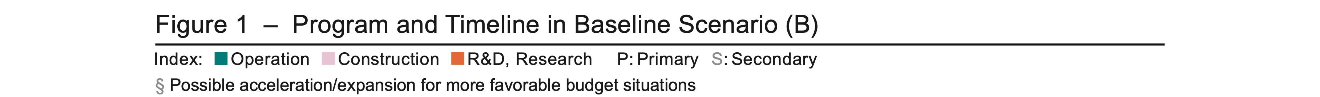

Slide 23
Recommendation 5
Invest in initiatives aimed at developing the workforce, broadening engagement, and supporting ethical conduct in the field. This commitment nurtures an advanced technological workforce not only for particle physics, but for the nation as a whole.

Slide 24
Recommendation 5
Not Rank-Ordered
The following workforce initiatives are detailed in section 7:
All projects, workshops, conferences, and collaborations must incorporate ethics agreements that detail expectations for professional conduct and establish mechanisms for transparent reporting, response, and training. These mechanisms should be supported by laboratory and funding agency infrastructure. The efficacy and coverage of this infrastructure should be reviewed by a HEPAP subpanel.
Funding agencies should continue to support programs that broaden engagement in particle physics, including strategic academic partnership programs, traineeship programs, and programs in support of dependent care and accessibility. A systematic review of these programs should be used to identify and remove barriers.
Comprehensive work-climate studies should be conducted with the support of funding agencies. Large collaborations and national laboratories should consistently undertake such studies so that issues can be identified, addressed, and monitored. Professional associations should spearhead field-wide work-climate investigations to ensure that the unique experiences of individuals engaged in smaller collaborations and university settings are effectively captured.
Funding agencies should strategically increase support for research scientists, research hardware and software engineers, technicians, and other professionals at universities.
A plan for dissemination of scientific results to the public should be included in the proposed operations and research budgets of experiments. The funding agencies should include funding for the dissemination of results to the public in operation and research budgets.

Slide 25
Recommendation 6
Convene a targeted panel with broad membership across particle physics later this decade that makes decisions on the US accelerator-based program at the time when major decisions concerning an off-shore Higgs factory are expected, and/or significant adjustments within the accelerator-based R&D portfolio are likely to be needed. A plan for the Fermilab accelerator complex consistent with the long-term vision in this report should also be reviewed.
The panel would consider the following:
The level and nature of US contribution in a specific Higgs factory including an evaluation of the associated schedule, budget, and risks once crucial information becomes available.
Mid- and large-scale test and demonstrator facilities in the accelerator and collider R&D portfolios.
A plan for the evolution of the Fermilab accelerator complex consistent with the longterm vision in this report, which may commence construction in the event of a more favorable budget situation.

Slide 26
3
Some Key Elements
of the P5 Vision

Slide 27
2.3 The Path to a 10 TeV pCM
Realization of a future collider will require resources at a global scale and will be built through a world-wide collaborative effort where decisions will be taken collectively from the outset by the partners. This differs from current and past international projects in particle physics, where individual laboratories started projects that were later joined by other laboratories. The proposed program aligns with the long-term ambition of hosting a major international collider facility in the US, leading the global effort to understand the fundamental nature of the universe.
…
In particular, a muon collider presents an attractive option both for technological innovation and for bringing energy frontier colliders back to the US. The footprint of a 10 TeV pCM muon collider is almost exactly the size of the Fermilab campus. A muon collider would rely on a powerful multi-megawatt proton driver delivering very intense and short beam pulses to a target, resulting in the production of pions, which in turn decay into muons. This cloud of muons needs to be captured and cooled before the bulk of the muons have decayed. Once cooled into a beam, fast acceleration is required to further suppress decay losses.
…
Although we do not know if a muon collider is ultimately feasible, the road toward it leads from current Fermilab strengths and capabilities to a series of proton beam improvements and neutrino beam facilities, each producing world-class science while performing critical R&D towards a muon collider. At the end of the path is an unparalleled global facility on US soil. This is our Muon Shot.

Slide 28
2.4 Stewardship of Key Infrastructure and Expertise
Successful completion of the recommended major projects depends on critical US infrastructure (section 6.6), including particular research sites and facilities. DOE National Laboratories are critical research infrastructure that must be maintained and enhanced based on the needs of the particle physics community. This is particularly true for Fermilab as the only dedicated US laboratory for particle physics. The South Pole, a unique site that enables the world-leading science of CMB-S4 and IceCube-Gen2, must be maintained as a premier site of science to allow continued US leadership in these areas. SURF, a deep underground research laboratory supported by the South Dakota Science and Technology Authority, private foundation funds, and DOE, is a critical addition to the suite of US research infrastructure, providing new space and essential infrastructure for DUNE and potentially a G3 dark matter experiment.
In other cases, the infrastructure is technological and intellectual. The GARD program is critical in supporting a broad range of accelerator science and technology (AS&T) for DOE’s Office of Science, separate from the targeted R&D toward future colliders. Along with NSF-funded fundamental accelerator science, GARD supports a broad workforce of essential accelerator expertise. The program also provides stewardship of AS&T for DOE’s Office of Science. This program and the balance across the different research thrusts should be reviewed regularly to ensure alignment with the goals in particle physics. Reviews should be conducted by broad teams, not only specialists.

Slide 29
2.5 International and Inter-Agency Partnerships
In the case of the Higgs factory, crucial decisions must be made in consultation with potential international partners. The FCC-ee feasibility study is expected to be completed by 2025 and will be followed by a European Strategy Group update and a CERN council decision on the 2028 timescale. The ILC design is technically ready and awaiting a formulation as a global project. A dedicated panel should review the plan for a specific Higgs factory once it is deemed feasible and well-defined; evaluate the schedule, budget and risks of US participation; and give recommendations to the US funding agencies later this decade (Recommendation 6). When a clear choice for a specific Higgs factory emerges, US efforts will focus on that project, and R&D related to other Higgs factory projects would ramp down.
Parallel to the R&D for a Higgs factory, the US R&D effort should develop a 10 TeV pCM collider (design and technology), such as a muon collider, a proton collider, or possibly an electron-positron collider based on wakefield technology. The US should participate in the International Muon Collider Collaboration (IMCC) and take a leading role in defining a reference design. We note that there are many synergies between muon and proton colliders, especially in the area of development of high-field magnets. R&D efforts in the next 5-year timescale will define the scope of test facilities for later in the decade, paving the way for initiating demonstrator facilities within a 10-year timescale (Recommendation 6).

Slide 30
A summary of Area Recommendations as driven by the elements of the preceding slides is included at the end of this talk
Note: Strong support for targeted initiatives in Collider R&D, theory, instrumentation, and computing
These initiatives are not intended to disappear in a less than ideal budget scenario!!!

Slide 31
Area Recommendations
Instrumentation
Increase the budget for generic Detector R&D by at least $4 million per year in 2023 dollars. This should be supplemented by additional funds for the collider R&D program
The detector R&D program should continue to leverage national initiatives such as QIS, microelectronics, and AI/ML.
General Accelerator R&D
Increase annual funding to the General Accelerator R&D program by $10M per year in 2023 dollars to ensure US leadership in key areas.
Support generic accelerator R&D with the construction of small scale test facilities. Initiate construction of larger test facilities based on project review, and informed by the collider R&D program.
Collider R&D
To enable targeted R&D before specific collider projects are established in the US, an investment in collider detector R&D funding at the level of $20M per year and collider accelerator R&D at the level of $35M per year in 2023 dollars is warranted.
Relevant to MDP planning

Slide 32
Comments & Discussion
Recommendations provide a strong basis for MDP to move forward
  Goal: modest expansion of GARD program
  Goal: significant focus on directed Collider R&D (FCC-hh, MC, other elements?)
  Of course, P5 only provides recommendations…
What are the implications given the current budget situation?
  We are likely to be below the P5 guidance in the near term
  The 3-year budget cycle means that changes can only be implemented gradually
Significant concerns are also present about how we maintain a suitable workforce that supports
  Ongoing operations
  Approved projects
  And R&D

Slide 33
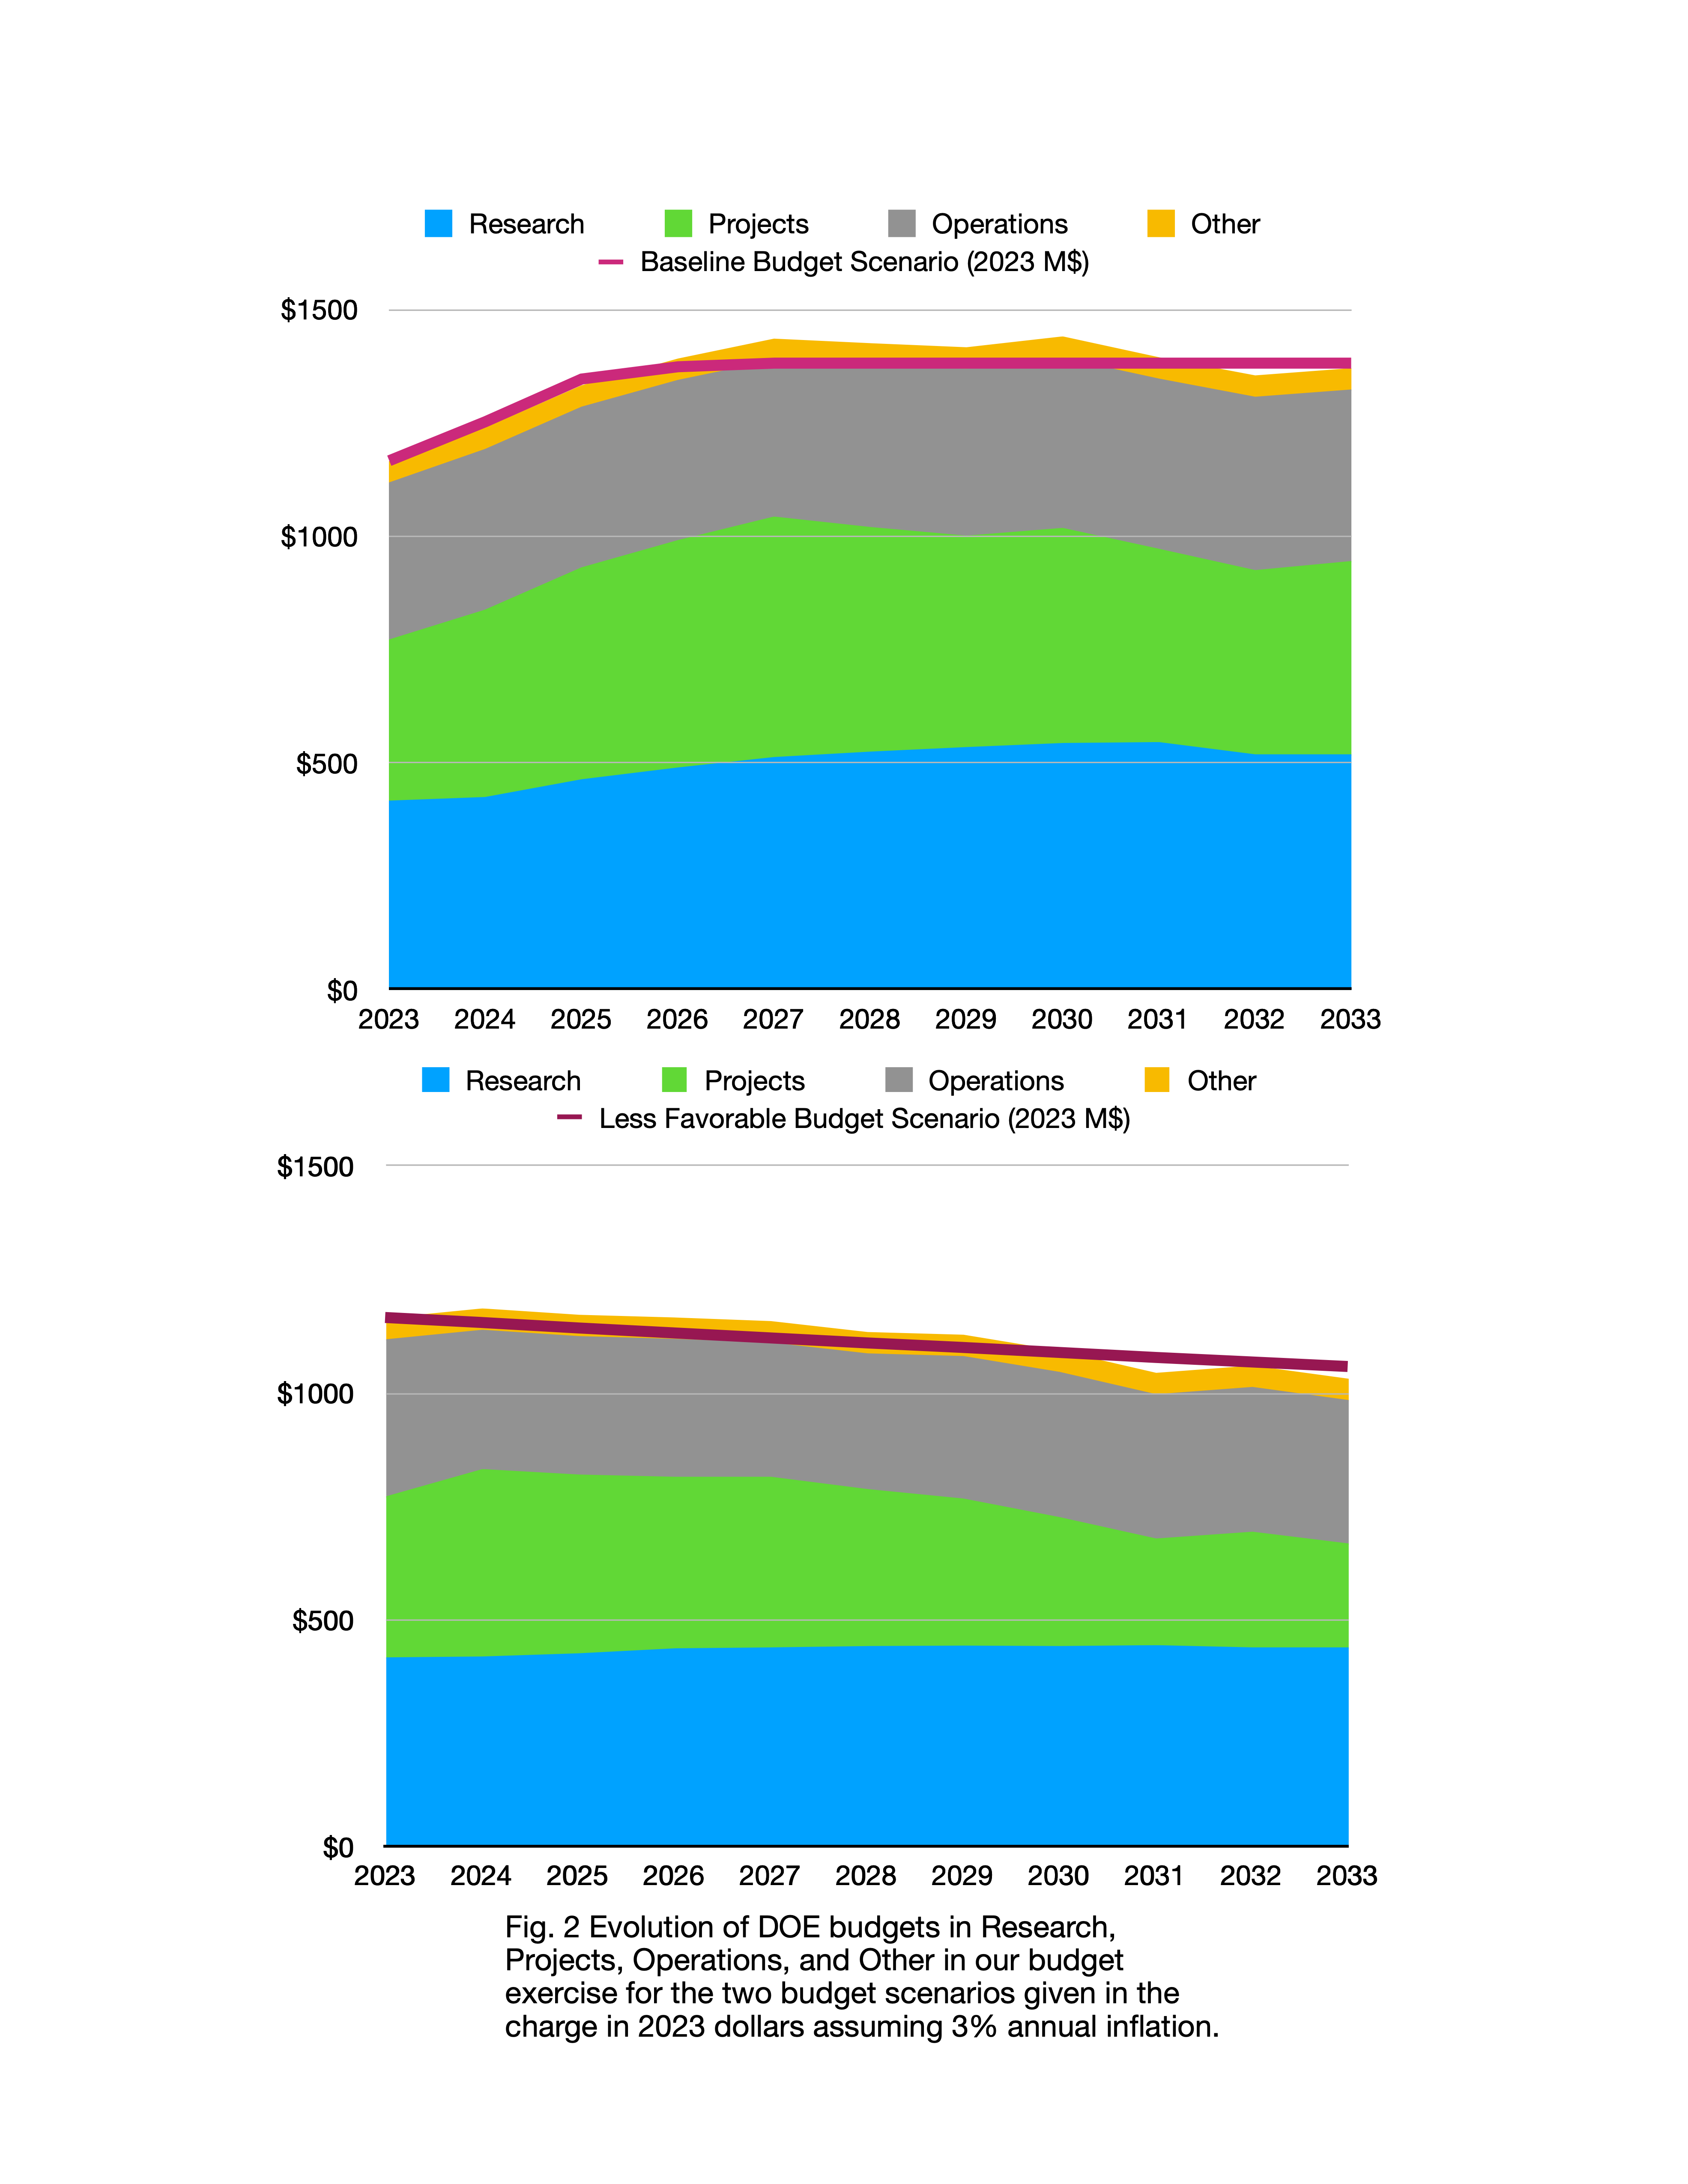
M
Other
Operations
M
Projects
M
Research
Not in the Report

Slide 34
Not in the Report

Slide 35
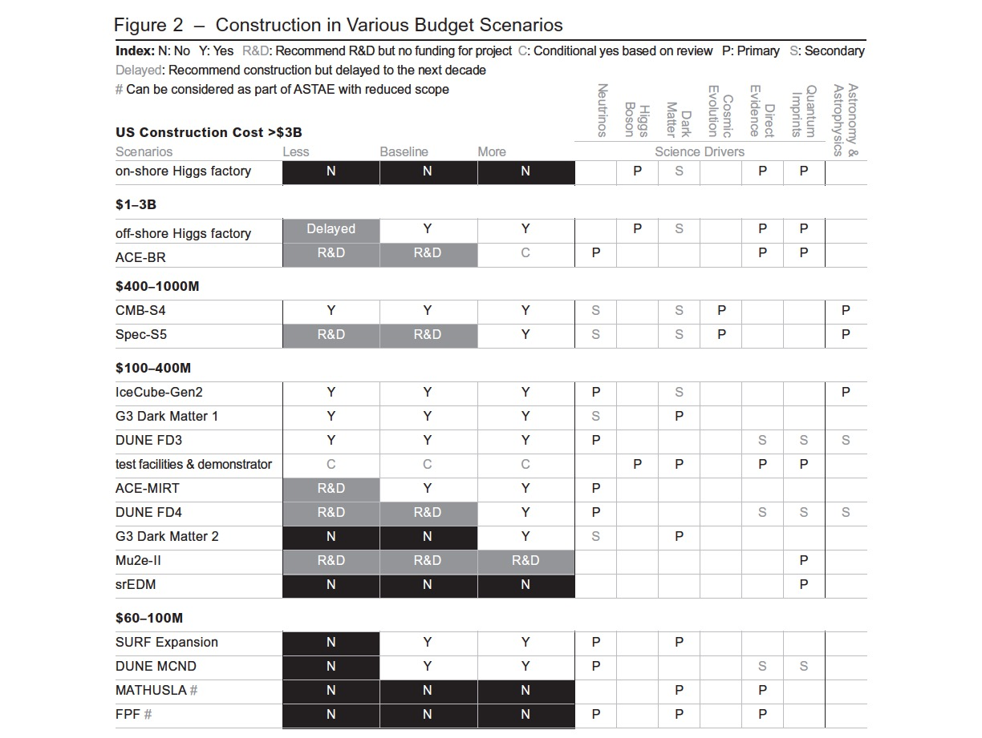
Difficult
Choices
A: Can be considered as part of ASTAE with reduced scope
A
A
A
A
A
A

Slide 36
Thank you for your attention!
Questions or Comments?

Slide 37
Area Recommendations

Slide 38
Area Recommendations
Theory
Increase DOE HEP-funded university-based theory research by $15 million per year in 2023 dollars (or about 30% of the theory program), to propel innovation and ensure international competitiveness. Such an increase would bring theory support back to 2010 levels. Maintain DOE lab-based theory groups as an essential component of the theory community.
ASTAE
For the ASTAE program to be agile, we recommend a broad, predictable, and recurring (preferably annual) call for proposals. This ensures the flexibility to target emerging opportunities and fields. A program on the scale of $35 million per year in 2023 dollars is needed to ensure a healthy pipeline of projects.
To preserve the agility of the ASTAE program, project management requirements should be outlined for the portfolio and should be adjusted to be commensurate with the scale of the experiment.
A successful ASTAE experiment involves 3 phases: design, construction, and operations. A design phase proposal should precede a construction proposal, and construction proposals are considered from projects within the group that have successfully completed their design phase.
The DMNI projects that have successfully completed their design phase and are ready to be reviewed for construction, should form the first set of construction proposals for ASTAE. The corresponding design phase call would be open to proposals from all areas of particle physics.

Slide 39
Area Recommendations
Instrumentation
Increase the budget for generic Detector R&D by at least $4 million per year in 2023 dollars. This should be supplemented by additional funds for the collider R&D program
The detector R&D program should continue to leverage national initiatives such as QIS, microelectronics, and AI/ML.
General Accelerator R&D
Increase annual funding to the General Accelerator R&D program by $10M per year in 2023 dollars to ensure US leadership in key areas.
Support generic accelerator R&D with the construction of small scale test facilities. Initiate construction of larger test facilities based on project review, and informed by the collider R&D program.
Collider R&D
To enable targeted R&D before specific collider projects are established in the US, an investment in collider detector R&D funding at the level of $20M per year and collider accelerator R&D at the level of $35M per year in 2023 dollars is warranted.

Slide 40
Area Recommendations
Facilities and Infrastructure
To successfully deliver major initiatives and leading global projects, we recommend that:
  National Laboratories and facilities should work with funding agencies to establish and maintain streamlined access policies enabling efficient remote and on-site collaboration by international and domestic partners.
  National Laboratories should prioritize the facilitation of procurement processes and ensure robust technical support for experimenters.
  National Laboratories and facilities should prioritize the creation and maintenance of a supportive, inclusive, and welcoming culture.
Form a dedicated task force, to be led by Fermilab with broad community membership. This task force is to be charged with defining a roadmap for upgrade efforts and delivering a strategic 20-year plan for the Fermilab accelerator complex within the next five years for consideration (Recommendation 6). Direct task force funding of up to $10M should be provided.
Assess the Booster synchrotron and related systems for reliability risks through the first decade of DUNE operation, and take measures to preemptively address these risks.
Maintaining the capabilities of NSF’s infrastructure at the South Pole, focused on enabling future world-leading scientific discoveries, is essential. We recommend continued direct coordination and planning between NSF-OPP and the CMB-S4 and IceCube-Gen2 projects, which is of critical importance to the field of particle physics.

Slide 41
Area Recommendations
Software, Computing, and Cyberinfrastructure
Resources for national initiatives in AI/ML, quantum, computing, and microprocessors should be leveraged and incorporated into research and R&D efforts to maximize the physics reach of the program.
Add support for a sustained R&D effort at the level of $9M per year in 2023 dollars to adapt software and computing systems to emerging hardware, incorporate other advances in computing technologies, and fund directed efforts to transition those developments into systems used for operations of experiments and facilities.
Through targeted investments at the level of $8M per year in 2023 dollars, ensure sustained support for key cyberinfrastructure components. This includes widely-used software packages, simulation tools, information resources such as the Particle Data Group and INSPIRE, as well as the shared infrastructure for preservation, dissemination, and analysis of the unique data collected by various experiments and surveys in order to realize their full scientific impact.
Research software engineers and other professionals at universities and labs are key to realizing the vision of the field and are critical for maintaining a technologically advanced workforce. We recommend that the funding agencies embrace these roles as a critical component of the workforce when investing in software, computing, and cyberinfrastructure.
Sustainability
HEPAP, potentially in collaboration with international partners, should conduct a dedicated study aiming at developing a sustainability strategy for particle physics.

Slide 42
Backup Slides

Slide 43
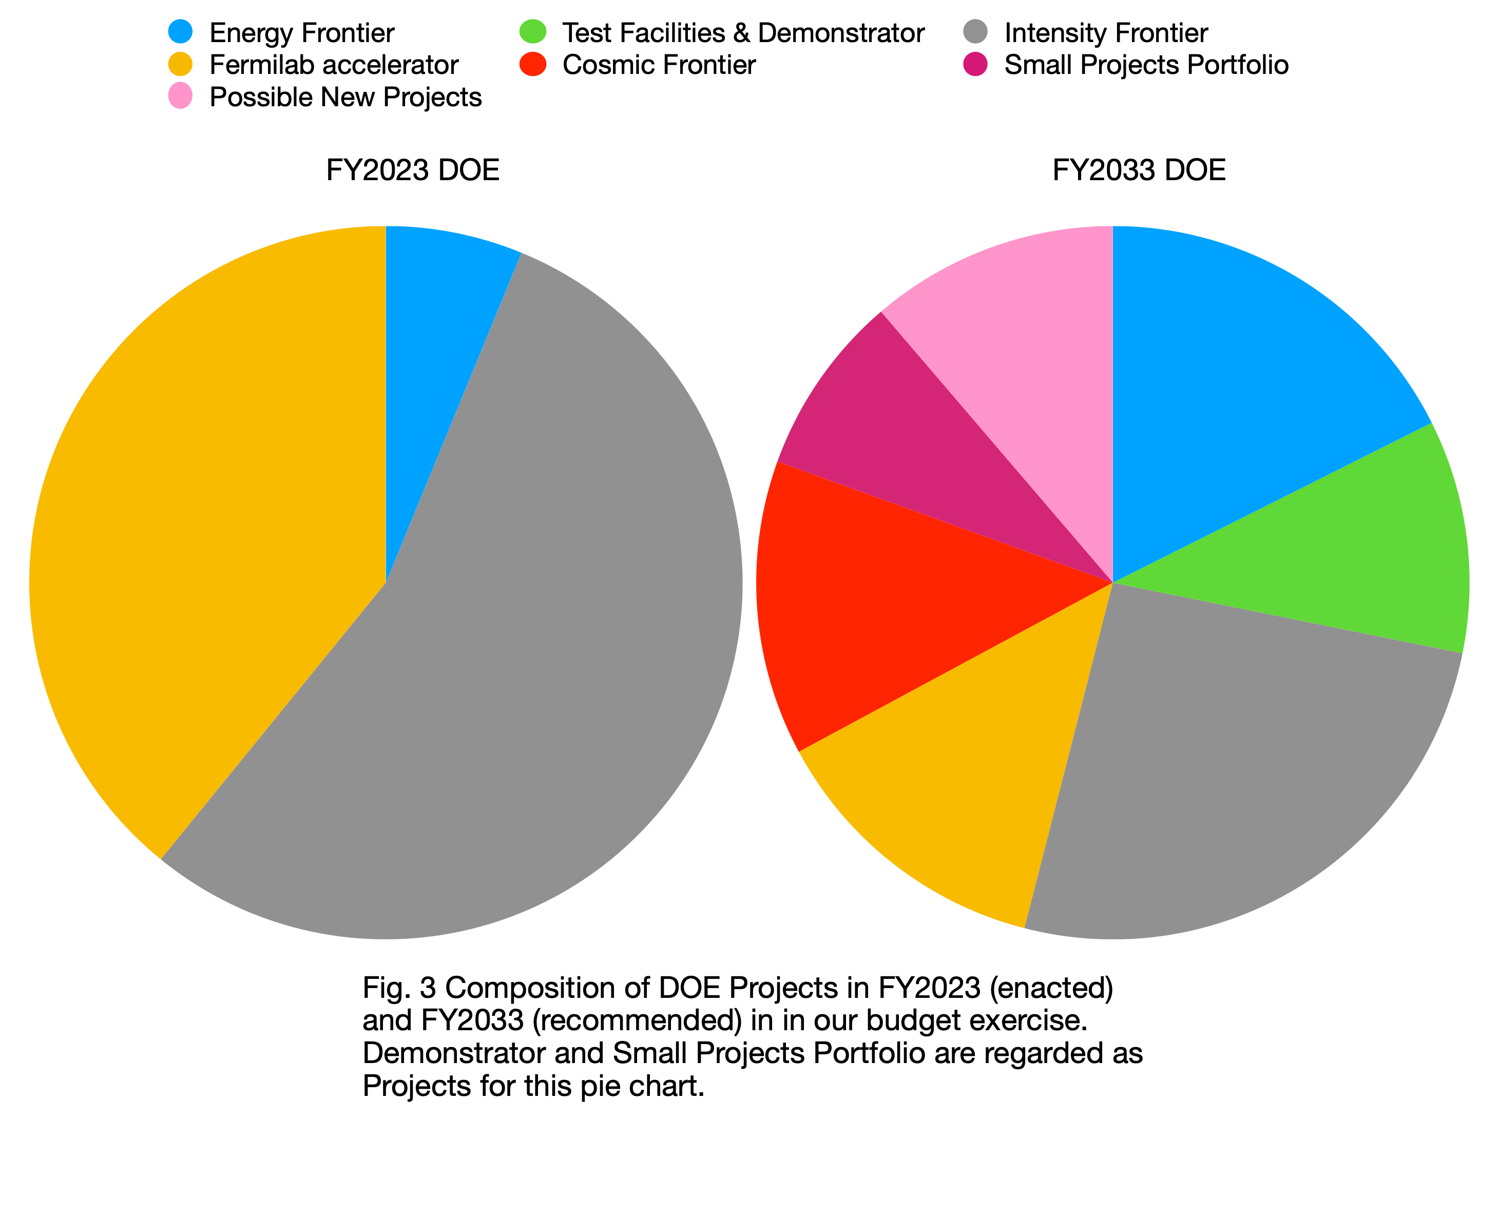
Not in the Report

Slide 44
Acknowledgements
Special thanks are due to:
The members of the cost subcommittee for their timely and hard work, in particular its chair, Jay Marx.
All the national laboratories that made their staff available for this important task.
The people at funding agencies for providing us all necessary information and support throughout the process.
Our peer reviewers for giving us constructive feedback under a tight deadline.
Lawrence Berkeley National Laboratory, Fermilab, Argonne National Laboratory, Brookhaven National Laboratory, SLAC National Laboratory, Virginia Tech University, and University of Texas Austin for hosting the town halls.
James Dawson and Marty Hanna for professional editing.
Michael Branigan, Brad Nagle, Olena Shmahalo and Abigail Malate for providing beautiful graphics and layout.
The Yale Physics Department for supporting the development of the website.
Kerri Fomby, Jody Crisp, and Taylor Pitchford at ORISE and Stephany Tone at LBNL for logistical support.
Our families for supporting us during this year-long process.
And most importantly, we thank APS/DPF for organizing the Snowmass Community Study, and all members of our community for their bold and creative vision as well as their input to the process.

Slide 45
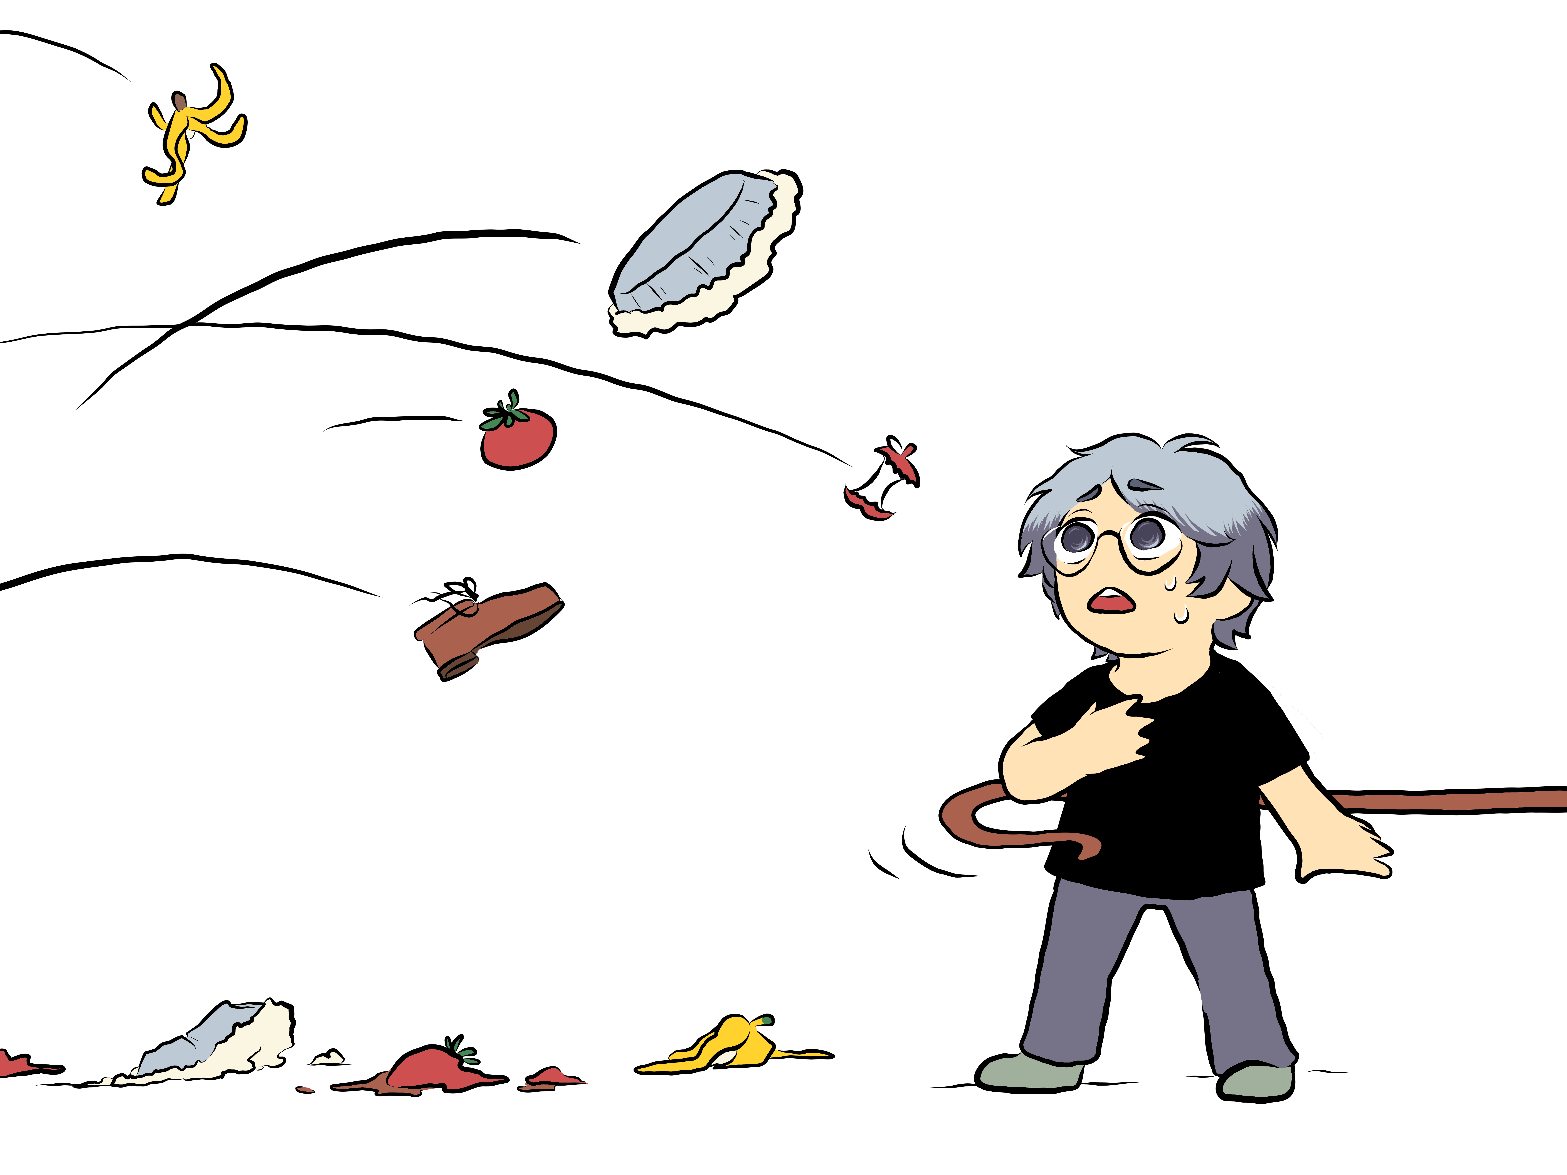
Credit:
Yurie
Murayama

Slide 46
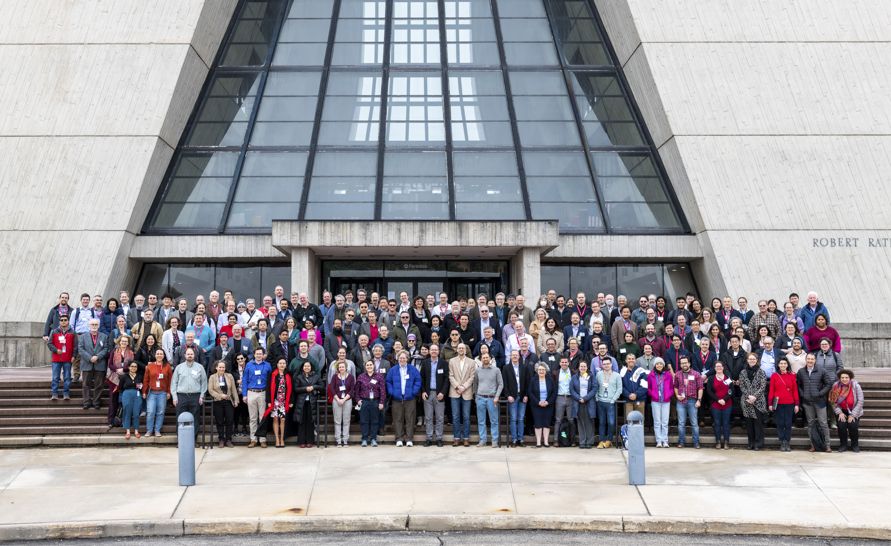
P5 town hall at FNAL

