Slide 1
US MDP Status Update
Presentation to the MDP TAC
January 18, 2024
Soren Prestemon
For the MDP Team

Slide 2
Guidance to the Technical Advisory Committee
The purpose of the meeting is to update the TAC on
  MDP progress since the last Collaboration meeting and
  MDP strategy in light of new P5 report
Feedback is appreciated on all fronts, most importantly the TAC’s perspective on:
  MDP technical progress
  Observations and impressions of potential impact of developments
  Strategy on engagement in community planning, P5 alignment, and in international collaboration

Slide 3
Recap of our MDP vision
Maintain and strengthen US Leadership in high-field accelerator magnet technology for future colliders
Focus on the four primary goals identified in the the original MDP Plan
  Explore the performance limits of Nb₃Sn accelerator magnets, with a focus on minimizing the required operating margin and significantly reducing or eliminating training
  Develop and demonstrate an HTS accelerator magnet with a self-field of 5T or greater, compatible with operation in a hybrid HTS/LTS magnet for fields beyond 16T
  Investigate fundamental aspects of magnet design and technology that can lead to substantial performance improvements and magnet cost reduction
  Pursue Nb₃Sn and HTS conductor R&D with clear targets to increase performance and reduce the cost of accelerator magnets
Further develop and integrate the teams across the partner laboratories and Universities for maximum value and effectiveness to the program
Identify and nurture cross-cutting / synergistic activities with other programs to more rapidly advance progress towards our goals

Slide 4
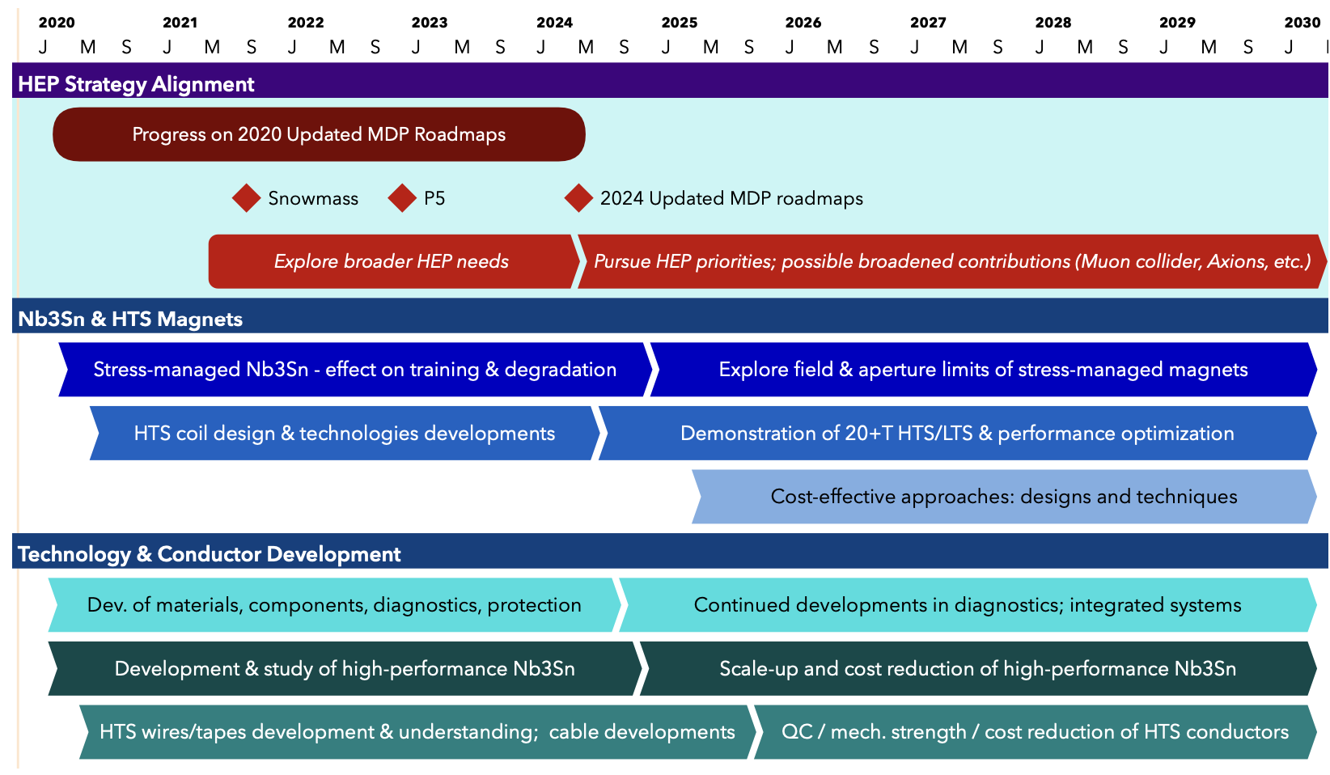
US MDP 2020 roadmaps – long range
Continue alignment with physics community needs
Focus on “stress-management” as well as hybrid HTS/LTS magnet technology
Continue to invest in the “science of magnets” and in improved conductors

Slide 5
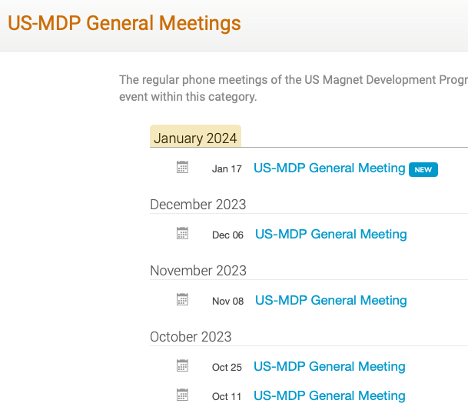
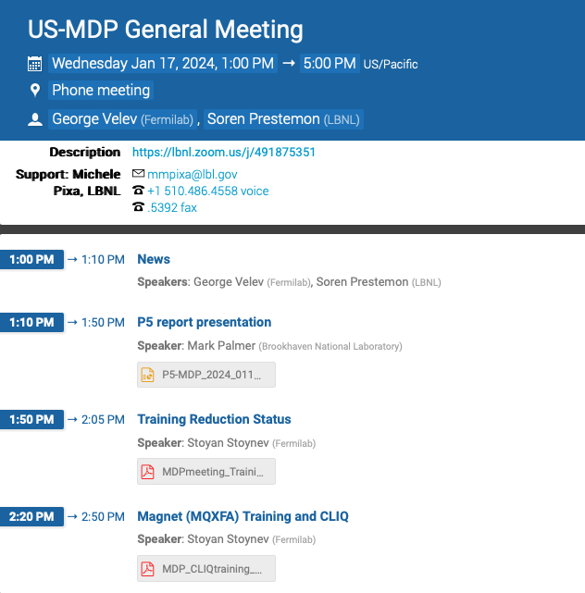
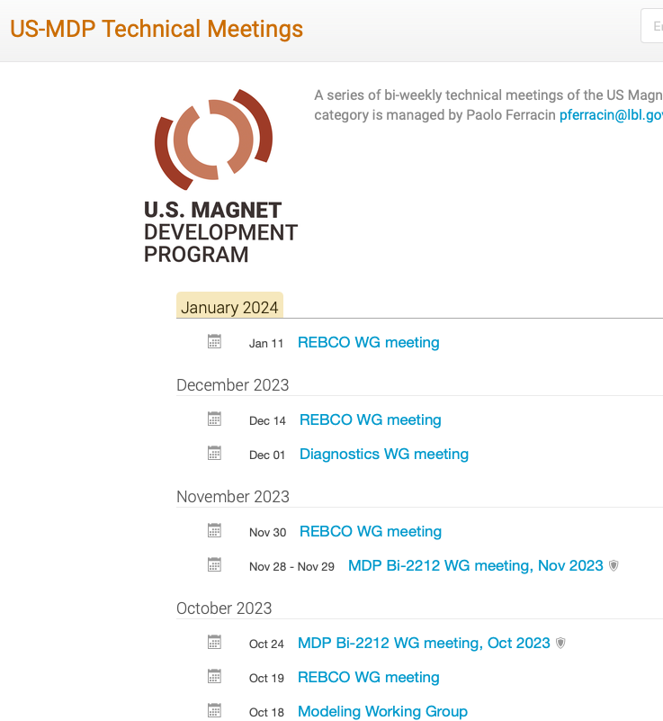
Program approach to collaboration and communication
MDP G7 meets regularly Tuesday 2/4/5pm
  GV and SP typically touch base Tuesday morning to set a basic agenda for the day’s G7 meeting, and review plans for next general meeting
  Meeting covers agenda but is then free-flowing – excellent attendance and communication
Technical coordinators set up “regular” Technical Meetings of technical areas
  Some “ad-hoc” technical meetings focus on specific collaborations
  Coordinators are empowered and able to create their own Indico page, and do so regularly
General meetings are now held bi-weekly
  Most meetings include an update on milestone and technical progress of one technical area
  A meeting can also include an invited presentation – internal or external – to MDP

Slide 6
Central themes of MDP magnet R&D
Use fast turn-around platforms (subscale magnets, mirror magnets, etc)
Develop and apply advanced diagnostics, modeling
Explore “Quench Current-boosting”, high-Cp concepts, etc.
Understanding the disturbance spectrum and its control
  Study training, operating margin, and means to mitigate/reduce
Develop stress-management concepts to enable high-field accelerator magnets with strain-sensitive materials (Nb3Sn, HTS)
Develop and demonstrate REBCO and Bi2212 magnet technologies
Explore the viability of hybrid HTS/LTS magnets for efficient high-field accelerator magnets
Work with industry to advance superconductors tailored to HEP needs
Focus on developing conductor / cable / coil / magnet processes, identifying key issues
Leverage elements above to design optimized high-field configurations
Longstanding nexus between Labs, Universities, and industry in the US
  Example: Annual Low Temperature Superconductor Workshop >40+ years!

Slide 7
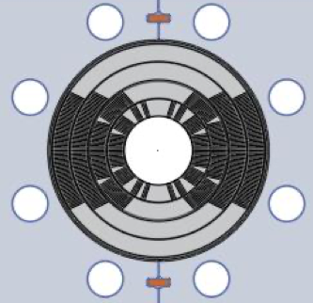
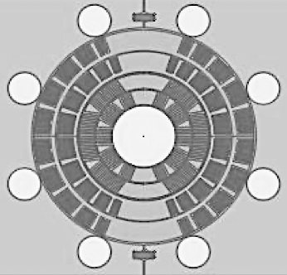
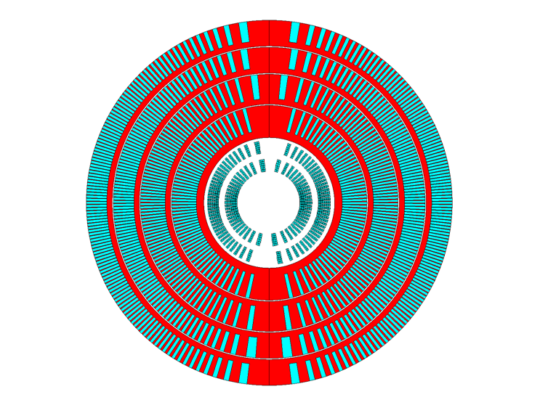
Managing mechanical stresses is key to higher fields – exploring stress-managed structures
“Traditional” Cos-theta
- Midplane stress due to azimuthal force accumulation
“Stress-managed” Cos-theta
- Groups of turns, azimuthal forces intercepted by support
MDP stress-managed hybrid magnets are under development
Critical for strain sensitive Nb₃Sn & HTS conductors
Characterized by significant interfaces
Nb₃Sn outsert
These “stress-managed” structures may enable combined function high-field accelerator magnets, which are subject to complex force distributions
HTS insert
Serves as good candidate for muon collider ring dipole

Slide 8
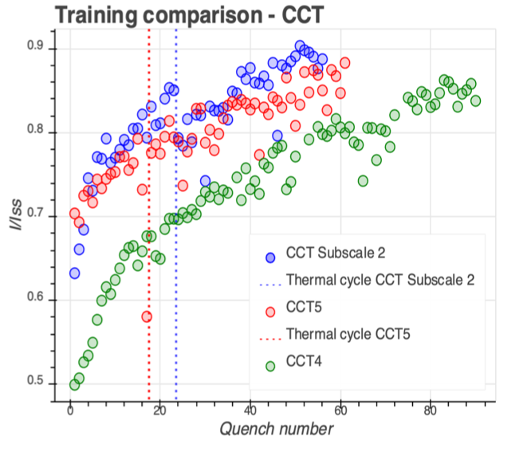
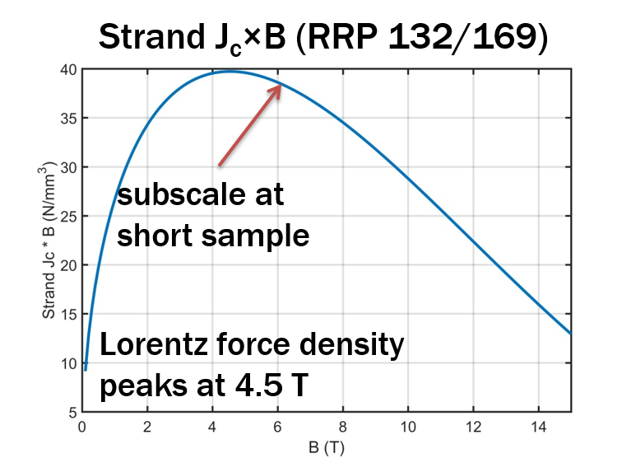
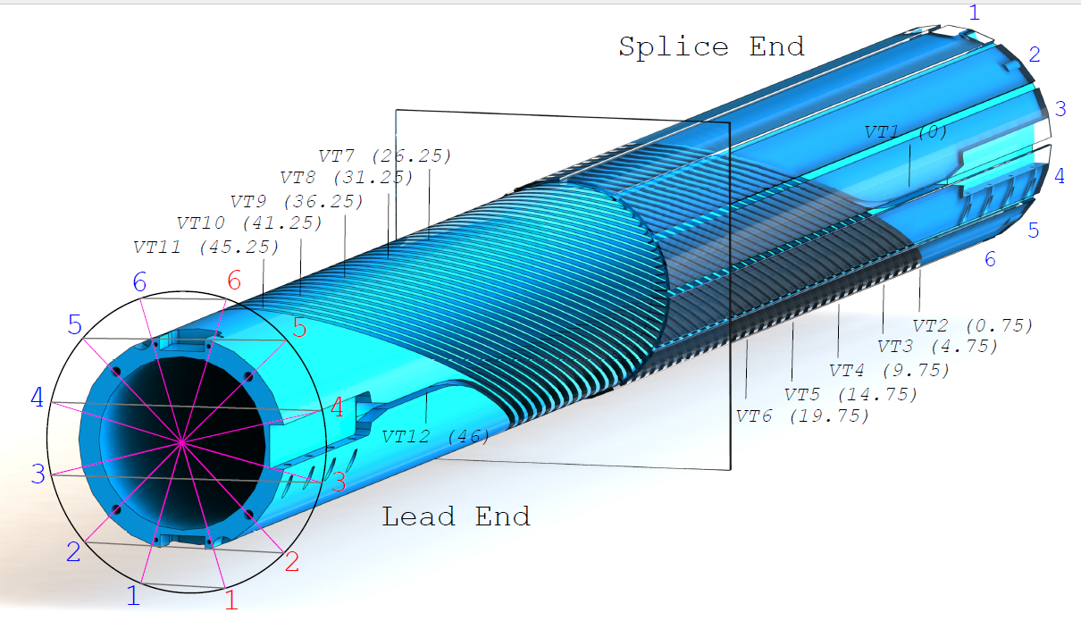
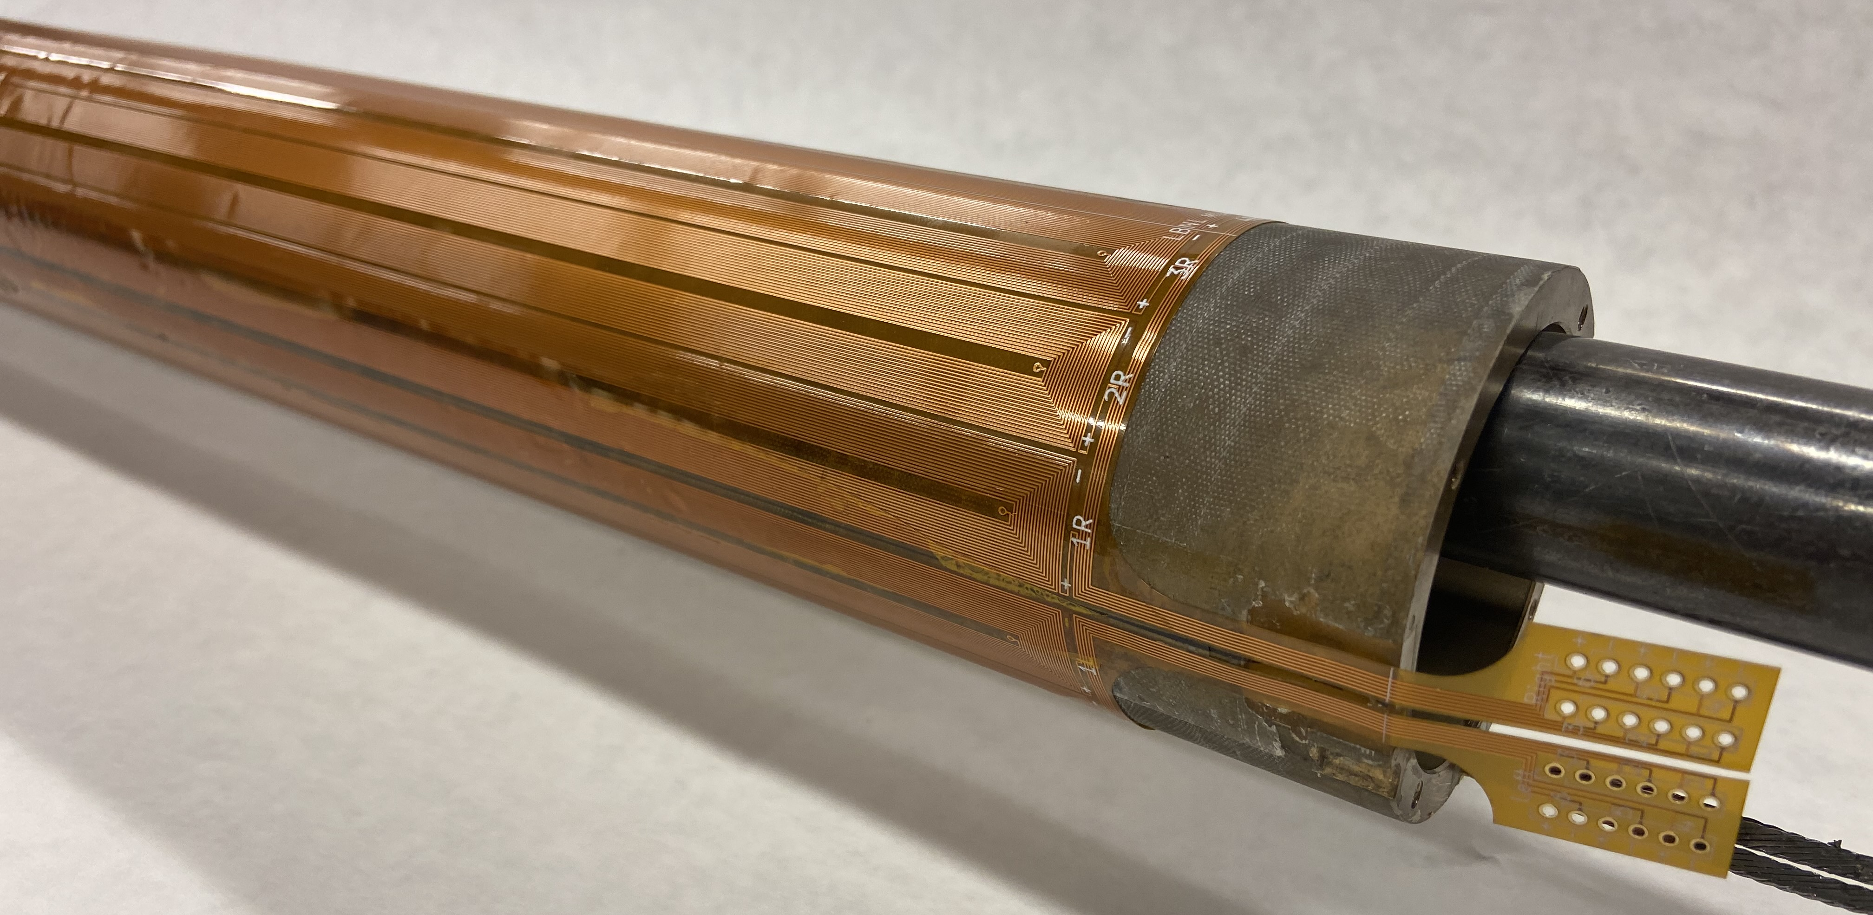
Subscale magnets as a platform for rapid development
”Canted Cosine Theta” (CCT) is limiting case of stress-management
  Every turn supported – minimal azimuthal accumulation of force
  Subscale probes relevant stress state
Test demonstrated that the subscale magnet exhibits similar training to “full scale”
CCT4 – Epoxy filled interface (CTD 101k)
CCT5 – Bend and shim interface (FSU Mix 61)

Slide 9
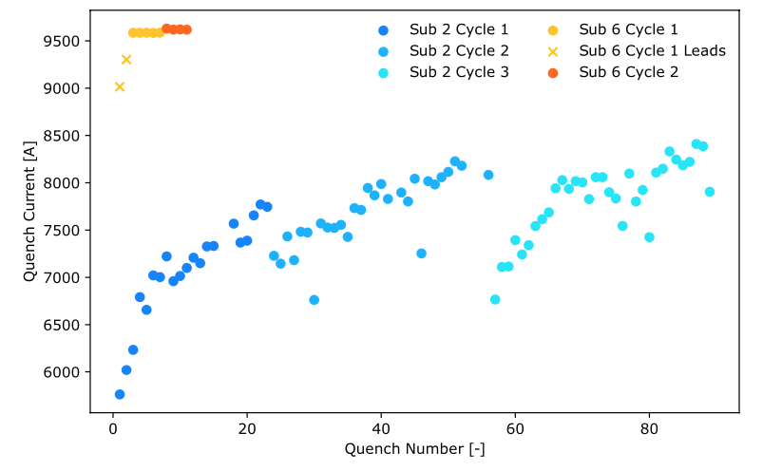
Subscale magnets are used to evaluate impregnation materials – the return of Paraffin Wax!
A subscale CCT (CCT_sub_6) was built with two coils, both impregnated with Paraffin wax
Dramatic impact on training and margin
  Only two ”training” quenches, located in leads
  Highly reproducible quench current (~9500A)
  Held field (no quench) for 7 minutes at I_{q}-30A
  Thermal cycle showed no degradation
Excellent example of international collaboration
  Motivating studies using PSI “BOX” test platform
    Data indicated wax reduced/eliminated training
    Daly et al 2022 ,SUST 35 055014
Recent tests using Telene (on a different “platform”) also suggest dramatic reduction/elimination of training
  Collaboration between FNAL, ANL and NIMS
First test performed at LBNL Aug 29th, 2023

Slide 10
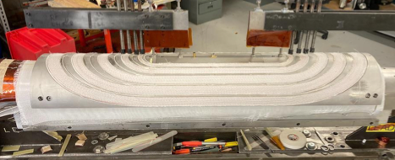
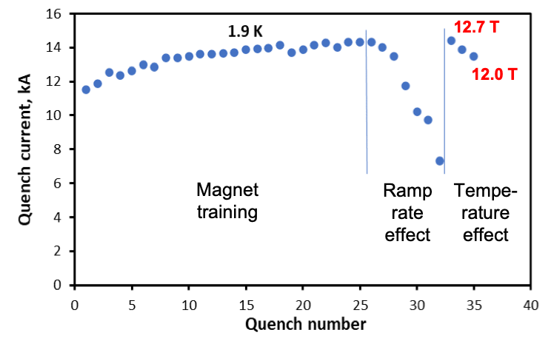
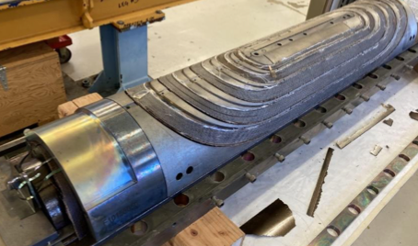
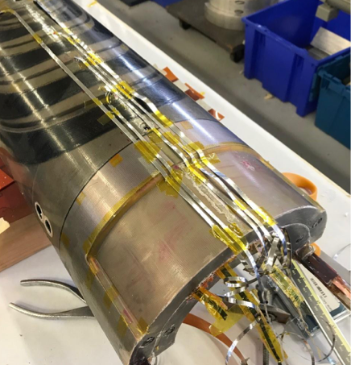
Strong progress on the Stress—managed Cos-theta (SMCT)
Mirror coil fabricated and tested
  Solid Initial training to B_{max}=12.7T
  Indication reached conductor limit (~90% SS)
Assembled magnet included inner 2 layers from 15T
  Now wired in series – test imminent!

Slide 11
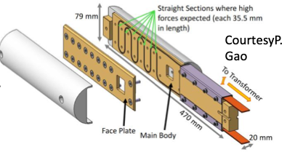
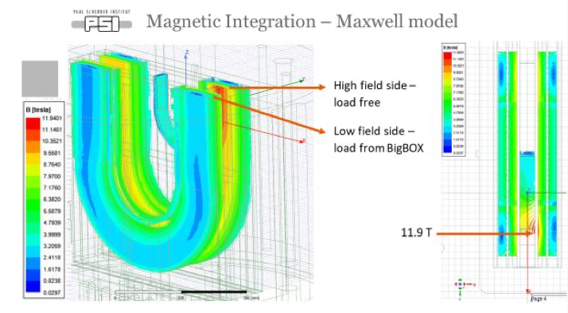
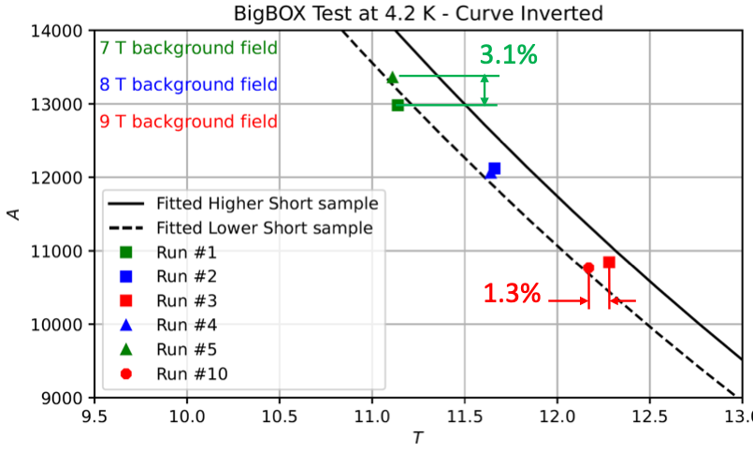
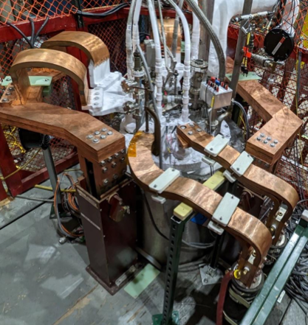
International collaboration supports MDP developments
PSI “BigBox” experiment designed to probe stress-management
  Leverages BNL 10T common-coil test facility
  Single-turn wax-impregnated sample (PSI & U. Twente)
  Provides “knob” to vary transverse force on cable

Slide 12
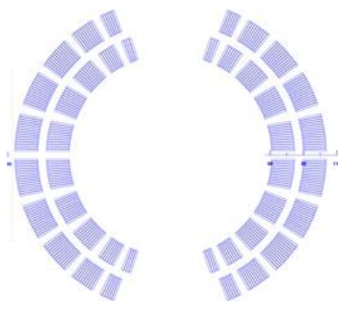
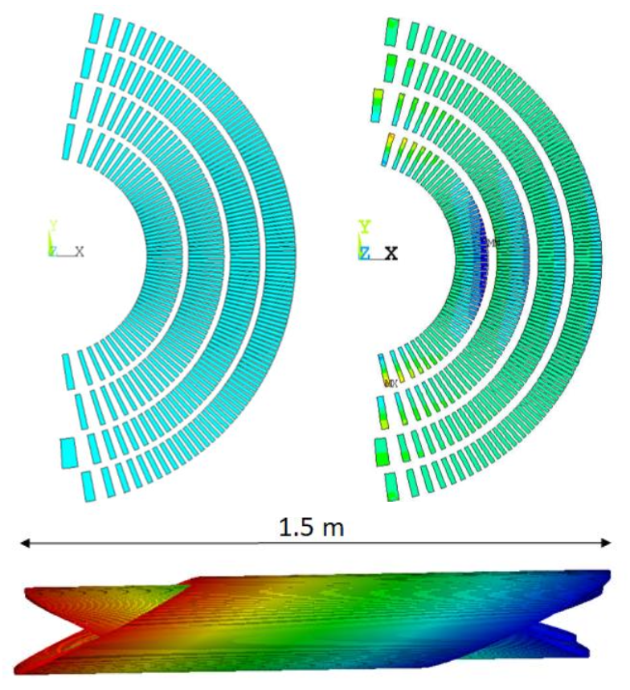
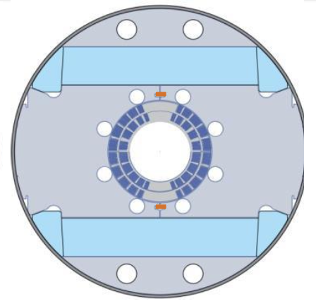
A priority now is to build the Nb₃Sn outserts
Canted Cosine theta:
  4 layers
    Bore field of 12 T / 13 T for standalone operation
    Bore diameter: 120 mm
Stress-managed Cosine Theta:
  2 layers
    Bore field of 11 T
    Bore diameter: 120mm
SMCT
CCT
30+ % current margin at target fields of 12 T, 4.2 K and 13 T, 1.9 K
These are two variants on stress-management
CCT is a “limiting case” of maximal SM
SMCT is a more efficient design

Slide 13
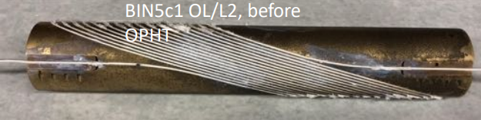
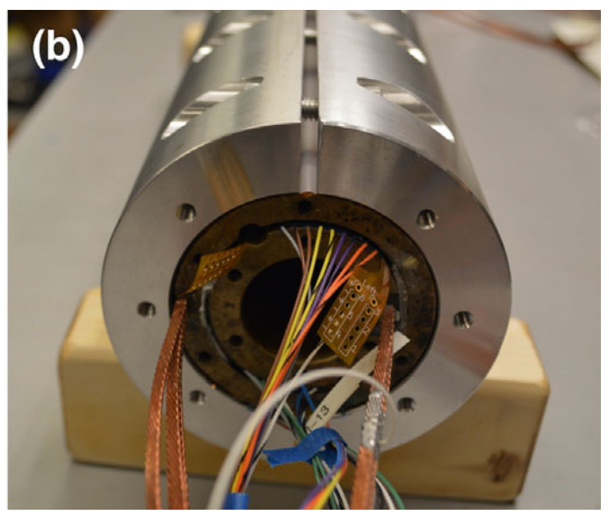
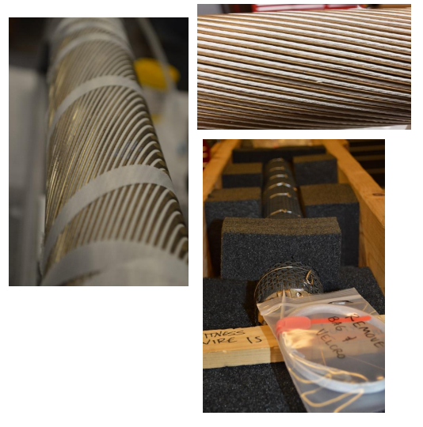
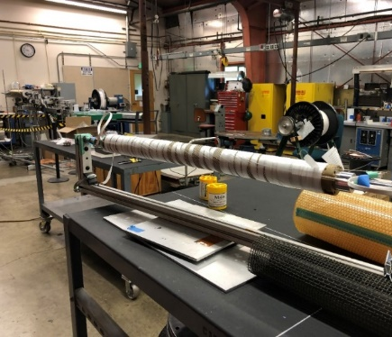
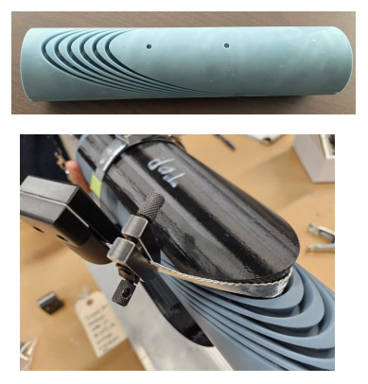
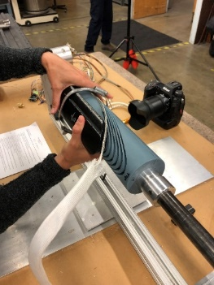
Bi2212 inserts
Canted-Cosθ: Bin5, BiCCT1, and BiCCT2
Bin5
  1.6 T in 31 mm aperture
  Successfully tested in stand-alone
  To be tested in CCT5
BiCCT1
  3 T in 40 mm aperture
  Coil wound and ready for reaction
  To be tested in CCT6
BiCCT2
  5 T in 40 mm aperture
  Winding test in progress
  To be tested in CCT6

Slide 14
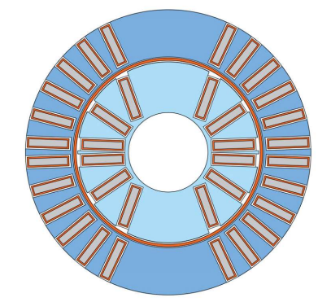
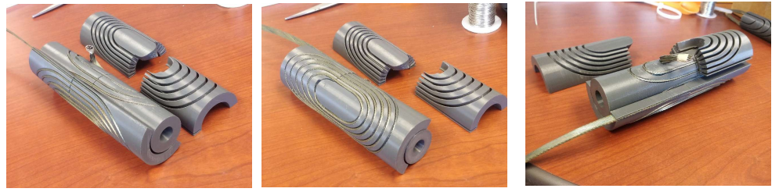
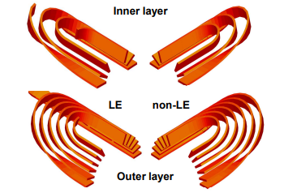
Bi2212 inserts
Stress Management Cosθ (SMCT)
Bi2212 SMCT
  1-2 T in 15 mm aperture
  Winding test in progress
  To be tested first inside a 2L CT coil and then inside a 4L CT+SMCT coil

Slide 15
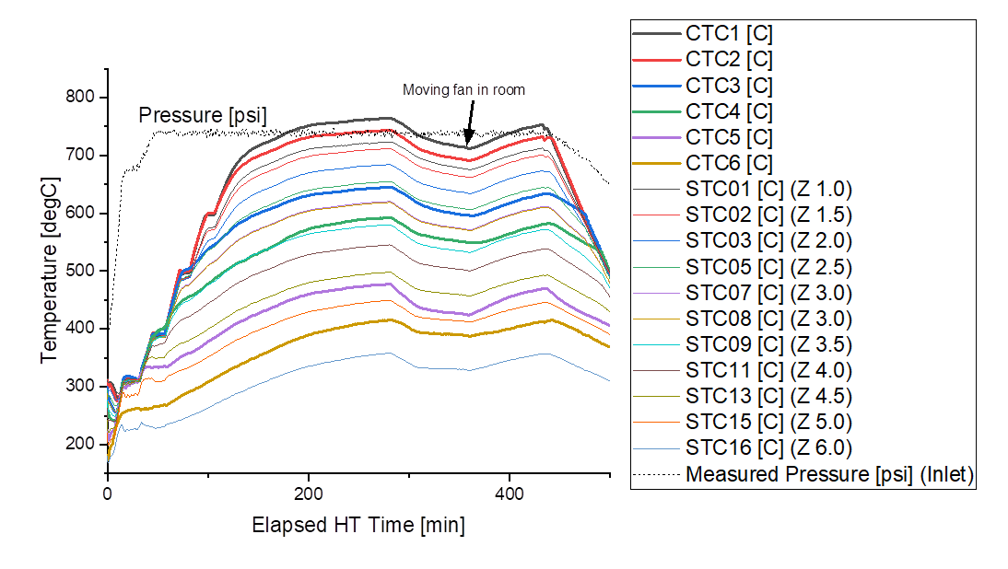
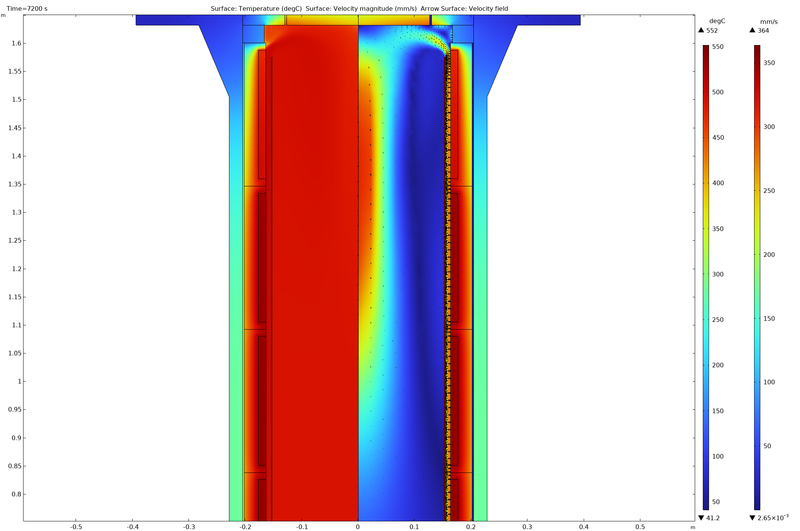
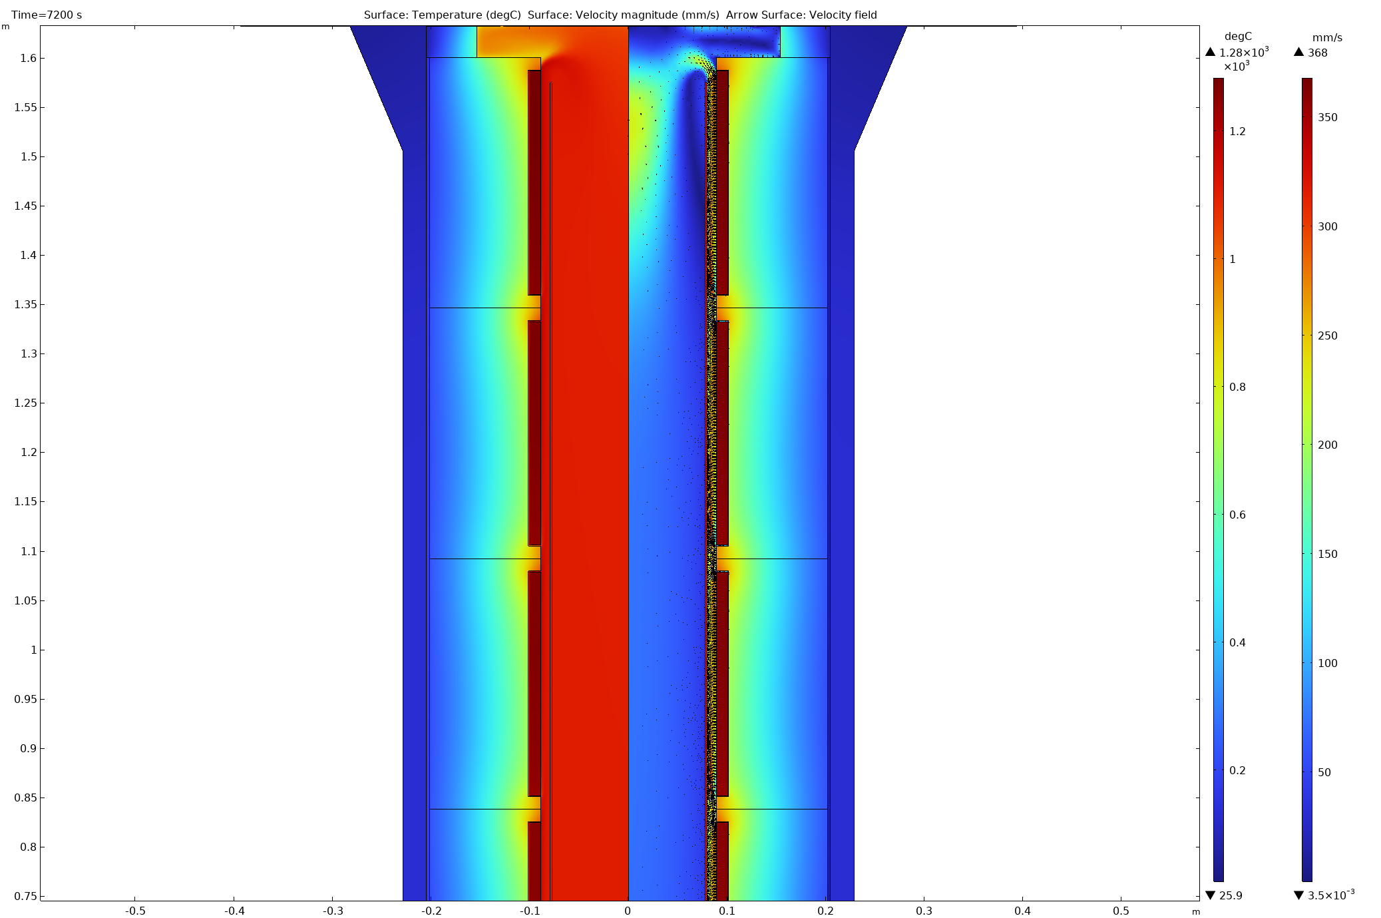
Bi2212 furnace status
Insulation on large Furnace Insufficient
  Furnace not able to reach target temperature at 50 bar
  Too high heat losses through the furnace wall thus not enough power reserve available
Old design
New design
FEA predicts significantly better thermal properties than previous design

Slide 16
Large OP-Furnace Heater Rebuilt
In the works:
Smaller heater ID (7”) requires new bore hole pattern in existing bottom flange and new baffle tube assembly (in-house or outside machine shop, tbd)
FEA to optimize gap space between heater and baffle and manufacture new baffle assembly
Assembly plan
6-zones, every zone now 4 kW
Uses free radiating heater design (not embedded)
Substantial increase of thermal insulation thickness from ~2” to 4.4”
TCs embedded with ceramic liners on the OD of heater coils
Production drawing signed on 12/14/24, ETA 10 weeks

Slide 17
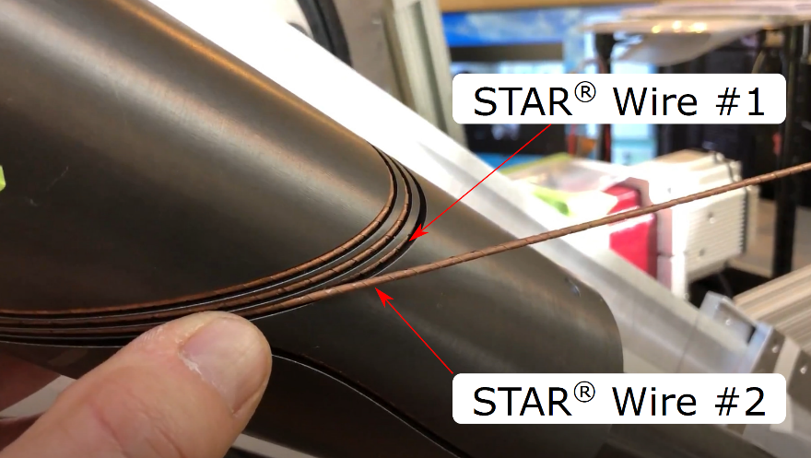
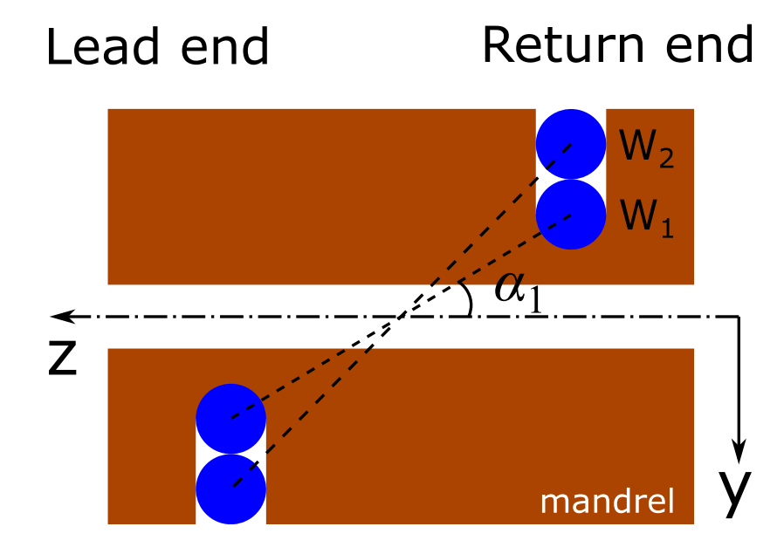
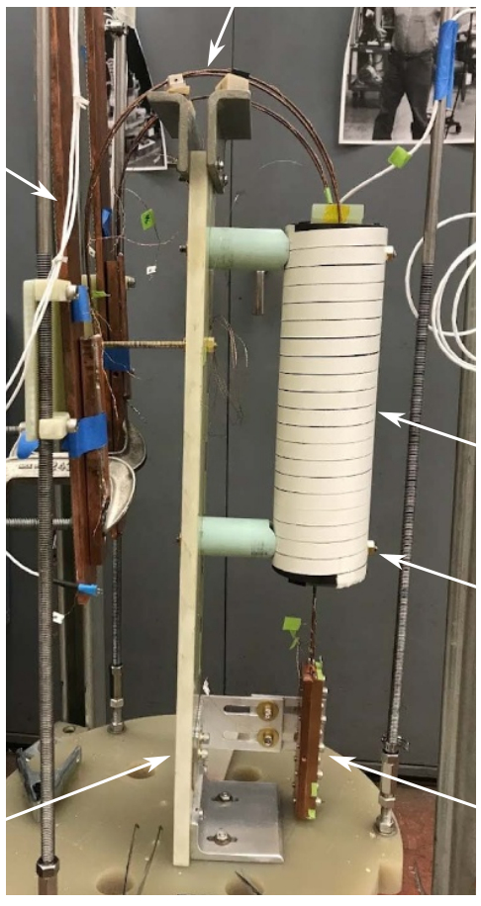
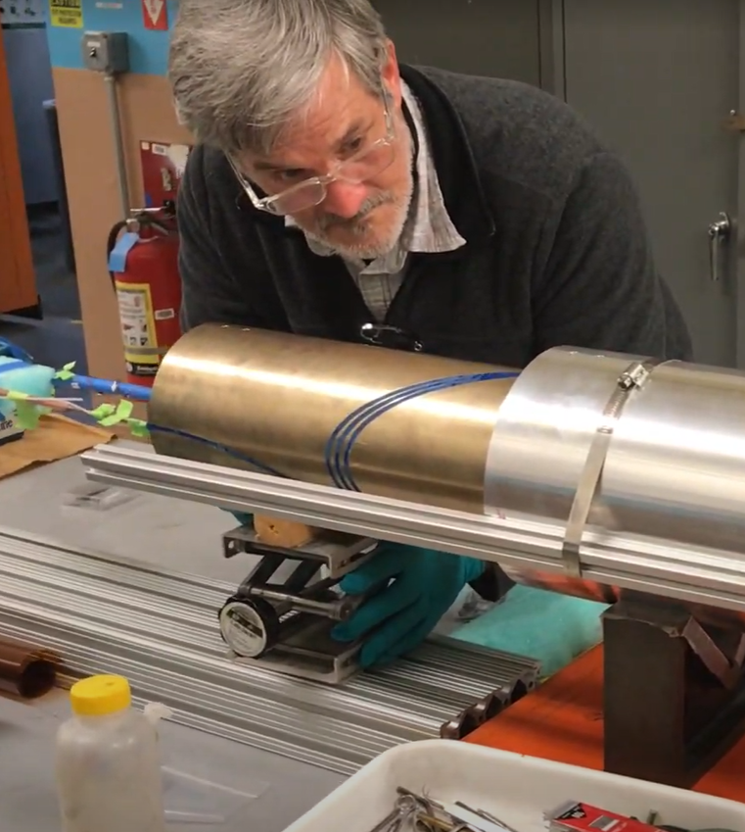
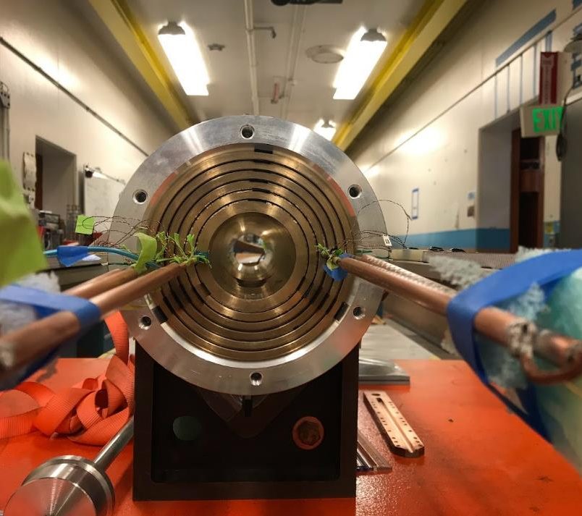
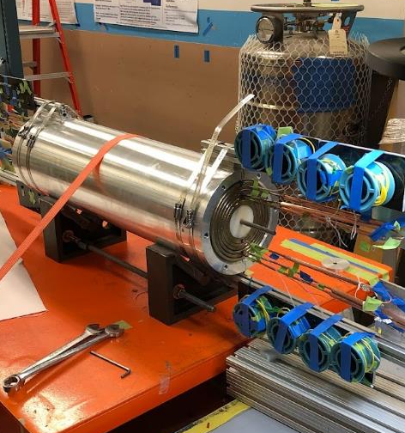
REBCO inserts
Canted-Cosθ: the “S” and “C” series
“S” (STAR® wire) CCT
  1-2 T in 50 mm aperture
  To be tested as S1 in CCT5
  Currently testing subscale coils
“C” (CORC® wire) CCT
  5 T in 70 mm aperture (C3)
    Conductor mostly delivered
  3-turns magnet C3a tested
  C4 design initiated – target ~5T insert
    To be tested in CCT6 or SMCT
X. Wang, 2022 Supercond. Sci. Technol. 35 125011

Slide 18
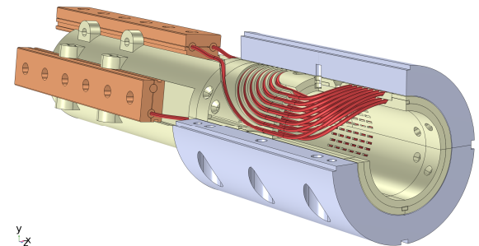
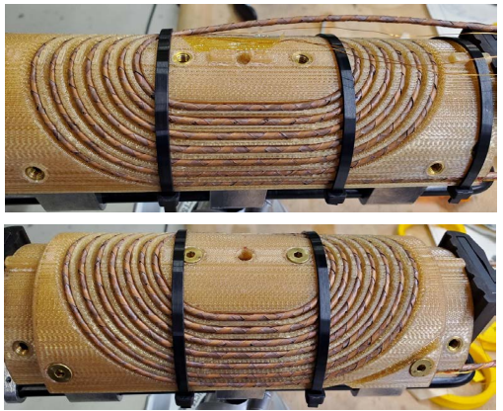
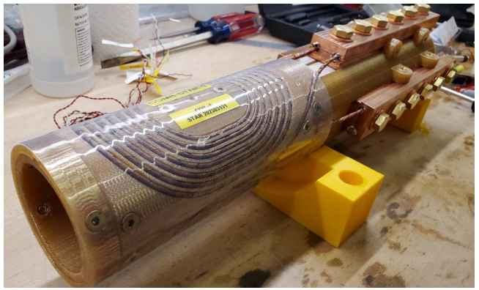
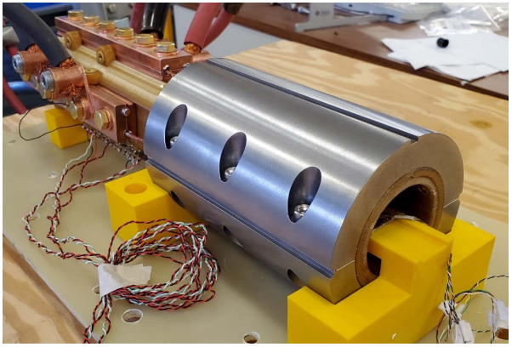
REBCO inserts
The COMB (Conductor on Molded Barrel) series
COMB insert
  2-3 T in 100 mm aperture with CORC® wire
  To be tested in SMCT
  Test with STAR® wire at 77 K
    Less than 7% degradation and multiple thermal cycles

Slide 19
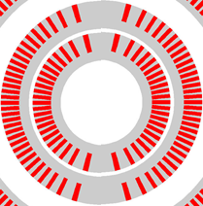
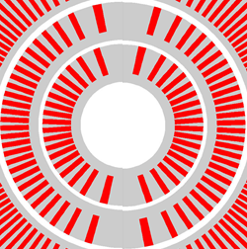
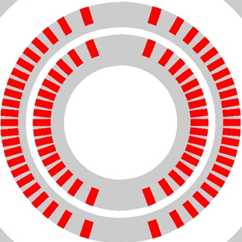
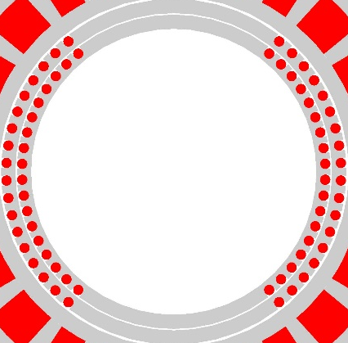
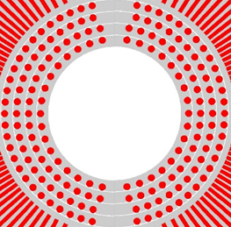

Bi2212 and REBCO outserts
Summary – a strategy for systematic exploration
in scale
Bi2212
SMCT
15 mm
1-2 T
(target)
Bin5
31 mm
1.6 T
BiCCT1
40 mm
3 T
(target)
BiCCT2
40 mm
5 T
(target)
REBCO
S1
50 mm
1-2 T
(target)
COMB
100 mm
2-3 T
(target)
C4
70 mm
5 T
(target)

Slide 20

Diagnostics Area contributing throughout the program
https://agenda.infn.it/event/32061/
https://indico.cern.ch/event/1281454/timetable/
Active in international arena
  Co-organized 2nd Instr. and Diagnostics for Superconducting Magnets Workshop (IDSM)
  Contributed to Lectures on Superc. Magnet Test Stands, Magnet Protections and Diagnostics
Diagnostics Area focus is beginning to change/grow:
  “traditional” goal: guide understanding (“science”) of magnets
  Growing focus on supporting HTS magnet protection
Pathways to understanding

Slide 21

Diagnostics insight into training - example
Acoustic events are stronger in amplitude, last longer, & corelate with current in wax-impregnated coils!
  Suggests heat dissipation process critical

Slide 22
Conductor Procurement and R&D
CPRD committee:
Ian Pong,
Lance Cooley,
Matt Jewel,
David Larbalestier,
Vlad Matias,
Ian Pong,
Xingchen Xu,
Soren Prestemon
Funding now at the level of $1.2M / year
  Process: CPRD committee (lead now I. Pong) meets monthly
    Reviews status of PO’s
    Summarizes needs from MDP
    Evaluates proposals from industry
  Ongoing contracts:
    Hf development by OST
    High Cp development with HyperTech
    Bi2212 development with A. Otto
    CORC “QA” order from ACT
    STAR wire order with AMPEERS
    Nb3Sn production from OST

Slide 23
Strong presence at MT28 in Aix en Provence
More than 30 papers related to MDP were presented!
Some examples…
S. Prestemon, plenary, “Progress and plans for the US Magnet Development Program”
S. Gourlay, invited talk “Enabling the next generation of facilities for particle physics”
P. Ferracin, invited talk, “Development of Hybrid Dipole Magnets for Particle Accelerators by the US Magnet Development Program”
I. Novitski, invited talk, “Development and test of a large-aperture Nb3Sn cos-theta dipole coil with stress management”
Also highly relevant:
  Kathleen Amm, invited talk, “Strategic Roadmap of Grand Challenges in Healthcare”
  G. Velev, invited talk, “Current status of the facility for high field cable testing at Fermilab”
  L. Cooley, invited talk, “Partnership Models for Stewardship of Superconducting Magnet Technology and Assurance of Supply Chains for Large Science Facilities”

Slide 24
Strong visibility & contributions to the international community
- some examples
National Academies Study in High Magnetic Field Science and Technology
  MDP NAS committee members: Kathleen Amm, Diego Arbelaez
  Presentations to the committee:
    D. Larbalestier, “Birthing new Superconducting Magnet Technologies with REBCO Coated Conductors and Round Multifilamentary Bi-2212”
    S. Prestemon, “Magnet technology for Energy Frontier Colliders”
    S. Gourlay, “Magnet Technology to Enable the Next Generation of Facilities for Particle Physics”
International Symposium on Superconductivity
  D. Larbalestier, “What specifications would general use of REBCO for laboratory user magnets really require?”

Slide 25


Strategic planning and preparations for P5 alignment
– REBCO example
REBCO Roundtable organized at FNAL
Contributions from throughout MDP, as well as broader community
Report being drafted

Slide 26







Strong synergies with Fusion REBCO research are leveraged
No sign of degradation seen in high field & low-cycle fatigue testing - IC>80% sum of tapes
Demonstrate feasibility of direct dry wound (non-VPI) coil design
DOE Offices of HEP & FES jointly funding a large-bore cable test facility
Will provide 15T dipole field over 750mm good-field, 1.9-50K on-sample
Cryostat will enable testing of high-field hybrid magnets
Being located at FNAL
A two layer Cable Model Coil to test for cyclic degradation

Slide 27


ASC Collaborations with Industry on Bi-2212 Technology
Partnered with two renowned magnet manufacturers, Cryomagnetics Inc. and Oxford Instruments
Compact general science magnets in the 25 T range and high homogeneity magnets >30 T
These magnets will have a substantial amount of Bi-2212 in them with a substantial percentage of field generated by the HTS sections
LTS

Slide 28

Approach for P5 alignment of the US MDP
Understand the P5 report
  Detailed read of the language used
  Insight into the full intent of the committee
Work with HEP:
  Understand their timeline for implementation
  Provide critical data for decision making
    Resources available
    Technical progress, impact
Prepare updated MDP Roadmap over coming year
Maintain/increase presence at:
International Muon Collider Collaboration
FCC-week
Associated workshops (e.g. HFM, etc.)

Slide 29
Summary
MDP continues to grow stronger, leveraging the collaboration between the members
  Increased funding for CPRD has been vital – need to build more magnets!
Significant progress towards major goals of the program:
  Stress management – its viability and “large-scale” implementation
  Development of HTS magnet technology and transition to “real” inserts
  “20T Design Studies” group is strengthening, integrating with upcoming hybrid magnet tests
Investments in infrastructure are ongoing and/or being pursued to support MDP goals
  Bi2212 furnace– issues, but they are being resolved
  Continued improvements to testing capabilities at BNL’s 10T facility (e.g. higher current), additional liquefier being procured
  Ongoing progress on FNAL’s planned HTS Cable Test Facility / Hybrid Magnet Test Facility
  Hybrid header and extraction system upgrades at LBNL, liquefier upgrade
  The MDP team is focused and working hard on the Roadmap milestones!
HEP, FES, ARPA-E, internal funds, etc.

Slide 30
Engagement with industry
We work to identify SBIR partners aligned with MDP goals
2021 Phase I
Accelerator Technology Corp., College Station, TX | 77845-7158 | McIntyre, Peter | SBIR | Nb3Sn SuperCIC Outsert and REBCO Conformal Insert for an 18 T Collider Dipole
AMPEERS LLC, Houston, TX | 77059-3733 | Galstyan, Eduard | SBIR | Multi-Strand Transposed Cables of Round REBCO Wires for Accelerator Magnets
Advanced Conductor Technologies LLC, Boulder, CO | 80301-2385 | van der Laan, Danko | SBIR | Hybrid accelerator magnets based on dog bone shaped CORC® wire inserts for operation beyond 20 T
Cryomagnetics, Incorporated, Oak Ridge, TN | 37830-8011 | Minter, Stephen | STTR | Very High Field Superconducting Magnets Using REBCO
2021 Phase II
Engi-Mat Co., Lexington, KY | 40511-2637 | Bugaris, Daniel | SBIR | Bi2212 powder production with wide Tmax window for high field magnet applications
Solid Material Solutions, N. Chelmsford, MA | 50011-1061 | Otto, Alexander | SBIR | Advanced silver sheathed 2212/Ag wire for high field magnets
Cryomagnetics, Incorporated, Oak Ridge, TN | 37830-8011 | Minter, Stephen | STTR | Very High Field Hybrid Superconducting Magnet Using Bi-2212
2020 Phase I
AMPEERS, LLC | 77059-7705 | Kar, Soumen | SBIR | Low-cost Manufacturing of Round REBCO Wires for Accelerator Magnets
Hyper Tech Research, Inc. | 43228-2412 | PENG, XUAN | SBIR | Improved Stability of Nb3Sn Superconductor by Increasing Specific Heat
MetaMateria Technologies, LLC | 43228-1155 | Sengupta, Suvankar | SBIR | Multifilamentary high JE Bi2Sr2CaCu2Ox/Ag superconducting wires for high fields
Accelerator Technology Corp. | 77845-7158 | Sattarov, Akhdiyor | SBIR | Jelly-roll Fabrication of Textured-Powder Bi-2212/Ag wire
Particle Beam Lasers, Inc. | 75167-2807 | Gupta, Ramesh | STTR | Overpass/Underpass Coil Design for High Field Dipoles
2020 Phase II
Hyper Tech Research, Inc | 43228-2412 | Peng, Xuan | SBIR | A Novel Way to Dope Ti in Nb3Sn Conductor to Reduce A15 Grain Size and Improve non-Cu Critical Current at High Fields

Slide 31
Ongoing / planned international collaborations
International
Activity | MDP Relevance | Collaborating Institution | Contact(s) | MDP Contact | Tier Category | Start Date | End Date
Study of transverse loading on Rutherford cables in FRESCA II using 10mm cable with Hi-Lumi strands. | MDP Nb3Sn Program | CERN | Bernardo Bordini | Ian Pong | 3 | Dec-18 | N/A
Possible collaboration with PSI to jointly build a 4-layer SM-CT* | Nb3Sn dipole | PSI | Auchmann, B. | Zlobin, A. | 3 | TBD | TBD
CCT Development | Nb3Sn CCT | PSI | Auchmann, B. | Brouwer, L. | 1 |  | Ongoing
CCT Instrumentation | Nb3Sn CCT | PSI | Auchmann, B., Montenero, G. | Marchevsky, M. | 3 |  | Ongoing
Acoustic Sensor Development | Technology Development | CERN | Kirby, G. | Marchevsky, M. | 3 |  | Ongoing
APC Nb3Sn | Conductor Development | CERN | A. Ballarino | D. Larbalestier | 1 | 2018 | 2020
A Collaboration Framework To Advance High-Temperature Superconducting Magnets For Accelerator Facilities | Technology Development/HTS - HTS Magnet and Magterials R&D | KEK, Kyoto Univ. | T. Ogitsu), N. Amemiya | Shen, Gupta | 3 | 2018 | Ongoing
History and Documentation of Nb3Sn Magnet R&D | MDP Nb3Sn Program | EuroCirCol | Schoerling, D. | Zlobin, A. | 3 | 10-Jul | 11-Jul
Conceptual design of the Quadrupole magnets for high low luminosity interaction regions of FCC | Magnet design | CERN | Schoerling, D. | Velev, George | 1 | 3/18/19 | 12/31/22

