Slide 1
Quench Antenna Data on Telene Undulator - First Look
J. DiMarco, E. Barzi, D. Turrioni
31Jan 2024

Slide 2
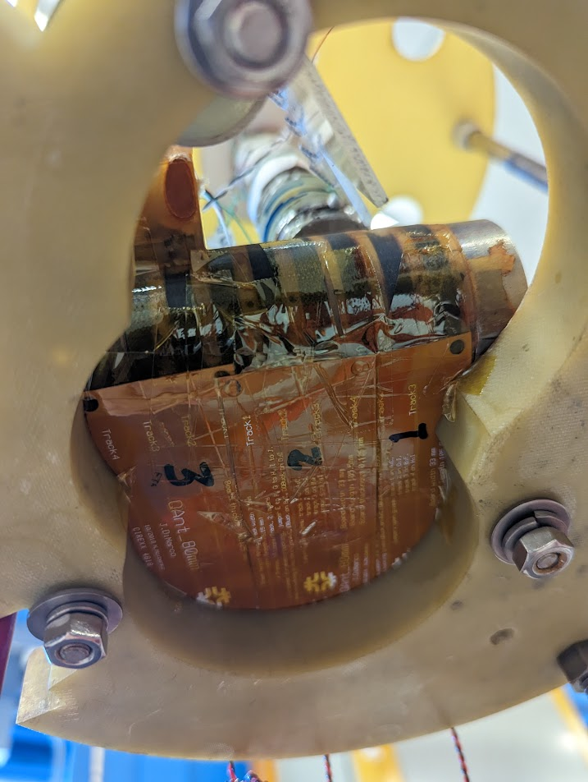
Instrumented a Telene-coated Nb3Sn-wire undulator with standard ‘quadrupole-bucked’ QA
First used on Undulator #1, Run 3, 08 Dec2023
Quench events shown here are 65, 66, 85, 86, 87, 88

Slide 3
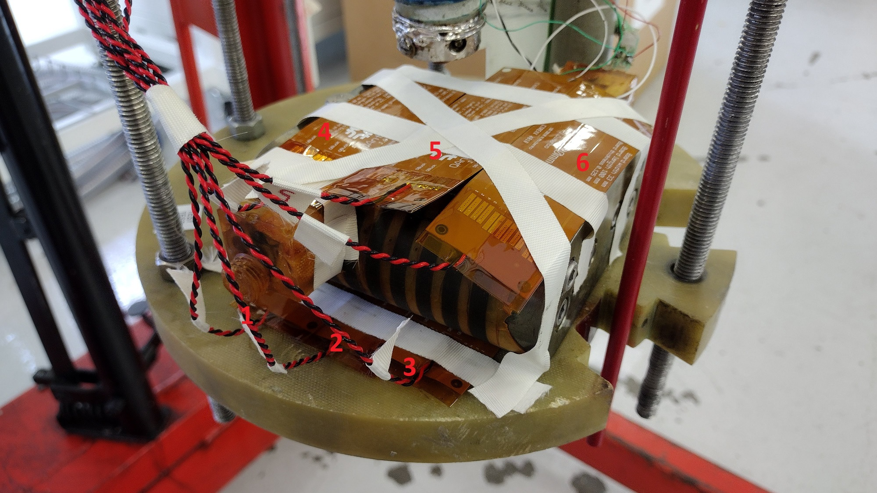
QA locations on telene undulator run3

Slide 4
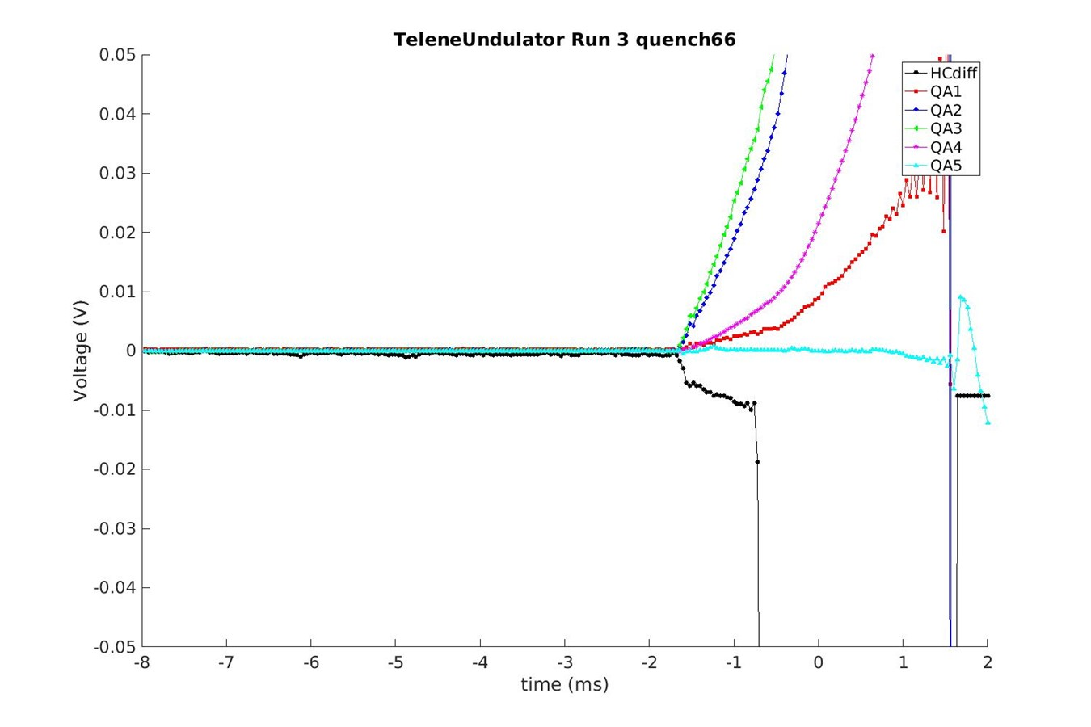
QA apparently sees the quench in the cable, even though not ‘Rutherford-type’ with inter-strand current redistribution
Half-coil difference
Note that HC diff signal is pretty flat before quench

Slide 5
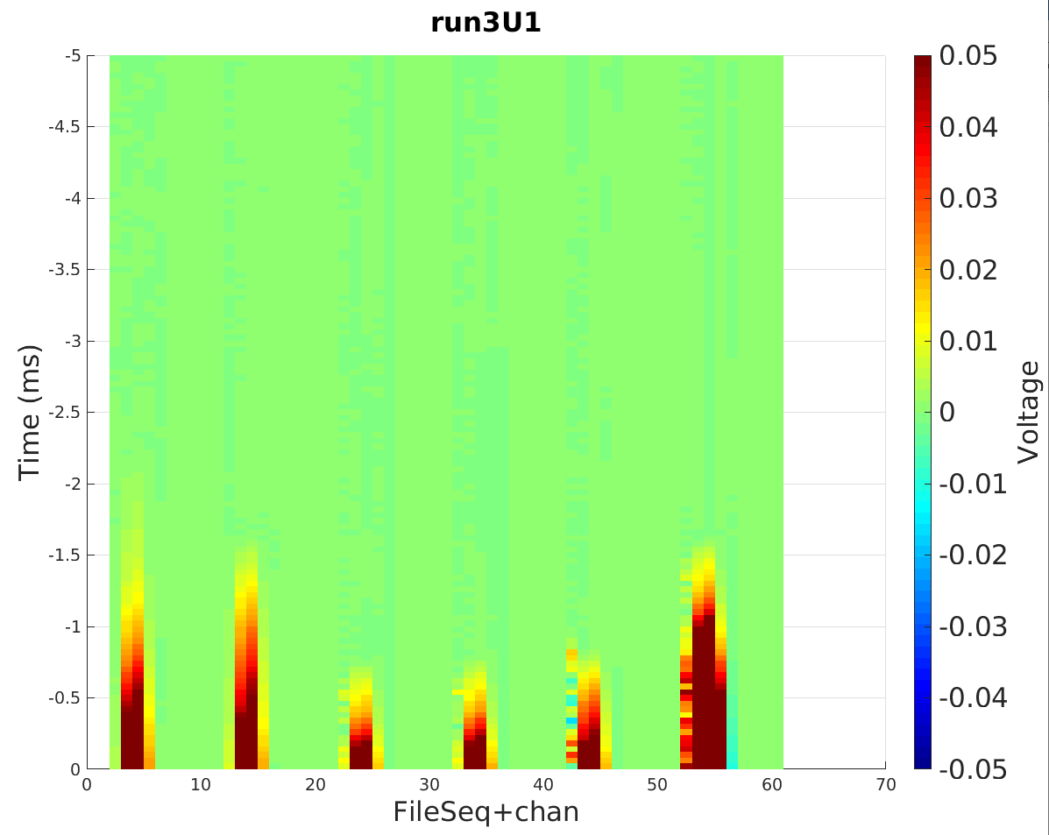
plateau quenches
Training quenches
Different Q-start here
Note: 10 numbers (5 signals, 5 blank) per file
Q87
Q85
Q86
‘fall-back’ quench
quenchTrigger t=0
Q65
Q66
Q88

Slide 6
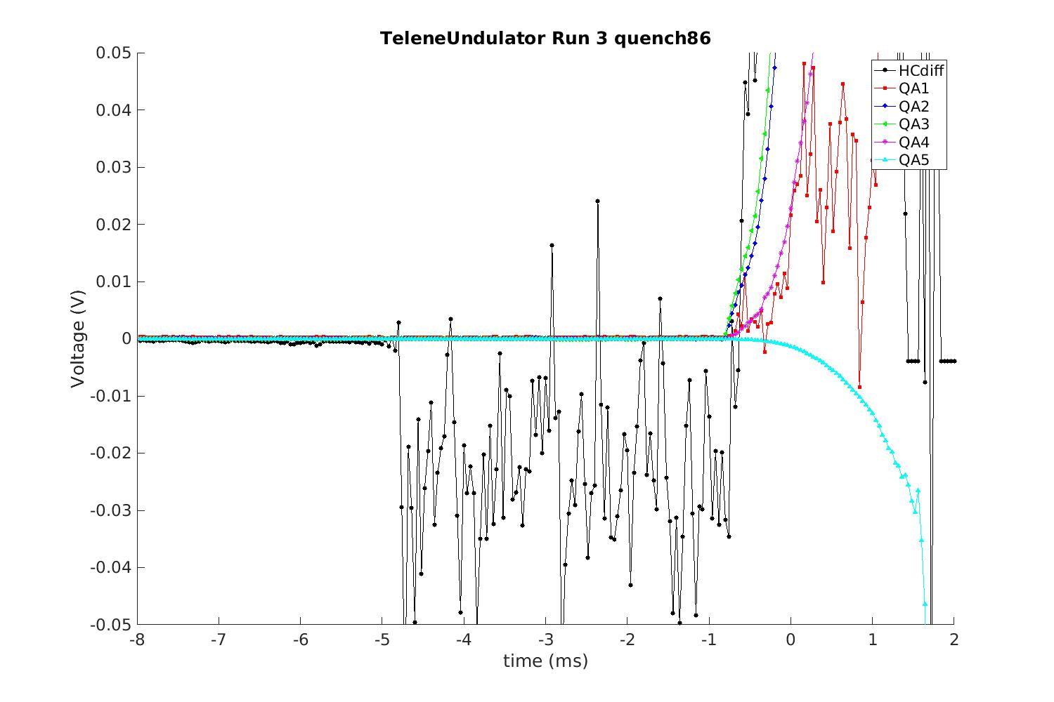
Plateau quench with HC diff signal becoming ‘noisy’ just before quench

Slide 7
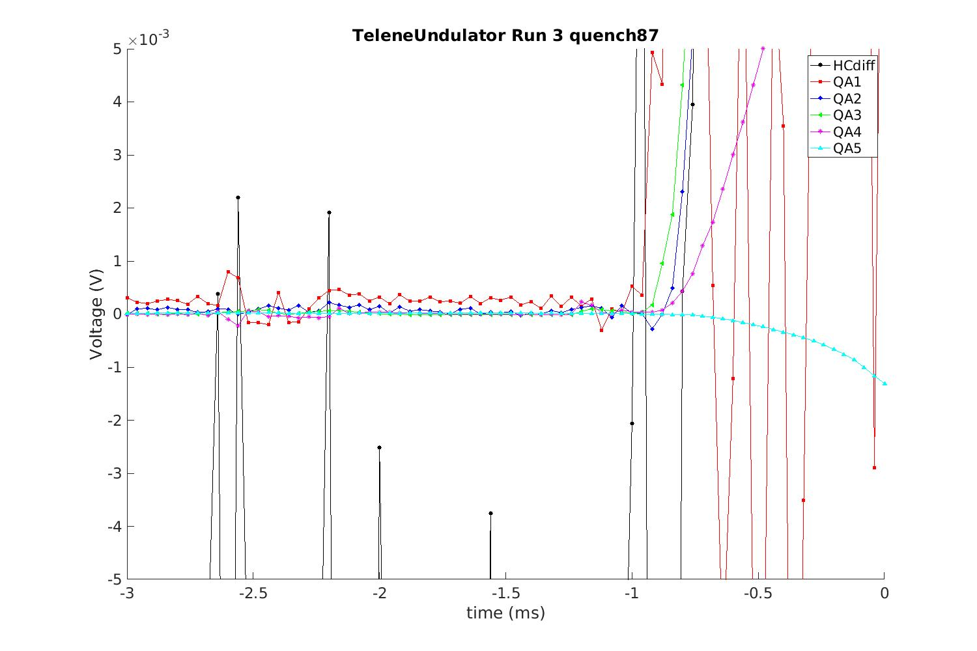
Unlike plateau quenches, coil with QA1 is earliest in this ‘fall-back’ quench
HC diff is noisy again

Slide 8
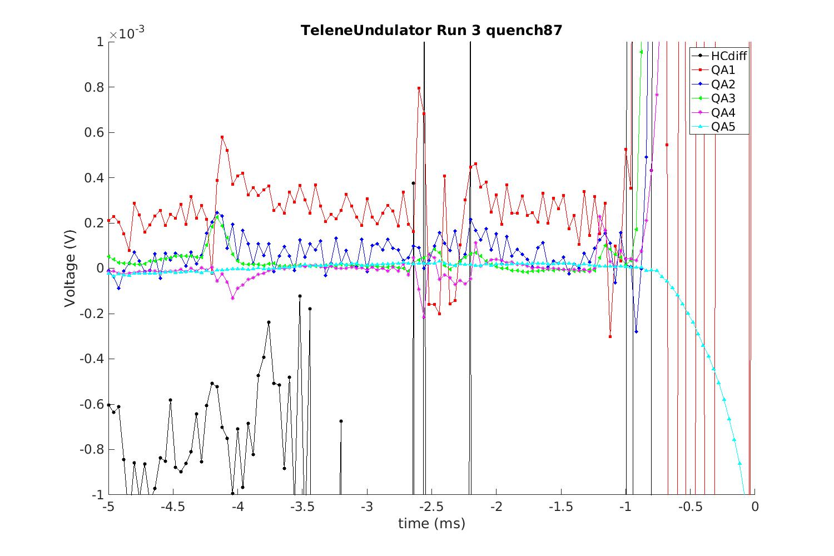
Unlike the plateau quenches, QA1 is seeing some more ‘spike-like’ activity early
QA1 is the first to quench, unlike plateau quenches
QA4 is also seeing early activity at about the same time as QA1 – note that these are top and bottom of the same section of coil
QA3 (and QA2) is seeing excursions and seeming to recover

Slide 9
Undulator #2, Run 1, 23Jan2024

Slide 10
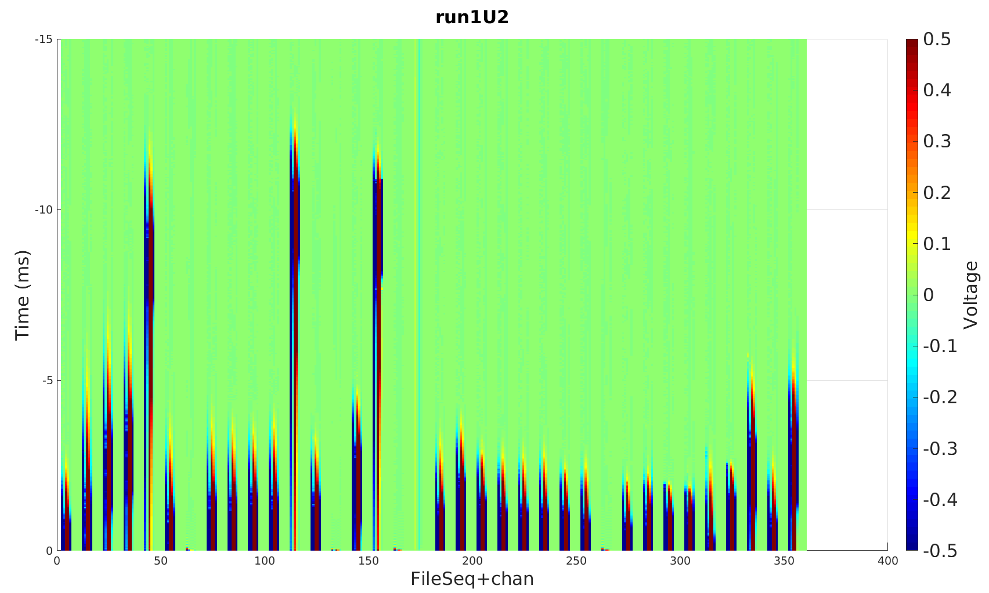
Note: there are 39 quenches, but files 8, 34, and 38 are missing. 10 numbers (5signals, 5 blank) per file
False trips

Slide 11
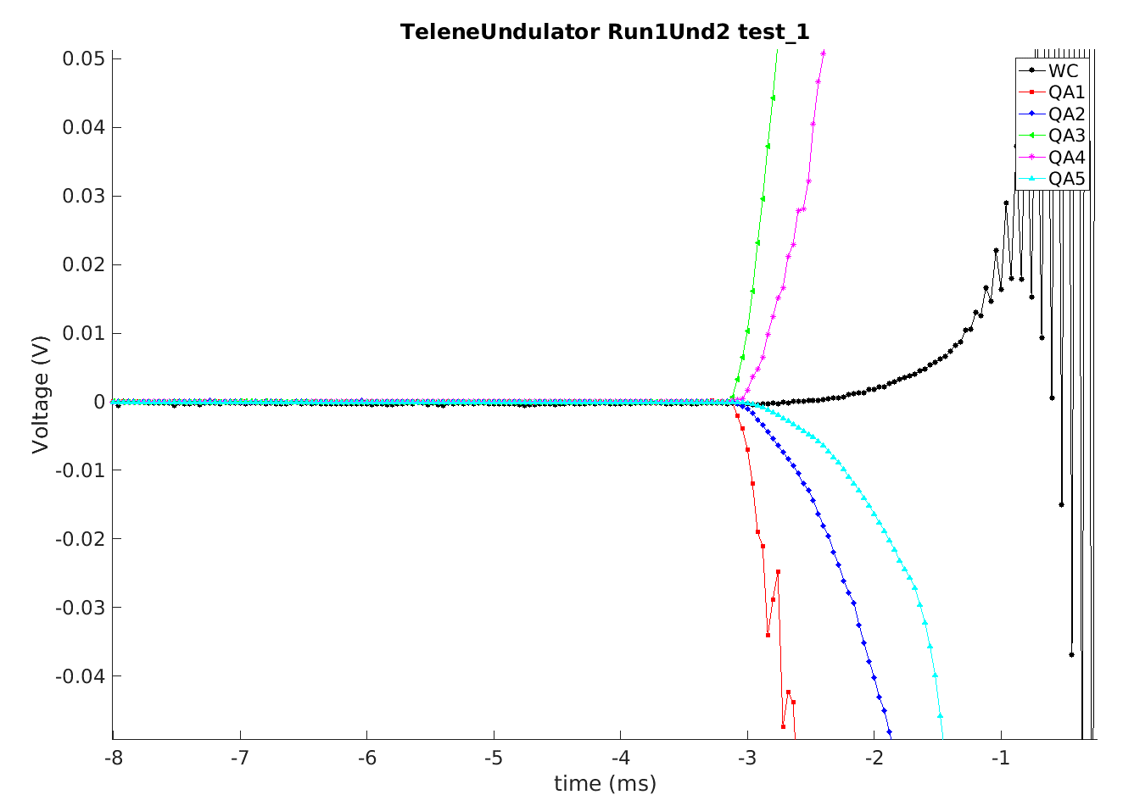
First training quench
QA5 later than QA2
Spike features on QA1

Slide 12
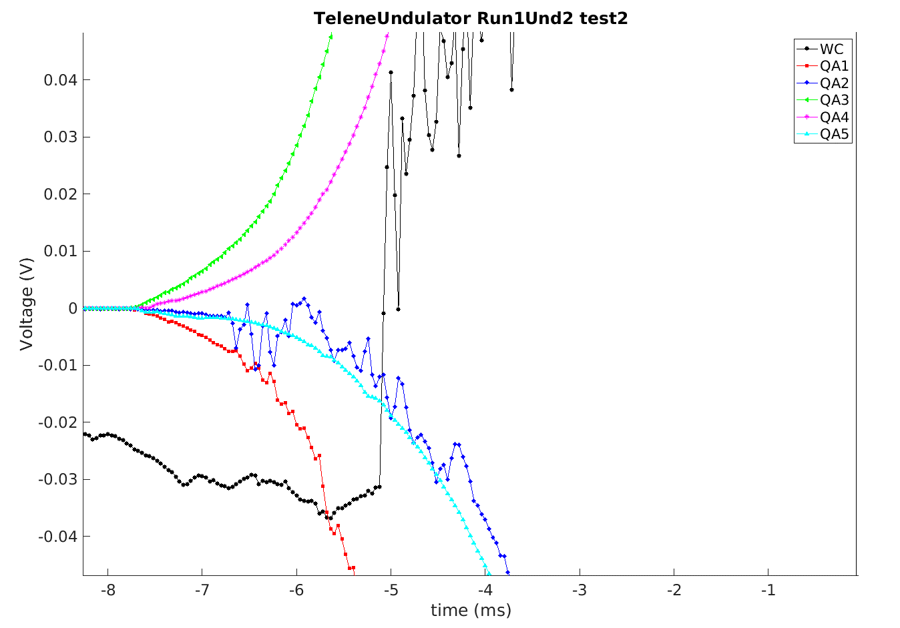
2nd training quench – slower development
QA5 ~same time as QA2

Slide 13
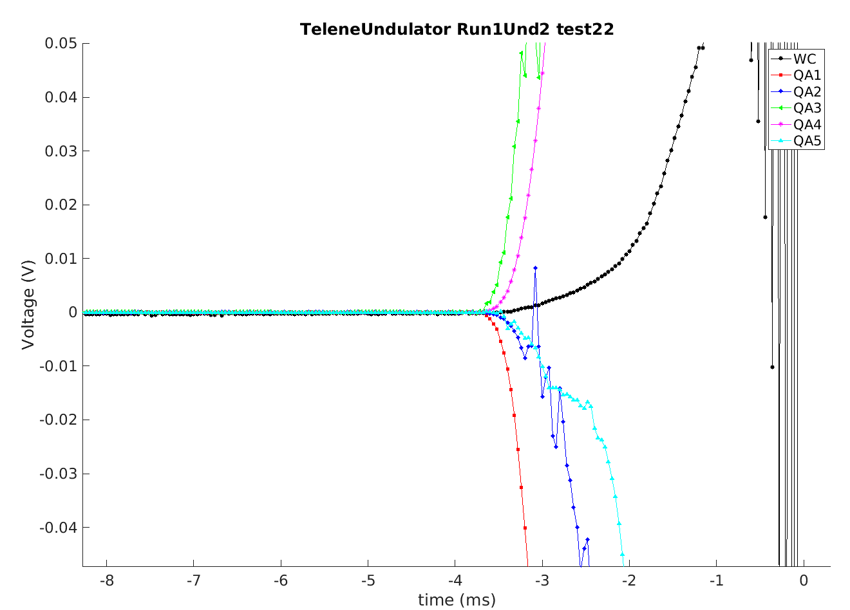
Quench at plateau
QA5 again lags a bit
Spike features on QA2, QA3

Slide 14
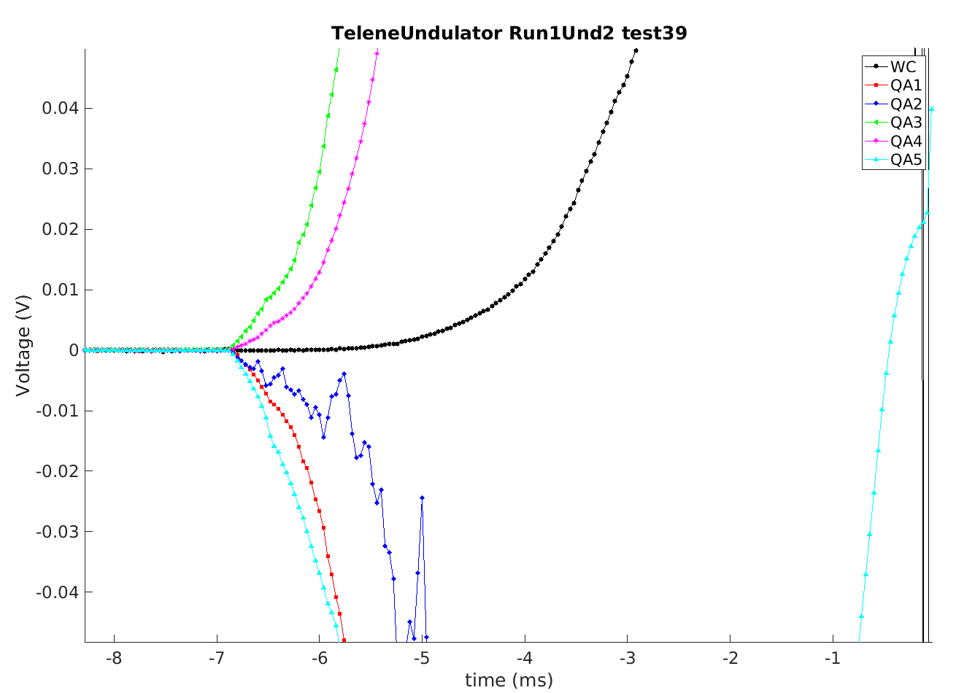
Last quench at plateau
QA5 LEADS QA1 and QA2

Slide 15
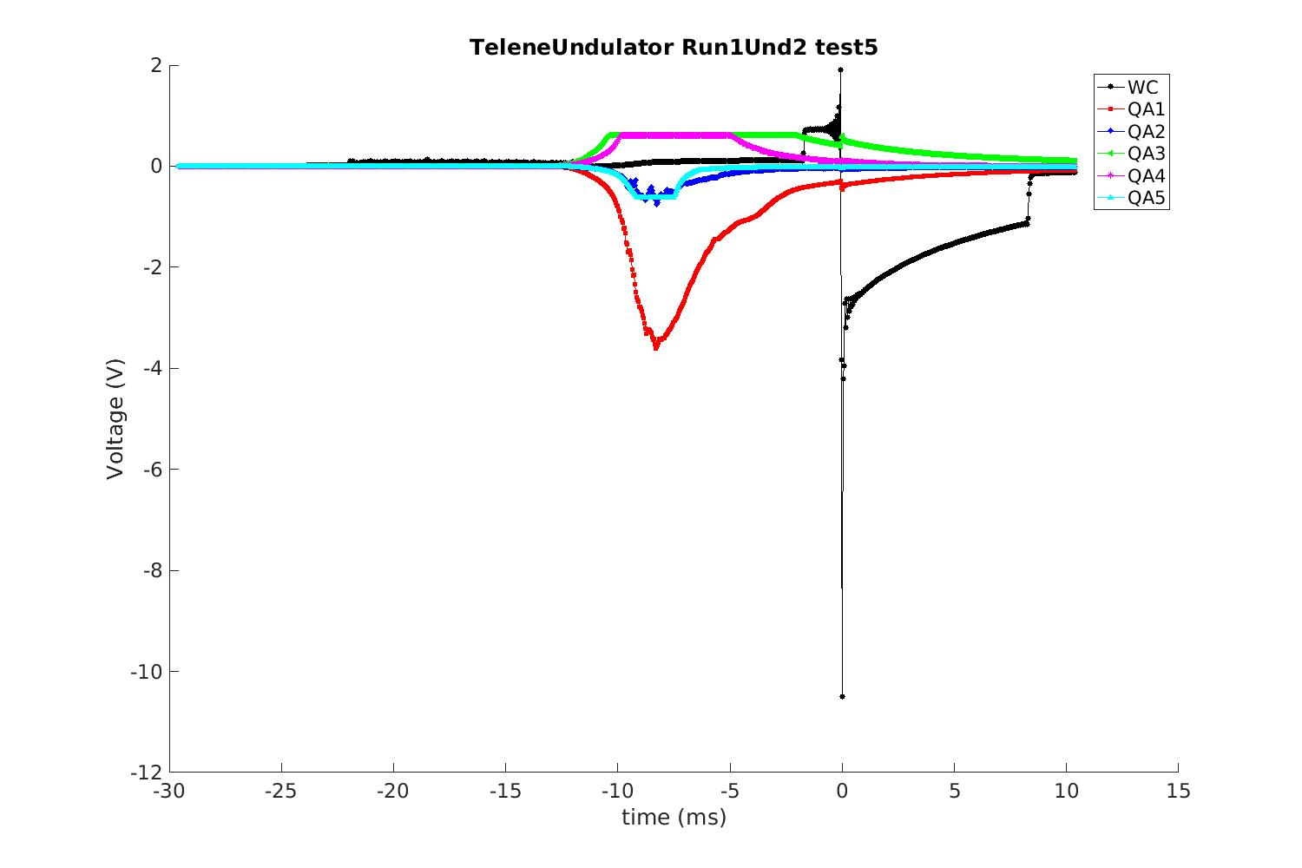
Three of the quenches had some sort of early start – QA activity peaks at ~-7ms before t0

Slide 16
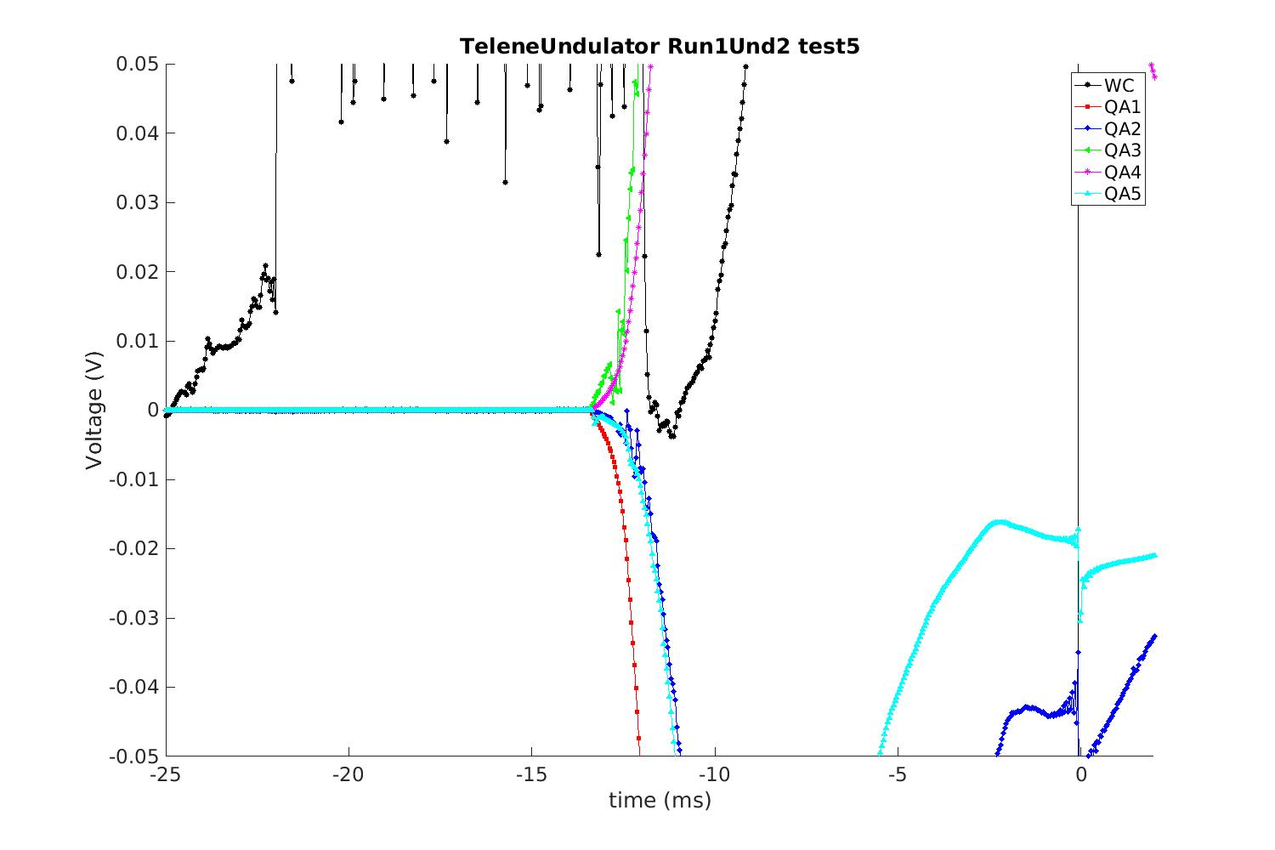
Start is at -13ms

Slide 17
Summary and next steps:
Seem to be able to detect quench related pick-up signals even with non-optimized QAs
Detailed differences can be seen between events, and potentially, perhaps with some improvements, can be used to understand something more about quenches in the undulators.
Analysis will continue, including trying to tie QA observations with acoustic ones.

Slide 18
Back-up slides

