Slide 1
Fiber Optics Sensors Status at FNAL
M. Baldini, S. Krave
February 2024

Slide 2
Quench propagation study using fibers
Barrel Samples
Test with a star cable
Work performed from June to November by
Nisa Kuvvet, Undergraduate student @Dartmouth
Simone Busatto, Graduate student @LASA

Slide 3
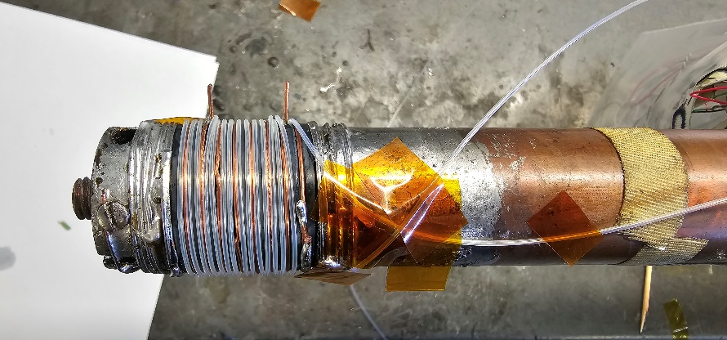
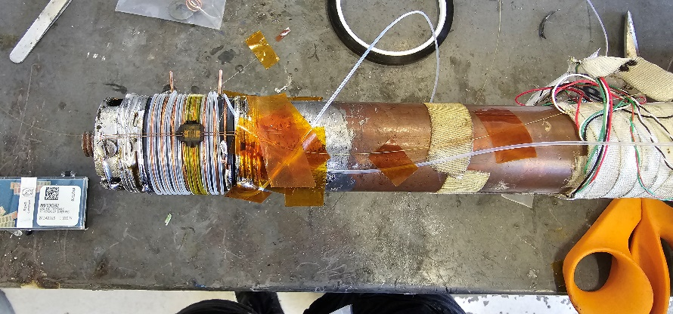
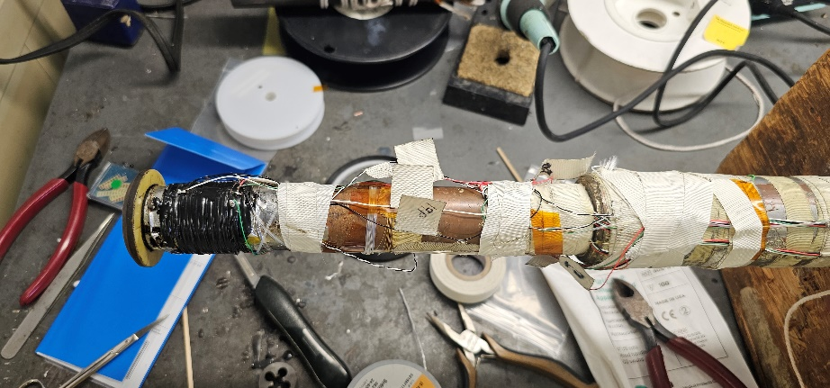
Quench propagation study on Nb3Sn strand
Nb₃Sn witness sample from QXFA coil
Strain gauge was used as a spot heater to quench the wire
5 m temperature and strain fiber to study quench propagation.
Test in liquid He
Cool down to 4.5K
At 15T, 14T, 12T, 10T ramped up the current until quench
Critical current increased accordingly
Magnetic Field | Critical Current
15T | 376A
14T | 466A
12T | 693A
10T | 985A

Slide 4
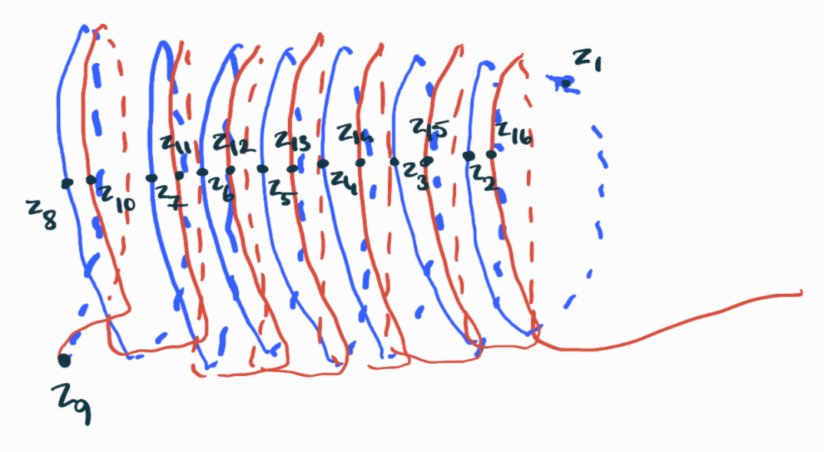
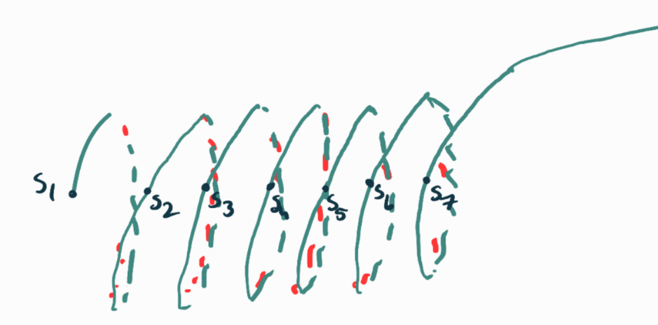
Fiber Installation
Temperature sensor
Credit: Nisa Kuvvet
Strain sensor

Slide 5
Current-induced Quench
Cooldown to 4.5 in liquid He, during cooldown the wrapping back became less sensitive.
Take the tare
Increase current up to quench with different magnetic field
Magnetic Field​ | Critical Current​
15T​ | 376A​
14T​ | 466A​
12T​ | 693A ​
10T​ | 985A

Slide 6
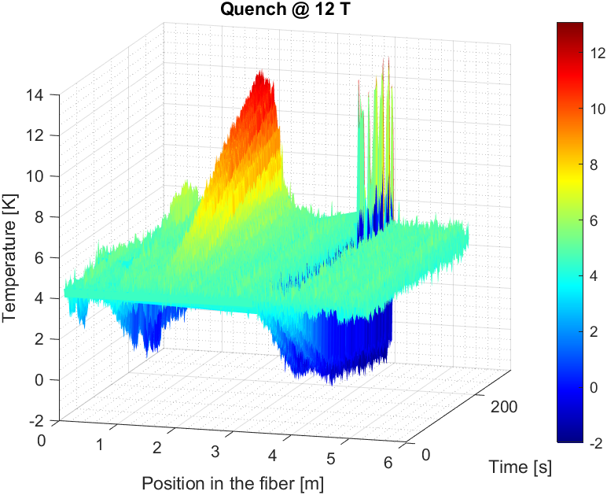
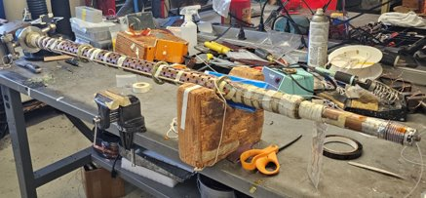
12T DATA analysis
Heating due to contact with the probe
Ramp before and after the quench (just first wrapping)

Slide 7
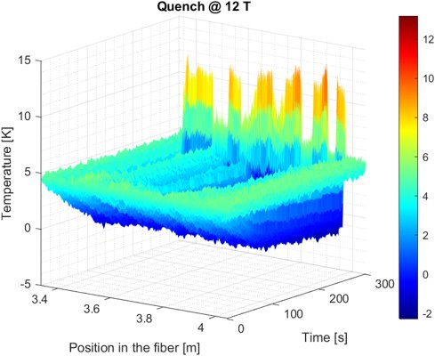
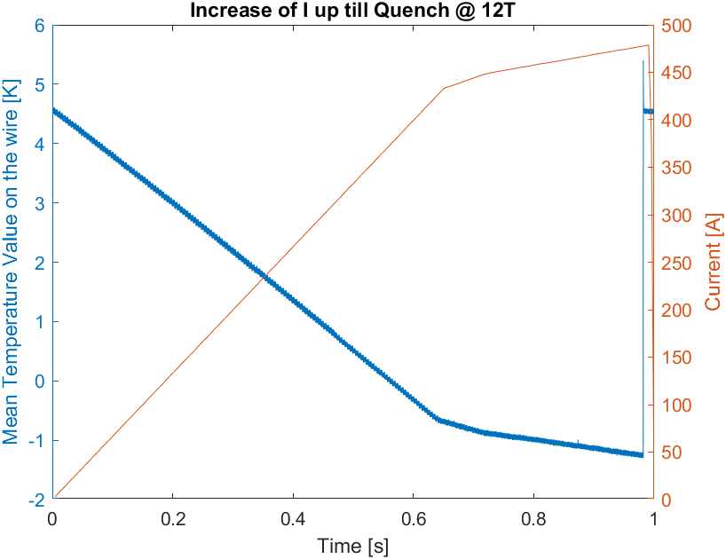
12T DATA Analysis: current ramp
Decrease of temperature observed during ramp it is due to the compression of the fiber during the current increase.

Slide 8
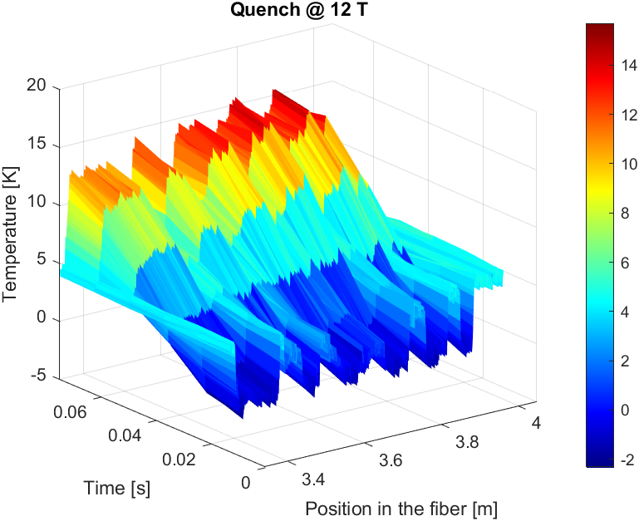
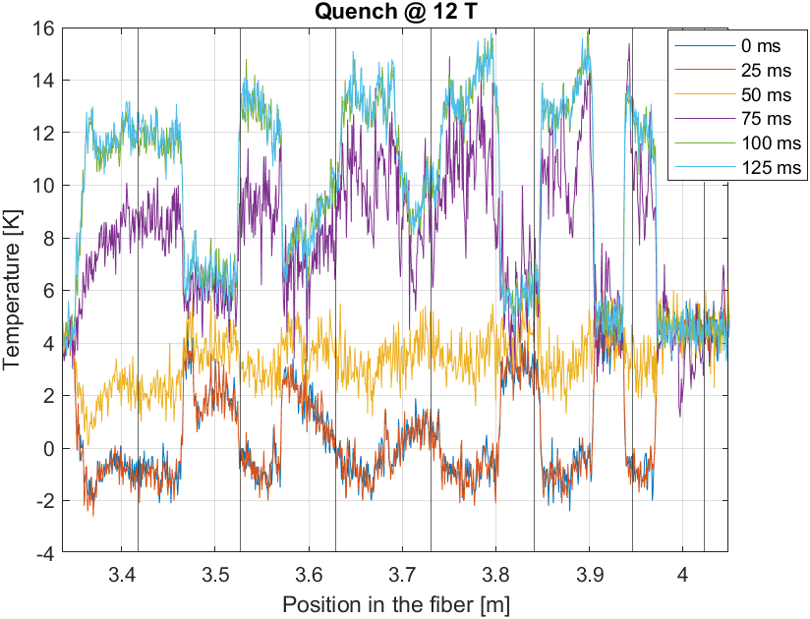
T variation during quench

Slide 9
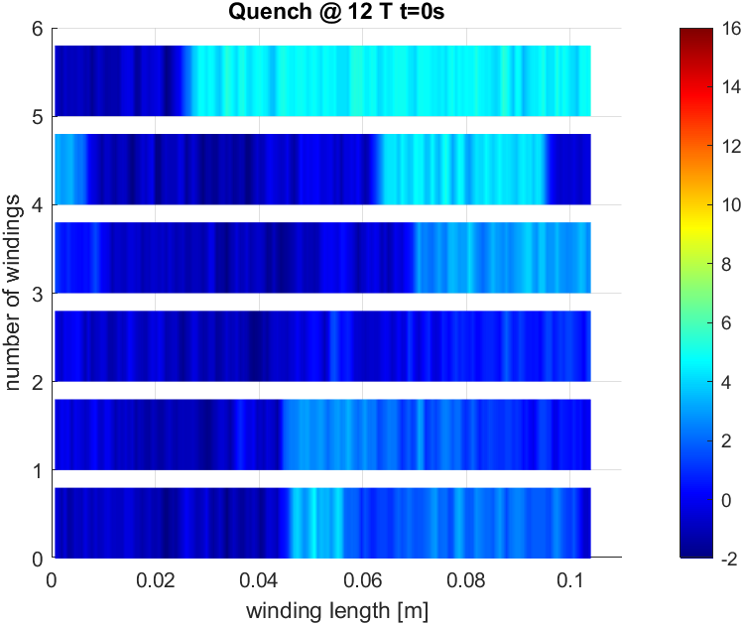
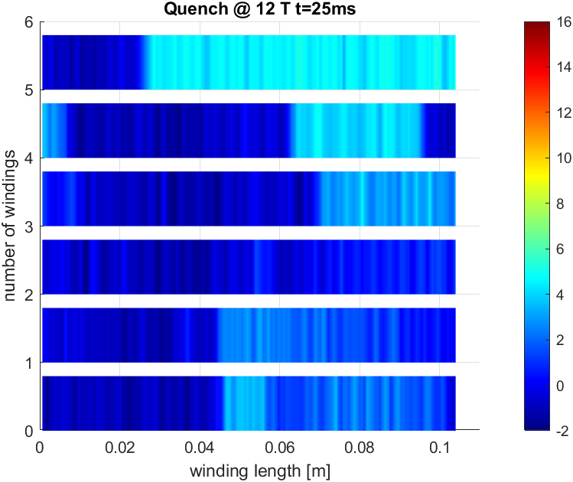
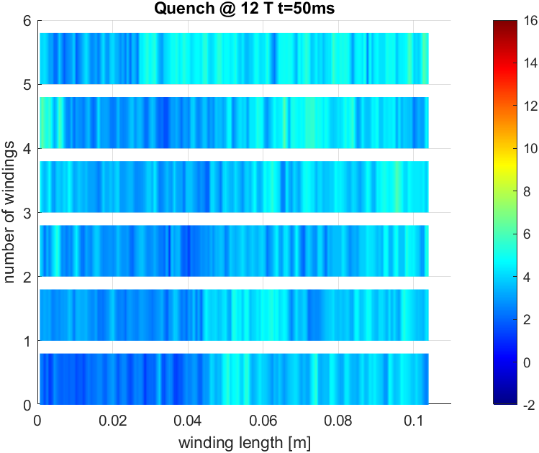
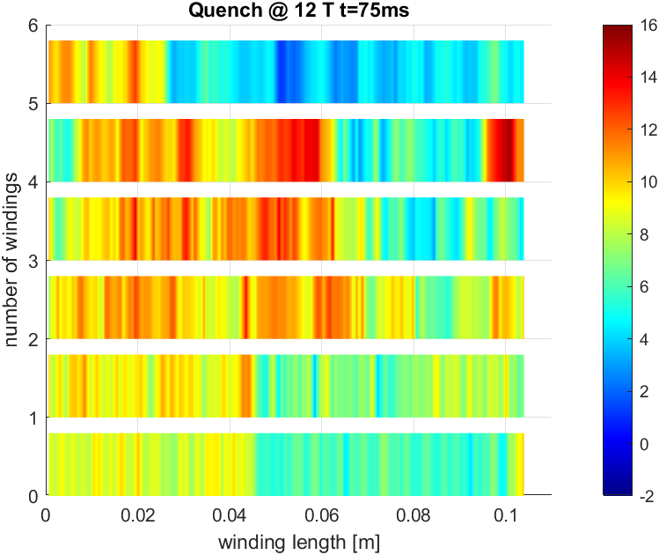
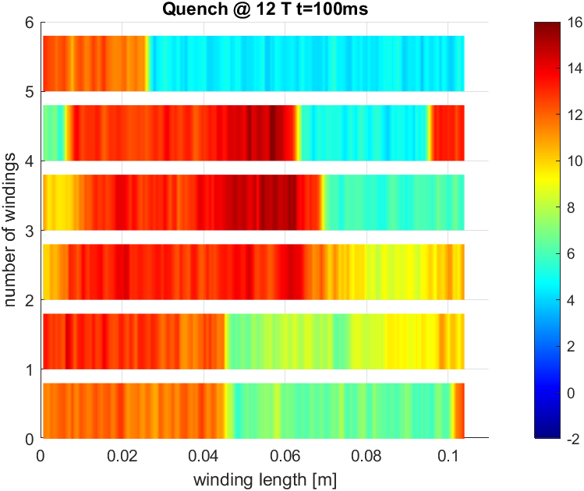
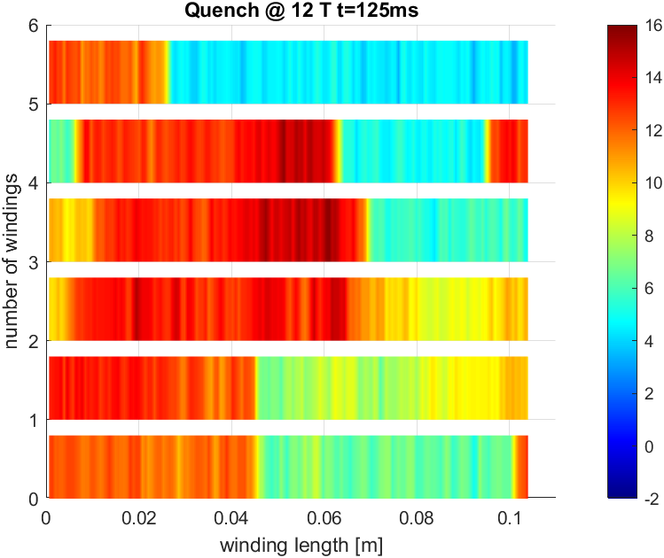
2D plot of the T profile

Slide 10
Spot Heater induced Quench
Test at 4 different magnetic fields (15T, 14T, 12T, 10T) at 4.5 K.
Current set at 80% of the critical current.
Increase of pulse power given to the spot heater
Magnetic Field​ | Current​
15T​ | 300A​
14T​ | 372A​
12T​ | 555A ​
10T​ | 788A
Spot Heater position under the epoxy resin

Slide 11
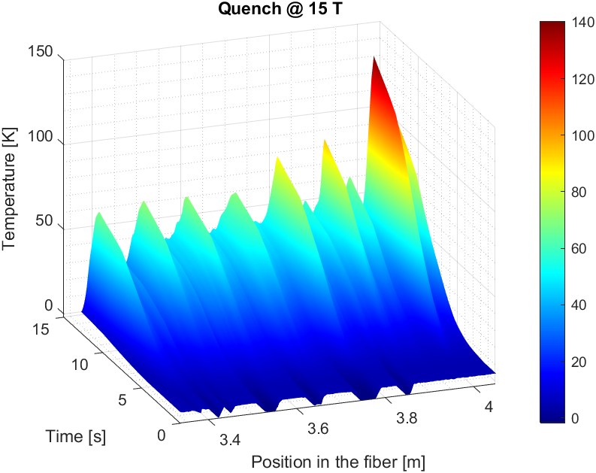
Quench at 15 T
In the first test 13.08 mJ were required to quench the wire, most likely beccause of bad thermal contact between the spot heater and the wire.
Very high temperatures were reached during this test.

Slide 12
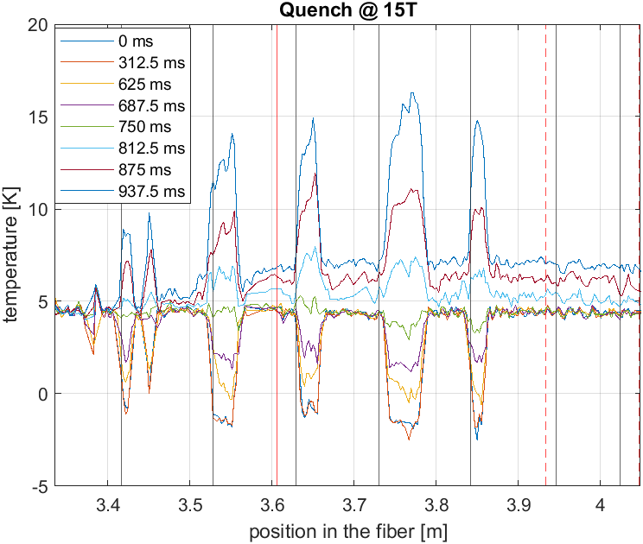
Quench at 15T with spot heater
Spot Heater

Slide 13
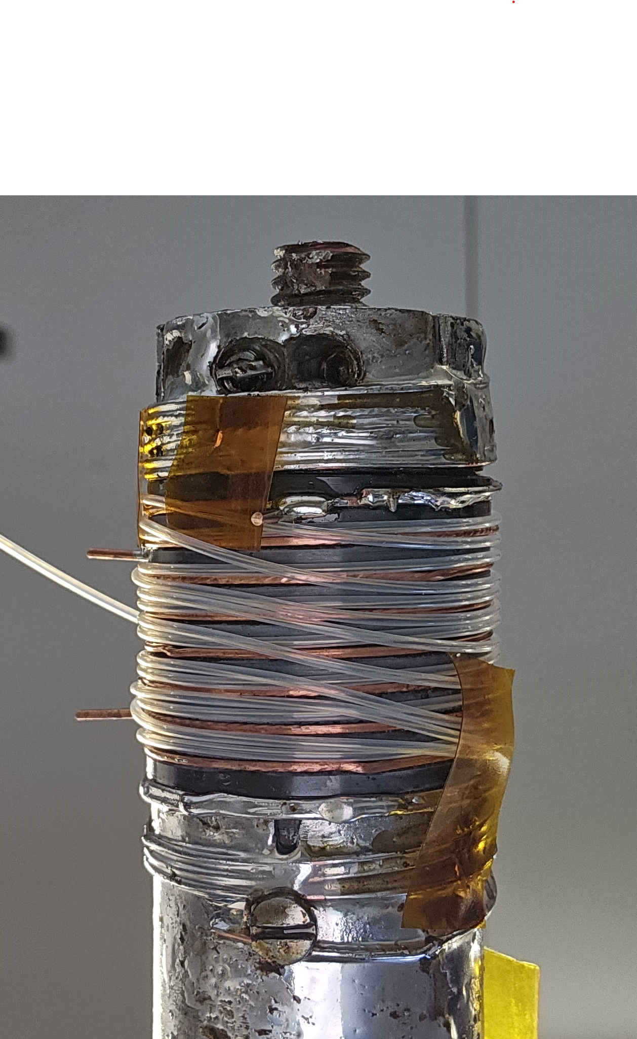
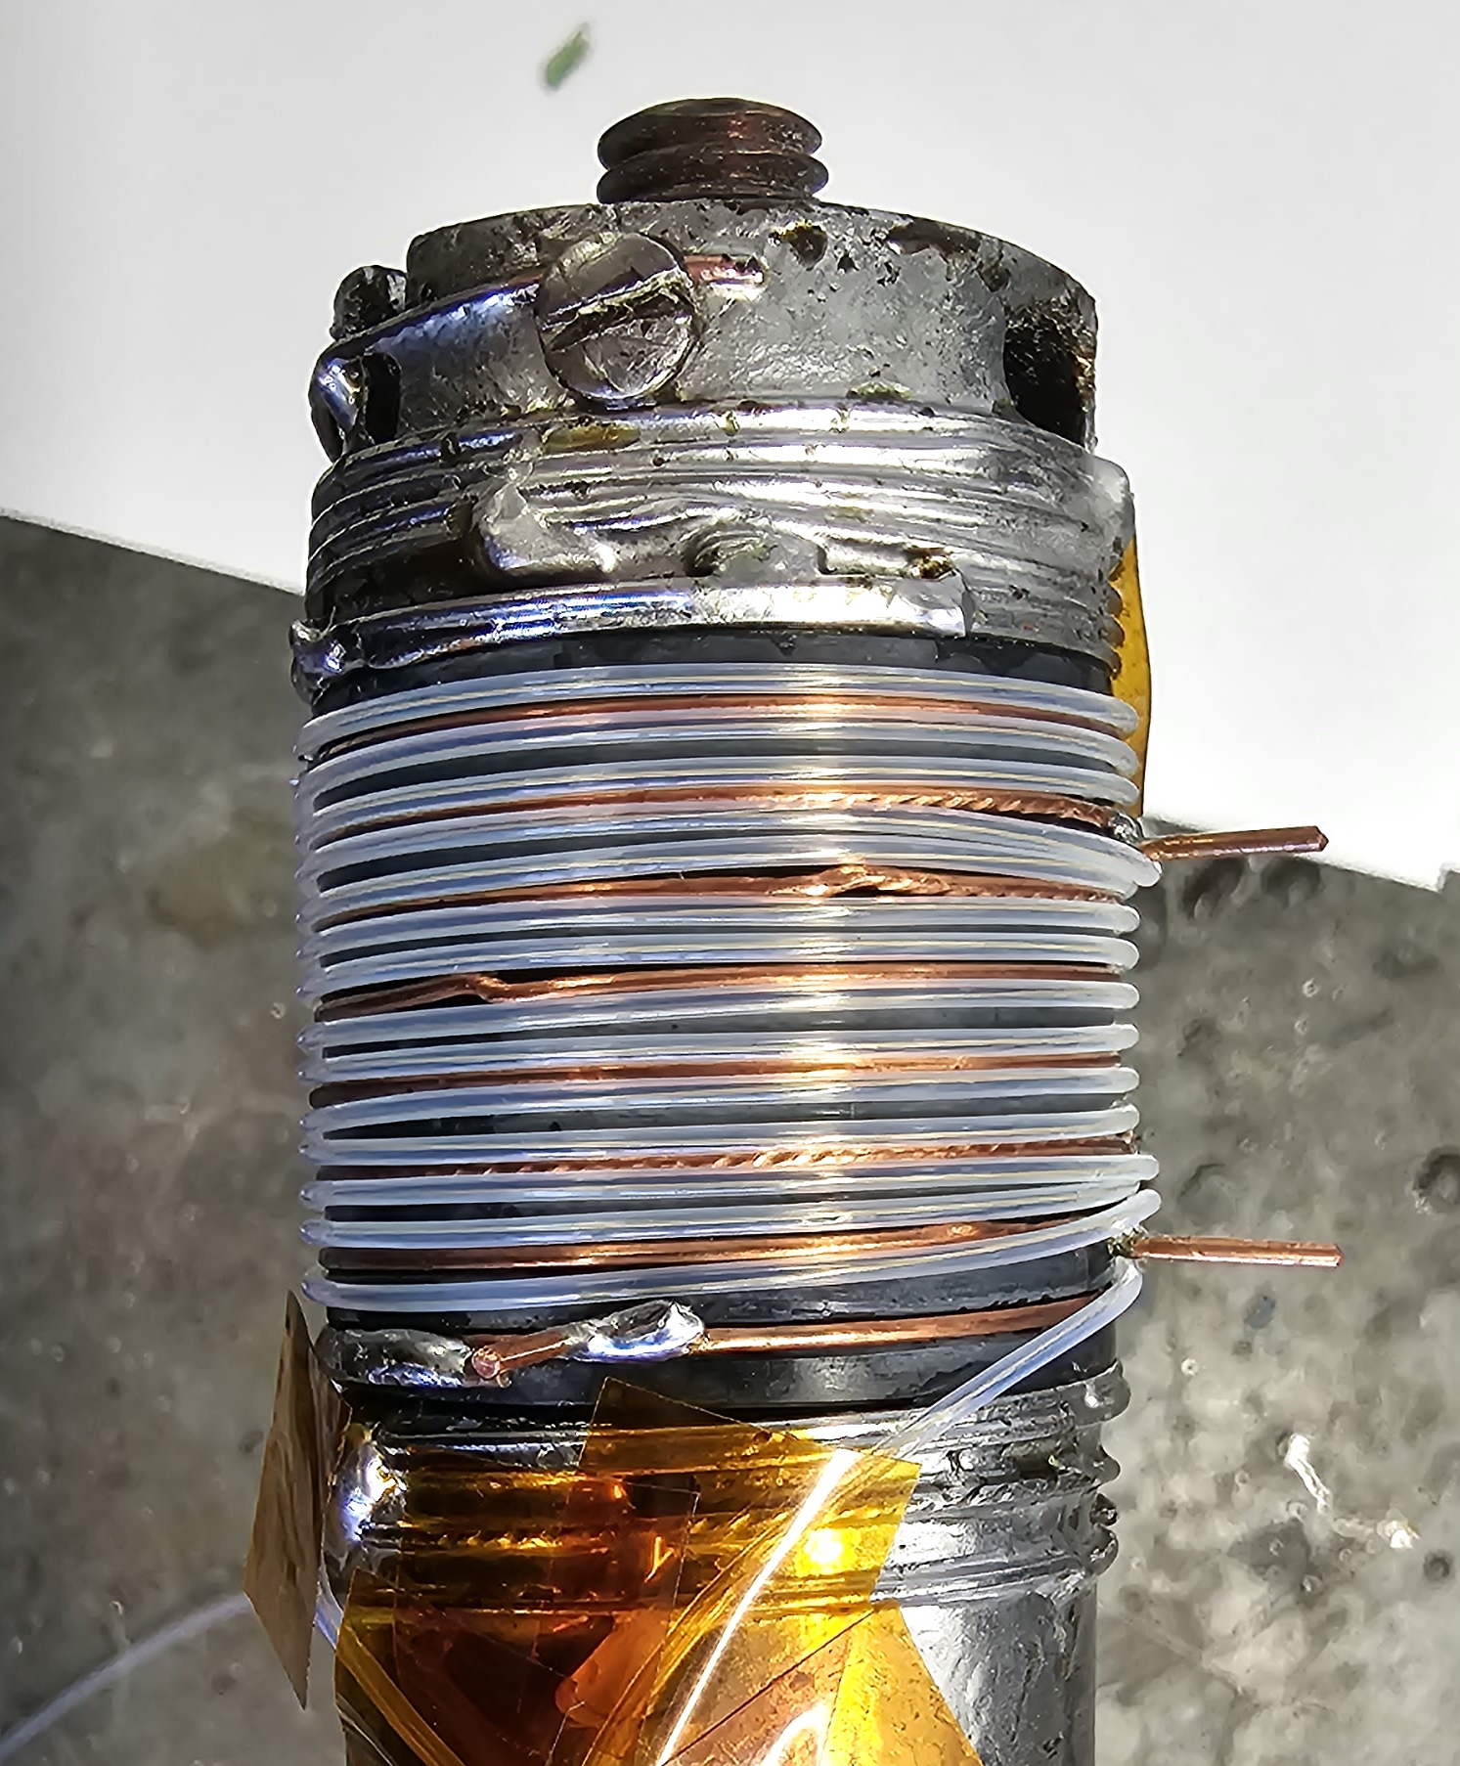
Further Analysis
During the analysis it seems that one side of the barrel was more sensitive to temperature variation, maybe this is due to the different arrangement, but more tests are needed.

Slide 14
Microscopic Analysis
Wire
Fiber + Teflon
Fiber + Teflon
Wire

Slide 15
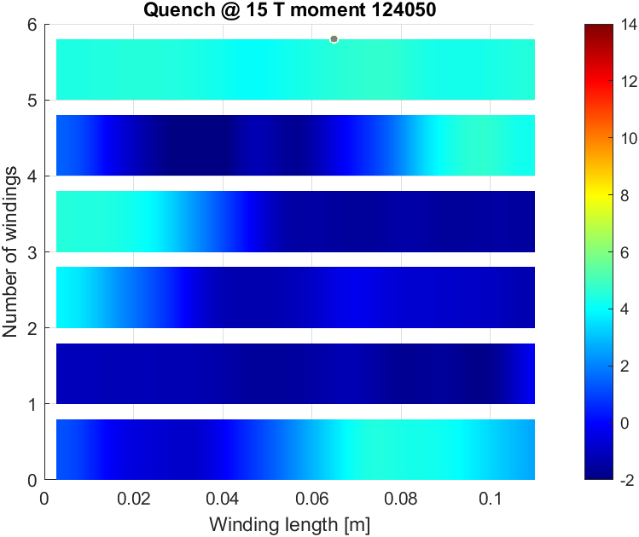
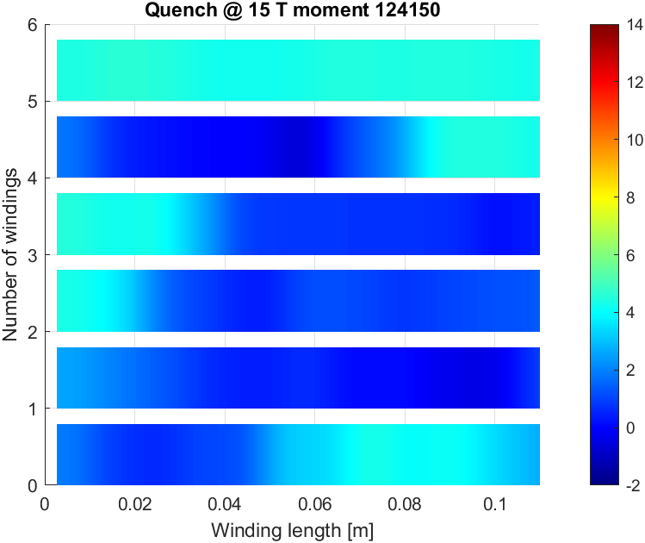
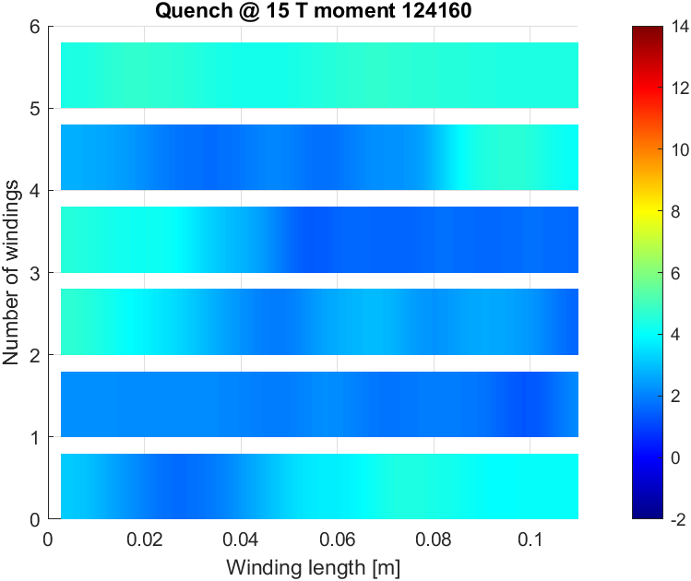
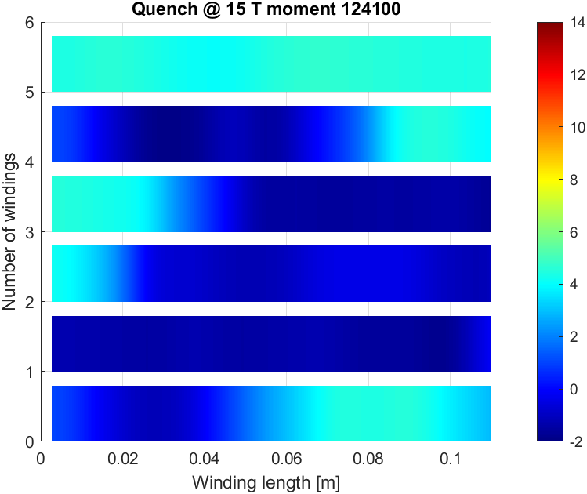
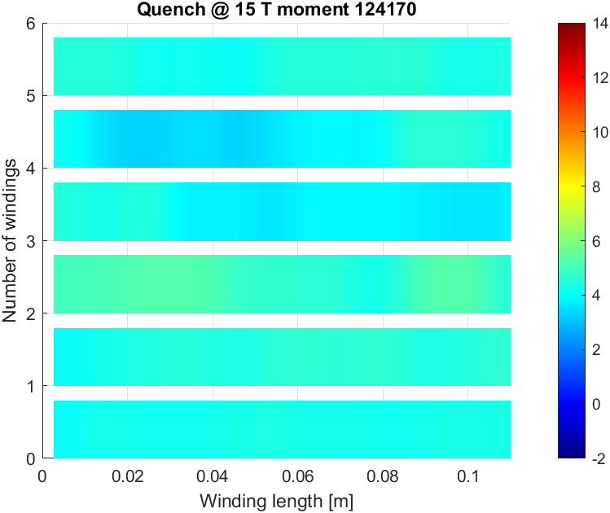
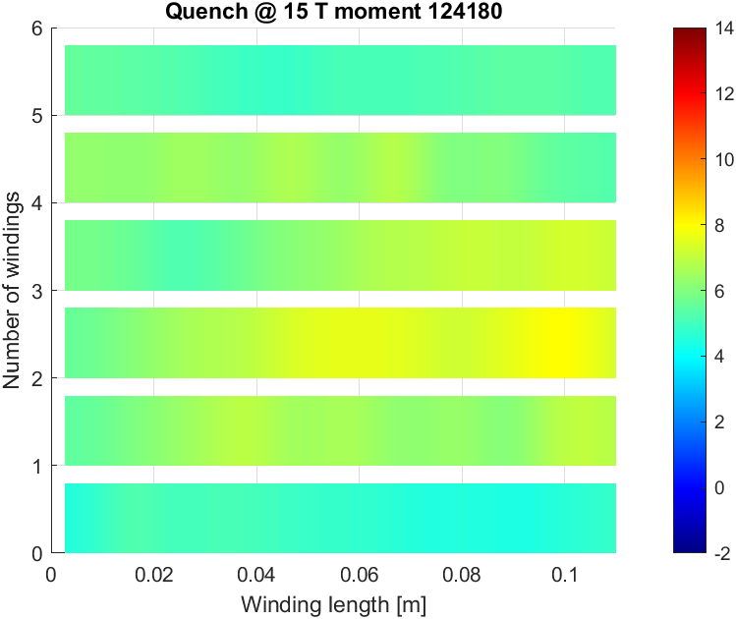
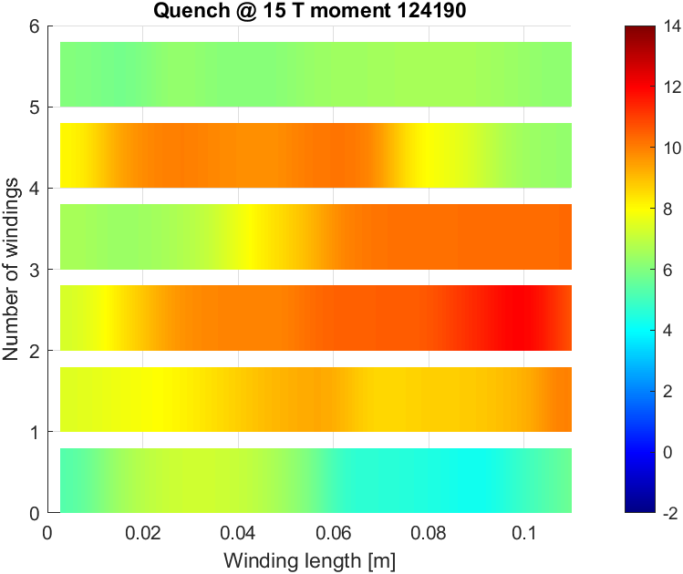
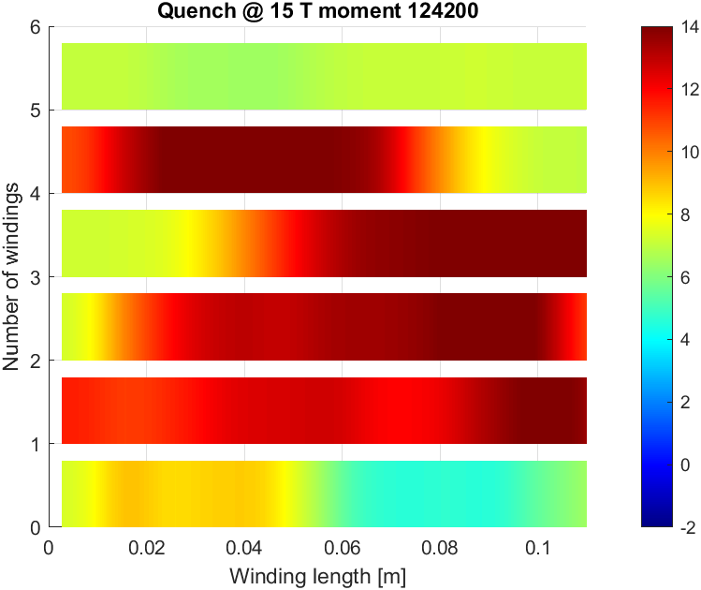
2D plot of the windings at 15T with 80% of the critical current

Slide 16
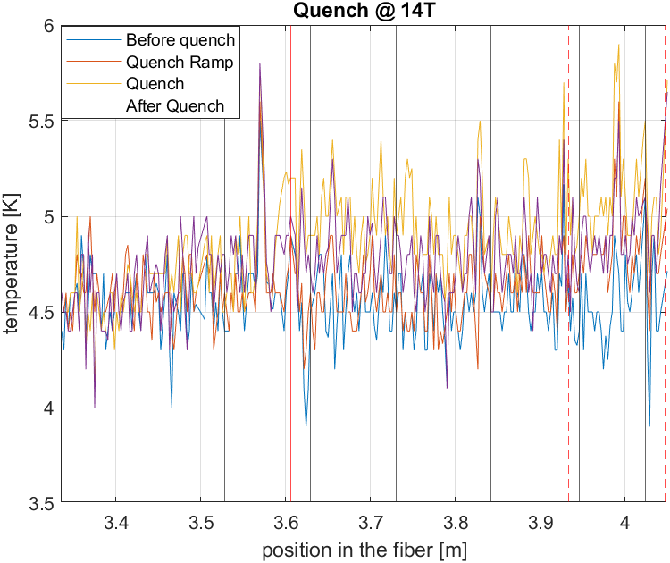
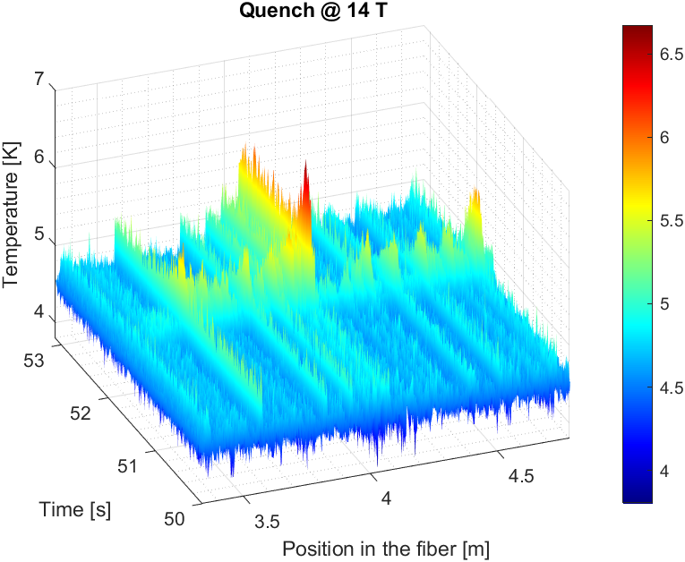
No good Quench detection in the following tests
Fiber winding losen up/ worsen the thermal contact.

Slide 17
Conclusion
Temperature variation on Nb₃Sn wires during a quench was investigated
Optical fibers are very temperature sensitive devices
Temperature variation during current ramp up and during quench was osserved
We can determine
the starting time of the quench
Spatial information on where the quench starts and how it propagates
fiber wrapping/ good thermal contact is a crucial parameter

Slide 18
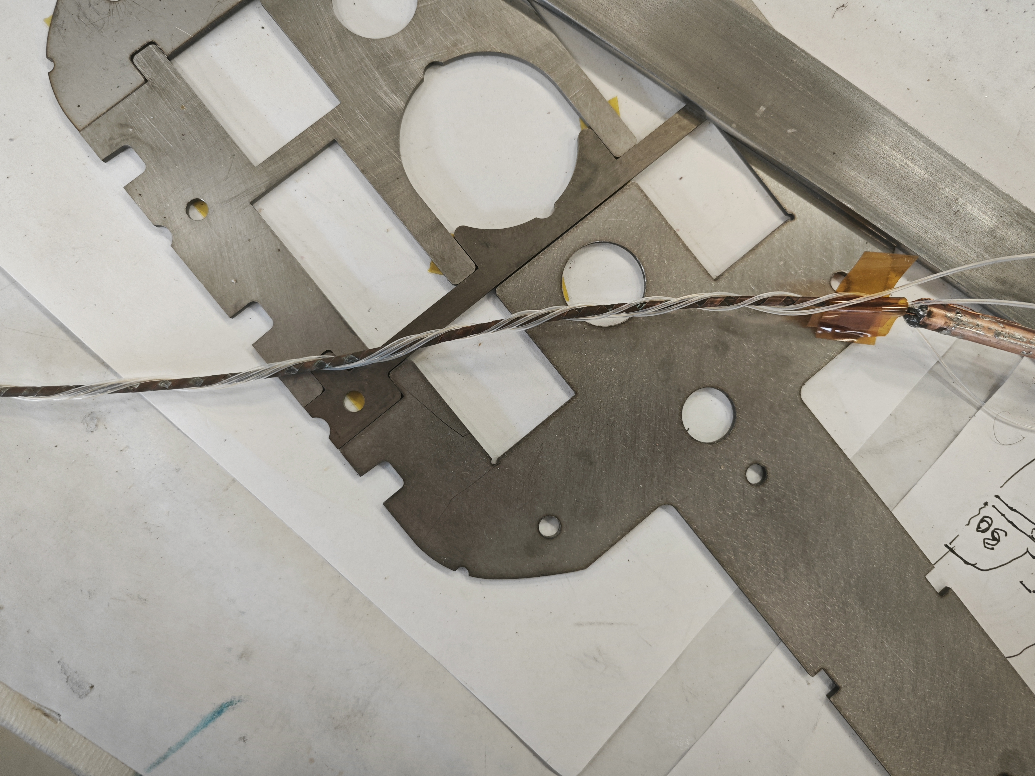
REBCO STAR wire test
Wrapped the fiber three times around STAR cable.
Starting from one end: 23 turns on fist wrapping (Z), 24 on second wrapping (Y) and 22 (X) on the third wrapping.

Slide 19
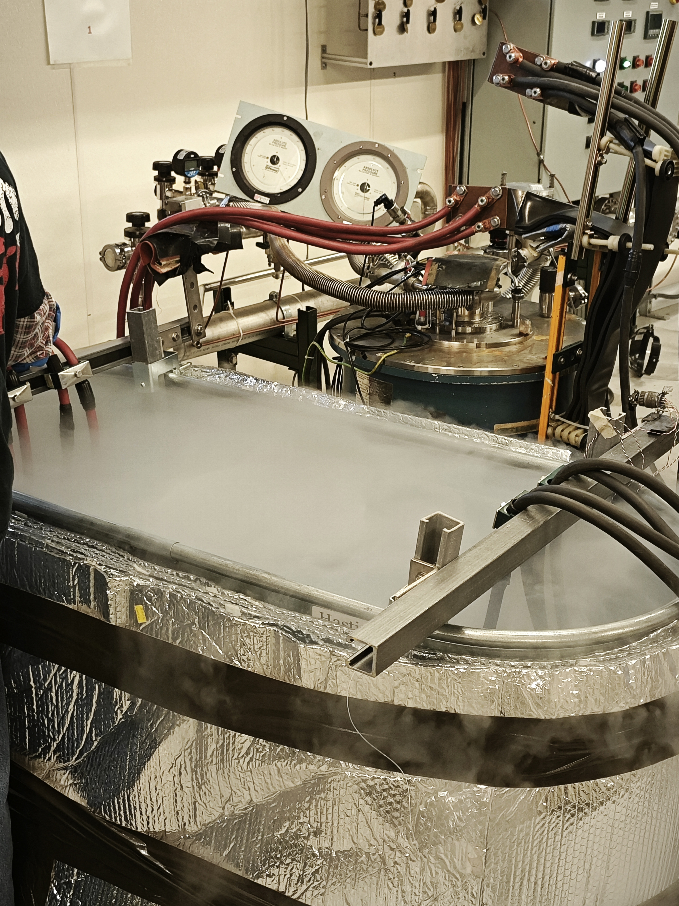
Experiment:
Fiber without Kapton
Cable was cooled down to 77 K with liquid nitrogen.
Several run were made:
RUN 1: up to 700A, with 10A /s up to 500 A and 5 A/s above 500A
RUN 2: Up to 500 A
RUN 3: Up to 600 A
RUN 4: Up to 750 A
Fiber with Kapton
The cable and the fiber were wrapped in a kapton layer with sticky kapton holding it in place.
Several tests were made:
RUN 1: up to 500 A,
RUN 2: Up to 600 A
RUN 3: Up to 750 A
RUN 4: up to 650 A holding the current at 650 A for two minutes.

Slide 20
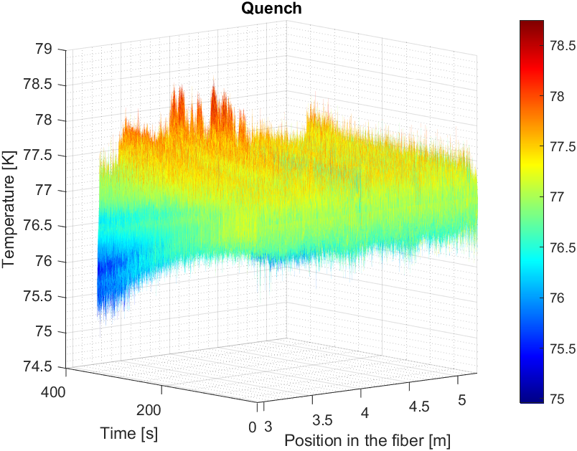
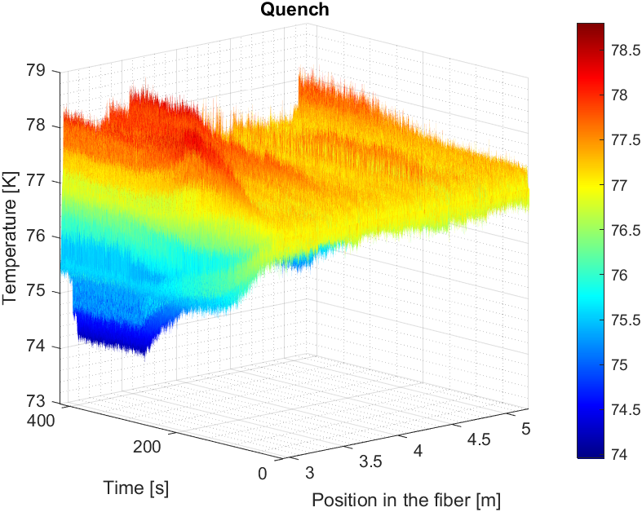
Preliminary results
RUN 4/ no kapton
RUN 4/ kapton

Slide 21
Future work
Barrel test will be repeated installing more than one strain gauge to insure good thermal contact and be able to control the quench
Acrylate coating Temperature sensors will be tested
Comparison with Polyimide coating
Results on REBCO STAR cable are preliminary
Thermal contact need to be improved.
Add epoxy?/ Test acrylate coated sensor
Use strain sensors vs T sensors

Slide 22
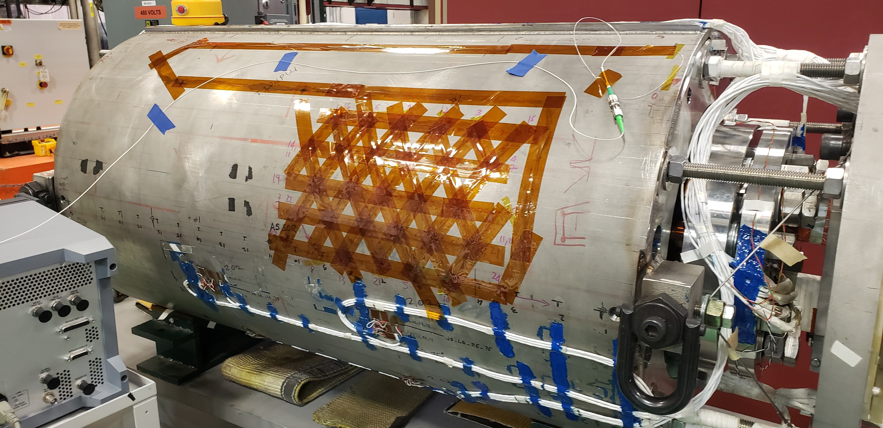
Fiber optics on SMCTM1 magnet
7 m Rayleigh fiber on the magnet skin
Test Goals:
Validate updated fiber feedthrough and connectors at 1.9 K
Validate fiber splices at 1.9 K
Validate Fiber technique at 1.9 K
Measure shell strain during testing

Slide 23
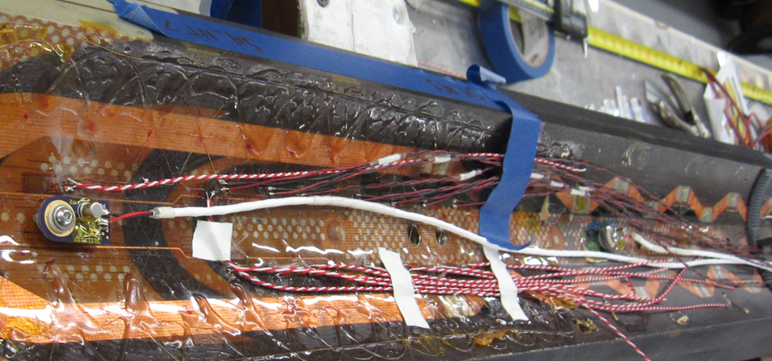
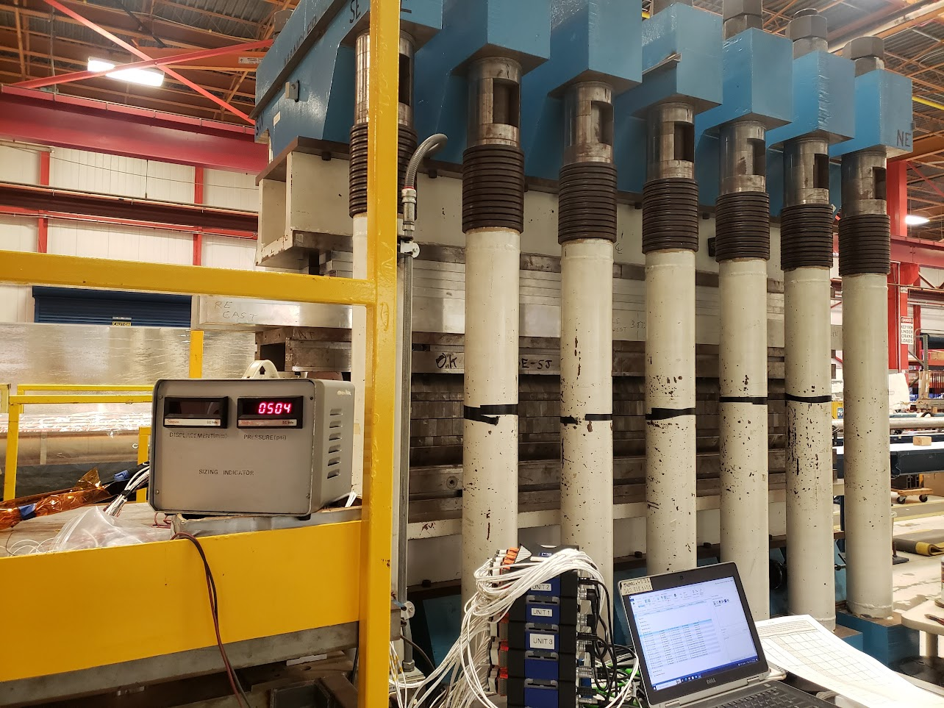
QXFSM03
Fibers have been installed on ID and OD of coil
Test goals:
Validate fibers mounted directly to coil during magnet powering
View pole/wedge strain discontinuity behaver during operation
Observe magnet mechanics

Slide 24
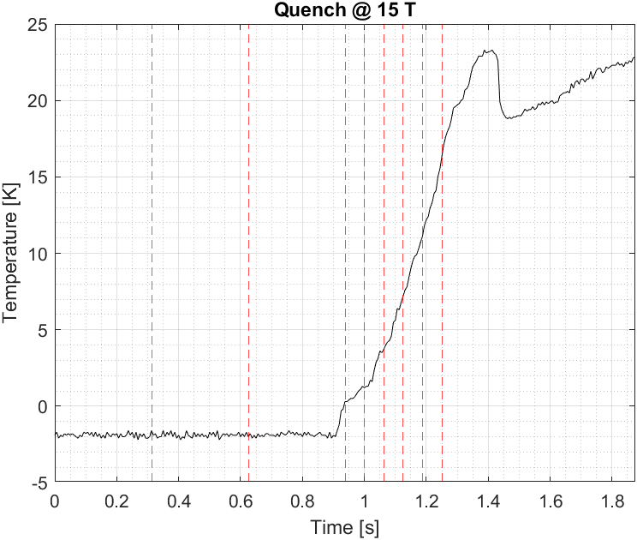
Data analysis of the Quench
Temperature keep increasing after quench

