Slide 1
Interlaminar Fracture Toughness of Nb₃Sn Composites
S. Krave, C. English
28 February 2024

Slide 2
Outline
Introduction to interlaminar fracture toughness
Silanes
Experimental method
Results
Future plans

Slide 3
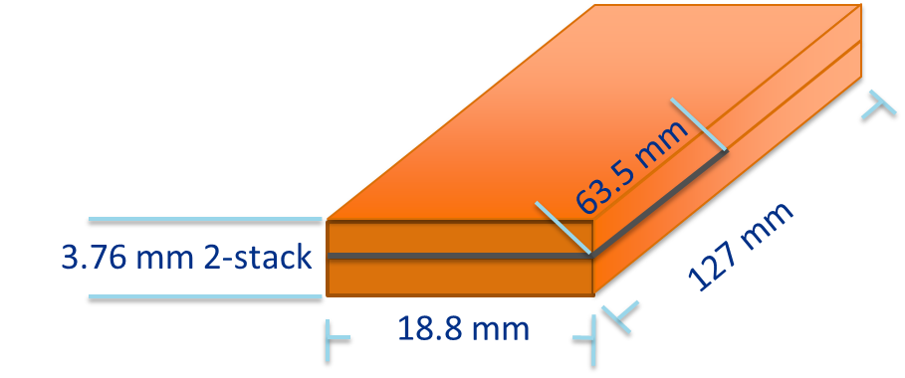
Why Interlaminar Fracture Toughness?
Past ten stack measurements focus on engineering properties for overall mechanical design
  Plastic deformation, strain, thermal contraction and modulus are not good predictors of training behavior
  Some work on interface properties exists, but the existing literature is thin and not directly comparable to cable
Mode I (Peel) Interlaminar fracture toughness probes the interface between objects and relates the energy release rate to loading.
  Stronger interfaces de-bond less
  Stronger interfaces release more energy per unit crack area
The above criteria work against each other in a magnet application
  Applying realistic parameters in FEA or other analysis may be able to guide interface design.
In the case that low strength materials are not able to be used, a combination of selective weak interfaces to manage stress accumulations
Interfaces and training
Relative Training
Weak interfaces that don’t store energy
Strong interfaces that don’t de-bond
Interface Strength

Slide 4
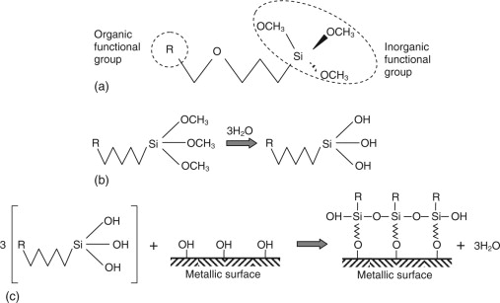
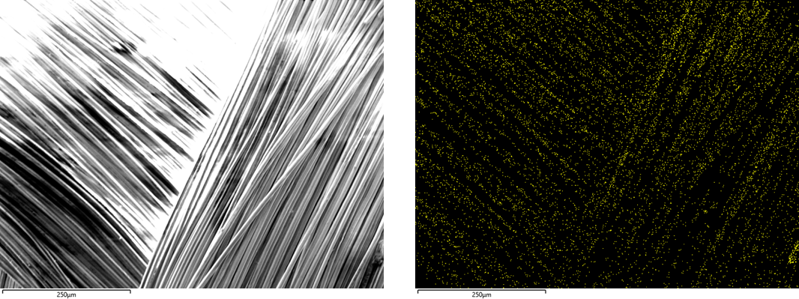
Silanes: Good or bad?
Fiberglass fabrics (Cable insulation) are treated with a lubricant so they can be manufactured into products
This lubricant may additionally function as a finish or coupling agent, as is the case with he 933 HTS often found on S2 glass
Reaction in argon causes this substance to decompose
  Decomposition (cracking) leaves behind carbon residue and potentially other silicon compounds (SiC?)
Contamination leads to shorts, low dielectric strength, and poor adhesion
Silanes do not like to be washed away
No luck with organic acid or basic cleaning, or even vapor degreasing
They will burn in air, leaving only SiO₂
From: https://www.sciencedirect.com/topics/engineering/organosilane
S2 glass after reaction in Argon. Right image shows carbon visible by EDS.

Slide 5
Heat cleaning of insulation results in stronger composites compared to standard cable
In comparing resin systems previously, we measured the short beam strength of several resins, and one set of samples with heat cleaned insulation.
With regular 101K, we have 4 samples
  With standard amount of 1202 binder ~9 MPa
  Without any binder, just standard glass (with 933) ~12 MPa
  Heat Cleaned insulation (no binder) ~32* MPa
    Sample failed in bending and is not technically a valid result
  Vapor Degreased cable and insulation ~24 MPa
Note that there are no noticeable cracking events in the heat cleaned glass until sample failure (it was also quiet)
Also note: These stacks all have approximately the same compression behavior to 60 MPa (Instron limit)
Room temperature data shown, trends hold at 77K, but values generally go up a little.

Slide 6
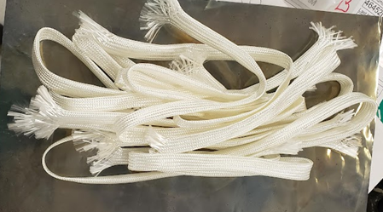
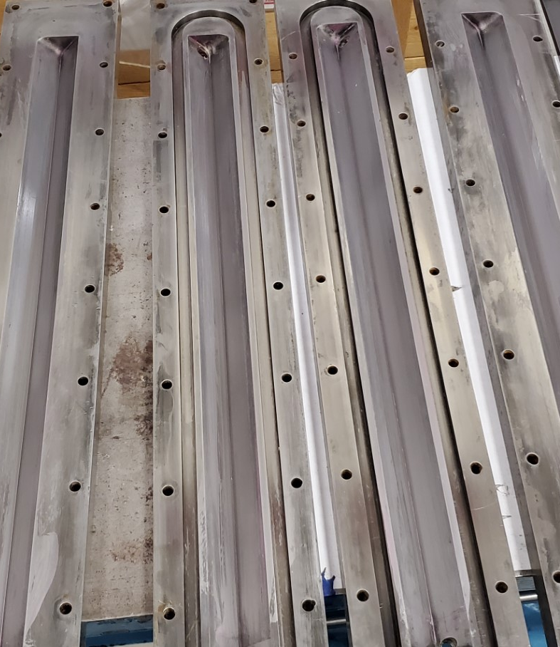
Experimental Method
Preparation
  Set of ten layers of coil are laid out with a 0.5 mil insert every 5 inches
  Heat treatment per standard AUP
  101K epoxy impregnation
  The samples are then numbered and coated for visibility
  Piano hinge bonded per standard using Stycast 2850 FT
Tests
  Sample is put into the Instron and set to be pulled apart at a constant extension rate (up to 5mm/min)
Heat Cleaned cable insulation: Standard QXF insulation removed from coil, heat cleaned at 600°C for 4 hours. Yarn is 933 sized AGY S2 Glass
Pair of fixtures used to house the two stacks for heat treatment and impregnation

Slide 7
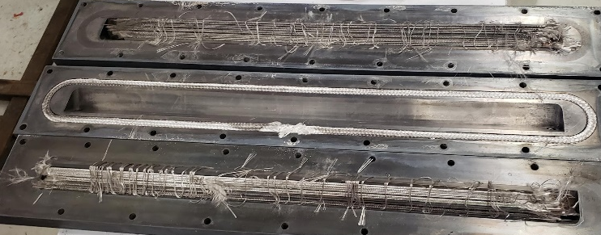
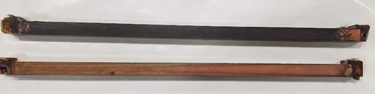
Samples After reaction and Impregnation
Samples after reaction. Top samples use raw glass, bottom use heat cleaned (except last two fillers on bottom)
Both samples reacted simultaneously under argon. Argon does not remove contamination.
Samples after impregnation. Top samples turn black as glass has gone clear once full of epoxy. Carbon residue gives black color
Bottom sample glass is now clear when full of epoxy.
  Typical of clean epoxy impregnated glass

Slide 8
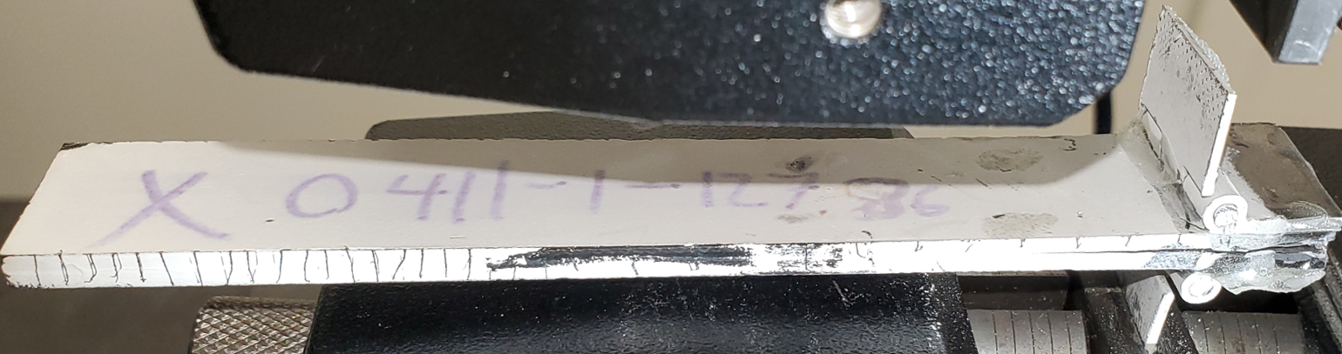
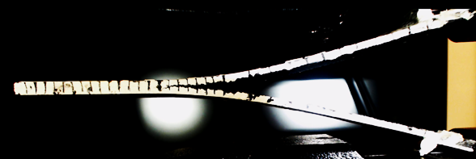
Experimental Method Continued
Measurement System
  Data is recorded by Instron and a webcam
  What we are looking for
Results gained
  Measured
    Force (by Instron loadcell)
    Displacement (by Instron)
    Crack Elongation (by Webcam)
    Time
  Calculated
    Strain Energy Release Rate (SERR)
    Change in the measured results
A sample before testing starts
Sample during testing. Samples were painted white for contrast.

Slide 9
Results
Samples are loaded as shown above at a few mm per minute, with crack front plotted vs calculated G_{IC} from crosshead displacement and load.
The heat cleaned samples show higher values of fracture toughness, with stars showing onset of cracking in the heat cleaned samples. This is roughly a factor of 3-4
Heat cleaned insulation was also more difficult to cause to de-bond, with 40% of samples cracking rather than delaminating.
See Interlaminar Fracture Toughness
Testing of Nb3Sn Insulation Systems presented at MT-28

Slide 10
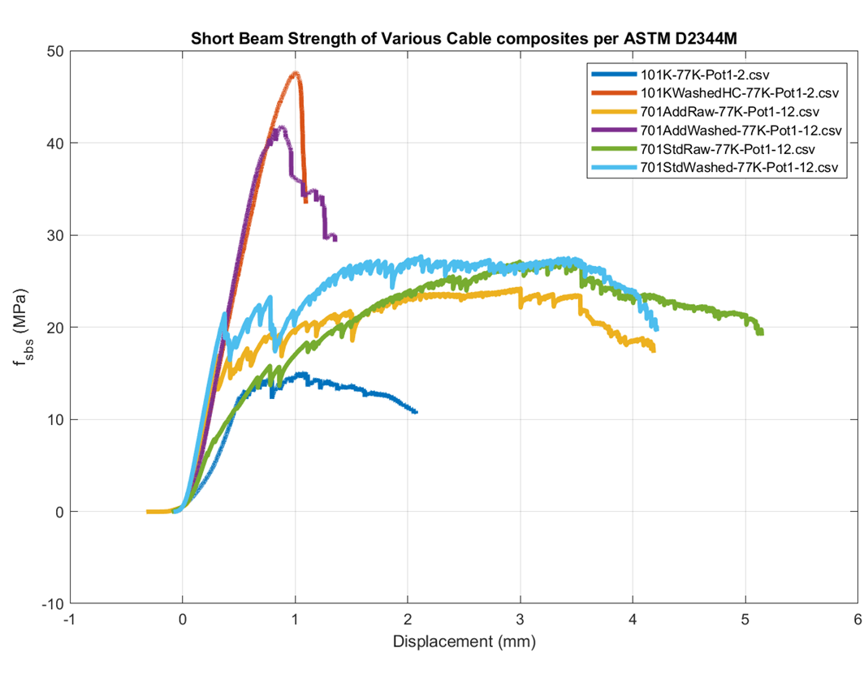
Conclusions
Clean Insulation = Good, Dirty insulation = Bad
  In the spirit of making quality composites, might not apply to magnets
  This is in line with previous work on shear strength measurements
Clean glass should be attempted
  Cold oxidation
  In-situ oxidation in reaction
  Unsized glass braiding
G_{IC} at room temperature for raw glass is ~500 J/m², for heat cleaned glass it is closer to 2000 J/m²
Heat cleaned insulation outperforms standard raw insulation by more than a factor of 3 compared to untreated glass. This is repeatable. The above data also does not reflect a shear failure, as such the “true” value is higher. Special resins can approach this limit on standard glass.

Slide 11
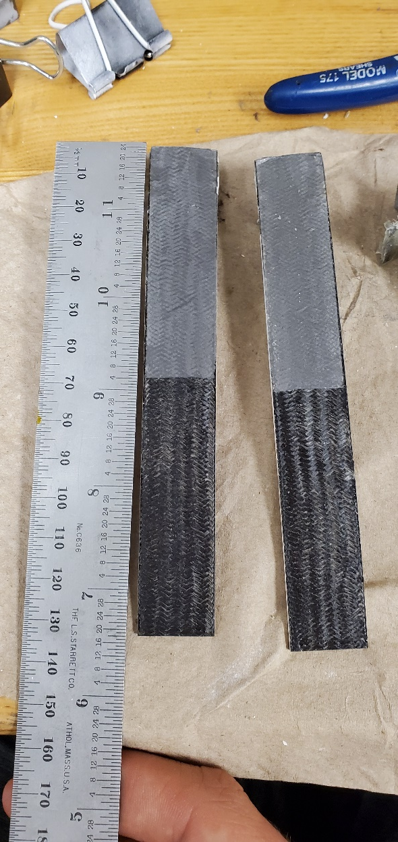
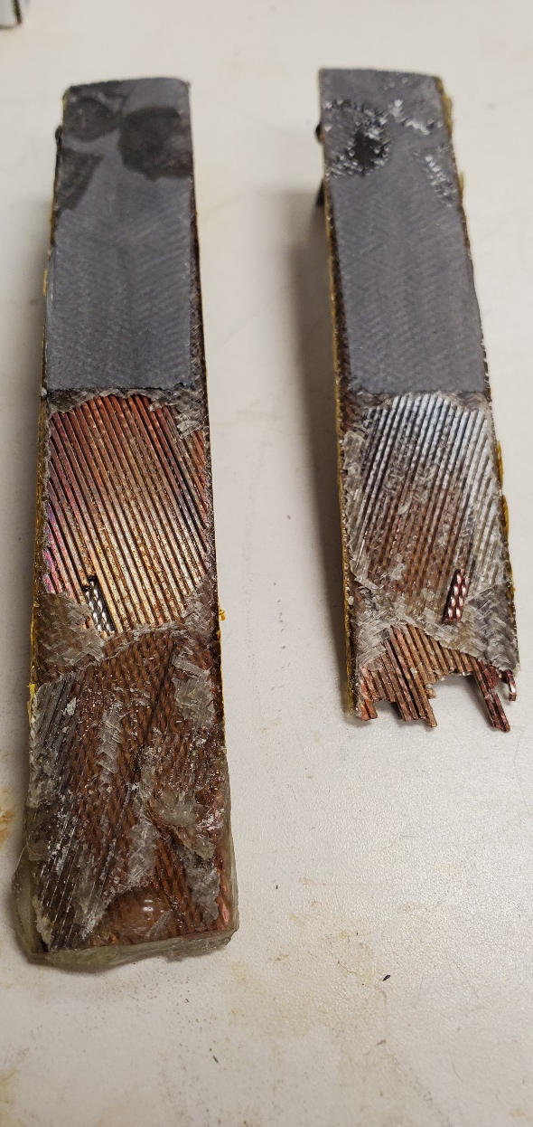
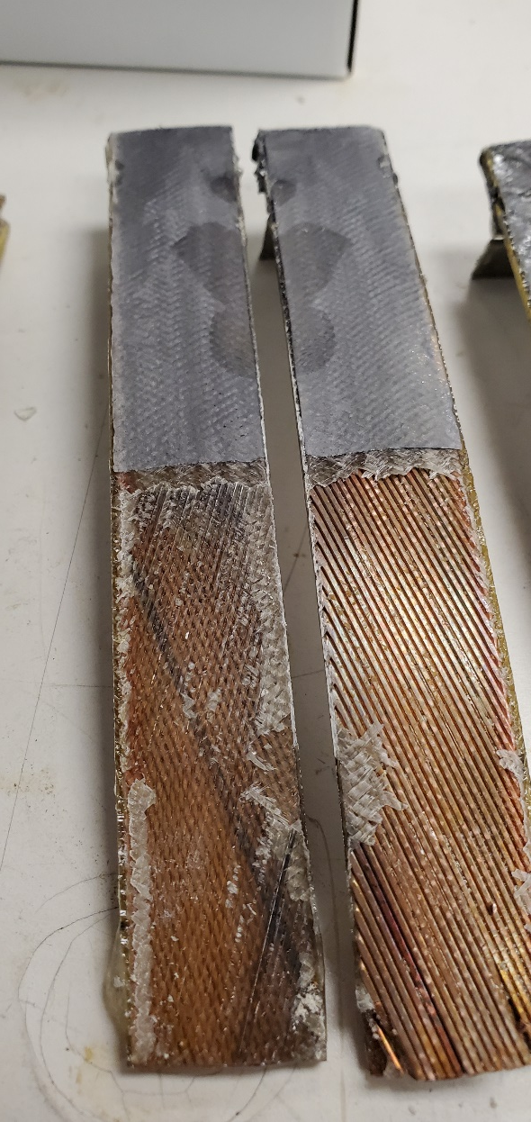
Next Steps
It never ends…
More samples of the same types have been fabricated
  Increase statistics at room temperature
  Take data at 77K
    Needs some tooling design to facilitate viewing
Test different in-situ oxidation techniques
  See A. Brem talk from MT
Add shear measurements for similar sample types
Investigate interface between insulation and cable

Slide 12
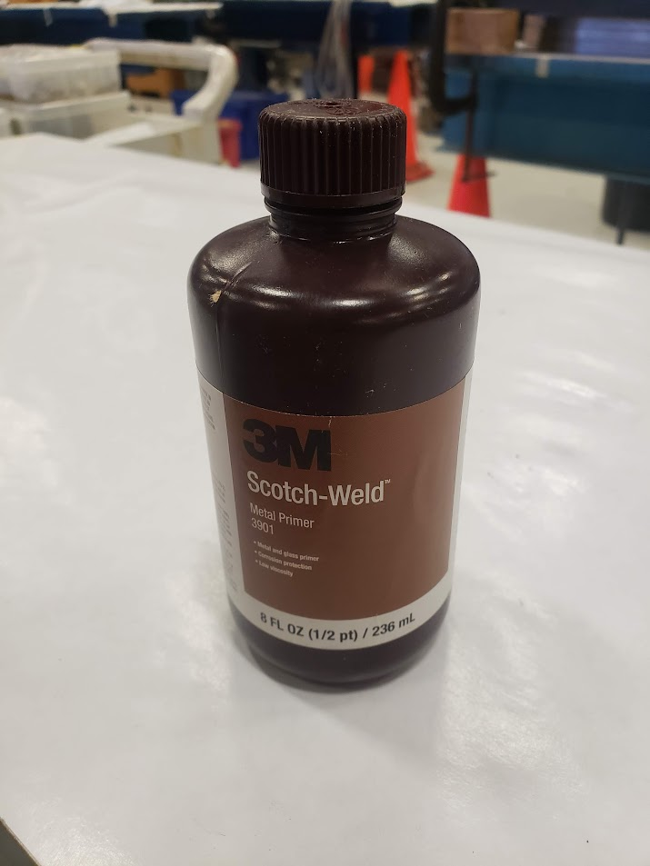
Future Work
Current dataset is sparse with low statistics
  New samples have been reacted and are awaiting impregnation
    And have been for months at this point
  Work to repeat test at 77K
Since silanes as normally used improve adhesion, we can re-apply a coupling agent after heat cleaning to likely further increase strength
  Could be applied to coils after reaction to improve adhesion. (highly diluted in methanol)
Additionally, test cable samples with in-situ oxidation

