Slide 1
A Bayesian Approach to Radiation Image Reconstruction and Uncertainty Quantification
NSD Meeting – Mar. 5, 2024
Jaewon Lee — jwonlee@berkeley.edu

Slide 2
Outline
Introduction — Scene Data Fusion / Single Detector Imaging
Gaussian Process Prior (GPP) for Image Reconstruction
Bayesian Uncertainty Quantification
Simultaneous Full Spectral Imaging and Spectral Decomposition

Slide 3
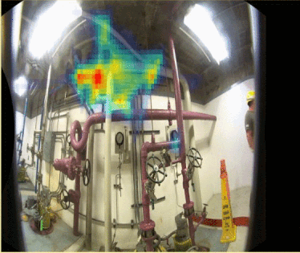
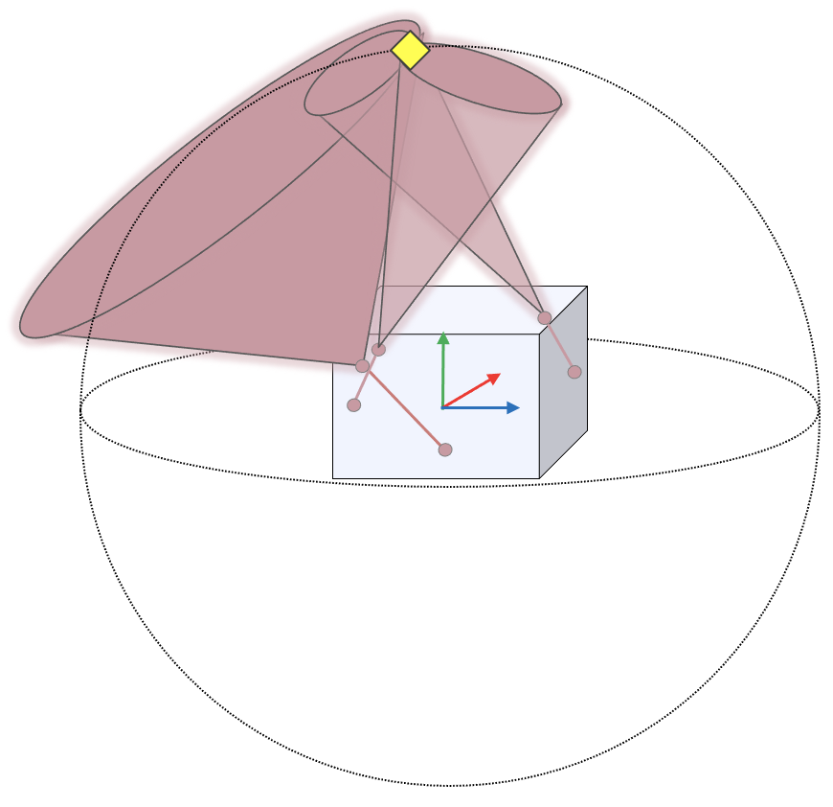
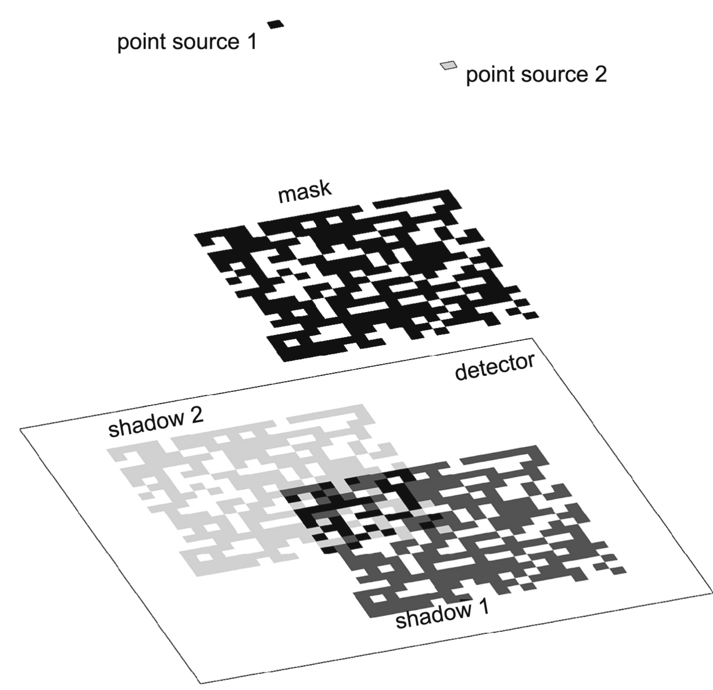
Single Detector Imaging - Introduction
Radiation Imagers
†
Compton imaging
Coded aperture imaging
Co-60 Imaging using a Compton camera
† https://h3dgamma.com/
Notes:
Img source https://www.sciencedirect.com/science/article/pii/S0168900209012819
Todo read about some Compton Imaging reconstruction algorithm (Don’s paper, Dan xu’s paper, )

Slide 4
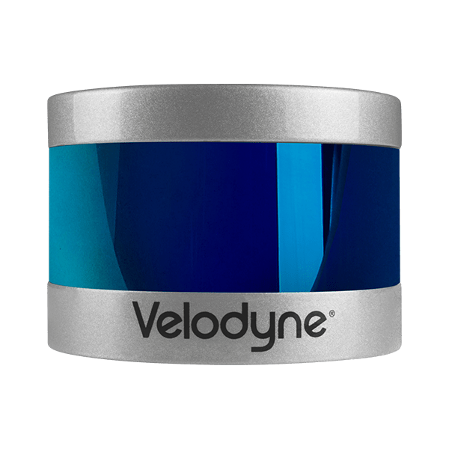
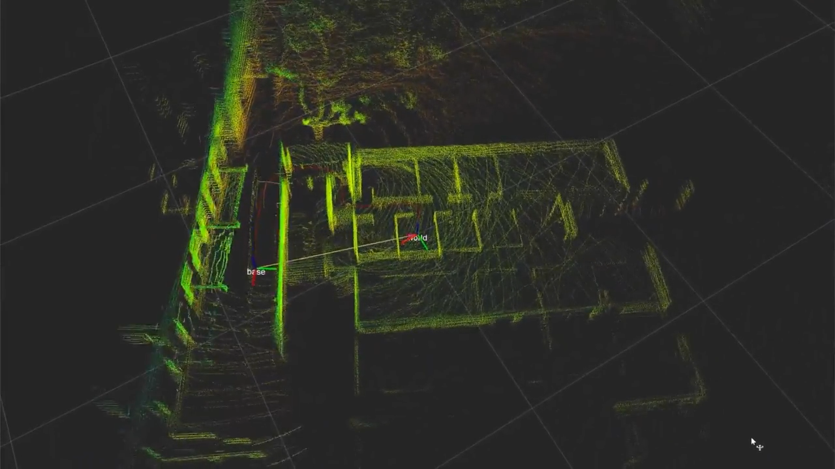
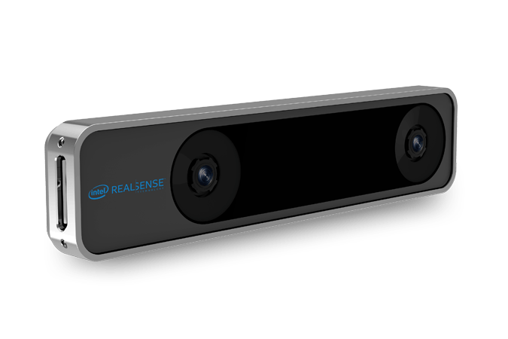
Single Detector Imaging - Introduction
Radiation Imagers
SLAM, Odometry
†
LiDAR
Stereo camera \ IMU
Simultaneous Localization and Mapping (SLAM)
† BLAM, https://www.youtube.com/watch?v=08GTGfNneCI
Notes:
So first I’ll start with a brief introduction. Radioactive source imaging is an important task with many applications related to nuclear safety and security, such as accident remediation, lost source search, and accident response. And many different radiation imagers with different concepts have been developed in the past, such as Compton imager or coded aperture.
On the other hand, what we have today is this enormous advance in computer vision technology, such as Simultaneous localization and mapping, using lidar and stereo camaras.

Slide 5
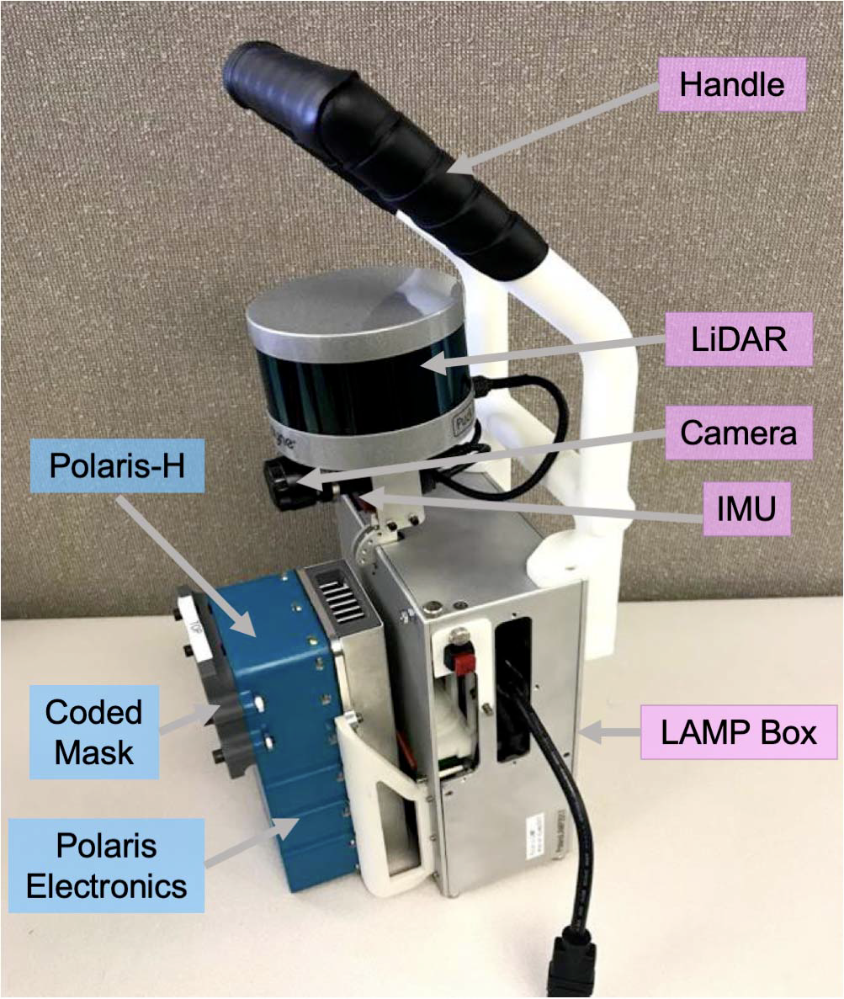
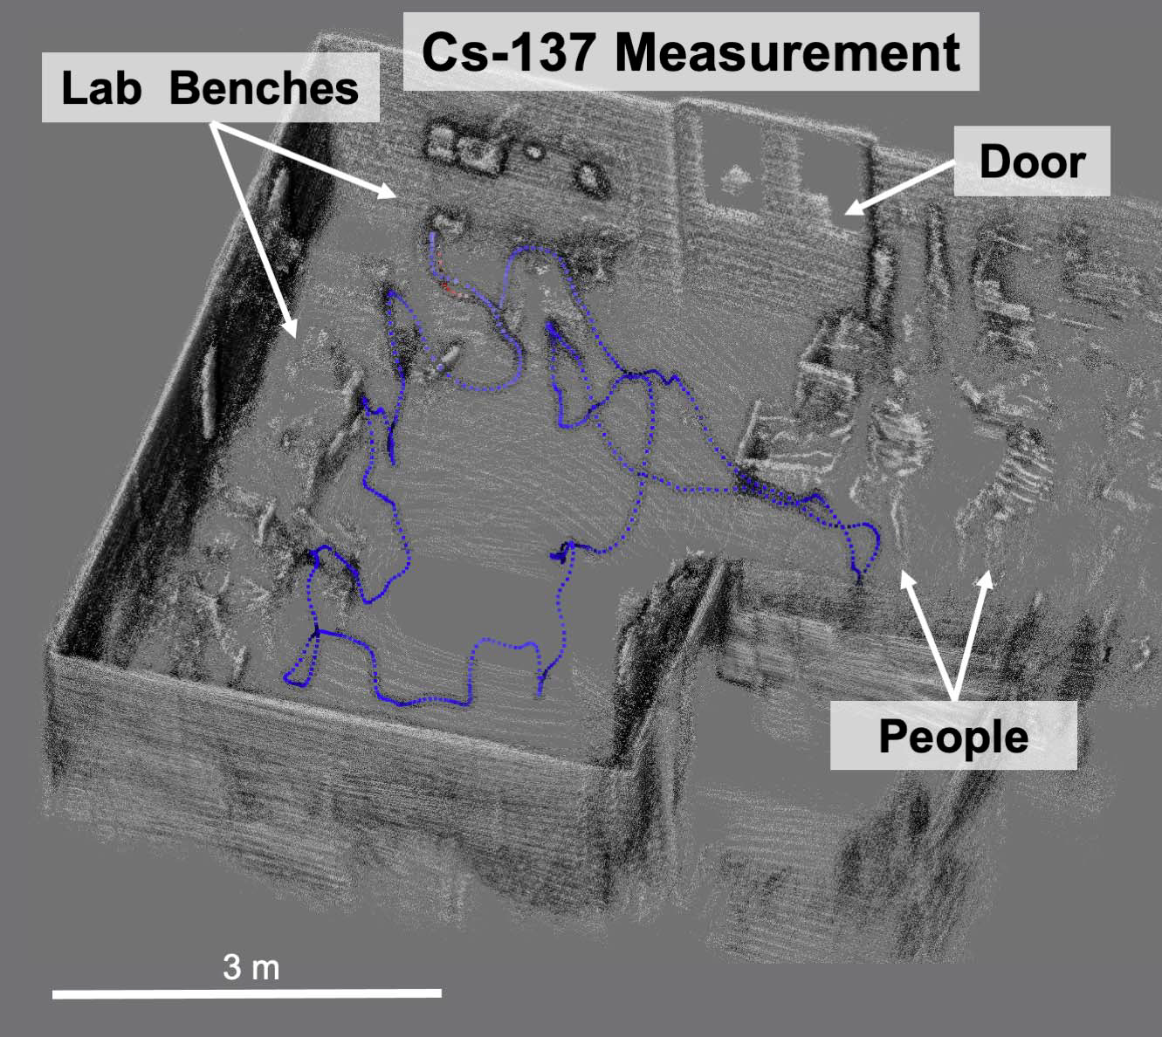
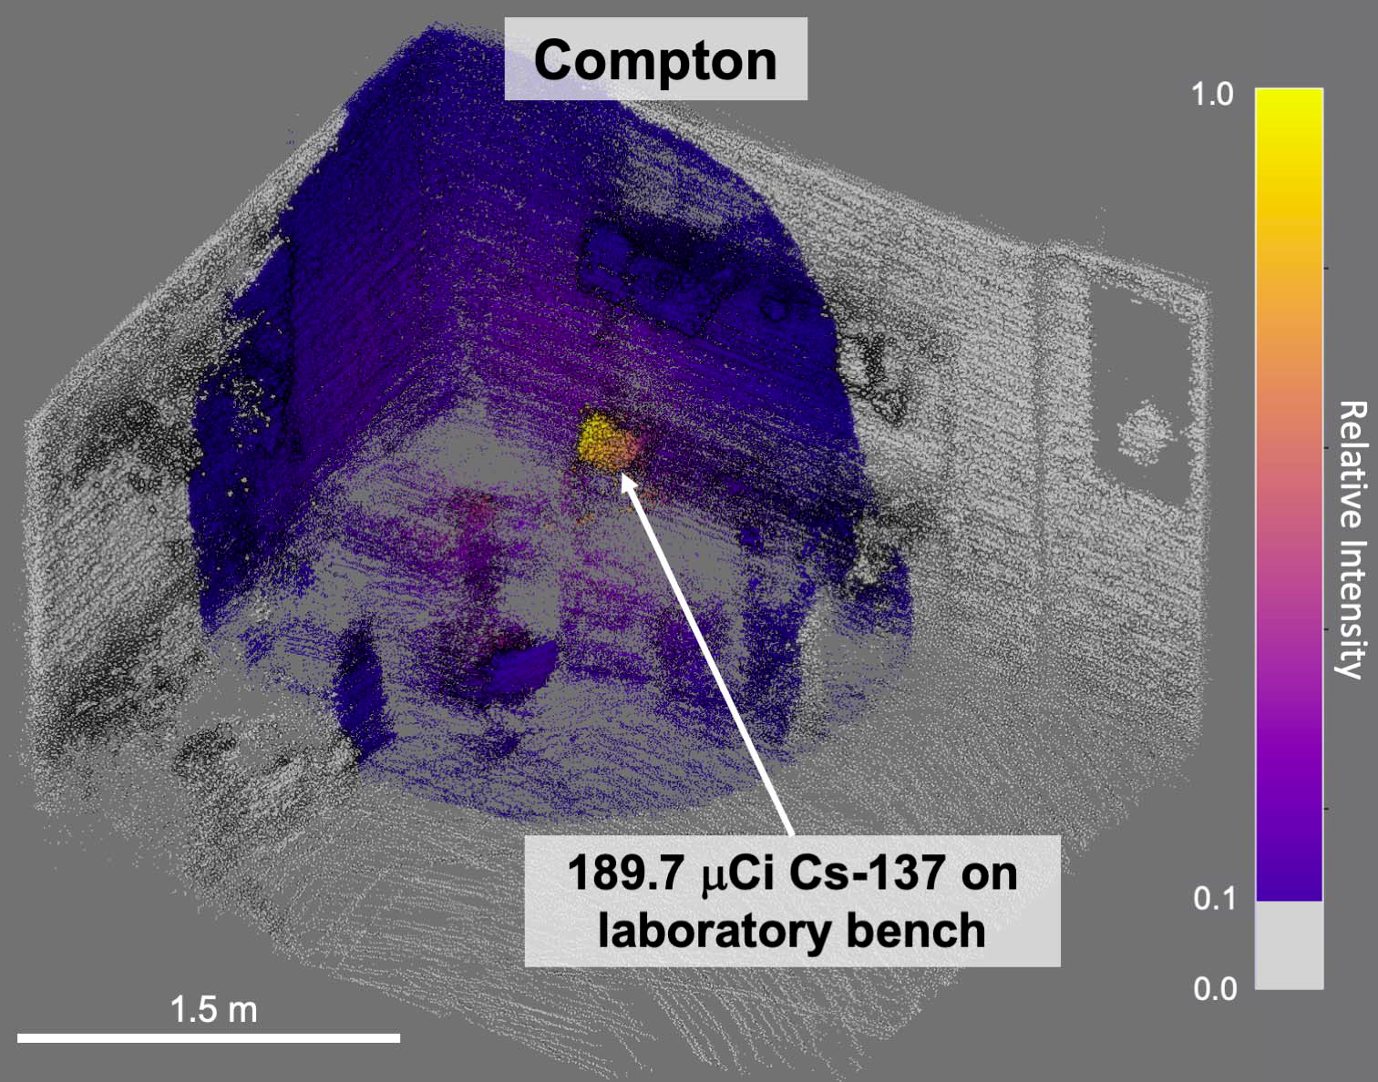
Single Detector Imaging - Introduction
Radiation Imagers
SLAM, Odometry
Scene Data Fusion (SDF)
†
Polaris-LAMP
Free-moving, 3D radiation imaging
† J. Hecla et al., “Polaris-LAMP: Multi-Modal 3-D Image Reconstruction With a Commercial Gamma-Ray Imager,” IEEE Transactions on Nuclear Science
Notes:
So first I’ll start with a brief introduction. Radioactive source imaging is an important task with many applications related to nuclear safety and security, such as accident remediation, lost source search, and accident response. And many different radiation imagers with different concepts have been developed in the past, such as Compton imager or coded aperture.
On the other hand, what we have today is this enormous advance in computer vision technology, such as Simultaneous localization and mapping, using lidar and stereo camaras.

Slide 6
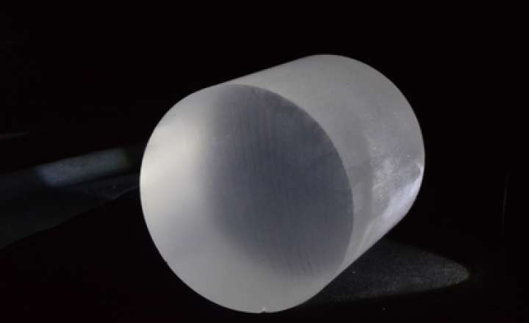
Single Detector Imaging - Introduction
Single detector
SLAM, Odometry
Scene Data Fusion (SDF)
SLAM
Single detector
Single detector Free-moving 3D radiation imaging?
Inexpensive, less complicated electronics, rugged…
Notes:
So first I’ll start with a brief introduction. Radioactive source imaging is an important task with many applications related to nuclear safety and security, such as accident remediation, lost source search, and accident response. And many different radiation imagers with different concepts have been developed in the past, such as Compton imager or coded aperture.
On the other hand, what we have today is this enormous advance in computer vision technology, such as Simultaneous localization and mapping, using lidar and stereo camaras.

Slide 7
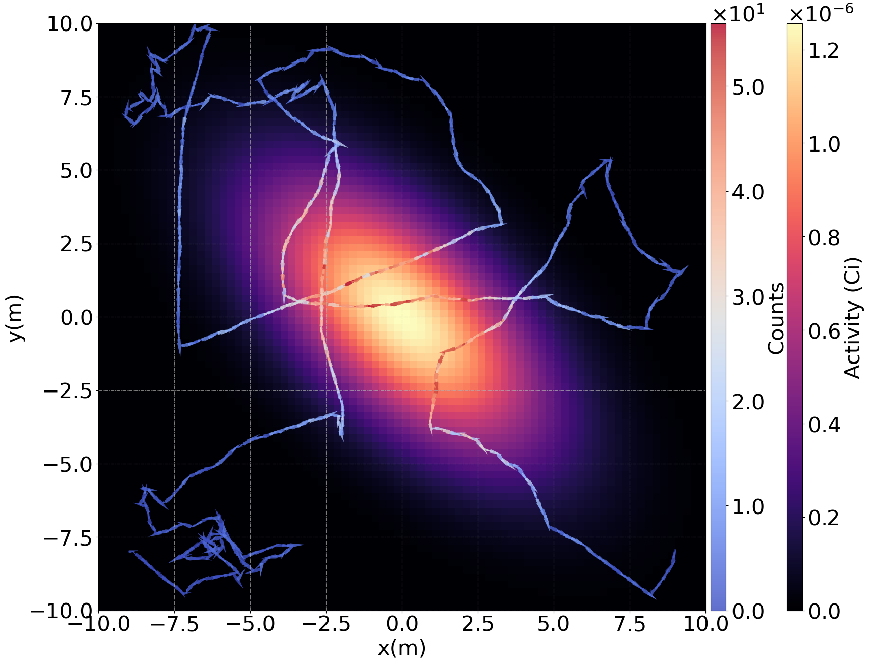
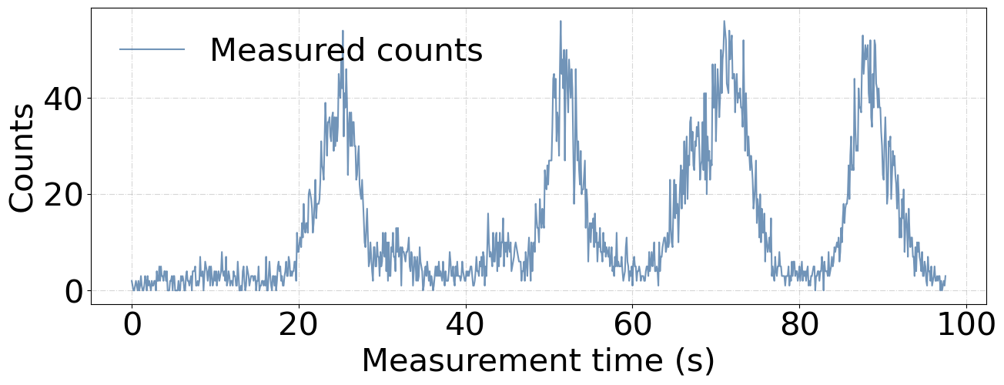
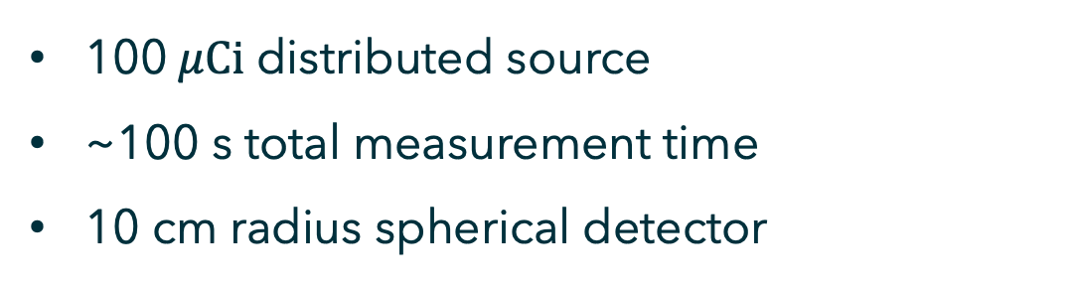
Single Detector Imaging - Introduction
100$μCi$ distributed source
~100 s total measurement time
10 cm radius spherical detector
Can we reconstruct the source image just by looking at the measurement?
Notes:
So here is a simulated example scenario. A point source of 10 microcurie is placed in the middle of the imaging space, and it is marked with red x. We assume a constant background of 50 cps, and the detector is moving around, and the moving path is drawn with arrows, starting from the bottom left corner. The integration time is 0.1 second per measurement, so each arrow represents 0.1 second of measurement. And the arrows are colored differently, depending on the number of counts we get from the source in the middle. The variance in count rate is also shown in the figure bottom right. Here the x axis is the measurement number, and y axis is the number counts in each measurement.
And although here we are showing only 2-d image, the simulation was full 3d, so that the simulated space is 10x10x10m 3d space, and only the projection onto the xy plane is shown here. .
For image reconstruction, ML-EM algorithm is often a popular choice, so we can use MLEM algorithm on this data,

Slide 8
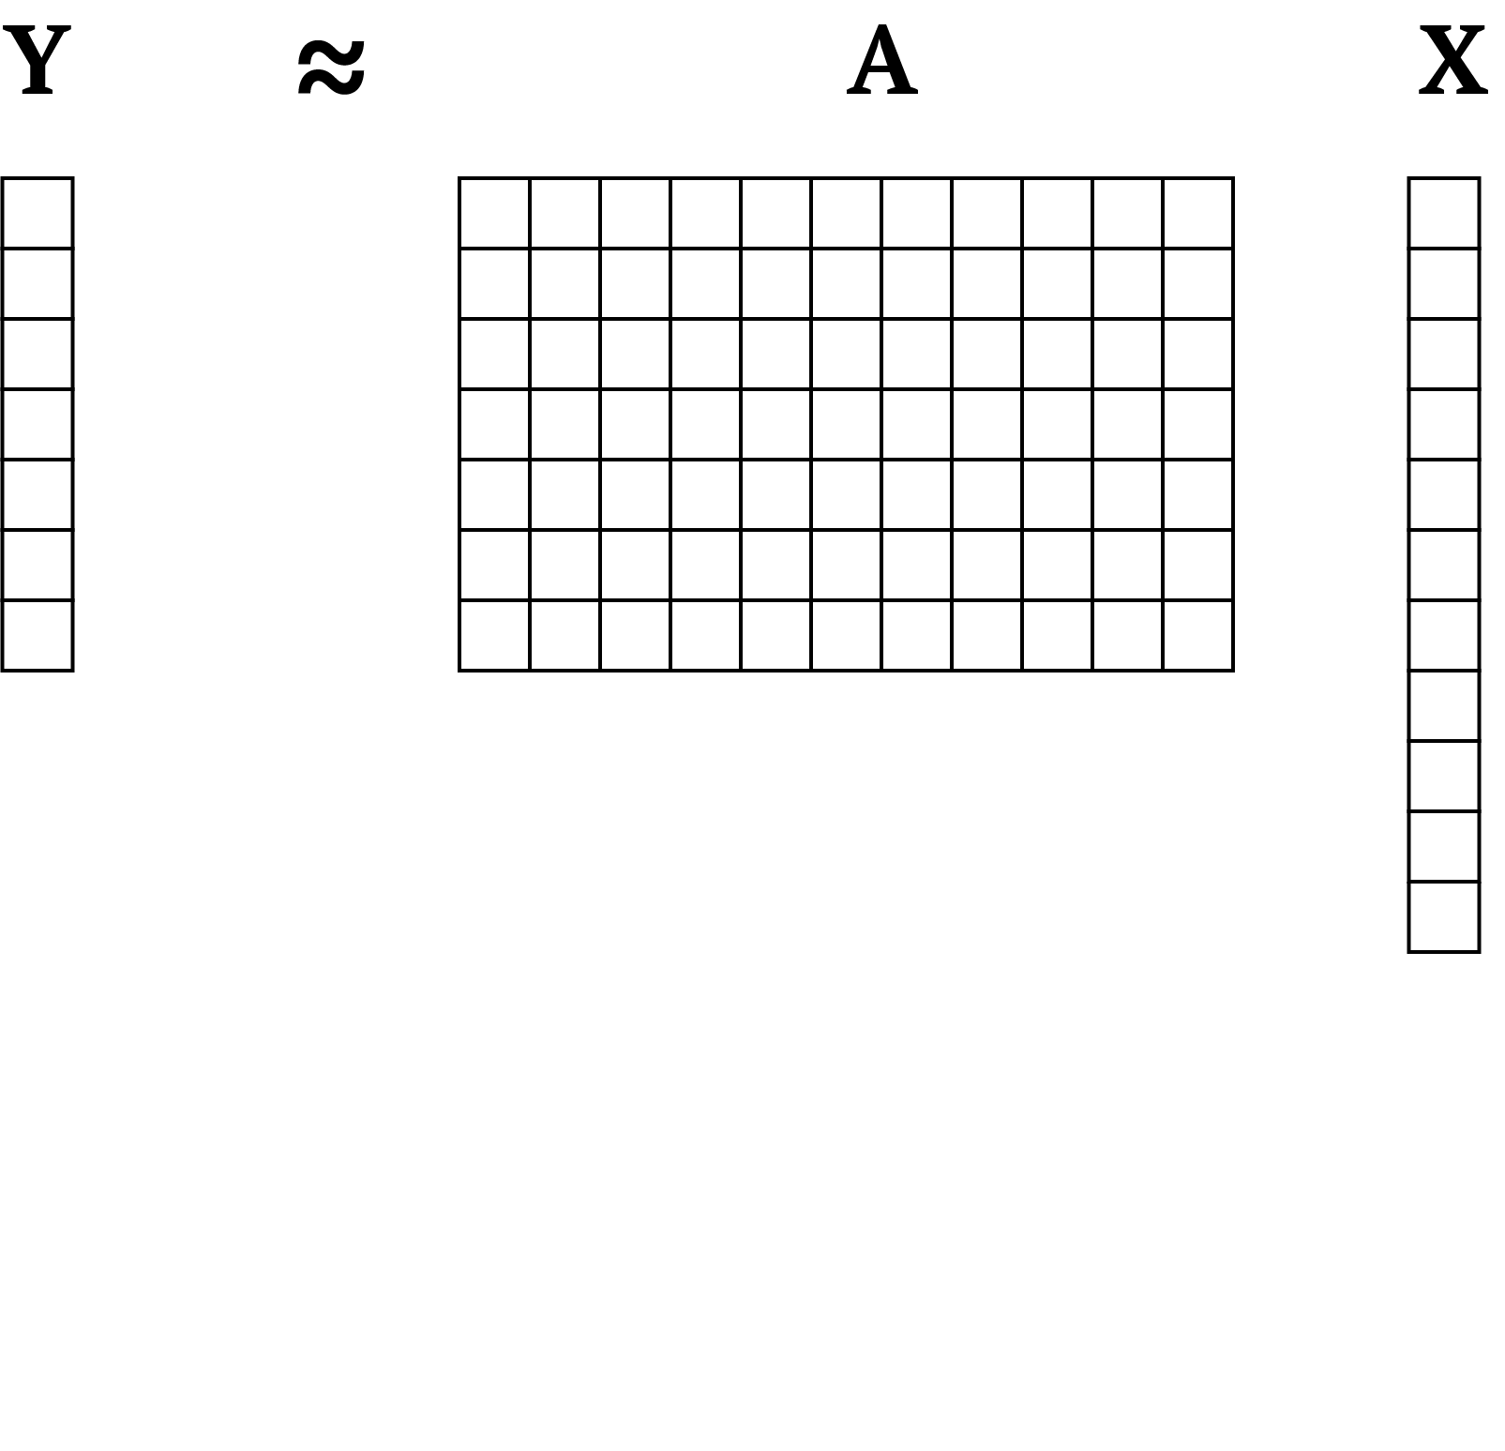
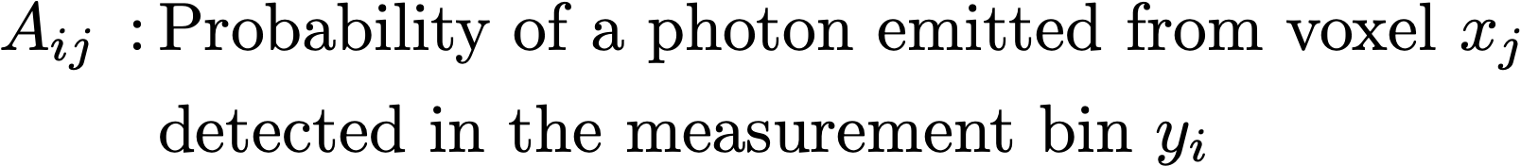
Single Detector Imaging - Introduction
Data vector
System matrix
Image vector

Slide 9
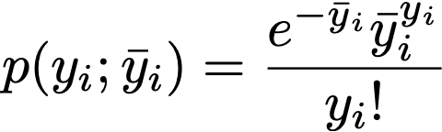
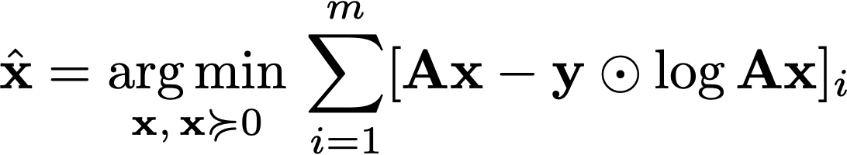
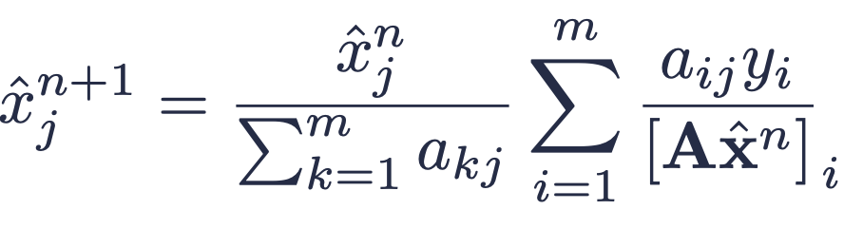
Single Detector Imaging - Introduction
Data vector
System matrix
Image vector
Maximum likelihood estimation (MLE) with the negative log-likelihood
Maximum likelihood — Expectation Maximization (ML-EM) algorithm update rule

Slide 10
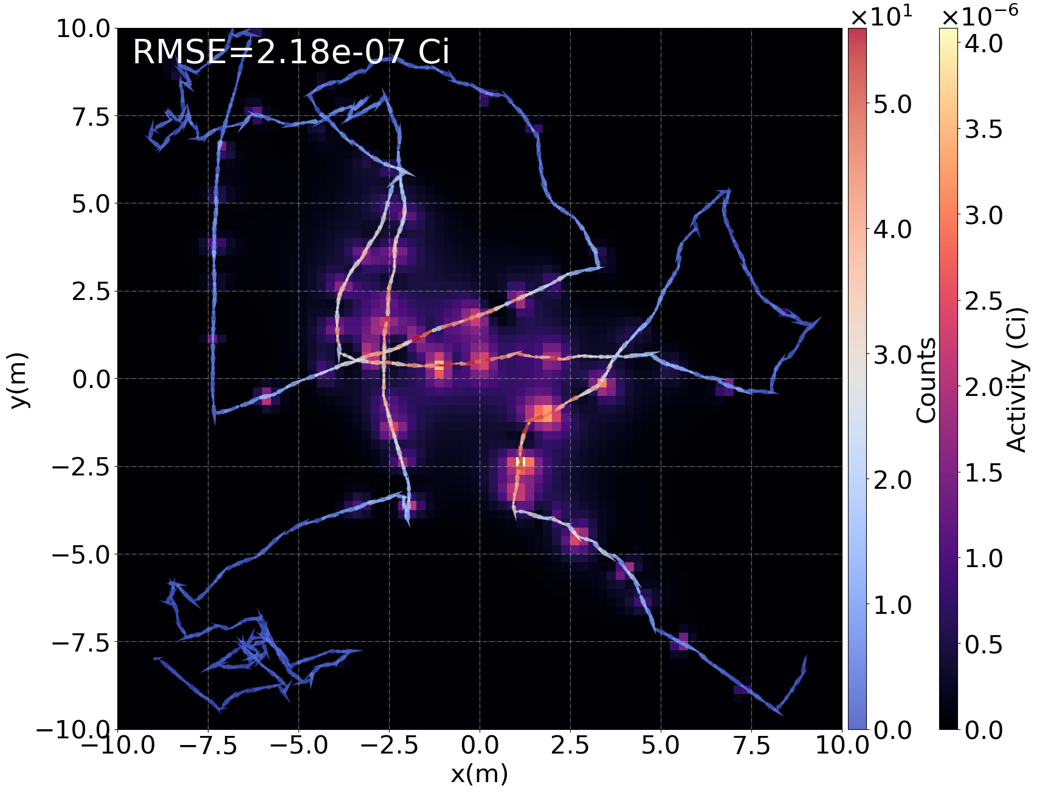
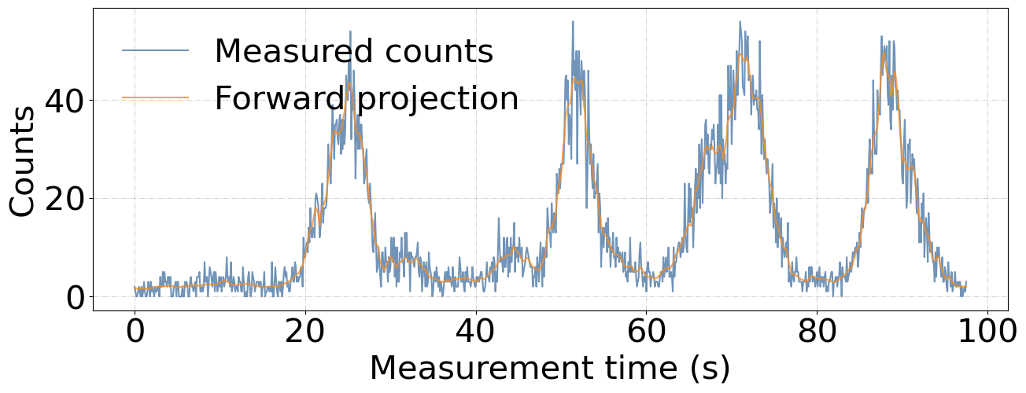
Failure of ML-EM
MLEM 200 iterations results.
A major failure!
Notes:
And this I the reconstructed image we get after 200 iterations of MLEM algorithm. As you can see, the mlem algorithm completely fails to localize the source. And interestingly, the mlem reconstruction prefers images with high voxel values close to the moving path. Also, as you can see in the forward projection plotted in orange in the figure bottom right, there is some signs of the forward projection overfitting to the data.

Slide 11
Gaussian Process Prior (GPP)
Image Reconstruction

Slide 12
Gaussian Process Prior - Introduction
Image pixels are not independent!
Pixels close to each other are more correlated than pixels afar.

Slide 13
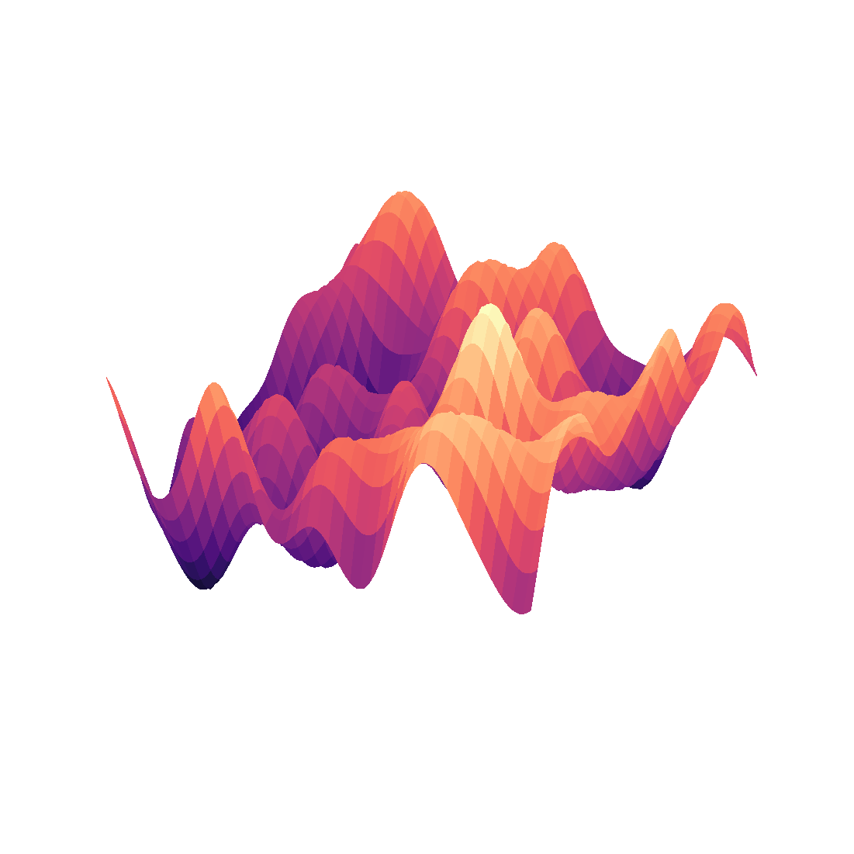
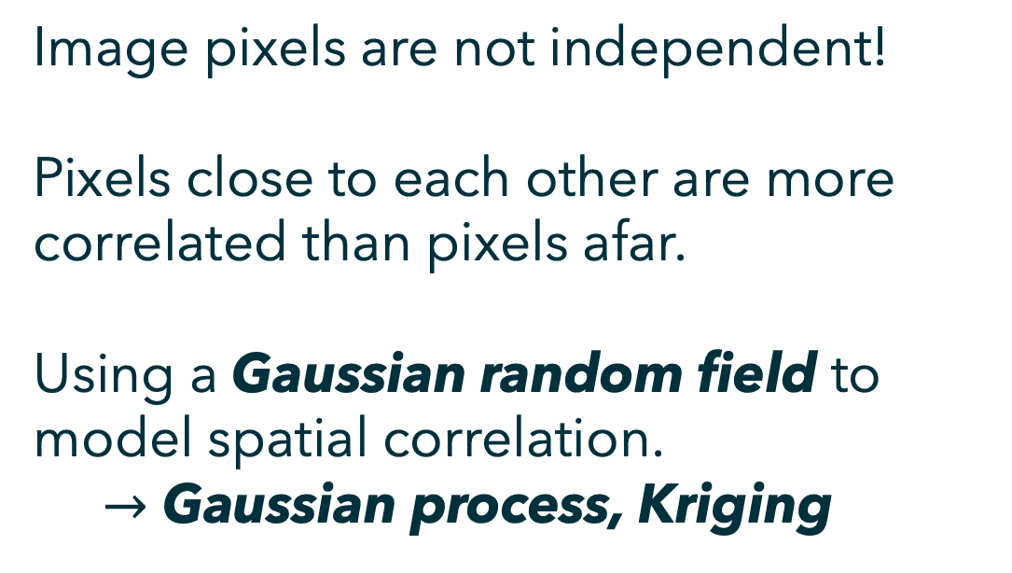
Gaussian Process Prior - Introduction
Image pixels are not independent!
Pixels close to each other are more correlated than pixels afar.
Using a Gaussian random field to model spatial correlation.
$→$ Gaussian process, Kriging
A Gaussian random field with local correlation

Slide 14
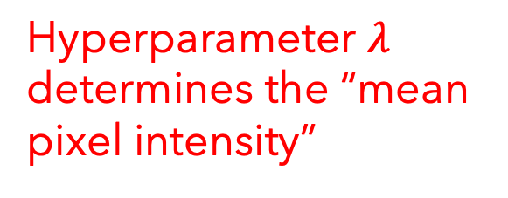
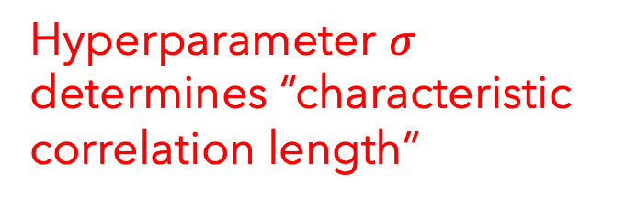
Constructing a Gaussian Process Prior
Image vector is governed by a zero-mean multivariate Gaussian distribution
Hyperparameter $σ$ determines “characteristic correlation length”
Squared exponential kernel
Hyperparameter $λ$ determines the “mean pixel intensity”
Gaussian-to-exponential link function

Slide 15
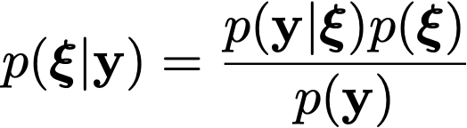
Constructing a Gaussian Process Prior
Image vector is governed by a zero-mean multivariate Gaussian distribution
Bayes’ rule in terms of the underlying variable $ξ.$
Prior distribution
Maximum a posteriori (MAP) formulation

Slide 16
Gaussian Process Prior — Results
Ground truth

Slide 17
Gaussian Process Prior — Results
MLEM reconstruction
200 iterations
Ground truth

Slide 18
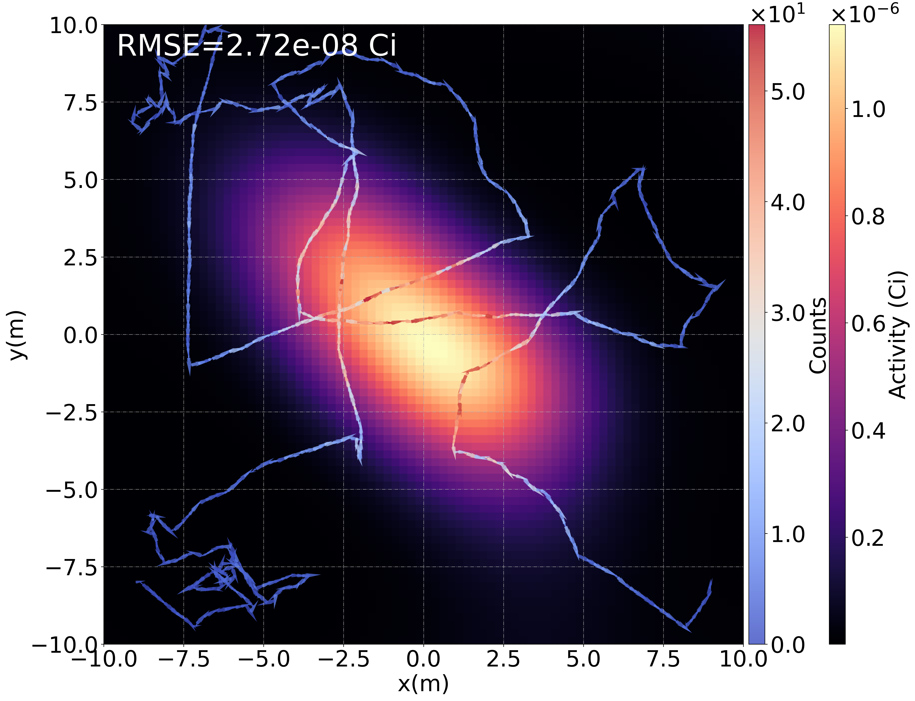
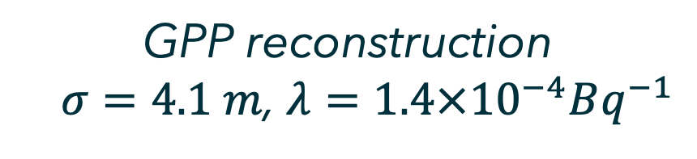
Gaussian Process Prior — Results
GPP reconstruction
$σ=4.1 m$, $λ={1.4×10}^{−4}Bq^{−1}$
Ground truth

Slide 19
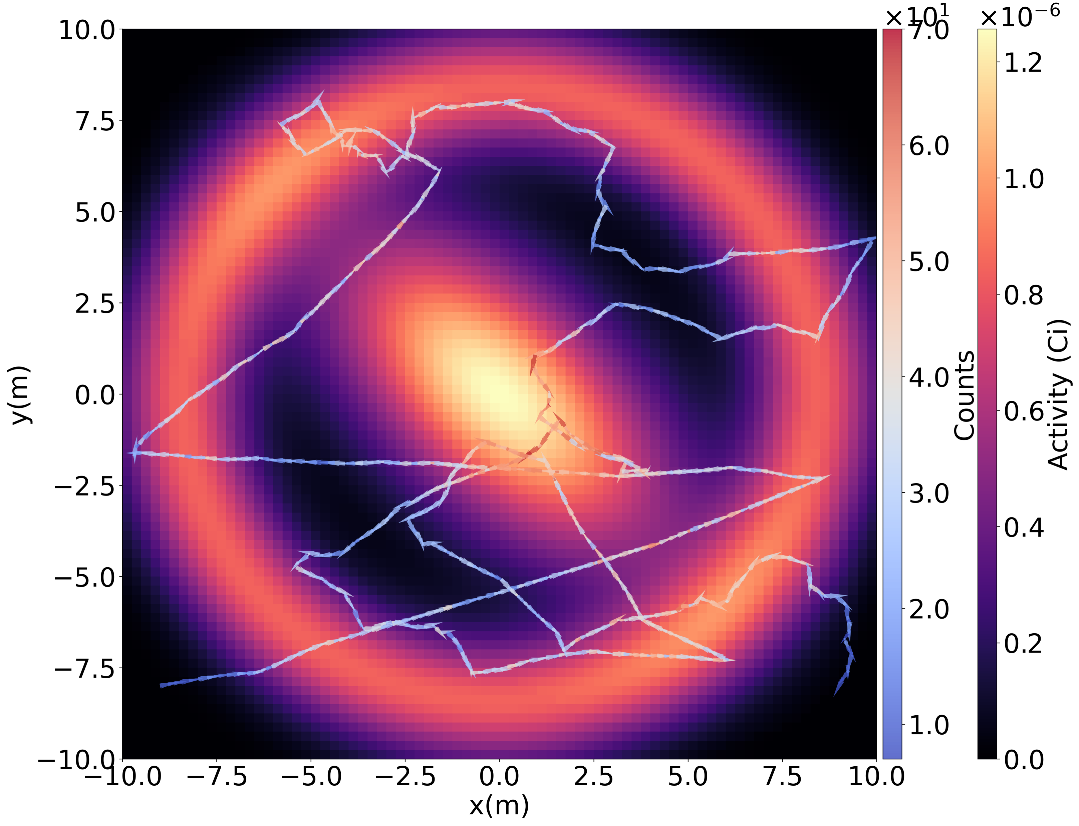
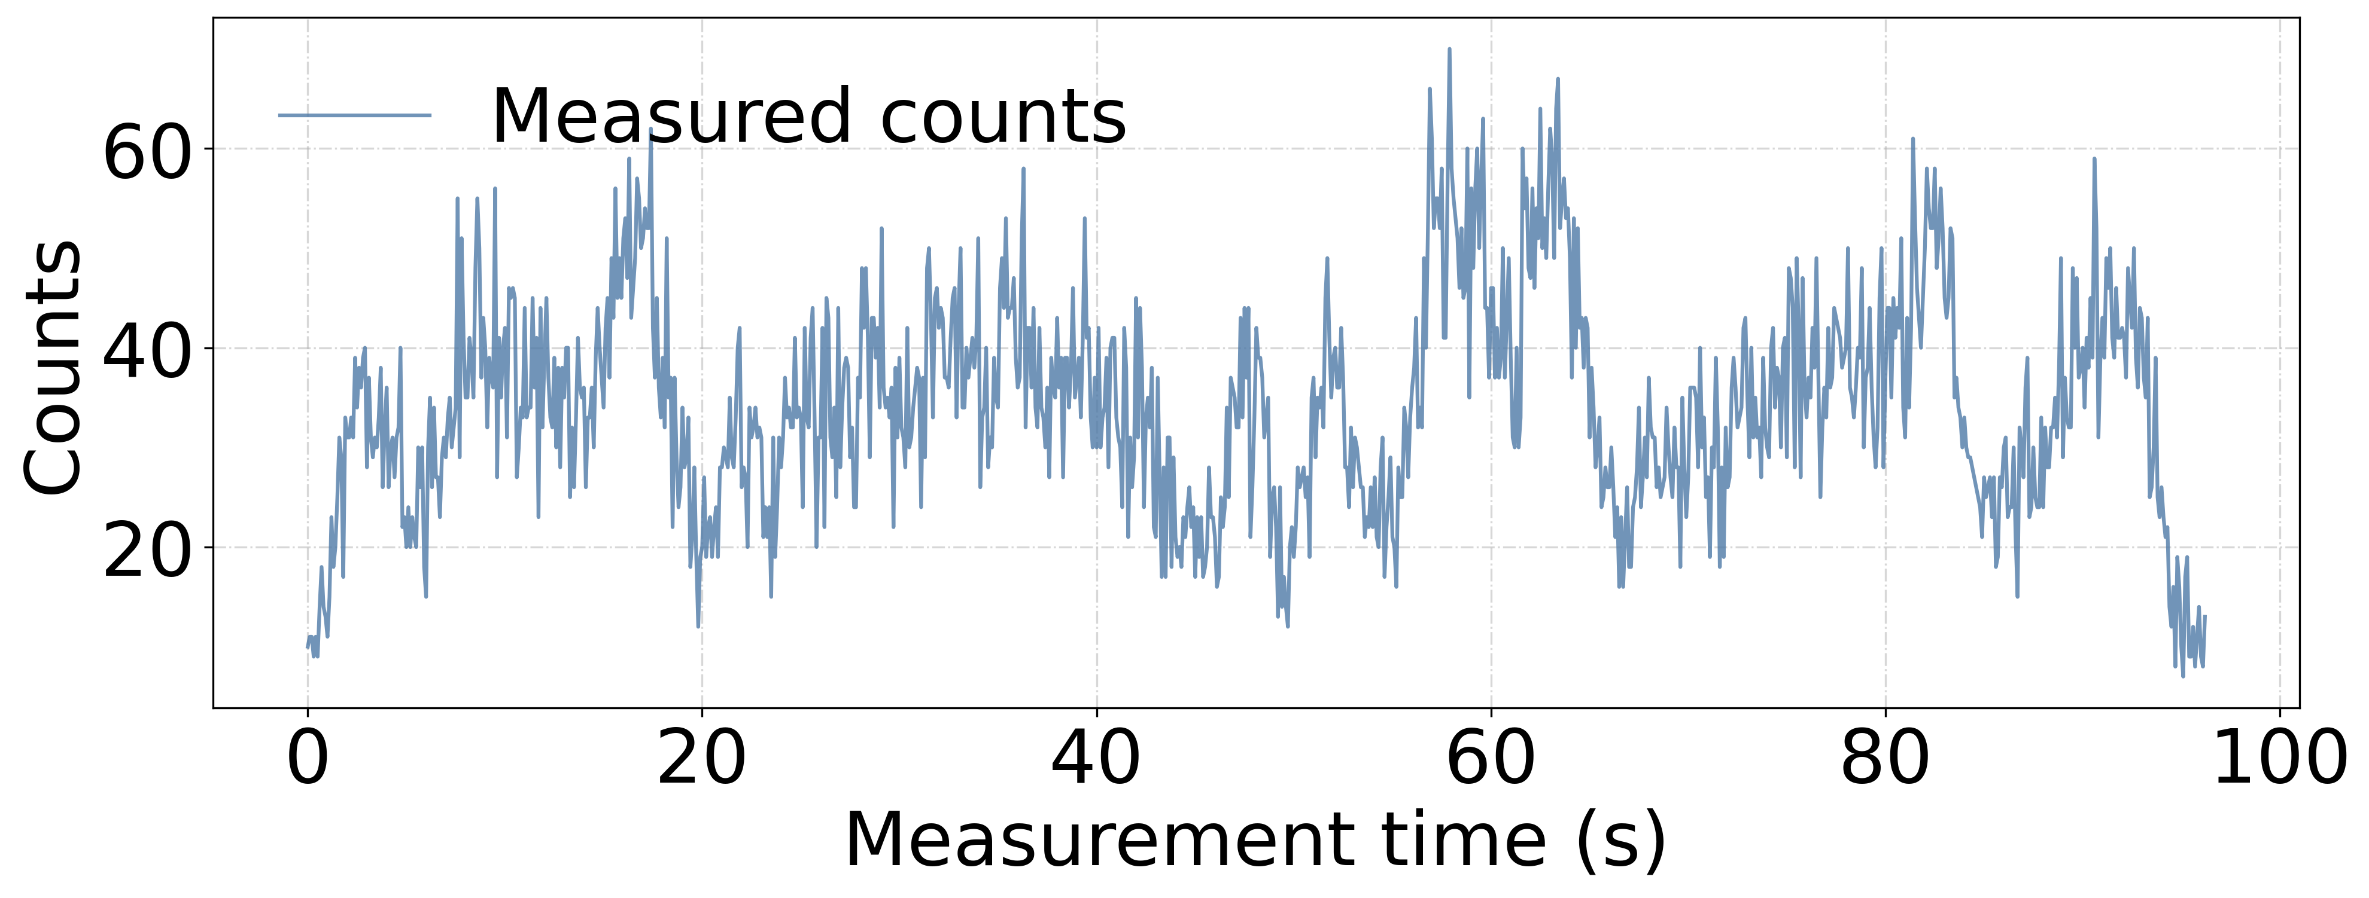

Gaussian Process Prior — Results
300$μCi$ distributed source
Ground truth

Slide 20
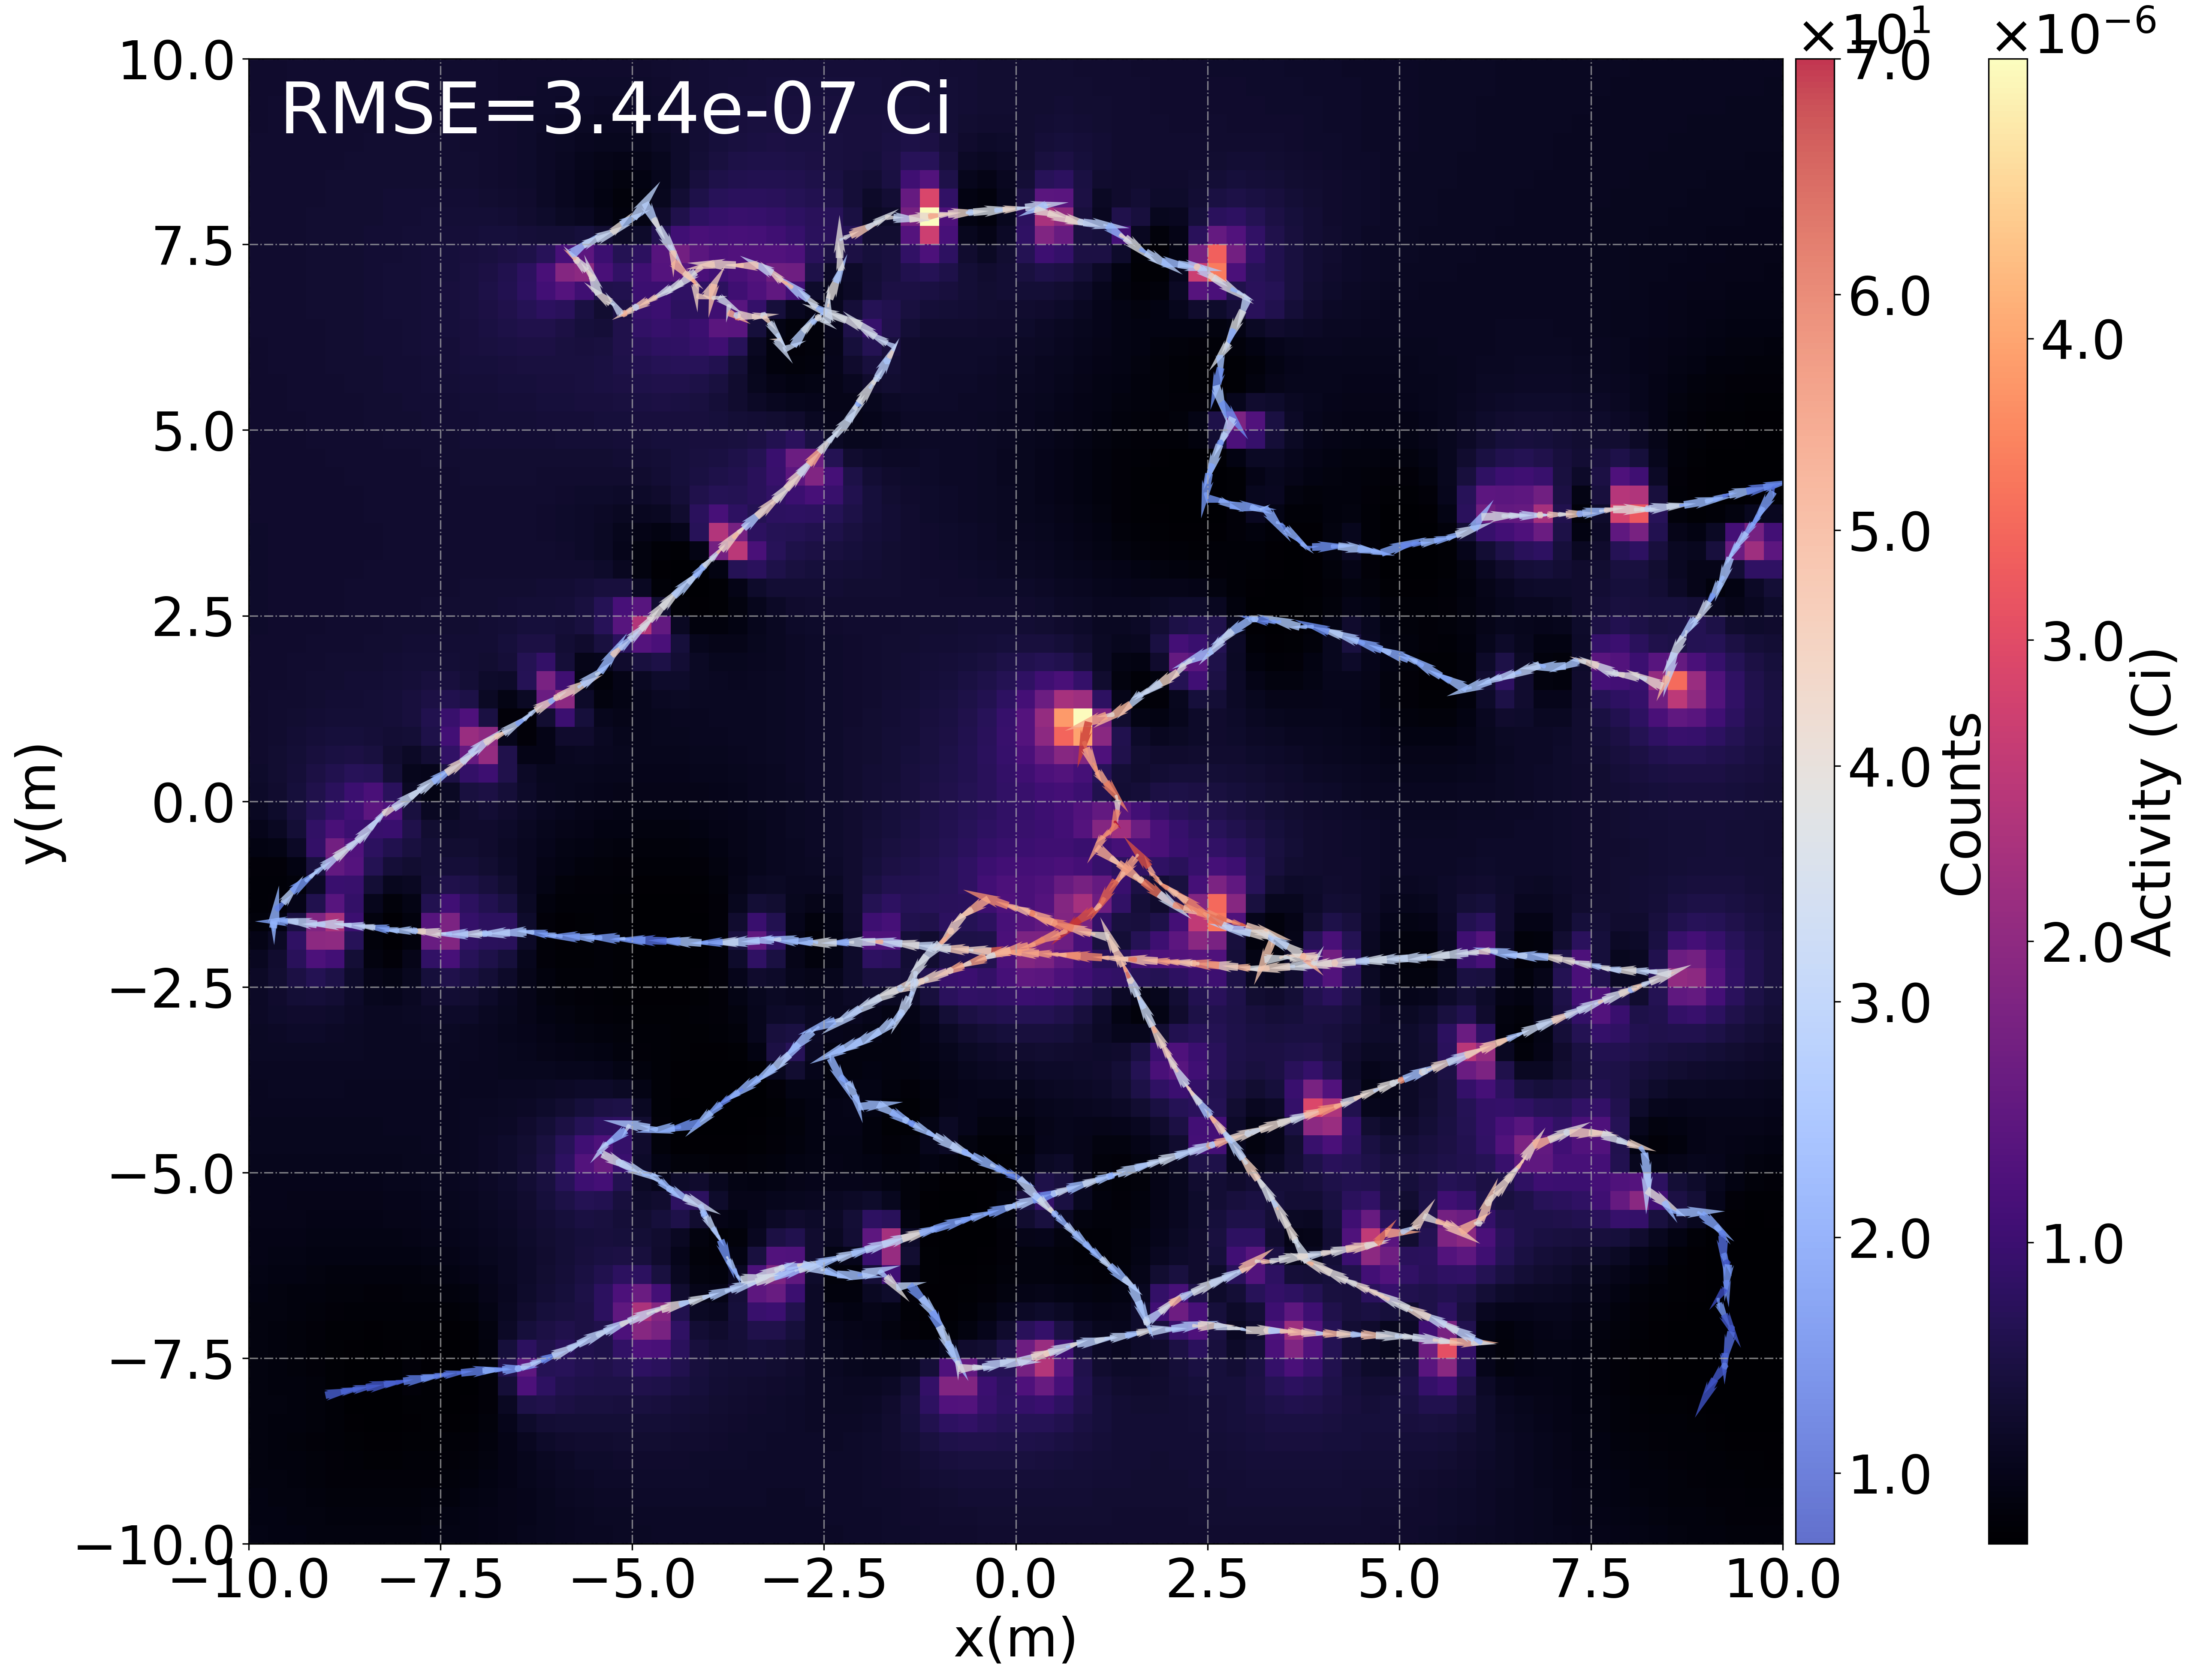
Gaussian Process Prior — Results
Ground truth
MLEM reconstruction
200 iterations

Slide 21
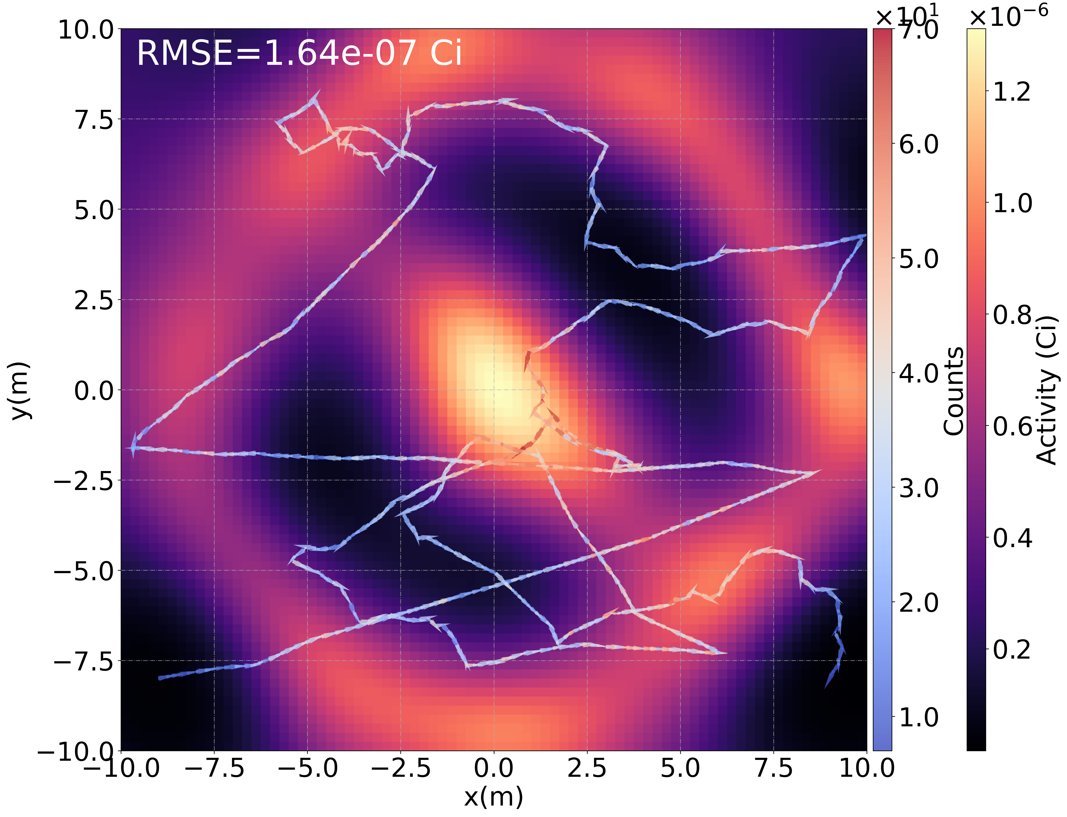
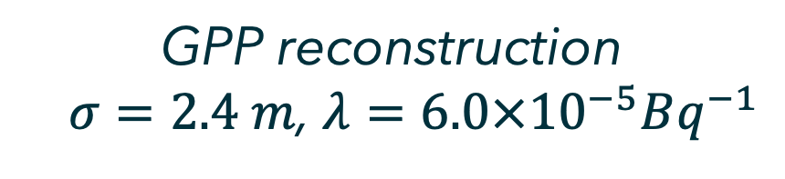
Gaussian Process Prior — Results
How much can we trust this image reconstruction?
Ground truth
GPP reconstruction
$σ=2.4 m$, $λ={6.0×10}^{−5}Bq^{−1}$

Slide 22
Bayesian Uncertainty Quantification

Slide 23
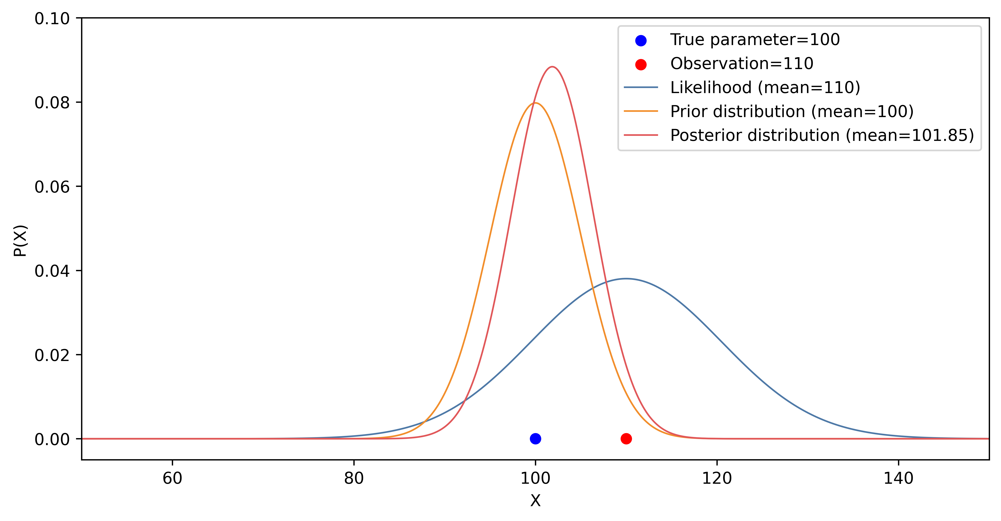
Uncertainty — Bayesian Credible Interval
Prior distribution
Bayes’ rule
Posterior distribution
Likelihood
Notes:
Showing the Bayesian form of posterior

Slide 24
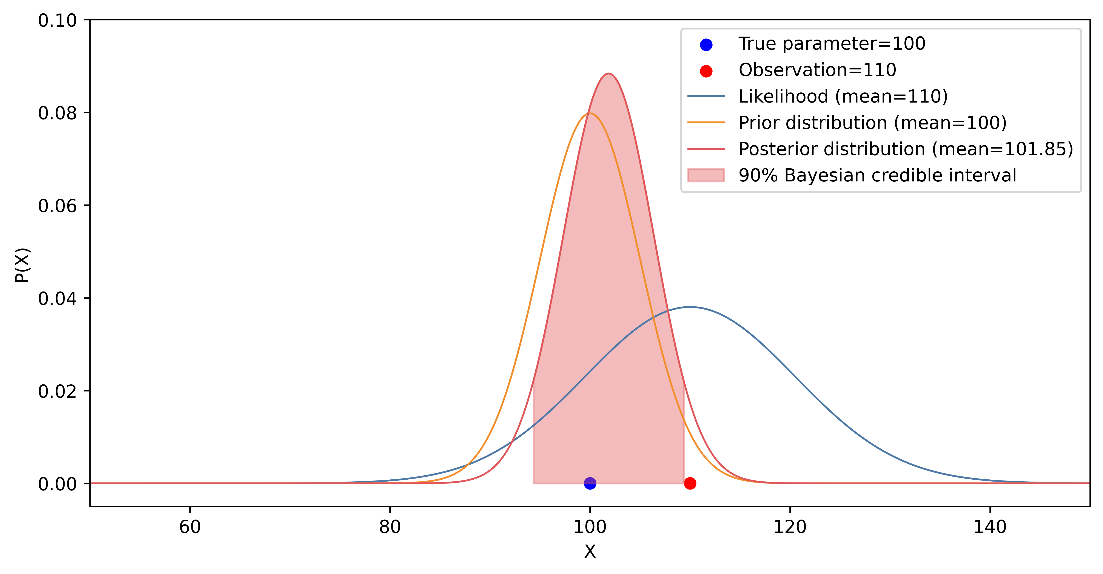
Uncertainty — Bayesian Credible Interval
In Bayesian statistics, credible intervals are often quoted to represent uncertainties.
Notes:
Showing the Bayesian form of posterior

Slide 25
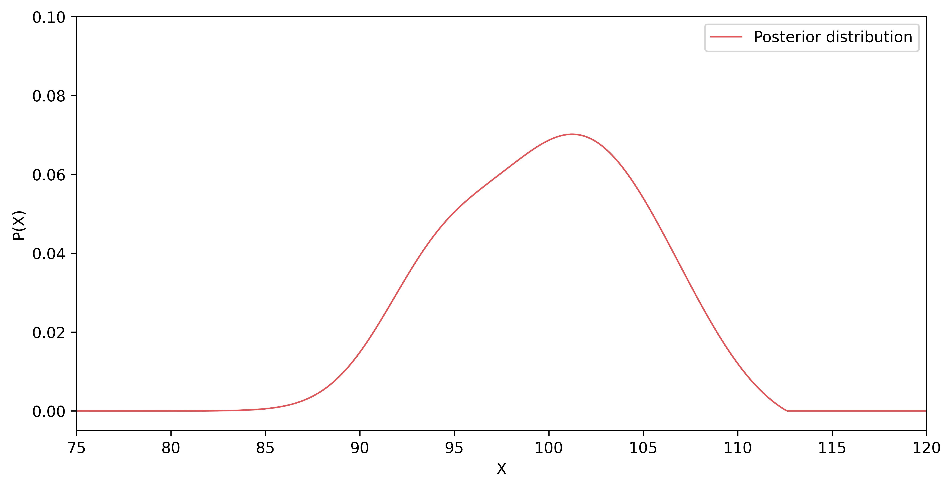
Uncertainty — Bayesian Credible Interval
How can we find the credible interval, when the posterior is not analytically available?
Notes:
Showing the Bayesian form of posterior

Slide 26
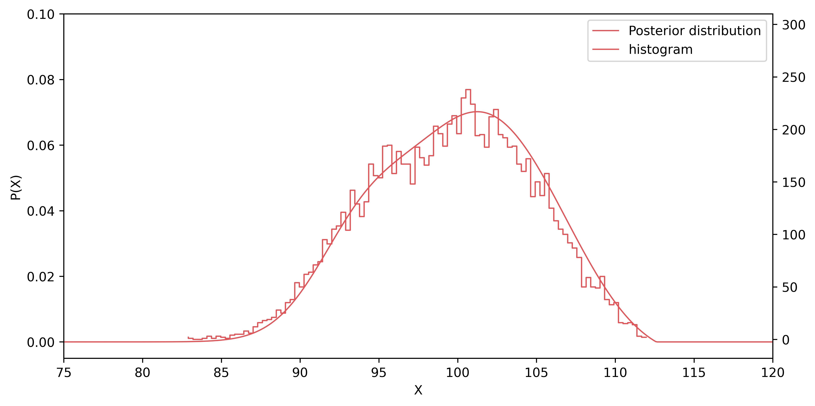
Uncertainty — Bayesian Credible Interval
How can we find the credible interval, when the posterior is not analytically available? : Collect samples.
Notes:
MCMC

Slide 27
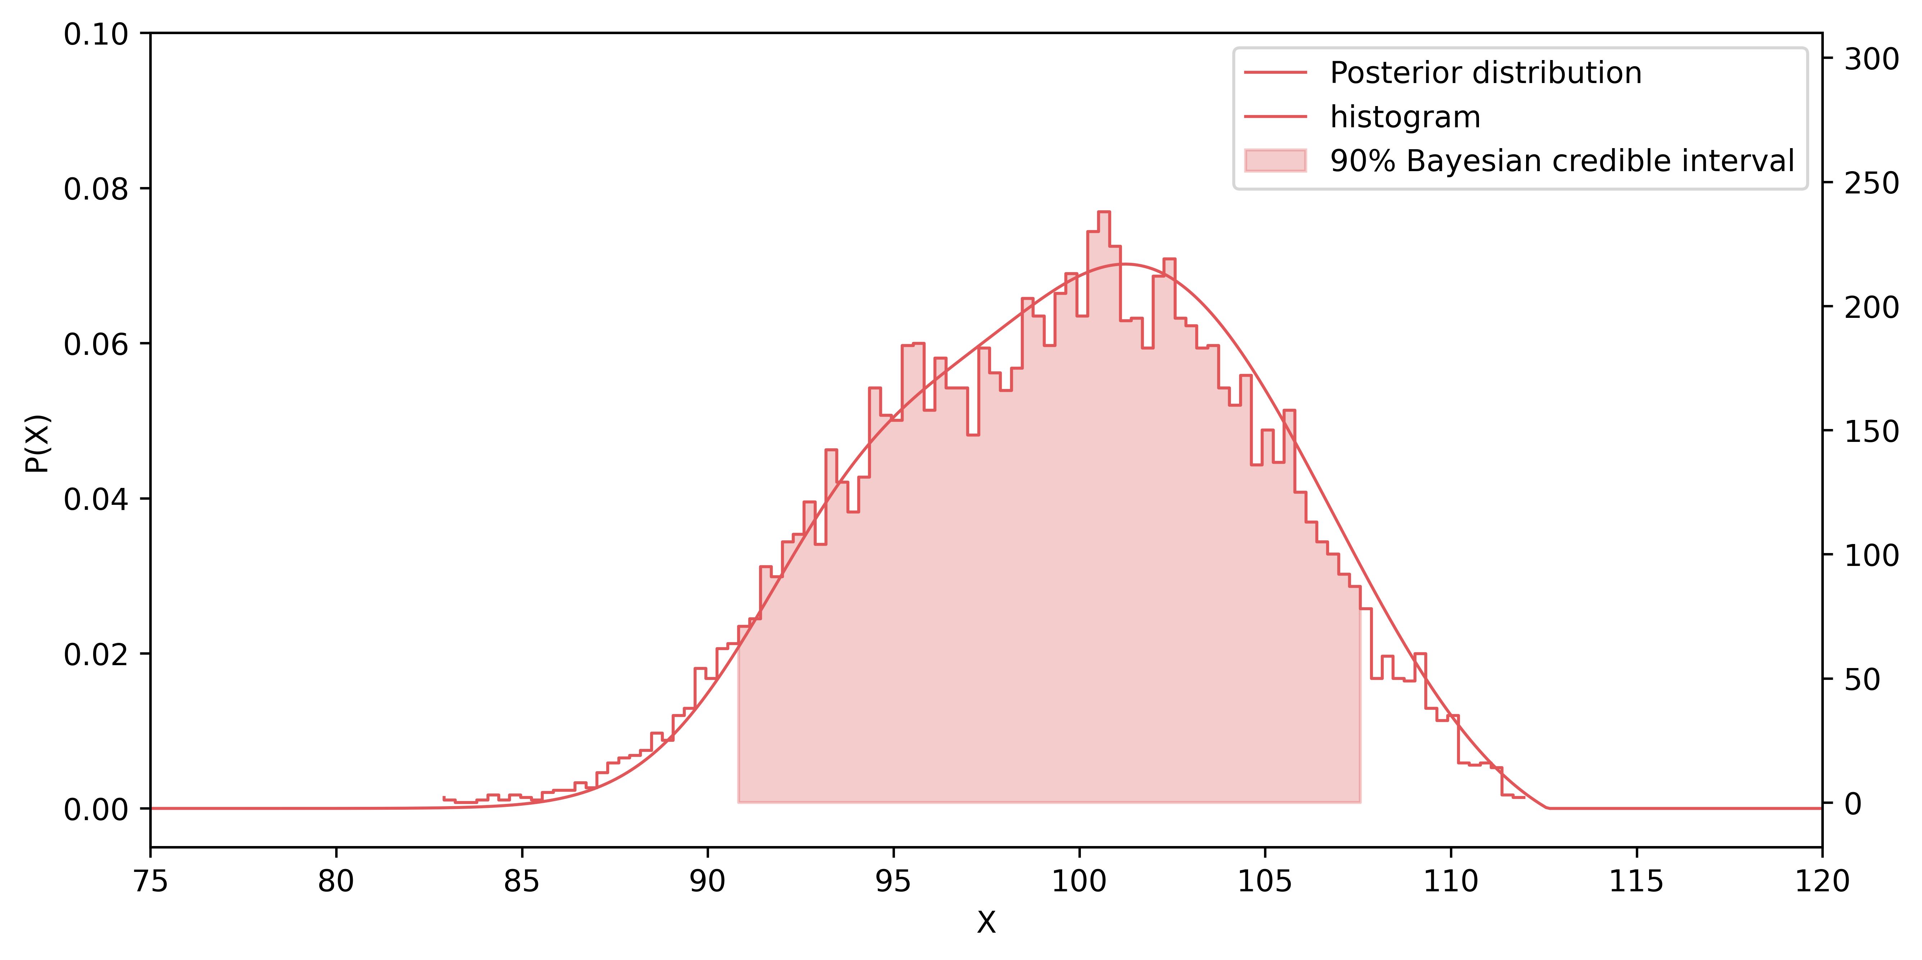
Uncertainty — Bayesian Credible Interval
How can we find the credible interval, when the posterior is not analytically available? : Collect samples.
Notes:
MCMC

Slide 28
Uncertainty — Bayesian Credible Interval
Posterior from the GPP algorithm :
Markov Chain Monte Carlo (MCMC) to sample from the intractable posterior
Notes:
MCMC

Slide 29
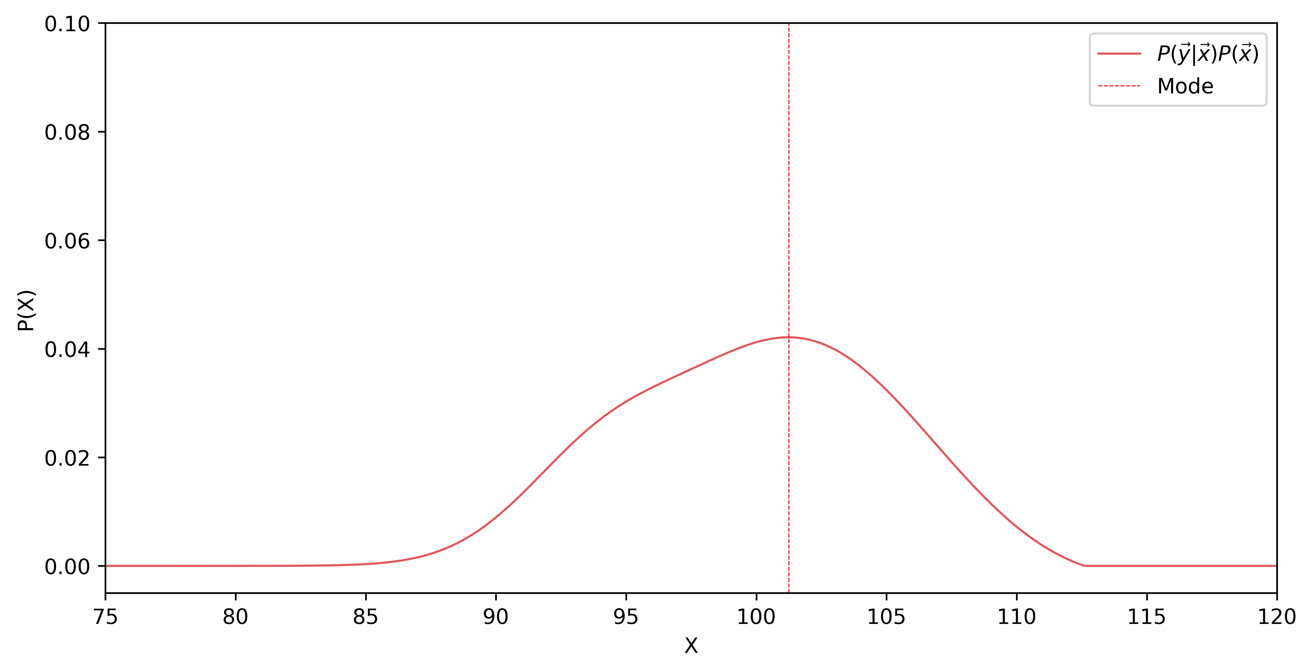
Laplace Approximation
Instead of sampling the posterior, we approximate the posterior
Notes:
Laplace approximation

Slide 30
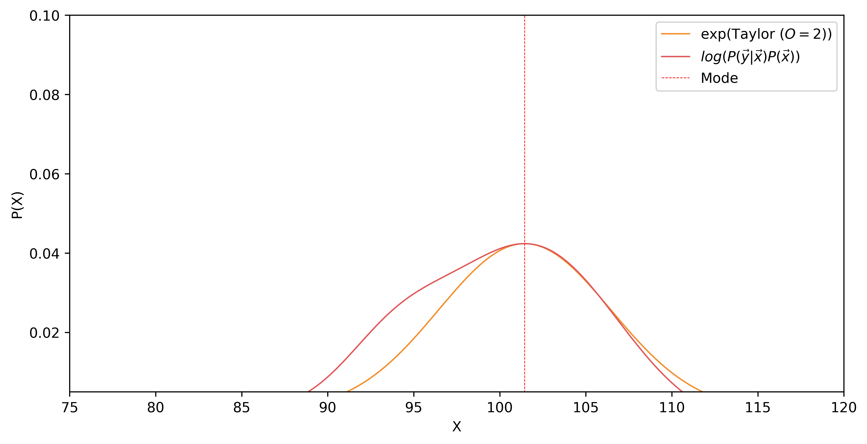
Laplace Approximation
Approximate the posterior with a multivariate Gaussian distribution
Notes:
Comparison between pcn mcmc and laplace’s approximation

Slide 31
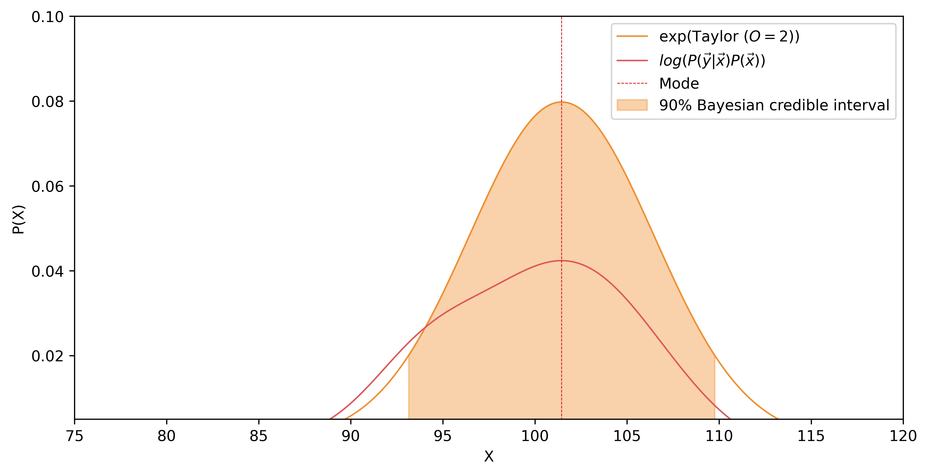
Laplace Approximation
Notes:
Some more figures

Slide 32
Bayesian UQ Can Be Done in Two Ways…
1. Sampling method
Slow, but more accurate
— Preconditioned Crank-Nicolson Markov Chain Monte Carlo (pCN MCMC)
2. Approximation method
Fast, but less accurate
— Laplace approximation
Notes:
Some more figures

Slide 33
pCN MCMC Uncertainty Quantification
GPP reconstruction
$σ=4.1 m$, $λ={1.4×10}^{−4}Bq^{−1}$
Ground truth
Notes:
Laplace approximation

Slide 34
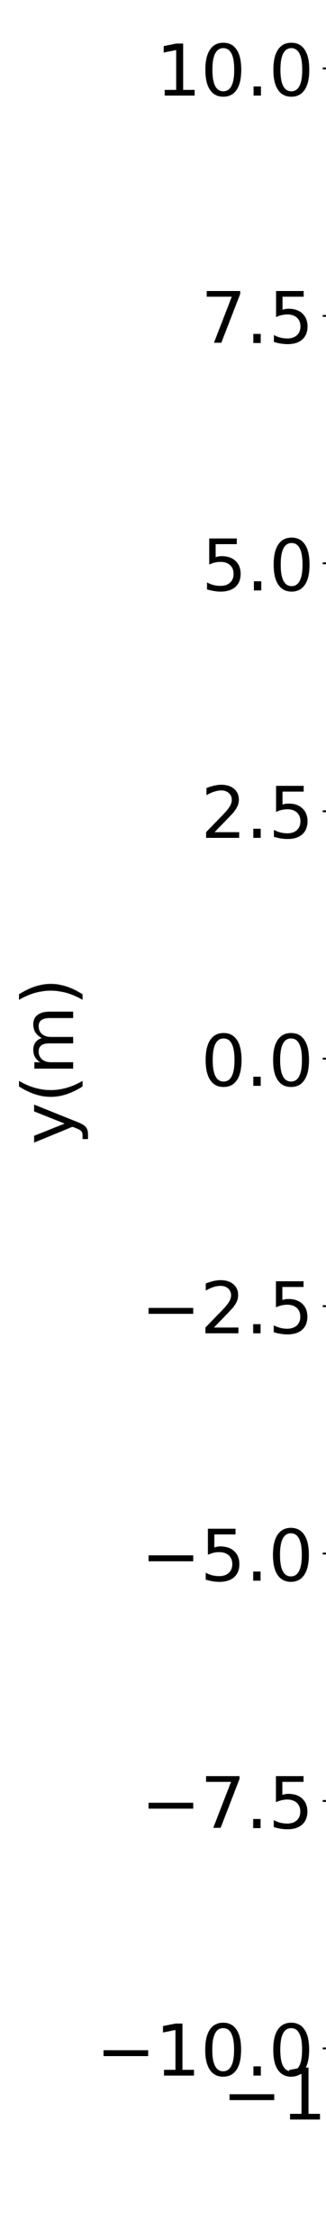
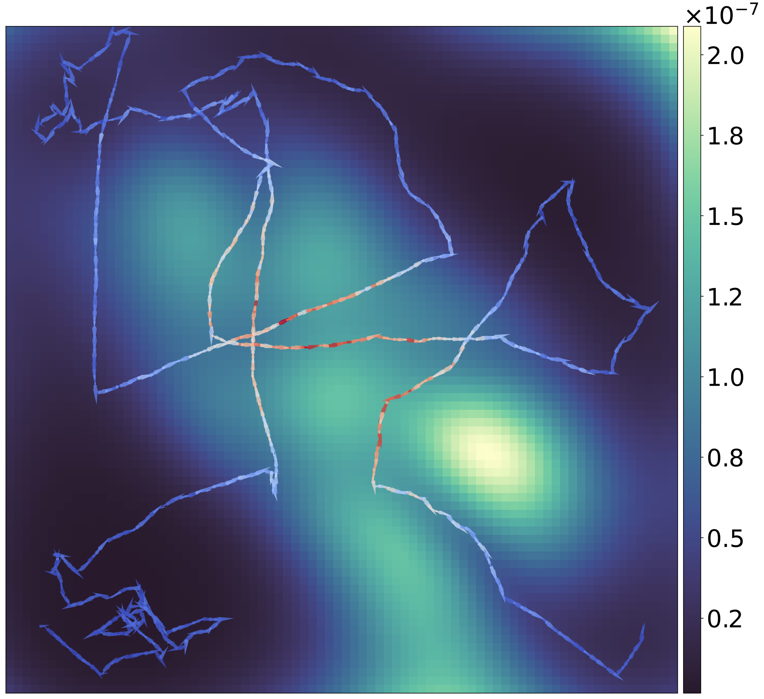

pCN MCMC Uncertainty Quantification
High uncertainties in the “unexplored regions”
High uncertainties around the source and low uncertainties along the path
90% Bayesian credible interval
(pCN MCMC, 10⁶ samples, ~45 min)
GPP reconstruction
$σ=4.1 m$, $λ={1.4×10}^{−4}Bq^{−1}$
Notes:
Laplace approximation

Slide 35
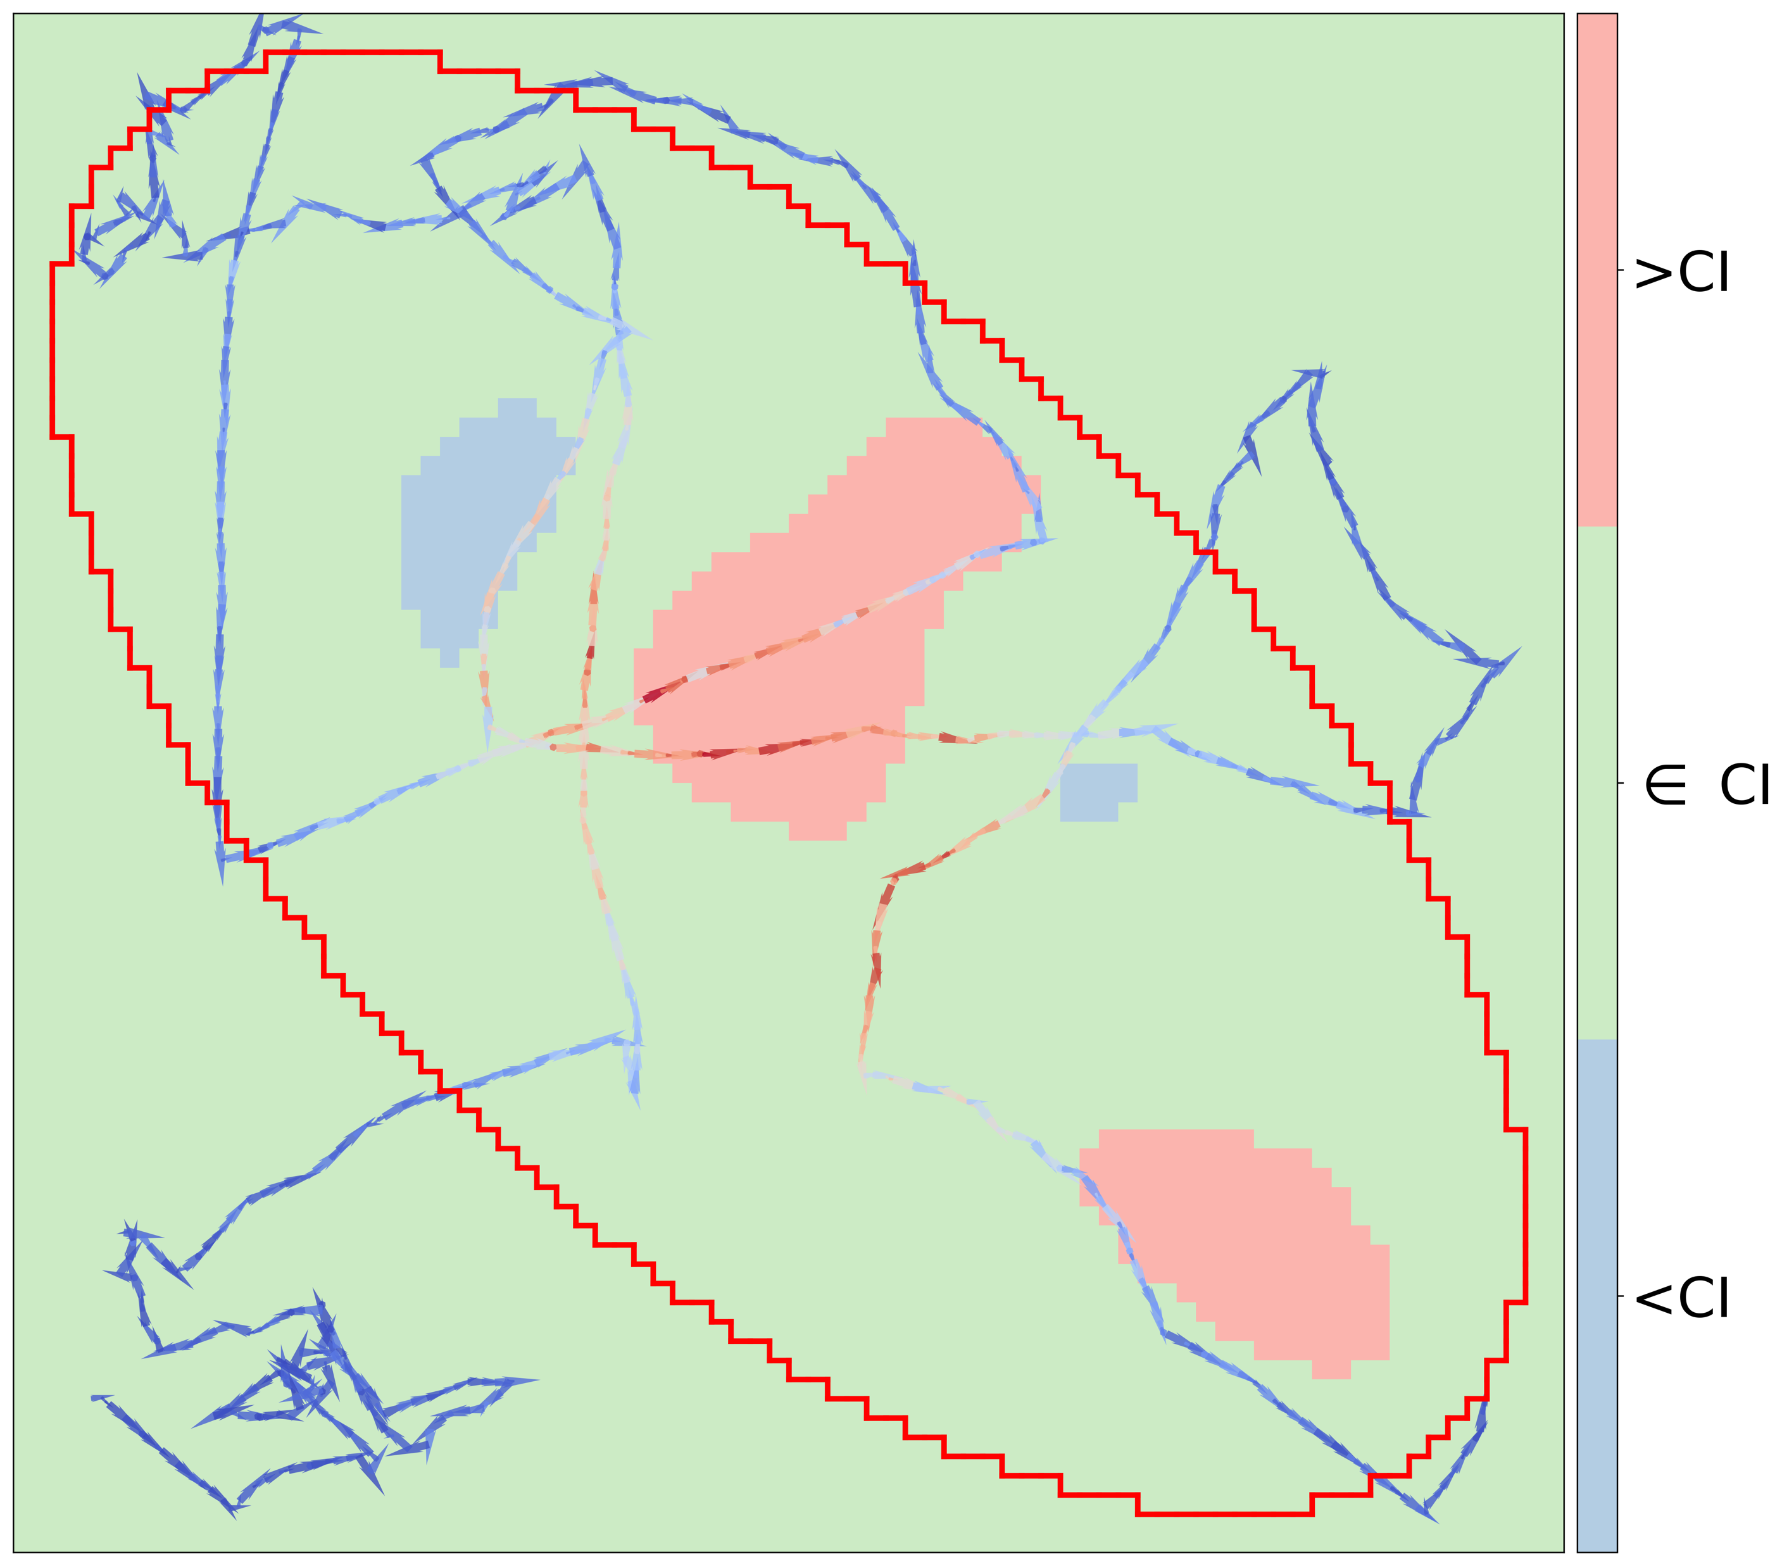
pCN MCMC Uncertainty Quantification
Non-zero true source activities inside the red boundary (ROI)
Boolean map (pCN MCMC ~45 min)
Red : True value above the interval
Green : True value within the interval
Blue : True value below the interval
GPP reconstruction
$σ=4.1 m$, $λ={1.4×10}^{−4}Bq^{−1}$
Notes:
Laplace approximation

Slide 36
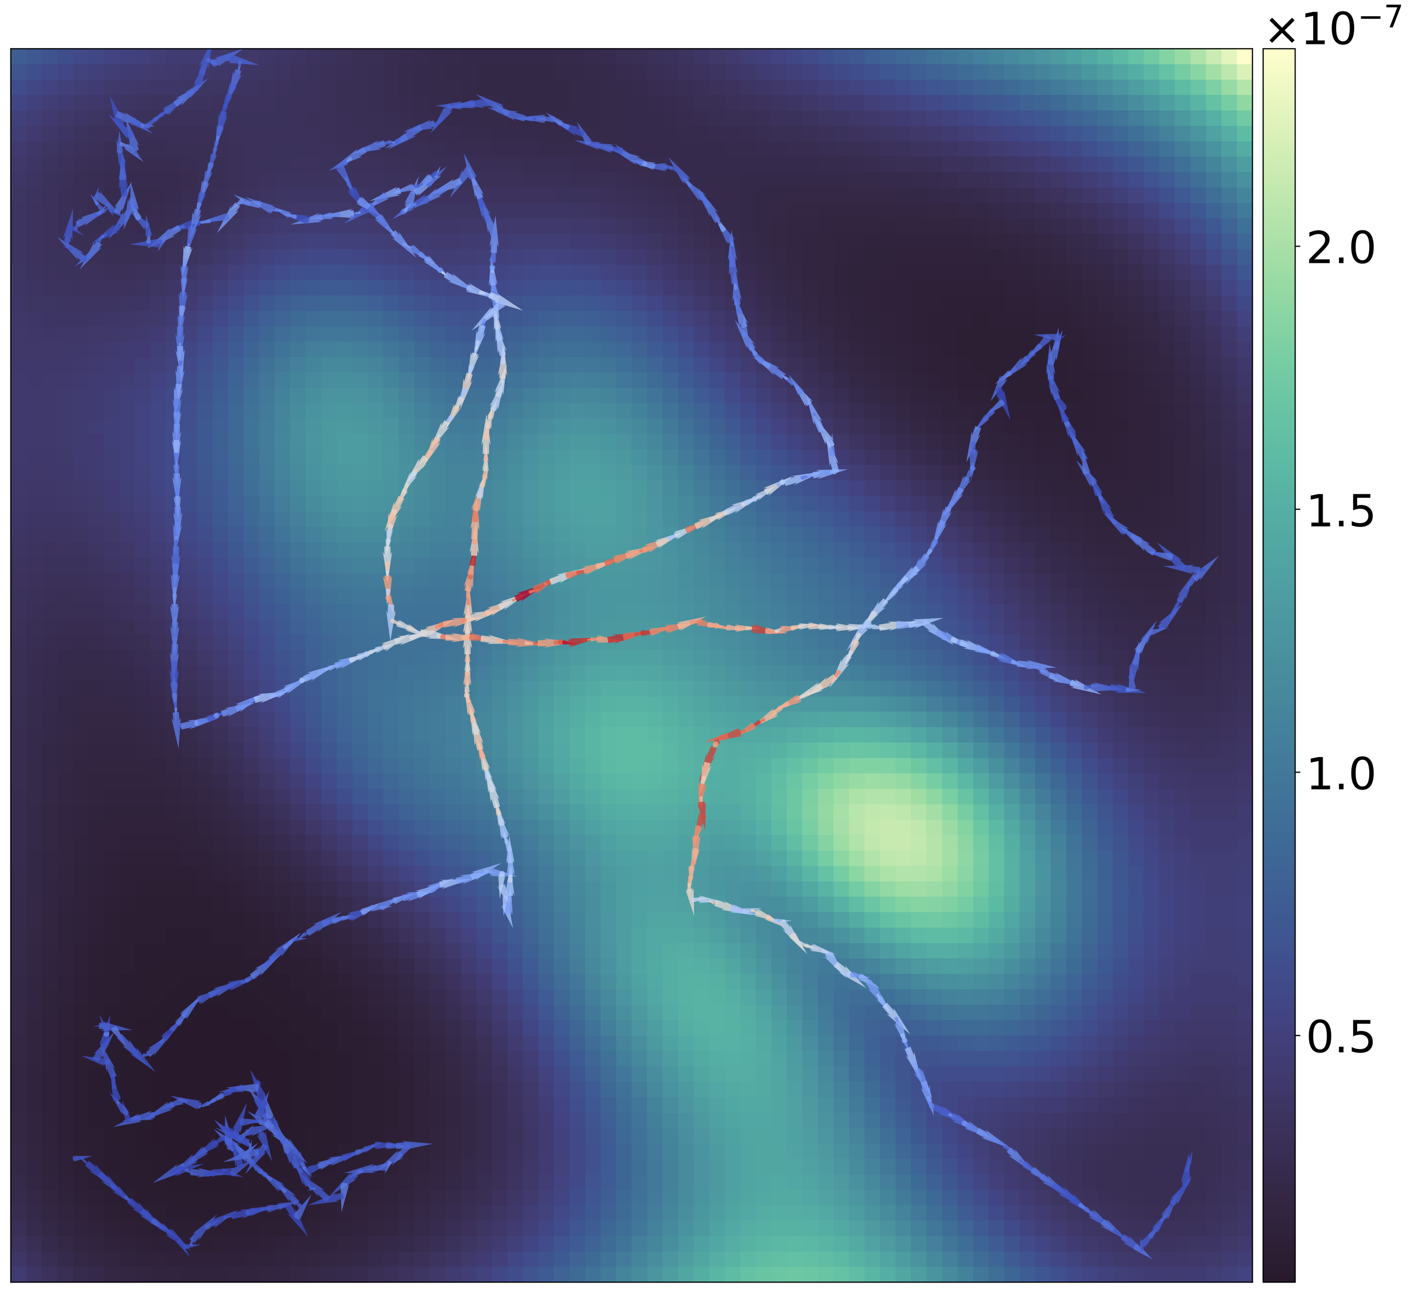
Laplace Approximation Uncertainty Quantification
90% Bayesian credible interval
(Laplace approx., ~0.5 s)
GPP reconstruction
$σ=4.1 m$, $λ={1.4×10}^{−4}Bq^{−1}$
Notes:
Laplace approximation

Slide 37
Laplace Approximation Uncertainty Quantification
90% Bayesian credible interval
(Laplace approx., ~0.5 s)
90% Bayesian credible interval
(pCN MCMC, 10⁶ samples, ~45 min)
Notes:
Laplace approximation

Slide 38
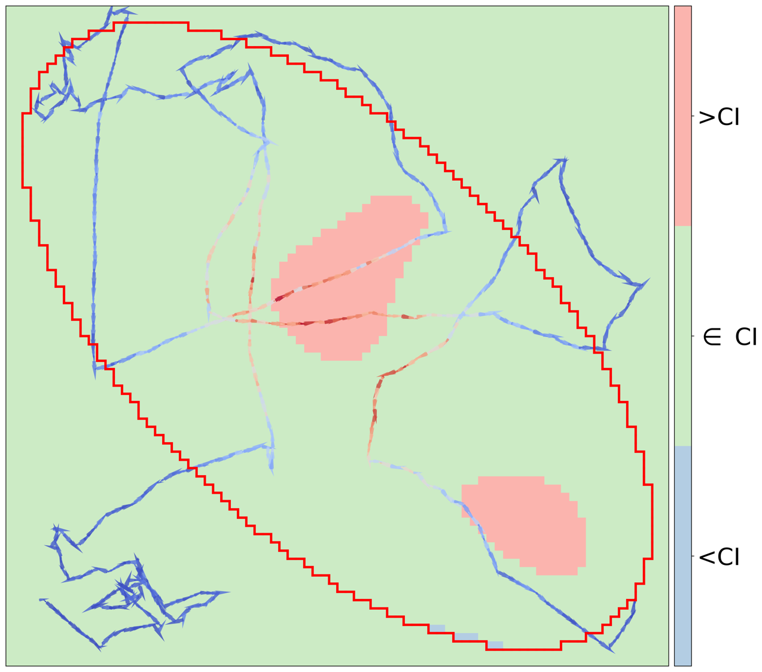
Laplace Approximation Uncertainty Quantification
Boolean map (Laplace approx. ~0.5 s)
Red : True value above the interval
Green : True value within the interval
Blue : True value below the interval
Boolean map (pCN MCMC ~45 min)
Red : True value above the interval
Green : True value within the interval
Blue : True value below the interval
Notes:
Laplace approximation

Slide 39
Laplace Approximation Uncertainty Quantification
Ground truth
GPP reconstruction
$σ=2.4 m$, $λ={6.0×10}^{−5}Bq^{−1}$

Slide 40
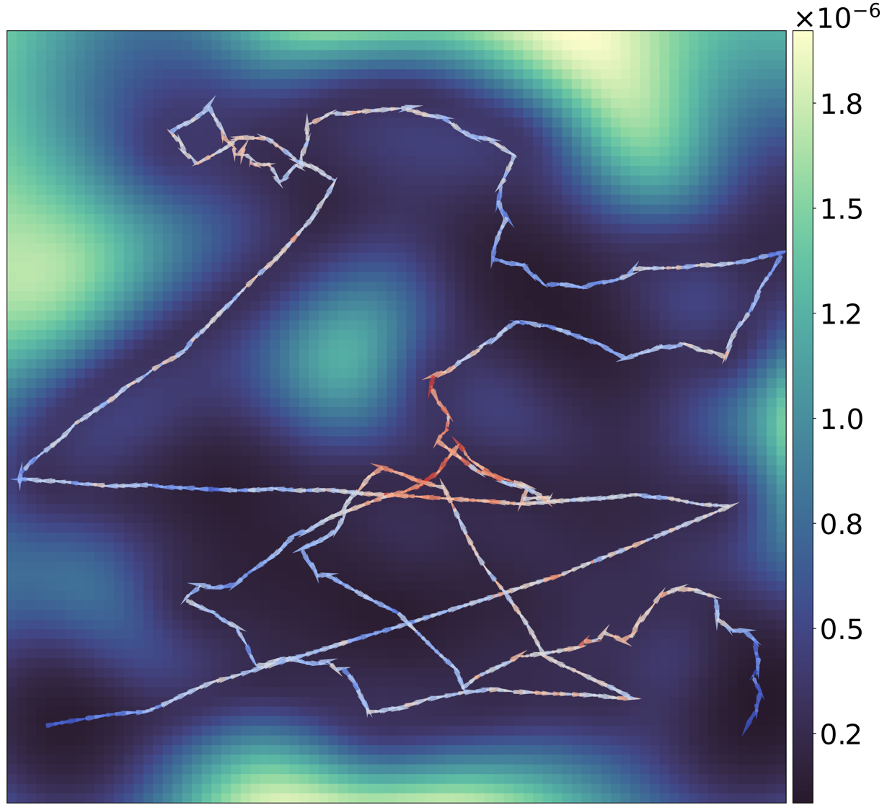
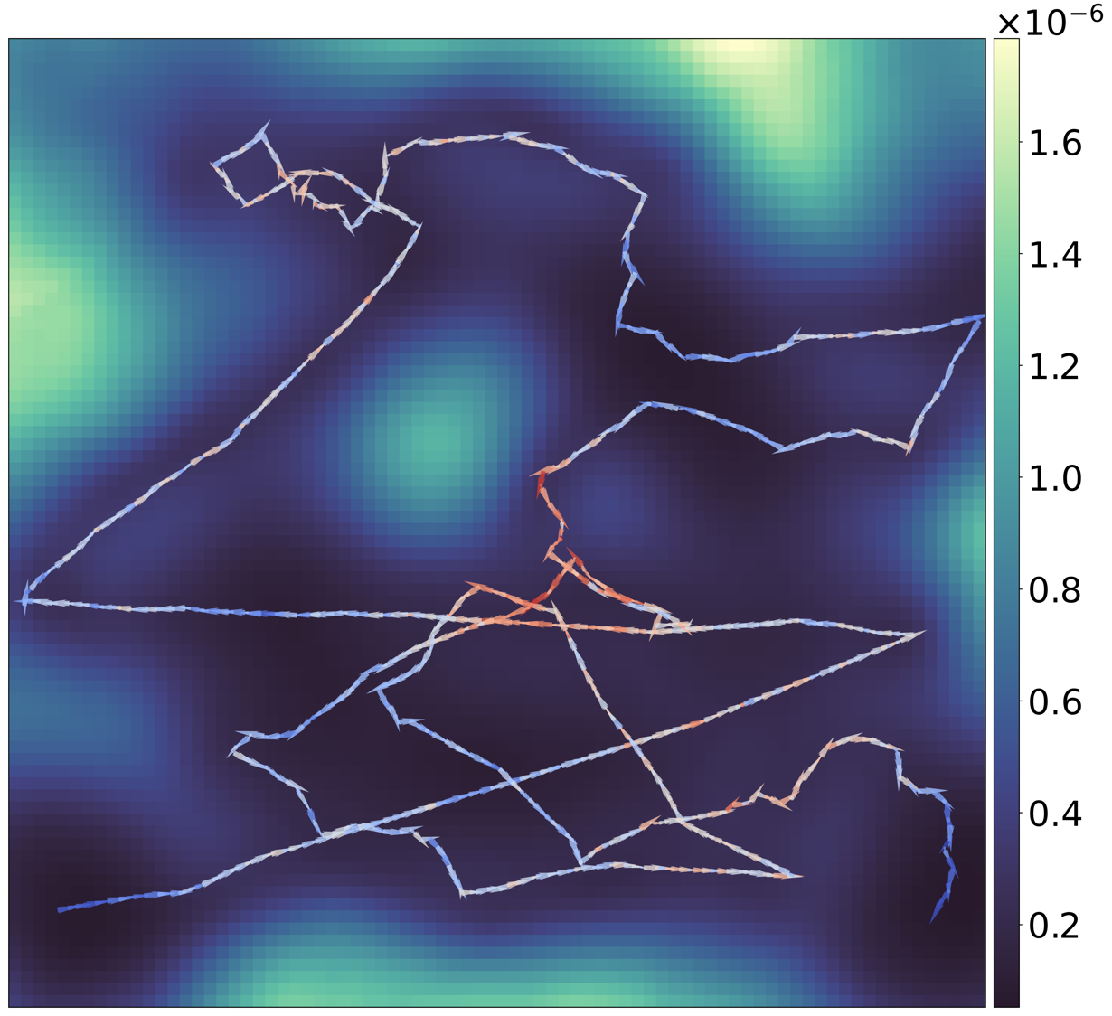
Laplace Approximation Uncertainty Quantification
90% Bayesian credible interval
(Laplace approx., ~0.5 s)
GPP reconstruction
$σ=2.4 m$, $λ={6.0×10}^{−5}Bq^{−1}$
Notes:
Laplace approximation

Slide 41
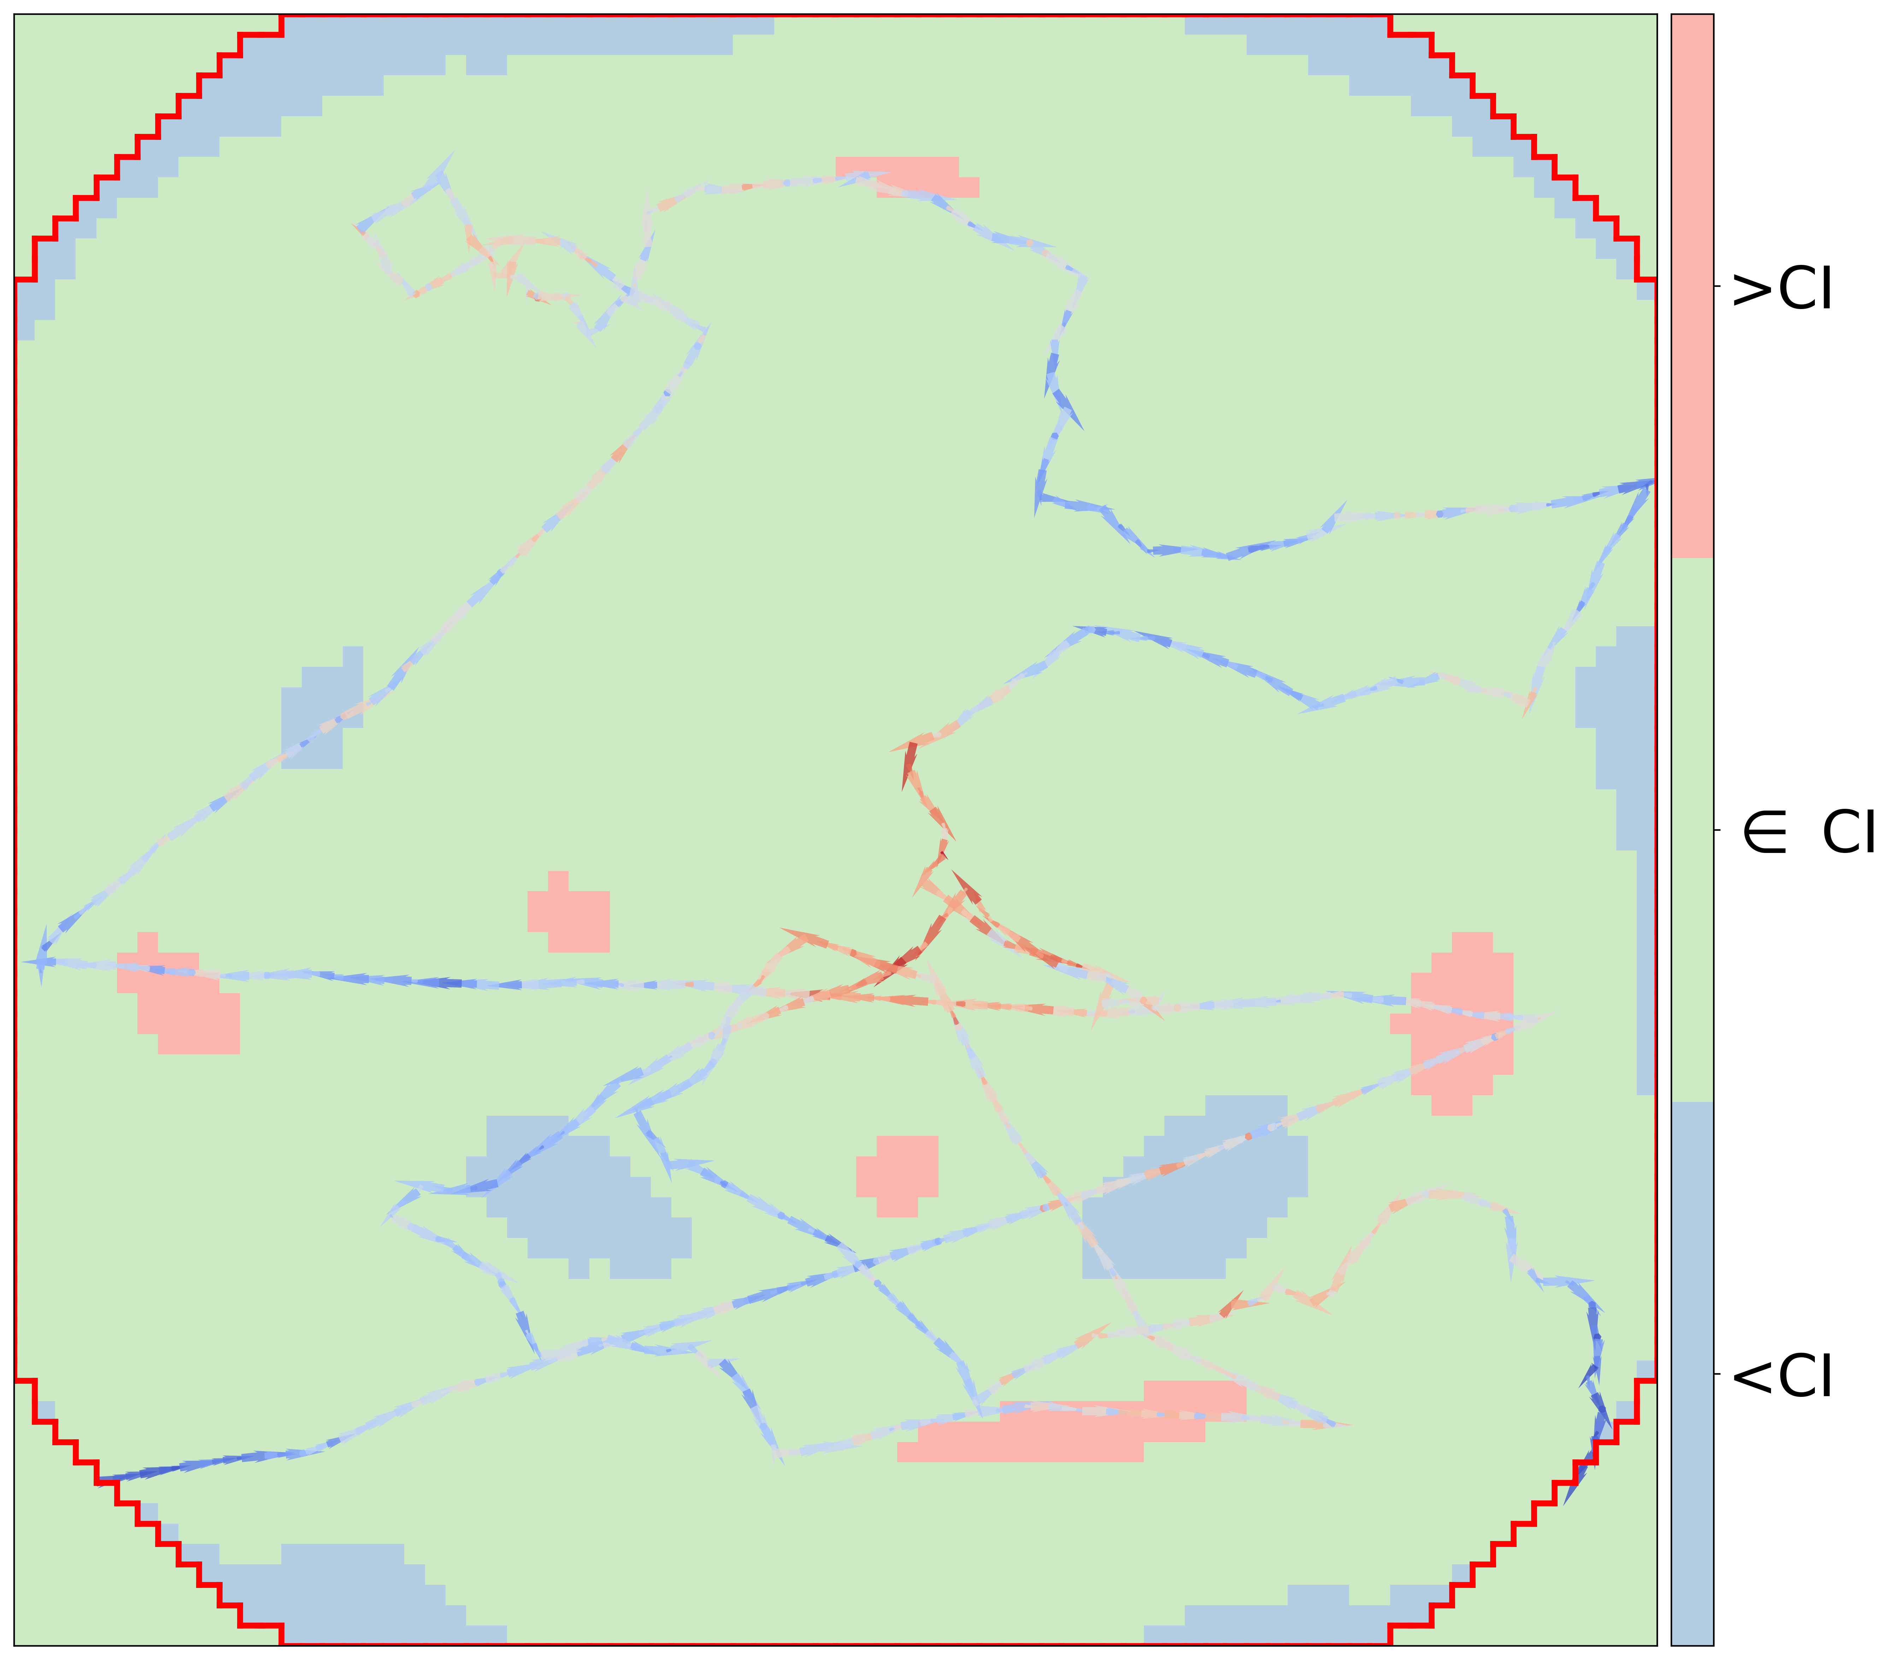
Laplace Approximation Uncertainty Quantification
Boolean map (Laplace approx. ~0.5 s)
Red : True value above the interval
Green : True value within the interval
Blue : True value below the interval
GPP reconstruction
$σ=2.4 m$, $λ={6.0×10}^{−5}Bq^{−1}$
Notes:
Caveat!

Slide 42
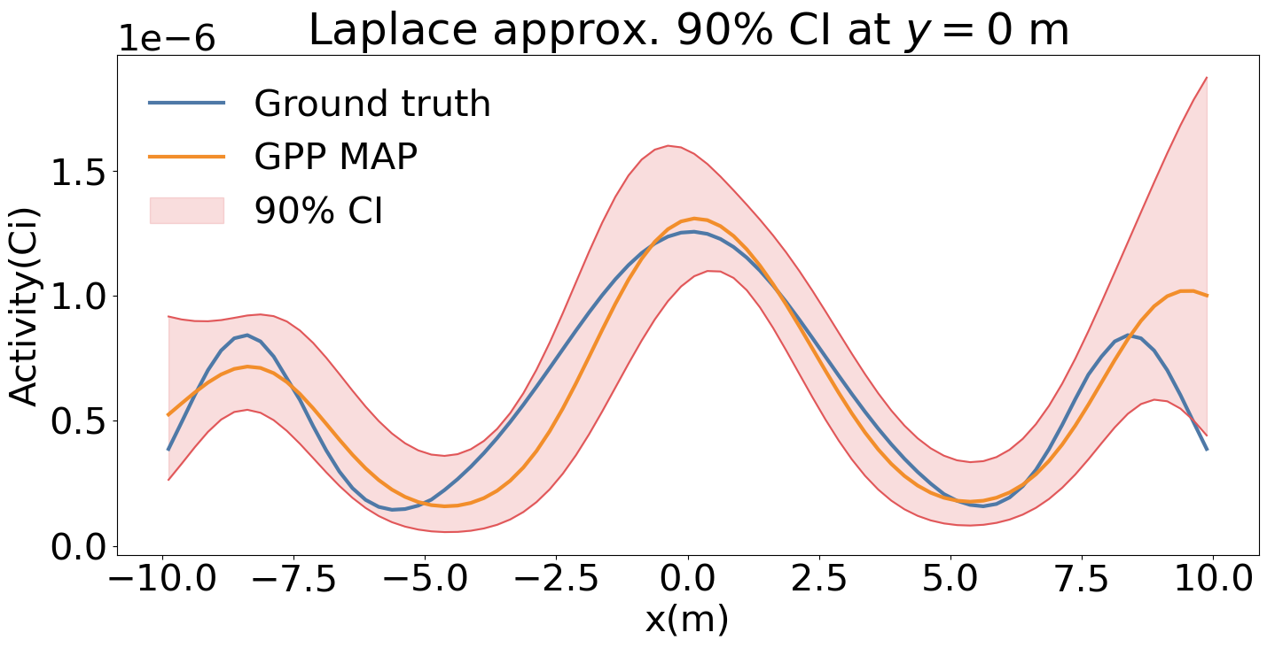
Laplace Approximation Uncertainty Quantification
Boolean map (Laplace approx. ~0.5 s)
Red : True value above the interval
Green : True value within the interval
Blue : True value below the interval
Notes:
Caveat!

Slide 43
Simultaneous Spectral Decomposition and Full Spectral Imaging

Slide 44
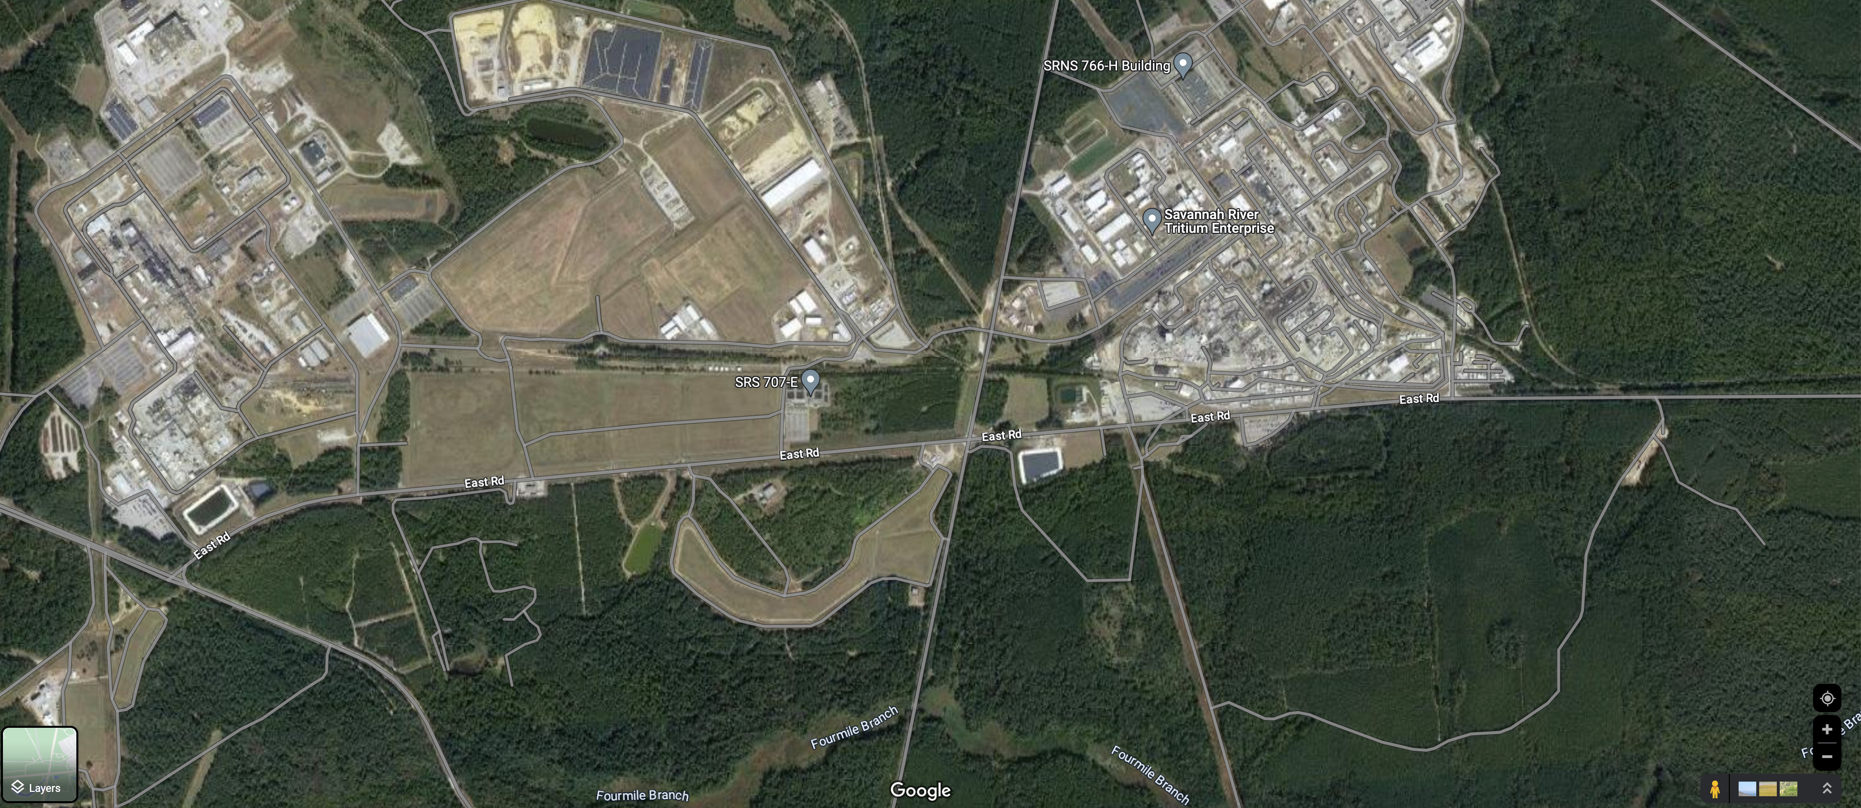

SRNL H Area Contamination Measurements
Fence
Forest
Savannah River National Lab (SRNL)
SRNL H-area

Slide 45


SRNL H Area Contamination Measurements
LiDAR
58 CZT detectors
MiniPRiSM imaging system
H-area LiDAR point cloud map

Slide 46


SRNL H Area Contamination Measurements
Elevated counts near the fence.
Is it the source signal or the background?

Slide 47


SRNL H Area Contamination Measurements
“Waterfall plots” from the measurements
2-D time-energy count histograms

Slide 48


SRNL H Area Contamination Measurements
Very low Cs137 662 keV photopeak counts
Multiple background spectral features

Slide 49
SRNL H Area Contamination Measurements
Setting energy ROIs around 662 keV and reconstruct images to increase the signal-to-noise ratio

Slide 50




SRNL H Area Contamination Measurements
GPP reconstructed images

Slide 51



Full Spectral Imaging and Spectral Decomposition
Data matrix
System matrix
Image matrix
Photon emission E
Problem — Too large image matrix and the system matrix

Slide 52
Full Spectral Imaging and Spectral Decomposition
Data matrix
System matrix
Image matrix

Slide 53





Full Spectral Imaging and Spectral Decomposition
Data matrix
System matrix
Images
Components
Low-rank approximation of the image matrix

Slide 54



Full Spectral Imaging and Spectral Decomposition
Data matrix
System matrix
Images
Components
Det. response
Decompose the system matrix A into the geometric efficiency matrix A_{g} and the detector response matrix R

Slide 55



Full Spectral Imaging and Spectral Decomposition
Data matrix
System matrix
Images
Components
Det. response
Bkg weights & components
The background can also be decomposed into different background components and their corresponding count contribution.

Slide 56
Full Spectral Imaging and Spectral Decomposition
Data matrix
System matrix
Images
Components
Det. response
Bkg weights & components
Apply the GPP to the images, components, and the background weights
Estimating 4 matrices altogether!

Slide 57



SRNL H Area Contamination Measurements
Compton edge at 477 keV
Combined data with the GPP
Component containing the 662keV peak

Slide 58



SRNL H Area Contamination Measurements
Compton edge at 477 keV
Component containing the 662keV peak

Slide 59
Conclusions / Future works
Scene Data Fusion (SDF) enables imaging with a single detector, which has a significant potential impact on radiation safety and security applications.
The proposed GPP algorithm can significantly improve image reconstruction quality over the conventional reconstruction methods while providing the uncertainty quantification capabilities.
The full spectral GPP allows for radiation mapping in scenarios with very low Signal-to-Noise Ratio (SNR) measurements and dynamically changing backgrounds.
Currently, we are working on applying the framework to various related applications, such as medical image reconstruction and dose rate mapping within the Chernobyl NPP shelter object.

Slide 60
Questions?

