Slide 1

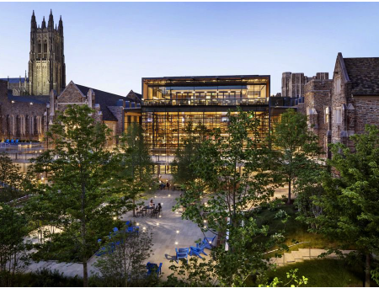
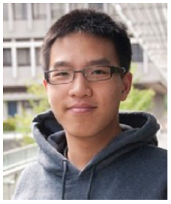
Bayesian Uncertainty Quantification methods for advancing NP
Simon Mak
Department of Statistical Science
Duke University

Slide 2
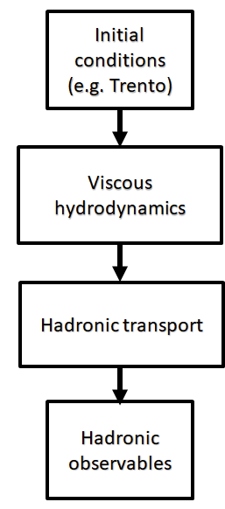
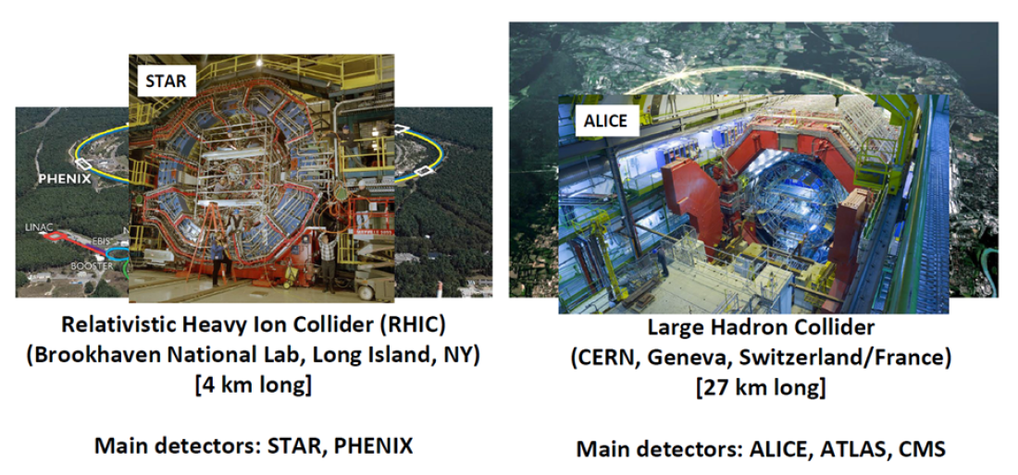


Quark-gluon plasma
Parameters $θ$
Parameter calibration
Bruni, Shi et al. (2024+ BA)
Particle collider simulator
QGP observable $f\left(θ\right)$
Experimental data

Slide 3
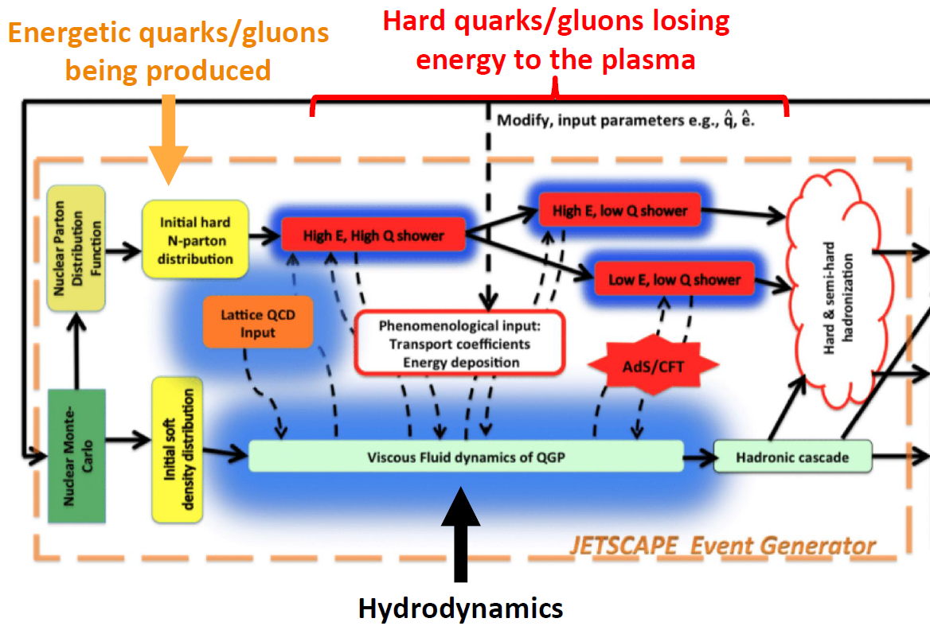

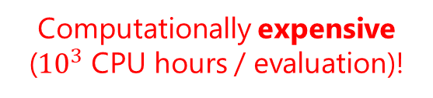
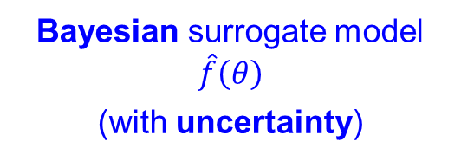
Quark-gluon plasma
Parameters $θ$
QGP simulator:
Key bottleneck:
Expensive: ${10}^{3}$ CPU hours / parameter
Many simulations of $f\left(θ\right)$ needed for parameter calibration from experimental data
High-dimensional parameter space (~20-dim.)
Enter Bayesian surrogate modeling
Particle collider simulator
Bayesian surrogate model $\hat{f}\left(θ\right)$
(with uncertainty)
Computationally expensive (${10}^{3}$ CPU hours / evaluation)!
QGP observable $f\left(θ\right)$

Slide 4

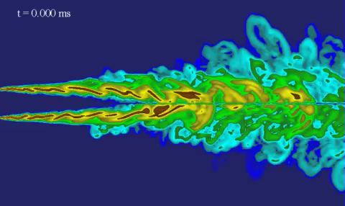
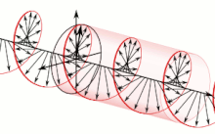



AdMIn-GP model
Additive Multi-Index GP (AdMIn-GP) model (Li et al., 2024+ JASA):
$$f\left(θ\right)=\sum_{l=1}^{L}{g_{l}(z_{l})}=\sum_{l=1}^{L}{g_{l}(M_{l}θ)}, g_{l}∼^{indep.}GP\left(μ_{l},k_{l}\left(⋅,⋅\right)\right)$$
Each component $g_{l}$ involves an active subspace, modeling a distinct dominant mechanism in the simulator
$f$ can capture multiple dominant mechanisms (multi-physics)
Active subspace for $M_{1}$
Hydrodynamics
Active subspace for $M_{2}$
Electromagnetics

Slide 5
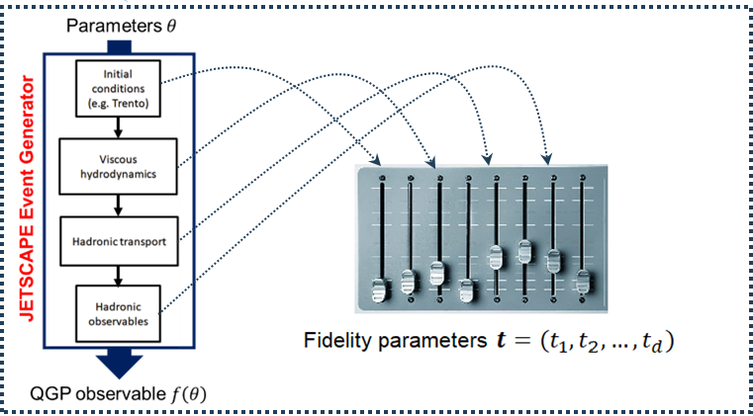
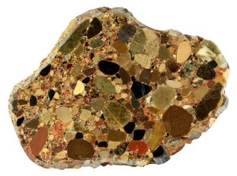
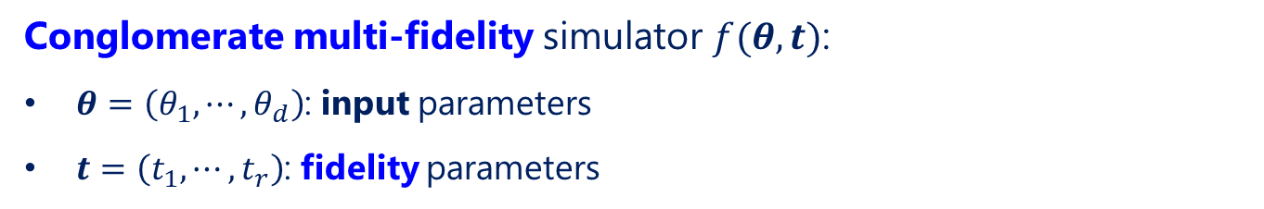
CONFIG surrogate model
Conglomerate multi-fidelity simulator $f(θ,t)$:
$θ=\left(θ_{1},⋯, θ_{d}\right)$: input parameters
$t=\left(t_{1},⋯, t_{r}\right)$: fidelity parameters
Conglomerate rock

Slide 6
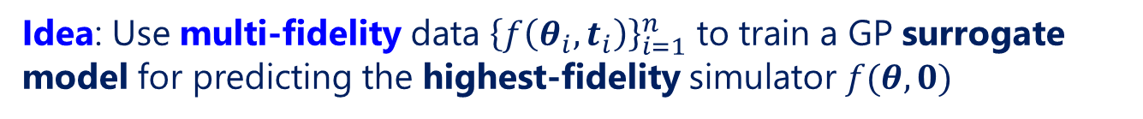
CONFIG surrogate model
Idea: Use multi-fidelity data ${\left\{f\left(θ_{i},t_{i}\right)\right\}}_{i=1}^{n}$ to train a GP surrogate model for predicting the highest-fidelity simulator $f(θ,0)$
CONglomerate multi-FIdelity Gaussian process modeling
(CONFIG; Ji et al., 2024 JUQ)
Standard surrogate modeling

Slide 7
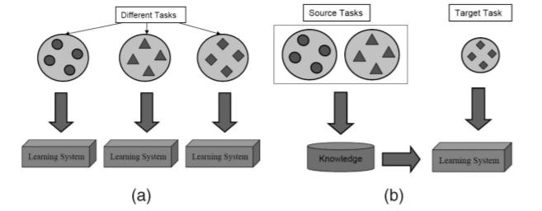
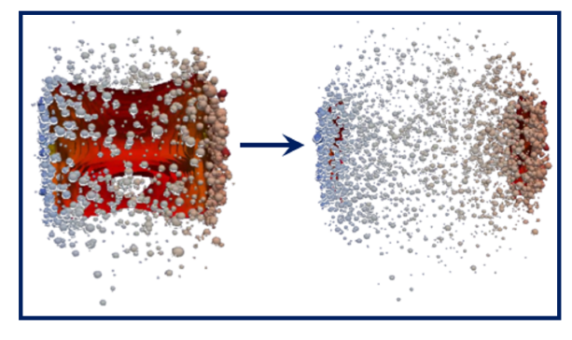
Transfer learning surrogate model
Transfer learning GPs (Liyanage et al., 2022 PRC; Wang et al., 2024+ SISC):
Idea: Using simulations on a related system (e.g., from previous analyses), apply transfer learning for cost-efficient surrogates on target system
Comparably accurate surrogates with reduced runs on target system
… or more accurate surrogates with comparable runs on target system
Grad
CE
PTB
Grad
CE
PTB

Slide 8
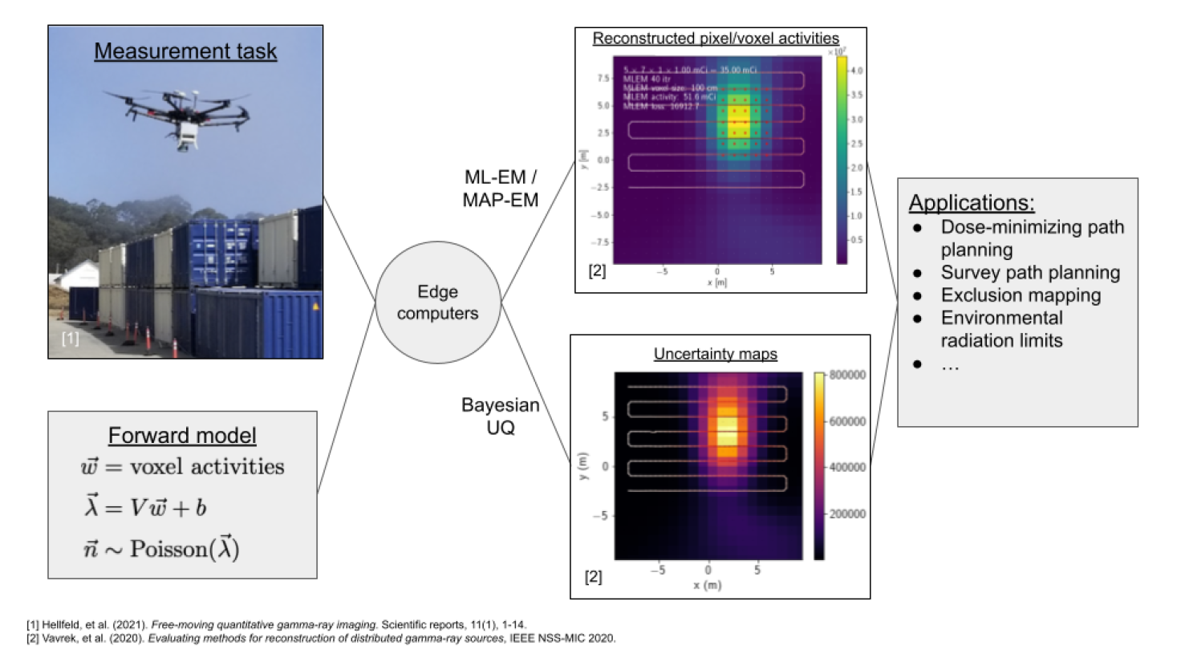
Radiological mapping
High-dimensional inverse problems with large image inputs
Probabilistic (i.e., Bayesian) uncertainty is important for decision-making
Quick (online) detection of anomalies from image data streams

Slide 9
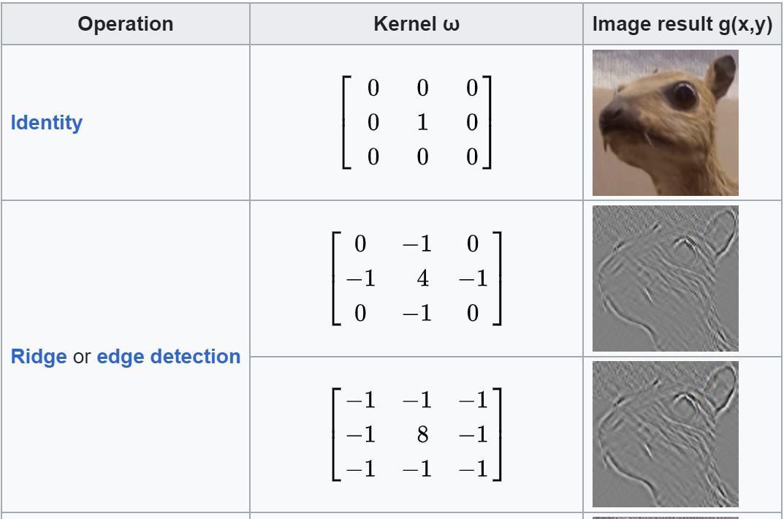
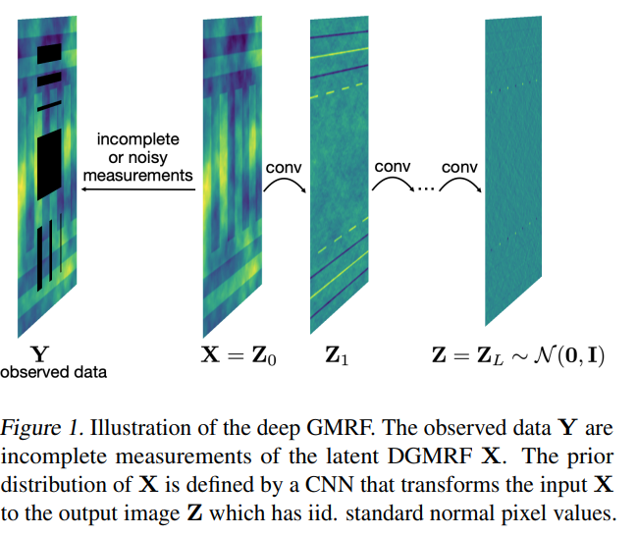
Deep GMRFs
Siden et al. (2020): Deep Gaussian Markov random fields
Deep
GMRF
Each convolution layer consists of a “GP-like” model that learns specific types of image structure (e.g., edges, blurs)
Scalable Bayesian convolution neural network: structure-aware!

Slide 10
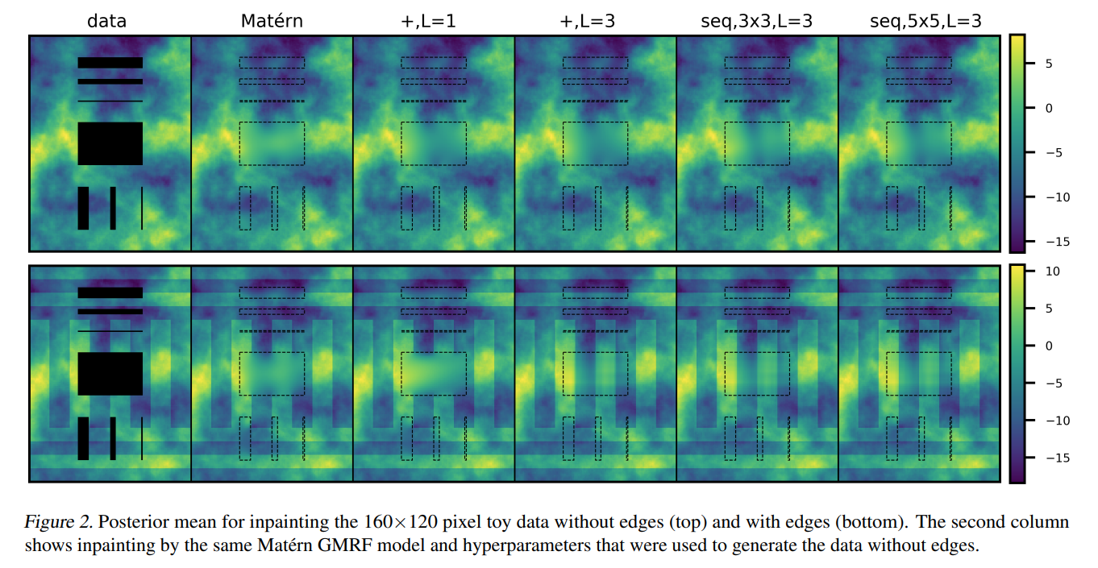
Deep GMRFs
Siden et al. (2020): Deep Gaussian Markov random fields
Partial image measurement
Image impainting
Application: image inpainting (with uncertainty)
Prior in Bayesian inverse problems for learning important image features?

Slide 11
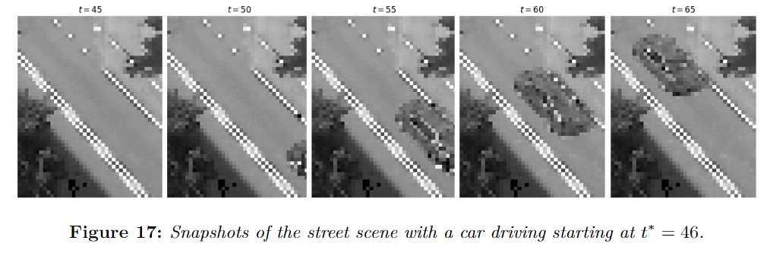
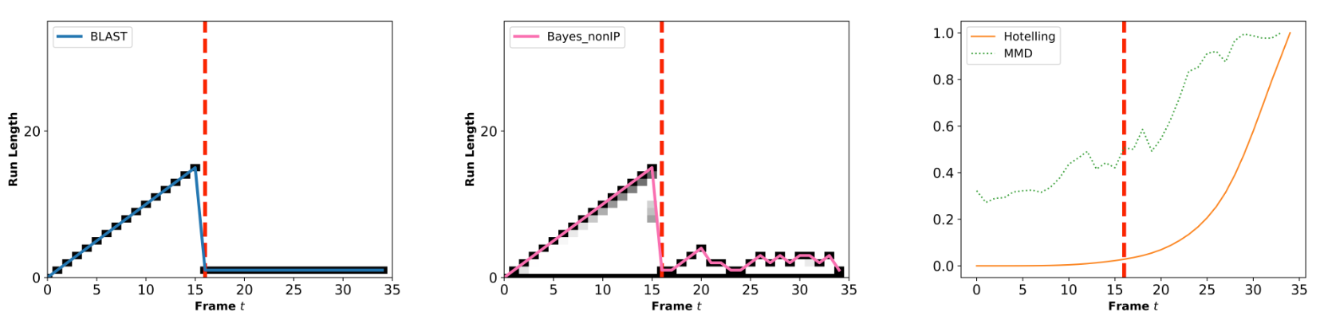
BLAST
Zheng et al. (2024+ BA): Bayesian onLine Structure-Aware change-poinT detection
Structure-aware detection
Existing methods
Application: online anomaly detection – uncertainty is key!

Slide 12
Short-term action items
Monthly meetings (bi-weekly?) with QGP, neutrinos, radiological mapping?
QGP:
  Transfer learning surrogates for (3+1)D simulations (Chun)
  Bayesian analysis with AdMIn-GP and CONFIG surrogates (Lipei?)
  Prior-informed design of surrogate runs? Quantifying model-to-data tension? (Lipei?)
Neutrinos:
  Neutron shield design via Bayesian optimization (Ann-Kathrin)
  Generative modeling of calorimeter shower simulations (e.g., GEANT4)
Radiological mapping (Jayson):
  Bayesian image inpainting
  Online anomaly detection
Developments from Uros?

Slide 13

Questions

Slide 14
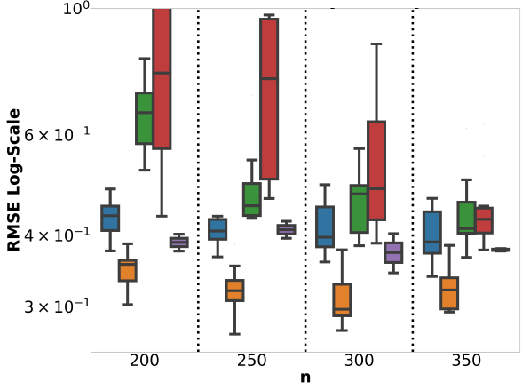
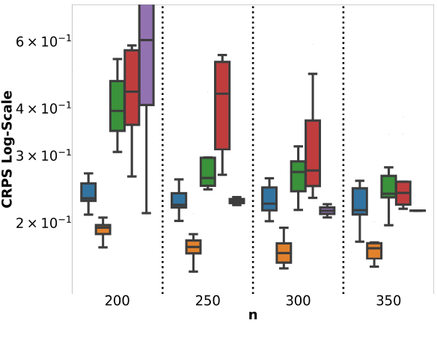
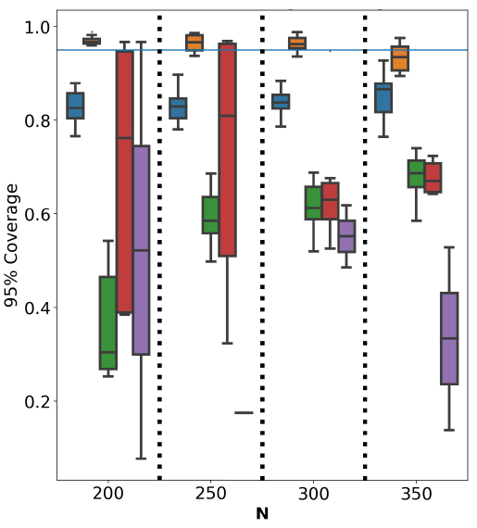
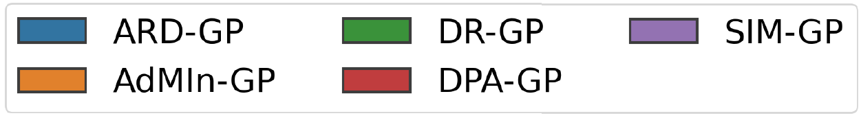
AdMIn-GP surrogate model
Existing embedded GPs: poor predictions & coverage (misspecification)
AdMIn-GP: better predictions & coverage (learned embedded multi-physics)
Surrogate modeling of a QGP observable:
Worse empirical coverage
Better empirical coverage
Better point & probabilistic predictions than existing models
Worse predictions than standard GPs

Slide 15
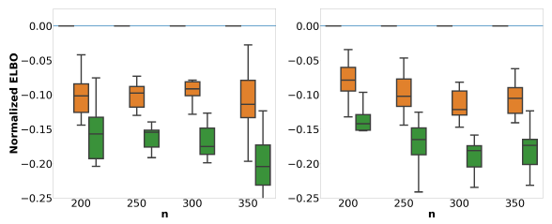
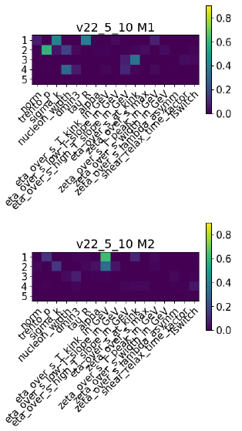



AdMIn-GP surrogate model
This also sheds light on dominant mechanisms in the QGP:
Likely two dominant mechanisms dictating the plasma. What are they?
Observable 1
Observable 2
: $L=2$
: $L=3$
: $L=4$
Initial condition physics
Shear viscosity of plasma

Slide 16

CONFIG surrogate model
Surrogate modeling of a QGP observable:
$d=17$ control parameters $θ$
$r=2$ fidelity parameters
  $t_{1}$: spatial mesh size, $t_{2}$: simulation timestep

Slide 17
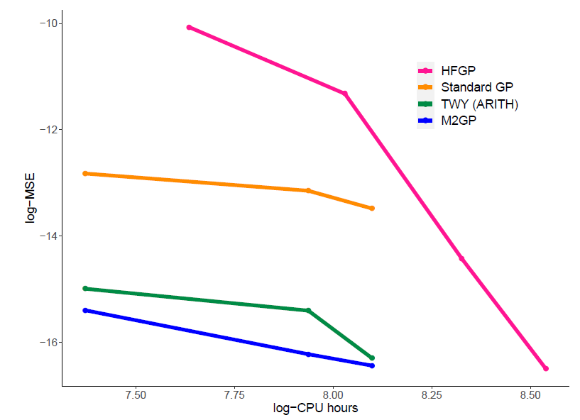
CONFIG surrogate model
Surrogate modeling of a QGP observable:
CONFIG

Slide 18
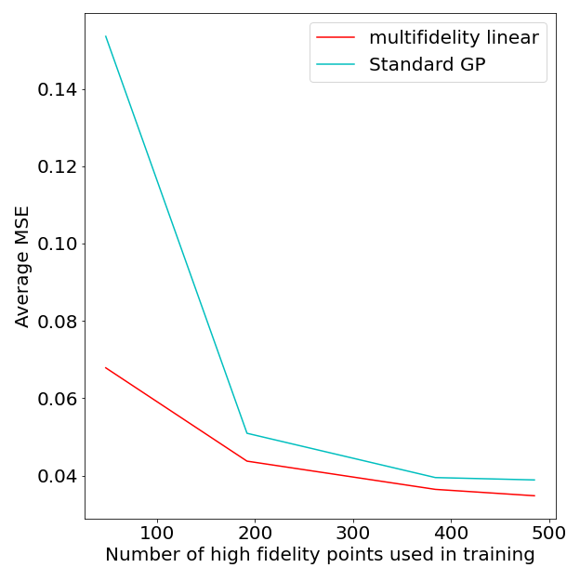
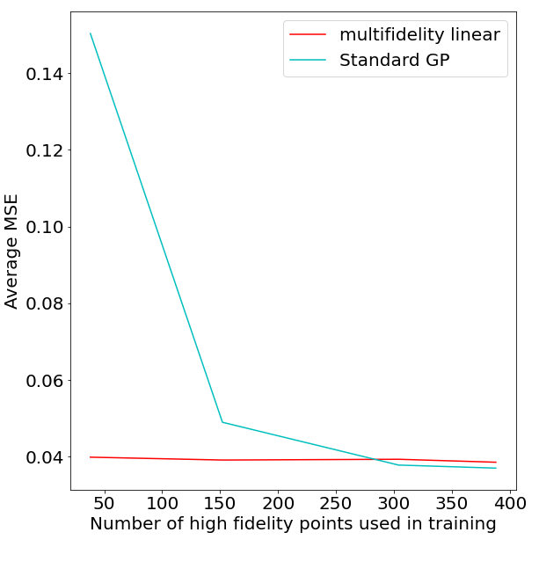
Transfer learning surrogate model
Liyanage et al. (2022 PRC):
Source: Pb-Pb collisions at 2.76 TeV with Grad viscous correction
Target: Au+Au (Grad)
Target: Pb+Pb (CE)
Great - more accurate surrogates at reduced cost!

