Slide 1
Test Facility Dipole
Magnet Design and Procurement Status
G. Vallone, D. Arbelaez, P. Ferracin, A. Hafalia, P. Mallon, S. Nguyen, R. Norris, S. Prestemon, JL. Rudeiros Fernandez, GL. Sabbi, A. Saravanan
EOC Meeting #3
20 March 2024

Slide 2
Outline
Introduction and Design Overview
Analysis Highlights
Engineering and Procurement Status
    Coil Pack
    Structure
Status Summary

Slide 3
Outline
Introduction and Design Overview
Analysis Highlights
Engineering Status
    Coil Pack
    Structure
Status Summary

Slide 4
Timeline
  Design benefitted from HEPDipo collaboration (2017-2020), see MT26, 2019:
      https://ieeexplore.ieee.org/document/8982034
  Conceptual Design Review 08/19/2020:
      https://conferences.lbl.gov/event/359/
  EOC #1 (01/07/2021):
      https://conferences.lbl.gov/event/513/
  Wire Specification Review (10/28/2021):
      https://conferences.lbl.gov/event/759/
  EOC #2 (08/19/2022):
      https://conferences.lbl.gov/event/1036/
  Preliminary Design Review (02/16/2023):
      https://conferences.lbl.gov/event/1201/
  Progress on the coils development presented at MT28 (09/11/2023):
      https://mt28.aoscongres.com/detailed-programme

Slide 5
Publications
  Magnetic and mechanical analysis (ASC2020):
      https://ieeexplore.ieee.org/abstract/document/9376992
  Initial developments on engineering design (MT27, 2021):
      https://ieeexplore.ieee.org/abstract/document/9733270
  Short sample computation including strain effects (ASC2022)
      https://ieeexplore.ieee.org/abstract/document/10050160/
  Analysis of the thermo-mechanical stresses after a quench (MT28, 2023):
      https://ieeexplore.ieee.org/abstract/document/10452760

Slide 6
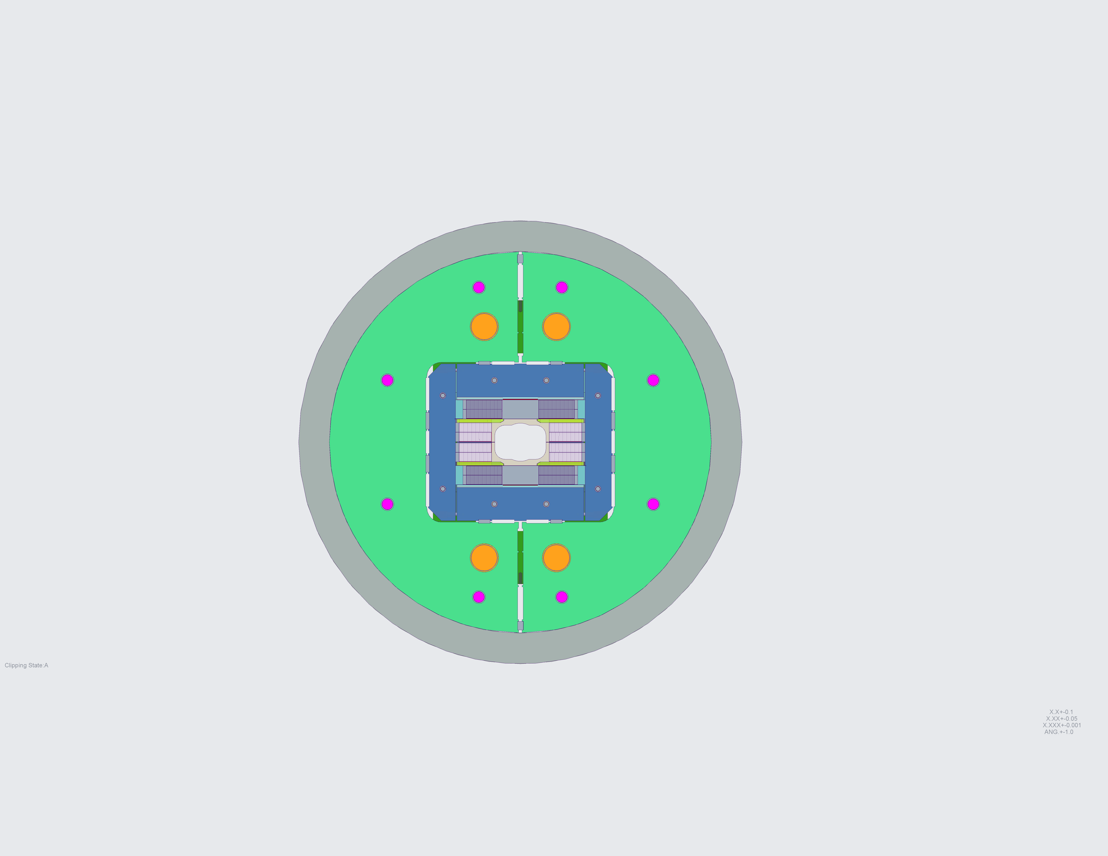
The Test Facility Dipole
  Target field:
    Operation target: 15 T at 1.9 K
    Design target: 16 T with 15% margin at 1.9 K based on conductor specs
Clear bore:
    144 mm x 94 mm rectangular aperture with superimposed 106 mm diameter
  Nb₃Sn coils layout:
    Block coil design with flared ends and rectangular bore
  Mechanical design:
    Aluminum shell-based structure using key-and-bladder technology, with axial pre-load provided by steel rods.

Slide 7
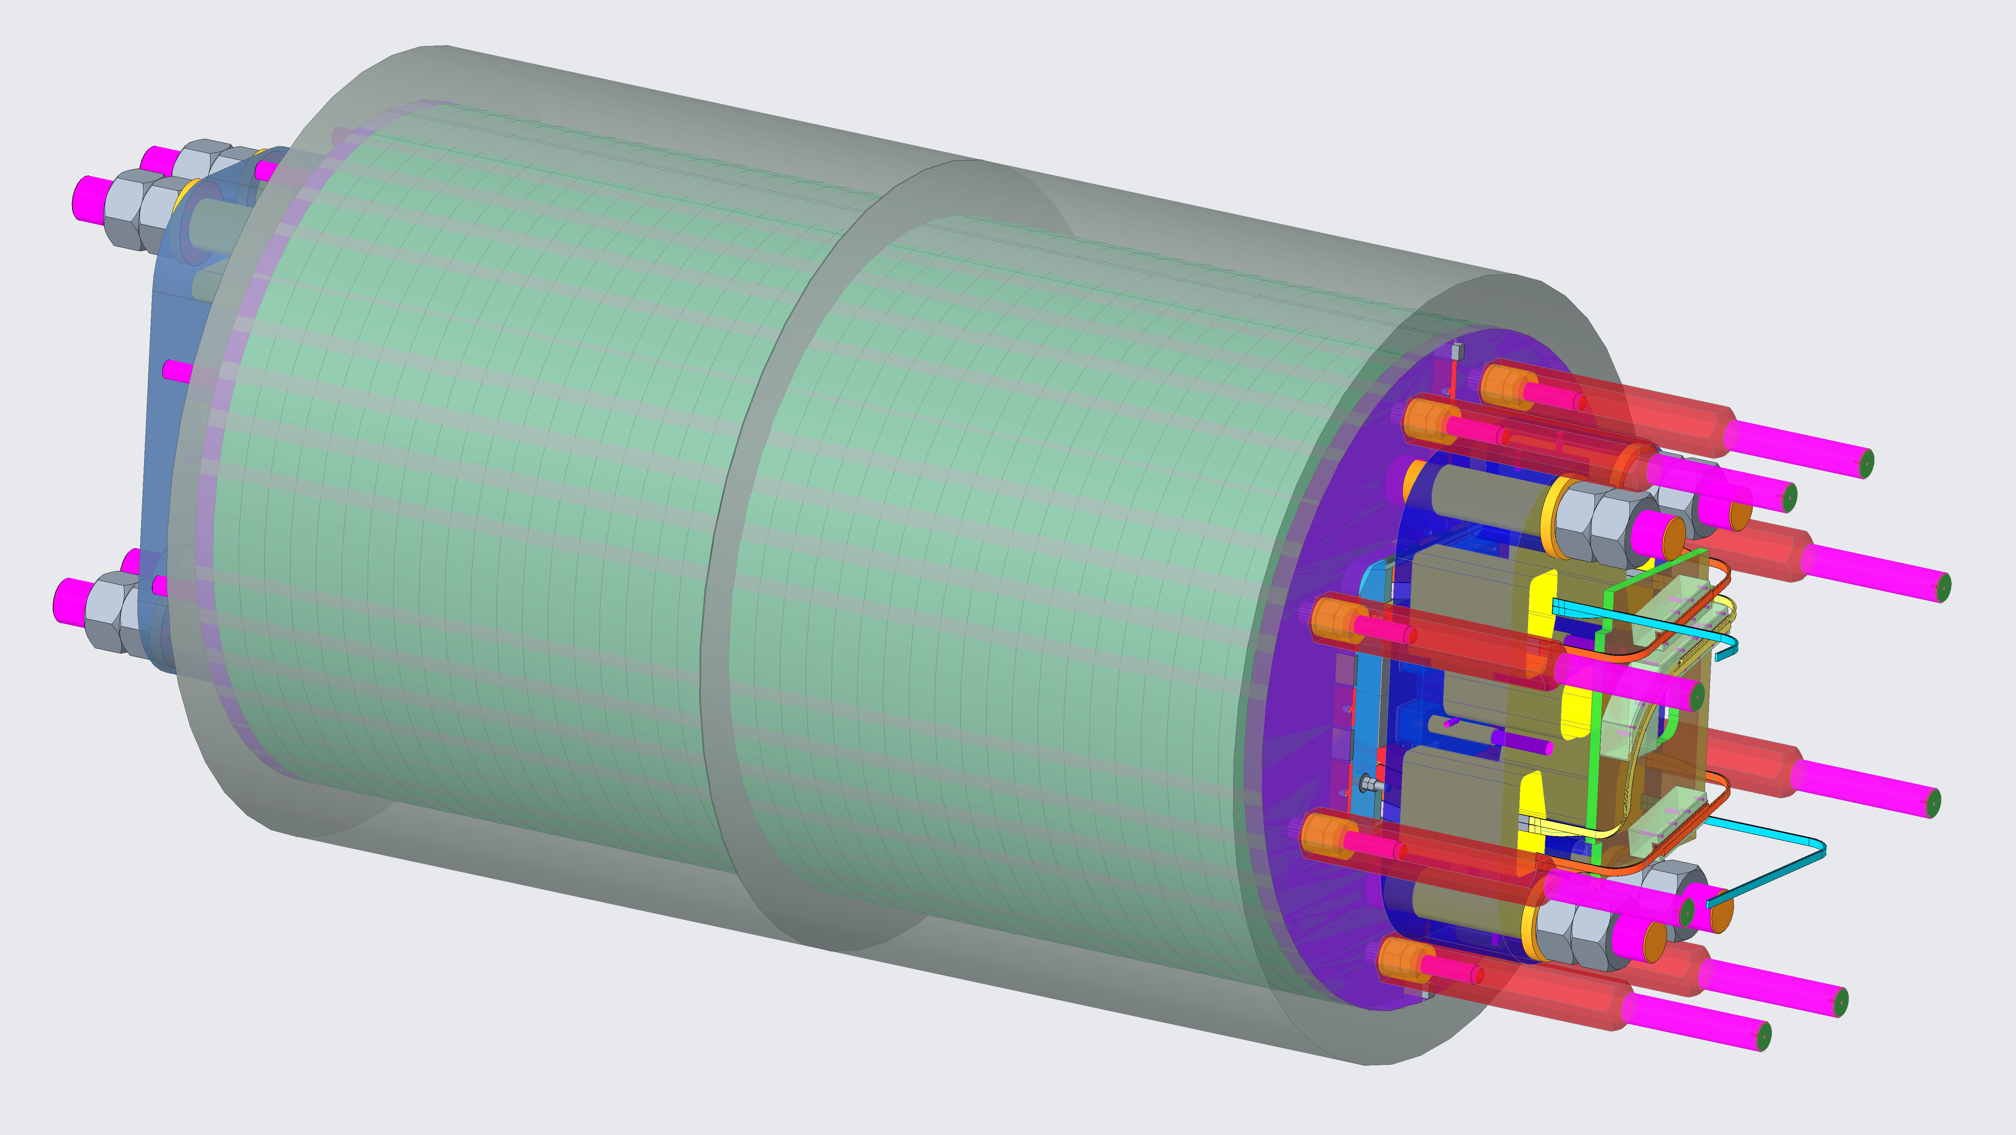
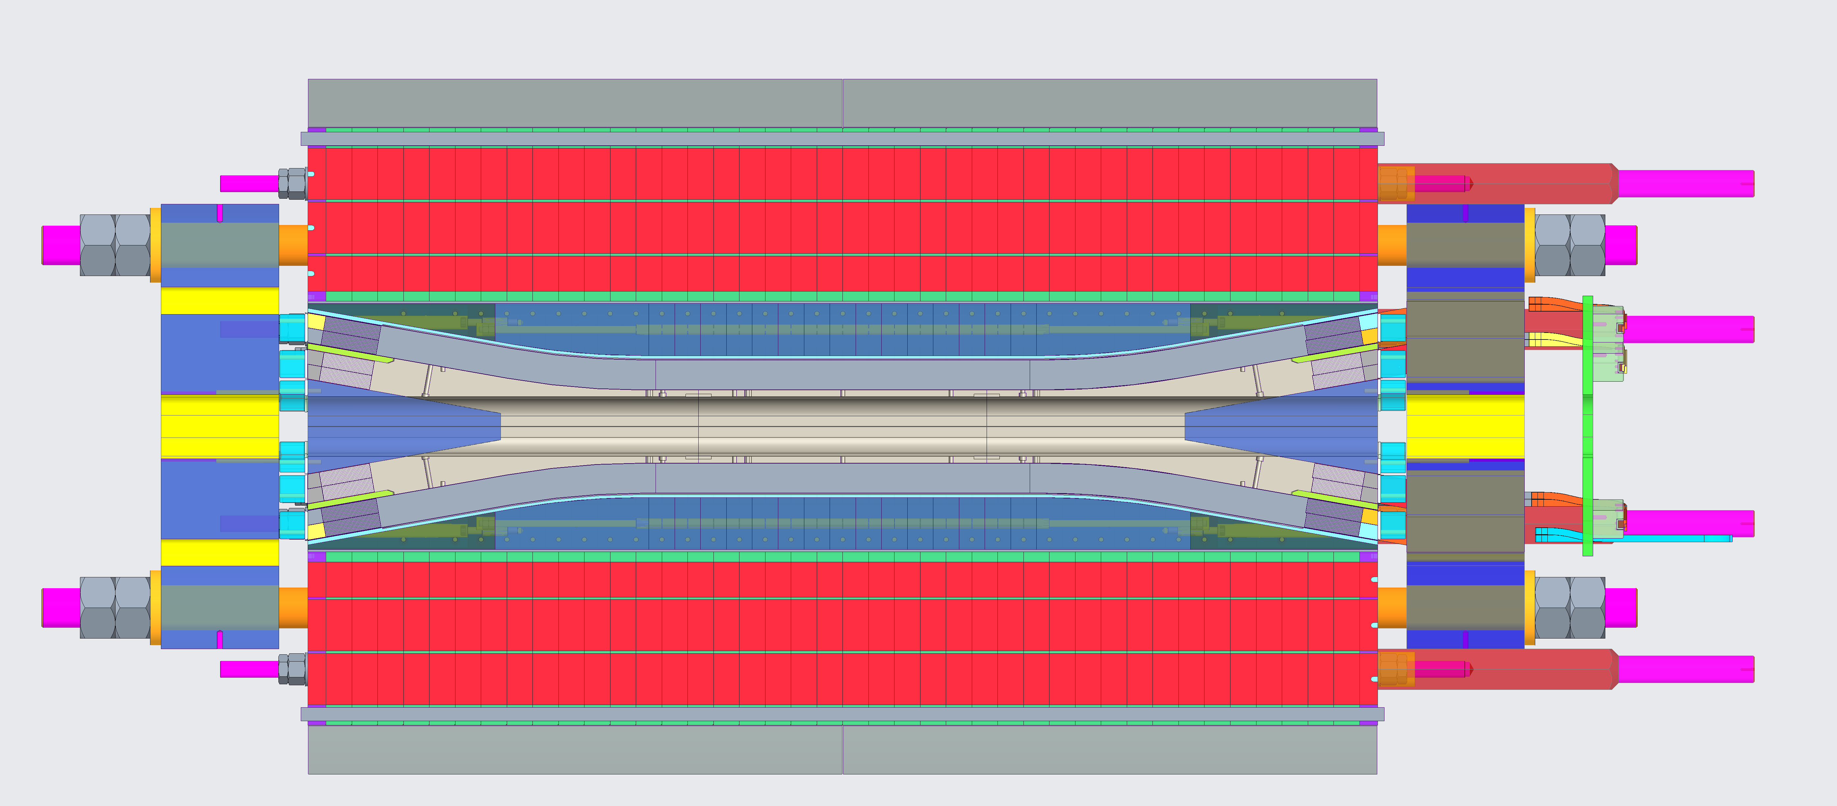
TFD Design Overview
L_{y} = 2.00 m
Φ = 1.3 m

Slide 8
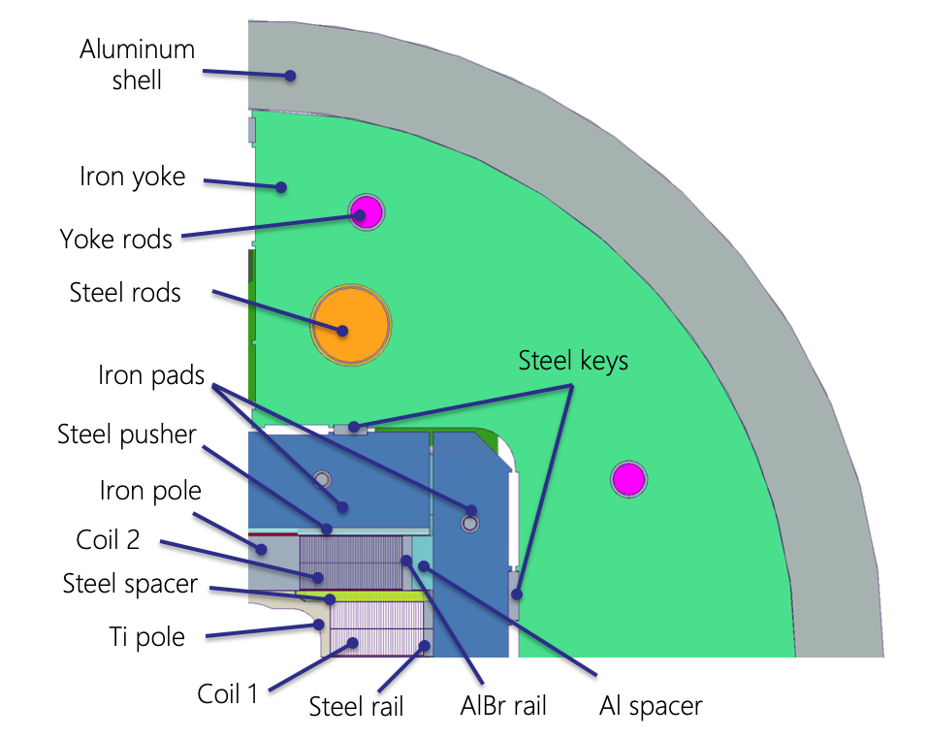
TFD Design – Cross-Section
Highlights:
    Shifted coil blocks with spacer (stress management component)
    Aluminum bronze rail with Al shim
      A ‘soft’ layer between the coil and the horizontal pad allows to remove local high stress zones in the coil
    Horizontal gap in the boat
      Reduces the impact of the vertical pad magnetic forces
      Limits the pole bending, reducing the pole stress and tension ‘spikes’ at the pole/coil interface
    Combined pad-yoke bladder loading
      Limits the coil peak stress at room temperature
For details see PDR design analysis

Slide 9
TFD Design – Longitudinal
End-plate
Coil 1
Coil
Pushers
Wedge
Bullet
Coil 2
Rods
Aluminum shell
Yoke laminations

Slide 10
Outline
Introduction and Design Overview
Analysis Highlights
Engineering Status
    Coil Pack
    Structure
Status Summary

Slide 11
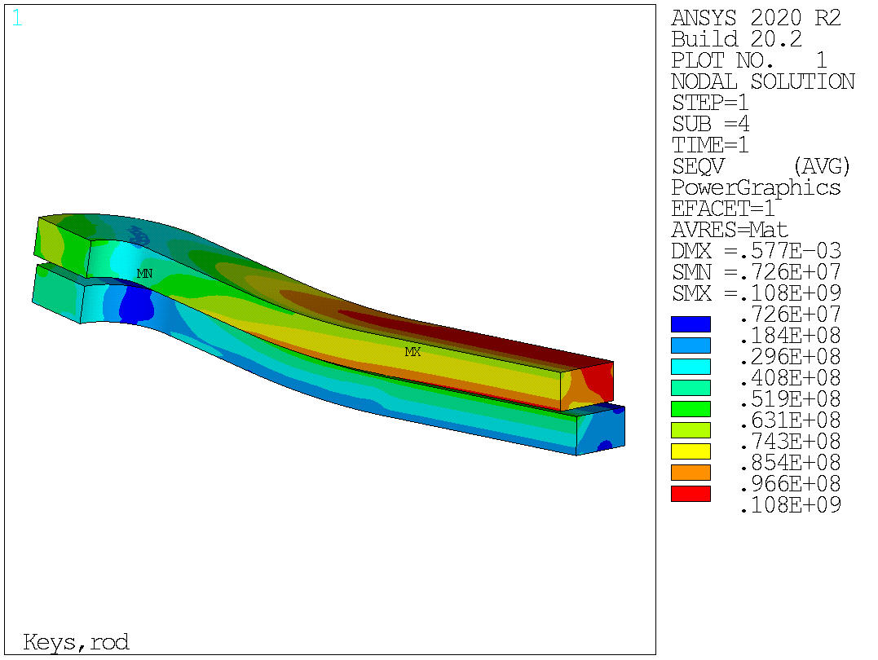
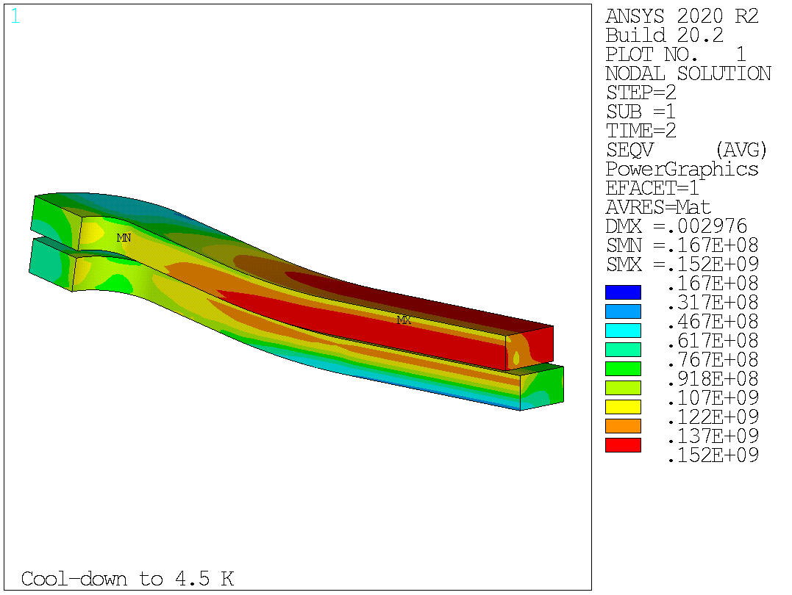
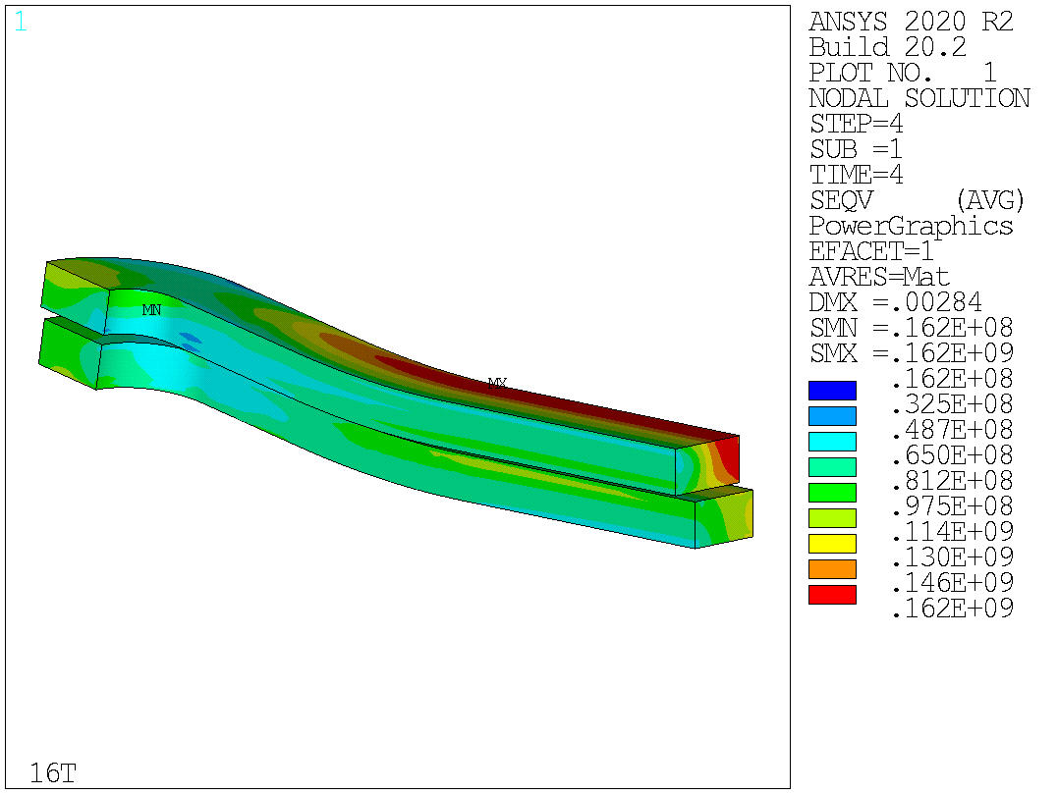
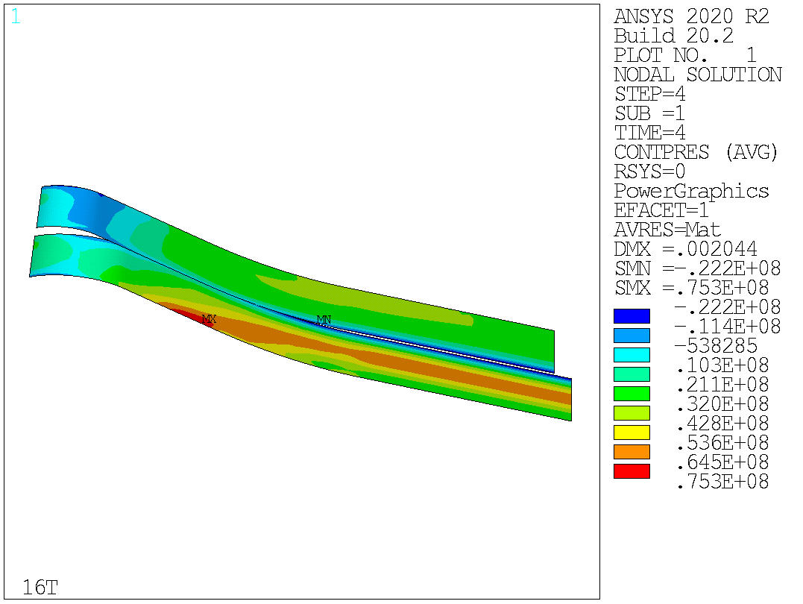
Current Design Results - Mechanics
Current design satisfies the mechanical constraints on the coil limits
With full prestress for 16 T operation:
      Peak stress below 110 MPa at room temperature
      152 MPa on the high field region after cooldown
      162 MPa in the low field region at 16 T

Slide 12
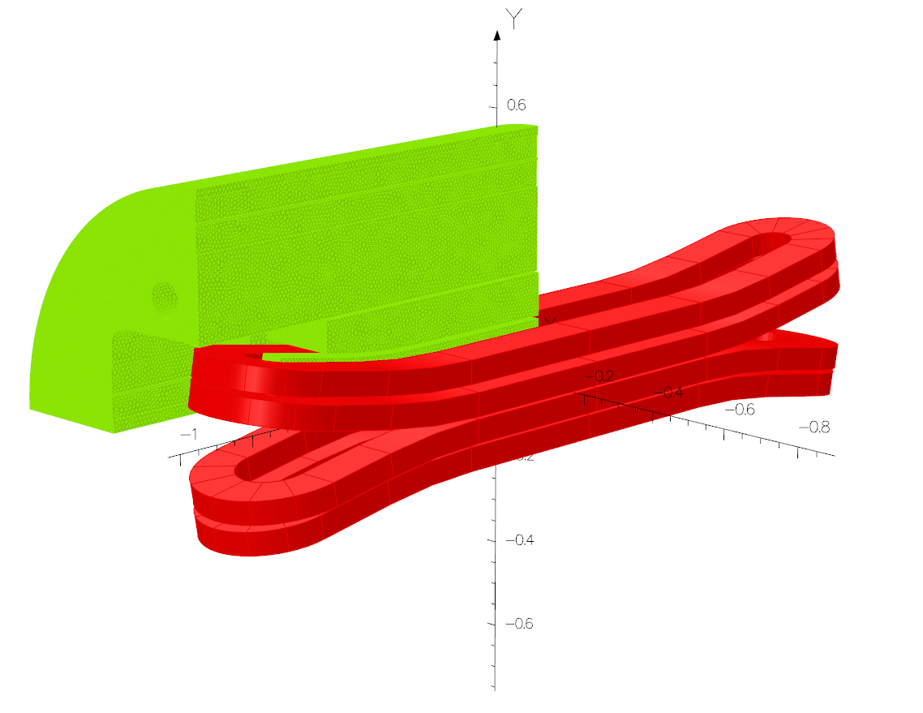
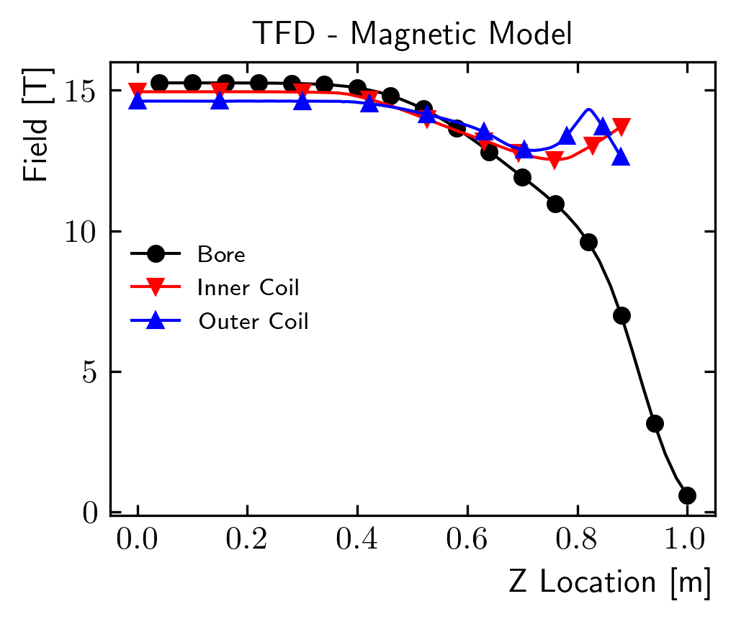
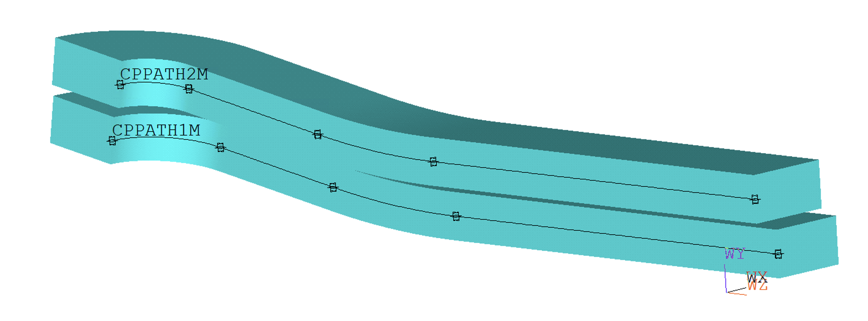
Magnetic Model Results – 3D
Coil ramp length optimized to reduce the peak field in the ends
Iron pad length optimized evaluating peak stress and magnetic performance
Uniform field length (B/B0>99%, at 15 T): 760 mm

Slide 13
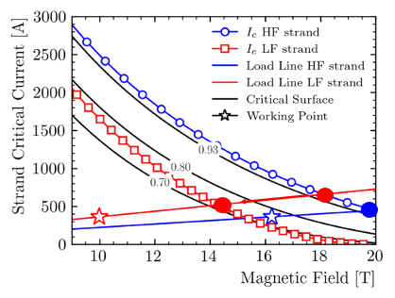
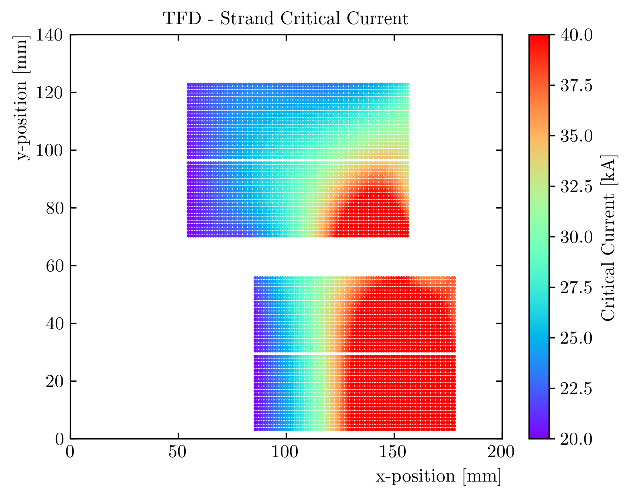
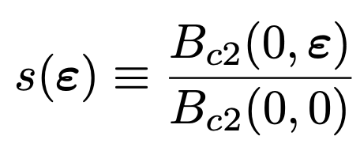
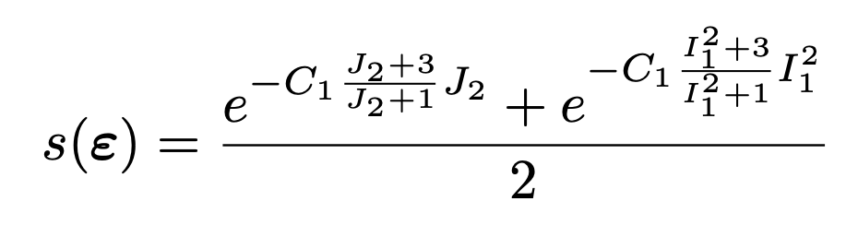
Load Line Margin @1.9 K Including Strain
Low field
High stress
High field
Low stress
Magnet load line margin computed for each strand, including strain effects on the critical surface
    Critical surface parametrization from strand measurements
    20% in the high field / low stress region
    32% in the low field / high stress region

Slide 14
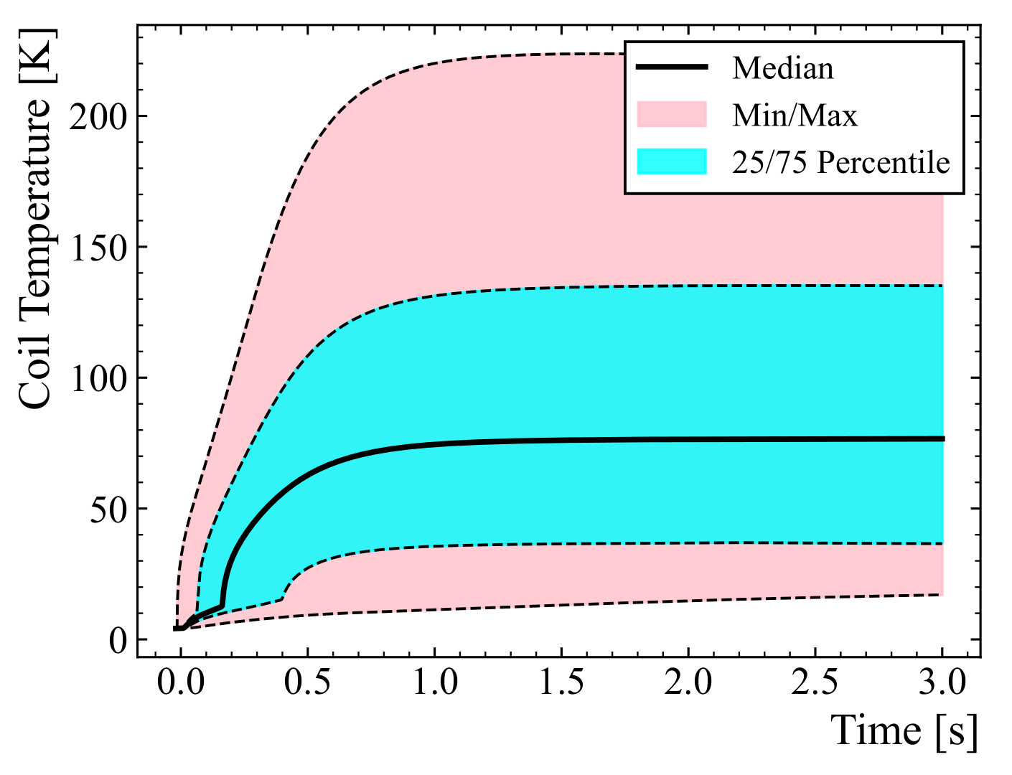
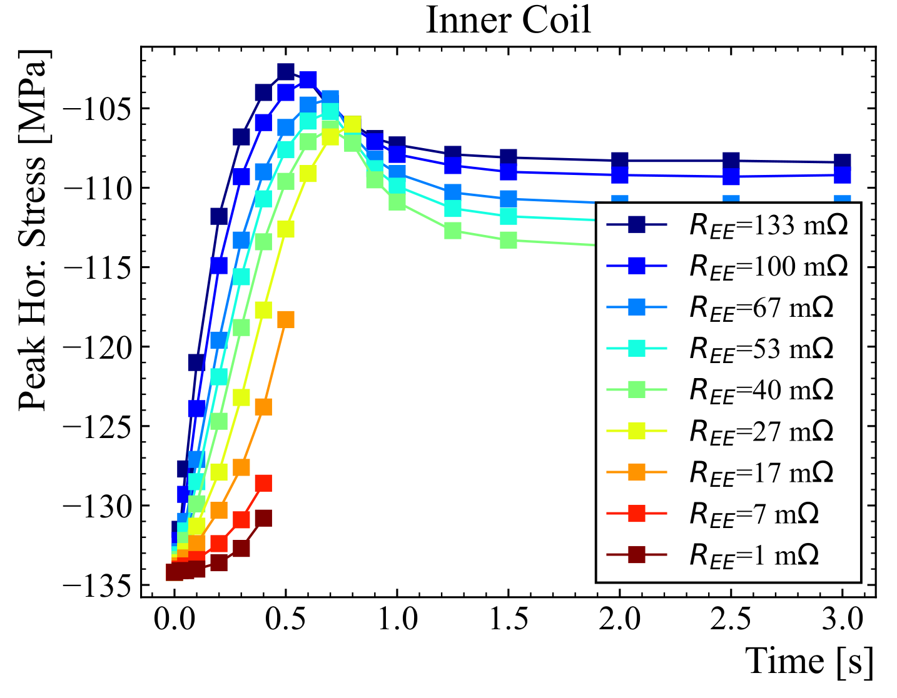
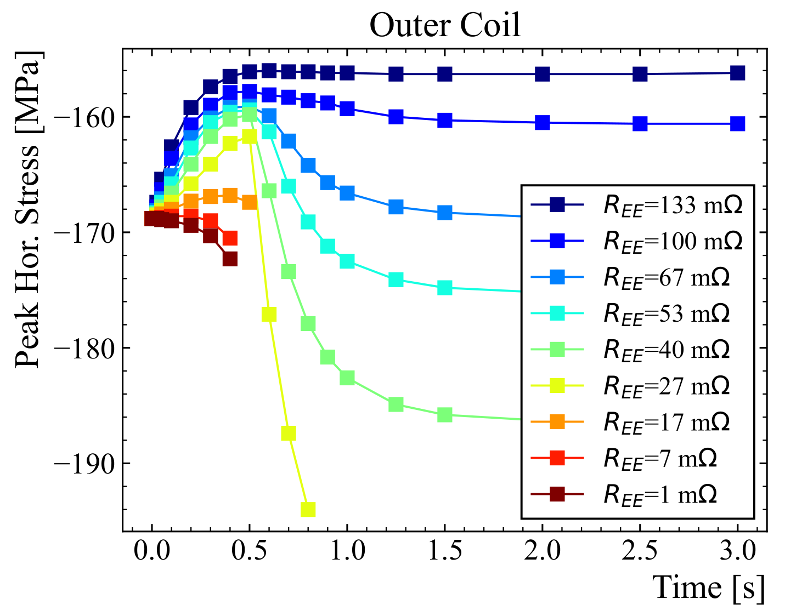
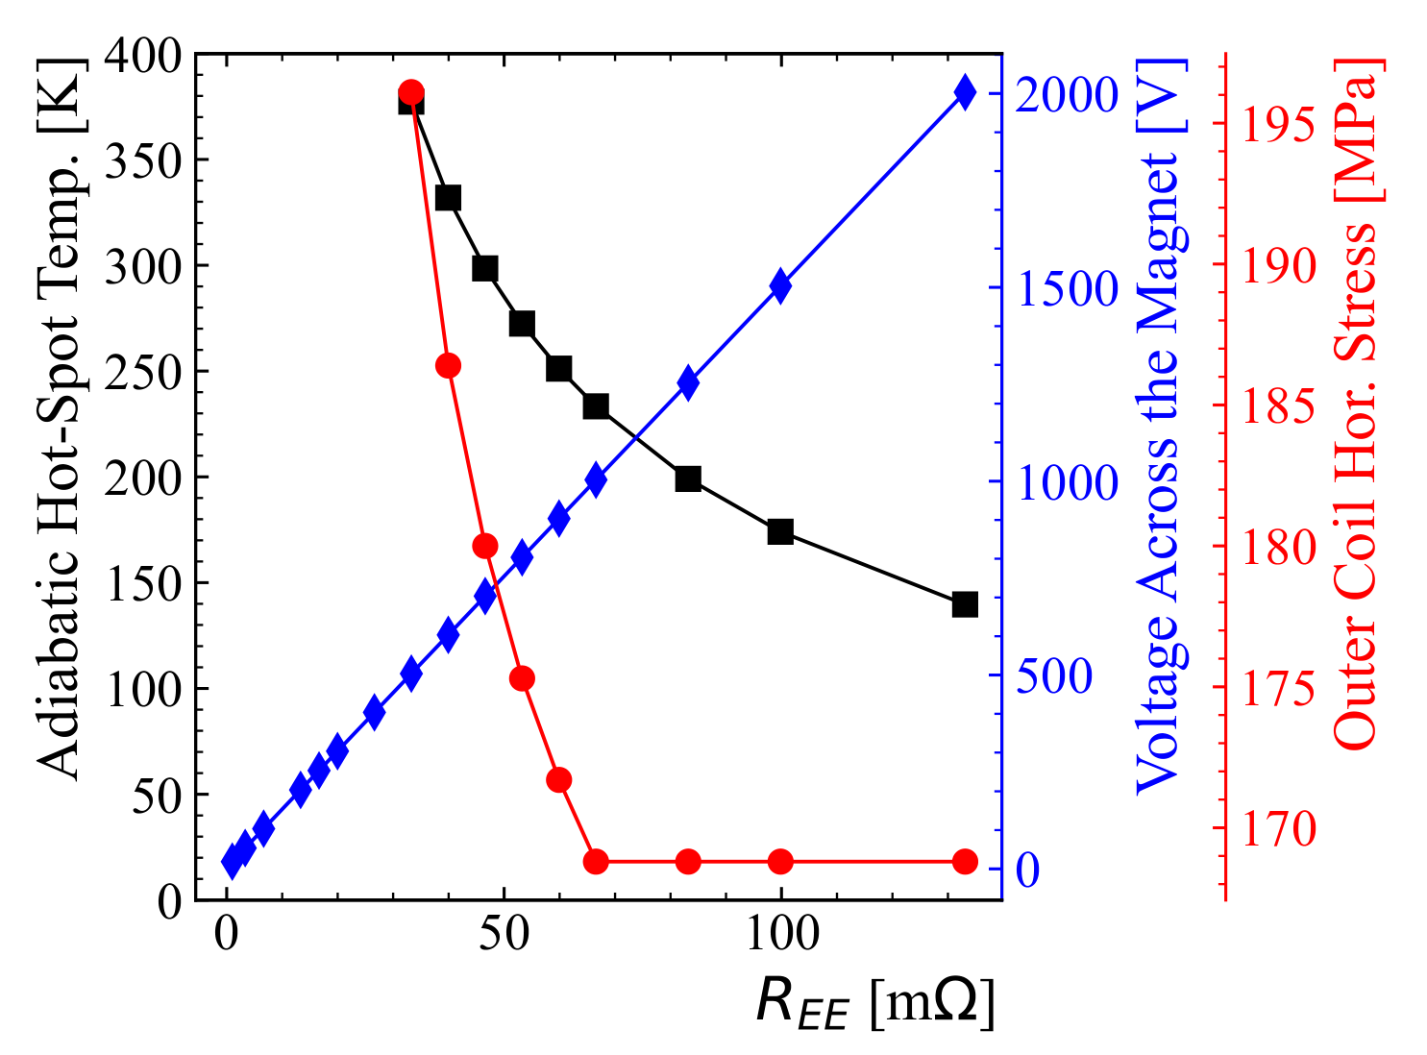
Thermo-Mechanical Stresses After a Quench
Detailed quench protection design study presented at the wire specification review
New simulation tools used to simulate the stresses during a quench in an automated way
    Stresses after a quench vary since the current decreases and temperature increases... Final result not so intuitive
    Investigated the effect of energy extraction resistance and magnet prestress
    With energy extraction and design prestress level, stress does not increase with respect to the cooldown case if the extraction resistance is larger than 60 mΩ
G. Vallone, E. Ravaioli et al., IEEE Trans, 2024

Slide 15
Outline
Introduction and Design Overview
Analysis Highlights
Engineering Status
    Coil Pack
    Structure
Status Summary

Slide 16
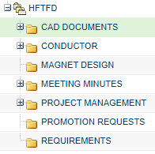
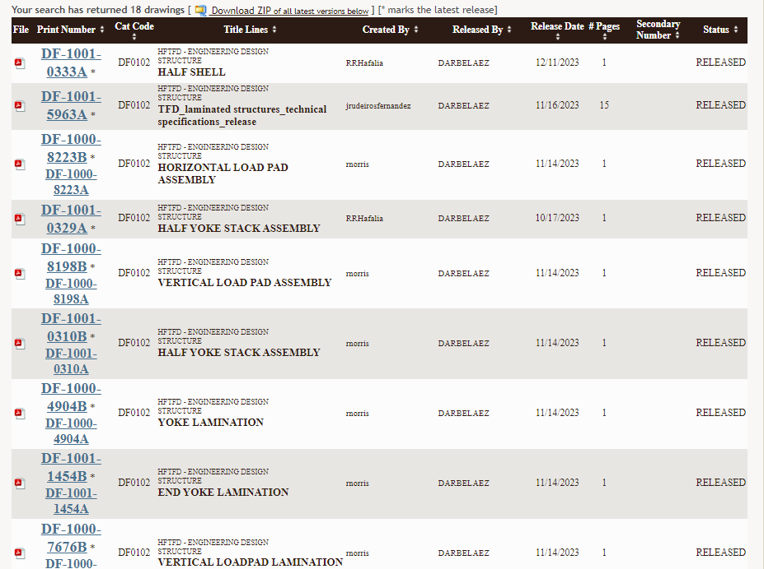
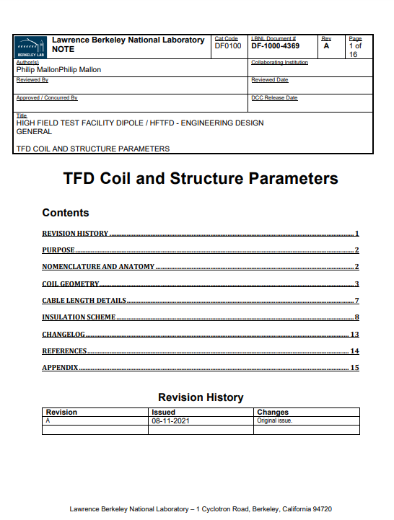
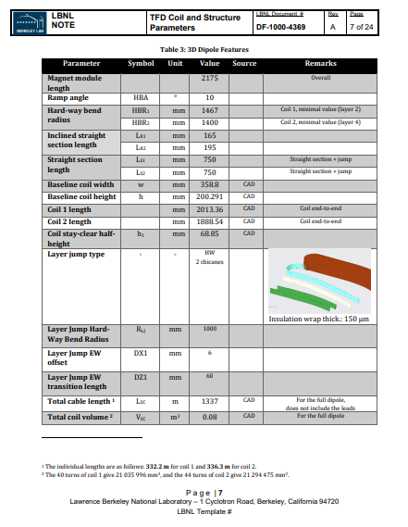
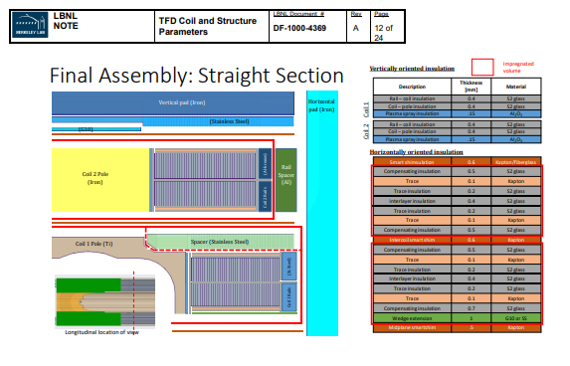
Engineering Process
All engineering data related to the magnet is version controlled and managed in the product lifecycle management (PLM) tool used at LBNL (PTC Windchill)
The parameters required to define the components of the magnet are compiled in a master document managed from the PLM system
Drawings and documents are released after review and approval process
Released drawings and documents are published to the LBNL document control center (DCC)
Windchill Structure
Document Control Center
Parameter Document

Slide 17
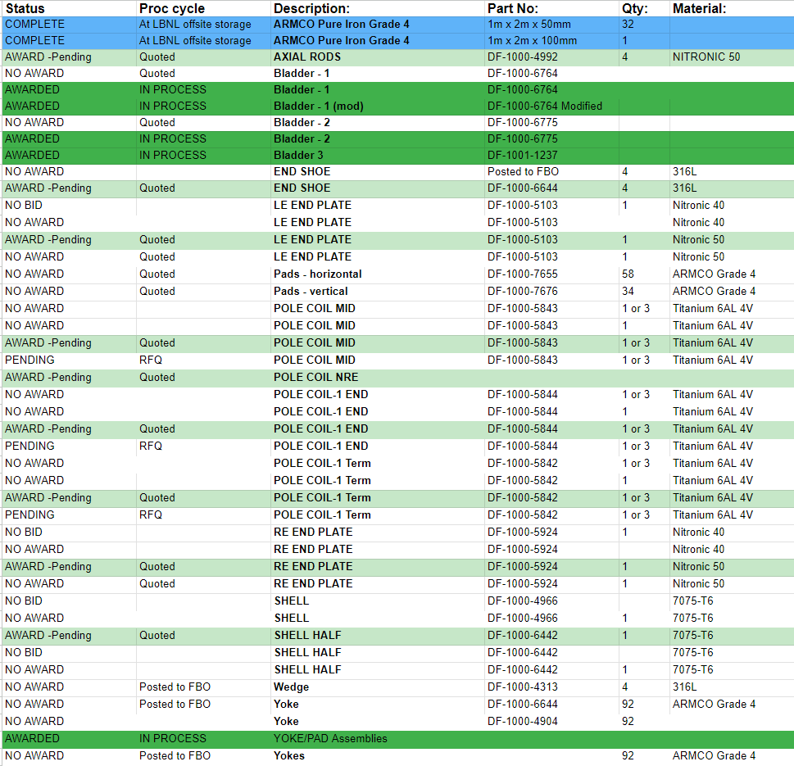
Procurement - Tracking
  Procurement tracking in a single smarthseets document
  Multiple quotes obtained for most parts, also considering multiple materials where possible

Slide 18
Outline
Introduction and Design Overview
Analysis Highlights
Engineering Status
    Coil Pack
    Structure
Status Summary

Slide 19
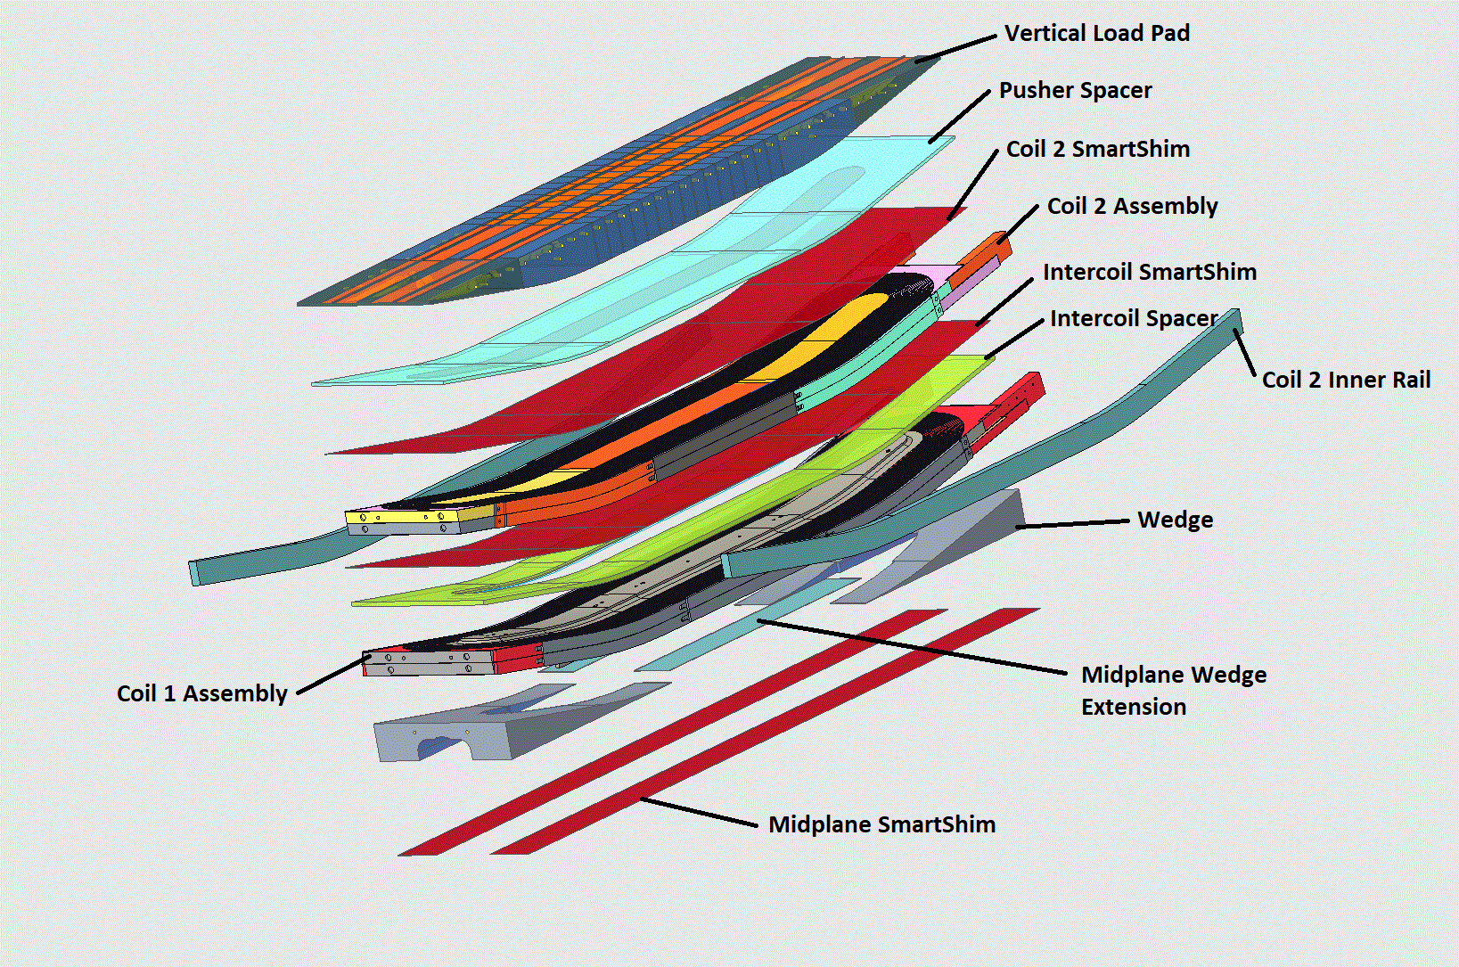
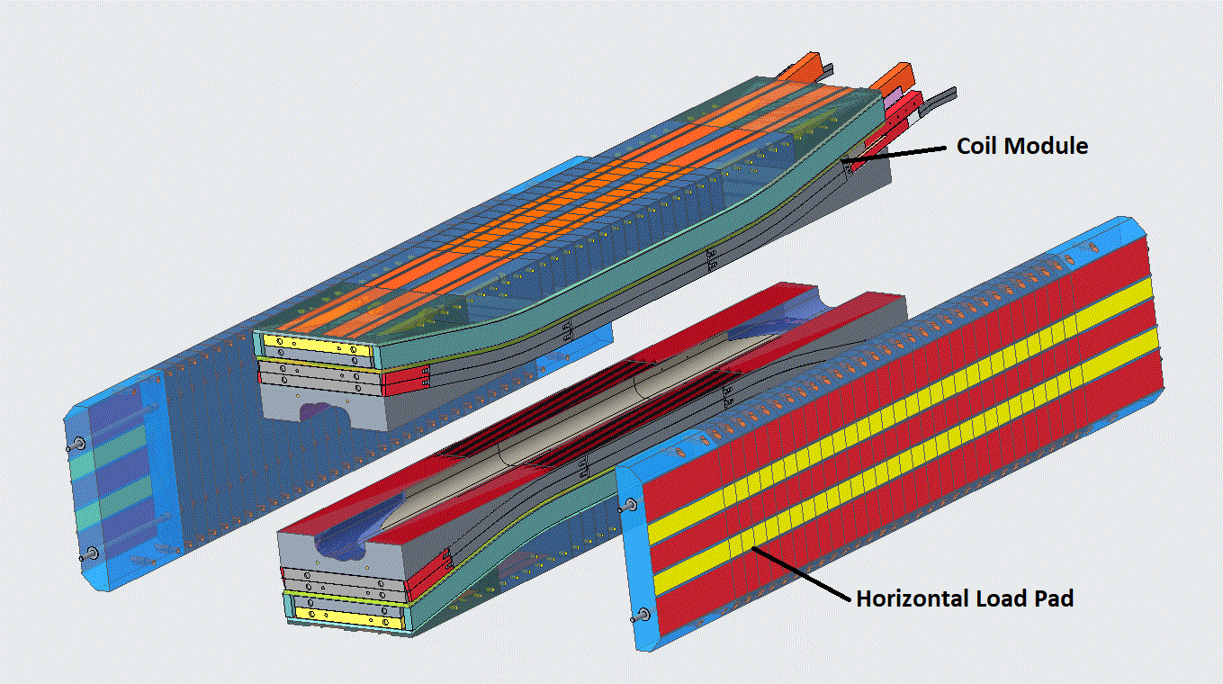
Coil Pack - Overview
Coil pack design employs three different smart shims to ensure good contact at all interfaces (coil/coil, coil/structure, mid-plane)
    This should reduce the impact of impregnated coil size variations
    Key components of coil 1 assembly finalized, others under review
    Coil 2 assembly design in progress

Slide 20
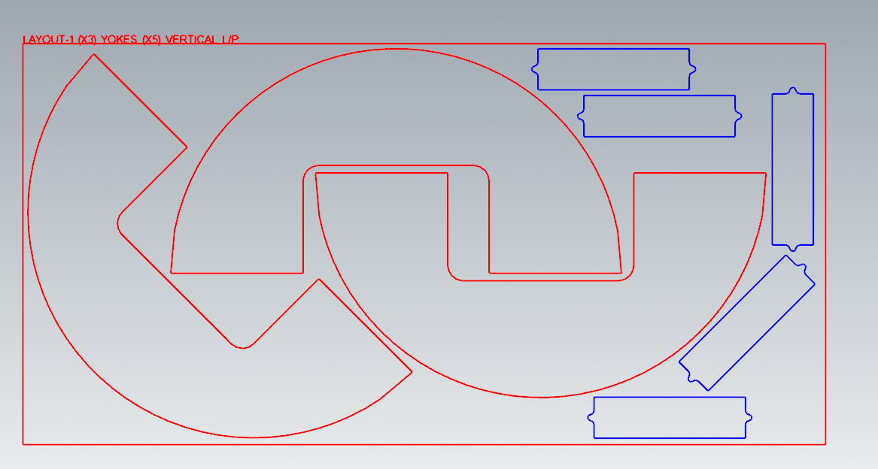
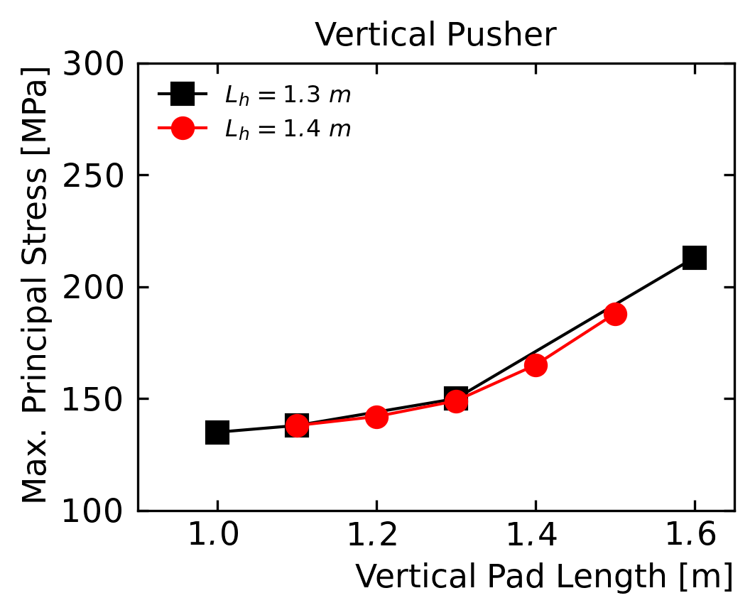
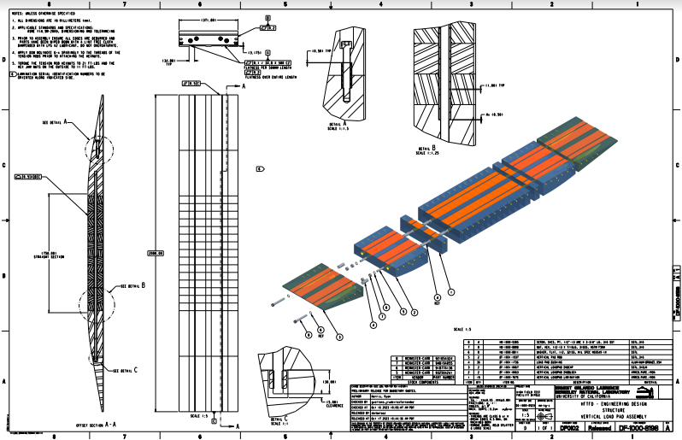
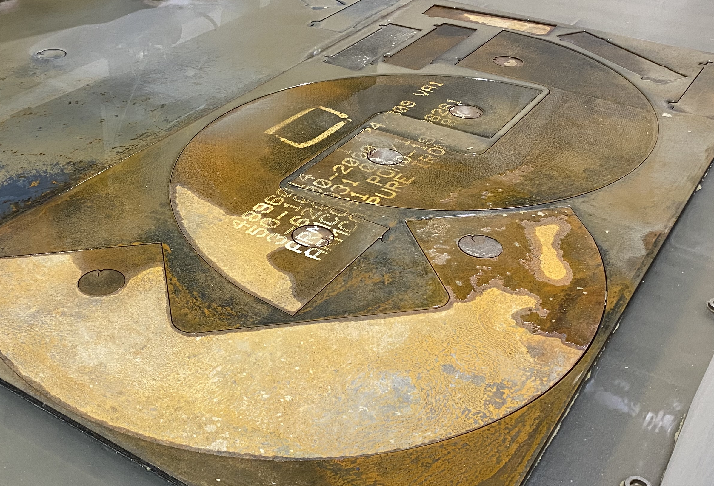
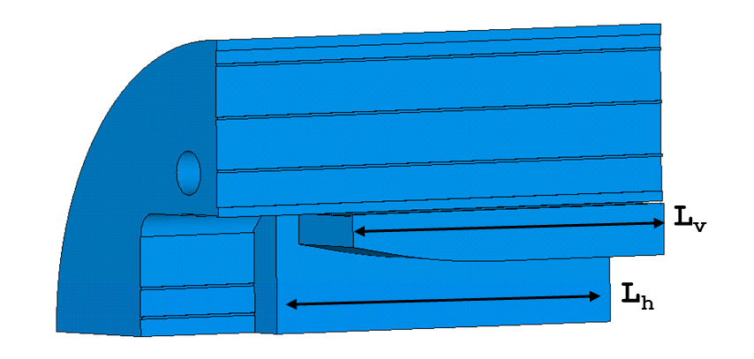
Load Pad Fabrication is in Progress
Load pads composed of iron and stainless steel portions – optimized w.r.t. magnetic and mechanical performance
Procurement of load pads and yoke placed
  Vendor will deliver full load pad assemblies
  Rough water jet cutting of parts in progress – pads and yoke laminations cut from the same plates
Rough Cutting of Yoke/Pad Laminations
Vertical Pad Analysis
Vertical Pad Assembly Drawing

Slide 21
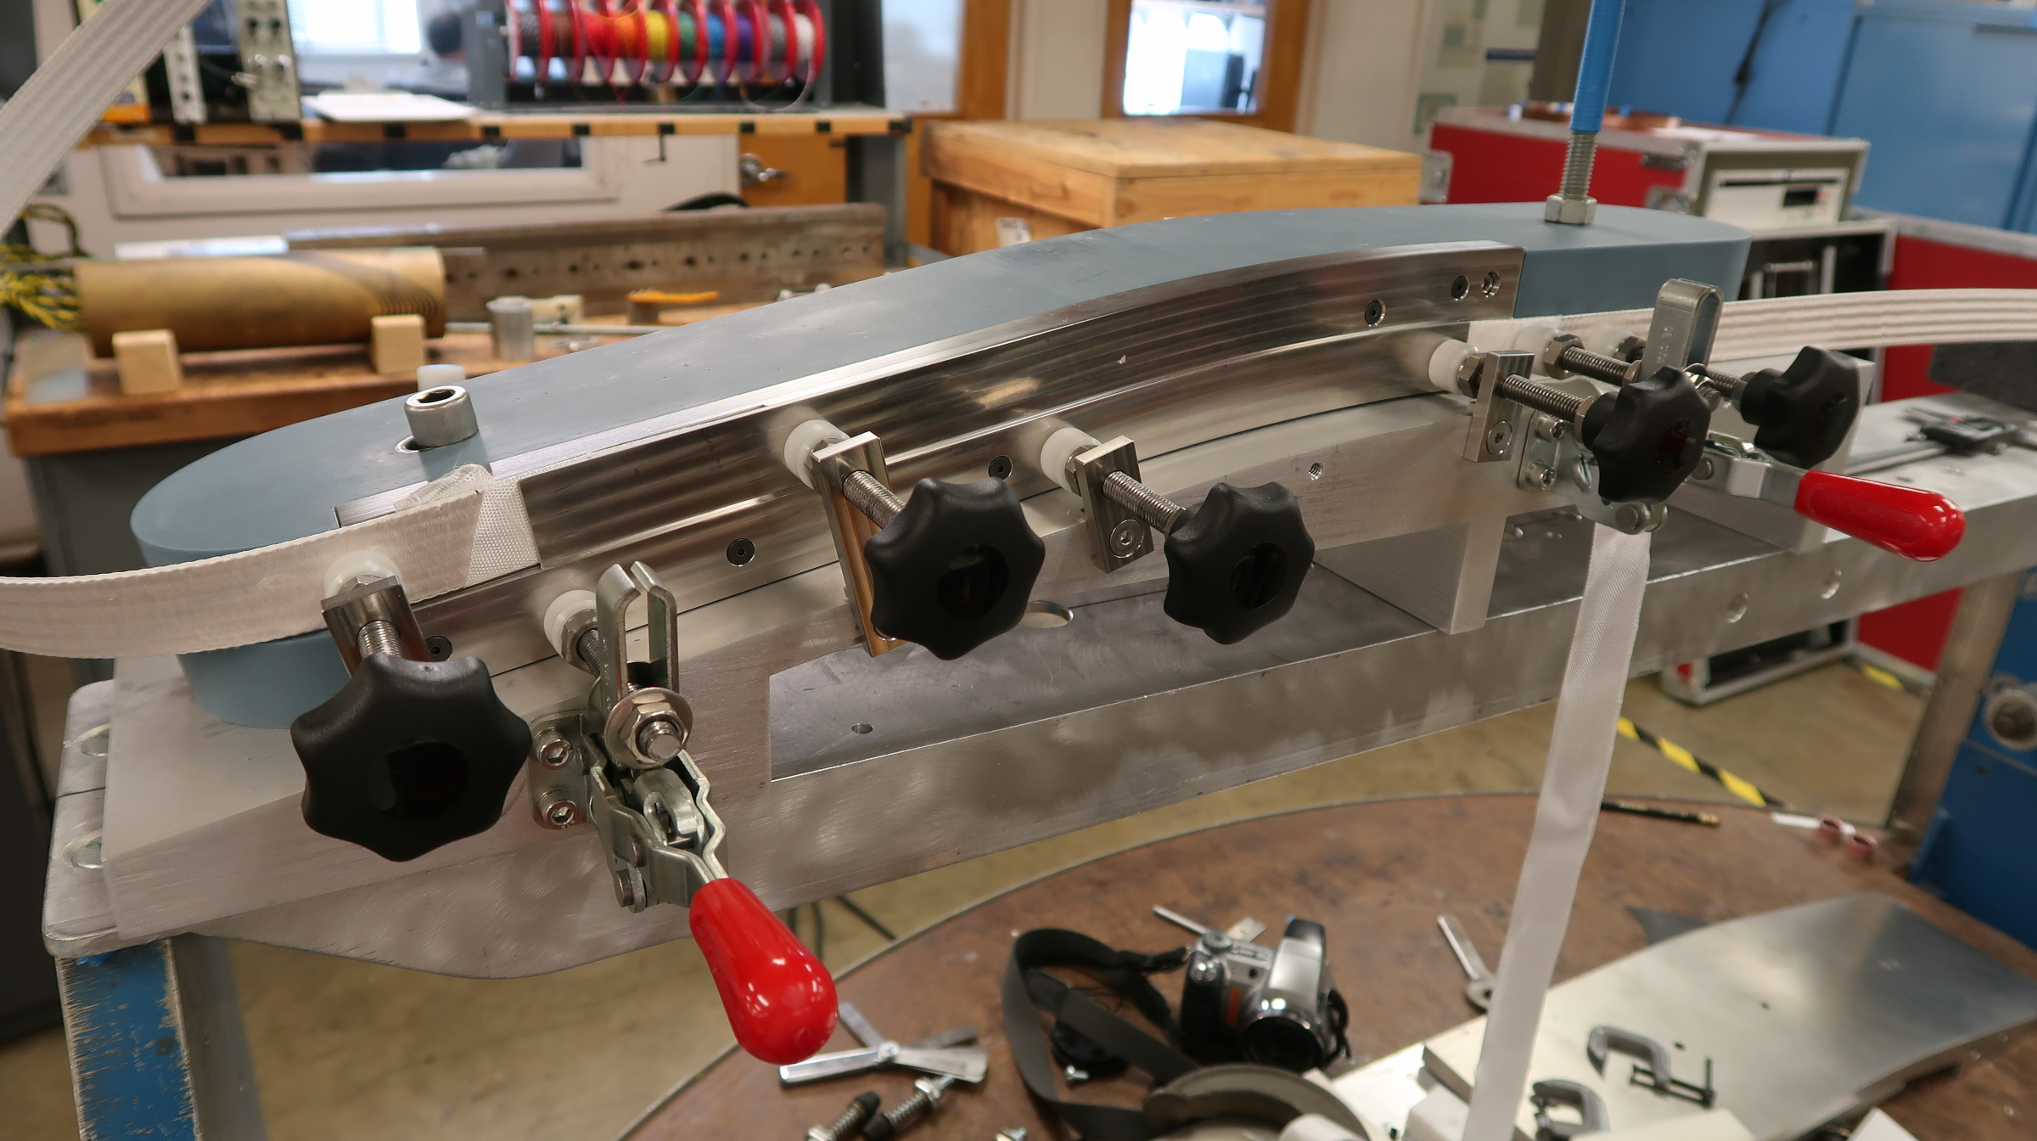
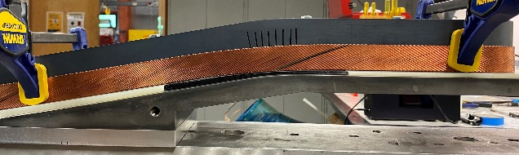
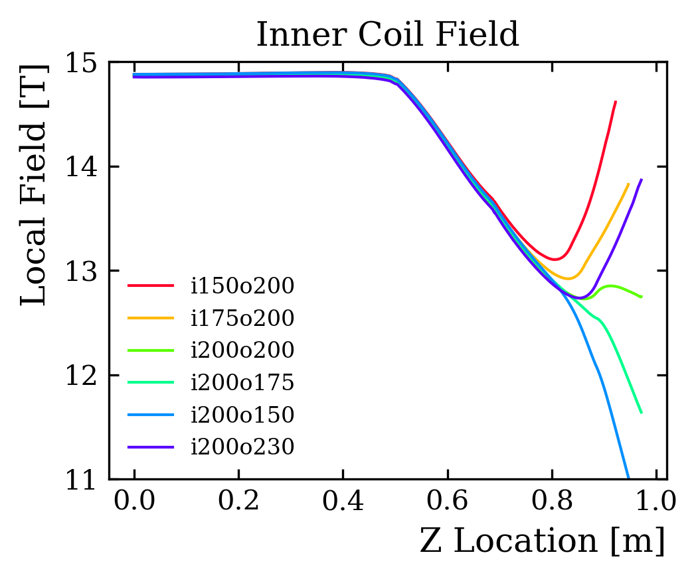
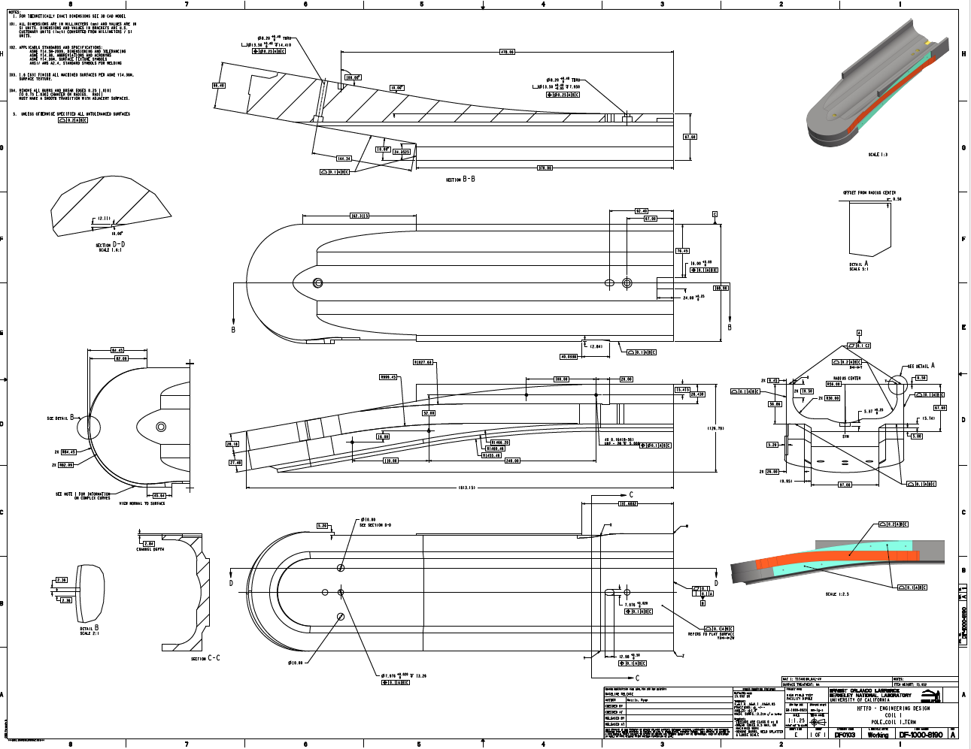
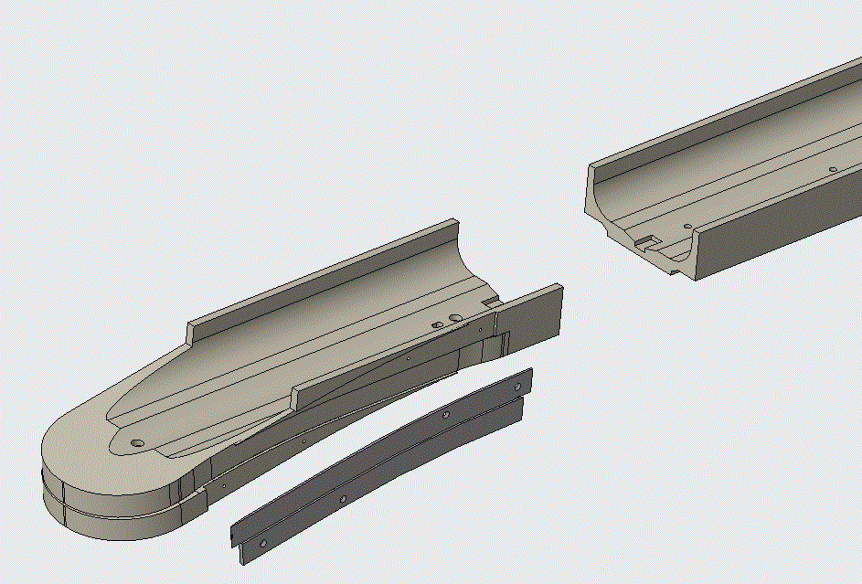
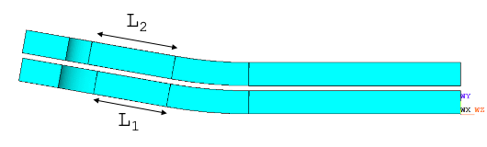
Coil 1 Pole Design is Complete
Hard Bend and Layer Jump Tests
Coil 1 pole composed of three segments, with gaps optimized to account for geometry changes during heat treatment
Pole design was optimized following hard bend tests and layer jump prototyping
Pole drawings are complete, and have been sent for manufacturing quotes
Coil Length Optimization
Pole Segment Drawing

Slide 22
Outline
Introduction and Design Overview
Analysis Highlights
Engineering Status
    Coil Pack
    Structure
Status Summary

Slide 23
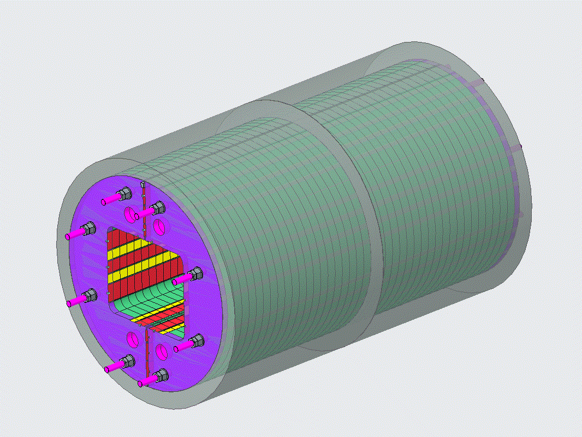
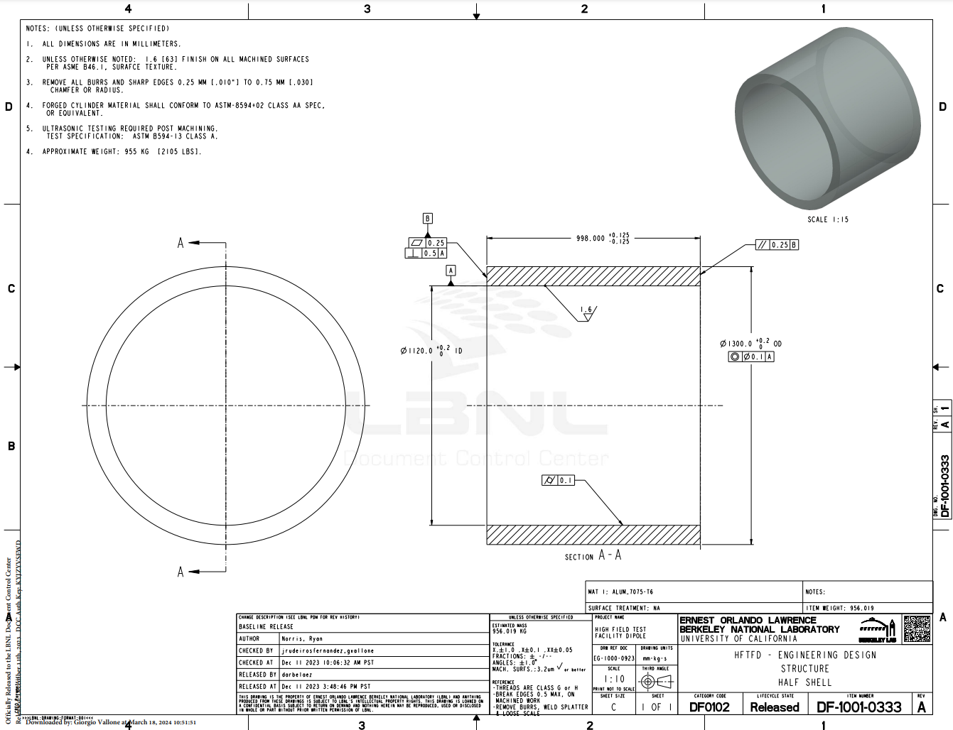
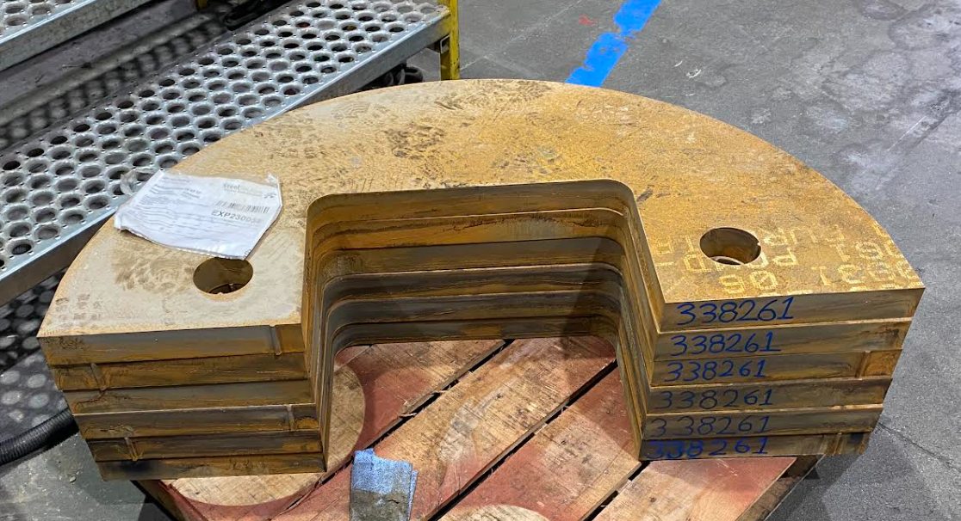
Structure – Shell and Yoke
Shell/yoke subassemblies
    Shell design and drawing finalized, out for quote
    Using Al 7075-T6 leveraging on AUP experience
    Yoke stack in fabrication!
      Procured as complete sub-assembly

Slide 24
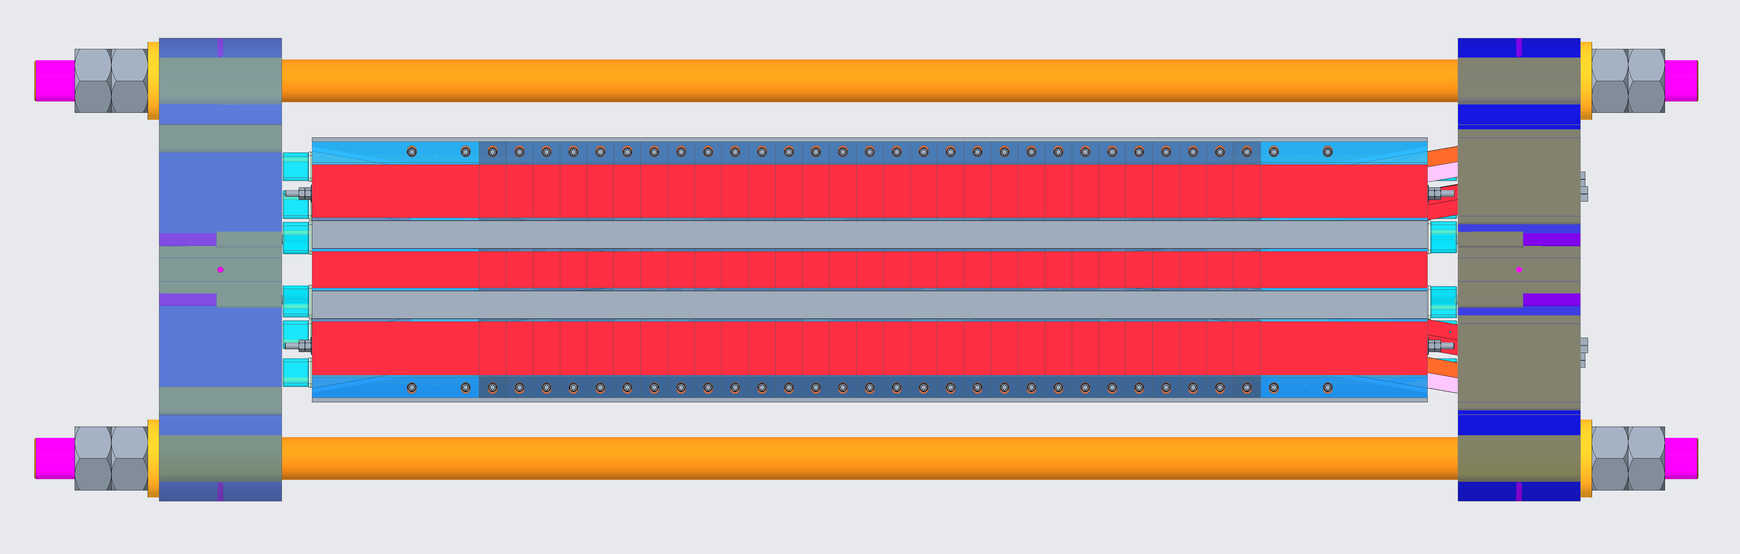
Longitudinal Loading System
Rods
End-plate
Wedge Bullet
Spacers
Rods + end plates longitudinal support system
      ‘Standard’ approach for bladder and key designs
      Target prestress force at cold equal to the e.m. force
Forces significantly larger than anything built before, requiring special solutions
    Spacers used as bullets would not be able to carry the required force
      Custom shimming to guarantee good contact
    End plate and rods require high strength materials
Magnet | Current | Field | Force
/ | kA | T | MN
MQXF | 16.2 | 12.1 | 1.2
FRESCA 2 | 12.2 | 15 | 3.3
TFD | 15.0 | 15 | 6.4
TFD | 16.0 | 16 | 7.3

Slide 25
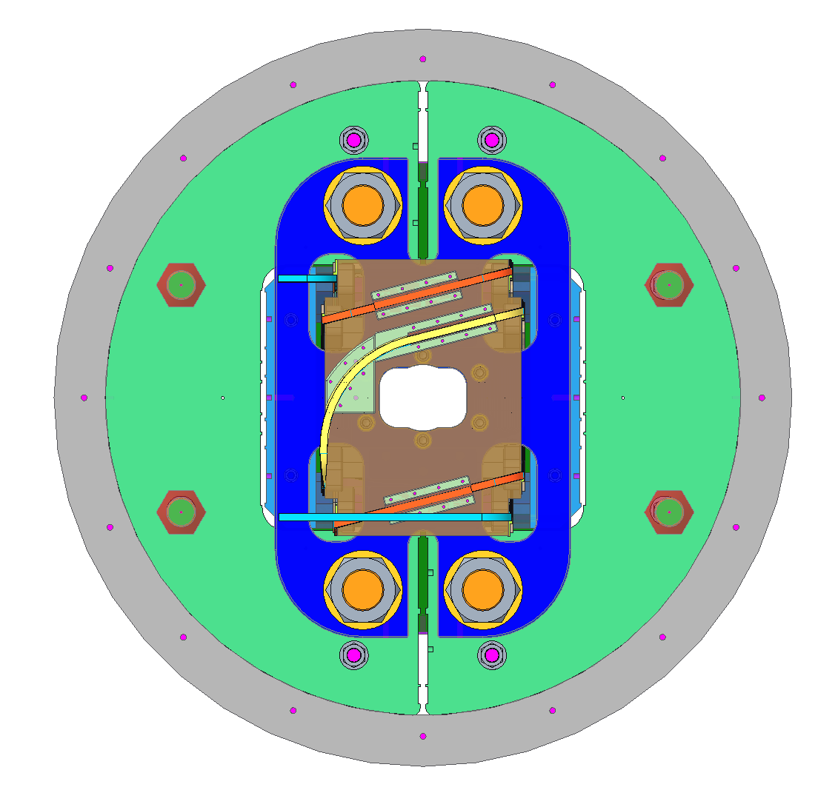
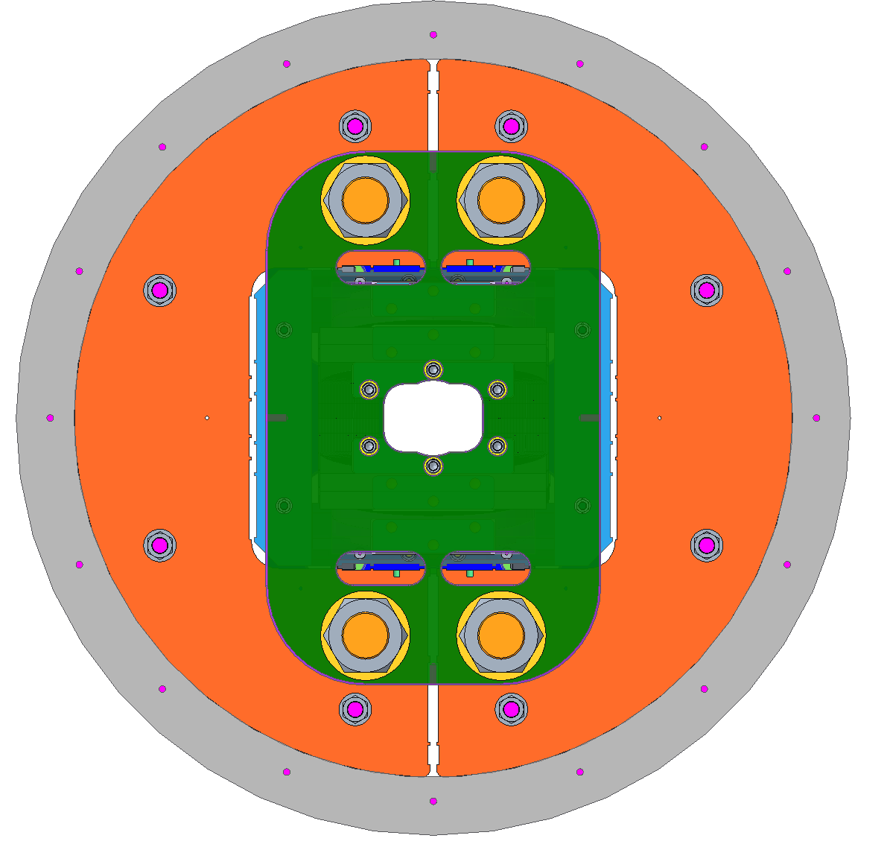
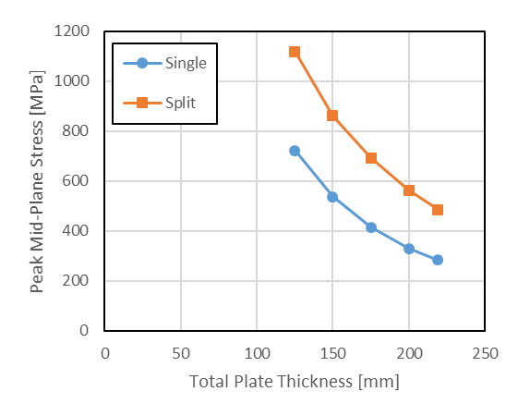
Longitudinal Loading System
Lead
End
Return
End
End plates design allows access to all bladders and keys during assembly operations
  Preliminary design material was Nitronic 40/50 for both rods and end plates
    Requires hardened state (higher yield stress), but this is not available for thick plates
  New baseline use 2 plates in Inconel (nickel-chromium super alloy)
    Similar price, even higher strength. Split plates can be easily procured from stock
    Currently exploring potential procurement of thicker plates

Slide 26
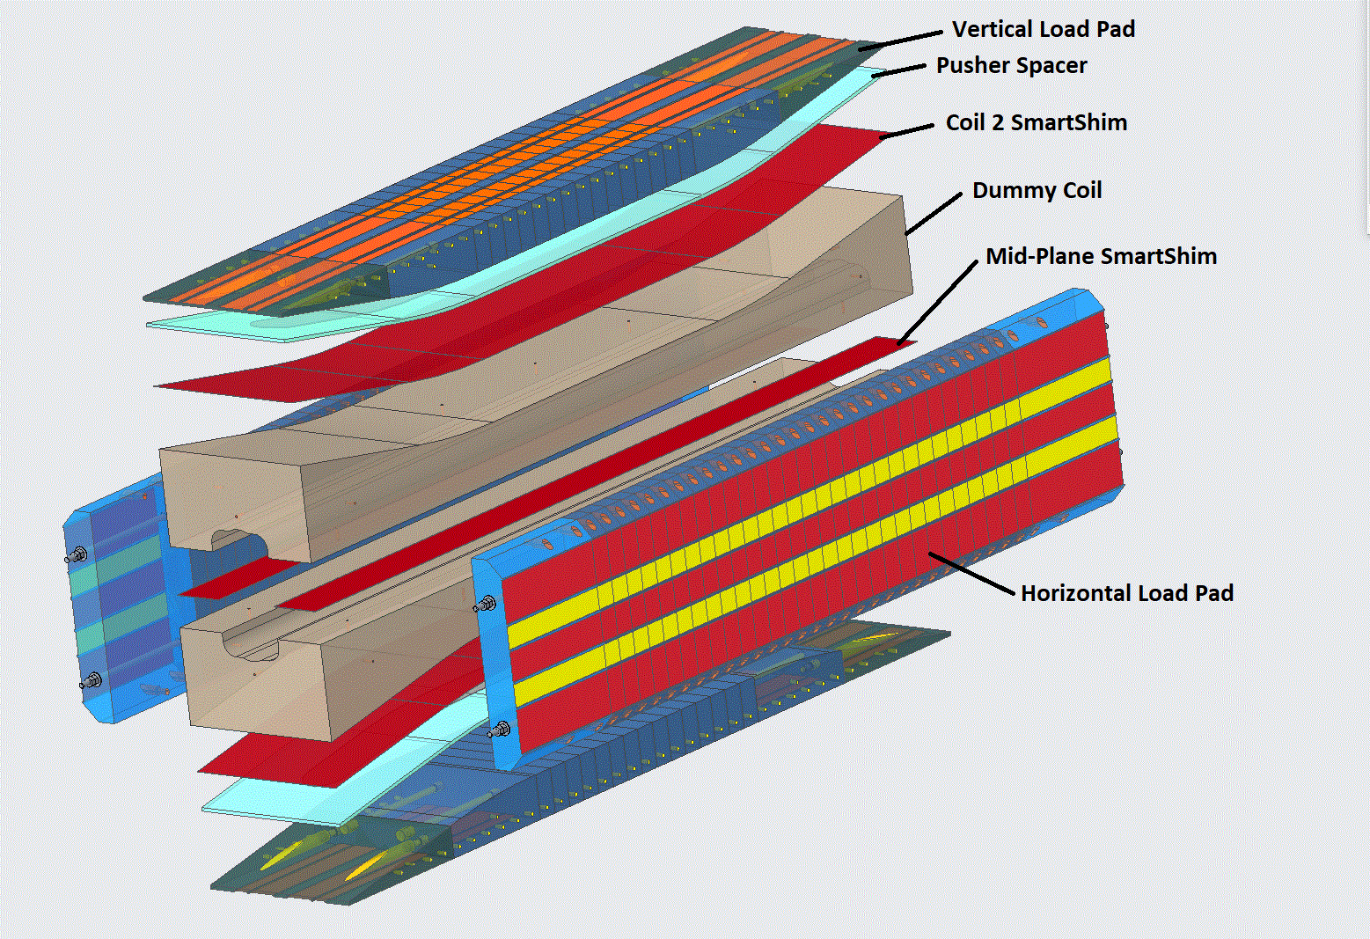
Mechanical Model Assemblies
Mechanical assemblies planned to verify assembly process (e.g. smart shims to accommodate for size variations), structure performance and validate structural analysis
Aluminum dummy coil design finalized, under review
    Single coil, but plan to repeat assembly test after splitting it in two
      Will allow to check smart shim between the coils, and tailored rail shimming

Slide 27
Outline
Introduction and Design Overview
Analysis Highlights
Engineering Status
    Coil Pack
    Structure
Status Summary

Slide 28
Procurement - Status Summary
Part/Assembly | CAD Status | Drawing Status | Procurement Status
Dummy Coils | finalized | pre-review | pending
Half Shells | finalized | released | out for quote
Half Yoke Stack Assembly | finalized | released | in fabrication
Vertical Load Pad Assembly | finalized | released | in fabrication
Horizontal Load Pad Assembly | finalized | released | in fabrication
Spacers | working | pending | pending
End Plates | Iterating - Discussing with vendors available materials
Axial Rods | working | pending | pending
Coil 1 - Pole | finalized | released | out for quote
Coil 1 - Layer Jump Shim | finalized | review | pending
Coil 1 - Other Spacers | working | pending | pending
Coil 2 Components | working | pending | pending
Coil Module Components | working | pending | pending
Key components required to start assembly in fabrication or out for quote
    Will be able to start soon with the shell/yoke subassemblies and coil 1 winding

Slide 29
EOC#2 Answers (1)
1. Calculations and performance allowables should address fracture limit of Nb₃Sn filaments (…) The equivalence approach used to date may not be fully representative (…)
Research is in progress at LBNL to further understand fracture in Nb₃Sn filaments under realistic load conditions. See: https://ieeexplore.ieee.org/abstract/document/10354066
2. How the experience accumulated from the HL-LHC, the US-MDP, and the EU FCC activities is included (…) winding geometry (strand pop-outs), tooling, and geometry changes during heat treatment, quality of the impregnation vs. dielectric strength, and impregnated coil geometry.
Hard-way bend testing and winding testing (with layer-jump) allow the team to select an optimal geometry that prevents strand pop-out
Geometry changes during heat treatment taken into consideration with pole gaps, not introduced in other block magnets
We plan to account for variations in the impregnated coil geometry using smart shims. The process will be tested with mechanical assemblies

Slide 30
EOC#2 Answers (2)
3. Based on the experience in FRESCA2, the most critical area appeared to be the transition from the straight to the end, at the location of the sharp wedge. Engineering should address this transition, answering the points left open by the work on FRESCA2. It will be beneficial to use direct data from FRESCA2 testing (through P. Ferracin and colleagues at CERN), as well as more recent work on block coils taking place at CEA (e.g., E. Rochepault).
Wedge design was optimized using a non-impregnated approach as analysis showed debonding during preloading and operation, which could lead to quenches.
Prestress system was optimized to minimize the gap opening at the transition between the coil and the wedge.
4. It was not clear from the presentations how design changes were managed, approved, and documented. We recommend creating an “official” design document that contains all specifications and requirements. It wasn’t clear that the PLM document covered everything, e.g., insulation thickness, strand, and cable specifications, etc
All engineering data related to the magnet is version controlled and managed in PTC Windchill (PLM), which is also used for release, review and approval process. Released drawings and documents are published to the LBNL document control center (DCC).

Slide 31
Extra

Slide 32
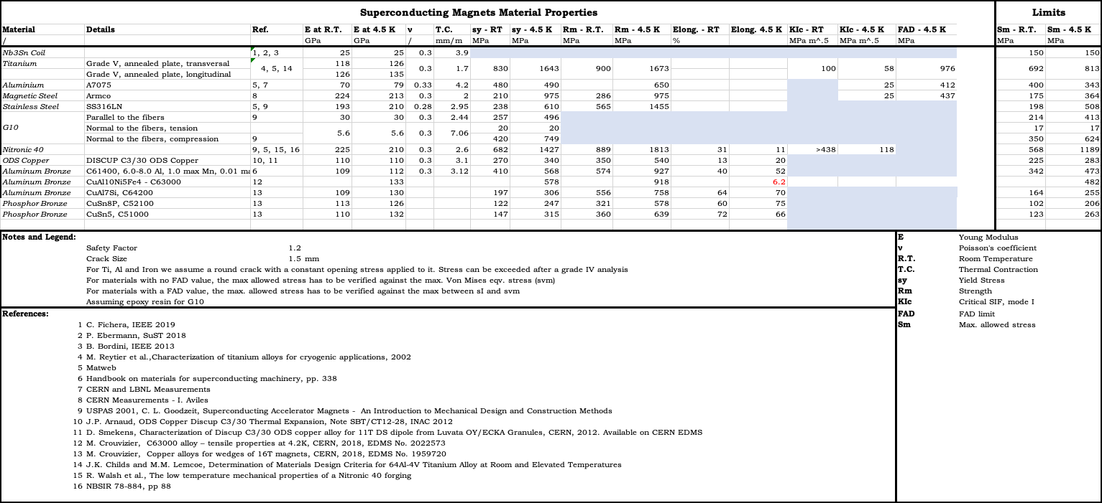
Material Properties
Design criteria extracted from AUP design criteria, and material properties from literature review
Von Mises eqv. stress for ductile materials. Higher between VM/ S1 for fragile materials (conservative)
Coil limits at cold: Von Mises < 150/180 MPa (low field/ high field regions)

Slide 33
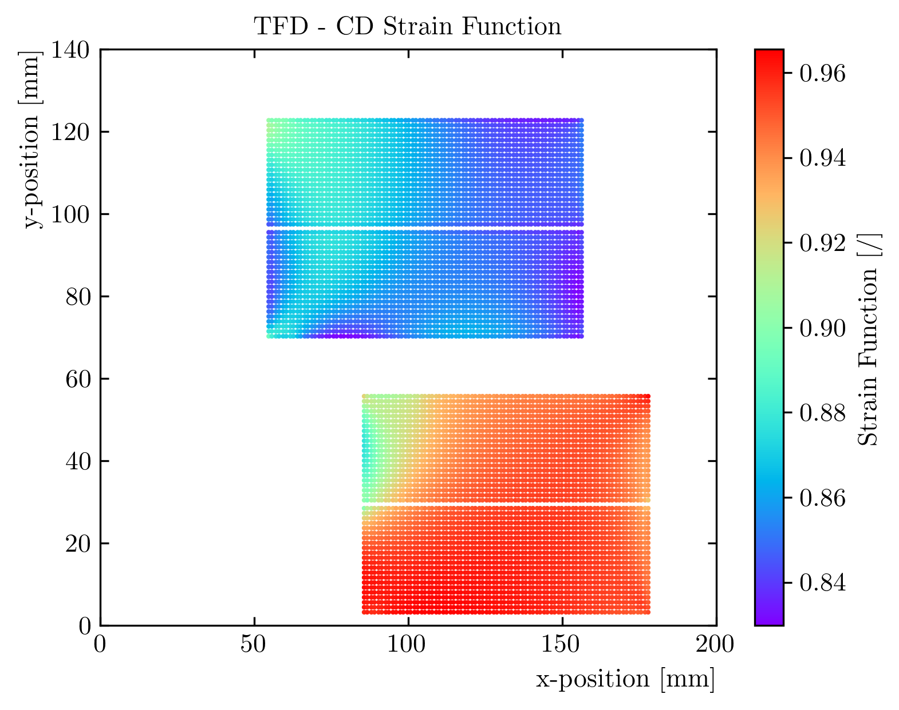
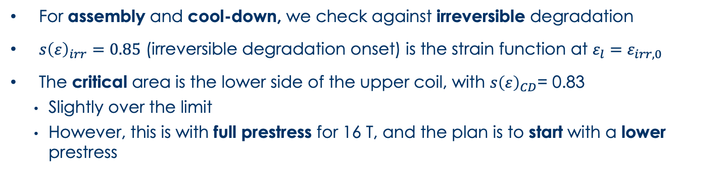
Irreversible Degradation
Critical
area
For assembly and cool-down, we check against irreversible degradation
$s{\left(ε\right)}_{irr}=0.85$ (irreversible degradation onset) is the strain function at $ε_{l}=ε_{irr,0}$
The critical area is the lower side of the upper coil, with $s{\left(ε\right)}_{CD}$= 0.83
    Slightly over the limit
    However, this is with full prestress for 16 T, and the plan is to start with a lower prestress

Slide 34
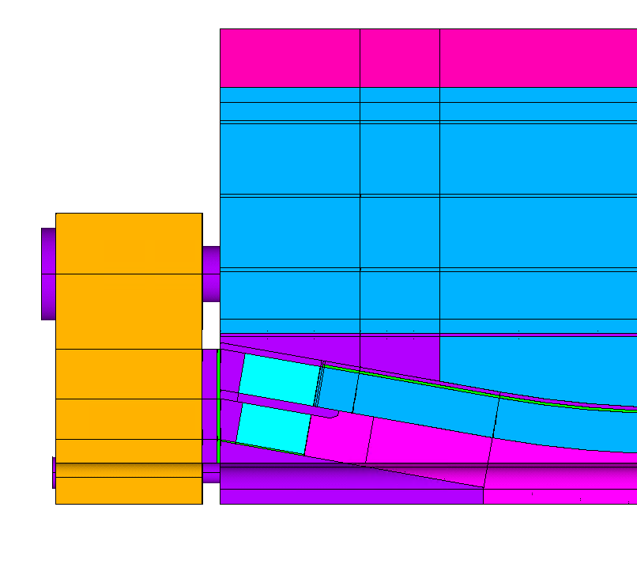


End Region Optimization
Coil ramp length
Iron pads
length
Longitudinal load system
End spacer thickness
Several solutions for the end-region optimized to minimize coil stress, avoid coil/pole debonding, and maximize the straight section length…
…respecting fabrication/manufacturability constraints
Wedge design

Slide 35



Wedge Optimization
Wedge
Wedge
Interface
Mid-plane shim
Interface
Triangle
Pole Interface
Wedge/Pole Gap
Options considered for wedge design:
    Triangle and wedge in one steel piece, non-bonded
    Triangle in GFRP, bonded
    Triangle in GFRP, as additional component
    Option II discarded because computations show that the triangle would debond during loading
    Option III discarded as a gap between the wedge/triangle would open during operation
Non impregnated wedge is kept in place by ‘soft’ bullets:
    Bullet size/material was optimized minimizing the wedge/pole gap, and limiting the impact on coil prestress
Wedge
bullet

Slide 36



Sample Holder Load Cases
F_{s}
F_{s}
Displacements
Design was created assuming no mechanical interaction between the magnet and the test well
    At the moment, it is not clear if this will be the case
We investigated potential usage scenarios:
    E.g. non-centered fusion cables: 200 kN symmetric load. Only quadrant model available but should be as conservative as possible
    Negligible impact: displacements < 4; stresses < 1 MPa
Stresses

Slide 37
Aluminum shell
Iron yoke
Yoke rods
Steel rods
Iron pads
Steel keys
Steel pusher
Iron pole
Coil 2
Steel spacer
Ti pole
Coil 1
Steel rail
AlBr rail
Al spacer

