Slide 1
High Temperature Superconductor Cable Test Facility
Manufacturing and infrastructure status
José Luis Rudeiros Fernández, Diego Arbelaez, P. Ferracin, R. Hafalia, P. Mallon, M. Naus, S. Nguyen, R. Norris, G. Sabbi, A. Saravanan, M. Solis, G. Vallone
Lawrence Berkeley National Laboratory
March 20, 2024
LBNL, Berkeley, CA

Slide 2
Outline
Introduction
Coil manufacturing
Magnet assembly
Summary

Slide 3
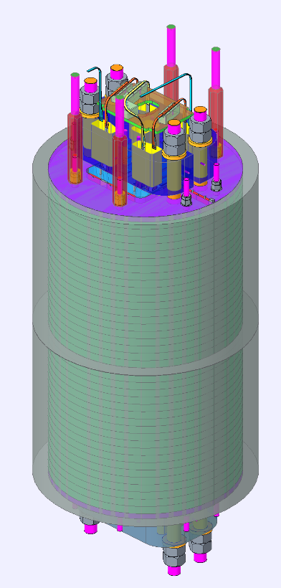
Introduction
Magnet assembly
Half-shell yoke assembly
Alignment of two half-shell yoke assemblies
Coil pack insertion
Magnet loading
Coil fabrication
Preparation for winding
Winding
Preparation for reaction
Reaction
Preparation for impregnation
Impregnation
Presented coil fabrication process, main components, tooling, and fabrication sequence are focused on coil 1 (practice coil).
Components, fabrication tooling, and process expected to feedback into coil 2.
Magnet assembly processes to be tested during the dummy assembly (aluminum dummy coils).
Main contributions to all design presented here from the new design team: S. Nguyen, R. Norris, A. Saravanan
Coil 1
Coil 2

Slide 4
Outline
Introduction
Coil manufacturing
Magnet assembly
Summary

Slide 5
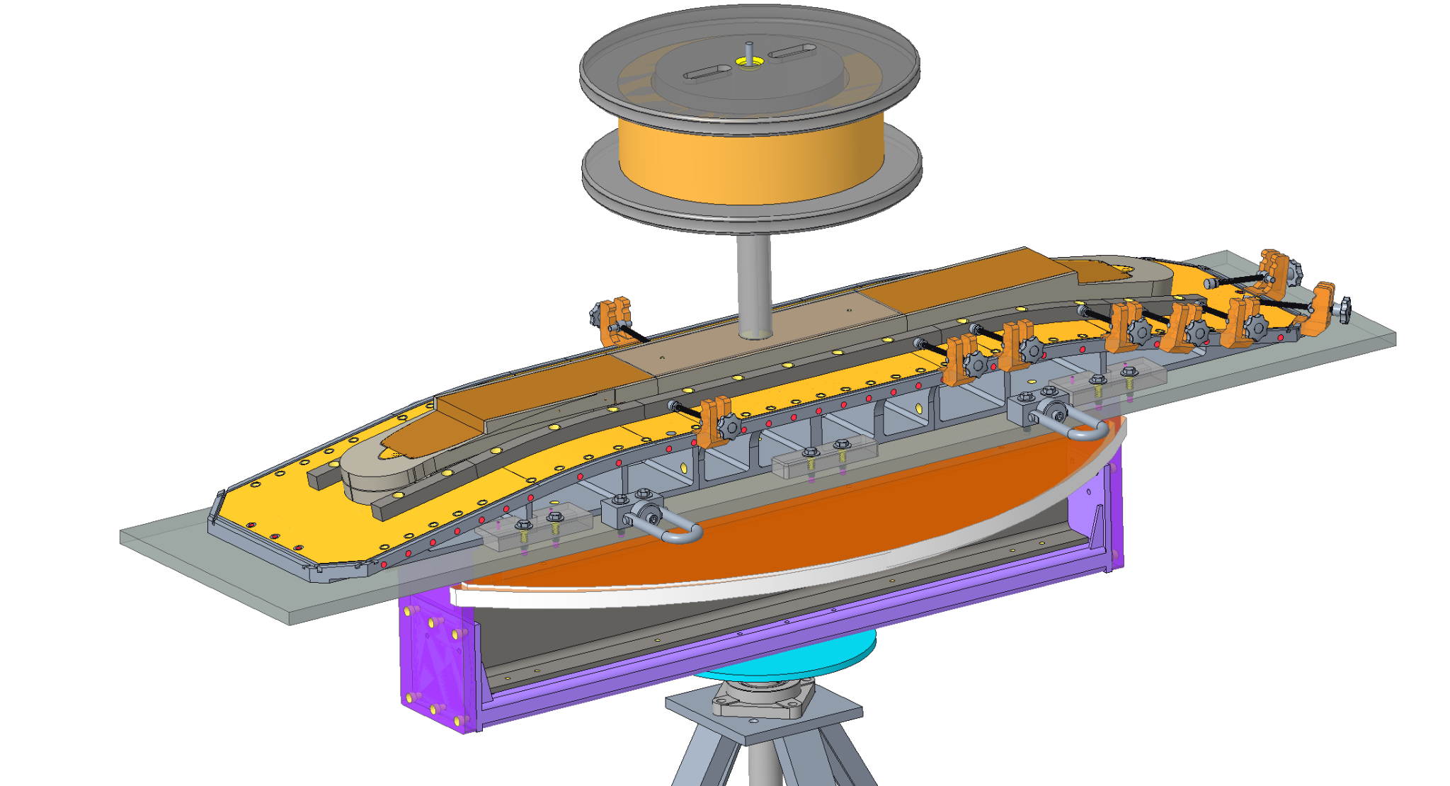
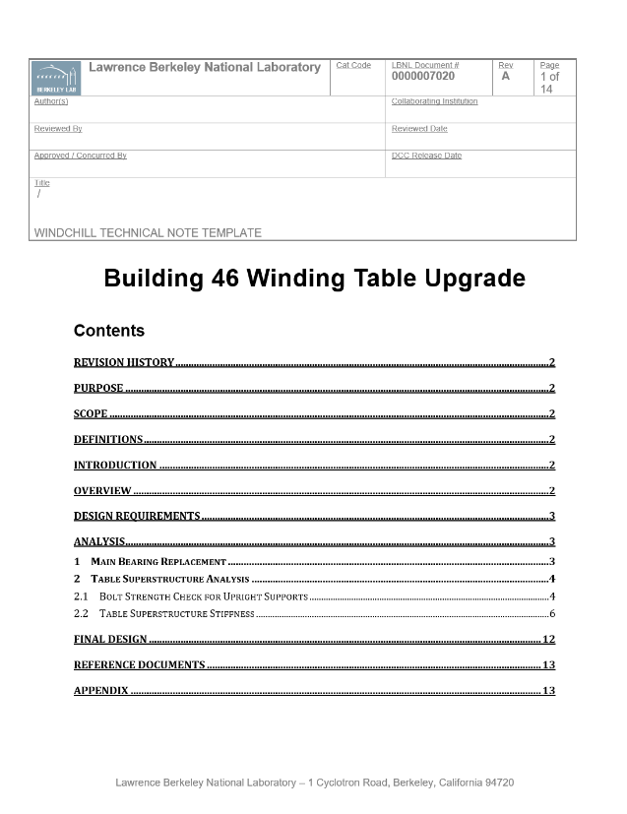
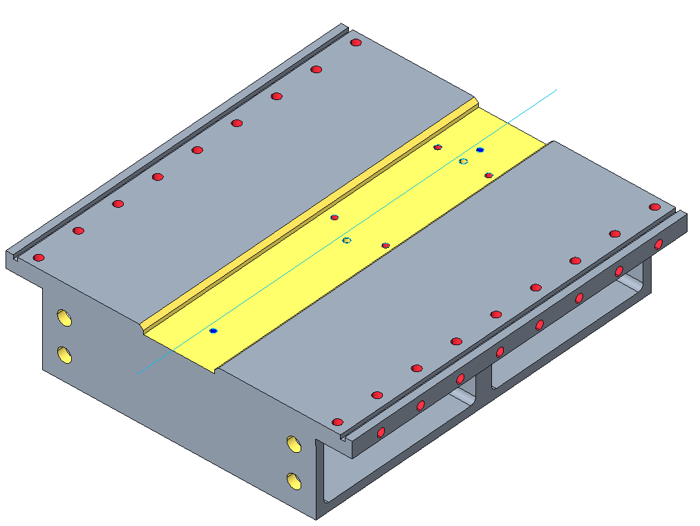
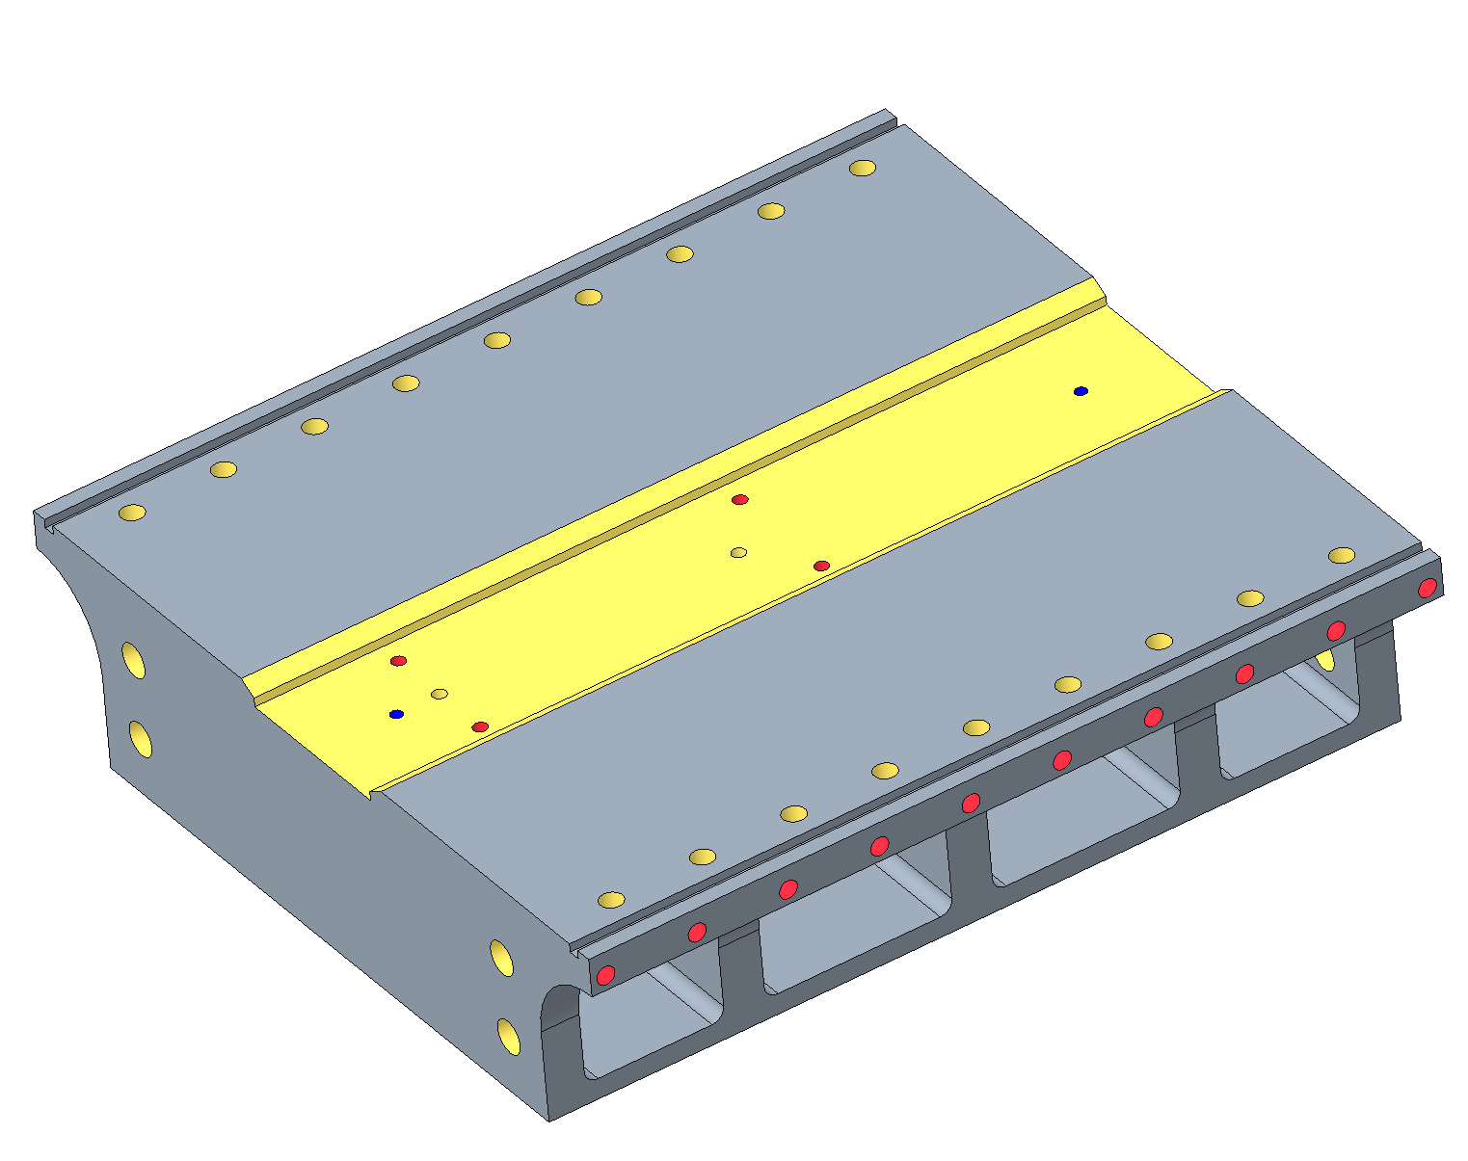
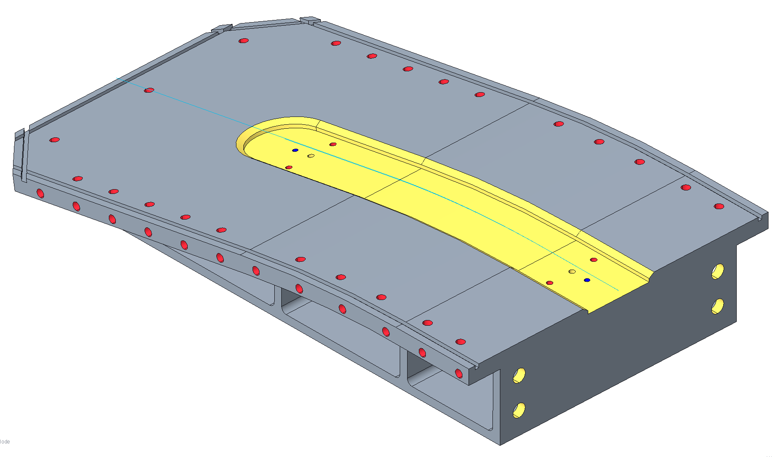
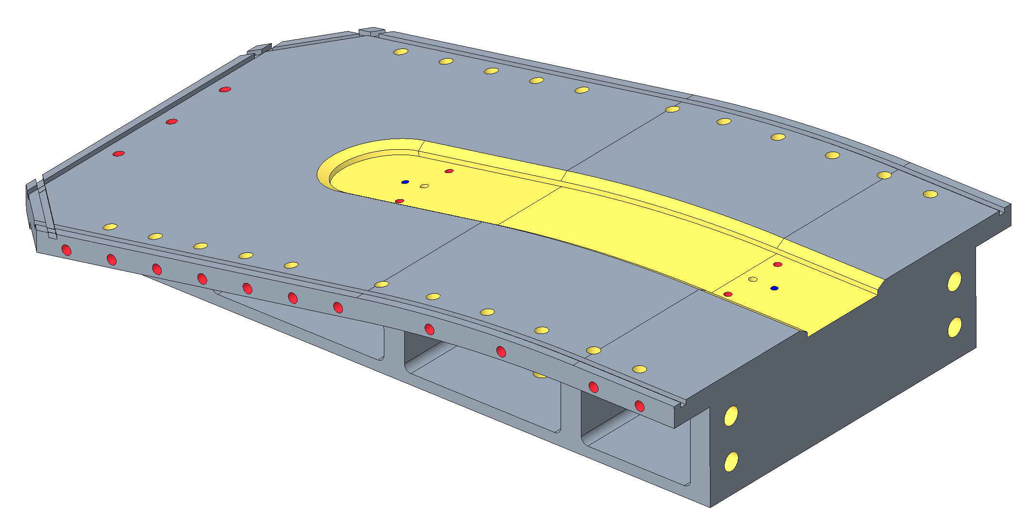
Coil manufacturing – Winding: support structure
Coil fabrication
Preparation for winding
Upgraded winding support structure
Progress since EOC #2
New design of winding table (beam, lateral posts, and spool support).
Engineering Document in release process with all details of the upgraded winding structure.
Improved design of winding base components (reducing potential creep at high temperatures).
B46
Winding base design

Slide 6
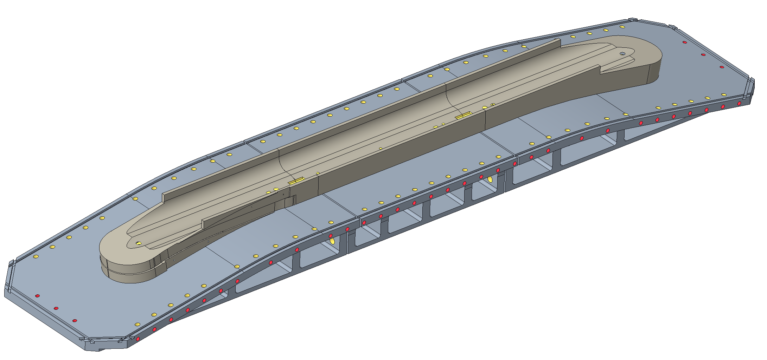
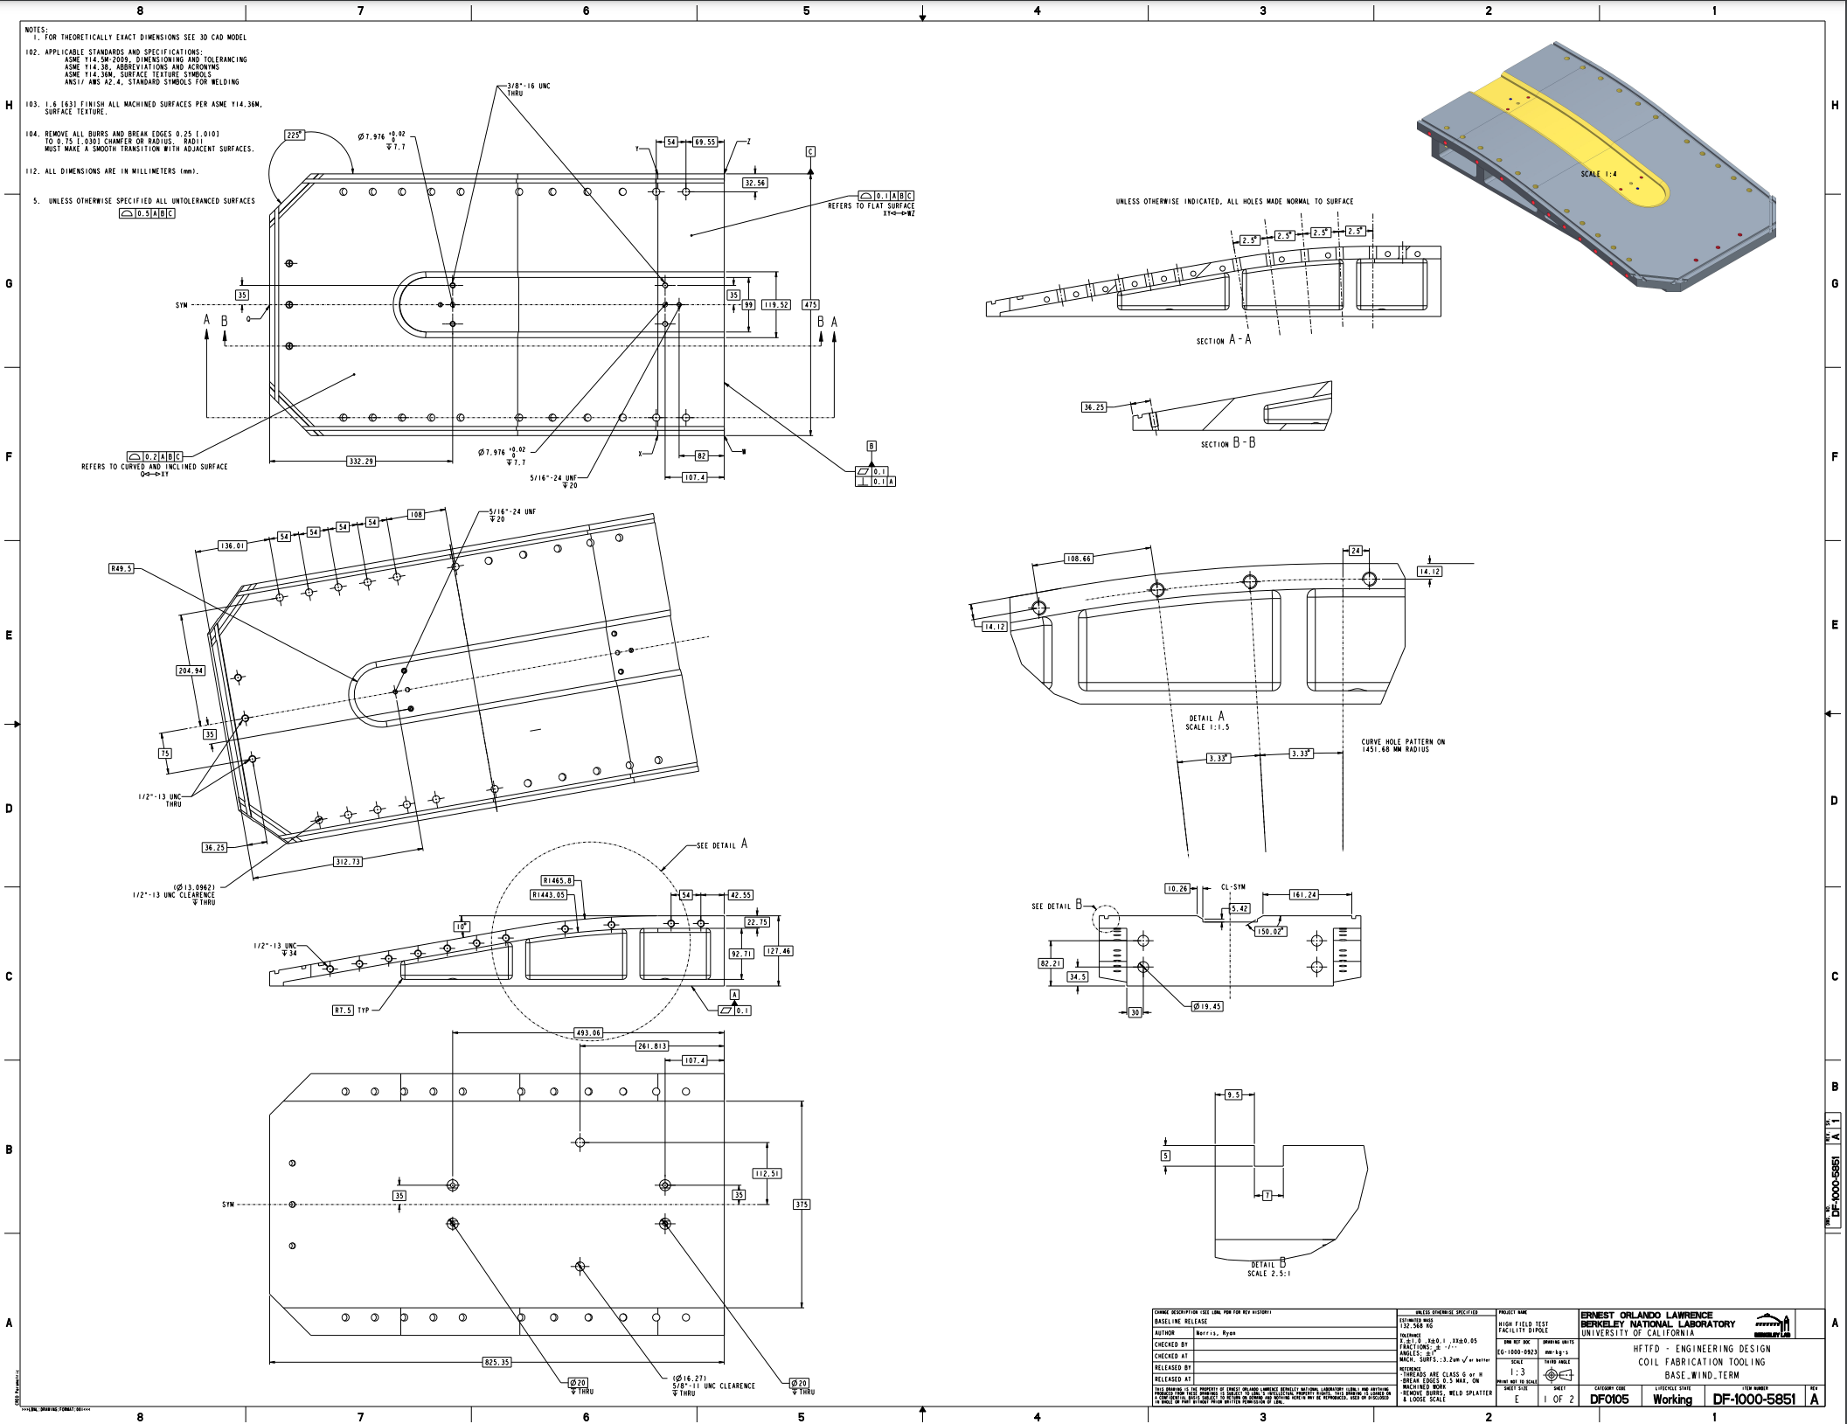
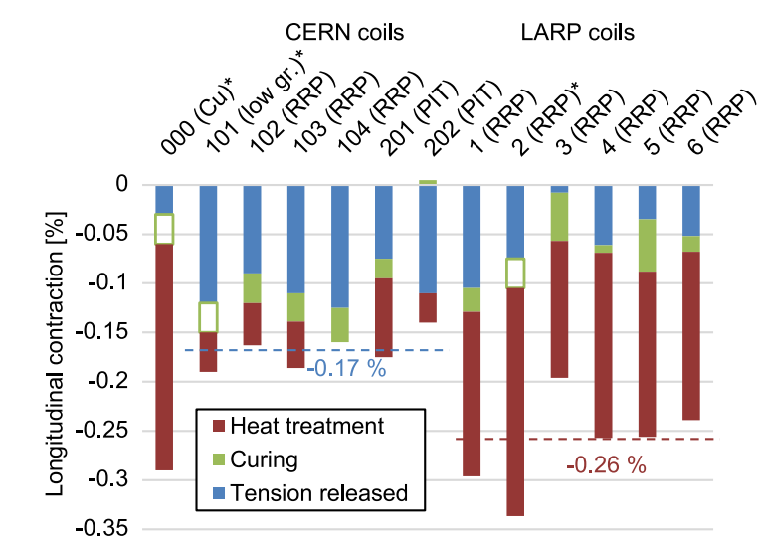
Coil manufacturing – Winding: Pole and gaps
Coil fabrication
Preparation for winding
Table and pole spacing
Progress since EOC #2
For the prototype coil, an initial gap in the pole will be established at >5 mm to ensure the gap does not close completely.
The material of the winding base (and all similar components) is planned to be a series 316 stainless steel.
Exploration study comparing SS 316 and SS 400 series in order to find a better material for reaction tooling.
Implementation in the design of the winding base of required gaps.
Technical drawings in final release process.
B46
Gaps for reaction
$$L_{p2}$$
$${Gap}_{pole}$$
$$L_{p1}$$
Central plane
Initial estimations for gaps are based on information from CERN and LARP coils, as well as FRESCA2 coils.
Pole extremity
Pole center
Cable
$$L_{cable}$$
Table extremity
Table center
$$L_{t2}$$
$${Gap}_{table}$$
$$L_{t1}$$

Slide 7
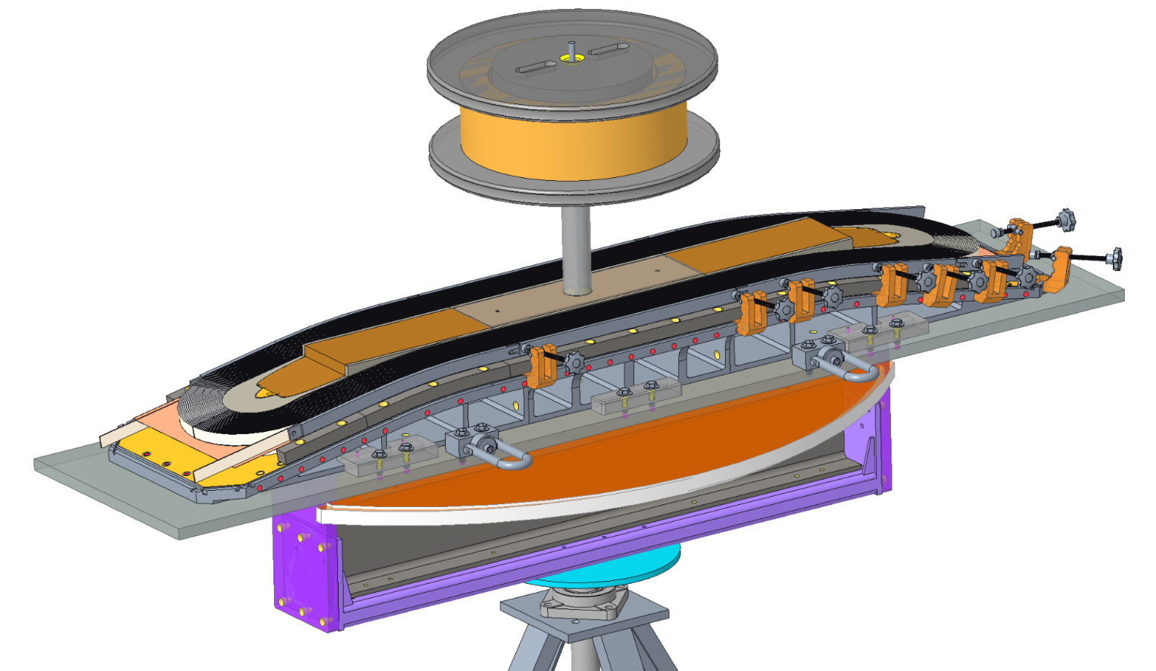
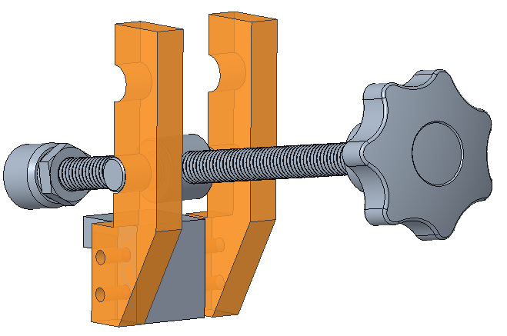
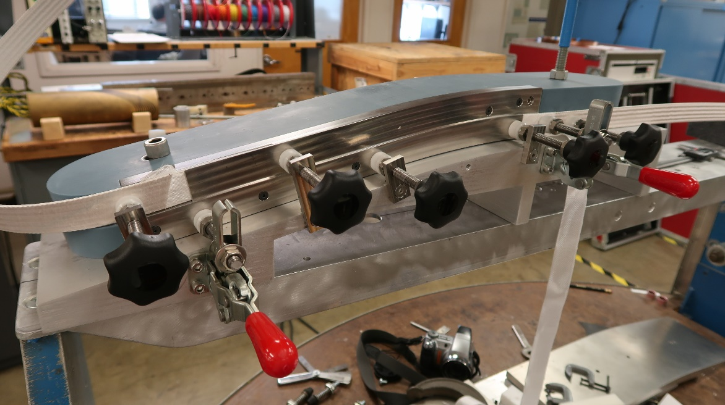
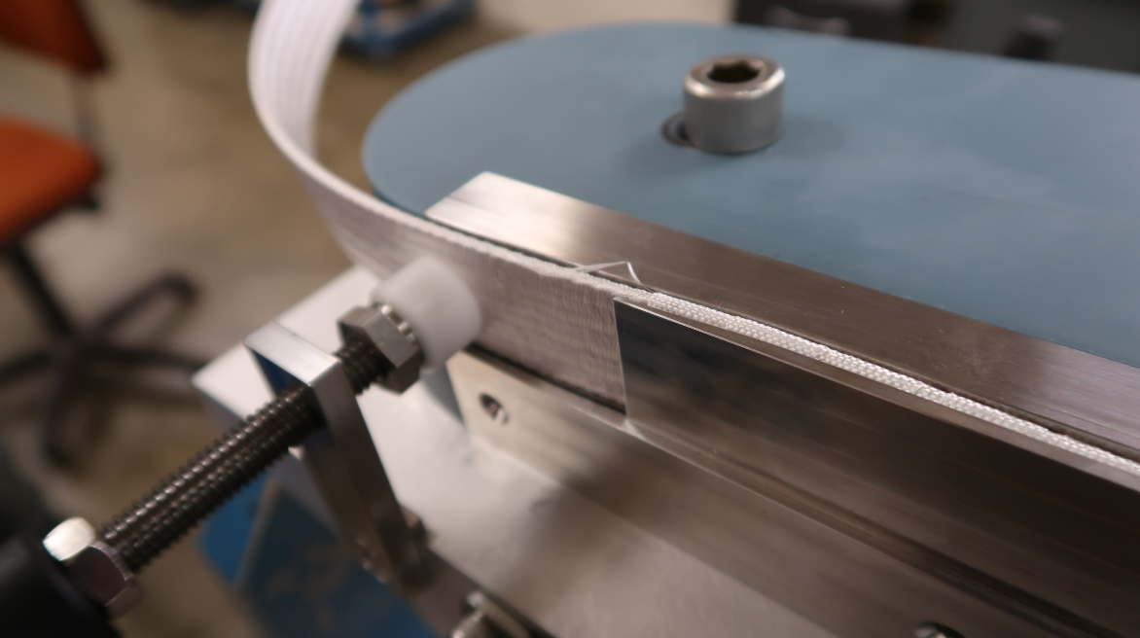
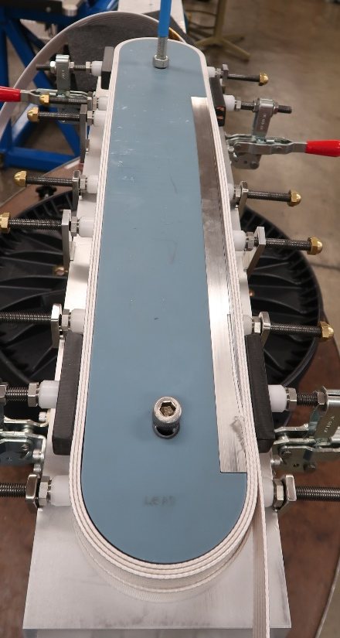
Coil manufacturing - Winding
Coil fabrication
Preparation for winding
Winding
Winding of the coil
Progress since EOC #2
During winding, the cable is held in place by a few that are pushed by a series of clamps that are locked into the outer groove included in the winding bases (like FRESCA2).
Redesigned clamping system and lateral pushers. First parts in fabrication.
Redesign of pole fillers for reaction.
Technical drawings in final release process.
B46
B46
*No gaps are represented
Initial winding testing feedback into the design of the layer jump and winding process.

Slide 8
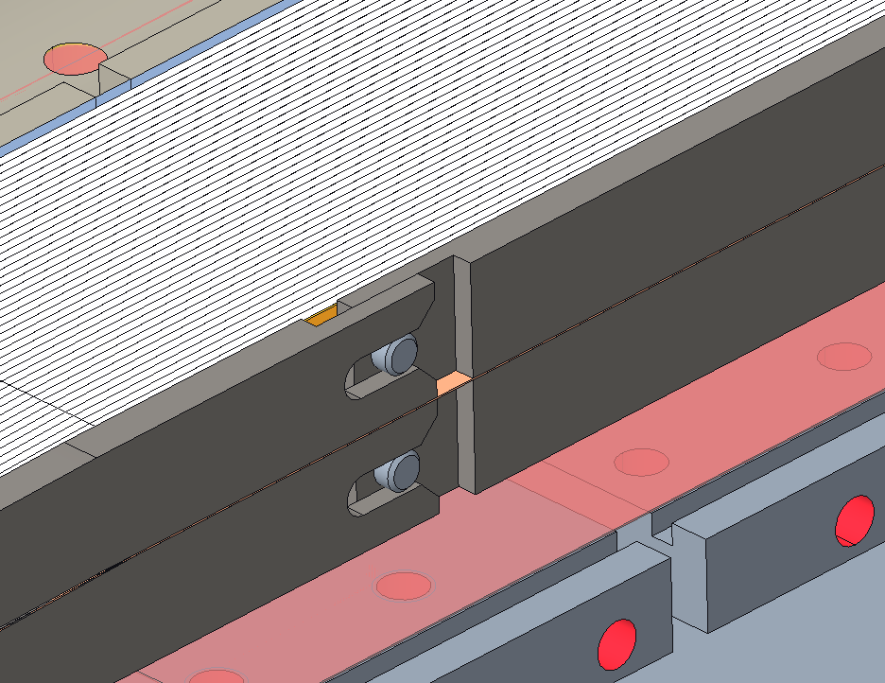
Coil manufacturing - Preparation for reaction
Coil fabrication
Preparation for winding
Winding
Preparation for reaction
Progress since EOC #2
New design of reaction tooling components (significant reduction of complexity by reducing the number of components).
Improved design of reaction lead support, splice support, and end shoe pushers.
B46
B46
B46
After winding, the winding base is unlocked from the support structure, and the winding tension is relaxed.
The side rails (plasma sprayed in the inner surfaces) are put in place.
The side blocks are added until the coil is enclosed.
After placing the bore-filler the assembly is closed with a series of top plates.
The assembly is closed with bolted connections between the side pushers and base and top plates.
Double mica layer bridging the table gap.

Slide 9
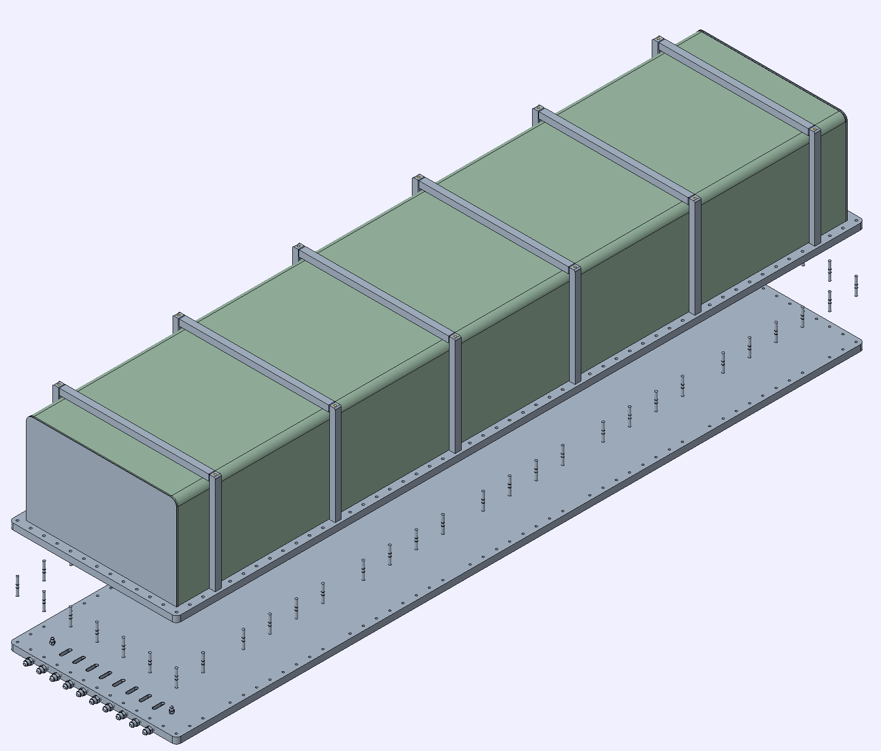
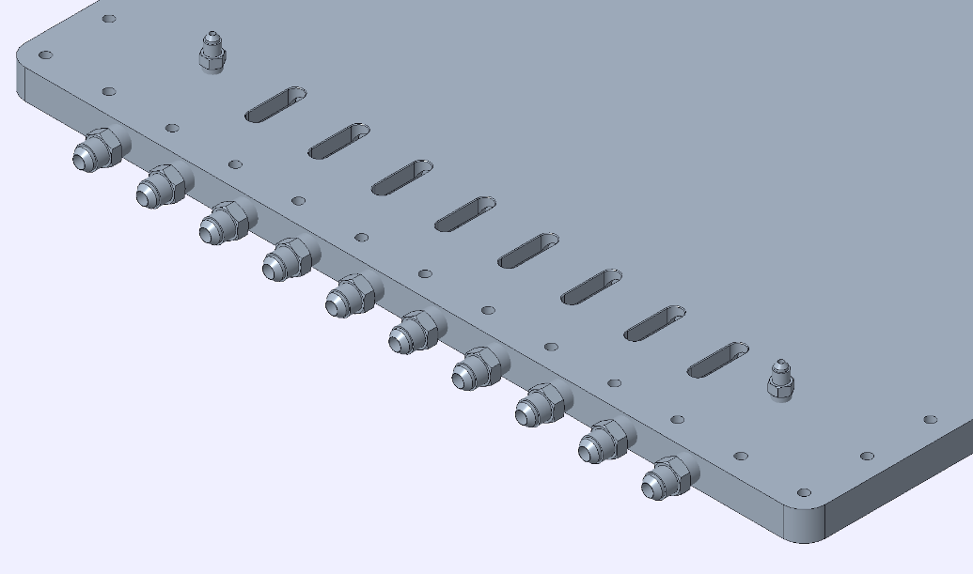
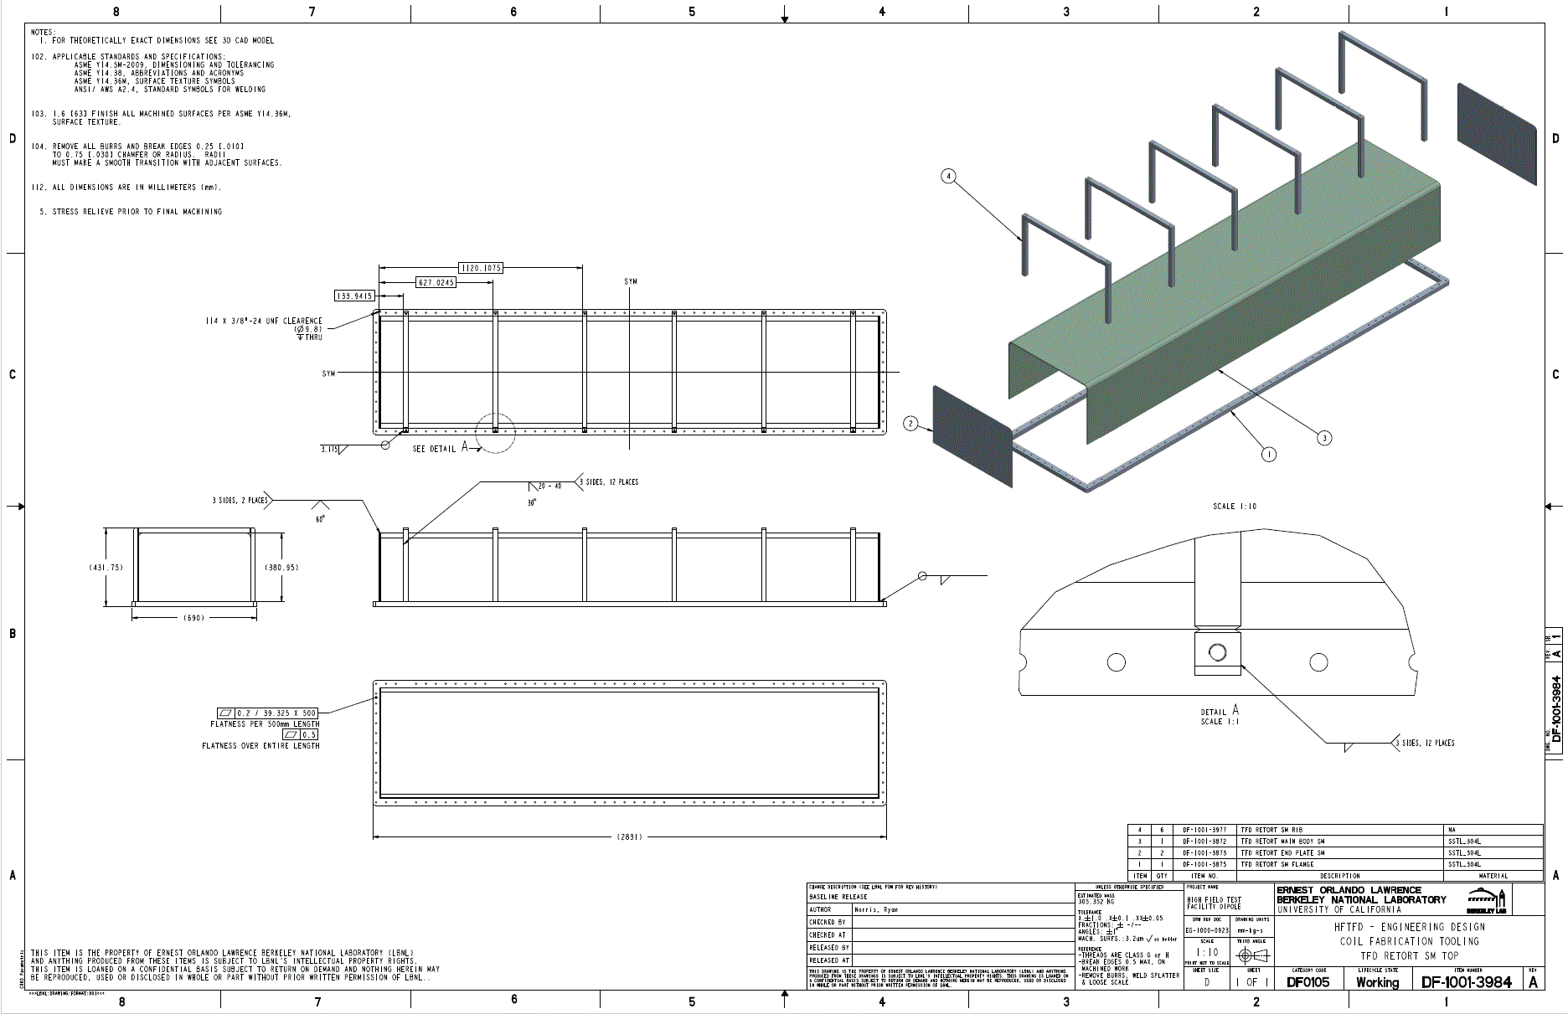
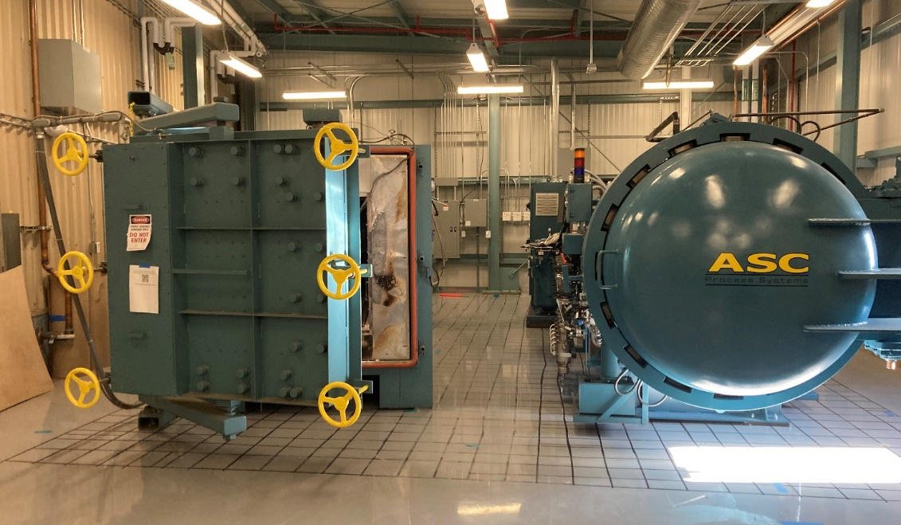
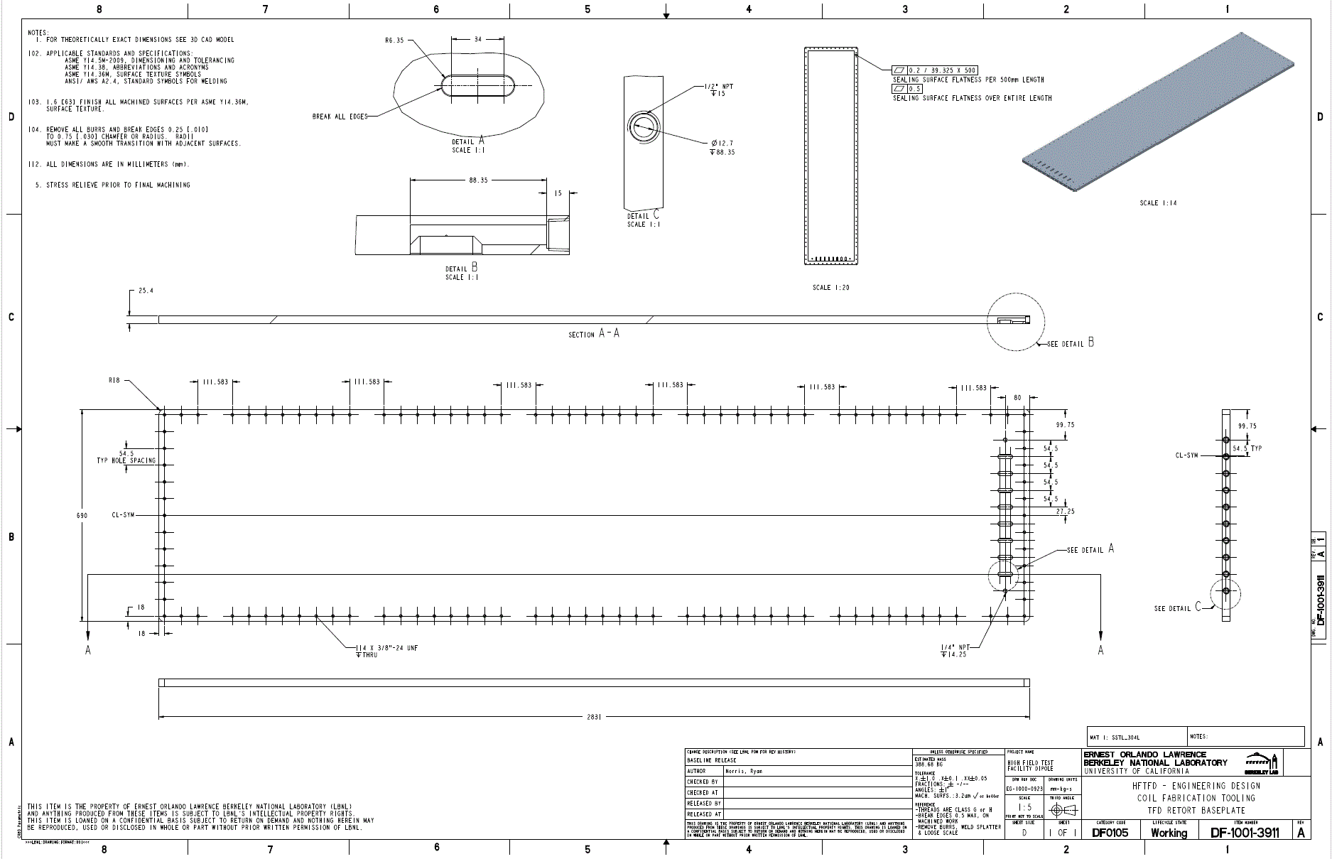
Coil manufacturing - Reaction
Coil fabrication
Preparation for winding
Winding
Preparation for reaction
Reaction
Retort manufacturing
Progress since EOC #2
Retort top
Improved design of retort based on a new developed high temperature sealing based on a flat mica gasket (instead of a round copper gasket).
Additional feedthroughs for measurement of gaps during reaction.
Retort fabrication drawings.
Completed testing after conclusion of work on instrumentation and electrical powering of the reaction furnace.
Gas
B46
B46
TCs main feedthroughs
B46
Retort base
New retort high temperature sealing developed based on a flat mica gasket.
B77A
Commissioning of Reaction furnace in progress
The reaction furnace has been moved to its final work in B77A.
Extensive work has been carried regarding instrumentation and powering.
A series of tests leading to a full reaction cycle including retort and a dummy coil to fully qualify the system prior to the prototype coil are on-going.
In discussion with manufacturer

Slide 10
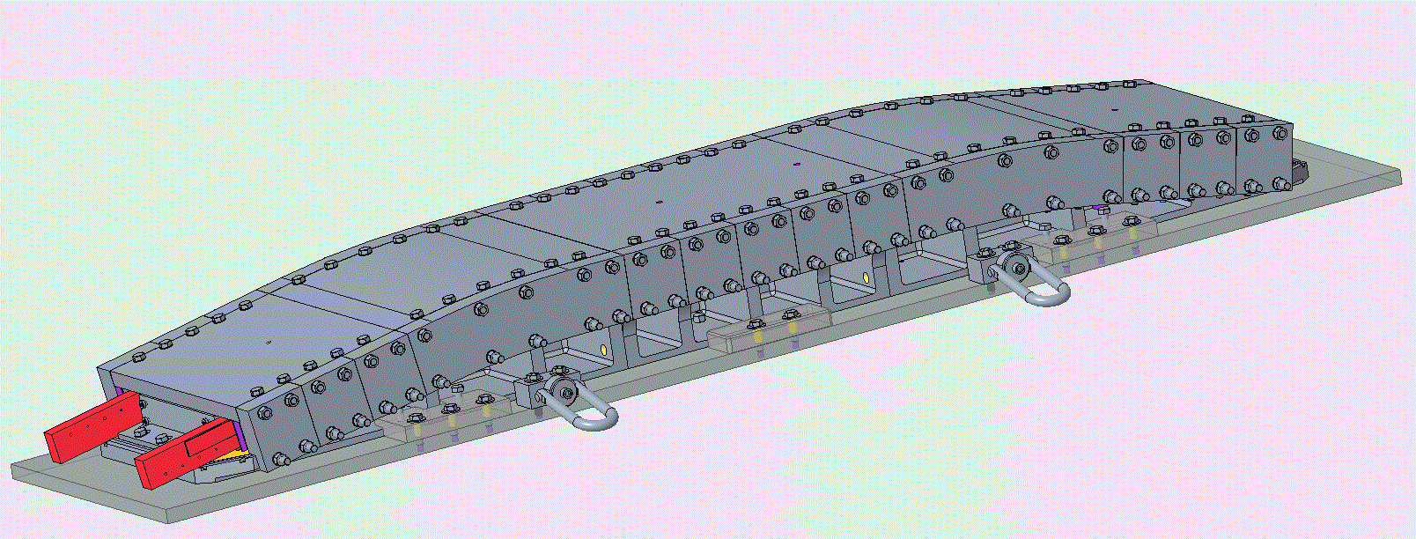
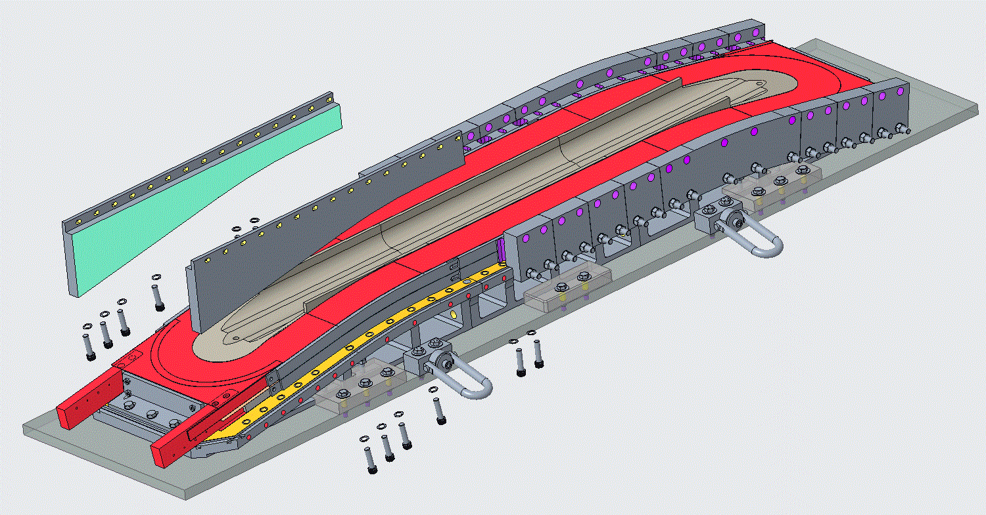
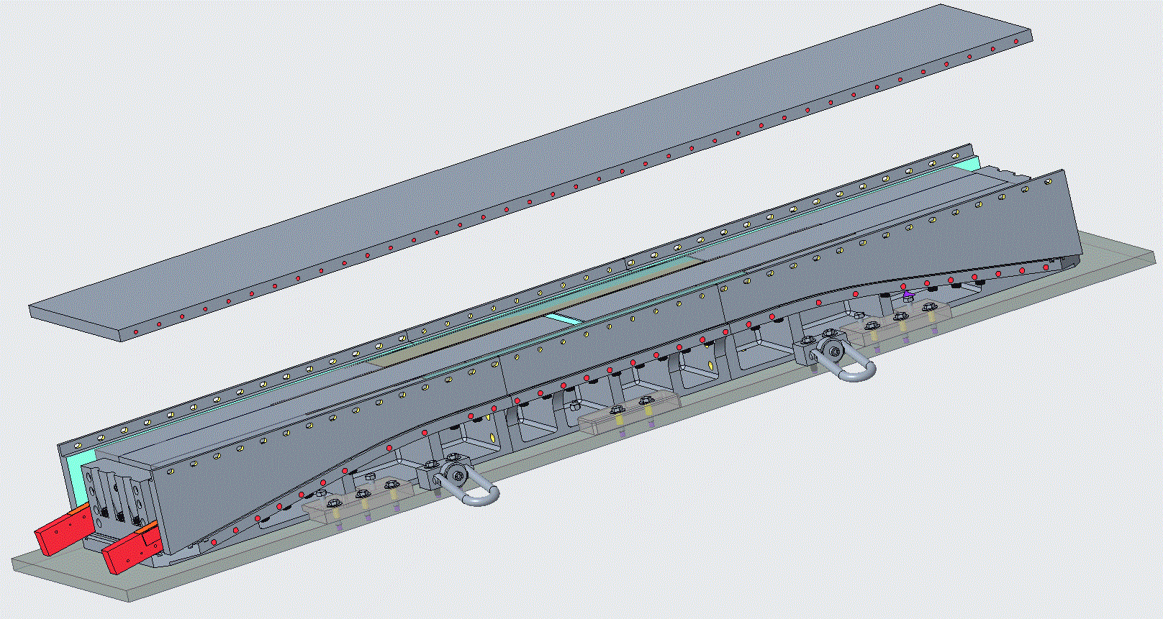
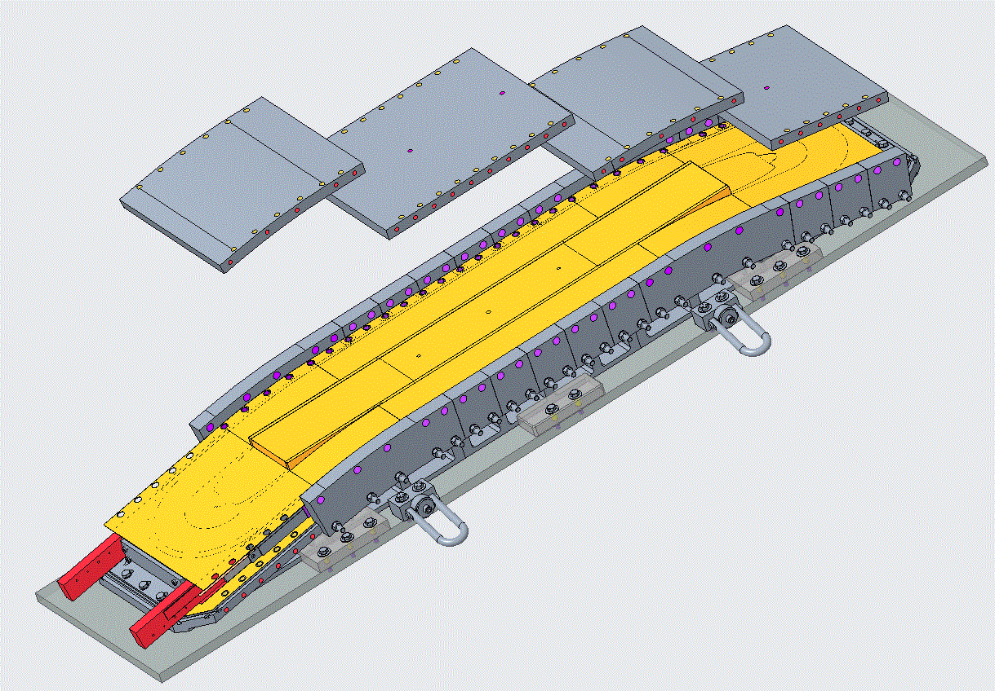
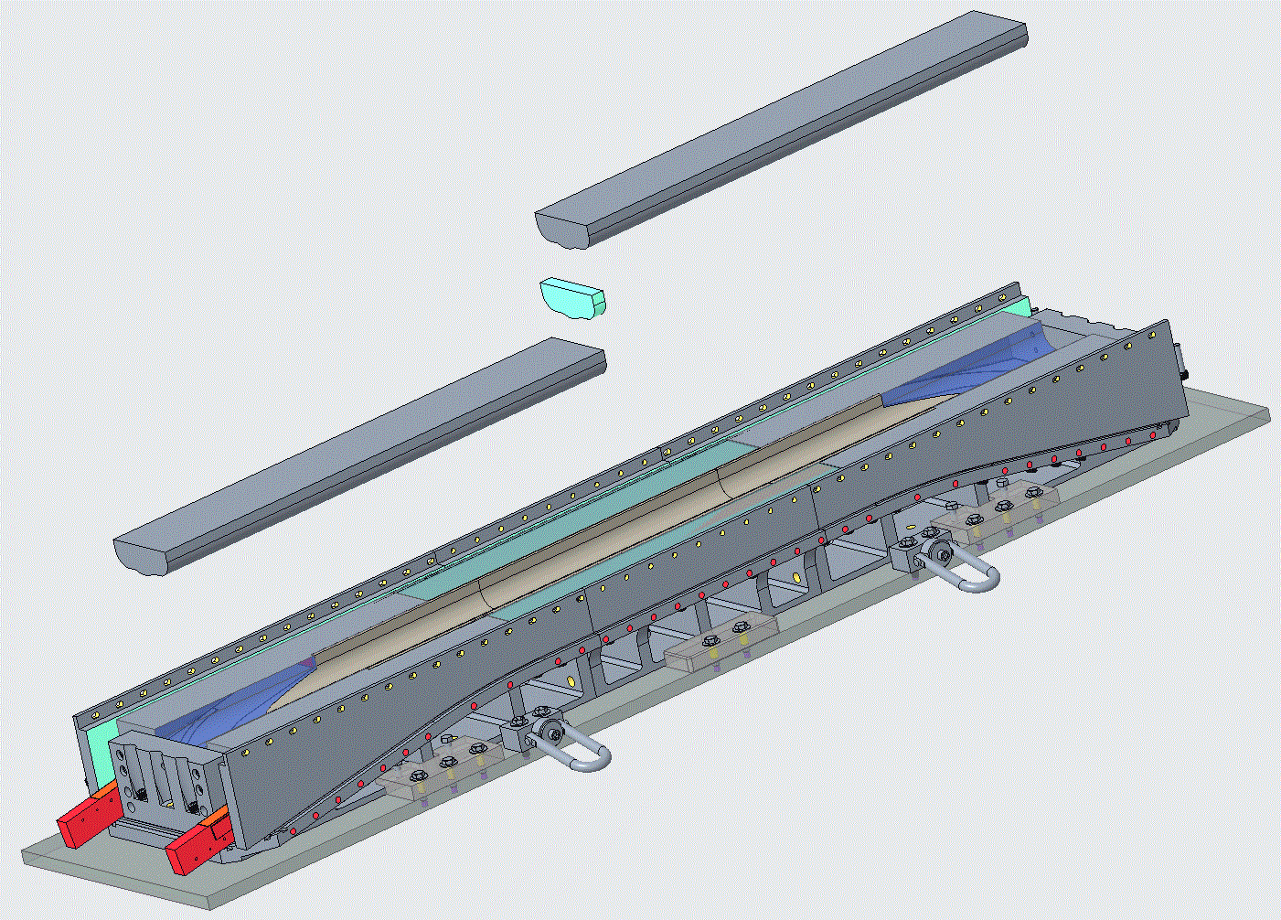
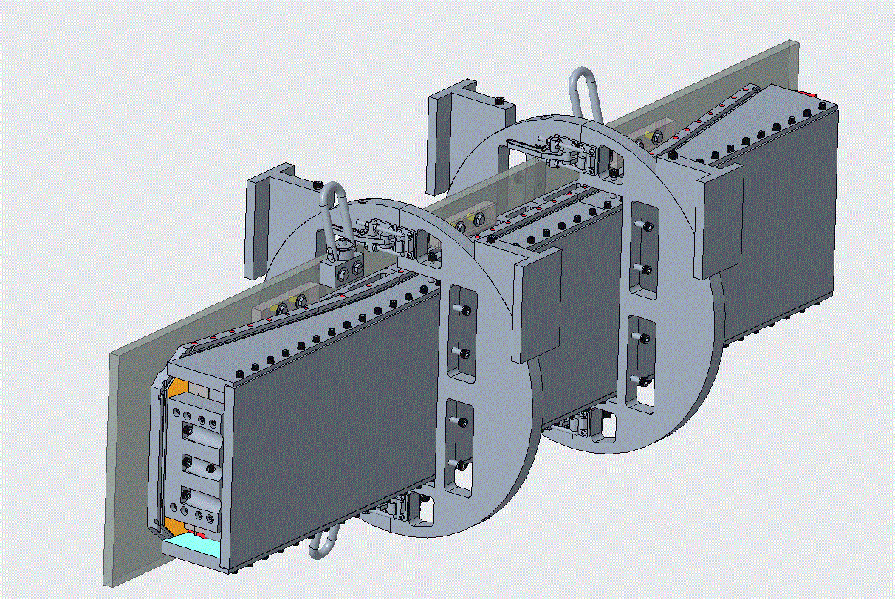
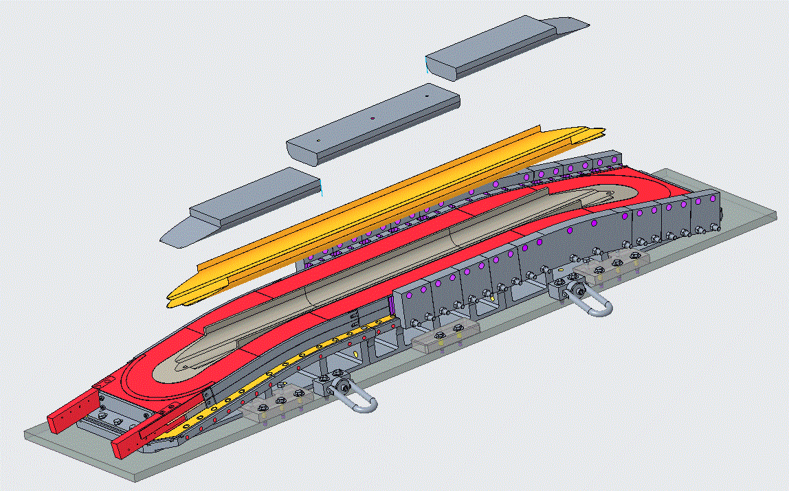
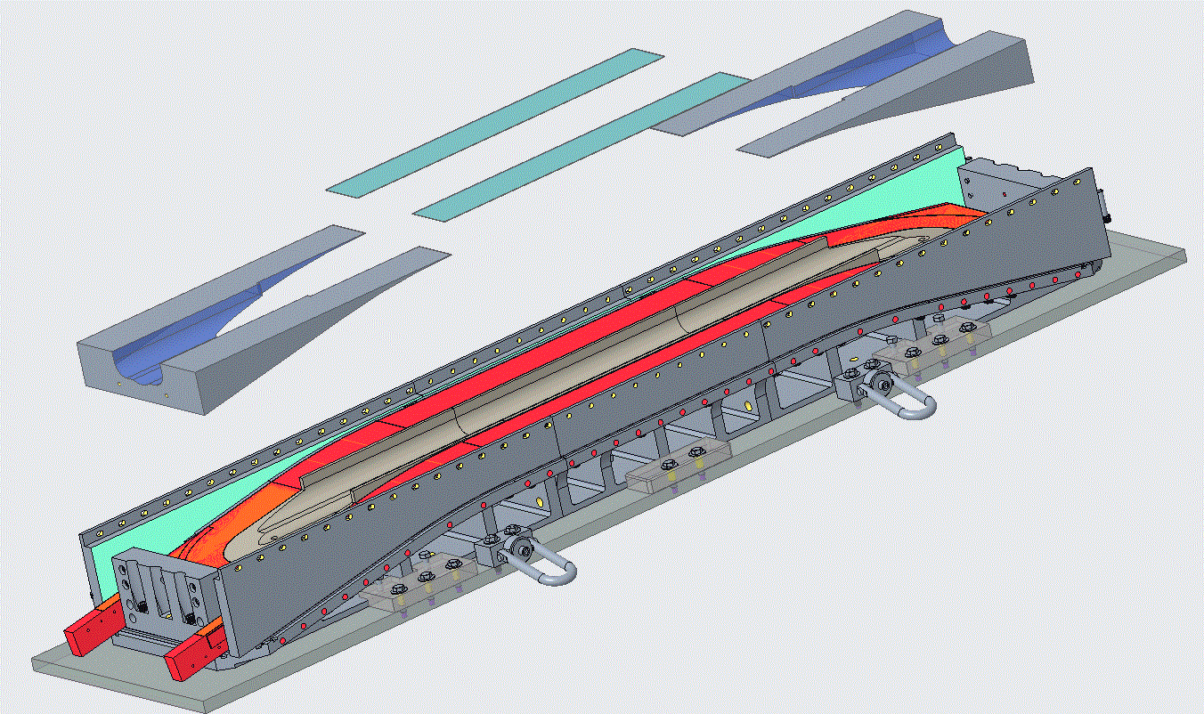
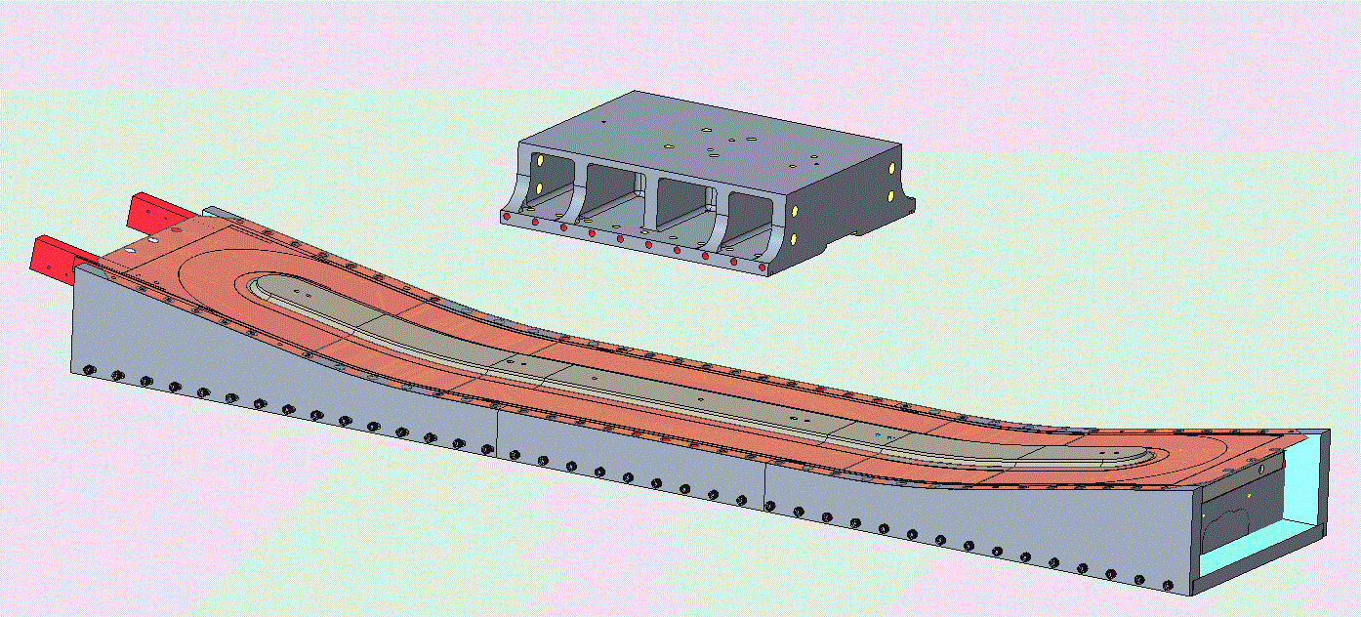
Coil manufacturing - Preparation for impregnation
Coil fabrication
Preparation for winding
Winding
Preparation for reaction
Reaction
Preparation for impregnation
1
4
7
Progress since EOC #2
Complete detail design step-by step of coil transfer from reaction to impregnation.
B46
2
B46
5
8
B46
B77A
After the reaction, the top parts are removed, and the splicing process starts.
The current plan is to splice two NbTi cables to each Nb₃Sn lead.
After the splice is completed, the transfer to the impregnation mold starts.
3
B77A
9
6

Slide 11
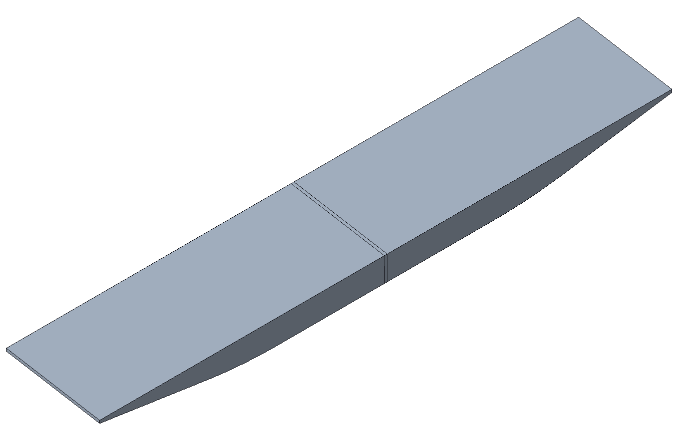
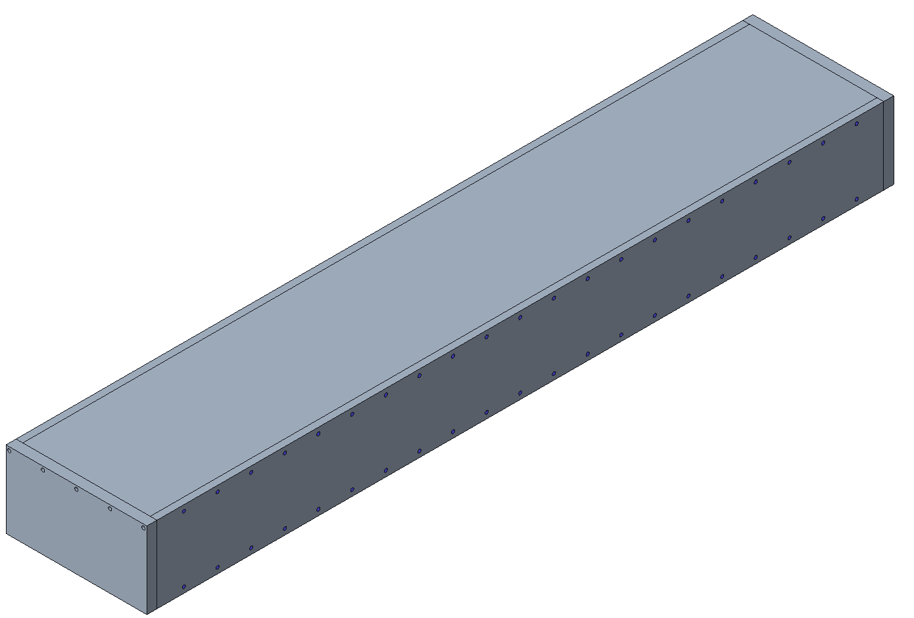
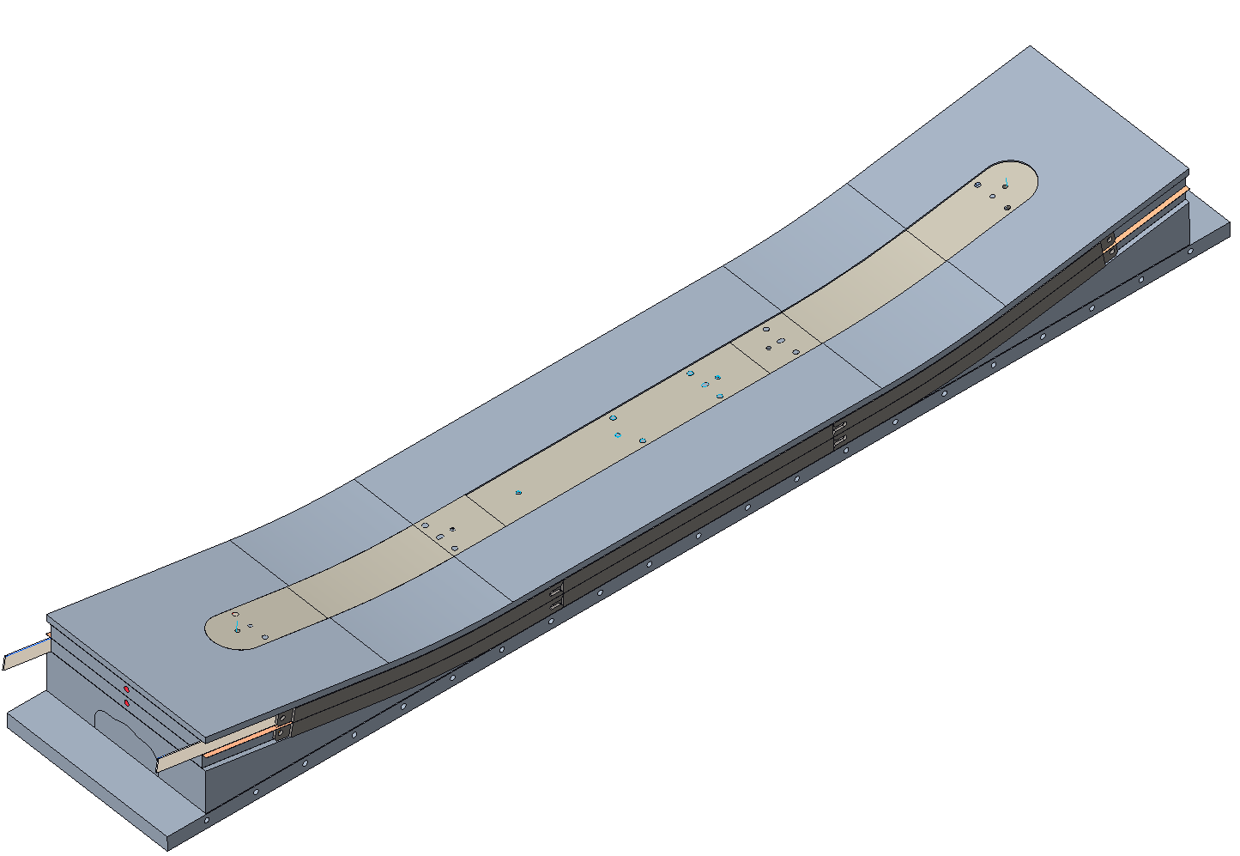
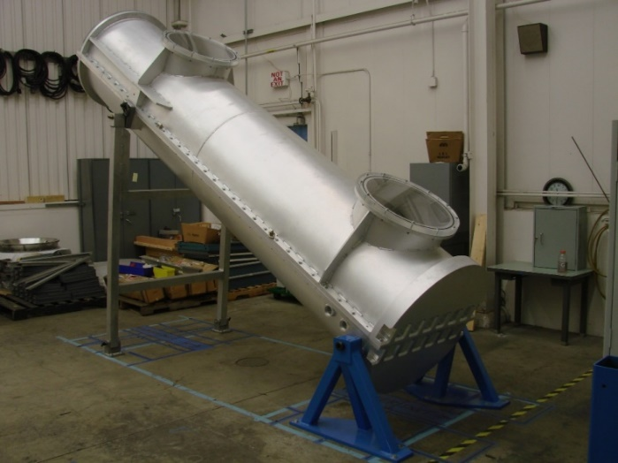
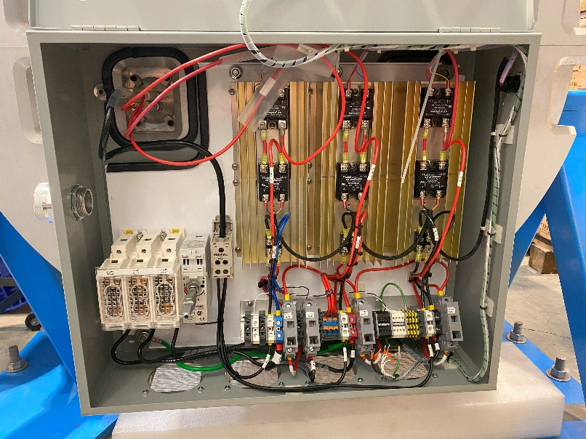
Coil manufacturing - Impregnation
Coil fabrication
Preparation for winding
Winding
Preparation for reaction
Reaction
Preparation for impregnation
Impregnation
The main filler pieces (i.e. the boat) are placed. The division of the fillers allows for the accommodation of small variations in the size of the coils after the reaction.
With the lateral plates, end plates, and top mold plates, a close cavity ready for impregnation is created.
The impregnation system is designed to accommodate slight variations in the size of the coils after the reaction.
Impregnation mold
Progress since EOC #2
Design of the impregnation mold.
Design and construction of the powering system of a 3-zone heating of the coil during impregnation.
Control system for the impregnation system.
Offline testing of the control system.
Electrical rewiring of the impregnation chamber completed.
Adaptive filler pieces
B46
Impregnation mold for coil 1
B46
B46
Impregnation chamber commissioning
B77A
The impregnation mold is fixed to the impregnation chamber.
The magnet will be impregnated in an inclined position with CTD 101K.
New control, powering and heating system with 3 heating zones for maximum temperature uniformity during resin curing.
Commissioning of the impregnation system planned in the coming weeks.
B77A
B77A
New control and power system

Slide 12
Outline
Introduction
Coil manufacturing
Magnet assembly
Summary

Slide 13
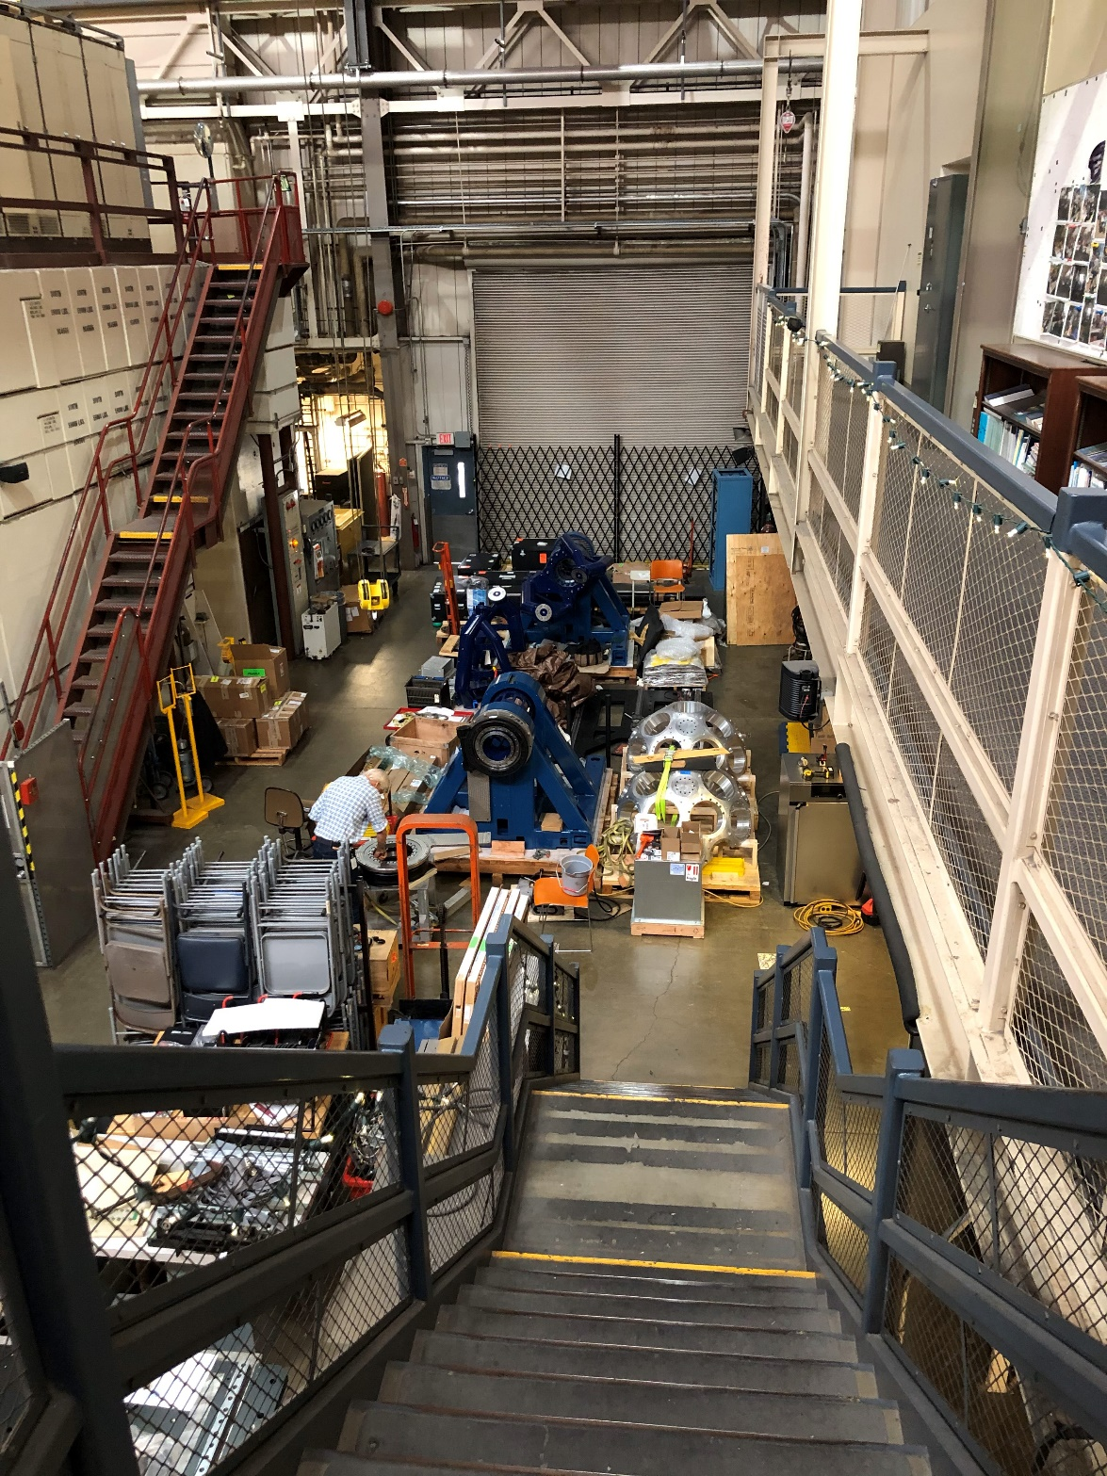
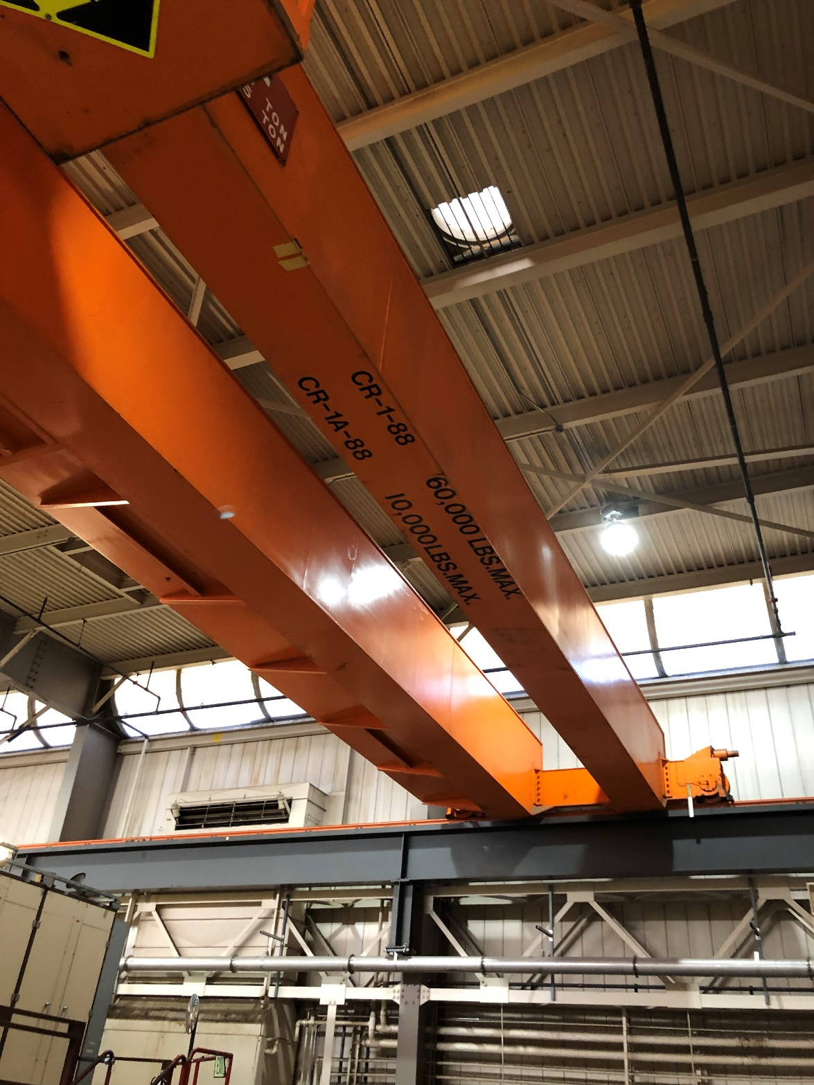
Magnet assembly – Assembly space
Magnet assembly
Total weight of approximately 18 tons
Designated space for assembly in B88 with available crane with sufficient capacity.
B88

Slide 14
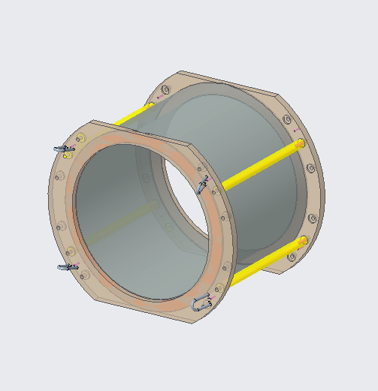
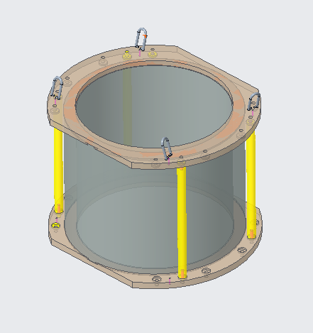
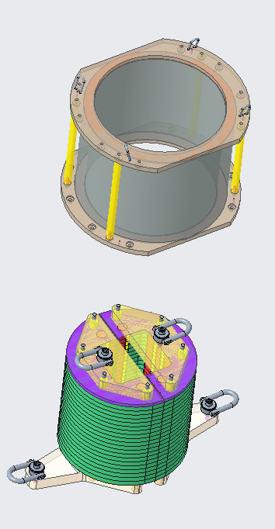
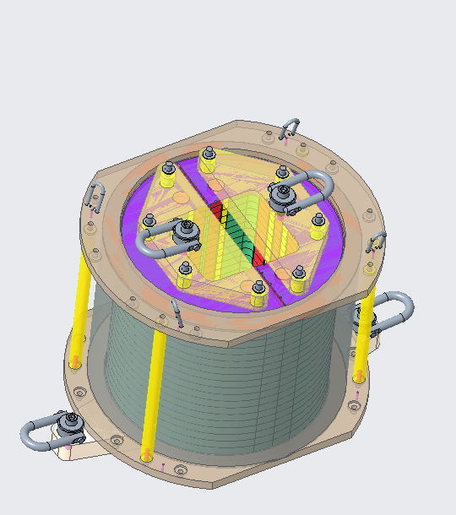
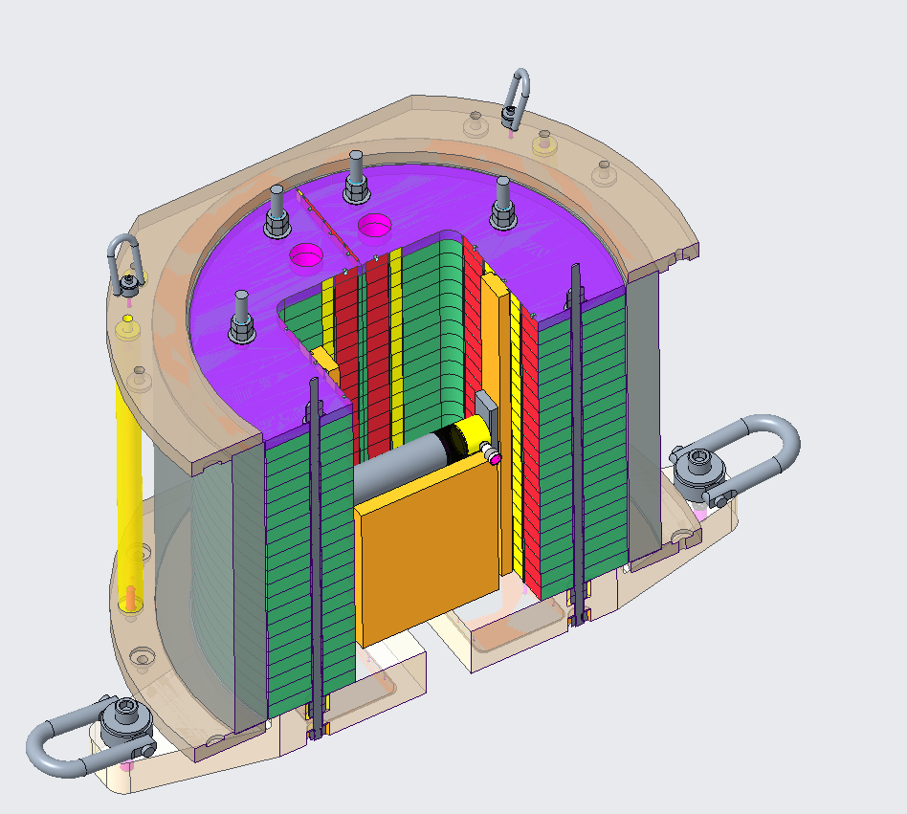
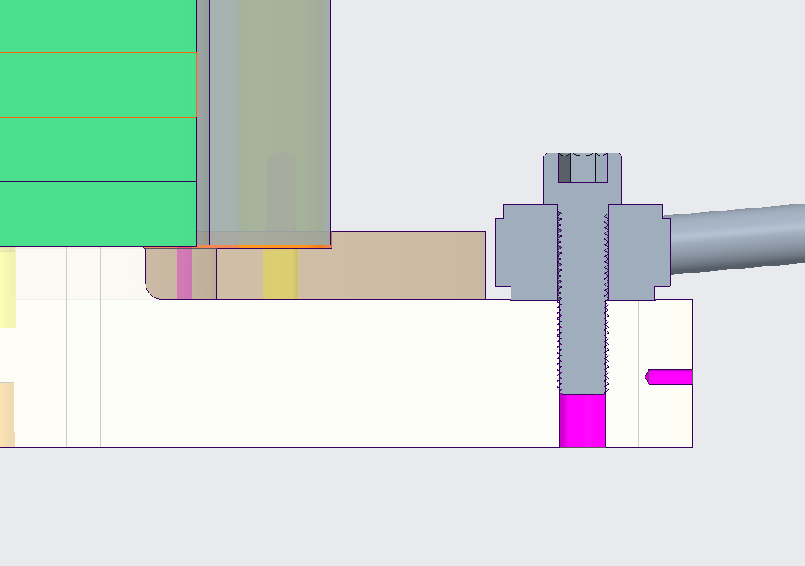
Magnet assembly – Half-shell yoke assembly
Magnet assembly
Half-shell yoke assembly
Manipulation of the shell
The shell is designed as a pure cylinder with no features for 3D manipulation.
An exo-structure is placed around the shell to enable manipulation.
Assembly is picked up via hoist rings and moved to vertical position.
The half-shell is lowered around the yoke while it is is a collapsed position (closed yokes’ gap).
The yoke is opened with the help of a hydraulic cylinder and bladders.
B88
1
2
3
Assembly
Vertical alignment of yoke and shell

Slide 15
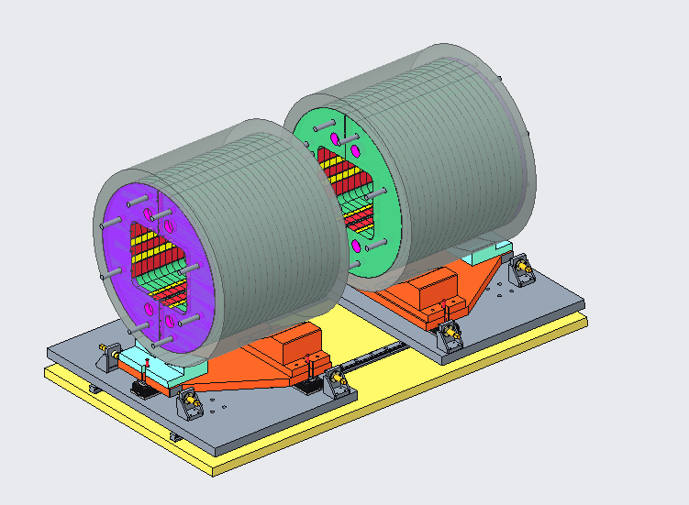
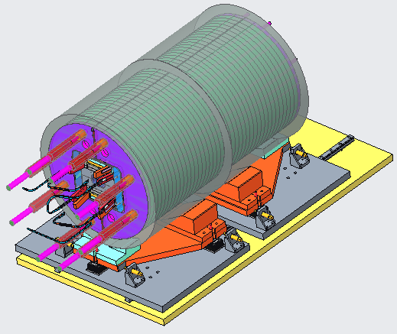
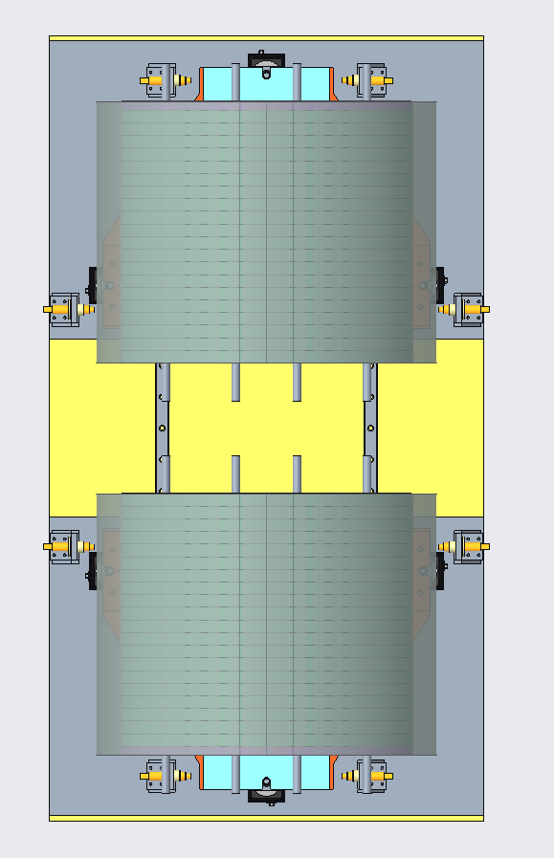
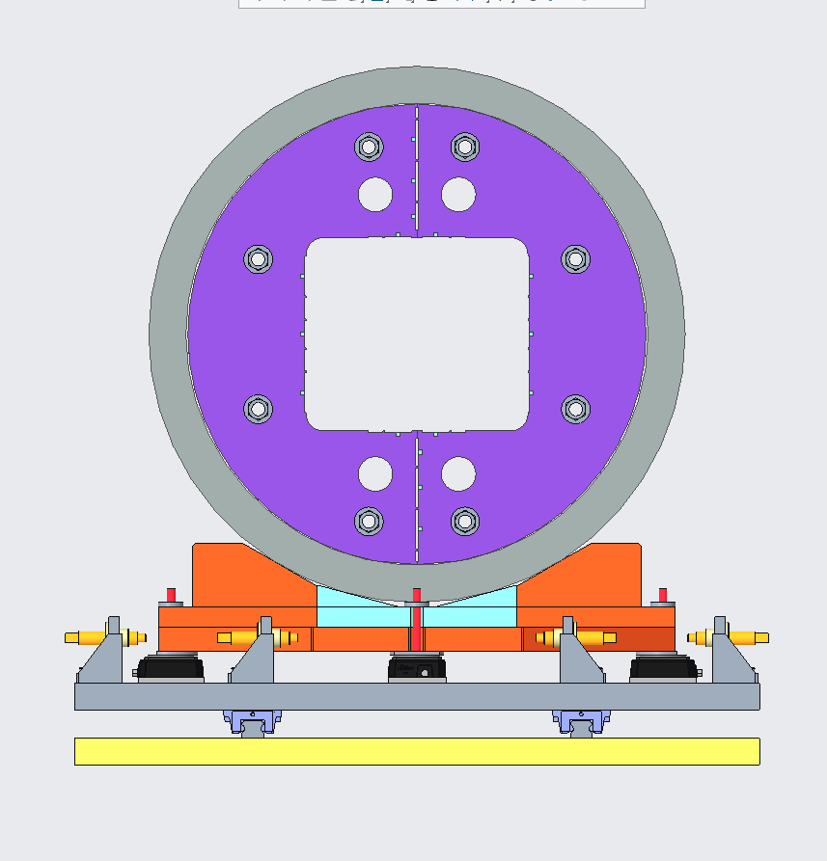
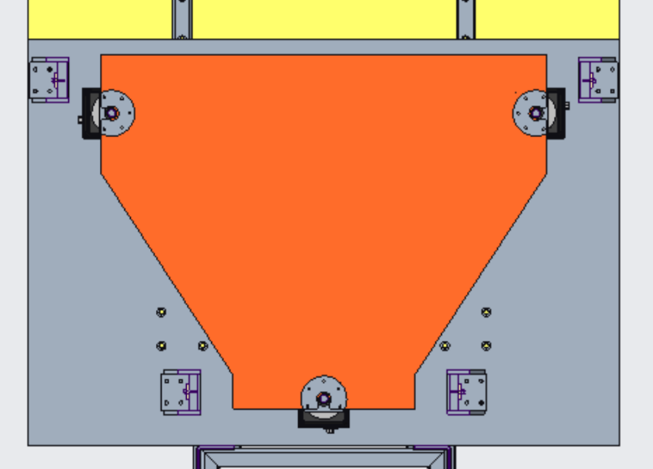
Magnet assembly – Alignment of two half-shell yoke assemblies
Magnet assembly
Half-shell yoke assembly
Alignment of two half-shell yoke assemblies
Assembly
The two half assemblies are aligned using a laser tracker.
The two parts are joined together through full length yoke rods and keys
B88
B88
Control of degrees of freedom of the half structures
The combination of all positioning systems included allows for the control of 6 DOF of each half assembly.

Slide 16
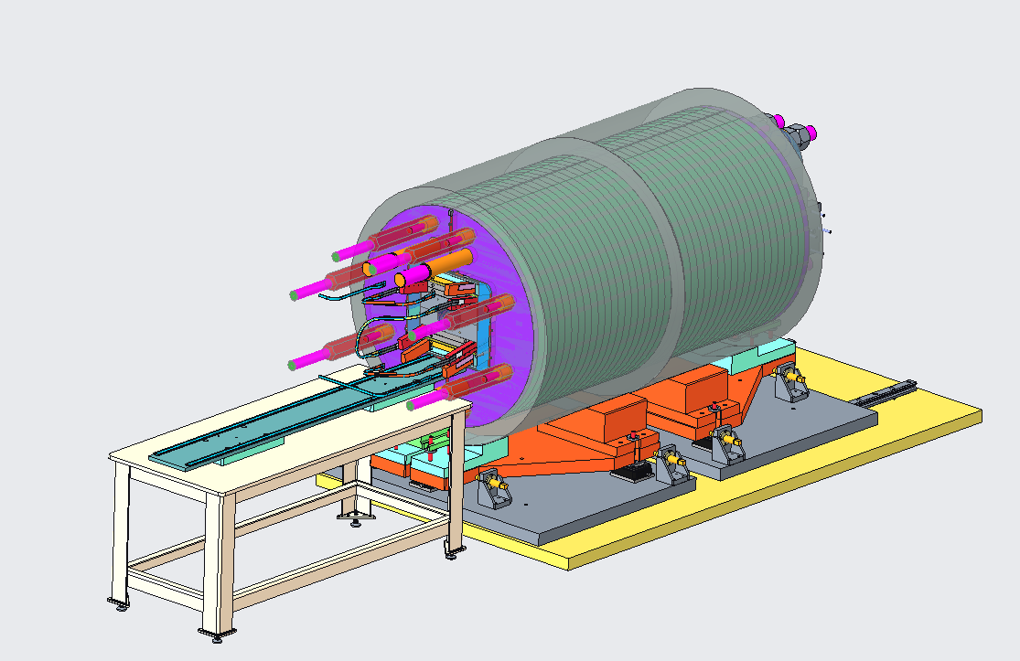
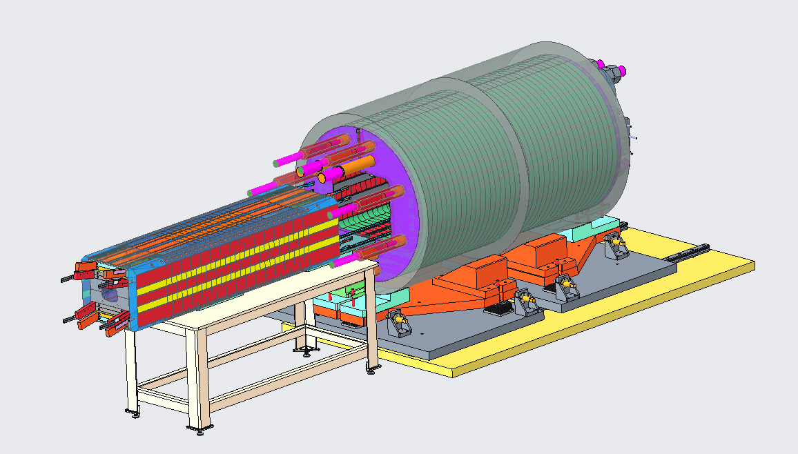
Magnet assembly – Coil pack insertion
Magnet assembly
Half-shell yoke assembly
Alignment of two half-shell yoke assemblies
Coil pack insertion
Insertion
The coil pack is inserted with the help of a support table in horizontal position.
B88
B88
B88
The coil pack is supported by rollers in flat cages.
After insertion, vertical bladders are used to elevate the assembly and remove the rollers.

Slide 17
Magnet assembly – Magnet loading
Magnet assembly
Half-shell yoke assembly
Alignment of two half-shell yoke assemblies
Coil pack insertion
Magnet loading
Bladder system
End plate alignment
Prototype bladders satisfactorily passed the tests.
Manufacturing of all bladders in progress.
B88
B88
B88
Axial loading
B88
spacer plate
The magnet is loaded axially with a hydraulic piston to a force of about 700 tons.
pusher
plate
piston
End plate
rod extension

Slide 18
Outline
Introduction
Coil manufacturing
Magnet assembly
Summary

Slide 19
Summary
The design of the main tooling and manufacturing processes required for coil manufacturing are ready. Procurement of tooling has started.
Preparation of the required infrastructure for coil fabrication (i.e. reaction furnace and impregnation chamber) is on going.
The magnet assembly process is detailed in design, and procurement of required tooling has started.
Assembly space and compatible crane have been allocated to the project for the full magnet assembly.

