Slide 1
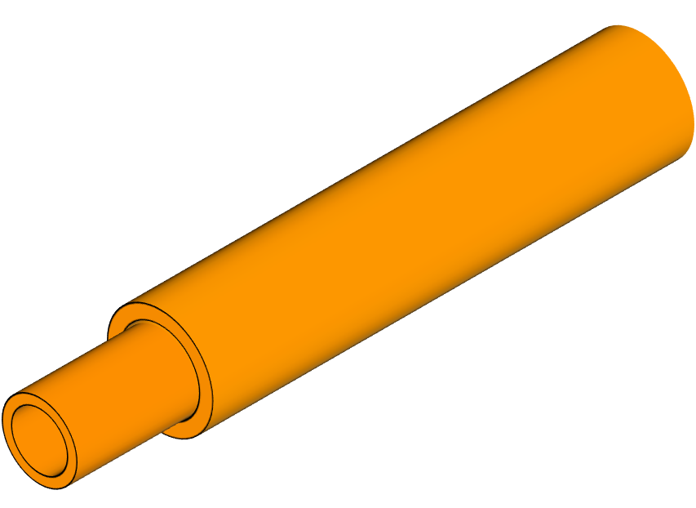
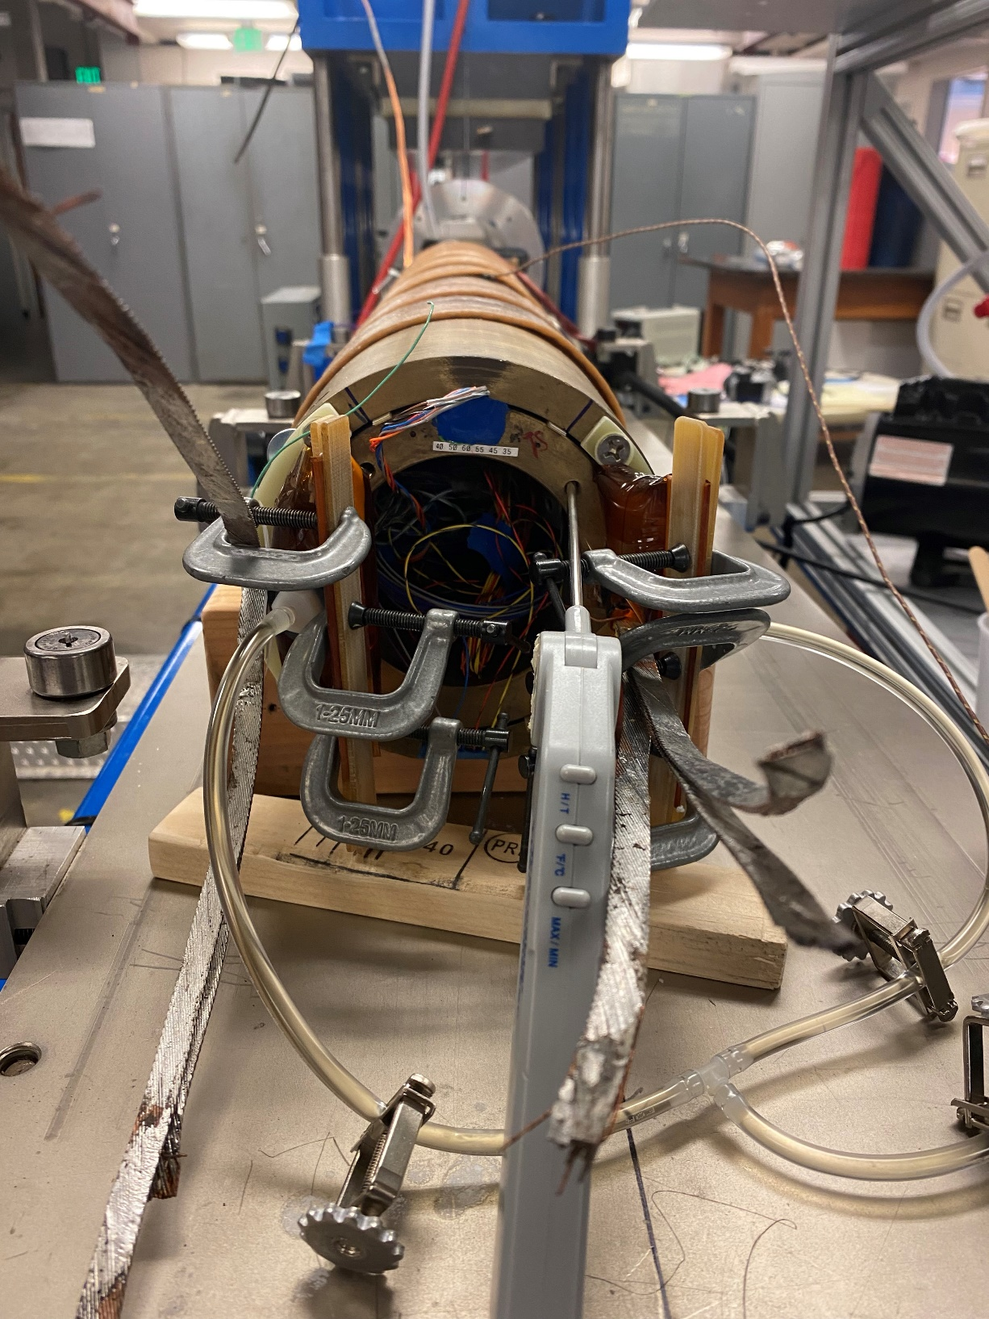
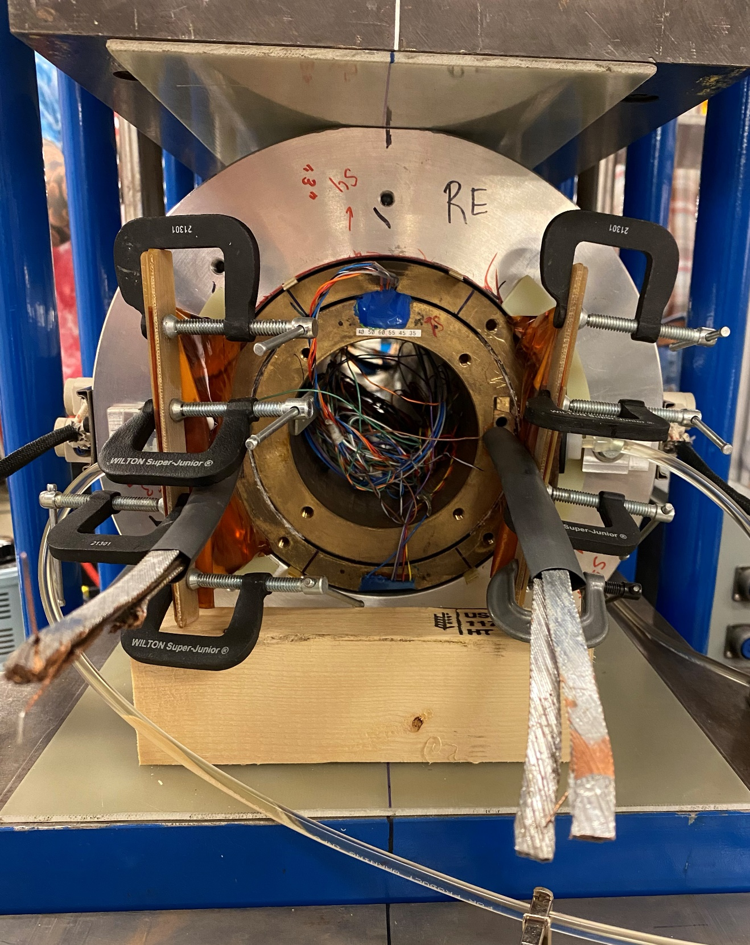
Clarification on Smartshims – an example in CCT5
Smartshims diagram
(a)
Return
end
(b)
Lead end
Left
Right
Alignment pins
Layer 2
Layer 1
(c)
Smartshims
Compressed air
Smartshim left
Smartshim right
Vacuum pump
Resin mixer
Overflow
https://ieeexplore.ieee.org/abstract/document/9756043
Smartshims are bladder-type shims, fabricated with polyimide, that are filled with certain reinforcement within a resin matrix. The polyimide surface of the shim is flexible enough to conform to uneven surfaces creating a solid contact between distinct components of the magnet after the resin is cured.
This component solves the complex issue of mating irregular surfaces, normally found in the assembly processes of superconducting magnets. In the case shown here, the smartshims were filled with woven glass cloth reinforcement and epoxy resin CTD-528. After the process is completed, the system is placed in a furnace, where the resin is cured at 50 °C for 24 hours.

Slide 2
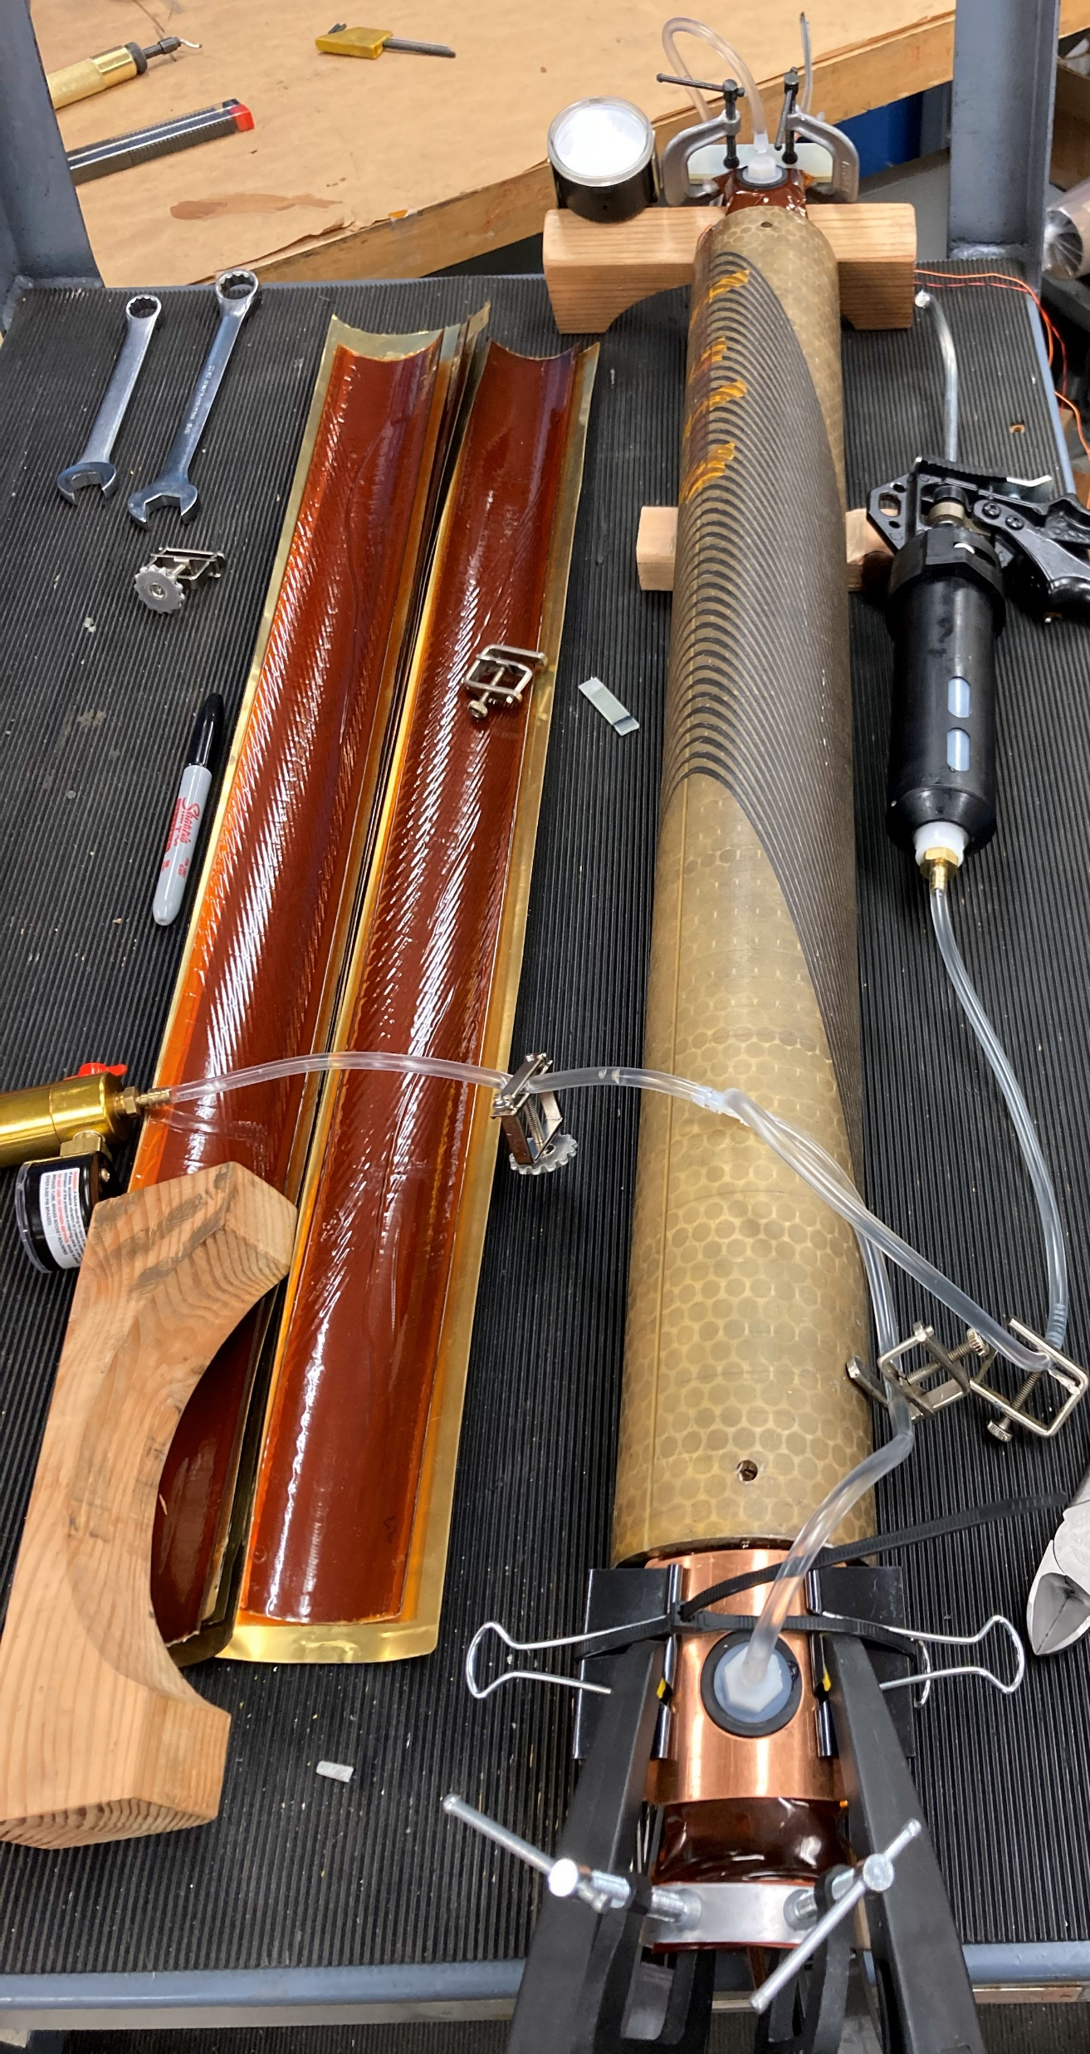
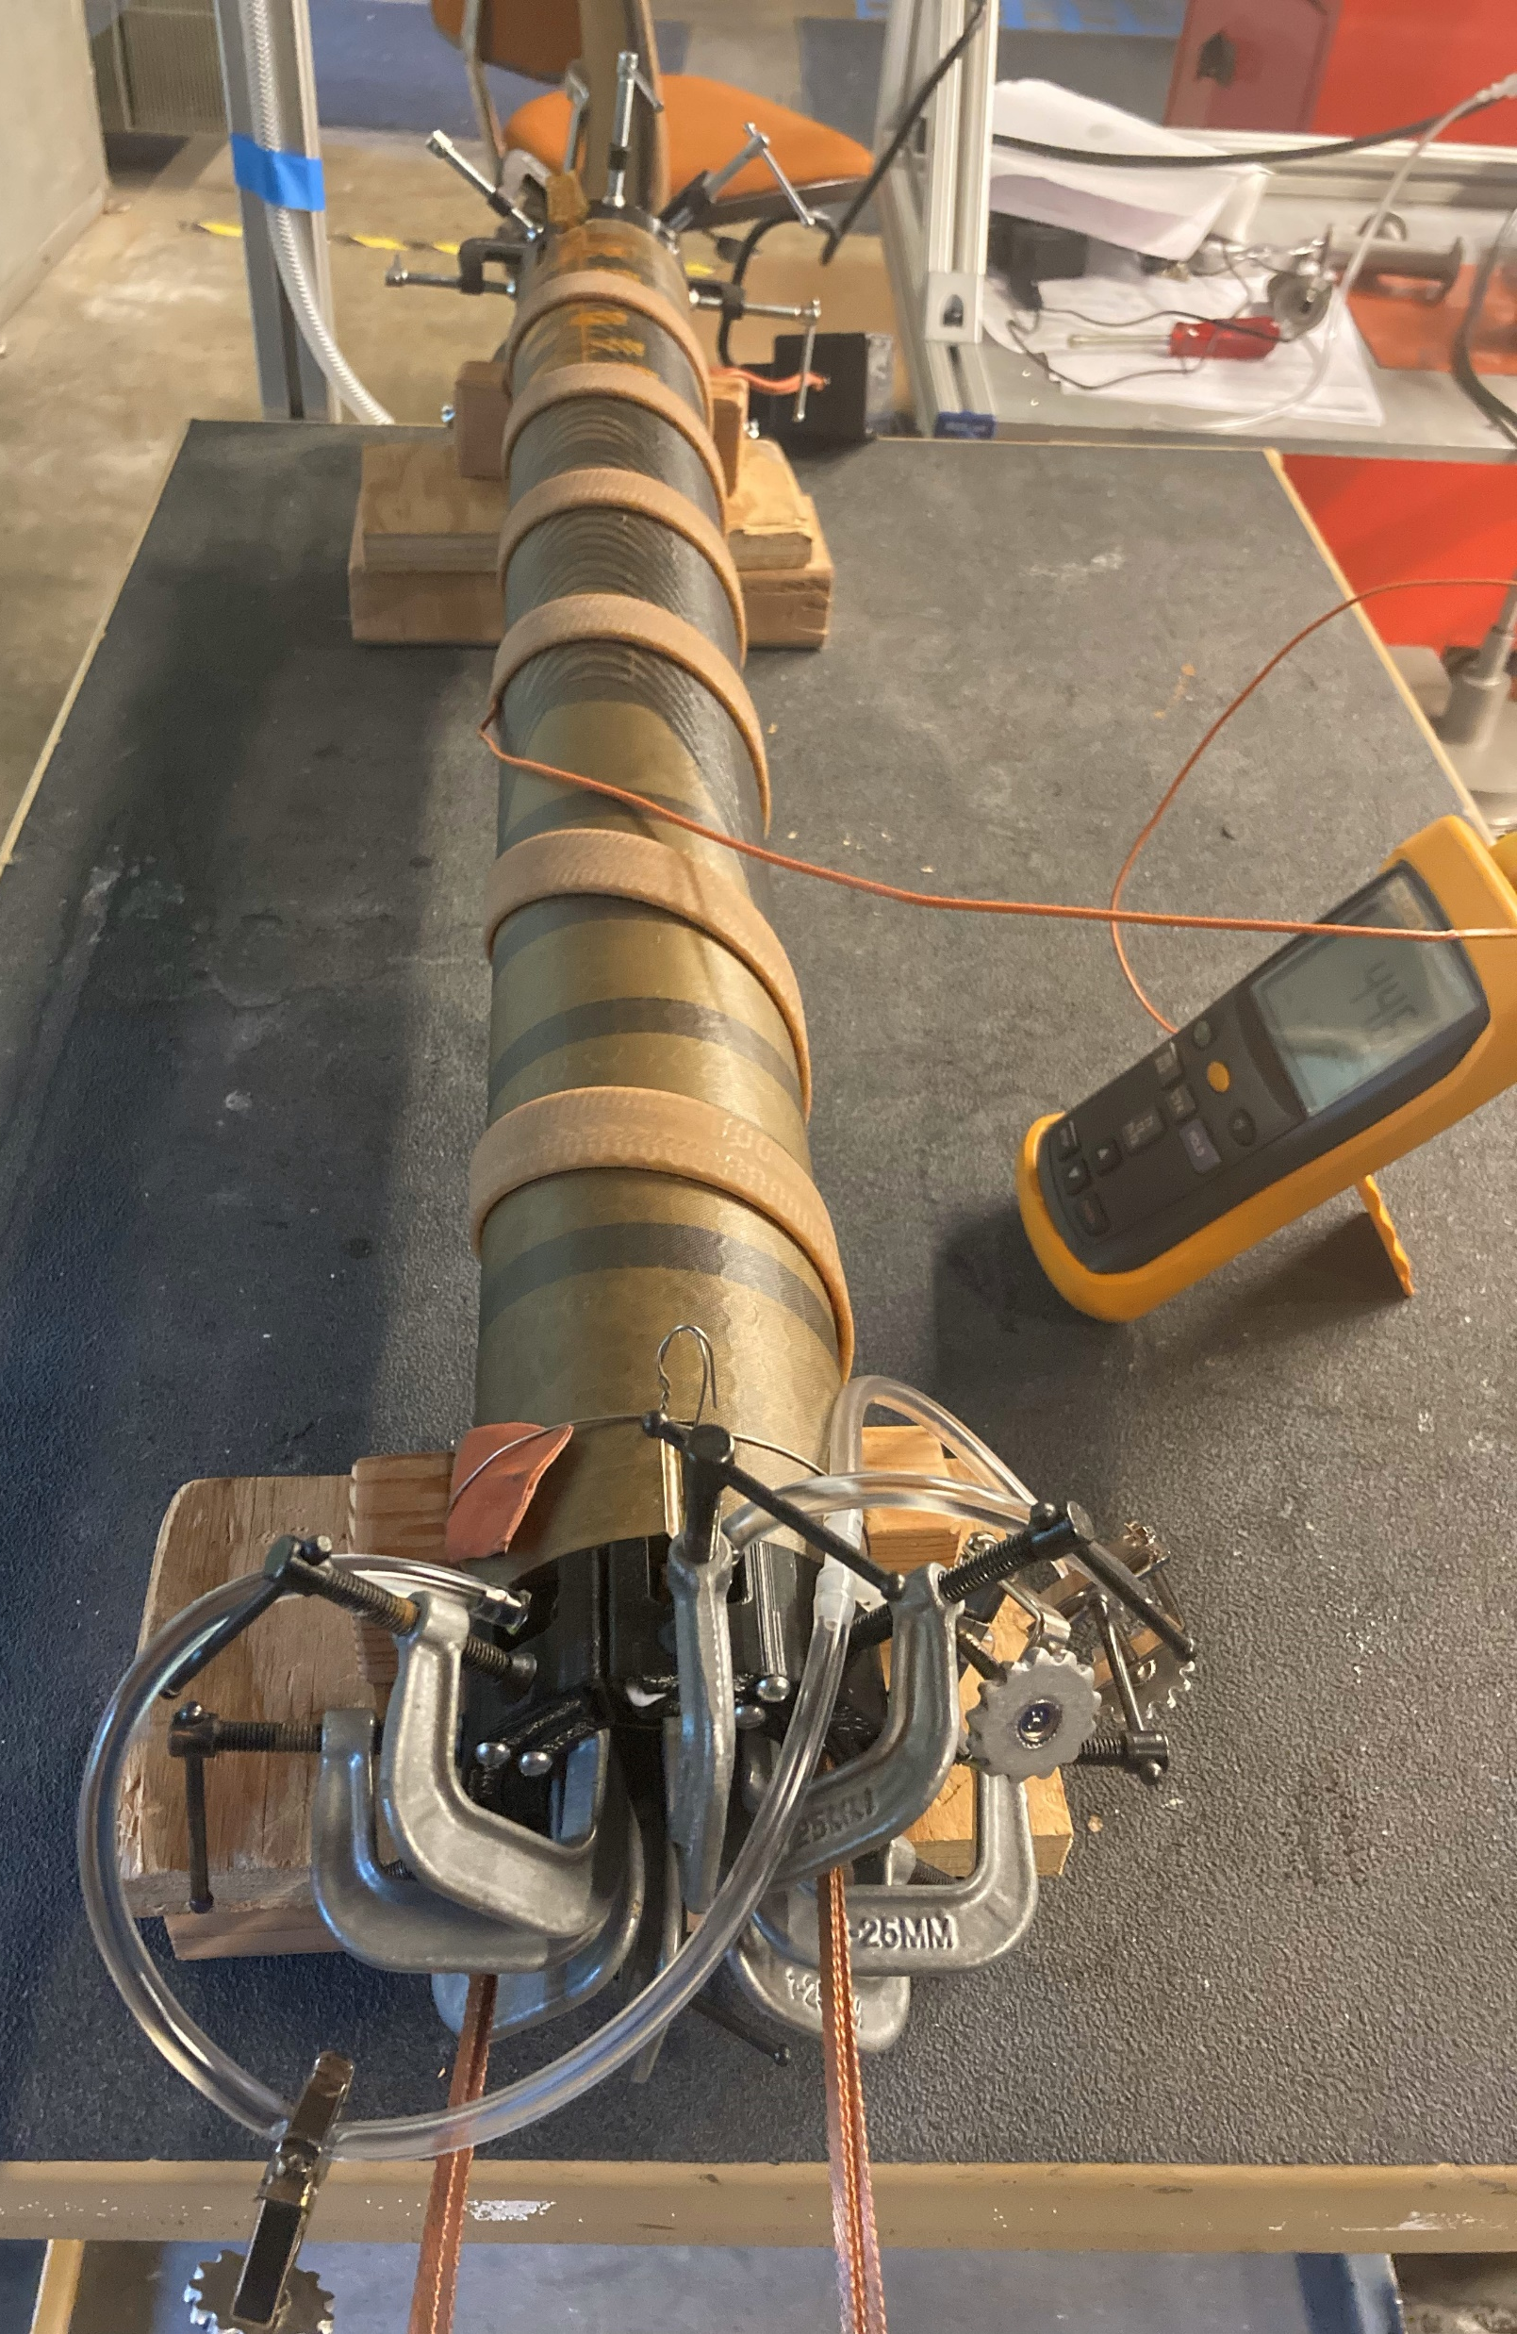
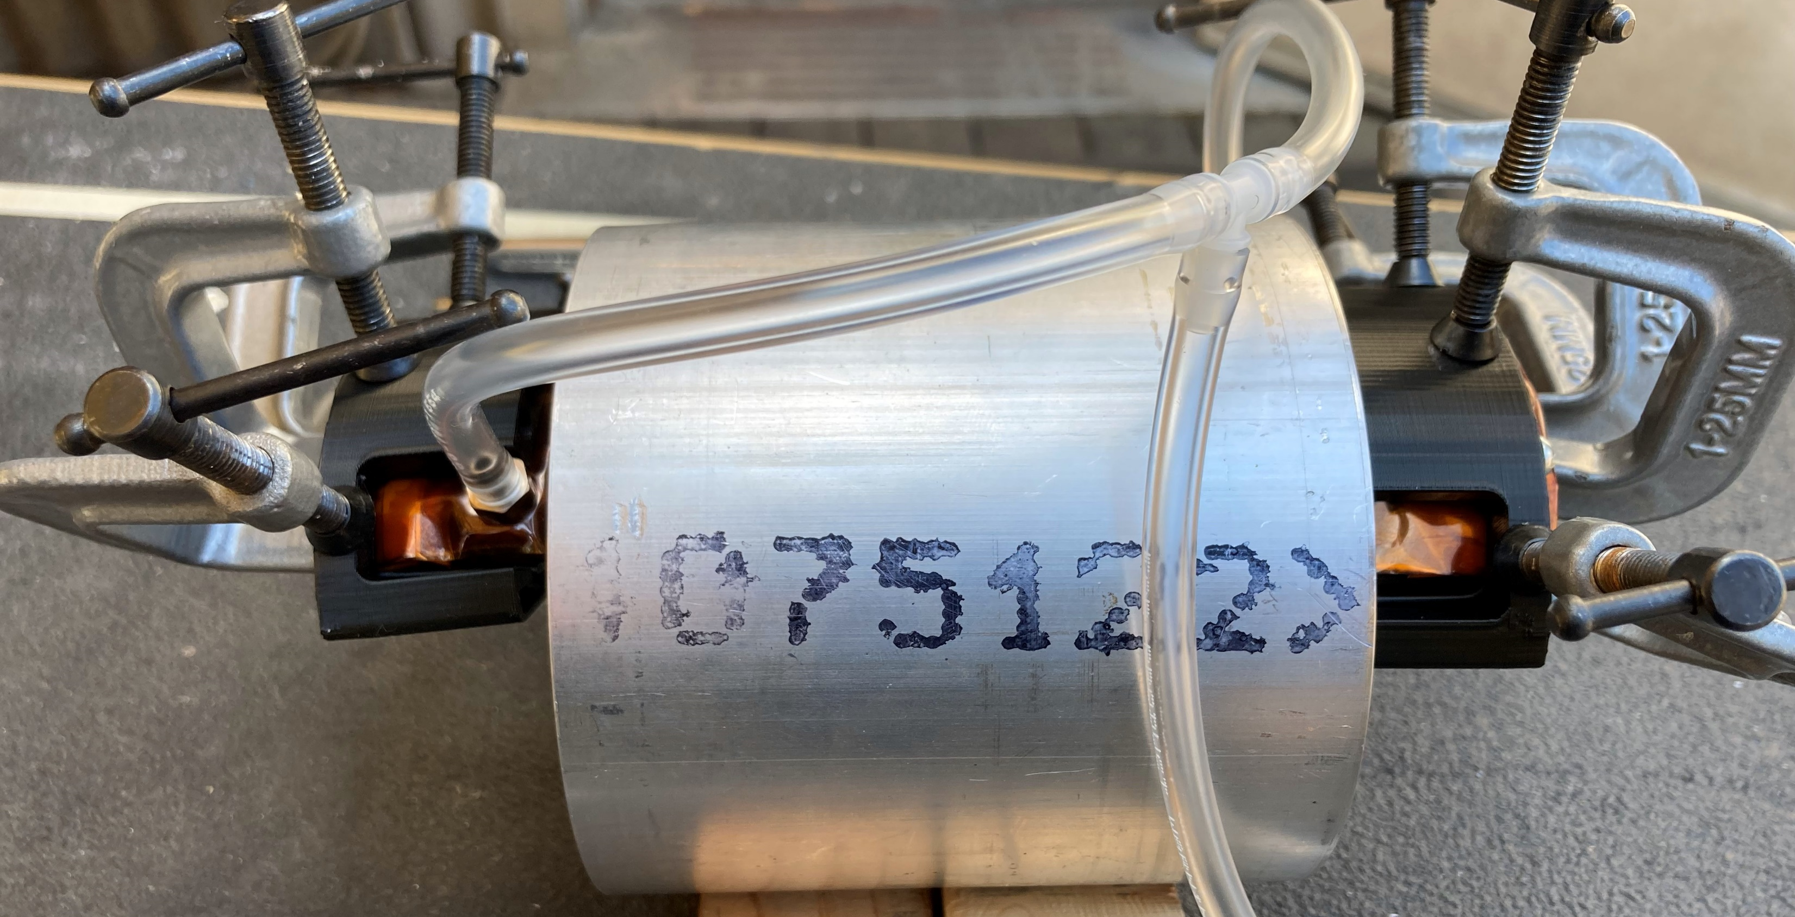
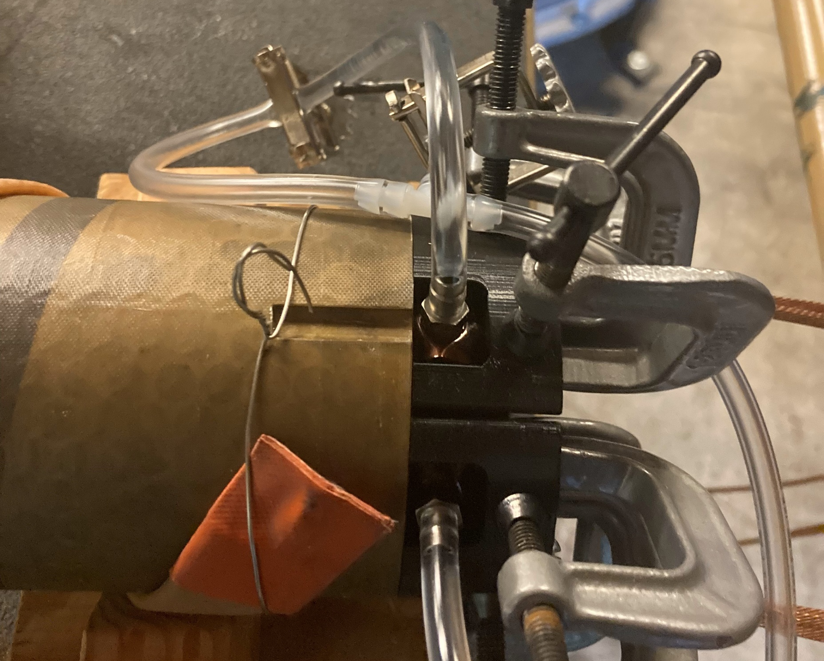
Other photos
Smartshim left
Smartshim right

