Slide 1



G. Sabbi, LBNL
TFD External Oversight Committee #3
March 20, 2024
Project Summary and Schedule

Slide 2
Presentation Outline
Schedule Update
  Timeline and comparison with EOC2
  Schedule details by category: wire and cable, design and development, coil fabrication, magnet assembly and test
Budget Update
  Cost profile and comparison with EOC2
  Sources of cost increase
  Magnet fabrication effort
  Testing at Fermilab
Risk Assessment
Summary

Slide 3
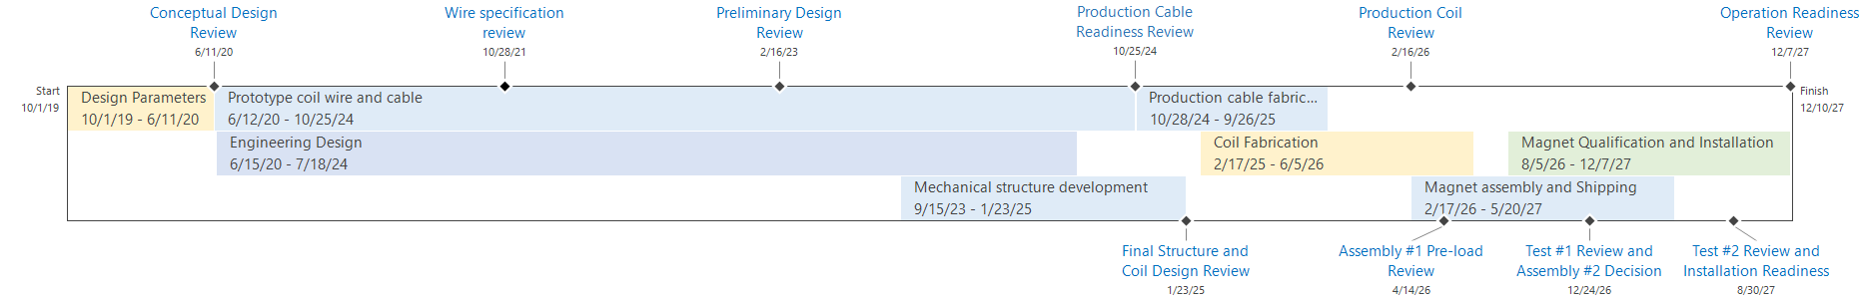
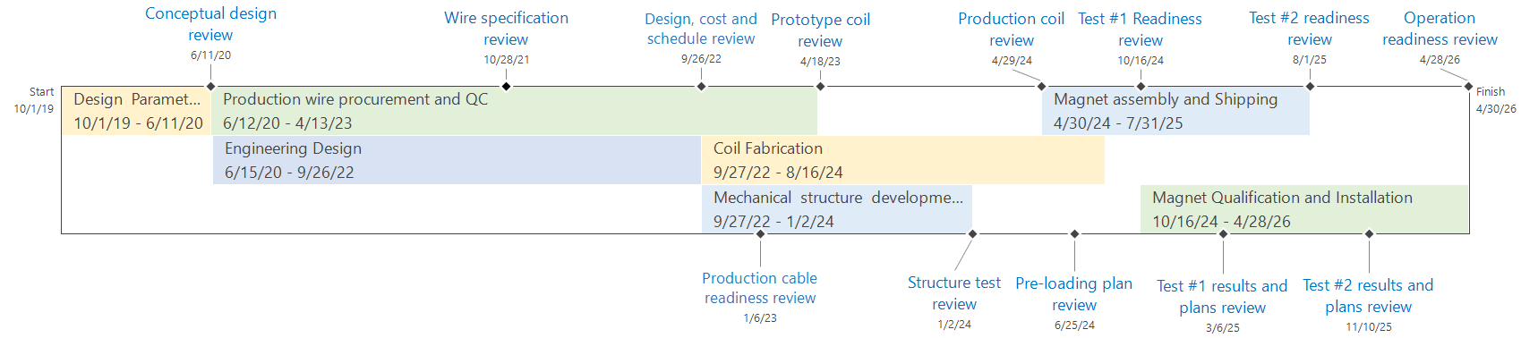
TFD Schedule: EOC3 vs. EOC2
March 2024 (EOC3)
August 2022 (EOC2)

Slide 4
Wire and Cable

Slide 5
Design, Coil and Structure Development
@FNAL

Slide 6
Coil Fabrication (4 production, 2 spares)

Slide 7
Magnet Assembly and Test (2 cycles)

Slide 8
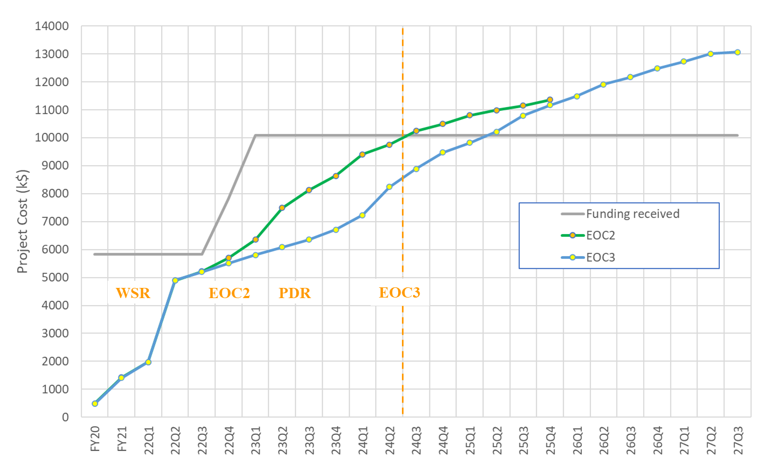
Funding Profile
Actual
Projection
Cost estimate (2018): 9.9 M$ without including escalation, management and contingency

Slide 9
Main Sources of Cost Increases
Fabrication infrastructure (not included in baseline cost)
  Recommissioning of reaction oven and impregnation chamber in new location
  New retort design and procurement
  Cabling machine, based on prototype cable feedback
  Winding table upgrade
Engineering design effort and timeline
  Resource availability, design complexity
Cabling effort (prototype cable improvement, new copper cable)
Escalation, especially 2020-2023 (18% cumulative inflation)
Procurement cost and timeline/effort
  Conductor: +165 k$
  Iron yoke and pads: +150 k$
  New shell: +70k$ (est.)
  End plates: +50 k$ (est.)
Combined increase relative to the 2018 baseline estimate is 20%

Slide 10
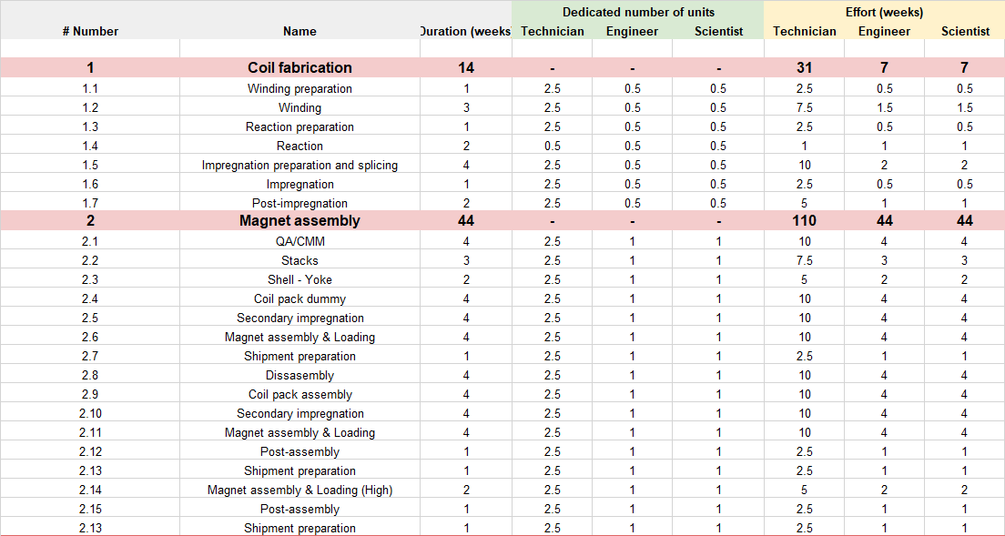
Magnet fabrication effort
Updated “bottom up” effort estimate by engineering team is consistent with TFD budget allocations

Slide 11
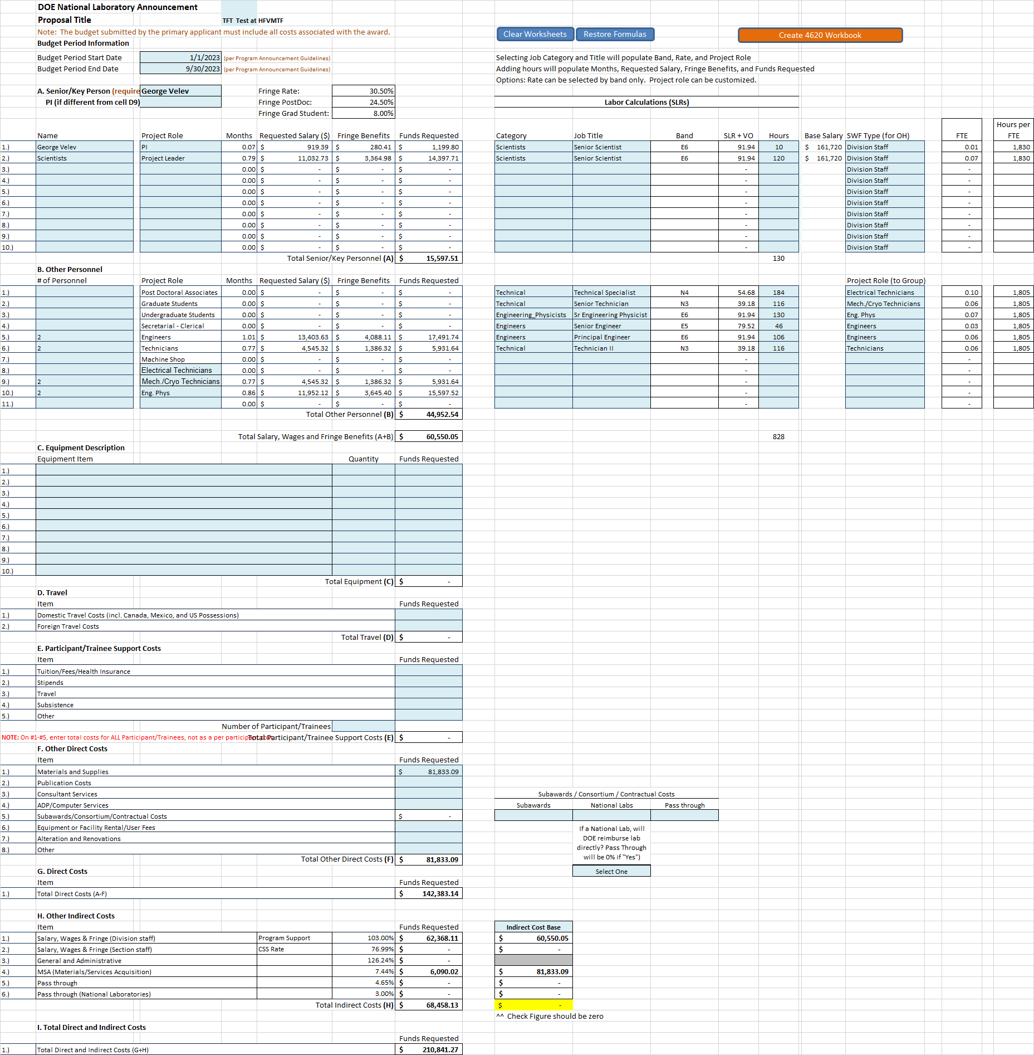
Magnet Test at Fermilab
Reference: TFT_Test-PAMS Budget-TFT _Test_at_HFVMTF-FY23
Summary
Included:
Cold test with TC
Setup
TC1: 2.5 wks
TC2: 1 wk
15-20 quenches
Basic analysis
Total requested (k$):
Labor: 142.4
M&S: 81.8
Total: 210.8
Previous (EOC2) budget:
  Test 1: 198.8 k$ (w/TC)
  Test 2: 173.3 k$ (no TC)
Budget was revised to reflect FNAL estimate
Detailed analysis covered separately
Need to add contingency

Slide 12
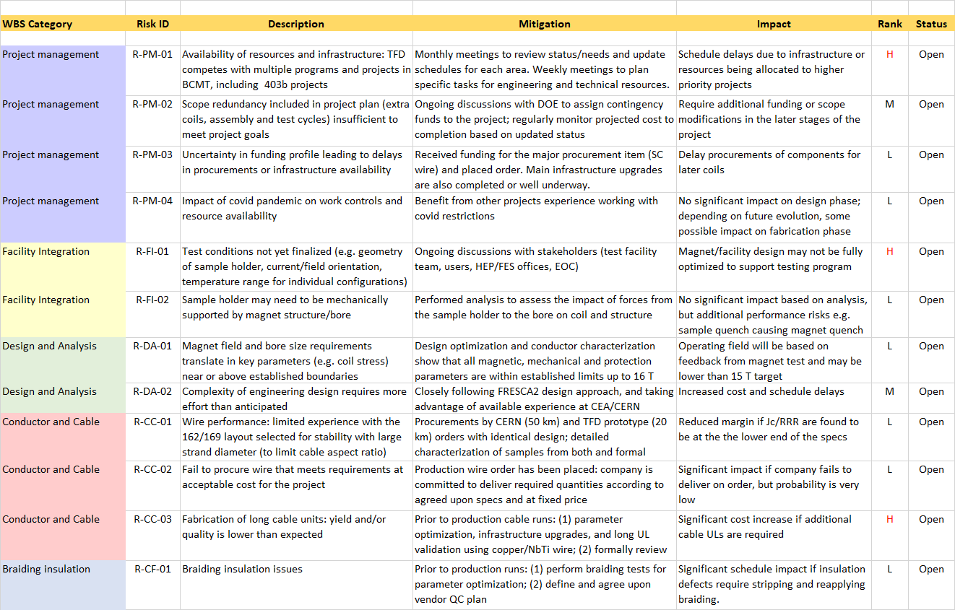
Risk Register (1)

Slide 13
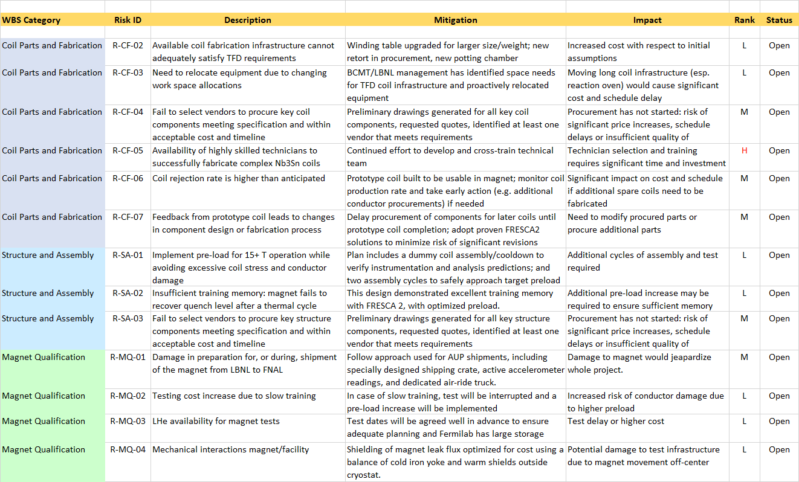
Risk Register (2)

Slide 14
Summary
Main updates from EOC2:
Preliminary Design Review in February 2023: https://conferences.lbl.gov/event/1201/
Significant progress in engineering design, drawings, assembly procedures and component procurement by the new design team
Nevertheless, it has been challenging to complete scheduled activities within the time allocated in the schedule
Additional work is also needed in preparation for cable production runs
Main sources of 20% cost increase are understood and correspond to identified project risks
Bottom-up effort estimates for magnet fabrication were developed and incorporated in the schedule projections
Several intermediate tests will allow to verify key aspects of the installation and operation in HFVMTF prior to final installation
Continued progress in test planning at Fermilab and related facility interfaces

