Slide 1
HTS Cable Test Facility: Update on Facility Preparations
G. Velev for HFVMTF team

Slide 2
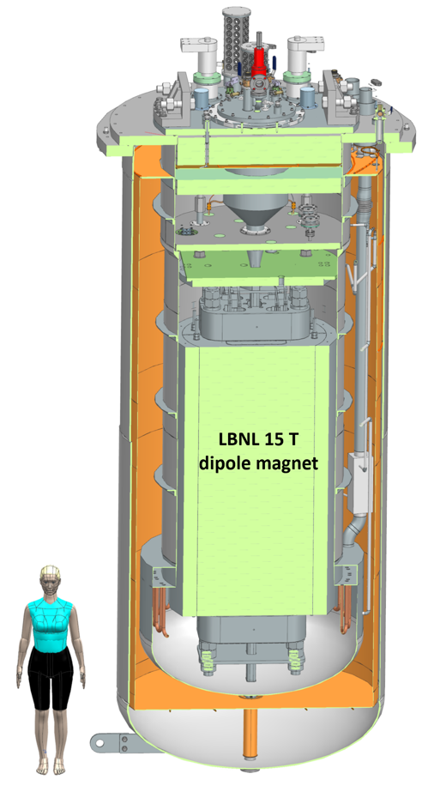
Outline
One Slide History
Short Overview
STEP 1: Test Pit construction and cryostat (GPP at Fermilab)
STEP 2: Quench Protection and Monitoring systems (QP/QM), Power Supplies
STEP 3: Test Facility integration
Schedule
Funding status
Summary
Note: Addressing EOC-2 feedback is highlighted in cyan.

Slide 3
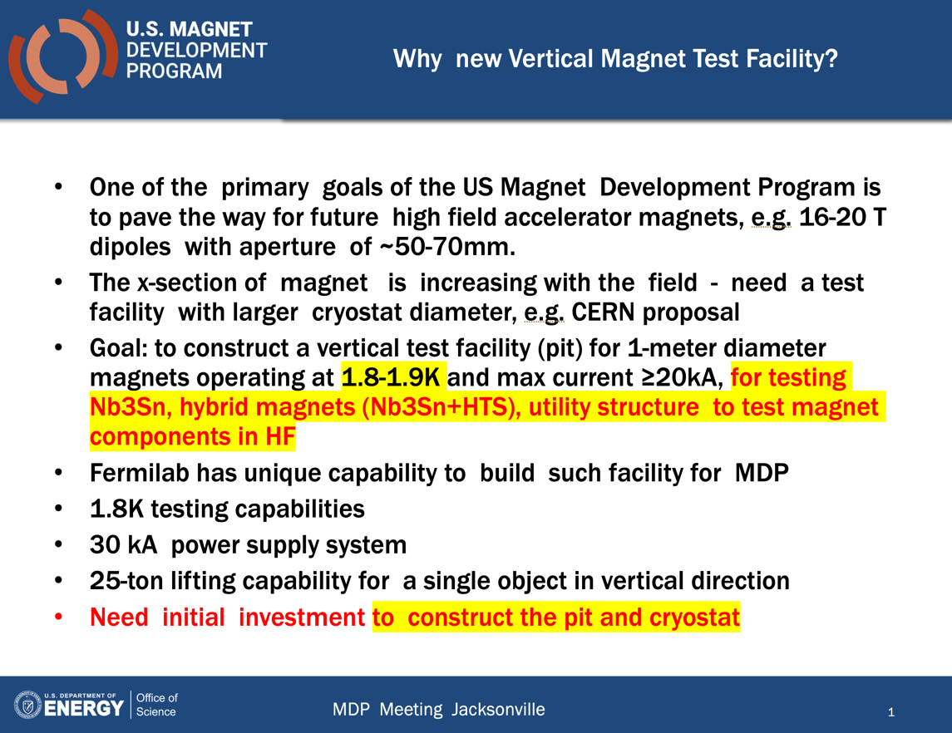
History
In 2018, during the MDP collaboration meeting, it was proposed the construction of a new vertical magnet test facility at Fermilab to serve HF magnet testing.
The idea evolved, and by the 2019 MDP meeting, it was discussed “informally” that this facility could serve both fusion and HEP purposes
The first funding was provided at the end of FY19, in August 2019, eventually becoming the GPP part of the project
The initial goal was to "recycle" as much as possible, including PS, dumps, QP from mu2e, and others.
This project did not follow the typical 413.3B project execution; the absence of a project office led to significant cost savings.

Slide 4
Test Facility – parameters
The place was selected based on the proximity to the needed base infrastructure, including cryogenic, power, water, and cranes.
Two liquefiers, one of which is new, have a capacity of ~600 liters per hour.
The minimum operating temperature of the facility is 1.9K for the magnet providing the background field, with a minimum of 4.5K for the test samples, variable to ~50K.
The test pit cryostat should accommodate a magnet with maximum dimensions of 1.3 meters and a length of approximately 3 meters.
The maximum energy stored in the test field dipole should be less than 20 MJ.
The maximum weight of the dipole cold mass should not exceed 20 tons.
The operational lifetime of the facility should be at least 20 years.
The test facility should be efficient and safe, minimizing the time for experiment preparation and avoiding helium losses.

Slide 5
Fermilab team
Fermilab team is fully assembled to L2.
To execute the tasks, we rely on the personnel of the Magnet Technology Division and Cryo Technology Division (Magnet and Cry Sectors in APS-TD).
We are in strong competition with two 413b projects at CD3 level – Mu2e, and US LHC-AUP.
COVID and other factors have caused delays in the projects.
None of the team members works 100% on HFVMTF.
We have defined R2A2 for the L2s (document exist)
Project Director
G. Velev
Project Manager
V. Nikolic
Mechanical
V. Nikolic
Cryostat
R.Bruce
QP/QM system
C.Arcola
Power Supplies
X. Yuan
Integration
G. Velev
V.Nikolic (interim)
Magnet and Cryo
Division Personnel
Notes:
Roles and Responsibilities, authorities and accountabilities

Slide 6
Project goal (KPP)
Our goal is to complete all subsystems, fully integrate them, and conduct testing with cooling, powering, and operational QP and QM systems on a superconducting magnet. While we are working on the design of the antycryostat and sample holder, it was not originally included in the project budget.
Notes:
Key Performance Parameters

Slide 7
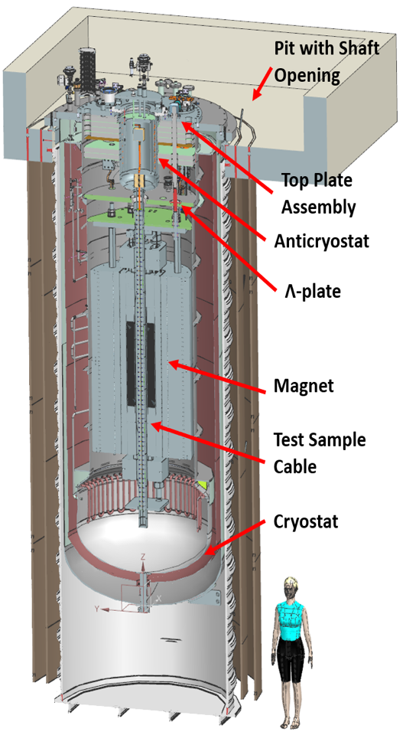
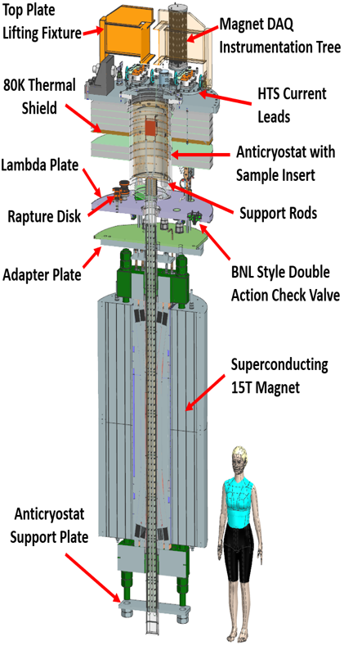
Test Pit and Cryostat (GPP) – Status/Plans
This part of the project includes only the civil (pit) construction and the magnet cryostat.
The pit construction is complete and remains dry even during strong Midwest rains.
The cryostat vendor is behind by approximately 21 months.
  Weekly meetings are conducted with the vendor.
  Additional effort was required to confirm the ANSYS design of the cryostat's vacuum vessel.
  Current phase: production.
  Expected delivery is in June-July 2024, representing a one-year delay from the last meeting.
The design for the top and lambda plate is complete, and has been reviewed. Procurement is started.

Slide 8
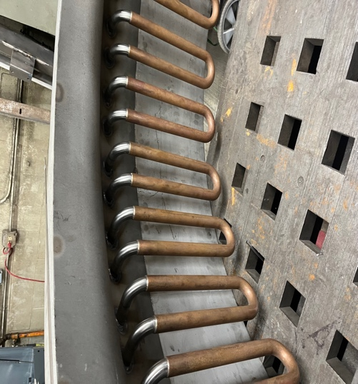
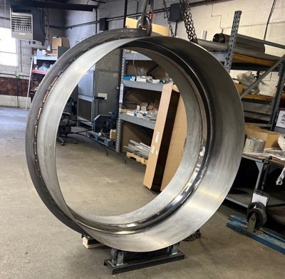
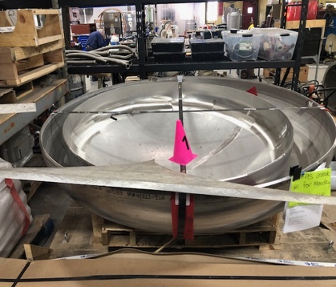
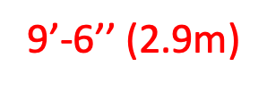
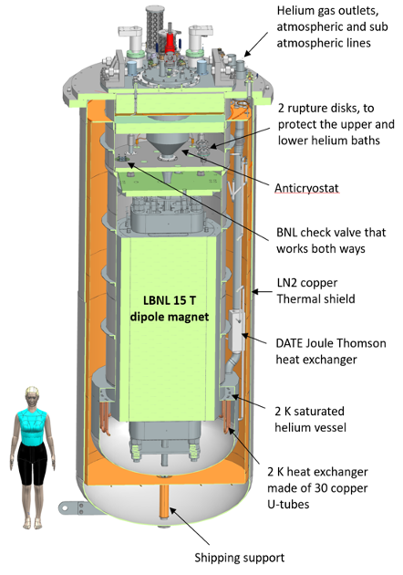
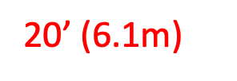
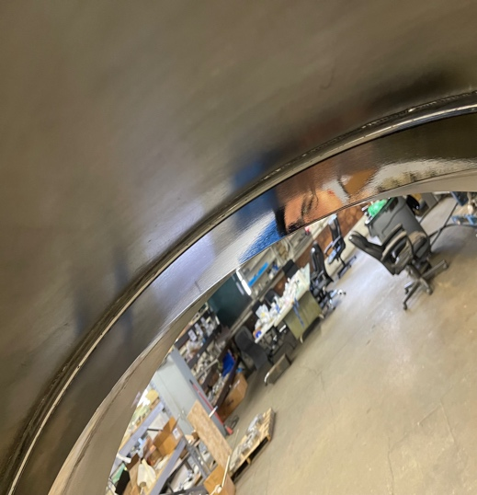
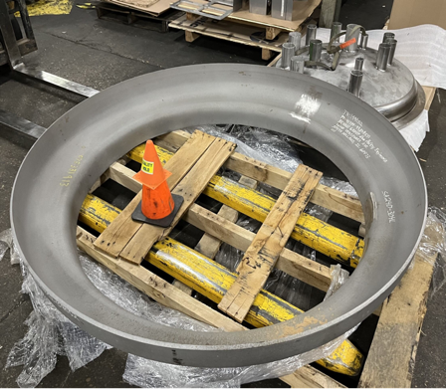
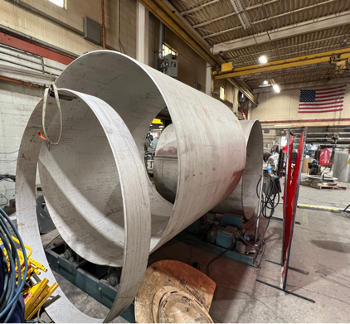
Cryostat Production in Pictures
1.9K Heat Exchanger
Lambda ring polishing

Slide 9
Stored Energy and He recovery
The substantial stored energy of the magnet requires a careful design of the helium venting system. Besides safety considerations, it is important to ensure that the venting system is correctly designed to prevent relief valves from opening and venting helium to atmosphere during a magnet quench.
Work performed:
  First, for all vent calculations, we utilized the previously conducted calculations to justify a maximum heat load of 50 kW to the bath during the quench.
  On the lambda plate, there is a report summarizing the work done to prevent damage to the lambda plate during the quench using the BNL check valve and a rupture disk. These calculations have undergone review by several individuals from the cryogenic division, and the results were also presented at the last CEC conference.
  Regarding the cryostat, two configurations have been considered: one with the relief valves close to the cryostat and the other with the relief valve located near the future brick wall. The minimum required diameter for this pipe is 3", and we plan to use at least a 4". A report on this matter is currently in progress.

Slide 10
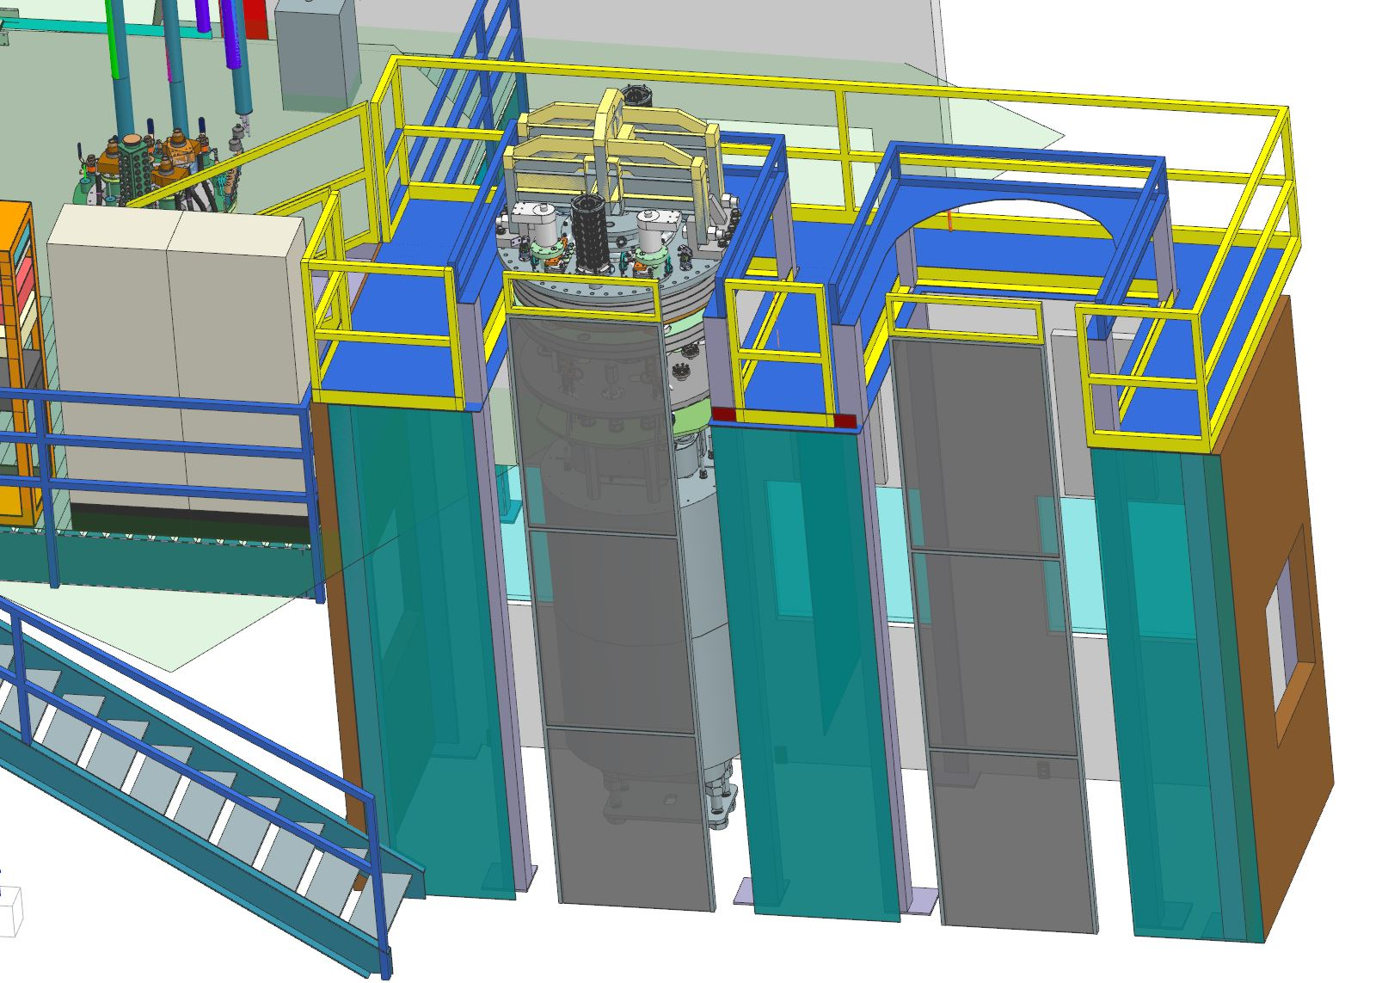
Prep Station Platform
During the design process, we identified the need for a prep station platform (which is currently unfunded). The magnet will be positioned upright to facilitate the easy attachment of the top and lambda plates.

Slide 11
Quench Protection and Quench Monitoring (QP/QM)
The facility is benefiting from the projects, primarily Mu2e Production/Operational grade QP/QM.
Primary Custom Digital Quench Detection System (DQD).
Redundant Custom Analog Quench Detection (AQD).
Quench management system, based on National Instruments C-RIO (Tier III). Provides quench configuration, control, monitoring, and quench data management.
It is 85% finalized. Some modifications are needed to include test capabilities for the samples.
Critical components are ordered, and 70% have been received.
Additional funding is needed for DCCT and protection switches, as well as extraction resistors for magnet and sample protection.
The facility is benefiting from the projects mostly Mu2e Production/Operational grade QM/QC
Primary Custom Digital Quench Detection System (DQD)
Redundant Custom Analog Quench Detection (AQD)
Quench management system, based on National Instruments C-RIO (Tier III ). Provides quench configuration, control and monitoring, and quench data management.
It is 85% finalized. Some modifications are needed to include some test capabilities for the samples.
Critical components are ordered and 70% received
We need additional funding for DCCT and extraction switches and extraction resistors for magnet and sample protection
Branch #1

Slide 12
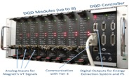
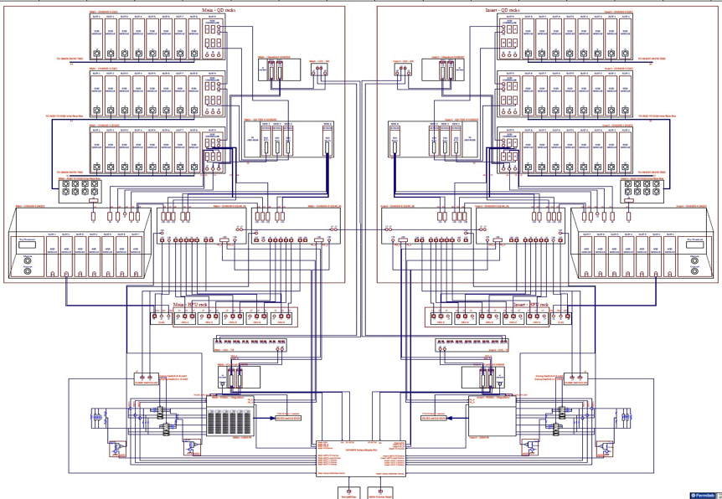

Quench Protection Architecture
Two branches protecting main dipole and test sample
DQD
Branch 1
Branch 2
AQD
Quench Detection & Management
Quench Logic &Protection
PS Control and Monitoring

Slide 13
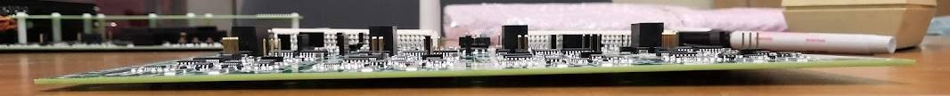
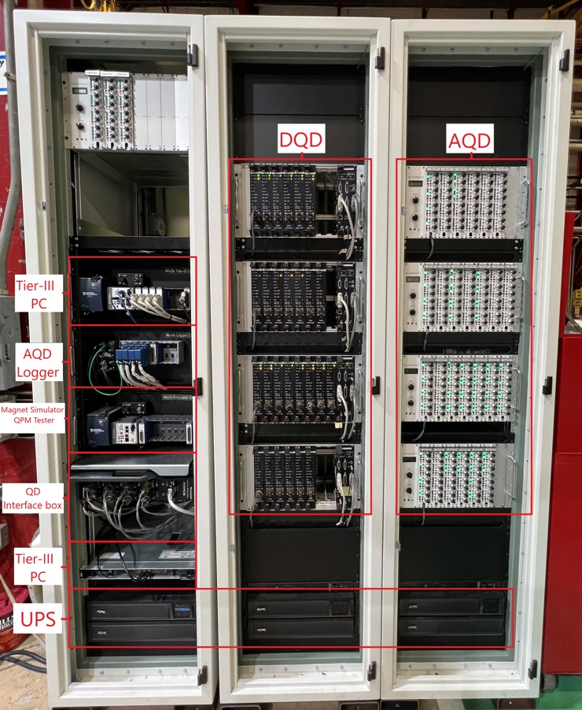
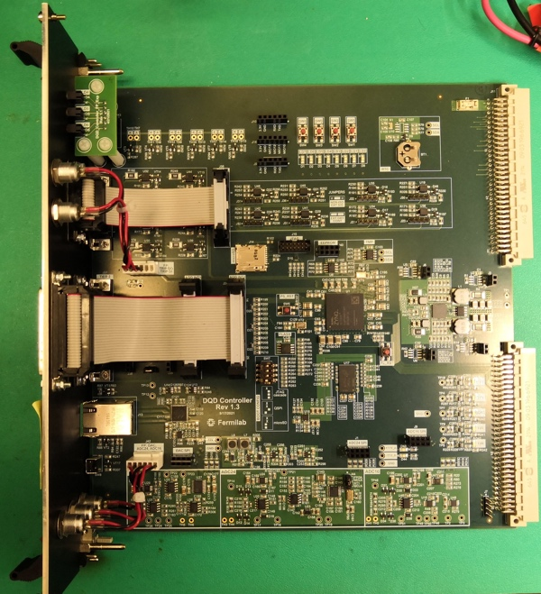
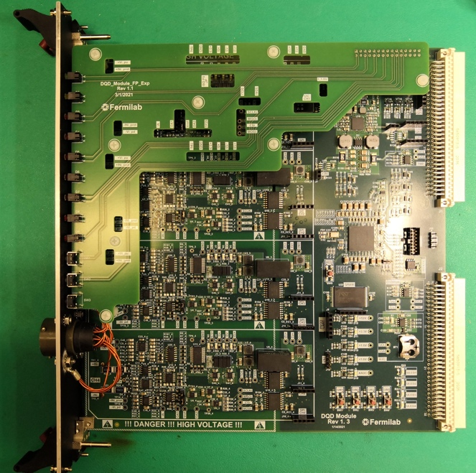
Quench Protection Cabinets and Boards
bend

Slide 14
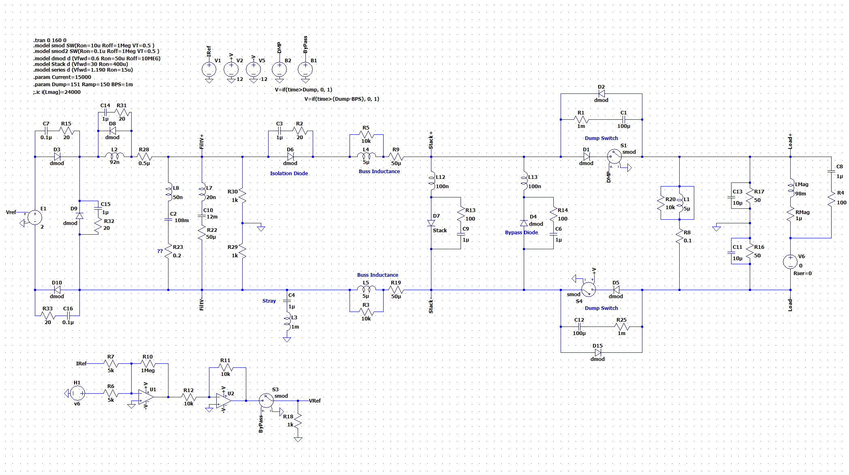
Magnets Quench Protection
We use the Mu2e scheme: extraction resistor (dump) and two dump switches to protect the magnet

Slide 15
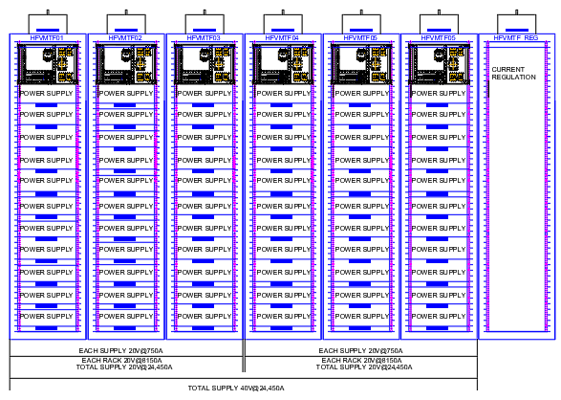
Power Supplies
Power Supply cost is $/per watt.
The procurement process has been ongoing and took more than a year to find a company.
After three iterations, changing specs to encourage U.S. companies to meet requirements, we concluded and selected the European company as no U.S. company met our specifications.
We have a contract for a two sets of PSs:
  Minimum 20 V @ 24 kA to power the main field magnet (LTS for hybrid magnet tests).
  Minimum 20 V @ 16 kA to power the sample (HTS for hybrid magnet tests).
The cost for two sets is: $1.1M + overhead (FNAL charge) ~$1.2M.
We had $963k (originally planned $700k in FY19) allocated for this bid. We used funds from cryo integration to secure the bid.
We have biweekly meetings with the company – preliminary design review was held in December 2023

Slide 16
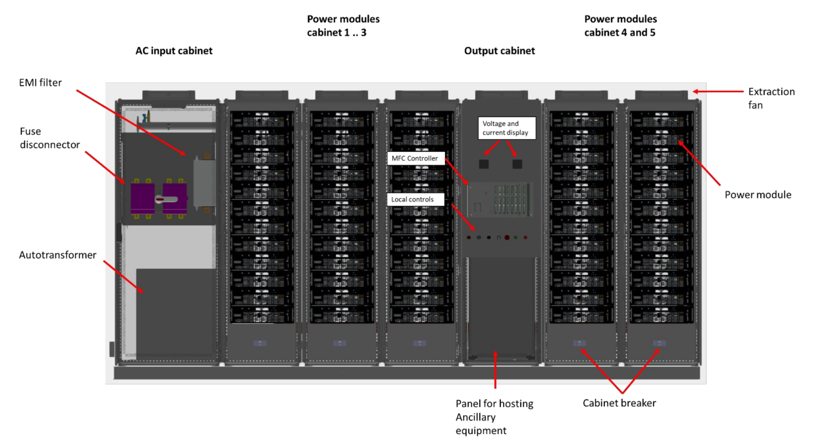
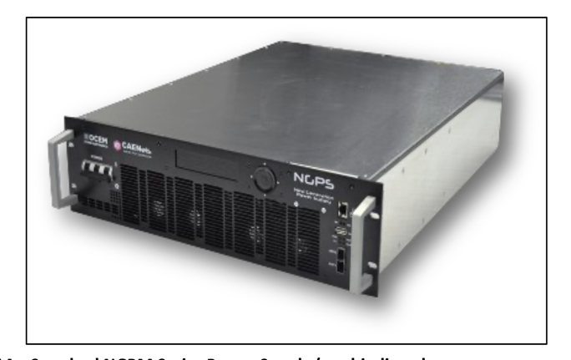
Power Supplies – Preliminary Design

Slide 17
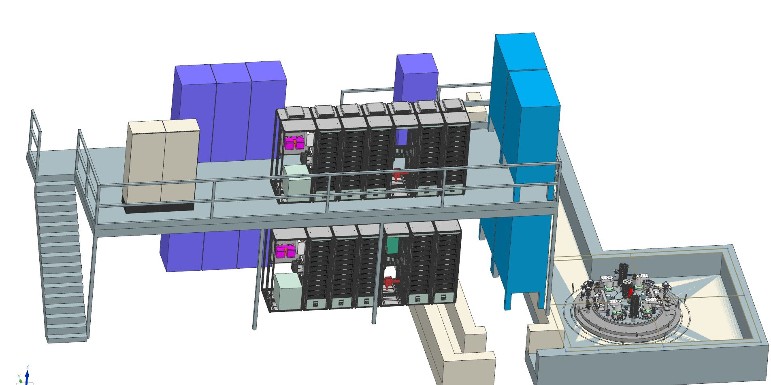
Power Supplies – Platform
Quench Protection, Extraction Resistors (dump)
Note: the Power Supply platform is not funded but we have the funds to start the procurement
Power supplies
Quench electronics
Axillary electronics
Test Pit

Slide 18
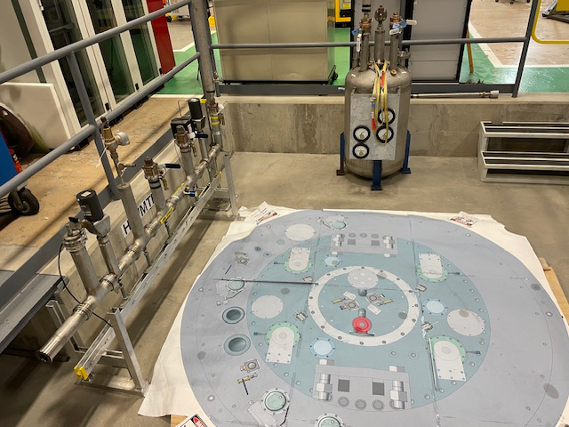
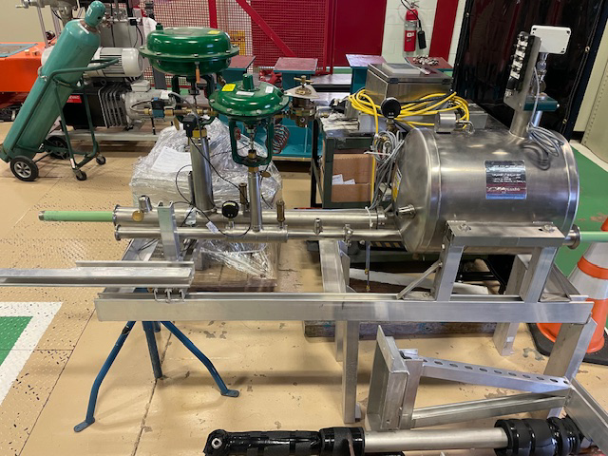
Pit Infrastructure
We have begun preparations for the cryostat delivery and LN "dummy" magnet test.
We are utilizing some cryo infrastructure from the Mu2e solenoid test facility.

Slide 19
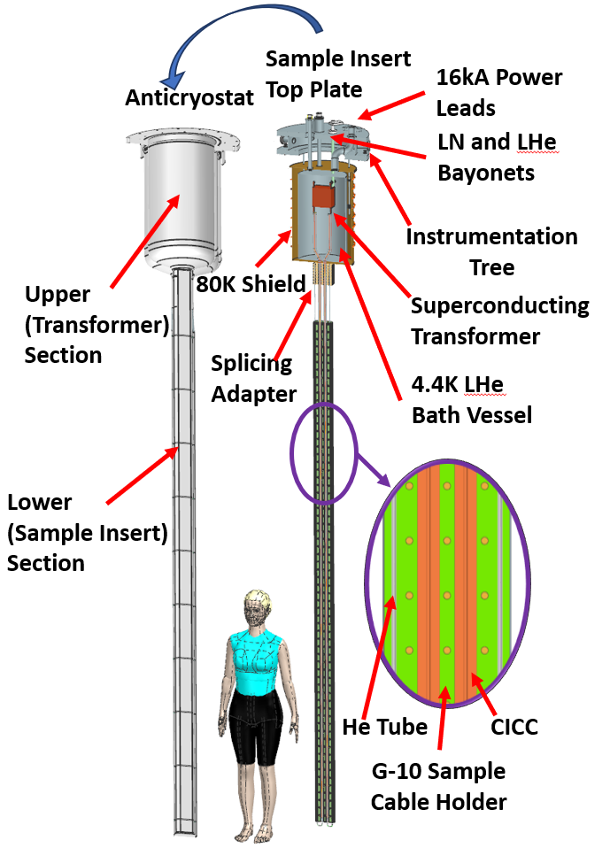
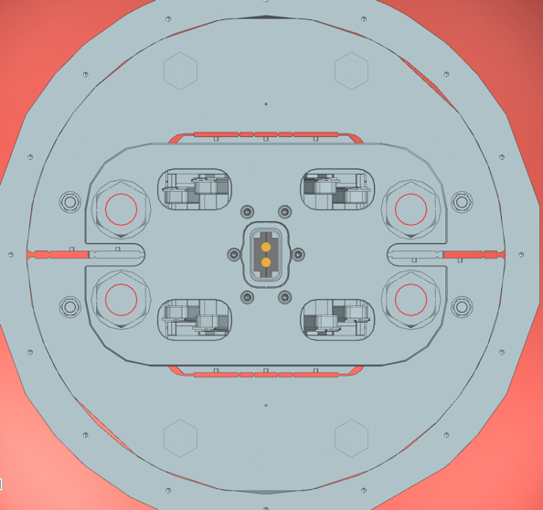
Anti-cryostat and sample holder
We have a preliminary design of the anti-cryostat
  (V. Nikolic and etc. https://arxiv.org/abs/2302.08559)
It is similar to the EDIPO sample holder
Operational mode: field is perpendicular to the test sample
We need additional manpower and funds to expedite the design process.
B=15 T
I_{max}=100 kA

Slide 20
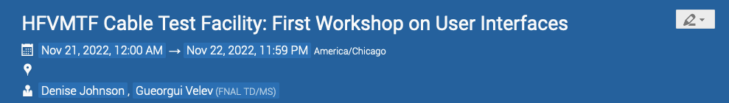
Recommendation from EOC
We had questions connected mostly with SC test sample cryostat and test sample well for FES
  Assuming EDIPO type sample cryostat, is this what we need?
  What are sample dimensions? Constant?
  Any limitations on temperature gradient within the sample during testing?
  Are there any requirements for warmup/cooldown?
  SC transformer, what design we should use? Primary and secondary coil turns? Is 100kA what we need?
Nov. 21-22, 2022 we had virtual meeting with users' community - ~ 33 potential users were registered, more connected
Indico event: https://indico.fnal.gov/event/57027/
It was very productive, We categorized the recommendation to 5 categories: in the plan, easy to implement, moderate to implement , difficult but not impossible, very difficult, maybe impossible with this facility
For now we are working on implementation of the up-to moderate recommendations

Slide 21
Summary of the HFVMTF status
IB1 pit construction is complete.
Cryostat delivery is anticipated this summer, with final assembly steps underway.
Power supplies have been ordered, FDR done, with an expected delivery in June 2025.
Approximately 75% of the QP electronics have been ordered, following the Mu2e style.
Design of the top and lambda plates are in procurement
Various smaller items are in progress, including the quench relief pipe.
Design of the antycryostat and the sample holder is progressing well
Workshop on user interfaces was hold in Nov 2022
We presented the status of facility to the wider community on the 4th Superconducting Magnet Test Stand Workshop

Slide 22
Integration
Documentation for the integration of the pit has commenced, drawing from the experience of AUP stand 4.
We are currently operating at full speed to ensure preparedness for the final step of cryo integration when the cryostat arrives, expected around June 2024. Additional funding is required for this phase of the project.

Slide 23
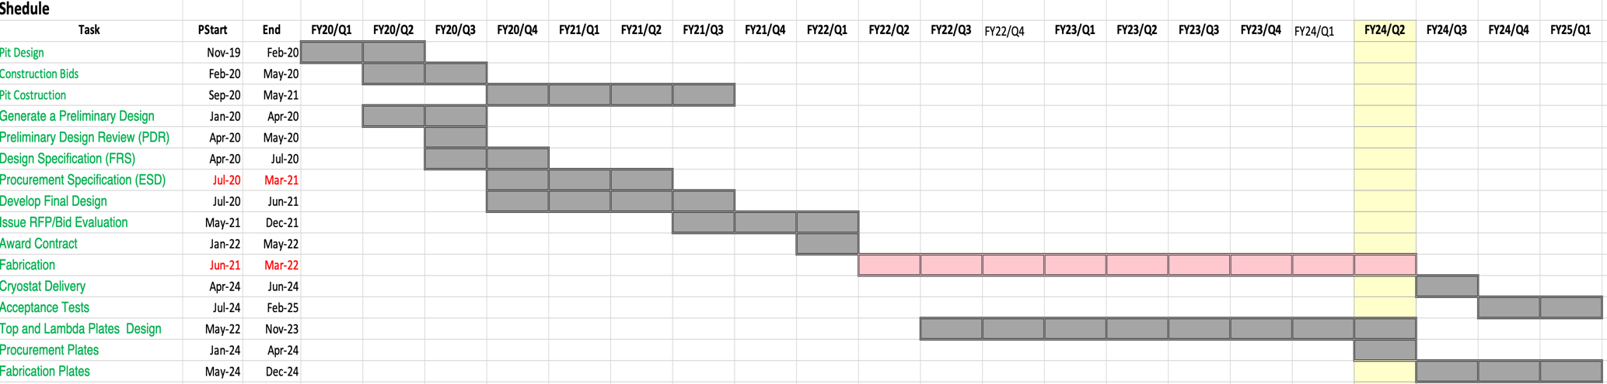
Schedule
Two major known-unknowns:
  PS delivery – Estimated in January 2025?
  QP/QM system chip delivery – Commenced receiving components, currently at 70% completion.
Best estimation for receiving all test facility components is in Winter 2025.

Slide 24
Schedule Update –QP/PS/Integration
The QP/QM schedule has been updated.
  It incorporates the completion of the system design and the testing of article (version)
  Indirectly, it was affected by COVID-19 project delays.
  The schedule also accounts for the delay in COVID-related electronic component deliveries.
The final integration schedule is estimated to be 9-11 months, which is considered reasonable.
The overarching goal is to conduct the final integration test of a magnet in the pit by the summer of 2026.

Slide 25
Keeping the cost down
The team is committed to cost efficiency at every stage of the project.
Occasionally, we were prioritizing cost over schedule leads to delays.
Some delays are beyond our control, such as those related to external procurement (cryostat)
Recycling is a key strategy to maintain efficiency and reduce costs (e.g., repurposing HTS Tevatron leads).
None of our team members is dedicated 100% to the projects, a measure taken to manage costs effectively.
Delays in major MTD projects (413.3B projects) largely due to COVID-19 and technical issues, are affecting us too, engaging key team members.
This project deviates from the typical DOE setup: lacking a project office. Spending is overseen by the project team.

Slide 26
Opportunities/Savings
We are incorporating the QP design utilized in the mu2e experiment, ensuring efficient design reuse.
To minimize thermal load from power sources, we are repurposing the superconducting (SC) leads previously employed in the Tevatron.
The existing infrastructure associated with these leads, such as the cryo precooler, will also be reused, contributing to significant cost savings.
Cumulatively, these measures result in substantial savings, estimated at approximately $1.5-$2M.

Slide 27
Current Project Profile
This was a request in Jan 2022. In Sep 2022 we got the required funds.
This project has practically no contingency
 | Funds Planned/Recived/Pending |  |  |  | Jan 2022
Cost Estimate (k$) | Step 1 | Step 2 | Step 3 | TPC | Comments
k$ | $2,018.0 | $1,612.5 | $1011.0 | $4,641.5 | Total Cost
Year received | FES | HEP | FY total | Steps
FY19 received (GPP-test pit) | $1,299.0 | $250.0 | $1,549.0 | Step 1 | Received in August 2019, $500k is for the civil construction and $1000k for cryostat
FY20 Received (QP/QM) | $0.0 | $650.0 | $650.0 | Step 2 | Received in May 2020, for QP/QM electronics
FY21 Received (Power Supplies) | $0.0 | $962.5 | $962.5 | Step 2 | Received in April 2021, for PSs and supporting electronics
FY22 Cryostat additional funds | $234.5 | $234.5 | $469 | Step 1 | Top and Lambda plate additional funds. Cryostat additional funds.
FY23 (Integration) | $563.5 | $0.0 | $563.5 | Step 3 | Needed for Integration (not received)
FY23 Pit Integration with Power, Cryo and controls | $223.8 | $223.8 | $447.5 | Step 3 | Needed for Integration (not received)
Total | $2,320.8 | $2,320.8 | $4,641.5

Slide 28
Project status
Currently, we have $685k in the “bank.”
The majority of the funding, $3M, has been allocated to M&S, covering:
  Steel magnetic shields and pit construction
  Cryostat
  Power supplies
  Quench protection electronics
We maintained a "lean" approach to SWF spending, with $995k allocated over approximately 4 years.
Service Type | Description | Funding Amount | Funding Type | Received | ITD SWF Cost | M&S Total | Balance after RIP's
AT 10 10 300 FUSION ENERGY SCIENCES - ENABLING R&D - GPP | IB1 High Field Vertical Magnet Test Facility Pit Design and Construction - FES (Fusion Energy Sciences) FWP 19-29 | $1,299,000 | GPP | Aug-19 | $527,430
KA 22 02 023 INTENSITY OTHER COMPLEX SUPPORT - GPP | IB1 High Field Vertical Magnet Test Facility Pit Construction Phase - HEP Intensity Frontier FWP 19-28 | $250,000 | GPP | Aug-19 | $38,374
 |  | $1,549,000 |  |  | $565,803 | $924,142 | $59,055
KA 25 02 01 TEST FACILITIES - ACCELERATOR-EQU | HIGH FIELD VERTICAL MAGNET TEST FACILITIES QUENCH PROTECTION & QUENCH MONITORING | $650,000 | Non-Base | May-20 | $282,315
 |  | $650,000 |  |  | $282,315 | $202,690 | $164,995
KA 25 01 012 EQU ADVANCED TECHNOLOGY - NATIONAL LABORATORIES | High Field VMTF Quench protection and monitoring | $965,000 | Base | FY21 IFP
KA 25 01 012 EQU ADVANCED TECHNOLOGY - NATIONAL LABORATORIES | High Field VMTF Quench protection and monitoring | $234,500 | Base | Jun-22
KA 25 01 012 EQU ADVANCED TECHNOLOGY - NATIONAL LABORATORIES | High Field VMTF Quench protection and monitoring | $172,314 | Base | Sep-22
 |  | $1,371,814 |  |  | $15,149 | $1,222,277 | $134,387
AT 10 70 000 STRATEGIC ACCELERATOR TECHNOLOGY | High Field VMTF Cryoplant Test Stand | $234,500 | Non-Base | Jun-22
AT 10 70 000 STRATEGIC ACCELERATOR TECHNOLOGY | High Field VMTF Cryoplant Test Stand | $814,300 | Non-Base | Sep-22
 |  | $1,048,800 |  |  | $131,758 | $590,154 | $326,889
 | Total | $4,619,614 |  | - | $995,025 | -$2,939,263 | =$685,326

Slide 29
Reason for cost increase (1/2)
The initial cost of the project in 2019 was estimated based on the Vertical Magnet Test Facility built in 1997 for R&D testing of the “original” LHC quadrupoles.
  We utilized an official inflation factor up to 2019 of 1.63 (1997-2019). However, with COVID-19 delays, it became evident that this factor was insufficient.
  Having experienced the process, I am convinced, not all costs were accounted for, especially in terms of labor.
The project's prolonged timeline is attributed to several factors:
  COVID-19 disruptions and skilled manpower shortages due to project delays (COVID-19-related). The original completion date was set for the end of 2023.
  The manufacture of the cryostat is 1.5 years behind schedule. Constant supervision and design checks (considering the cryostat is a pressure vessel) have impacted the overall cost.
  Power supplies were ordered with similar delay which increased the cost

Slide 30
Reason for cost increase (2/2)
Rescaling the cost with size of the VMTF test pit did not produce satisfactory results. We paid 30-50% more for everything ordered during and after COVID-19.
  Cryostat: $430k -> $735k
  Power supplies: $700k -> $1.2M
  Electronics components cost practically doubled
  Labor rates increased too
With the commissioning of test stands for quadrupole testing for AUP and quench protection work for mu2e, we now have a much better understanding. It has become evident that labor hours for integration were not sufficient.

Slide 31
Summary
The HFVMTF test pit construction is complete.
Procurement is finalized, and the production is in progress with the company – the cryostat is expected in June 2024.
The QP/QM system closely resembles the mu2e/AUP production systems, but modifications are necessary.
Main electronic parts were ordered in the fall of 2021, and approximately 75% of components have been received.
  Additional funding is required to complete the systems.
Power supplies design has successfully passed preliminary design review, with delivery expected at the beginning of FY25.
Integration of the stand requires additional cryogenic effort
  Additional funding is necessary to finalize cryostat checks and integration.
As of today, the current estimation for stand completion is Summer 2026.

Slide 32
Backup Slides

Slide 33
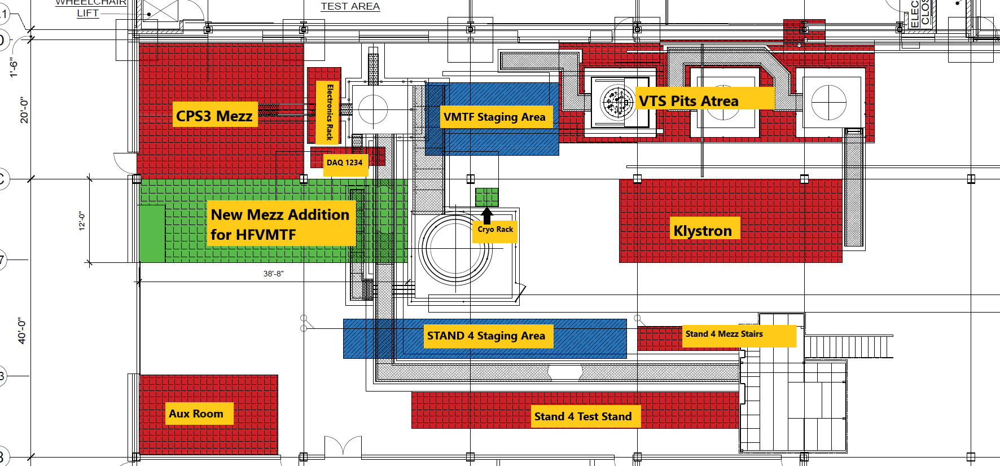
TF layout
We do not stop VMTF and space is premium

Slide 34
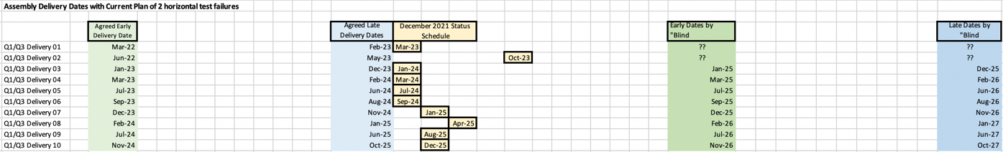
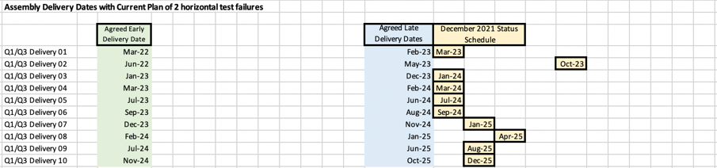

Delivery Dates Renegotiation
LS3 Start from Jan 1st 2024 to Jan 1st 2026
  Early and Late Dates moved “blindly” by 24 months
Early Dates moved by 24 months
Future COVID Impact
FRS Change
?
1 cell = 1 month
~11 months for AUP Schedule Risks

Slide 35
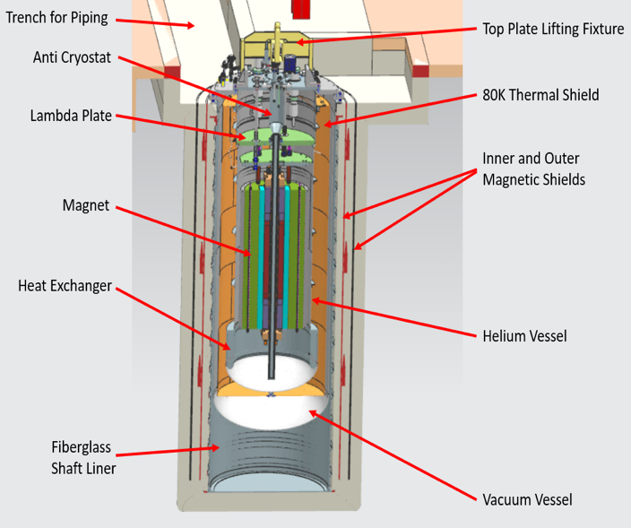
Civil Construction Design
Current VMTF
HFVMTF

Slide 36
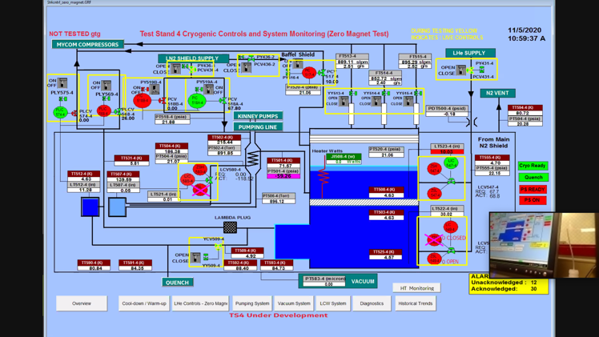
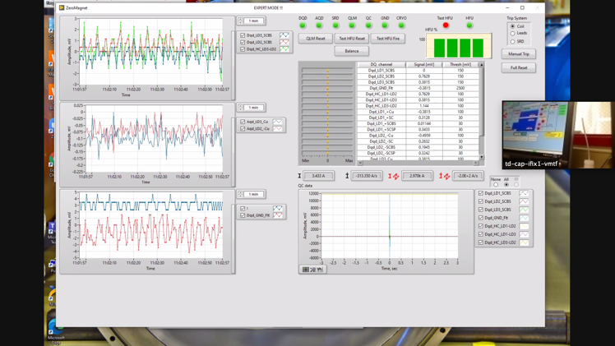
Mu2e 1st Article Quench Protection
Hi-Lumi ZMT Cold Test
ZOOM Power Test side note:
The test was carried out in the control room, which has a limited capacity due to COVID-19
Zoom meetings were set up so all the subject matter experts could participate
The relevant test GUIs were shared with audio – worked great!
Darryl Orris

Slide 37
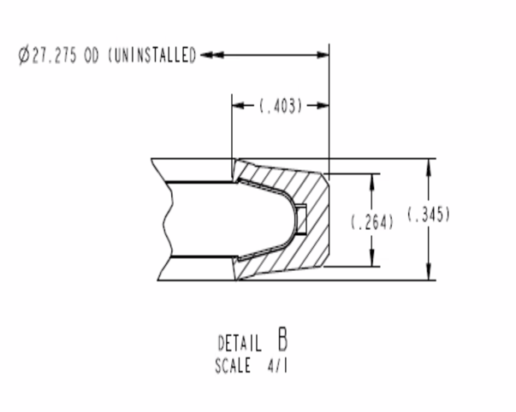
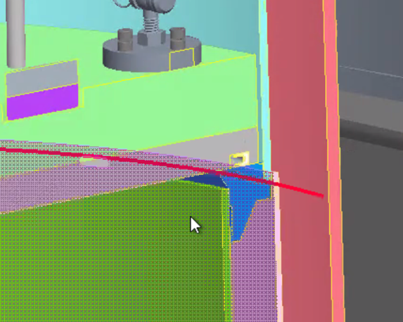
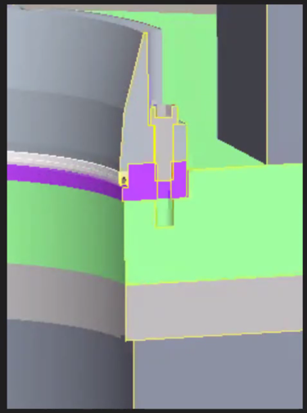
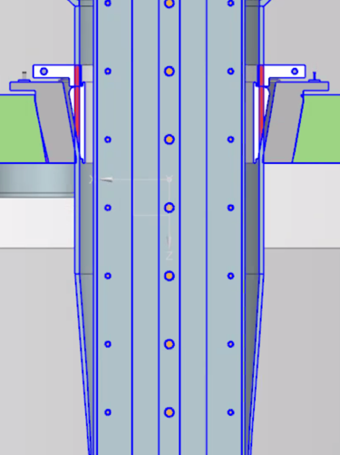
Lambda plate seal
We entertained 3 different options for lambda plate sealing - decided on the BNL seal following one of the EOC recommendations
After several meetings with BNL and evaluating our options, we decided to used BNL Lambda plate seal
For the anti-cryostat seal, we are still looking at two options BNL and Fermilab

Slide 38
Summary of the parameters
Parameter | Value
Background Dipole Field | 15 T
Minimum Operational Temperature | 1.9 K
Maximum Magnet Diameter | 1.3 m
Maximum Magnet Length | 3.0 m
Maximum Stored Energy | 20 MJ
Maximum Weight | 20 t
Test Sample Temperature | 4.5-50.0 K
Maximum Test Sample Current (direct) | 16 kA
Maximum Test Sample Current (transformer) | 100 kA

