Slide 1
Quench protection of the 20 T dipole common-coil magnet
HFM Protection Studies
WP4.5-T4-D9
Emmanuele Ravaioli (CERN),
D.M. Araujo (PSI), R. Gupta (BNL)
19.03.2024

Slide 2
DISCLAIMER
Quench protection of an accelerator dipole magnet should be designed for protecting the full-scale version of the magnet (~15 meter long) without using energy extraction (which can’t be applied to protect many high-field magnets in series)
Today I’m presenting the results of the quench protection study for the 1 m long version using either energy-extraction (EE) or CLIQ
PROVOCATION OF THE DAY
If you can’t protect its 15 m long version without EE, it’s not an accelerator dipole magnet.

Slide 3
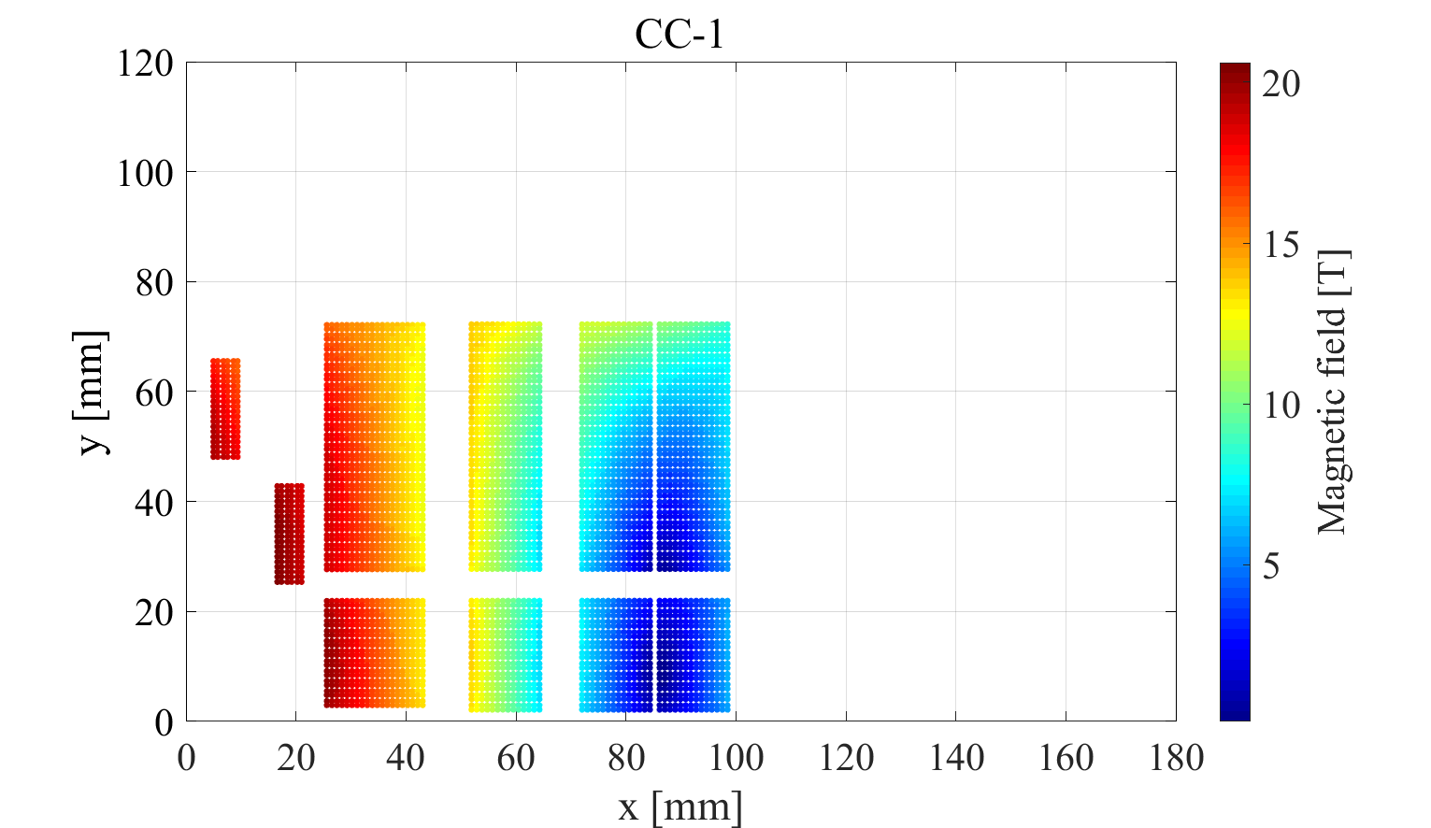
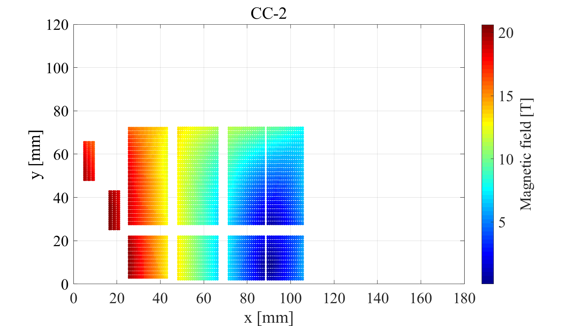
20 T dipole common-coil magnet – Design iteration
Version | B_bore [T] | SC | B_peak [T] | I_{op}/I_{SS} [-] | (I_{SS}-I_{op})/I_{SS} [-] | A_bare_layers [mm²] | A_bare_tot [mm²] | A_strands [mm²] | A_strands_tot [mm²]
CC-1 | 19.98 | Bi-2212 | 20.2634 | 87.6% | 14.1% | 2.37E+03 | 3.42E+03 | 9.65E+02 | 2.84E+03
 |  | Nb3Sn | 13.8833 | 86.0% | 16.3% | 4.47E+03 |  | 1.87E+03
CC-2 | 19.98 | Bi-2212 | 20.7342 | 88.3% | 13.3% | 2.37E+03 | 4.16E+03 | 9.65E+02 | 3.46E+03
 |  | Nb3Sn | 13.8481 | 85.8% | 16.6% | 5.96E+03 |  | 2.49E+03
 |  | Nb3Sn | 12.3764 | 78.9% | 26.8%
Bi-2212 | Nb₃Sn | TOT
same | +25% | +18%
All cross-section figures are given per half pole (quadrant)

Slide 4
CC-1 – 1 m long – 1 kV energy extraction (EE)

Slide 5
CC-1 – 1 m long – 2 kV energy extraction (EE)

Slide 6
CC-2 – 1 m long – 1 kV energy extraction (EE)

Slide 7
CC-2 – 1 m long – 2 kV energy extraction (EE)
Quench protection is possible
with a 2 kV EE

Slide 8
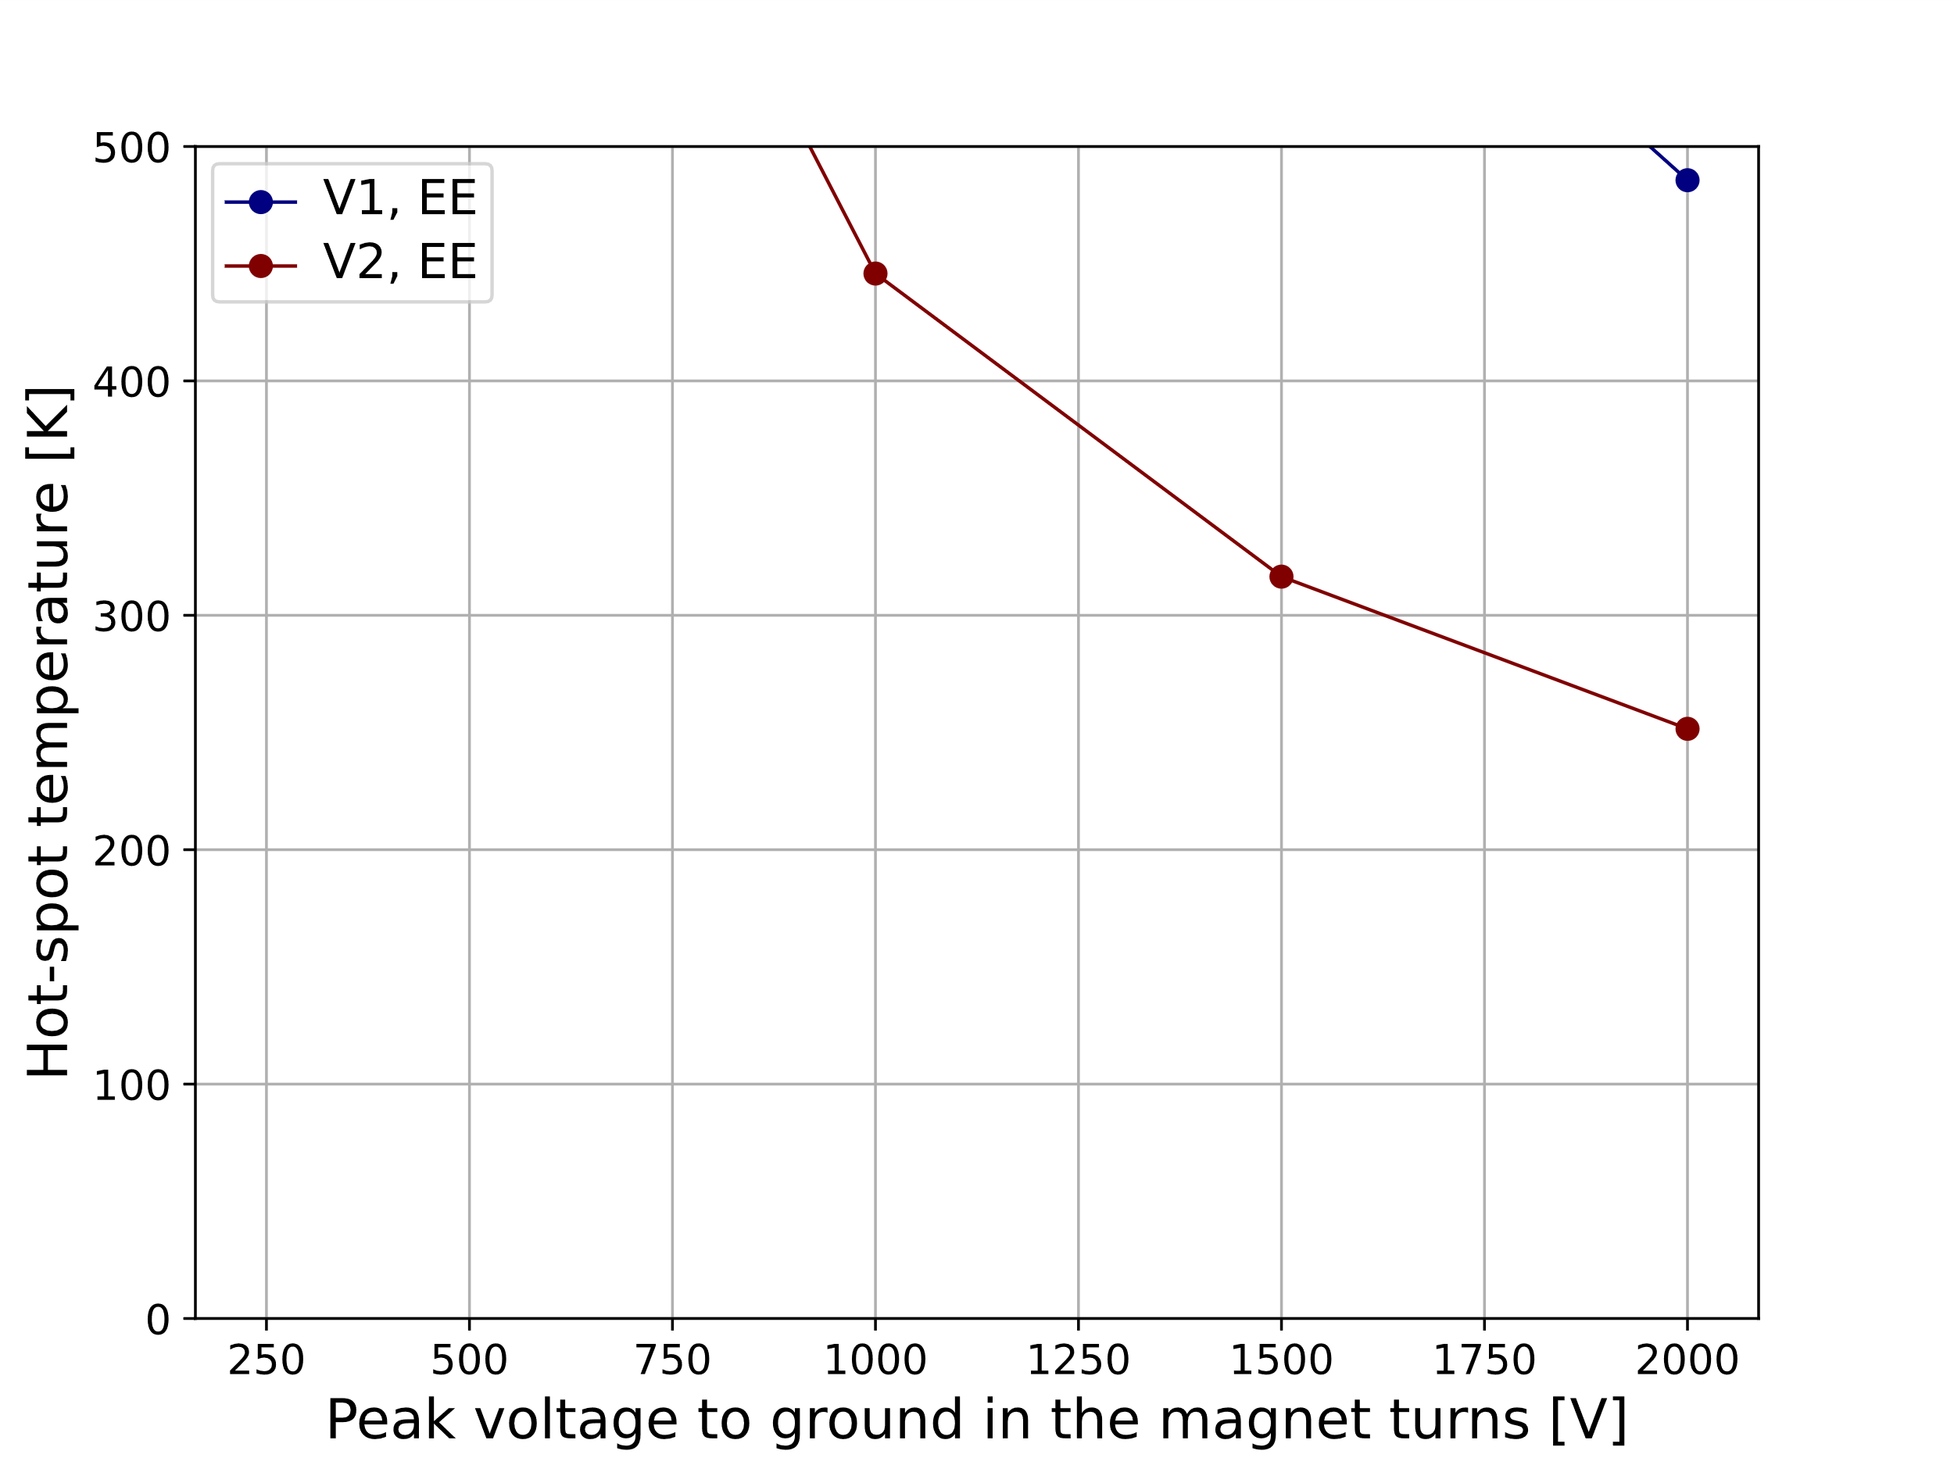
EE – 1 m long – Hot-spot temperature versus peak voltage to ground
Grounding at the mid-point of the EE resistor would halve these figures

Slide 9
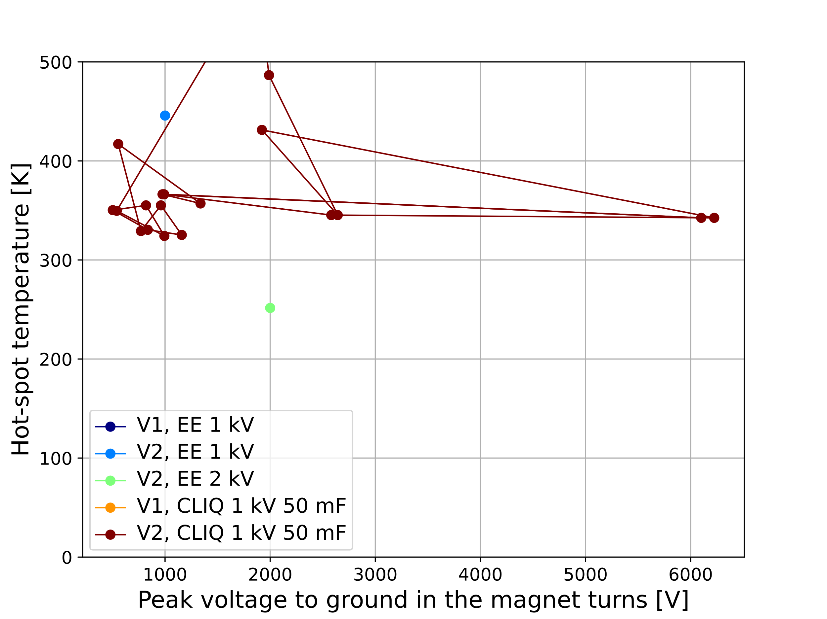
1 kV CLIQ – 1 m long – Hot-spot temperature versus peak voltage to ground
19 CLIQ configurations studied
(all possible symmetric configurations)
9 result in T_hot ≤ 350 K
4 also U_ground ≤ 1000 V

Slide 10
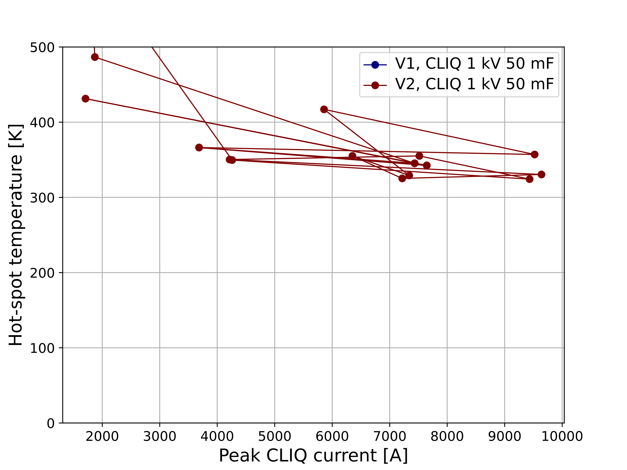
1 kV CLIQ – 1 m long – Hot-spot temperature versus peak CLIQ current
19 CLIQ configurations studied
(all possible symmetric configurations)
9 result in T_hot ≤ 350 K
4 also U_ground ≤ 1000 V
2 also I_CLIQ ≤ 5 kA

Slide 11
CLIQ option 1 – 50 mF, 1 kV
Red: Negative initial CLIQ dI/dt
Green: Positive initial CLIQ dI/dt
Currents vs time
Hot-spot temperature vs time
Temperature in the turns
(hot-spot not shown here)
Hot-spot temperature | Peak voltage to ground | Peak CLIQ current
350 K | 503 V | 4216 A

Slide 12
CLIQ option 2 – 50 mF, 1 kV
Red: Negative initial CLIQ dI/dt
Green: Positive initial CLIQ dI/dt
Currents vs time
Hot-spot temperature vs time
Temperature in the turns
(hot-spot not shown here)
Hot-spot temperature | Peak voltage to ground | Peak CLIQ current
350 K | 540 V | 4260 A

Slide 13
NEXT
Is it possible to protect the 15 m long version using ESC?

