Slide 1
SMCTM1a/b test summary
April 10, 2024
Maria Baldini
US Magnet Development Program
Fermi National Accelerator Laboratory

Slide 2
Outline
Magnet design and test goals
Magnet instrumentation
SMCTM1a test plan and quench performance
  quench sequence, training, ramp rate, temperature, TC
  S-N transition, quench location, Splice resistance
SMCTM1b test plan and quench performance:
  spike analysis and quench classification
  Quench sequence, training, ramp rate, temperature dependence
Heater study
and RRR measurement
Summary

Slide 3
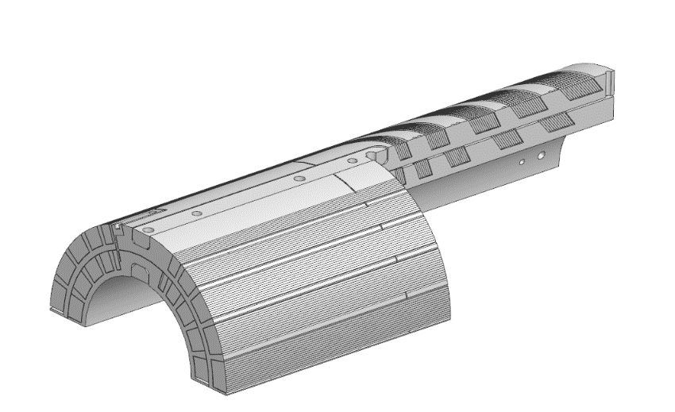
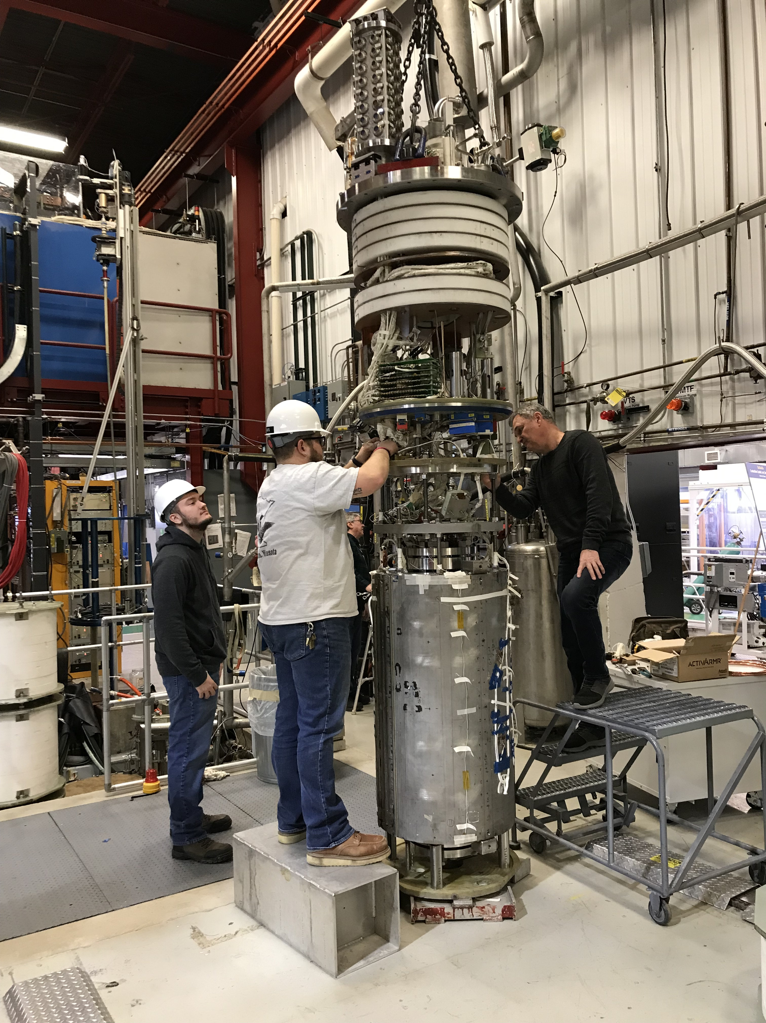
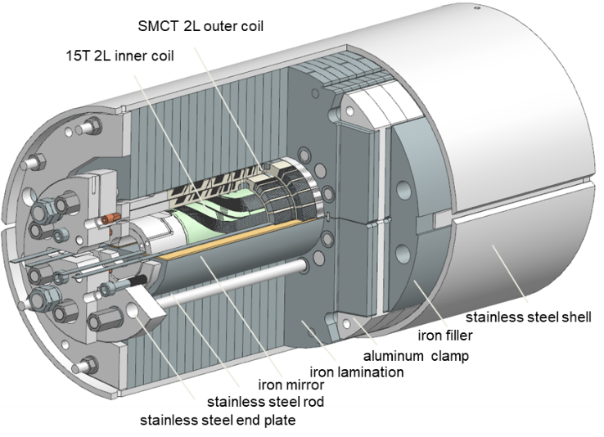
SMCTM1 design and test goals
Test goals
Prove the concept of SMCT dipole coil design in 2-layer and 4-layer mirror configurations
Demonstrate the magnet can reach the targeted quench current at the set pre-load
Study coil training, ramp rate and temperature dependences of magnet quench current
QP heater test

Slide 4
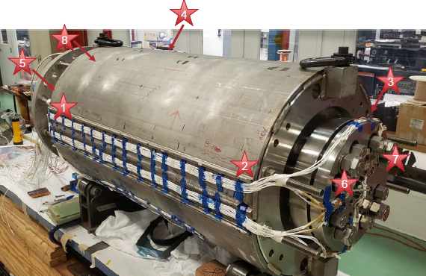
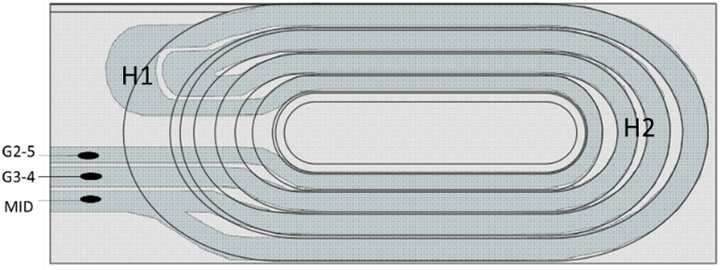
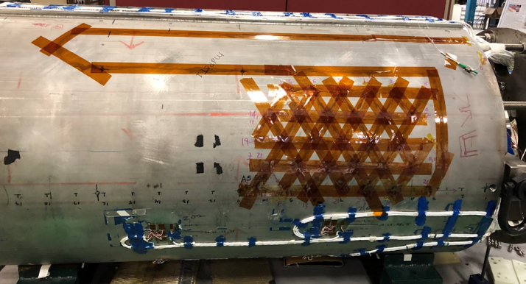
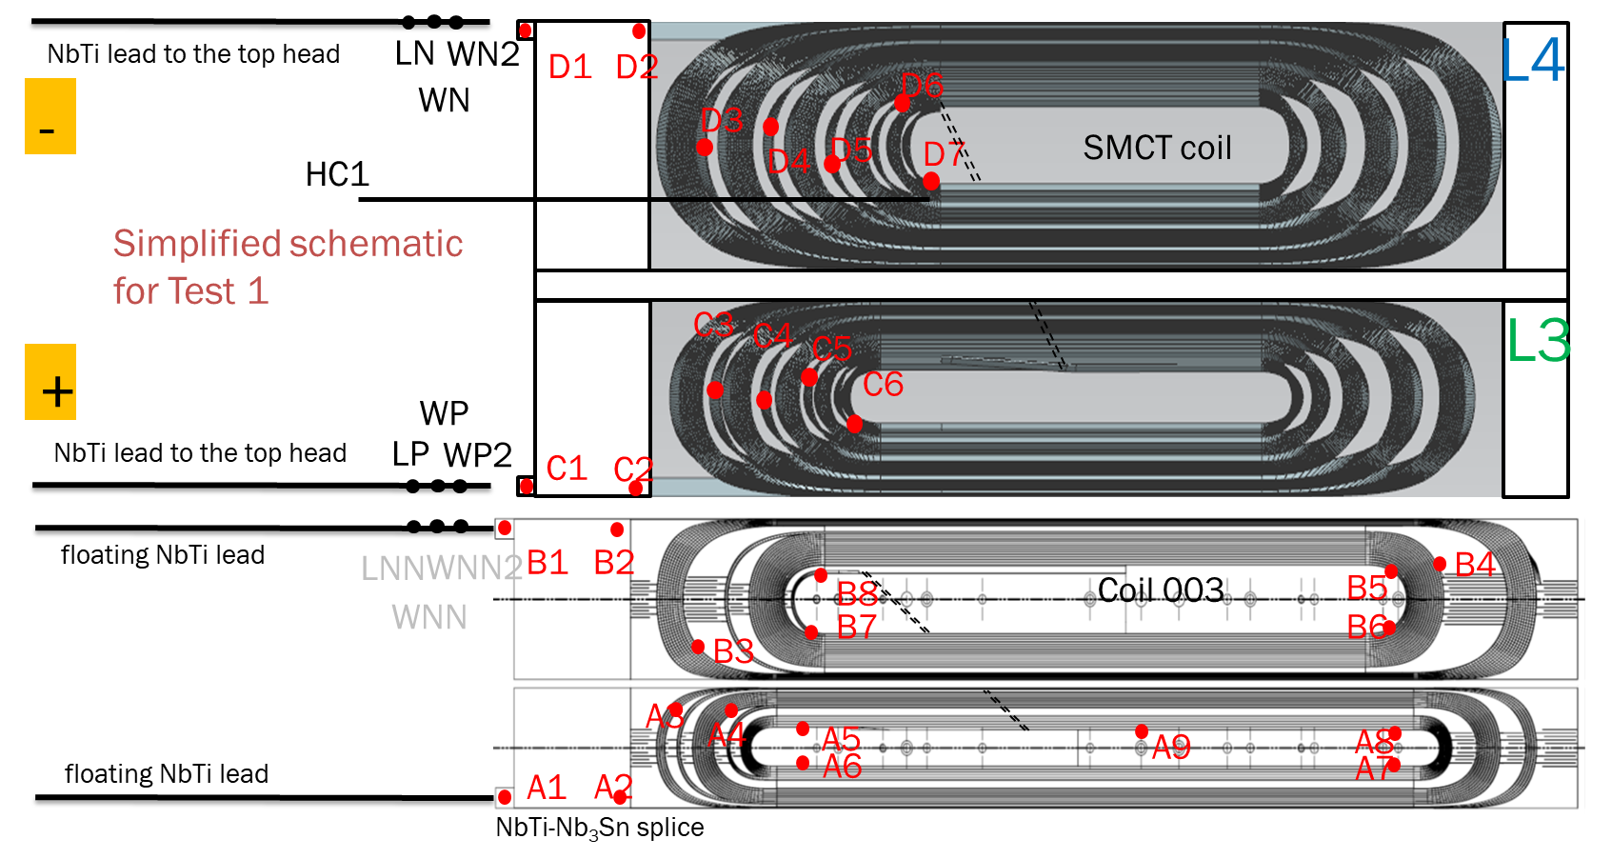
SMCTM1 Instrumentation – General overview
VT – for quench detection; splice resistance measurements
SG on coils, poles, bullets/rods and shell – strain monitoring during cool down, warm up and quenches
QPH – for SC coil quench protection
  this magnet was protected by energy extraction system
Acustic Sensor - for independent quench characterization (Stev)
Fiber Optics – strain measurements of the shell.
TS – outside magnet/coil temperature

Slide 5
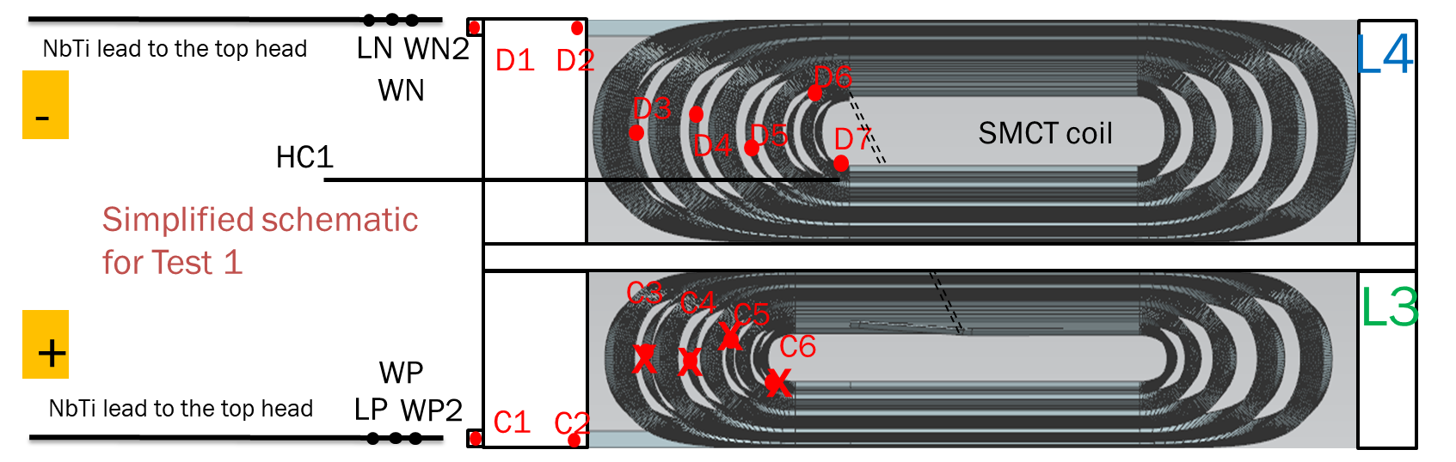
SMCTM1a Test plan and Quench summary
Electrical check after magnet fabrication: C3-C6 taps are open: to locate a quench in L3 layer will not be possible
Test campaign: training quenches at 1.9 K, ramp rate dependence at 1. 9 K started close to a plateau and Temperature dependence. Thermocycle was performed and the test repeated.
Notes:
Description of test plan and what happened

Slide 6
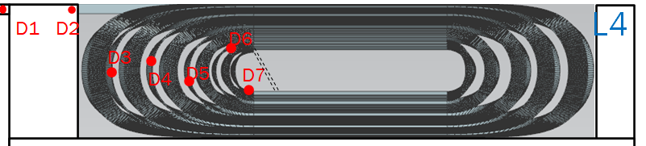
SMCTM1a Training at 1.9 K
Outer layer quenches:
1st quench was in the D4-D5 segment
3 more quenches in the D6-D7 segment (pole turn); the last one at 50 A/s
Remaining quenches were all in the inner layer:
Position is unknown because VTs were open
14.3 kA 12.7 T was reached in 24 quenches
No memory after thermocycle
Notes:
Add TC
T 86% of SSL
Check field at 12. 5 kA

Slide 7
SMCTM1a Ramp rate dependance
No degradation in TC2: all quenches in the inner layers
Magnet was still training in TC2
Data at 4.5 K were collected when Iq> 13600 A (same force level observed during TC1 at 4.5 K)
Linear extrapolation at 0 ramp rate: maximum quench current is 15 kA and 13.1 T (91%of SSL).
All quenches were in inner layer beside the first one at 50 A/s (outer layer).
Maximum current was at 50 A/s at 14.3 kA
No degradation during TC2
Notes:
91% of SSL at 1.9 K
9% reduction of maximum achieved quench current with respect to SSL
m

Slide 8
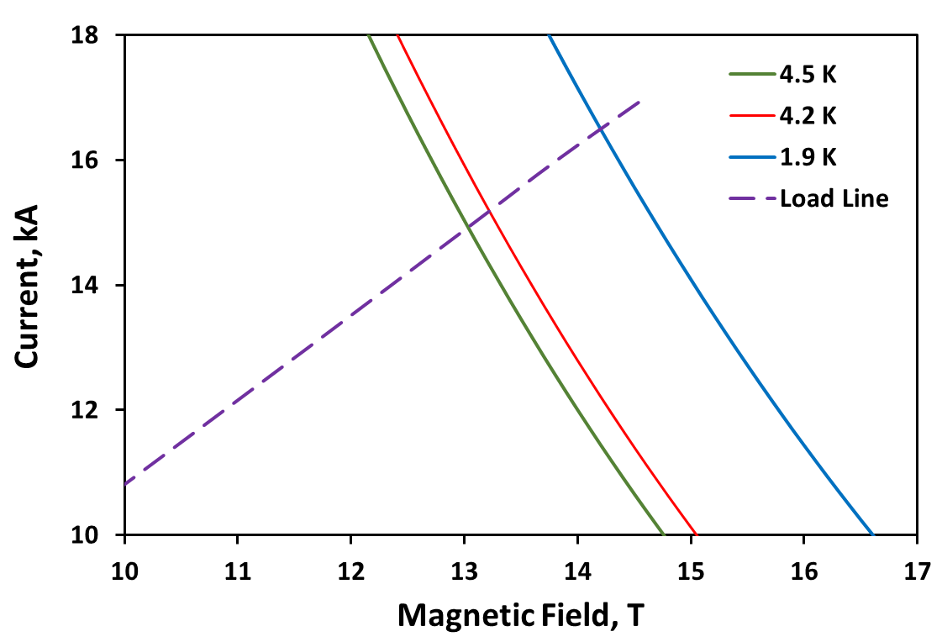
SMCTM1a Temperature dependence
Outer 2L mirror
 | 1.9 K |  | 4.5 K
 | Ic, kA | Bc, T | Ic, kA | Bc, T
SSL | 16.47 | 14.21 | 14.89 | 13.04
test | 14.3 | 12.68 | 13.45 | 11.98
test/ssl | 0.87 | 0.89 | 0.90 | 0.92

Slide 9
Splice resistance of SM coil
Splice resistance = 0.3 nΩ

Slide 10
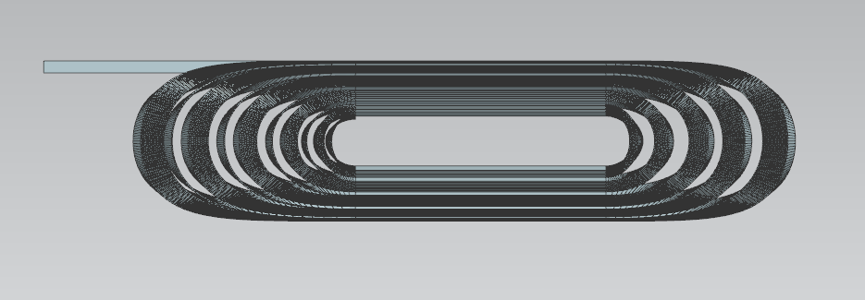
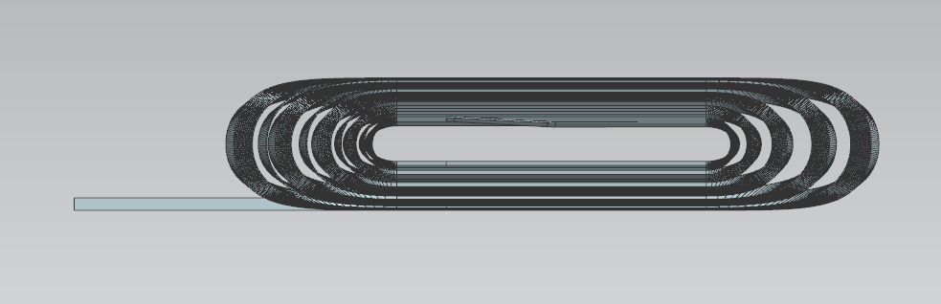
SMCTM1b test
SMCTM1b test: Magnet SMCTM1a was warmed up and SM coil and coil 003 were connected together (no magnet disasembly).
NbTi-Nb₃Sn splice
LN
WN2
D1
D2
L4
SMCTM1b test: both coils connected to the power supply
Test plan was the same:
  Training quenches
  Ramp rate dependence
  T dependence
  QH studies
Spike observations since ramp 1. Test plan was adjusted because of spike occurrence.
WN
D6
D3
D4
D5
D7
SMCT coil
Simplified schematic
for Test 2
C3
C4
C5
L3
C6
NbTi-NbTi splice
+
WP
LP
WP2
C1
C2
NbTi leads to the top head
L2
-
B1
B2
B4
LNN
WNN2
B8
Coil 003
B5
WNN
B7
B6
B3
A3
A4
A5
A8
A2
A6
A9
A7
L1
A1
NbTi-Nb₃Sn splice
Notes:
Coil 3 how many quenches (check)

Slide 11
Initial trips
Spike signal is present in most of the voltage taps
Spike duration is 1 ms
Spike is present that trigger the quench detection
Notes:
Combine 11 and 12

Slide 12
Quenches vs SQuenches: half coil bucked signal
NO SPIKE
Half coil bucked signal: SM coil – 15 T coil
SPIKE
Positive bucked signal =Quench in SM outer coil
Negative bucked signal=Quench in 15 T inner coil
Positive bucked signal + spike =SQuench in SM outer coil
Negative bucked signal +spike=SQuench in 15 T inner coil
Notes:
Spike sign in each in half coil signal

Slide 13
All quenches
SMCTM1b test: both coils connected to the power supply
Test plan was the same:
  Training quenches
  Ramp rate at 1.9
  T dependence at 20 A/s
  Ramp rate at 4.5 K
  Quench protection heater studies
  T dependence at 300 A/s
According to this classification the majority of quenches were SQuenches with negative HC signal (15)
Outer coil quenches are the second most numerous
QPH test

Slide 14
Quench/SQuench analysis and classification

Slide 15
Quench types: inner coil quench (type A)
First quench ramp 7: 15 T inner coil quench no spike
D1
D2
L4
D6
D3
D4
D5
D7
C3
C4
C5
L3
C6
C1
C2
B1
B2
B5
B4
B8
B3
B7
B6
A3
A4
A5
A8
A6
A9
A1
A2
A7
Notes:
It covers all the turns

Slide 16
Quench type: Outer coil quench (type B)
D1
D2
L4
D6
D3
D4
D5
D7
Ramp 9
Quench in inner layer of the SM coil
No spike
C3
C4
C5
L3
C6
C1
C2
B1
B2
B5
B4
B8
B3
B7
B6
A3
A4
A5
A8
A6
A9
A7
A1
A2

Slide 17
Quench types: Spike induced quenches with Negative HC (Type C)
L4
Second quench ramp 8: 15 T coil- with spike
D1
D2
D6
D3
D4
D5
D7
C3
C4
C5
L3
C6
C1
C2
B1
B2
B8
B4
B5
B3
B7
B6
A3
A4
A9
A8
A5
A1
A2
A6
A7
Squench: HC negative signal
Quench observed simultaneously in inner and outer coil: A08-A09 and C02-D07
Notes:
A3-A4 check if it is simultaneous and expand plot

Slide 18
Quench types: Spike induced quenches with Positive HC (Type D)
D1
D2
L4
D6
D3
D4
D5
D7
C3
C4
C5
L3
C6
C1
C2
A6-A7
C2-D7
B1
B2
B5
B4
B8
B3
B7
B6
Quench observed simultaneously in inner and outer coil
A3
A4
A5
A8
A6
A9
A7
A1
A2
Notes:
Filtered the signal

Slide 19
Quench types: Spike induced quenches with Negative HC (Type E)
D1
D2
L4
D6
D3
D4
D5
D7
C3
C4
C5
L3
C6
C1
C2
B1
B2
B8
B5
B4
Quenches only in the inner coil
B3
B7
B6
A3
A4
A5
A9
A8
A1
A2
A6
A7

Slide 20
Quench types: Spike induced quenches with Positive HC (Type F)
D1
D2
L4
D6
D3
D4
D5
D7
C3
C4
C5
L3
C6
A8-A9
C2-D7
C1
C2
Quench observed simultaneously in inner and outer coil
B1
B2
B8
B5
B4
B3
B7
B6
A3
A4
A5
A9
A8
A1
A2
A6
A7

Slide 21
Quench types: quench with Positive HC (type G)
D1
D2
L4
D6
D3
D4
D5
D7
C3
C4
C5
L3
C6
C1
C2
B1
B2
B8
B4
B5
B3
B7
B6
A3
A4
A5
A8
A6
A9
A7
A1
A2

Slide 22
SMCTM1b Test results: all data
Type C D and F: SQUENCH both coils
Type E: SQUENCH inner coil
Type B: quench outer coil
Highest current was 11.46 kA
The majority of SQuenches are type E: spike induced quenches of the inner coil (those can be further divided in groups)
Spike induced quenches of the SM coil are always simultaneously take place in the inner coil (inner layer pole): type D and F.
Most of the quenches with no spike takes place in the SM coil: type B
QPH test

Slide 23
Training quenches + ramp rate dependence
SQUENCH both coils
SQUENCH both coils
SQUENCH Inner coil
SQUENCH Inner
Ramp rate: majority are SQuenches in inner coil
Great variety of quench location
Notes:
Try to add

Slide 24
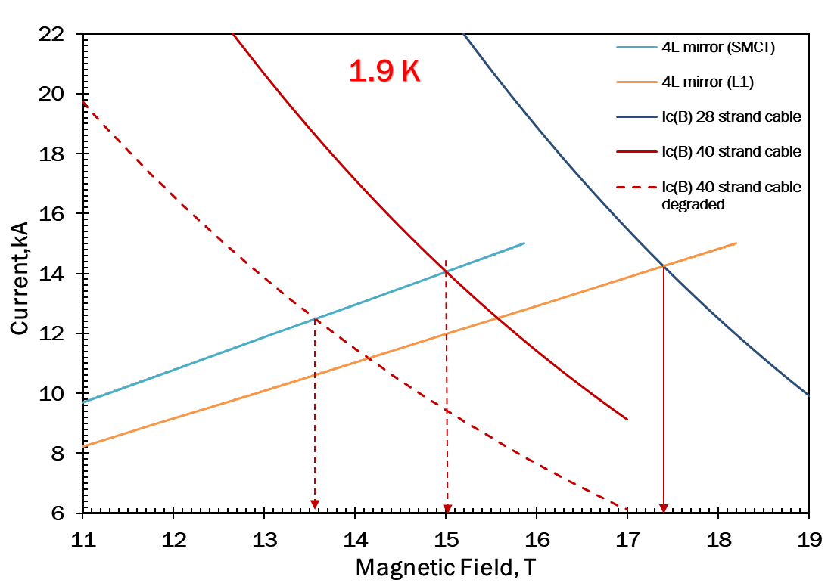
Temperature dependence
SQUENCH inner coil
QUENCH SM coil
Inner 4L mirror (L1)
 | 1.9 K |  | 4.5 K
 | Ic, kA | Bc, T | Ic, kA | Bc, T
SSL | 14.25 | 17.4 | 12.73 | 15.81
test | 11.46 | 14.45 | 10.39 | 13.31
test/ssl | 0.80 | 0.83 | 0.82 | 0.84
Outer 4L mirror (SMCT)
 | 1.9 K |  | 4.5 K
 | Ic, kA | Bc, T | Ic, kA | Bc, T
SSL | 14.06 | 15.01 | 12.69 | 13.76
test | 11.46 | 12.62 | 10.39 | 11.63
test/ssl | 0.82 | 0.84 | 0.82 | 0.85

Slide 25
QH test
Heater is installed on the outer layer of the SM coil
Heater delay and minimum quench energy at selected current level and HFU power. Maximum power is with 340 V
Results are compared with MBHSM01 mirror magnet
Notes:
Minimum quench energy…
Cable is the same/ check insulation thinkness

Slide 26
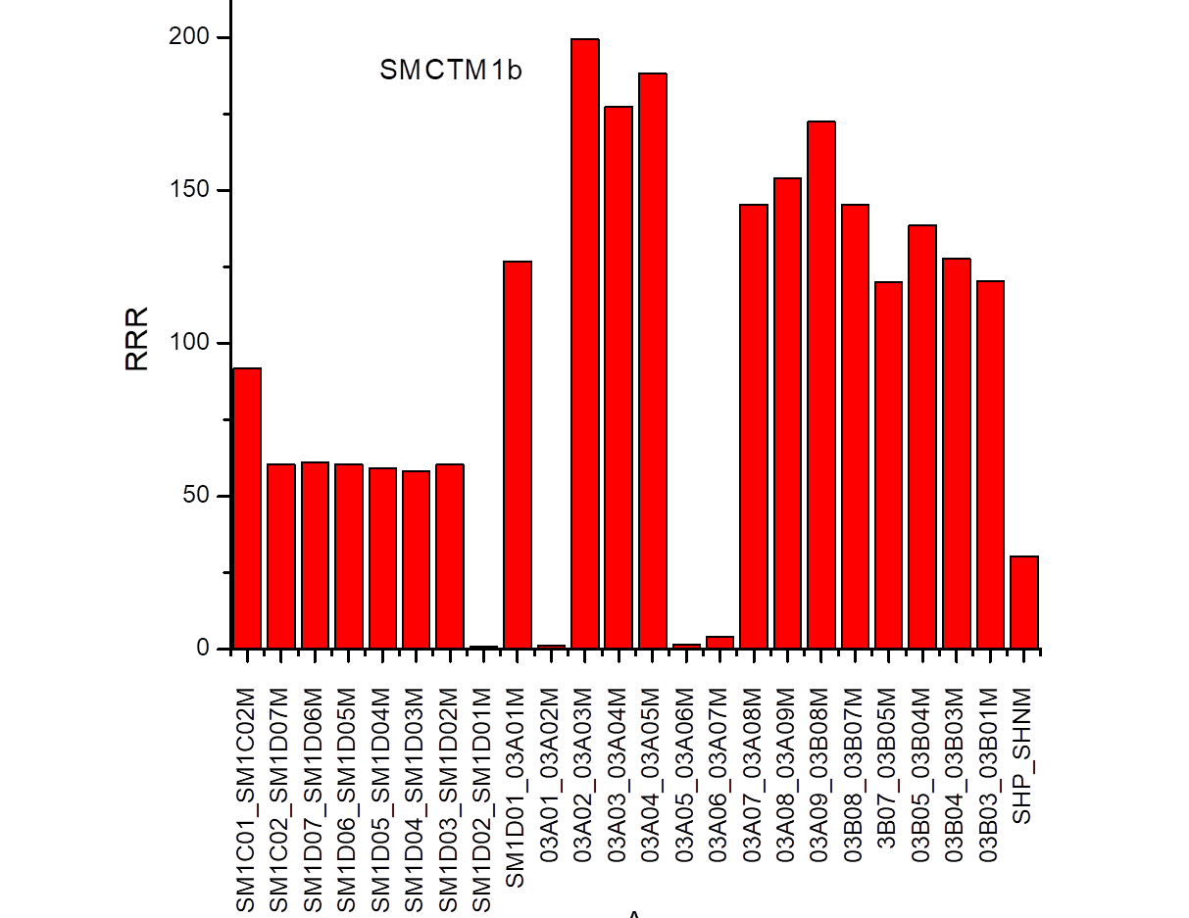
RRR measurements
RRR measurements were taken with 10 A current at cold and at warm
Data are very noisy.
Notes:
15 T magnet plot…
SM coil has different heat treatment

Slide 27
Summary
The first milestone of the MDP SMCT program has been achieved
  The first 2L 123-mm ID cos-theta coil with stress management (SMCT coil) has been developed and fabricated
  The SMCT coil was assembled with 60-mm ID 2L cos-theta coil (previously tested in MDPCT1 dipole) inside the dipole mirror structure SMCTM1 and successfully tested at Fermilab
SMCTM1 mirror magnet has been tested in two configurations
  In the first configuration only the SMCT coil was powered (SMCTM1a)
  In the second configuration both coils were powered in series (SMCTM1b)
SMCTM1a test:
  the maximum current of 14.3 kA was reached at 1.9 K which corresponds to B_{max} in the SMCT coil of 12.7 T
  Ramp rate data suggest 9% reduction of maximum achieved quench current wrt coil SSL based on WS data
  No training memory and no performance degradation was found after thermal cycle
SMCTM1b test:
  11.4 kA current and 14.5 T/12.6 T maximum field in the inner/SMCT coils were reached
  Test was complicated by presence of the current and voltage spikes detected before some quenches
  Quench location varied and it was often simultaneous in both inner and SMCT coils
  Origin of spikes seems associated with relative coil mechanical movement (see Steve’s slides)

Slide 29
Ramp 15 and 16: Type D. Quench on both coils: Inner SM coil and pole turn of the inner 15T coil

Slide 30
Ramp 22, Type F quench: on both coils inner SM coil + pole turn and transition turn of inner 15T coil
Ramp 55, Type E quench: inner 15T coil quench

