Slide 1
20 T REBCO/Nb₃Sn hybrid dipole
design study update
A.V. Zlobin
U.S. MDP 20 T working group meeting
04/16/2024

Slide 2
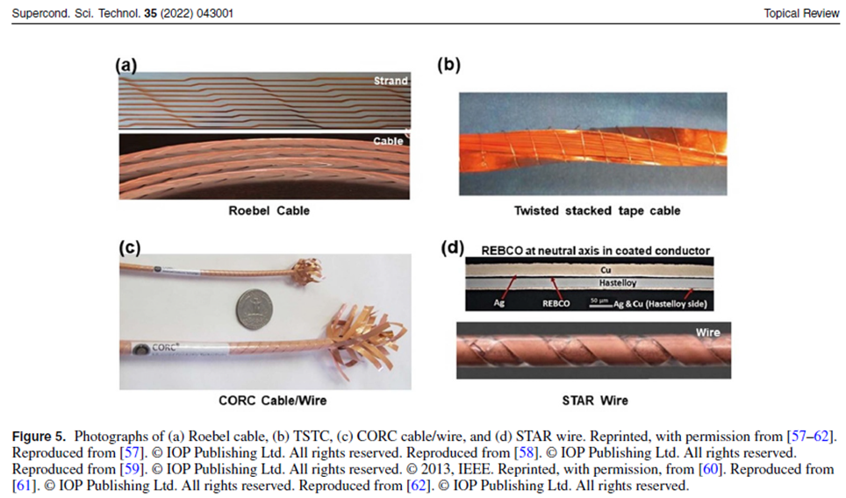
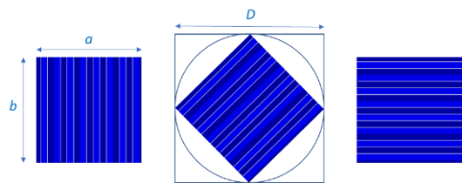
Cable parameters
TST cable structure and cross-section
Cable Parameter | Cable 1 | Cable 2 | Cable 3
Superconductor | REBCO | Nb₃Sn | Nb₃Sn
Strand size, mm | 7.1 | 1.1 | 0.8
Cu/nonCu ratio | 0.5* | 1.0 | 1.1
Number of strands | 1 | 38 | 38
Cable width, mm | 7.1 | 21.5 | 15.7
Cable small edge, mm | 7.1 | 1.85 | 1.39
Cable large edge, mm | 7.1 | 2.05 | 1.58
Cable packing factor | 0.78 | 0.90 | 0.85
Cross-section of the insulated cable is 8 mm by 8 mm.

Slide 3
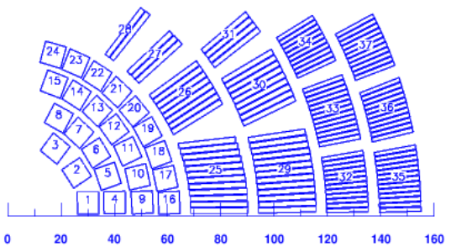
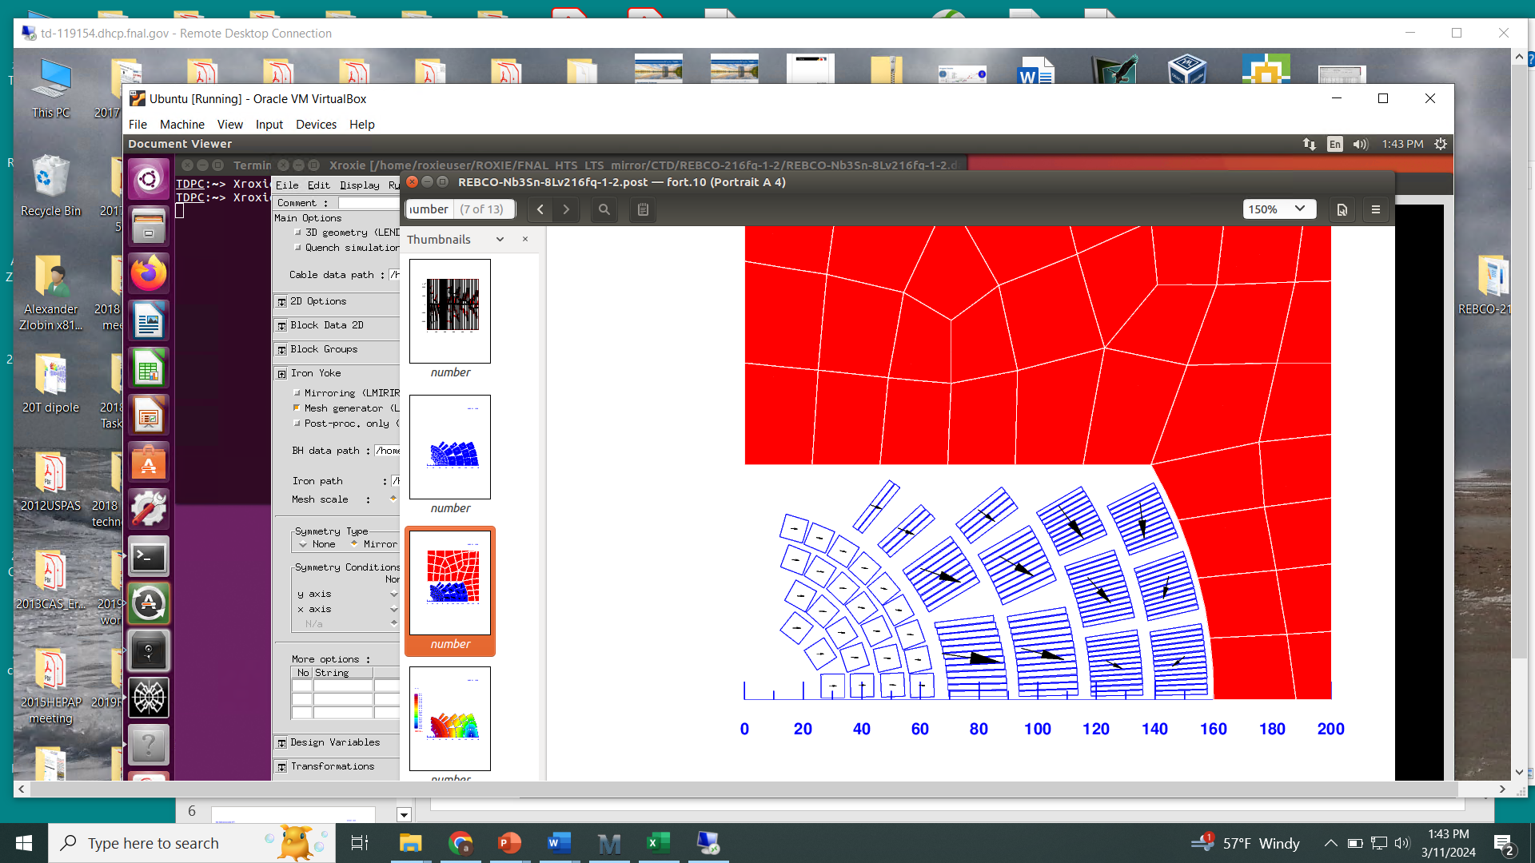
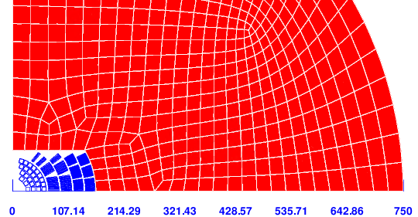
Coil and yoke cross-sections
REBCO layers are made of individual turns.
Space between REBCO turns and Nb₃Sn blocks is reserved for the SM structure.
Number of turns in L1-2/L3-4/L5-6/L7-8 is 8/16/51/70.
The coil ID and OD are 50 and 315 mm.
Yoke OD is 1500 mm

Slide 4
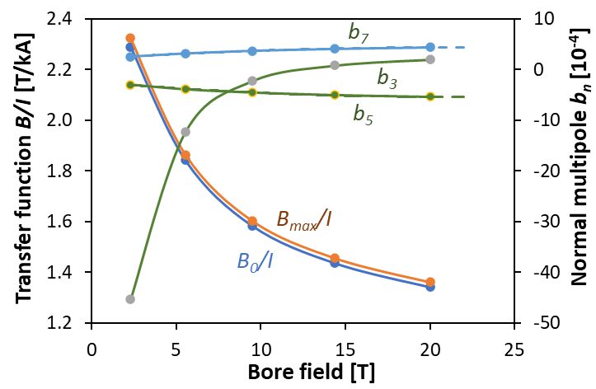
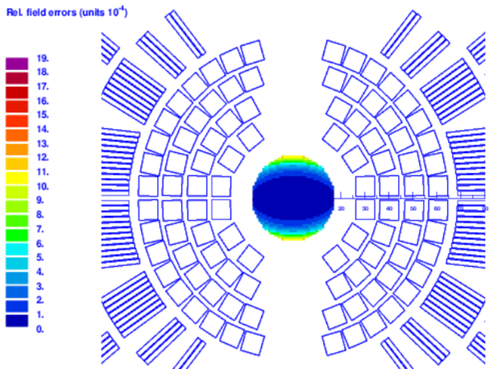
Field harmonics and magnet main parameters
Field harmonics at R_{ref}=17 mm and B=20 T
n | 3 | 5 | 7 | 9
b_{n,} 10⁻⁴ | 1.6 | -5.38 | 4.40 | -0.49

Slide 5
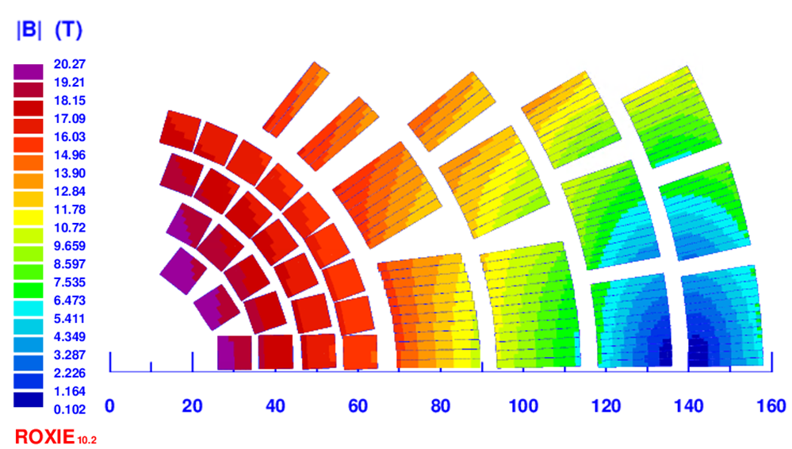
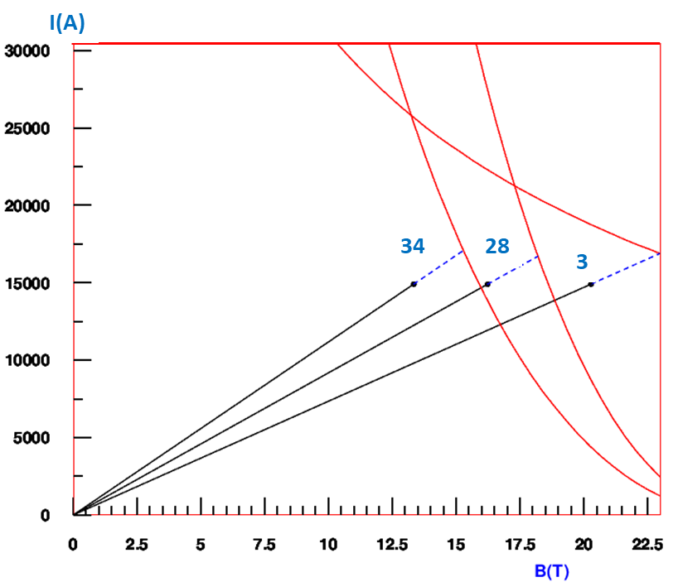
Magnet margin to quench
Nb₃Sn coils: J_{sc}= 825/1638 A/mm²
28
34
3
The margins to quench along the load line
  11.8% for REBCO
  10.9% for Nb₃Sn L5-6 and 12.8% for L7-8.
The magnet critical current margin is 10.9%, determined by the Nb₃Sn L5

Slide 6
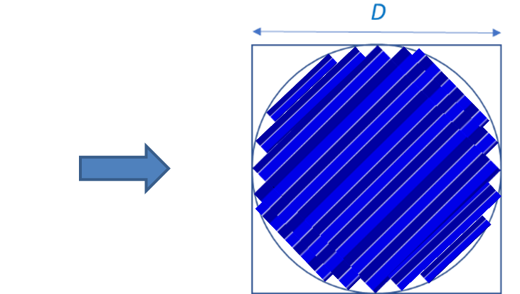
Coil margin optimization
REBCO coil:
higher tape J_{c}
combining 4-, 5- and 6-mm wide tapes to increase the cable critical current
Nb₃Sn coils:
higher J_{c} of Nb₃Sn strands
higher J_{e} by optimizing the Cu:nCu ratio
Further cable and coil optimization need to be done to increase and equalize these values for REBCO and Nb₃Sn coils.
Present margin
Target margin

Slide 7
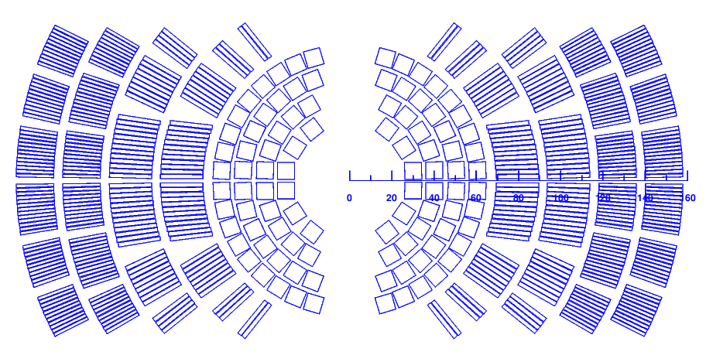
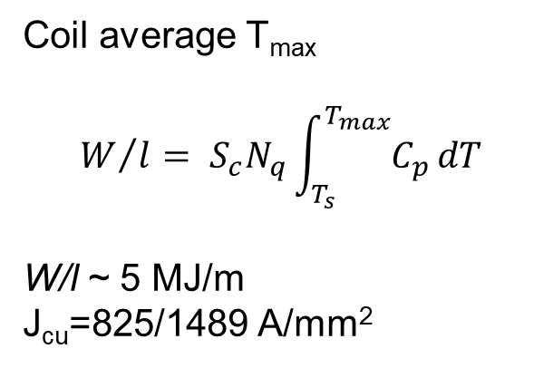
Quench protection considerations
Can we protect magnet by dumping the stored energy only into Nb₃Sn coils?
Can we provide QP system redundancy?
Coil average T_{max}
$$W/l= S_{c}N_{q}\int_{T_{s}}^{T_{max}}{C_{p}}dT$$
W/l ~ 5 MJ/m
J_{cu}=825/1489 A/mm²
L# (bloks) | L5 | L6 | L7 | L8
N turns | 25 | 26 | 35 | 35
N_{q} turns | 204 (L5+L6) | 104 (L6) | 280 (L7+L8) | 140 (L8)
T_{max}, K | 200 | 305 | 240 | 390

Slide 8
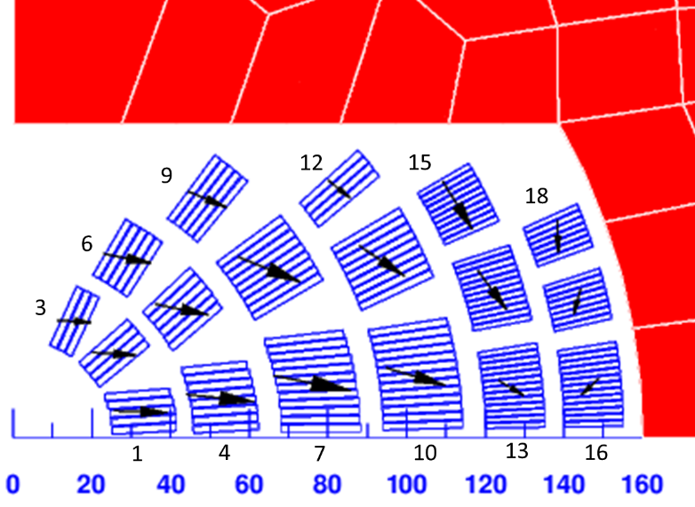
Magnet parameter comparison
Parameter | REBCO/ Nb₃Sn | Bi2212/ Nb₃Sn
Nominal current I_{nom}, kA | 14.90 | 13.45
Nominal bore field B_{nom}, T | 20.0 | 20.0
Coil nominal field B_{nom}, T | 20.34 | 20.04
Coil to aperture field ratio B_{max}/B_{o} | 1.017 | 1.002
Magnet margin at 1.9 K, % | 10.9 | 13.2
Total HTS coil area, mm² | 601 | 972
Total Nb₃Sn coil area, mm² | 3854 | 3110
REBCO/Nb₃Sn
B2212/Nb₃Sn

Slide 9
Summary and next steps
Complementary conceptual designs of a 20 T hybrid dipole based on REBCO and Nb₃Sn shell-type coils with realistic SC parameters and 150 mm cold iron yoke are being analyzed.
REBCO/Nb₃Sn dipole
  efficient design with small HTS coil
  10.9% load line margins at 1.9 K <= limited by Nb₃Sn coils
    possibilities of increasing the Nb₃Sn coil and total magnet margin to the acceptable level are being studied
SM elements are integrated in the coil cross-section to keep the mechanical stresses in brittle HTS and Nb₃Sn superconductors within the acceptable limits.
Next steps:
  mechanical and quench protection analysis
  magnetic design optimization of REBCO/Nb₃Sn dipole
  REBCO coil technology development – in progress

