Slide 1

20 T Hybrid Magnet – Cos(θ) Design
Key analysis
Marika D’Addazio
04/23/2024

Slide 2
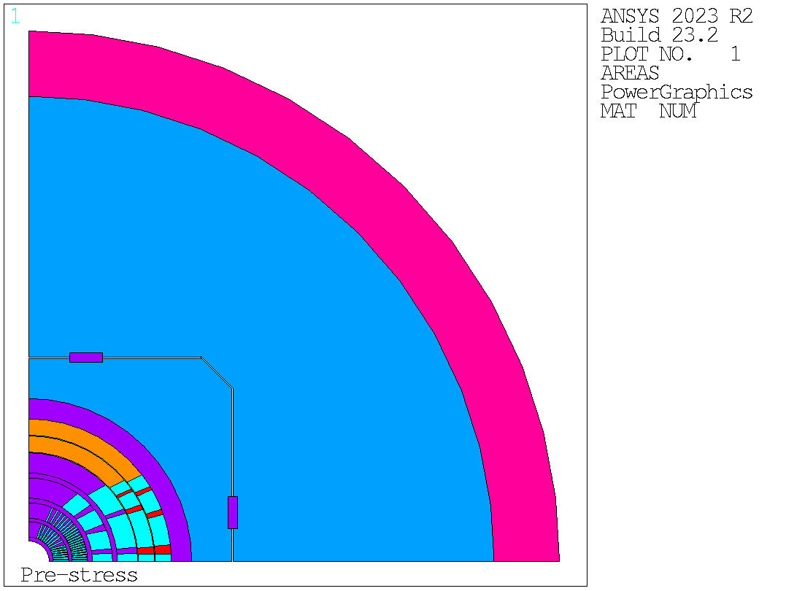
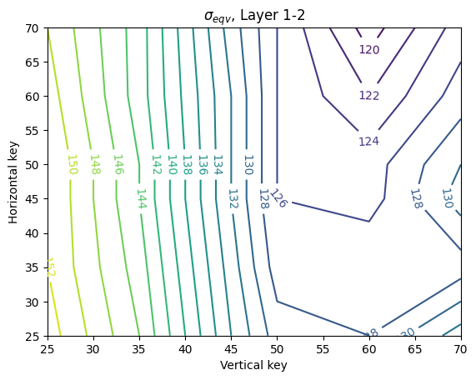
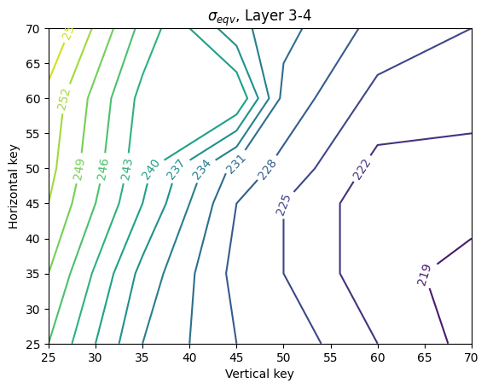
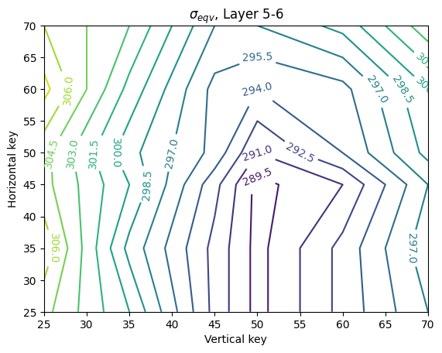
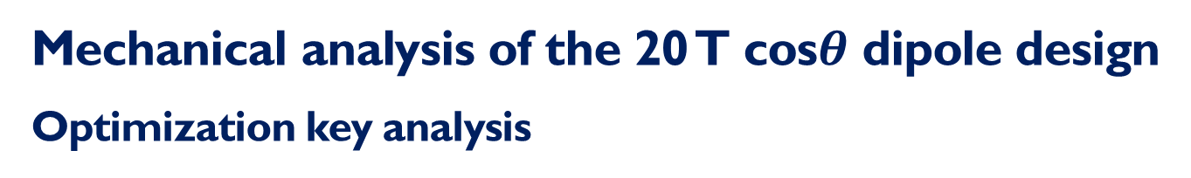
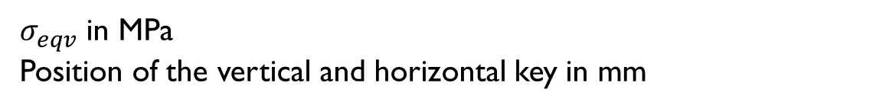
Mechanical analysis of the 20 T cos$θ$ dipole design
Optimization key analysis
Equivalent stress evaluated in all the layers of the dipole magnet after powering.
$σ_{eqv}$ in MPa
Position of the vertical and horizontal key in mm

Slide 3
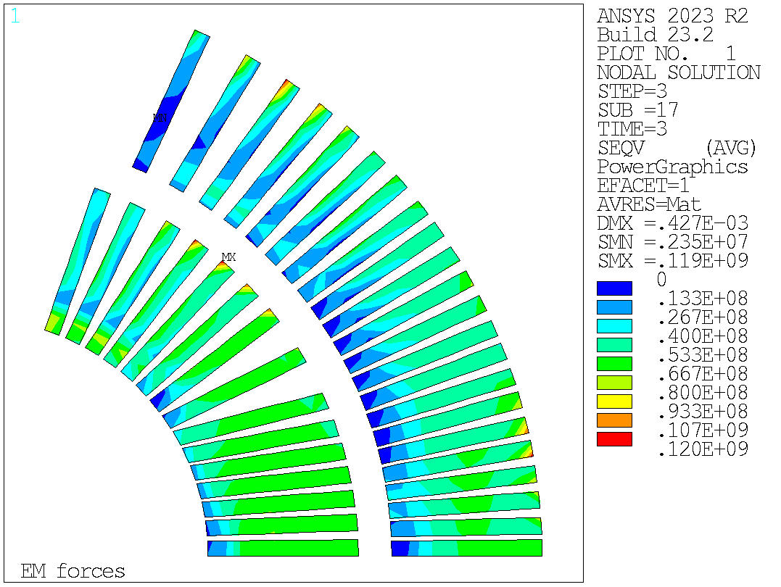
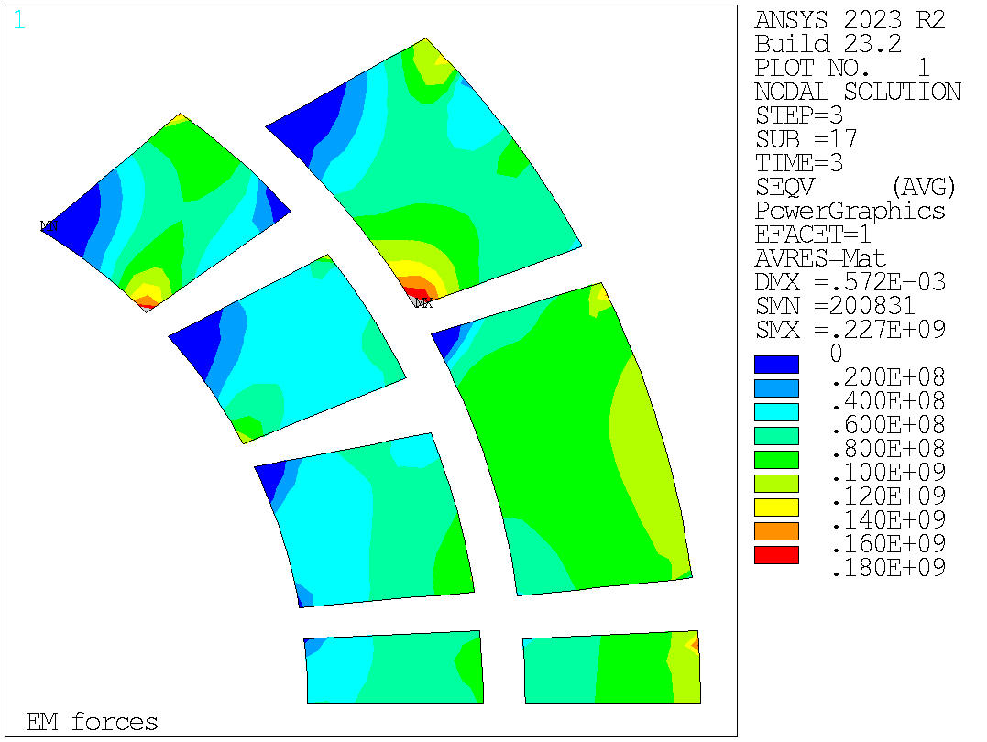
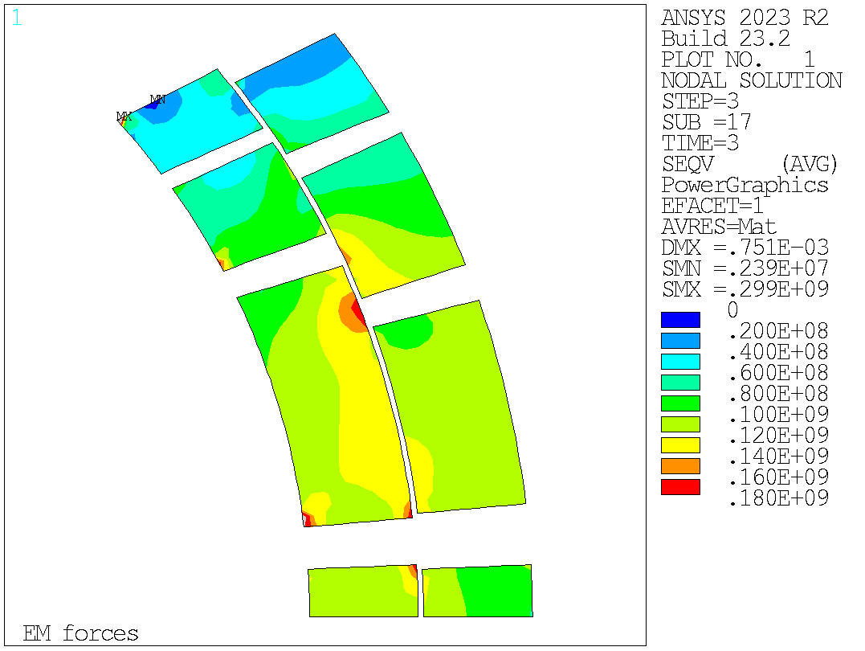

Mechanical analysis of the 20 T cos$θ$ dipole design
Optimization key analysis
Equivalent stress (nodal solution)
This results are obtained considering the vertical key at 70 mm and the horizontal one at 60 mm.

Slide 4
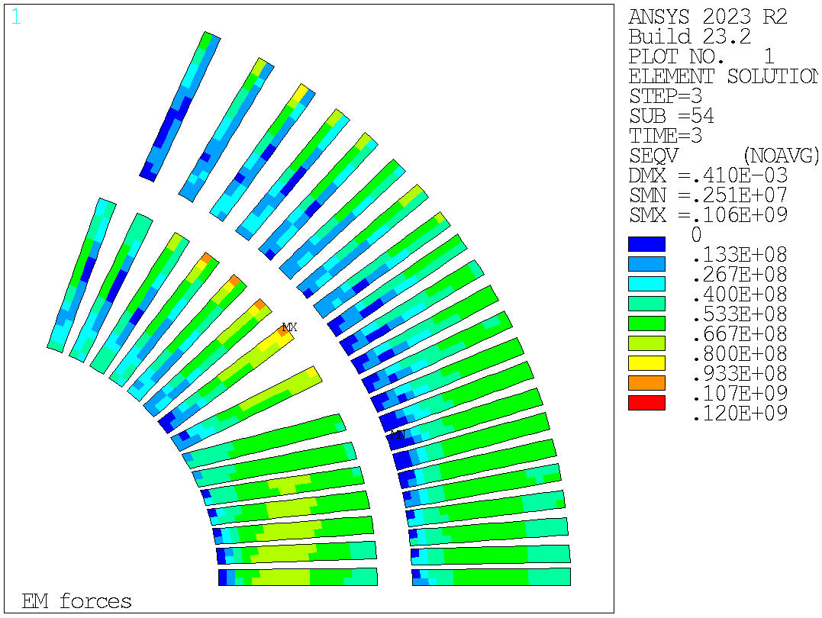
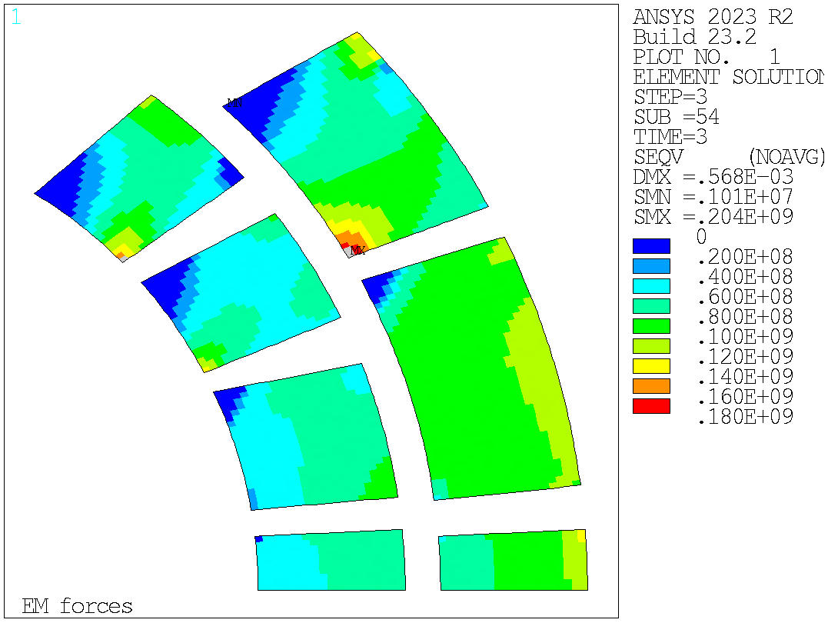
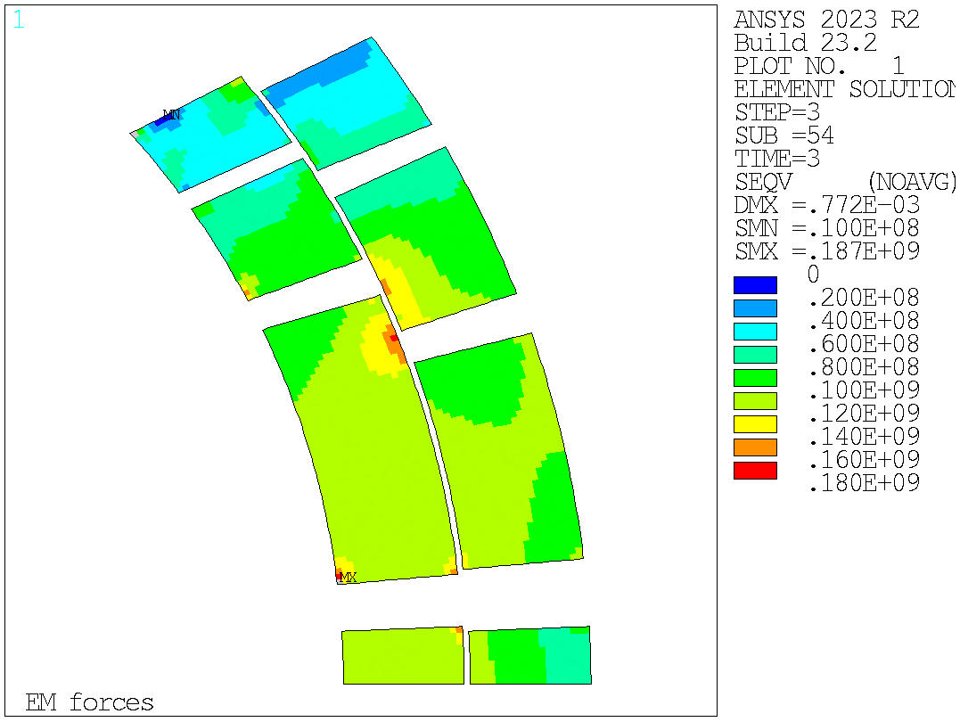
Mechanical analysis of the 20 T cos$θ$ dipole design
Optimization key analysis
Equivalent stress (element solution)
This results are obtained considering the vertical key at 70 mm and the horizontal one at 60 mm.

Slide 5
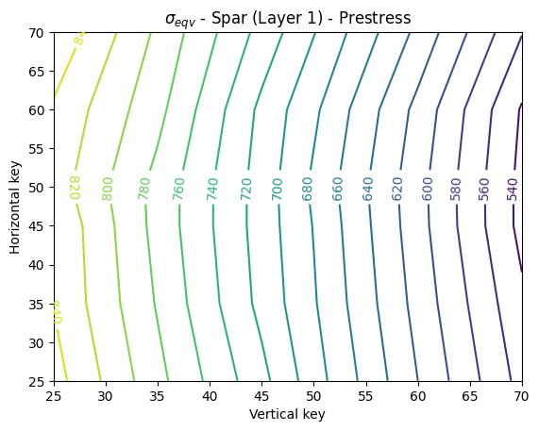
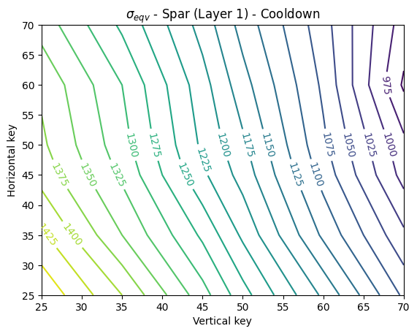
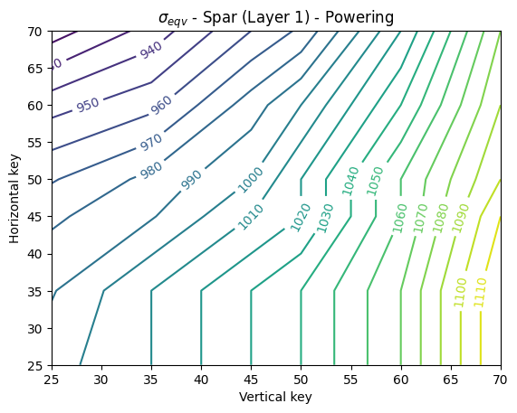
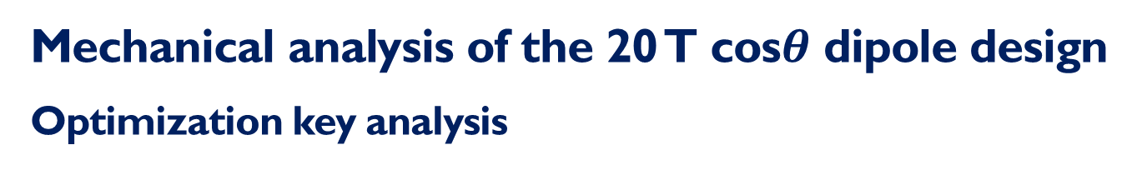
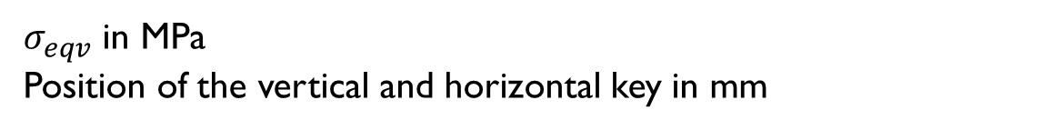
Mechanical analysis of the 20 T cos$θ$ dipole design
Optimization key analysis
Equivalent stress evaluated in the spar of the first layer of the magnet after each phase.
$σ_{eqv}$ in MPa
Position of the vertical and horizontal key in mm

Slide 6
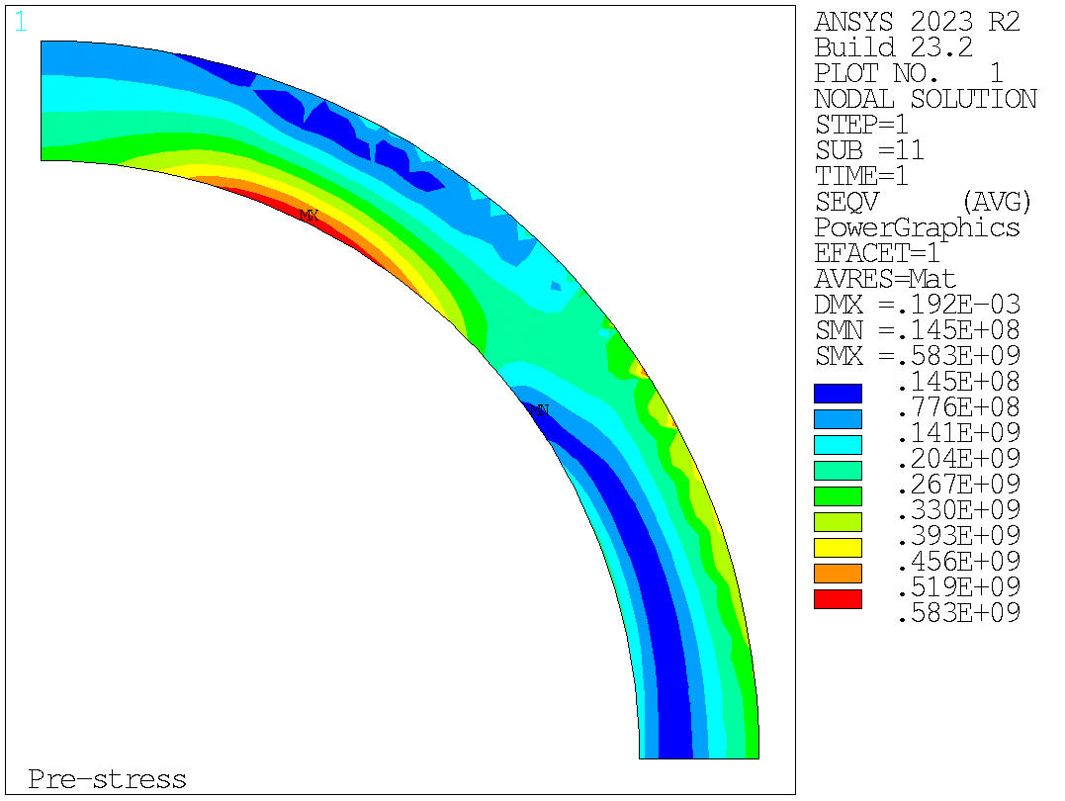
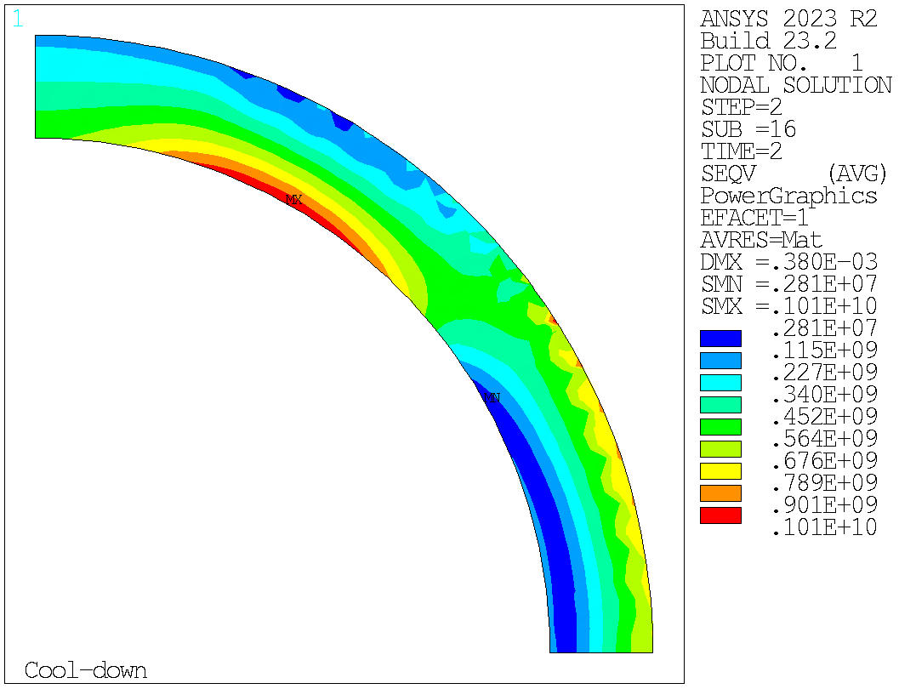
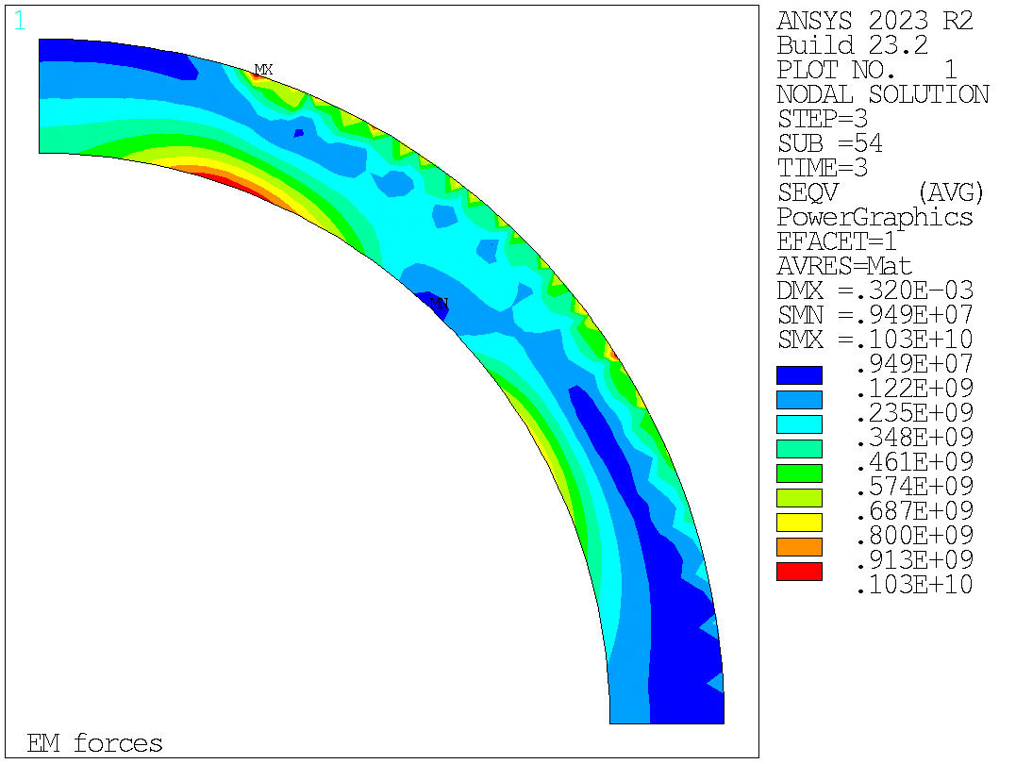
Mechanical analysis of the 20 T cos$θ$ dipole design
Optimization key analysis
Equivalent stress (nodal solution) of the spar in the first layer
This results are obtained considering the vertical key at 70 mm and the horizontal one at 60 mm.

Slide 7
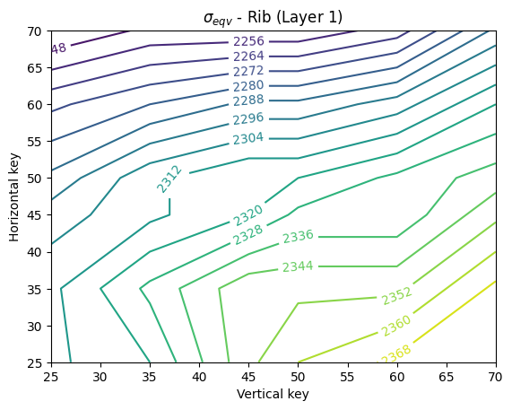
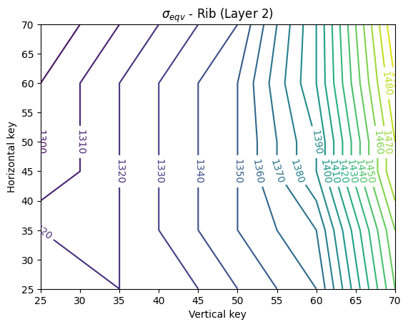
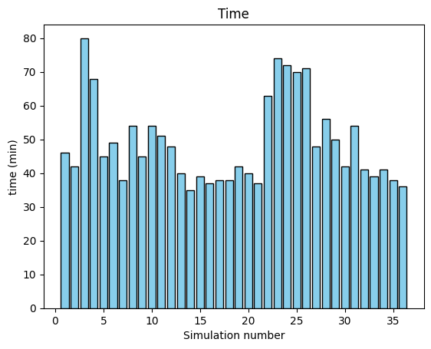

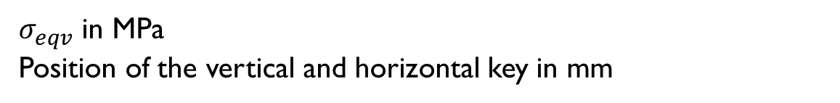
Mechanical analysis of the 20 T cos$θ$ dipole design
Optimization key analysis
Equivalent stress evaluated only in the ribs of layer 1 and 2 of the magnet.
Simulation time
$σ_{eqv}$ in MPa
Position of the vertical and horizontal key in mm

Slide 8
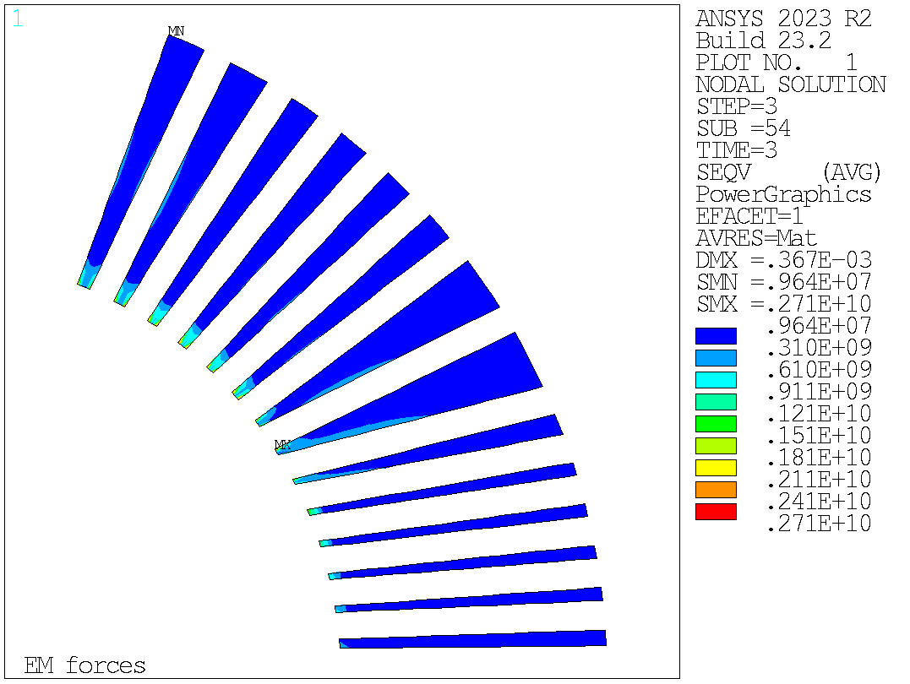
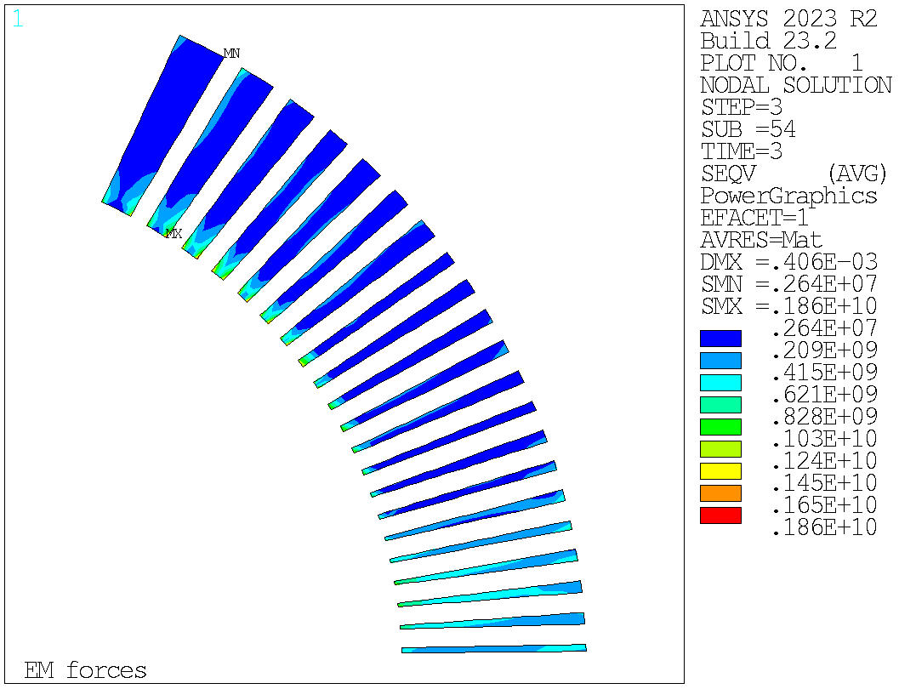
Mechanical analysis of the 20 T cos$θ$ dipole design
Optimization key analysis
Equivalent stress of the ribs in layers 1-2 after powering considering the nodal solution.

Slide 9
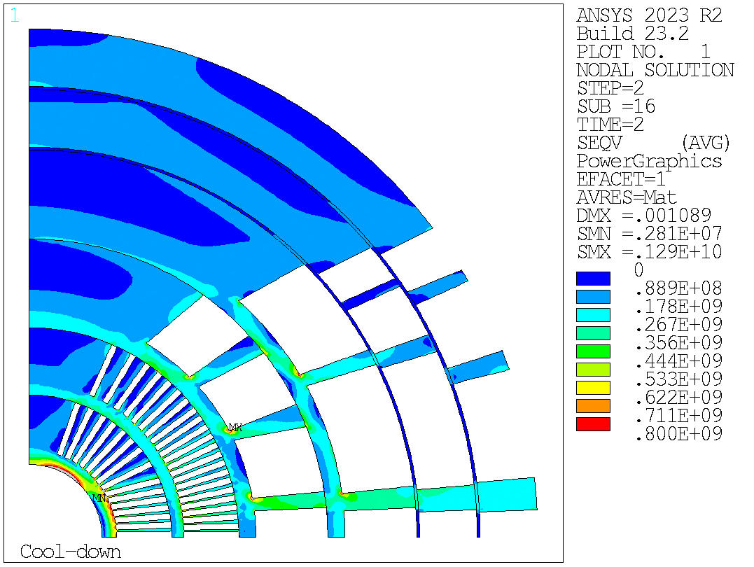
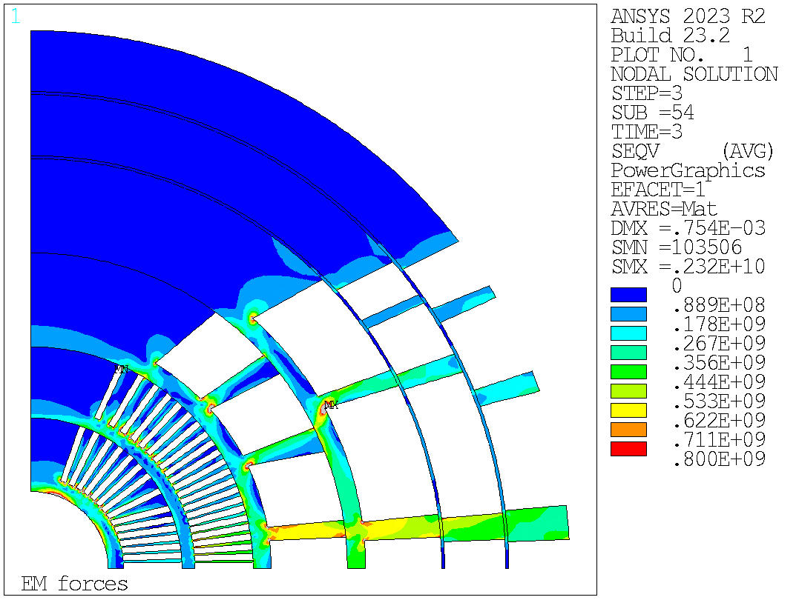

Mechanical analysis of the 20 T cos$θ$ dipole design
Optimization key analysis
Equivalent stress of the mandrel of the magnet after cooldown and powering considering the nodal solution.

Slide 10
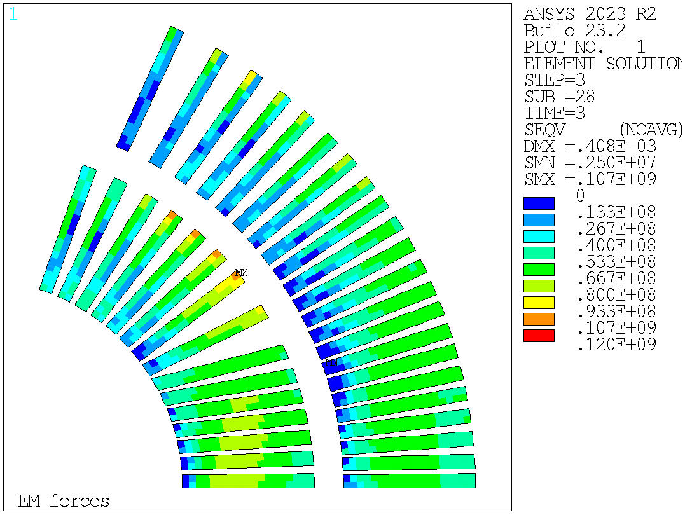
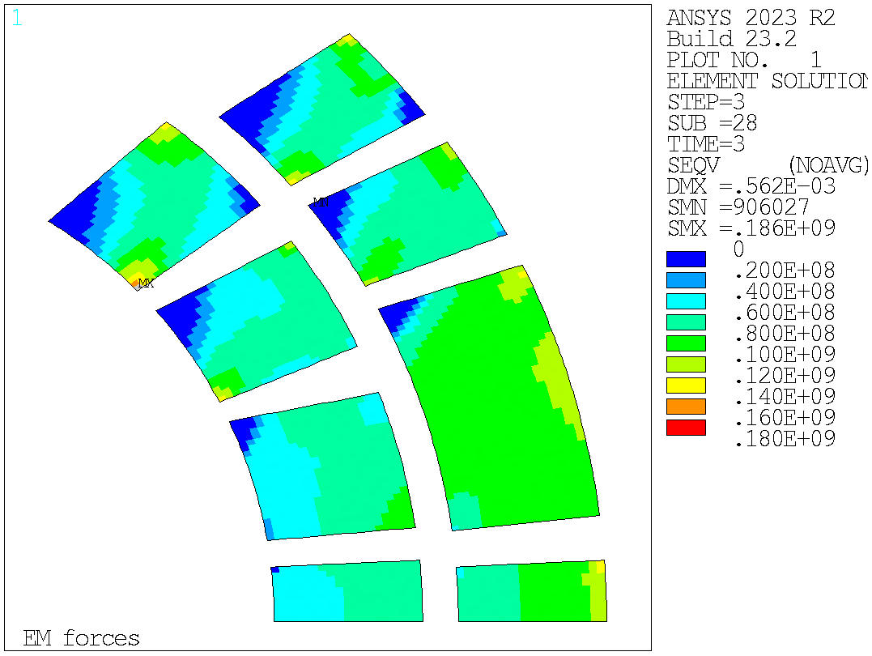
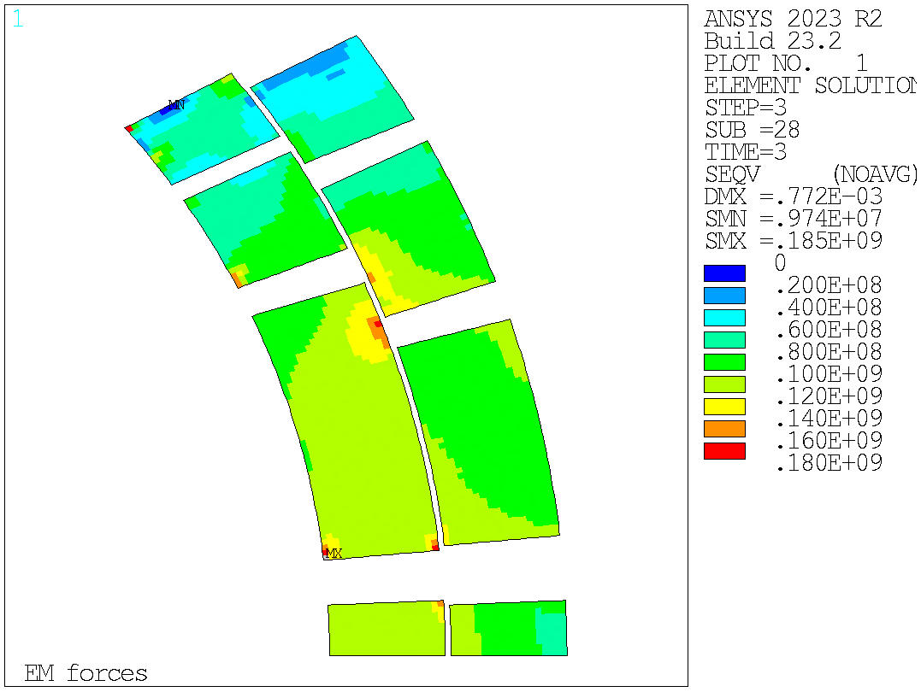
Mechanical analysis of the 20 T cos$θ$ dipole design
Optimization key analysis
To reduce the peak stress in the LTS conductors, a possible way is to split the last block in layer 4.

Slide 11

Mechanical analysis of the 20 T cos$θ$ dipole design
Optimization key analysis
Old version
New version (split block)

