Slide 1
Artificial pinning induced by high energy irradiation
Tiziana Spina
Magnet Development Program meeting
26 September 2018

Slide 2
The Future Circular Collider
FCC (100km accelerator at CERN, 2035)
16T by quadrupole:
➔ J_{c}: 1’500 A/mm² at 4.2K/16T
Is it possible to increase J_{c} in LTS?
How to produce such high J_{c}?
Sufficiently high J_{c} ☺
HTS conductors
(YBCO):
High cost ☹
LTS conductors
(RRP and PIT Nb₃Sn):
Lower cost ☺
$\sim$ 30% lower J_{c} than required ☹
Notes:
The magnetic field produced by quadrupoles in future accelerators, e.g. FCC, will reach 16 T at 4.2K.
These fields can be reached by HTS coated conductors, which already exhibit the required critical current value of 1’500 A/mm² at this field. Nb₃Sn wires are still envisaged as an alternative, essentially for economic reasons. However, the present J_{c} values of commercial Nb₃Sn wires need a further enhancement before to reach a sufficient safety margin at the required operation conditions.
Thus, the question is raised whether it is possible to further enhance J_{c} in Nb₃Sn wires.

Slide 3
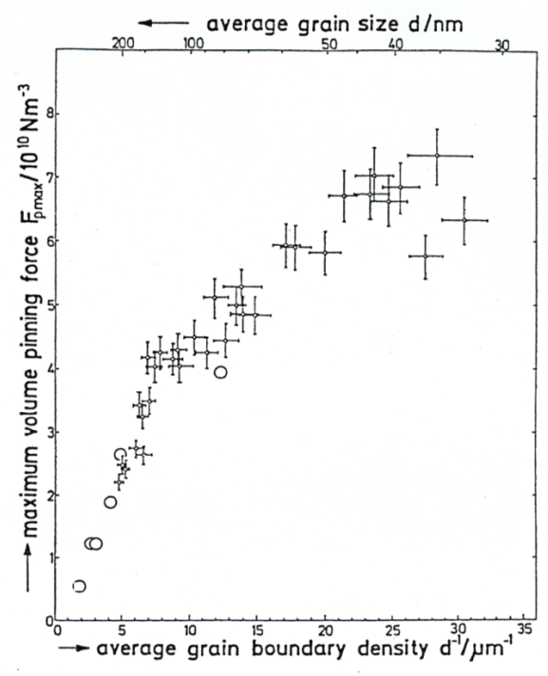
Nb₃Sn: the good alternative to HTS!
In a LTS (e.g. Nb₃Sn):
Dominant pinning mechanism due to dislocations at the grain boundaries
F_{p} maximum for the smallest grain sizes
The ideal limit: grain size approaches the inter flux line spacing, a∆, i.e. around 14 nm at 12T
$$a_{∆}={\left(\frac{4}{3}\right)}^{\frac{1}{4}}{\left(\frac{φ_{0}}{μ_{0}H}\right)}^{\frac{1}{2}}$$
A. Godeke, Supercond. Sci. Technol., (2006)
R.M. Scanlan et al., J. Appl. Phys., 1975
Nb₃Sn grain size:
100- 150 nm,
i.e. a factor of 10 too large
Improvement still possible!
Notes:
High potential for improvement
The optimum grain size to achieve the ideal limit of one pinning size per flux line can be estimated since g.b. Are the primary pinning centers in Nb3Sn
This limit will be approached if the grain size is comparable to the flux line spacing at a given field.

Slide 4
The twofold aim of my research on irradiation
Evaluation of the damage expected in the future accelerator magnets (i.e. HL-LHC and FCC)
Irradiation effects on A15 s.c.
To prevent loss of performance of the superconducting magnets (QUENCH/ Stability)
Improving the understanding of superconductivity in A15 compounds
Allowing the discovery of new techniques to improve the Nb₃Sn transport properties: ARTIFICIAL PINNING

Slide 5
The Nb₃Sn triplet
$\sim$30m from IP
Due to their proximity to the Interaction Points (IP), the inner triplets are exposed to a complex and intense radiation field up to 100 GeV.
QXF
(Nb₃Sn low β quadrupoles)
Notes:
After interaction with the shielding material the radiation reaching the superconductors is comprised mostly of photons, electrons, positrons, neutrons, protons and pions with particle energies up tp about 100GeV
$L\sim f∙\frac{N^{2}}{4∙π∙σ^{2}}$From LHC to HiLumi LHC
Integrated L: ~300 ➔ 3000fb–1
Reduce beam size in IR by factor 2
Triplet quadrupole aperture doubled (70 mm ➔ 150 mm)

Slide 6
Motivation of this work
Evaluate the damage caused by high energy irradiation on the superconducting properties of Nb₃Sn wires for the quadrupoles of HL-LHC.
Number of total dpa
(displacement per atom)
What is known:
From FLUKA calculations (Monte Carlo code):
(A. Lechner, F. Cerutti et al. 2014)
dpa vs. ∆T_{c}
dpa vs. ∆J_{c}
These correlations have never been studied before
Task: to determine
Notes:
Lifetime.......
Since no available reactor is able to produce simultaneously different high energy sources, irradiation effects have to be studied separately for each one of them being present in the HL LHC radiation environment, i.e. Photons, electrons, pions, neutrons and protons.

Slide 7
Working strategy
CERN launched a campaign to study the variation of the superconducting properties of Nb₃Sn wires during the entire acceleration lifetime.
Same industrial multifilamentary Nb₃Sn wires
Nb₃Sn bulk samples
Proton irradiation study
@ CERN
Neutron irradiation study
@ Atominstitut Vienna
(T. Baumgartner,
M. Eisterer et al.)
Proton irradiation study
NRC Kurchatov (Russia)
(A. Ryazanov,
Y. Zubavichus et al.)
Notes:
The investigation was carried out on the same industrial multifilamentary Nb₃Sn wires chosen for the QXF quadrupole for the HL LHC

Slide 8
Radiation environment in the HL-LHC coils
Integrated luminosity: 4000 fb⁻¹
FLUKA calculations
with W shielding
(A. Lechner, F. Cerutti et al. 2014 )
W
(to reduce the
dose from
150 to 30 MGy)
Q1
Tot. dpa in Q1 $\sim 2,4×{10}^{−4}$
Particles | Peak Fluence max in Q1 After 4000 fb⁻¹
Neutrons | 2,4x10²¹n/m²
Protons | >4x10¹⁹p/m²
Pions | >1x10²⁰pions/m²
Contribution to tot. dpa in Q1 [%]
Neutrons | $\sim$70
Charged particles (protons, pions, ions above E_{th}) | $\sim$30
Charged particles
(Bragg peak)

Slide 9
Proton energies & fluences
A. Lechner, F. Cerutti et al., 2014
Room temperature proton irradiations
Proton spectrum in the inner coil of Q1
24 GeV protons, IRRAD1 (CERN);
Фt ≤ 1.38×10²¹ p/m²
65 MeV protons, Louvain-la-Neuve(B); Ф t ≤ 1×10²¹ p/m²
Investigated alloyed Nb₃Sn wires:
RRP + Ta (#7419) OST
RRP + Ti (#11976) OST
PIT + Ta (#0904) Bruker
Notes:
The maximum fluence estimated for the quadrupole after the introduction of W shield is 1.8x1021 n/m2; 1.3x1019p/m2 (tot hadrons: >3x1020hadrons/m2)
Experimental set up:
Belgium: aluminium sample holder positioned in a water cooled Cu holder; the surface of the beam produced by the cyclotron is delimited by a collimator with a diameter of 3.4cm and the beam intensity homogeneity inside the collimator measured by means of alanine dosimeter;
IRRAD1: PS, wires inserted in paperboard sample holder and fixed with adhesive Kapton tape; the beam homogeneity was 97%
Soll et al showed that the self-annealing effects between 4.2K and 300K are negligible (negligible thermal recombination effects)

Slide 10
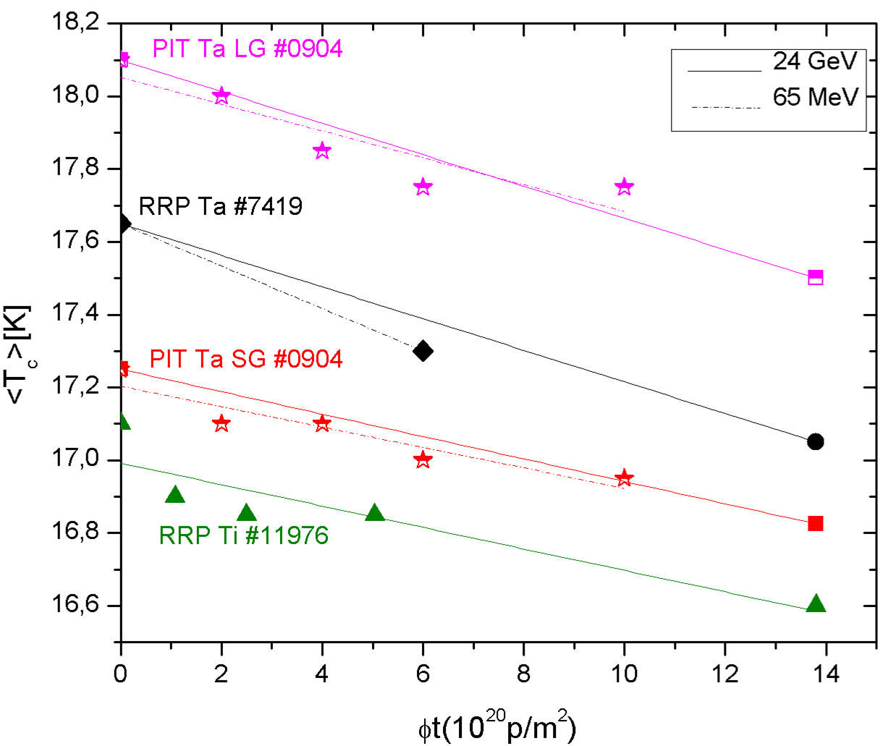
Linear decrease of T_{c} after irradiation
From AC susceptibility measures at CERN
Slope: k_{T}=dT_{c}/dΦt
T_{c}=T_{c0} - k_{T}Φt
Similar slope K_{T} :
K_{T} ~ 0.3 - 0.5 x 10⁻²⁰p⁻¹m²
similar effects on T_{c}
for the two proton sources (24GeV and 65MeV)
Small variation of transition width :
∆T_{c}≈0.2K
➔ Homogeneous damage
ΔT_{c} : due to decreasing
atomic order parameter, S
T.Spina, C.Scheuerlein, D.Richter, B.Bordini, L.Bottura, A.Ballarino, R.Flükiger, IEEE Trans.Appl.Supercond, 25,6000505 (2015).
Linearity: Also observed after neutron irradiation:
F. Weiss et al. 1987
T. Baumgartner, 2014

Slide 11
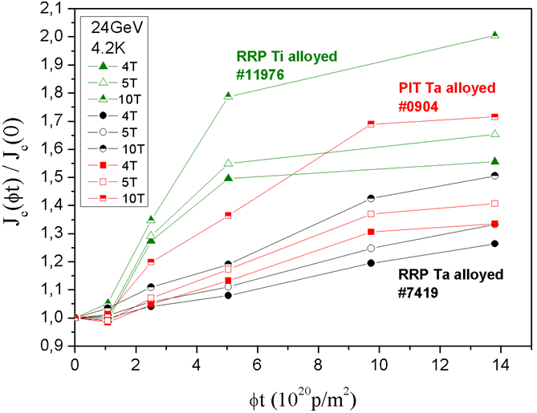
Enhancement of J_{c} after proton irradiation
From VSM measures at CERN
Type of alloyed | J_{c}/J_{c0} @10T, @1.38x10²¹p/m²
RRP Ti | 2.0
RRP Ta | 1.5
PIT Ta | 1.7
Maximum of J_{c} almost reached;
Expected: between 1.38 and 3 x 10²¹ p/m²
T. Spina et al., IEEE Trans. Appl. Supercond., 25,6000505 (2015).
J_{c}(non-Cu) at 10T after 1.38 x 10²¹ p/m²: 10’200 A/mm²
Highest value ever measured in multifilamentary Nb₃Sn wires: there is still a potential!
Notes:
No difference was found.... Thus demonstrating the importance of the alloying elelment on the radiation damage
Similar effects regardless of the fabrication technique (RRP and PIT)
Ti alloyed wires exhibit a larger enhancement than Ta alloyed wires

Slide 12
What is the reason for the enhancement of J_{c}?

Slide 13
What is the reason?
Enhancement of J_{c}
(up to a factor 2 at 4.2K/10T)
Shift of the F_{pmax}
towards higher values of b
In Literature:
Observation of «defect clusters»: new pinning centers (Pande 1978)
The variation ∆B_{c2} is not sufficient for explaining the increase of J_{c} at B<10T (Brown, 1976; Colucci 1977, Fähnle 1977; Weiss et al. 1987)
Additional mechanism to grain boundary pinning: point pinning
Notes:
A marked enhancement of J_{c} (up to a factor 2 at 4.2K/10T) was found after proton irradiation of RRP and PIT multifilamentary wires at 24GeV
After neutron irradiation, a similar enhancement of J_{c} was observed
As shown in Fig. 2, the pinning force F_{p}^{max} after irradiation is shifted towards higher values of b = B/B_{c2}. This was interpreted as the effect of radiation induced point pinning.

Slide 14
Pinning centers in Nb₃Sn
Grain boundaries
(Surface pins: 2Dimensions>$a_{∆}$)
Defect clusters (APC)
(Point pins: 1Dimension<$a_{∆}$)
$\sim$ξ₀
$\sim$ξ₀
M. Cantoni et al., 2006
For F_{pmax} two conditions have to be fulfilled:
$a_{∆}\sim$14nm/12T ➔ small grain size (limited by the interflux line)
ξ₀ $\sim 4nm for Nb3Sn$ ➔small inclusion size (limited by the coherence length)
Neutron irradiated
Pande et al.,1978
Notes:
At interfaces the periodicity of the lattice is broken:
* at the grain boundaries
* at the interface with an inclusion or precipitation.
The atoms of the outermost layers are displaced
Creation of non superconducting sites
These defects will act as pinning centers for the flux lines
In order to maximize the number of pinning centers, two conditions have to be fulfilled:
* small grain size: < 100 mm (lowest possible size given by
thermodynamics of phase formation)
* small inclusion size: < 10 nm (the highest number of inclusion
is limited, their size is correlated to ξ_{o}.
Ombreggiato, freccia, n.s., damage region

Slide 15
Flux pinning mechanisms
D. Dew Hughes (1974):
Relating the F_{p} to the type of microstructure and to the principal interactions involved in the anchorage mechanism:
Tot. Length pinned
Work done to move 1 flux line
Efficiency factor
$$Fp = − \frac{η L ΔW}{x}$$
Effective range of interaction
Field dependence of F_{p}:
$${f\left(b\right)=b}^{p}{(1−b)}^{q}$$
Grain boundary pinning: p=1/2; q=2
Point pinning : p=1; q=2
$$b_{max}=\frac{p}{p+q}$$
Notes:
where exponents $p$ and $q$ must be constant for the pinning
force to be shape invariant.
The reduced field at which $f\left(b\right)$ is maximum:
Dew Hughes (1974) studied flux pinning for various defect
types. The most important ones are:

Slide 16
Analysis of Pinning force:
«The two mechanism model»
Hypothesis:
Grain boundary pinning doesn’t change after irradiation
T. Baumgartner ATI
Grain boundaries
Point defects
F_{p}$\left(b\right)=c1∗b^{0.5}{\left(1−b\right)}^{2}+c2∗b^{1}{(1−b)}^{2}$
$$c1≡cunirr$$
$c_{2}$ and B_{c2}
Fitting parameters
∆B_{c2}$\sim 5$%
T. Spina et al., IEEE Trans App. Supercond. 2015
Notes:
Aggiungere Thomas

Slide 17
The enhancement of J_{c} after irradiation is due to the formation of radiation induced pinning centers!

Slide 18
Protons vs. Neutrons
Same Nb₃Sn wires:
proton irradiation (my work at CERN); neutron irradiation (by T. Baumgartner et al.)
proton fluence ~ 10x neutron fluence
same effect on the variation of T_{c}/T_{c0} and J_{c}/J_{c0}

Slide 19
Comparing the effects obtained by irradiation with different projectiles, fluence is not the ideal parameter: it does not take into account the damage energy
Frenkel pair:
$$N_{F}=k\frac{ξ(T)T}{2E_{d}}$$
(Norget-Robinson-Torrent Damage Theory)
$ξ(T)T$ is related to NIEL
Lindhard partition function
$$ξ\left(T\right)=\frac{S_{n}(E, E_{d})}{S\left(T\right)}$$
dpa: calculated by the FLUKA code:
Monte Carlo simulation package (the secondary ions are taken into account)
Notes:
FLUKA is a fully integrated particle physics MonteCarlo simulation package. It has many applications in high energy experimental physics and engineering, shielding, detector and telescope design, cosmic ray studies, dosimetry, medical physics and radio-biology.

Slide 20
Table: from fluence to dpa
Projectile | Energy [MeV] | Φt [p or n / m²] | dpa [from FLUKA]
Neutron | 1 | 1$×$10²² | 1$×$10⁻³
Proton | 65 | 1$×$10²¹ | 8$×$10⁻⁴
Proton | 24$×$10³ | 1$×$10²¹ | 1$×$10⁻³
At these energies, the same value of dpa is obtained for proton fluences one order of magnitude lower than in the case of neutrons.
Notes:
At lower energies 1 to 3MeV the fluence ratio can reach 30 and more

Slide 21
Protons vs. Neutrons: T_{c}
T. Spina et al., IEEE Trans. Appl. Supercond., 2016➔ protons
T. Baumgartner, Supercond. Science Technol., 2014 ➔ neutrons
For a given value of dpa the decrease of T_{c} is the same regardless of the type of projectile and the different energy during irradiation.
∆T_{c} depends on the number of Frenkel pairs, this number being correlated with the value of the long range atomic order parameter, S.
dpa: universal parameter for ∆T_{c}
Notes:
Another proof that after irradiation the new pinning centers are represented by point defect can be found making some comparisons between proton and neutron irradiations. Recently we found that the variation of Tc for both projectiles coincides when replacing the fluences by dpa. As shown in the formula this is a statistical quantity that is proportional to the number of Frenkel defects and such universal relation between DTc and dpa let us state that the induced disorder by irradiation leading to the decrease of Tc is linked to the creation of this type of point defects.

Slide 22
The dpa value is an appropriate quantity for quantifying the radiation damage that leads to the decrease of T_{c}
dpa and T_{c} are directly correlated by the Bragg Williams LRO parameter, S.
“Variation of T_{c}, lattice parameter and atomic ordering in Nb₃Sn platelets irradiated with 12MeV protons: correlation with the number of induced Frenkel defects”, R. Flukiger, T. Spina, F. Cerutti, A. Ballarino, C. Scheurlein, L. Bottura, Y. Zubavichus, A. Ryazanov, R. D. Svetogovov, S. Shavkin, P. Degtyarenko, Y. Semenov, C. Senatore and R. Cerny, Supercond. Sci. Technol. 30 (2017) 054003 (11pp).

Slide 23
Decrease of T_{c} in Nb₃Sn wires for HL-LHC
Total dpa in Q1=2.4$×$10⁻⁴
for 4’000fb⁻¹
∆T_{c}~ 0.3 K
Expected decrease of T_{c} in Nb₃Sn wires after 10 years of operation of MQXF magnets.

Slide 24
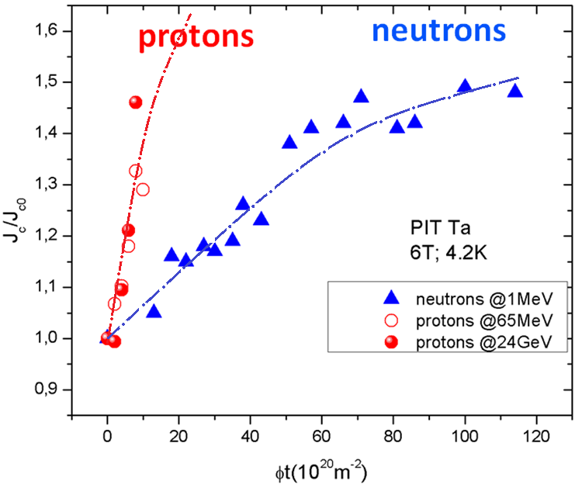
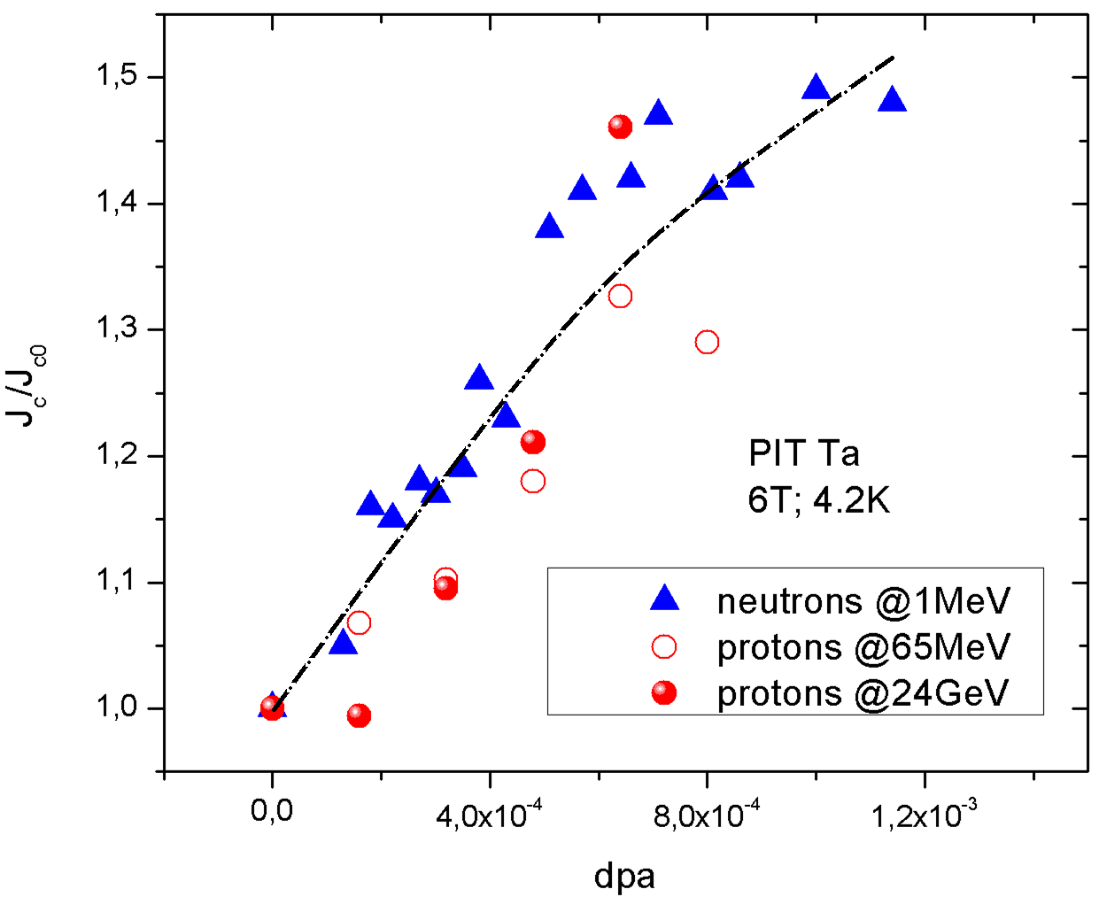
Protons vs. Neutrons: J_{c}
In contrast to T_{c}, the link between ∆J_{c} and dpa is not linked to S but to the radiation induced defect clusters (point pinning)
T. Spina et al, IEEE Trans.Appl.Supercond., 2015
The enhancement ∆J_{c} in Nb₃Sn wires after irradiation is correlated to the number of Frenkel defects in the newly produced defect clusters.
Notes:
The correlation is not straightforward as in the case of T_{c}
This suggests that the enhancement DJ_{c} in Nb₃Sn wires after high energy irradiation is correlated to the number of Frenkel defects in the newly produced defect clusters.

Slide 25
Conclusions
Linear decrease of T_{c} and enhancement of J_{c} after high energy proton irradiation on Nb₃Sn wires
The effects induced by high energy protons (charged particles) and neutrons on T_{c} (and J_{c}) can be represented by an universal parameter: the displacement per atom (dpa).
For the lifetime of HL-LHC (4’000 fb⁻¹) we estimate the decrease in T_{c} of the Nb₃Sn wires to ∆T_{c}$\sim 0.3K$ while
Notes:
The same variation in T_{c}/T_{c0} and of the J_{c}/J_{c0} factor is induced at proton fluences ~ 10 times smaller than for neutron fluences.

Slide 26
Future development
However to completely answer the question about the effects of irradiations…
Further investigations on the reduction of the RRR of the Cu matrix in the Nb₃Sn wires after high energy irradiations at low temperature, followed by a recovery at 300 K, would be needed
New irradiation experiments with higher energies and fluences to validate the model in view of FCC: higher damage during FCC/run2 can lead to loss of performances (higher decrease of T_{c} and decrease of J_{c} as well as of B_{c2})

Slide 27
Lesson learned from the irradiation study

Slide 28
APC after irradiation
The “artificial pinning” in Nb₃Sn wires, can be introduced by high energy irradiation (protons and neutrons)
After irradiations the observed enhancement of J_{c} with respect to the unirradiated case is due to new point pinning centers (defect clusters);
Two mechanism model was used to analyze the F_{p} after irradiation
The enhancement of J_{c} is correlated to the number of Frenkel defects, represented by the calculated property displacement per atom (dpa)

Slide 30
Do you have any questions?

Slide 31
Superconductor for 16T
Data by courtesy of L. Rossi, CERN

Slide 32
The Nb₃Sn cost and targets
$$$
Target cost including testing and waste 5 EUR/kA.m at 16T and 4,2K (3,5Eur/kA.m at 16 T and 1,9 K), corresponding to 450 EUR/kg for a Cu/Non-Cu ratio of 1/1 and the target performance
Target critical current performance of J_{c} of 1500A/mm² at 16T and 4.2K (J_{c} of 2300 A/mm² at 16T and 1.9K, i.e. 50% above HL-LHC specification)
Cu/Non-Cu down to 0,8 to increase the overall current density in the high-field part
Courtesy Daniel Schoerling, CERN, 5 th of February 2017

Slide 33
The Bragg Williams LRO parameter, S
$S_{a}=\frac{r_{a}−(1−β)}{β}$
$$S_{b}=\frac{r_{b}−β}{1−β}$$
Before
irradiation
Perfectly ordered
S = 1
After irradiation
6c
2a
Partly disordered
S ≠ 1
r_{a}=fraction of 6c sites (or a sites) occupied by A atoms (Nb)
r_{b}=fraction of 2a sites (or b sites) occupied by B atoms (Sn)

Slide 34
Nanoinclusions (2)
Composite Cores (adsorbed Oxigen)
Wires produced with identical composition and reactions conditions:
* Composite cores (Nb+Ta P/M): S. Gauss, R. Flükiger, Adv. Cryo. Eng., Vol. 34(1988)843
* Melted Nb-Ta rods: M. Klemm et al., SuST, 3 (1990) 249
(point pinning: observed shift in the F_{pmax})
Artificial Pinning: Nanoinclusions formed by Oxygen adsorbed at the powder surface (~ 0.5 wt.%)
∆J_{c}
Not by Ta nanoinclusions, due to their dissolution in the A15 phase
RRP, PIT: values from P. Lee, 2008
Notes:
The oxygen adsorbed at the Ta powder particle surfaces (~ 0.5 wt.%) lead to nanoinclusions.
No Ta nanoinclusions due to their dissolution in the A15 phase

Slide 35
Nanoinclusions: comparison
Higher values for Internal Oxidation attributed to higher oxygen content leading to a stronger grain refinement.
Notes:
The difference DJ_{cN} = J_{c,Nanoincl} – J_{co} between the Nb₃Sn wires with composite cores and the corresponding wires with Nb-Ta melted core is shown in fig.

Slide 36
Nanoinclusions vs. Irradiations
T. Spina et al., IEEE Trans, App. Superc., vol. 27, no. 4, June 2017
At Low field (B<12T):
∆J_{c} higher for nanoinclusions:
APC in irradiated wires:
Defect clusters (point pinning)
APC in wires with nanoinclusions:
Second phase (point pinning)
Grain refinement (grain boundary pinning)
At High field (B>12T):
@18-19T for nanoinclusions
@B_{c2} for irradiations
∆J_{c}→0
Notes:
At High field:
At Low Field:
∆J_{c} of wires with nanoinclusions show a steeper slope than those of irradiated wires, leading to considerably higher J_{c} values at fields of below 12 T.

Slide 37
Conclusions (2)
The enhancement ∆J_{c}
after irradiation decreases gradually with increasing field and is zero at B_{c2} (around 23 T for a binary Nb₃Sn wire)
for Internally Oxidized (binary) wires with ZrO₂ nanoinclusions , this limit is already reached around 18 - 19 T.
For ternary alloyed Nb₃Sn wires (as will be employed in FCC), a similar difference is expected, raising the limit for ∆ J_{c} = 0 to higher magnetic fields.

Slide 38
The HL-LHC project
Why?
To increase the integrated luminosity from 300fb⁻¹ to
4000fb⁻¹
How?
NbTi inner triplet will be replaced by Nb₃Sn quadrupoles with larger aperture (150 mm).
QXF (Nb₃Sn low β quadrupoles)
When?
Notes:
4000fb-1
The HL LHC project aims at accumulating 3000fb-1 in the years 2023-2035
Plan:Short model program: 2014-2017
Long model program: 2015-2018
Series production: 2018-2022

Slide 39
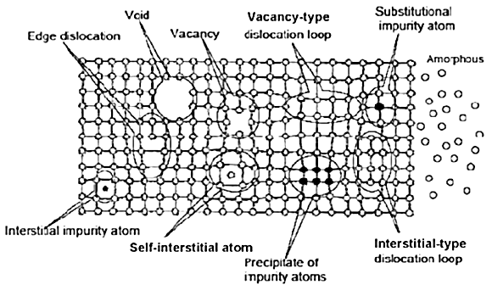
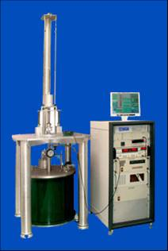
Main ingredients needed for this work...
FLUKA simulation ➔ dpa
Metallurgy➔ HIP (Unige)
Irradiation facilities: Université Catholique de Louvain-la-Neuve (Belgium); IRRAD1 at CERN; Kurchatov Institute (Russia).
Collaboration with Atom Institute of Vienna (Austria)
Safety condition for irradiated samples
(@CERN: 1 µSv/h at 10 cm)
Radiation damage theory
Nb₃Sn wires
Spark erosion (Unige)
➔ Nb₃Sn platelets
Diffraction measures (Unige)
and Full Prof refinement➔S, a
Magnetization (CERN)
➔ ∆J_{c}, ∆ T_{c}
Flux pinning models
SEM, SQUID measures (Unige)➔to characterize the Nb₃Sn platelets
Notes:
Multidiscplinary work......
Above all....
Collaboration with more than one institute to irradiate the Nb₃Sn wires and platelets
The present PhD thesis work contains a series of experiments which are performed at different locations. Under these conditions, the organization of the work required a very careful planning; overlapping with other users at the various experimental places caused some difficulties, which had to be overcome. In addition, the very time consuming preparation of the large number of thin Nb₃Sn samples required for the planned Bragg peak experiments and for the preparation of Ti sheathed MgB₂ wires was successfully accomplished.

Slide 40
Why is it important to study the damage induced by charged particles?

Slide 41
Reasons to investigate proton irradiation damage (1)
From literature…..

Slide 42
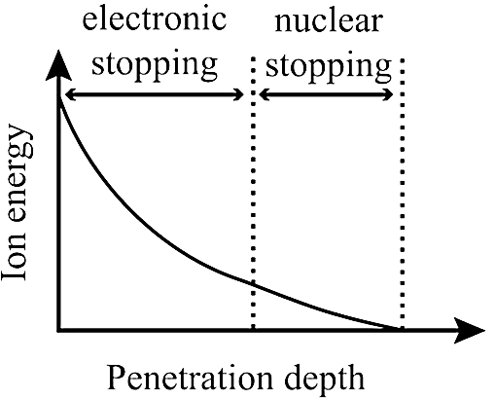
Reasons to investigate proton irradiation damage (2)
….due to their charge they exhibit a different behavior inside the matter
Stopping power:
$NS\left(E\right)={(−\frac{dE}{dx})}_{tot}=S_{n}+S_{e}$
S(E)=$\int_{T_{min}}^{T_{max}}{Tσ\left(E_{i},T\right)dT.}$
10 MeV protons in Nb₃Sn
(FLUKA)
Steady loss➔ homogeneous damage
(as for neutrons)
Bragg peak➔ higher damage
(no analogy with neutrons)
Notes:
When a fast charged particle travel through the lattice it ionizes atoms of the material and deposits a dose along its path due primarily to the electronic stopping power
As the energy of the charge particle decreases the collisions with nuclei become more probable (the interaction cross section increases) and consequently from equation.... It follows that the total stopping power increases up to the formation of a peak in the energy deposition

Slide 43
It is necessary to know the behavior after proton irradiation as an example of charged particles

Slide 44
What happens really in HL-LHC?

Slide 45
What happens really in HL-LHC?
No study is known so far about the decrease of the Bragg Williams LRO parameter S (and thus of T_{c}) due to the proton radiation damage at the location of the Bragg peaks in Nb₃Sn.
$\sim$70% of tot. dpa is due to neutrons
But....
$\sim$30% of tot. dpa is due to charged particles:
➔ many trajectories of charged particles (secondary ions from the interaction with W shield) end in the Nb₃Sn filaments: Bragg peaks.

Slide 46
The Bragg peak experiment
The Experiment
Main target:
Study of ∆S, ∆a and ∆ T_{c} in both regions.
Fluence [p/m²] | Energy [MeV] | Thickness [mm]
 |  | Al | Steady loss | Bragg peak
5x10²⁰ | 11.85 | 0.15 | I-1 0.18 | II-1 0.12
1x10²¹ | 12.16 | 0.15 | I-2 0.18 | II-2 0.14
3x10²¹ | 12.18 | 0.15 | I-3 0.20 | II-3 0.18
5x10²¹ | 11.99 | 0.15 | I-4 0.17 | II-4 0.14
1x10²² | 12.78 | 0.15 | I-5 0.20 | II-5 0.18
Proton irradiation at the cyclotron U-150 of the National Research Centre in Kurchatov Institute (NRC-KI), Russia.

Slide 47
What was needed...
HIP (Hot Isostatic Pressure)
Spark erosion and Polishing
Flash annealing: 900°C/10’
Notes:
p(Ar)=2Kbar, at T=1250°C for 94h
To avoid oxidation of the sample surface during the flash-anneal procedure, the platelets were enclosed into a Ti box

Slide 48
Characterization before irradiation
SEM analysis
SQUID measurement
average grain size of 20 µm
T_{c}=17.9K
Rietveld refinement (FULL PROF software)
http://www.ill.eu/sites/fullprof/
First complete Rietveld Refinement of S for Nb₃Sn by means of X-ray data
S $⋍$ S_{a} = S_{b} = 0,98 ± 0,02
a = 5,291±0,002Å
Notes:
Due to the difference between the form factor of Nb and Sn I110/I211<0.14➔ homogeneous, excellent X-ray counting statistics
The average grain size of the Nb₃Sn platelets described in this work was close to 20 mm (see SEM photo in Fig. 1). By means of Hot Extraction analysis it was found that these platelets contain a small amount of oxygen, 0.14 wt. % (approximately 1 at.) and 0.01 wt. % of Carbon. The platelets can thus be considered as being essentially single phased, as confirmed by the X-ray pattern of a powdered platelet (Fig. 2), which indicate a complete absence of the reflexes due to the neighbor phase Nb₆Sn₅. In Fig. 2, very weak CuO peaks can be detected; they do not interfere with the A15 peaks.
Before irradiation, a sharp superconducting transition at 17.9 K in zero field was observed by SQUID magnetometry: in the “AC option” of the Quantum Design MPMS XL, the magnetic susceptibility was measured in an alternating field up to 0.3 mT from 0.01 to 1 kHz. After irradiation, T_{c} of the platelets were measured at Kurchatov by means of a Vibrating Sample Magnetometer (VSM) with a sweeping rate of 10 mT/s at various fields.
The Nb₃Sn platelets showed almost no preferential orientation and the order parameter prior to irradiation was essentially the same for the whole series of platelets, either determined by a full refinement of powders or more simply by the ratio I₁₁₀/I₂₁₁. The measurement of the lattice parameter and of the order parameter S prior to irradiation have been performed at the University of Geneva by means of a Rietveld refinement using the FullProf software [35] on X-ray powder diffraction patterns acquired with an automatic diffractometer in the CuK_{α1} Bragg-Brentano geometry. Exposure times as long as 15 hours, with 3.5 seconds per step were chosen. In addition, the chemical composition, the atomic scattering factors were taken into account.

Slide 49
Results on Nb₃Sn platelets
Microstrain
Lattice constant
Bragg peak
Bragg peak
Critical temperature
Bragg Williams LRO parameter
Bragg peak
Bragg peak
Higher damage induced into the A15 structure by the Bragg peak
Notes:
The enhancement of microstrains with fluence for both the steady loss and the Bragg peak regions determined by a Williamson-Hall plot are reported in Fig. 6. A considerably larger microstrain is observed for the platelets #II (Bragg peak region) compared to the platelets #I, reflecting a heavier damage

Slide 50
Comparisons: a, S
Lattice constant
LRO Parameter
Neutron data from: “Sweedler A R, Cox D E and Moehlecke S 1978 J Nucl Mater 72 50 “
dpa:
universal parameter for a and S
First relationship between S and dpa

Slide 51
Conclusions
First measurements of the effects at the Bragg peak of Nb₃Sn crystallographic properties
Higher enhancement of a
Higher decrease of T_{c} and S
A direct correlation between the atomic order parameter, S, and the dpa value has been found
dpa: universal parameter for T_{c}, S and a

Slide 52
References
1.“Irradiation Effects in Superconductors: the case of Nb3Sn”, T Spina et al., to be published in invited SuST 2018.
2.“Development of HTS Current Leads for the ITER Project”, P. Bauer, A. Ballarino, Y. Bi, N. Clayton, A. Devred1, K. Ding, E. Niu, Q. Du, C.Y. Gung, Q. Han, R. Heller, X. Huang, T. Ichihara, S. Lee, C. Liu, C.L. Liu, K. Lu, N. Mitchell, Y. Song, T. Spina, Q. Ran, T. Taylor, S. Yamada, Y. Yang, T. Zhou, to be published in SuST 2018.
3.“Impact of the Number of dpa on the Superconducting Properties in HiLumi-LHC and FCC Accelerators”, R. Flükiger, T. Spina, F. Cerutti, M. I. Besana, C. Scheuerlein, A. Ballarino L. Bottura, to be published in IEEE Trans. App. Superc. 2018.
4. “Variation of Tc, lattice parameter and atomic ordering in Nb3Sn platelets irradiated with 12MeV protons: correlation with the number of induced Frenkel defects”, R. Flukiger, T. Spina, F. Cerutti, A. Ballarino, C. Scheurlein, L. Bottura, Y. Zubavichus, A. Ryazanov, R. D. Svetogovov, S. Shavkin, P. Degtyarenko, Y. Semenov, C. Senatore and R. Cerny, Supercond. Sci. Technol. 30 (2017) 054003 (11pp).
5.“Artificial Pinning in Nb3Sn Wires”, T. Spinaret, A. Ballarino, L. Bottura, C. Scheuerlein and R. Flukiger, IEEE Trans, App. Superc., vol. 27, no. 4, June 2017.
6.“Effect of Irradiation with 32 MeV Protons on Critical Parameters of Modern Nb3Sn-Based Superconducting Composite Wires”, P. N. Degtyarenko, A. Ballarino, L. Bottura, S. Yu. Gavrilkin, R. Flukiger, V. S. Kruglov, S. T. Latushkin, C. Scheuerlein, A. I. Ryazanov, E. V. Semenov, T. Spina, S. V. Shavkin, V. N. Unezhev, Technical Physics Letters, 2017, Vol. 43, No. 6, pp. 574-576.
7.“Influence of fast proton irradiation with energies of 12.4 and 12.8MeV on magnetic characteristics and microstructure changes of superconducting intermetallic compound Nb3Sn”, P. N. Degtyarenko, A. Ballarino, L. Bottura, S. Y. Gavrilkin, R. Flukiger, I. A. Karateev, V. S. Kruglov, S. T. Latushkin, C. Scheuerlein, A. I. Ryazanov, E. V. Semenov, T. Spina, V. N. Unezhev, A. L. Vasiliev, Journal of physics: Conference Series 747 (2016) 012030
8.“Correlation Between the Number of Displacements Per Atom and Tc After High-Energy Irradiations of Nb3Sn wires for the HL-LHC”, T. Spina, C. Scheuerlein, D. Richter, A. Ballarino, F. Cerutti, L. S. Esposito, A. Lechner, L. Bottura and R. Flukiger, IEEE Trans. App. Superc., vol. 26, no.3, April 2016
9.“Variation of the critical properties of alloyed Nb-Sn wires after proton irradiation at 65MeV and 24GeV” T. Spina, C. Scheuerlein, D. Richter, B. Bordini, L. Bottura, A. Ballarino and R. Flukiger, IEEE Trans. App. Superc., vol. 25, no. 3, June 2015.
10.“Critical current density of Nb3Sn wires after irradiation with 65MeV and 24GeV protons”, T. Spina, C. Scheuerlein, D. Richter, L. Bottura, A. Ballarino, R. Flukiger Journal of Physics: Conference Series 507 (2014) 022035 doi:10.1088/17426596/507/2/022035
11.“Experimental and numerical analysis of interfilament resistances in NbTi strands”, M. Breschi, M. Massimini, P. L. Ribani, T. Spina and V. Corato, Supercond. Sci. Technolo. 27 (2014) 055021
12.“The behavior of copper in view of radiation damage in the LHC luminosity upgrade”, R. Flukiger and T. Spina, Internal Note in Indico, CERN, Geneva, Switzerland (2012).
13.“Variation of (Jc/Jc0)max of binary and ternary alloyed RRP and PIT Nb3Sn wires exposed to fast neutron irradiation at 300K”, R. Flukiger, T. Baumgartner, M. Eisterer, H. W. Weber, T. Spina, C. Scheuerlein, C. Senatore, A. Ballarino and L. Bottura, IEEE Trans. App. Sup. Vol.23, no. 3, June 2013.
14.“Experimental investigation of the transverse resistivity in Nb3Sn wires through ac susceptibility”, P. Fabbricatore, S. Farinon, V. Corato, G. De Marzi, T. Spina, U. Gambardella and A. Saggese, Supercond. Sci. Technolo. 26 (2013) 085001
15.“Comparison of direct inter-filament resistance measurement on Nb3Sn strands between University of Twente and ENEA”, C. Zhou, M. Dhalle’, A. Nijhuis, M. Breschi, T. Spina, A. della Corte and V. Corato, Applied Superconductivity, IEEE Transactions Volume: 2, Issue: 3, Part: 3, 2013
16.“Direct observation of Nb3Sn lattice deformation by high energy X-ray diffraction in internal-tin Nb3Sn wires subject to mechanical loads at 4.2K”, L. Muzzi, V. Corato, A. della Corte, G. De Marzi, T. Spina, J. Daniels, M. Di Michiel, F. Buta, G. Mondonico, B. Seeber, R. Flukiger and C. Senatore, Supercond. Sci. Technol. 25 054006, 2012
17.“Comparison between direct and indirect measurements of the transverse resistivity in NbTi strands”, Tiziana Spina, Valentina Corato, Gianluca De Marzi, Chiarasole Fiamozzi Zignani, Luigi Muzzi, Umberto Gambardella, Pasquale Fabbricatore, and Antonio della Corte, Elsevier Ltd. Physics Procedia, 2011 available online at www.sciencedirect.com

