Slide 1
Quench Current-boosting Device (QCD) concepts
Stoyan Stoynev, Maria Baldini, Sandor Feher
MDP meeting
26 September 2018
Material from various sources
(FNAL, LBNL, CERN)

Slide 2
Outline
Addressing a problem (training)
Following an idea (speeding up training)
Contemporary context and by-product support
(what is going on indirectly related to this )
Preliminary tests and design (some work done)
Plan of action (toward QCD)

Slide 3
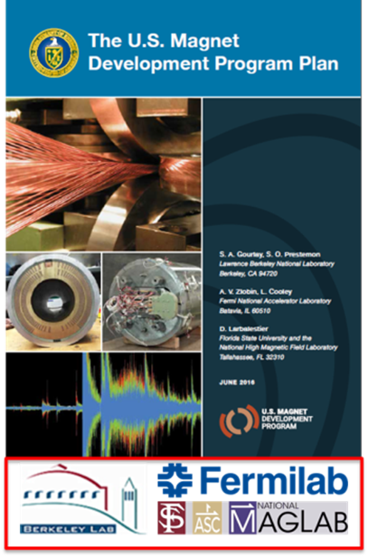
Accelerator magnet development and training
P5 report (May 2014):
“…a very high-energy proton-proton collider is the most powerful future tool for direct discovery of new particles and interactions under any scenario of physics results that can be acquired in the P5 time window… The U.S. is the world leader in R&D on high-field superconducting magnet technology, which will be a critical enabling technology for such a collider.”
Recommendation 24:
“Participate in global conceptual design studies and critical path R&D for future very high-energy proton-proton colliders. Continue to play a leadership role in superconducting magnet technology focused on the dual goals of increasing performance and decreasing costs.”
FNAL Accelerator Advisory Committee
(end of 2015) on the HFM program
Comments:
Recommendation:
Since 2015
MDP is collaboration between
FNAL/LBNL/BNL/FSU(NHMFL)

Slide 4
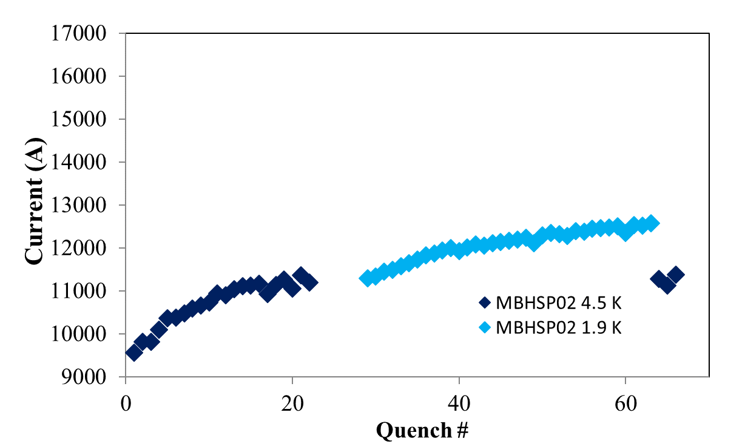
Nb₃Sn magnet quench training - challenges
conductor limit (1.9 K)
The typical Nb₃Sn accelerator magnet training is very slow in contrast to NbTi magnets which need ~ one quench (LHC) to reach 80% of the conductor limit.
Current AUP plan for Nb₃Sn magnet training ~ 9 days per magnet
optimistically - one week per magnet for training
In a future high energy accelerator the projected number of dipole magnets reaches ~5000 – roughly 5000 /52 ~ 100 years/ # facilities for training
The cost itself is about 15 k$ per quench (rough estimate based on AUP schedules)
The task to address those is not trivial

Slide 5
The idea: magnet training by a capacitor discharge
Old one (claimed to be successful)
Ideas with a twist
Capacitor discharge (pulse) through a cooled SC magnet (original case)
Same but magnet is powered
Same but the discharge is in synch with
(training) quench detection
Arguably the optimal case for training is the last one
NbTi

Slide 6
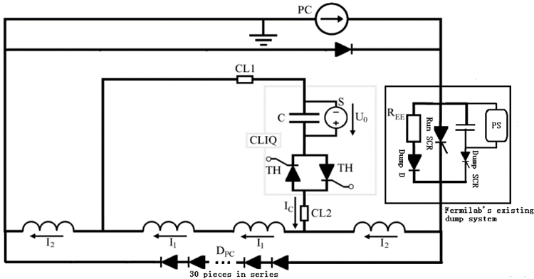
The shadow of CLIQ (Coupling-Loss-Induced Quench)
A capacitor based device (mechanism) for quench protection to be used in LHC Nb₃Sn quads (QXF) - ~ 50 mF, ~500 V
It is triggered immediately after quench detection
It was also commissioned and tested at FNAL
It almost looks what we may want…
Schematics for a CLIQ connection
to the magnet and protection circuit

Slide 7
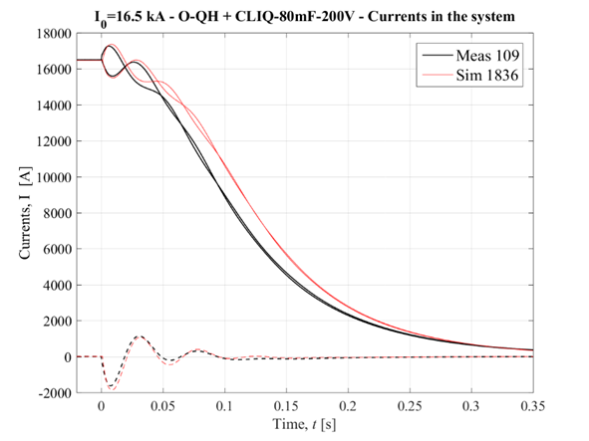
CLIQ discharges
Safety considerations require the CLIQ system to be discharged in part of the magnet (see the schematics)
It creates ”over-current” (magnitude of the first oscillation)
in part of the magnet and “under-current” in the other
“Over” is above the quench current (typically by ~ 1000 A) and flows through half the magnet
One could assume this half (those coils) will train faster
CLIQ discharges during tests
and simulations
Emmanuele R.

Slide 8
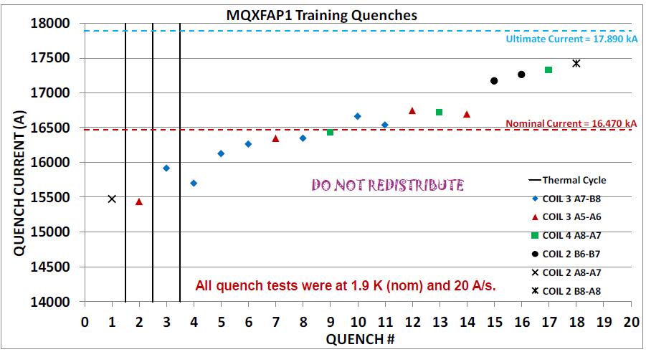
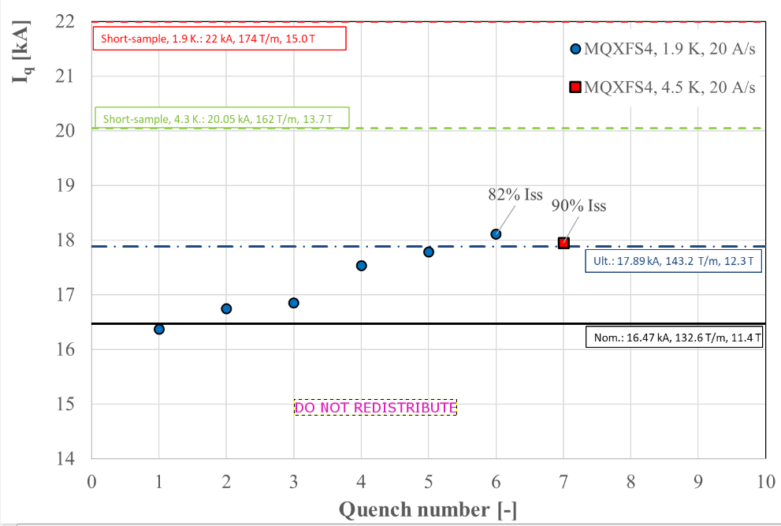
By-product support
For the first time CLIQ was tested/used during training at BNL and later at CERN
BNL test
CERN test
CLIQ used for the first time in the test
Uncharacteristic jump in
quench current next quench
Magnet schematics is such that “over-current” runs
through coils 3 and 5 and “under-current” through
coils 2 and 4. After CLIQ is used quench location
switches from coil 3 to coils 2 and 4
(four quenches in a raw!).
Magnet schematics is such that “over-current” runs through coils 110 and 111 and “under-current” through coils 108 and 109. All quenches except the first one are in coil 108 or 109!
CLIQ used from the
very beginning of
the test

Slide 9
A step back and a test
Although all of this is discussed with our partners models do not necessarily support that “over-current” means “over-field” or “over-stress” (which is the relevant “over”)
Due to the nature of coupling currents magnetic field is not in phase with the current
On local sub-filament level the statement is that the phase could lead up to tens of milliseconds delay – enough to derail the idea
The model claims consistency with observed inductance trends
We did a test – measuring the current and the magnetic field in the bore
Unfortunately I can not show the graph now for technical reasons
We didn’t see delay in the bore field wrt current
(within a couple of milliseconds)
However the model quoted has no predictions for the bore field

Slide 10
More history
The idea to test on LARP magnet (MQXFS1) was floated and proposed at FNAL a couple of years ago
Ever since there is (slow) on-going work on the subject, including the before-mentioned test
We initiated preliminary collaboration with Emanuele (LBNL) but it didn’t go far
We discussed with CERN people and suggested tests to be performed at CERN (as part of Hi-Lumi)
FNAL R&D discussions, more data, tentative support from the Lab/TD

Slide 11
CLIQ aside
The CLIQ units have limited capacitance
They are for magnet protection and not optimized or necessarily adequate for other purposes
They are patented
The available ones are not FNAL property
There is a long lead time to buy one (from Europe)
They cost about $40,000 each
Note: An informal proposal to test the
idea with CLIQ within LARP/AUP/HL-LHC
was so far turned down at CERN and
previously at FNAL

Slide 12
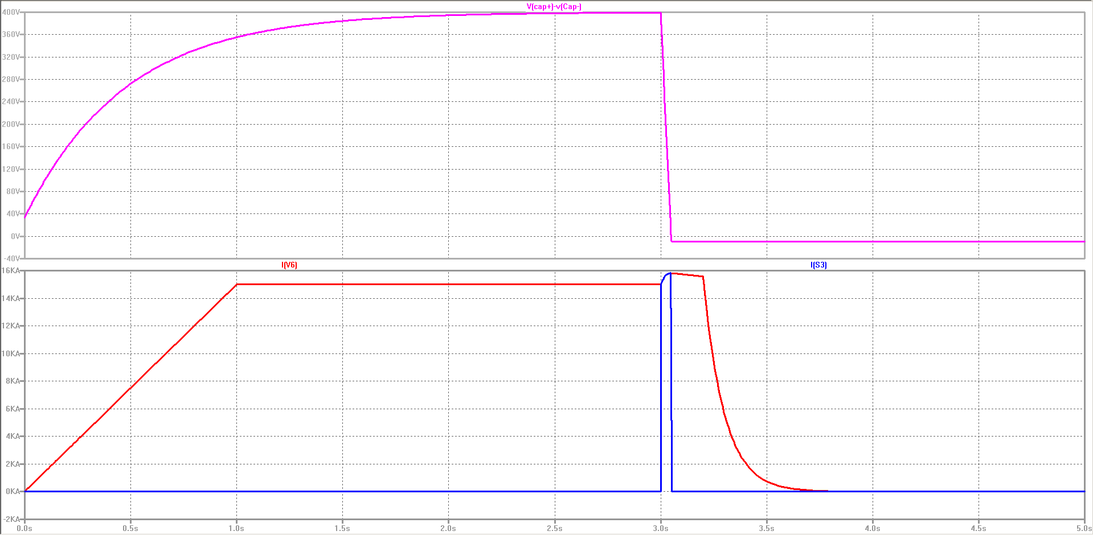
Quench Current-boosting Device (QCD)
So, we are going to build one according to our needs – QCD
Alternative name: Quench-current Booster at Current Limit
(QBCL, read as “cubicle”)
We estimate we need at least few F in capacitor banks to address training in a whole accelerator magnet
Initial design studies performed by Howard P. and Matt K.
Those plots are simulations
of voltages and currents with a QCD
With adequately tuned electrical
schematics we’ll have
overcurrent for hundred or so
milliseconds through the whole
magnet avoiding oscillations
altogether
1.9 F
10 mH
15 kA
Magnet current
We did a similar test with CLIQ
and a conventional magnet

Slide 13
Funding
At FNAL we are applying for a Lab grant
We have a tentative support from our department to launch studies and cost estimates without the grant, possibly parts procurement
We have a plan to follow
Develop and optimize QCD and electrical diagrams for tests
Procure parts, commission QCD
Model and simulation framework development
Use available “11 T” program components for testing
Mirror structure
Coil never used/tested before
Test QCD with this mirror magnet and analyze the results
Further in future (> 1 year): extend the project to include series of small magnets (coils?) for statistical precision and systematic deviation studies

Slide 14
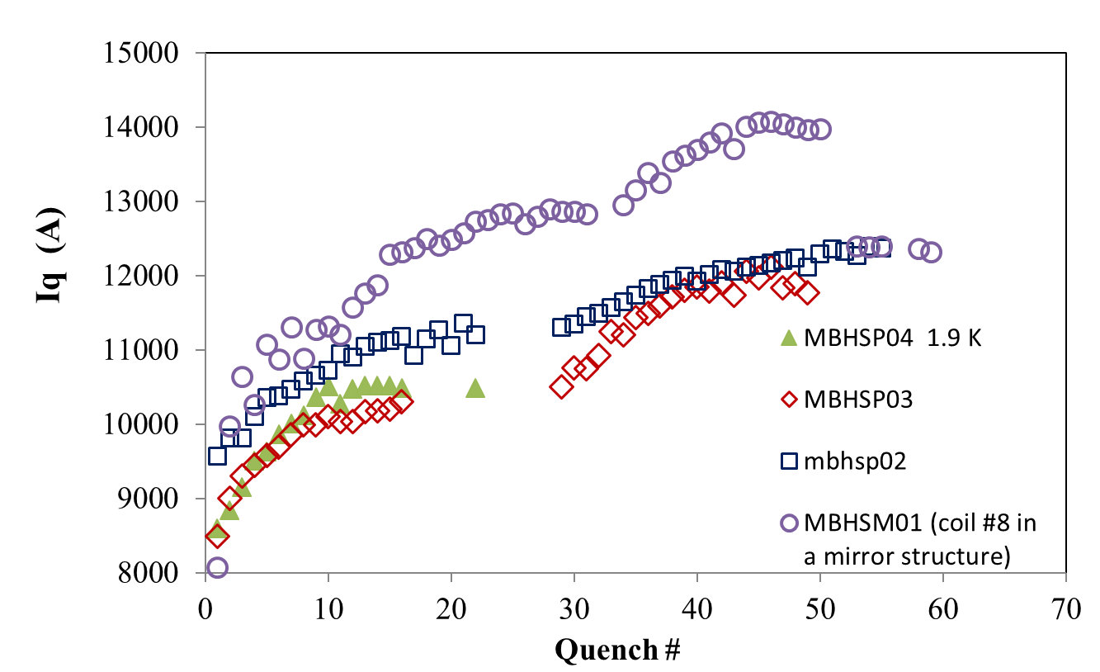
Relying on 11 T
We consider the use of 11 T components optimal and crucial
It may be possible to use a LARP coil later as a back up
It keeps the initial investment relatively low
It is a good base to compare to with its
consistent long coil training (magnets and a mirror)
11 T magnets training
We also have the expertise
to build a new mirror magnet
of the series

Slide 15
Modeling
There is extensive work related to LARP/AUP magnet protection and our project will benefit from it
We will be simulating the mechanisms and effects behind the QCD
We hope to have a full understanding of the processes and clarify the current controversial claims

Slide 16
Timeline and cost
We plan to have the QCD and the mirror magnet assembled and ready in about 9 months (after starting the program)
Few months for test and analysis
The device itself will cost about $50,000
Work expenses will be twice that and over
(includes work on the magnet)
With overhead we are talking about $300,000
Better estimates will follow
The extension of the program will cost significantly more (magnet series) and needs a separate discussion

Slide 17
Criticism
The proposal is not widely supported at FNAL, there are couple of main objections
Due to large L and limited U_{max} ( ~1 kV), significant acceleration of a long magnet training is impossible due to the quench protection limitations
in essence, high inductance will limit the speed of current rise, will likely accelerate current discharge (quench-back), will reduce the time budget we have for delaying quench protection and ultimately will make impossible significant “over-current” for reasonable time in real accelerator magnets
(2) Resources, in particular workforce, will compete with other programs (for instance “15 T”) and this will create additional tension which may be impossible to overcome

Slide 18
Responses to criticism (1)
The proposed project is in part “proof of principle” – in my opinion it is a scientific investigation and if it can be directly applied to a large magnet of the types developed today is irrelevant at this point
Part of the criticism was that such a proof is not needed at all, it was “obvious” that with “over-current” one could affect training; this is in contrast to what relevant people at CERN support (see some phenomenological reasoning previously); we plan to investigate
The project also aims to create a tool that is much more suitable for training larger magnets than CLIQ could ever be (factor of ~100 in C)
There is certainly agreement among all that large L is much harder to address and will have limitations. However, quantitative statements can not be given (or supported by us) without studying the problem – even now the “inferior” CLIQ is able to deliver ~ 1 kA over-current to (half the) 4.5 m long magnet; maybe we’ll find that special non-trivial electrical scheme between magnets is needed, or that only magnets with given length can benefit, or that a different magnet design would be needed to apply QCD, … Better not to speculate, whatever it is will serve as input for decisions and an option in hand

Slide 19
Responses to criticism (2)
Workforce constraints are a very valid point
We rely on the Department (and Lab) to set priorities right
It may be that we’ll have to extend the period of project execution to accommodate those constraints
Nevertheless, this should not mean to refrain from proposing new
ideas and cut them short based on interference with other Lab activities –
there is a phase where those could be channeled (delayed) or dis-favored
but lack of resources shall not be the leading concern in R&D thinking

Slide 20
Summary
A plan for Quench Current-boosting Device fabrication and testing is in place
Optimal approach adopted
Heavy use of existing elements and know-how
We hope to have Lab support
Extension of the program is in later plans

