Slide 1
PRECONDITIONED MONTE CARLO A new tool for Bayesian inference in Cosmology
Minas Karamanis
BCCP, UC Berkeley & LBNL
w/ Uroš Seljak
UC Berkeley 2024

Slide 2
What’s this all about?

Slide 3
Bayes theorem
Given a model $ℳ$ with parameters $θ$, and data $𝒟$:
likelihood function
$$ℒ(θ)$$
prior probability
$$π(θ)$$
$$p\left(θ | 𝒟,ℳ\right)=\frac{p\left(𝒟 | θ,ℳ\right) p(θ|ℳ)}{p(𝒟|ℳ)}$$
posterior probability
marginal likelihood
or
model evidence
$$𝒫(θ)$$
$$𝒵$$

Slide 4
Do we need another sampler?
Multimodal posteriors
Non-linear correlations
Parallelization
Non-differentiable models
Curse of dimensionality
Convergence criteria
Model evidence
Hyperparameter tuning

Slide 5
Plan
Sequential Monte Carlo
Persistent Sequential Monte Carlo
Preconditioned Crank-Nicolson & Preconditioned Monte Carlo
Examples
Links to Nested Sampling
pocoMC software implementation

Slide 6
Sequential Monte Carlo

Slide 7
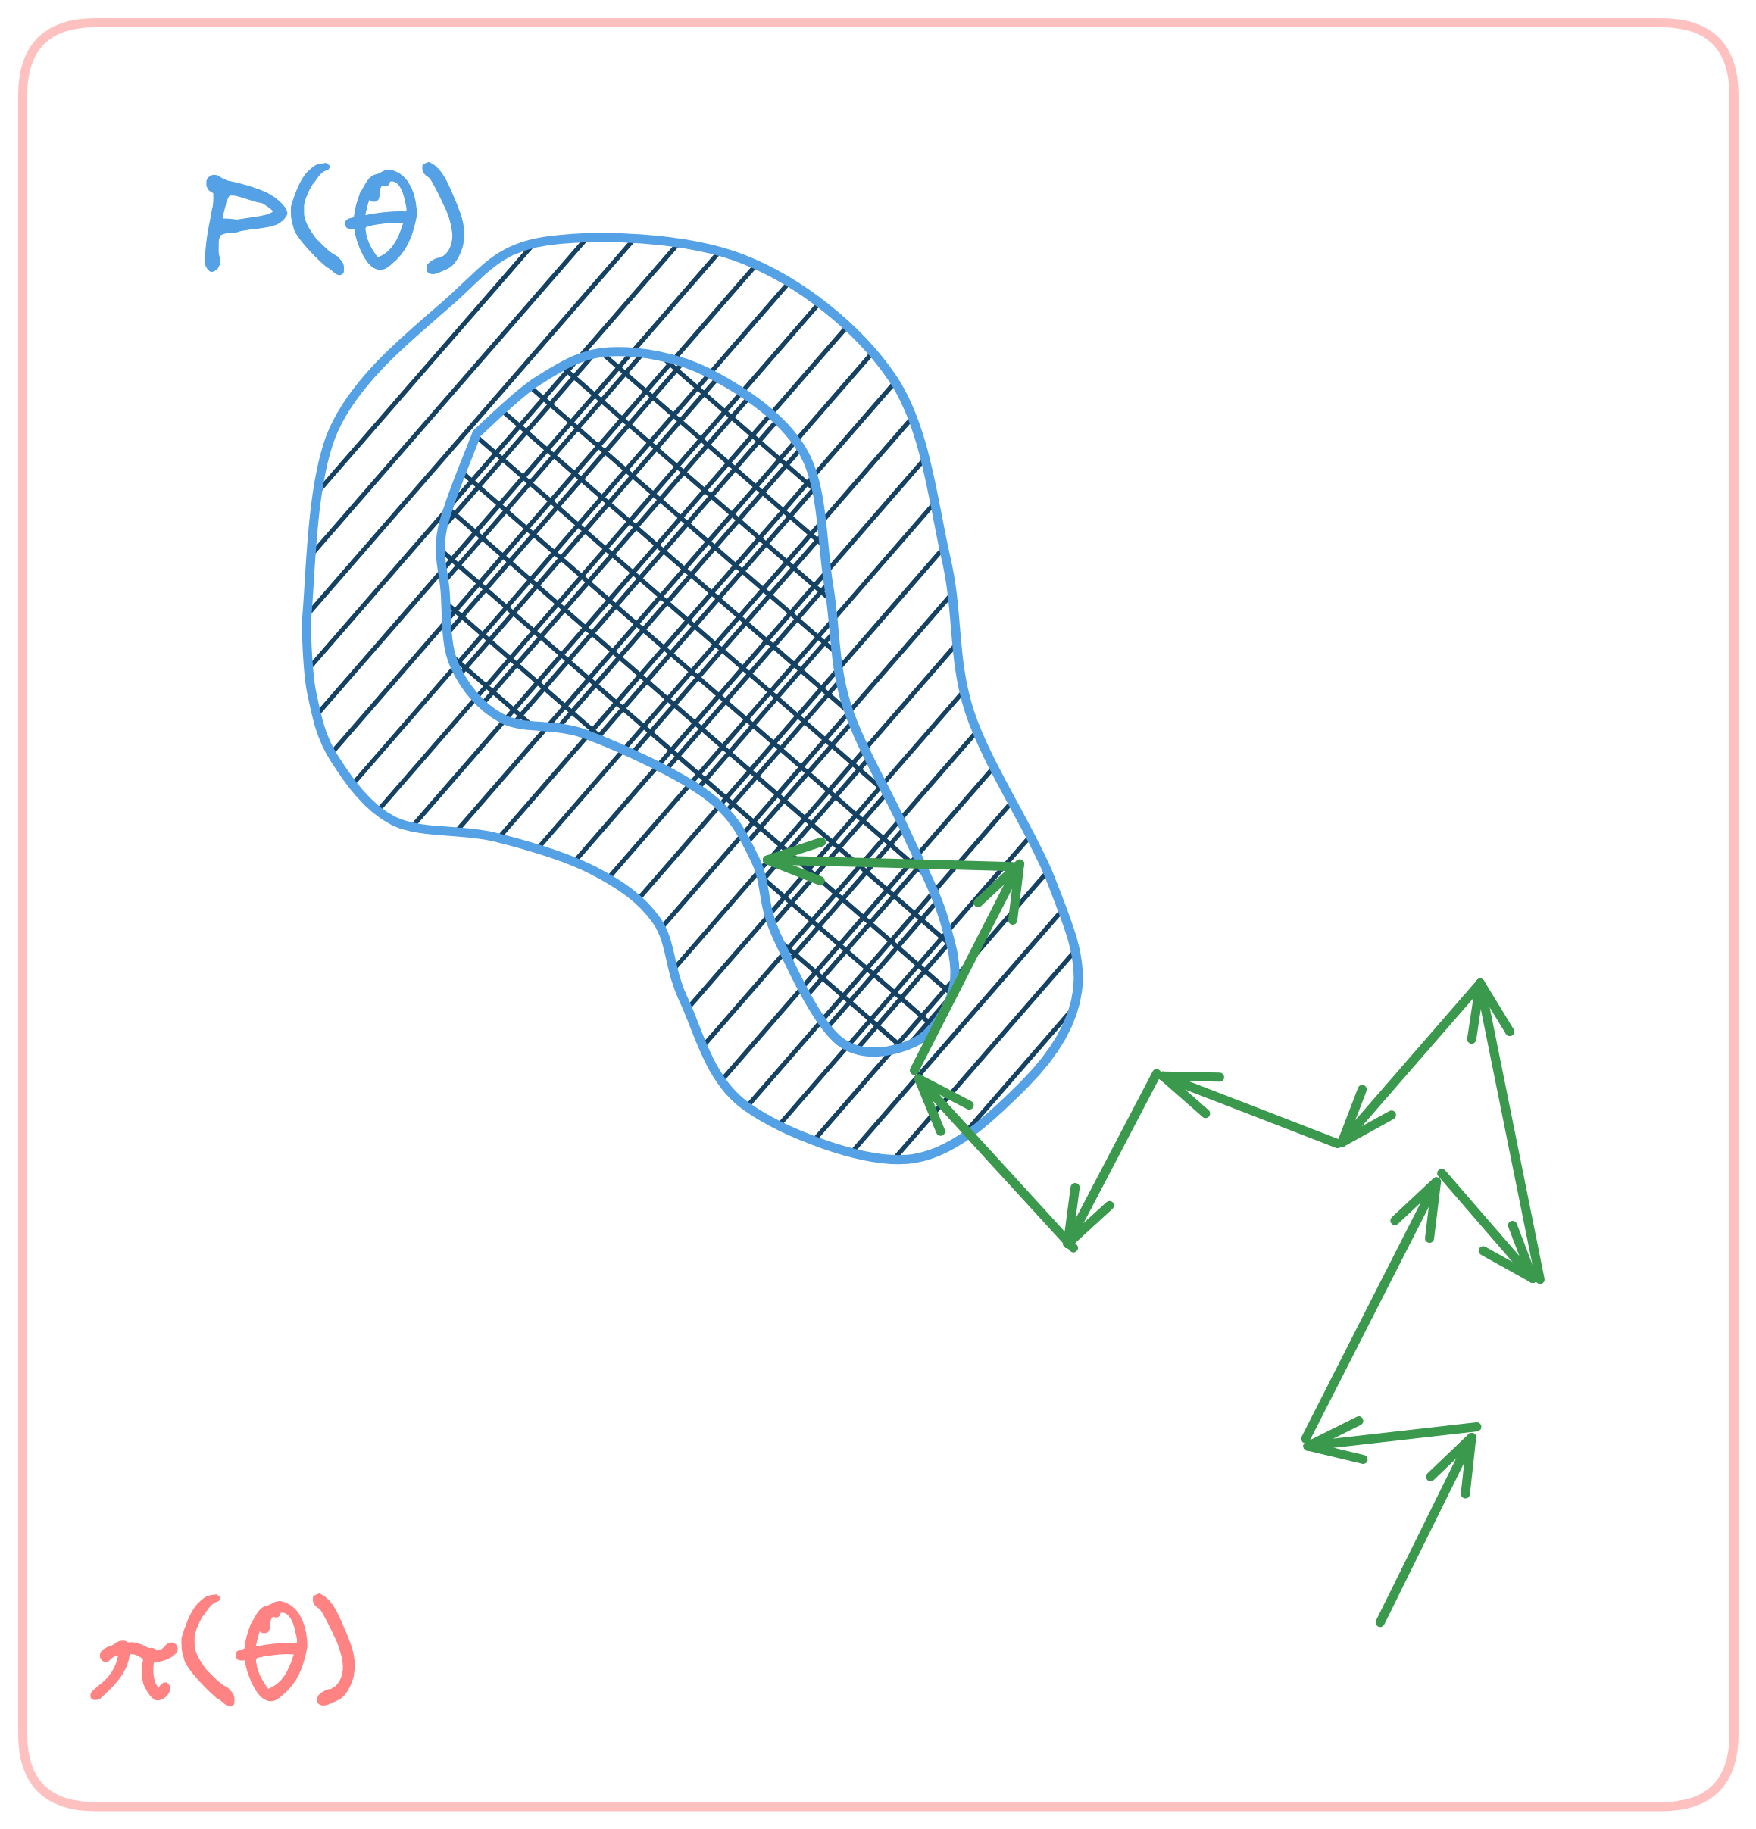
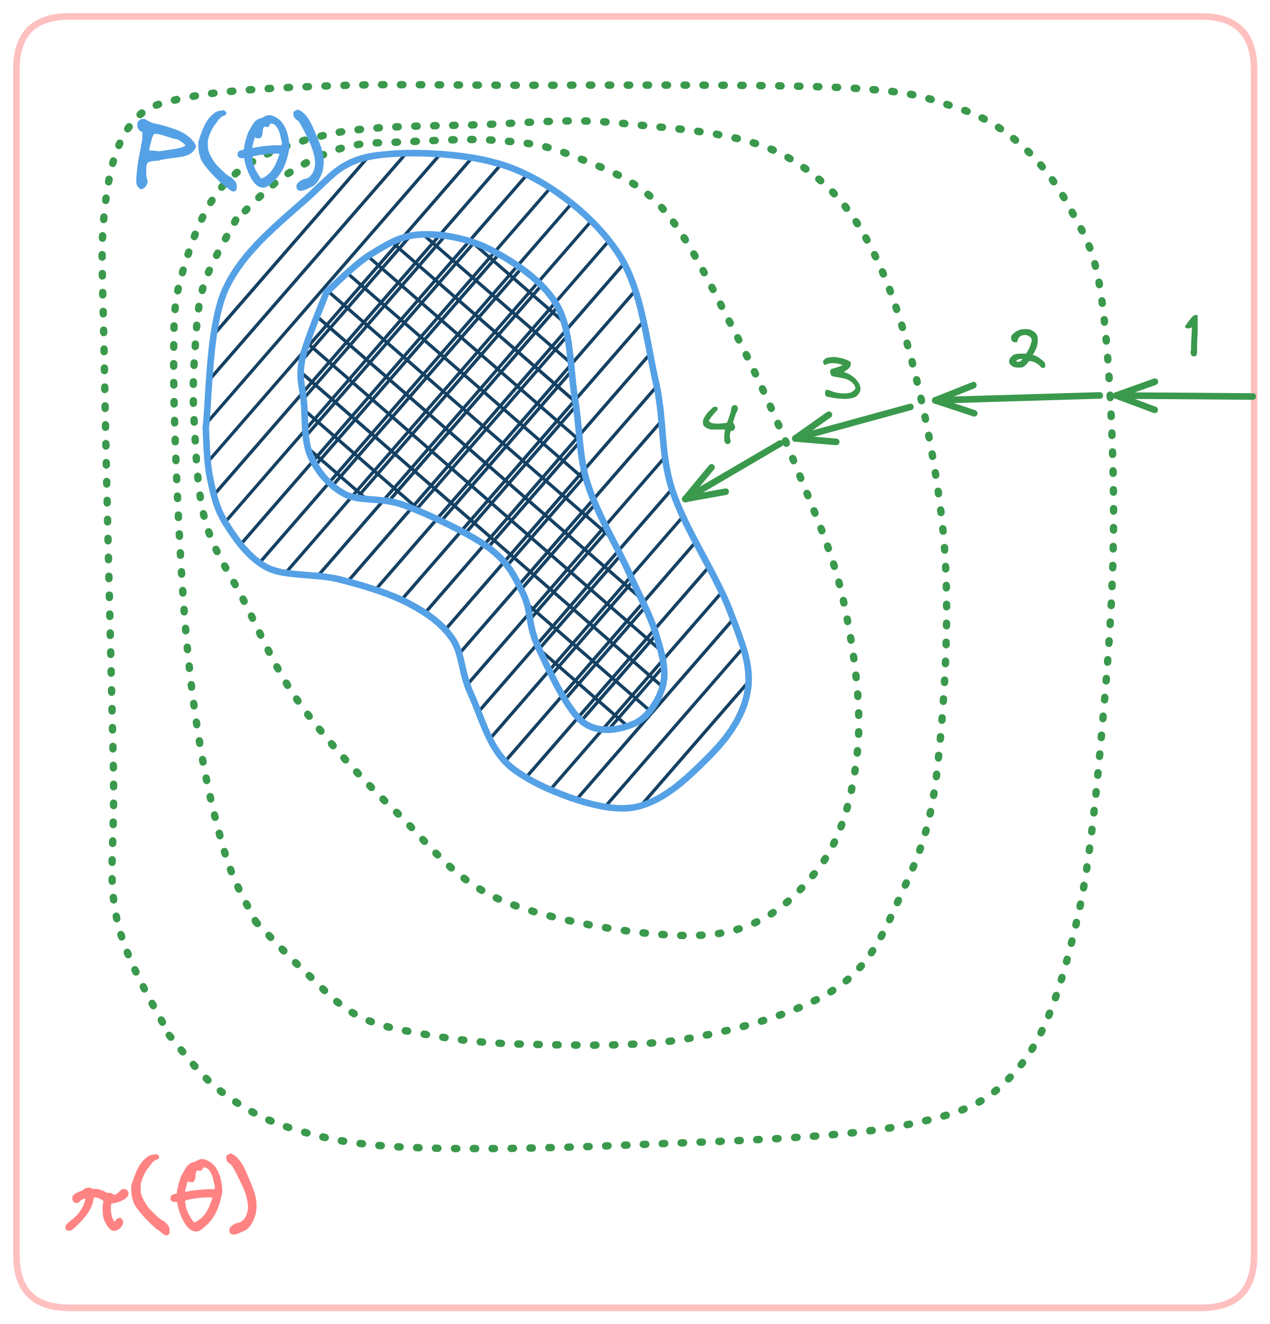
Basic idea
one hard problem
many easy problems

Slide 8
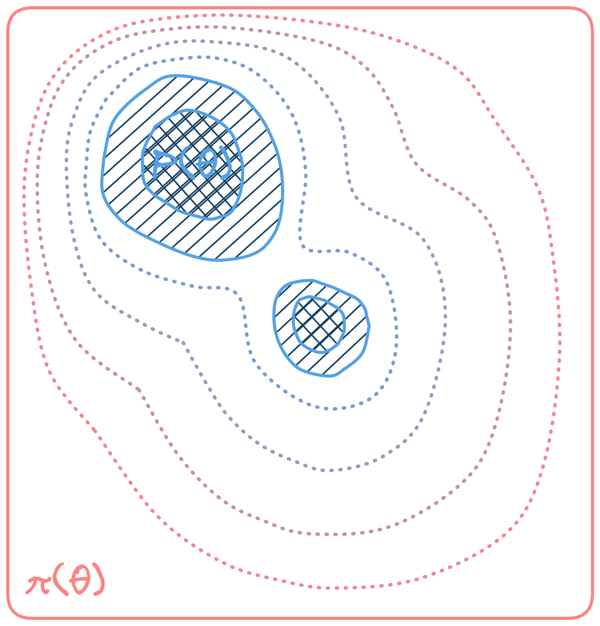
Temperature annealing
Interpolate prior and posterior
$$p_{t}\left(θ\right)=ℒ^{β_{t}}(θ)π(θ)/𝒵_{t}$$
$$0=β_{1}<⋯<β_{t}<⋯<β_{T}=1$$
such that
$p_{1}\left(θ\right)≡π(θ)$ (prior)
$p_{T}(θ)≡𝒫(θ)$ (posterior)

Slide 9
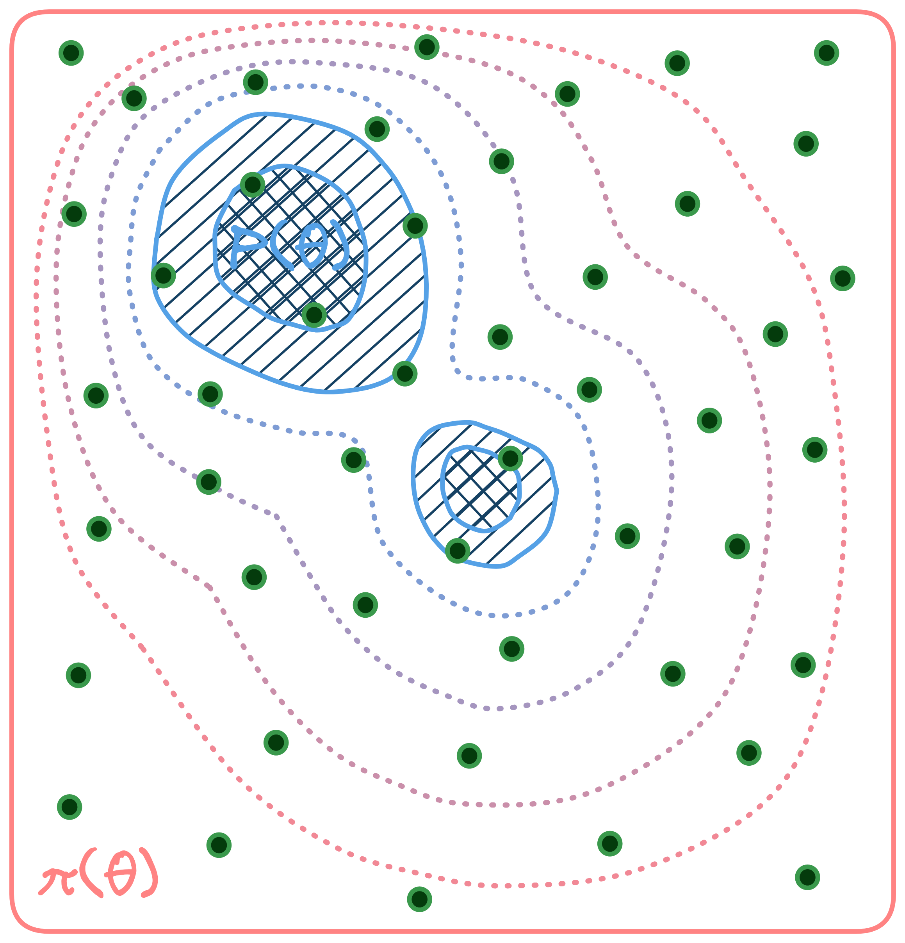
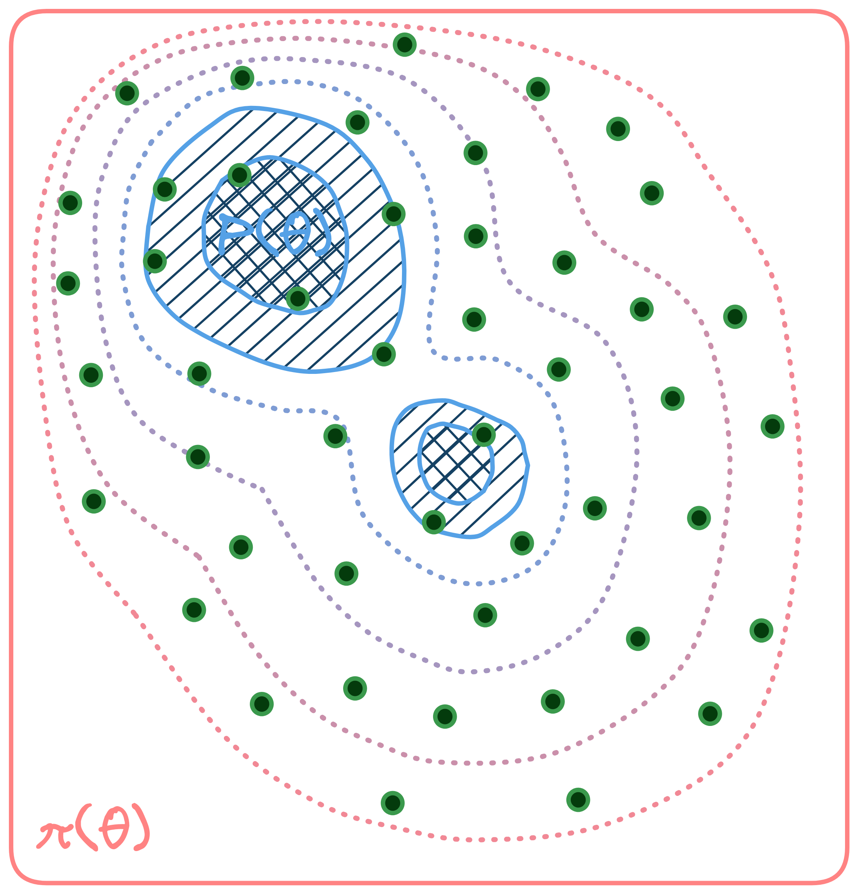
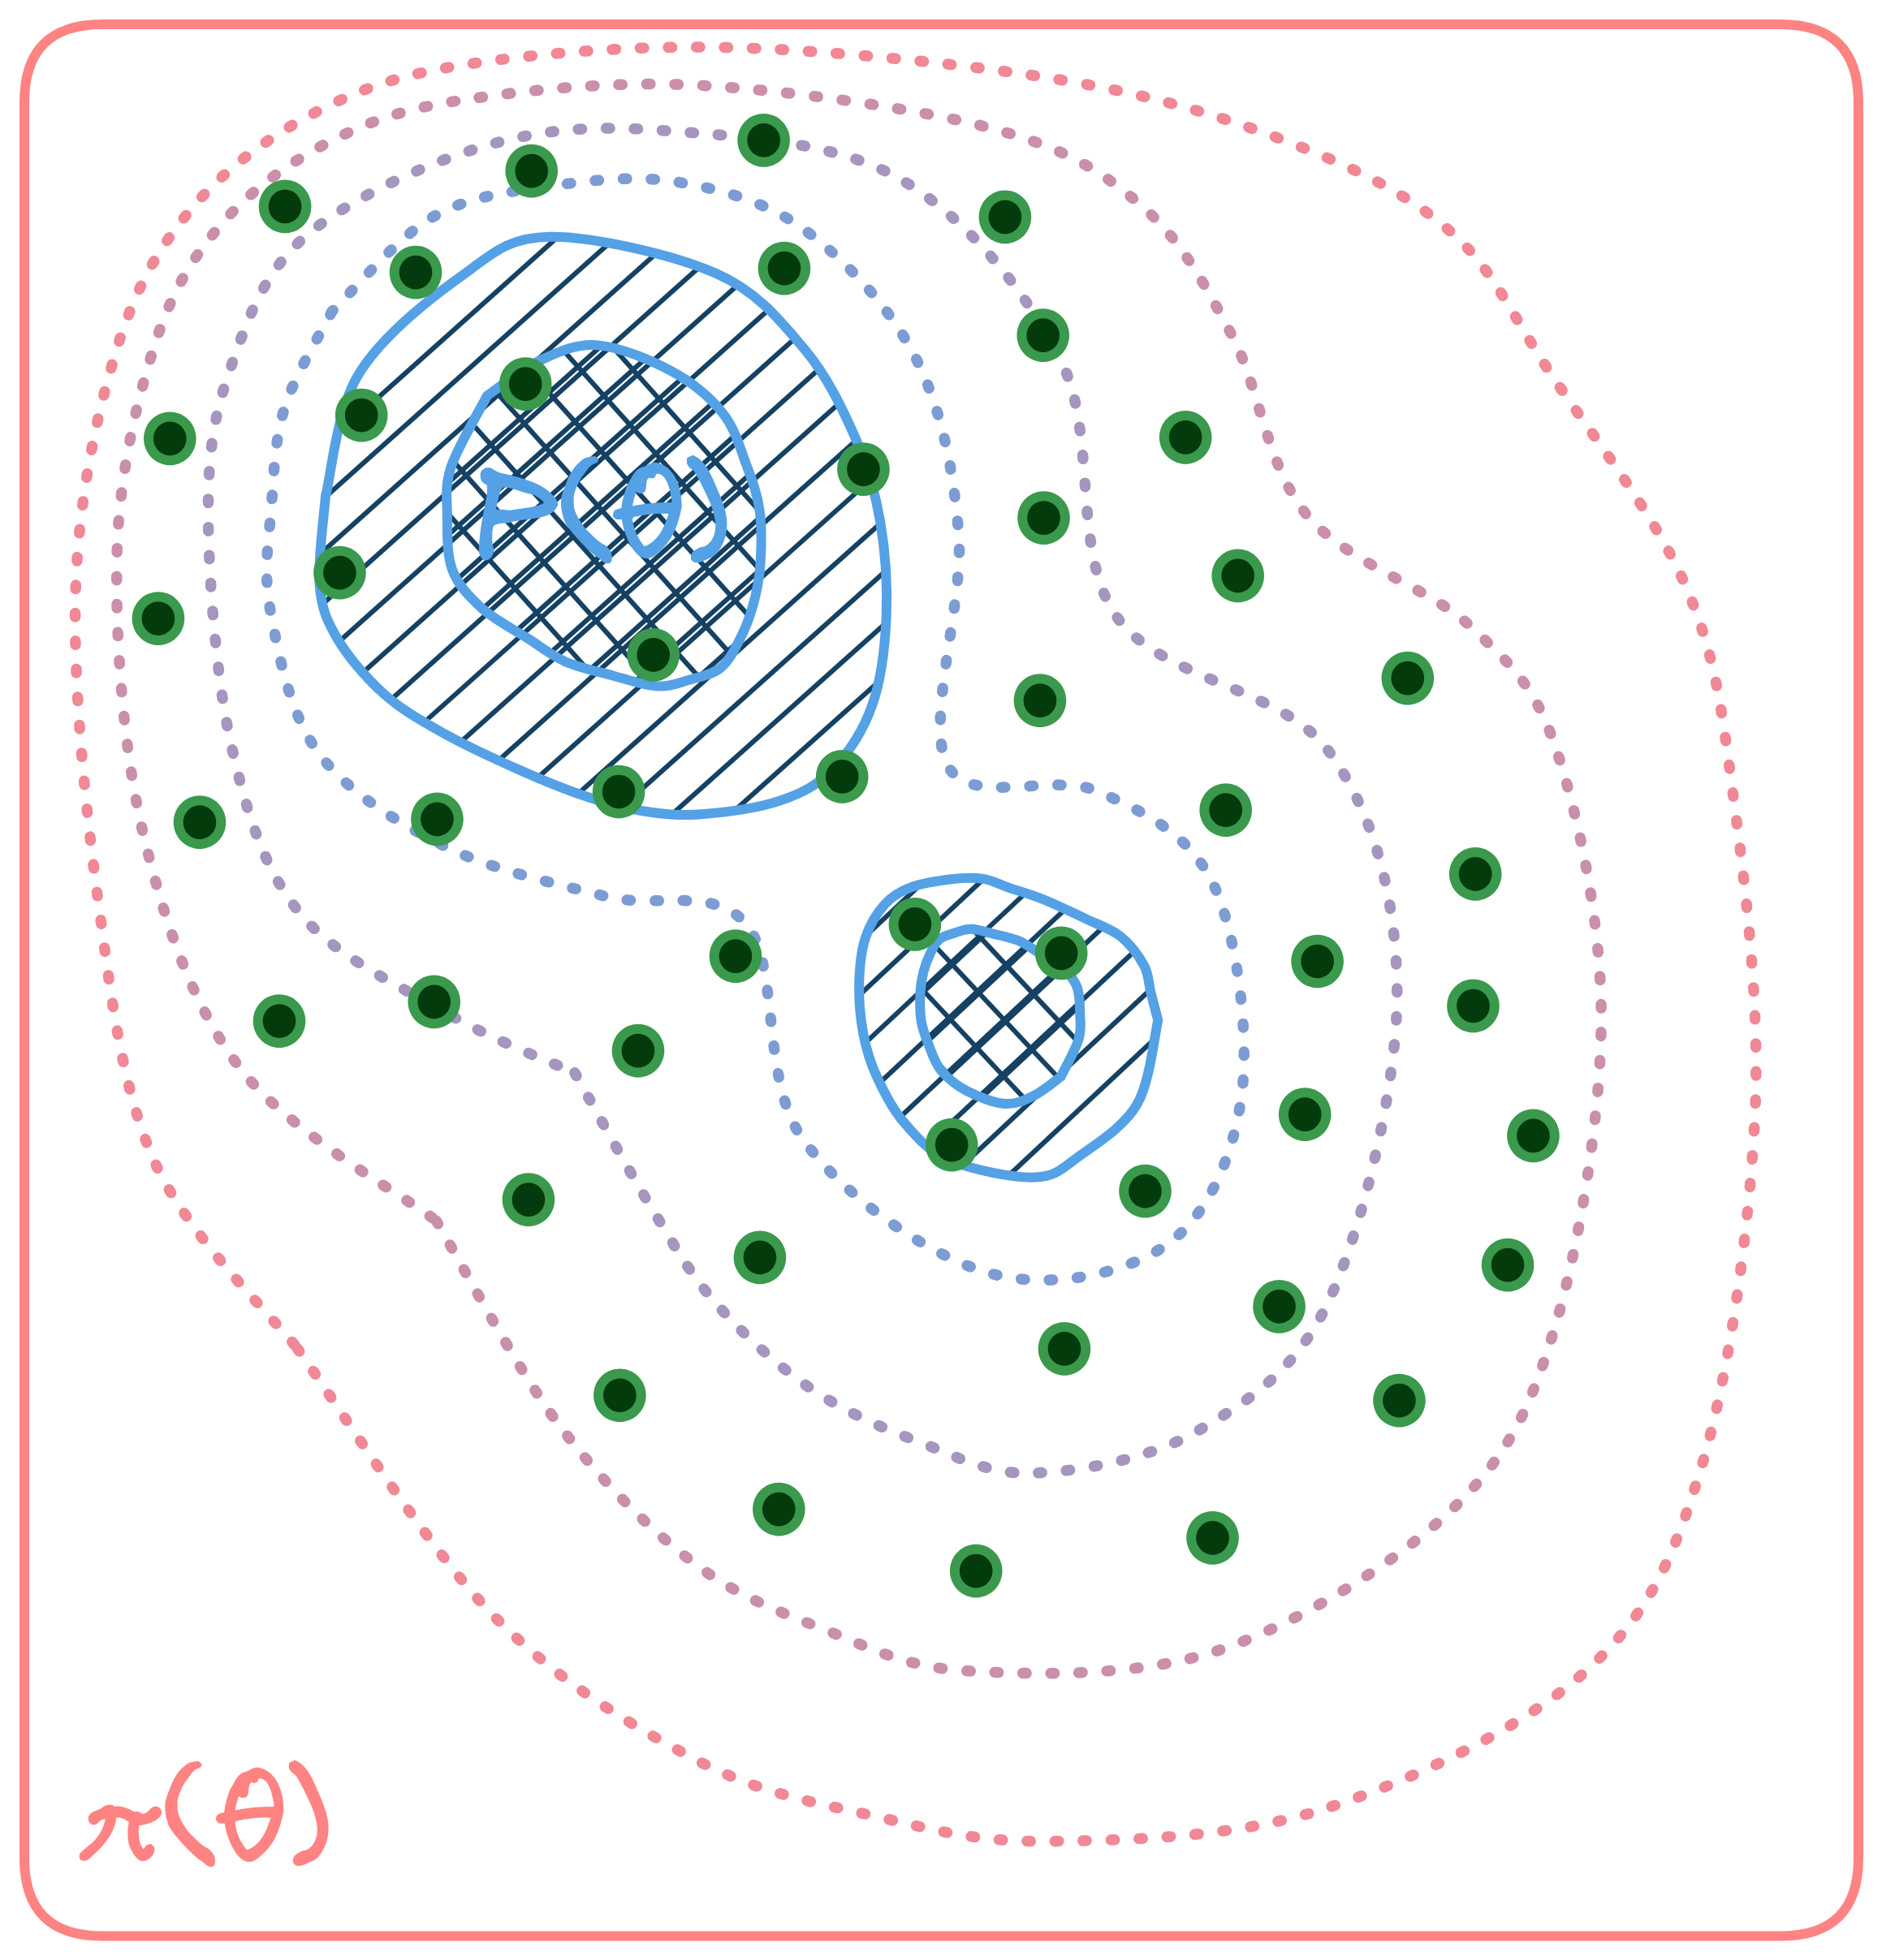
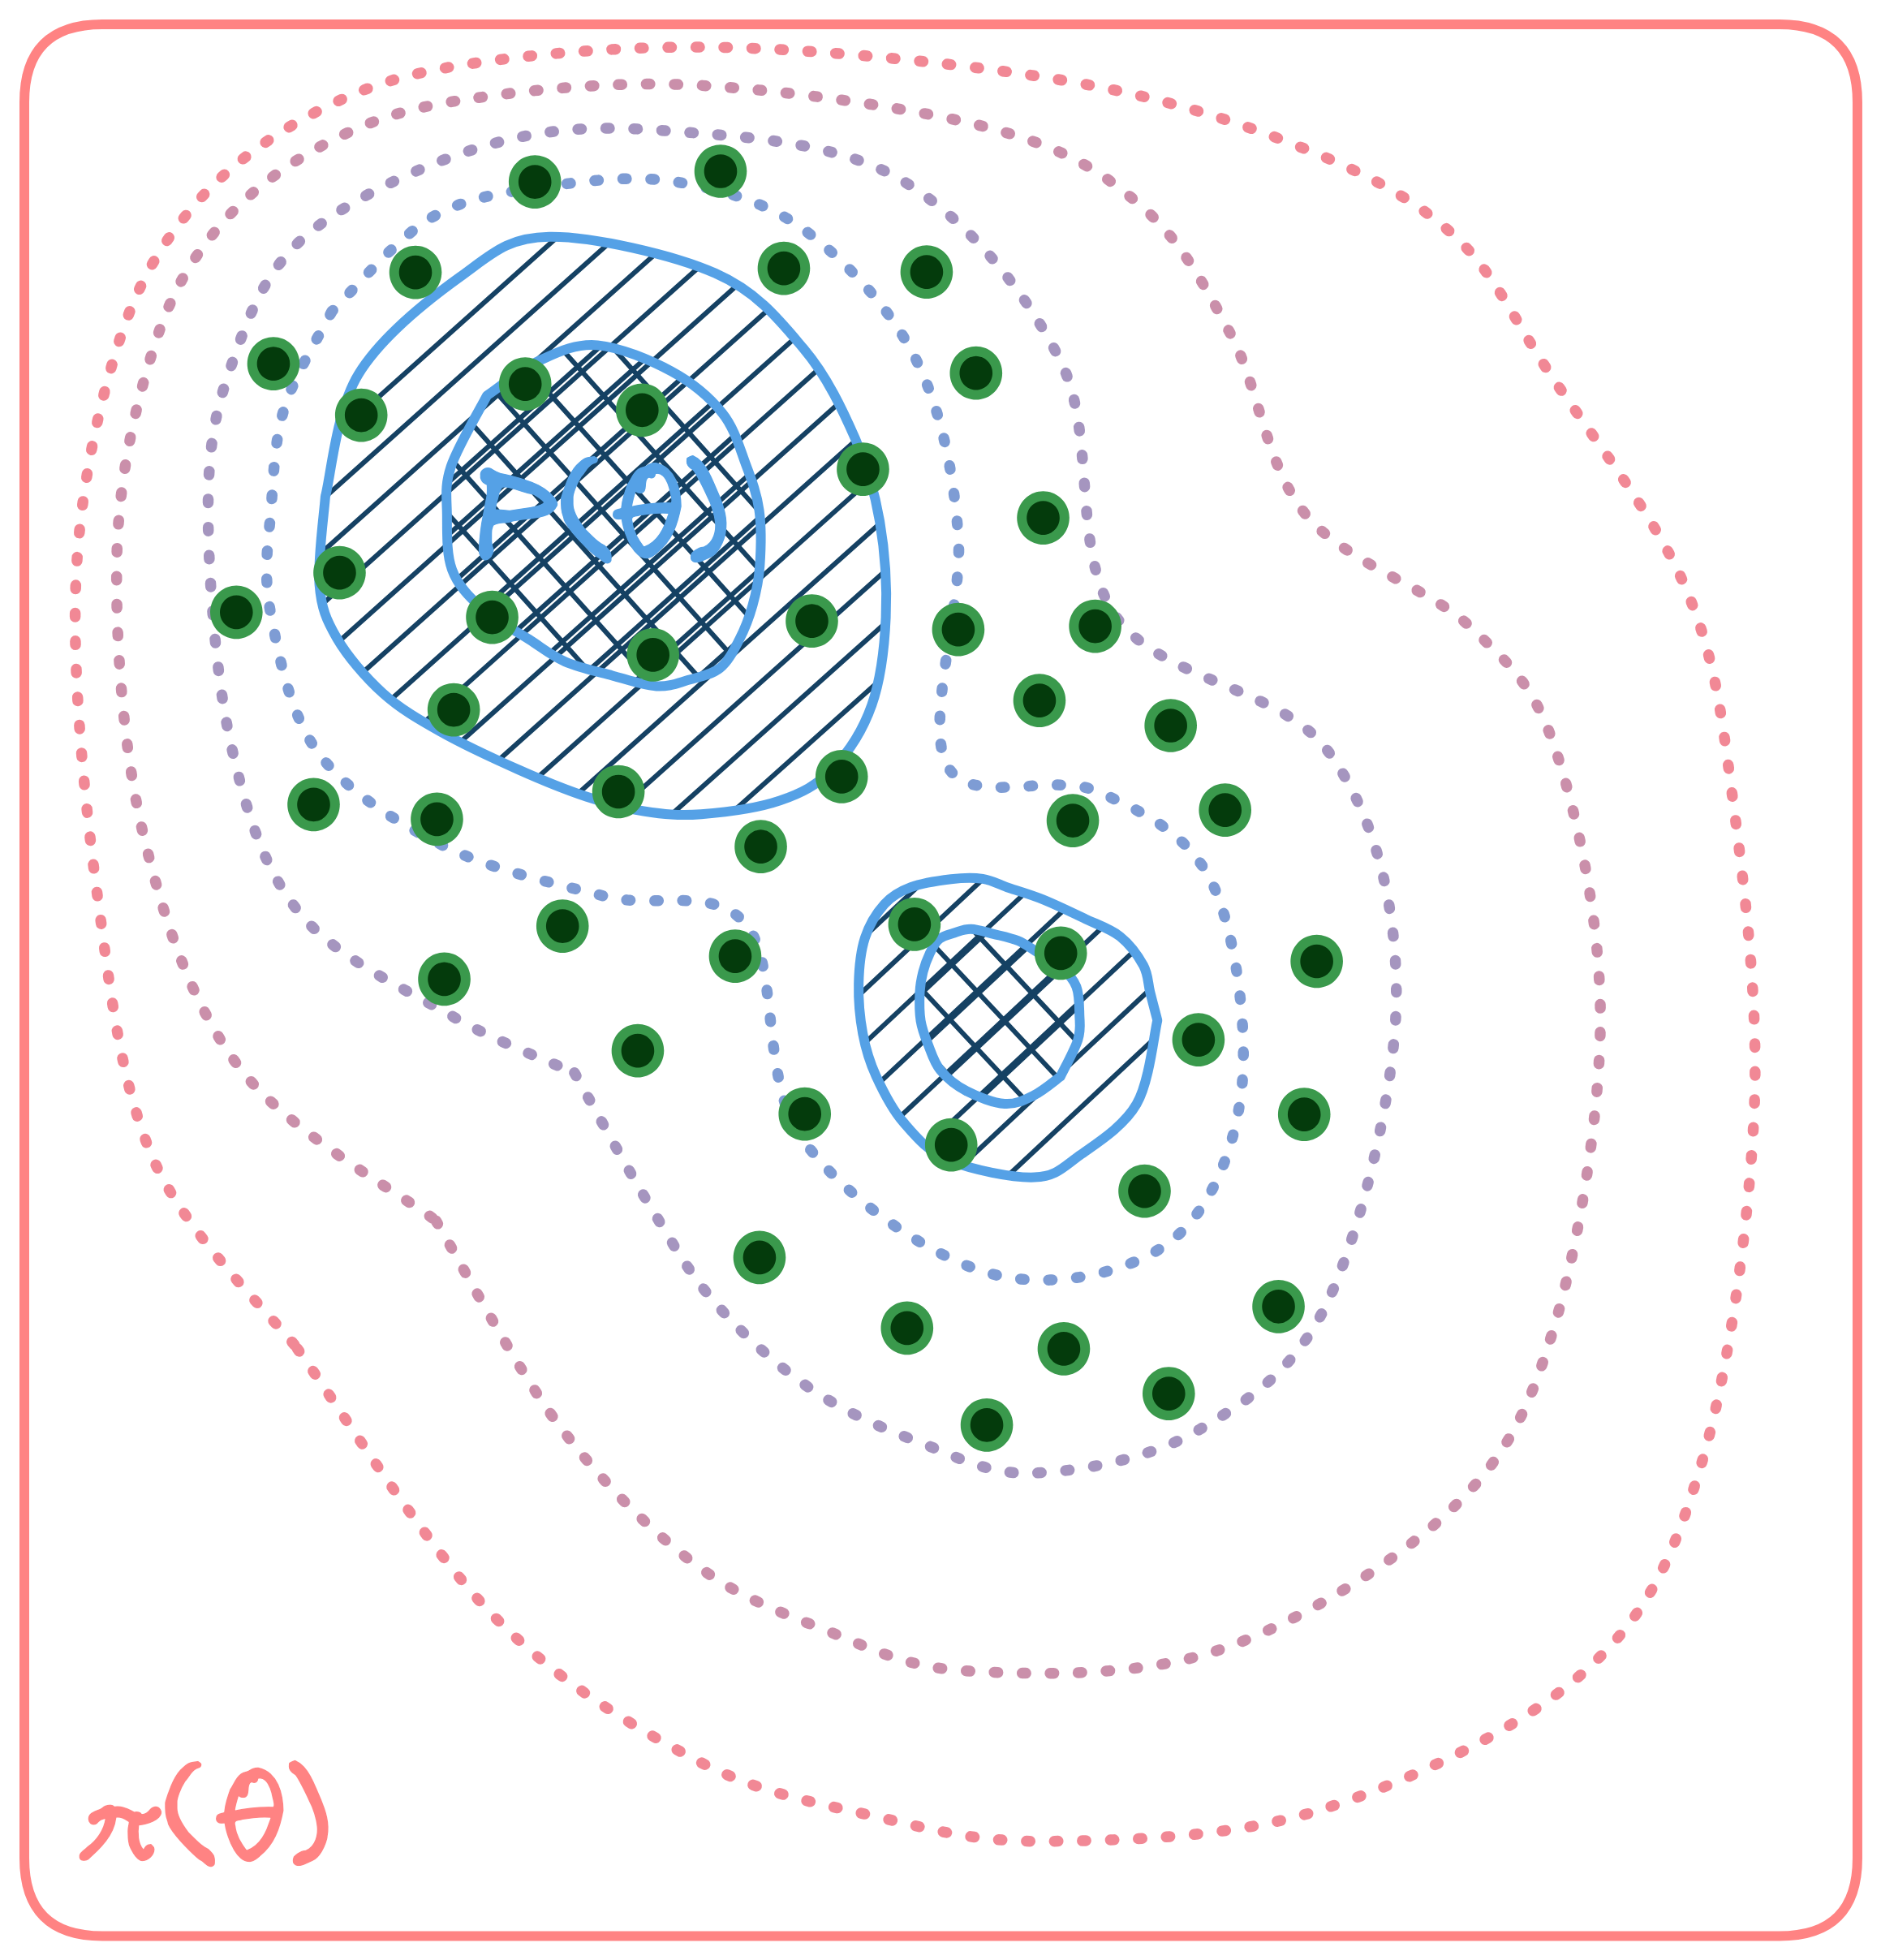
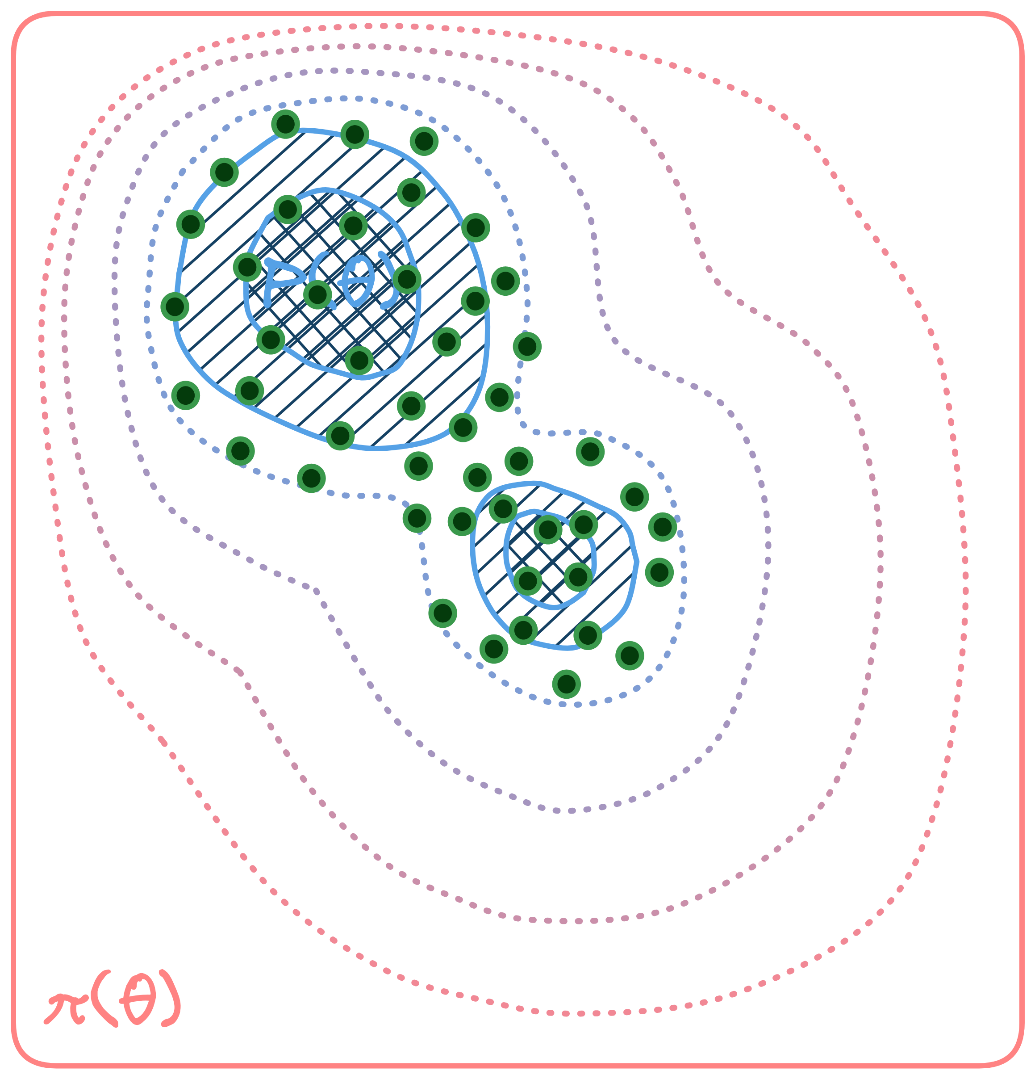
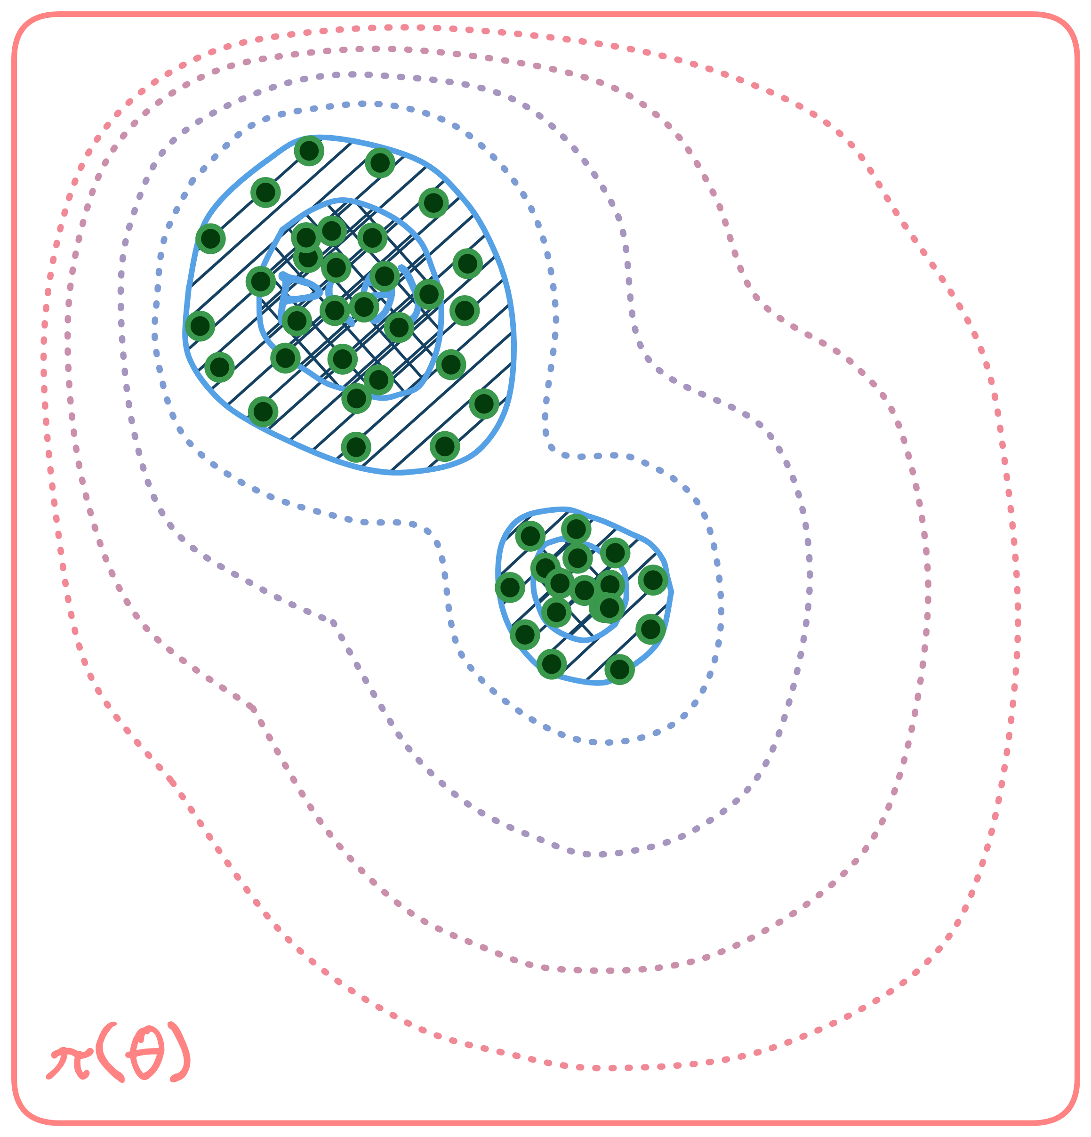
Sequential Monte Carlo (SMC)
$$p_{1}(θ)$$
$$p_{2}(θ)$$
$$p_{3}(θ)$$
$$p_{4}(θ)$$
$$p_{5}(θ)$$
$$p_{6}(θ)$$

Slide 10
Update rules
Reweighting step
$$w_{t}^{i}={ℒ(θ_{t−1}^{i})}^{β_{t}−β_{t−1}}$$
$$𝒵_{t}=𝒵_{t−1}×N^{−1}\sum_{i=1}^{N}{w_{t}^{i}}$$
Resampling step
Moving step

Slide 11
Update rules
Reweighting step
$$w_{t}^{i}={ℒ(θ_{t−1}^{i})}^{β_{t}−β_{t−1}}$$
$$𝒵_{t}=𝒵_{t−1}×N^{−1}\sum_{i=1}^{N}{w_{t}^{i}}$$
Resampling step
Moving step

Slide 12
Update rules
Reweighting step
$$w_{t}^{i}={ℒ(θ_{t−1}^{i})}^{β_{t}−β_{t−1}}$$
$$𝒵_{t}=𝒵_{t−1}×N^{−1}\sum_{i=1}^{N}{w_{t}^{i}}$$
Resampling step
Moving step

Slide 13
Update rules
Reweighting step
$$w_{t}^{i}={ℒ(θ_{t−1}^{i})}^{β_{t}−β_{t−1}}$$
$$𝒵_{t}=𝒵_{t−1}×N^{−1}\sum_{i=1}^{N}{w_{t}^{i}}$$
Resampling step
Moving step

Slide 14
Pros and cons
Advantages
easily parallelizable
non-linear correlations
multimodality
evidence estimation
naturally adaptive
well-defined termination
Disadvantages
high variance
large number of particles
computational cost
particle degeneracy
wasted particles

Slide 15
Persistent Sequential Monte Carlo

Slide 16
Basic idea
$$p_{t−4}(θ)$$
$$p_{t−3}(θ)$$
$$p_{t−2}(θ)$$
$$p_{t−1}(θ)$$
$$p_{t}(θ)$$
SMC
$$⋯$$
PSMC

Slide 17
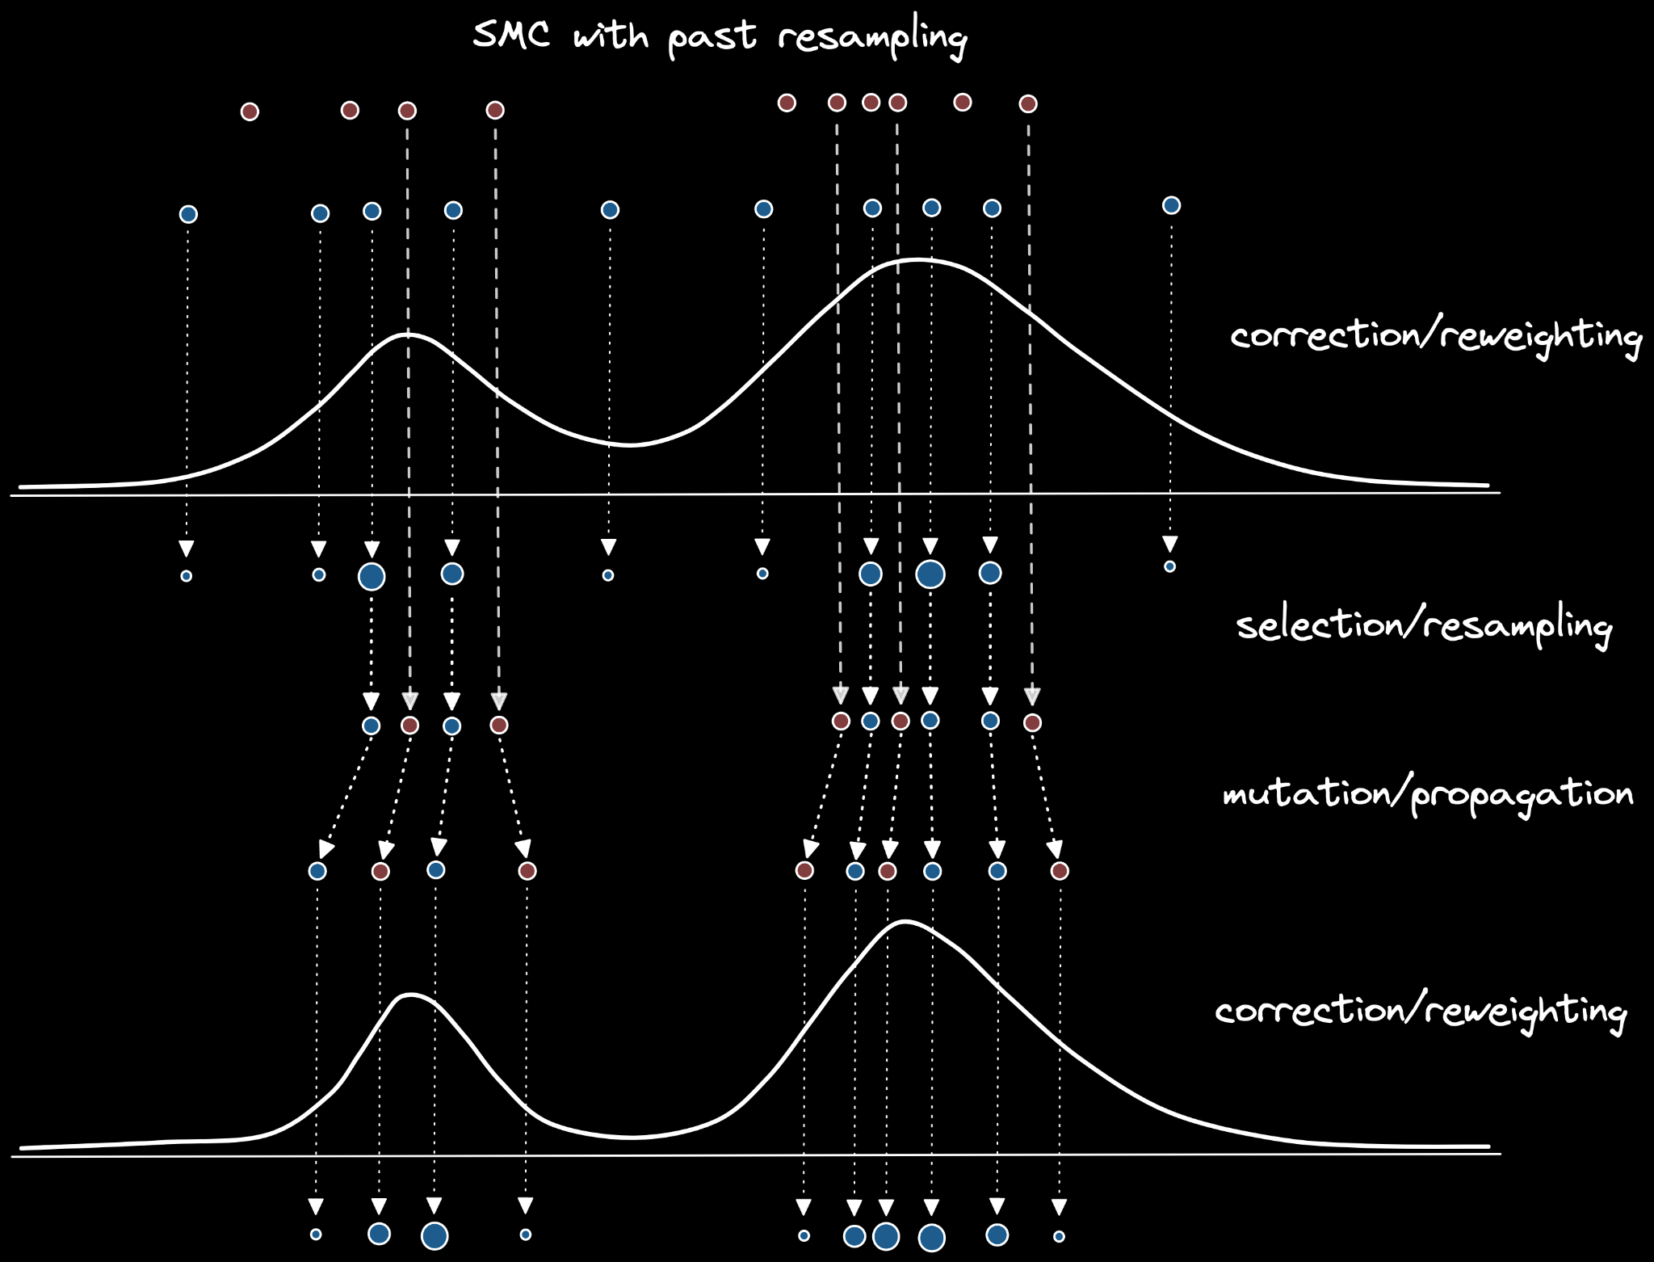
Persistent particles
Allow particles from past iterations to persist.
Advantages:
Since N << N x (t-1), the resampled particles are effectively independent
No copies of the same particles
Higher ESS at no additional computational cost
Superior tail-coverage

Slide 18
Mixtures and persistent particles
$$W_{t}^{i}=\frac{p_{t}(θ_{t−1}^{i})}{p_{t−1}(θ_{t−1}^{i})}=\frac{𝒵_{t−1}}{𝒵_{t}}{ℒ\left(θ_{t−1}^{i}\right)}^{β_{t}−β_{t−1}}$$
$$𝒵_{t}=𝒵_{t−1}\frac{1}{N}\sum_{i=1}^{N}{{ℒ\left(θ_{t−1}^{i}\right)}^{β_{t}−β_{t−1}}}$$
$$W_{tt^{′}}^{i}=\frac{p_{t}(θ_{t^{′}}^{i})}{\frac{1}{t−1}\sum_{s=1}^{t−1}{p_{s}(θ_{t^{′}}^{i})}}=\frac{{ℒ\left(θ_{t^{′}}^{i}\right)}^{β_{t}}/𝒵_{t}}{\frac{1}{t−1}\sum_{s=1}^{t−1}{{ℒ\left(θ_{t^{′}}^{i}\right)}^{β_{s}}/𝒵_{s}}}$$
$$for t^{′}=1,⋯,t−1$$
$$𝒵_{t}=\frac{1}{t−1}\sum_{t^{′}=1}^{t−1}{\left(\frac{1}{N}\sum_{i=1}^{N}{\frac{{ℒ\left(θ_{t^{′}}^{i}\right)}^{β_{t}}}{\frac{1}{t−1}\sum_{s=1}^{t−1}{{ℒ\left(θ_{t^{′}}^{i}\right)}^{β_{s}}/𝒵_{s}}}}\right)}$$
$$p_{t−4}(θ)$$
$$p_{t−3}(θ)$$
$$p_{t−2}(θ)$$
$$p_{t−1}(θ)$$
$$p_{t}(θ)$$

Slide 19
Preconditioned Monte Carlo

Slide 20
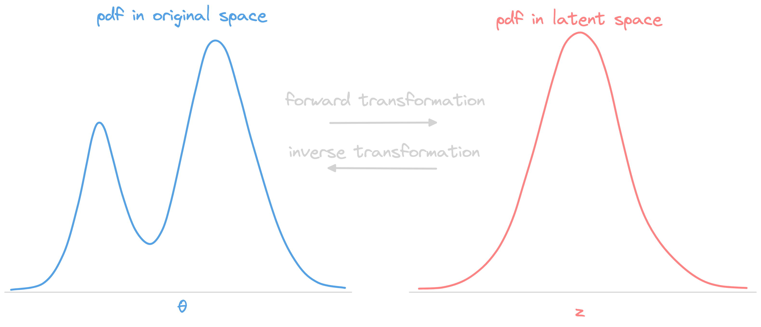
Normalizing flows
$$z=f(θ)$$
$$θ=f^{−1}(z)$$
$$p_{z}\left(z\right)=p_{θ}\left(f^{−1}(z)\right)\left|det\frac{∂f^{−1}\left(z\right)}{∂z}\right|$$

Slide 21
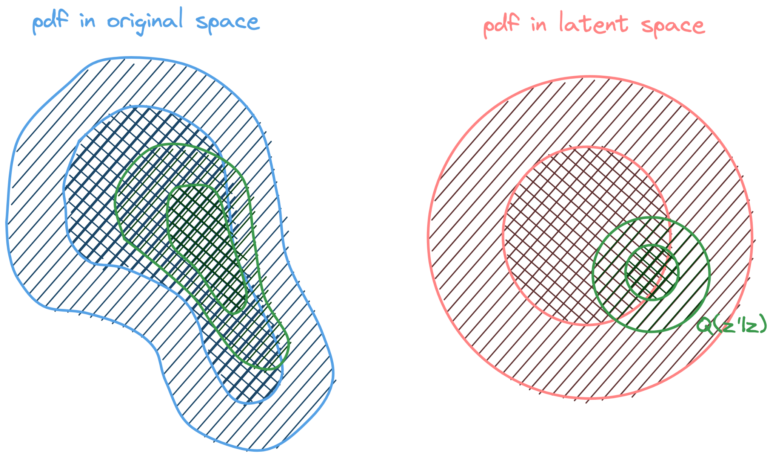
Normalizing flow preconditioning

Slide 22
Preconditioned Crank-Nicolson
Random-walk Metropolis
new state
noise
$$θ^{′}←θ+υ$$
current state
Preconditioned Crank-Nicolson
new state
rescaled noise
$$θ^{′}←\sqrt{1−ε^{2}} θ+ε υ$$
step size
current state
shifted toward mode
$$0< ε<1$$

Slide 23
RWM vs. pCN
Random-walk Metropolis
Preconditioned Crank-Nicolson
 | RWM | pCN
Target
Proposal
Acceptance

Slide 24
pCN in latent space
Challenge: Standard pCN requires a normal prior and a weak likelihood.
Solution: Apply pCN in the latent space of the preconditioning transform z = f(θ).
Target
Proposal
where
Acceptance
where

Slide 25
PMC
=
SMC + RWM

Slide 26
PMC
=
SMC + RWM
PSMC
pCN

Slide 27
Examples

Slide 28
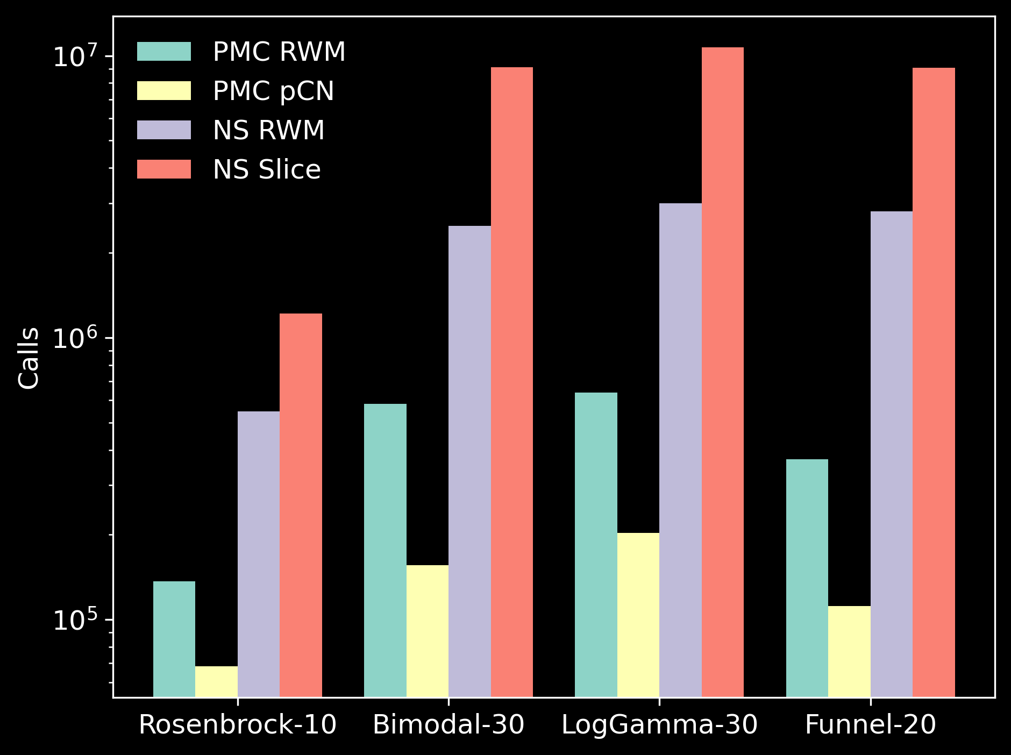
Computational cost benchmark

Slide 29
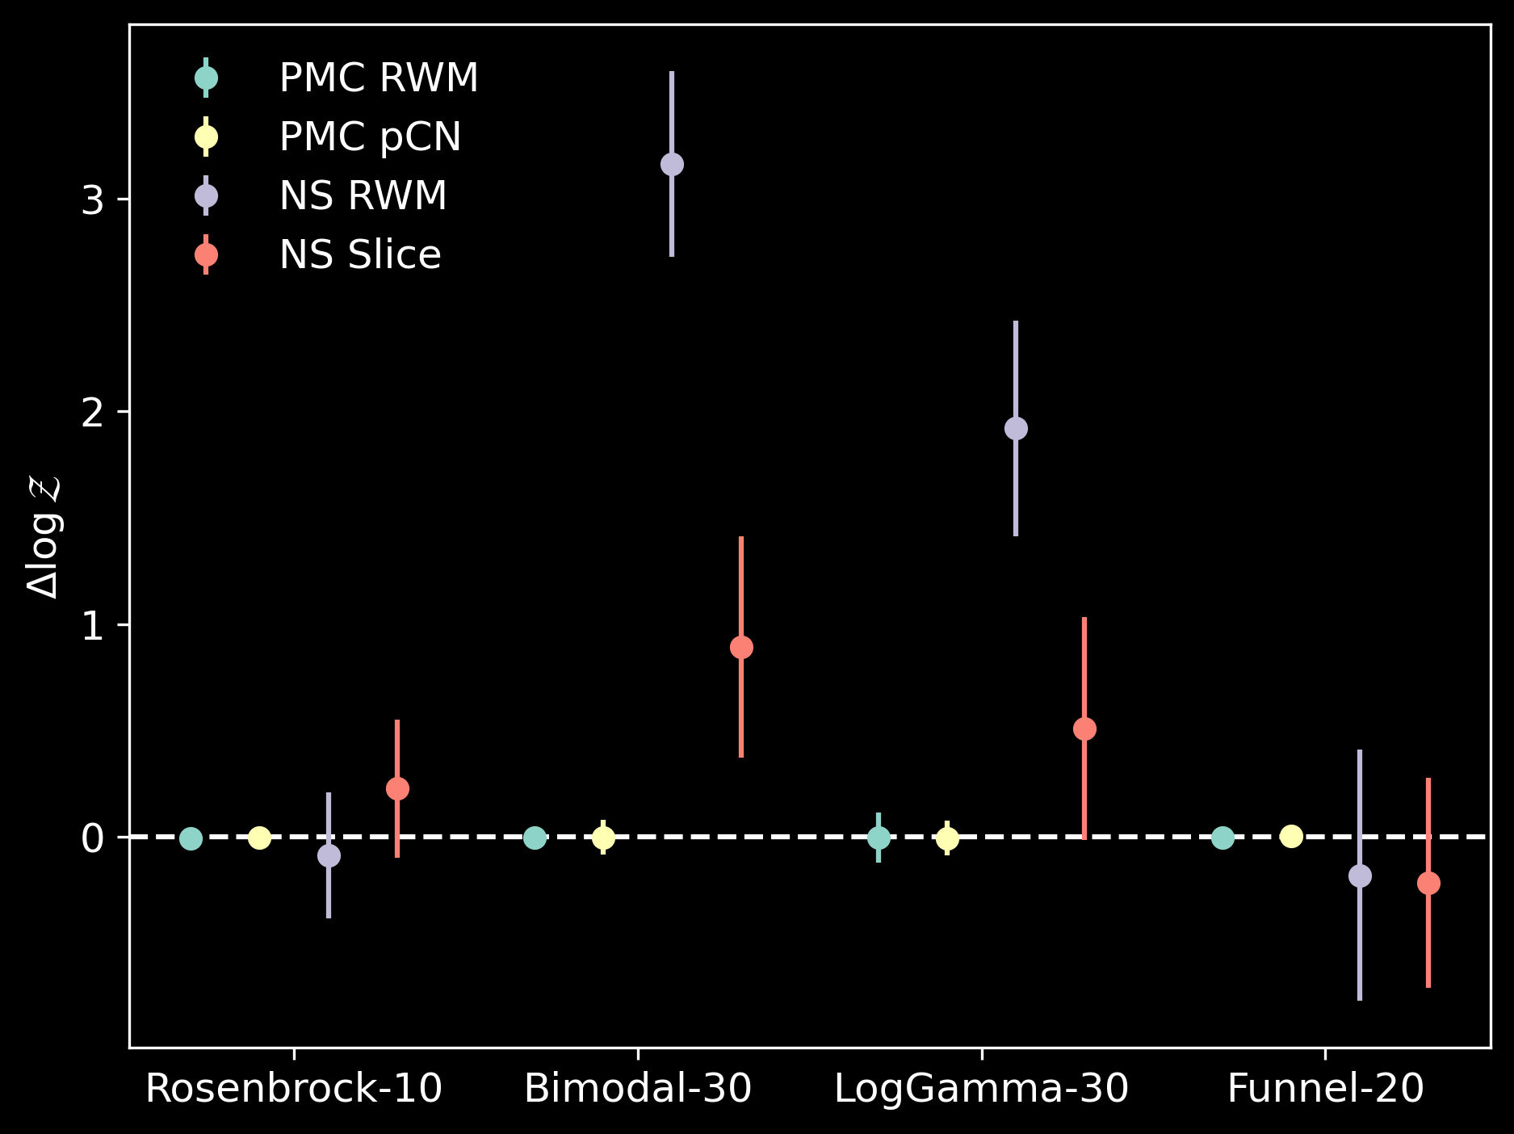
Model evidence benchmark

Slide 30
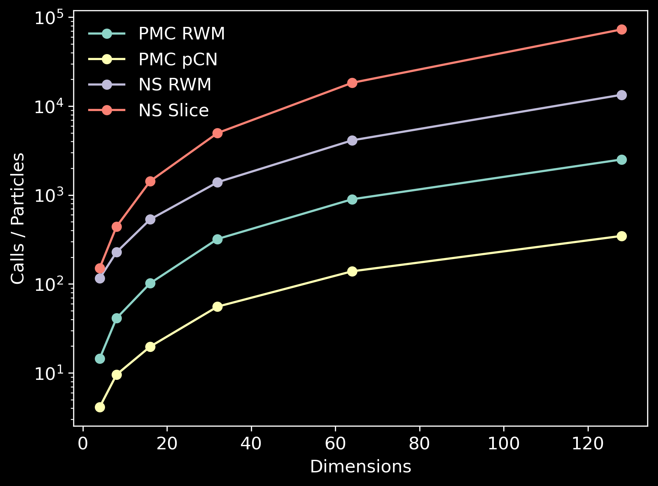
Computational cost scaling

Slide 31
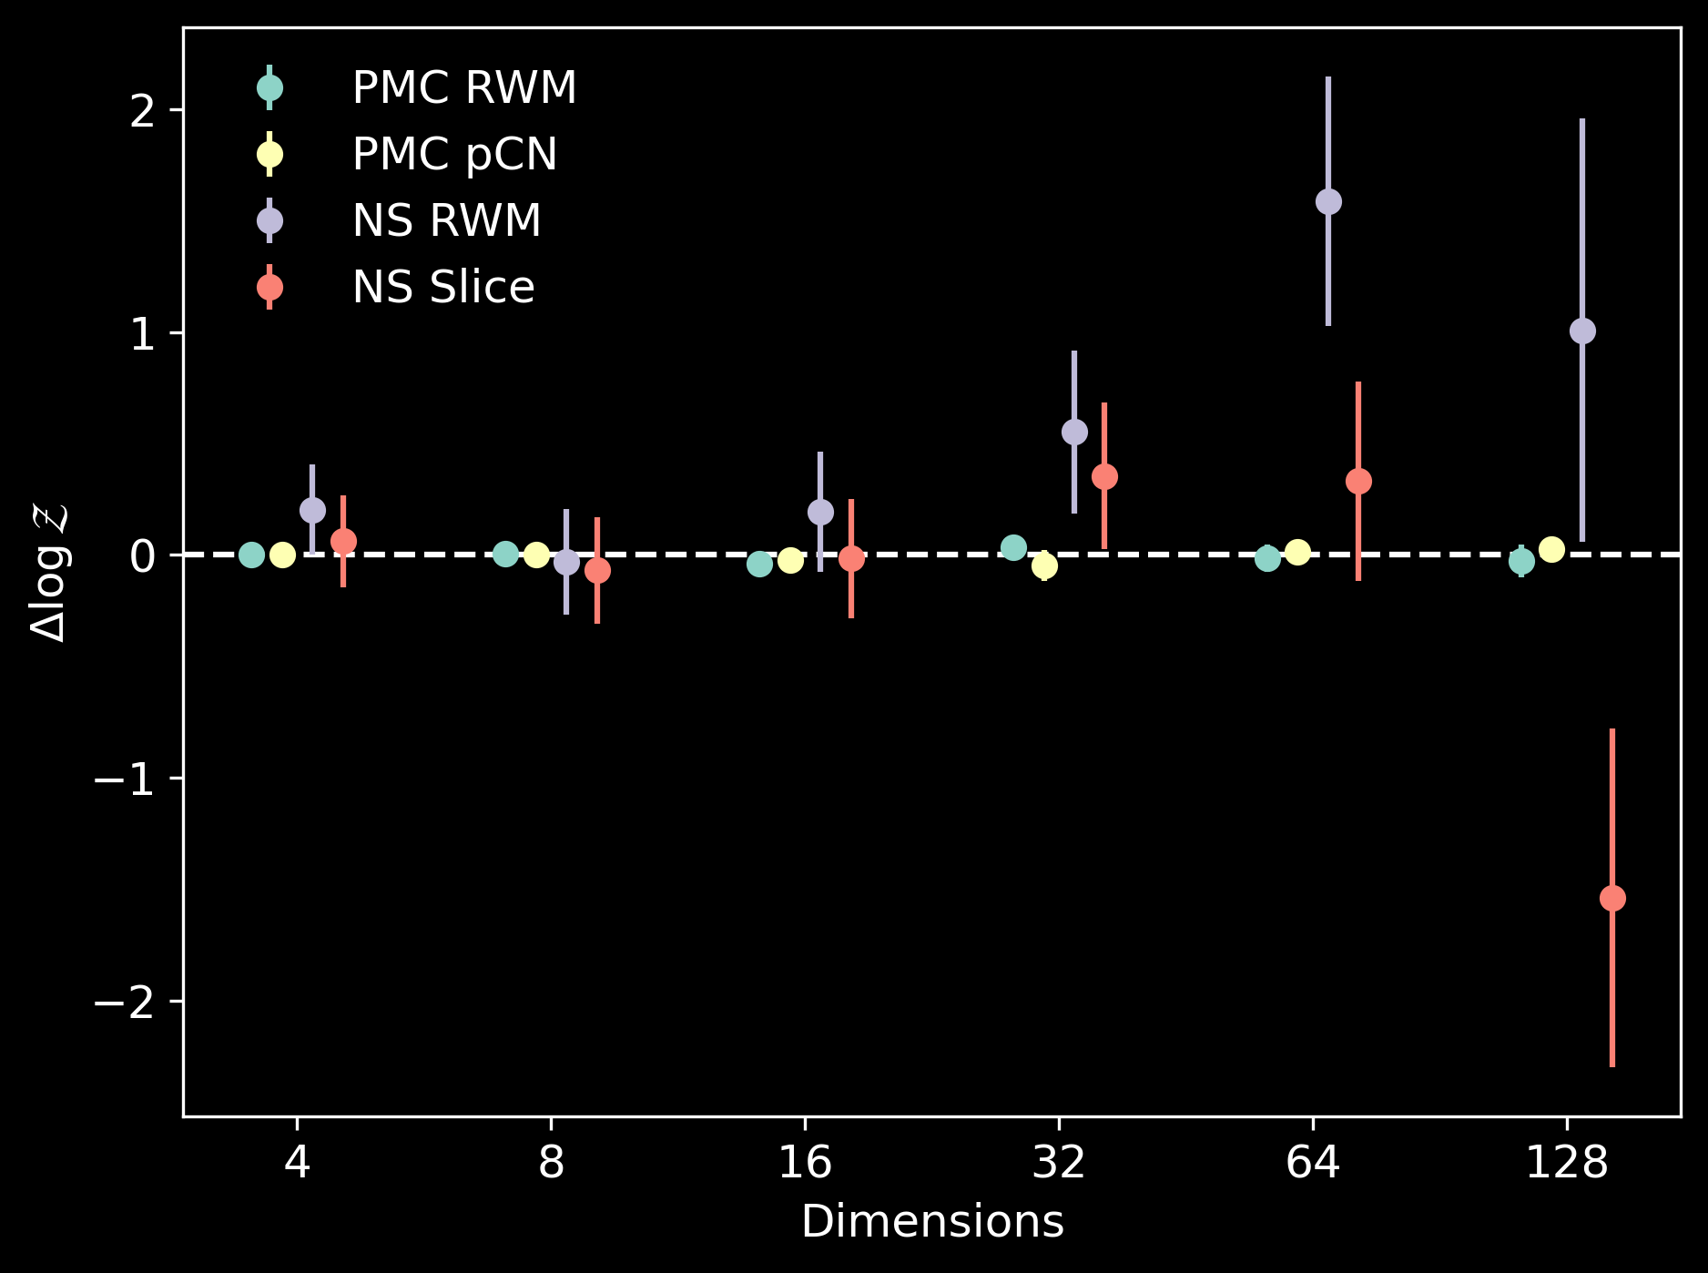
Model evidence scaling

Slide 32
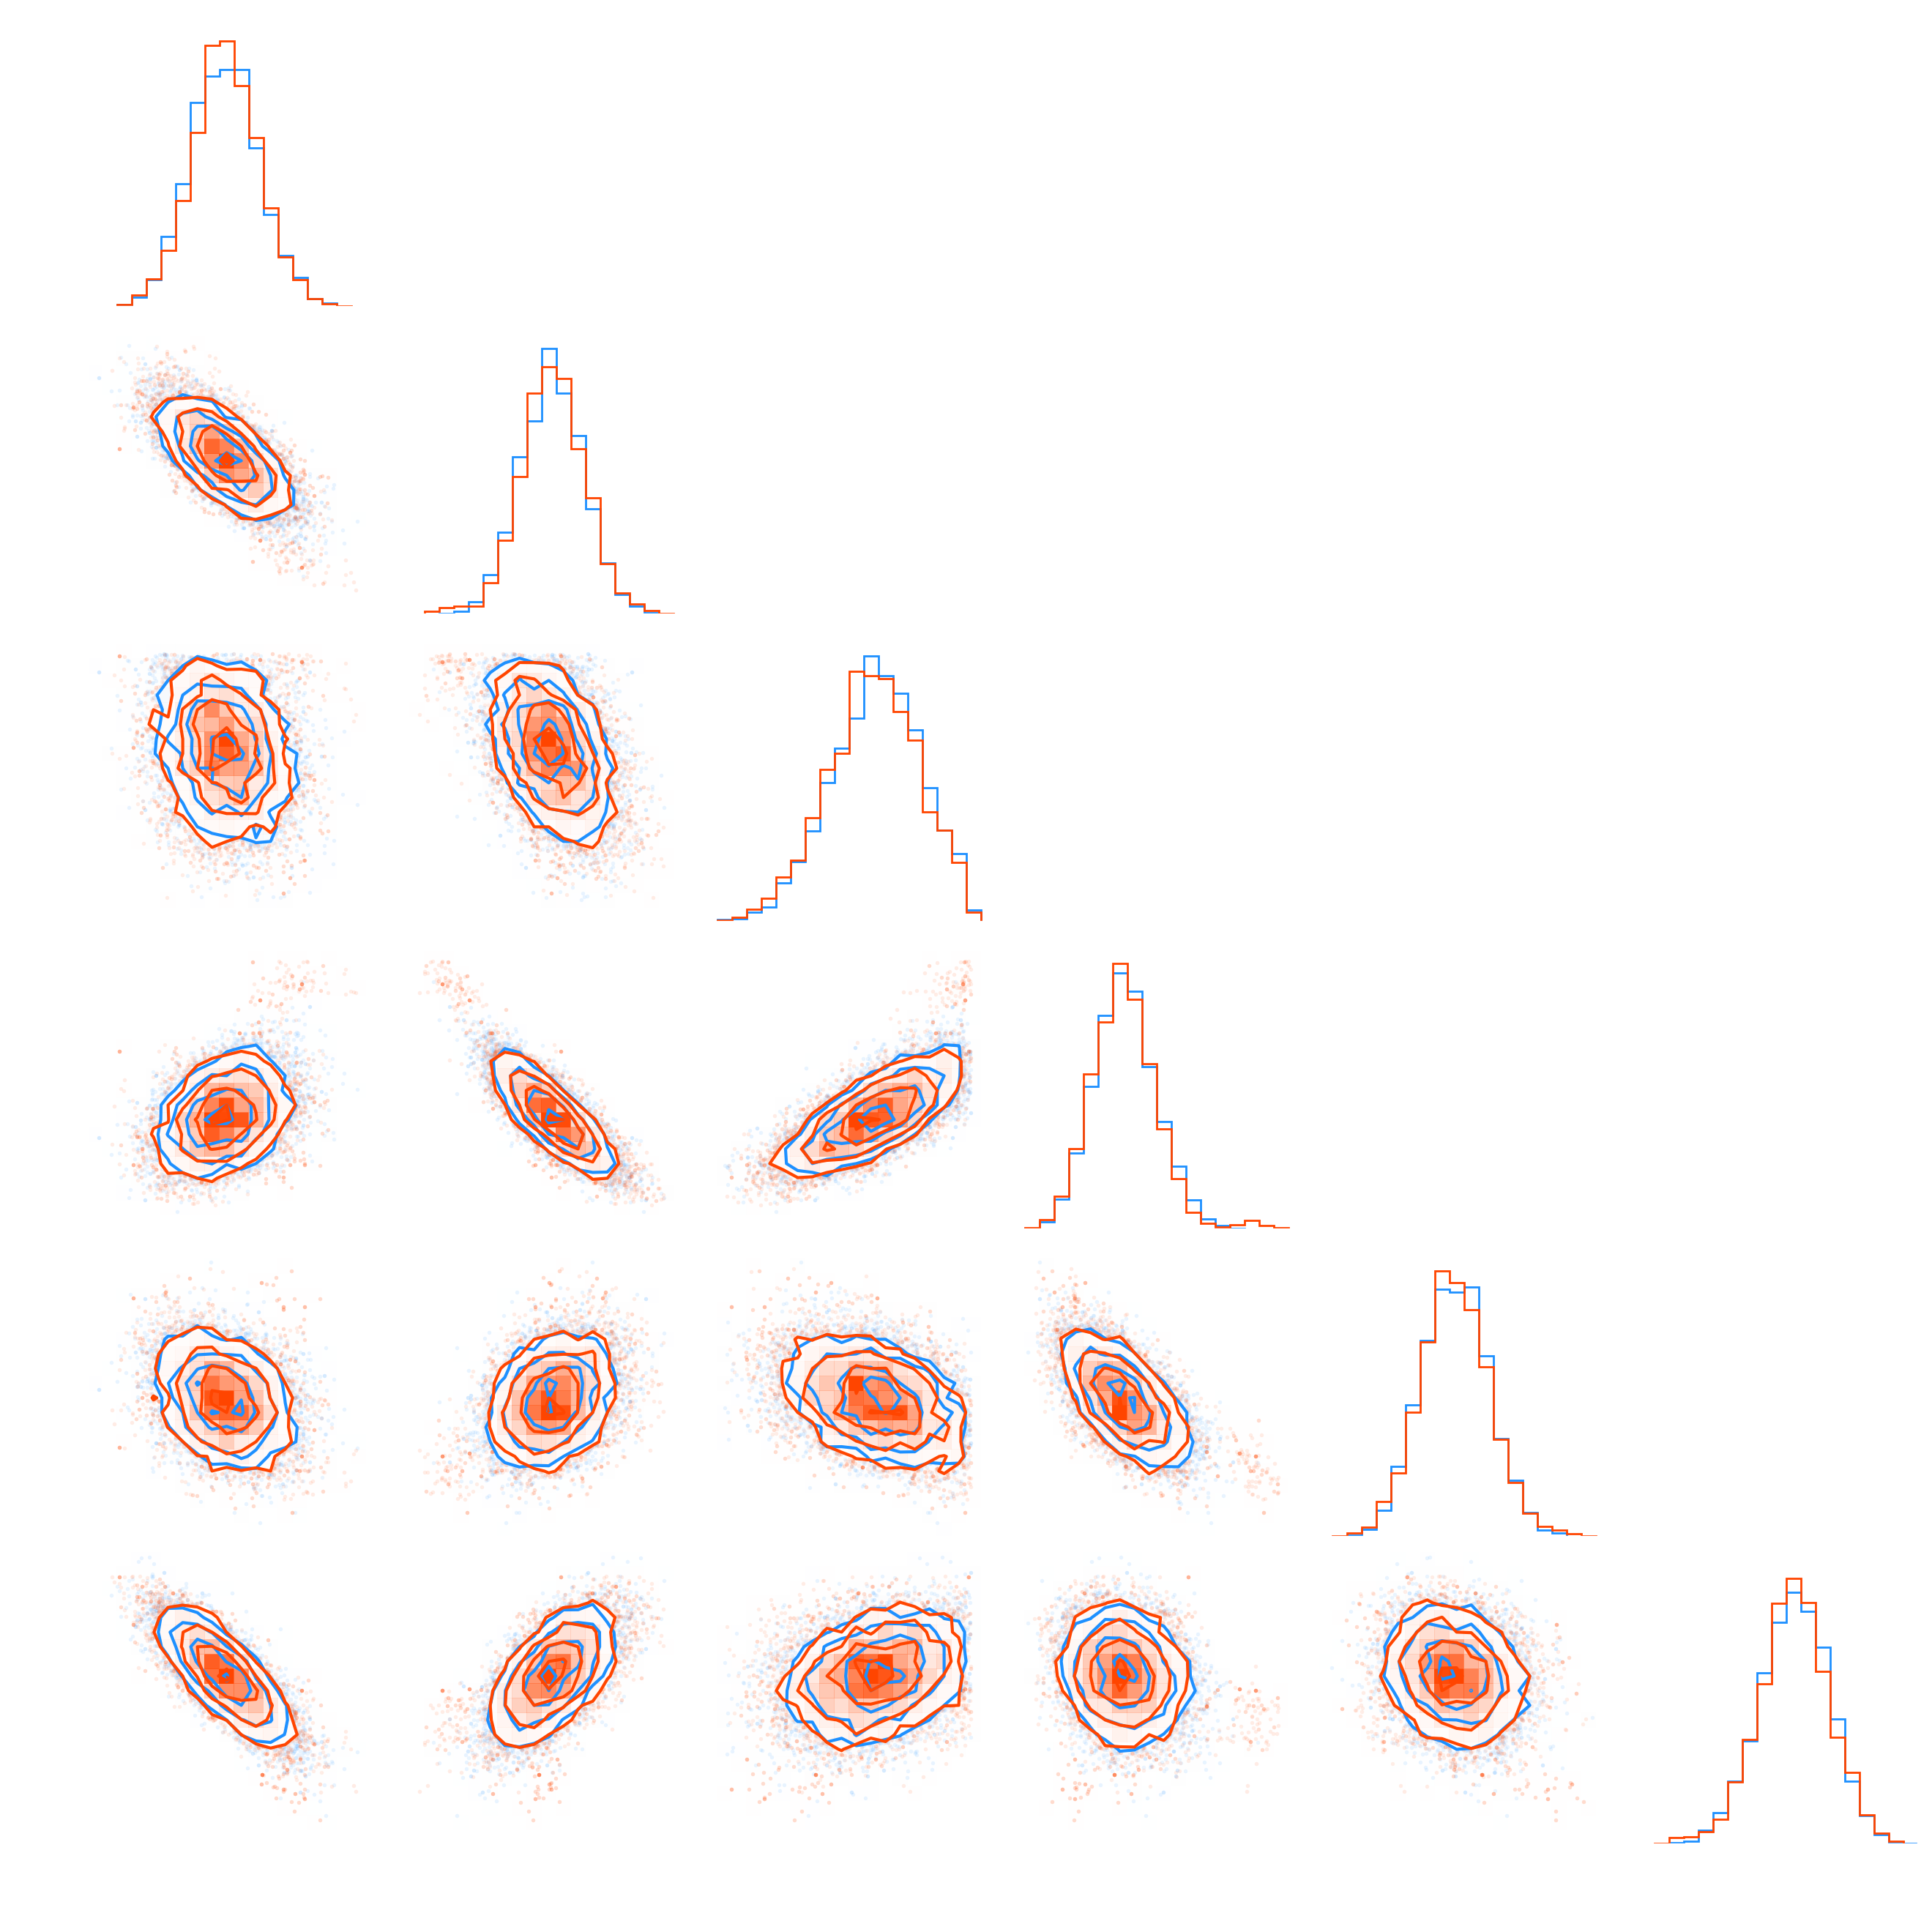
DES Y1 3x2pt
Preliminary results (target ESS: 10⁴)
- Metropolis-Hastings ~ 40 h
- No U-Turn Sampler (NUTS) ~ 4.5 h
- PMC ~ 20 min

Slide 33
Relation to Nested Sampling

Slide 34
Nested sampling as PSMC
 | Temperature annealing | Energy annealing
Targets | $$p_{t}\left(θ\right)=ℒ^{β_{t}}(θ)π(θ)/𝒵_{t}$$ | $$p_{t}\left(θ\right)=π\left(θ\right)𝕀\left\{ℒ\left(θ\right)>ℓ_{t}\right\}/𝒬_{t}$$
Levels | $$0=β_{1}<⋯<β_{t}<⋯<β_{T}=1$$ | $$0=ℓ_{1}<⋯<ℓ_{t}<⋯<ℓ_{T}=+∞$$
Advantages over standard NS
Well-defined termination
Pure Monte Carlo
Unbiased
No independence requirement
Riemann integral
Lebesgue integral

Slide 35
Software

Slide 37
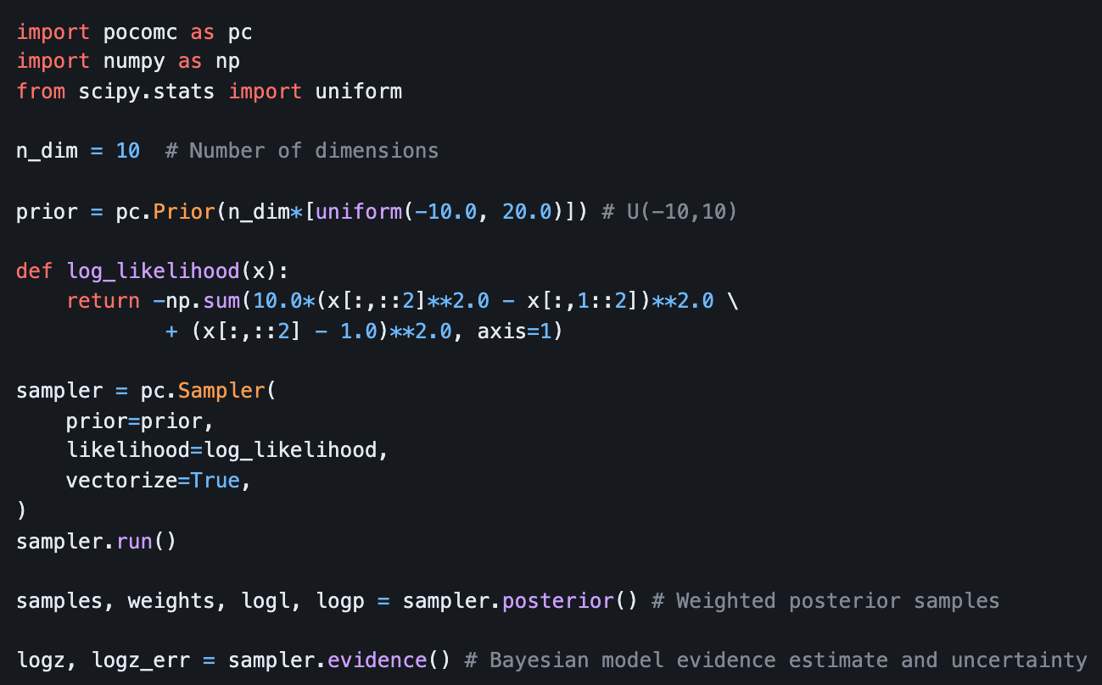

Slide 38
Take-home message
Sampling complex/multimodal posteriors and estimating their evidence in moderate-to-high dimensions is now feasible, both efficiently and without gradients.

