Slide 1
babyMOSS FTBF test beam status update
Tucker Hwang, Danush Shekar, Zhenyu Ye
EIC/RNC meeting
21 May 2024

Slide 2
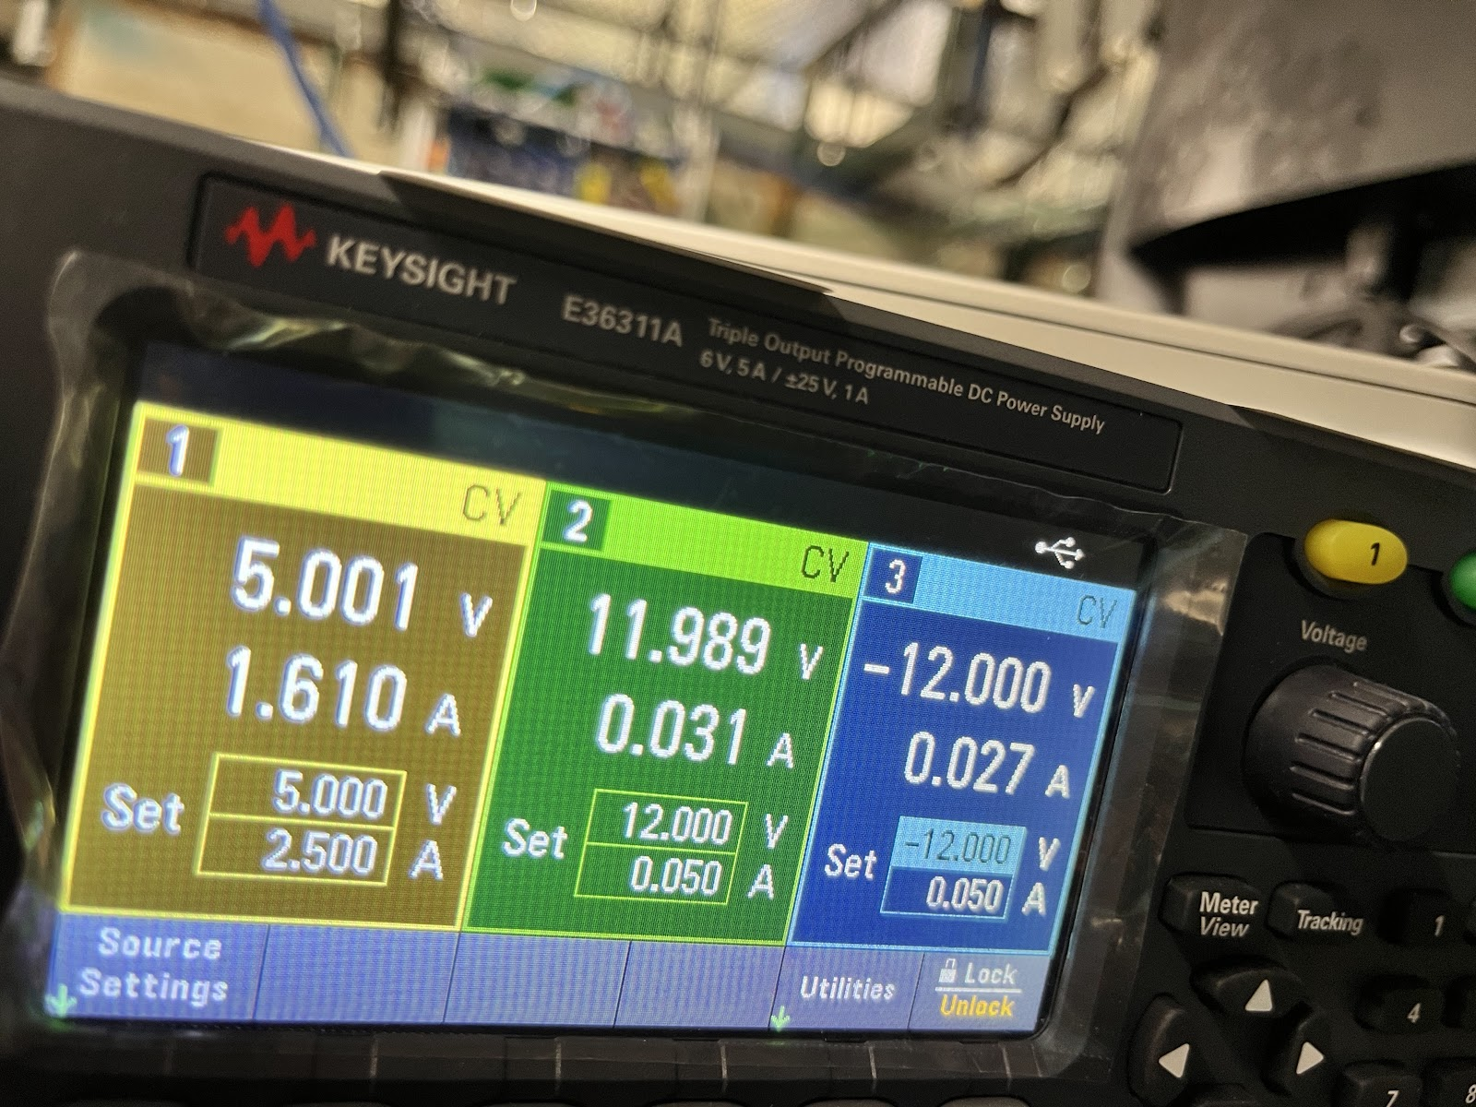
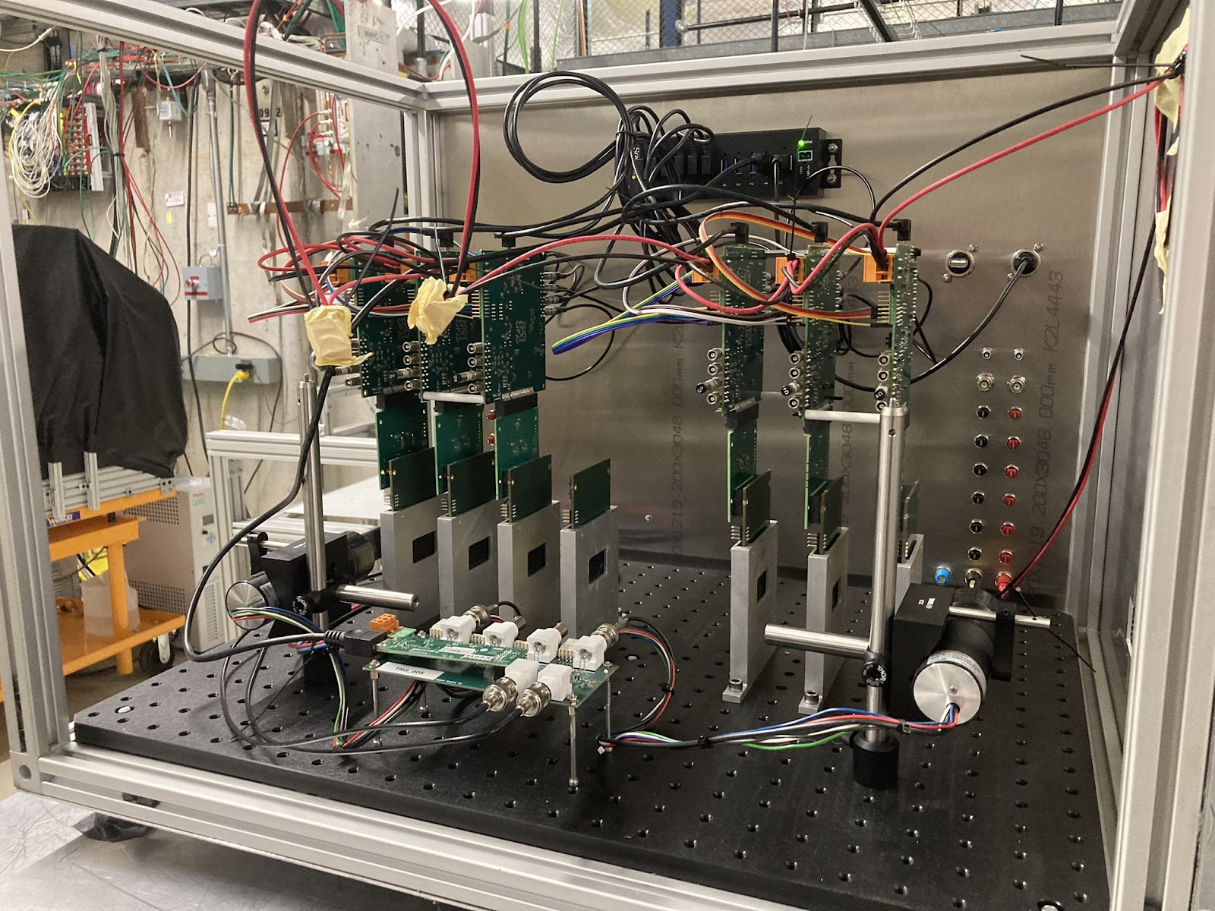
Completed items
Full physical setup of beam telescope box complete
Rough alignment of box + scintillators completed with laser system out-of-beam
Remote control/monitoring for power supplies, moving table, DAQ computer confirmed
Safety check complete
Installation ready for data-taking
Standalone FW→SW→DAQ ready
Resolved ssh connectivity issues from over the weekend
EUDAQ installed but not integrated, Corryvreckan more difficult

Slide 3
Plans for the next week
Beam turns on Tuesday 5/21 morning, reaching FTBF by Tuesday night/Wednesday morning
Possibility of some beam overnight on Tuesday (if primary user decides)
ORC (not us) scheduled for Wednesday 1pm, installation of other setups that morning
On an ideal schedule:
Confirm alignment with hitmaps overnight Tuesday (beamspot on R2/3), make modifications as necessary
Start data-taking Wednesday night
Data-taking
Efficiency, spatial resolution vs. VCASB (threshold), all other settings at default
FHR vs. VCASB out-of-beam, all other settings at default?
Also works as stress test
Add new plane after BASE test: cluster size over incident angle at default settings

Slide 4
CERN beam test: Apr 2024
Adapting cosmics data analysis code for beam
3 planes → 4 planes, spaced 1 inch apart
Our telescope has 6 planes
Stress testing the alignment procedure
Why not Corryvreckan?
Has lots of capability + widespread use + fast + out of the box!
(baby)MOSS has non-uniform pixel pitch, but reference arms in Corry require uniform pitch/resolution
May be possible to focus the beam on one region+HU? Or only select tracks in the same HU
Latter would require some pre-processing; former consideration of beam spot size

Slide 6
Alignment procedure
Find midpoints from 4 layers pairwise, then connect with line
Produces a “average track”
Collect residuals in given DUT layer (e.g. 0)
Attach cut to remove bad fits (e.g. for layer 0, -0.05 < x < -0.01)
Send cleaned hit data to alignment algorithm
MIGRAD minimizes sum of square of residuals in X, Y over all tracks
16 free parameters: rotation in XY, shifts in X, Y, Z for each layer
Possibly reduce this to 12?
With new alignment values, recalculate residuals in X and Y (true hits minus average track) for all tracks

Slide 7
