Slide 1
babyMOSS FTBF test beam status
Tucker Hwang, Danush Shekar, Zhenyu Ye
EIC/RNC meeting
4 June 2024

Slide 2
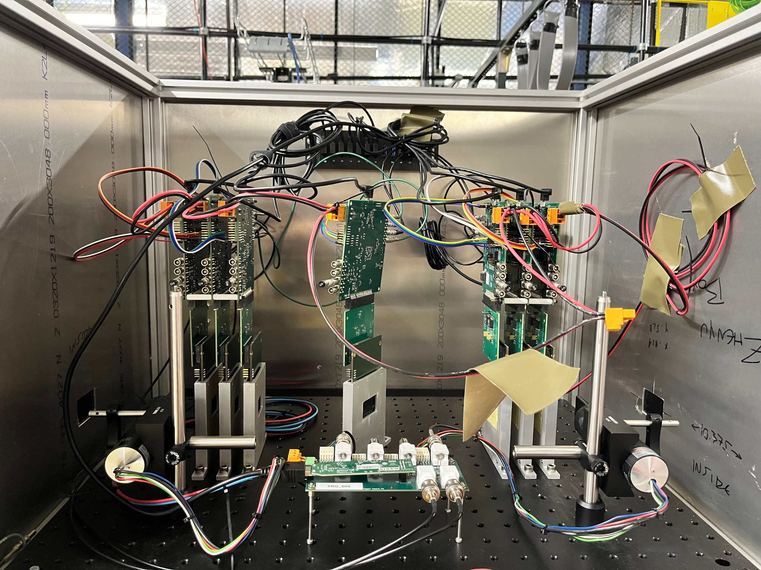
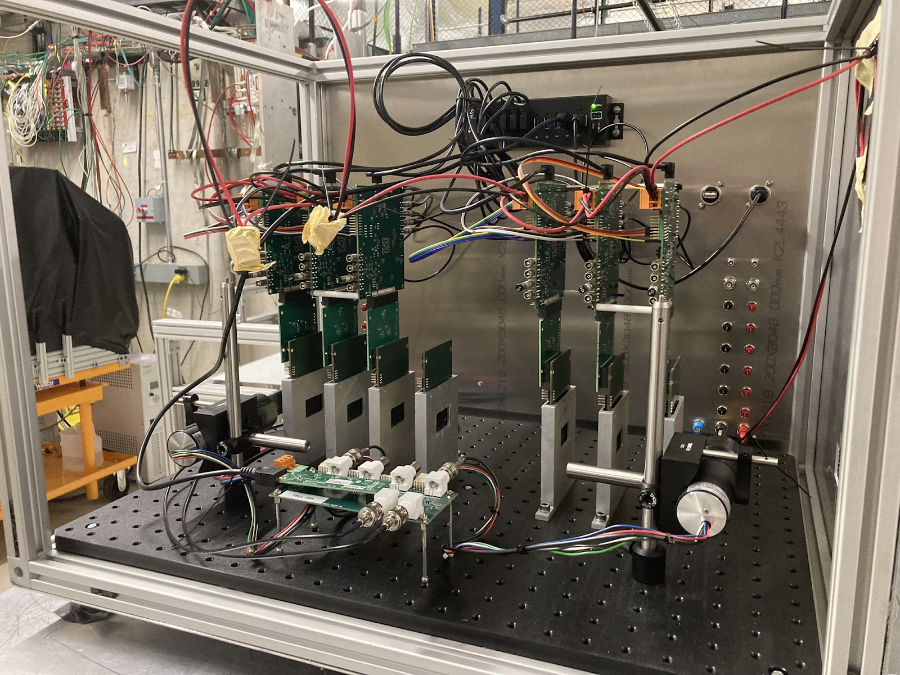
FTBF telescope

Slide 3
Studies for this beam test
Non-DUT planes fixed at VCASB=15 DAC:
Efficiency as function of VCASB, angle
Spatial resolution vs. VCASB, angle
Cluster size vs. VCASB, angle
FHR vs. VCASB (out of beam, all VCASB set to scan value)
N.B. VCASB ↑ = pixel threshold ↓
VCASB in DAC units, conversion to e⁻

Slide 4
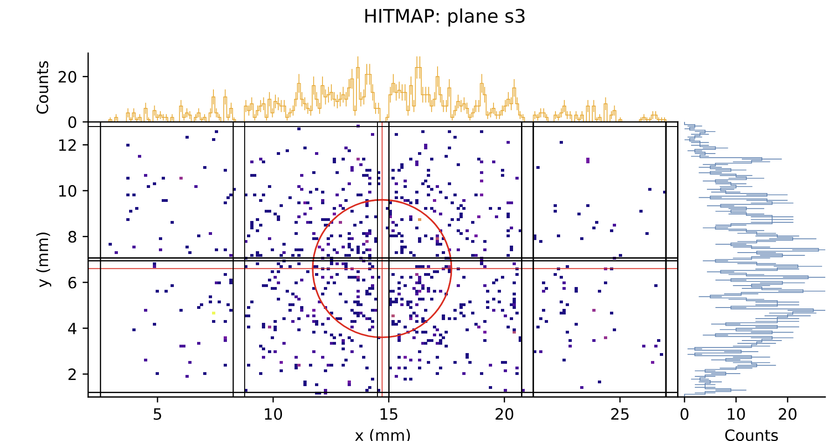
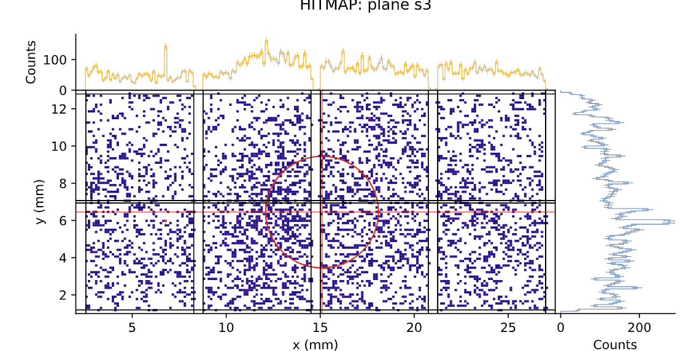
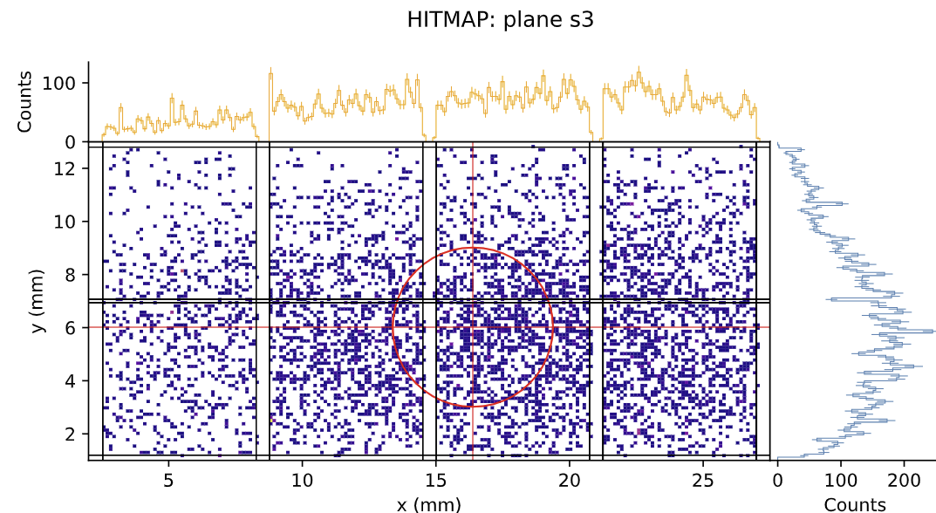
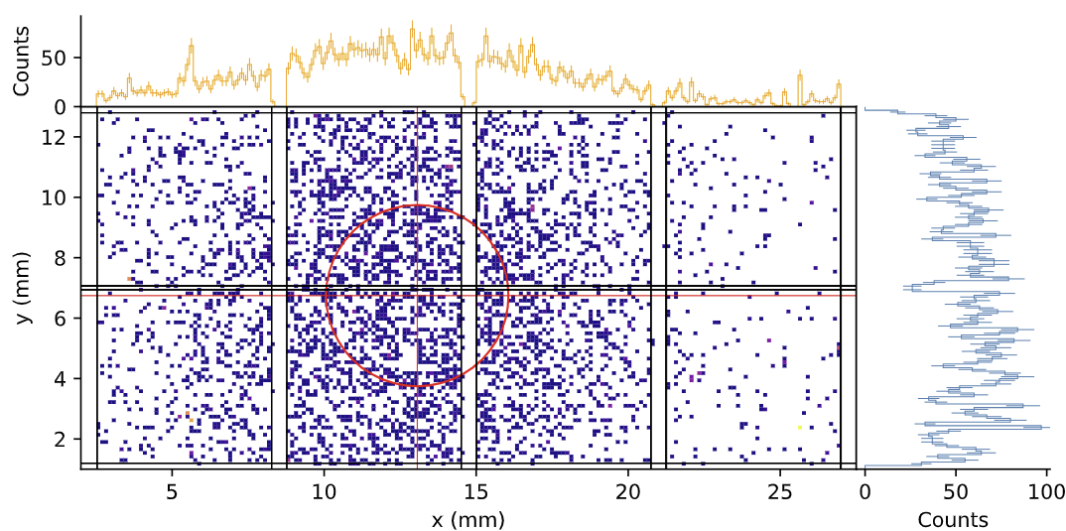
60 deg
15 deg
90 deg
30 deg

Slide 5
Alignment
“Garbage in, garbage out”
We want clean, “real particle” tracks to use for alignment
Sources of contamination: noise hit(s) accompanying real hit(s) + only noise hit(s) on some layer
Reduce “noise tracks” with event selection:
Require: exactly 1 hit/layer, apply cuts on residuals with linear fit
Calculating residuals on unaligned hits:
Replaced averaging method with SVD-based orthogonal regression fit to hit on each layer (7 total)
Minimal reduction in calculation speed in alignment/resolution studies
Possible Numba acceleration? To be investigated
Collect residuals in each layer
Apply cut to remove tracks with noise hits (e.g. for layer 0, -0.05 < x < -0.01)
No direct metric from SVD fit: cut on orthogonal distance to hits could work
Send cleaned hit data to alignment algorithm:
Minuit minimizes sum of square of residuals in X, Y over all planes over all tracks
Without plane rotation: 28 free parameters: rotation in XY, shifts in X, Y, Z for each layer
With plane rotation: XY rotation; XZ rotation; X, Y, Z shift; X-Z rot. center (2) = 49 free parameters (42 with one plane fixed)
Recalculate hit positions in each plane with new parameters

Slide 6
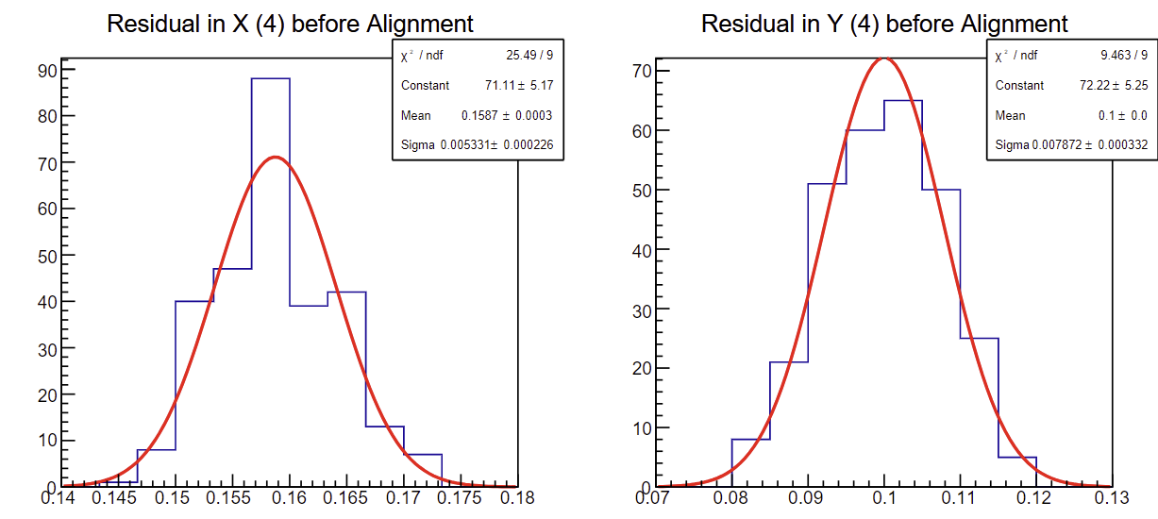
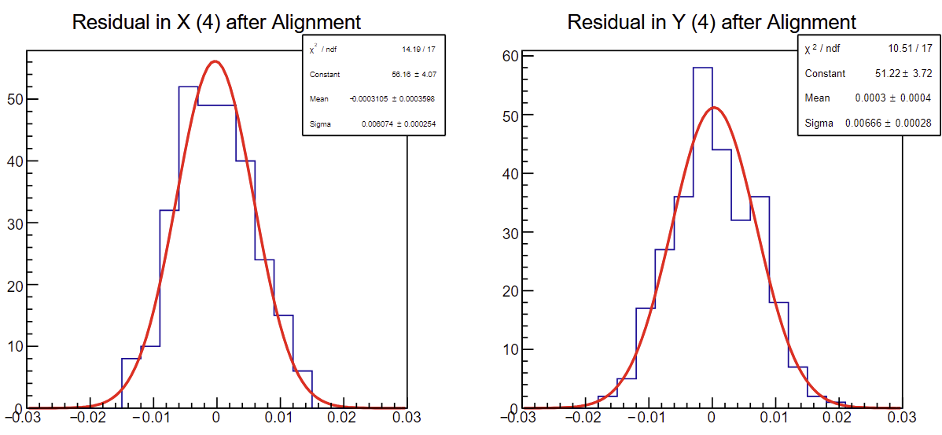
Resolution
Designate one plane as DUT, others as reference arms
Require tracks to have exactly 1 hit/layer, with wider residual cuts than in alignment
SVD fit to 6 non-DUT planes; residuals in X, Y in DUT
Sanity check for alignment: are residuals centered near zero?
Residuals std. dev. around 6-7.5 μm, translates to ~5.5-7 μm resolution
VCASB=15 all planes
All other settings default
90° angle

Slide 7
From Danush Shekar

Slide 8
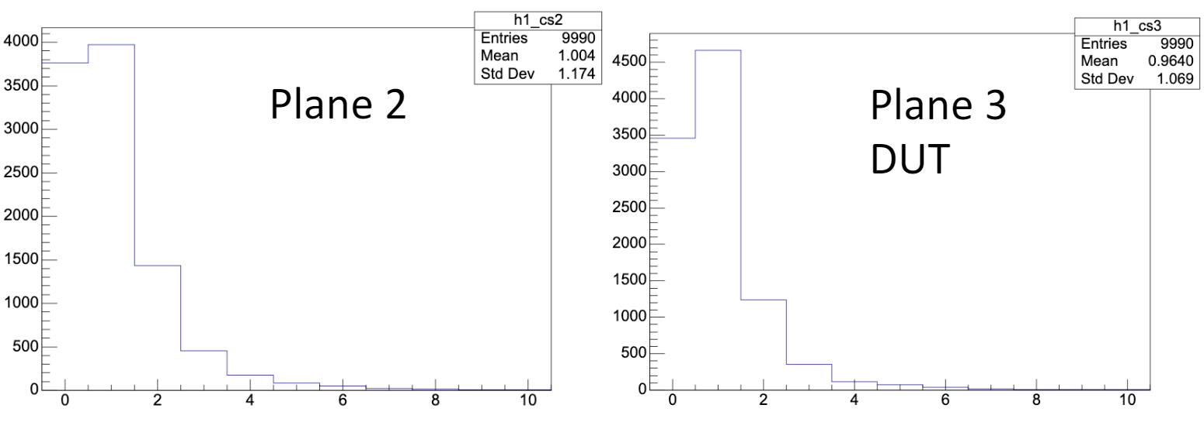
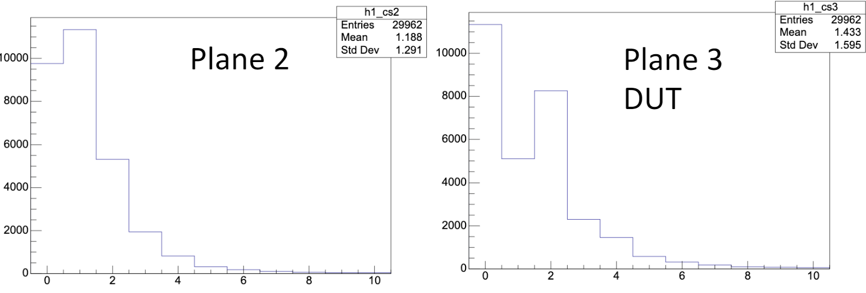
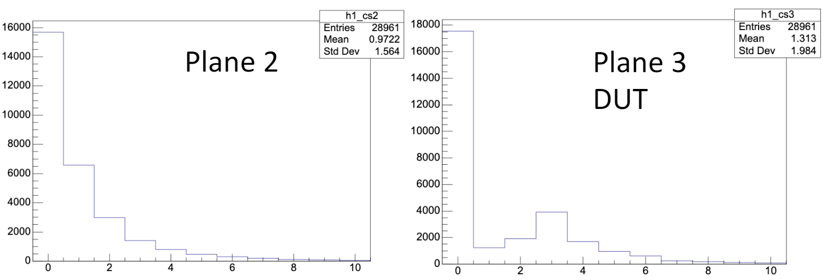
Hits per event per plane vs. angle
VCASB=15 for ref. arms, 10 for DUT
Definitive trend to higher cluster size at steeper incident angle
30 deg.
90 deg.
15 deg.
From Danush Shekar

Slide 9
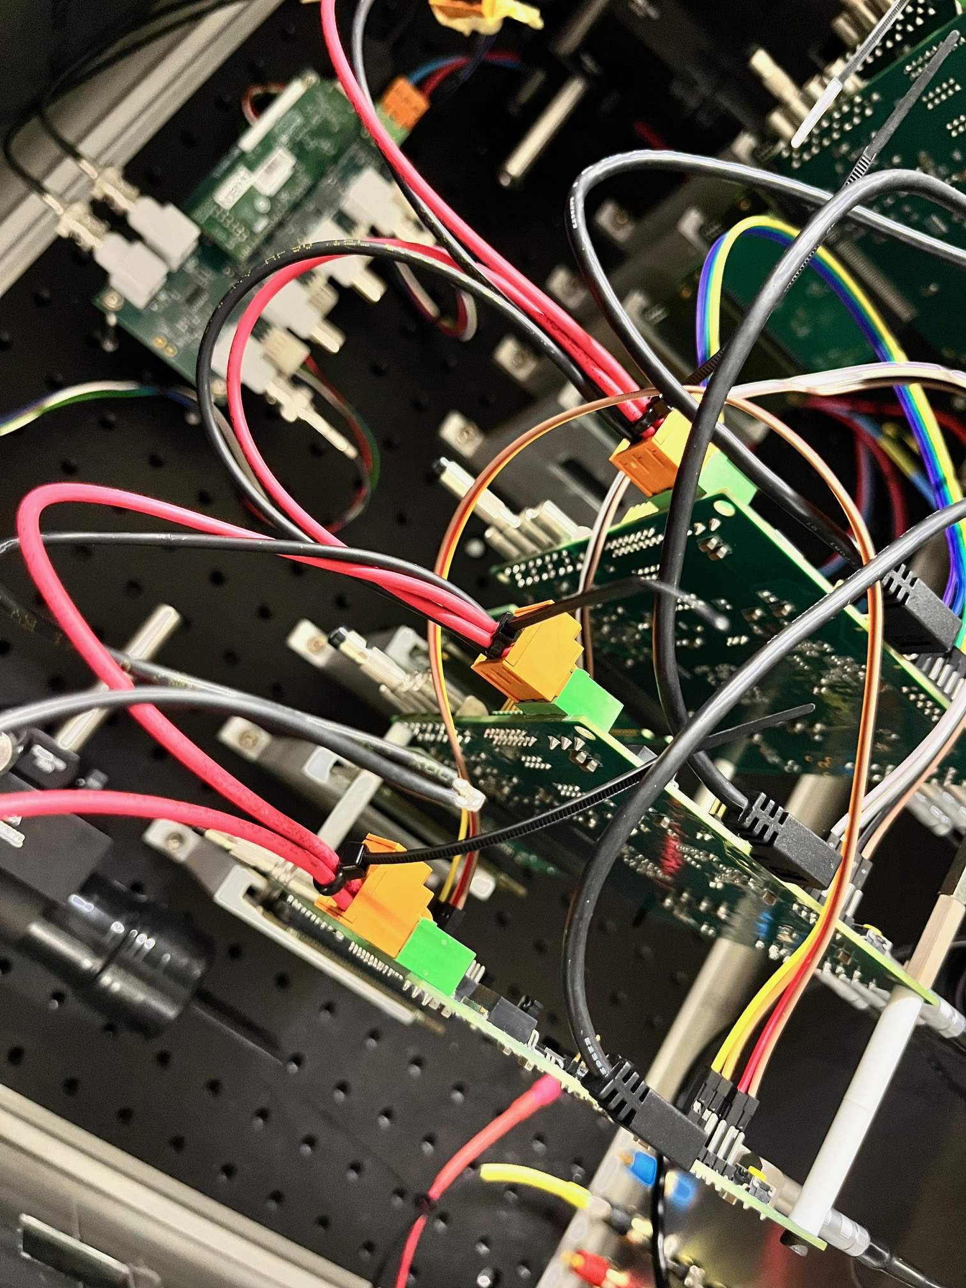
Challenges during data-taking
Recurring power connection issues, appeared during initial commissioning with FHR scan
Manifests as USBError: Input/Output Error
Occasionally accompanied by current dropping to zero (normally 1.8-2.5A)
Interruptions/inefficiencies/unevenness in data-taking, up to outright power failures
Possible cause(s): weak/loose connections from power supply
Ground/5V cables are daisy-chained, so loss of connection in one plane would lose power to the rest down the chain
Viable workarounds:
Physically reaffirming power cable connections (orange board connectors, power supply connectors inside/outside box)
Sanded down some solder connections (worked the best)
To be more fully understood, permanent solution to be found

Slide 10
Plans
Analysis of remaining data
Majority of analysis chain completed
Remaining to-do tasks:
Finalized alignment parameters for rotated DUT datasets
Overall improvements to analysis chain (in backup)
Clustering algorithms: edge vs. corner? Common/uncommon shapes?
Improvements to existing setup:
Improved power connections: sanding down soldered connections, redoing them entirely…
DUT rotation, scintillator shift had to be done by hand: remote-controllable table?
Steep angles cause secondary particle showers from aluminum holders: large holder apertures?
Future: incorporation of LGAD for timing studies: late June-early July; Jlab test beam: early fall

Slide 11
Backup

Slide 12
Beam schedule
Beam to MTest Fri 5/24 ~1 PM
Primary users (beam profile control) swap every 12 hours (night vs. day shifts)
Some interruptions (e.g. linac filament) but relatively minor/short-term
Total: 5 shifts as primary user, 3 shifts as parasitic

Slide 13
Improvements
With clustering algorithm: requiring one cluster per layer vs. one hit
Residual cut finder for alignment:
Found by hand for now
Misalignment produces shift+broadening/narrowing of Gaussian peaks in some random direction/magnitude
Iterative procedure:
Sample over wide range → identify highest peak → narrow search window around peak → try again until std. dev. is of ~ same order as window: set this as residual cut
Fit metric for SVD fitting
Initial thought: total orthogonal distance to hits from line
Can validate this by looking at distance distribution from tracks within a residual cut and not
Minimization for alignment
Individual parameter optimization instead of simultaneous
Not sure how it affects runtime, but only needed once per data set

