Slide 1
FTBF testbeam analysis update
D. Shekar, Z. Ye, TH
EIC-RNC meeting
16 July 2024

Slide 2
FTBF June testbeam: physical and procedural improvements
Retaking data at high incident angles and large VCASB
Board desync at high VCASB
Secondary showers for high incident angles
Fixing DUT, bot HU, reg3 VCASB=15 to reduce noise
Consolidated power supply connection (loss of power in May testbeams)
Longer trigger delay window, shorter individual runs (for board desync, see backup)
Larger DUT holder (for secondary showers)
DC-LGAD+ETROC2 planes for timing reference

Slide 4
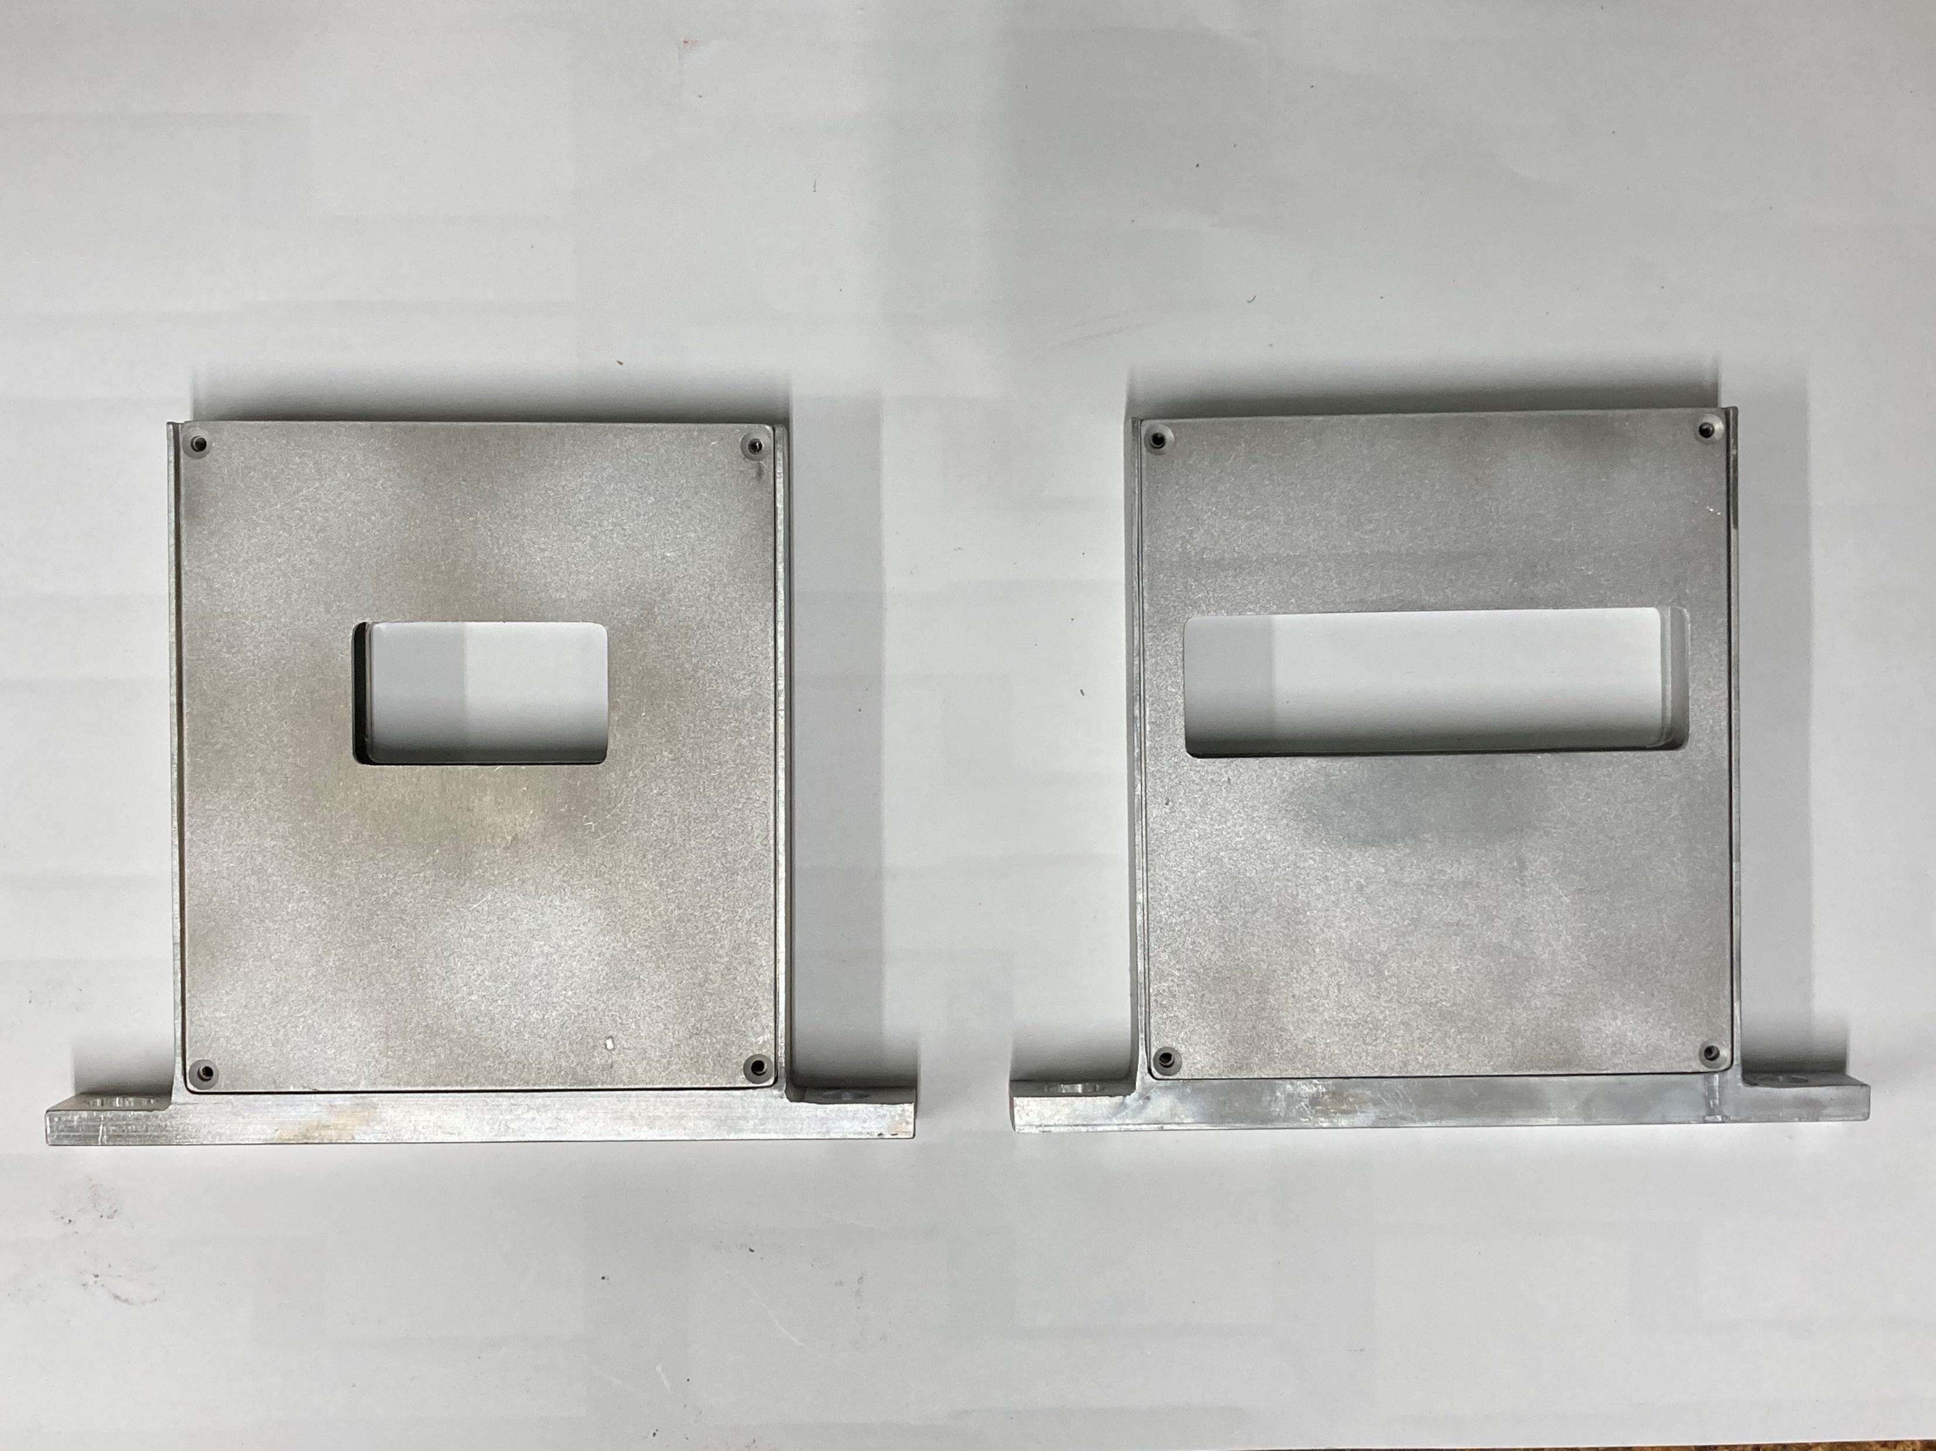
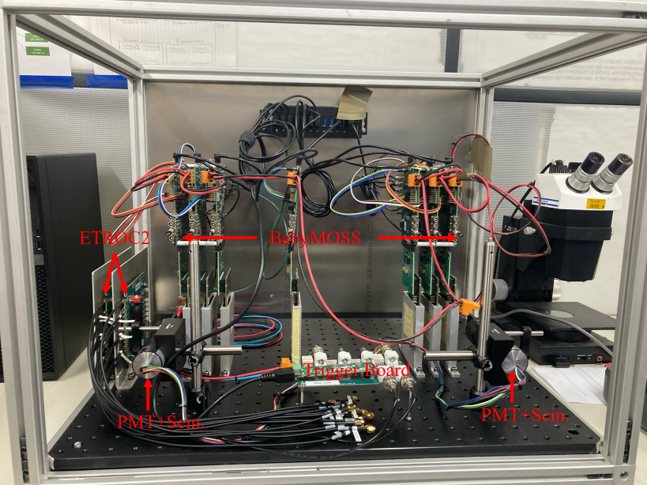
Physical setup improvements
before ☹
after ☺

Slide 5
Current status – resolution and alignment
Full rotation: 3 translations, 3 rotations per layer = 42 – 6 parameters
Implemented via for loops / transformation matrices
Multiple alignment passes
Alignment performance check
Alignment of new June testbeam data!
Useful statistics have increased a significant margin, e.g. nearly 1/3 events contribute to alignment at 90 degrees
Code consolidation, bugfixes

Slide 6
Multi-alignment and alignment performance
Multiple passes:
Take set of tracks from file; perform alignment
Write new positions after alignment to file
Perform alignment again; repeat X times
Performance: trend of μ, σ of residual distribution in each layer after each pass

Slide 7
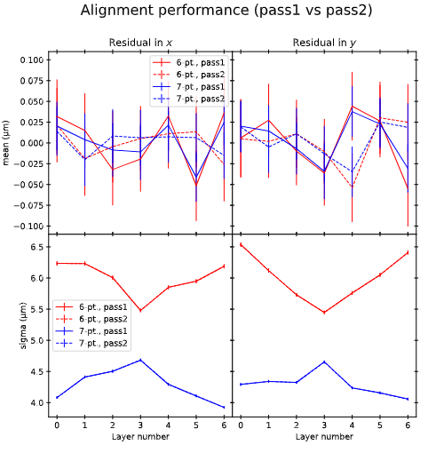
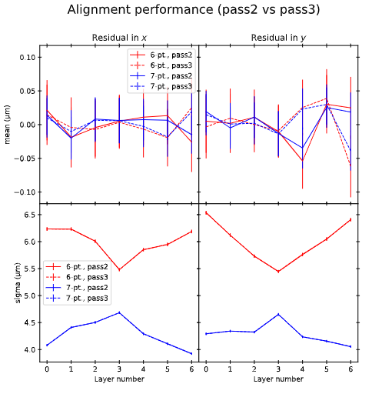
Example from 90 deg, June testbeam

Slide 8
Remaining open questions
Remaining double peak structures in aligned residual distributions
Inflated (wrt. reference planes) resolution in data samples with inclined DUTs

Slide 9
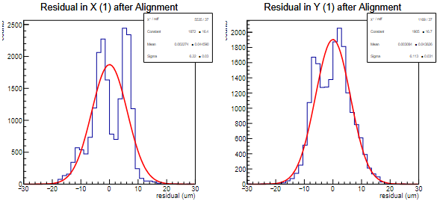
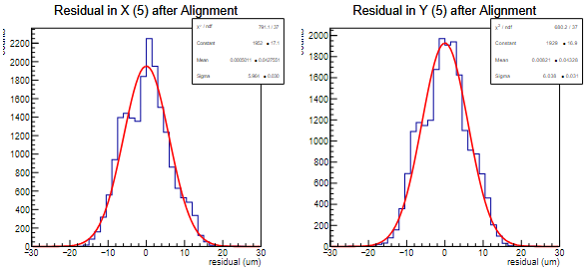
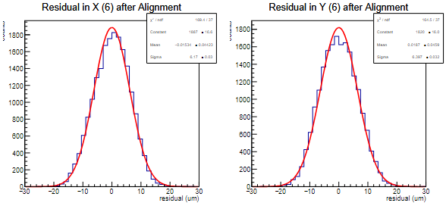
Resolution
Double peak structures remain after alignment
Doesn’t matter how you select tracks:
Use same sample as for alignment (residual cuts on unaligned raw tracks)
Residual cuts on aligned tracks
L1 and L5 seem to be most susceptible, but hard to tell for sure, and x-y seem to be correlated
And yet somehow the sigma values are not out of the ordinary (cf. performance plots in earlier slide)

Slide 10
Possible resolutions:
Things we have already tried
Things we will try
Full rotation
Multiple alignment passes
Additional alignment pass with transformation: take alignment transform and reselect tracks
Aligning just problematic planes
With either total residual or just problematic plane residual as χ²
Align with 6-point fits instead of 7-point
Top vs. bottom half-unit
More realistic rotation
…?

Slide 11
“Realistic” rotation
Mathematically should be equivalent, BUT:
Z-shifts must be bounded in the minimizer (get unphysical values ~ O(10 mm) otherwise)
Bounding is physically well-motivated: planes are fixed in z
With fixed/narrowly bounded z-shift:
Bounding z-shift with original method actually doesn’t bound z-shift for far planes, since rotation around origin introduces appreciable changes in z even with small angles (up to 70um)
True equivalence no longer holds
“Realistic” rotation may represent true rotations more closely than in current method: sensors rotated “within their holders”
More “realistic” rotation (2): rotate each plane around its own center*, then shift in x, y, z
Current rotation method (1): rotate all planes around origin, then shift in x, y, z
*or close to it
381mm
L6
L0
L0
Common rotation point

Slide 12
Residual definition for rotated DUTs
z
x
In-plane Δx’ inflated by cos φ
Δx’
Δx
*not an effect of multiple scattering
φ
σ=15um @ 15°
Δx

Slide 13
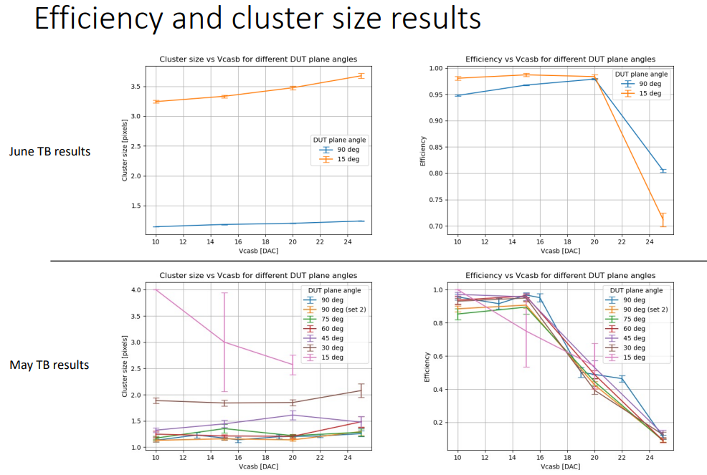
To be investigated

Slide 14
Summary and outlook
Resolution and alignment
Full transformation implemented and tested
Improvements in testbeam setup to minimize board desync
Two open questions remain:
inflated residuals in rotated DUTs
Multi-peak structures in residuals post-alignment
Efficiencies and cluster size scripts ready

Slide 15
Backup

Slide 16
Software alignment
z
Δx₂
x
Positions of sensors are not perfectly known
Misalignment results in shifts and changes in width of residual distributions
Define χ² and minimize:
Apply rotations+shifts to unaligned cluster positions
Minimize χ² by finding optimal rotation angles, shift values
Done with MINUIT+MIGRAD+HESSE (gradient minimizer)
Optimized parameters determine final alignment
Δx₁
φ
Δx₀

Slide 18
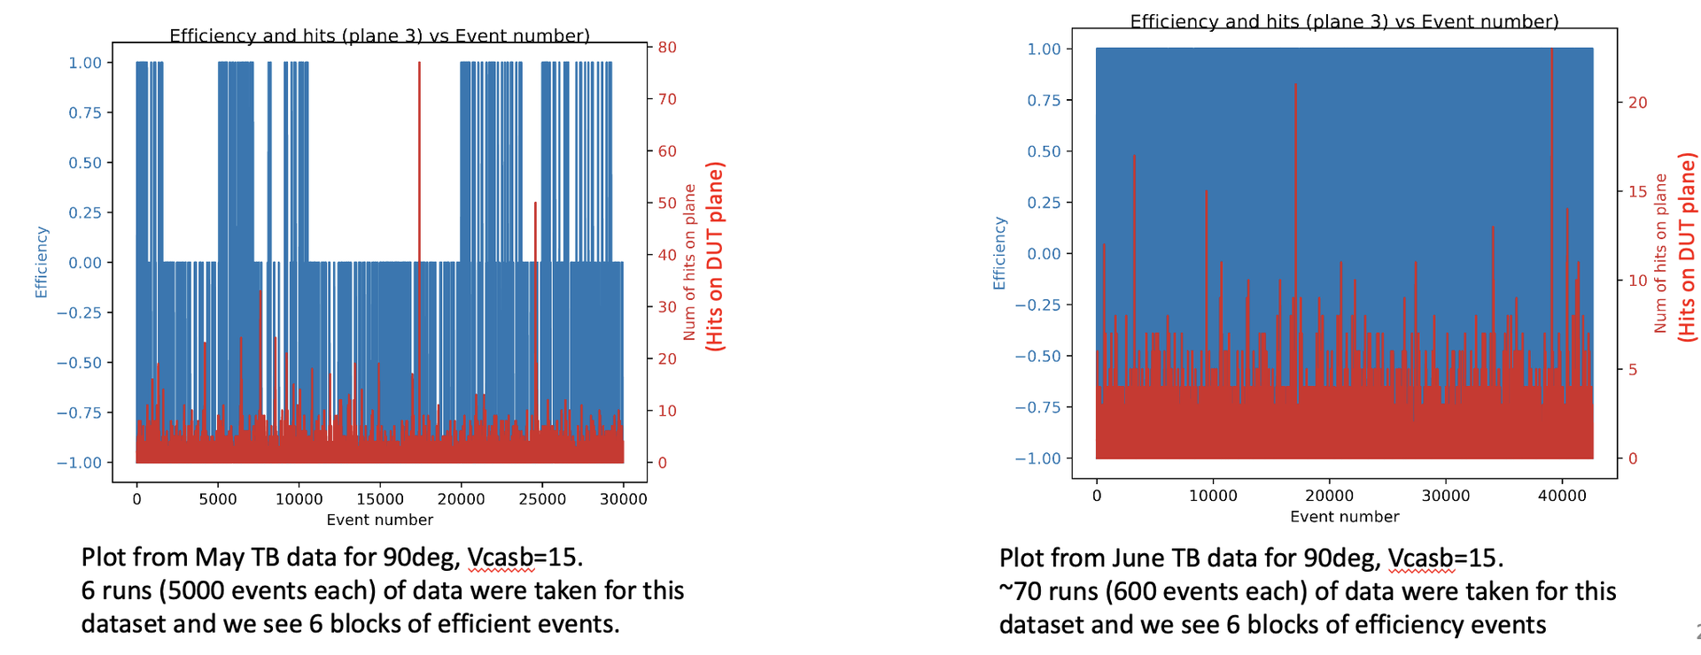

Slide 19
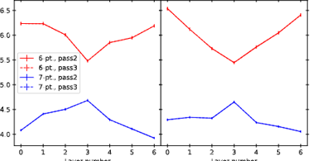
Some observations and notes on alignment performance
Intentional choice to use same hit/track sample
True apples-to-apples comparison: make sure any effects we see are purely from alignment, not from altered sample
Generally, performance doesn’t improve past 2-3 passes
Sigmas stay stable, means tend to get closer to zero but not a strong improvement (i.e. already very good after 2 passes)
Not the one and only way to determine performance; looking only at these plots can oversimplify the picture
Good as a “first check”
Bow-shape trend: sigma goes down in the middle layers

Slide 20
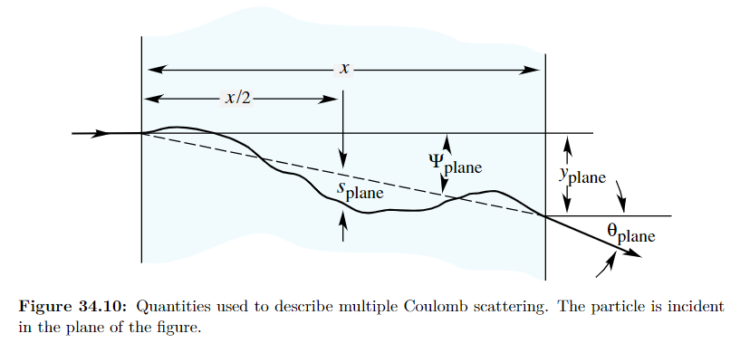
Material budget scattering calculation
Assuming:
p = 120 GeV/c
z = 1
β = 0.9999694
x/X₀ = 0.05% = 0.0005
At 90° DUT:
θ₀ = 1.80e-6 radians
For each cm downstream, scattering ≈ θ₀ * 1cm = 0.046 μm
At 15° DUT: expect x/X₀ inflated by factor 1/cos(75°) ≈ 3.86
θ₀ = 3.79e-6 radians
For each cm downstream, scattering ≈ θ₀ * 1cm = 0.096 μm
From PDG ch. 34

