Slide 1
ORNL Status Update
Pete Eby
ebypi@ornl.gov
Steve Moulton
moultonsa@ornl.gov
Slides:
Sept 18th 2024 @ LBNL

Slide 2
Operational Summary 2024
Ongoing stable operations of SE and CE.
Planned 2023-2024 SE,CE, network hardware refresh substantially completed.
Migration from EOS4 to EOS5 completed
Deployment of new CE nodes, and move to Rocky9 and Condor operationally complete. (Yay!)
Notes:
Good year of stable operations. Nominal planned downtime.

Slide 3
Organizational Continuity Summary
2023: T2 organizationally moved under Jonathan Wilson
RDSE Team Lead for Nuc Phys.
2024: Wilson subsequently assumed BRM role
Current: Jonathan Kyek is the new RDSE TL point of contact
(AJ Ierulli remains RDSE GL)
Susan Hicks, Senior ORNL Network Architect retires end of CY24
  David Wantland replacing
FY24Q4 Brian Ofsthus rejoining T2 Operations Team
  Now as an ORNL employee living in Knoxville
Expect to conduct 3 year DOE review in FY25/26
Notes:
Keeping an eye on operational an organizational continuity.
Brian re-joining was upon our request - he is welcomed aboard.

Slide 4
Network Refresh and Topology Update

Slide 5
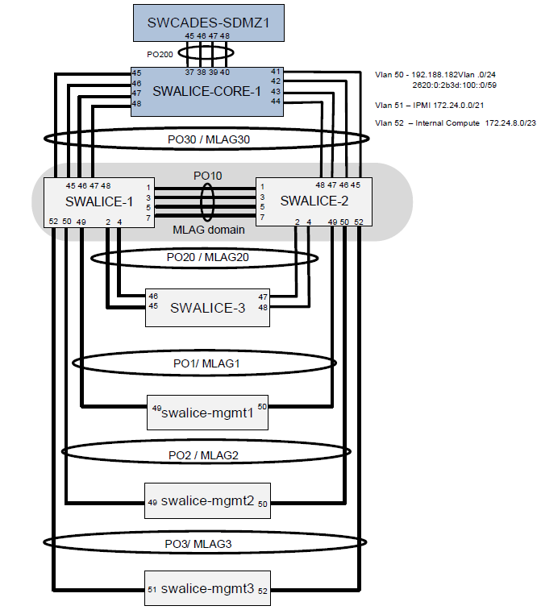
~2018-2023 Network Topology
Stable & performant
Sole vlan tenant
Legacy topological connection through ORNL SciDMZ / CADES
Notes:
Network infrastructure, placement in SciDMZ, etc. have served us quite well.

Slide 6
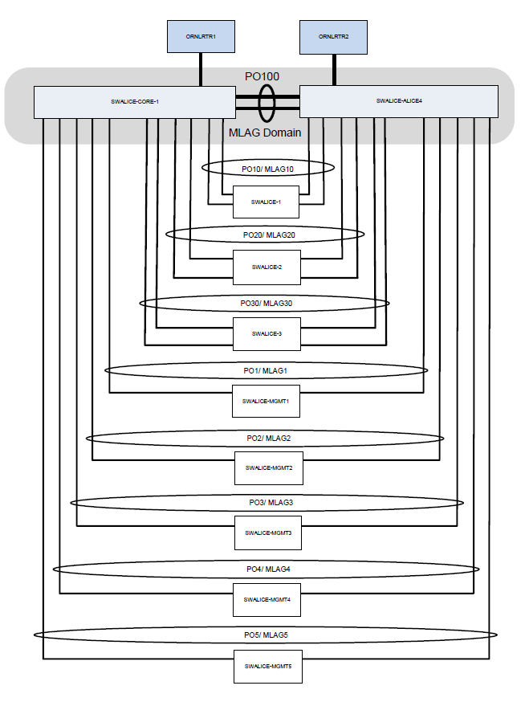
2024 Network Refresh Topology
Remaining:
Make border rtr connections
All newer CE/SE hardware to newer (supported) network equipment

Slide 7
Network Updates
New ORNL::EOS FSTs are 25Gbit (SFP28)
  PRF_EOS FSTs are 20Gbit bonded (802.3ad)
  Could move to 50Gbit (bond) or 100G (new switch required)
T2 uplink 40Gbit through CADES/SciDMZ
  Remaining: Swing uplinks directly to ORNL border routers
    Required software updates recently completed.
    New topology will restore improve redundancy
  Awaiting fiber runs from ORNL side, then move LHCOne peerings
    LHCOne may be unavailable a few days for netops to complete the various stages of work.
Added additional 10G core switch
  swalice-core-2 Arista 7280SR3-48YC6
Added two gigabit switches
  2x Arista 7010TX 1G (mgmt and older node data)

Slide 8
SE Overview and Planning

Slide 9
SE Hardware Refresh - Quickstart Option
(Fall 2023 slide - Now Completed)
SE
  Start small:
  New EOS deployment (ornl::prf_eos)
  Reuse cern-10 and 60 disks jbod
  Purchase and add two new prod MGMs.
  Migrate additional FSTs/JBODs to PRF later -- eventually replace cern10/JBOD if appropriate.
So this idea lead to…

Slide 10
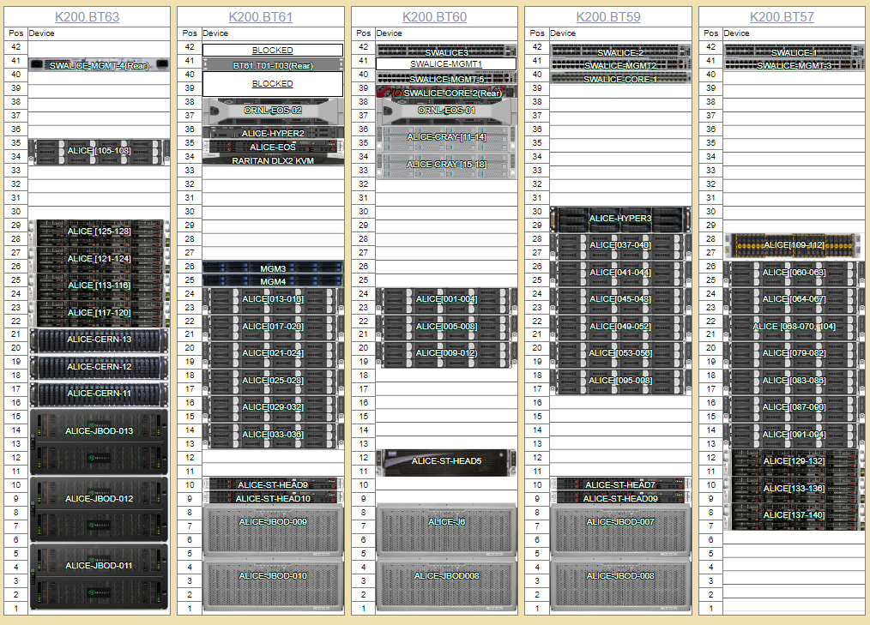
ORNL T2 Rack Layout (2024)

Slide 11
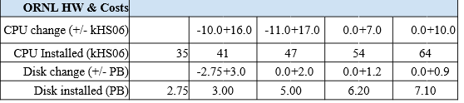
2024 PEAP Update ORNL Resource Pledges
Installed
FY2022
FY2023
FY2024
FY2025
2024 SE addition postponed so as to deploy both new FSTs together.

Slide 12
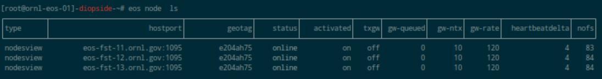
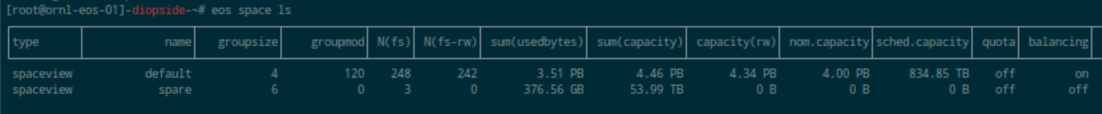
ORNL::EOS Production
4.5PB new hardware racked (3x 1.5PB new FSTs)
  Older FSTs decommissioned from prod environment. All new baby.
Recent +3PB ordered, vendor fulfilling. ETA next ~two months

Slide 13
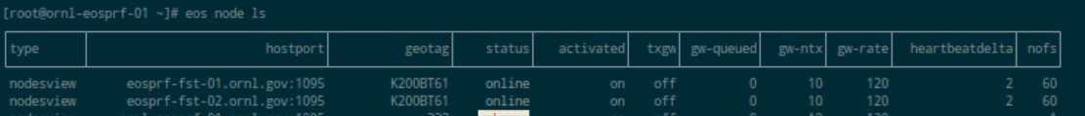
ORNL::PRF_EOS - Needs Some Lurve
Repurposed cern-09..10 FSTs (ca 2018 hardware)
  HGST JBODS and Helium drives (7TB and 9TB)
  Can add cern-07..08 (same hardware)
Final capacity expected to be ~2.5PB +/-
  Could provision one or two units for testing env
  to which external collaborators could access. Desired?
Needs redeployed (currently CentOS)
Own quarkdb cluster (three nodes)

Slide 14
ORNL::EOS (New Hardware Details)
New eos-fst-11,12,13 FSTs
  Supermicro (Silicon Mechanics)
  25G uplink (can increase if indicated)
  Seagate 84 disk JBODS
    Exos 18TB SAS drives (17TB usable in os/eos)
    12G SAS, multipath to each fsid device
  Presents as 1.5PB in eos
  Single disk fsids - for now…
  RHEL8

Slide 15
EOS5 Experiences
EOS stability improvements
Occasional odd stability issues remain
  SE becomes unavailable, restart of MGM resolves
  Unable to get free space, restart of MGM resolves
Single disk fsid has been stable, low hotspots
Hardware has performed quite well under high and mixed workloads

Slide 16
ORNL::EOS Next Steps
Issues to resolve
  Complete upgrade to EOS 5.2
  See if odd availability issue resurfaces
  See if “corrupt” file issue persists
Next Deployment Steps
  Deploy two new prod FSTs and JBODS (+3PB)
    Delayed intentionally to deploy them together
  Nuke the ORNL::PRF instance (~400TB) and redeploy from scratch on RHEL/Rocky9 (currently CentOS)
    Both above excellent opportunity to engage Brian Ofsthus is EOS internals, our environments, etc.

Slide 17

EOS Recommendations
Collect, retain and share deployment and operational “oh yeah” points.
Help associate common issues with root causes. Some are unique to ALICE, some EOS in general. (JAliEn testSE of alicetokenauth as misconfiguration results in no auth and is not particularly obvious to site admins, ldap space reporting, mlsensor nuances, eos headspace, “corrupt” files, etc.)
Determine design blueprint for ALICE EOS EC deployments
  Brings multiple dimensions of hardware and config considerations
  Standardize on drive size for life of deployment
  Expansion past design capacity may be… tricky

Slide 18
CE Overview and Planning

Slide 19
New Compute Hosts
All new hosts installed
Rocky 9.4 deployed
Slurm 22.05.9 deployed on all new nodes
BMC used for remote console and configuration
HepSpec 23 runs on two hosts (consistency check) completed
  Also ran on several older nodes to provide data for Marta’s scheduling work

Slide 20
Infrastructure Changes
Vobox, Slurm controller replaced with Rocky 9.4 VMs
Job submission via HTCondor, which then resubmits via Slurm
OSG node no longer needed, will not be upgraded
Squid move to Rocky 9.4 done, but new server not activated yet
  Affects both instances (prod and test)
New service host vm created
  Moved ansible, pxeboot, mail gateway services off of mgm
ORNL certificates removed from hosts no longer needing them
  letsencrypt certificates deployed for EOS http/s requirements

Slide 21
OSG Reporting Issue / Need for HT Condor
No longer an issue; job submission done via HTCondor
Future: remove slurm - go completely HTCondor
  This may increase flexibility for other opportunistic workloads
  Potentially reduced complexity in cluster management

Slide 22

ORNL T2 Compute Element
Model | Physical Cores | Count | Memory | Memory / Job Slot | Age
Supermicro SYS-2029BT-HTR 2022 | 48 | 4 | 384Gb | 4 Gb | 2
Silicon Mech R4420.v8 * 2023 | 48 | 28 | 256Gb | 2.6 Gb | 1
Cray S2600KPR | 36 | 8 | 256Gb | 3.6 Gb | 5
Dell PowerEdge C6220 | 16 | 33 | 64Gb* | 2.4 Gb | 9
Dell PowerEdge C6220 II | 16 | 54 | 64Gb* | 2.4 Gb | 8
All are in quad chassis.
Dell counts not even due to node failures.
Hyperthreading enabled on all nodes.

Slide 23
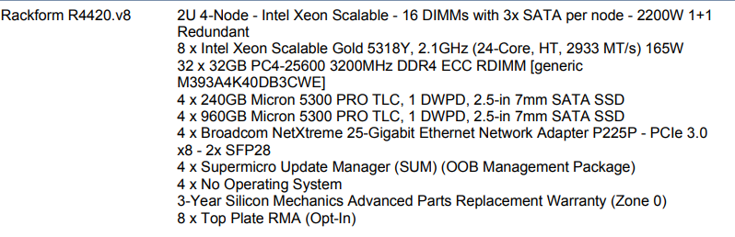
2023 Compute Nodes
Provisional ORNL ALICE HS06 Results 2022 (alice-110) and CE hs06 projections are here

Slide 24


OS/Licensing Options
Newer compute hosts and infrastructure hosts running Rocky 9.4
Prod FSTs, MGM running RHEL 8.8 and 8.9
(PRF CentOS, will nuke from orbit and redeploy
.)
No plan to change base OS releases until necessary

Slide 25
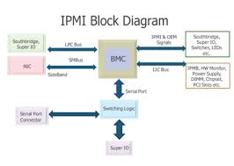
Operational Notes and Plans
IPv6 still on rader
  has not risen to top priority yet
BMC connections to be moved to isolated network with jump host access.
  Newest nodes and CRAY nodes
  ORNL requirement: do this or go on ORNL’s management network
  Just a good idea anyway
Reployment of login node and monitoring in the works
  Will be able to reallocate old hypervisor at that point

Slide 26
Operational Notes II - Rocky 9.4 & Cgroups V2
Compute element move to Rocky 9.4 and cgroups v2 generally successful, some running since Monday Sep 16.
CPU heating problems (Zone 1 76 ℃) instigating fan reconfiguration
  New nodes don’t appear to have variable speed fans
  Setting fan speeds to full (13600 RPM) from default (5400 RPM) addresses all heating problems
  Base (unloaded) temperatures now similar to other hosts
10 new nodes still pending fan reconfiguration

Slide 27
Operational Notes III - overheating
Interestingly, alice-cray014 (converted to Rocky 9 for cgroups v2) exhibits same overheating behavior.
Cannot fix remotely - no BMC connection. Will resolve both.
Cause? More effective use of CPU with cgroups v2? Odd workload variance?
  Workload variance unlikely cause - only exhibited on Rocky9 nodes.
Even stress-ng could not heat things up this much

Slide 28

Operation Notes IV - HTCondor
Deploying the HTCondor to Slurm required creation and deployment of a NFS mount (nfs/zfs server is hyper03). Thank you Brian for doing this.
Use of /var/lib/ht_condor higher than anticipated.
tmp files going wrong place?
Will work with Irakli to resolve

Slide 29
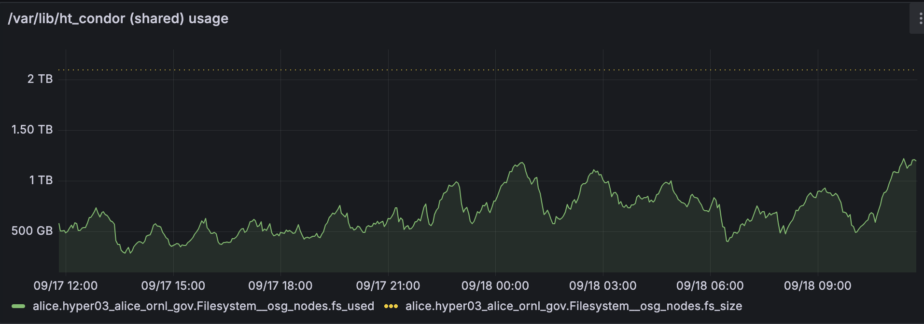
/var/lib/htcondor usage

Slide 30
Questions?

