Slide 1

ALICE-USA
T2 and AF Computing @ LBNL
ALICE-USA Annual Meeting
Sept 17-19 2024
John White LBNL

Slide 2
Lawrencium Overview
Lawrencium: Institutionally-supported HPC Linux Cluster
  ~2,650 nodes/ ~80,000 cores
  6.2PB Lustre parallel file system for Scratch supporting condo-style buy-in
  Rocky 8, SLURM job scheduler, Singularity containers, Open OnDemand 3
  Nvidia/AMD GPUs
    MI50/100, A100, 5 newly installed 8-way H100 HGX (and plenty of older stuff)
  New NDR200/400 Infiniband Fabric
Four models of access
  PAYG $0.01/core-hr
  Condo Cluster
  Dedicated cluster support
  Opportunistic
PCA - PI Computing Allowance
  Free - 300K SUs per year
  Can be shared with your staff or pooled together with other PIs
Notes:
GPU nodes used increasingly for ML frameworks
KNL nodes are similar to Cori2 and used for onramp to NERSC - Cori1 = Haswell/Broadwell is new version etc. Current intel is SKylake - new condo nodes are skylaee.
We have 20 DTNs in production across the Lab
PI Grants - 300k SU - a dozen customers.
$.01 per SU
Low priority QoS are free
PI Grants--->300K SU/Year per PI free
68 KNL nodes avilalbe.

Slide 3
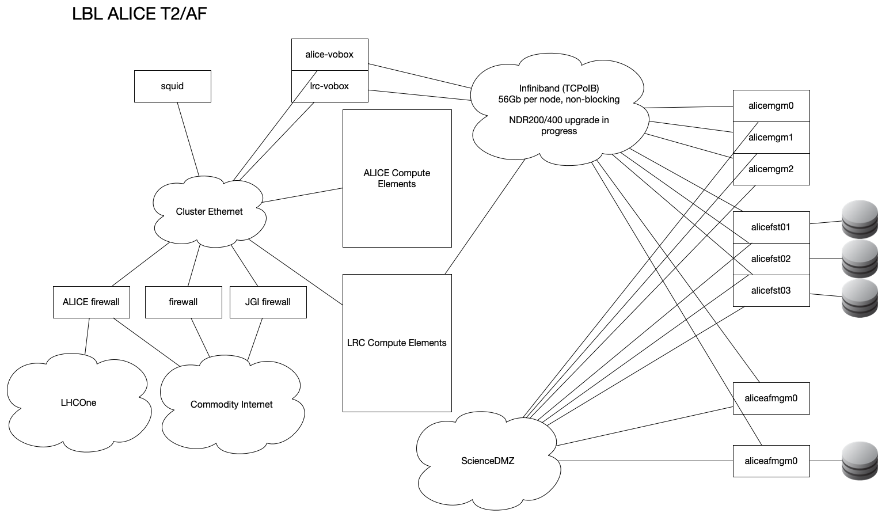

Slide 4
Storage Futures
2x40Gb routed link from LBLNet to HPC network
  Currently providing a 8.4PiB CEPH platform
    S3/RADOS
    Cephfs
    NFS
  New VAST offering
    Home, group, software
    Formulating condo pricing
    Infiniband, New NDR fabric
Scratch File system
  DDN SFA 18K
    180GB/s theoretical peak R/W
    First 64MB of every file on NVME Flash (Progressive File Layout)
    Rest on Spindle
    440TB Buy-in available (non-purged space)

Slide 5
Cluster Futures
Upgrades in the near future
  Monitoring Project
    Vast S3 backend
    LGTM? ELK?
  Rocky 8
    Last minute change to Inbox OFED
    4.18.0-553.5.1 - fix xroot lockups
LDAP migration in progress
CondorHT integration

Slide 6
AF EOS
1 MGM node
  10Gb external, 56Gb internal
  Need to re-re-enable HTTP interface
1 FST node
  1 JBOD, 125 drives
  Again, 10Gb external, 56Gb internal

Slide 7
HPCS EOS
3 MGM nodes
  10Gb external, 56Gb internal
  Need to re-re-enable HTTPS interface
3 FST nodes
  Again, 10Gb external, 56Gb internal
  305 total drives, 1 warm spare per node
EOS 5.2.24
  Upgraded on a whim
  Didn't fix issue
  Can't roll back
Currently at ~79% Use, 3.13PiB out of 3.94PiB
2 New FSTs on order
  1 JBOD per, 90 drives each

Slide 8
HPCS EOS Current Issues
Seemingly two distinct issues
  JBOD Power resets
    Drives in use at the instant of reset throw EIO until reboot
    Over time, more and more drives impacted
    JBOD under maintenance still, vendor engaged
  XrdZMQ client errors until full EOS reset
    Post-Rocky 8 Upgrade
    'eos' command utterly unresponsive
    Waiting for recurrence but power-resets preventing reproduction
    XrdZMQ::client looping since 24480.00 seconds ...

Slide 9
Projects
New LLM Service, CBorg
  Rancher-based Kubernetes
  3 4-way AMD MI100 nodes
  3 4-way Nvidia A100 nodes
  1 8-way Nvidia H100 (Dell HGX)
  Chat, Code assistant, Customer RAGs
CVMFS
  Replacing annoyingly replicated rsync'd NFS at multiple sites
  NFS-CVMFS Gateway planned for backward compatibility
Owncloud + Cephfs
  Kubernetes OCIS
  Stand-alone REVA instance
  Custom Public OIDC forthcoming

