Slide 1




ALICE-USA Computing Project
PEAP 2025 Overview
ALICE-USA Computing Annual Meeting @ LBNL
September 18, 2024
Irakli Chakaberia

Slide 2
Project Execution and Acquisition Plan 2025

Slide 3
ALICE-USA CPU and Storage Obligations
In 2025
  russian resource contribution will need to be shared among other Fas
  Share of 45 russian M&OAs removed (but 8 JINR kept, this is only fair when presenting to the DOE)
  ALICE-USA M&O-A kept at 45 throughout
  2025 estimate is based on the RRB approved numbers
  These resources have already been pledged
  For the 2026 I used the current estimates submitted to C-RSG
  For 2027 estimate here I used just 5% increase as we will be in a long shutdown period
Year | FY2025 | FY2026 | FY2027
ALICE Requirements
CPU (kHS06) | 1420 | 1530 | 1607
Disk (PB) | 156 | 182 | 191
ALICE-USA Participation
(ALICE - CERN) M&O-A | 534 | 534 | 534
ALICE-USA M&O-A | 45 | 45 | 45
ALICE-USA/ALICE (%) | 8.43% | 8.43% | 8.43%
ALICE-USA Obligations
CPU (kHS06) | 119.7 | 128.9 | 135.4
Disk (PB) | 13.1 | 15.3 | 16.1

Slide 4
Resource Acquisition Plan
Resource | FY2024 |  | FY2025 |  | FY2026 |  | FY2027
LBNL HW & Costs
CPU change (+/- kHS06) | -5.0 | +0.0 | -5.0 | +18.0 | -10.0 | +18.0 | -10.0 | +12.0
CPU Installed (kHS06) | 42 |  | 55 |  | 63 |  | 65
Disk change (+/- PB) | -1.6 | +3.0 | 0.0 | +0.0 | -1.5 | +3.0 | 0.0 | +1.5
Disk installed (PB) | 6.15 |  | 6.15 |  | 7.65 |  | 9.15
ORNL HW & Costs
CPU change (+/- kHS06) | 0.0 | +0.0 | -7.0 | +12.0 | 0.0 | +5.0 | -5.0 | +12.0
CPU Installed (kHS06) | 45.5 |  | 50.5 |  | 55.5 |  | 62.5
Disk change (+/- PB) | 0.0 | +3.0 | 0.0 | +0.0 | 0.0 | +1.5 | -1.5 | +1.5
Disk installed (PB) | 7.50 |  | 7.50 |  | 9.00 |  | 9.00

Slide 5
Deployment Strategy
Resource | FY2021 | FY2022 | FY2023 | FY2024 | FY2025 | FY2026 | FY2027
ALICE-USA Obligations
CPU (kHS23) | 69.9 | 81.6 | 93.8 | 100.9 | 119.7 | 128.9 | 135.4
Disk (PB) | 7.5 | 8.4 | 9.7 | 10.9 | 13.1 | 15.3 | 16.1
ALICE-USA Plan
Opportunistic CPU Resource (kHS23) |  |  | 20.0 | 20.0 | 20.0 | 10.0 | 5.0
CPU (kHS23) | 70.0 | 92.0 | 92.5 | 87.5 | 105.5 | 118.5 | 127.5
% CPU obligation | 100.2% | 112.7% | 120.0% | 106.6% | 104.9% | 99.7% | 97.9%
Disk (PB) | 5.5 | 7.8 | 9.3 | 13.7 | 13.7 | 16.7 | 18.2
% Disk obligation | 73.7% | 92.5% | 94.9% | 125.5% | 103.8% | 108.9% | 113.0%

Slide 6
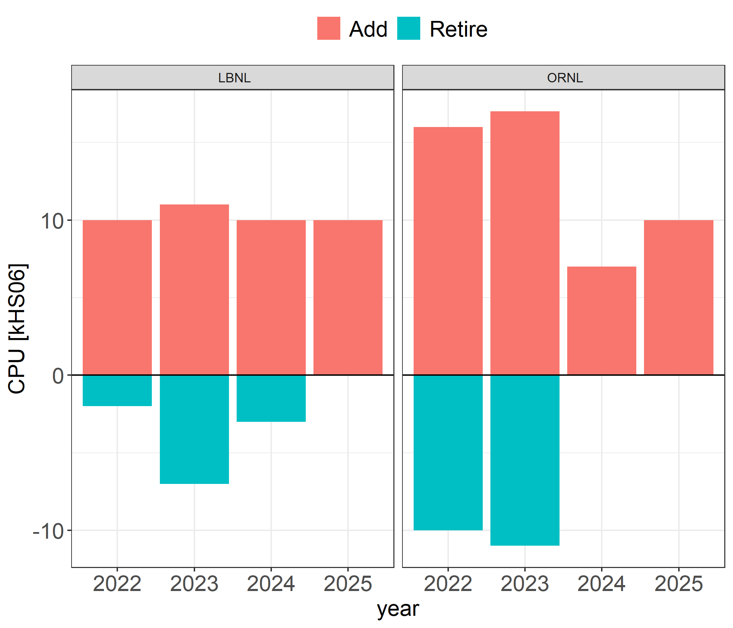
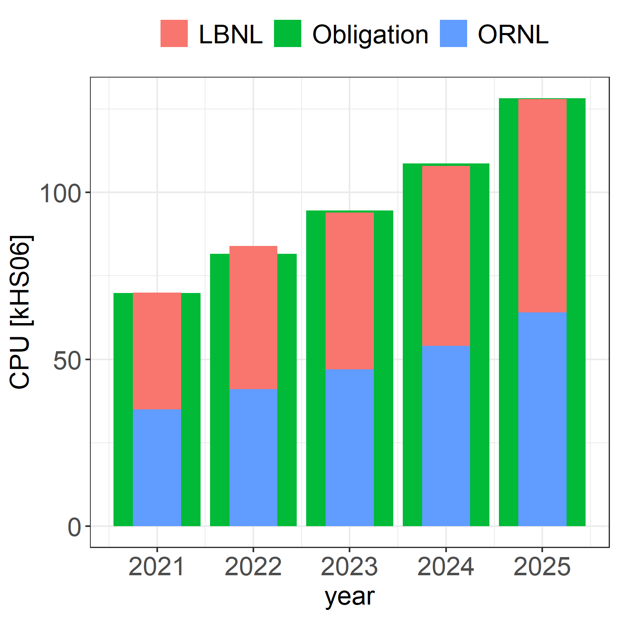
CPU Acquisition
We are gradually retiring out of warranty hardware
2024 and 2025 CPU acquisition was postposed in lieu of storage
kHS23 numbers are based on ORNL measurement of the most recent WNs

Slide 7
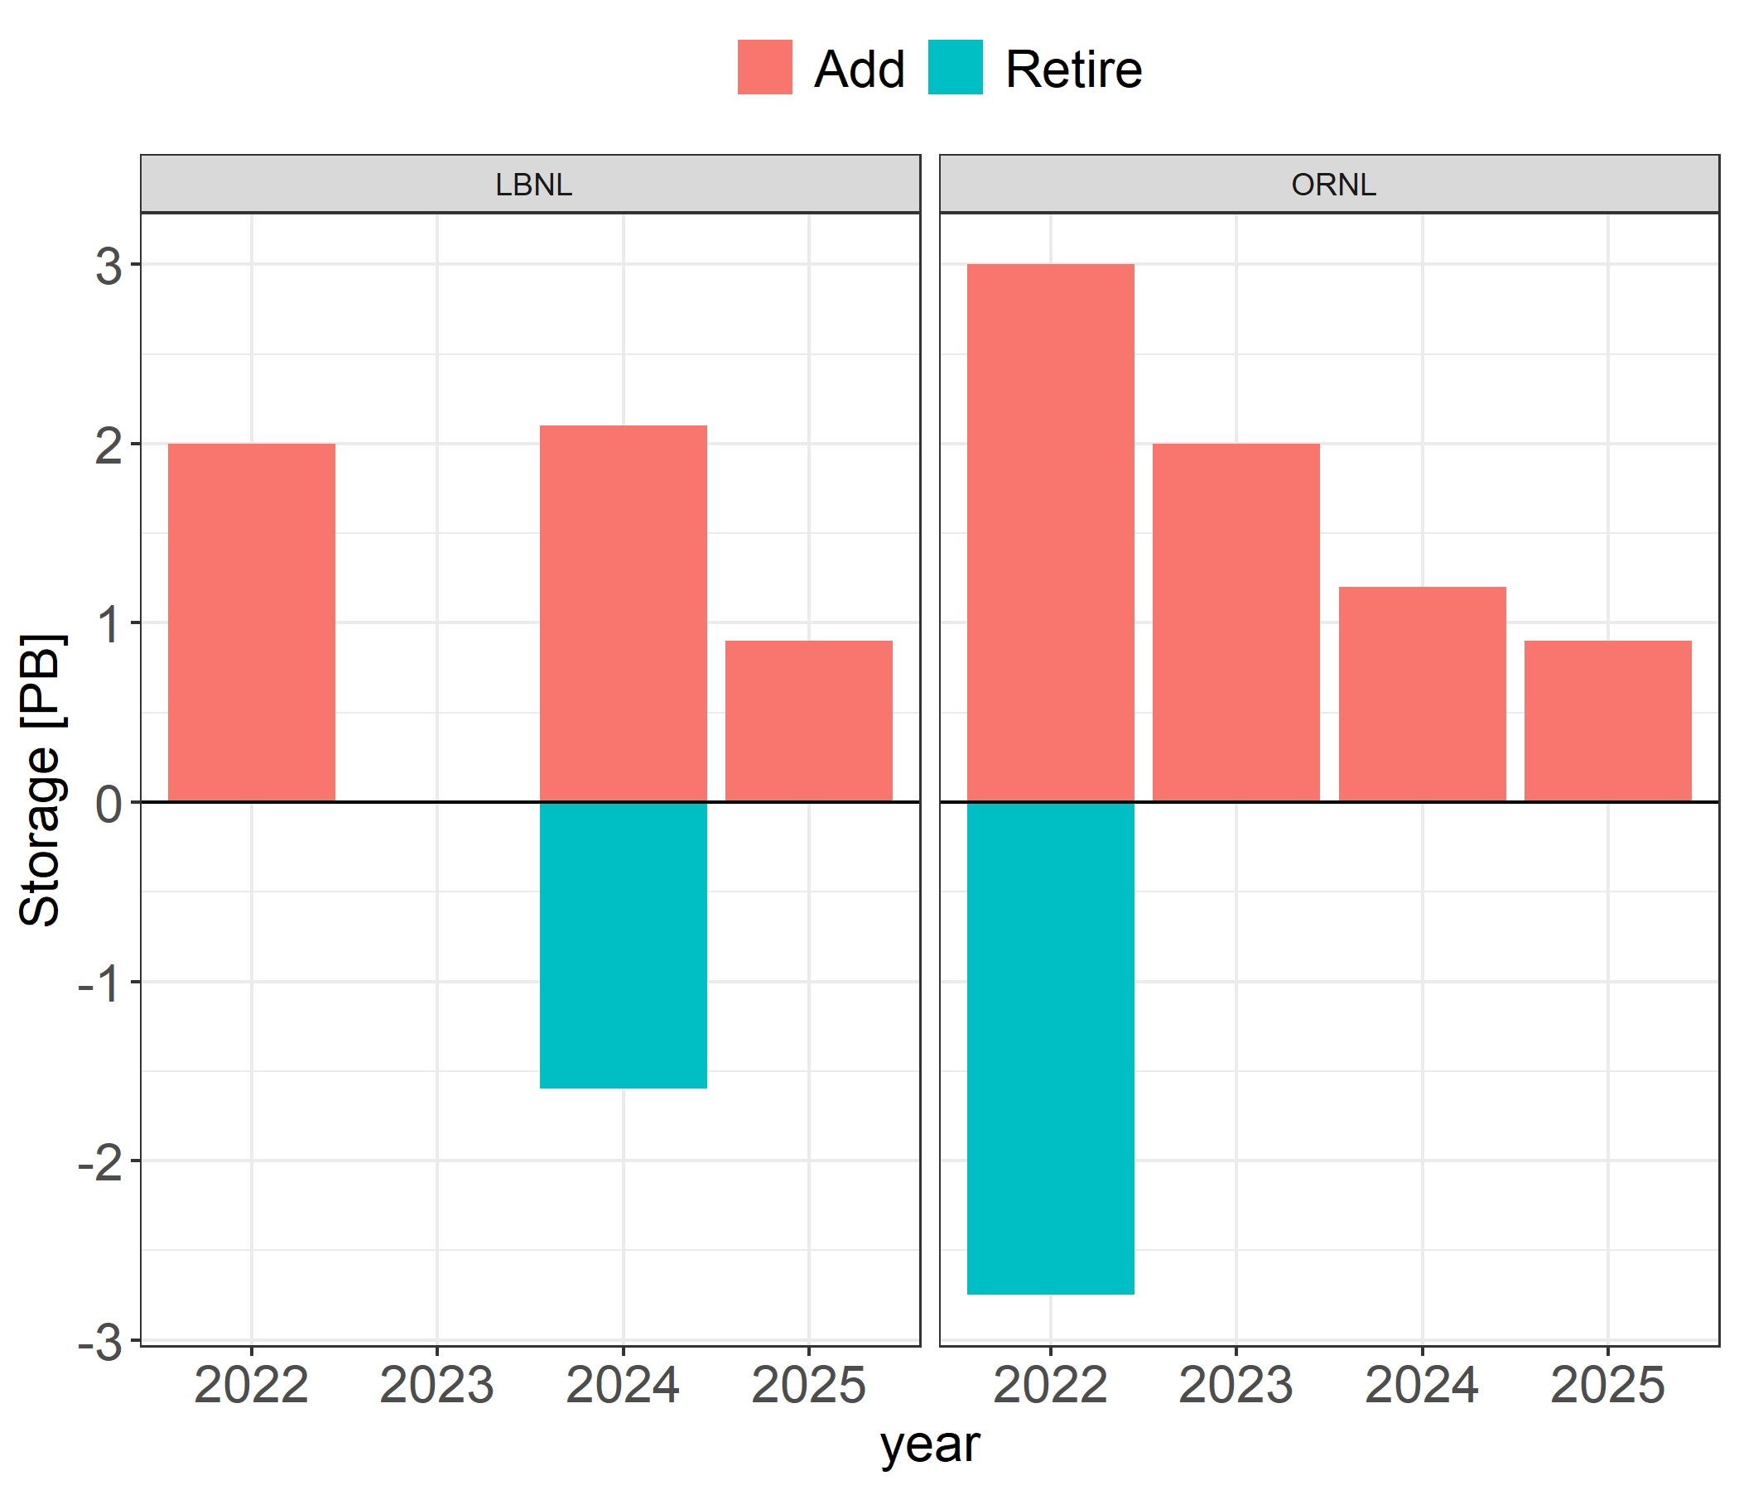
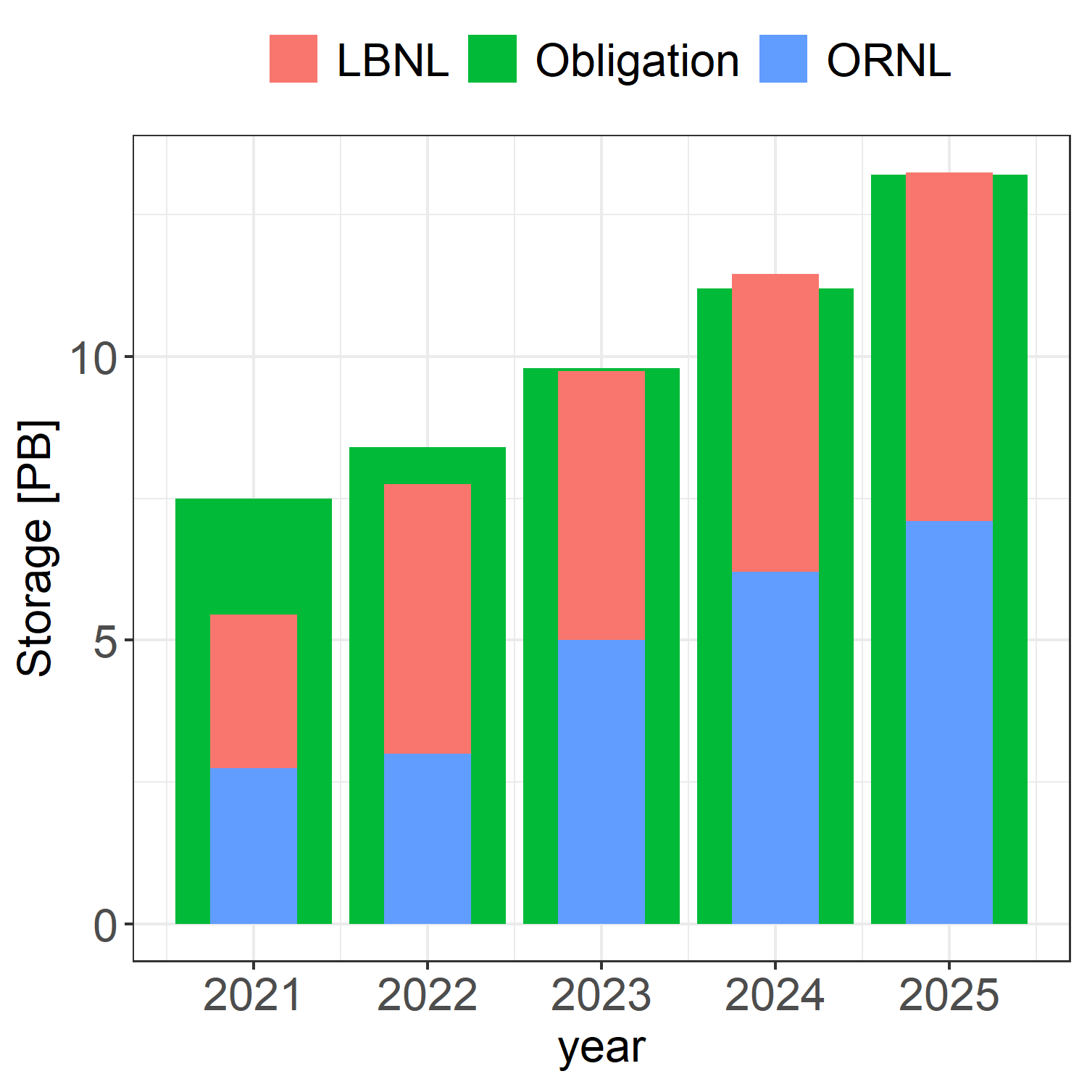
Storage Acquisition
Storage use of both sites have spiked with the 2023 and 2024 HI data
This prompted us to put all the hardware budget toward the storage
This will help out ALICE in general and with long waiting times on hardware will give us some headstart

Slide 8
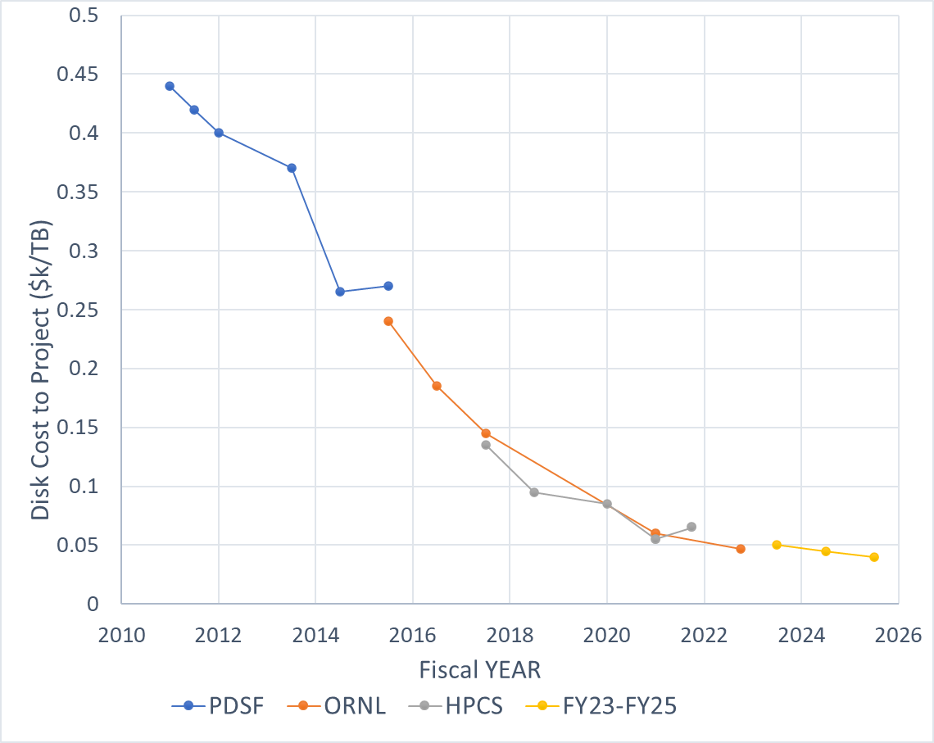
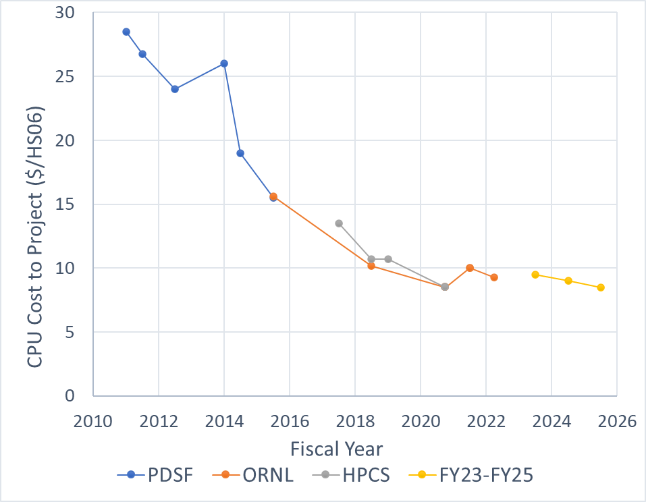
Cost trends for the CPU and Storage
CPU unit cost per HS06 is based on extrapolating the CPU clock frequency
We’ll measure the new HS23 values as soon as the new hardware is deployed

Slide 9
PEAP 2025 Quarterly Milestones – Q1-Q2
Q1 FY2025
Upgrade remaining centos7 ORNL cluster and merge with the new rocky9 cluster
Transition LBNL to HTCondor CE setup
Restore HTTPS support in EOS at ORNL and LBNL
ORNL: IPv6 support
Receive and review 2025 ERCAP allocations at NERSC
Understand and address ongoing EOS problems
Q2 FY2025
SLURM setup with ‘cgroups v2’ using workaround for rocky8
Evaluate EOS SE redesign for HPCS and AFP to increase IO performance
Update Analysis Facility Proposal to DOE
Attend EOS community workshop
Deploy LBNL/HPCS perfsonar, register with OSG, and upgrade dashboard
Attend High Throughput Computing meeting
Purchase new CPU for the 2025 RRB year

Slide 10
PEAP 2023 Quarterly Milestones – Q3-Q4
Q3 FY2025
Deploy new CPU on both sites according to 2025 pledges
Develop workflow for local users to run jobs on Perlmutter with the AF hosted datasets
Hold annual ALICE-USA/CERN resource review meeting at LBNL
Report status of ALICE-USA grid operations at annual ALICE T1/T2 Workshop
Review updated ALICE requirements for 2025-2026
Q4 FY2025
Update PEAP for FY2026
Purchase and deploy remaining disk storage as needed depending on utilization
Submit FY2026 ERCAP request for NERSC HPC CPU allocation
Submit 2026 WLCG pledges

Slide 11


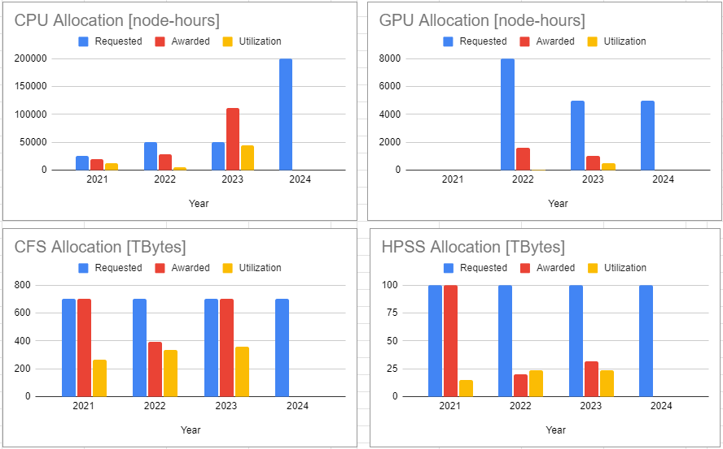
NERSC Allocation
As part of the project, we request allocation on NERSC HPCs
2024 CPU initial award was only 60,000 node-hours
We requested additional resources and were awarded another 140,000
We plan to request same amount next year
GPU resources were requested as well again in 2024

Slide 12
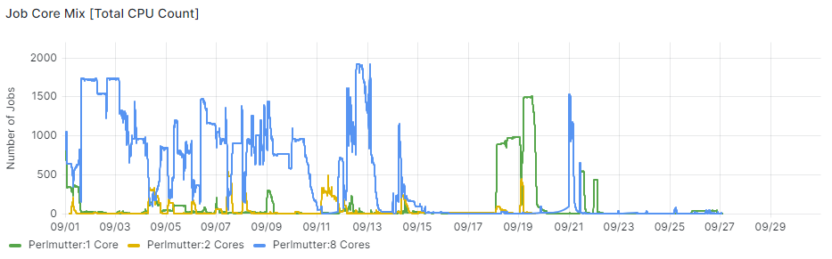
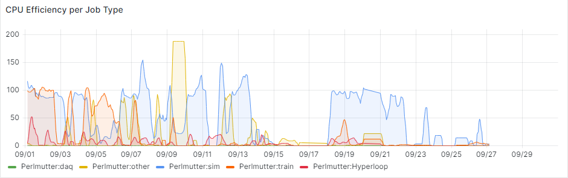
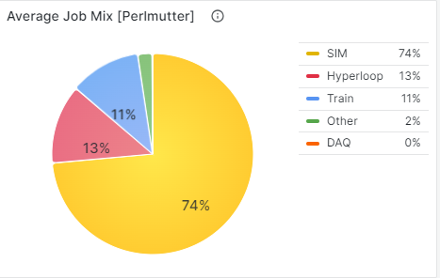
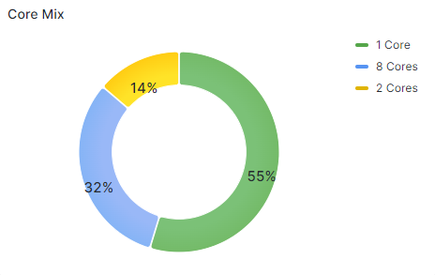
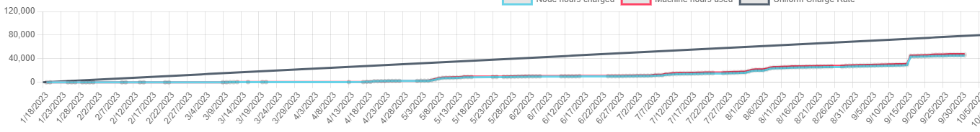
Perlmutter
Running on a VO box on Lawrencium NOW using SHARED USER
300 TB of scratch space
Some debugging ongoing for the large number of idle CPU jobs

Slide 13
Summary
We have 2025 plan in place
2024 storage is purchased but is awaiting delivery and deployment
2025 plan is to catch up to HS23 pledges with T2 resources only
Lawrencium contribution is expected to come back with October upgrade
Perlmutter is going strong, and we will request same number of resources in 2025

Slide 14

Questions

