Slide 1




ALICE-USA Computing Project
Status Report
ALICE-USA Computing Annual Meeting @ LBNL
September 18, 2024
Irakli Chakaberia

Slide 2
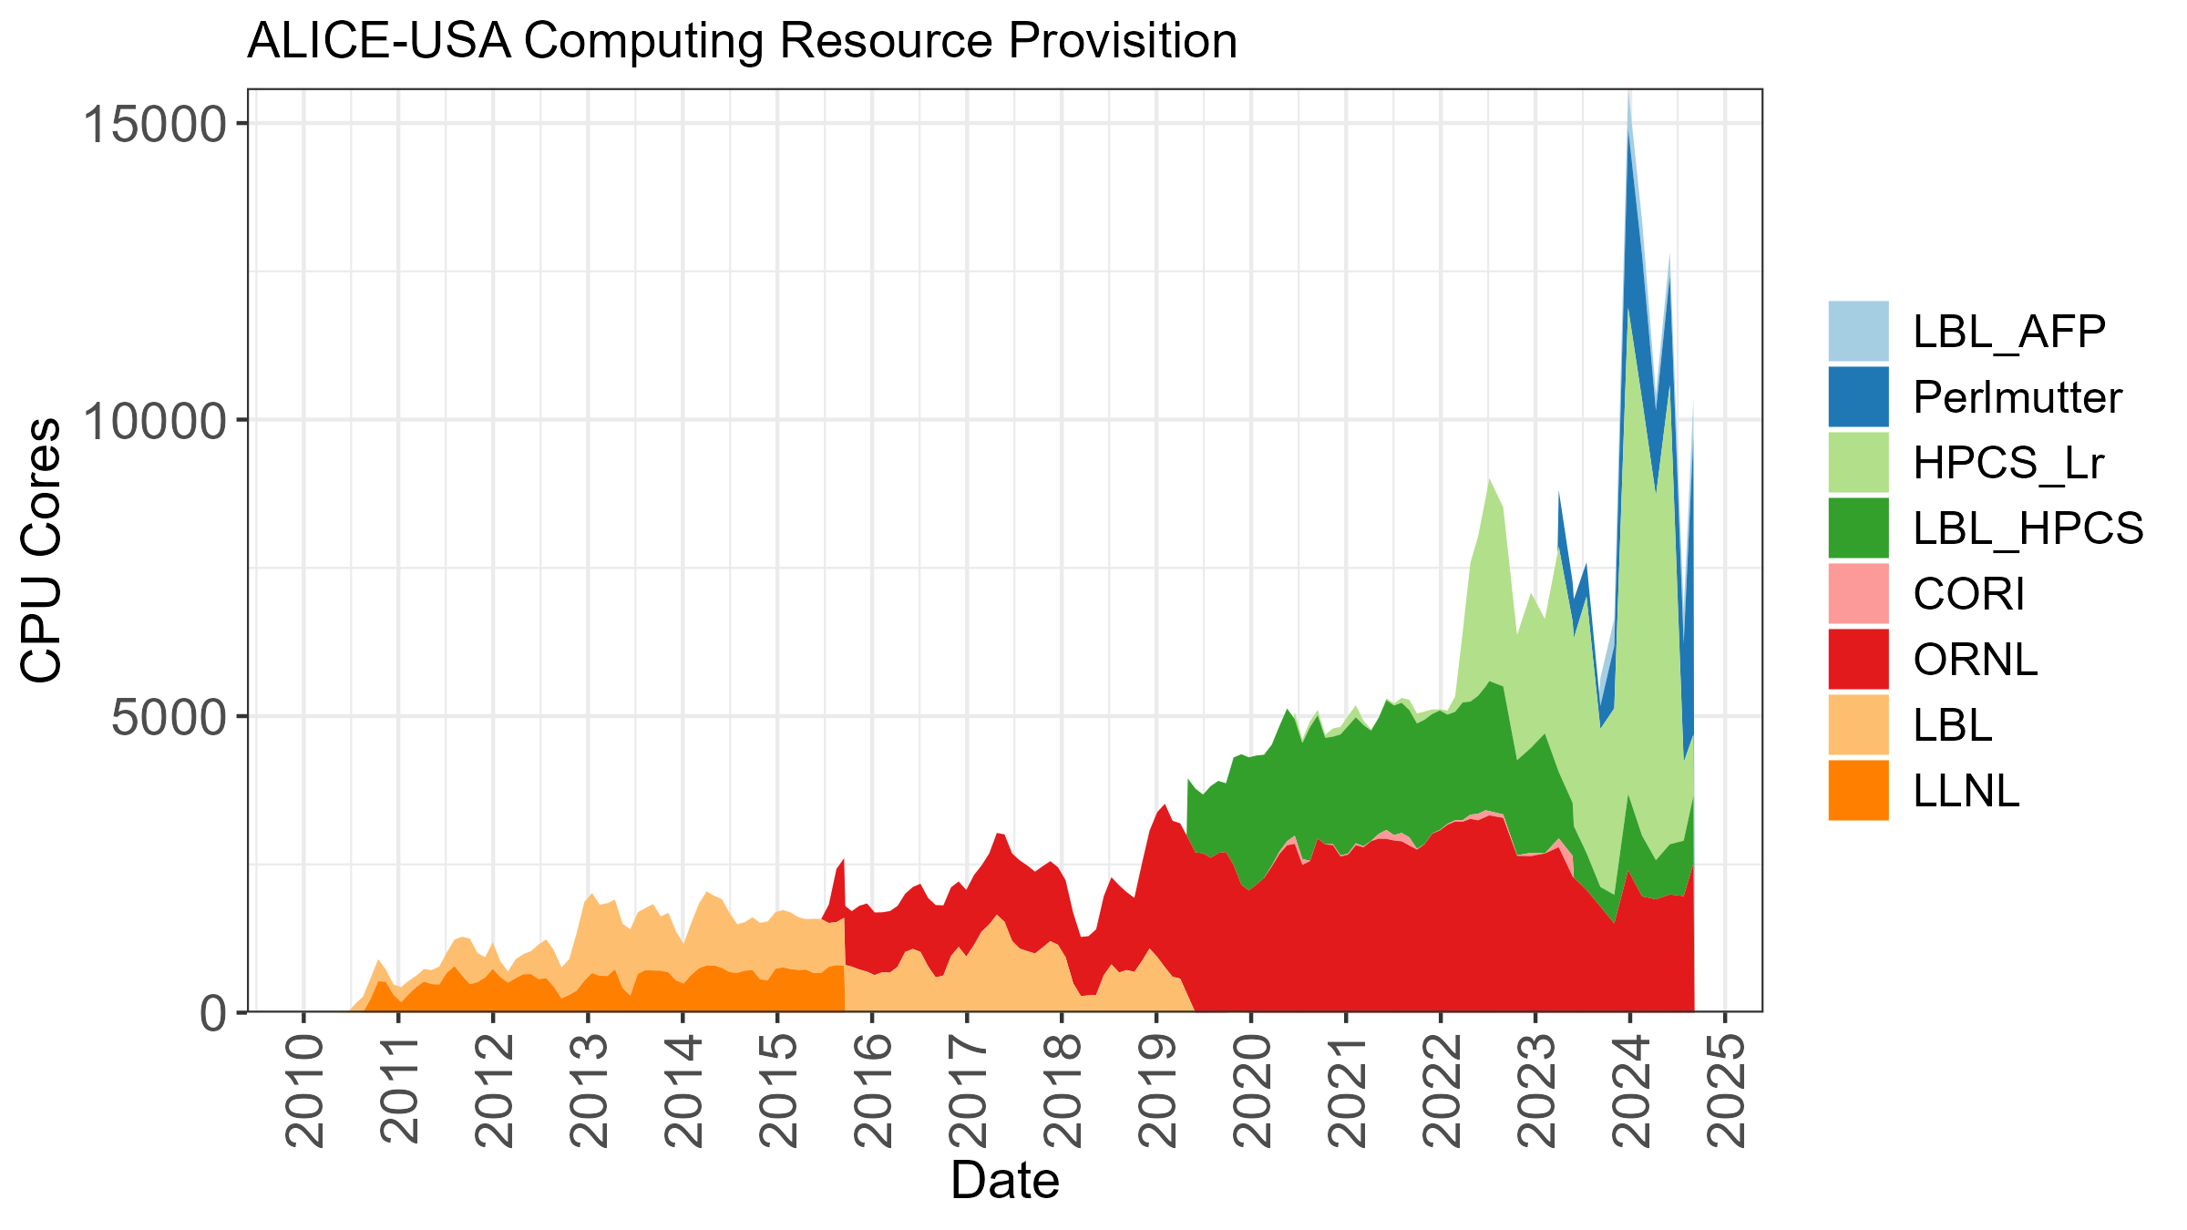
Brief History
Original Project Proposal – 2009
  15 years since its inception
In operational since 2010
  Nearing 15-year anniversary ☺
3-Year Project Review Cycle
  Initial plan requested in 2014
  Latest review in July 2021
  Potential review in 2025
Project Execution & Acquisition Plan (PEAP)
  Multi-year plan containing resource delivery,
  milestones, budget estimates, operations guide
  updated annually & submitted to DOE
  Latest one submitted in October 2023
ALICE-USA Computing Website: https://sites.google.com/lbl.gov/alice-usa-computing/meetings?authuser=1

Slide 3










US Department of Energy Supported ALICE-USA Group
The project’s main goal is to fulfills DOE funded MoU-based ALICE USA obligations for
  11 Institutions
  45 M&OA
Operates ALICE grid facilities at 2 DOE labs
ALICE-USA Computing core group meets monthly, every third Tuesday of the Month
We keep very close contact on our SLACK channel
Nominally we try to hold two annual grid review meetings
  Spring meeting at LBL
  Fall meeting at ORNL

Slide 4
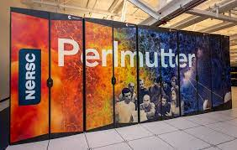
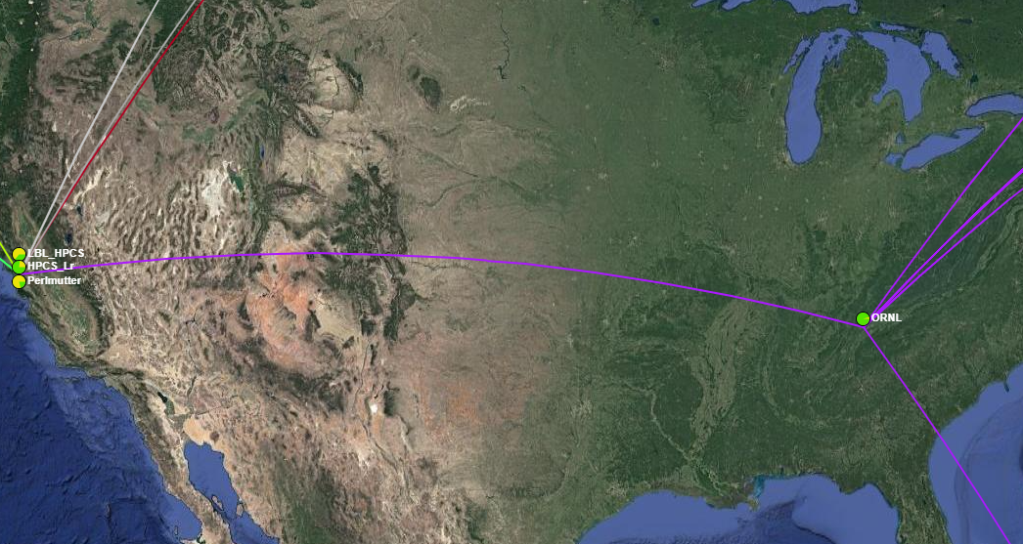
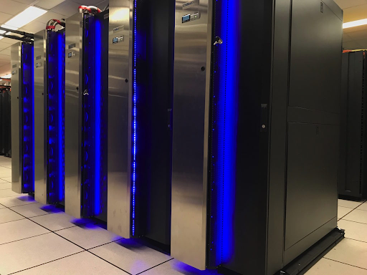

ALICE-USA T2 Sites & Analysis Facility (Prototype)
Project currently operates two T2 sites at ORNL and LBNL
The analysis facility prototype we deployed almost exactly a year ago have been up and operational since with some restrictions on number of jobs
In addition, we provide resources on Lawrencium (opportunistic) and Perlmutter HPCs

Slide 5
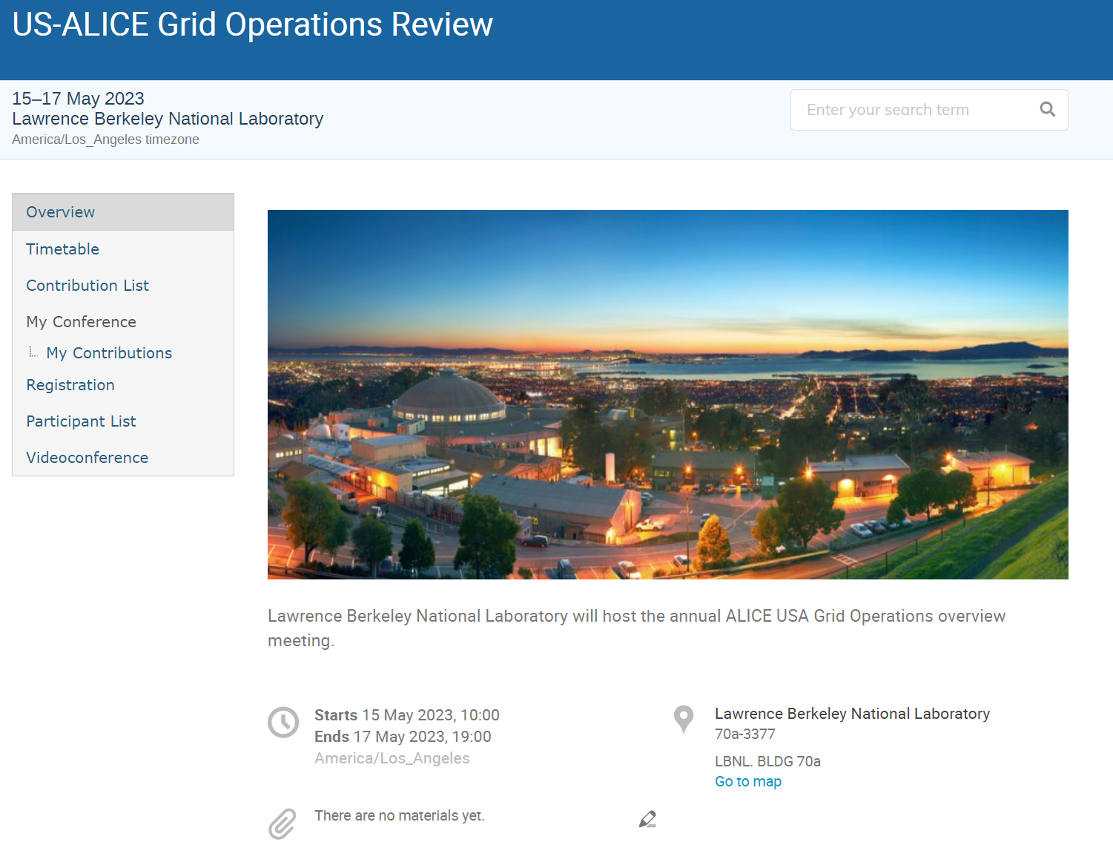
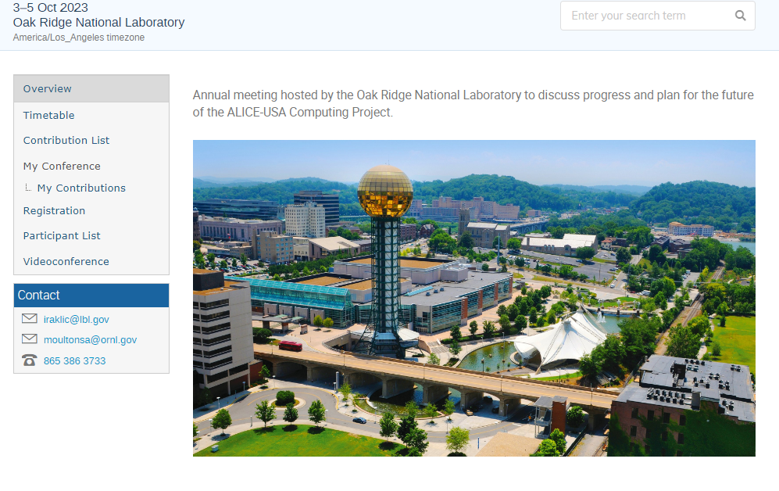
US-ALICE Computing Annual Meetings
US Grid Operations review in May 2023
ALICE-USA Computing Meeting at ORNL in October 2023

Slide 6
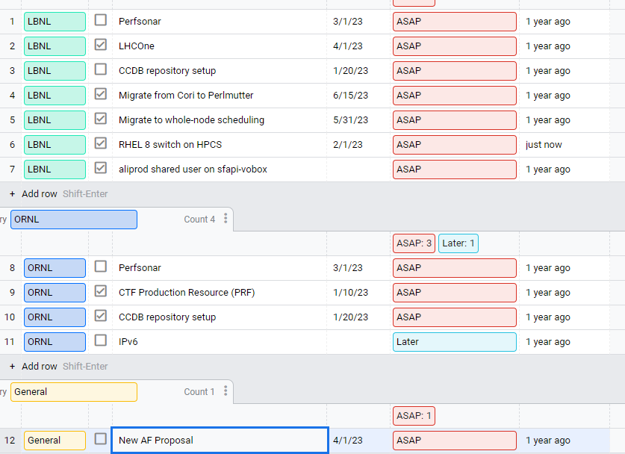
Task Tracking
After a meeting at ORNL we identified additional tasks not outlined in the key deliverables in PEAP
We set up a task tracking for the group
Remaining tasks
  Perfsonar at both sites
    Low priority
  CCDB @ LBNL – if needed and beneficial
    Have not seen problems related with CCDB delay (input box)
  IPv6 @ ORNL
Done but waiting for a favorable time
  New AF proposal to DOE

Slide 7
Status of operations
Monthly - August (since today we nominally would have a monthly meeting)
Since the last meeting @ ORNL

Slide 8
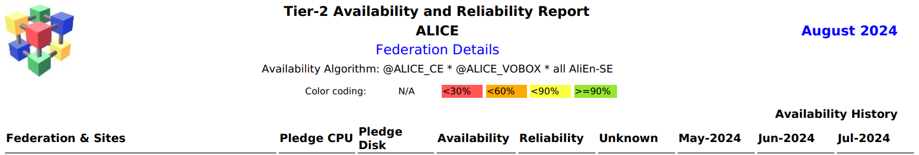
WLCG: August 2024
Lowest I remember. This is due to EOS issues.

Slide 9
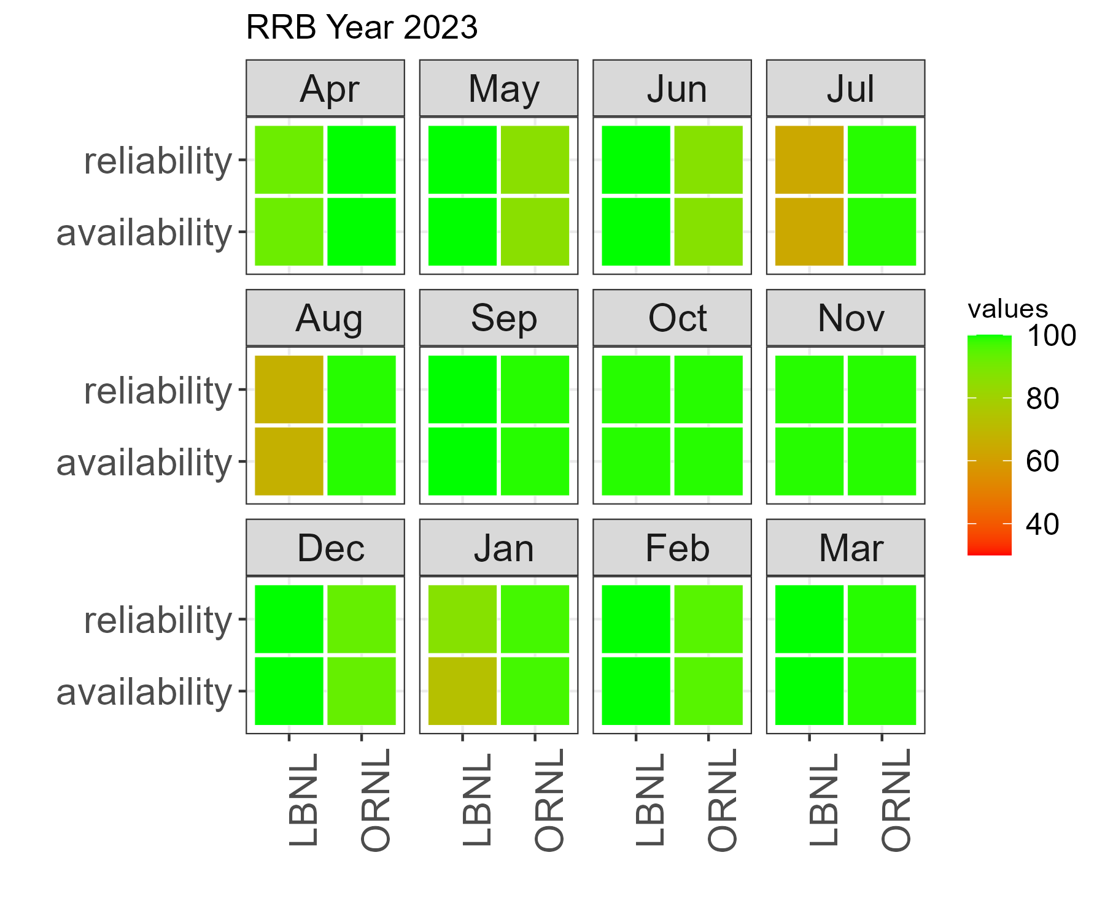
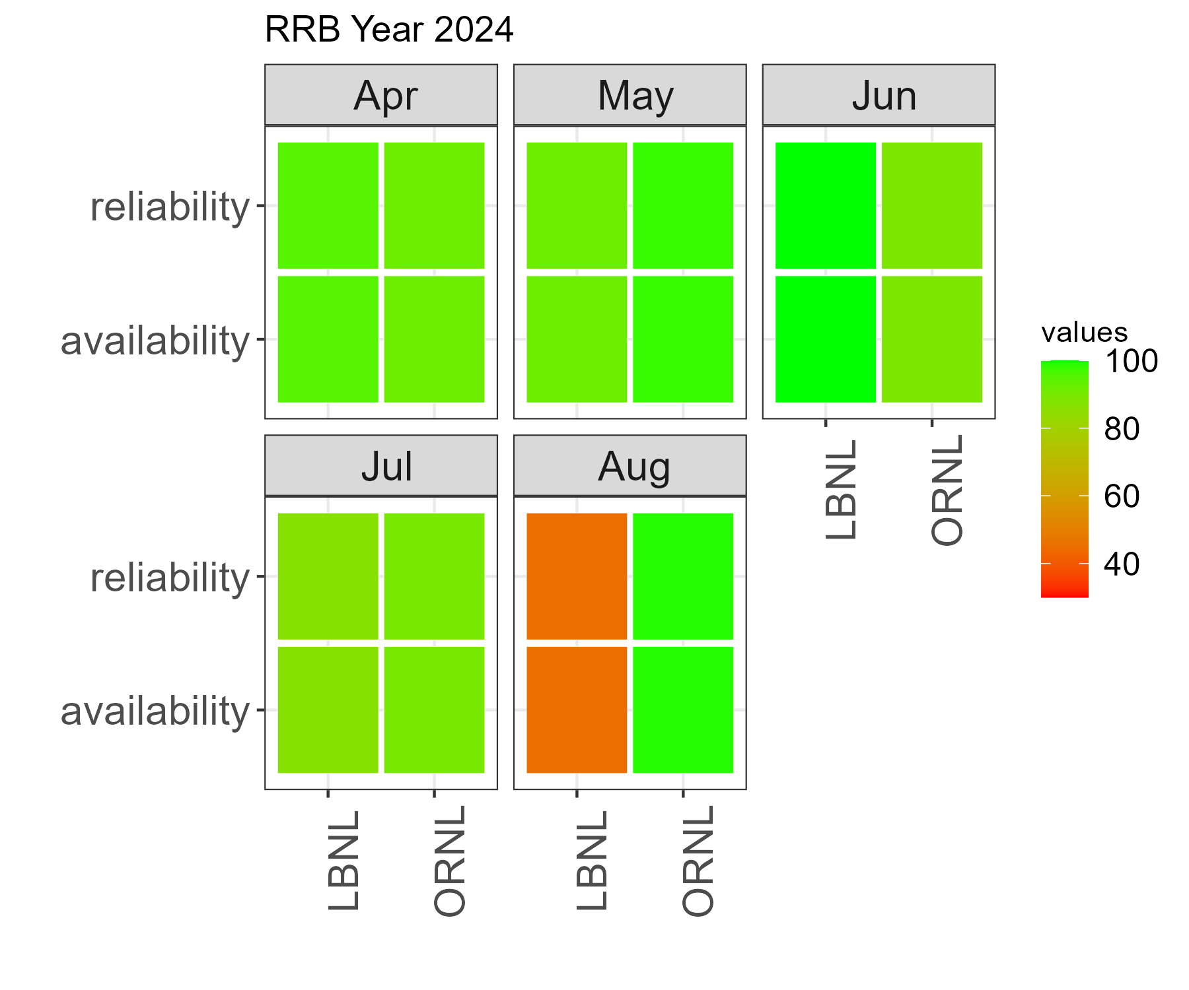
WLCG: October 2024 to Now
Availability Algorithm:
@ALICE_CE * @ALICE_VOBOX * all AliEn-SE
Since October 2024 we have reported only 290 hours downtime for the LBL_HPCS (and Lawrencium). No downtime at ORNL.
Low availability is solely due to the challenges related our SEs

Slide 10
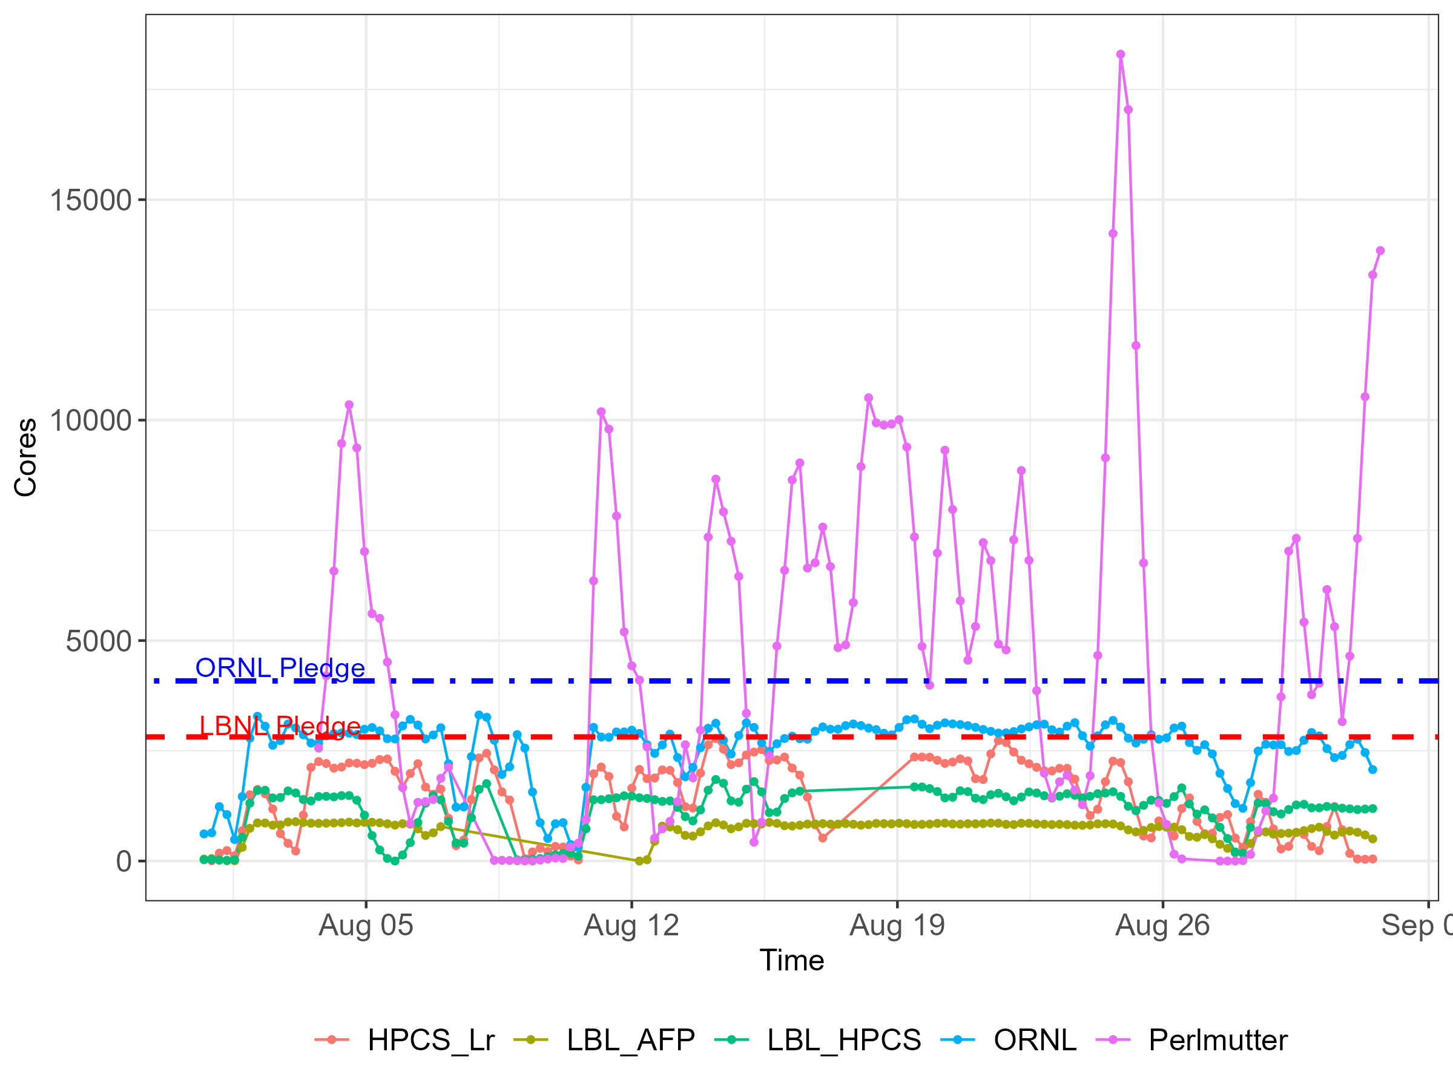
August 2024
Total number of jobs
  MC job load pretty high this month
  Perlmutter load is a good indication of MC jobs, as we only run MC on it
CEs
  LBL-HPCS - OK
  ORNL - OK
  Lawrencium
    Many nodes with broken CVMFS
    Tried to remove nodes as I saw them failing jobs
    More and more nodes joining broken CVMFS group
  Perlmutter – OK
    Huge number of jobs and allocated slots
  LBL_AFP - OK

Slide 11
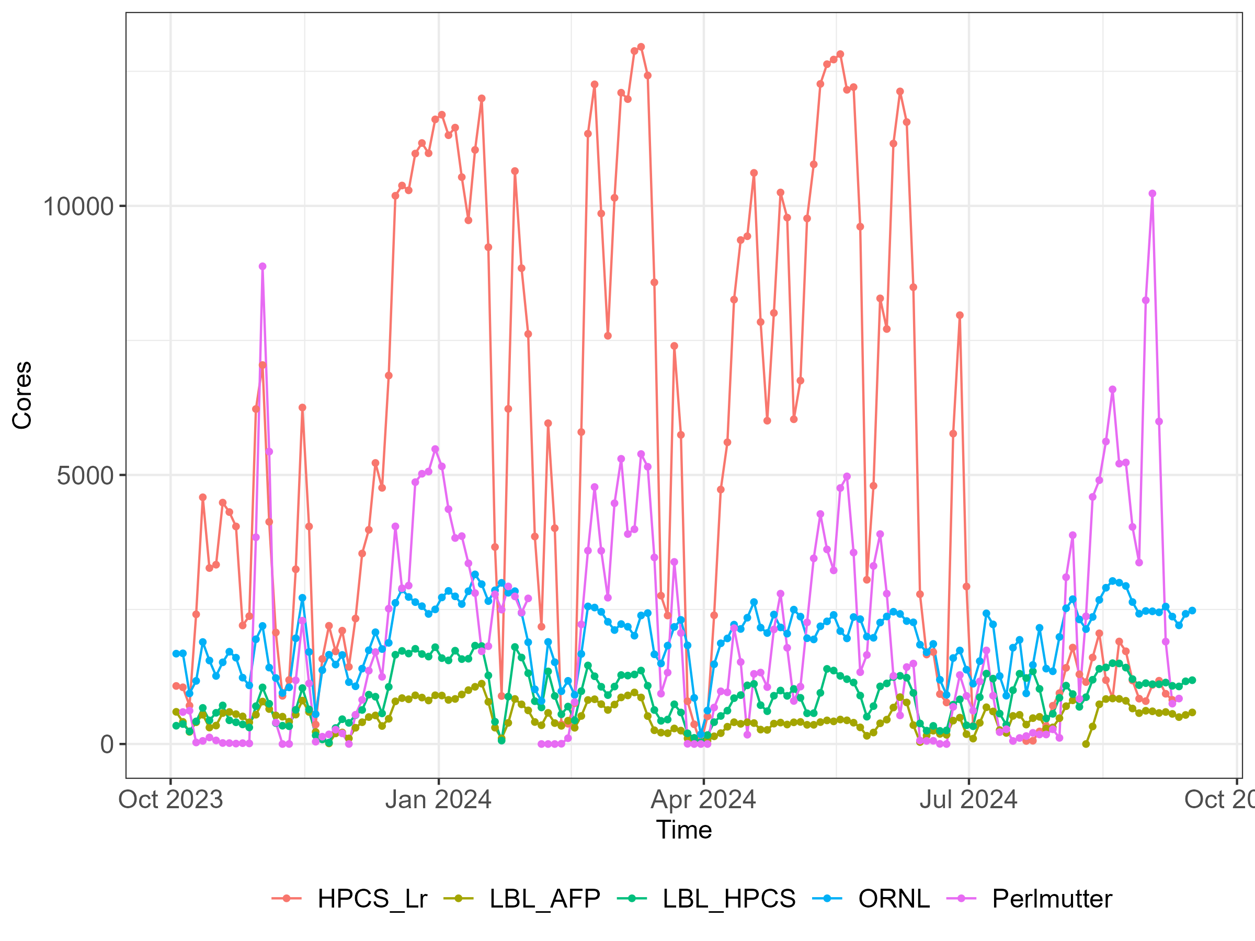
October 2023 to Now
Compute Elements
  LBL-HPCS
    Steady performance
    Almost no downtime, except a couple of CVMFS fixes and scheduled downtimes
  ORNL
    Steady performance
    Very soon will add about 2700 cores
  Lawrencium
    Very reliable and valuable resource
    CVMFS issues after OS upgrade
    Awaiting downtime in October that will come with kernel update
  Perlmutter
    Overall, pretty good allocation of nodes
  LBL_AFP
    Almost no downtime, except a couple of CVMFS fixes and scheduled downtimes

Slide 12
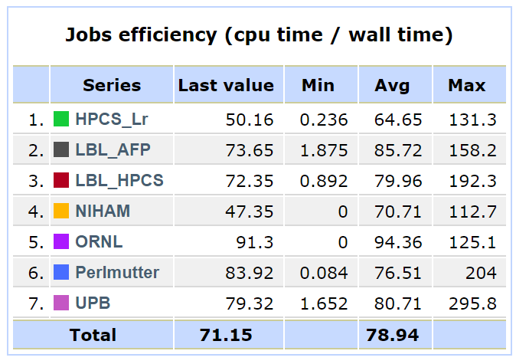
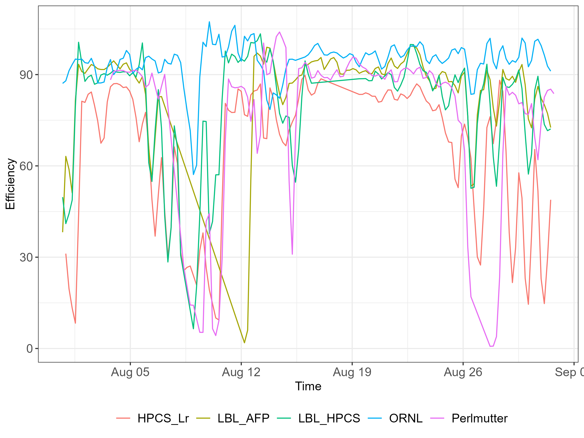
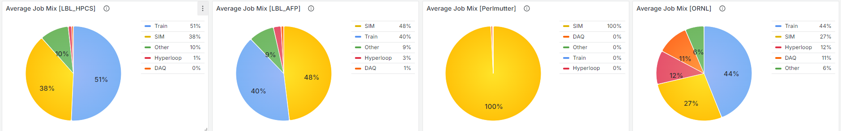
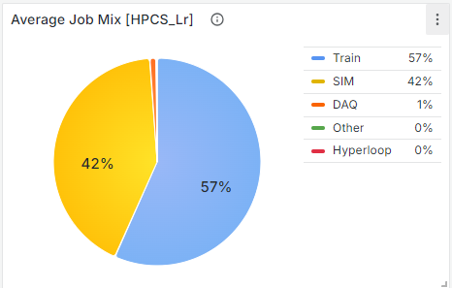
Efficiency: August 2024

Slide 13
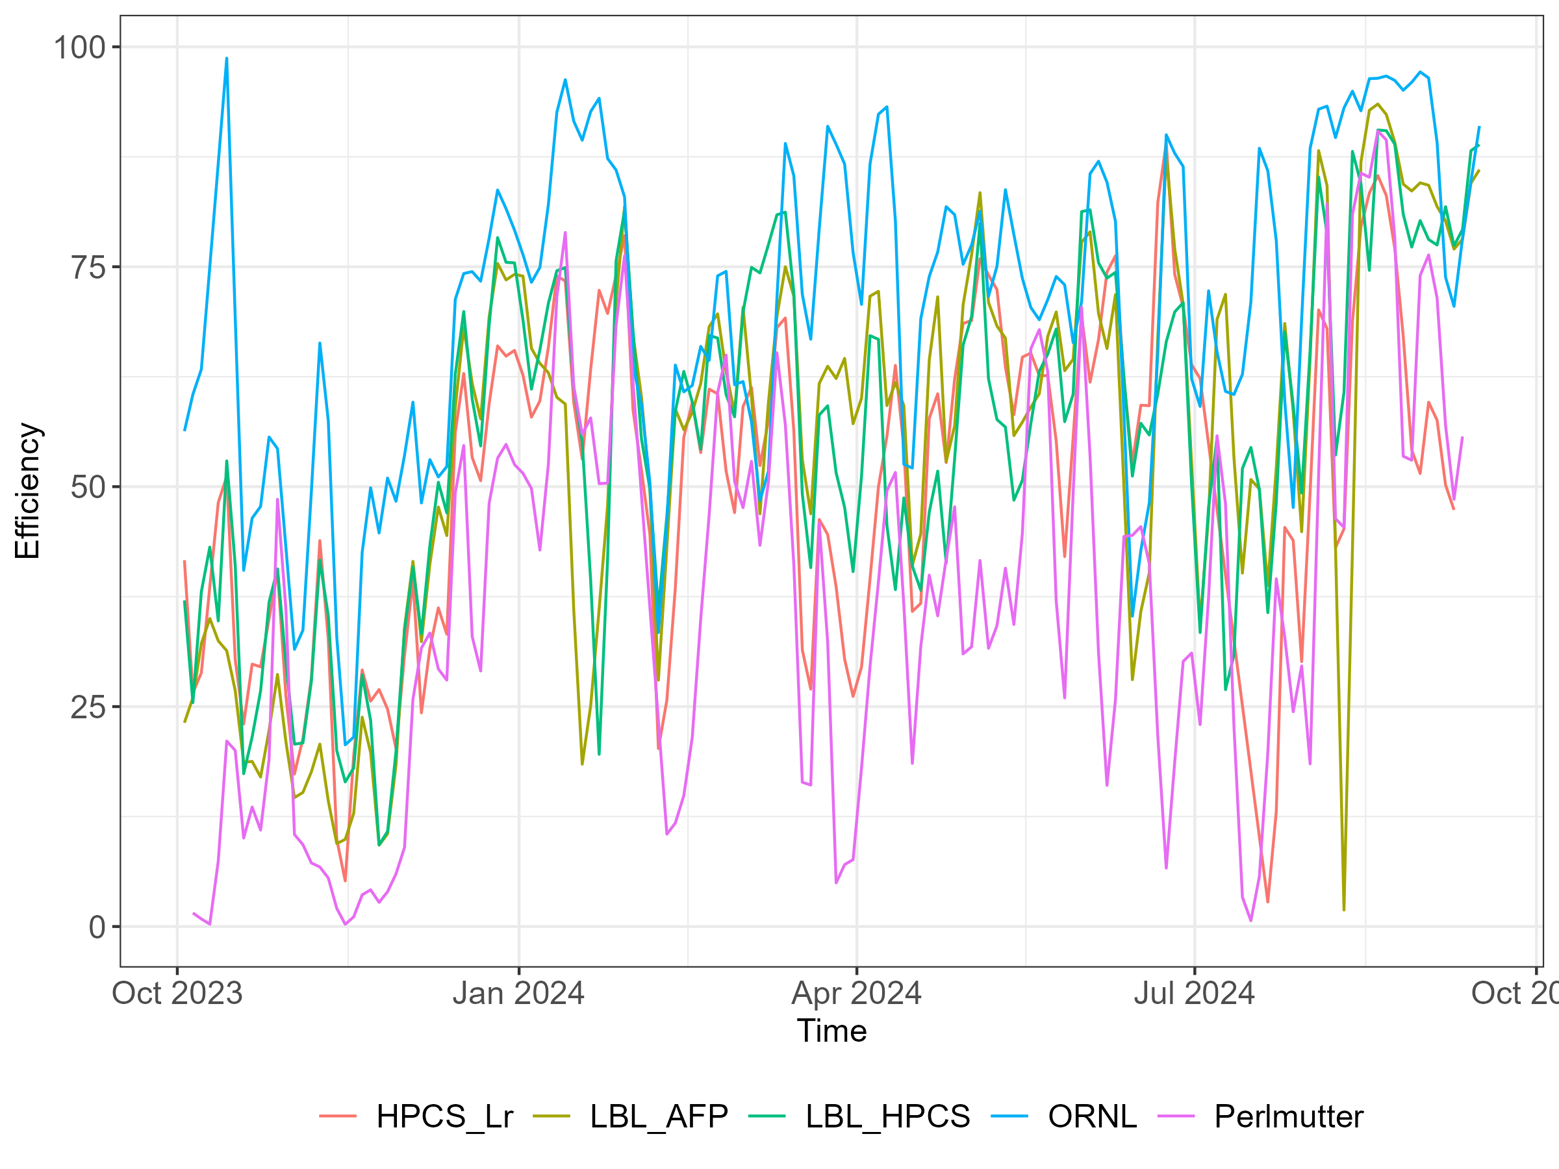
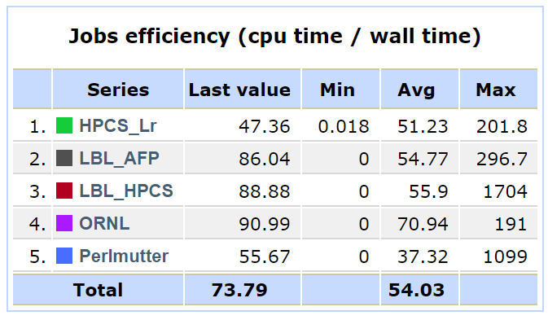
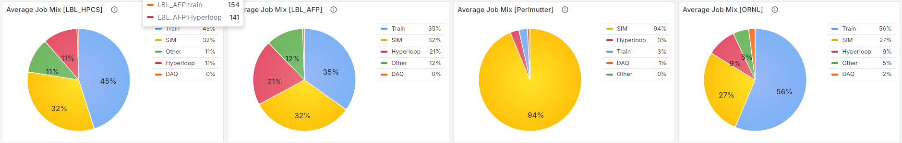
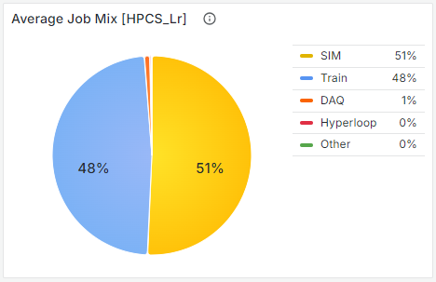
Efficiency: October 2023 to Now

Slide 14
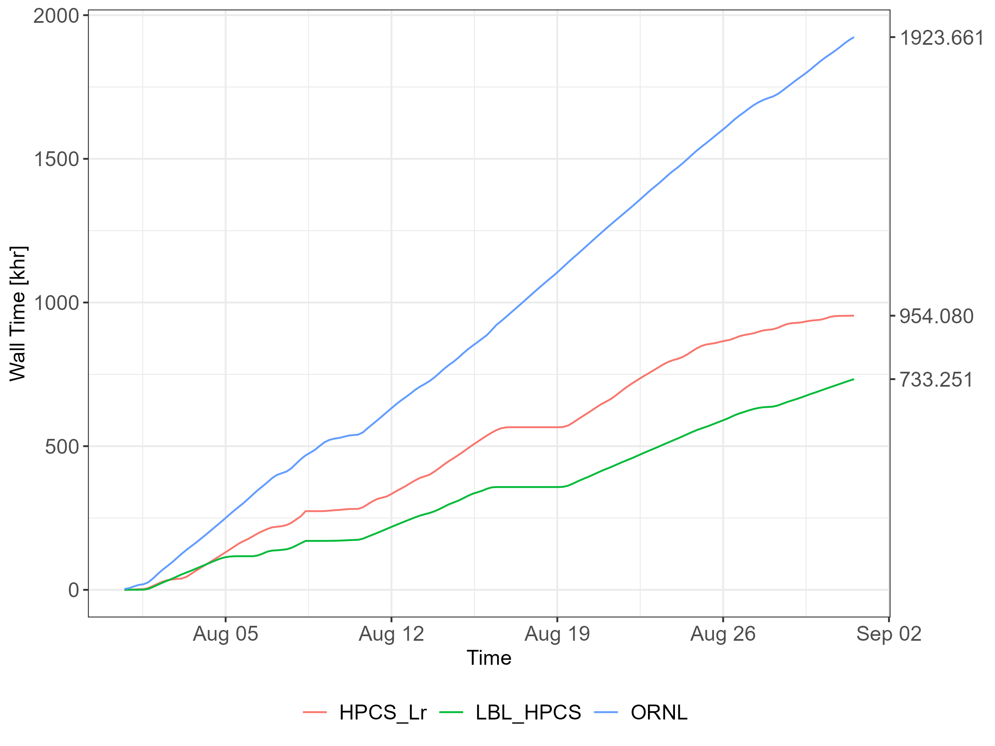
Accounting: August 2024
CPU Obligations | kHS06
ALICE-USA | 100.9
LBNL HPCS T2 | 50.45
ORNL T2 | 50.45
T2 Site | Monalisa (khr) | WLCG (khr) | %diff
HPCS_Lr | 954.08 | 2100.00 | 19.65
LBNL | 733.25
ORNL | 1923.66 | 2568.66 | 25.11
Total | 3,610.99 | 4,668.66 | 22.65
T2 Site and HPCS_Lr | CPU/Core [HS06/Core] | ALICE-USA Obligation [MHS06 x hr] | CPU Delivered [MHS23 x hr] (ML reporter) | CPU Delivered [MHS23 x hr] (WLCG reporter) | Delivered per Obligation [%] (ML reported) | Delivered per Obligation [%] (WLCG reported)
HPCS_Lr | 12.0 | 32.29 | 11.45 | 25.20 | 35.5 | 78.0
LBNL | 16.7 |  | 12.25 |  | 37.9
ORNL | 11.5 | 37.53 | 22.12 | 29.54 | 58.9 | 78.7
Total |  | 69.82 | 45.82 | 54.74 | 65.62% | 78.40%
N.B. We do not run accounting on Perlmutter & AFP. Including these we provided over 100% this month.

Slide 15
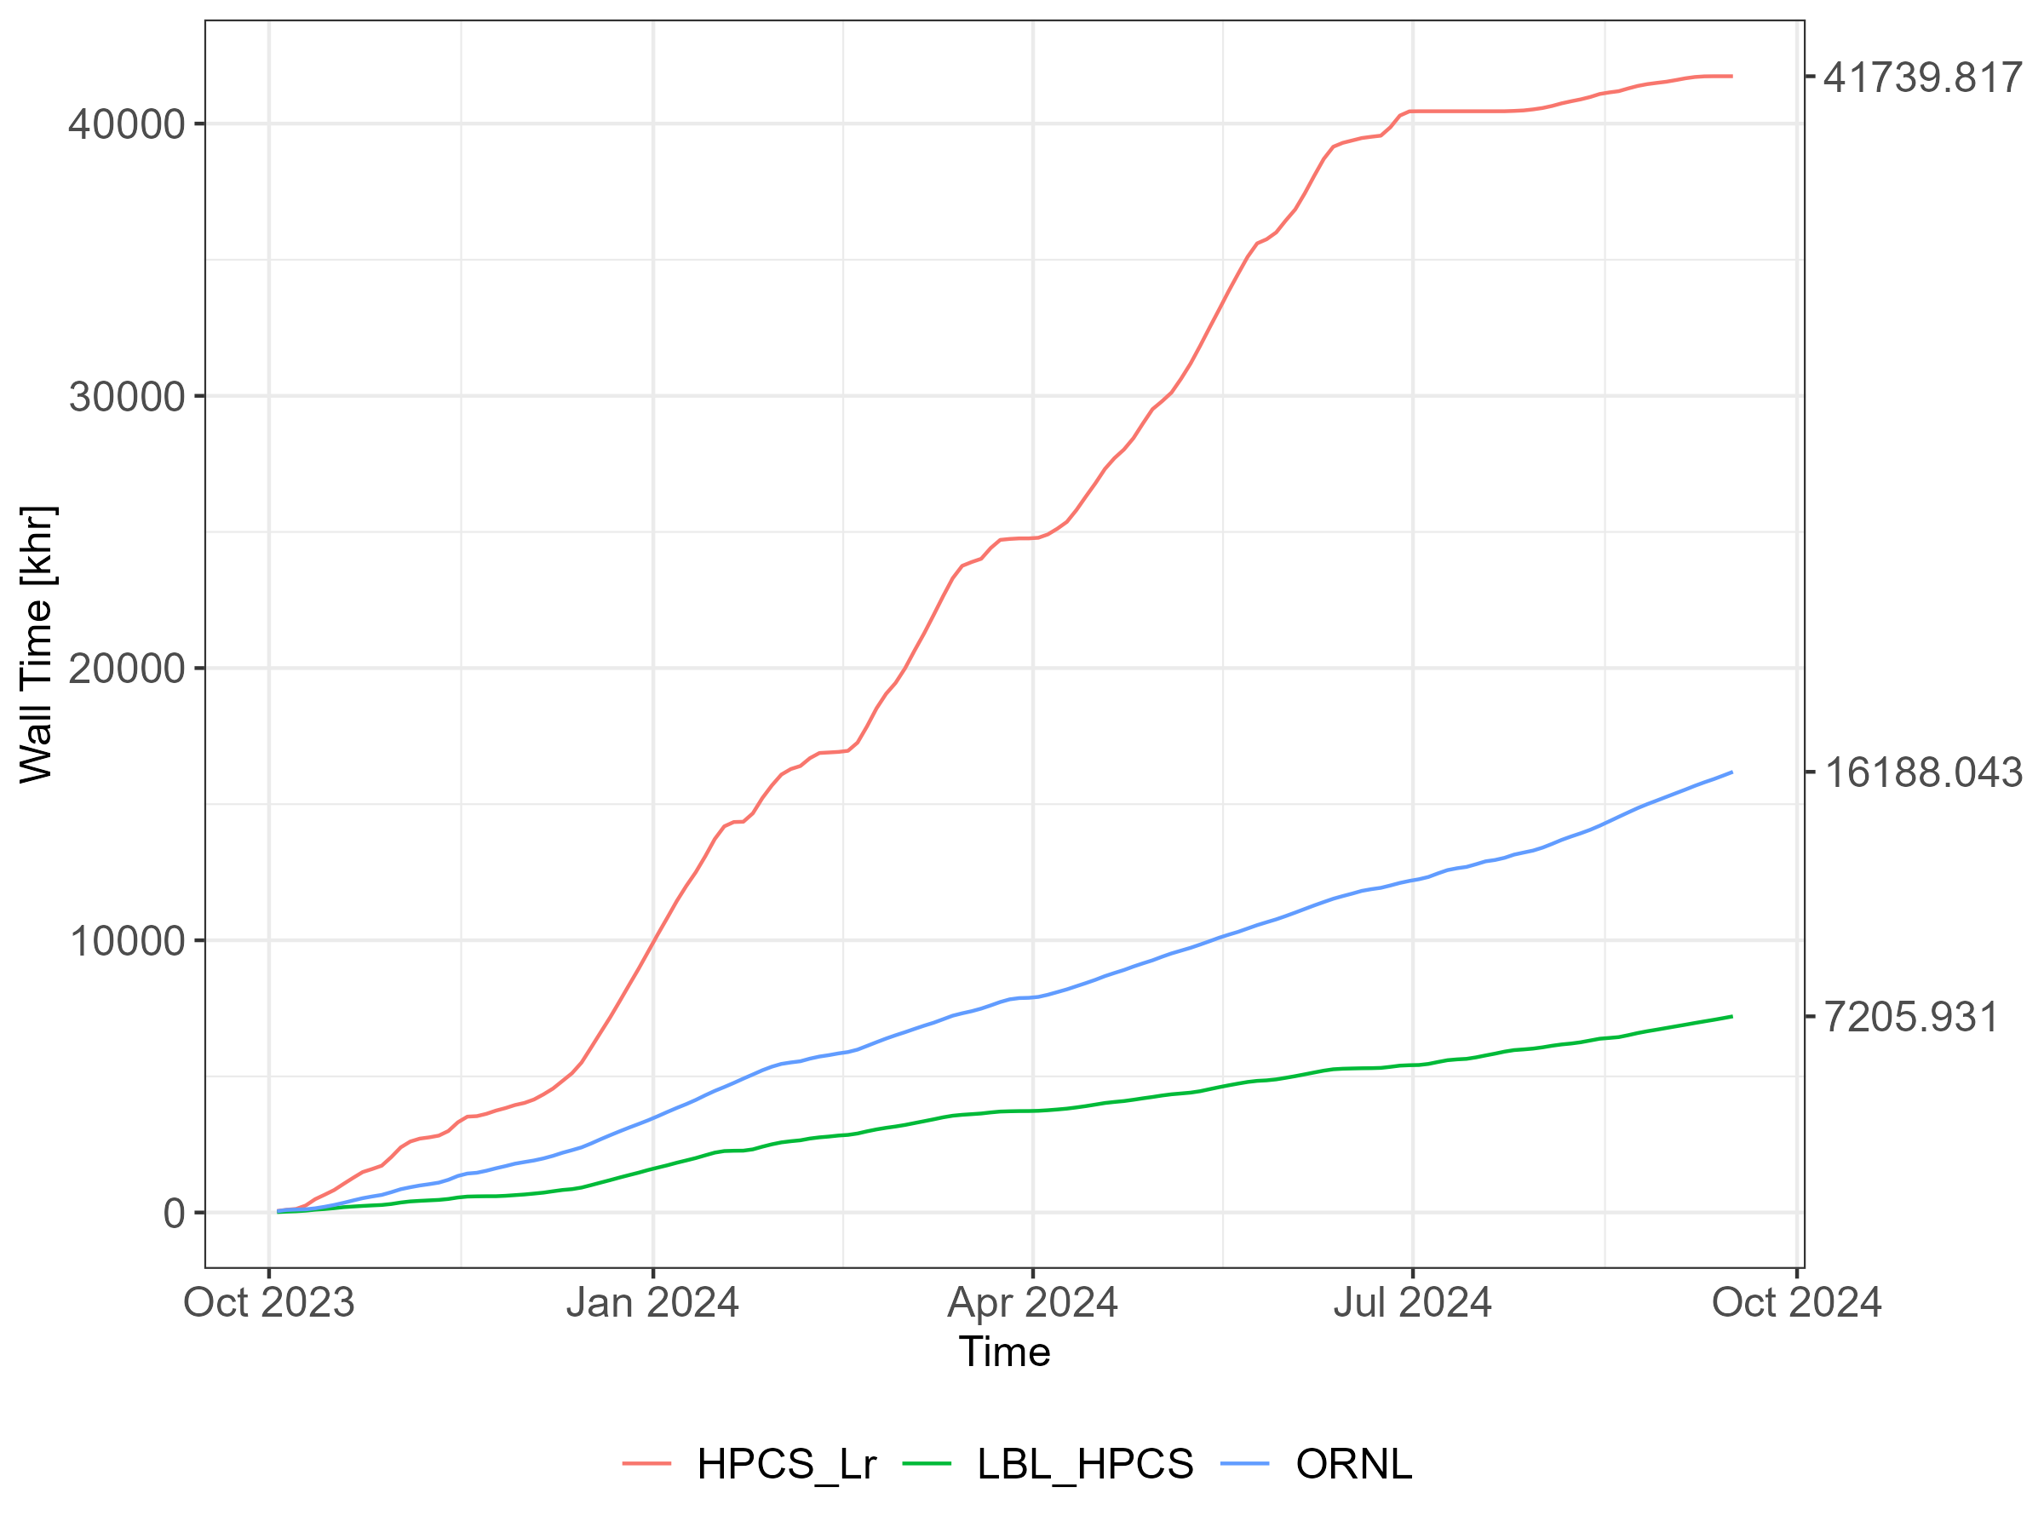
Accounting: October 2023 to Now
This period covers 50/50 RRB2023 and RRB2024
Including Lr resources that we had in reporting to OSG we overdelivered both times
In 2024 plan we had 20 kHS23 from Lr, which was very conservative estimate
This have us option to throw all 2024 hardware budget to storage
In 2025 we have 10 kHS23 from Lr to cushion the hardware budget a little

Slide 16
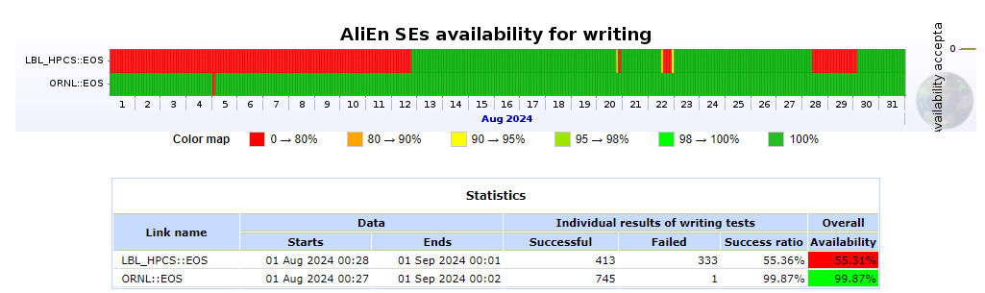
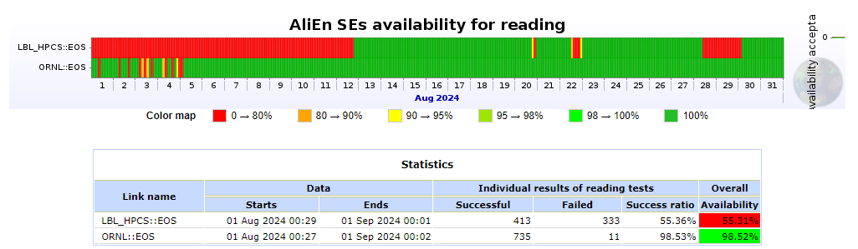
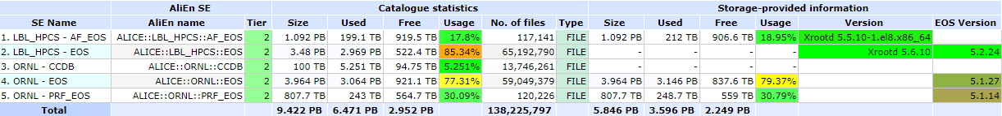
EOS: August 2024

Slide 17
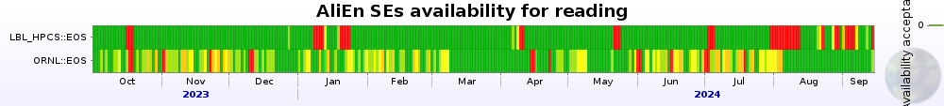
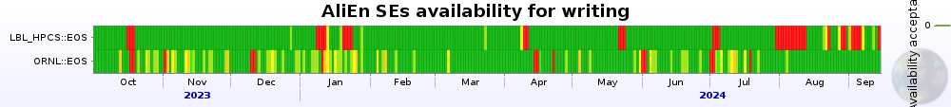
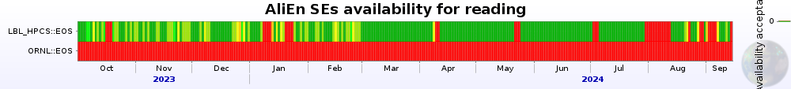
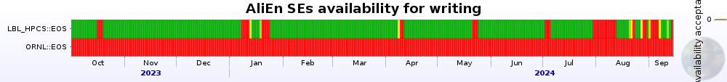
EOS: October 2023 to Now
IPv4/IPv6
SE availability
  LBNL: some problems starting late July
  ORNL: “file corruption” problem after same one solved @ LBNL appeared only to disappear after simple mgm restarts?!
IPv6 has been up at LBNL since early RRB2021
IPv6 at ORNL is still looming on a horizon
IPv6 Only
 | READ | WRITE
LBNL | 89.3 | 89.3
ORNL | 94.0 | 96.0

Slide 18
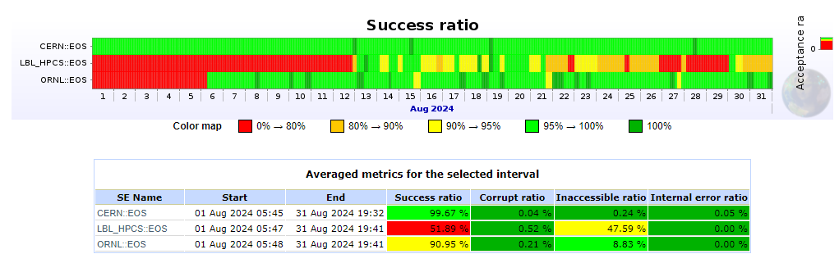
EOS: Success Ration: August 2024
Crawler reports significant improvement of ORNL problem since mgm restarts in early August
However, in last two weeks, same problems started to show back up at LBNL (the problem that seem to have been solved a few month ago)
This is perhaps the indication of EOS issues rather than actual file corruption
  High memory use on mgms?
John has a ticket open at EOS forum

Slide 19
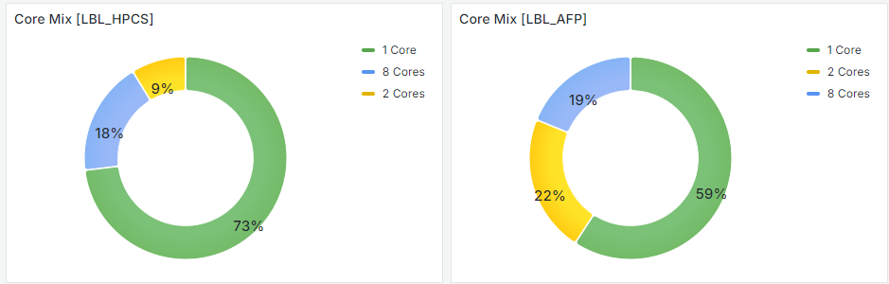
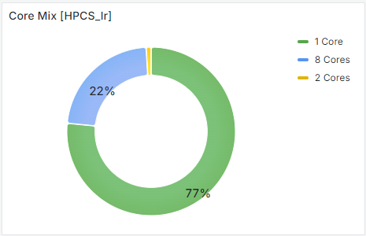
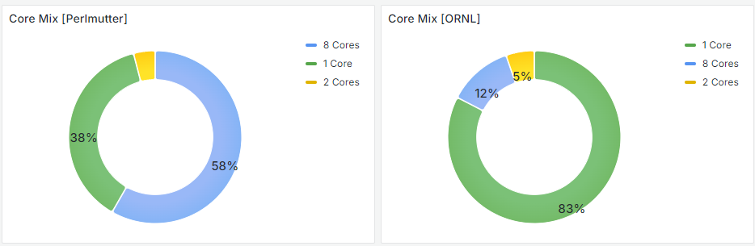
Job Core Mix: October 2023 to Now

Slide 20
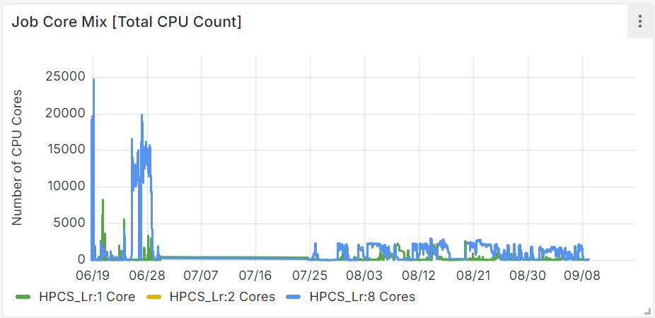
OS Update
LBNL Switched to rocky8
  We noticed problems on LBL_HPCS where root.exe processes would sometimes hand consequently draining the node
  Did many tests to try to reproduce the problem consistently but it was very intermittent and unreproducible when submitting jobs manually
  Finally, an update of kernel to it’s “latest” version solved the problem
  This update was done on LBL_HPCS cluster only, hence Lr remains on the default kernel
  However, the same problems did not show up on Lr
  But… CVMFS problems did. Many Lr (currently perhaps all) nodes had broken CVFMS
  Plan is to revisit CVMFS after Lr downtime (possible mid October)
ORNL
  New cluster with all rocky9 nodes was deployed
  Plan was to have this cluster with all the submission via HTCondor
  Once new cluster is fully operational rebuild old nodes and join

Slide 21
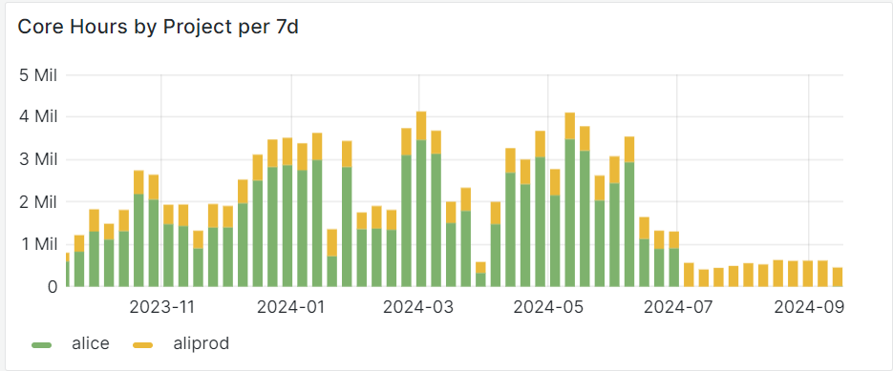
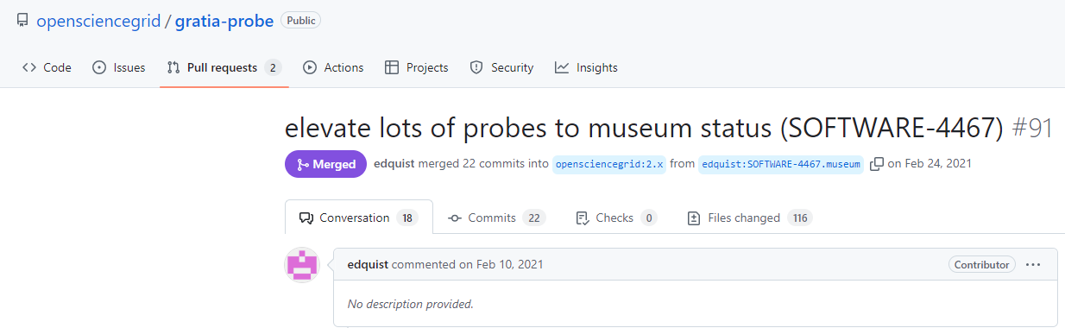
WLCG/OSG Accounting
Reporting/accounting to WLCG is done via OSG
OSG “gratia” tool collects batch system info and reports to GRACC
At some point OSG stopped maintaining separate dedicated probes for individual batch systems
We kept old “gratia” going but OS update necessitated the need for update
So we have to move to HTCondor CE

Slide 22
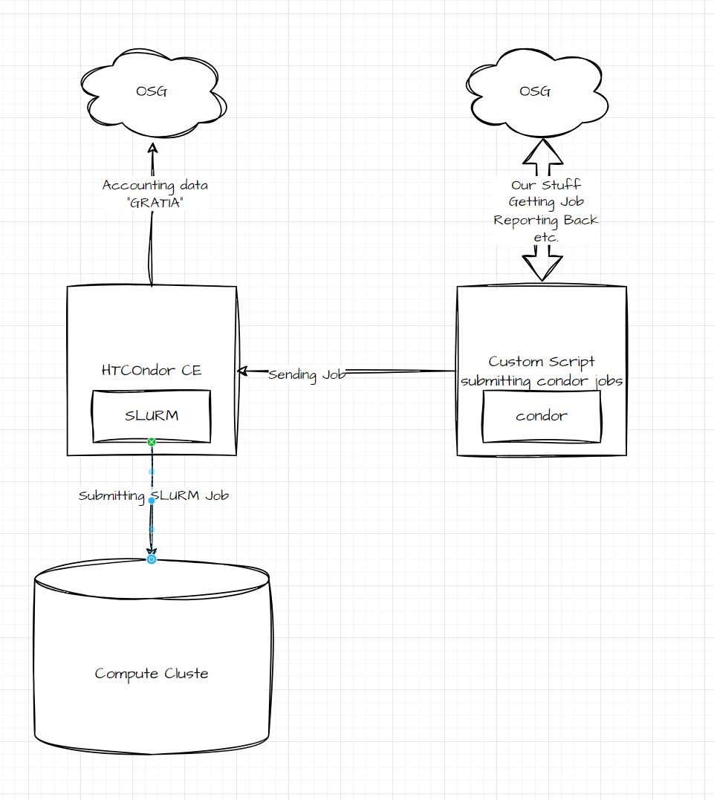
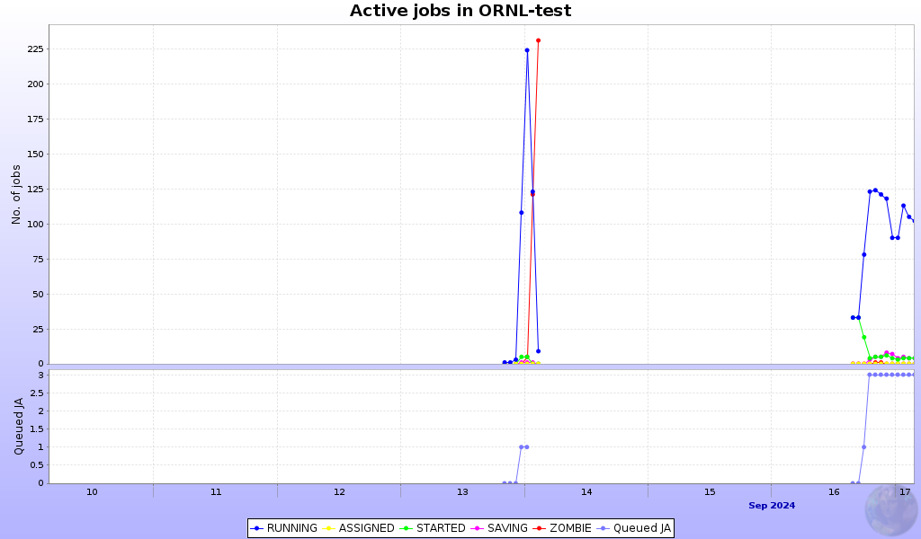
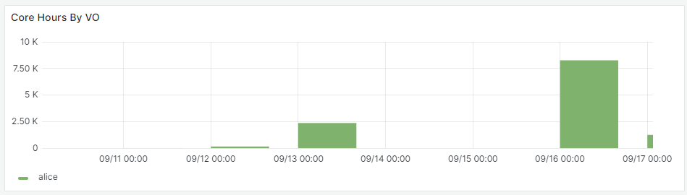
HTCondor @ ORNL
ALICE
After few weeks of going over many many config files
A lot of help from Maarten and HTCondor experts we have a working setup

Slide 23
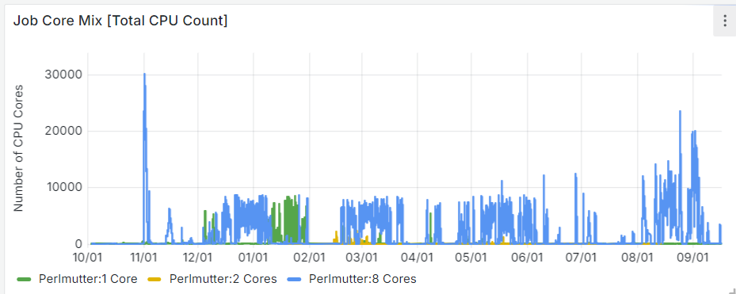
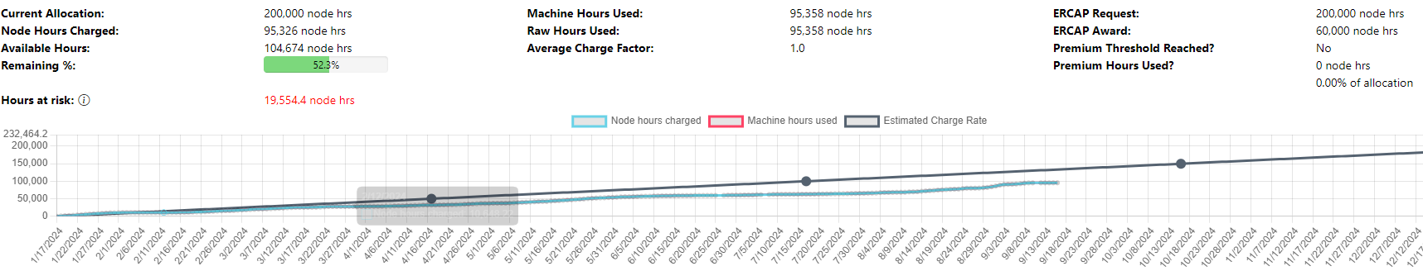
Perlmutter
In ERCAP 2024 we requested 200,000 node-hours
Initial award was only 60,000
But we were granted additional 140,000 as we demonstrated the successful use of this resource
We will apply for the same amount for 2025 allocation

Slide 24
Summary
ALICE-USA T2 sites are operational, growing, and updating
AFP is being maintained as an additional resource and a proof-of-principle for proposal renewal
HPC resources are going strong and alice project ERCAP for 2025 will request another 200,000 node-hours
We currently tackle issues with EOS
Lawrencium usage will be revisited after kernel update
HTCondor setup @ ORNL is complete
Same setup at LBNL will is next on the todo list

Slide 25

Questions

