Slide 1
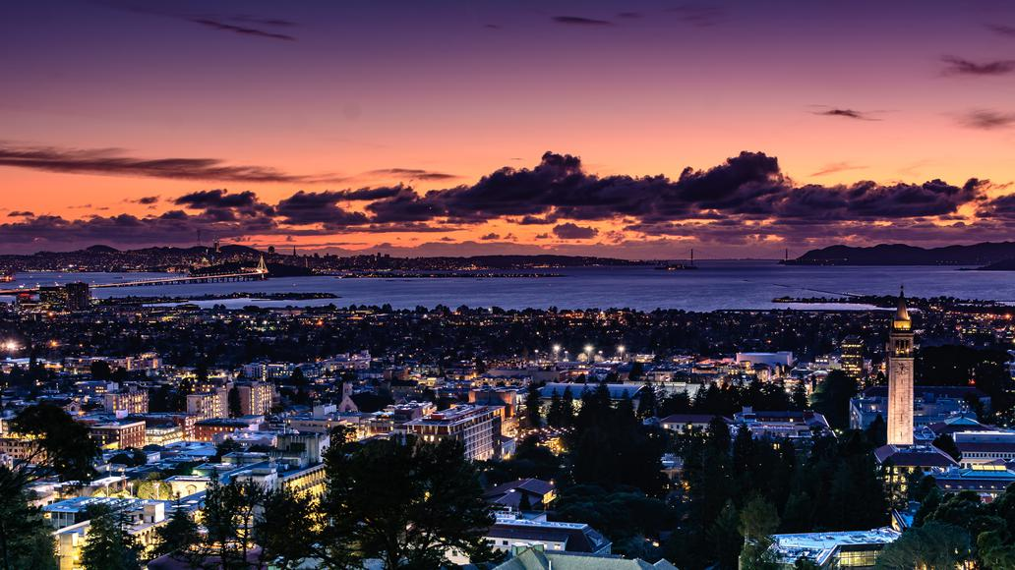
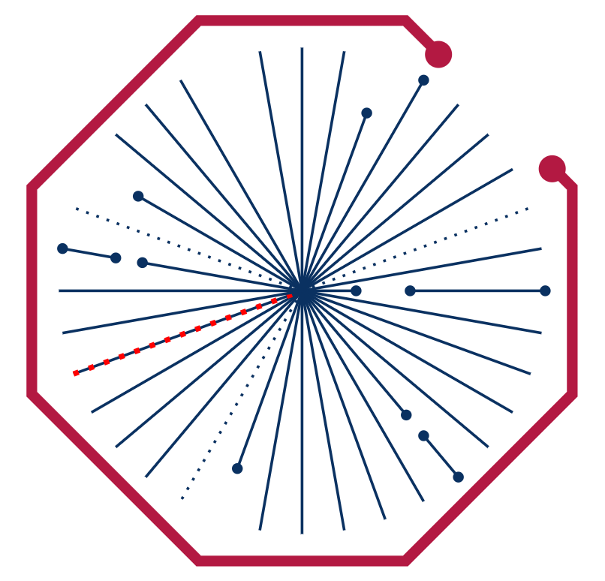
US-ALICE Grid Operations Review Meeting
September 17-19
LBNL, Berkeley, California

Slide 2
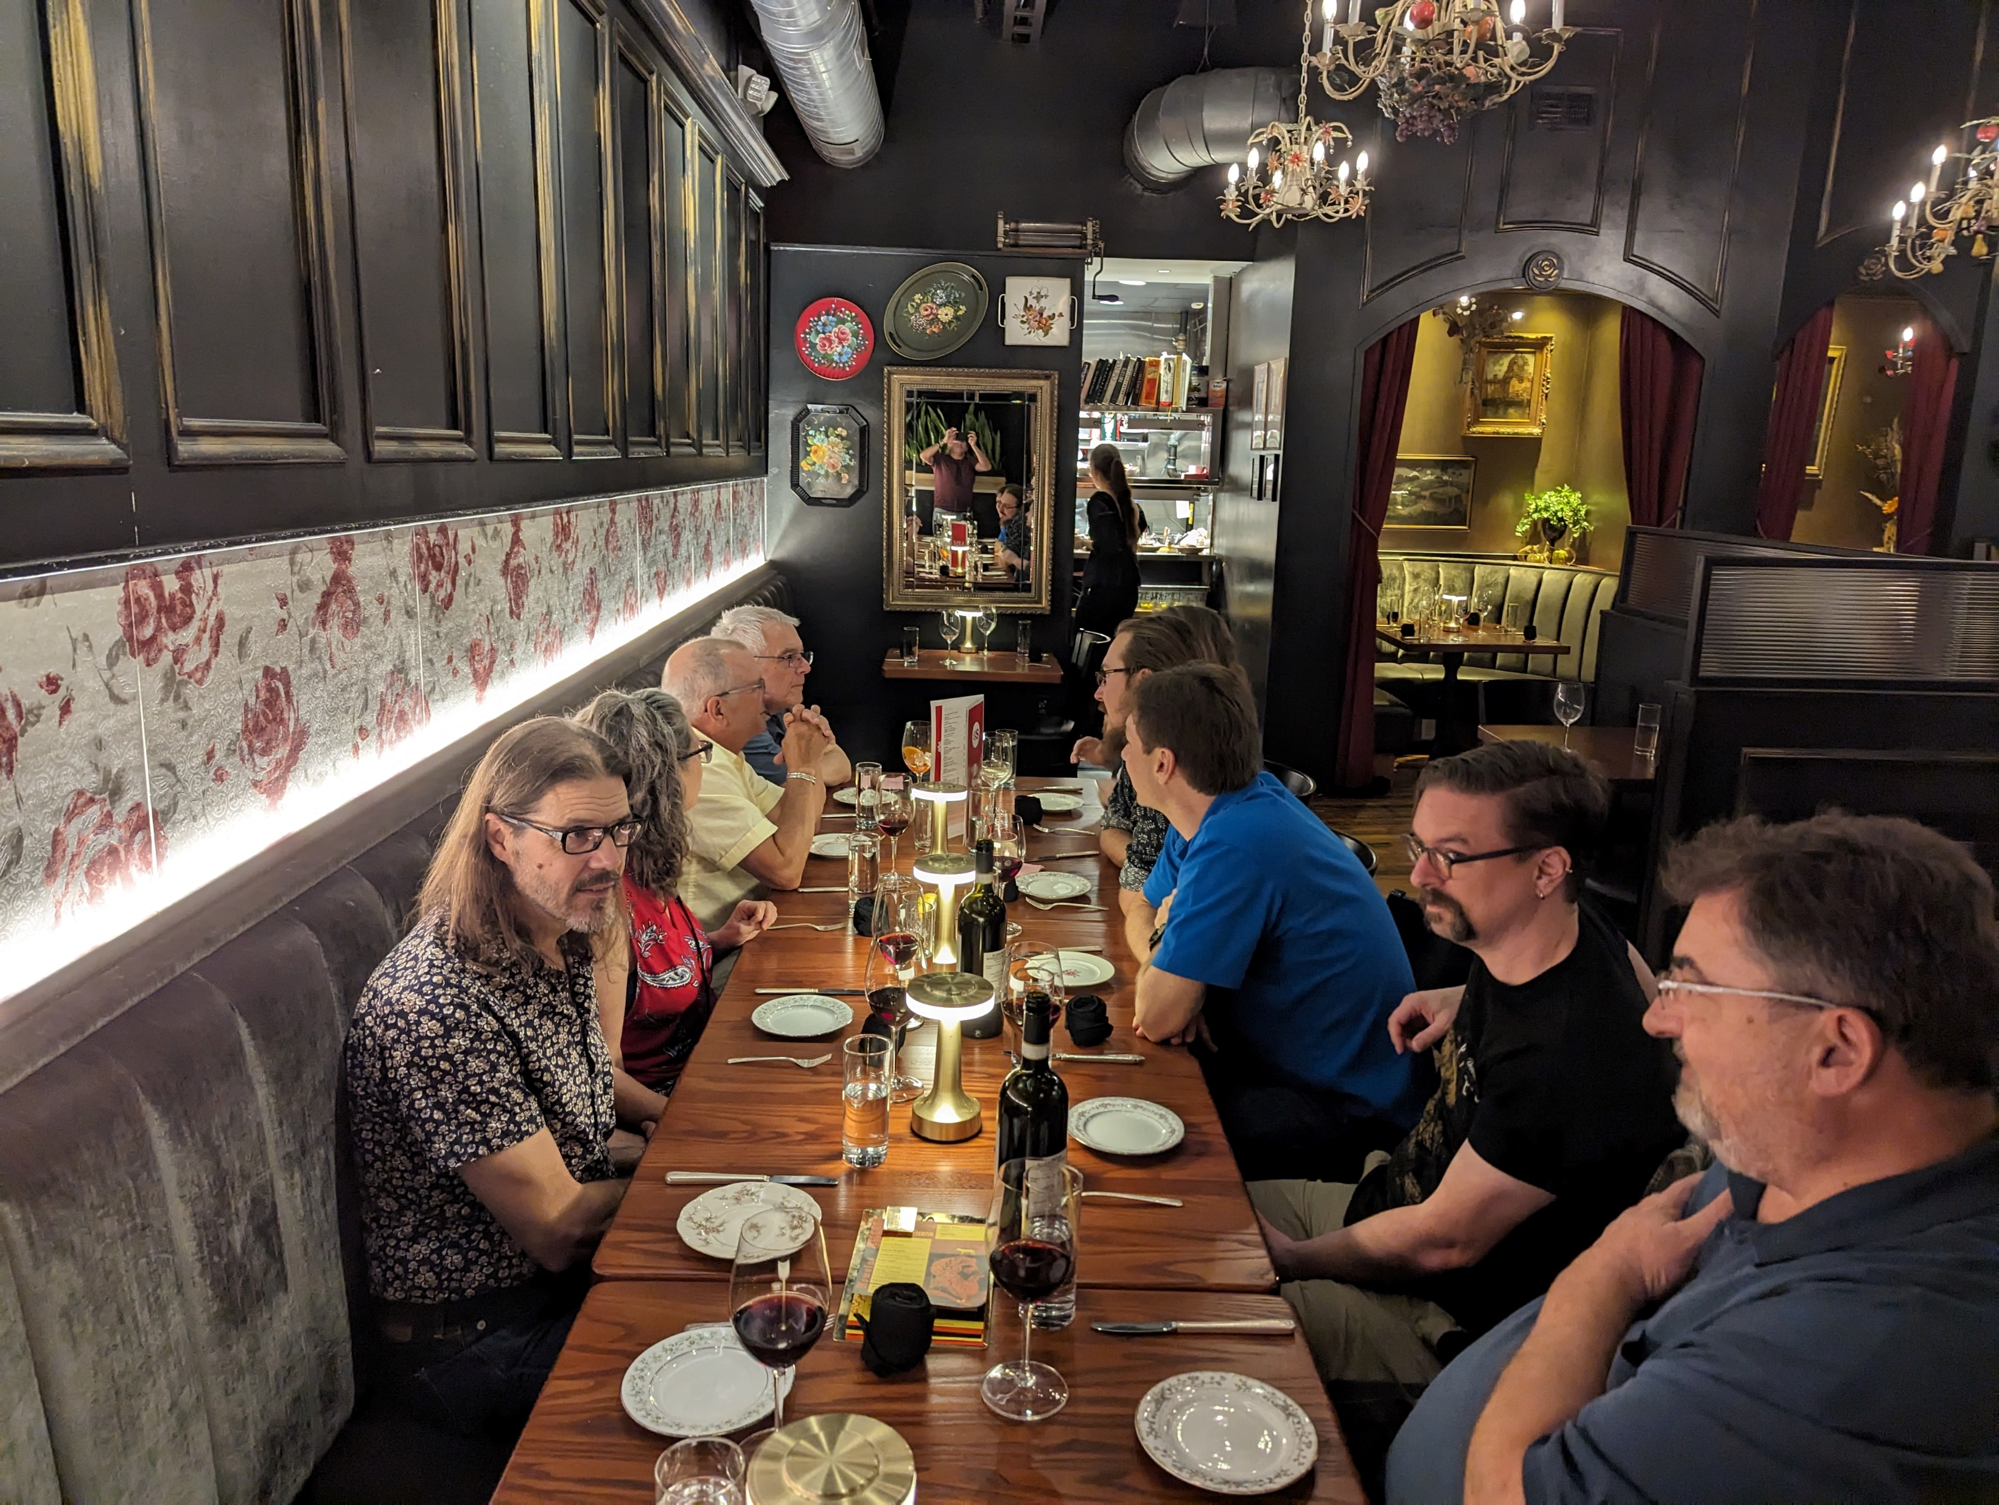
Previous ALICE-USA meeting
We had last meeting on Oct. 3-5 @ ORNL: https://conferences.lbl.gov/event/1428/
Spring meeting 2024 was pushed to the current Fall 2024 meeting

Slide 3
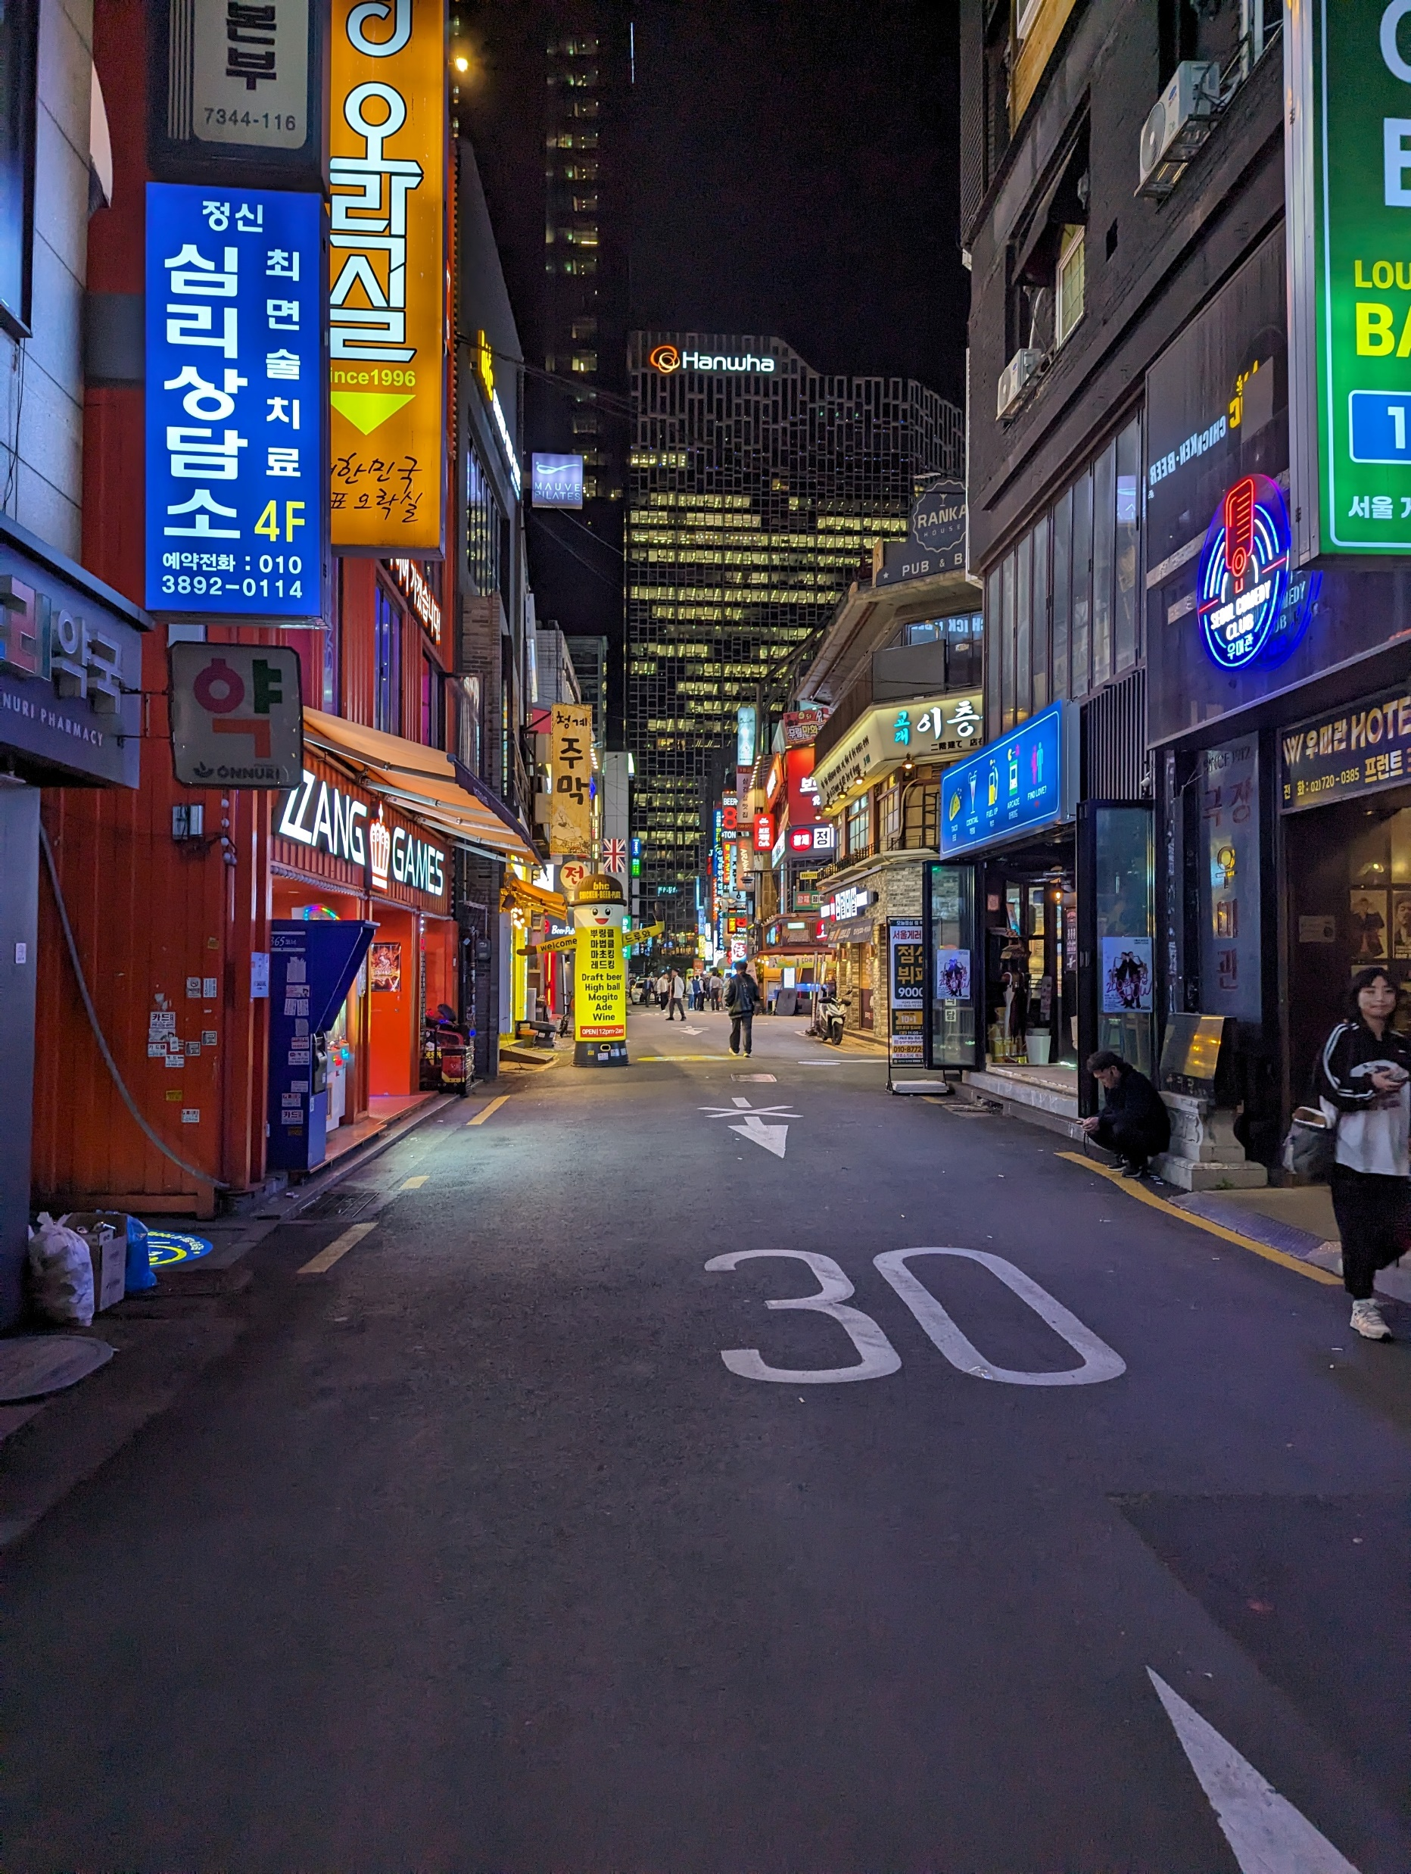
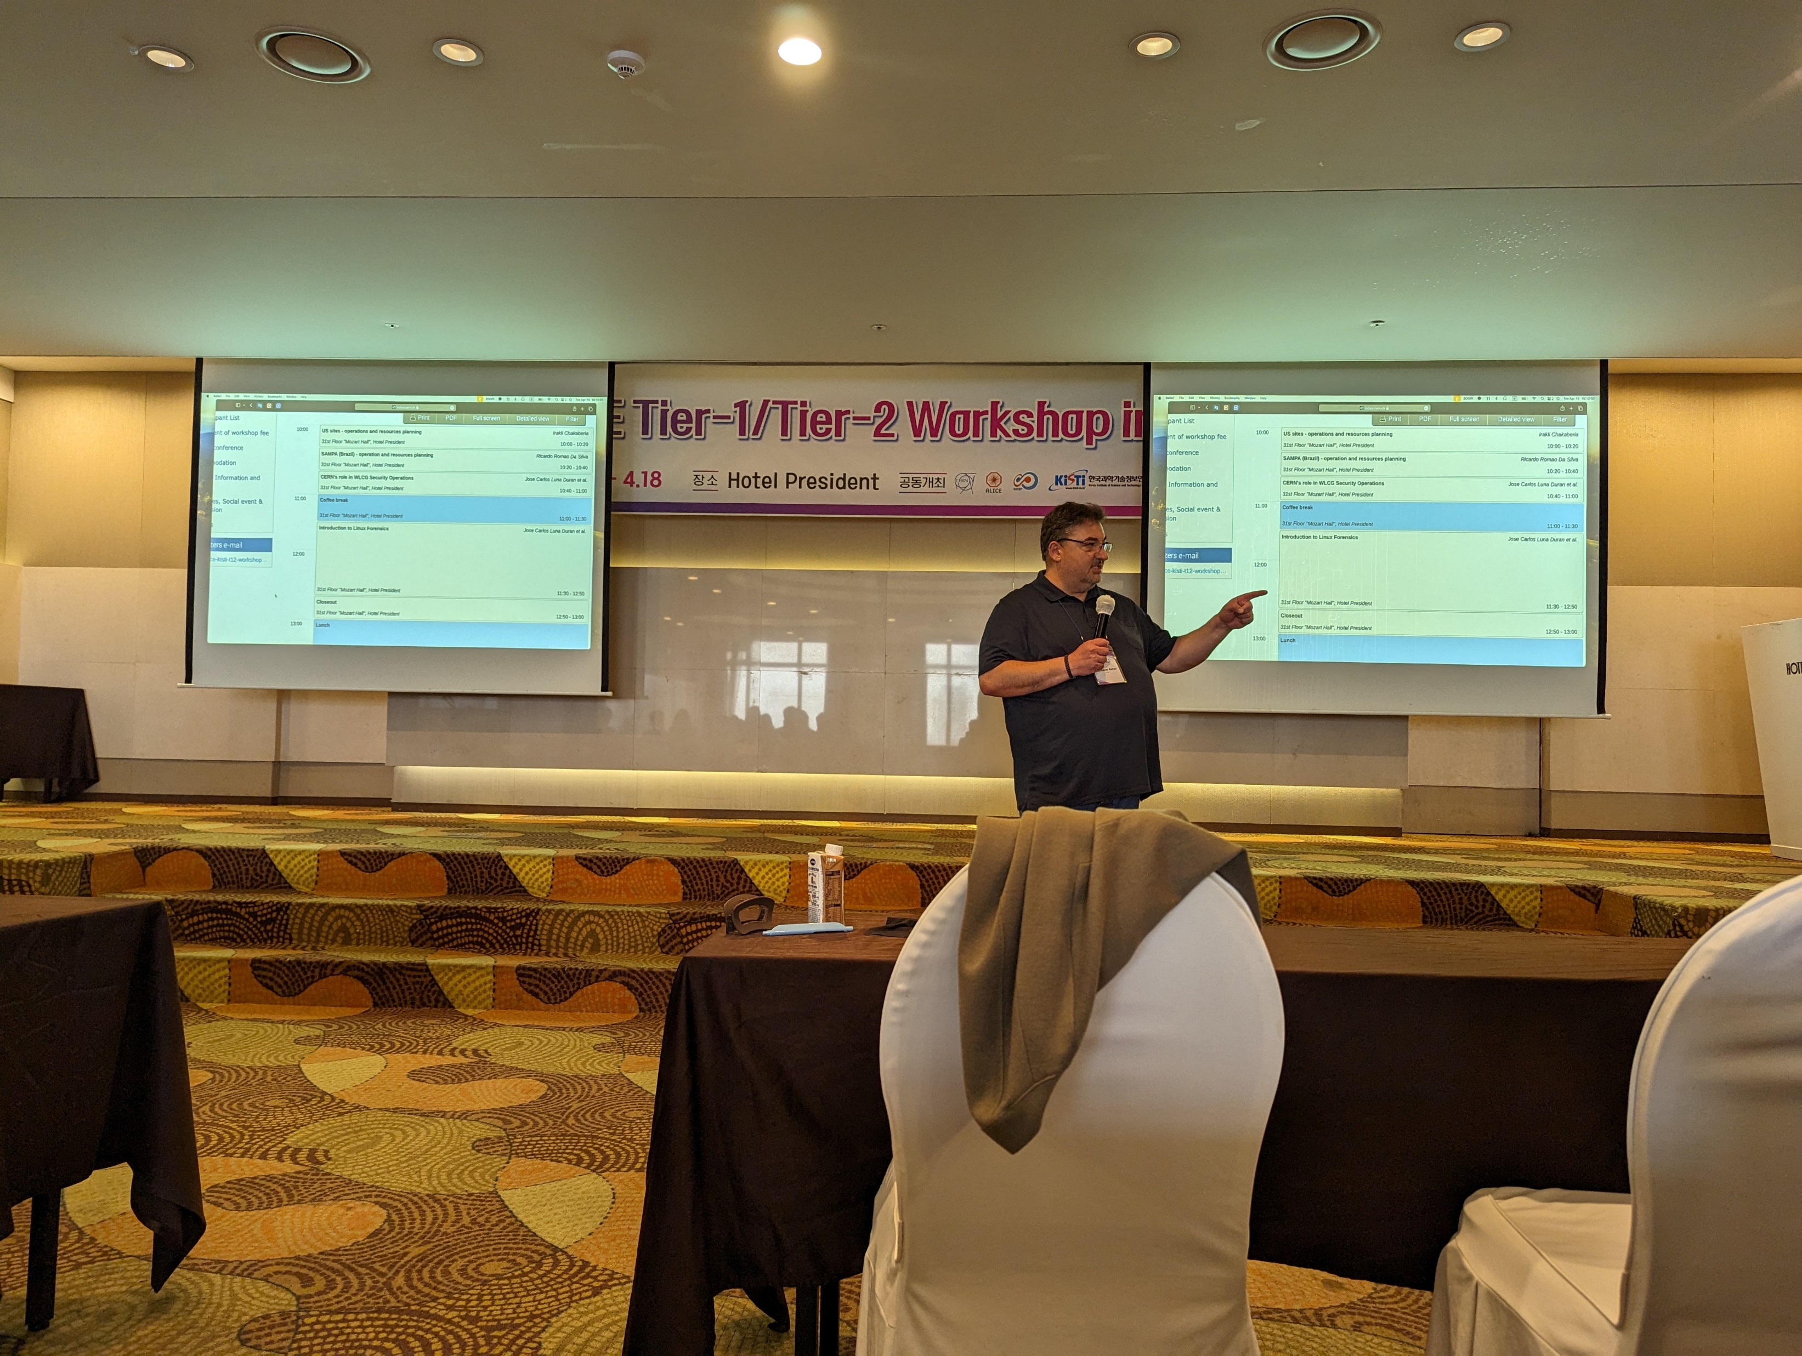
We all attended T1/T2 meeting in Seoul
I should get better at group photos
There were hints of next T1/T2 hosted in US (we will get back to this later)

Slide 4
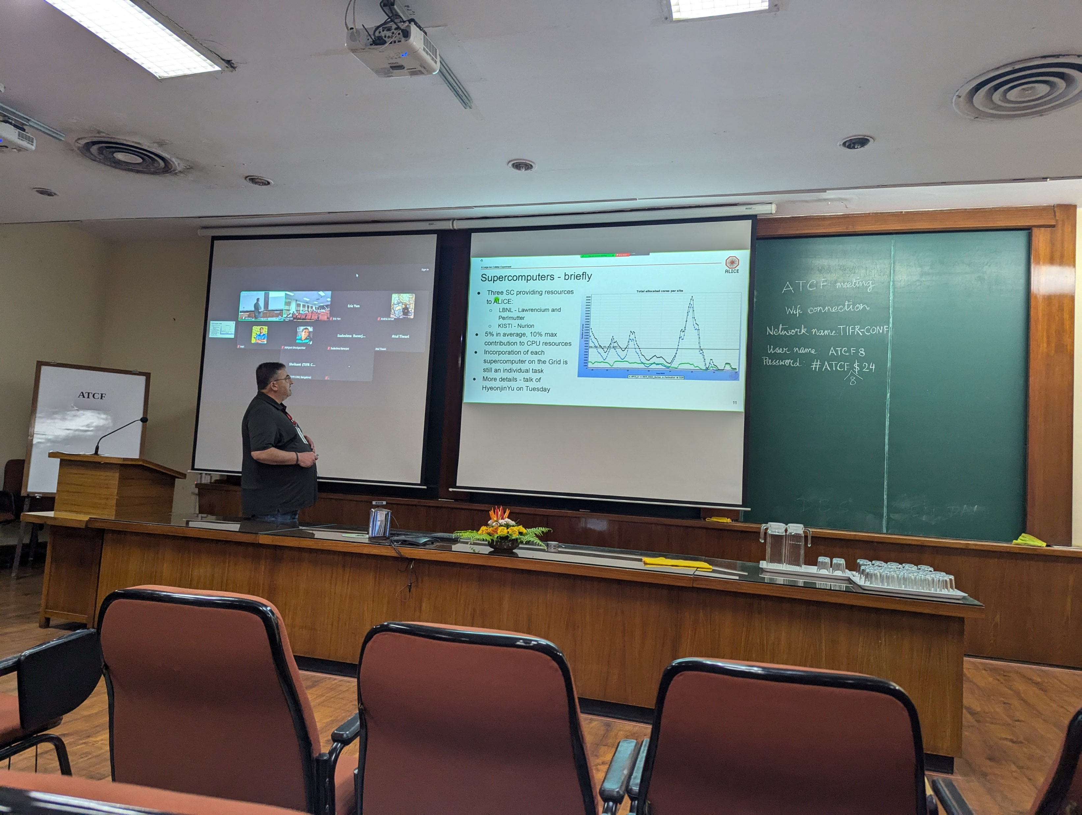
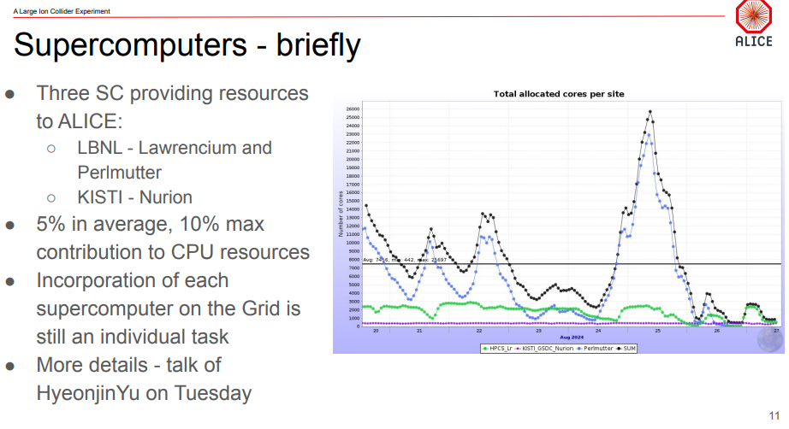
8th Asian Tier Center Forum
Latchezar and I attender ATCF
It was an interesting experience
We should keep up the good work to be showcased even more often ☺

Slide 5
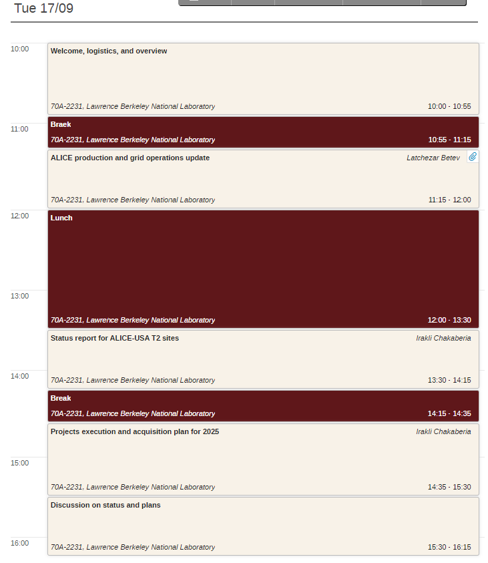
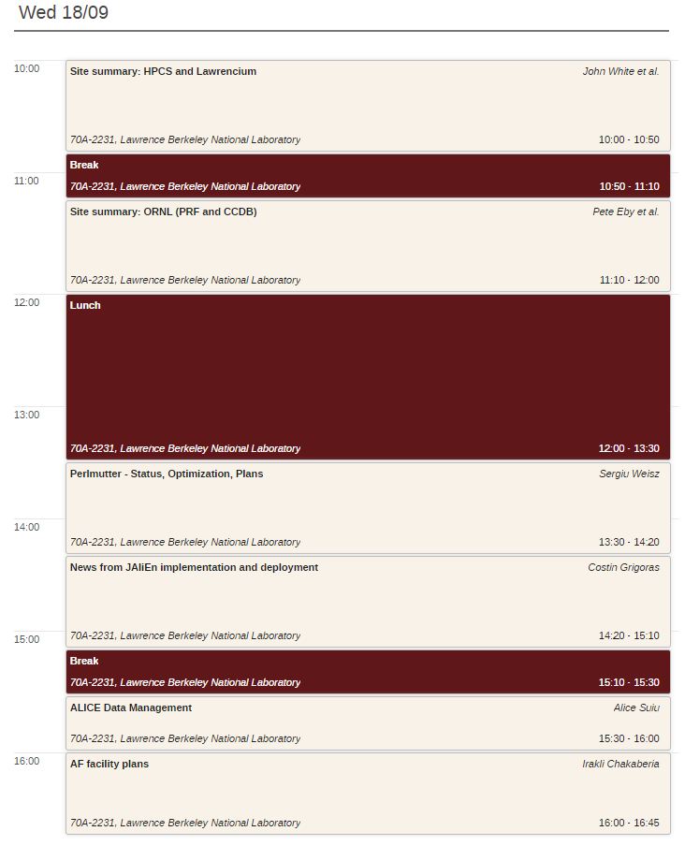
Current Agenda
Two full days in this room
Overflow discussion half-day on Thursday
It is a half-day because we only have this room till Thursday afternoon

Slide 6
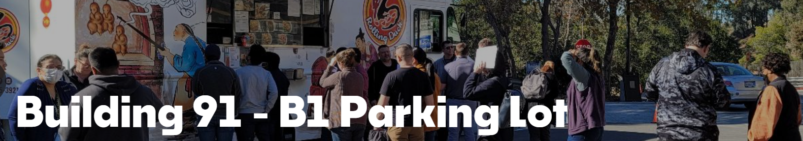
Lunch
Cafeteria is still under construction
  We now have a wall ☺
Meanwhile there are food trucks onsite
LBL food truck weekly menu:
https://cityflavor.com/locations/berkeley-lab-food-truck-lot/
We can always go to downtown Berkeley
Food delivery is also an option

Slide 7
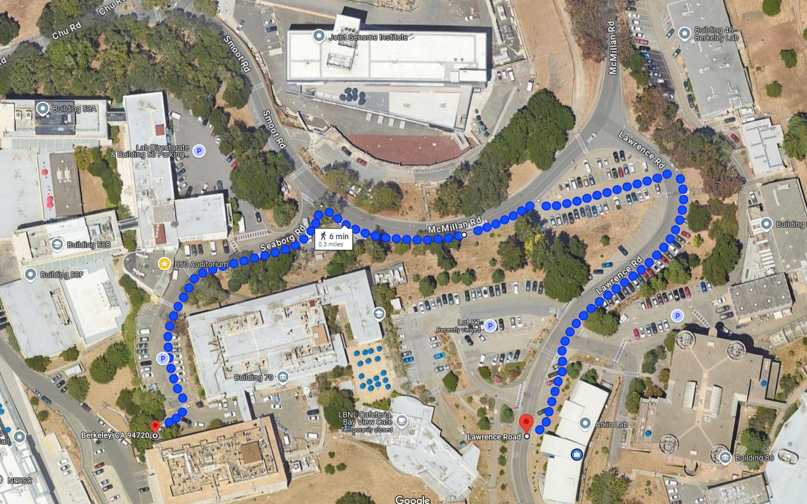
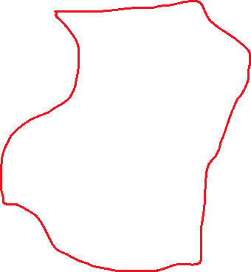




Food Trucks
Picnic Tables
Construction
Area
Guesthouse
BLDG 70a

Slide 8
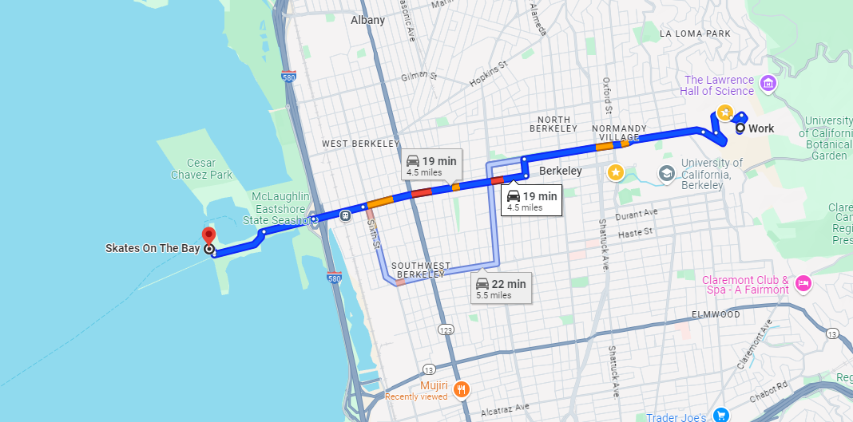
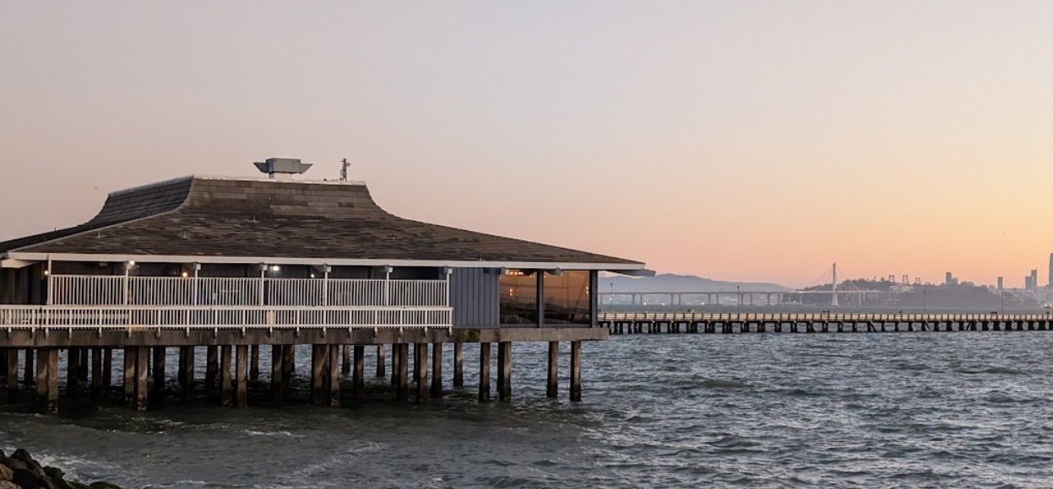
Social Parts of the Event
Sushi California is under the new management ☹
But there are many sushi options in the area
Another dinner option I would suggest is Skates on the Bay

Slide 9

Etc…
If stepping out remember you will need a badge to enter the buildings
My phone 785 37 7881
My office in BLDG 70 can be used as a workspace if needed

Slide 10
Thank you all for making time for the meeting
Let’s make it as productive as we usually do
THANKS…

