Slide 1



Bi-2212 Modelling Challenges and Needs
Draft V0
US MDP Bi-2212 Working Group…
Daniel Davis
MDP Meeting 06/18/2024

Slide 2
Modelling “Needs”
Topics
Coil Mechanics
  High Field Solenoids
  Hybrid Testing
  Interface Design
  Cable and Composite Properties
    Transverse compression
    Composite Tensile
Furnace
  Thermal
    Large uniform profiles
  Cool-down Stress
Quench Dynamics
SMCT
CCT
Conductor Properties
Existing Activities
Composite Samples Measurements
  Tensile wire stacks, transverse cable samples
J_{C}(B, OPHT T_{max}, σ) for different wires
COMSOL, ROXIE, & ANSYS models of coil mechanics, basic OPHT thermal, and quench

Slide 3
Modelling “Challenges”
Material Properties!!!
  Many brittle materials including 2212 filaments lead to challenges modelling interface and fatigue damage
  Limited temperature dependent data!!
    Furnace, quench, cooldown…
    Thermal contraction
  Epoxy filled coils have low interface strength with a moderate uncertainty
    Many interfaces in SMCT and CCT designs
  Furnace materials
Computation time of time-dependent models
Fracture of brittle materials

Slide 4
Backup Slides

Slide 5
US MDP roadmap2020

Slide 6
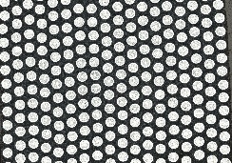
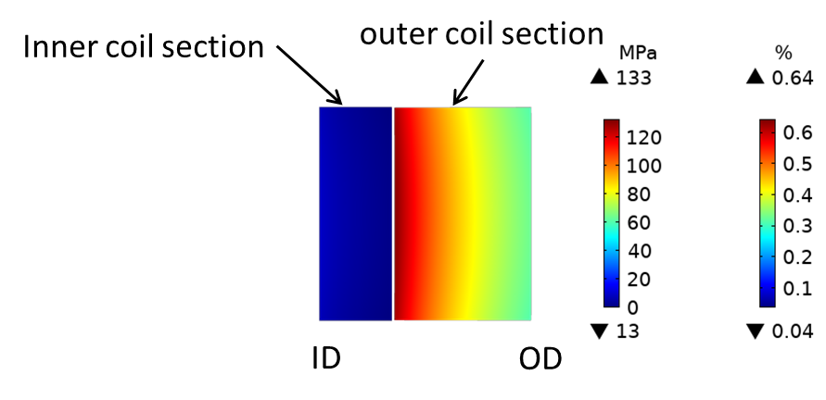
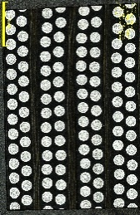
Bi-2212 Wire is Weak: Understanding their Mechanics is Central to Coil Development
FEA assumption: fully coupled winding pack but what if not…?
  If decoupled, significant strain (0.64% at Layer 9) where the cracking occurs makes the outer section of the coil a new free-standing section
  Layer 1 through 8 then become released from the outer coil which then shows very low stress
Critical role in crack formation: Interfaces
  Epoxy bonding strength near the bands
  CTE mismatch between components of the winding pack
  Local stress concentrations
  Coils have a composite behavior
Postmortem Investigation
Modelling
Test Coils
Lessons Learned
Positive Feedback
Pup-9 came completely apart at
Band 4 after cutting for post mortem
Practical and principal conclusion: uniform distribution of reinforcement layers better; need to improve understanding of the winding composite
Notes:
Based on the postmortem, we also ran a hypothetical case of pup-9 that has clean separation between last band and rest of the coil. During the post mortem process, we found one section had a clean separation as shown in the picture.
In this case, calculated strain was very high at layer 9 since it became a new free-standing section without reinforcement. And inner eight layers are now over-reinforced so their strain numbers dropped drastically.
Most important question for Pup-9 is why the cracks happened at the first place. There are some possible reasons as listed here and it might be combination of many reasons. And we are still trying to find the answer and solution for this question.

Slide 7
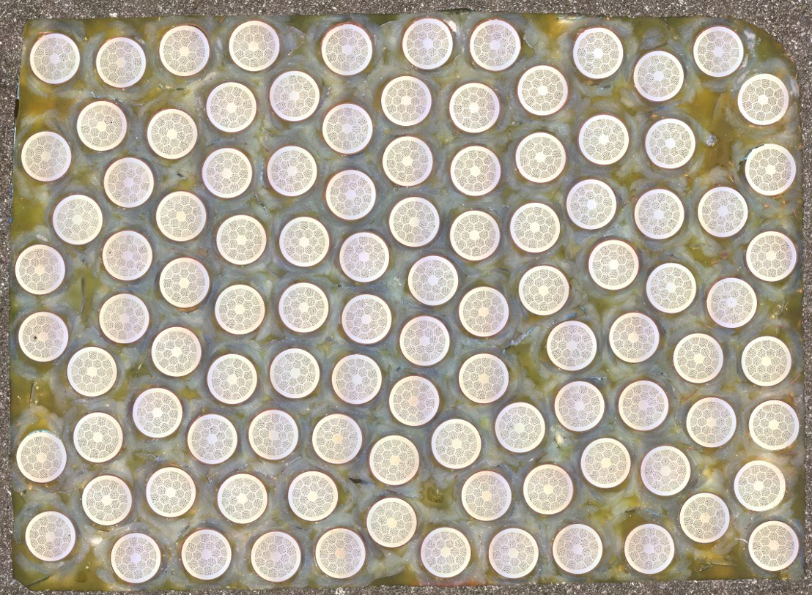
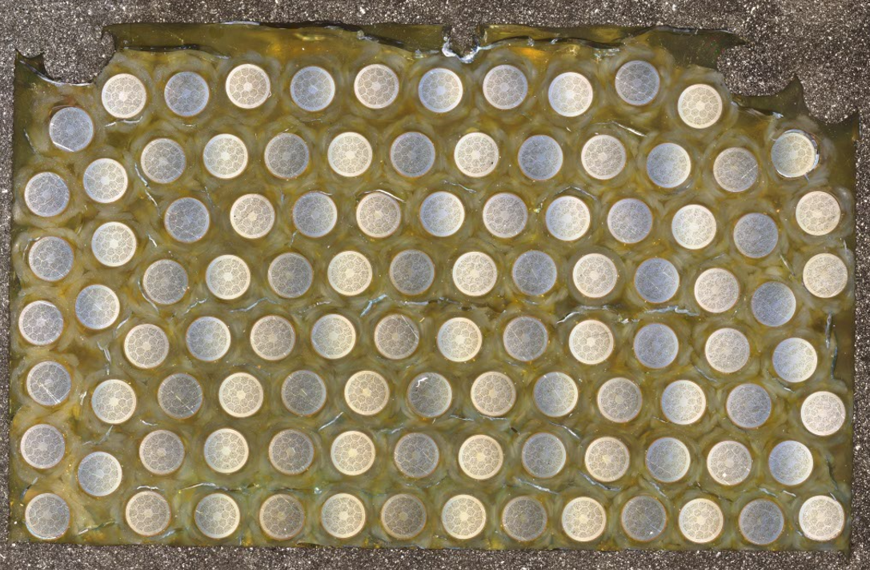
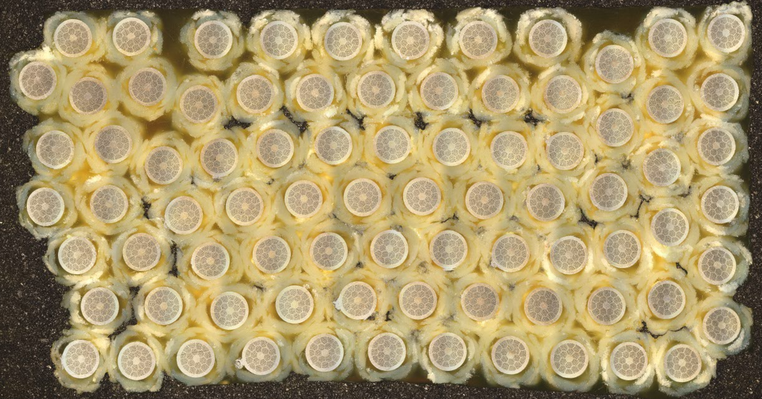
Composite Sample Testing to Aid Simulation (E. Martin)
These composite samples are stand ins for coil winding sections.
The samples were designed to have a relatively straightforward manufacturing process wound on a racetrack mandrel.
The samples were annealed in flowing oxygen.
The assemblies were then vacuum impregnated with NHMFL-61 epoxy and cut into four rectangular samples.
Two types of assemblies have been made and tested so far:
  Bi-2212 wire, TiO₂ coating, Alumino-silicate braid, NHMFL-61 epoxy.
    Two batches were made, one with a random assembly and one with a hexagonal dense structure (like coil wdg.).
  Bi-2212 wire, Alumina braided, NHMFL-61 epoxy (voids).
Bi-2212 wire
Epoxy
Random
Alumino-silicate braid
Hex-stacked
Epoxy
Alumina braid
Voids
Bi-2212 wire

Slide 8
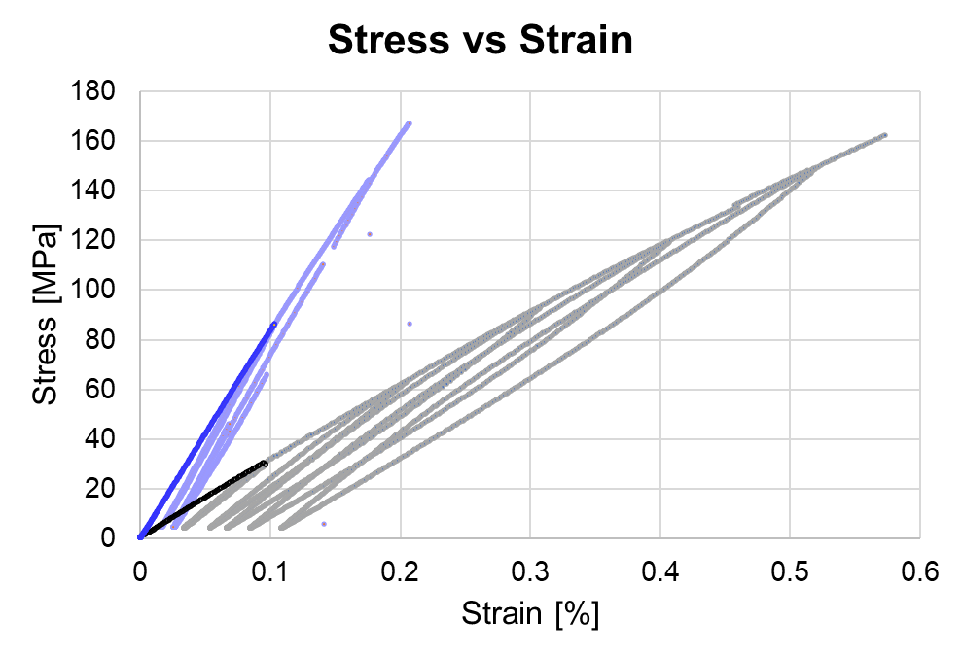
Alumina Braided Samples Show Increased Strength
Average Properties | Alumino-Silicate Braid (random) | Alumino- Silicate Braid (hex-stacked) | Pure Alumina Braid
E [GPa] | 32.4 | 32.3 | 78.7
ν | 0.39 | 0.40 | 0.45
Longitudinal Thermal Contraction [%] | -0.16 | -0.20 | -0.20
Transverse Thermal Contraction [%] | -0.69 | -0.44 | -0.98
Alumina Braid
Alumino-Silicate Braid
Procedure:
Young’s modulus and Poisson’s ratio were found using the first loading cycle.
  Where possible, strain gages of the same orientation were averaged to correct for bending stresses.
Results:
Both types of alumino-silicate braided samples had similar E and ν, regardless of winding architecture.
The pure alumina braided samples have a much higher Young’s modulus (>2x the alumino-silicate braided samples).
  The ultimate strength seen in the alumina braided samples is likely due the presence of voids.
Longitudinal thermal contraction was similar in both sample types.
  Likely driven by contraction of stiffer materials.
Transverse thermal contraction was much larger in the pure alumina braided samples.
  Likely driven by contraction of weaker materials and voids.
Notes:
Modulus of Nextel ~350 GPa
Thermal contraction of silver 0.3-0.4%

Slide 9
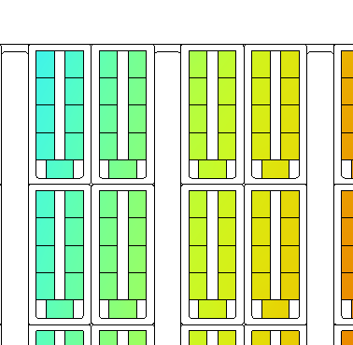
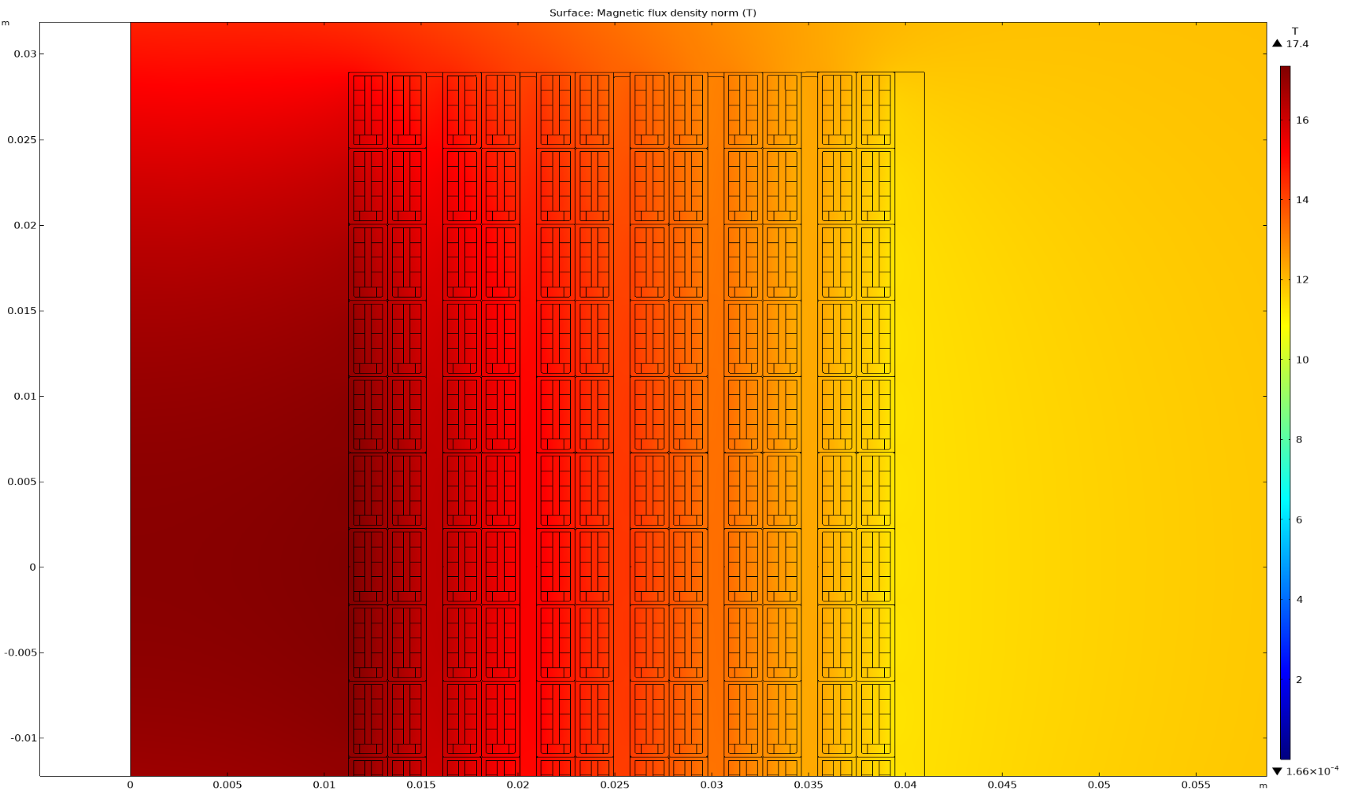
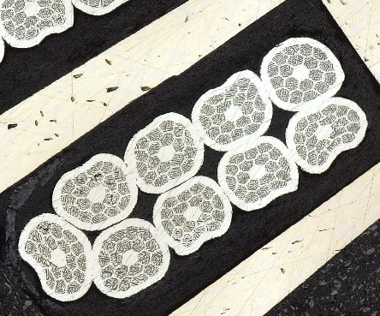
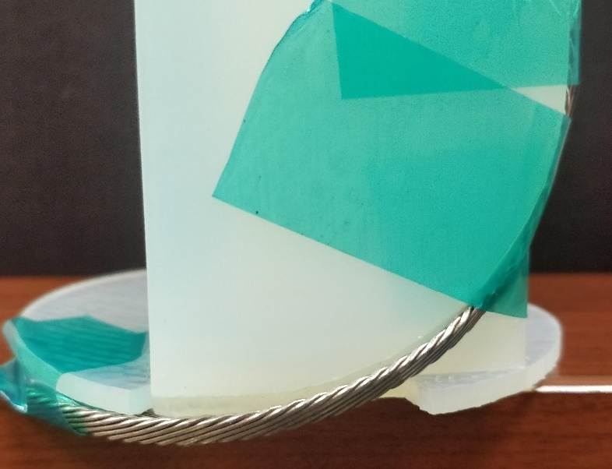
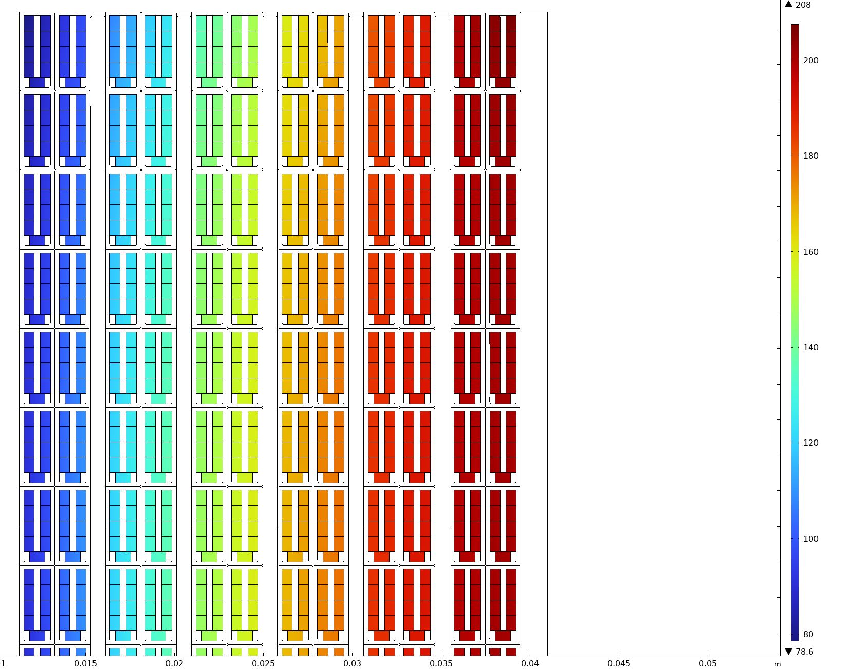
BR-2: ~5 T Rutherford Cable Solenoid to Validate Pure Alumina Braid Insulation on Cable
Uses twist-bend terminal design that we developed earlier for ReBCO coils
3d printed outer terminal model
12 T LTS
17.4 T
Peak on coil
@ 2kA, 4 K
Cabled Strands
Braid
High Strength Bands
Hoop Stress
208 MPa
3D-printed terminals for concept validation
Postmortem Investigation
Modelling
Test Coils
Lessons Learned
FEA: various reinforcement cases taken into account
Positive Feedback
208 MPa J_{E}*B*r Hoop Stress
80 MPa
Update slide
Notes:
The first coil had a modern cable with high JE, but the proposed coil design here BR-2 will attempt to validate the pure alumina braid on an old conductor with hard particles in the Bi-2212 powder that is challenging from a leakage point of view. The cable has been cleaned and braided and we are engineering the terminal design for this aggressive small ID. You can see the modelling geometry on the right with the real aspect ratio and cross section of the reacted Rutherford cable. As always garbage in-garbage out so let’s discuss some of the modelling discussions

Slide 10




Transverse stress of
Bi-2212 Rutherford cables at 4.2 K and 11 T
Anna Kario, Simon Otten, Sander Wessel, Jeroen Bijlsma, Mark Smithers, Herman ten Kate, Amalia Ballarino
Tengming Shen (LBNL), Ulf Trociewitz, Daniel Davis, Ernesto Bosque, David Larbalestier (FSU/NHMFL)

Slide 11
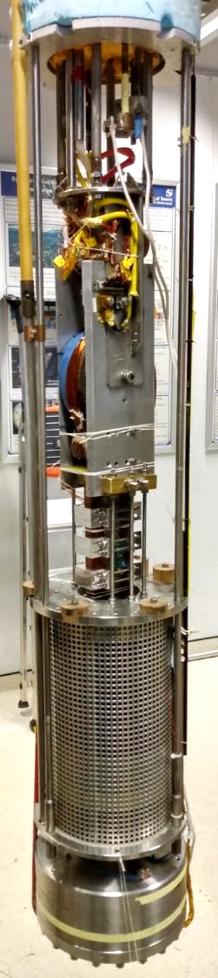

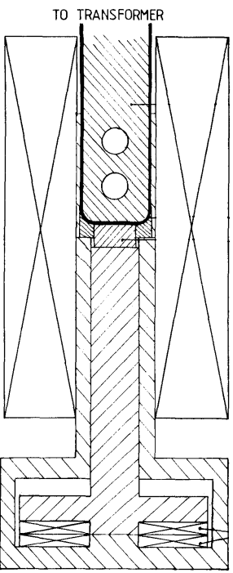
Transverse stress setup
50 kA trans-former
50 kA superconducting transformer
11 T solenoid magnet
250 kN press
4.2 K helium bath
Sample holder
11 T solenoid
Press coils
Image by Boschman et al.
https://doi.org/10.1109/20.133551

Slide 12
Comparison of the two samples 3 and 4
Sample comparison
Sample 3: LBNL1109, tested Dec 2022
Sample 4: LBNL2002, tested June 2023
Stronger stress dependence observed in sample 4, at 150 MPa:
Sample 3 has 3% degradation, whereas
Sample 4 has 6% degradation
Critical current as function of transverse stress
B_{a} = 11 T
The difference between the samples at 100 MPa is 1.5% and at 150 MPa is 3% only
Globally, from a magnet application point of view, the samples behave practically the same.

Slide 13
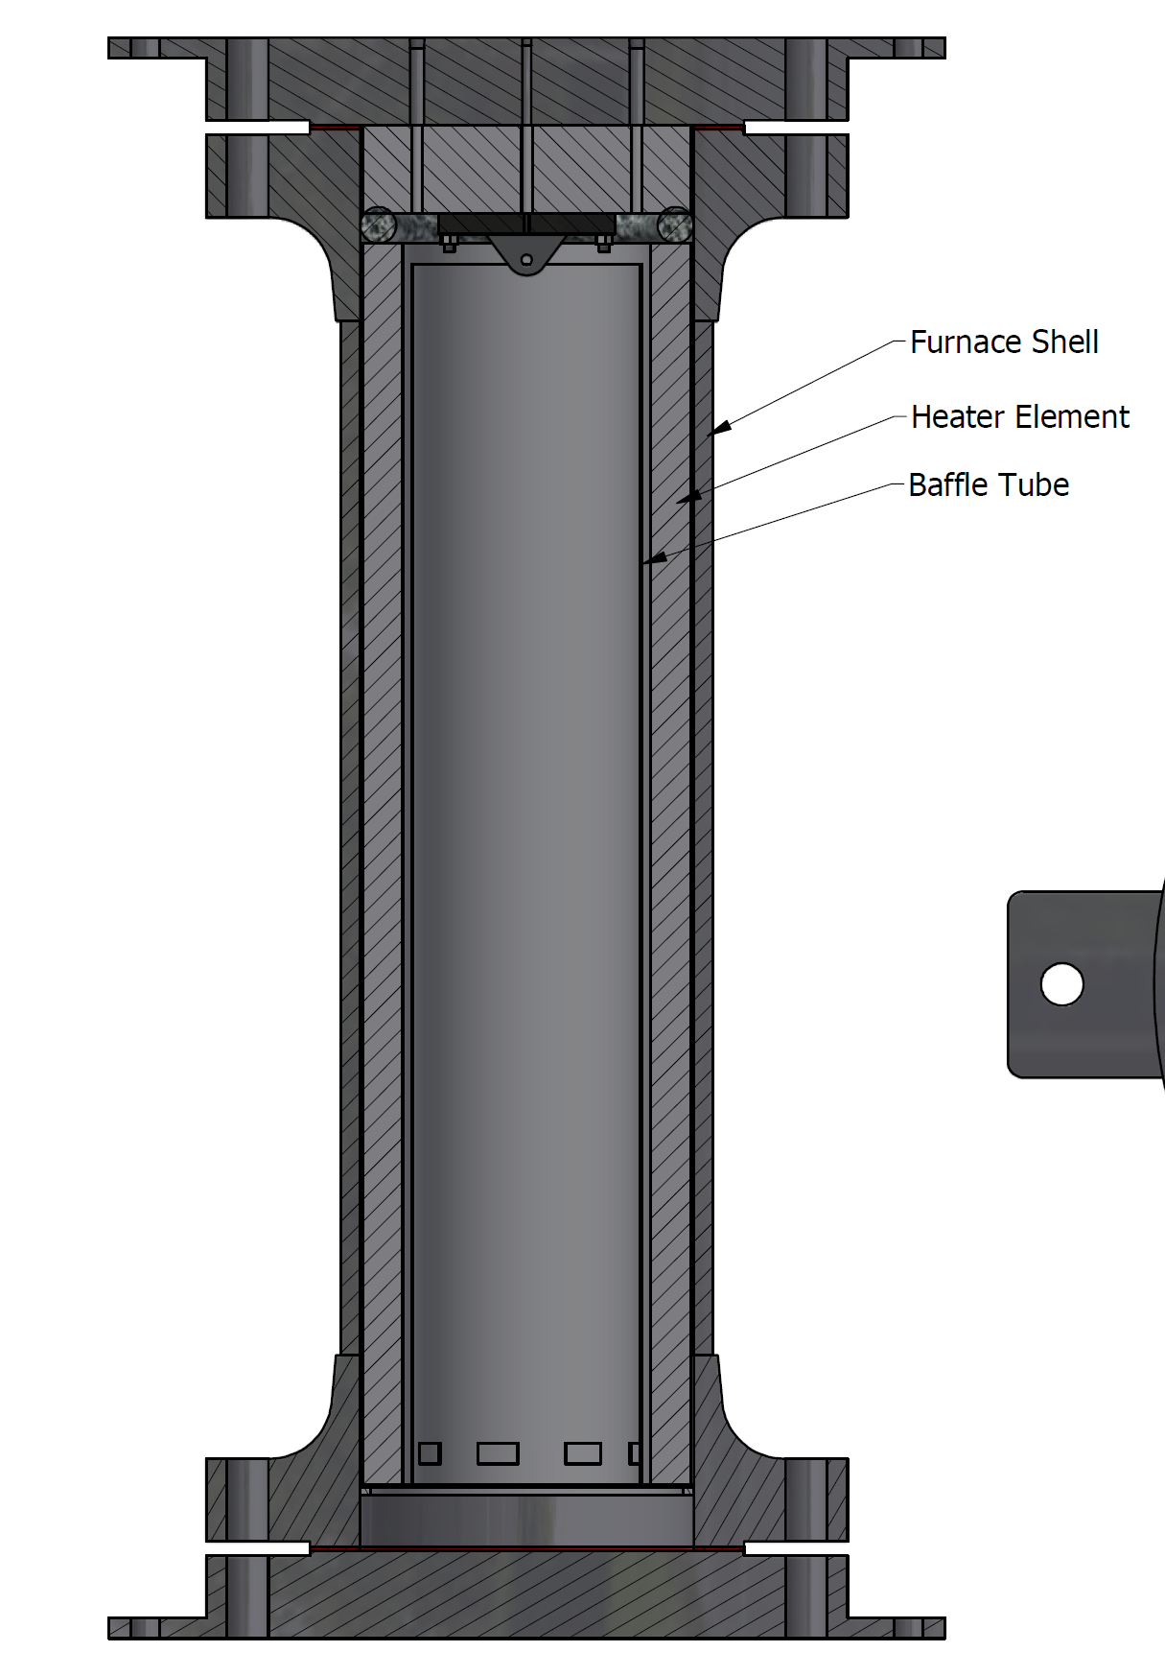
Renegade Furnace: First run at 50 bar
Ramp rates ~ 5-10ºC/min
Good pressure control but…
Gradient established from 300ºC onwards
Zone 1 (top)
Zone 1
Zone 6
Renegade furnace
Zone 6 (bottom)

Slide 14
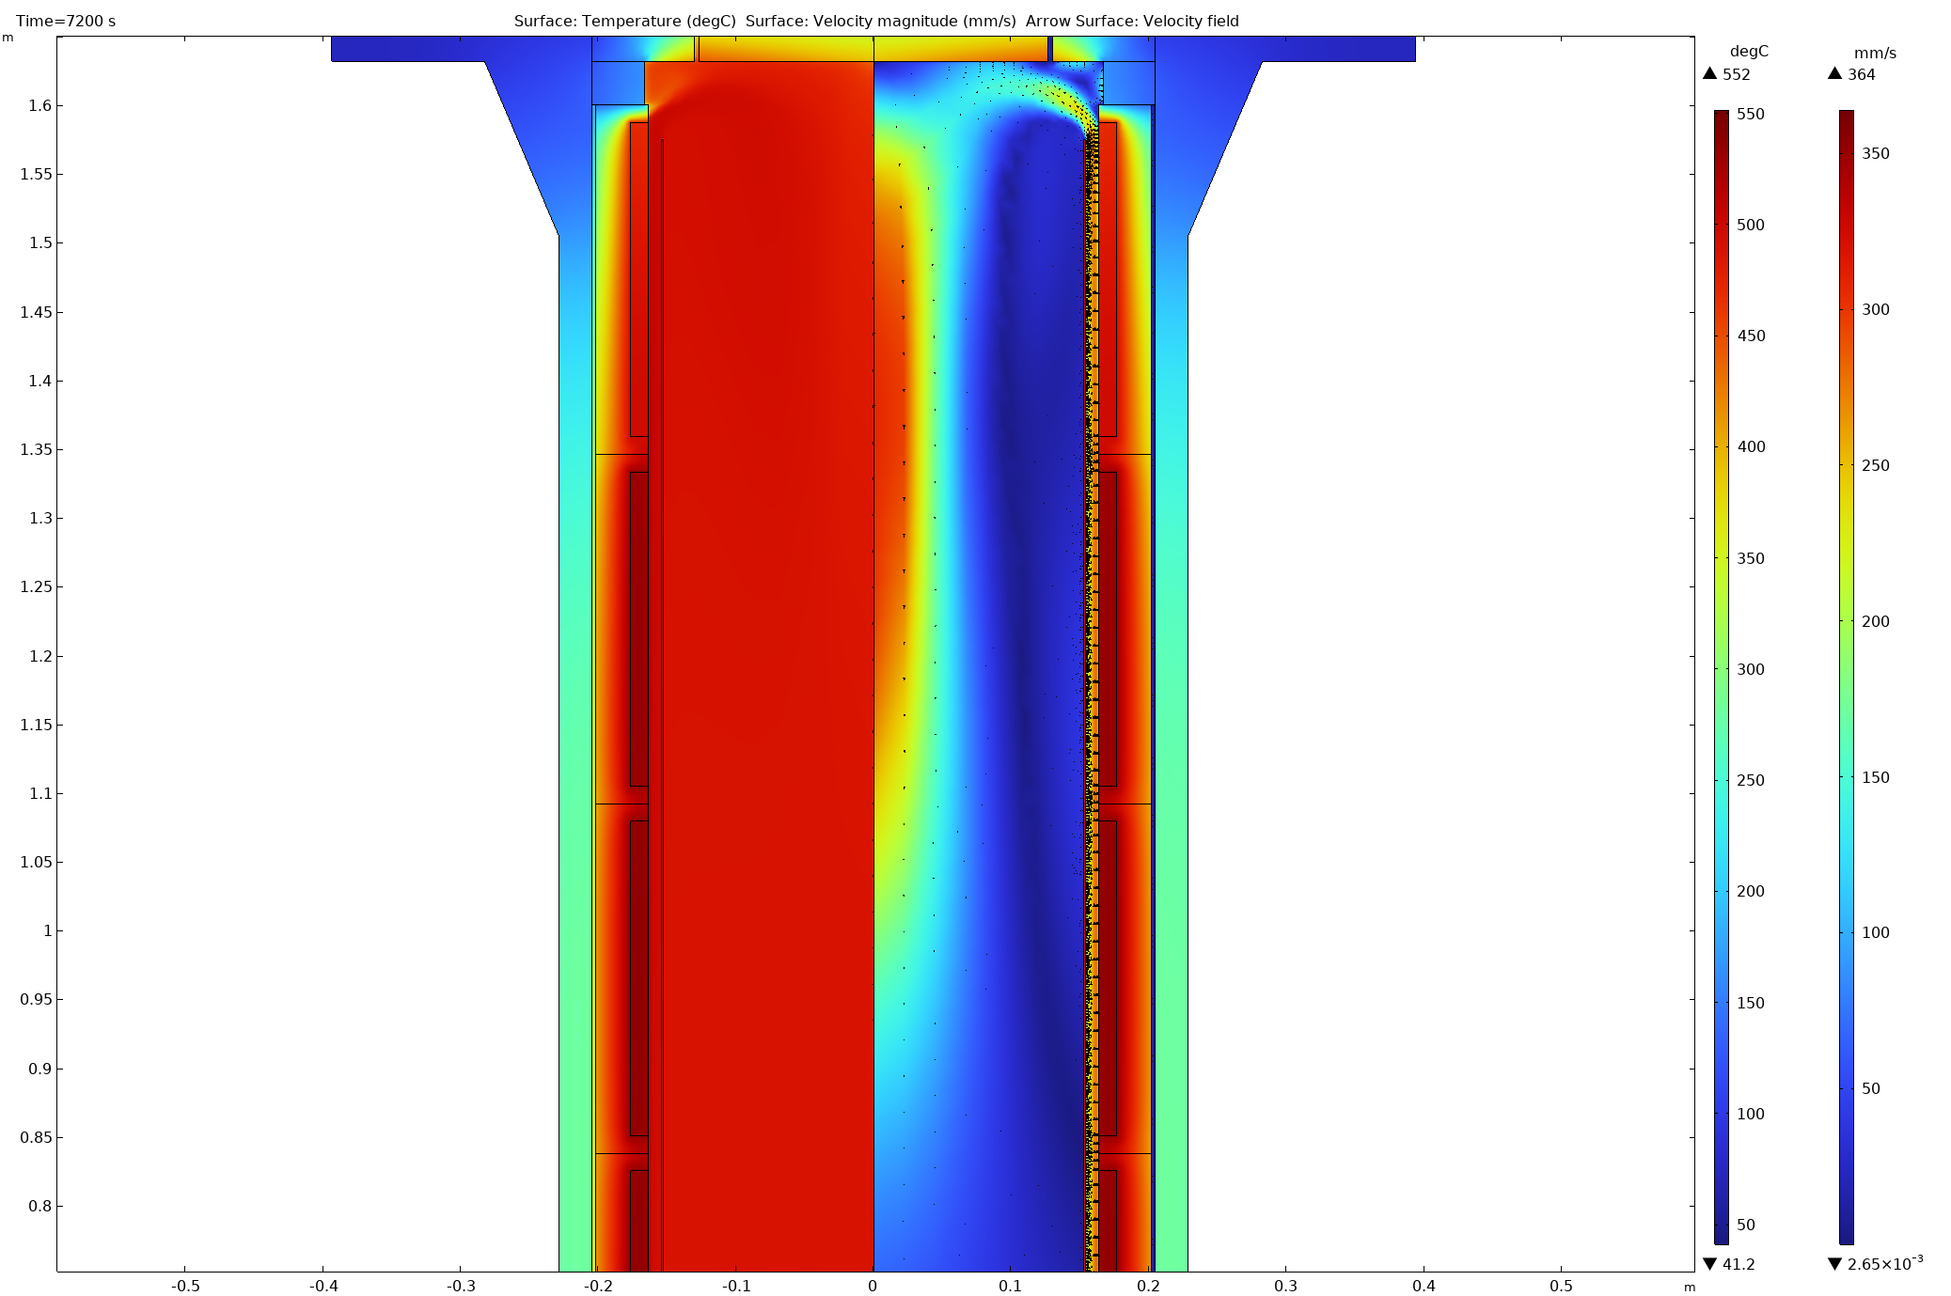
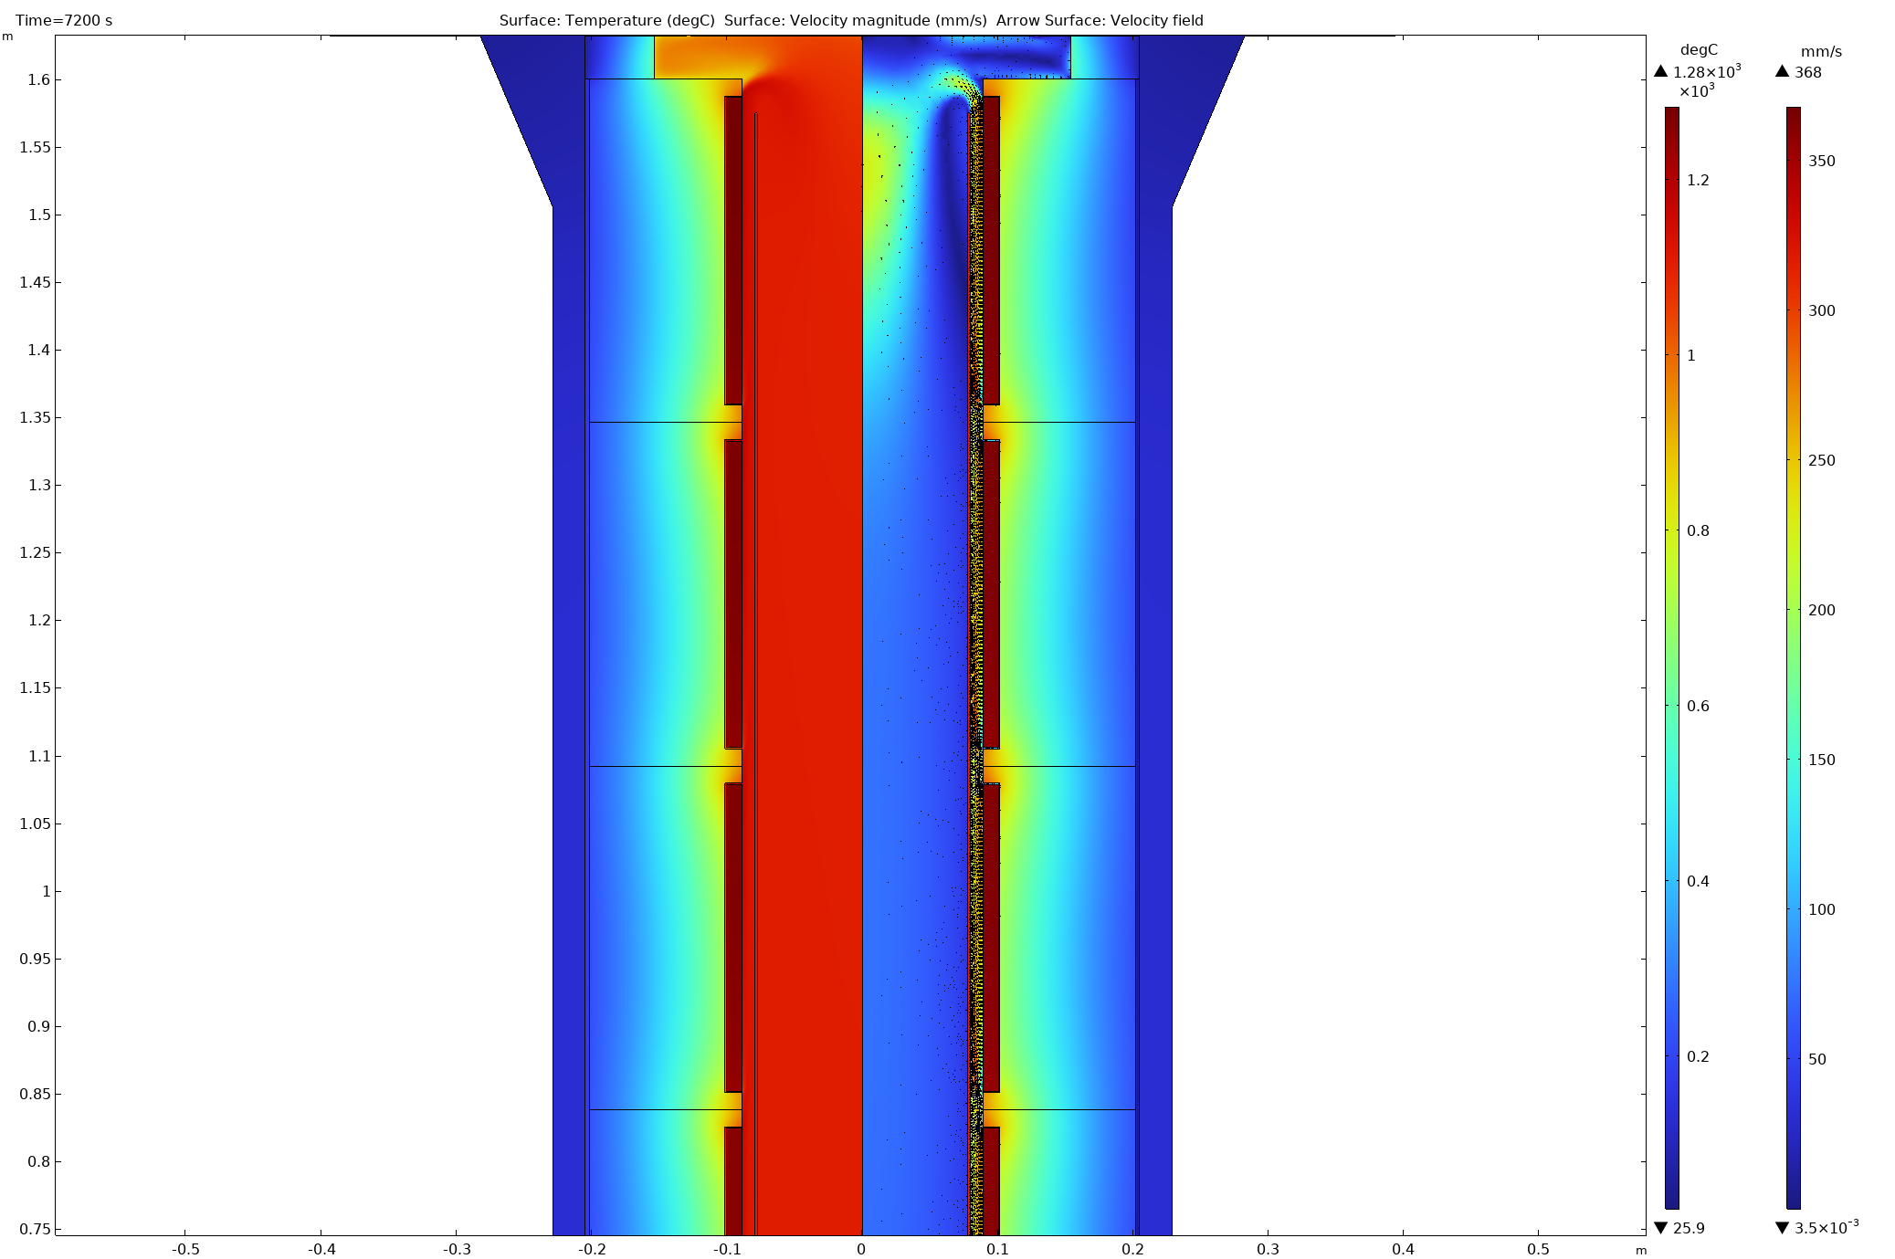
Insulation on large Furnace was Insufficient
Outcome of past commissioning:
Furnace not able to reach target temperature at 50 bar
Too high heat losses through the furnace wall thus not enough power reserve available
FEA modeling with adjusted material parameter derived from past commissioning runs:
Current situation:
With new heater:
We should see significantly better thermal properties than previous design

Slide 15
FNAL Bi2212 SMCT insert program overview
A.V. Zlobin
U.S. MDP Collaboration Meeting CM8
05/01/2024

Slide 16
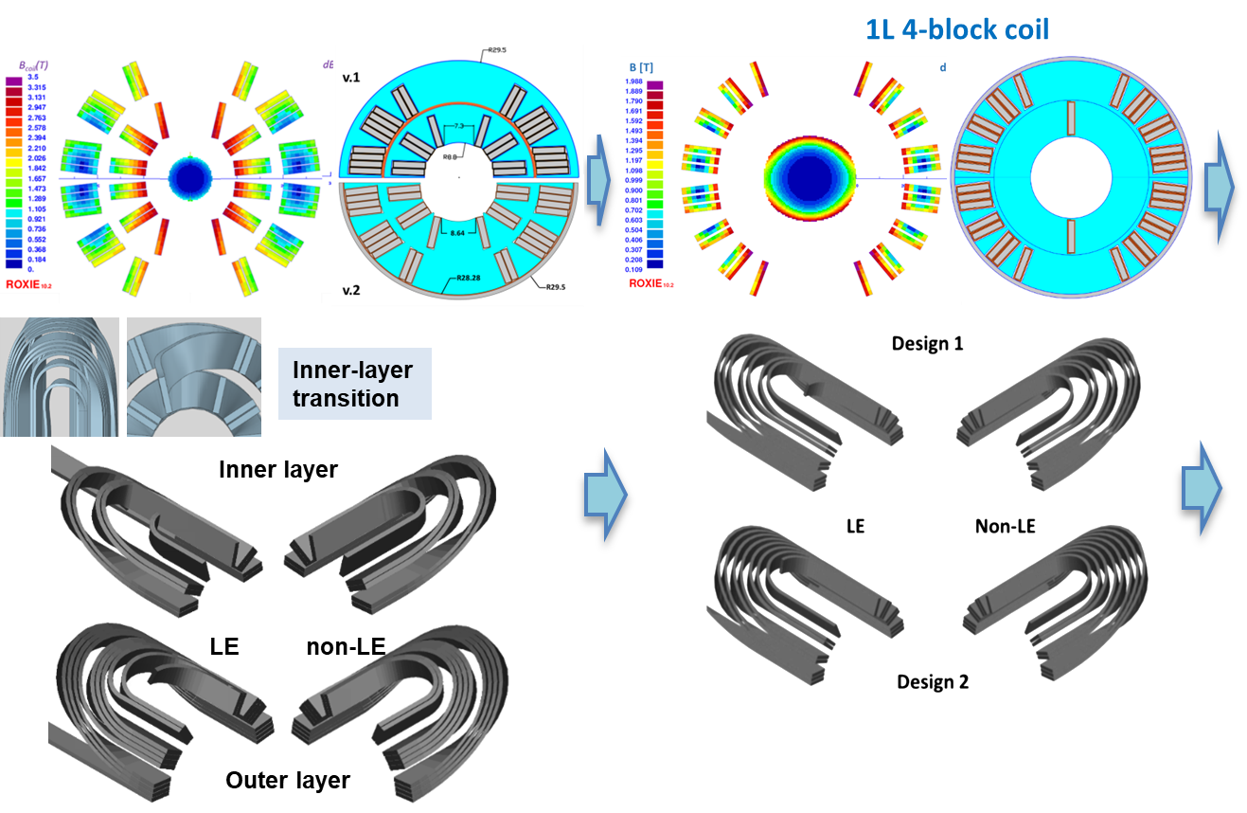
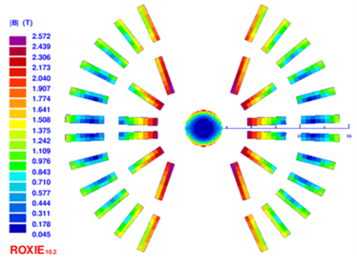
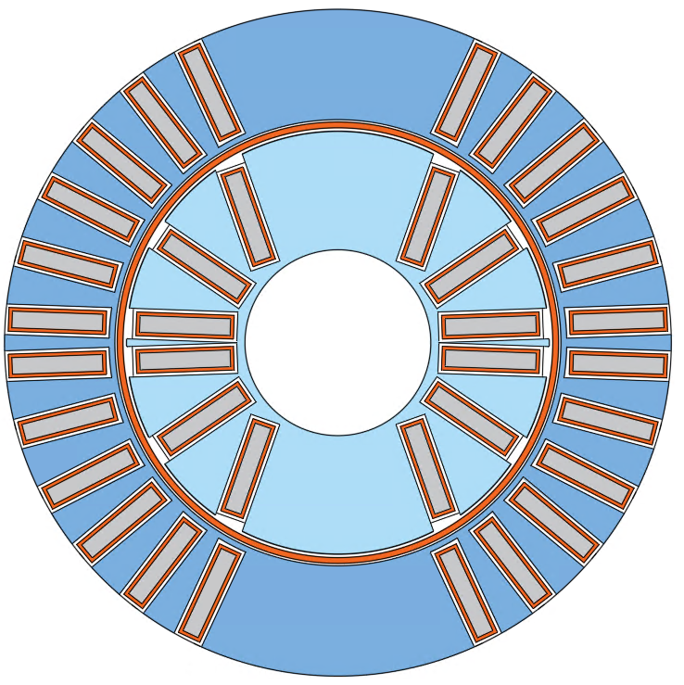
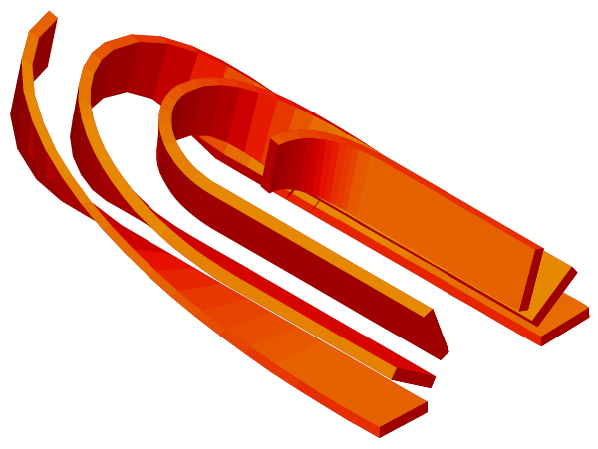
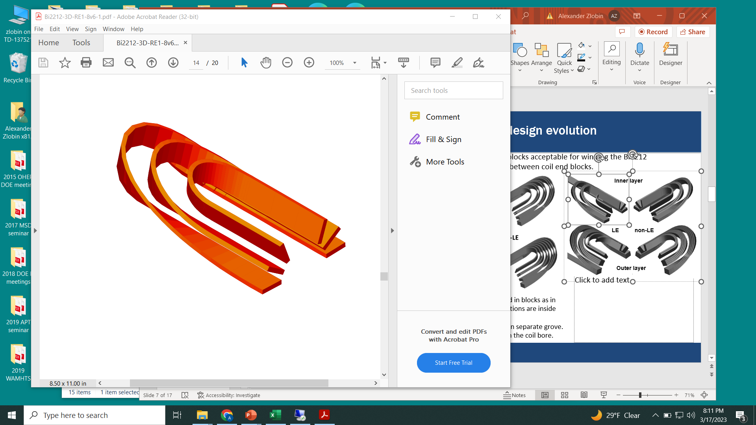
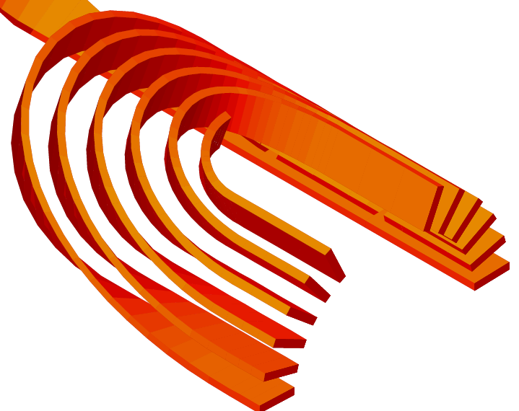
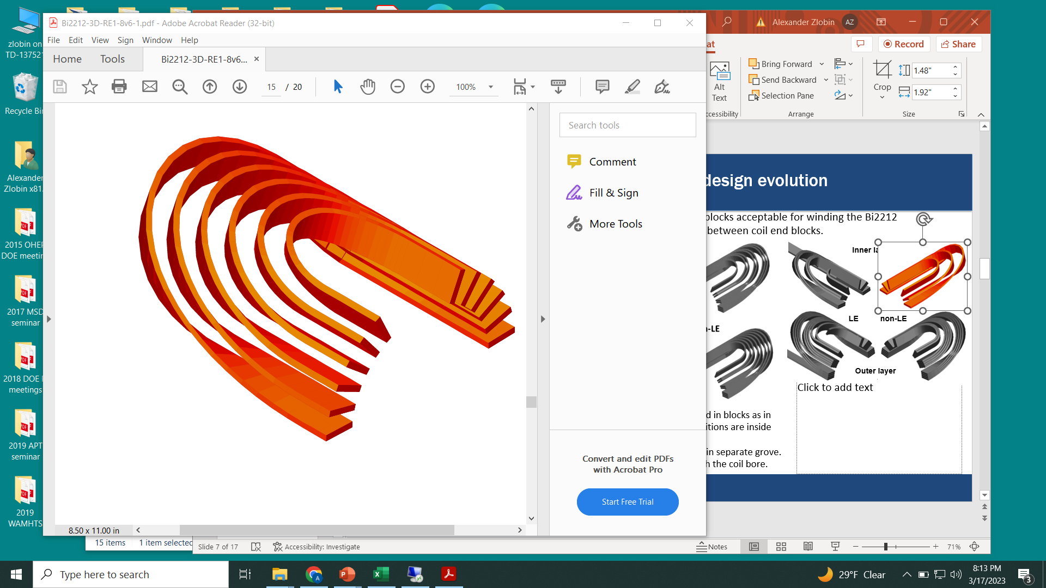
Bi2212 SMCT coil cross-section evolution
2L 6-block coil
2L 9-block coil
Inner layer
LE non-LE
Outer layer
Design 1: end turns are grouped in blocks as in the coil body
Design 2: end turns in separate grove
Design 1&2: pole leads go through the coil bore.
IL – whole coil with mid-plane cable transition
OL – independent half-coils

Slide 17


US MDP Bi-2212 Canted-Cosine-Theta (CCT) magnets at LBNL
The 8th US Magnet Development Program annual collaboration meeting, Fermilab, 04/30/2024- 05/03/2024
Tengming Shen (LBNL)
For the LBNL Supercon group and the US MDP 2212 WG 2024/04/30

Slide 18
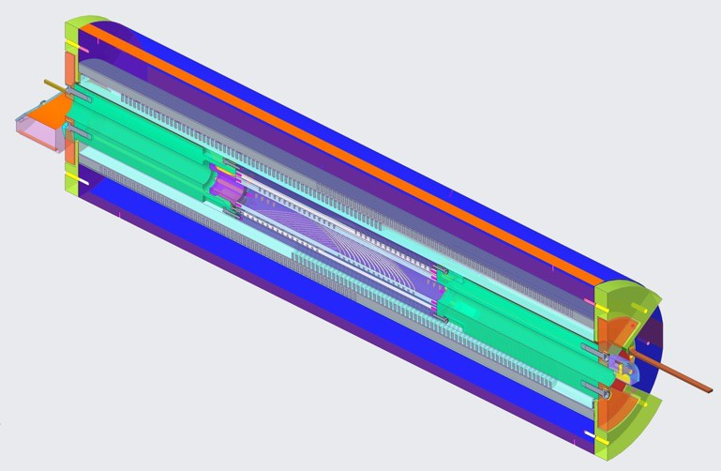
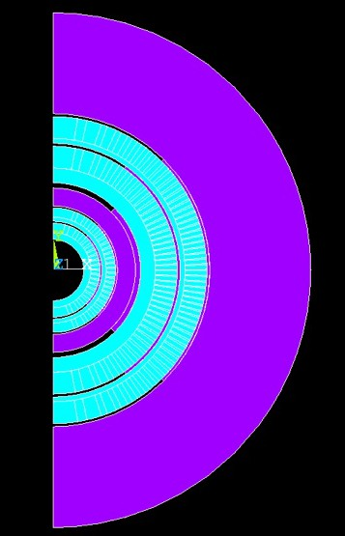


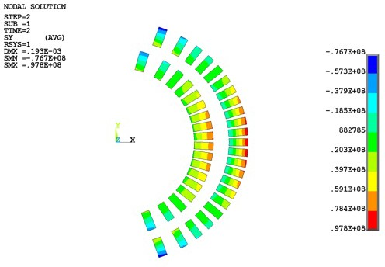
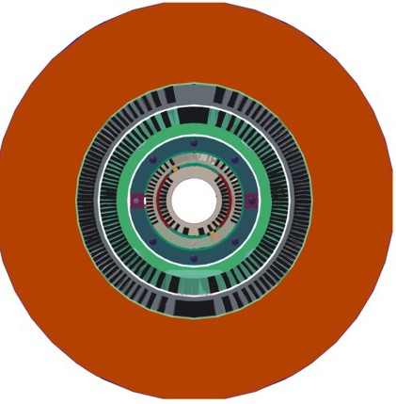




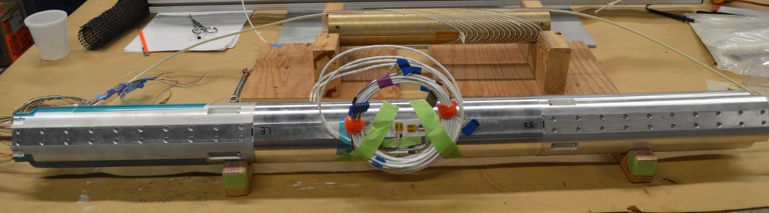
Mechanical integration of BIN5 and CCT5 and handling of special events
CCT5/BIN5c hybrid dipole magnet
CCT5 or CCT5w?
Add smart shim between CCT5 and BIN5?
  Eddy current during quench protection & force analysis, L. Brouwer
  Mech safety analysis by LG Fajardo
  Hybrid stress analysis, D. Arbelaez
CCT5
BIN5
BIN5 insert assembly
Peak azimuthal stress during energization
- 98 MPa with smart shim.

Slide 19
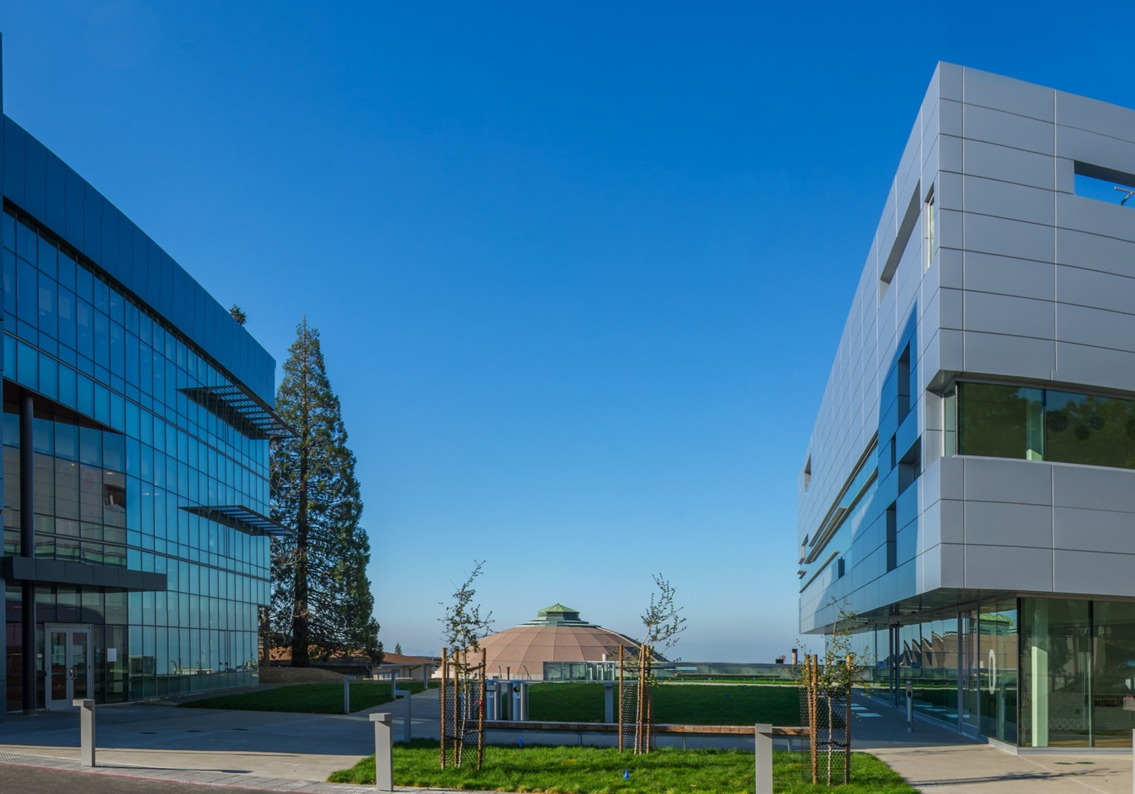
MDP Modeling Working Group Meeting
Modeling Transient Forces in Hybrid Tests
March 5th, 2024
Lucas Brouwer, Reed Teyber, Diego Arbelaez, Laura Garcia Fajardo, and Tengming Shen

Slide 20
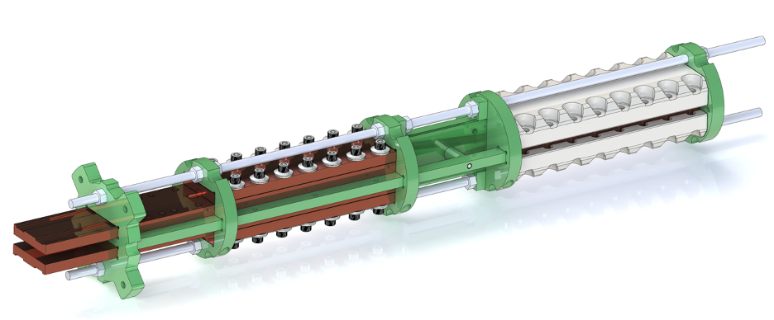
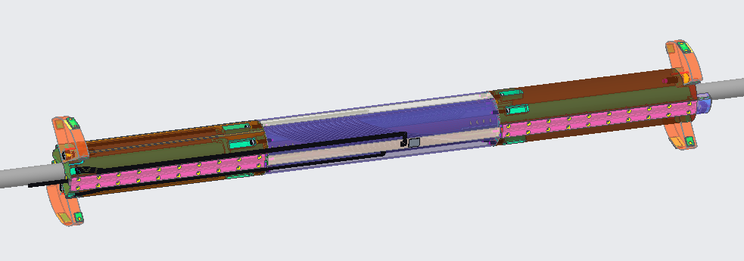
Motivation
Two upcoming hybrid tests in the 90 mm, ~8 T dipole magnet CCT5 place metallic material in regions of spatially changing field which see high dBdt during extraction (leading to net transient force)
HTS CORC joint
BIN5
What is the impact of transient forces due to eddy currents in this conducting material?

