Slide 1
Nb₃Sn CCT Updates and Next Steps
USMDP Bi-Weekly Meeting - 06/12/2024
D. Arbelaez, L. Brouwer, P. Ferracin, M. Juchno, M. Marchevsky, S. Prestemon, J. L. Rudeiros Fernandez, R. Teyber, G. Vallone

Slide 2
Outline
General Updates
CCT subscale updates and plans
CCT5 Hybrid updates and plans
CCT5-W update (new wax impregnated CCT5 style magnet) and plans
CCT6 updates and plans

Slide 3
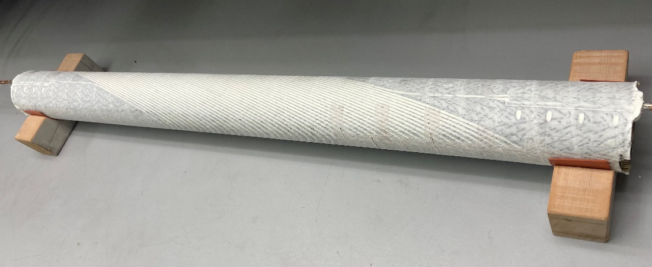
CCT Subscale Current Activities
Assembly of CCT SUB7 (filled wax inner layer) to be completed this week, magnet to be ready for testing in ~1 month
Heat treatment complete for inner layer coil to be impregnated with Telene (in collaboration with FNAL: E. Barzi)
Test at FNAL on the effect of LHe temperature on CCT subscale (CCT Sub2) training currently ongoing (M. Baldini and S. Stoynev to present in future meeting)
Will investigate use of filled epoxies (i.e. Stycast or other epoxy with added filler)
Need to understand the role of resin vs. filler on training
Plan to perform material tests to improve understanding before committing to specific resin / filler combination
Techniques developed for filled wax impregnation can be used for coil impregnation
Filled Wax Impregnated Coil
Coil for Telene in Furnace

Slide 4
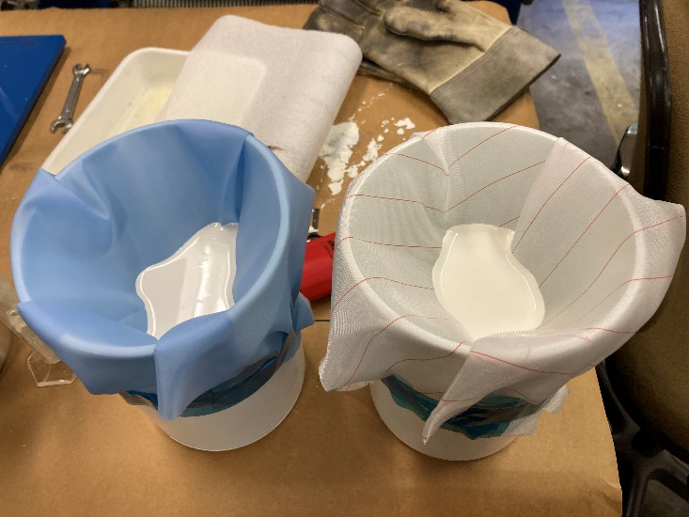
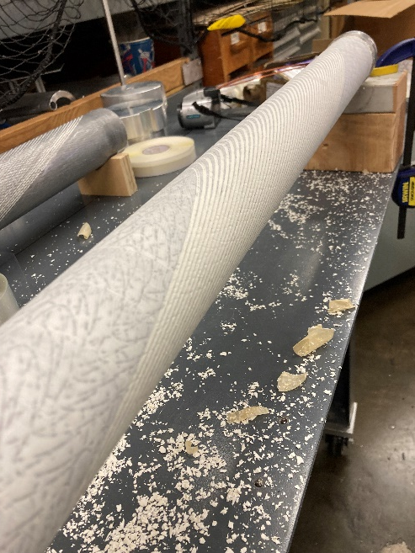
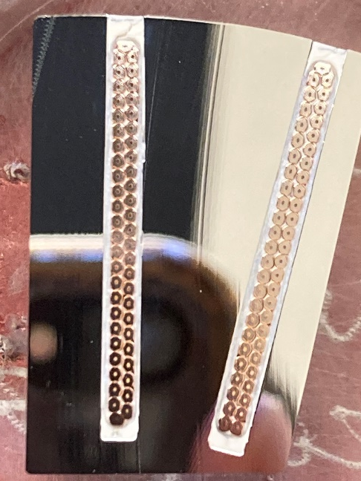
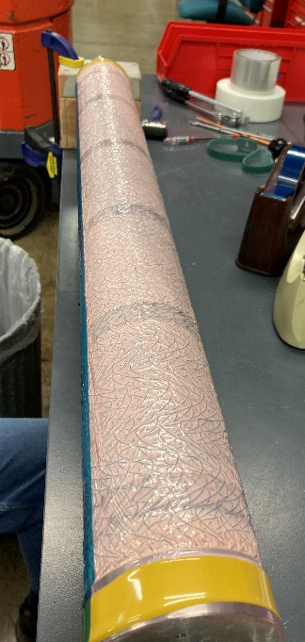
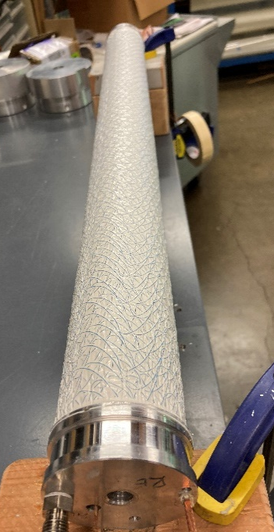
CCT Sub7 (filled wax) Impregnation
Process for filled wax impregnation uses same concept as for other subscales but new consumable materials implemented
Glass tape wrap with sufficiently large openings for particles used
Peel ply with sufficient permeability for particles used
Low density flow media replaces hex cell media used for wax / epoxy
Dispersion of particles in wax is improved by use of high shear mixer and probe sonicator
Impregnation Layers
Mandrel
Glass Tape Wrap
Peel Ply
Flow Media
Vacuum Bag / Shrink Tape
Peel Ply Experiments
Coil after Impregnation
Impregnated Sample
Coil Impregnation
Flow Media
Effort led by Jose Luis Rudeiros Fernandez

Slide 5
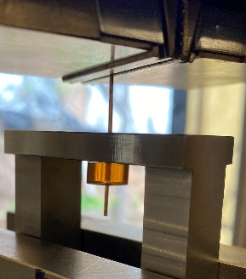
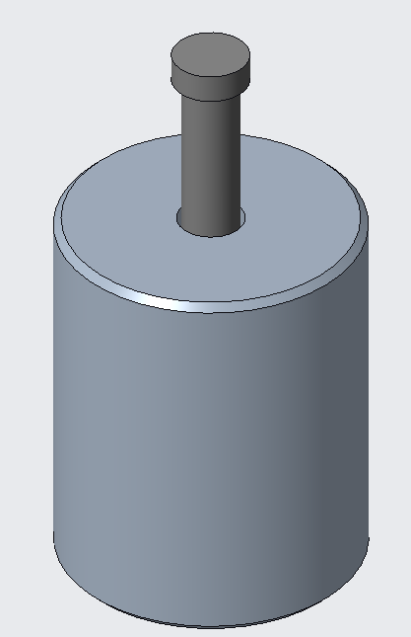
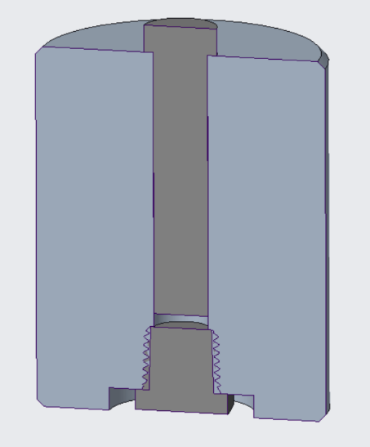
Material Characterization Activities
Single fiber pull-out (SFP) testing
Complete the characterization of interfacial properties with the addition of filled systems (i.e. filled paraffin wax and epoxy resins) at RT and 77 K.
Characterize the interfacial properties at 4.2 K as well as energy deposition in the copper strand during debonding (lead by M. Martchevskii).
$$F$$
Strand
Pull-out frame
Resin
Characterization of bulk properties of resin systems at various temperatures. This is especially relevant to understand the impact of filled systems (e.g. filled paraffin wax) on the stress on the strands due to Lorentz forces.
Matrix compression system
Effort led by Jose Luis Rudeiros Fernandez

Slide 6
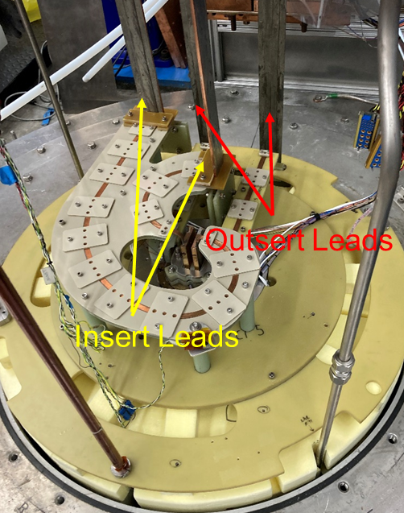
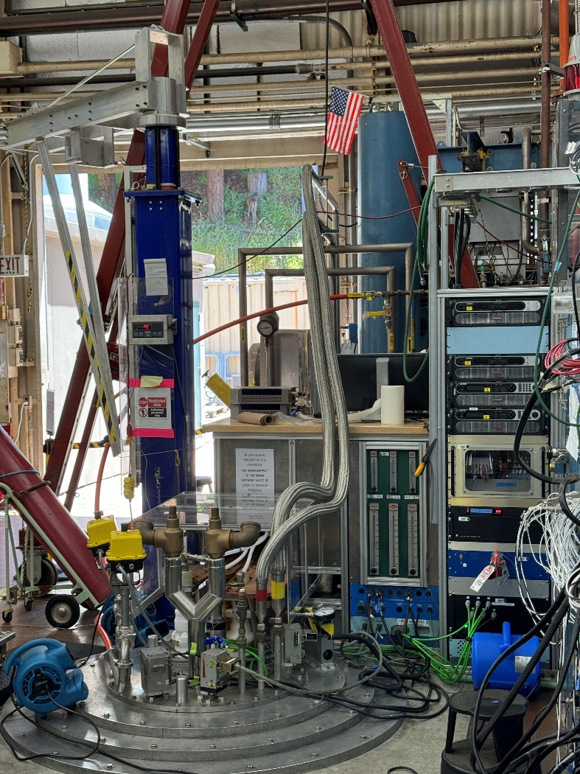
Hybrid Testing With CCT5
First hybrid powering test (GA CORC demountable joint) just successfully completed
CCT5 used as outsert for hybrid testing
90 mm open aperture with approximate short sample field of 9.7 T
Magnet was previously disassembled and reassembled
Maximum field achieved during test was 6 T* (no magnet quenches occurred)
Maximum insert current currently 4.8 kA (planned expansion in near future to 7.2 or 8.4 kA)
Facility is ready for upcoming MDP hybrid tests!**
Upgraded Test Facility
Insert Power Supply, control, and data acquisition rack
* Decision was made to limit maximum current to 11 kA due to high voltage during IGBT switching. More off-line testing and snubber design update is planned before next magnet tests.
** Reed to give comprehensive talk after returning from parental leave
Hybrid Facility and Testing Effort Led by Reed Teyber

Slide 7
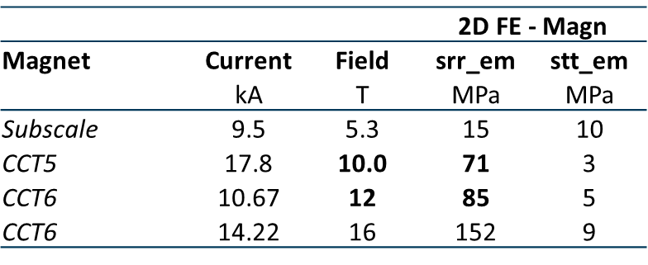
CCT5-W (Wax Impregnated) Motivation
Desire to operate close to the conductor limit with minimal training for CCT6
Wax subscale has been completed without training and we are currently working on filled wax subscale magnet
Have started work on building a wax impregnated CCT5 @10T (CCT5-W) as a stepping stone towards CCT6
Average radial stress of CCT5 at 10 T is representative of CCT6 at ~12 T. Subscale stresses are significantly lower
The cost and effort to build CCT5W is only slightly more than for a subscale magnet since the process is the same, the machining cost is only slightly higher, and cable is available
Stress on Turn from Lorentz Force
Plain Wax SUB
CCT5W
CCT6
Filled Wax SUB
Analysis performed by G. Vallone and M. Juchno

Slide 8
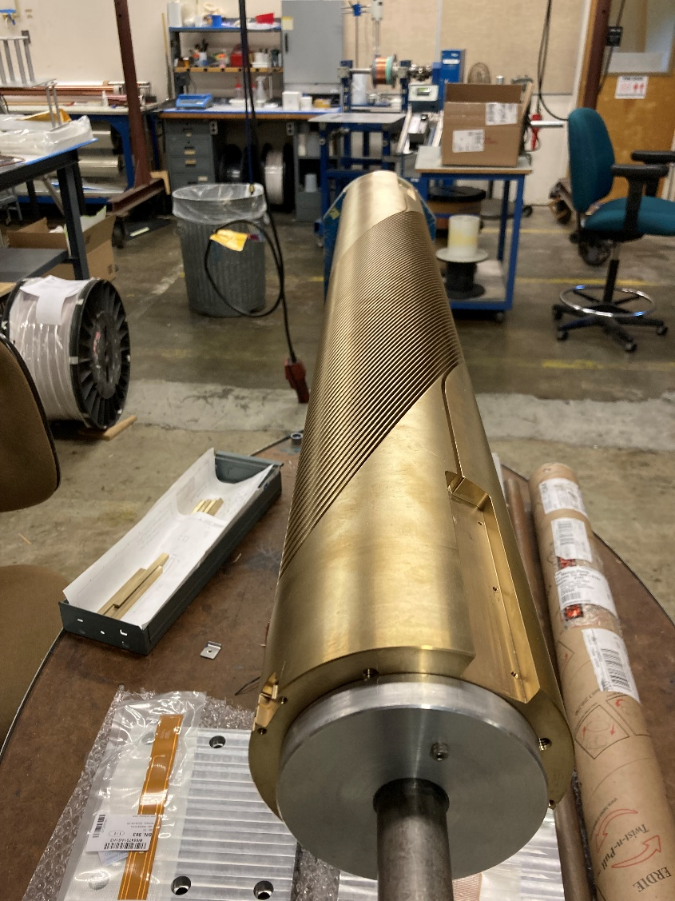
CCT5-W Status and Next Steps
Fabrication of inner layer and shell are complete
Outer layer “tube” is ready for machining (will machine grooves after CCT6 test mandrels are complete)
Cable was available as spare from previous production run but has been reinsulated since previous insulation (done as a test of new vendor) was found to be too thin during winding test
Winding of mandrels to start within next few weeks (~3 months to complete magnet after start of winding)

Slide 9
CCT6 Machining Updates
Update from last meeting:
After a lot of effort and improved communication / process with our main machine shop the situation is much improved
Testing first performed on flat plate to improve machining time starting from documented machining parameters from previous machinists within our group
Several iterations of machining of grooves on full length tube (1.5 m) led to correction of errors and improvements
Determined tool life parameters and will implement automatic tool changes based on expected tool lifetime
1.5 m

Slide 10
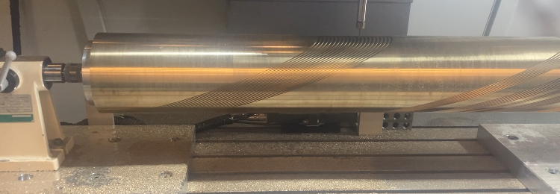
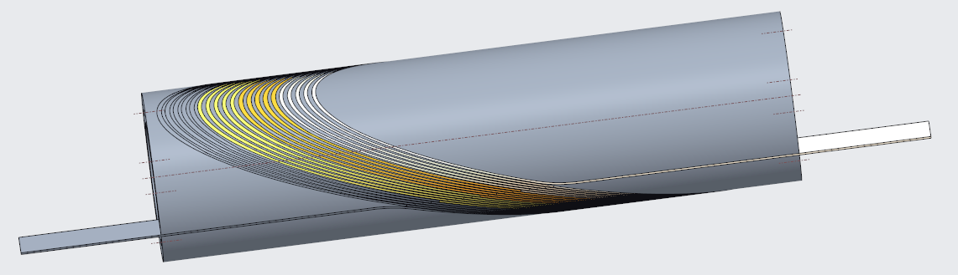
CCT6 Fabrication Status
Will perform machining / winding / reaction / impregnation test on two 20-turn mandrels (LD1 style cable, MQXF style cable)
Each 20-turn mandrel contains four slightly different groove geometries
Goals of these tests are:
Define final groove geometry (investigate trade-off between pole gap and total path length) based on reacted cable position
Determine machining time trade-off between two cases
20-Turn mandrel currently being fabricated
20-Turn mandrel with four different groove segments
Created by L. Brouwer

Slide 11
CCT6 Cable Decision
After 20-turn tests are complete, will make decision on cable choice based on the following criteria
Maximum achievable field (approximately 10% for LD1 vs MQXF)
Machining time / risk (early indication is that MQXF groove can be machined approximately 2x faster than LD1)
Ease of winding (risk of popped strands)
Detailed machining time information of 7-turn test provided by main LBL shop

Slide 12
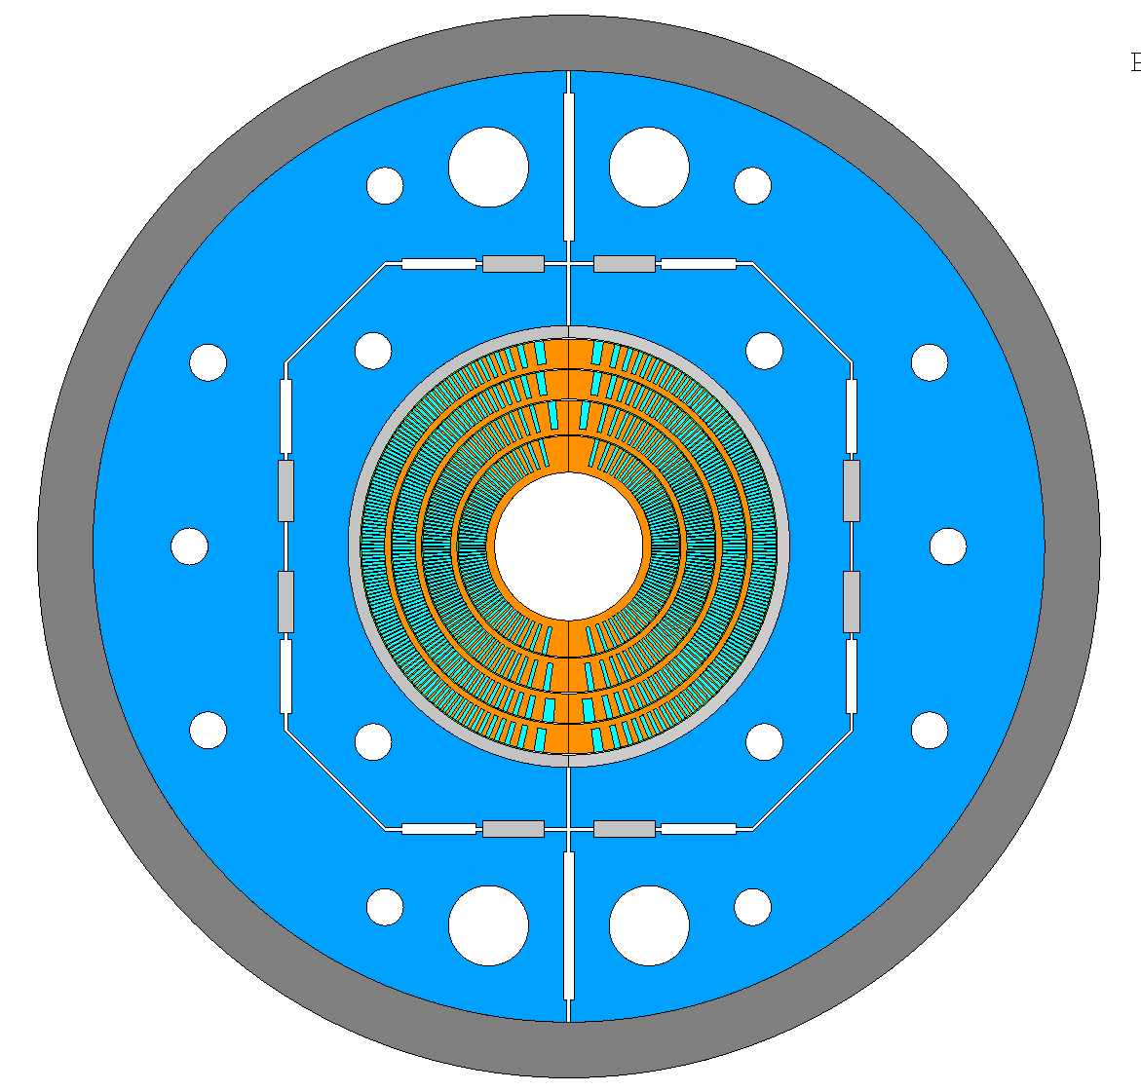
CCT6 Next Steps
Design and Analysis
Structural analysis of structure continues (Also includes analysis with SMCT magnet by M. Juchno)
CAD design of mandrels including splice / alignment / instrumentation features
CAD design of key-and-bladder structure
Mandrel Fabrication
Complete 20-turn tests and select cable and groove geometry
Start machining of CCT6 inner layer (within ~ 2-3 months)
Need to order material for layer 2 after decision on cable
Fabrication Technology
Investigating possible use of filled wax for CCT6 through subscale and CCT5-W tests

Slide 13
Summary
Subscale progress
Testing of filled wax subscale planned for ~1 month from now
Preparing coil for impregnation with Telene
Subscale results are influencing design of CCT6 (exploring possibility of wax impregnation)
Larger model progress (i.e. CCT5 type)
CCT5 successfully tested in hybrid configuration after reassembly
CCT5-W fabrication is in progress and planned to be complete within the next 3-4 months
Major improvement in previous CCT6 machining difficulties, now ready to move towards machining layer 1 within 2-3 months after final groove geometry tests are complete

