Slide 1
REBCO modeling needs
Vadim Kashikhin
MDP Meeting - Modeling Working Group
July 2, 2024

Slide 2
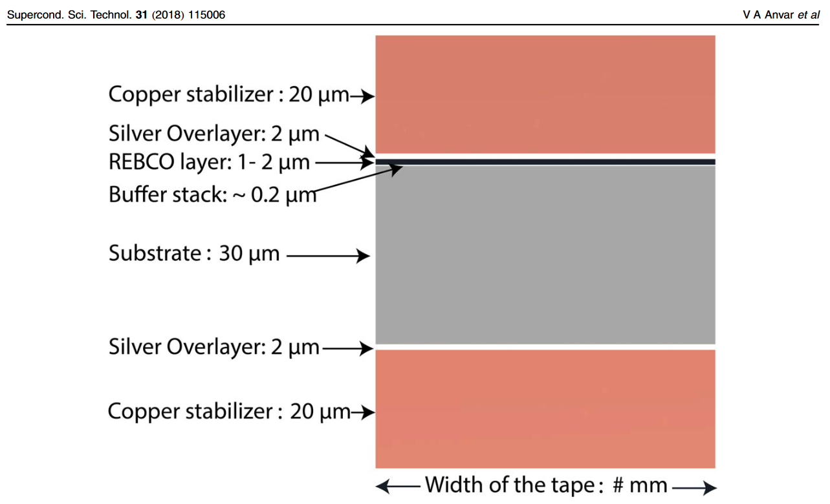
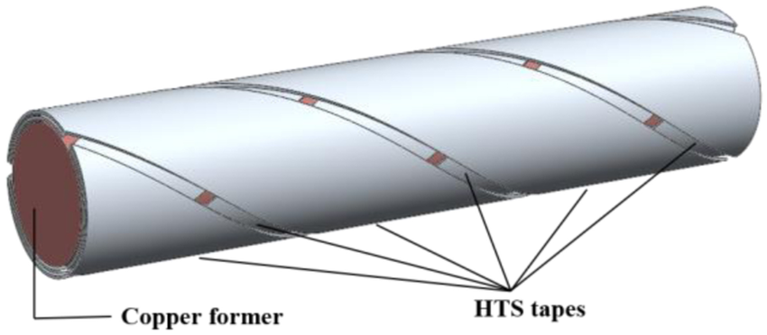
REBCO tape and round cable architecture
Inner core (copper) of 0.8-2.5 mm diameter
Multiple layers (12 are typical) of REBCO tape
Layers are counter-twisted
1-3 tapes per layer
Varying tape width between 2-3 mm
  Narrower tapes inside and wider tapes outside
REBCO tape REBCO cable

Slide 3
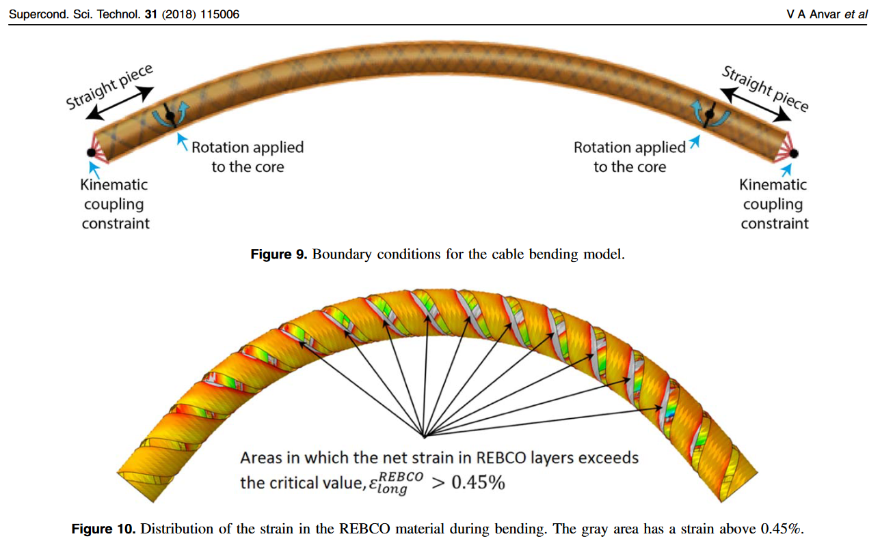
Past modeling developments
Structural models of the CORC-like cable have been developed
We need a reliable electromagnetic model that can predict the Ic

Slide 4
Challenges
We don’t have a good correlation between the tape Ic and the cable Ic
  Measuring the tape Ic is easy both in LN2 and LHe
  Measuring the cable Ic is relatively easy in LN2 in self-field
    Difficult in LHe and background field
The vendors give us expected cable Ic based on the tape measurements – i.e. the sum of the tape Ic with some correction factor for the increased self-field
  Works as a reference, however, does not seem to represent the actual cable performance in a magnet
  Due to the cable architecture, we may be underestimating the peak field on the conductor, which can appear as a poor (degraded) magnet performance

Slide 5
Needs
Unlike LTS conductors, our tapes are not isotropic and our cables are not fully transposed
  each layer can carry a different current based on the magnetic field at that location and the contact resistance between the tapes
  there may also be an effect of the solenoidal field due to the relatively tight twist
    it may not completely cancel and can contribute to the peak field on the conductor
It would be very helpful to have a model that can predict the cable performance – Ic(B,T) based on the tape Ic(B,T,angle) data
  the model may be calibrated using specific experiments, like small coil tests
  it can also be used to optimize the cable designs and provide input to the vendors

