Slide 1
Nb₃Sn - Coil Composite and Training Status and Goals
G. Vallone
07/02/2024 - MDP Modeling Group

Slide 2
Outline
Introduction
Coil Composite
Stiffness
Stress/Strain Limits
Training

Slide 3
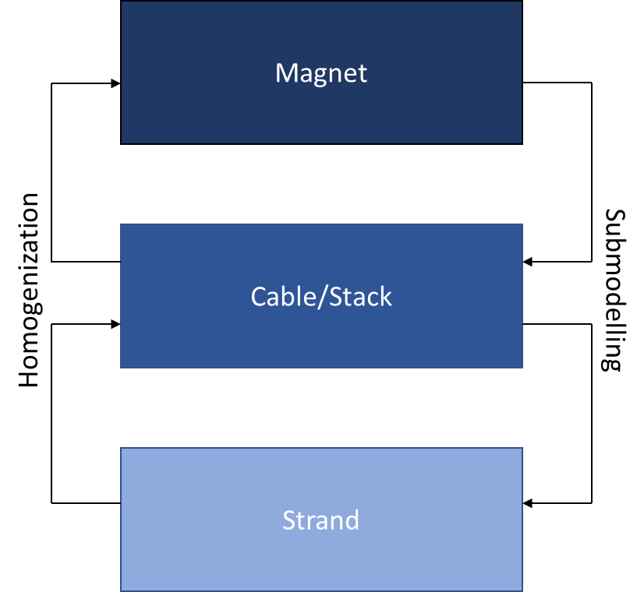
FE Coil Models
Key ingredients required for coil modelling:
Modelling strategy
To have a reasonably sized model we need several simplifying assumptions
Constitutive equations (material model)
Connect stress/strain inside the simplified model
Strength limits
Depending on the modelling strategy, the definition of these limits might be different

Slide 4
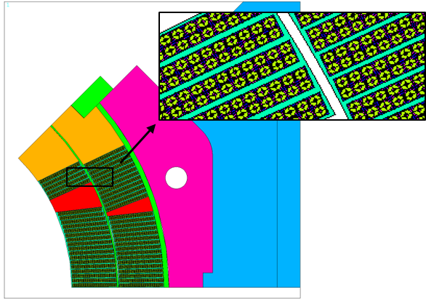
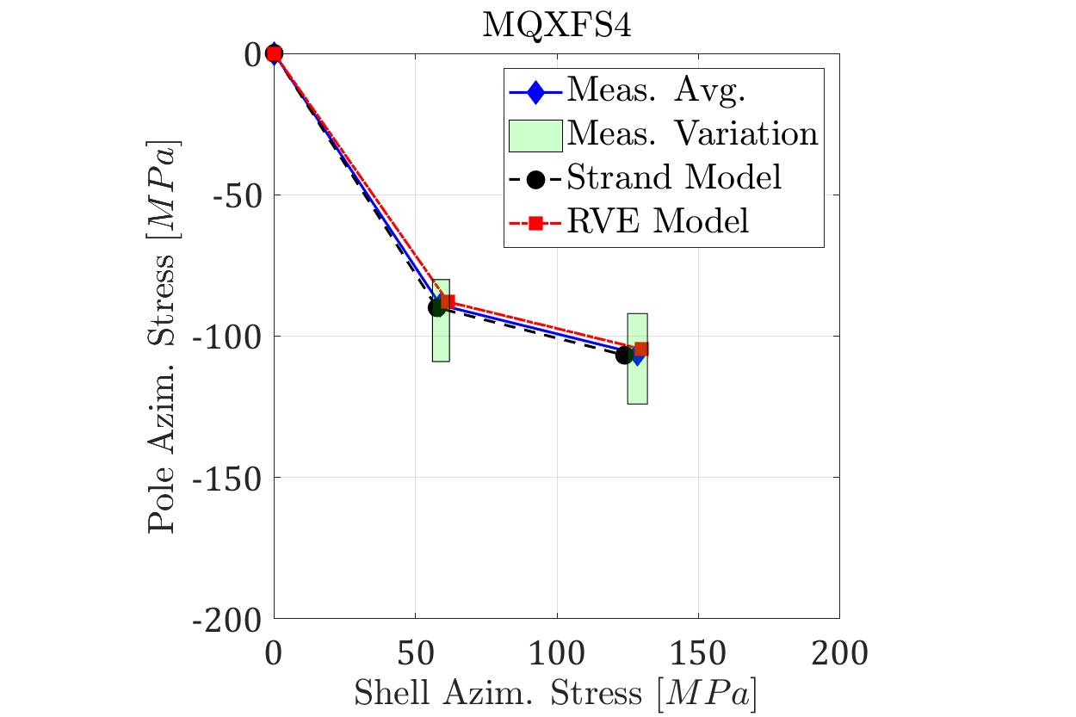
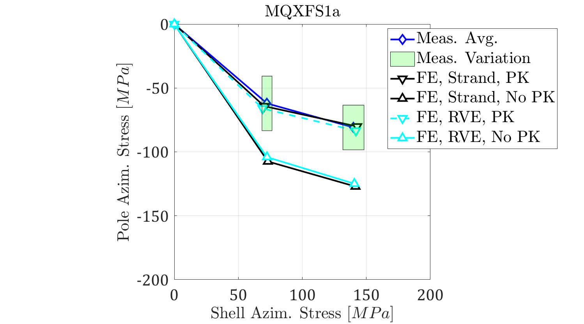
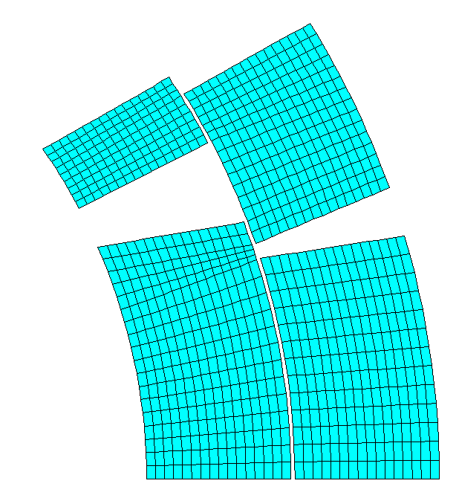
2D - Available Modelling Strategies
Strand Model
‘RVE’ Model
Two modelling strategies developed: ‘strand model’ and RVE model
Both the strand model and RVE model match the mechanical measurements, with no calibration necessary
The RVE model provides the same ‘average’ results, but does not allow to correctly evaluate local peaks
G. Vallone et al., SUST 2020

Slide 5
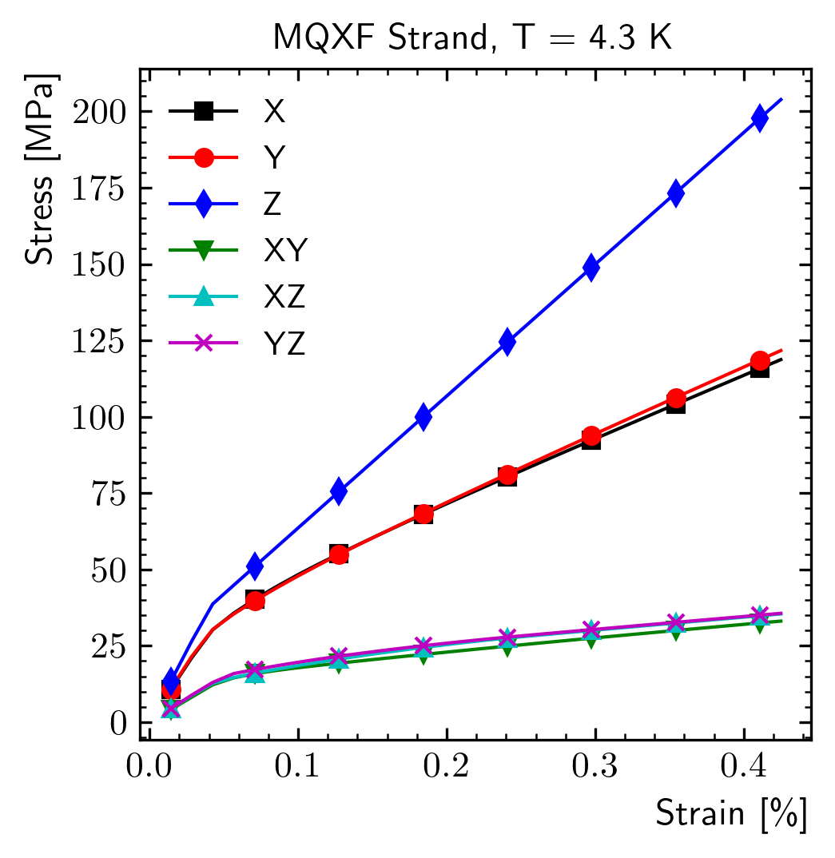
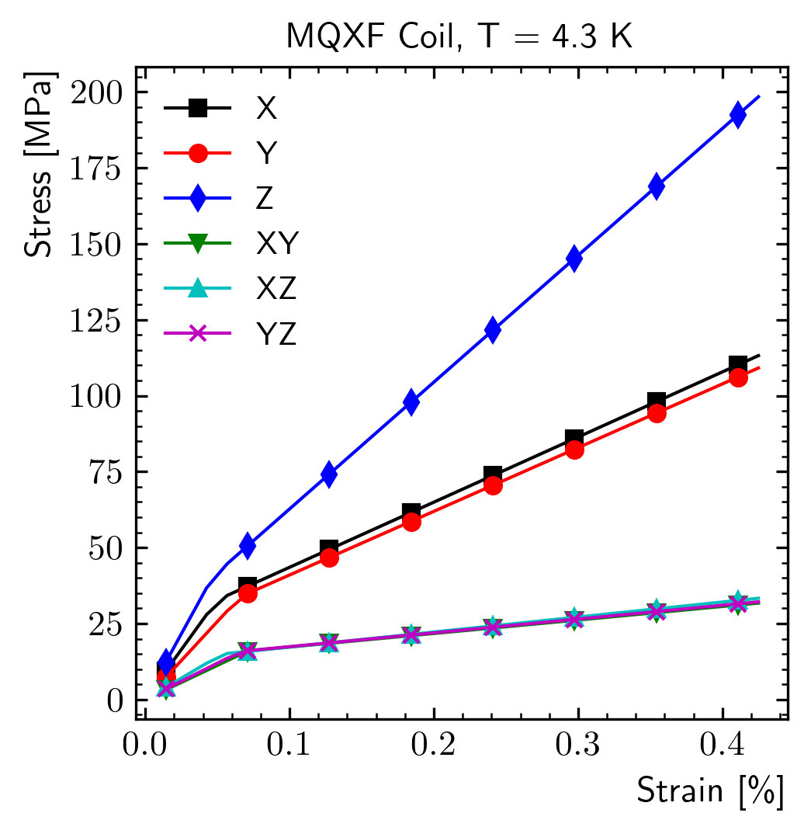
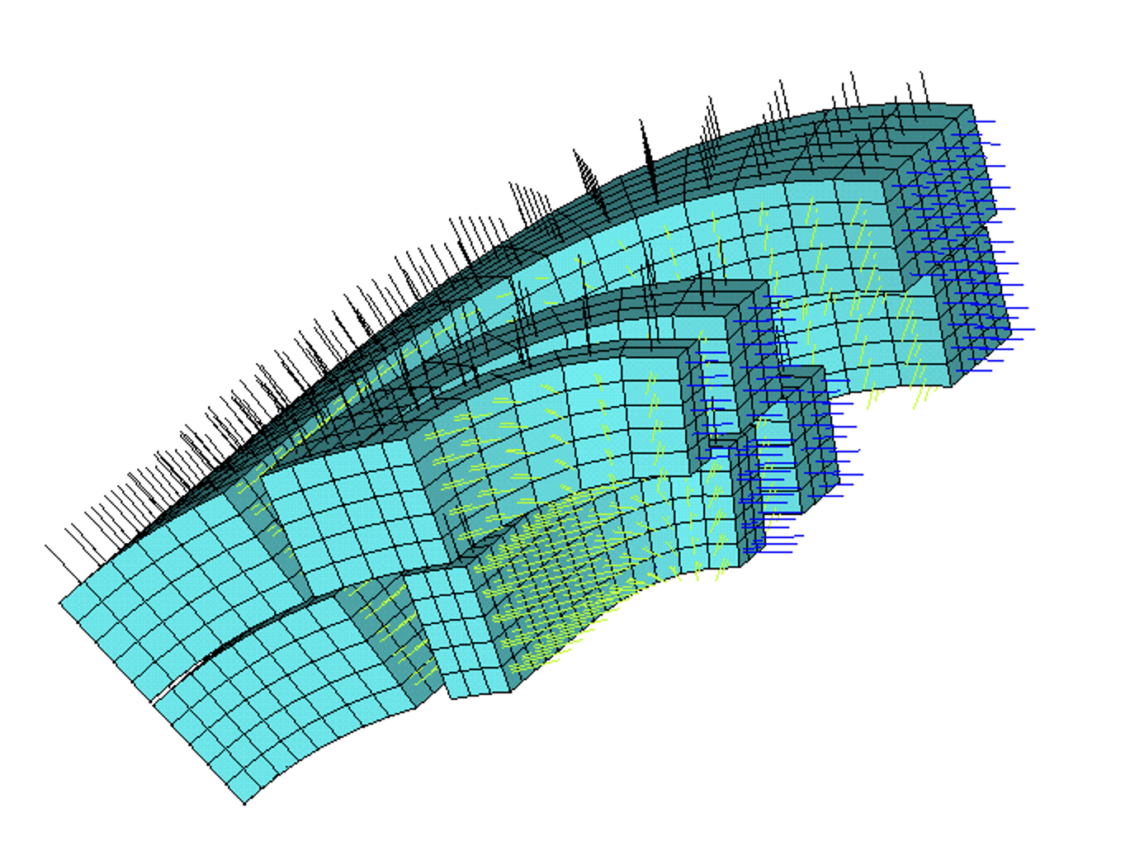
3D RVE Model - Status
Modeling at the strand level not easy in 3D
We have a set of assumptions/tools available to extend the RVE model in 3D
Anisotropic yield strength criterion
Anisotropic work-hardening rule (‘generalized Hill’)
Element (material) coordinate system definition
The model was tested on MQXFA, but for the moment the agreement between (longitudinal) measurements/computations is not great
G. Vallone et al., IEEE Trans (2023)

Slide 6
Coil Composite Tool
Cable Parameters
Python
Interface
APDL
Material
Strand Parameters
Other Formats…
APDL
We should compute the coil properties for each magnet design
These are a function of the strand/cable design
We had developed a tool in python/ANSYS that could do this, but it was never released…
It is missing only an interface to be used for at least certain ‘design’ families

Slide 7
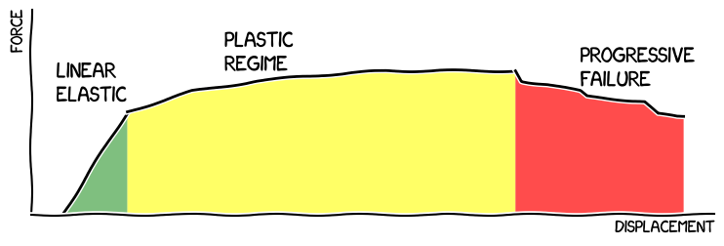
Mechanical Loads in Nb₃Sn Coils
Mechanical loads in Nb₃Sn coils can be divided in three regions, based on the effect they produce in the coil composite:
Region #1: only elastic strains are introduced in the coil composite
Region #2: loads introduce plastic deformations in the copper matrix, locking residual elastic strains in the filaments and thereby affecting their electro-magnetic performance irreversibly
Region #3: critical load configurations that introduce local failures in the coil, in the form, for example, of broken filaments or insulation damage
We are working on a framework that can predict the boundaries of these regions starting only from meas. on longitudinally loaded strands

Slide 8
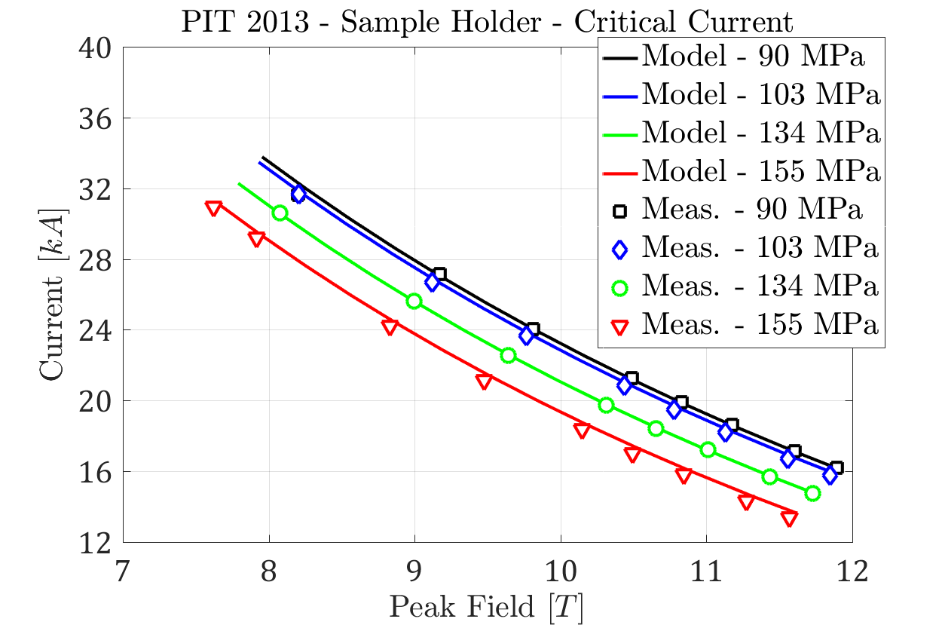
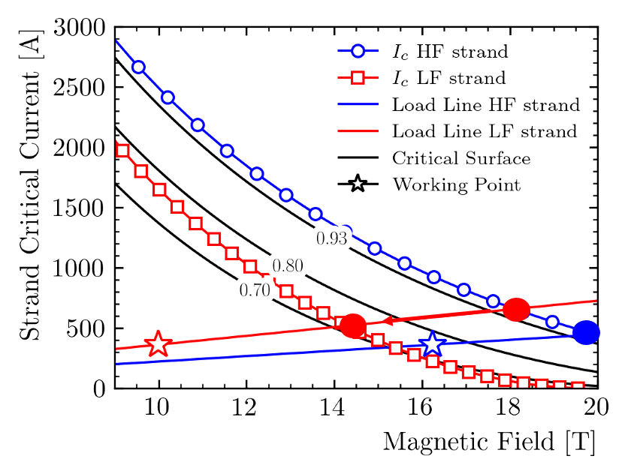
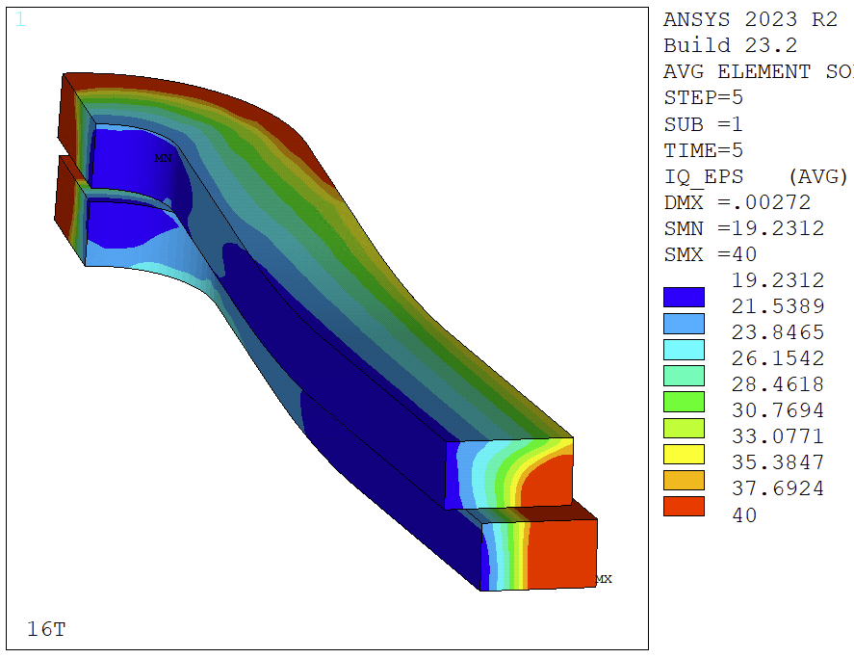
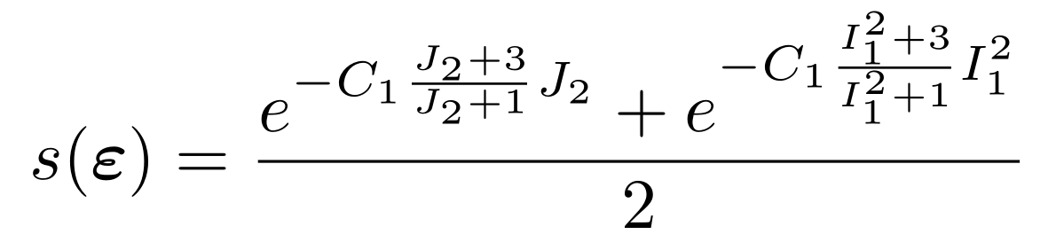
Strain/Stress Limits - Region 1 and 2
In Region 1: Elastic and Region 2: Plastic, the strain/stress limits coincide with the acceptable critical current reduction
This can be predicted using the strain function coupled with multi-scale modeling in the ‘loading’ regime
The same approach can be extended to Region 2, unloading, at least in 2D using measurements performed on strands under transverse pressure
This should not be necessary with more advanced modeling strategies
The approach can be applied with RVE strategies to 3D models
This can be only as good as our constitutive equations…

Slide 9
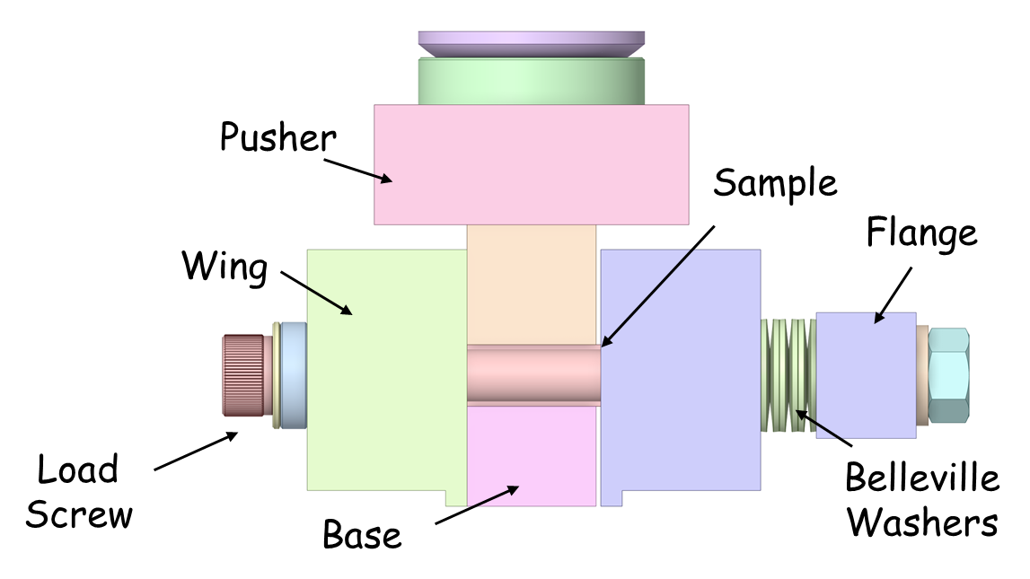
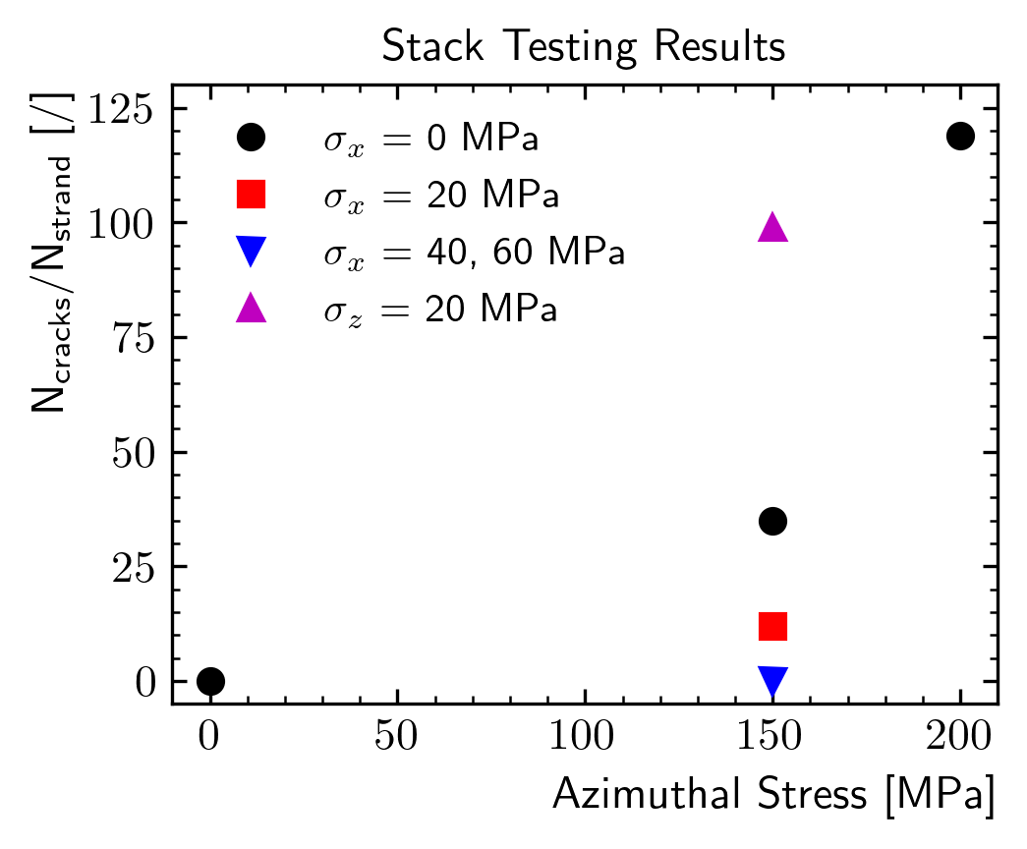
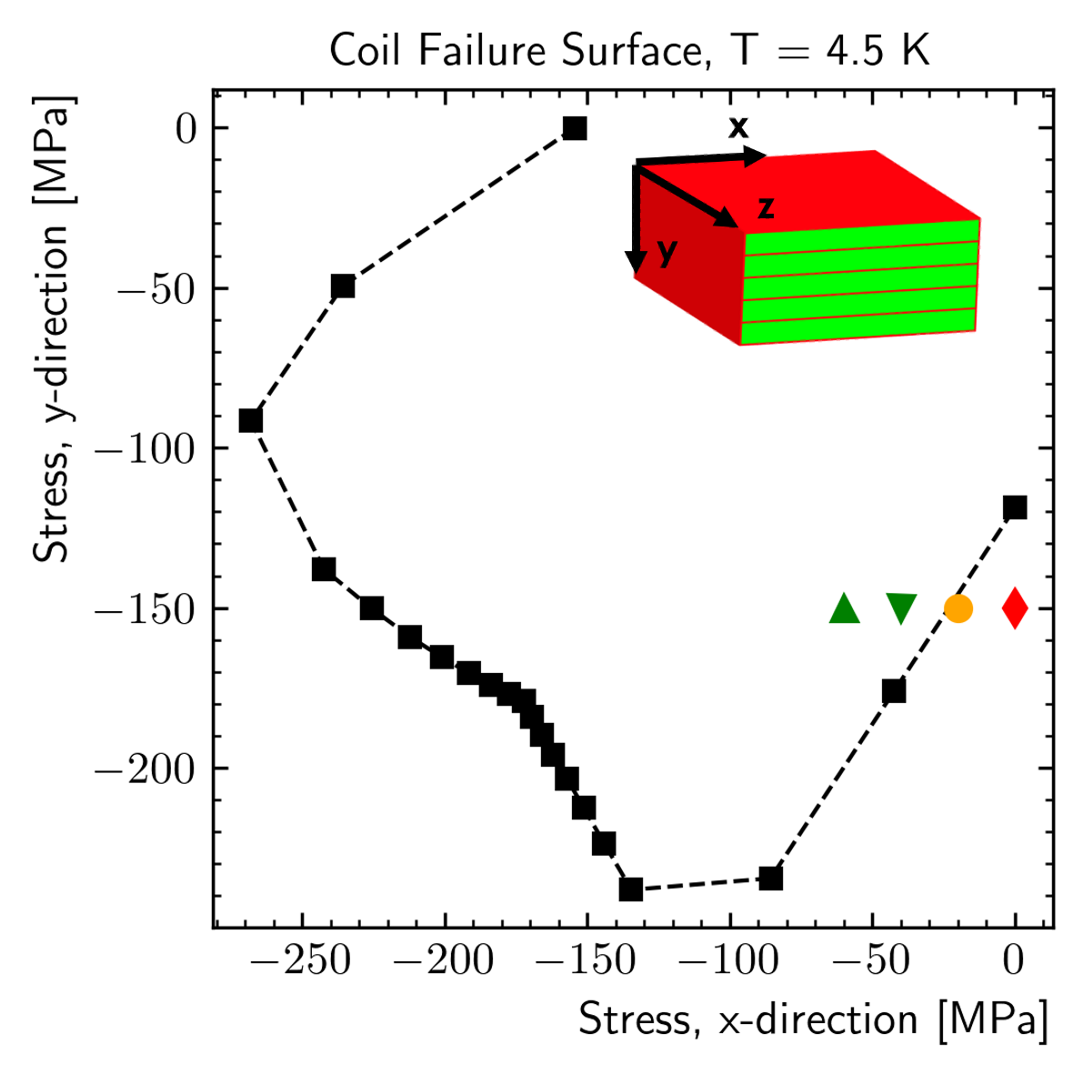
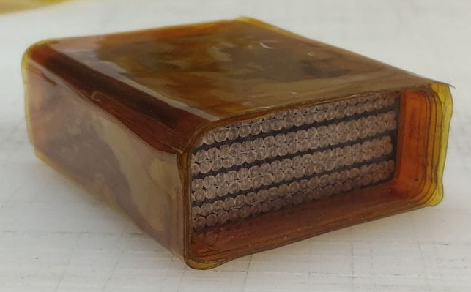
Stress/Strain Limits – Region 3
Region 3 is the most complicated, as coil failures can be very different in nature
Multi-scale models might predict correctly the onset of radial cracks
Measurements show significant ‘load’ interaction
Unclear relationship between radial and longitudinal cracks, being explored
G. Vallone, J.F Croteau et al., IEEE Trans. 2024

Slide 10
Coil Composite - Summary
What we have:
2D strand, RVE models validated against measurements
3D RVE models, non-validated
2D critical current ‘predictions’ in regions 1, 2
Extended to 3D, but not validated
A failure model, tested on a limited set of loading conditions
What we are missing (at least…):
Improve 3D RVE models
Check validity of strain function approach in 3D
Collect (a lot) more data on ‘failure’ of Nb3Sn as function of different loading conditions

Slide 11
Outline
Introduction
Coil Composite
Stiffness
Stress/Strain Limits
Training

Slide 12
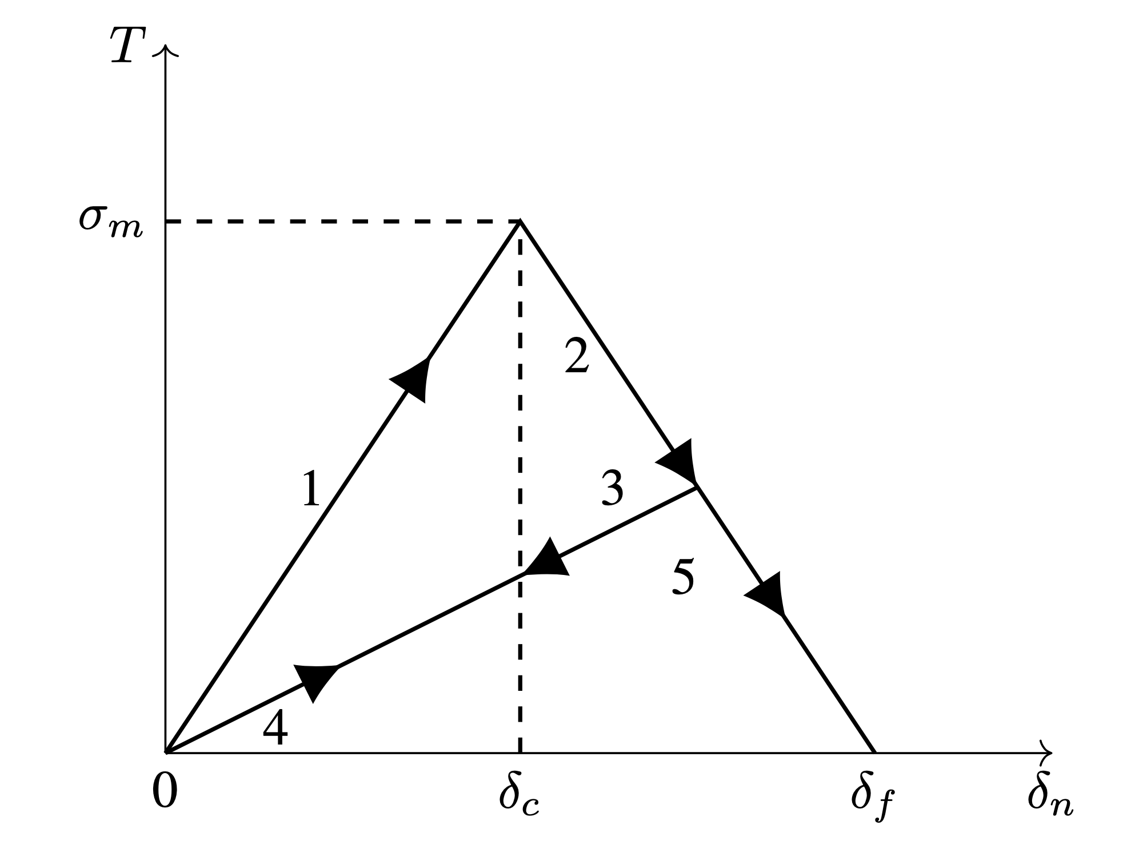
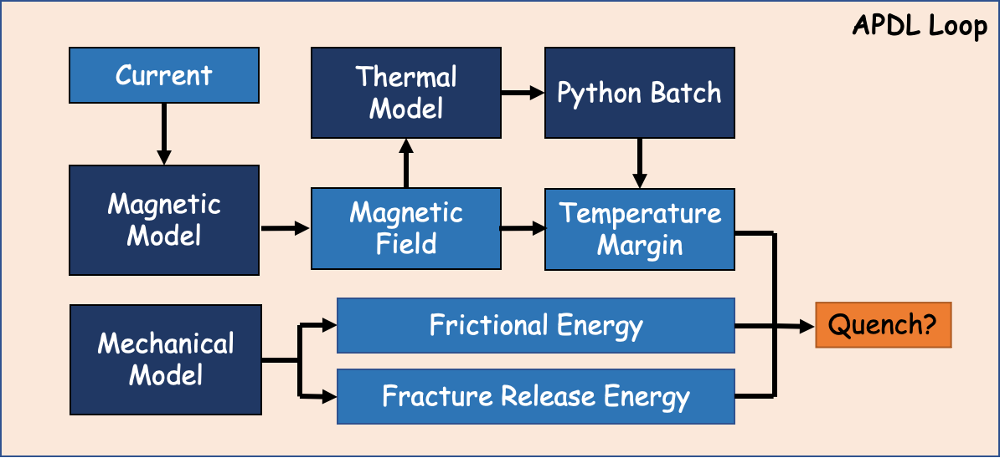
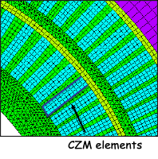
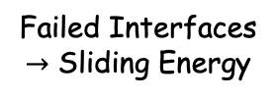
CCT Training Model
Debonding
Energy
Cable
Failed Interfaces
$→$ Sliding Energy
Mandrel
CCT training model:
Elasto-plastic material model for the conductor, extracted from RVE models
Cohesive Zone Model at the cable/mandrel interface
Energy released by debonding + frictional sliding computed at each step
Magnet ‘quench’ condition checked at each step

Slide 13
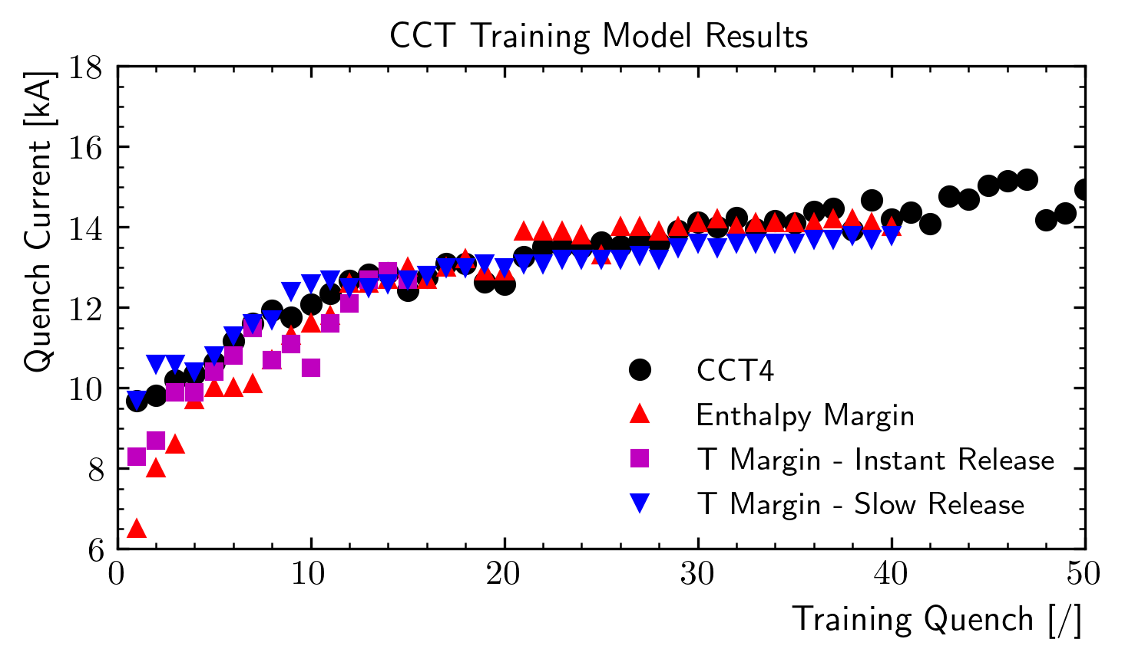
CCT4 - Quench Conditions Zoo
Model results depend on the assumption on the quench condition
Not clear what is the ‘correct’ assumption
The model produces ‘events’ at the ‘correct’ current, then the physics behind the thermal energy release is unclear
We need some experiment to better understand what is happening…

Slide 14
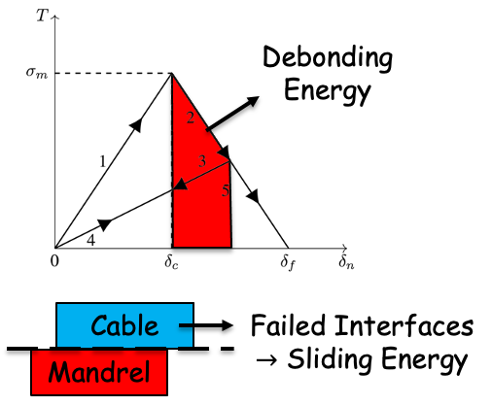
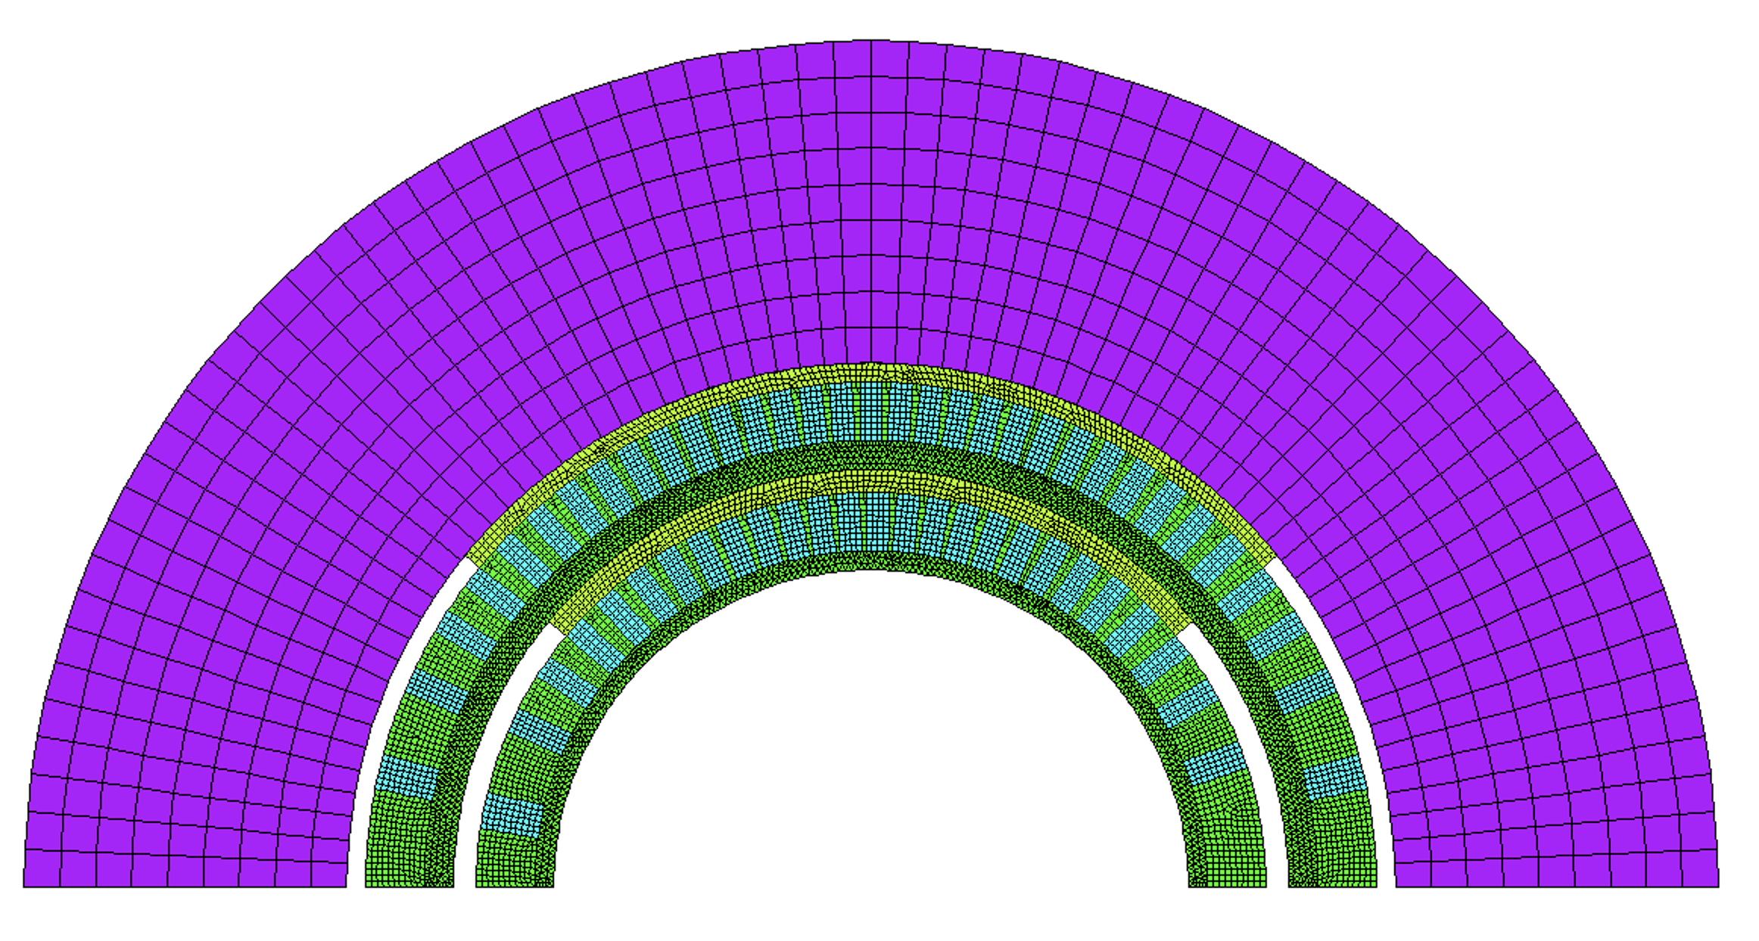
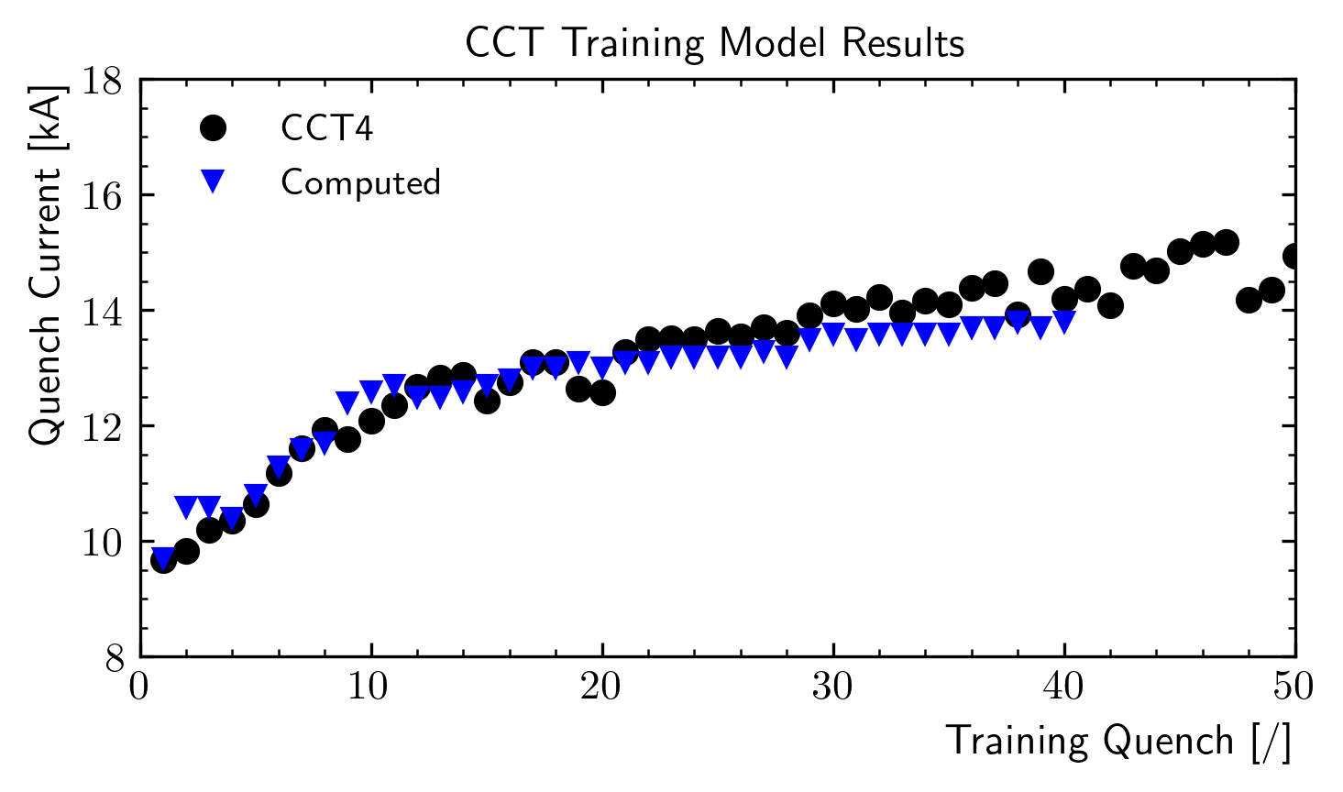
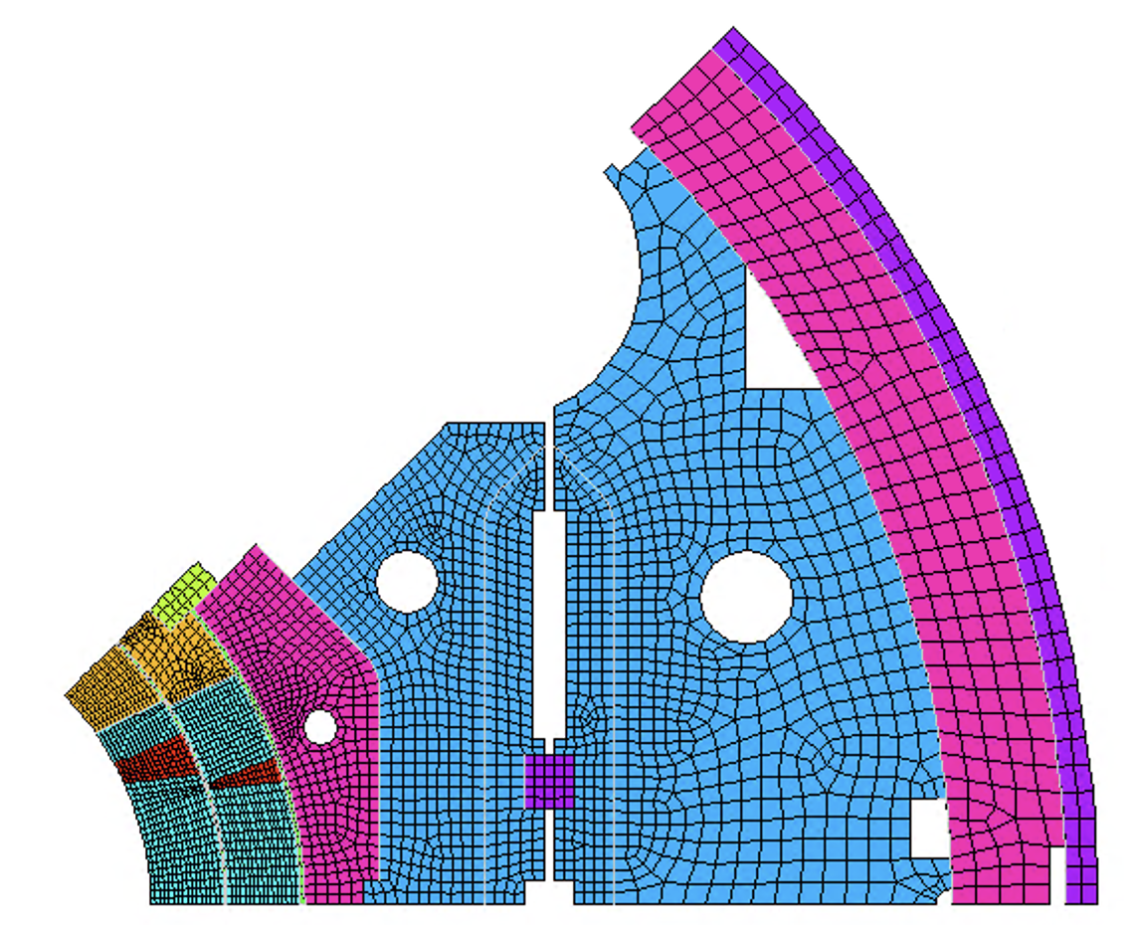
Conclusion
Training Simulation
Python/APDL
Failure of bonded interfaces can be modeled using cohesive elements
We proposed an iterative modeling approach to simulate training
Model results suggests that CCT training might be due to debonding and consequent sliding at the interfaces
This is consistent with recent ’wax’ results
Comparing the released energy ’patterns’ we see some similarities…
Tested on subscale magnets

Slide 15
Training - Status
What we have:
We proposed an iterative modeling approach to simulate training
Model results suggests that CCT training might be due to debonding and consequent sliding at the interfaces
We have some comparison with available Strain Gauge, AE and Quench antenna data
Tested on subscale magnets
What we are missing (at least…):
Quench condition validation/change with dedicated experiments
Work in progress!
Validation on other magnets (e.g. MQXF?)
Testing on ‘future’ magnets (e.g. SMCT)

