Slide 1
Bi2212 - Multi-Scale Modeling
PhD student: Alessio D’Agliano 07/02/2024
Advisors: E. Barzi (FNAL), S. Donati, V. Giusti (Pisa University)

Slide 2
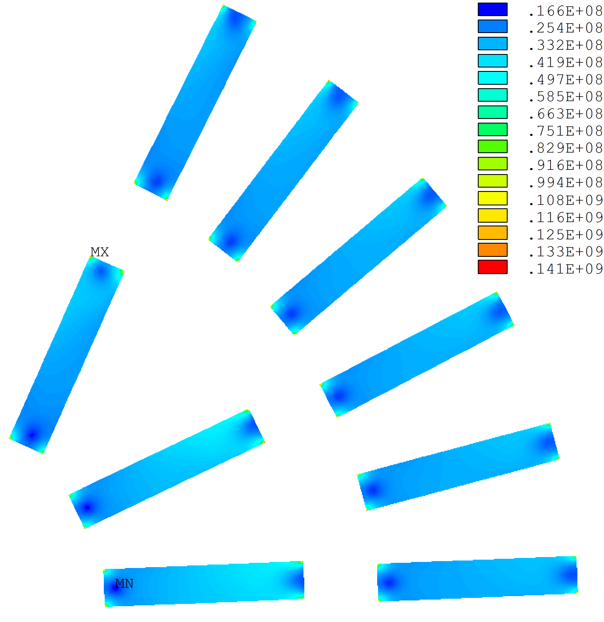
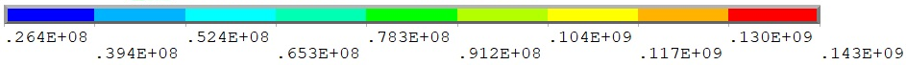
HTS Dipole Insert Coil Simulation – What so far
Max σ_{eq} in the edges: 141 MPa
FNAL Bi-2212 Insert Coil
Magnetic analysis:
1. Homogeneous model (ROXIE and ANSYS)
2. Heterogeneous Rutherford cable, in the same mandrel geometry
Mechanical analysis:
Homogeneous model (isotropic and anisotropic)
Heterogeneous mechanical model using detailed strand geometry (direct approach)
The homogeneous model can give a first order approximation of the stress/strain state inside the conductor areas.
Max σ_{eq} within white area: 50-55 MPa
The heterogeneous more model enhances the accuracy of stress intensity and stress localization in the mechanical analysis.
Max σ_{eq} epoxy: 143 MPa
Max σ_{eq} within Bi-2212: 68 MPa

Slide 3
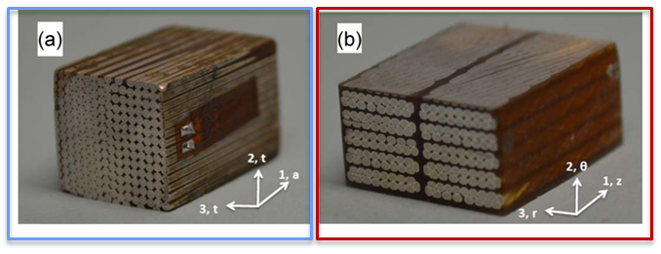
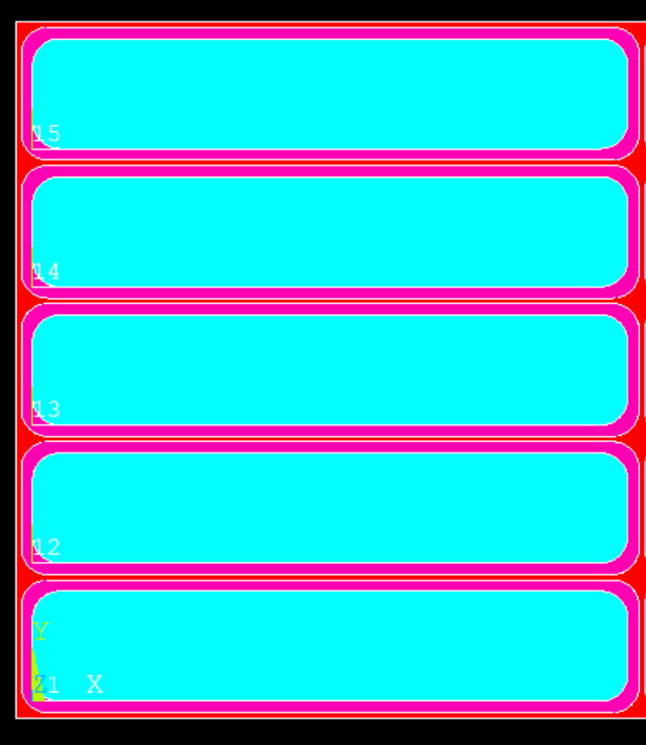
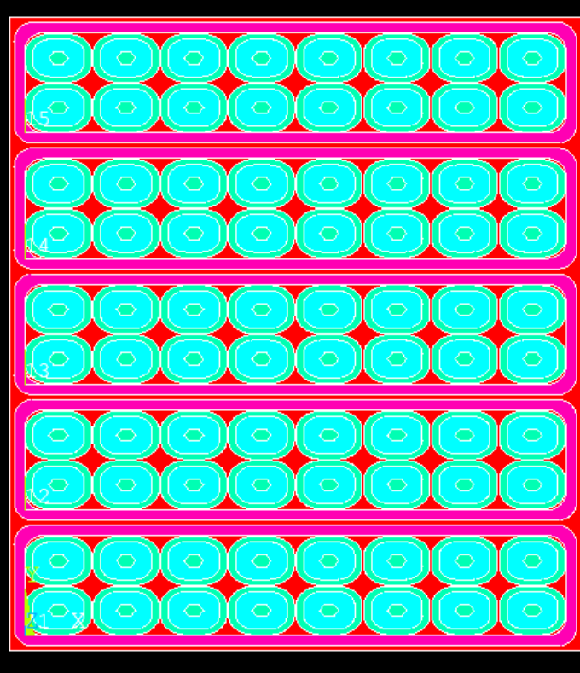
Bi-2212 10-stack Samples
2D models already implemented:
homogeneous orthotropic
heterogeneous composite with isotropic materials
H = 9.1 mm
Strand composite sample
Rutherford cable composite sample
θ
Orthotropic transversely isotropic
2D simulation is enough to characterize the sample in APDL
(E_{t}, E_{a}, ν_{at}, ν_{tt} , G_{at} )
Fully anisotropic
Need a 3D simulation to characterize the sample in ADPL
(more than 5 parameters)
r
B = 16.4/2 mm
Higher accuracy if remaining in elastic range, low deformation. After yield stress more detailed data need to be measured. Since Bi-2212 is brittle, we want to avoid yield in real magnets.
Thermal-Mechanical Properties of Epoxy-Impregnated Bi-2212/Ag Composite
Pei Li, Yang Wang, Arno Godeke, Liyang Ye, Gene Flanagan, and Tengming Shen, Member, IEEE

Slide 4
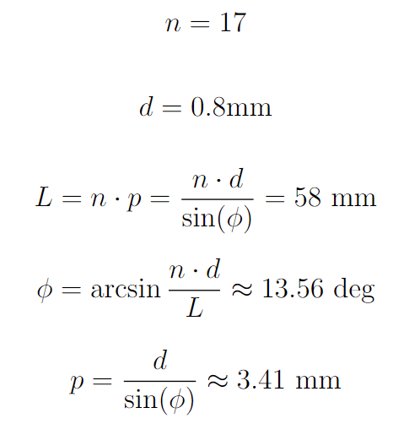
APDL 3D Ten Stack Module – Bi-2212 Rutherford Cable Sample
Impregnation
material
3 Inputs
SYM
Simulation steps done:
Geometry
Components definition and material allocation
Mesh
Remaining steps:
Contacts definition
Constraints / BC / Loads
Run (fix possible runtime issues)
Bi-2212
Silver

Slide 5
Bi-2212 FEM Analysis needs and goals
Gather all the material properties of Bi-2212 from the literature.
Define the strand, Rutherford cable parameter, and impregnation material to set as standard for future tensile/compression tests.
Composite samples analysis. Parallel APDL 2D/3D simulation to reproduce measurements validating material properties.
After 2D/3D FEM model calibration, the behavior of various Rutherford cable and strand geometries and impregnation materials can be studied.
2D Hybrid HTS/LTS dipole magnetic and mechanical simulations with heterogeneous Rutherford cable model characterized with up-to-date material properties.
J_{c}(B, σ, ε) can be investigated knowing the strands' detailed stress/strain state.

Slide 6
BACK UP SLIDES

Slide 7
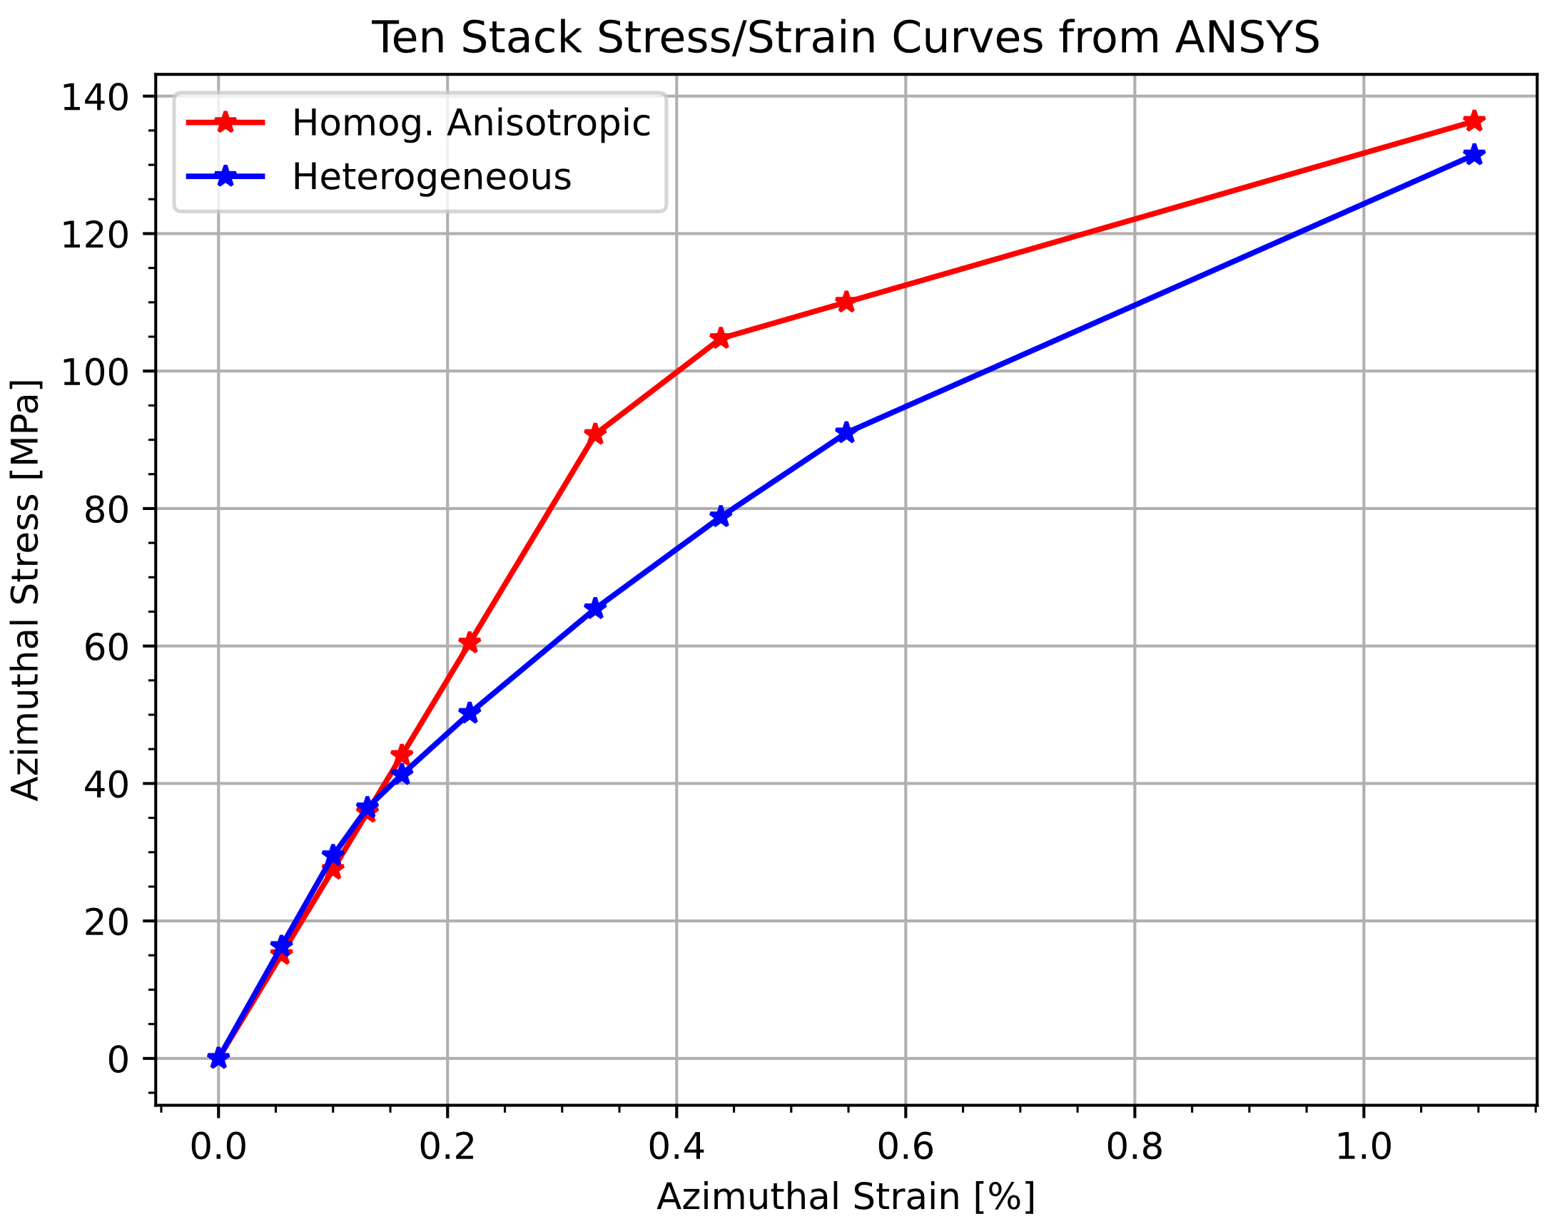
Bi-2212 Ten Stack ANSYS Analysis and Comparison
The ten-stack model (5x2) with detailed heterogeneous cables was used for the compression test in ANSYS.
Imposed displacement on the top surface.
Symmetry and displacement constrain were inserted as boundary conditions.
300 K
σ = F/B
ε = δ/H
H = 9.1 mm
θ
r
Thermal-Mechanical Properties of Epoxy-Impregnated Bi-2212/Ag Composite
Pei Li, Yang Wang, Arno Godeke, Liyang Ye, Gene Flanagan, and Tengming Shen, Member, IEEE
B = 16.4/2 mm

Slide 8
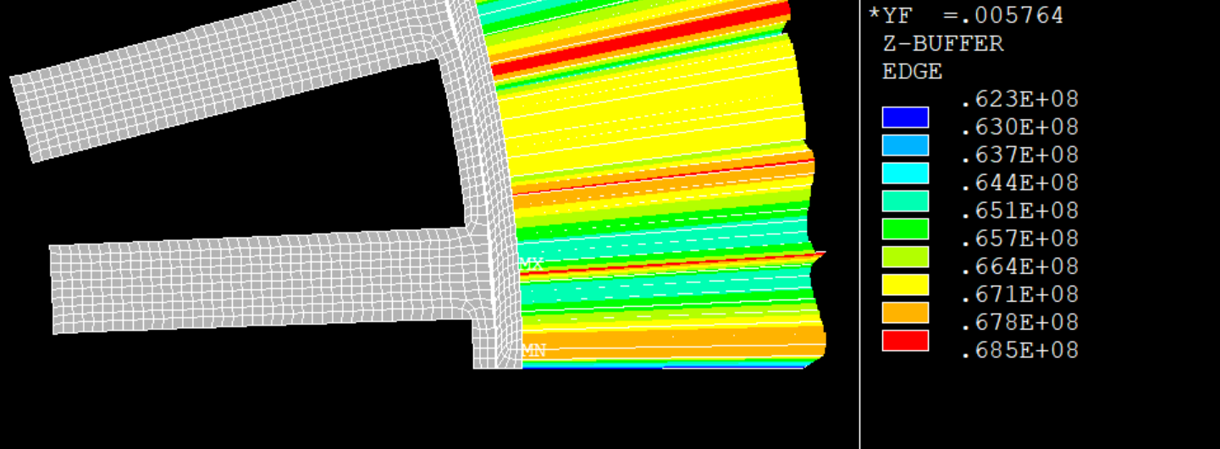
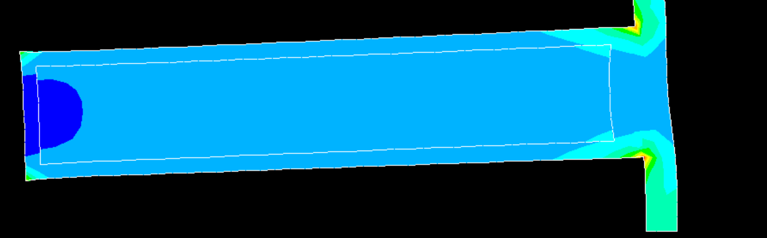
Insert Analysis – Pre-stress only

