Slide 1
Accelerated Decay Data Evaluation and Development of an Adopted Decay Data Library
Libby Ricard, Sanjanee Waniganeththi, Chris Morse, Donnie Mason
Andrea Mattera, Shuya Ota, Alejandro Sonzogni, Ben Shu, Jin Wu

Slide 2
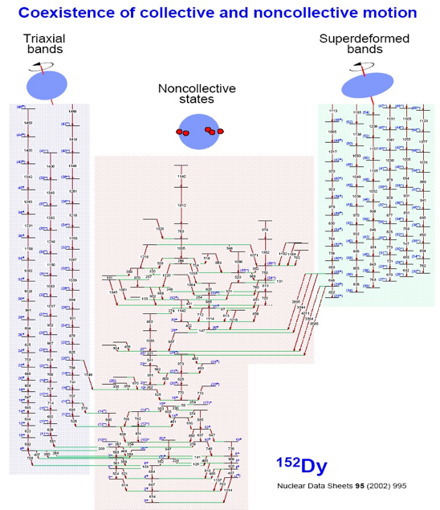
ENSDF : the ONLY comprehensive resource for
Data for more than 3,300 nuclides
Nuclear Structure
Nuclear Decay Data
Discrete Quantized States
Excitation Energy
Half-life
Angular Momentum
Magnetic Moment
Configuration
…
For each decay type:
Half-life
Branching ratio
Energy
Intensity
Coincidences
…
Emitted Radiation
Energy
Intensity
Dipole, Quadrupole, …
Mixing ratio
Conversion coefficient

Slide 3
The Path of Decay Data
Average “age” of ENSDF is 12 years
Evaluations can be 1 year old or 20 years old
ENSDF is the bottleneck for downstream databases

Slide 4
Why “Adopted”?
ENSDF decay data are currently a hybrid
Combination of experimental data specifically from decay measurements + recommended data from the Adopted Levels/Gammas
With new format we can do both and increase efficiency !!

Slide 5
Main Objectives of Proposal
Generate prioritized list of nuclides through consultation with user community
Develop policies for recommended decay data evaluations
Train a postdoc to perform decay data evaluations
Expand NuDat to visualize and search new evaluations

Slide 6
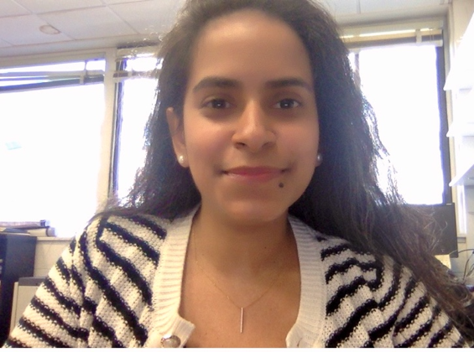
Workforce development
Sanjanee Waniganeththi hired as postdoc April 1, 2024
70% funded by proposal, 30% research
Summer performing XUNDL compilations (training tool)
Now fully focused on decay data evaluations
PhD, UMASS Lowell
Decay studies at ATLAS and FRIB

Slide 7
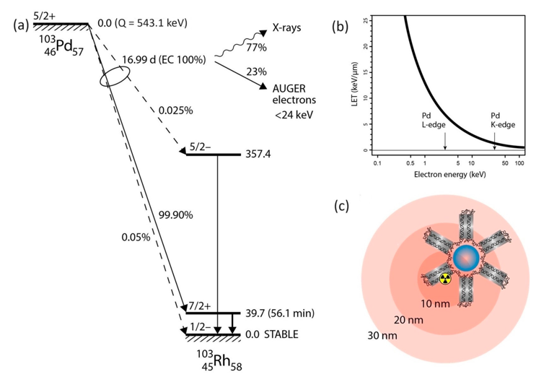
An illustrative example: ¹⁰³Pd
Standard for brachytherapy for prostate cancer
Now being considered for Auger electron therapy

Slide 8
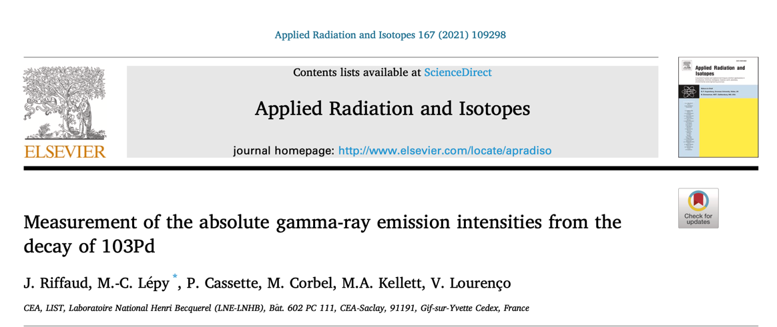
Current status of decay data
Last ENSDF evaluation in 2009 incorporating measurements in 1976 and earlier
New high precision measurement from metrology lab in 2021

Slide 9
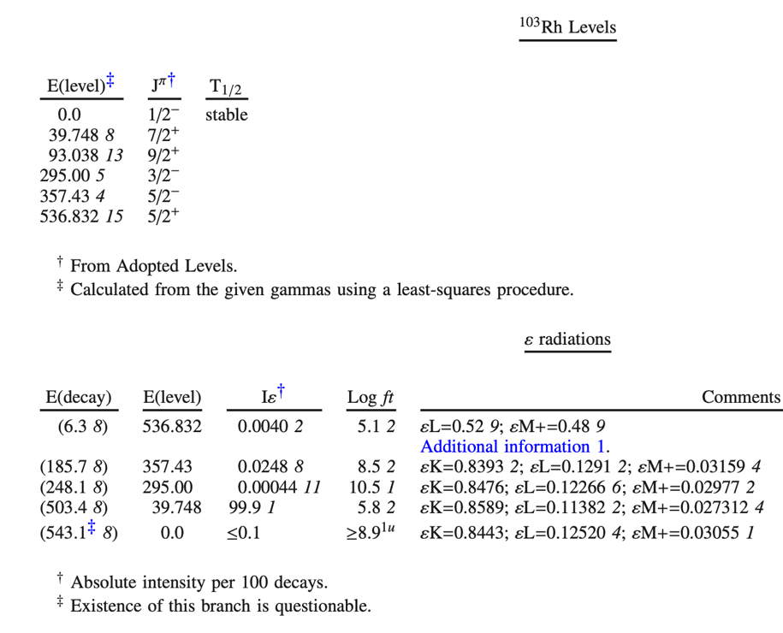
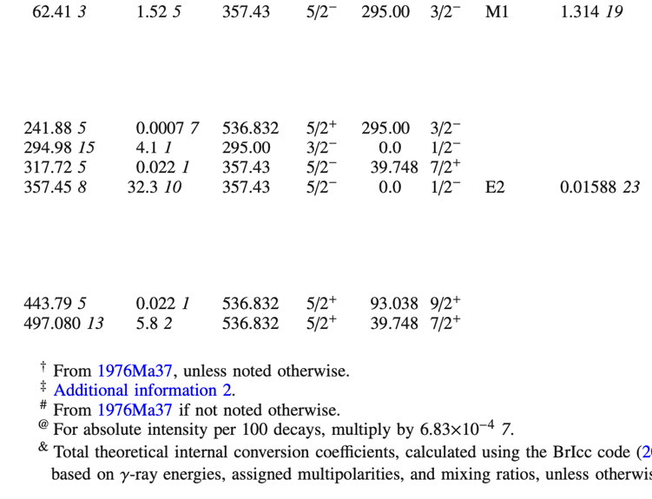
What are we changing/adding?
56 minutes
15 measurements of gamma-ray intensities
Data from Adopted Levels incorporated (half-lives, gamma energies, etc)
All measured values are stored in file (and method for combining)
Intensities will be absolute
Important missing quantities included, x-rays, Auger electrons, ce’s, etc

Slide 10
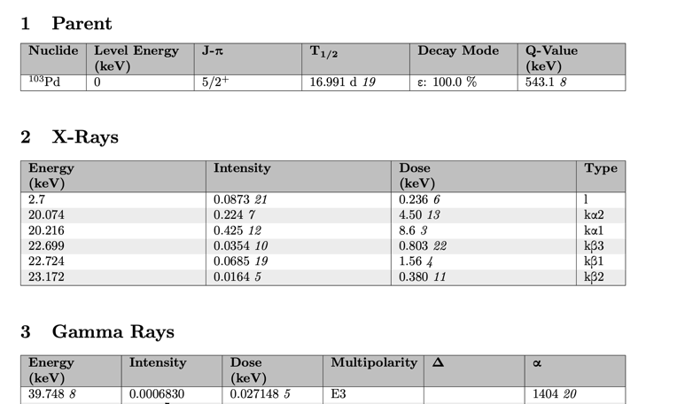
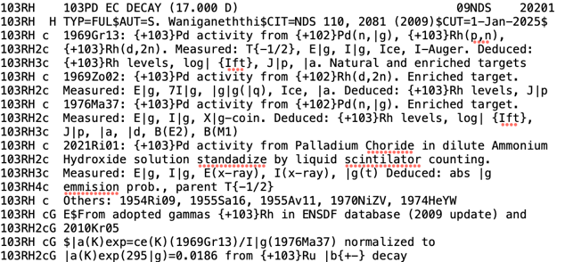
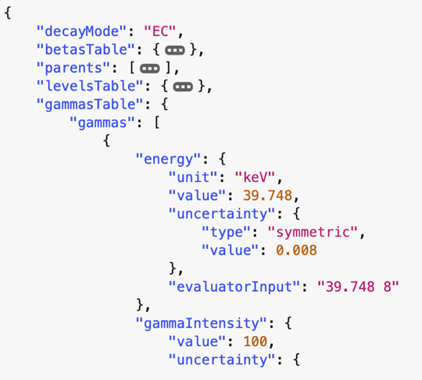
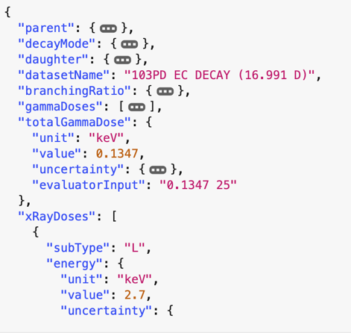
Summary of progress
Producing evaluations in
80 column and JSON (for now)
RadLst code
Only JSON has full documentation of measurements
Chris Morse
Ben Shu

Slide 11
Summary and Outlook
Project Metrics
Hire and Train Postdoctoral Researcher
Develop Evaluation Policies and JSON Schema
(Software Developments to process new JSON)
Comments, Feedback and Suggestions welcome on …
JSON format
Additional quantities to incorporate
Nuclei to evaluate
mccutchan@bnl.gov
swanigane@bnl.gov

Slide 12
With new ENSDF format
Each measurement stored in database
Mean Value
Uncertainty
Reference
Measurement type
General comments
Each calculation is also stored
Type
Input Values
Comments
Visual inspection

Slide 13
What are we missing ??
Microcalorimeters are an exciting new development as applied to radiation measurements for NP
Likely to generate some of the highest precision decay data to date
In ENSDF – last evaluated 2006
6 new measurements since
A.S. Hoover et al., IEEE Trans. Nucl. Sci. 61, 2365 (2014).

Slide 14
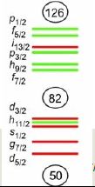
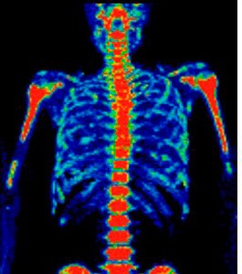
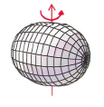
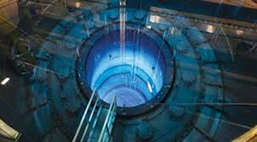
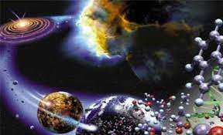
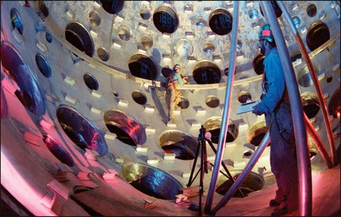
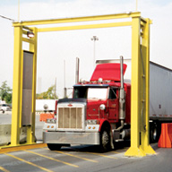
The Many Users of Decay Data
Nuclear Structure
Nuclear Medicine
Nuclear Power
Astrophysics
Stockpile Stewardship
Homeland Security

Slide 15
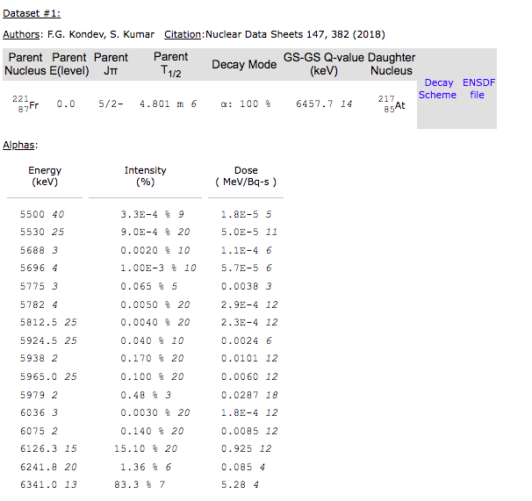
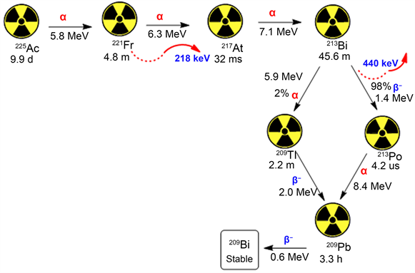
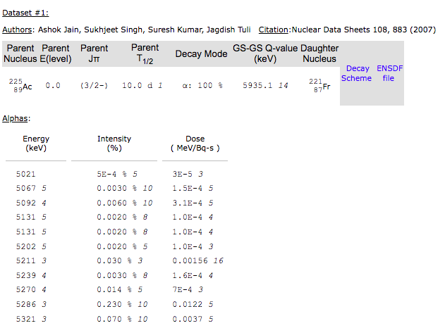
A Major Inconvenience in ENSDF and DDEP
Not all nuclei are one decay from stability
Then search ²²¹Fr decay in NuDat
Search ²²⁵Ac decay in NuDat

Slide 16
A Major Inconvenience in ENSDF and DDEP
Not all nuclei are one decay from stability
Then search ²²¹Fr decay in NuDat
Search ²²⁵Ac decay in NuDat

