Slide 1
Development of Benchmark Measurements for Capture
Gamma Cascades
Progress Report | WANDA 2025 | 13 FEB 2025

Slide 2
Overview & Team:
Objective: Develop the methodology & provide data to benchmark accuracy of neutron capture gamma-ray cascade evaluations
Rensselaer Polytechnic Institute:
Yaron Danon – PI
Katelyn Keparutis – Graduate Student
Ian Parker – Graduate Student
Brookhaven National Laboratory:
David Brown
Emanuel Chimanski
Naval Nuclear Laboratory:
Devin Barry
Amanda Lewis
Project Overview:
Collect measurement data using the RPI LINAC and the RPI Capture Gamma-Ray Multiplicity Detector.
Simulate neutron capture gamma-ray transport using Monte-Carlo codes & cascade generators.
Assess quality of neutron capture gamma-ray cascade evaluations by comparing measurements and simulations using evaluated data as cascade generator inputs.
Deliverables:
Benchmark methodology including a quantified accuracy assessment.
Experimental data collected at RPI and inputs for simulation codes.
Simulation methods including an in-line gamma-ray transport code and gamma-ray cascade generator.

Slide 3
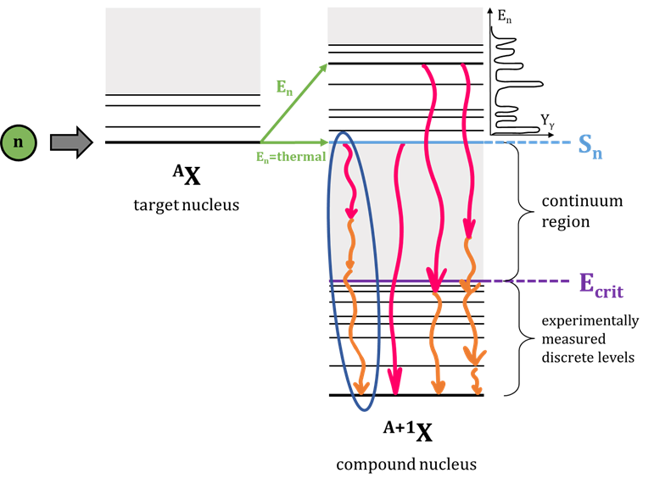
Motivation:
There is a need for benchmarking neutron capture gamma-ray spectra
Applications require accurate gamma-ray production data:
    Including gamma-ray heating in critical systems, active neutron interrogation, and detector response calculations.
    Both individual detectors and arrays are used, therefore individual and coincident gamma-ray emissions need to be known.
Traditional simulation methods do not always accurately predict gamma-ray emissions for single detectors and lack capabilities for coincident gamma-rays.
Limited or no data (primary gamma-rays, intensities, etc.) is available for many isotopes in nuclear databases.
Lack of validation experiments & methods to assess the data.

Slide 4


Benchmark Methodology:
Event-by-Event Analysis:
Individual & coincident neutron capture gamma-ray spectra
Measurement:
RPI γ-ray multiplicity detector
Experiment Processing:
Deposited gamma-ray energy &
multiplicity table, capture yield
Gamma-Ray
Transport Code:
mod-MCNP6.2
Simulation Processing:
Deposited gamma-ray energy & multiplicity table
Cascade Generator
Evaluated Data
Accuracy Assessment

Slide 5
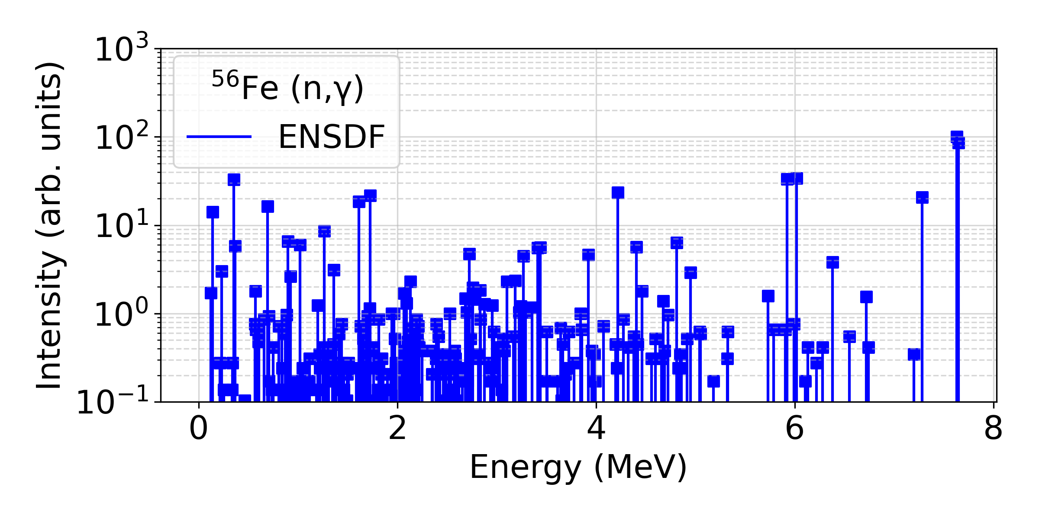
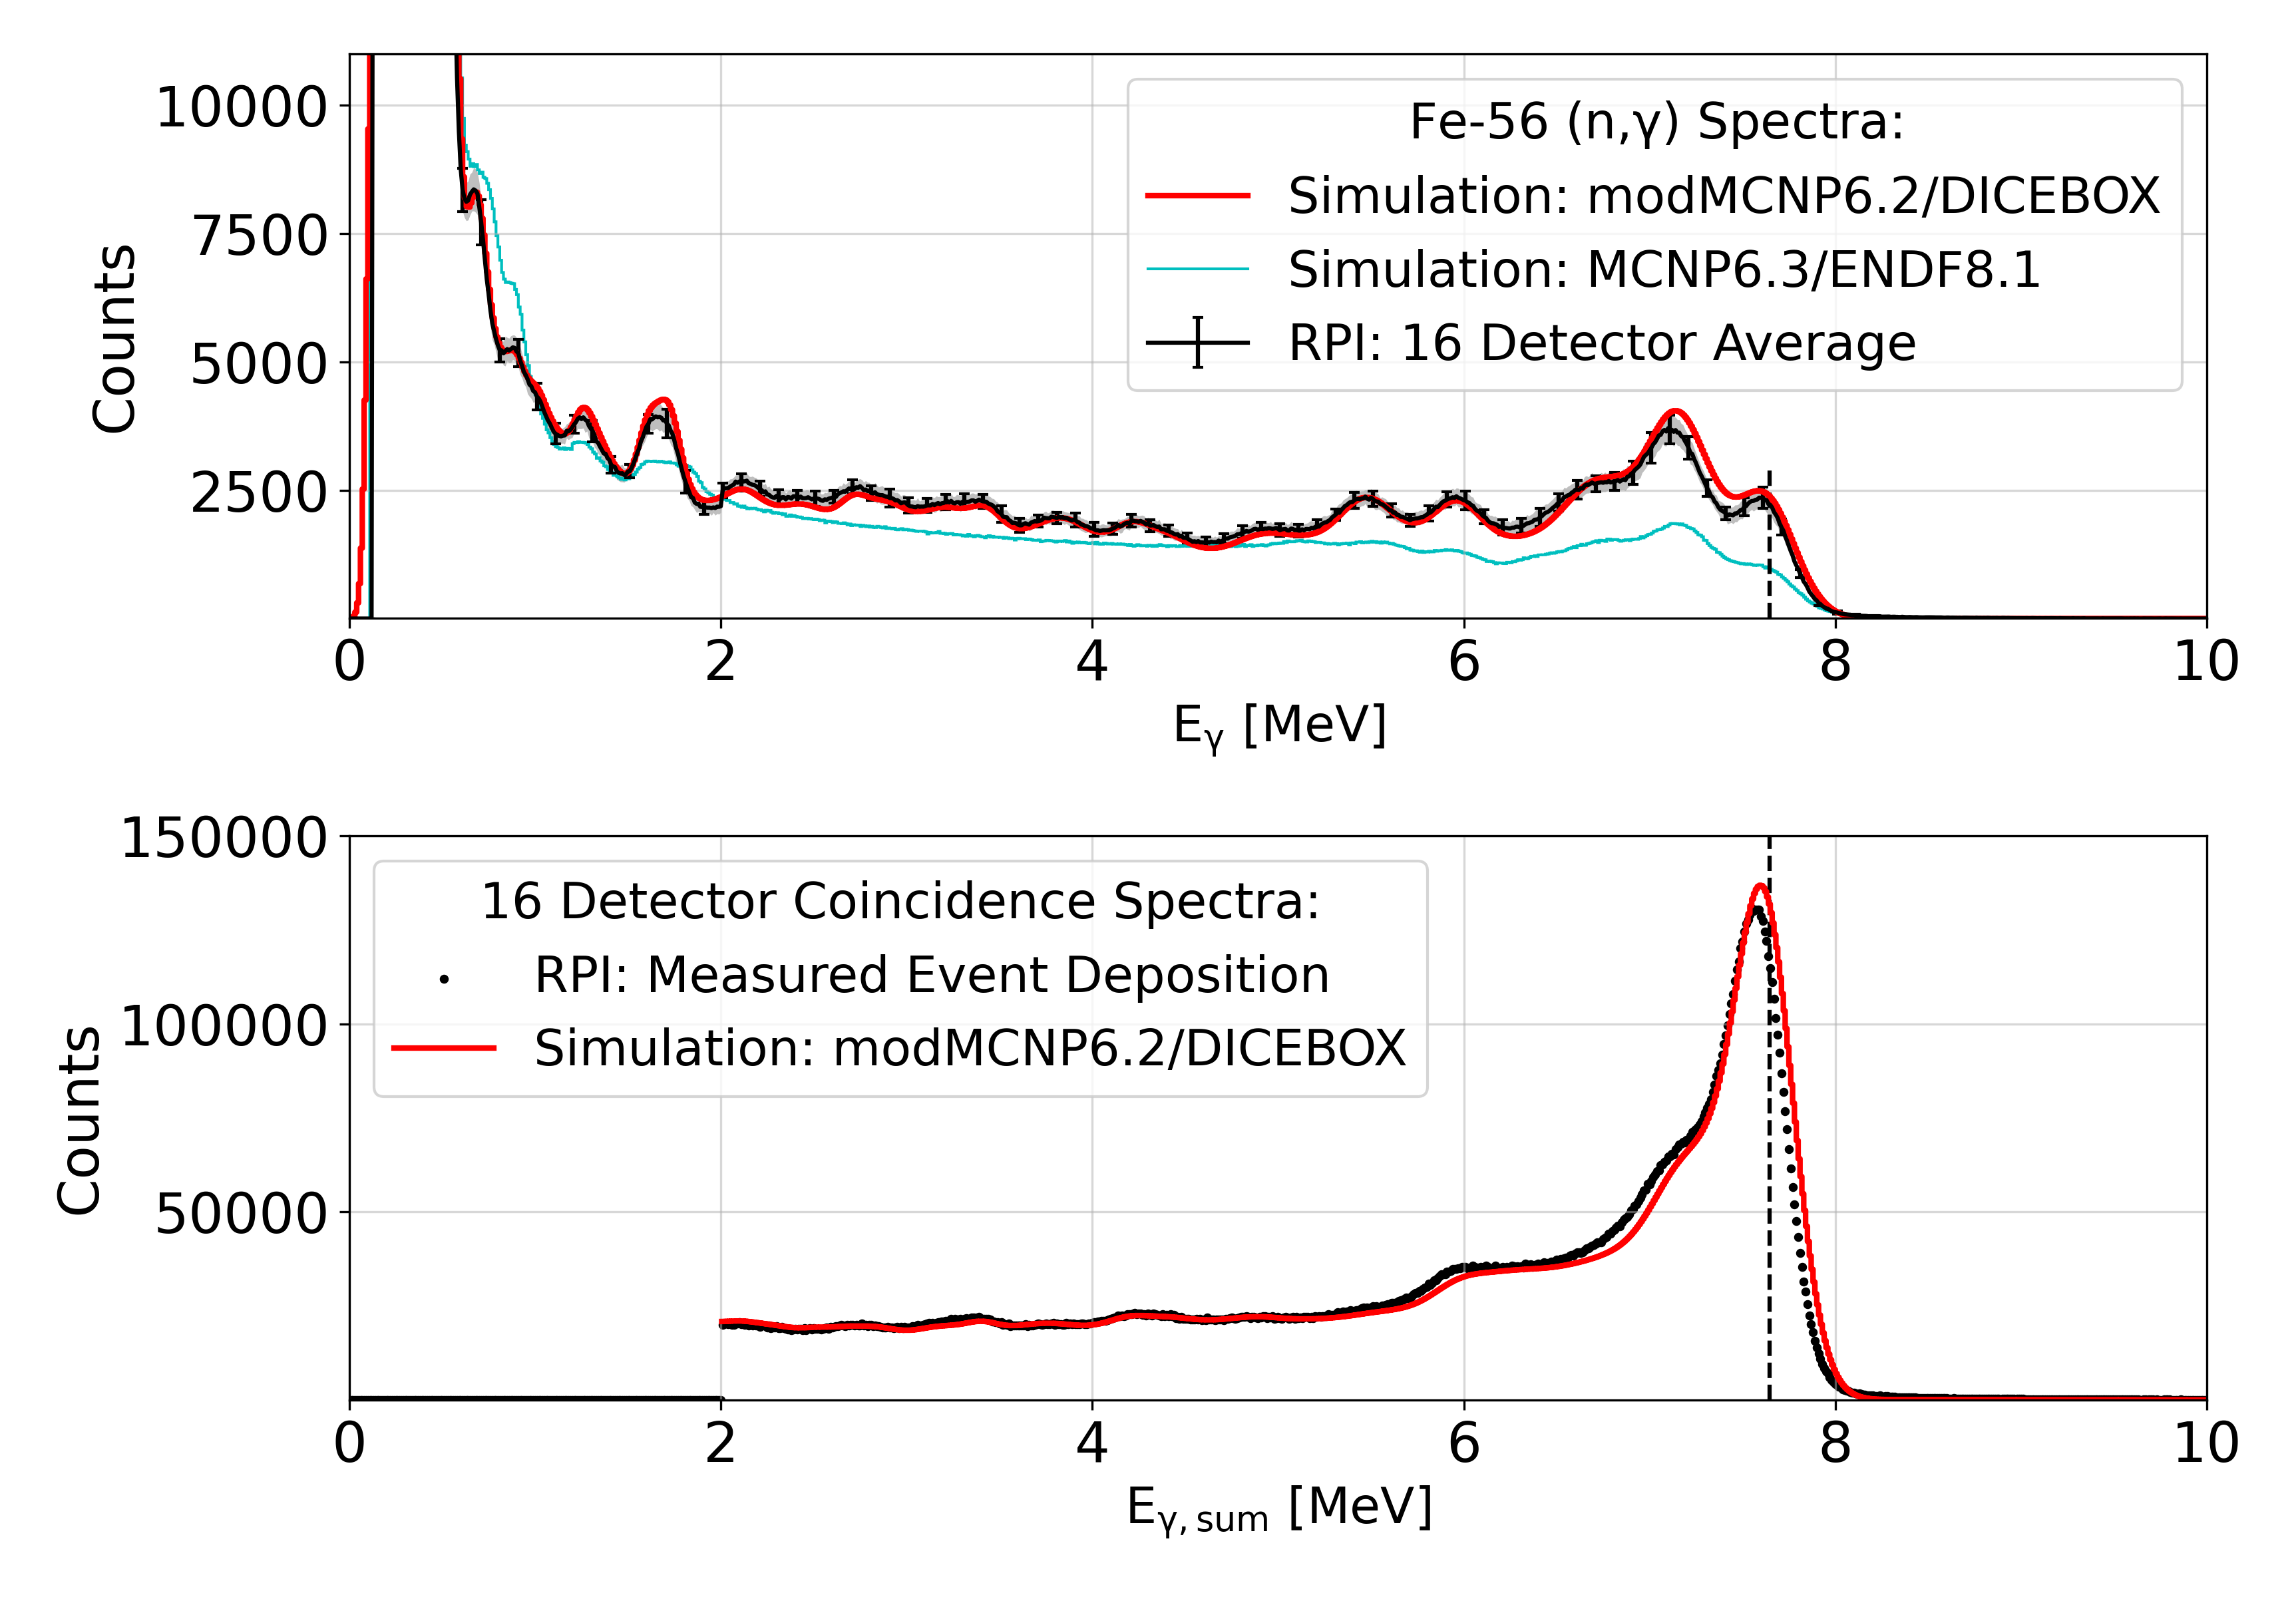
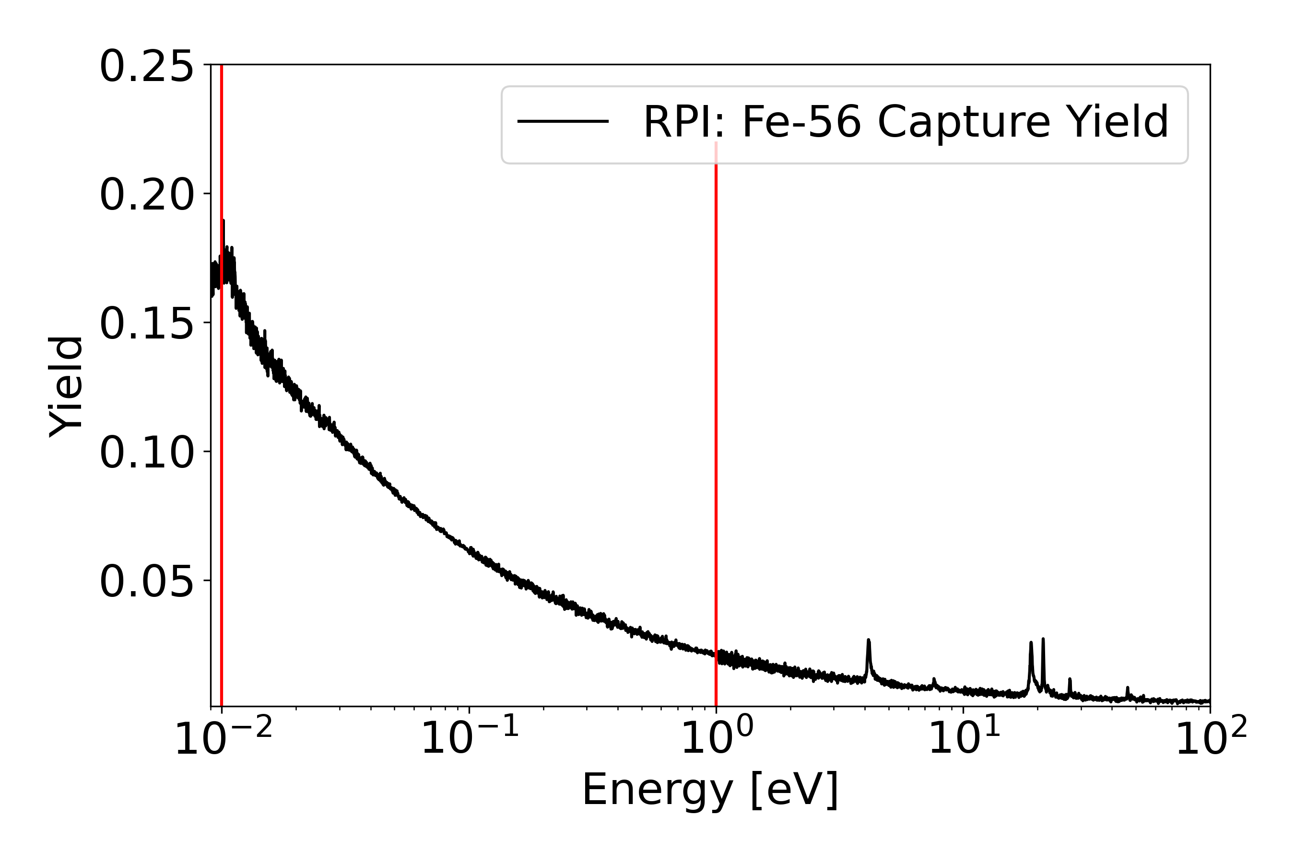
Methodology Verification: Fe-56
Fe-56 capture primary gamma-ray energies and intensities are well known up to the binding energy.
Variable experimental capabilities:
  Spectra for defined incident neutron energies.
  Gamma-ray spectra for each observed
  multiplicity and each detector.

Slide 6
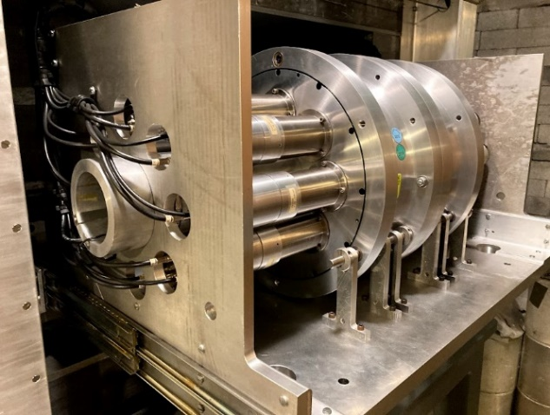
Progress Toward Benchmark: Accomplishments to Date
Implemented new experimental energy calibration and alignment procedures.
Investigated and utilized GIDI+ & OpenMC as simulation alternatives.
Identified potential sources of uncertainty within the methods & experimental setup.
Additional measurements of Cadmium, Indium, and Gold in Spring 24.

Slide 7
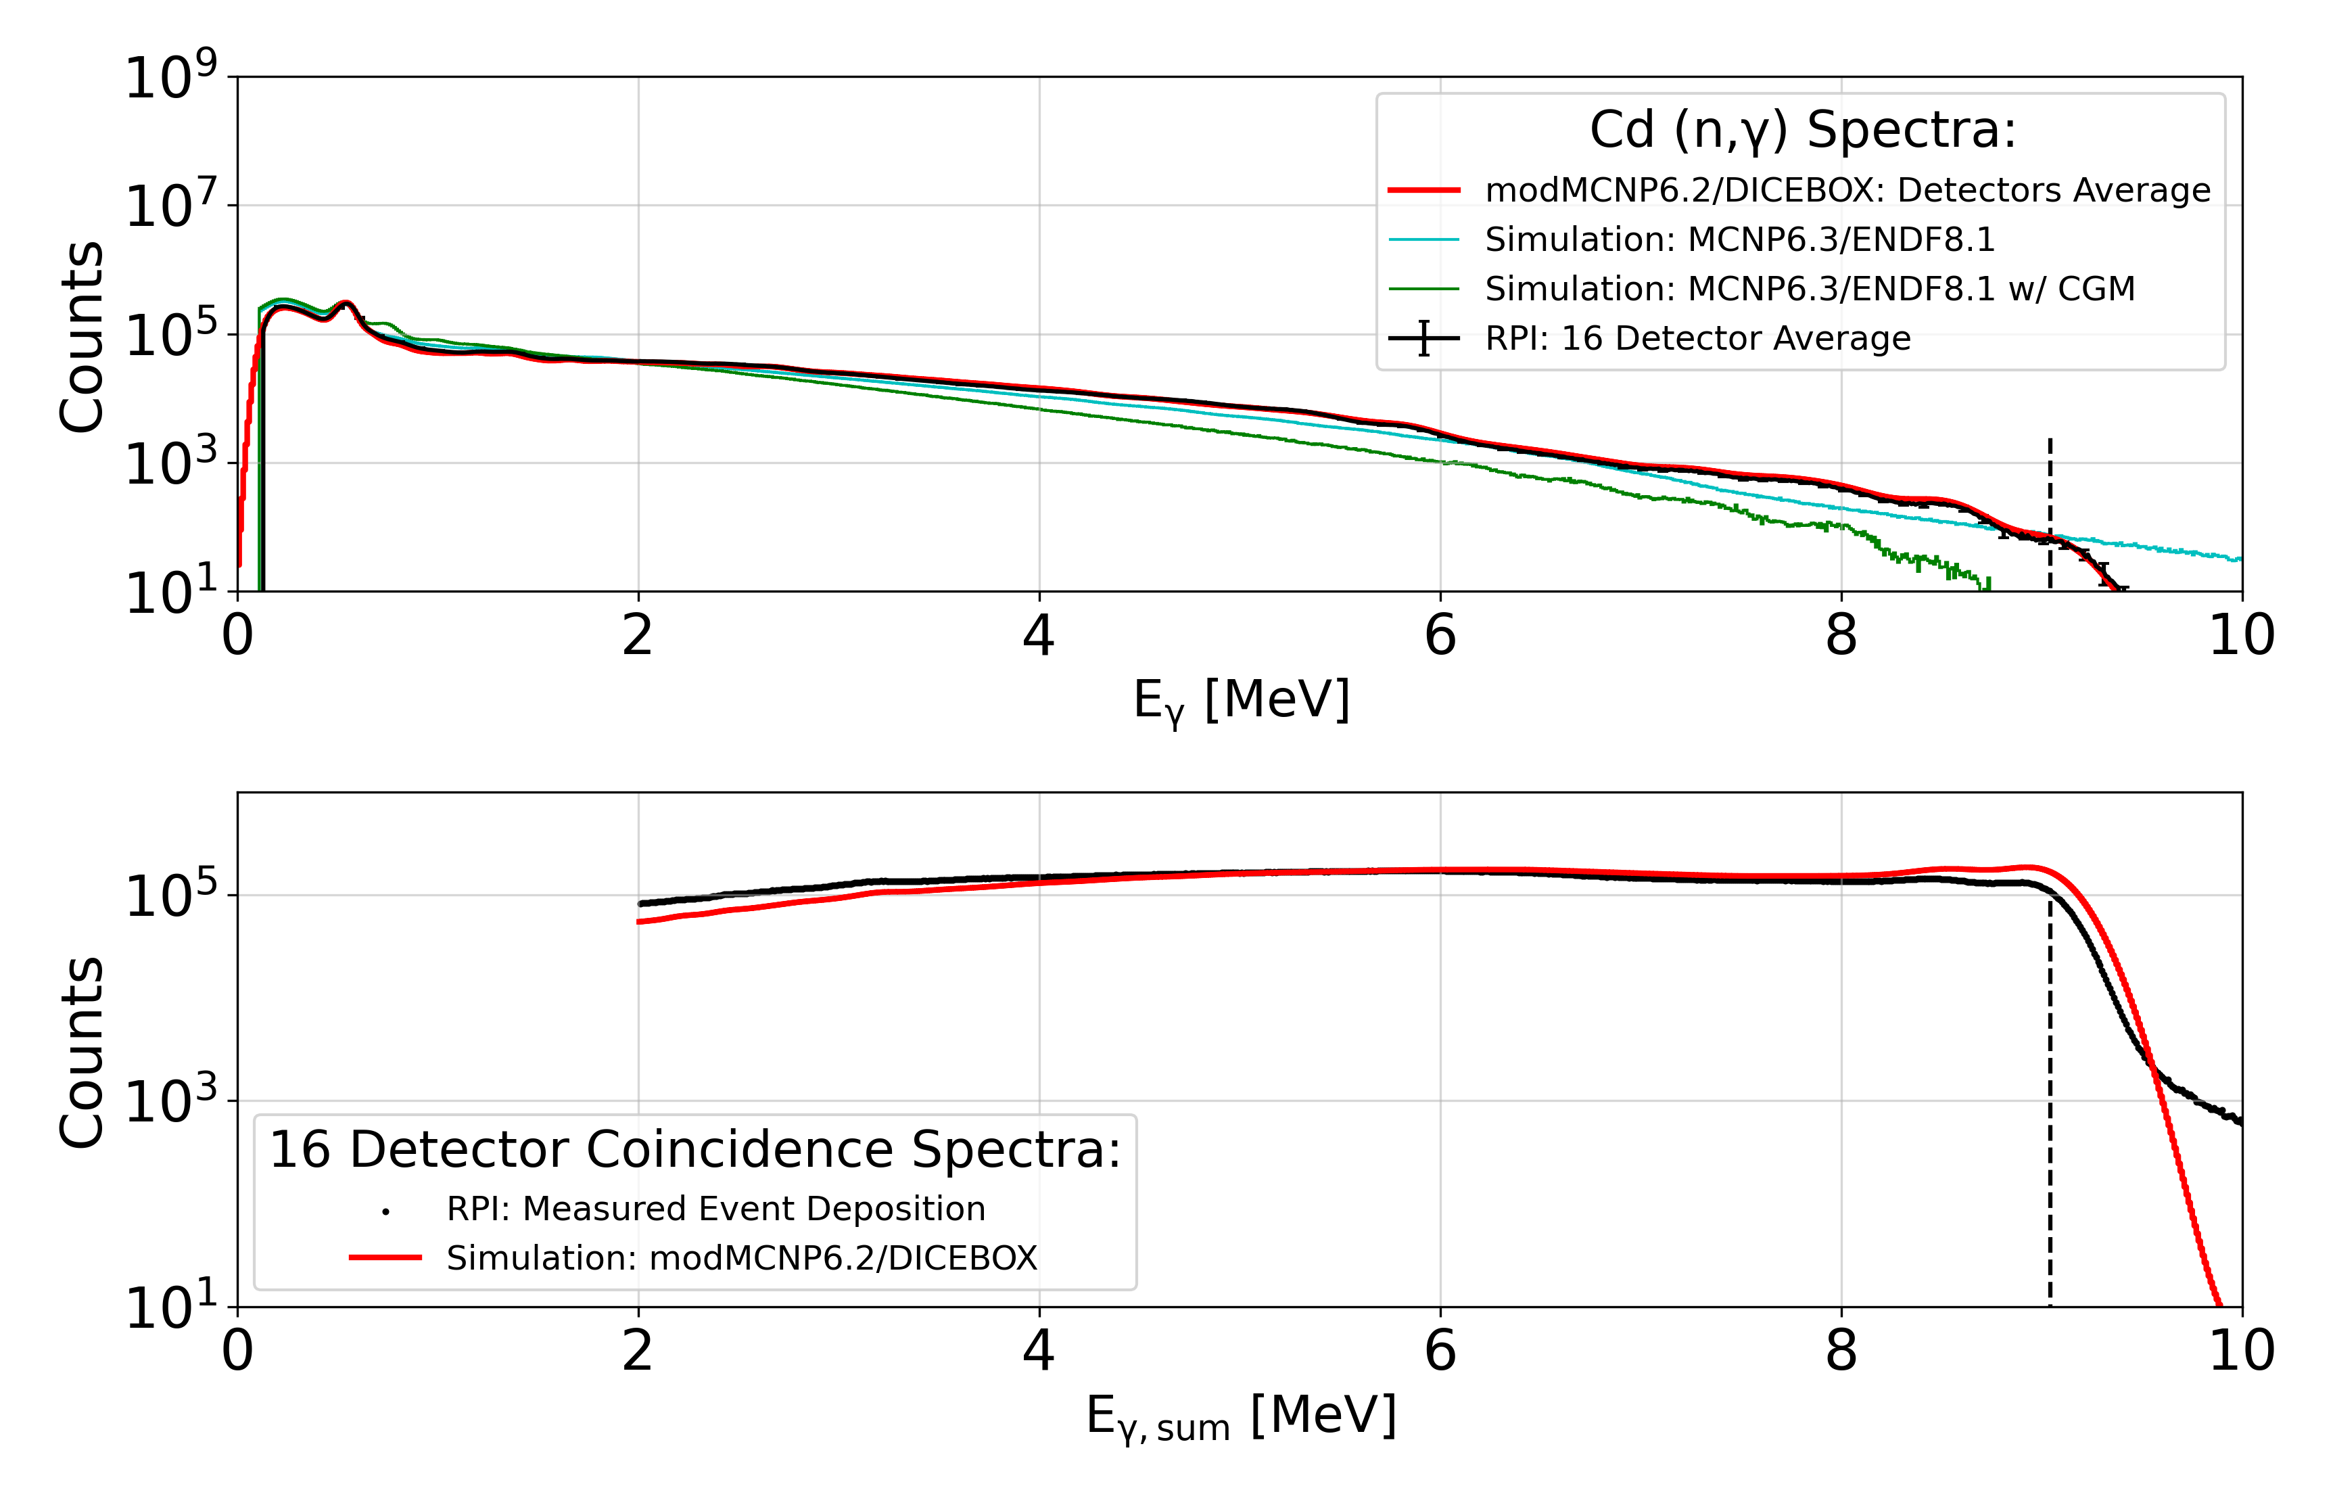
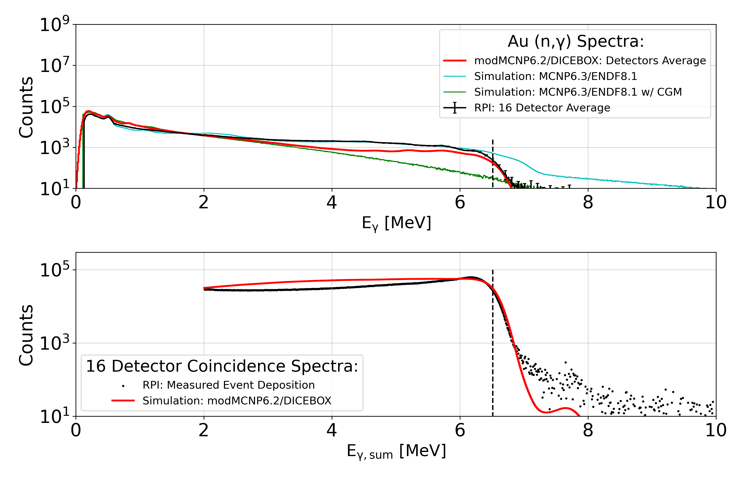
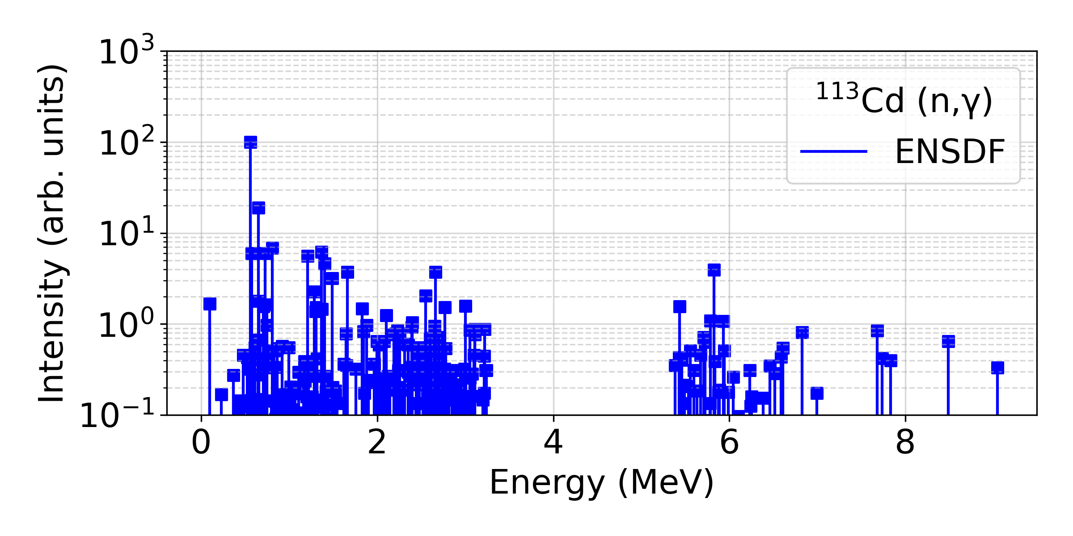
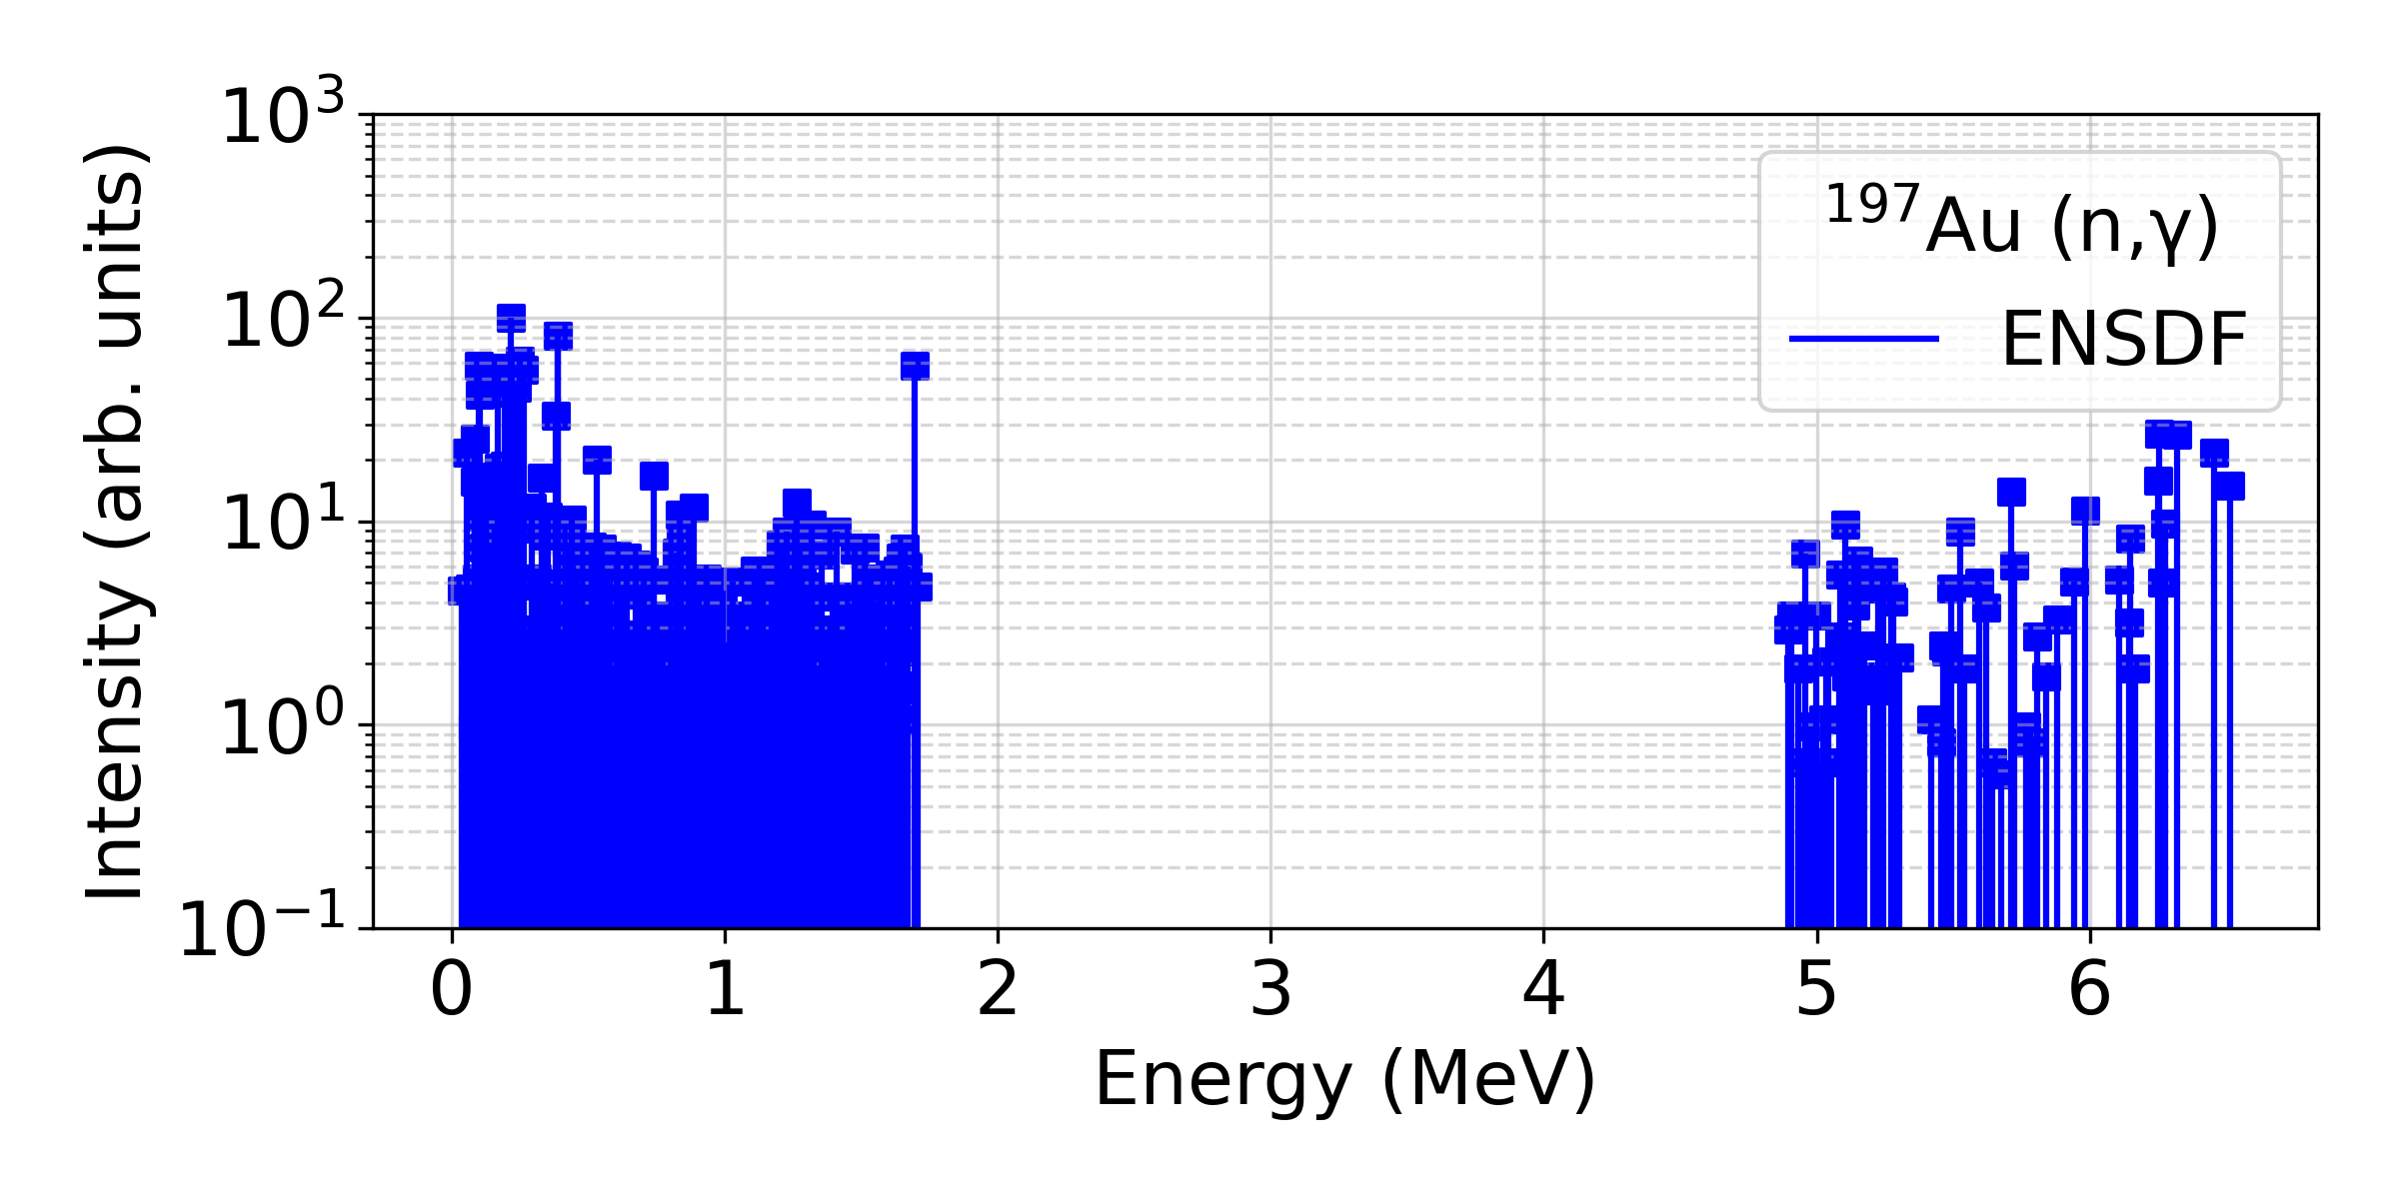
Experiment: Spring 2024 Results

Slide 8
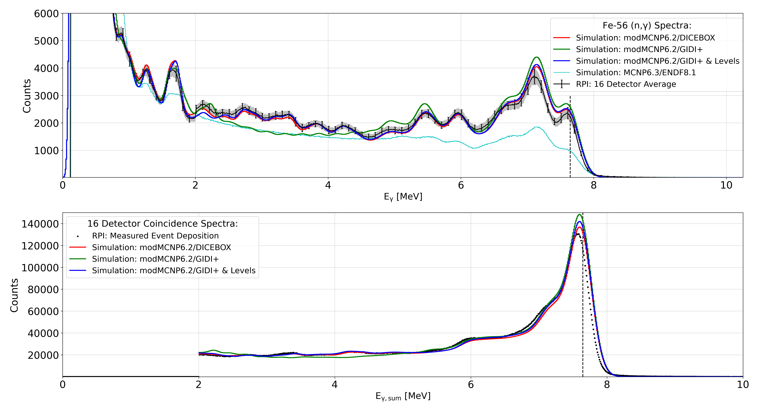
Simulation: mod-MCNP6.2 GIDI+ vs DICEBOX Cascades for Fe-56
DICEBOX¹ and GIDI+ (LLNL & GRIN) both create gamma-ray cascades.
September 2024 collaboration with BNL learning GIDI+ and doing comparison to DICEBOX (cascades & simulation results).
Using the same input data for the cascade generators, simulated spectra are very similar.
¹Bečvář, F. (1998). Simulation of γ cascades in complex nuclei with emphasis on assessment of uncertainties of cascade-related quantities. Nuclear Instruments and Methods in Physics Research Section A, 417(2-3), 434-449. https://doi.org/10.1016/S0168-9002(98)00787-6

Slide 9
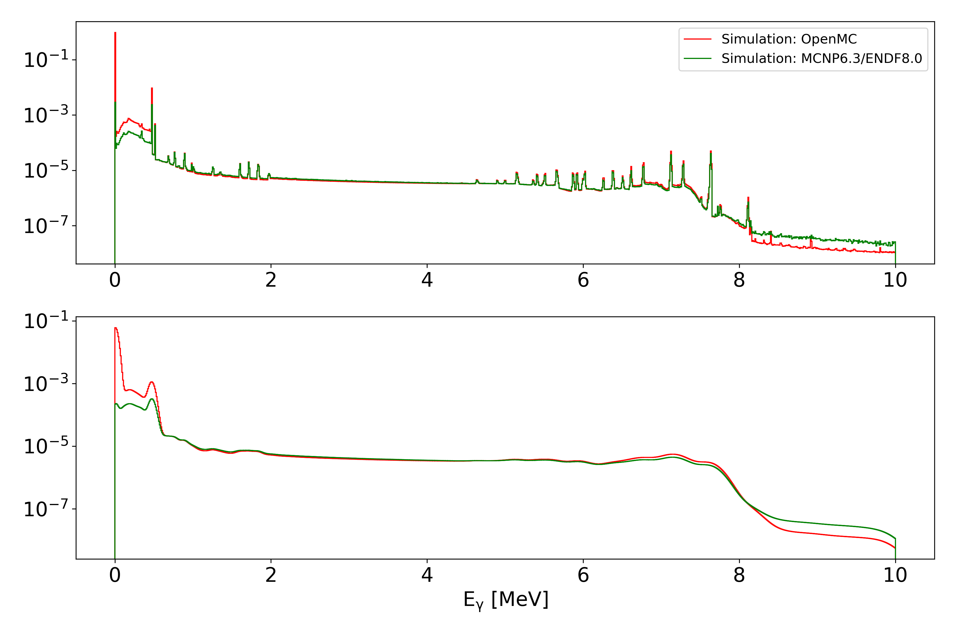
Simulation: OpenMC vs MCNP6.3 Fe-56 Simulation Results
To make the distribution of the benchmark easier, an open-source code such as OpenMC can be utilized rather than MCNP.
Preliminary results are generated using distributed nuclear data libraries.
Requires more work –
implementation of the
mod-MCNP6.2 abilities to read and transport gamma-ray cascades in OpenMC.

Slide 10
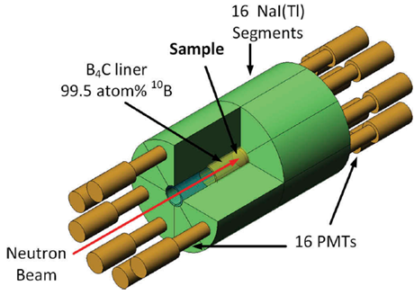
Uncertainty Analysis: Possible Sources of Uncertainty
LINAC:
Monitor Counts
Triggers
Flight Path
Gamma Flash
Collimation
Processing:
Energy Calibration
Alignment
Coincidence Time
Processing Parameters
System/Detector:
Background Spectra
Deadtime/Pileup
PMT & Hardware Performance
Sample:
Impurities
Scattering to Detector Structure
Activation
Radioactive Samples

Slide 11
Next Steps
Investigate discrepancies & unknowns between experimental results & simulations.
Continue uncertainty analysis & begin error propagation.
Spring 2025 measurement – Samples TBD.
    Expand & test capabilities and limitations of benchmark.
Begin benchmark qualifications & template.
This report was prepared as an account of work sponsored by an agency of the United States Government. Neither the United States Government nor any agency thereof, nor any of their employees, makes any warranty, express or implied, or assumes any legal liability or responsibility for the accuracy, completeness, or usefulness of any information, apparatus, product, or process disclosed, or represents that its use would not infringe privately owned rights. Reference herein to any specific commercial product, process, or service by trade name, trademark, manufacturer, or otherwise does not necessarily constitute or imply its endorsement, recommendation, or favoring by the United States Government or any agency thereof. The views and opinions of authors expressed herein do not necessarily state or reflect those of the United States Government or any agency thereof.
Thank you!
Questions/comments/suggestions? parkei@rpi.edu
This material is based upon work supported by the U.S. Department of Energy, Office of Science, Office of Nuclear Physics, under Award Number DE-SC0024679.

