Slide 1
Quasi-continuum Nuclear Data Evaluator Training
Mathis Wiedeking
Nuclear Science Division
mwiedeking@lbl.gov
https://www-nsd.lbl.gov/2024/10/29/nuclear-data
http://nucleardata.berkeley.edu
Supported by the U.S. Department of Energy, Office of Science, Office of Nuclear
Physics under Contracts No. DE-AC02-05CH11231

Slide 2
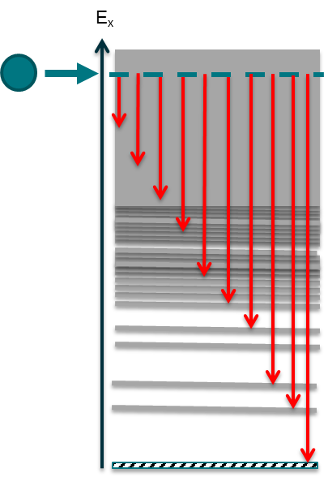
QC-Nuclear Data: PSF and NLD
Rapid increase in QC-data due to new facilities, experimental and analytical
methods.
Nuclei away from stability can now be reached
Number of QC-data producing groups has increased rapidly.

Slide 3
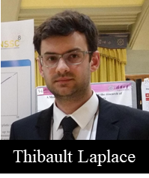
Trainees: Thibault Laplace and Kgashane Malatji will
Become experts in NLD and PSF data assessment and evaluation.
Obtain a comprehensive understanding of PSF and NLD nuclear data by working closely with experts (experimental and theory/models) over 4 years.
Receive training in general nuclear data evaluation aspects by attending evaluator schools and other relevant training courses.
Obtain a global view on importance of nuclear data
through the annual attendance of WANDA and
other Nuclear Data Workshops/Conferences.

Slide 4
NLD database
IAEA CRP 1st meeting 24-28 March 2025
Since 2008: important developments and new information available
Wealth of new experimental information obtained also with new methods
New advanced modelling capabilities for global calculations
Improved fundamental theories to guide the models
New measurements to validate the models
Enhanced dissemination tools: interactive retrieval interfaces, web-based APIs

Slide 5
Photon Strength Function Database
IAEA Coordinated Research Project on Photonuclear Data and Photon Strength Functions F41032, 2016-2019.
Experimental data:
NRF for 29 nuclei, 47 data files
Oslo method for 103 nuclei, 194 data files
ARC/DRC for 88 nuclei, 221 data files
(p,γ) for 22 nuclei, 37 data files
Shape/Ratio method for 10 nuclei, 28 data files
(p,p₀) measurements for 8 nuclei, 26 data files
E1 photodata for 159 nuclei, 452 data files
TC incl EGAF for 55 nuclei, 137 data files
Theoretical data:
D1M-QRPA data files
SMLO data file
https://www-nds.iaea.org/PSFdatabase/
Annual update

Slide 6
USNDP Traineeship
IAEA CRP 1st meeting 24-28 March 2025
Unique timing: Trainees active in NLD project from beginning to conclusion.
Will be active participants in all NLD database aspects
Will be active participants in PSF database annual update
Focus on:
Comprehensive compilation, assessment, evaluation of experimental NLD/PSF data.
Investigating trends in available data and identify outliers which need more attention
Scrutiny on uncertainties
Assignment of quality indicators
Validate and evaluate data with global models in collaboration with theorists/modelers

Slide 7
Thank you!
Mathis Wiedeking
Nuclear Science Division
mwiedeking@lbl.gov
https://www-nsd.lbl.gov/2024/10/29/nuclear-data/
http://nucleardata.berkeley.edu
Supported by the U.S. Department of Energy, Office of Science, Office of Nuclear
Physics under Contracts No. DE-AC02-05CH11231

