Slide 1
Deimos and other HALEU Critical Experiments at NCERC
N. Thompson and T. Cutler
2/11/2025

Slide 2
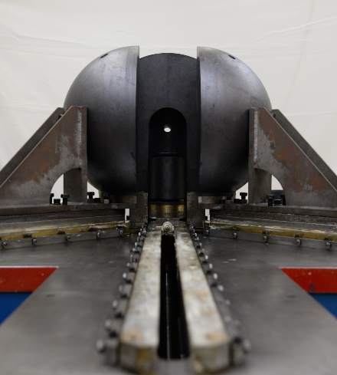
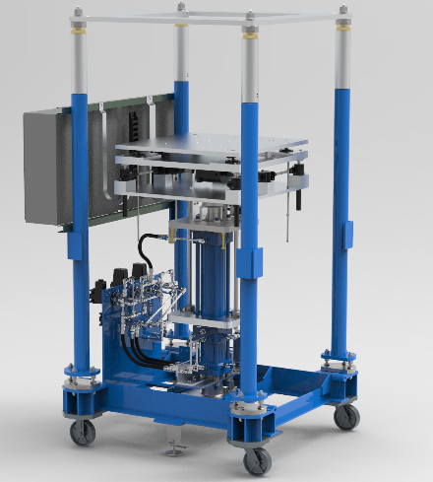
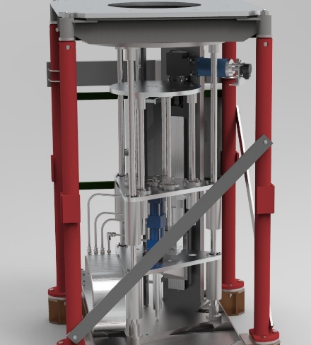
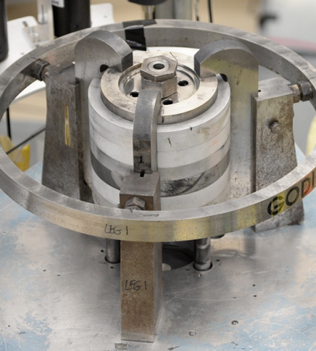
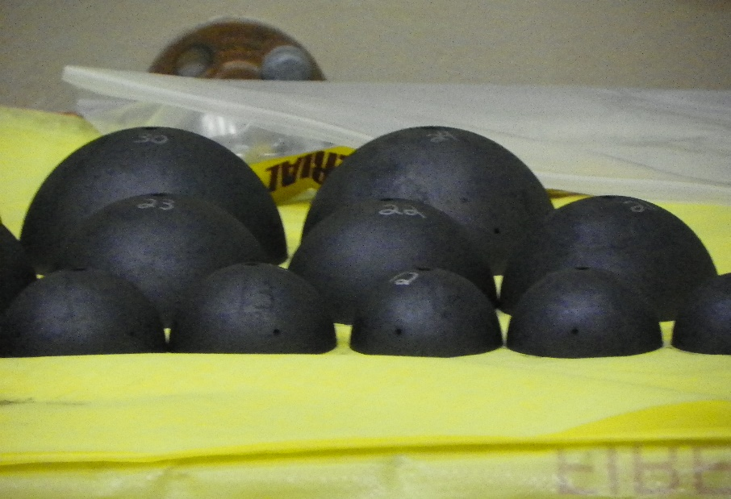
NCERC Overview
National Criticality Experiments Research Center – NCERC
Perform subcritical, critical, and above prompt critical experiments
Large inventory of nuclear materials and highly configurable machines allow for
Many experiments are performed for the Nuclear Criticality Safety Program
Recently there has been more nuclear energy related work, including Deimos

Slide 3
Nuclear Data Need
Very few HALEU benchmarks in ICSBEP, even fewer that use HALEU TRISO
Only 21 benchmarks have 10-20 w/o fuel, only two have HALEU TRISO
  ICT010/HTR10-GCR-RESR-001 – Chinese HTR10 Pebble Bed reactor
    C/E is ~1200 pcm over experimental value
  ICT008 – Russian Pebble Bed critical experiment
    C/E ranges from 900 pcm under experimental value to 60 pcm over for different cases
  Both are ‘older’ benchmarks (2006 and 2007)
Draft report from ORNL showed only two benchmarks with a c_k over 0.8 for HALEU TRISO particles in an infinite graphite lattice
Need new benchmarks that are representative of HALEU transportation, storage, handling, and operations

Slide 4
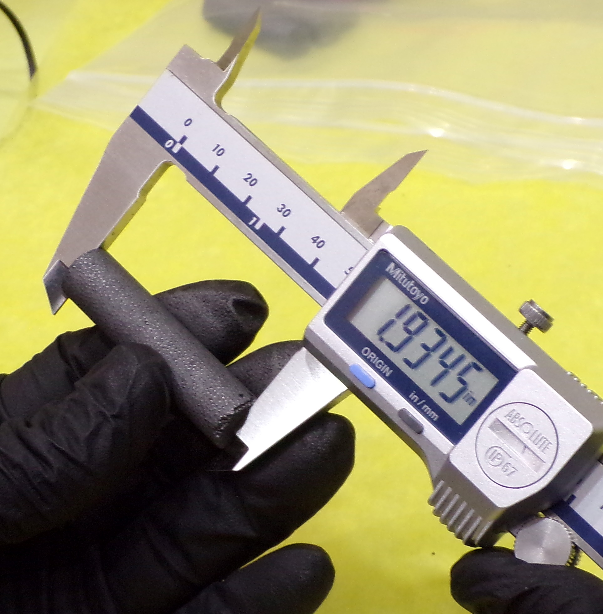
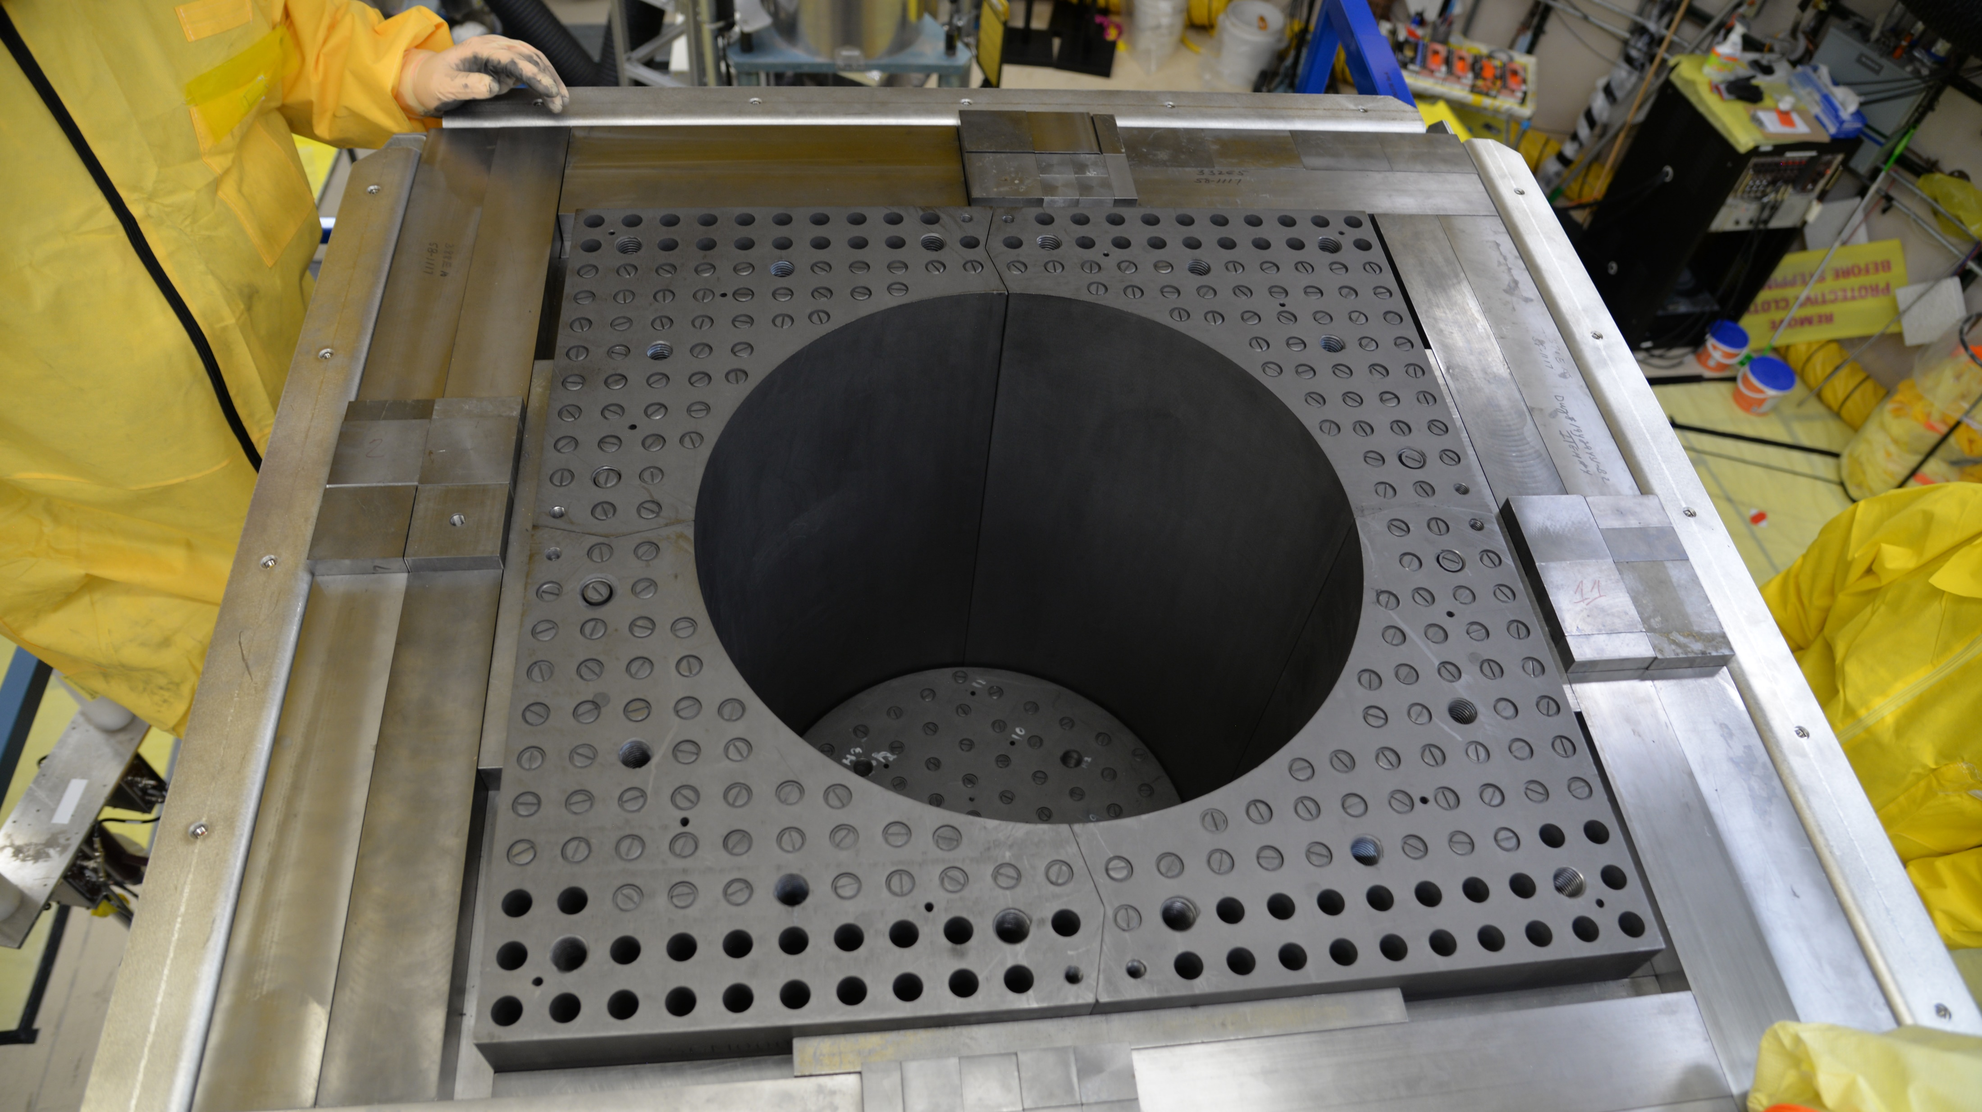
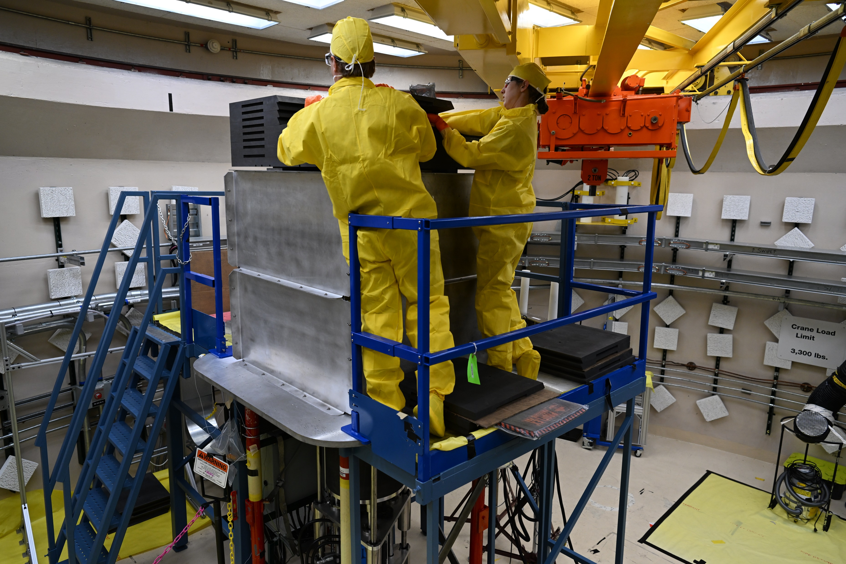
Deimos Overview
Deimos was funded by LANL LDRD as a micro-reactor test bed
Graphite moderated, HALEU TRISO fueled, outer Be reflector
On the Comet critical assembly at NCERC

Slide 5
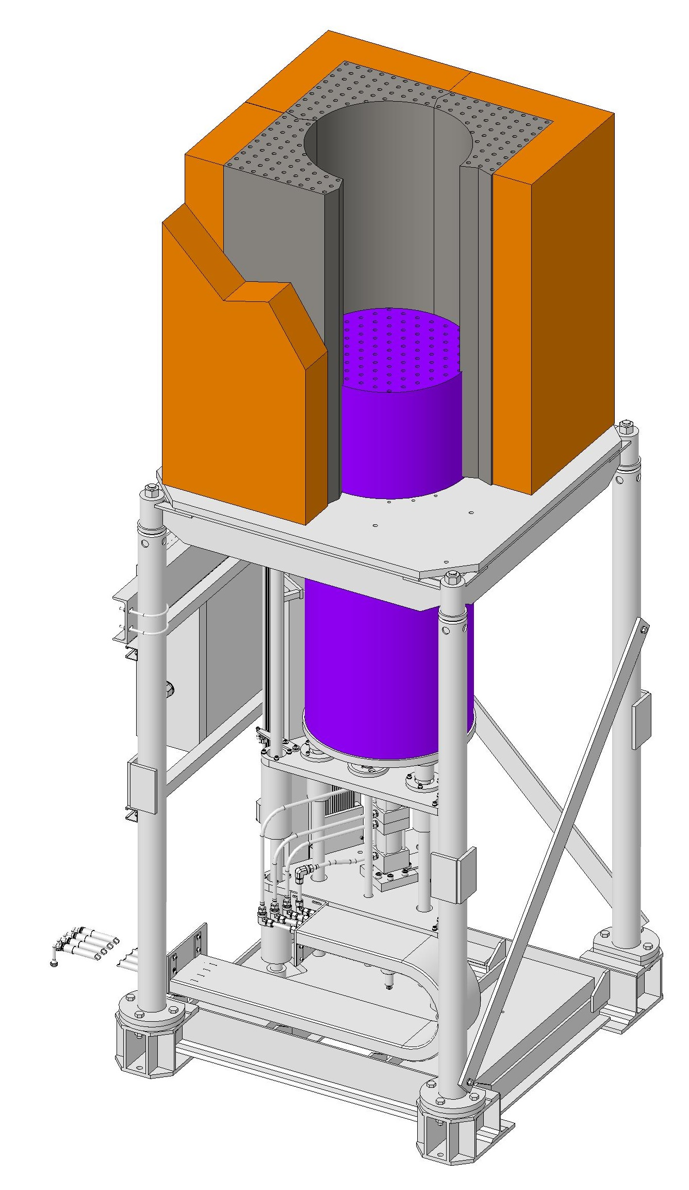
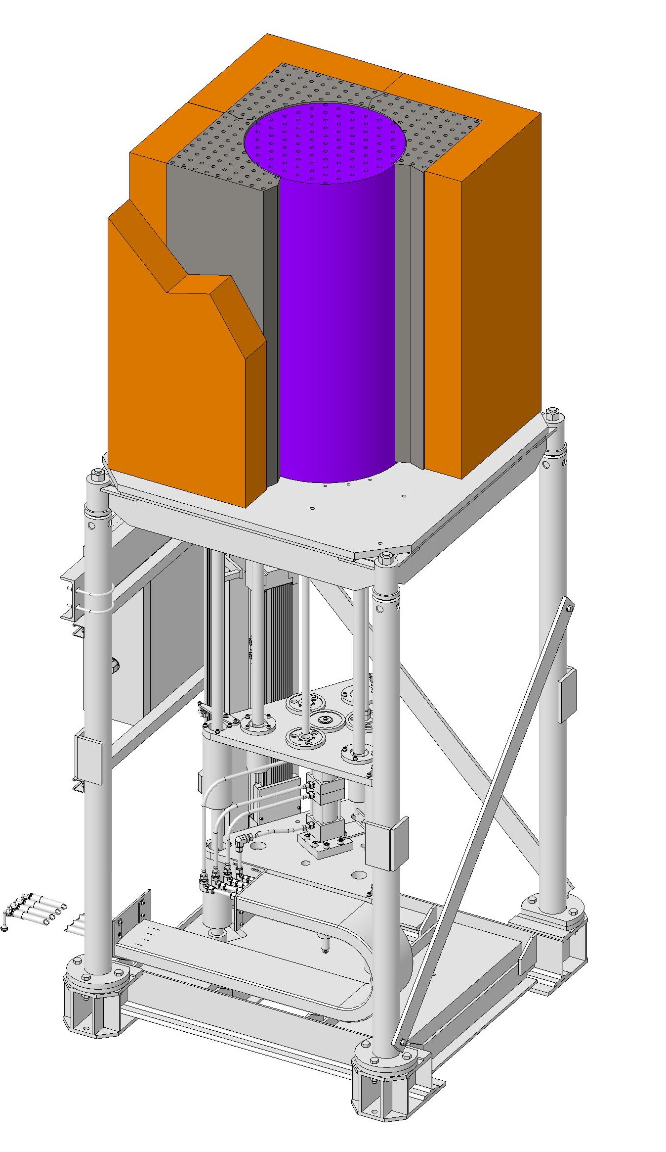
Deimos Overview
Reactivity is controlled by inserting the core block into the reflector.
Included heated experiments
  Core and reflector electrically heated independently
Benchmark measurements were performed which will be analyzed as a benchmark for inclusion in the ICSBEP

Slide 6
Deimos Overview
HALEU TRISO fuel is from the Compact Nuclear Power Source (CNPS) experiments – performed at LANL (TA-18) from 1987-1991
Packing fraction is >60% - much higher than TRISO produced today

Slide 7
DNCSH Overview
DOE/NRC Collaboration for Criticality Safety Support for Commercial-Scale HALEU for Fuel Cycles and Transportation (DNCSH)
  Authorized in the Energy Act of 2020, Section 2001, “Advanced Nuclear Fuel Availability”
  Specifically called for DOE and NRC to develop “criticality benchmark data” to assist in licensing and regulation of fuel fabrication/enrichment and transportation of HALEU
  Appropriated $100 million in the 2022 Inflation Reduction Act
DNCSH first call was ~April 2024, awards were announced mid 2024
NCERC had three proposals accepted
  Kairos, Terrapower, and Westinghouse

Slide 8
Westinghouse - eDeimos
Based on the Deimos platform
Will take the center platen region and replace it with geometry representative of the eVinci microreactor
Using sensitivity tools / c_{k} values to determine similarity between microreactor and critical experiment
Will also have a heated chamber which will allow for measurements of temperature coefficients of reactivity

Slide 9
Fuel Procurement
For the eDeimos experiment, we are procuring new HALEU TRISO
Procurement funded by the DNCSH program
Working with INL, NNSS, DNCSH, and a commercial fuel fabricator
Fuel will be based on a modern specification from Westinghouse
  One big change, packing fraction is much lower than CNPS
Fuel will become part of NCERC inventory following the Westinghouse/DNCSH experiments for use in future experiments
New fuel will allow for experiments that are much more representative of HALEU TRISO applications today

Slide 10
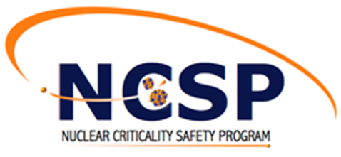


Acknowledgements
NCERC is supported by the DOE Nuclear Criticality Safety Program, funded and managed by the National Nuclear Security Administration for the Department of Energy.
The Deimos experiments are supported by the US Department of Energy through the Los Alamos National Laboratory and the Laboratory Directed Research & Development “Next Generation Small Nuclear Reactors”, 20220084DR.
This work was supported by the DOE/NRC Criticality Safety for Commercial-Scale HALEU for Fuel Cycle and Transportation (DNCSH) project, a collaboration between United States Department of Energy (DOE) and the Nuclear Regulatory Commission (NRC), a component of the Office of Nuclear Energy’s HALEU Availability Program.
This work was supported by the US Department of Energy through the Los Alamos National Laboratory. Los Alamos National Laboratory is operated by Triad National Security, LLC, for the National Nuclear Security Administration of the US Department of Energy under Contract No. 89233218CNA000001.
This work is also supported by a CRADA with Westinghouse Electric Company.

