Slide 1
Processing trails: beyond n-transport only
Jean-Christophe Sublet
United Kingdom Atomic Energy Authority,
Culham Campus, Abingdon, OX14 3DB, UK
Exploring the fusion fuel landscape –
Nuclear data for materials science, component engineering

Slide 2
Preliminary comments
Nuclear observables, data forms for digital twin needed by engineer, practitioner are not always similar, equivalent to the one evaluated by evaluator
Processed forms useful for application(s) are not anymore ENDF-102, ENDF-6 format forms compliant, similar maybe, derived certainly
It is subtle to differentiate between: format, formalism, nuclear data forms
Processed nuclear data forms are numerous, rich, abundant, diverse. Some are observable other not; all have a specific importance for at least one application
Processing enhances, enriches, deepens the evaluated nuclear data forms

Slide 3
Lexical semantics
Hybrid END File
Pointwise END File
Groupwise END File
ANISOtropy
A Compact Endf
Probability Tables
PDF and CDF
…
Multi-Level-Breit-Wigner, Reich-Moore, R-Matrix Limited, Legendre,
Blatt and Biedenharn, Kalbach-Mann, Froehner, Watt,..
Nuclear data forms
Formalisms

Slide 4
Lexical semantics
Pre-processing steps: convert the ENDF-6 nuclear data into simple forms that can be interpreted
Processing steps: processes the ENDF-6 nuclear data into complex forms useful for applications: particles transport, reactor analysis codes, inventory, source terms, etc.
Post-processing steps: verify either of the above steps
The lexical is ancient, as the ‘tape’ the above usually modular and sequential steps I/O uses. It belongs to the dawn of the computer age, does sound a bit odd now a day, however it does works – just about
if it ain't broke, don't fix it

Slide 5
Processing codes & steps & practices
ENDF file
NJOY-2016.78
  reconr
  broadr
  unresr
  thermr
  heatr
  gaspr
  mixr
  purr
  acer
  groupr
PREPRO-2023
    linear
    recent
    sigma1
    legend
    sixpack
    spectra
    activate
    merger
    fixup
    dictin
CALENDF
FRENDY
AMPX
GALILEE
FUDGE
NECP-Atlas
NDEX
…
cross-check
PENDF file
cross-check
ACE file
Single shell script, many steps for an entire library
bold = unique to..
Hybrid file

Slide 6
NJOY Processing scripts
cat>in$isma[$c1] <<EOF
moder
20 -21/ -- moder check & mode
reconr
-21 -22
'pendf $isma[$c1] ENDF/B-VIII.1 '/
$isma[$c2]/
.001/
0/
moder
-22 36/ -- pendf OK
broadr
-21 -22 -23
$isma[$c2] 1/
.001/
293.6/
0/
unresr
-21 -23 -24
$isma[$c2] 1 1 0/
293.6/
1.e+10/
0/
moder
-24 32/ -- pendf 293.6K sig-0 & T4XS
heatr
-21 -24 -26 30
$isma[$c2] 7 0 0 1 2/ -- heatr gamma heat local & chk print
302 303 304 318 401 403 407/
heatr
-21 -26 -27 33
$isma[$c2] 6 0 0 1 2/
442 443 444 445 446 447/
gaspr
-21 -27 -29
moder
-29 35/ -- pendf 293.6K & gas mt20x, partials mt30x kermas & mt40x damages
viewr
30 31/ -- viewr energy-balance check
cat>in$isma[$c1] <<EOF
moder
20 -21/ -- moder check & njoy mode
thermr
0 -22 -23
0 $isma[$c2] 20 1 1 0 0 1 221 0/ -- thermr free gas
293.6 /
0.001 10./
purr
-21 -23 -24
$isma[$c2] 1 1 20 64 / -- purr sig-0 20 bins 64 ladders
293.6 /
1.e+10/
0 /
-- heatr overwrite with gamma transported
heatr
-21 -24 -25 29
$isma[$c2] 7 0 0 0 2/
302 303 304 318 401 442 443/
heatr
-21 -25 -26 30
$isma[$c2] 4 0 0 0 2/
444 445 446 447/
--
-- 1st acer fast
acer
-21 -26 0 32 33/
1 1 1 0.81 0/
'Ace $isma[$c1] ENDF/B-VIII.1'
$isma[$c2] 293.6/
1 1/
/
1️⃣ basics
& isotopic
2️⃣ ACE
& other
bold = comments
--
-- 2nd acer check/plot/correct
acer
0 32 34 35 36/
7 1 1 -1/
'Ace $isma[$c1] ENDF/B-VIII.1 - check 1'/
-- tape35 ACE file, tape36 xsdir
-- pendf for Ace 293.6K &
-- mt152 bondarenko unresolved
-- mt153 probability tables unresolved
-- mt221 free gas thermal scattering
-- mt20x gaz production
-- mt30x partials kermas
-- mt40x partials damages
viewr
30 31/ -- heatr gamma heat nonlocal & chk print
viewr
34 37/ -- acer plots check 1
moder
-26 38/ -- pendf ace
stop
Loop over entire libraries

Slide 7
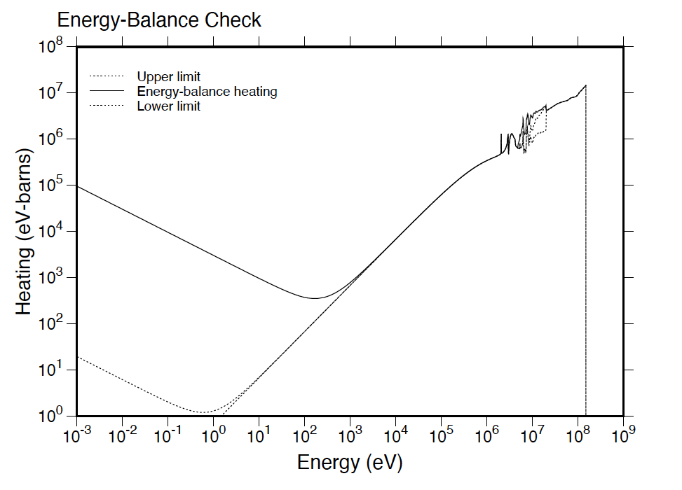
NJOY modules Print options: 0, 1, 2
A plethora of usually untapped information, intermediary and final forms, numerical and graphical outputs: Verification processes
broadr, heatr, acer, purr, groupr,….
thermal quantities at 293.6 K = 0.0253 eV
-----------------------------------------
thermal capture xsec: 3.8620E-03
thermal capture integral: 3.4230E-03
capture resonance integral: 2.0556E-03
-----------------------------------------
*****
angular distributions for …..
incident particle energy = 2.000000E+00 int = 2 np = 18
cosine pdf cdf cosine pdf cdf
------------ ------------ ------------ ------------ ------------ ------------
-1.000000E+00 6.333382E-01 0.000000E+00 -9.210000E-01 5.802944E-01 4.793849E-02
-8.430000E-01 5.368052E-01 9.150538E-02 -7.650000E-01 5.014318E-01 1.319966E-01
-6.870000E-01 4.734805E-01 1.700182E-01 -6.090000E-01 4.522744E-01 2.061226E-01
-5.310000E-01 4.371543E-01 2.408103E-01 -4.520000E-01 4.273886E-01 2.749597E-01
-3.590000E-01 4.221798E-01 3.144646E-01 -2.810000E-01 4.223566E-01 3.474015E-01
-1.870000E-01 4.272212E-01 3.873317E-01 -6.250000E-02 4.399583E-01 4.413136E-01
6.250000E-02 4.580496E-01 4.974392E-01 3.130000E-01 5.026719E-01 6.177696E-01
5.630000E-01 5.472430E-01 7.490090E-01 7.500000E-01 5.738266E-01 8.538290E-01
9.070000E-01 5.884447E-01 9.450673E-01 1.000000E+00 5.929042E-01 1.000000E+00
Look at the output
NJOY output file
Thanks Bob !

Slide 8
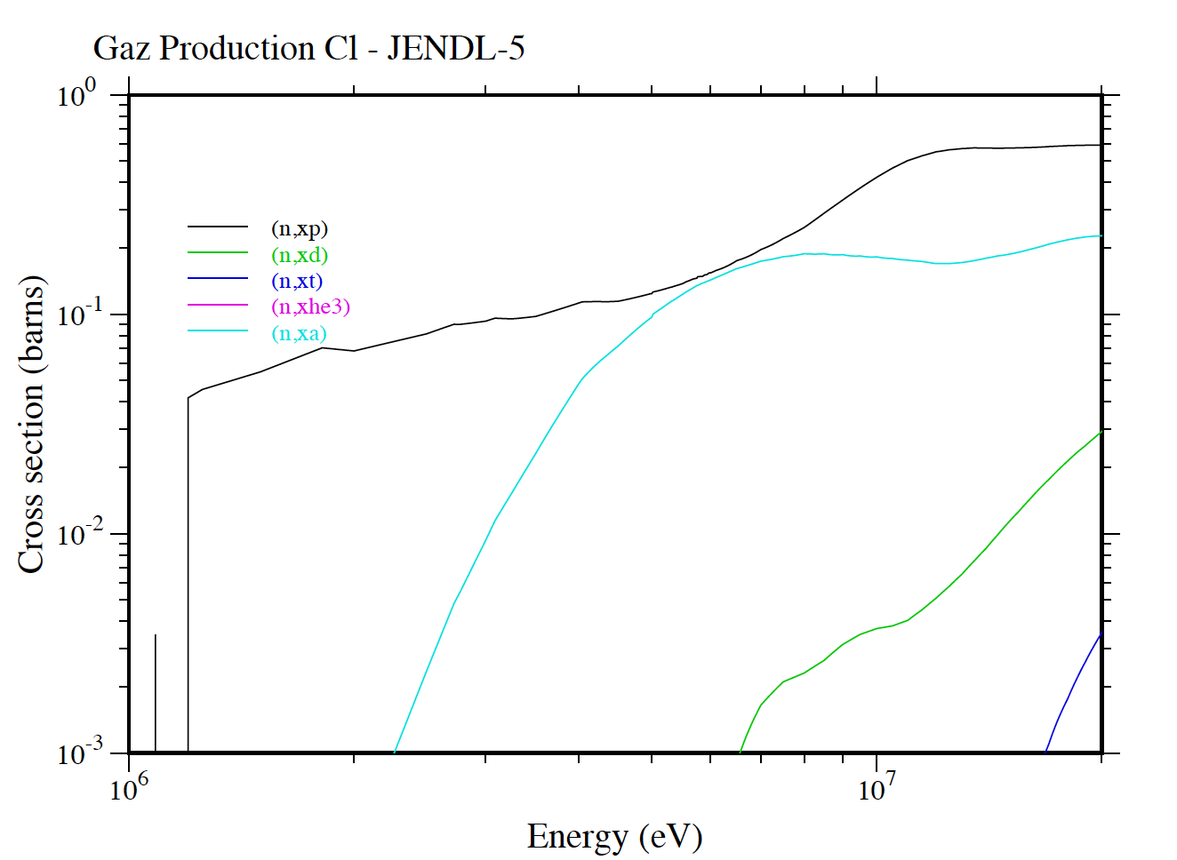
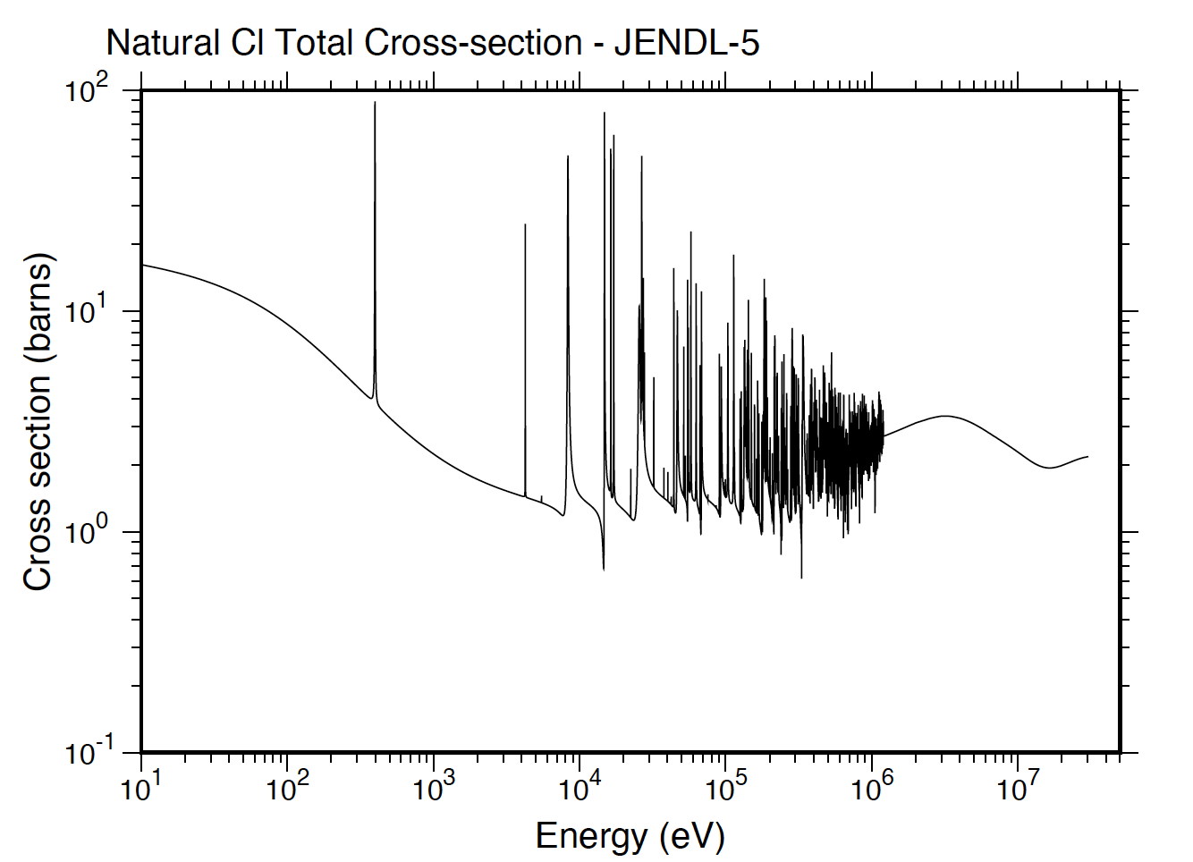
Processing script for natural element
cat>in$zant[$c1] <<EOF
mixr
30 $tx/
1 203 204 205 206 207 301 442 443 444 445 446 447/
$mx/
293.6/
$zant[$c2] $zant[$c5] $zant[$c3]/
' $zant[$c4]-$zant[$c1]- 0 IAEA TENDL-2025 $zant[$c1] Natural'/
plotr
31/
/
1/
'Natural $zant[$c1] Total Cross-section - TENDL-2025'/
/
4/
1e+1 3.e7/
/
/
/
6 30 $zant[$c2] 3 1 293.6/
0 0 0 0 1/
99/
viewr
31 32
stop
NJOY2016 mixr & plotr & viewr
Any MF=1,3 MT’s + derived mts
DPCS mts= 444 - 447
KERMA mts= 301- 450
GAZ production mts= 203 - 205
Loop over entire library

Slide 9
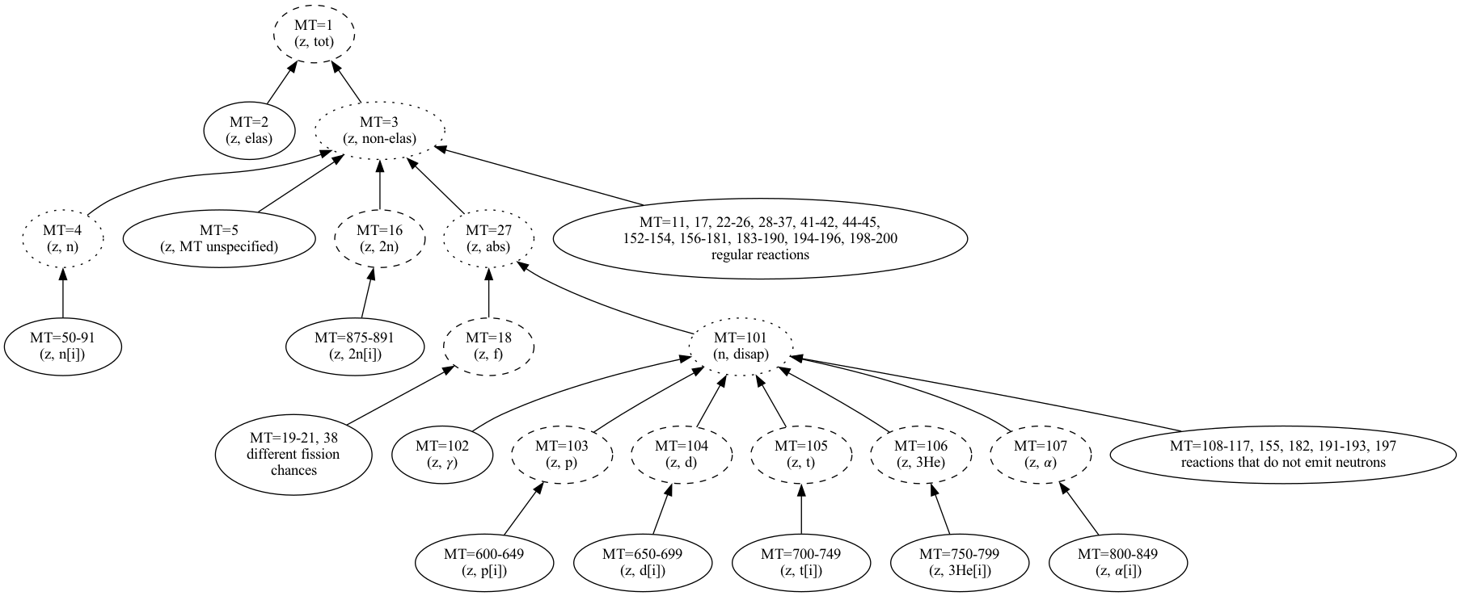
Format delicacy: ENDF-6 sum rules
Incomplete when explicit, with grey areas: TSL, MF-2 open channels, MF-6,…
difficult when implicit, treacherous when both
mt=1 ENDF-6 ≠ mt=1 processed
linearized & unionized – MF-3,10,9,6

Slide 10
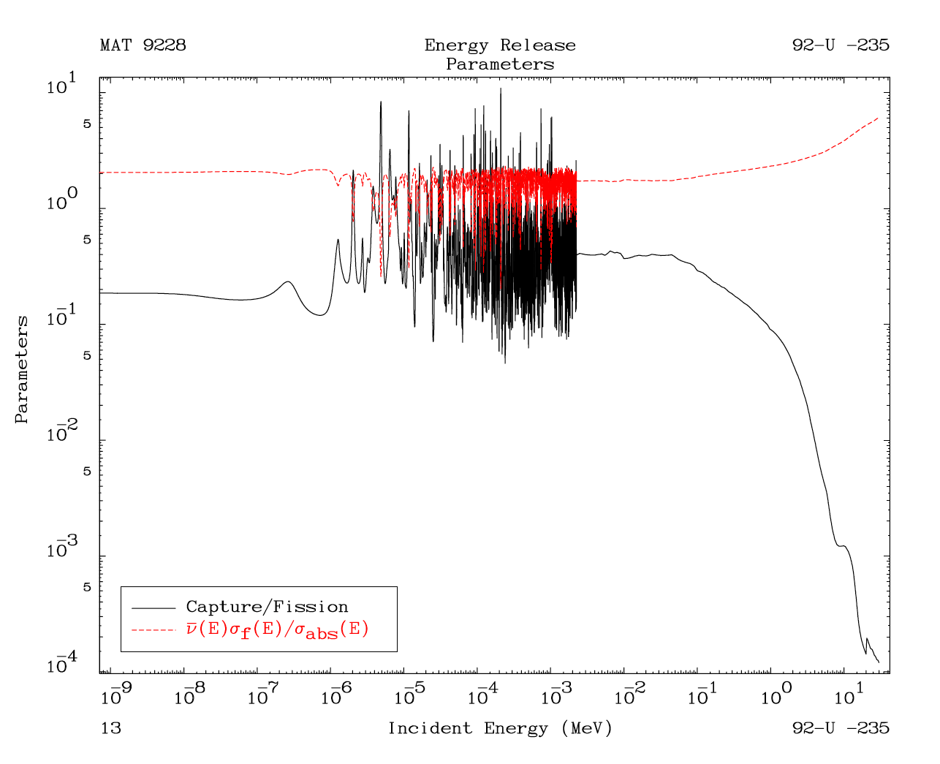
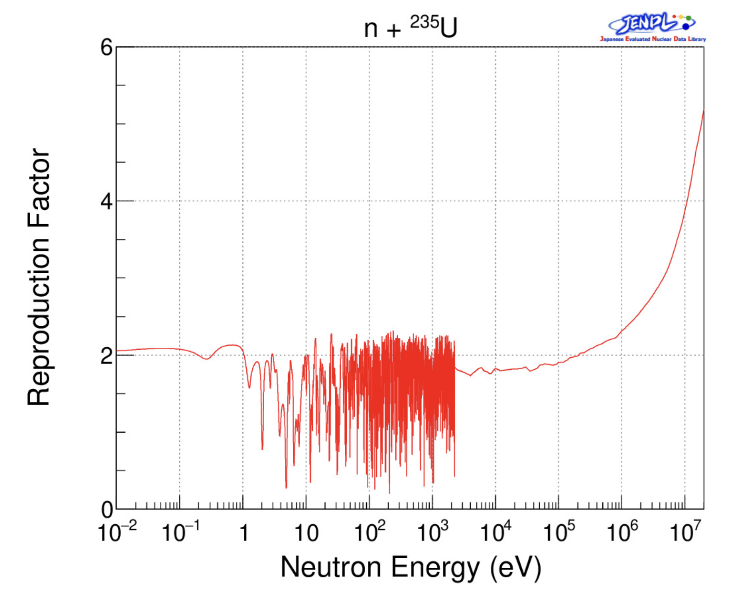
Processing scripts - PREPRO fixup
PREPRO fixup can fix many things !! has to
cat>FIXUP.INP <<EOF
10001111111000
../pendf/$isma[$c1]p.asc
FIXUP.OUT
27=( 18, 18)+(102,117)
*333=(452* 18)
R255=(333/ 27)
R254=(102/ 18)
*****
EOF
JENDL 5 neutron reproduction factors (η)
Alpha, Xi, Mu, Nu,…

Slide 11
Hidden in the URR, PURR PT’s SSF
PDFs @ 20 keV,
dashed @ 140 keV
R. E. MacFarlane NJOY
SSF’s, without them no
robust simulation
300 pcm on Bigten
Reactor physics lexical : background (dilution)

Slide 12
Groupwise forms and dilution, Bondarenko
Self Shielding Factor SSF on U²³⁸ first 3 resonances
RI slope with Temperature = negative temperature coefficient

Slide 13
Partials and Legendre coefficients
Red Cullen PREPRO
Fluctuations in the MF-3 -
not from resonance parameters MF-2 !!
0K = every K - no broadening

Slide 14
Partials and Legendre coefficients
Red Cullen PREPRO
Measurements evidence?
Overdone !! Definitely – really ??

Slide 15
Implicit MF3-MT5*MF6 – prod. yields & A < 4 production
Hundreds of isotopic production yields, A < 4 production - MF-8 dictionary – MT-5*MF-6 using sixpack - to 200 MeV
Implicit forms
30 – 200 MeV

Slide 16
Derived quantities: capture/fission and alpha
Steps show evaluator tweaks !!
to fit Keff C/E – ICSBEP – small, large leakage
Library differences
Below 2.25 KeV

Slide 17
Derived quantities: capture/fission and alpha
Steps influence on Civilian LWR
big core, small leakage
Keff in cycle – 18 months cycle
Library differences
Below 2.25 KeV

Slide 18

Backend of data forms for data portal
Scripted, automatic, basic and enhanced ENDF-6, GNDS-2.0 processing steps, parser and interpreter
Processed data forms are similar, identical to the ones used by, in application(s), not quite what’s has been plotted by an evaluator
Experimental data and Processed Evaluated data forms may correspond
Check with original NDC https://wwwndc.jaea.go.jp/ENDF_Graph/

Slide 19

Processing steps - MF-4 - conversion
PREPRO – LEGEND
only n-outgoing !
EXFOR: DA, μ_{lab ;} evaluated μ_{cm}
0.96 to 1.0 CM cut-off angles
A = mass target/projectile
Grey EXFOR not plotted !
# entrance energies

Slide 20
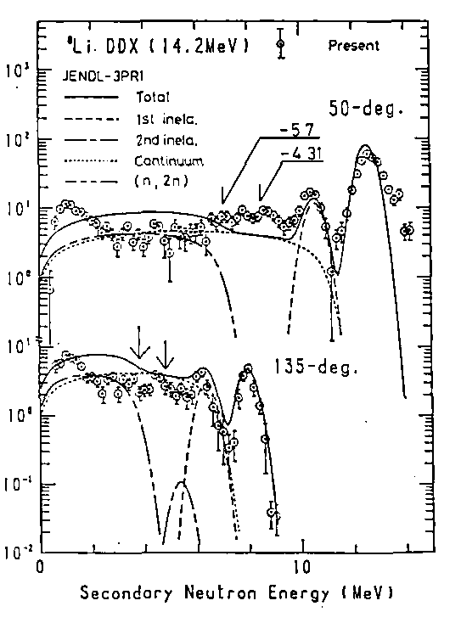
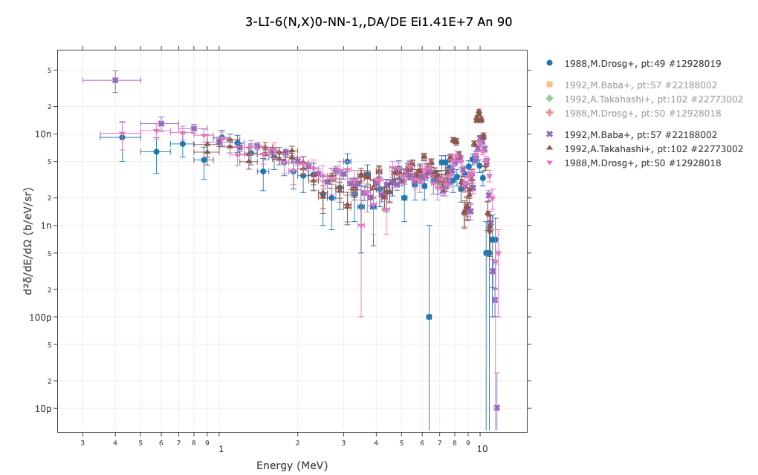
Processing steps - MF-6
The processing steps for evaluated DA/DE @ E_{in} from MF-6 entries to compare with experimental information mb/sr/MeV (lab) requires:
Processing capabilities for all allowed format representations
Accounting for all channels, levels: continuum, 1st, 2nd,.. inelastic, (n,2n), …
Conversion to lab from cm co-ordinate for all observables
The experimental data forms need to have been
properly compiled, not always the
case, complex process
Works, not quite… for
E_{in}= 14.1 MeV
S. Chiba 1985

Slide 21
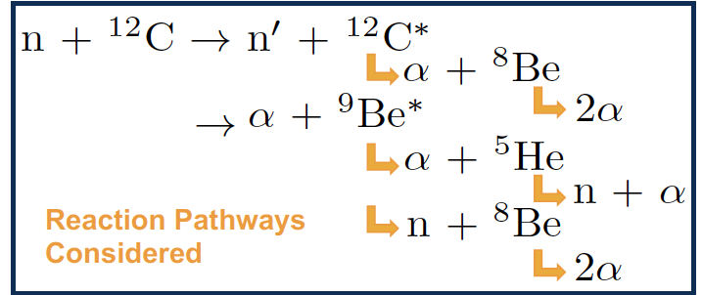
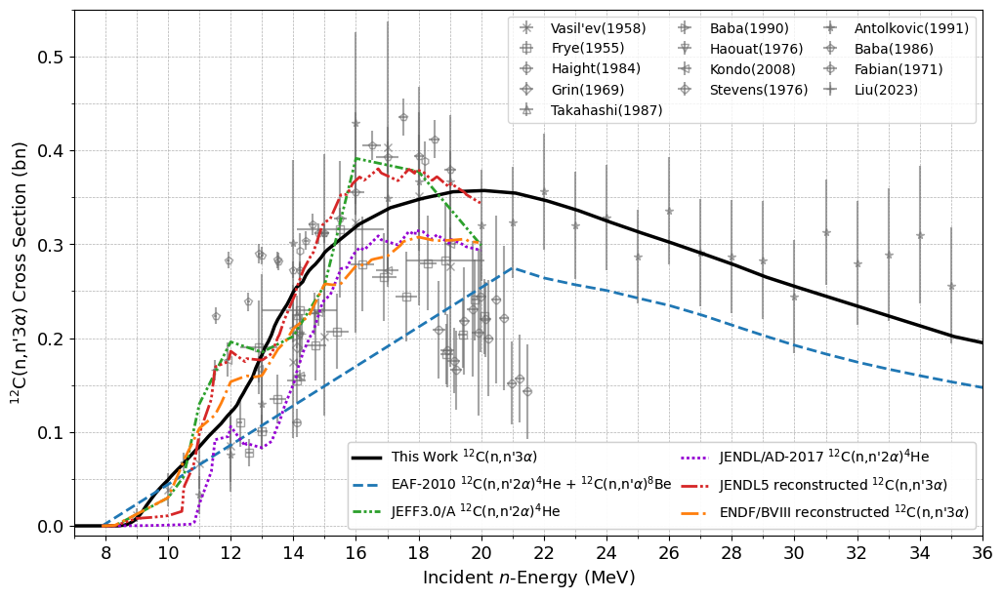
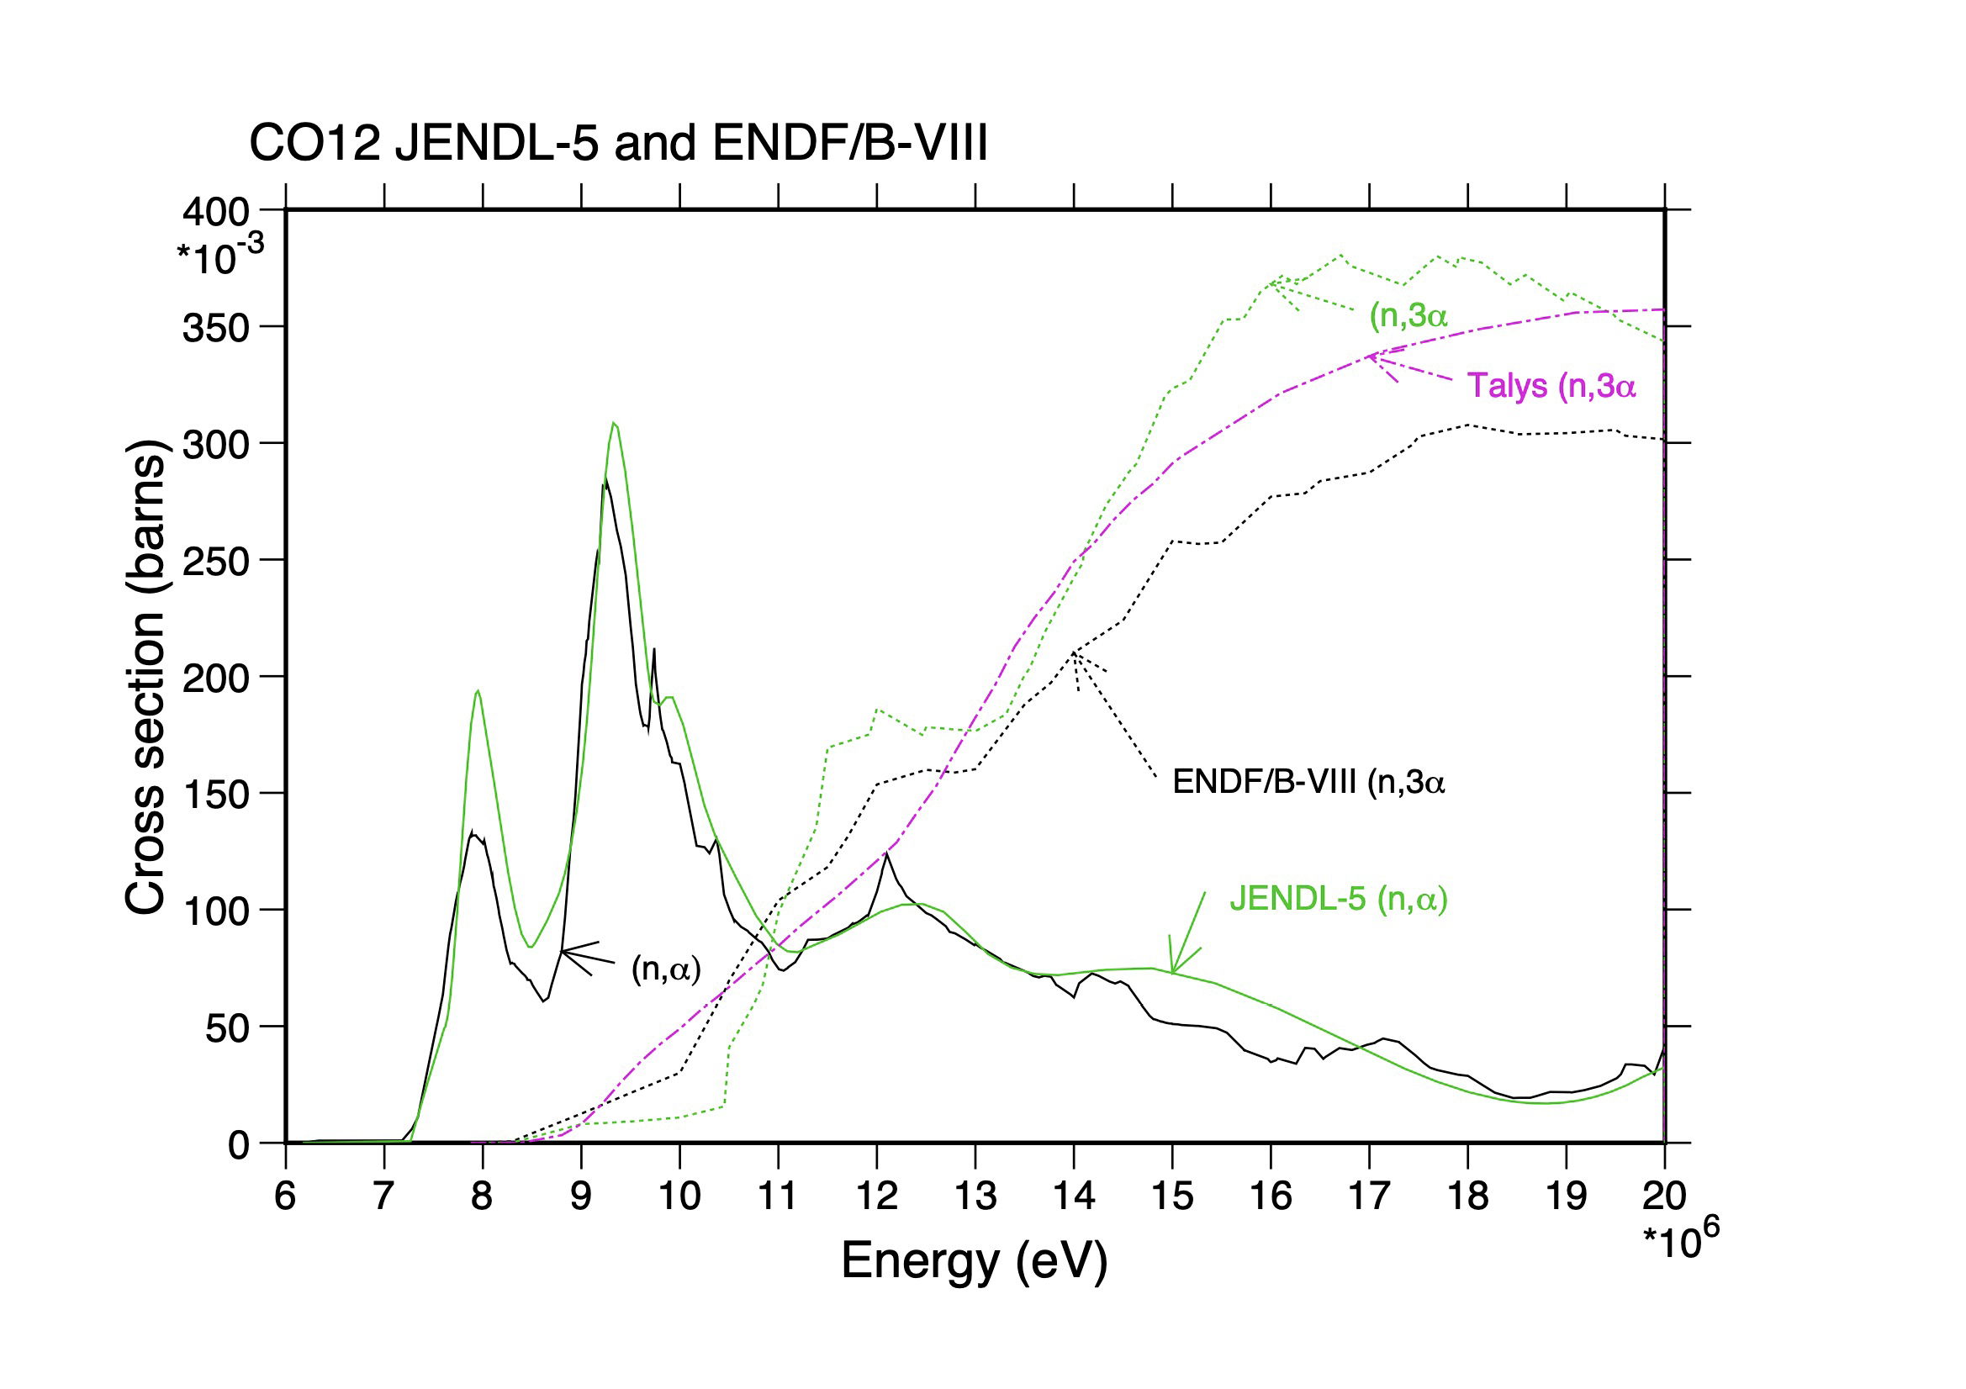
Processing steps, breakup, LR flags
EXFOR measured quantity ???
EXFOR ¹²C(n,2a+n)⁴He and ¹²C(n,X)⁴He ??
Compiled as MT=29, n2a !!!
EXFOR data, not reliable !!!
¹²C full breakup
Inelastic LR=23 flag ➔ derived form MT=23, constructed during processing

Slide 22
Conclusions
The processing steps, practices that need to be envisaged for modern nuclear data portal forms benefit from:
Relying on more than one processing systems, none are complete
Target simple comparable experimental metrics, but not only
Use open-source systems, preferably the same as the ones use for many application(s)
Rely on open-access steps, processes, practices
Output simple, defined, verifiable data forms, use modern graphics
Been externally audited, Verified and Validated V&V, shared
Been associated with model code physics : TALYS, CCONE, CoH3,…

