Slide 1
Multi-Generational Projects
Stephen T. Bell
Naval Reactors Headquarters
Notes:
Introduce yourself, title, org

Slide 2
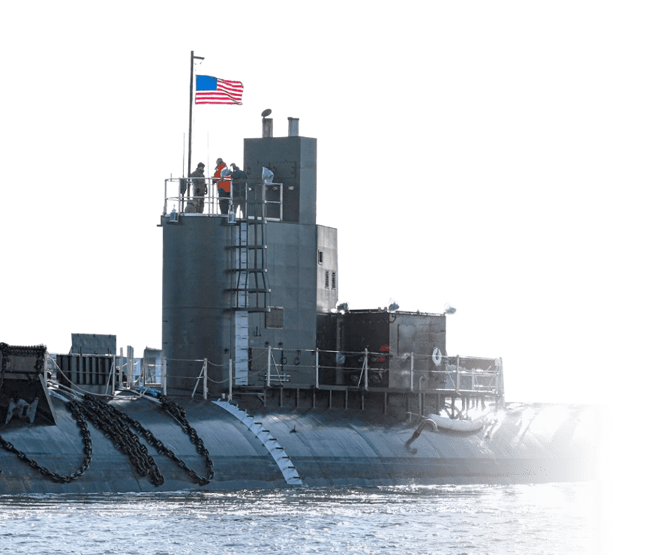
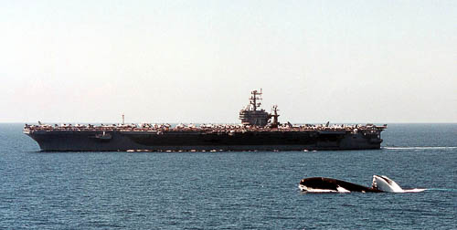
Naval Reactors Mission:
Deliver militarily effective nuclear propulsion plants and ensures their safe, reliable and long-lived operation.
Naval Nuclear Laboratory:
Designs nuclear propulsion systems and provide full lifecycle support
Delivers breakthrough innovations to enable a dominant Naval force.
Notes:
Naval Reactors and the Naval Nuclear Laboratory have one mission: naval nuclear propulsion. We put complex and unforgiving technology into an extremely unforgiving environment.
We have been doing this successfully for over 75 years, operating nuclear reactors all over the world, including entry into over 150 foreign ports.
I am going to talk specifically about the knowledge management part of our mission. My points will be about:
The challenges are in operating naval nuclear plants for decades. I expect that there are commercial nuclear corollaries.
What kinds of practices are proving effective for us.
How do I see that applying specifically to nuclear data.
Submarine image (top-right): https://navalnuclearlab.energy.gov/
Aircraft image(bottom-left): https://www.energy.gov/nnsa/powering-navy
Extra:
We continue our reputation as a paragon of engineering excellence because of our continued track record of safety, whose foundation lays upon utmost confidence in because of our tireless approach to

Slide 3
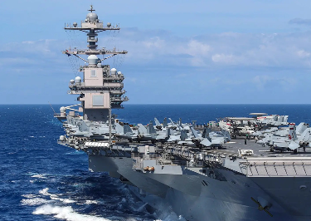
Modern Challenges
50-to-95-year design life cycle
Equipment can outlive knowledge
Competitive and evolve
Important changes over time
Emergent demands for specialists
Complex, multi-disciplinary engineering
Vast amounts of information
Information transfers among specialists
Long reactor technology development timelines
Notes:
Our operating environment.
Long design cycle life: Knowledge management has to be deliberate
NIMITZ: 50 year ship. 60 year old design
Competitive environment: A lot of things change over that time: how the reactor is built (e.g., 93% vs 97% enriched uranium). How the ship is used, etc.
Last nuclear design related update delivered last summer. It did not use ENDF 2.
The reactor and propulsion plant are tightly integrated into the ship. It is all a very complicated system.
Many specialties. The person who writes operating procedures does not do nuclear design but needs information from the nuclear designer. So do mechanics and electricians, at least indirectly.
There has to be disciplined information flow and storage.
Complex and expensive systems do have to change, but there is seldom a rush to change. Good risk management often involves relatively long development up front before introducing new technology, at least where the core is concerned.
Long development times can work in your favor, provided that they are not so long that they become irrelevant.

Slide 4
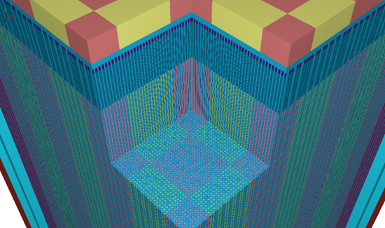
Some Principles and Practices
People make decisions and get things done
Documentation and peer review
Necessary for complex projects
Involves more people in technical basis for decisions
Enduring, self-describing information storage
Deliverable focus - Information organized by product and decisions
Searchable, centralized document database
Long-term R&D tied to clear Program goals
Sustain capability to meet emergent needs
Plan
Execute
Review
Decide and Act
Introspection
Notes:
Prioritize the needs of people for information to get their job done.
Use documentation and peer review: these are the “blocking and tackling” of engineering. These are the techniques that must stay strong.
We have moved away from storing models as solver input files:
The equipment way outlives software, compilers, computer environments and even people.
Using solver inputs ties the model of the equipment to a solver version, often a specific workflow
The number of workflows to maintain multiplies with time and number of designs
Common Nuclear Exchange File: HDF5
Common, equipment based input description that models – nuclear, thermal, mechanical, CAD, - are all built from.
Implement a new solver by implementing a new translator/builder – proving to be relatively easy to create
Never implement a standard without making room for exceptions. – enable change and innovation.

Slide 5
Application to nuclear data
ENDF/EXFOR are a data preservation standards
You must stay working and be improving
GNDS is an improvement – extendable and expandable
Re-evaluating/re-analyzing historic experimental measurements can be difficult – inconsistent raw data retention and reporting
Consider a common way to report and analyze experimental data to improve retention, archiving, and retrieval of information in support of department objectives
Validating data for application remains essential - NNPP maintains a curated library of Proprietary Critical Benchmarks
Notes:
Standard Experimental Nuclear Data File to enable easier re-evaluation of information.
Generalized Nuclear Database Standard

Slide 6
Summary
Document science and engineering work and lessons learned for both present and future needs
Enduring and self-describing data formats – consider this for raw experimental data
Centralized and Searchable Database
Notes:
Summary slide, quickly touch on documentation, the database, and trust & skeptical thinking

