Slide 1
Nuclear Data Toward Predictive Capabilities
Office of Experimental Science

Slide 2
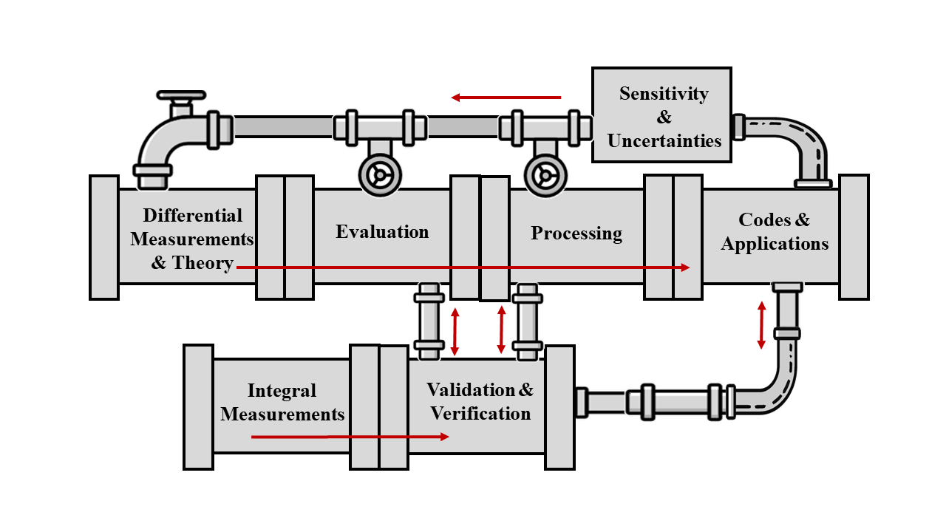
Nuclear Data Pipeline (NA-113 perspective)
NA-113 oversees critical activities in the nuclear data pipeline supporting the deterrent mission
Collaboration is key for maintaining and strengthening our capabilities
Uncertainty Quantification studies identify sensitivities and priorities
Machine Learning/Artificial Intelligence (ML/AI) is providing new methods for experimental data reduction/analysis and applications studies
Both LLNL and LANL maintain a complete and integrated nuclear data pipeline to achieve Defense Program goals – NA-113 directly supports foundational and applied activities

Slide 3
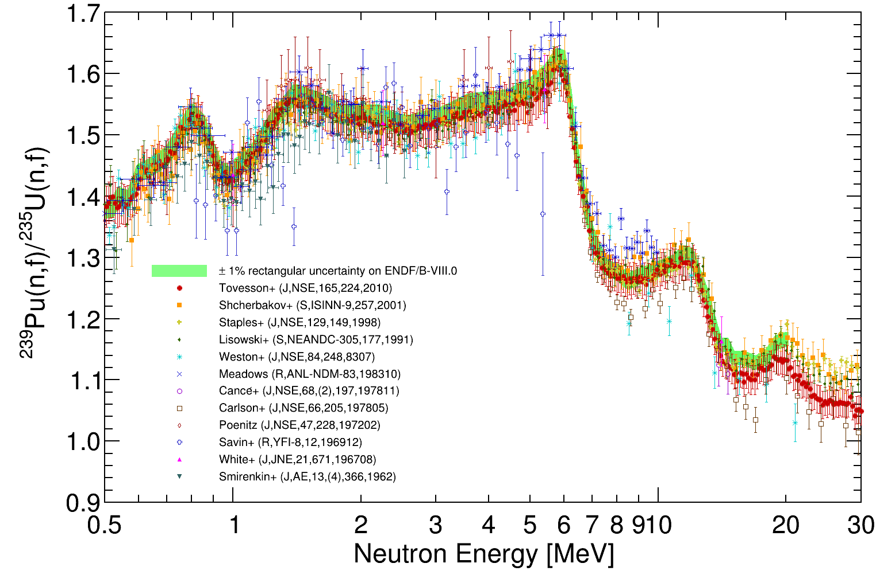
High-precision fission measurements incorporated into ENDF/B data library
Fission Time Projection Chamber (fissionTPC) was developed for precision cross-section measurements
  New data for ²³⁵U, ²³⁸U, and ²³⁹Pu neutron-induced fission with unprecedented uncertainty analysis
  Collaboration includes LLNL, LANL, Oregon State U., Colorado Sch. Mines, Abilene Christian U., Cal Poly
Chi-Nu was developed to reduce uncertainties of prompt neutron emission spectrum following fission
  New data for ²³⁵U, ²³⁸U, and ²³⁹Pu fission neutrons
  Collaboration includes LANL, LLNL
FissionTPC
Chi-Nu
ENDF/B-VIII.1 released Sept. 2024
These efforts were long-term investments that provided excellent data and were achieved through a collaboration between LLNL, LANL, and multiple universities

Slide 4
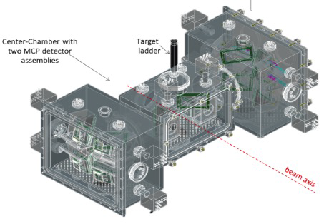
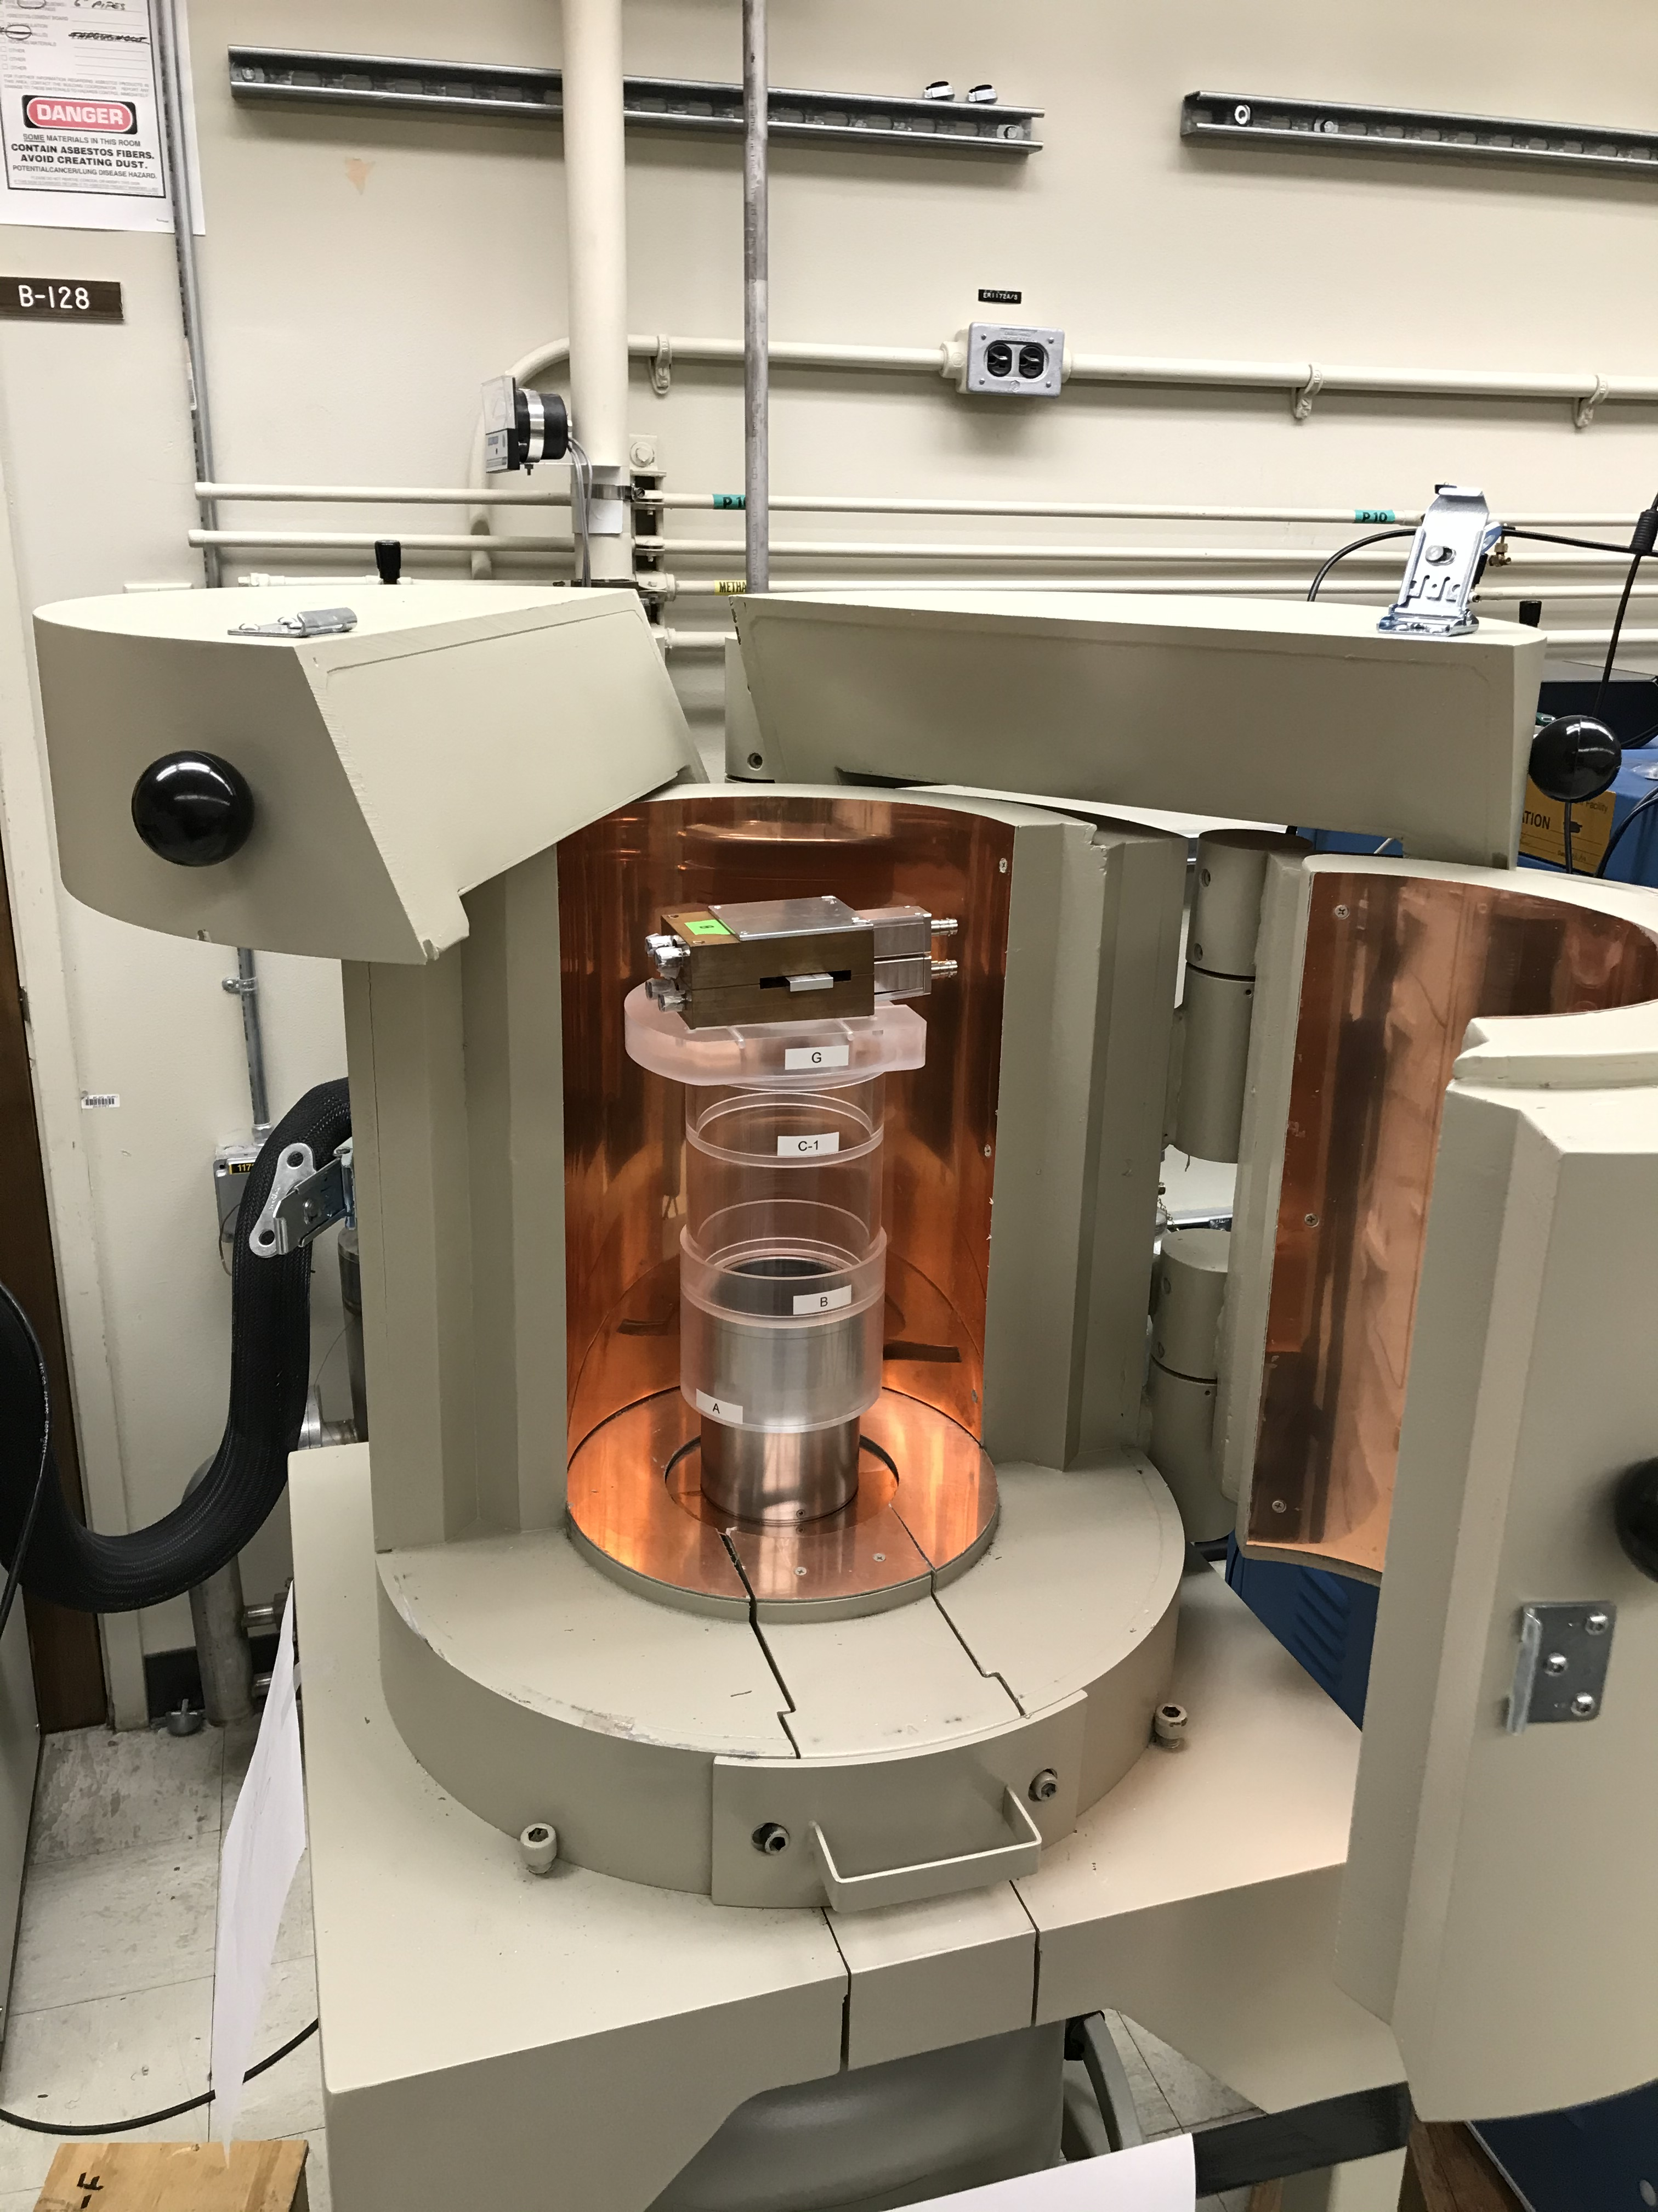
Fission product yields are also being updated
Successful completion of cumulative fission yields with monoenergetic neutrons at TUNL
  ²³⁵U, ²³⁸U, ²³⁹Pu neutron-induced fission to 20 MeV
  Data for independent yields also collected
High-precision fission product decay branches measured at LLNL and TAMU (SSAA)
  Irradiation at CARIBU (ANL), UC Davis
  Stockpile Stewardship Graduate Fellow on team
Yields and correlations measured with megaSPIDER at LANSCE
  8 detection arms
  1-arm system successfully demonstrated
TUNL data
megaSPIDER
LLNL decay counting system
Data from fission product measurement campaigns being used in current evaluation efforts

Slide 5
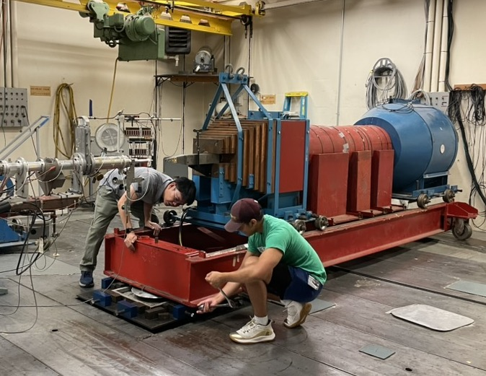
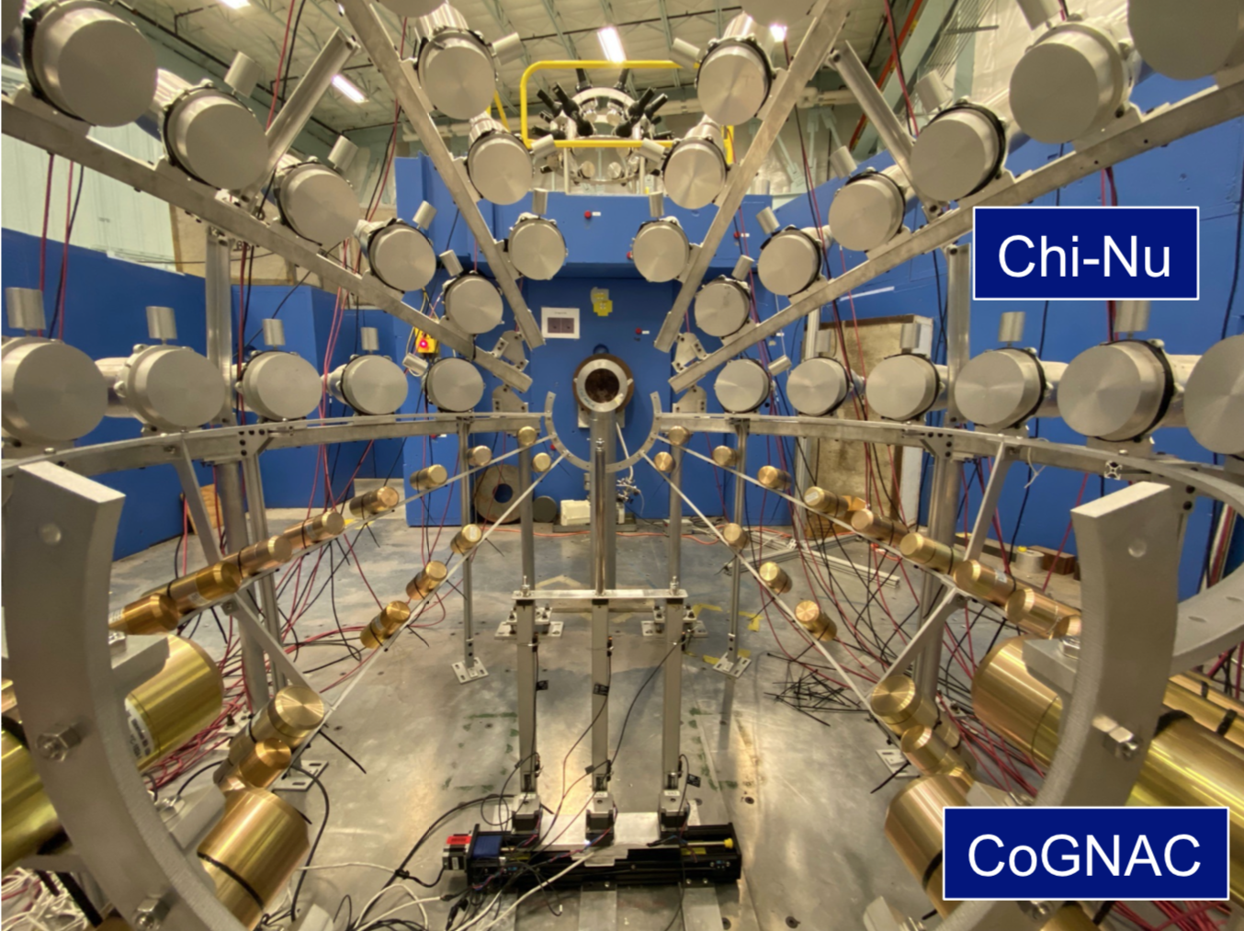
Neutron scatter measurements have been identified as a priority
Scattering is a difficult neutron reaction channel to measure and poorly constrained
  Limited reaction observables: neutrons, γ rays
  Neutrons are very hard (but necessary) to measure, generally rely on time-of-flight for energy measurement (>>10 ns flightpath)
Actinides present more obstacles:
  Significant neutron background from fission
  Low γ−ray energies/intensities in actinides make neutrons the only reliable probe
  Actinide material difficult to work with
Active efforts underway to collect these important data – need evaluation support to get data into library
Monoenergetic neutron source: LLNL with TUNL (actinides) and with Mississippi State, UKAL (non-fissionable)
Broad-energy neutron source: LANL at LANSCE with CoGNAC

Slide 6
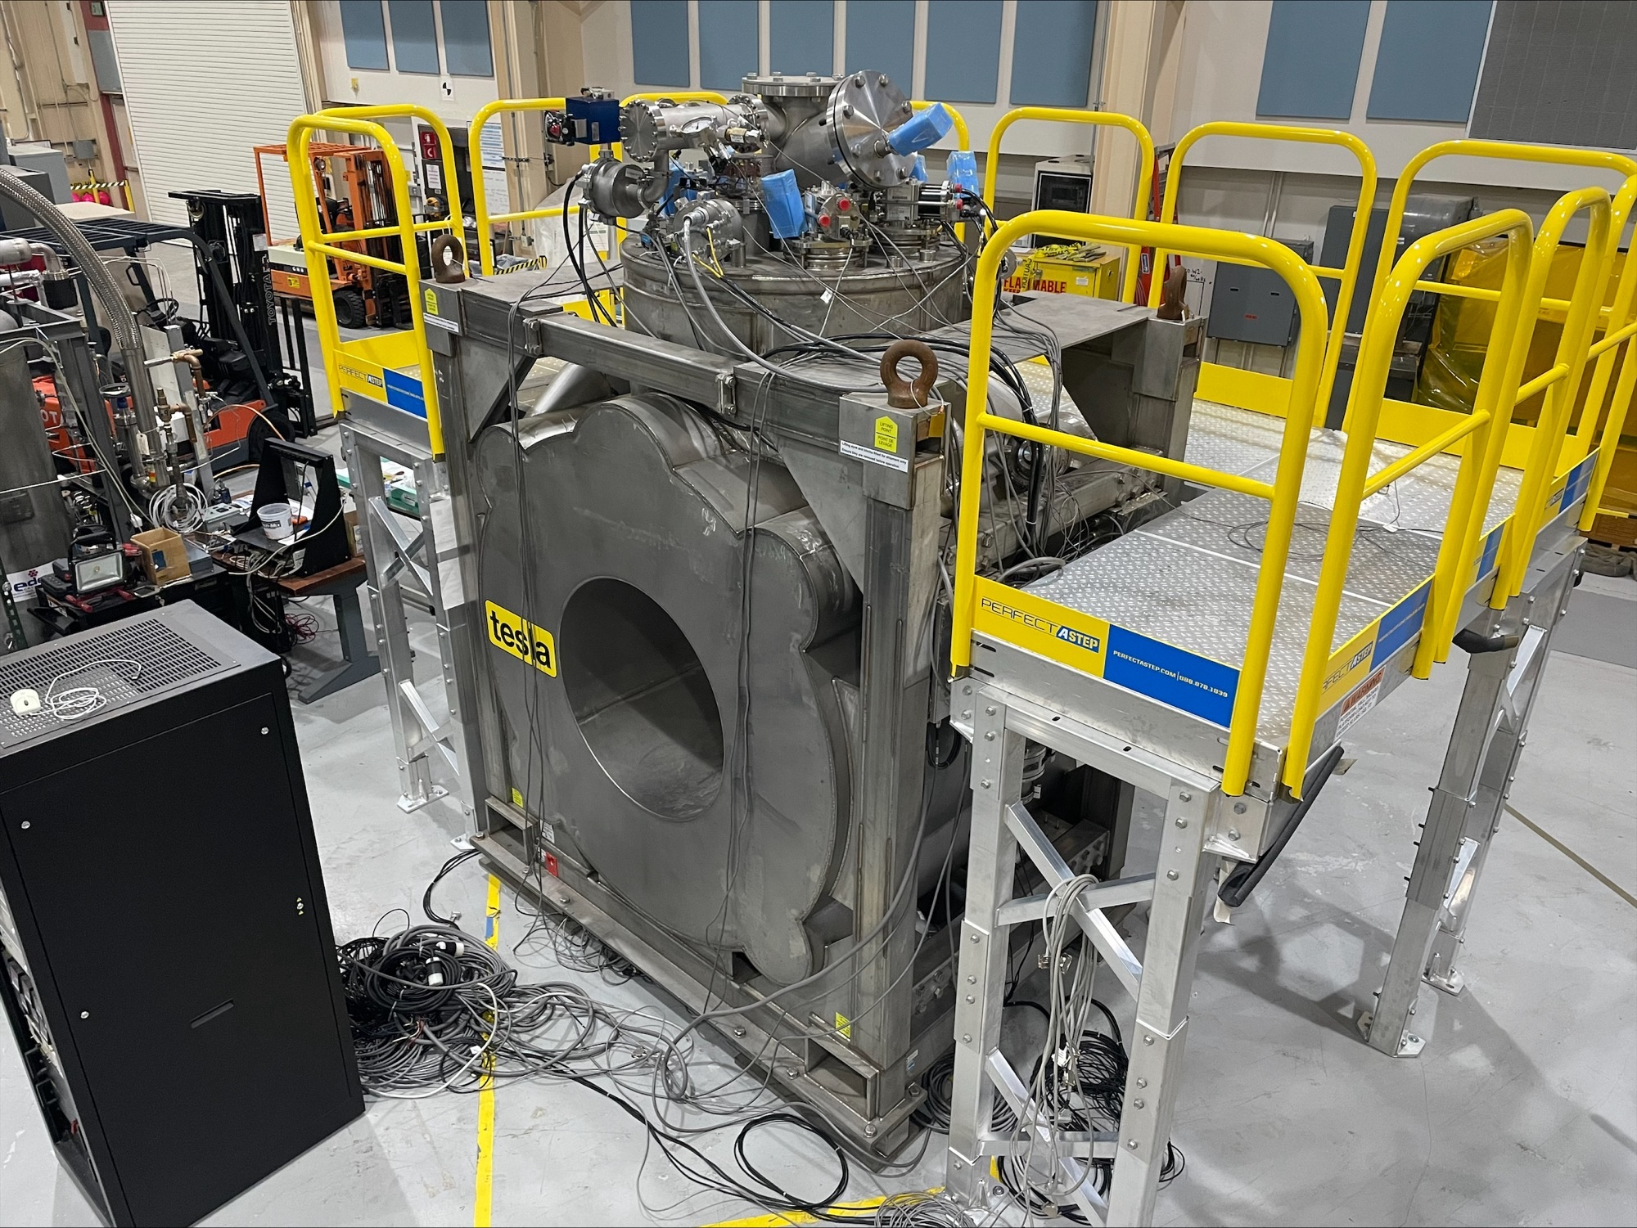
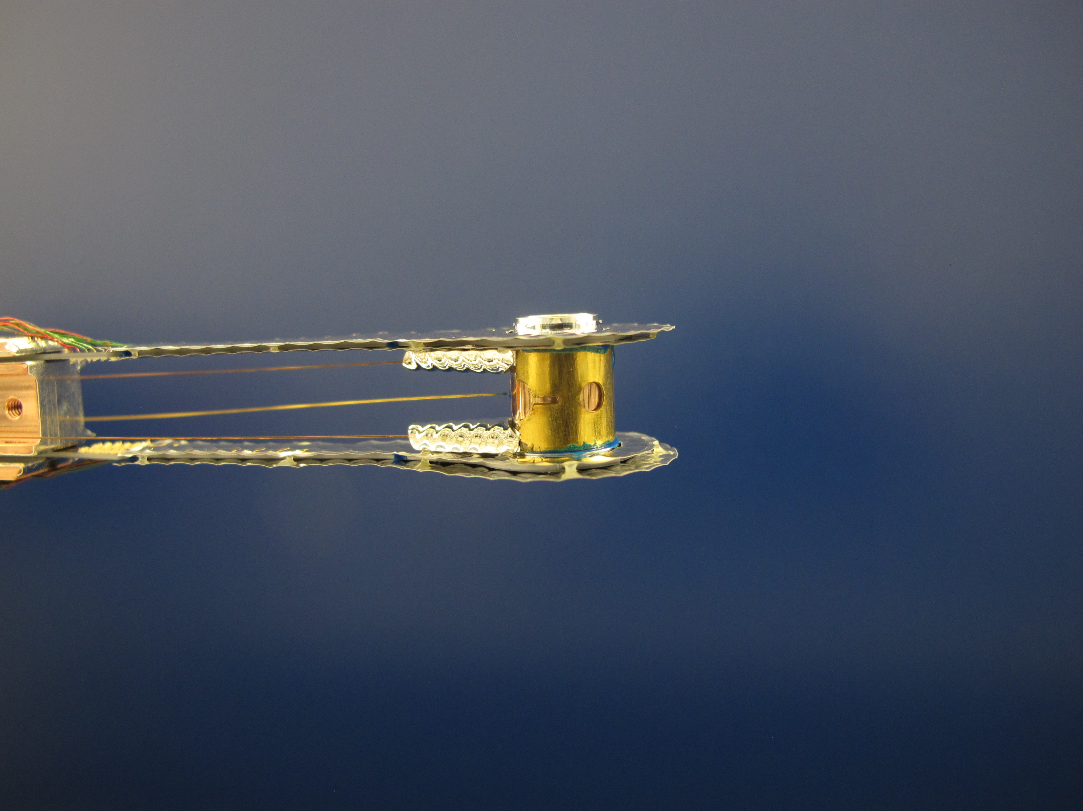
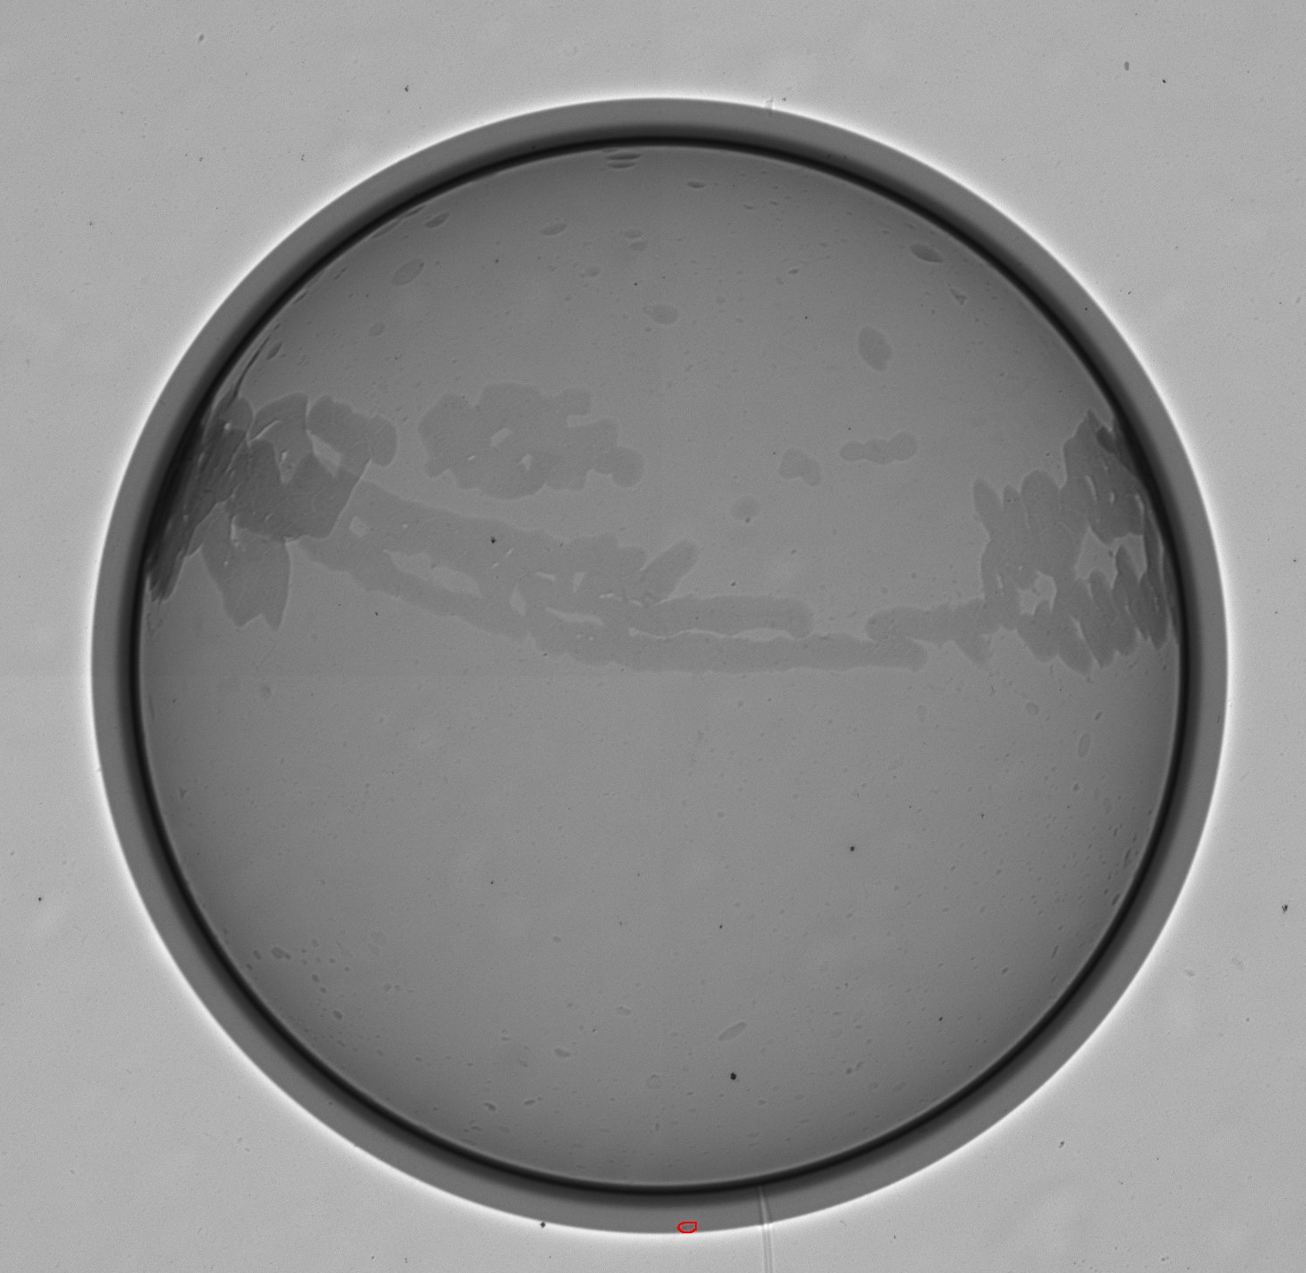
Improved reaction cross sections with unstable isotopes requires new measurements and theory
Reactions on fission products, “burn-up”
Radiochemical diagnostics
Challenging measurements
  Indirect techniques with LLNL at ANL, FRIB, TAMU
    Complex detector arrays, challenging analysis
    Need theory development for unstable nuclei
  Direct techniques at NIF and LANSCE
    Need isotope production capabilities (radioactive targets)
    Requires optimized detection capabilities
Magnetic solenoid for charged particle detection under development LANSCE; will measure (n,p) and (n,α)
87
(n,2n)
88
(n,2n)
89
80 h
107 d
100%
High neutron flux and low numbers of radioactive target atoms needed at NIF: Successful demonstration for (n,2n) cross sections
(n,γ)
(n,γ)
Example: simplified Y reaction network, where many reactions are on unstable nuclei (few to no measurements)

Slide 7
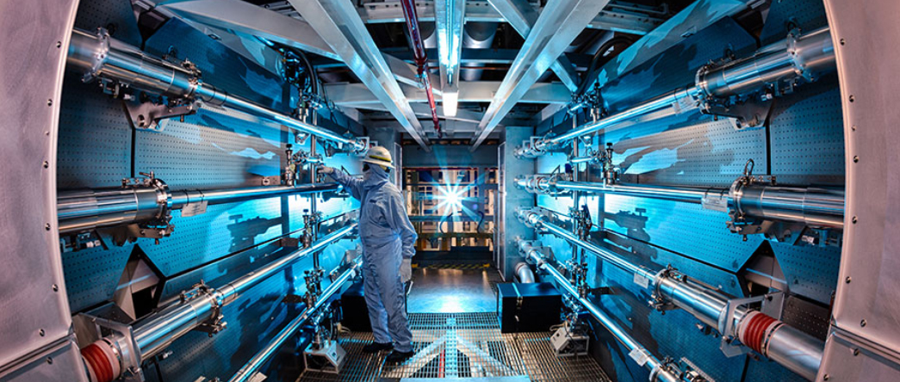
Facilities are the heart of experimental efforts
LANSCE Modernization Project (LAMP)
  LANCE provides an important resource for neutron and proton experiments
  Upgrades under LAMP improve/replace aging equipment
NIF Enhanced Yield Campaign (EYC)
  NIF provides intense burst of fusion-energy neutrons
  EYC will increase laser energy x10
Future facilities also being explored
  LANSCE Enhancements (LANE) at LANL, including “neutron target”
  Livermore Nuclear Science (LiNuS) at LLNL, high intensity, pulsed, monoenergetic neutrons
LANSCE
NIF

Slide 8
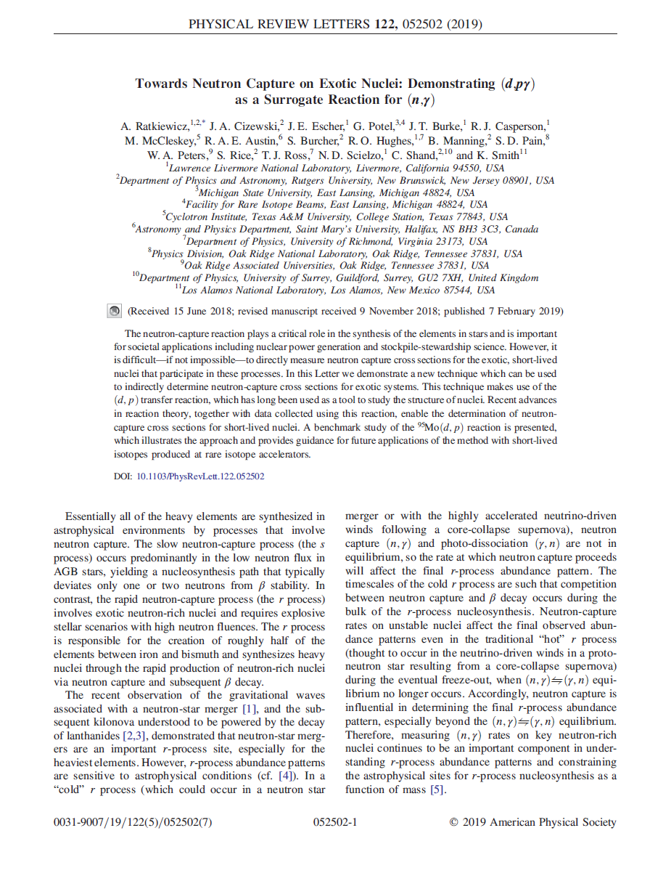
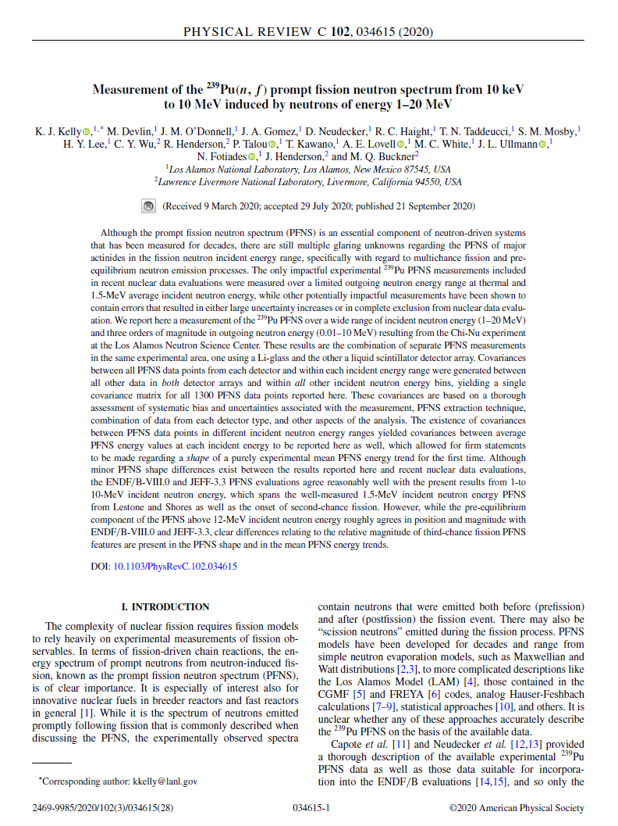
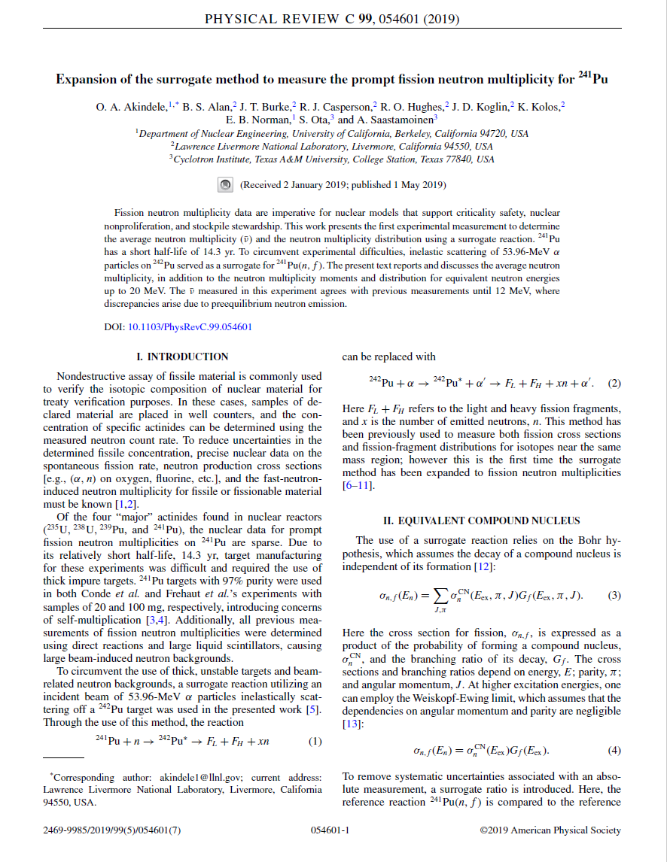
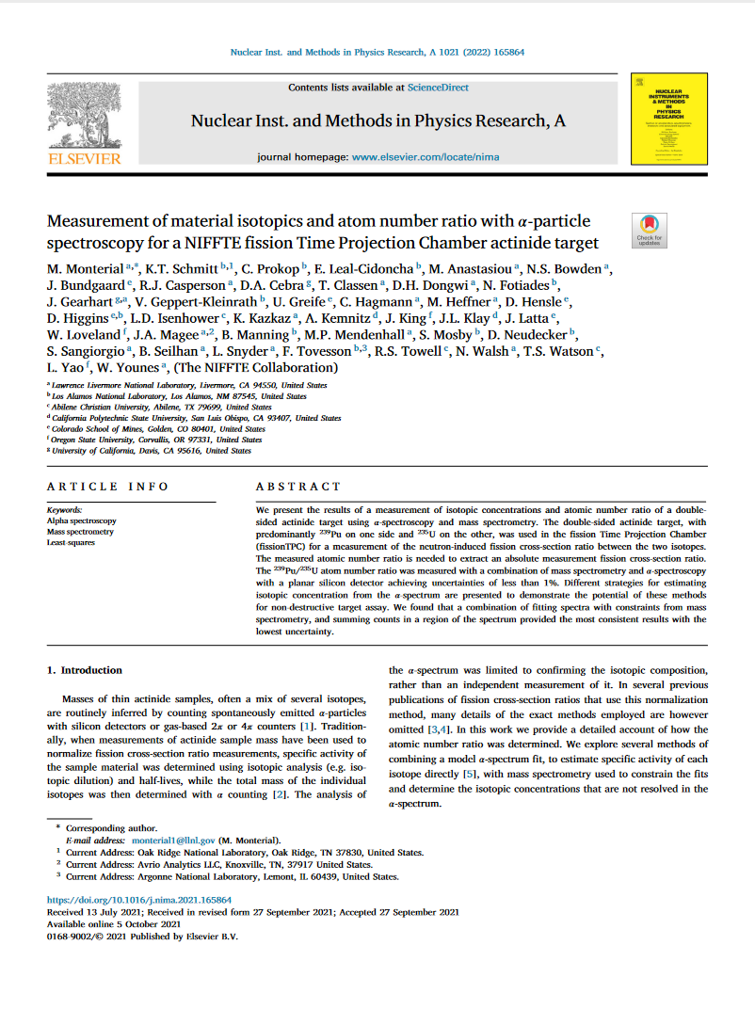

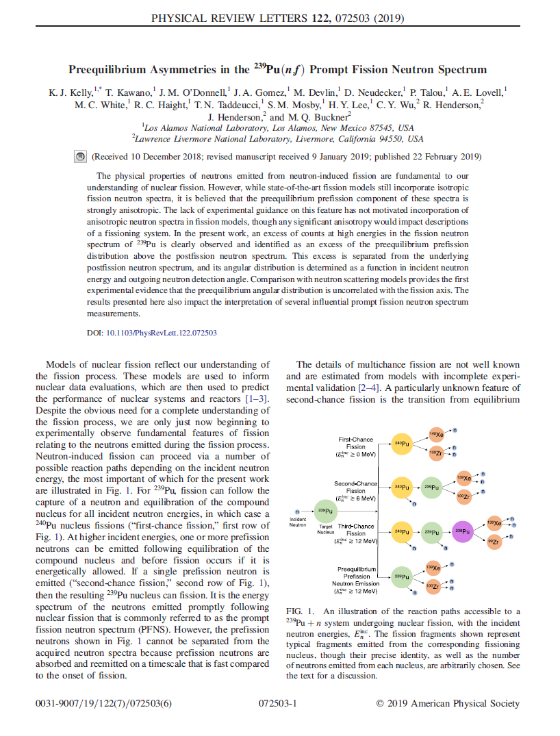
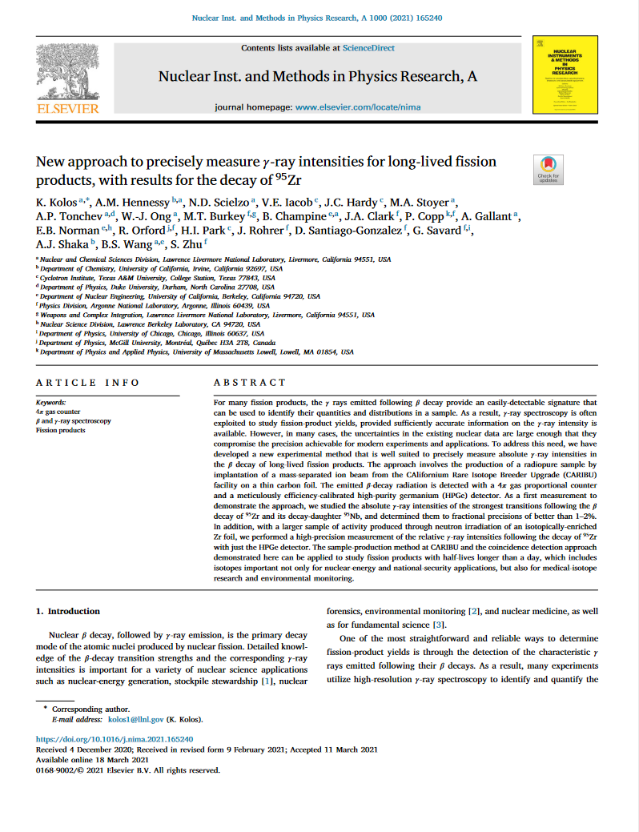
OES supports multiple experimental efforts driven by applications needs
Data needs identified through sensitivity studies and connections across NNSA offices
Challenging measurements taken on by diverse teams
  Data are shared with the broader community – improves foundational science understanding
  Expanding capabilities for challenging reaction measurements
Evaluation is a pinch point: need more evaluators
ML/AI may accelerate data delivery from experiment to application
  Detector channel calibrations, data fitting
  Identification/removal of contaminants
  … and more
Applications
Delivery
Needs
Nuclear Data
Library
Foundational Data
Experiment/Theory
Evaluation
Reaction Theory

Slide 9
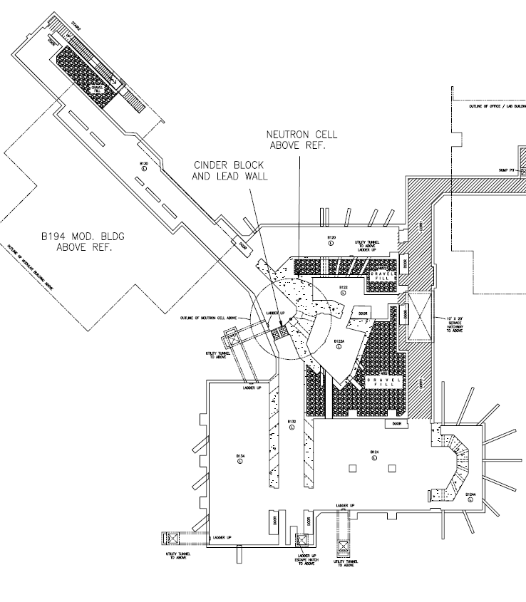
Livermore Nuclear Science (LiNuS) Center
LiNuS Center
(Proposed upgrade to B194)
LiNuS will provide high-flux, pulsed, monoenergetic neutrons at a range of energies
Complementary to LANSCE broad energy spectrum
Facility will provide high-priority Defense Program needs identified in L1 and L2 Milestone efforts:
  ²³⁹Pu(n,n’) – Pulsed, mono-energetic beam required
  ²³⁹Pu(n,2n) – High-flux, mono-energetic beam required
Facility can also be used for integrated measurements such as pulsed spheres providing nuclear data constraints for reduced uncertainties
LLNL has LDRD investments exploring accelerator and target technology
Accelerator
Buncher
Radioactive Target
Activation
Scattering Target
Integral
Experiments

Slide 10
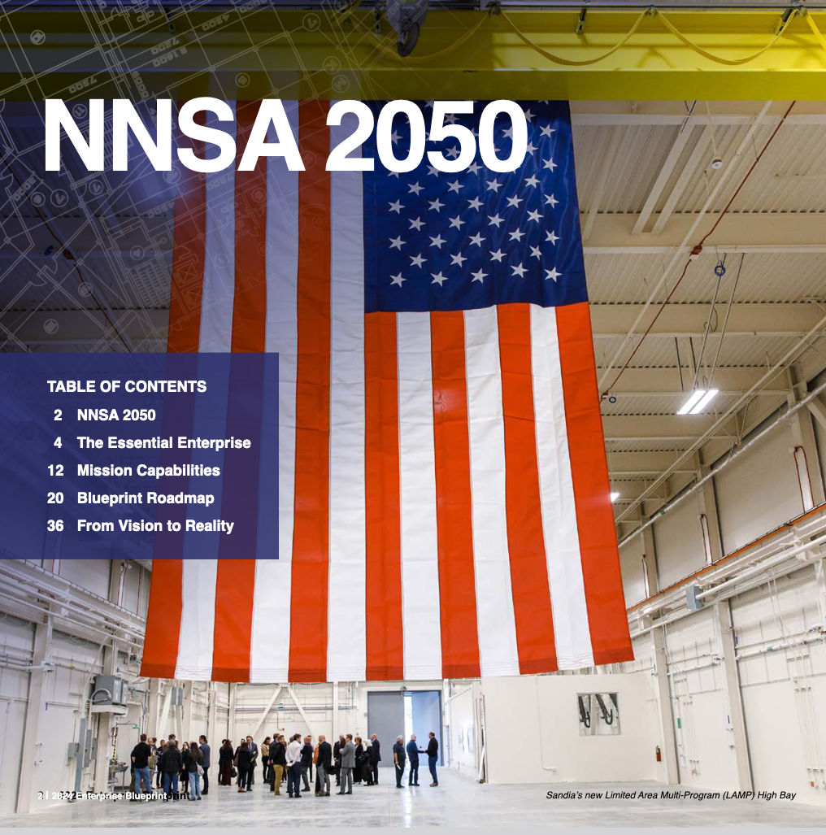

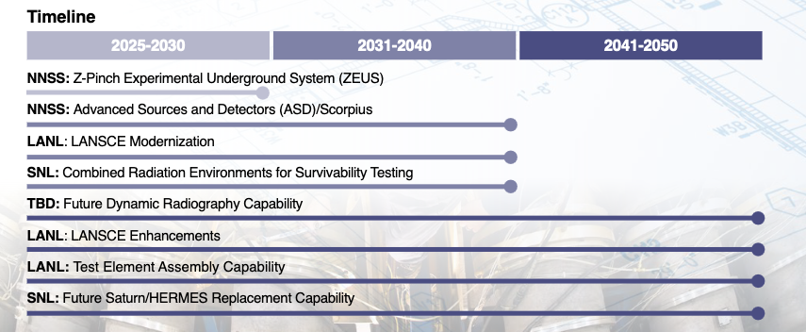
LANSCE Enhancements (LANE)
The Blueprint is “A 25-year NNSA roadmap that aligns timely delivery of specialized infrastructure with mission demands across the nuclear stockpile, global security, and naval nuclear propulsion”
The LANSCE facility is recognized as an essential scientific platform.
LANE focuses on the three major NNSA mission areas of dynamic imaging, materials characterization, and nuclear physics.
Currently in planning phase – no formal commitment to solid scope and timeline yet.
https://www.energy.gov/nnsa/nnsa-enterprise-blueprint

Slide 11
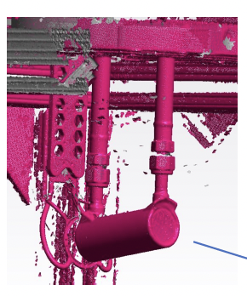
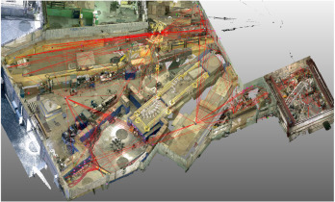
Potential LANE nuclear physics scope
Lujan/WNR optimizations
Neutron scattering known priority
Initial measurements on radioactive isotopes exploit new Lujan target → need enhanced WNR capabilities
Isotope Production Facility Partnering
Increased demand requires new target production capabilities
Advanced instrumentation enables the next generation of experiments
New Approach to Radionuclide Science
LANSCE can drive a radioactive ion beam facility
Nuclear reaction rates of interest for applications and nuclear astrophysics are on short-lived radioactive isotopes.
Half-life limit for a credible measurement could move from days-to-years limit to seconds-to-minutes.
Proposed solenoid spectrometer for radioactive isotope studies
LIDAR and Laser Tracking data for WNR facility, used to guide facility optimization planning
Timeline

