Slide 1
DTRA Research and Development 101
APPROVED For Public Release

Slide 2

Our Core Values
Team Oriented
Though complex and dispersed, we are a single cohesive Agency
People Centric
Our most valuable resource to counter WMD
Mission Focused
United in purpose that our work matters

Slide 3
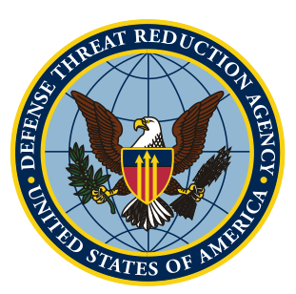
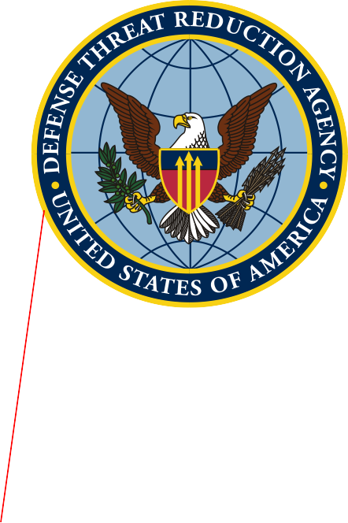
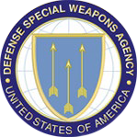
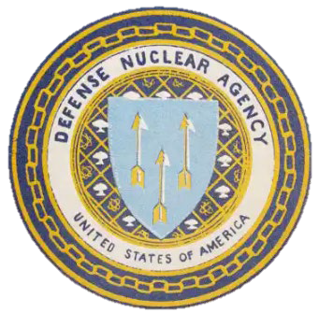
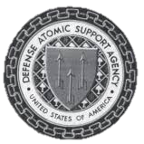



Our History
An Agency defined by 80 years of evolution…
that continues to evolve…
1998 -
Defense Threat Reduction Agency
1996-1998
Defense Special Weapons Agency
1971-1996
Defense Nuclear Agency
1959-1971
Defense Atomic Support Agency
1988-1998
On-Site Inspection Agency
1947-1959
Armed Forces Special Weapons Project
1941-1947
Manhattan Engineering District
…to address the most consequential threats to our national security

Slide 4

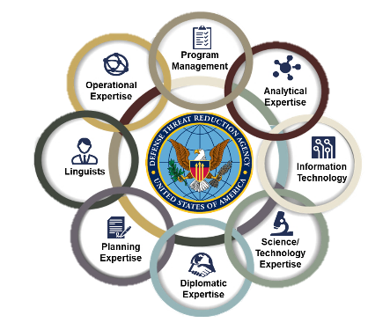
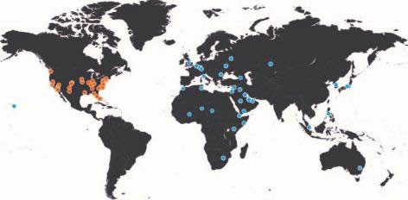
Our People & Resources
A team composed of highly diverse skillsets providing expertise throughout the CWMD enterprise

Slide 5
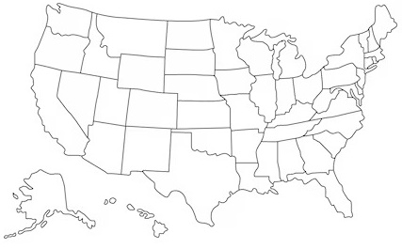
RD Workforce Locations
National Capital Region
Defense Threat Reduction Center (DTRC) / Fort Belvoir
New Mexico
Kirtland AFB
Some Additional Workforce Locations
West Point, NY; Las Vegas, NV; Fort Liberty, NC; and Edgewood/Aberdeen Proving Ground, MD

Slide 6
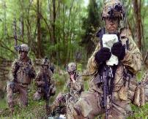
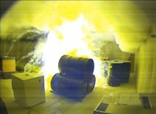
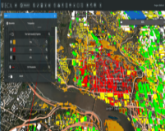
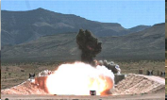
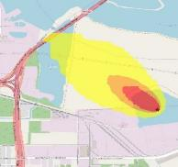



RD Mission and Functions
Generate customer focused, threat informed, trusted technical solutions to deter and counter critical WMD problems for today and tomorrow.
Insert picture
Insert picture
Insert picture
Insert picture
RD executes its mission by delivering innovative solutions that meet current mission requirements in a timely manner and by anticipating and preparing for emerging and future threats with a balance of fundamental and applied research across the portfolio.

Slide 7

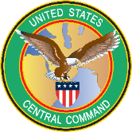


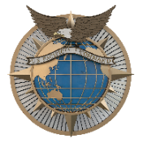
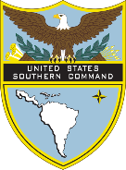
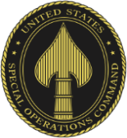
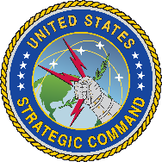

RD Strategic Partnering
RD partners with other U.S. Government agencies (such as National and Service Laboratories), and international S&T organizations to develop CWMD capabilities that address prioritized CCMD / Joint Force gaps.

Slide 8
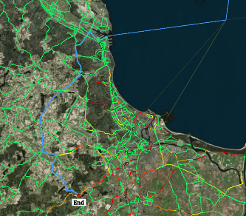
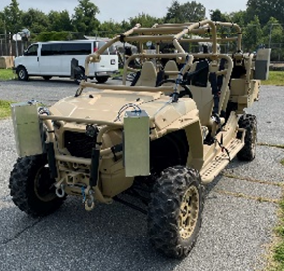
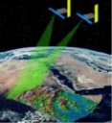
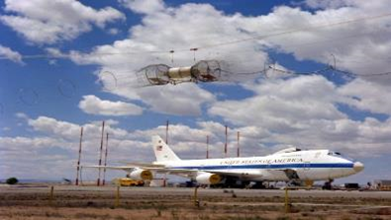
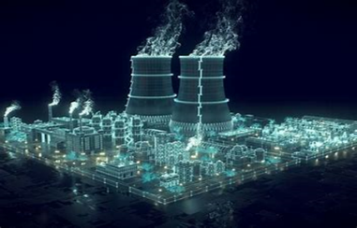

RD-NT: Nuclear Technologies Department
RD-NT researches, develops, and transitions nuclear weapons effects, survivability, detection, and monitoring capabilities to support and enable an effective nuclear deterrent.
Top NT priorities include Operating in a Nuclear Environment (ONE); Nuclear Modernization and Sustainment; Mission Assurance and Risk Mitigation Support; Nuclear Arms Control; and Forensics.

Slide 9
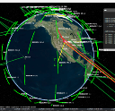
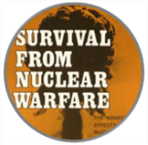


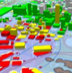
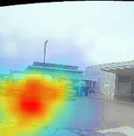

RD-NT: Nuclear Technologies Department
Nuclear Weapon Effects
  Creates modeling & simulation tools for nuclear targeting support and consequences of execution analyses.
Nuclear Survivability
  Provides technologies, standards, historical data, and testing capabilities to ensure that U.S. nuclear and conventional forces survive and fight through adversary nuclear attacks.
Nuclear Integration
  Provides cloud-ready nuclear modeling platform, interfaces and applications & nuclear archives accessibility.
Nuclear Detection
  Develops nuclear and radiological defense capabilities enabling actionable information to the Joint Force.
Nuclear Assessments
  Develops monitoring and verification, national technical nuclear forensics, and arms control capabilities.

Slide 10
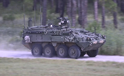




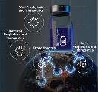

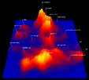


Developing Capabilities to Fight and Win on the CBRN Battlefield
Equip forces to operate effectively on the nuclear battlefield
Provide technologies, standards, historical data, and testing to ensure forces can survive and fight
Deliver tools that enable effective targeting of U.S. weapons and inform
the consequences of attacks
MERLIN / VIPER
Standoff Radiation Detection
Test bed structure to support full-spectrum testing
Mobile Field Kit-CBRN automates collection, sharing, and display of data
Nuclear Effects
Conventional Effects
Test concepts and plans through rigorous wargaming
Protect the U.S. Joint Force with advanced medical countermeasures and early warning capabilities
Deliver integrated, cloud-ready, AI-enhanced applications and data analysis
M&S to enable planning and
training
Prophylactic and medical countermeasure treatment options unburden and protect the U.S. Joint Force
24/7 technical analysis of CBRNE questions
Situational Awareness Tools
24/7 Access to DTRA M&S tools & experts to interpret results
Rapid Analysis of Threat Exposure technology allows data from wearable devices to warn of COVID-19 infections prior to the onset of symptoms

Slide 11
Nuclear Data Topics Summary
New 5-yr nuclear data project focused on:
Development of DoD experimental capabilities through measurements of high-priority reactions and materials
Development of unique DoD neutron sources
Project objectives
Cross section measurements of neutron inelastic scattering on atmospheric constituents
  → Collaboration with ARL, APEX facility
Neutron-induced gamma-ray yields on constituents used in metal additive manufacturing
  → Collaboration with ARL, APEX facility
Improvements of high-rep rate laser-based neutron sources
  → AFIT led, collaboration with AFOSR effort
Improvements of pulsed-power based neutron sources
  → Collaboration with NRL, GAMBLE-II facility
Project: Nuclear Data Topics
Air Force Institute of Technology
Army Research Laboratory (ARL)
Naval Research Laboratory (NRL)
University Labs (Ohio U & Notre Dame)
PI: Dr. John McClory (AFIT)
POC (1&2): Dr. Michael Febbraro (AFIT)
POC (3): Dr. Michael Dexter (AFIT)
POC (4): LtCol Jesse Foster (AFIT)
Sponsor – DTRA

Slide 12
DTRA Research and Development Summary
DTRA Research and Development Provides:
Science, technology, and capability development investments that maintain the United States military technological superiority to:
  Deter strategic attack against the United States and its allies
  Prevent, reduce, and counter weapons of mass destruction and emerging threats
  Prevail against adversaries in crisis and conflict
An integrated and coordinated portfolio that leverages the Department of Defense, Interagency, and international partners providing support to our United States Joint Forces.
Comprehensive research and development investment to increase agility, respond to new or changing Combatant Command requirements, as well as national, and Department of Defense countering weapons of mass destruction priorities

