Slide 1
WANDA-24 Fusion Energy Science
February 2025
Michael Loughlin
Oak Ridge National Laboratory

Slide 2
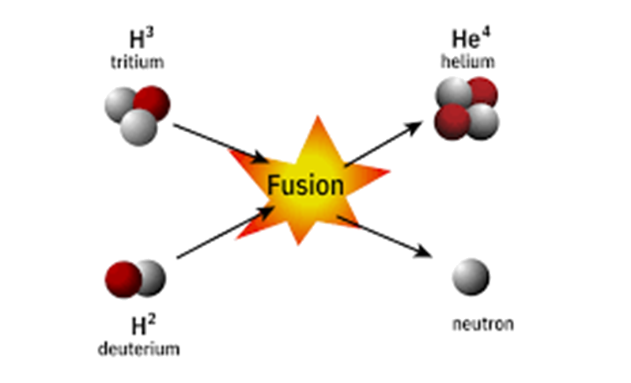
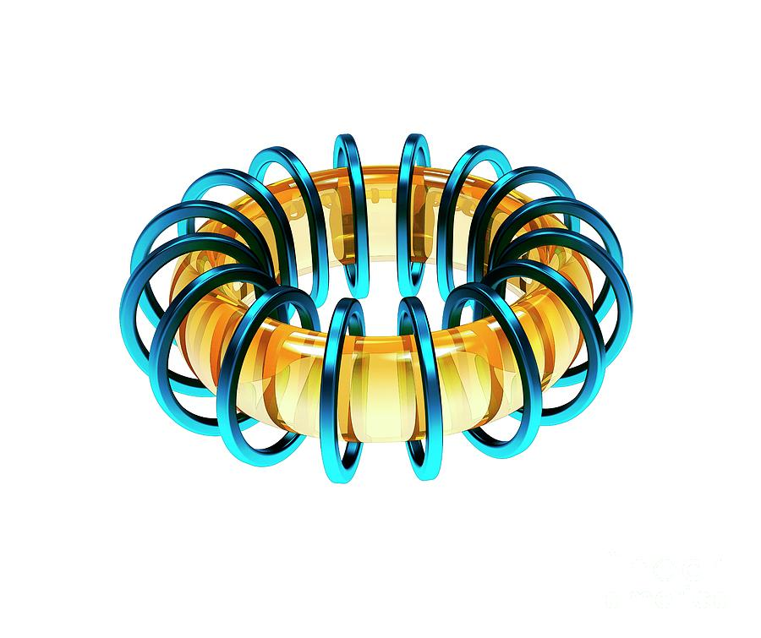
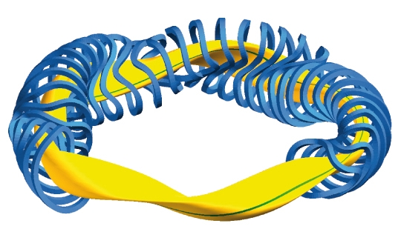
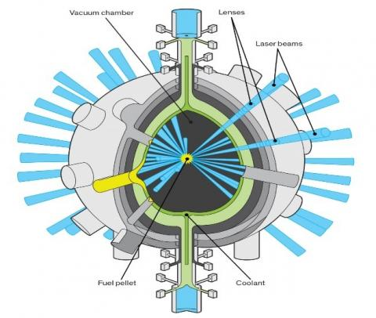
Nuclear Fusion
$$D+T → α+n(14.1MeV)$$
Magnetic confinement
Inertial confinement
Neutron production: 3.5×10²⁰ neutrons/sec/Gigawatt of fusion power.
Tritium breeding is essential for the fusion economy. Tritium breeding ratio > 1.05.
Notes:
All will generate neutrons and therefore activated materials and waste.
Tritium breeding is an essential part of the fusion economy.

Slide 3
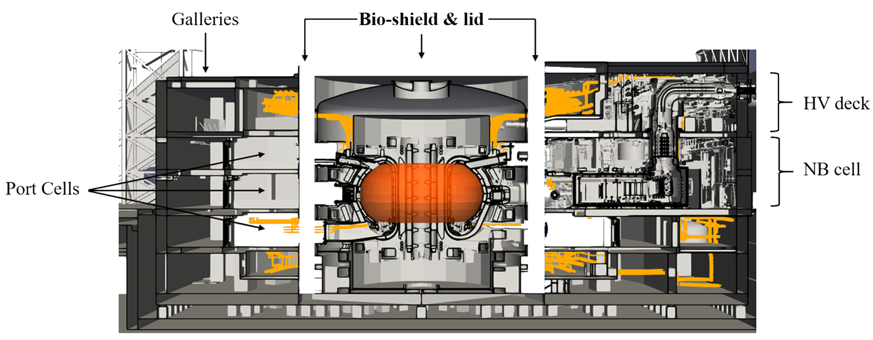
Radiation Responses for Fusion (Tokamak example)
Notes:
Shielding
Tritium breeding
Shutdown dose rate
Activation
Nuclear Heating
Damage
Transmutation

Slide 4
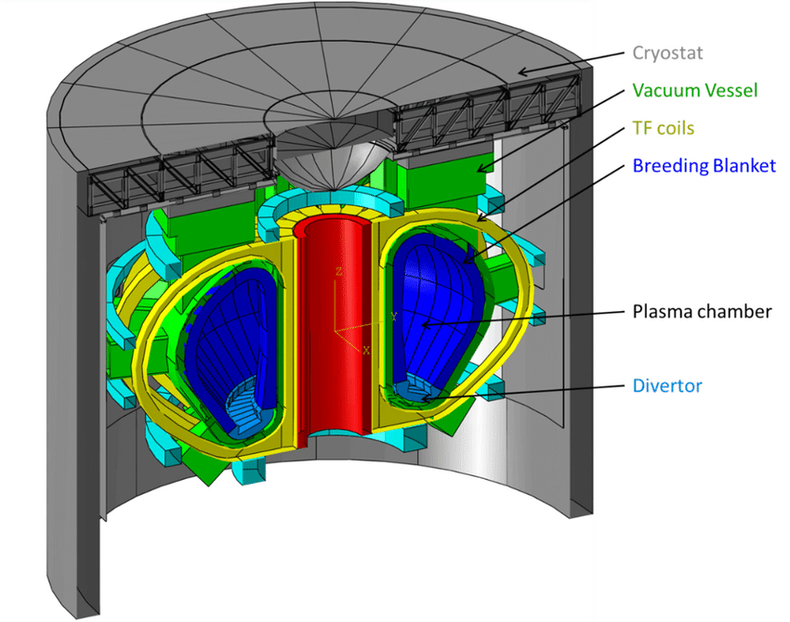
Tokamak materials
Plasma facing material: tungsten, boron
Blanket
Tritium breeding
Energy conversion
Shielding
Divertor
Tungsten
Vacuum vessel
Steel
Coils
Niobium-Tin
REBCO
Cryostat and Thermal Shield
Steel
Silver

Slide 5
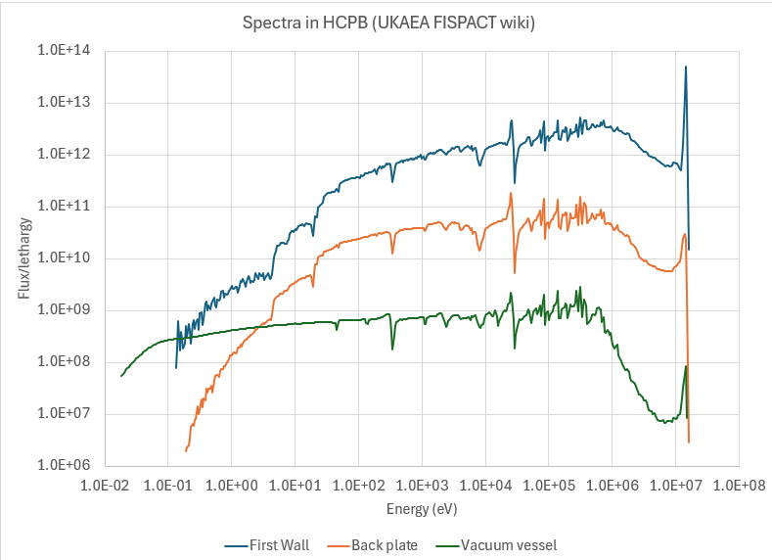
Neutron Spectra

Slide 6
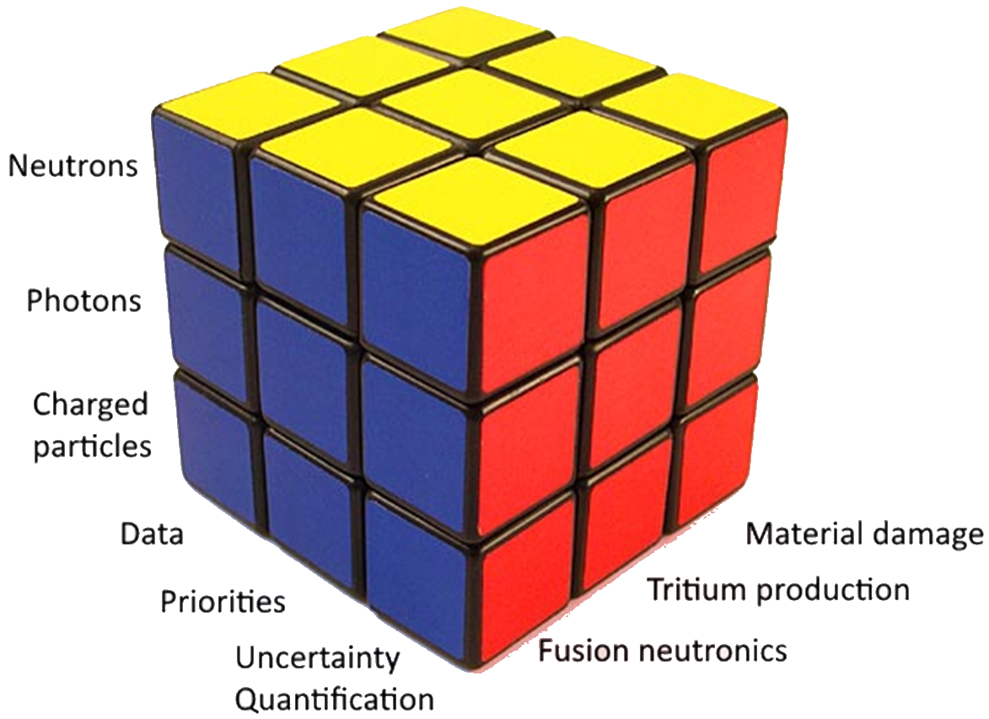
WANDA -24

Slide 7
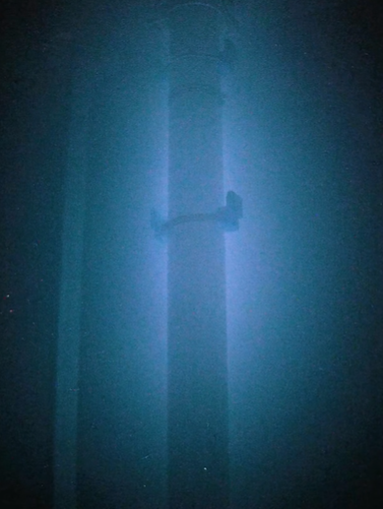
Fusion Neutronics
8 recommendations:
Sensitivity studies
Evaluations to prioritize specific nuclides
Benchmark experiments
Provide summary of existing fusion relevant integral experiments
High fluence source
Work force development
Fission/fusion information exchange
A repository of the facilities available for nuclear data measurements/experiments should be created.
SHINE Technologies has demonstrated clearly visible Cherenkov radiation

Slide 8
Tritium Production
5 recommendations
Narrow down the specific nuclear data inventory for breeder, multiplier and structural material
Assess data and predictions for tritium production
Build a path to integral benchmarks
Data exchange between fusion, defense and nuclear data communities
High performance computing including software development
Notes:
1. Can production processes or reactor materials be used to establish a source of tritium for fusion energy applications?
2. Which nuclear data are necessary to support testing and operation of breeder blankets?
3. Is the accuracy of nuclear data sufficient to predict activation of breeder blankets?
4. What are the uncertainties and sensitivities to the tritium breeding ratio?
5. Can nuclear cross sections be used to accurately predict transmutation of materials in blankets?

Slide 9
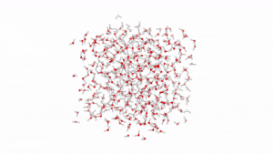
Material Damage
7 recommendations
Bridge transport and molecular dynamics
Improve recoil distributions
Recoil distribution sanity checks
Scoping studies to prioritize material damage data
Uncertainty Quantification
Switch to arc-dpa metric
Improve means to report issues to evaluators
Kmckiern, CC BY-SA 4.0 <https://creativecommons.org/licenses/by-sa/4.0>, via Wikimedia Commons

Slide 10
Summary
Discussion
Code development & Modeling
FPP
ID important nuclides
Data Evaluation and UQ
Evaluate experimental facilities
Benchmarks
Fusion Neutron Source

Slide 11
Further slides

Slide 12
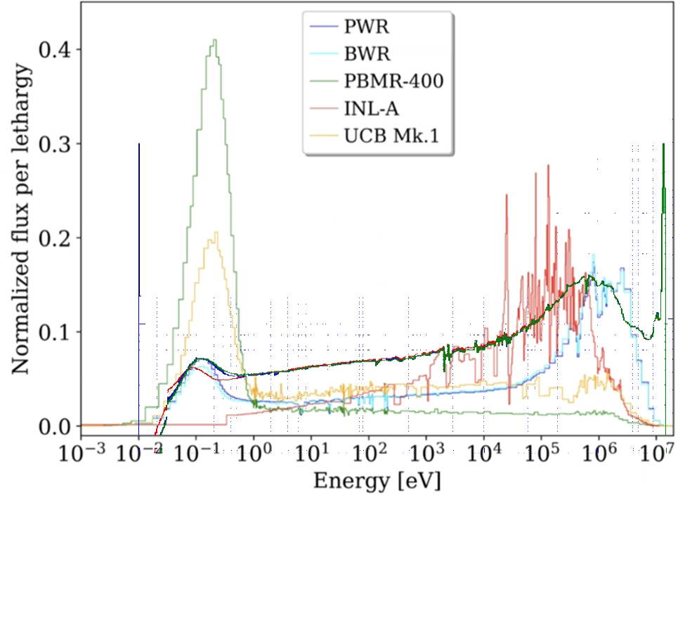
Fusion and Fission

