Slide 1
MDP 2024 Roadmapping process
Soren Prestemon
US Magnet Development Program
Lawrence Berkeley National Laboratory

Slide 2
Schedule for updating our roadmaps

Slide 3
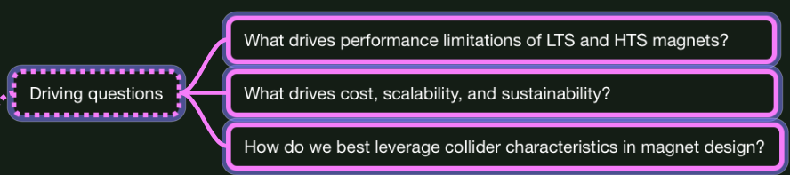
Framing our process with driving questions
These should be of a general nature
  Guide us in developing a program roadmap for broad value
  Pushing limits and innovating should be hallmarks of the program
  Supports accelerator designs:
    Provide guidance on what is possible – but we do not “build to spec”
    Clarify design aspects that drive cost, guide what is possible
Our program should note distinctions between Hadron and Muon colliders

Slide 4
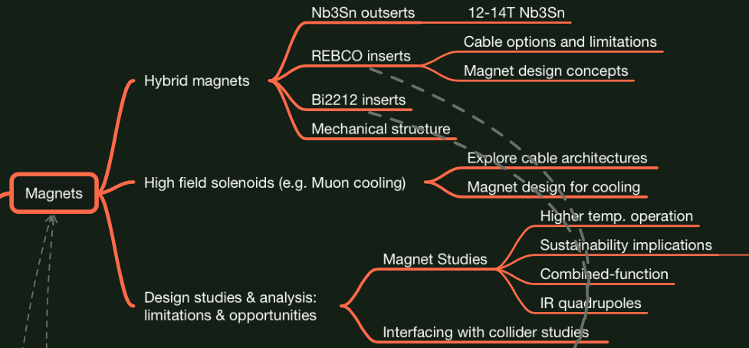
The roadmap updates should enhance our efforts in HTS
Build on the HTS developments to-date => get cables & magnets in high-field
  Leverage and grow connections with NHMFL:
    Get “HEP” cables into background field – fast feedback on performance
    Join forces to advance solenoid technology for HEP
  Test HTS accelerator coils in hybrid magnet configuration
Explore the potential of HTS
  Opportunities/issues with higher T
  Sustainability implications

Slide 5
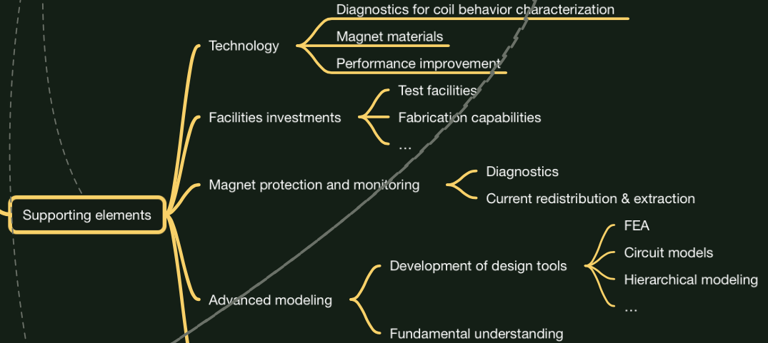
The magnet efforts build on a foundation of supporting elements – we need to tighten the linkage
These elements apply to all magnets
  This arena is ripe with opportunities to engage with Universities and students
  Is the list exhaustive?
  Modifications/additions and further ideas are welcome!

Slide 6
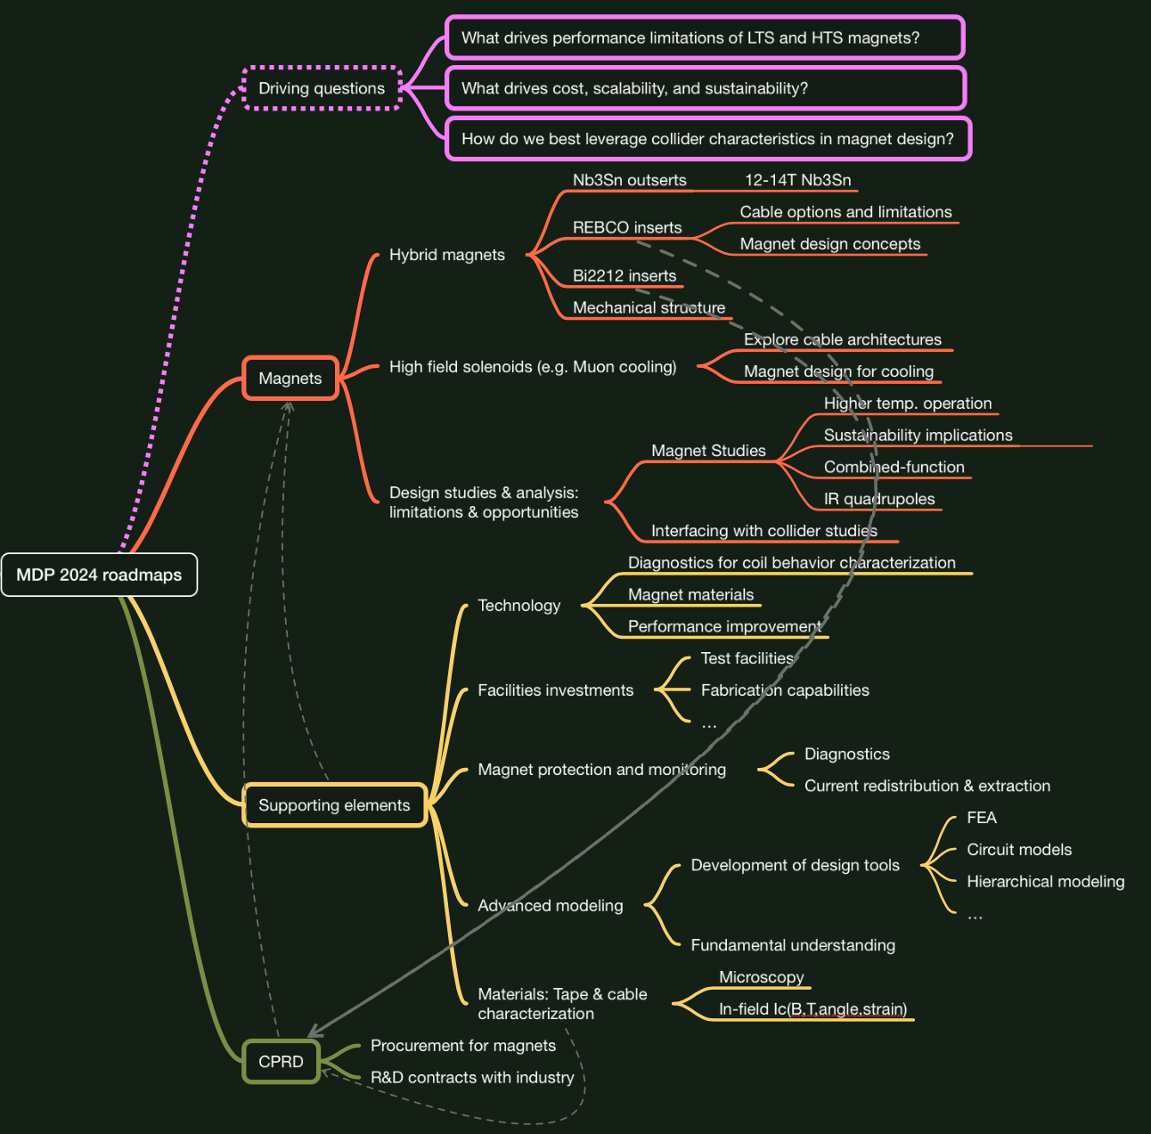
Perspective
This is a “July 17 snapshot”
  Further feedback welcomed!
  Via email or google form
Next steps (next ~2 weeks):
  Incorporate further feedback
  Develop “Areas” structure to align
Then through August:
  Develop timelines, milestones

Slide 7
Areas where we can improve our collaboration
Improve transparency:
  What research elements/activities are being supported at each lab and to what level
  Clarify who is involved and the expectations for collaborators
  Clarify criteria and process for reviews
Improve our documentation of lessons-learned
  What has worked and what has not
  Connect lessons-learned to update/adjust roadmap milestones
Tighten the connection between “supporting elements” and magnets:
  Diagnostics, modeling capabilities, magnet materials, etc.

Slide 8
Background

Slide 9
Our structure was revised with the 2020 Updated Roadmaps
  Current Strategic Priorities:
  Probing stress management structures
  Hybrid HTS/LTS designs
  Understanding and impacting the disturbance-spectrum
  Advancing both LTS and HTS conductors, optimized for HEP applications

Slide 10
P5 identified 10 pTeV colliders for the energy frontier
Colliders
Higgs factories
10 pTeV energy frontier
SC Magnets for IRs, misc.
Not a driver for magnet R&D
Muon collider
Hadron collider
These opportunities serve as drivers for magnet R&D

Slide 11
Identifying focal points, priorities, and synergies
We remain a GARD program, i.e. our focus is on “generic magnet R&D”
Cost
Performance
Sustainability

Slide 12
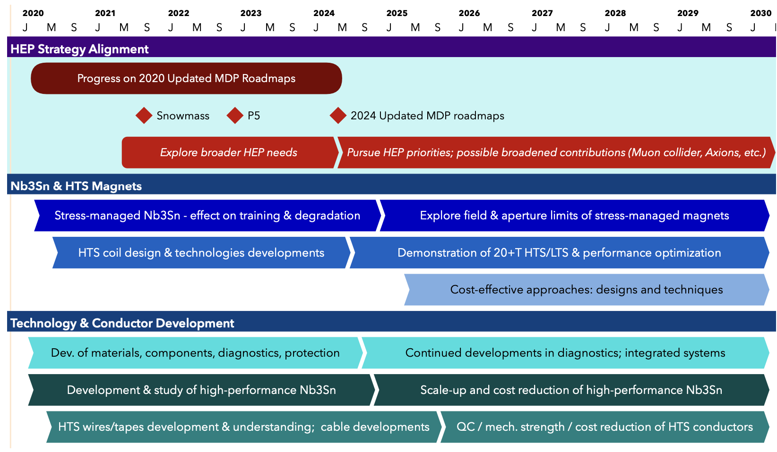
US MDP 2020 roadmaps – long range – time for an update!
Continue alignment with physics community needs
Focus on “stress-management” as well as hybrid HTS/LTS magnet technology
Continue to invest in the “science of magnets” and in improved conductors

Slide 13
Driving considerations in magnet R&D focus
The Muon collider is the only collider with “on-shore” potential
Both Muon and hadron colliders absolutely depend on magnet developments
The Muon collider requires some use of HTS
Both machines will be challenged by construction and operational costs
As part of this initiative, we recommend targeted collider R&D to establish the feasibility of a 10 TeV pCM muon collider. A key milestone on this path is to design a muon collider demonstrator facility.
Support vigorous R&D toward a cost-effective 10 TeV pCM collider based on proton, muon, or possible wakefield technologies, including an evaluation of options for US siting of such a machine, with a goal of being ready to build major test facilities and demonstrator facilities within the next 10 years
Although we do not know if a muon collider is ultimately feasible, the road toward it leads from current Fermilab strengths and capabilities to a series of proton beam improve- ments and neutrino beam facilities, each producing world-class science while performing critical R&D towards a muon collider. At the end of the path is an unparalleled global facility on US soil. This is our Muon Shot.

Slide 14
The P5 recognized commonality in 10pTeV collider R&D
Parallel to the R&D for a Higgs factory, the US R&D effort should develop a 10 TeV pCM collider, such as a muon collider, a proton collider, or possibly an electron-positron collider based on wakefield technology. The US should participate in the International Muon Collider Collaboration (IMCC) and take a leading role in defining a reference design.
We note that there are many synergies between muon and proton colliders, especially in the area of development of high-field magnets. R&D efforts in the next 5-year timescale will define the scope of test facilities for later in the decade, paving the way for initiating demonstrator facilities within a 10-year timescale (Recommendation 6).
Hadron collider magnet R&D
Muon collider magnet R&D
High field dipoles
Sustainability

Slide 15
Sustainability is a major concern for future colliders
Accelerator technologies play a key role in sustainability. Investments in high field magnets by the DOE Magnet Development Program and NSF’s MagLab have advanced the state of the art in conductors and magnet design to the benefit of particle physics, but also materials science, fusion energy research (FES), and commercial development. In this context, high temperature superconducting materials, operated at temperatures higher than superfluid or liquid helium, can play a key role in reducing energy consumption e.g. for future colliders including muons or FCC-hh.
This roadmap relies on the design and construction of accelerators and detectors at the forefront of particle physics. The technology choices for achieving the Higgs factory and 10 TeV pCM collider goals need to be determined based on technical feasibility, cost-effectiveness, host site capacity, sustainability, and synergies with the demands of other science topics.
Other new technologies such as muon and possibly wakefield colliders have potential to improve power required for a given luminosity and reduce the size and impact of future facilities. Innovation in electric power generation, management and distribution also contribute to sustainable development and shall be encouraged.

Slide 16
Cost is a driving, and likely decisive, factor in a future collider
The panel recommends dedicated R&D to explore a suite of promising future projects. One of the most ambitious is a future collider concept: a 10 TeV parton center-of-mo- mentum (pCM) collider to search for direct evidence and quantum imprints of new physics at unprecedented energies. Turning this concept into a cost-effective, realistic collider design demands that we aggressively develop multiple innovative accelerator and detector technologies. This process will establish whether a proton, electron, or muon accelerator is the optimal path to our goal.
We do not yet have a technology capable of building a 10 TeV pCM energy machine, but the case for one is clear. Extensive R&D is required to develop cost-effective options. Possibilities include proton beams with high-field magnets, muon beams that require rapid capture and acceleration of muons within their short lifetime, and conceivably electron and positron beams with wakefield acceleration.
The technology choices for achieving the Higgs factory and 10 TeV pCM collider goals need to be determined based on technical feasibility, cost-effectiveness, host site capacity, sustainability, and synergies with the demands of other science topics.

Slide 17
Recap of our MDP vision and goals
Maintain and strengthen US Leadership in high-field accelerator magnet technology for future colliders
Focus on the four primary goals identified in the the original MDP Plan
  Explore the performance limits of Nb₃Sn accelerator magnets, with a focus on minimizing the required operating margin and significantly reducing or eliminating training
  Develop and demonstrate an HTS accelerator magnet with a self-field of 5T or greater, compatible with operation in a hybrid HTS/LTS magnet for fields beyond 16T
  Investigate fundamental aspects of magnet design and technology that can lead to substantial performance improvements and magnet cost reduction
  Pursue Nb₃Sn and HTS conductor R&D with clear targets to increase performance and reduce the cost of accelerator magnets
Further develop and integrate the teams across the partner laboratories and Universities for maximum value and effectiveness to the program
Identify and nurture cross-cutting / synergistic activities with other programs to more rapidly advance progress towards our goals

