Slide 1
Updates on 20 T working group activities
P. Ferracin
MDP General Meeting
July 17th, 2024

Slide 2
Outline
Introduction of 20 T working group
Key results presented at the Collaboration Meeting and recent work/analysis
  20 T design study
  Hybrid magnets development

Slide 3
Acknowledgement (20 T working group)
Members US MDP 20 T working group
  LBNL: D. Arbelaez, L. Brouwer, M. D’Addazio, L. Garcia Fajardo, J.L. Rudeiros Fernandez, M. Juchno, S. Prestemon, T. Shen, R. Teyber, G. Vallone, X. Wang
  FNAL: G. Ambrosio, M. Baldini, E. Barzi, S. Gourlay, V. Kashikhin, V. Marinozzi, I. Novitski, G. Velev, A. Zlobin
  NHMFL: L. Cooley, D. Larbalestier
  BNL: K. Amm, M. Anerella, J. Cozzolino, R. Gupta, F. Kurian, B. Yahia
European Contributors
  Emmanuele Ravaioli (CERN)
  Douglas Martins Araujo (PSI)
  Etienne Rochepault (CEA)

Slide 4
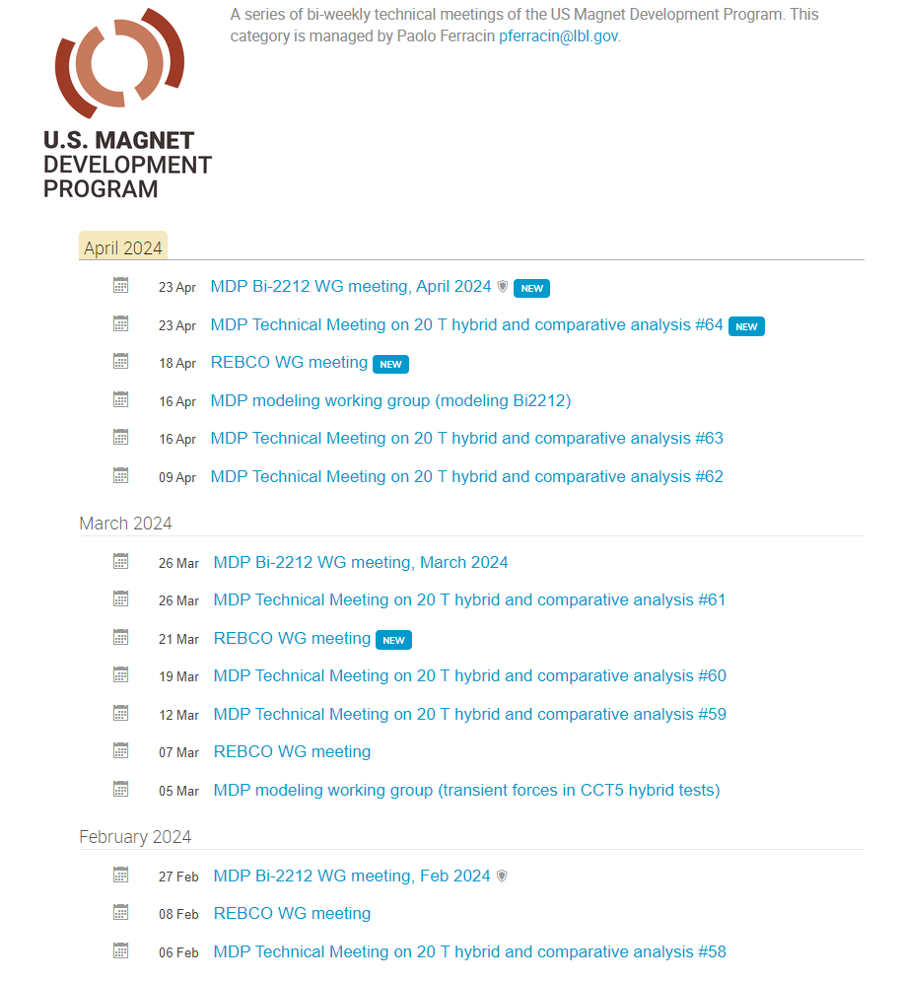
Introduction
Bi-weekly meetings (but recently weekly…)
66 meetings so far
  https://conferences.lbl.gov/category/100/

Slide 5
Introduction
Goals of working group
Conceptual design of a 20 T hybrid HTS-LTS magnet
  Comparative analysis of different design options for a 20 T hybrid
    Cosϑ design and its stress-management options
    Block-type coil design (block with flared ends)
    Common-coil design (block with racetrack coils)
Review and follow-up of current work on hybrid magnets
  Collect and organize information to provide inputs for 20 T hybrid design and feed-backs to hybrid program

Slide 6
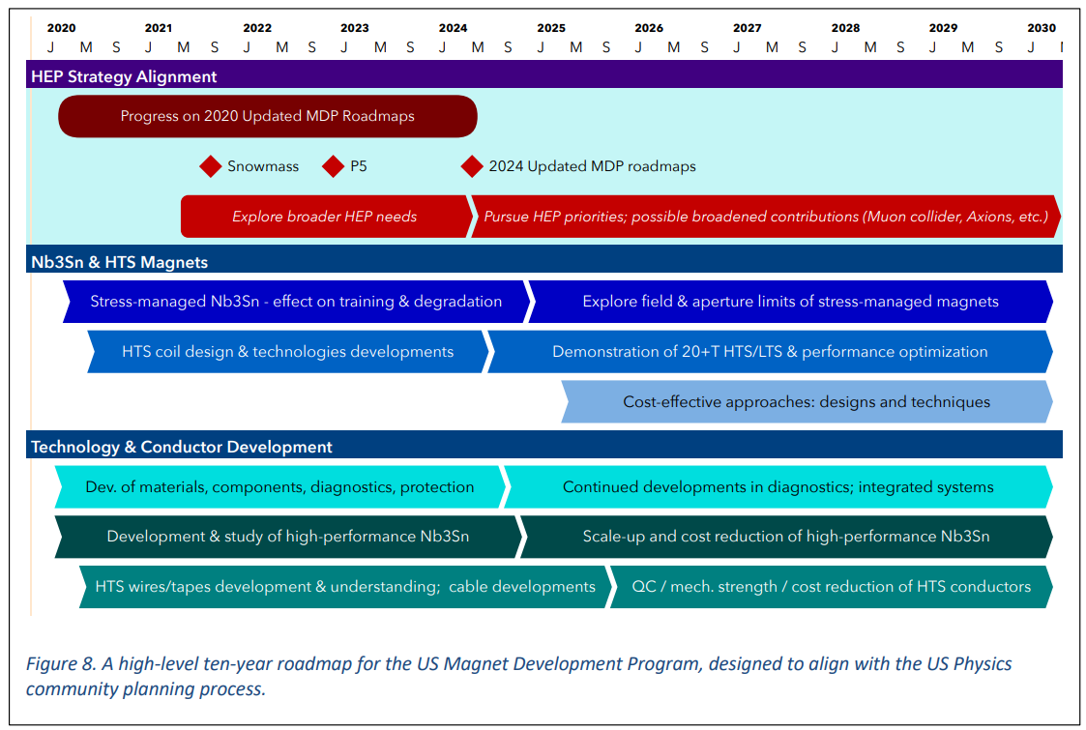
US Magnet development program roadmap
Road-map updated in 2020
  and to be updated again in by the end 2024
https://arxiv.org/abs/2011.09539

Slide 7
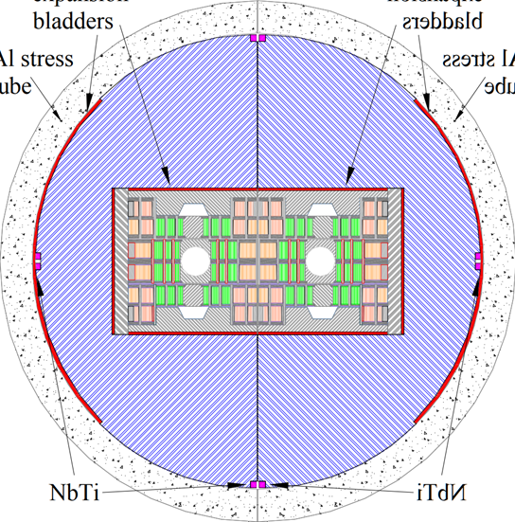
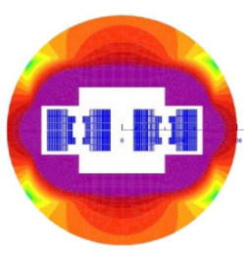
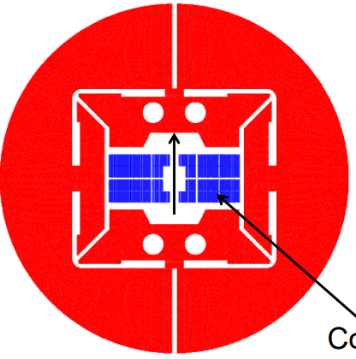
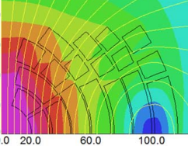
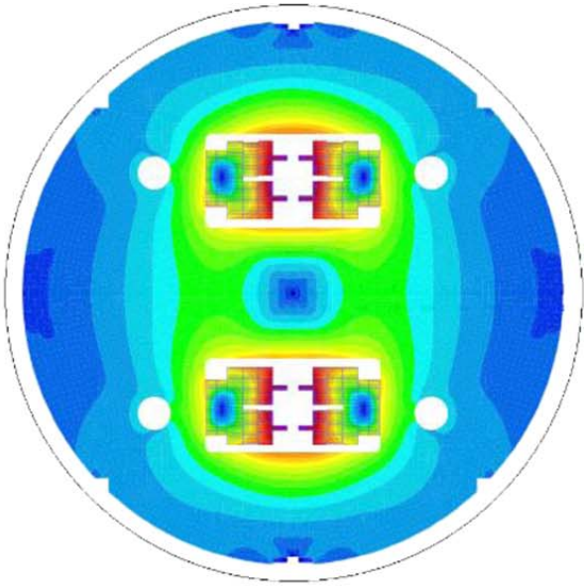
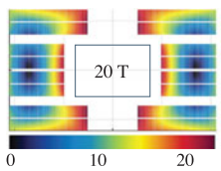
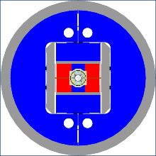
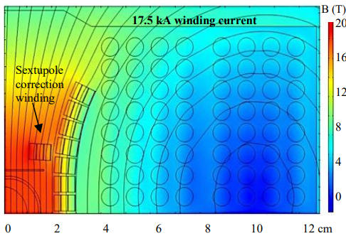
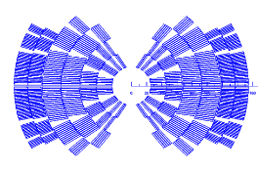
Motivations of a 20 T hybrid design
Previous work
2005, P. McIntyre, et al., 24 T hybrid for LHC tripler (TAMU)
2011, 2014, E. Todesco, et al., 20 T hybrid for LHC upgrade (CERN)
2015, G. Sabbi, et al., 20 T hybrid for SPPC China and FCC (LBNL)
2015, R. Gupta, et al., 20 T hybrid for LHC upgrade (BNL)
2016, Q. Xu, et al., 20 T hybrid for SPPC China (IHEP)
2018, J. van Nugteren, et al., 20+ T HTS for LHC upgrade or FCC (CERN)
2020, D. Martins Araujo , et al., towards 20 T FRESCA2+Feather (CERN)
2021, J.S. Rogers, et al., 18 T hybrid (TAMU)
2022, P. Ferracin, et al., 20 T hybrid demonstrator (US MDP)

Slide 8

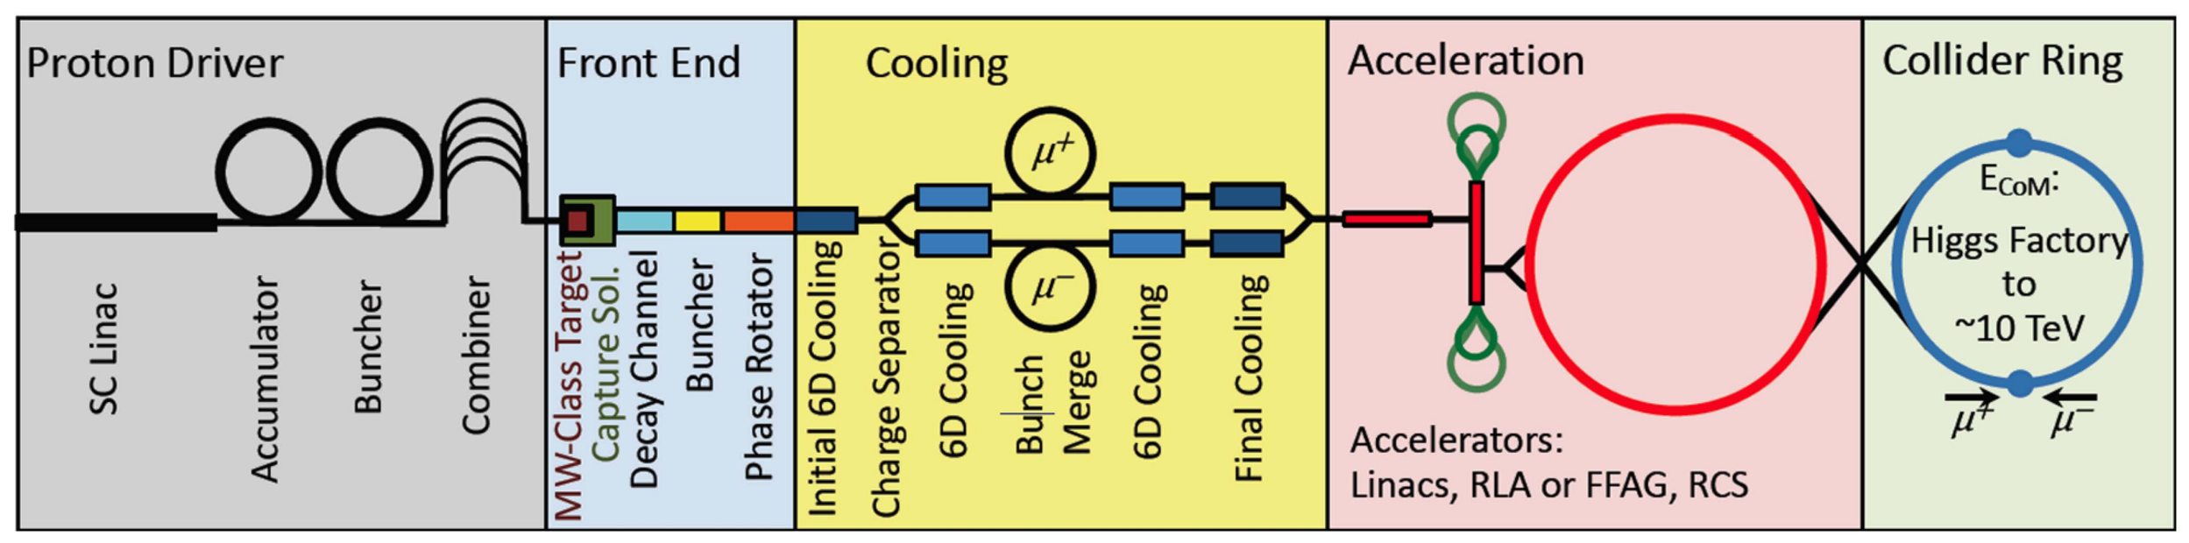
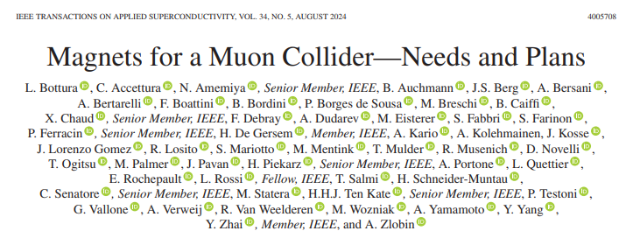
Motivations of a 20 T hybrid design
Relevant to…
  FCC-hh
    “high-field superconducting magnets: 14-20 T”
  Muon colliders
    Collider ring dipole
      Large aperture (100-160 mm), 12-16 T
        Similar to the outsert of a 20 T hybrid
    IR quadrupole magnets
      “…with a peak field of 20 T, also associated with, large apertures, up to 300 mm”

Slide 9
Motivations
Summary
Hybrid magnets development
  HTS/LTS hybrids are a very effective tool to perform R&D on a broad spectrum magnets similar to those considered for FCC-hh or Muon Colliders
  So far, it is also an economically viable option to explore the very high field
    16+ T range
  It forces HTS and LTS teams to work together on integrated designs
20 T design study
  Very effective way of perform studies/analysis on a broad spectrum magnets similar to those considered for FCC-hh or Muon Colliders
  On a side note (but still important)
    It is a very interesting and fun problem for magnet designers
  Excellent case study for students and Postdocs
    It contains almost everything: different SC materials…different cable geometries…magnetics… mechanics…quench detection and protection…..

Slide 10
Outline
Introduction of 20 T working group
Key results presented at the Collaboration Meeting and recent work/analysis
  20 T design study
  Hybrid magnets development

Slide 11
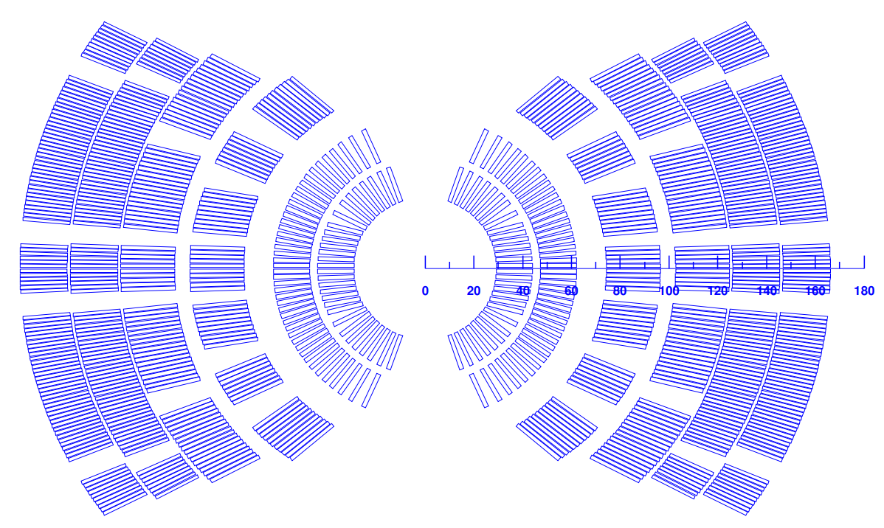
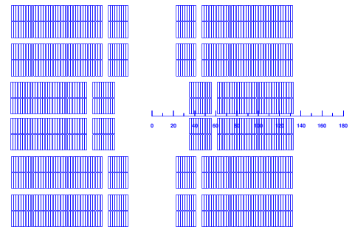
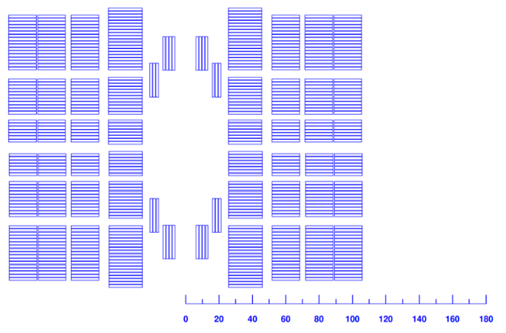
Key results presented at the Collaboration Meeting
Current 20 T reference cross-sections
HTS
LTS
HTS
LTS
LTS
HTS
Three options considered (CT, BL, CC), for now focusing mainly on an HTS coil made with Bi2212 cable
Iterative process on going
  Magnetic analysis → Margin and field quality
  Mechanical analysis → stress in HTS and LTS coils (and the structure)
  Quench protection → Non-SC/SC ratio, strand-cable design, CLIC, dump…..
  …. And back and forth
More focus on CT and CC, less on BL so far

Slide 12
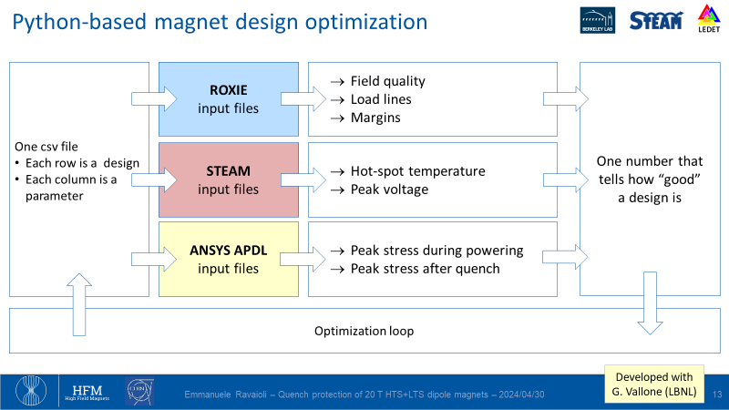
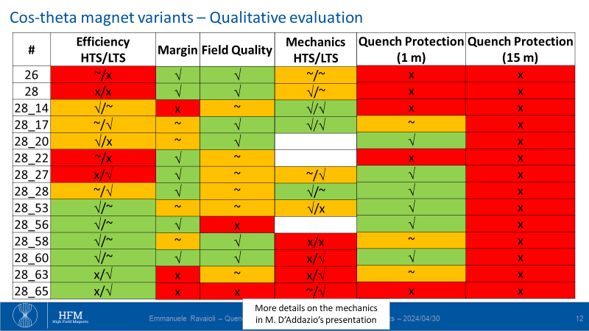
Key results presented at the Collaboration Meeting
Optimization process

Slide 13
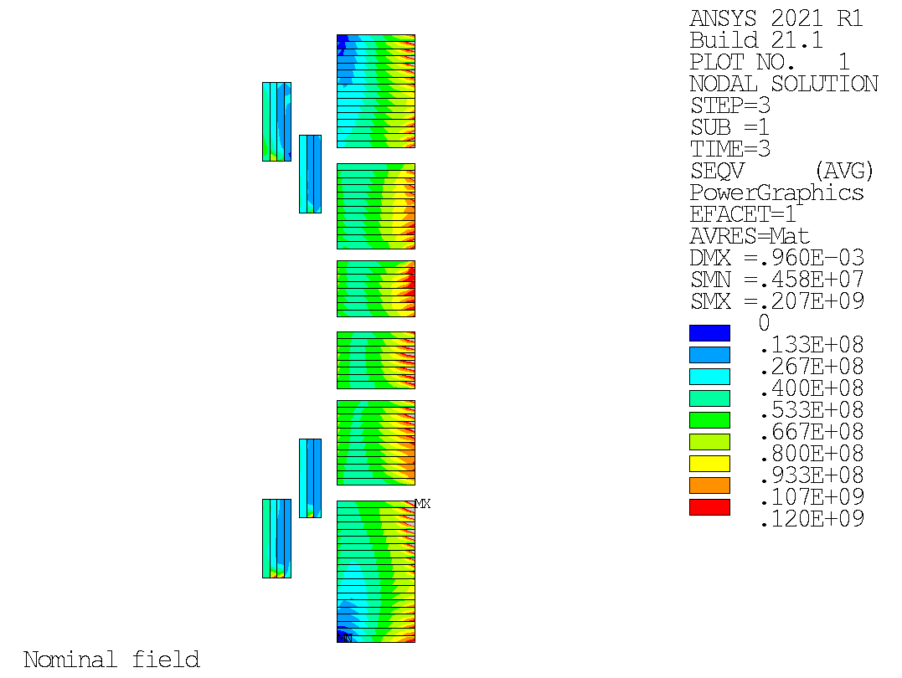
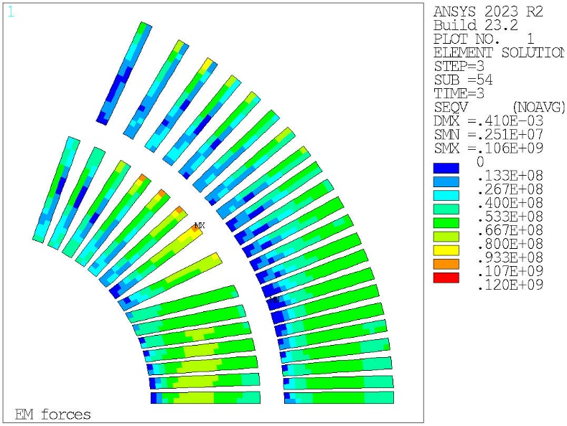
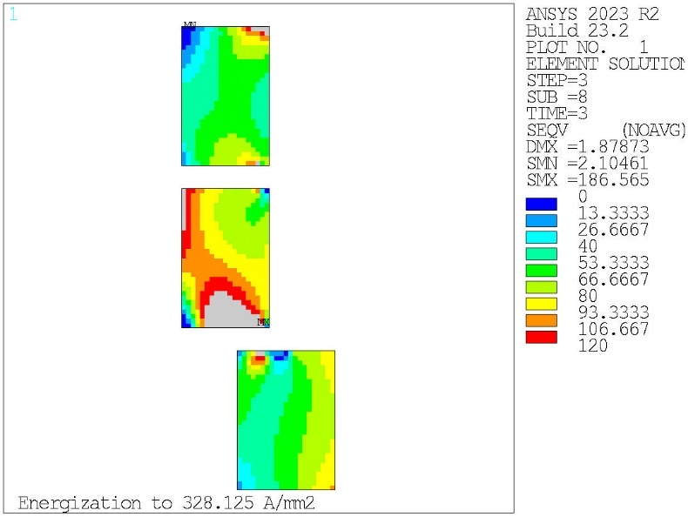
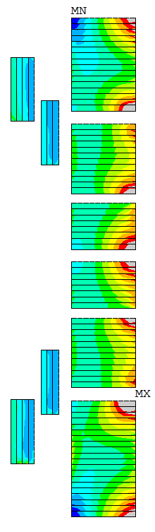
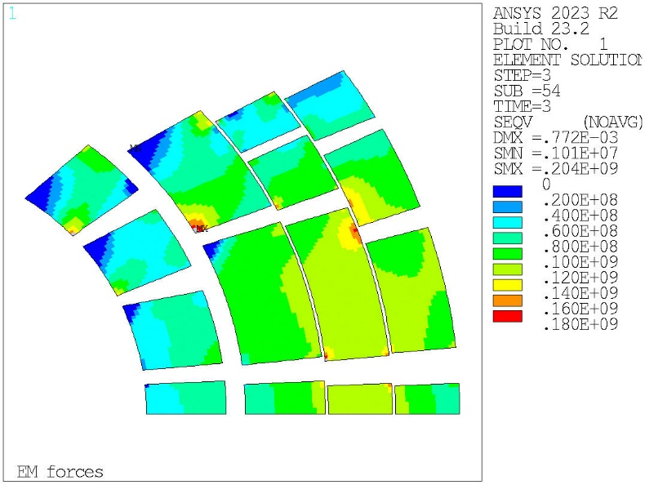
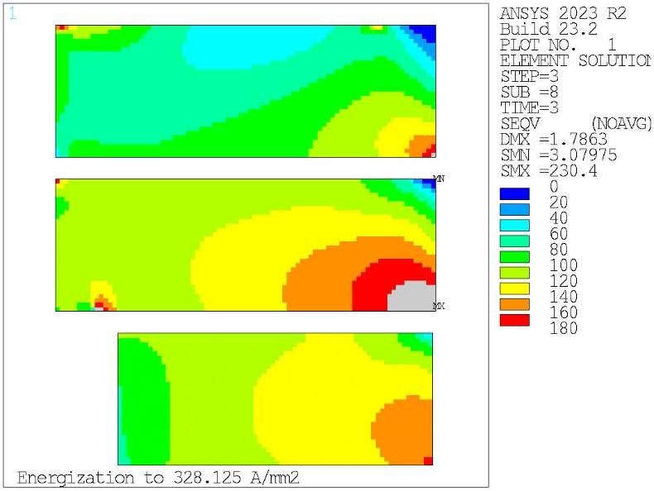
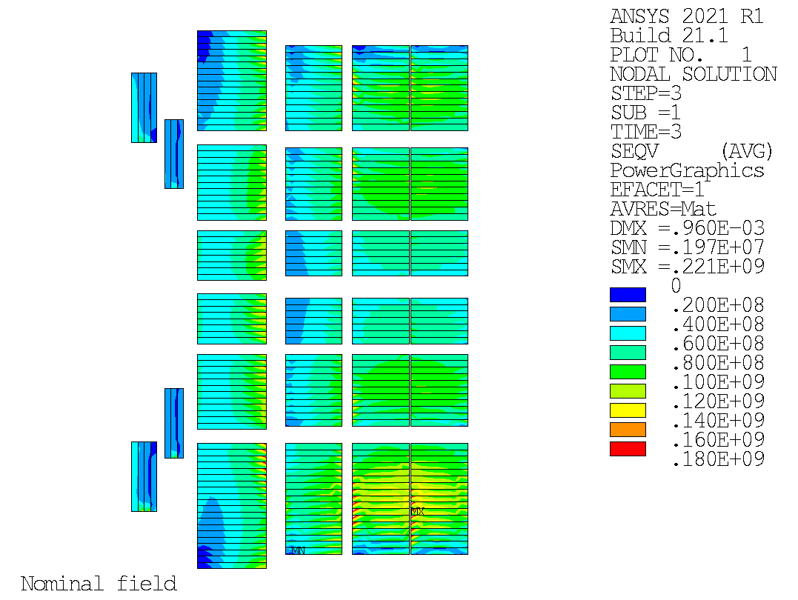
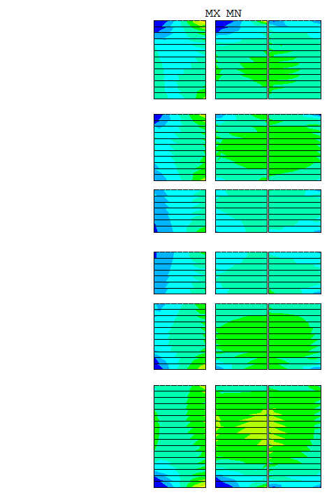
Key results presented at the Collaboration Meeting
20 T Mechanics

Slide 14
Key results presented at the Collaboration Meeting
20 T Quench protection (1 m long magnet)
Block-coil
V1
Common-coil
V5
Cos-theta
V28_137
Hot-spot temperature | Peak voltage to ground | Peak CLIQ current
242 | Not optimized yet | 5670
Hot-spot temperature | Peak voltage to ground | Peak CLIQ current
313 | 501 | 4329
Hot-spot temperature | Peak voltage to ground | Peak CLIQ current
286 | 570 | 3810

Slide 15
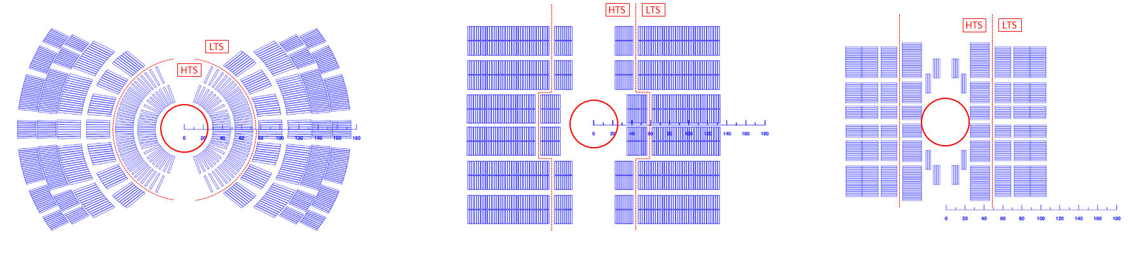
Key results presented at the Collaboration Meeting
20 T Summary
For now, CT and CC most analyzed: for 1 m, they meet the criteria (still some work on the corner peaks)
More work required on BL for fair comparison
Mechanics: stress management required in all directions; still very high stress in the mandrel/ribs
Quench protection seems ok for 1 m magnets in all 3 designs
  For longer new solutions to be considered

Slide 16
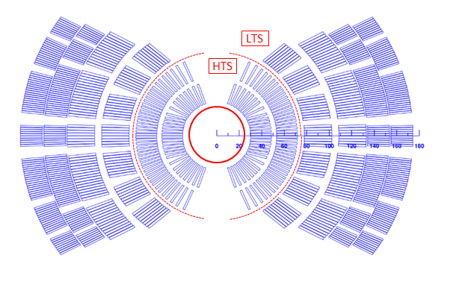
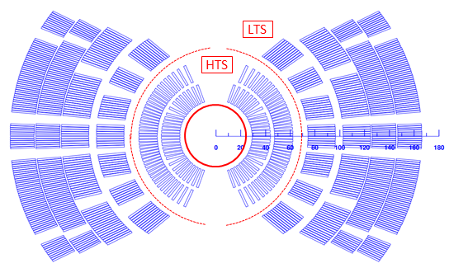
Recent work/analysis
Update of CT design
Fine tune and overall improvement in most of the aspects (margin/efficiency, mechanics, QP)

Slide 17
Recent work/analysis
Hybrid vs stand-alone
We started to look not only at the hybrid conditions but also at the stand-alone ones
Example with the current CT
  When operating at 20 T (87% of I_{ss}), how much field is provided by HTS and LTS?
    6 T given by HTS and 14 T given by LTS
  When operating in stand-alone (87% of I_{ss}), which bore field would the HTS and LTS generate?
    9 T for the HTS and 15 T for the LTS

Slide 18
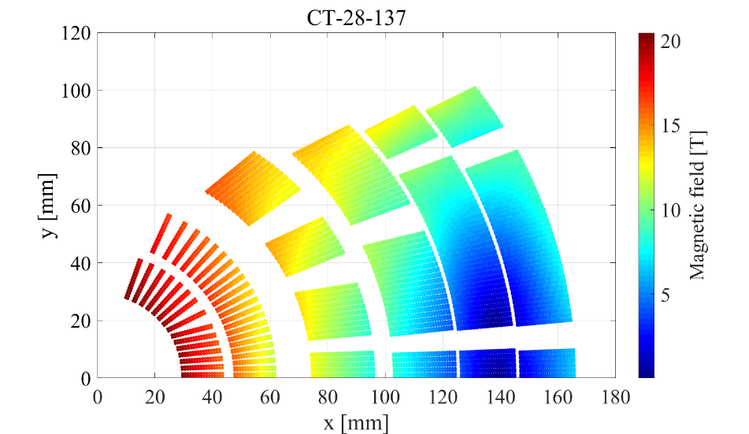
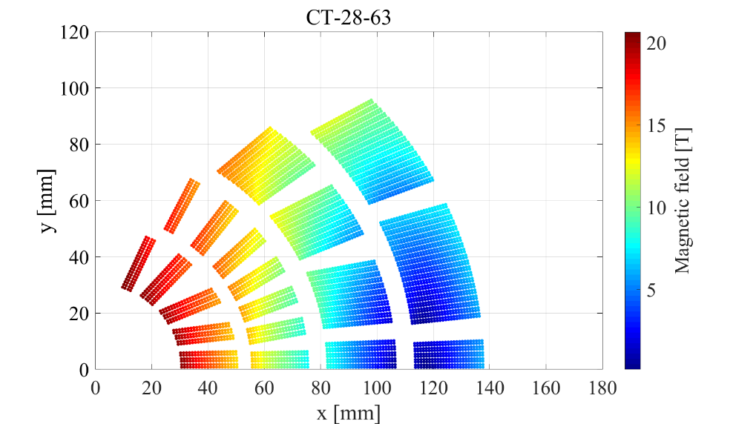
Recent work/analysis
Minimum HTS vs minimum coil size
However, the current CT design is only one of the possible options
When operating at 20 T (87%)
  6 T given by HTS and 14 T given by LTS
In stand-alone (87%)
  9 T for the HTS and 15 T for the LTS
When operating at 20 T (87%)
  9.5 T given by HTS and 11.5 T given by LTS
In stand-alone (87%)
  11 T for the HTS and 13 T for the LTS

Slide 19
Recent work/analysis
Minimum HTS vs minimum coil size
The main difference between the two approaches is that
  In one case we minimize the HTS coil
    Focus on cost (assuming HTS more expensive than LTS)
  In the other case we minimize the overall coils size
    Focus on size (work in progress)

Slide 20
Recent work/analysis
Minimum HTS vs minimum coil size
On paper both approaches are valid and achievable, but one has to make a choice
This is likely the explanation (again, work in progress) of the CT_vs_CC issue
  CC has 50 % more HTS than CT but significant less LTS

Slide 21
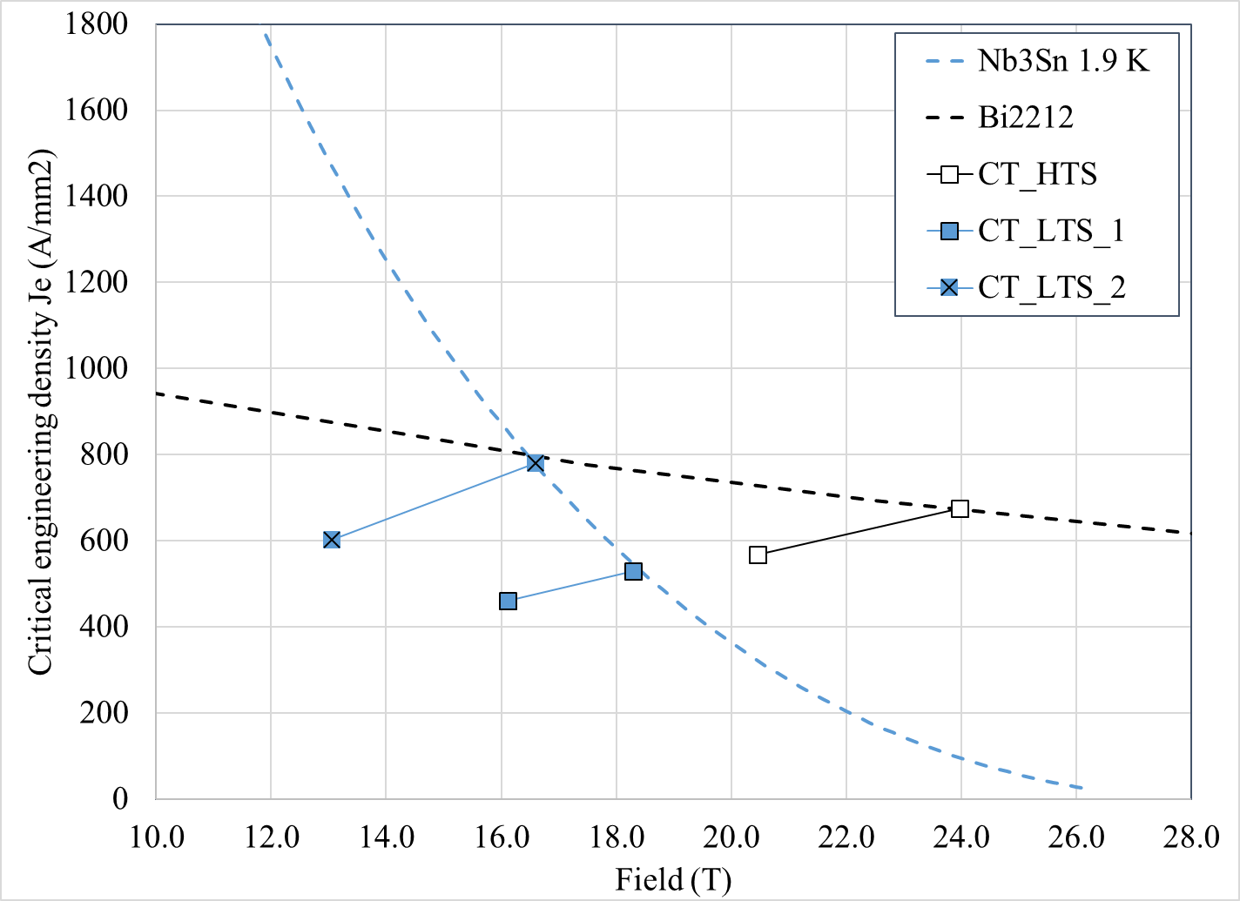
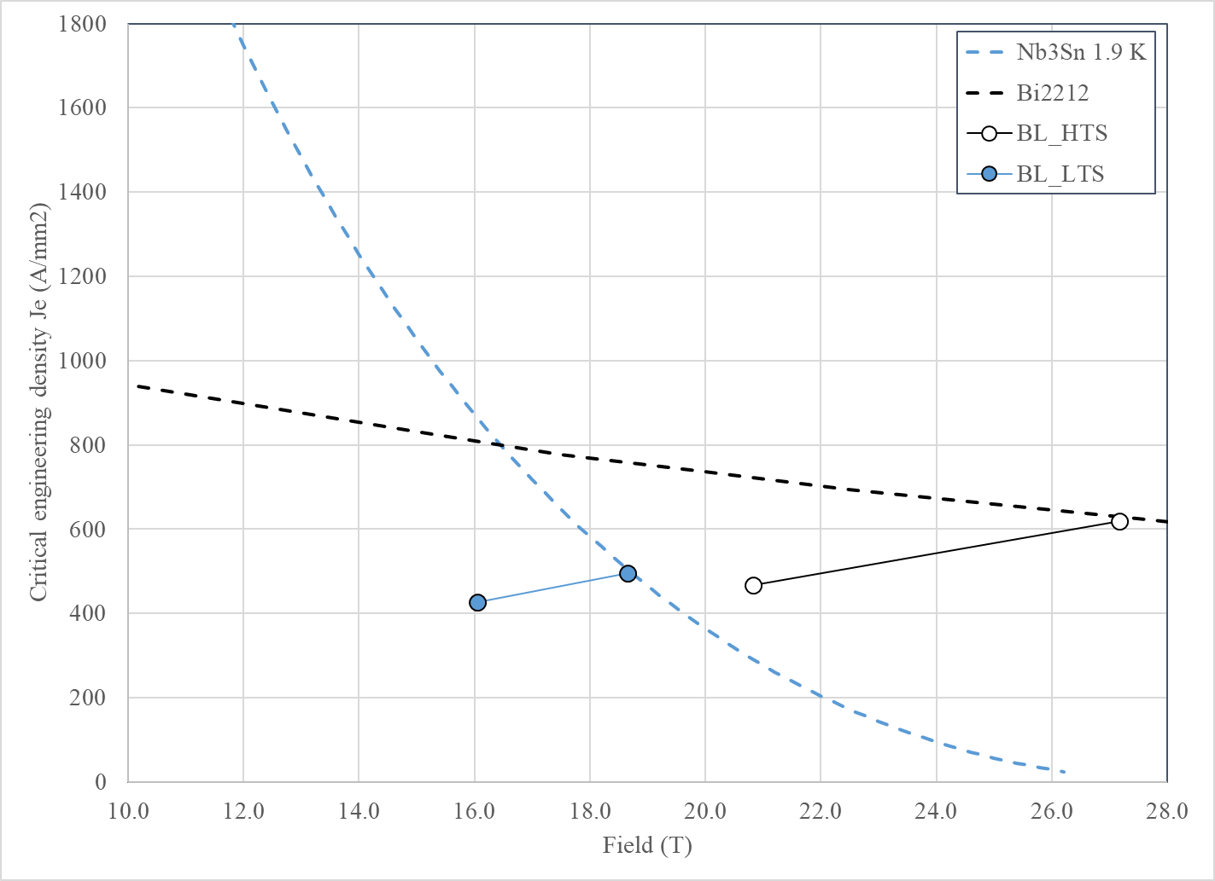
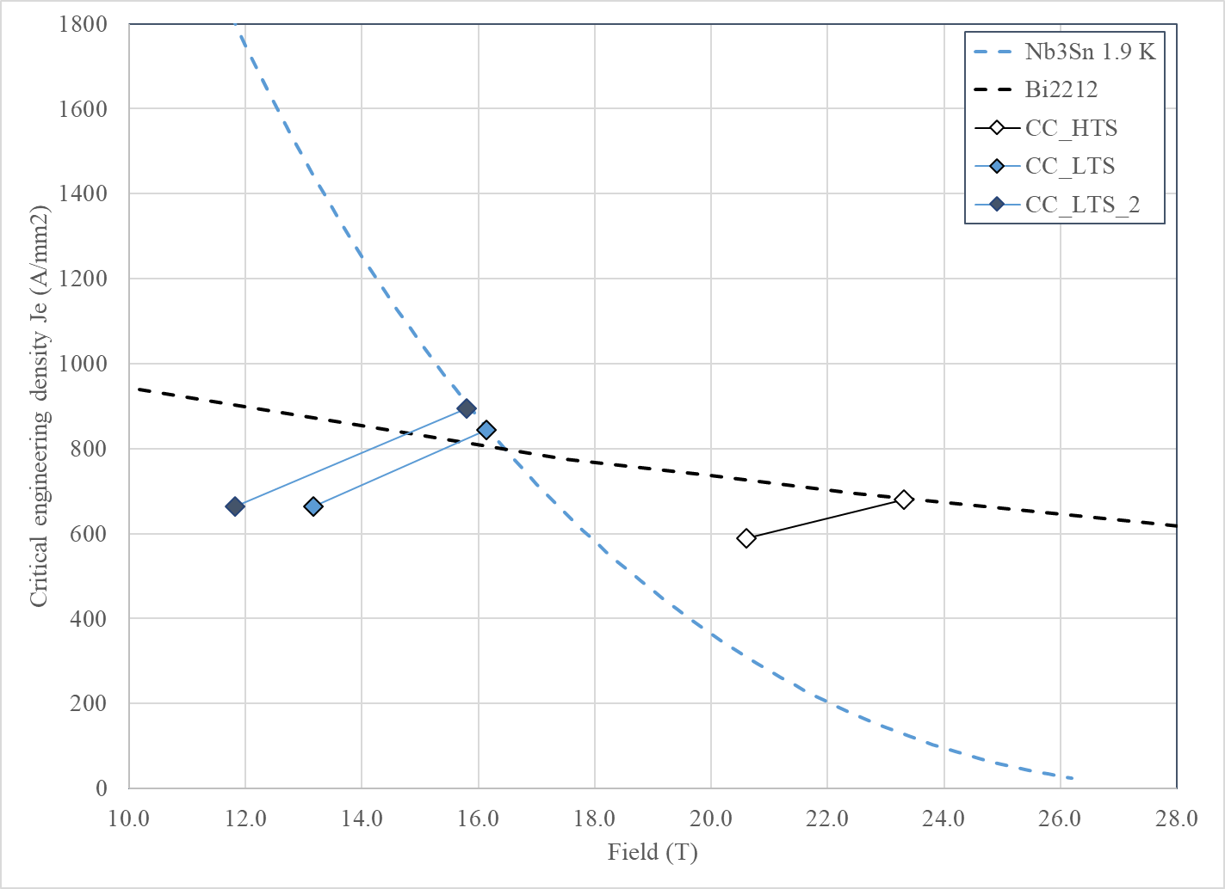
Recent work/analysis
Hybrid vs all HTS
Let’s look at the load-lines: all with a J_{e} below 600 A/mm2 → all HTS?

Slide 22


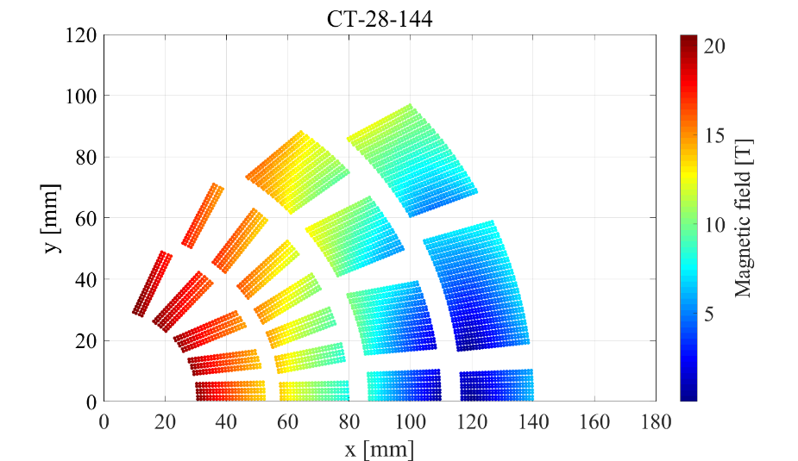
Recent work/analysis
Hybrid vs all HTS
A third option can be considered: all HTS
  Still to be fully analyzed, but ok in term of margin
Hybrid
Minimum HTS
Hybrid
Minimum overall coil
Hybrid
All HTS

Slide 23
Recent work/analysis
Hybrid vs all HTS
All HTS option: we are not yet taking advantage of the area where LTS is better than HTS
  Only marginally with the CC
Are we limited by the old “rule of thumb”?
  “Accelerator magnets operate with a J_{o} not much higher than ~500 A/mm² → J_{e} not much higher than ~750 A/mm²”

Slide 24
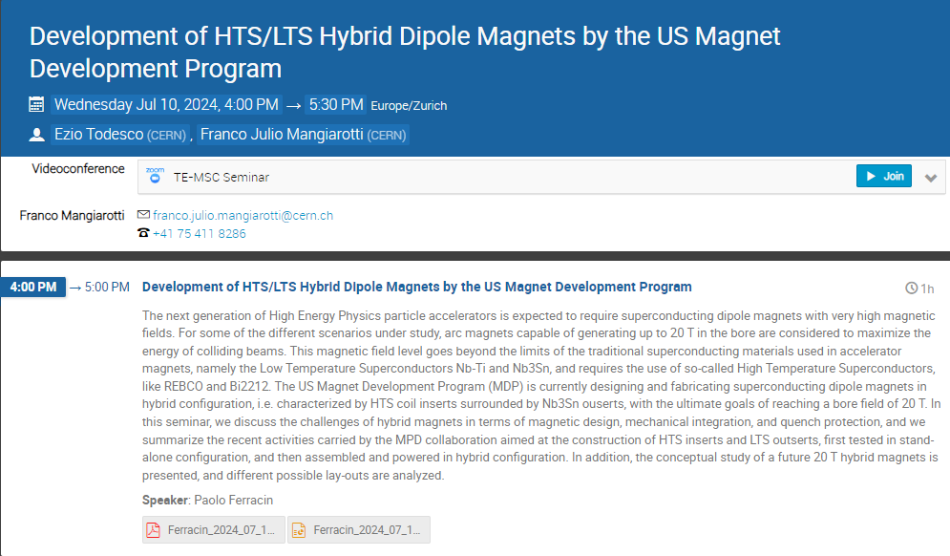
Recent work/analysis
Seminar at CERN (remote)
Among the feedbacks-comments
  The approach has been so far a very traditional one
    CT, BL, CC with Rutherford cables
    Large and expensive coils/magnets
  How about exploring new options (new paradigm)?

Slide 25
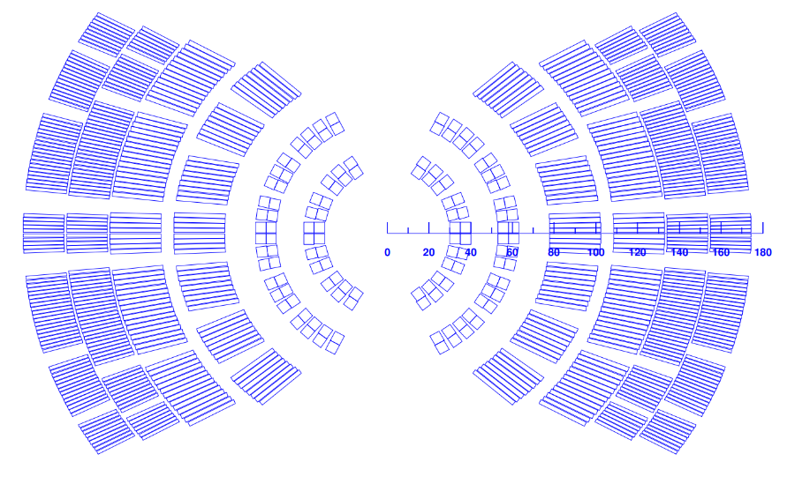
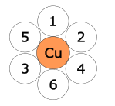

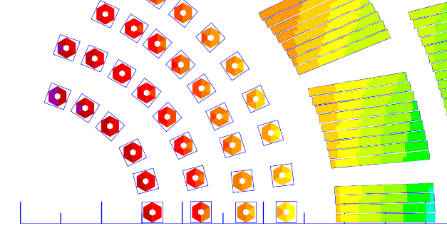
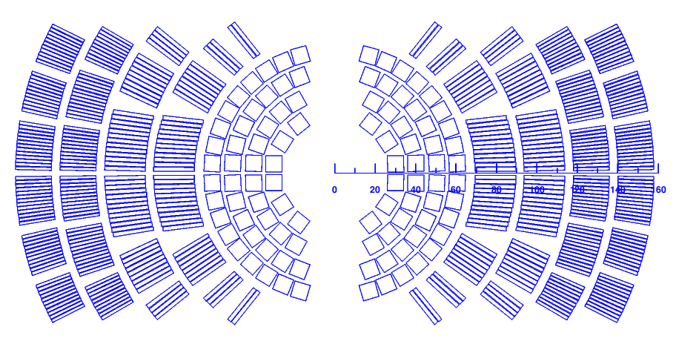
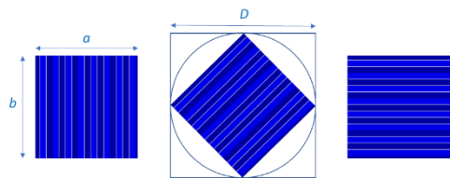
Recent work/analysis
New design study options: REBCO
“Advanced”
  STAR 6-around-1 cable or CORC
    “Familiar” cable but more work needed
“More advanced”?
  Twisted stack
  Aligned stack
    Take advantage of tape anisotropy

Slide 26
Next steps for the 20 T analysis
For the hybrid designs with Bi2212
  Explore the 3 options: minimum HTS, minimum overall coil, all HTS
  Always consider the stand alone fields
    Relevant for future colliders
      10 T all HTS…..16 T large aperture LTS
For the more advanced hybrid designs with REBCO
  Conceptual designs of REBCO hybrid magnets which meets the criteria
    Major questions marks on mechanics (limited stress) and quench protection

Slide 27
Outline
Introduction of 20 T working group
Key results presented at the Collaboration Meeting and recent work/analysis
  20 T design study
  Hybrid magnets development

Slide 28
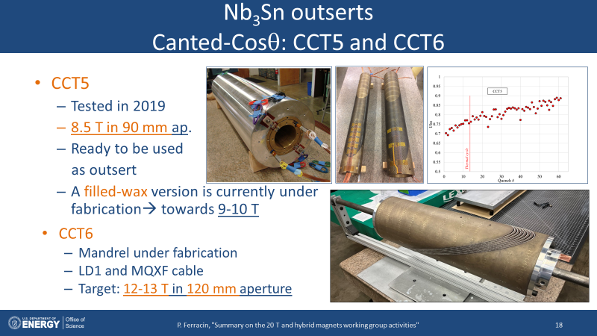
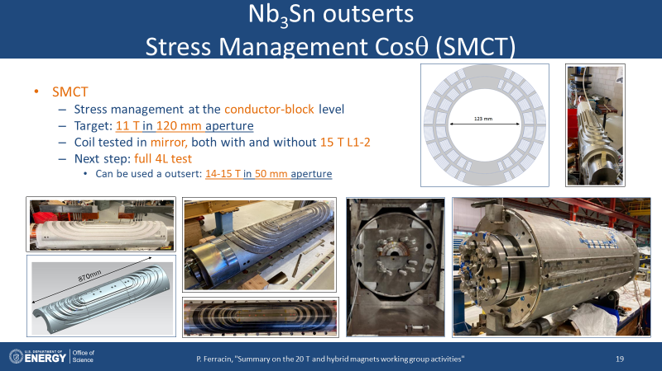
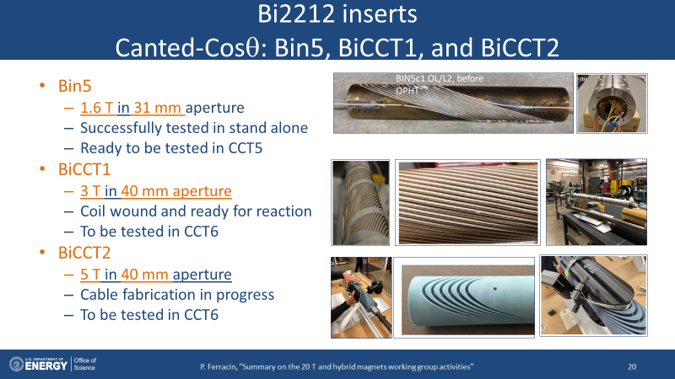
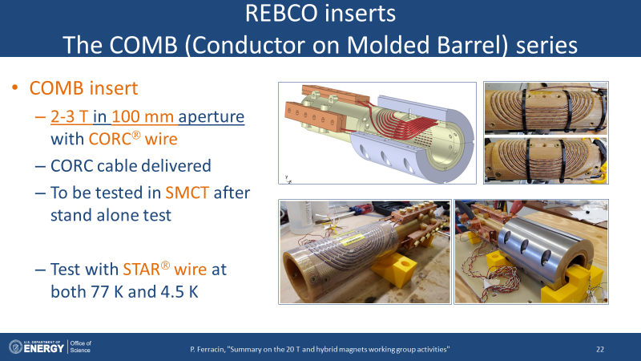
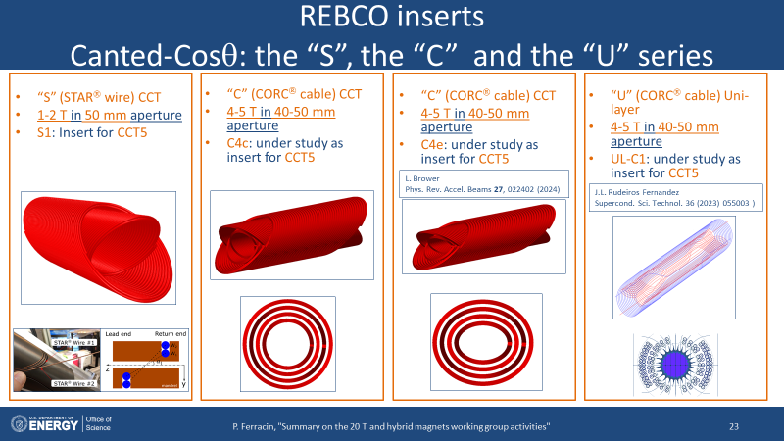
Key results presented at the Collaboration Meeting
Hybrid magnets activities

Slide 29
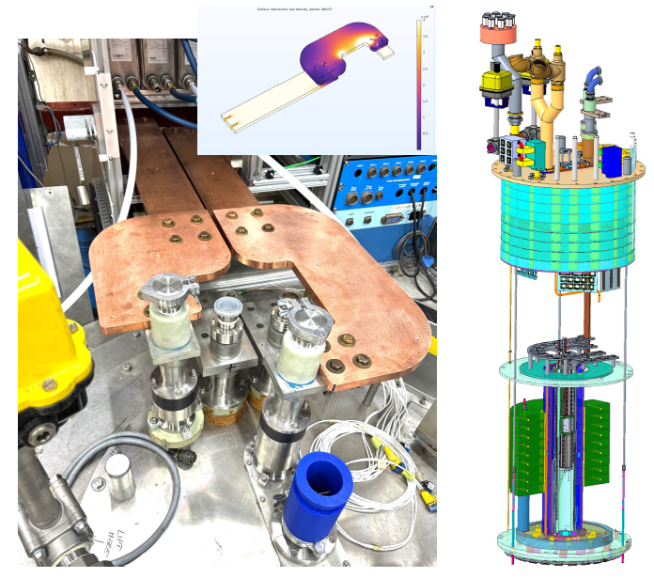
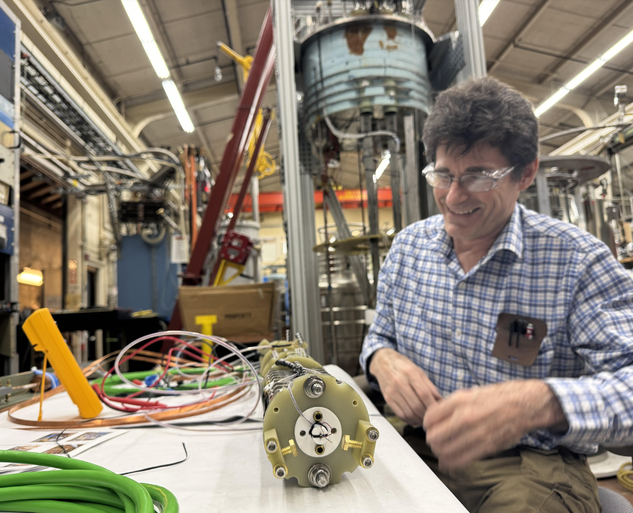
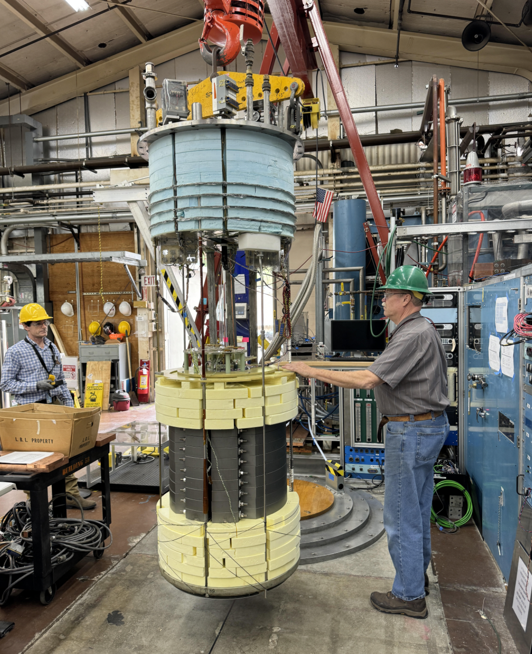
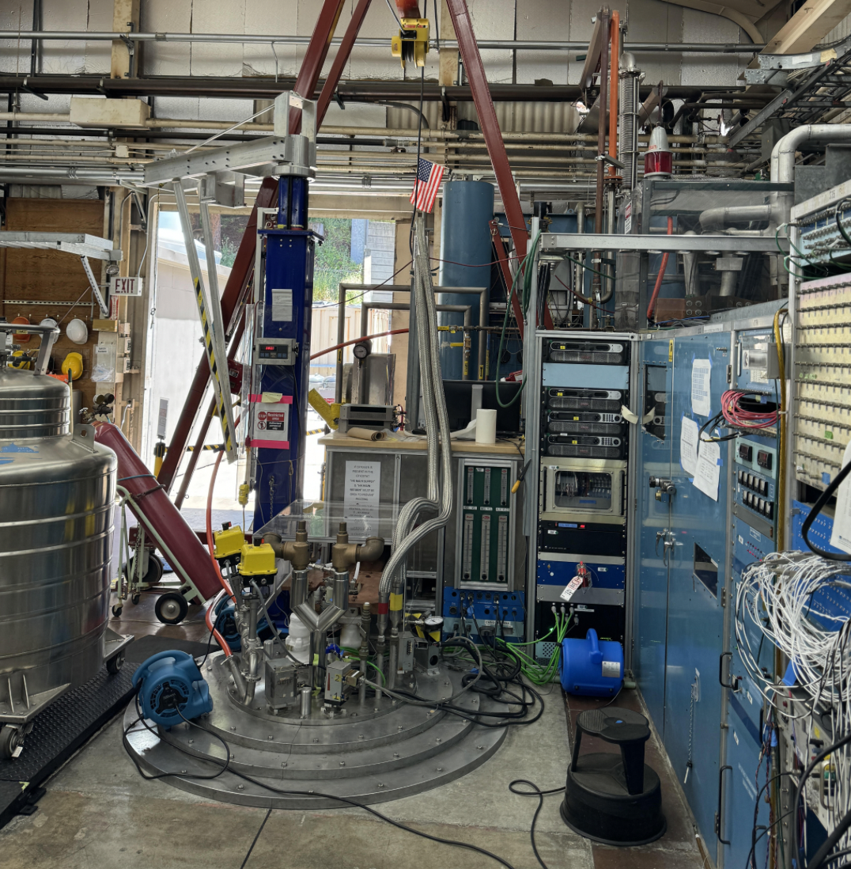
Recent work/analysis
Qualification of test facility upgrade
Upgrade of the LBNL test facility specifically to test hybrid magnets
  Challenge: two independent facilities (PS, quench protection, header) in one facility
Successful test of REBCO insert (CORC demountable joint samples) inside CCT5
  First, 4.8 kA in the REBCO insert without back-ground field → qualification new PS and QP
  Then, 2.4 kA in REBCO in 6 T background field → full qualification of the facility → ready for Bin5-CCT5

Slide 30
Recent work/analysis
Hybrid work
Several options under consideration for “C4”
  Next steps: comparative analysis and “prioritization”

Slide 31




Recent work/analysis
Overview of hybrid magnets
CCT5-Bin5
30 mm
9-10 T
CCT5-C4
30 mm
11-12 T
COMB-SMCT
100 mm
11-12 T
11T-Bi SMCT-SMCT
15 mm
14-16 T
CCT6-BiCCT1-2
40 mm
16-18 T
Next steps: timeline and more precise field estimate

Slide 32
Appendix

Slide 34
Design criteria
Coil and magnet parameters
  Free coil aperture (diameter) 50 mm
  Operational bore field 20 T
  load-line fraction @ 1.9K: I_{op}/I_{ss} <= 87 %
  2D Geometrical harmonics b_{n}<3 units for n<10 (at R_{ref}=17 mm)
Quench protection
  All coils powered in series
  Maximum hot spot temperature 350 K
Mechanics
  Maximum Nb₃Sn coil stress <180 (<150) MPa at 1.9 (293) K
  For the HTS <120 MPa

Slide 35
Design criteria: some comments
Size
  No limits or constraints set (request from the working group)
  So far the goal has been to minimize coil size, but not significant effort has been devoted to minimize the structure (next step)
Quench protection
  We focus for now on a 1 m long magnet, with CLIC/dump.
  But we start considering also the issue of protecting a long accelerator magnet
Mechanics
  Good knowledge of mechanical properties and limits of Nb₃Sn, recent interesting results from Twente on Bi2212 cables → the assumptions seem reasonable
  Much less knowledge on REBCO CORC/STAR stress limits and properties

Slide 36





Design criteria:
Wires and cables
Nb₃Sn
  0.7 – 1.1 mm strands
    Typical properties of 127 or 169 (Bruker-OST) RRP stacks
  Rutherford cables: 8-26 mm wide, 1.3-2.0 mm thick
Bi2212
  Isotropic, round, multifilamentary
    Bruker-OST architecture 19 × 36, 37 × 18 or 55 × 18 for 0.8 mm diameter wires
  On paper, possible same strand and Rutherford cable dimensions as Nb₃Sn
REBCO
  CORC (ATC LLC) cable and STAR (AMPeers) wires:
    Tapes around Cu former
      Diameter from 1.3 to 3.6 mm
  6-around-1 STAR cable

Slide 37

Superconducting materials: J_{e} and J_{o}
Assumptions for magnetic analysis
  J_{e} = Strand current / strand area
    J_{e_LTS} = 875 A/mm² (1.9 K, 16 T, 5% degrad.)
      3000 A/mm² J_{c} (4.2 K, 12 T, virgin)
    J_{e_HTS} = 740 A/mm² (20 T)
      Bi2212 value
Nb₃Sn and HTS cross at 16.5 T
CORC/STAR wire still lower in J_{e} (600 A/mm², 20 T)

Slide 38

Current reference cross-sections
Cos-theta
Coil inner diameter 60 mm
  Internal support structure
Design constraint: double-layer coils
6 layers, with cables 15 to 22 mm wide
  2 layer HTS, 4 layer LTS
HTS: CCT-like or “single turn” SMCT
LTS: SMCT design + CT
Field quality and margin in spec
j_{e}= 450-600 A/mm², j_{o}= 300-400 A/mm²
OR coil: 165 mm
LTS
HTS

Slide 39


Current reference cross-sections
Cos-theta
4 out of 6 layers with stress management
  Result of several iterations
First two layers (HTS) with a CCT-type design
  Single cable in grove, with ribs and spar
Second two layers (LTS) with SMCT-type design
  Single block in grove, with ribs and spar
Last two layers traditional CT
Coil stress in spec
  but very high stress in the mandrel (Inconel or Nitronic?)

Slide 40


Current reference cross-sections
Block
Coil inner diameter 70 mm
  Internal support structure
Design constraint
  double-layer coils
  HD2/FRESCA2 style coil
3 double-layer coils, with 15 mm wide cable
Field quality and margin in spec
j_{e}= 450 A/mm², j_{o}= 300 A/mm²
OR coil: 130 mm
  Less efficient than CT (50% more HTS, 15% more LTS), but less optimized

Slide 41


Current reference cross-sections
Block
10 mm thick winding pole
  FRESCA2 style
Coils vertically separated by horizontal plates
  Vertical stress management
HTS and LTS separated by vertical ribs
  Horizontal stress management
Stress not yet in spec
Challenges: “insertion” of HTS coil inside LTS coils, grading and splicing

Slide 42



Current reference cross-sections
Common-coil
Coil inner diameter 50 mm
  No internal support structure
Single layer coils allowed : splice in the central pole
  So, more vertical and horizontal flexibility
4 layers, with cables 16 mm to 20 mm wide
  1 layer HTS (plus pole coils), 3 layer LTS
Field quality and margin in spec
j_{e}= 550-650 A/mm², j_{o}= 400-450 A/mm²
OR coil: 110 mm
  ~50% more HTS than CT, but ~50% less LTS
    Overall smaller coil, but at the expense of larger HTS coil
  CT vs CC similar to Case II vs Case I

Slide 43




Current reference cross-sections
Common-coil
No internal structure in innermost layer
Coils vertically separated by horizontal plates
  Vertical stress management
HTS and LTS separated by vertical ribs
  Horizontal stress management
Stress almost in spec
Challenge: pole turns
  Avoidable with asymmetric coils

Slide 44

Current reference cross-sections
Quench protection (more than 1 m length)
Without new solutions, hard to go beyond 3-4 m
Longer lengths protectable with ESC (Energy Shift with Coupling)

Slide 45






Nb₃Sn outserts
Canted-Cosθ: CCT5 and CCT6
CCT5
  Tested in 2019
  8.5 T in 90 mm ap.
  Ready to be used
  as outsert
CCT6
  Mandrel under fabrication
  LD1 (HD2) and MQXF cable
  Design: 15 T (1.9 K, 80% I_{ss}) in 120 mm aperture

Slide 46






Nb₃Sn outserts
Stress Management Cosθ (SMCT)
SMCT
  Stress management at the conductor-block level
  Target: 11 T in 120 mm aperture
  Coil tested in mirror, both with and without inner coil of the MDPCT1

Slide 47
Nb₃Sn outserts
Stress Management Cosθ (SMCT)
SMCTM1
  14.3 kA, 87 % I_{ss} reached in 24 quenches
  12.7 T conductor peak field
  No memory after thermocycle
SMCTM1b
  Highest current was 11.46 kA, 82 % I_{ss}
  14.5 T conductor peak field in the inner coil

Slide 48


Nb₃Sn outserts
Summary
in scale
CCT5
90 mm
8.5 T
CCT6
120 mm
15 T
(design)
SMCT
120 mm
11 T
(design)

Slide 49
Outline
Introduction and motivations
  US Magnet Development Program and the 20 T working group
  Why hybrid and why 20 T
20 T design
  Design criteria
  Preliminary considerations based on sector coils
  Current reference cross-sections
Overview of hybrid activities
  Nb₃Sn outserts
  HTS inserts
Conclusions

Slide 50







Bi2212 inserts
Canted-Cosθ: Bin5, BiCCT1, and BiCCT2
Bin5
  1.6 T in 31 mm aperture
  Successfully tested in stand alone
  Ready to be tested in CCT5
BiCCT1
  5 T in 40 mm aperture
  Coil wound and ready for reaction
  To be tested in CCT6
BiCCT2
  7 T in 40 mm aperture
  12 mm cable fabricated
  To be tested in CCT6

Slide 51




Bi2212 inserts
Stress Management Cosθ (SMCT)
Bi2212 SMCT
  1-2 T in 15 mm aperture
  Winding test performed with plastic parts
  Fabrication of Inconel 3D printed mandrel in progress
  To be tested in a 4L (CT from 15T magnet + SMCT coil)

Slide 52






REBCO inserts
Canted-Cosθ (“C” series)
C2: stand-alone test in 2020
  2.9 T in 65 mm aperture
  Fundamental step towards development CORC CCT inserts
Next step: C3
  Target: 5 T in 60 mm aperture
  Under fabrication

Slide 53




REBCO inserts
The COMB (Conductor on Molded Barrel) series
COMB insert
  Target: 2-3 T in 100 mm aperture with CORC® wire
  To be tested in SMCT after stand alone test
  Test with STAR® wire at both 77 K and 4.5 K
    1.5 T bore field reached

Slide 54


Bi2212 and REBCO inserts
Summary
in scale
Bi2212
SMCT
15 mm
1-2 T
(target)
Bin5
31 mm
1.6 T
BiCCT1
40 mm
3 T
(target)
BiCCT2
40 mm
5 T
(target)
REBCO
COMB
100 mm
2-3 T
(target)

Slide 55
Overview of planned MDP hybrid magnets
CCT5-Bin5
30 mm
9-10 T
CCT5-C4
30 mm
11-12 T
COMB-SMCT
100 mm
11-12 T
11T-Bi SMCT-SMCT
15 mm
14-16 T
CCT6-BiCCT1-2
40 mm
16-18 T

Slide 56
Outline
Introduction and motivations
  US Magnet Development Program and the 20 T working group
  Why hybrid and why 20 T
20 T design
  Design criteria
  Preliminary considerations based on sector coils
  Current reference cross-sections
Overview of hybrid activities
  Nb₃Sn outserts
  HTS inserts
Conclusions

Slide 57
Conclusions
US MDP pursuing an LTS-HTS hybrids magnets program towards 20 T
  Excellent tool to perform R&D on various materials and magnets
20 T design study
  Coil size ranging from 120 to 160 mm OR depending on design options and assumptions (HTS vs overall)
  Stress management required in particular in the innermost layers
  Up to 3-4 m length can be protected, beyond new solutions required
Large aperture Nb₃Sn outserts under development with stress management concepts
  CCT: “5” is ready, “6” under develop.,
  SMCT first coil being tested in mirror configuration
HTS inserts
  Successful test of Bi2212 Bin5
  Both REBCO CCT and COMB insert designs validated with CORC® and STAR® wires
First hybrid test (9-11 T field level) expected in 2024

Slide 58
Appendix

Slide 59

Motivations of a 20 T hybrid design
…also….the “4 T step”
  8 T
    Nb-Ti “limit” (LHC)
  12 T
    Nb₃Sn (HL-LHC)
  16 T
    Limits of Nb₃Sn
  20 T
    HTS

Slide 60
Current reference cross-sections
Optimization process

Slide 61

Critical current versus transverse stress
Sample 3: LBNL1109 (Dec 2022)
Applied field 11 T, data normalized to initial I_{c} of 2.70 kA (sample 3), and
4.07 kA (sample 4)
Measurement sequence:
  10 MPa
  20 MPa
  10 MPa
  30 MPa
  10 MPa
  40 MPa
  etc.
5% degradation reached at:
170-200 MPa in sample 3 and
120-150 MPa in sample 4
B_{a} = 11 T
Sample 4: LBNL2002 (June 2023)
B_{a} = 11 T

Slide 62
Appendix

Slide 63

CCT5_Bin5: coil_OR_329
CCT5_Bin5: magnet_coil_OR_76
CCT6-BiCCT2 : coil_OR_158
CCT6_BiCCT2 : magnet _OR_430

Slide 64


Magnetic analysis
“Traditional” Cosϑ (without stress management)
See talk from V. Marinozzi
6 layers, with cables 13 mm to 21 mm wide
  Double-layer coils with internal splice and not graded
Two options considered
  4 layer HTS, 2 layer LTS or 2 layer HTS, 4 layer LTS
Field quality requirements met
  Margin to be optimized
Quench protection addressed (J in Cu)
Stress requirements partially addressed
  Accumulated σ_{ϑ} → 150-160 MPa
  Accumulated σ_{r}→ approaching 200 MPa
Nb₃Sn
Bi2212
Nb₃Sn

Slide 65



R&D towards Nb₃Sn outserts
Canted-Cosθ: subscales
Development of sub-scale CCT for material/training study
  5.5 T in 50 mm aperture
  Focus on impregnation material
Sub_2 to Sub_6: from Mix-61 to wax
  Excellent training (no training) performance
  Stable plateau and holding
Currently under development: Sub_7
  Filled wax
    Based on PSI box test, same training performance as wax, better mech properties
    Better candidate for higher stress outsert magnets
  Coil fabricated, magnet assembly in progress, test expected in the summer

Slide 66




