Slide 1
Electrical Safety at Home:
- Hidden dangers -

Slide 2
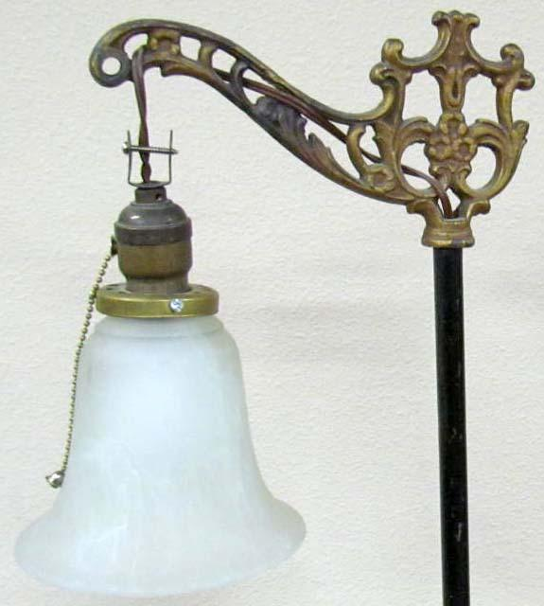
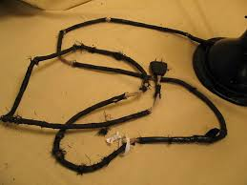
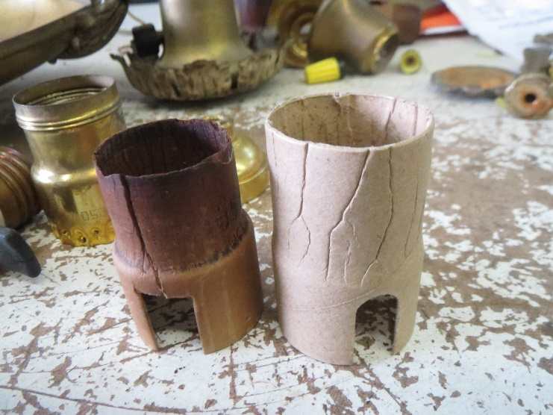
Electrical Safety at Home:
- Hidden dangers -
Vintage lighting fixtures
Cord can be frayed: rewire even if no fraying is visible
Paper insulation can be deteriorated: Replace it and the inner socket.

