Slide 1
Vector mesons and more at an EIC
Spencer Klein & Ya-Ping Xie
NSD Tuesday Meeting, Jan. 8, 2019
Motivation:
  Partons and nuclear shadowing
  Nuclear imaging with vector mesons
Vector mesons at an EIC
The eSTARlight Monte Carlo
Vector meson rates and kinematics
Beyond vector mesons: the a₂⁺(1320) and Z_{c}⁺

Slide 2
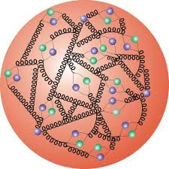
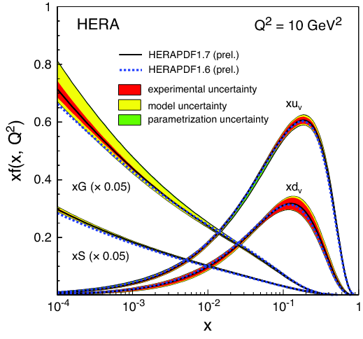
Parton distributions
The quarks and gluons abundances in a nucleon at a given momentum fraction are the parton distributions
  u(x,Q²), d(x,Q²), g(x,Q²), etc.
  x is momentum fraction in infinite momentum frame
  Q² is photon virtuality (effective mass)
    1/photon (dipole) size
3 valence quarks + gluons + sea quarks
  Gluons split into quarks, etc.
Mostly measured in deep inelastic scattering
g(x,Q²) increases with decreasing x
  Valence quarks follow
  xg(x,Q²) ~ x^{-λ} ~~~ power law
At sufficiently small x, the gluon density should reach a limit-> ‘saturation’
  No high-energy eA collider

Slide 3
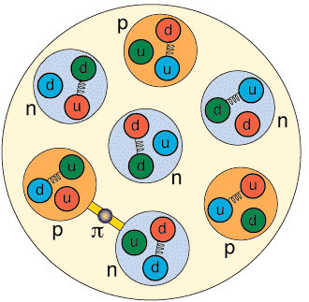
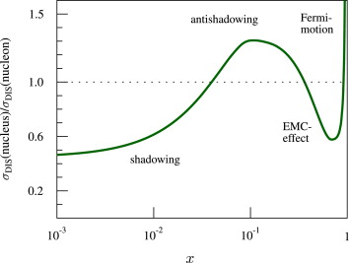
Nuclear shadowing
When a proton or neutron is inserted into a nucleus, the parton distributions may change
  Quark/gluon exchange
  Multiple scattering
  Higher parton densities –> gluon fusion, etc.
    expected at higher x values than in isolated protons
      Scaling arguments give x_{s}~ A ^{1/3}
Data shows complex behavior, with multiple regions
Current nuclear-target data (mostly) at large x
  An EIC can map out parton densities in a wide range of x, Q² in diverse nuclei

Slide 4
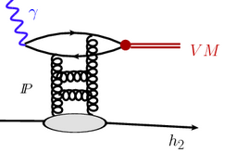
Vector meson photoproduction
Vector Meson photoproduction occurs via Pomeron (two-gluon) exchange
To lowest order, σ(VM) ~ |xg(x)|²
  Square of gluon density
  But, gluons are not ‘bare’
    Corrections for skewing, NLO, etc.
      Ongoing work….
  If xg(x,Q²) ~ x^{-λ} -> σ(k) ~ W^{4λ} ~ W^{0.7}
    Lowest order only!
    Pure power law, exponent ~ good for J/ψ
By comparing γp->Vp and γA->VA, we can measure shadowing
  J/ψ & heavier probe pQCD
  Q² = M_{V}² + Q_{γ}²
    Need an EIC to scan over Q²
    High photon energy -> low x

Slide 5
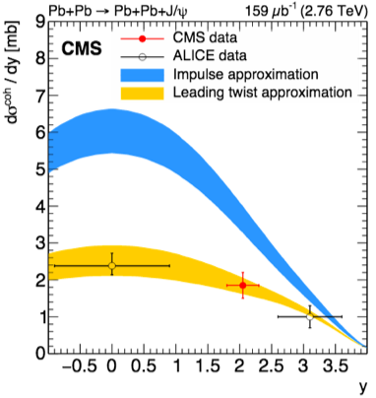
LHC data shows moderate shadowing
x ~few 10⁻⁶ with proton targets (LHCb)
  Evidence for NLO terms?
x ~ 10⁻³ to 10⁻¹ for lead targets
Moderate shadowing
  Consistent with ’leading twist’ approach
    Shadowing from multiple scattering
    At some x, expect ‘saturation’
J/ψ photoproduction on protons
<y>= 4.37; x=3*10⁻⁶
<y>=2.12; x=3*10⁻⁵
W_{γp} (GeV)
J/ψ photoproduction on lead
Gluon suppression ratio

Slide 6
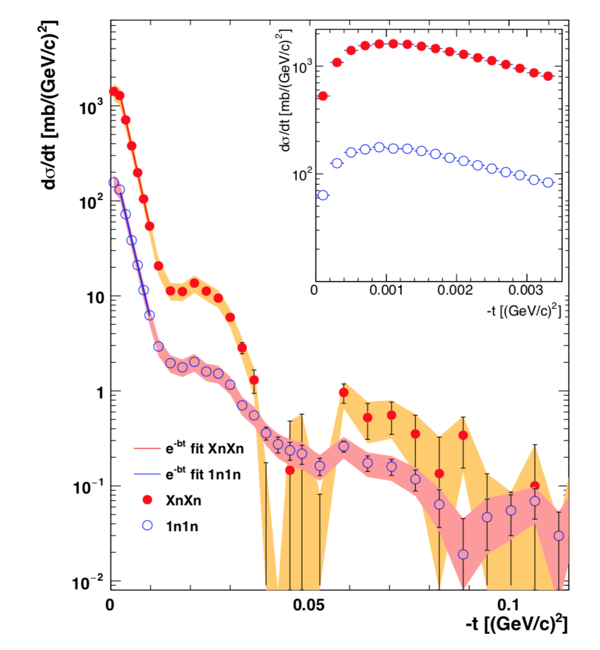
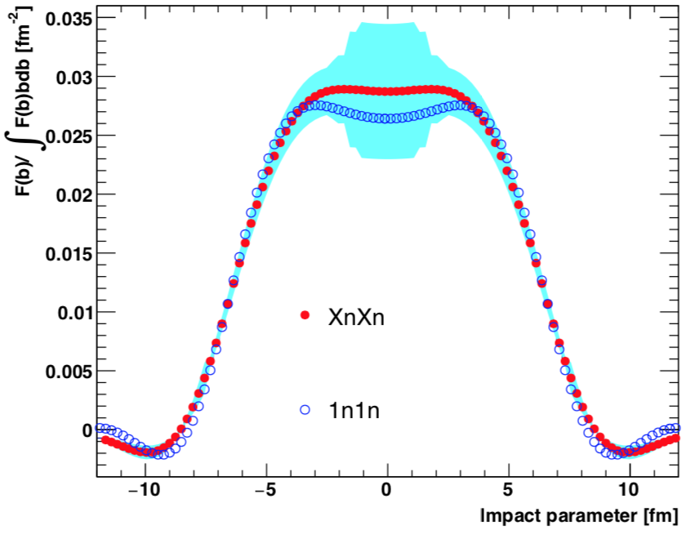
Imaging with vector mesons
Photoproduction carries information about the actual positions of the interaction sites in the target
σ= |Σ_{i} A_{i} e(^{ikx})|²
  A_{i} is interactions strength
  x_{i} is interaction position
  k is momentum transfer from target
Coherence for k<hbar/R_{A}
dσ_{coherent}/dt encodes position of interaction sites in target
  t=p_{T}²
Expect most shadowing in nuclear interior, less at edges
Fourier
Transform
STAR, Phys. Rev. C96, 054904 (2017)

Slide 7
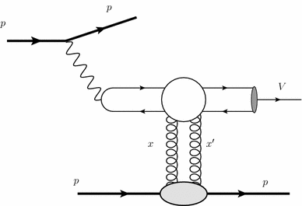
Vector mesons at an EIC
UPC mostly probe fixed Q²=M_{v}²
  Exception: Vary M_{ππ} in UPCs, but only M_{ππ} < 1 GeV
An Electron-Ion Collider can vary Q² independently
  Outgoing electron tags Q² independent of rest of reaction
    Photon virtuality Q²=(p_{e} – p_{e}’)²
    Independent of:
      k = Photon energy
      W = gamma Pomeron center of mass energy
        Vector meson mass
An EIC can also vary A, collide polarized electrons and light ions
e
e
γ*

Slide 8
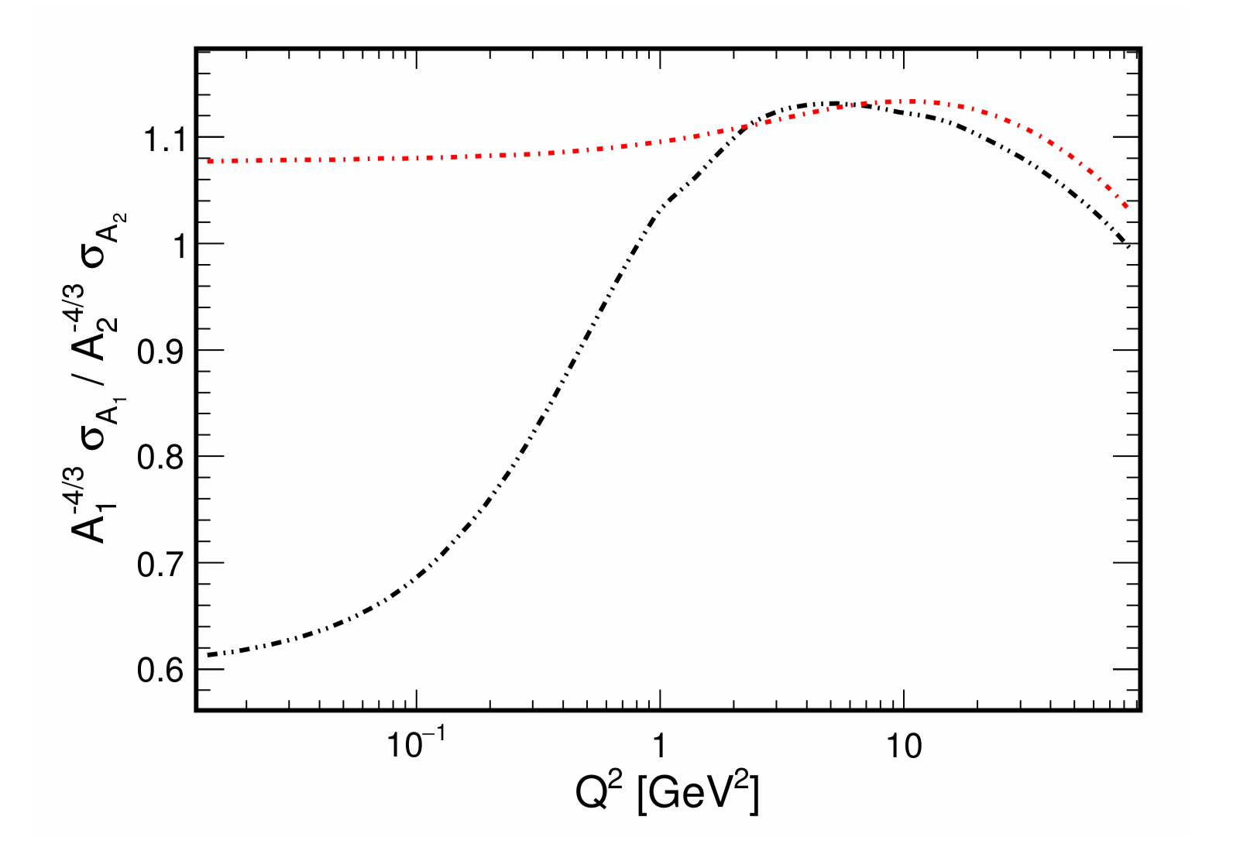
Q² evolution of shadowing
<Dipole size> scales with 1/Q²
Shadowing disappears with increasing Q² /smaller dipoles
Probe ratio of lead:iron cross-section ratio, scaled by A ^{-4/3}
Large dipole (ρ⁰, black) shows very large shadowing
  Breakdown of ‘independent nucleon’ picture
Small dipole (J/ψ, red) shows less shadowing
J/ψ
A₁^{-4/3} σ_{A1}/A₂^{-4/3} σ_{A2}
eSTARlight, qualitatively similar to
Mantysaari & Venugopalan,
Phys. Lett. B781, 664 (2018).
ρ⁰
Q² [GeV]

Slide 9
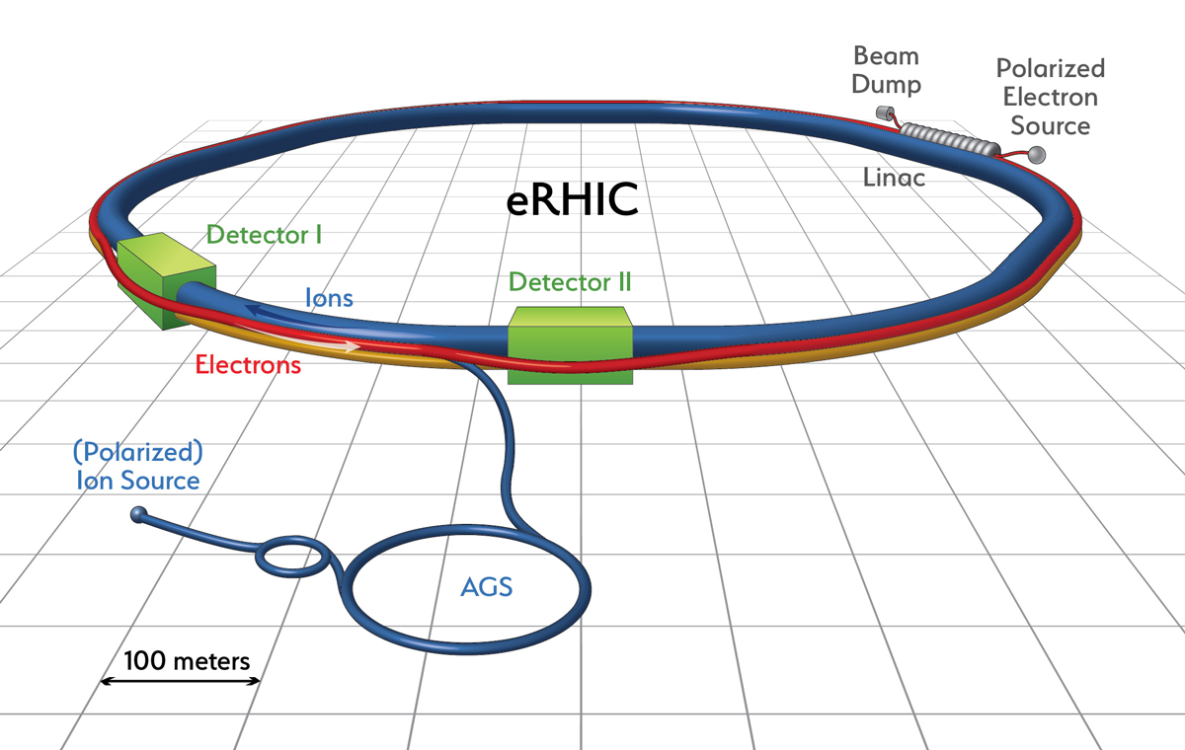
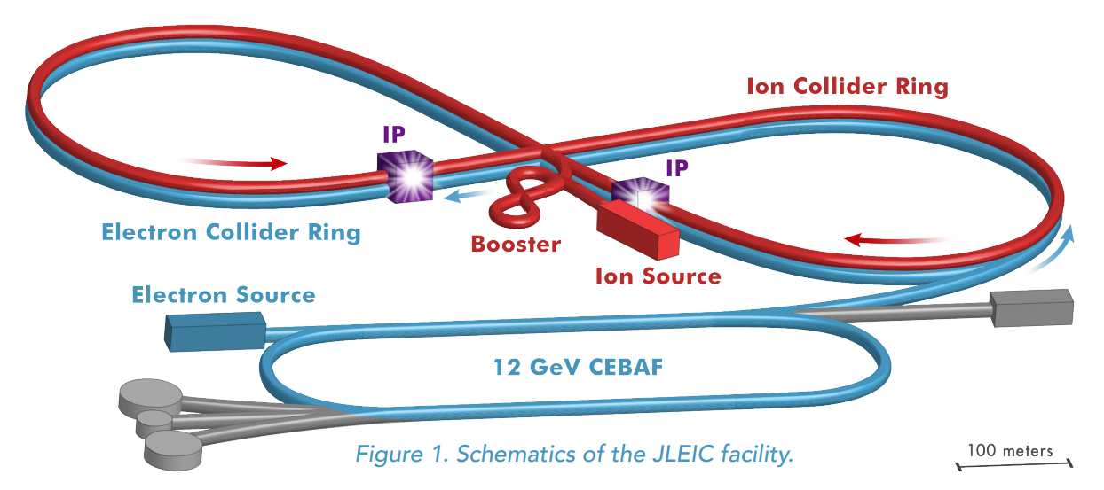
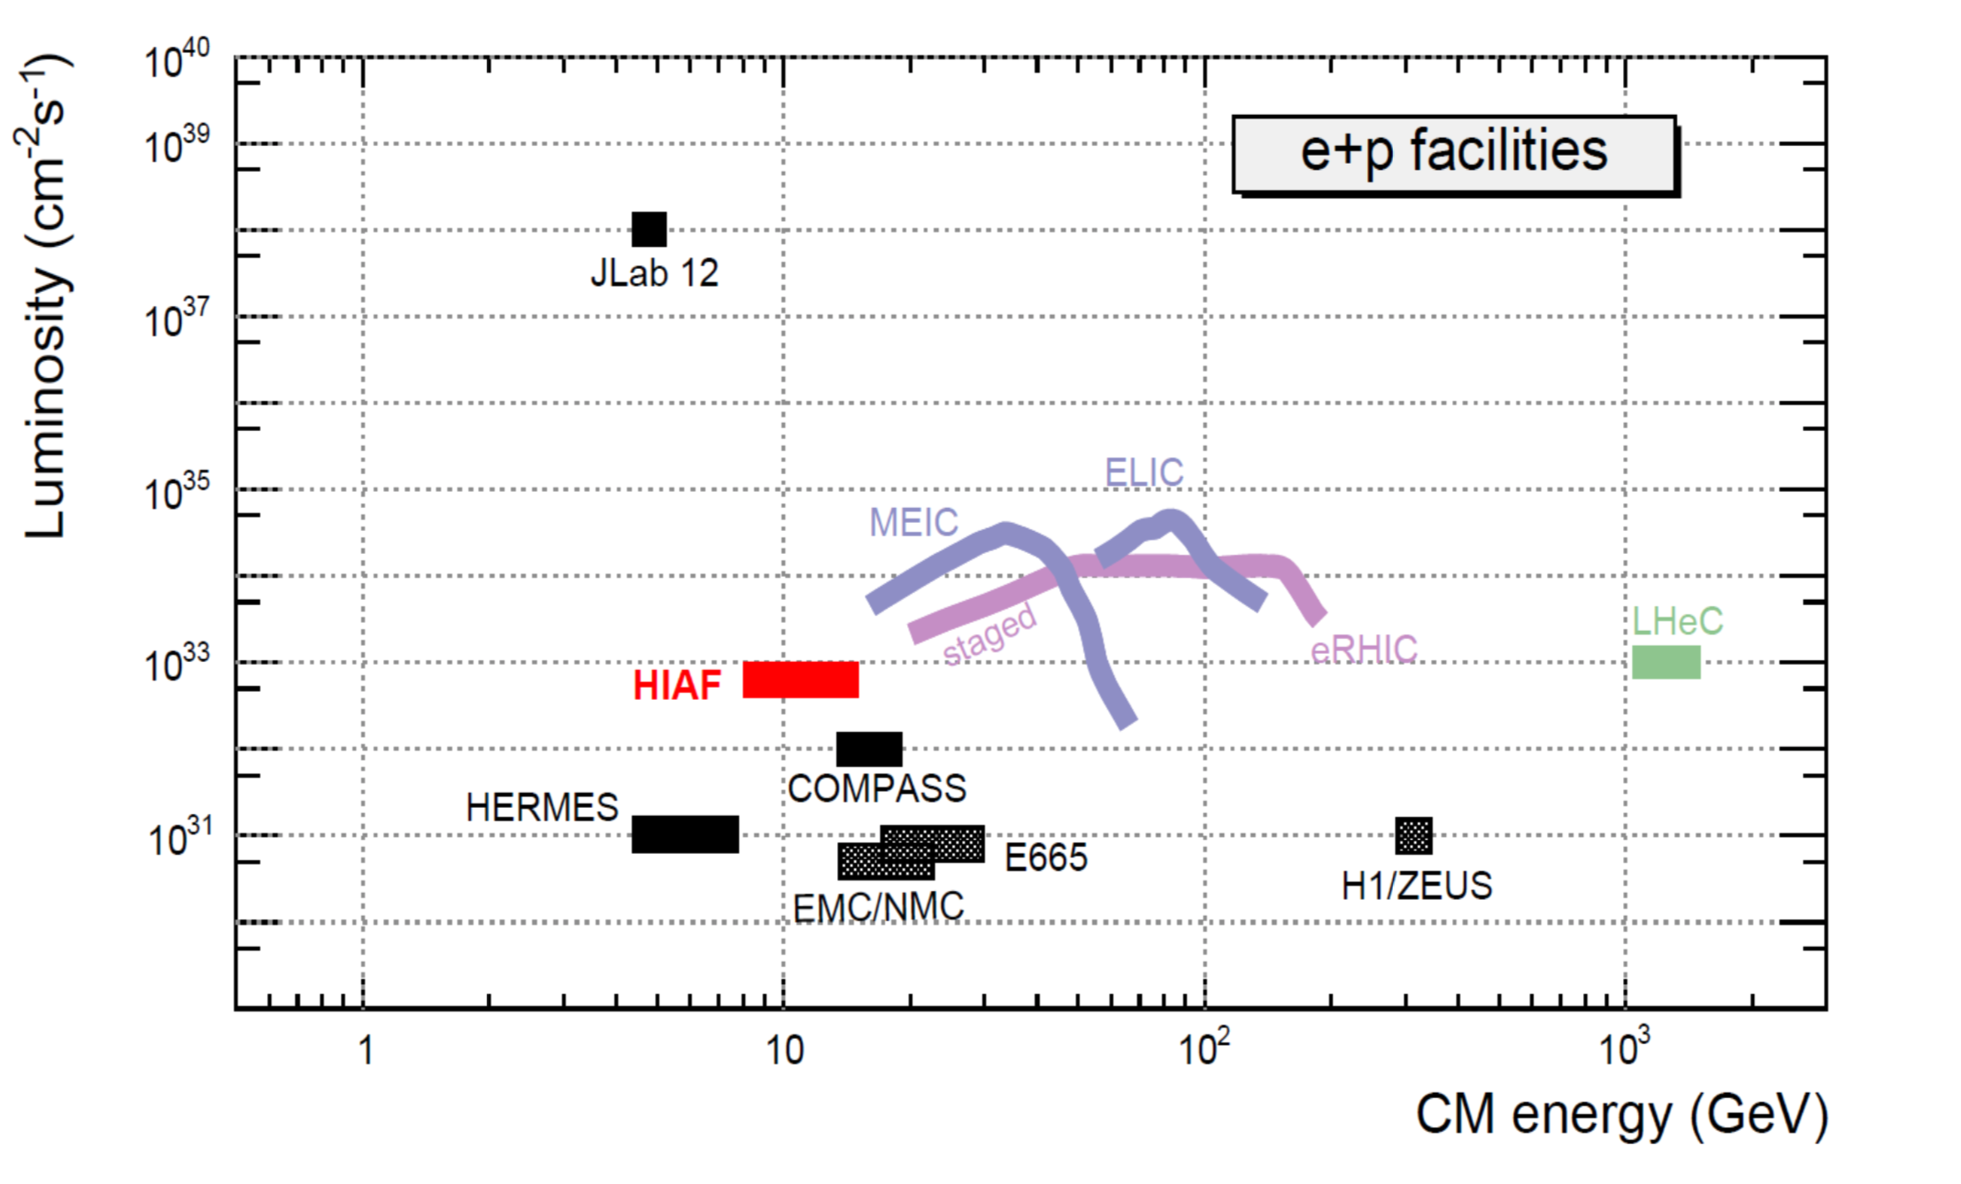
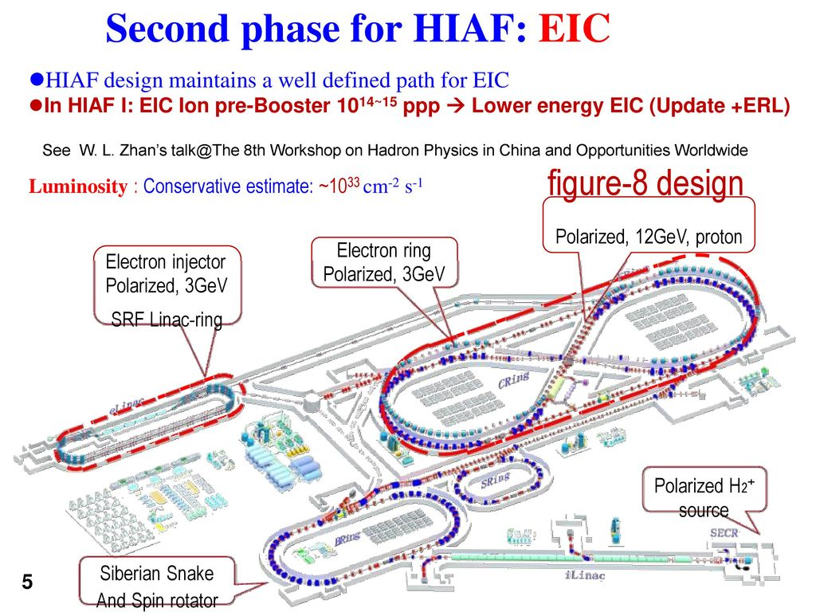
Proposed EICs
eRHIC at Brookhaven
  Adds an electron ring to RHIC
MEIC at Jefferson Lab
  Uses existing accelerator as injector
LHeC at CERN
  Adds an electron linac/ring to the LHC
EICC, in China
  Focus on valence quarks
Luminosity (cm⁻²s⁻¹)
Plot & graphic from Xurong Chen, IMP, Lanzhou
CM Energy [GeV]

Slide 10
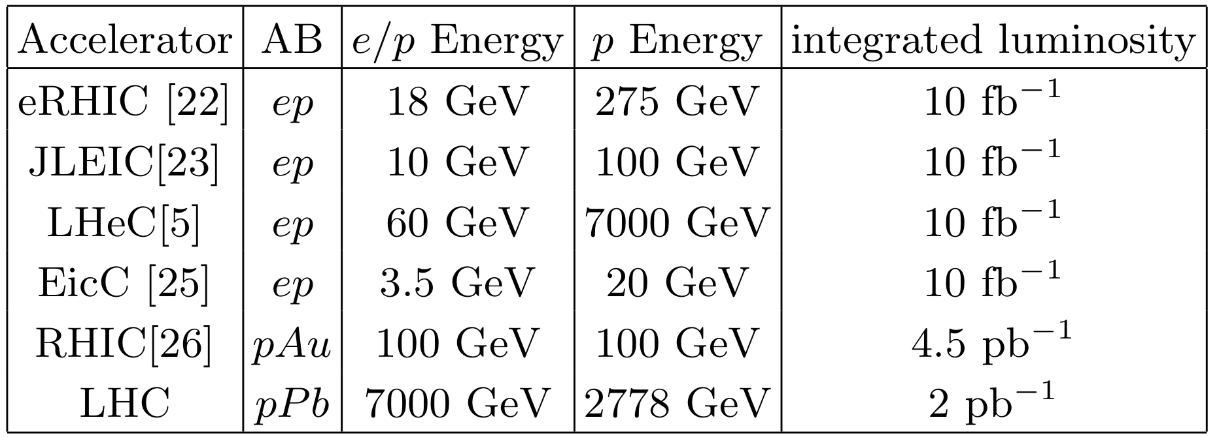
The eSTARlight Monte Carlo
Collides electrons with ions (of any A,Z) at arbitrary energy
Diverse final states: ρ, ω, φ, ρ’, J/ψ, ψ’, Υ(1S), Υ(2S), Υ(3S)
  Simple (two-prong) decays correctly account for photon polarization
    Real photons are transversely polarized
    Virtual photons can be longitudinally polarized
      Fraction scales with increasing Q²
  Complex decays via Pythia 8
Based on parameterized HERA data
  Judicious extrapolations/analogies needed.
Michael Lomnitz and SK, arXiv:1803.06420, to appear in Phys. Rev. C

Slide 11
Framework for production of vector mesons in ep scattering
In ep scattering, we calculate the vector meson cross section:
The cross section of photon-proton interaction is
eSTARlight refactorizes this, and uses lookup tables and rejection sampling to generate events from these distributions
Photon flux
γp Cross-section
Meson width
(Breit-Wigner)
Q² dependence
σ(Q²=0)

Slide 12
Mechanisms for photoproduction of vector mesons
In light vector meson photoproduction, Pomeron exchange and Reggeon exchange both contribute to the total cross section.
  In pQCD, Pomeron is a gluon ladder
  Reggeon represents meson exchange
    Summed over multiple mesons
    High quark content
  Near threshold, the Reggeon exchange contributions are dominant.
For heavy quarkonium (including the φ), only the Pomeron contributes to the total cross section
  No c, few s quarks in nucleon

Slide 13
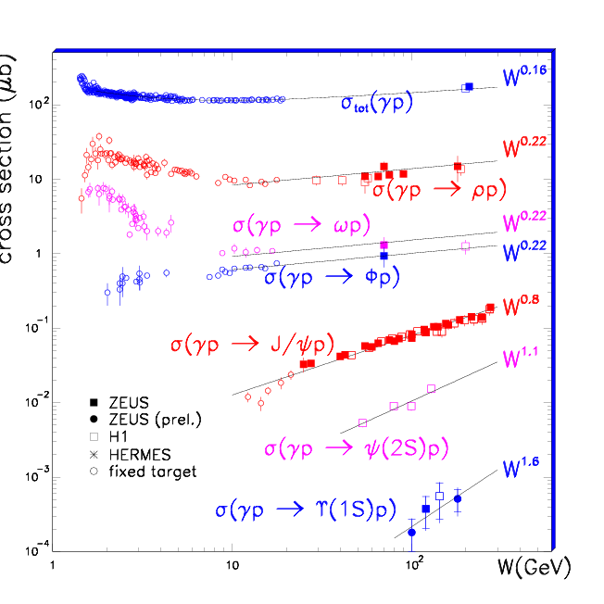
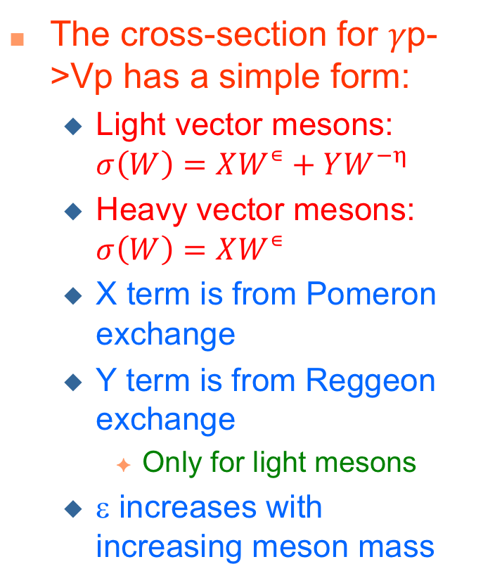
Cross sections for vector meson photoproduction
The cross-section for 𝛾p->Vp has a simple form:
  Light vector mesons: $σ\left(W\right)=XW^{∊}+YW^{−η}$
  Heavy vector mesons: $σ\left(W\right)=XW^{∊}$
  X term is from Pomeron exchange
  Y term is from Reggeon exchange
    Only for light mesons
  ε increases with increasing meson mass
J/ψ photoproduction
arXiv:0709.2178

Slide 14
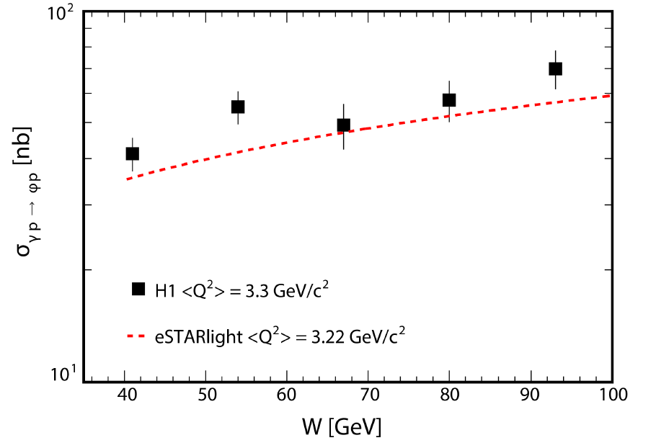
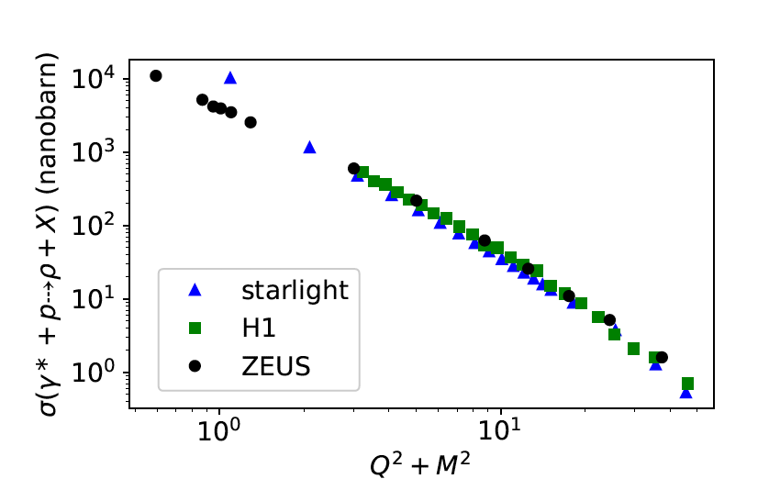
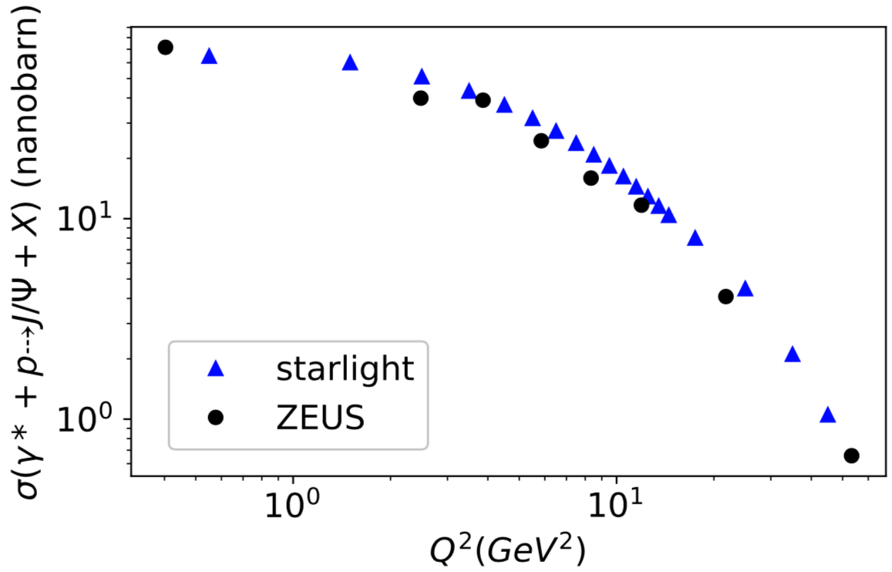

eSTARlight compared with HERA data
σ (γp->φp)
We use eSTARlight to calculate the total cross section as a function of $Q^{2}$and W.
It shows good agreement with HERA data
σ (γp->ρp)
σ (γp->J/ψp)
eSTARlight
eSTARlight
Michael Lomnitz and SK, arXiv:1803.06420, to appear in Phys. Rev. C

Slide 15
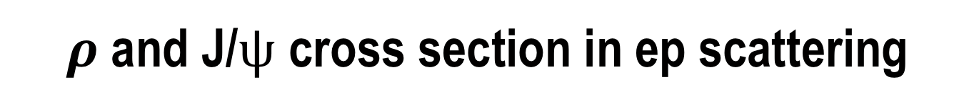
$ρ$and J/$ψ$ cross section in ep scattering
We use eSTARlight to find dσ/dy at proposed EICs
  dσ/dy distribution is very broad
  ρ⁰ - two peaks correspond to Reggeon exchange (near threshold) and Pomeron exchange
  J/ψ single peak due to Pomeron exchange
Need a wide acceptance detector to study full energy range
ep->epρ
ep->epJ/ψ

Slide 16
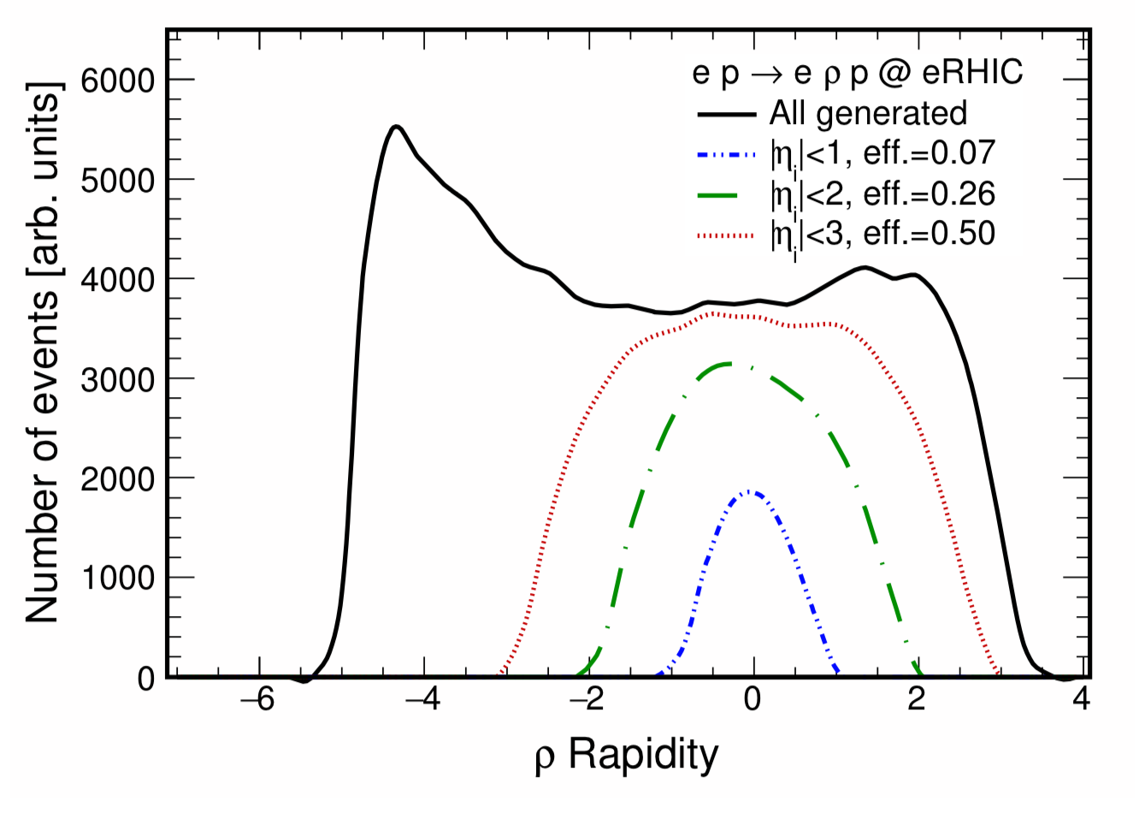
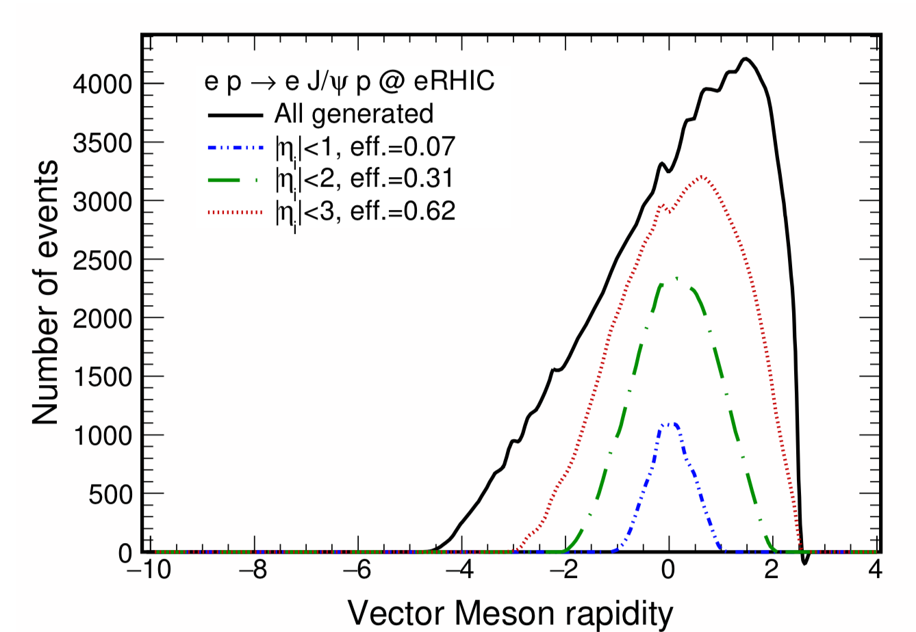
Detector acceptance
Vector meson acceptance depends on the chargedparticle pseudorapidity coverage of the detector.
  In ρ->π⁺π⁻, J/ψ->e⁺e⁻, the final state π/e particle pseudorapidity (η) is correlated with the vector meson rapidity (y)
  The plots show vector meson efficiency for 3 toy detectors, with charged particles detection over |η|<1, |η|<2 and |η|<3
A wide-acceptance detector is needed
ρ rapidity
J/ψ rapidity

Slide 17
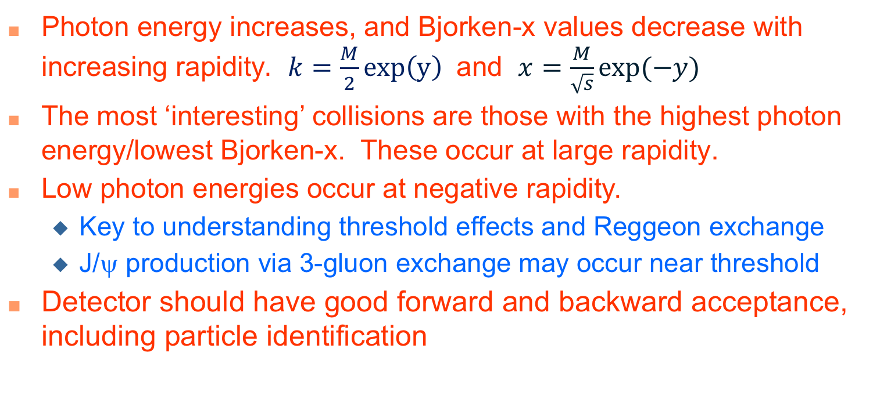
dσ/dy vs. photon energy and Bjorken-x
Photon energy increases, and Bjorken-x values decrease with increasing rapidity$. k=\frac{M}{2}exp\left(y\right)$ and $x=\frac{M}{\sqrt{s}}exp⁡(−y)$
The most ‘interesting’ collisions are those with the highest photon energy/lowest Bjorken-x. These occur at large rapidity.
Low photon energies occur at negative rapidity.
  Key to understanding threshold effects and Reggeon exchange
  J/ψ production via 3-gluon exchange may occur near threshold
Detector should have good forward and backward acceptance, including particle identification

Slide 18


$Q^{2}$-dependent cross section of vector mesons in ep scattering
We also investigate the contribution of $Q^{2}$ of photon to the production of vector mesons in ep scattering
  As Q² increases, threshold shifts slightly toward larger rapidity

Slide 19
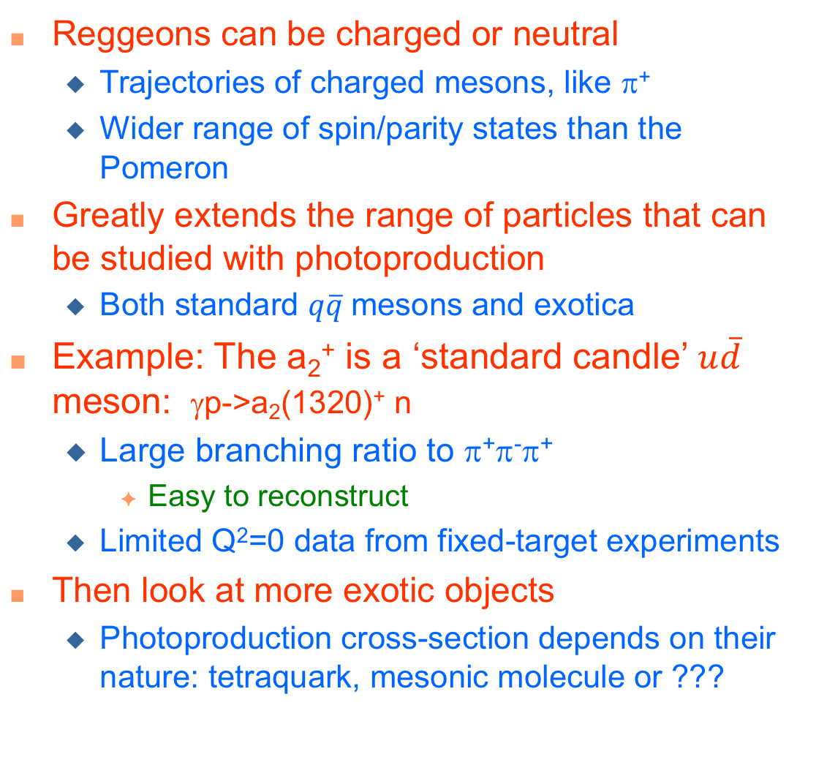
Mechanics for photoproduction of charged particles
Reggeons can be charged or neutral
  Trajectories of charged mesons, like π⁺
  Wider range of spin/parity states than the Pomeron
Greatly extends the range of particles that can be studied with photoproduction
  Both standard $q\overline{q}$mesons and exotica
Example: The a₂⁺ is a ‘standard candle’ $u\overline{d}$ meson: γp->a₂(1320)⁺ n
  Large branching ratio to π⁺π⁻π⁺
    Easy to reconstruct
  Limited Q²=0 data from fixed-target experiments
Then look at more exotic objects
  Photoproduction cross-section depends on their nature: tetraquark, mesonic molecule or ???
IJMPA(30)1530002, PRD(77)094005

Slide 20
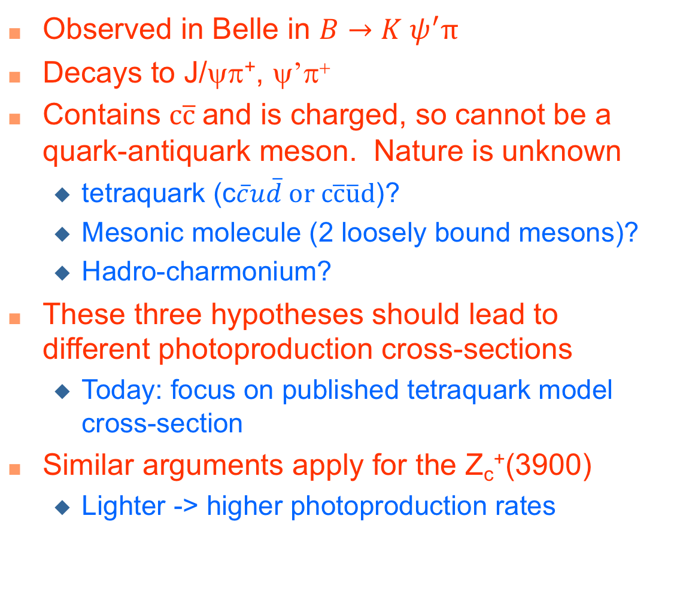
The Z_{c}⁺(4430)
Observed in Belle in $B→K ψ^{′}π$
Decays to J/ψπ⁺, ψ’π⁺
Contains $c\overline{c}$and is charged, so cannot be a quark-antiquark meson. Nature is unknown
  tetraquark (c$\overline{c}u\overline{d} or c\overline{c}\overline{u}d$)?
  Mesonic molecule (2 loosely bound mesons)?
  Hadro-charmonium?
These three hypotheses should lead to different photoproduction cross-sections
  Today: focus on published tetraquark model cross-section
Similar arguments apply for the Z_{c}⁺(3900)
  Lighter -> higher photoproduction rates

Slide 21
Cross section of charged particles in photoproduction process
Use data or calculations of σ(γp->X+n) as input to eSTARlight to predict dσ/dy for the same process in EIC collisions.
  Assume the same Q² scaling as similar vector mesons.
γp->Z_{C}(4430)⁺ n
Fit to theory curve
γp->a₂(1320)⁺ n
Reggeon inspired fit
PRD(93)074016 & PRC(83)065203

Slide 22
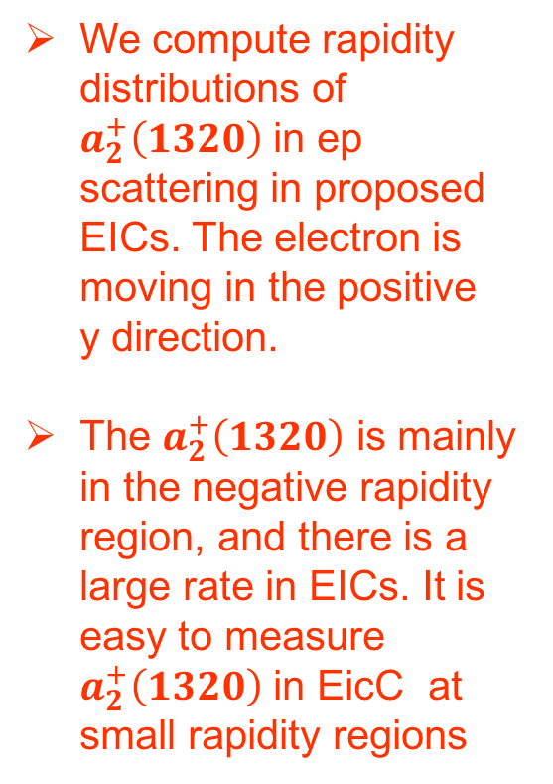
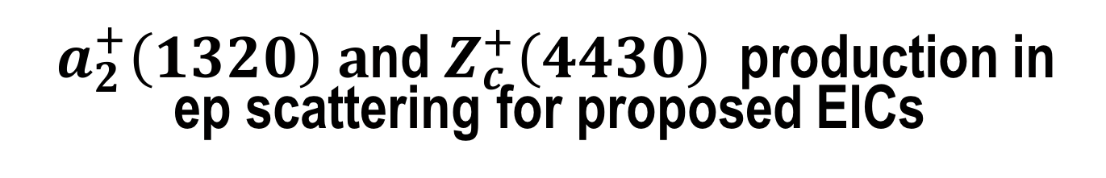
$a_{2}^{+}\left(1320\right) a$nd $Z_{c}^{+}\left(4430\right)$ production in ep scattering for proposed EICs
We compute rapidity distributions of $a_{2}^{+}\left(1320\right)$ in ep scattering in proposed EICs. The electron is moving in the positive y direction.
The $a_{2}^{+}\left(1320\right)$ is mainly in the negative rapidity region, and there is a large rate in EICs. It is easy to measure $a_{2}^{+}\left(1320\right)$ in EicC at small rapidity regions

Slide 23
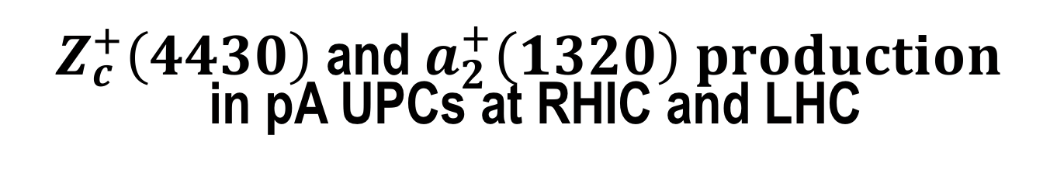
$Z_{c}^{+}\left(4430\right)$ and $a_{2}^{+}\left(1320\right) production$ in pA UPCs at RHIC and LHC
Ultra-peripheral collisions means that two nuclear collide with each other in a large impact parameter.
  Strong interaction is suppressed
  Electromagnetic interactions.
We also compute the two charged particles production in pA UPCs. The cross-section is:
The photon flux from protons is much smaller that photon flux from heavy ions. The 𝛄-p cross-section is dominant in p-A UPCs.

Slide 24
Expected event rate for vector mesons, a2+(1320) and ZC+
Total cross sections and expected events for vector mesons and two charged particles on EICs, RHIC and LHC
  For ~ 1 year (for HLLHC – all of Run period 3 & 4)

Slide 25
Conclusions
Vector meson photoproduction is an attractive way to image the partons in the nucleus.
  Data from ultra-peripheral collisions points to moderate shadowing in heavy ions for 10⁻³ < x < 10⁻² & moderate Q²
An electron-ion collider will allow precise measurements of shadowing as a function of Q²
  High rates for ρ,ρ’, J/ψ, ψ’; moderate rates for the Υ(1S)
The eSTARlight Monte Carlo can simulate the production of different vector mesons in ep and eA collisions.
To reach the lowest possible Bjorken-x requires a forward detector.
ep and pA UPCs also produce charged mesons, via charged Reggeon exchange. The a₂⁺(1320) is a ‘standard candle’.
  This is a way to determine the nature of exotic mesons like the Z_{c}⁺

