Slide 1
Status report: ePIC corrugated paneling
Skye Heiles • 07.26.2024

Slide 2
Agenda
The project, contextualized
Carbon layup background
The problem
Past R&D
Current R&D
Testing
Next steps

Slide 3
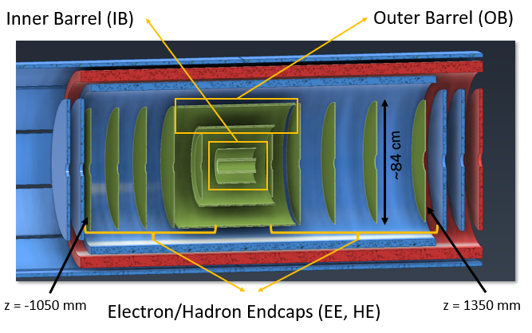

Slide 4
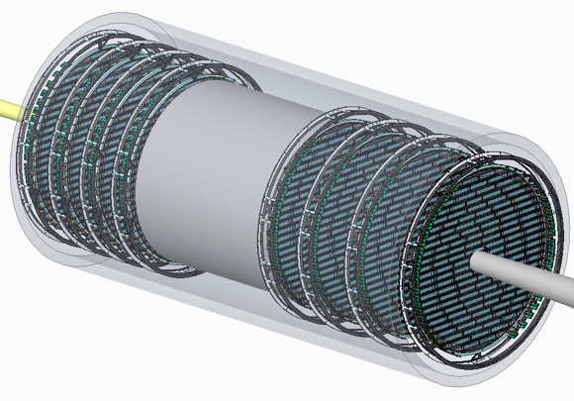
Discs
Double sided
  Increases acceptance
Strength without added mass
🡪 Carbon fiber
🡪 Corrugation in the core

Slide 5
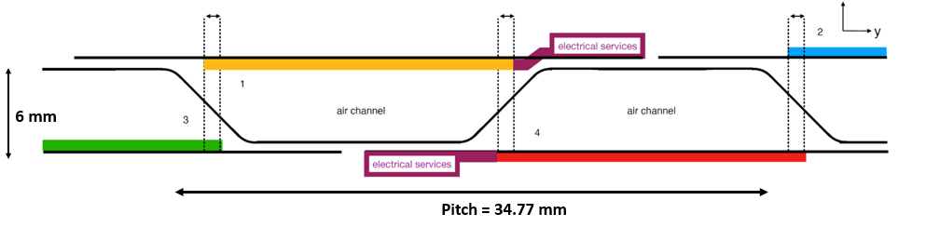
Corrugated core
z
*This design allows for overlap on the long axis, adds strength and has air channels for cooling

Slide 6
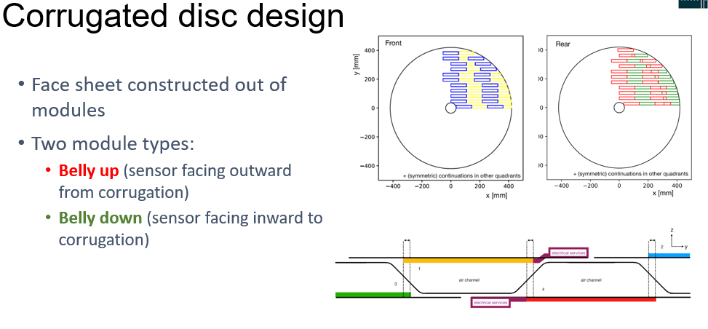
Corrugated disc design
Module types
Outward Facing: sensor facing outward from corrugation
Face sheet constructed out of modules gives overlap on the short axis
Inward Facing: sensor facing inward to corrugation

Slide 7
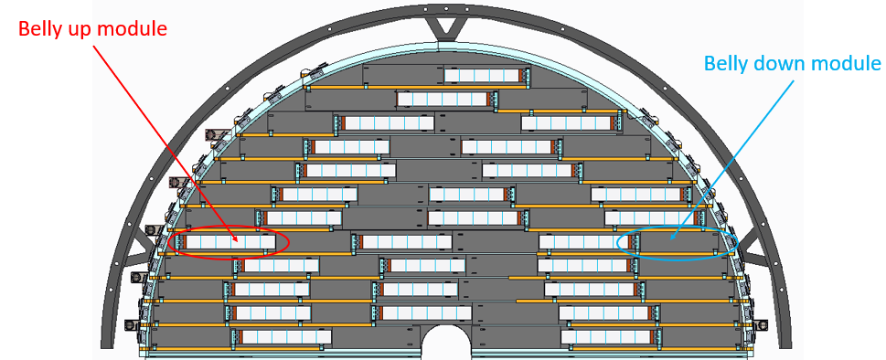
Sensor layout
Outward Facing
Downward Facing
“Front” face of disc (facing in towards interaction region)

Slide 8

The challenge
Make the laminate as light as possible while preserving structural integrity

Slide 9
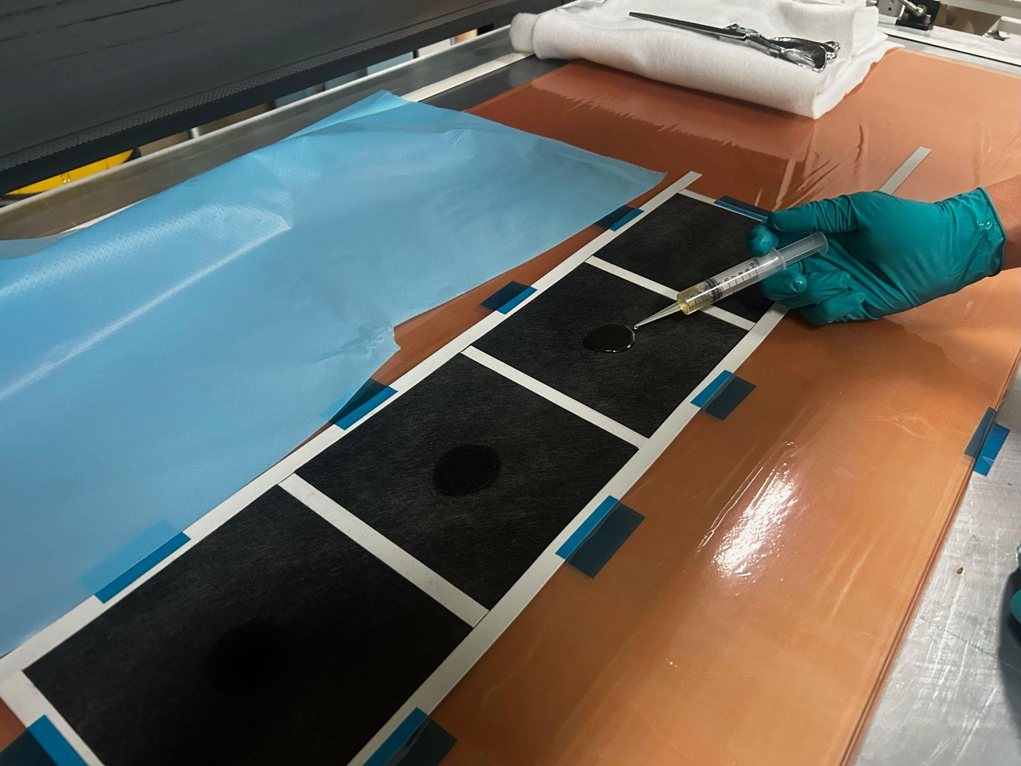
Old prototype
Used the veil and 10 gsm resin.
  Ran out of resin. Veil was difficult to get on and off tooling and never got fully wetted.
  Used for first prototype (thermal tests), moved on to unidirectional fiber for next prototypes.

Slide 10
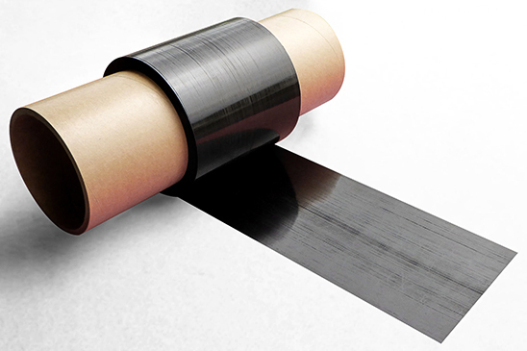
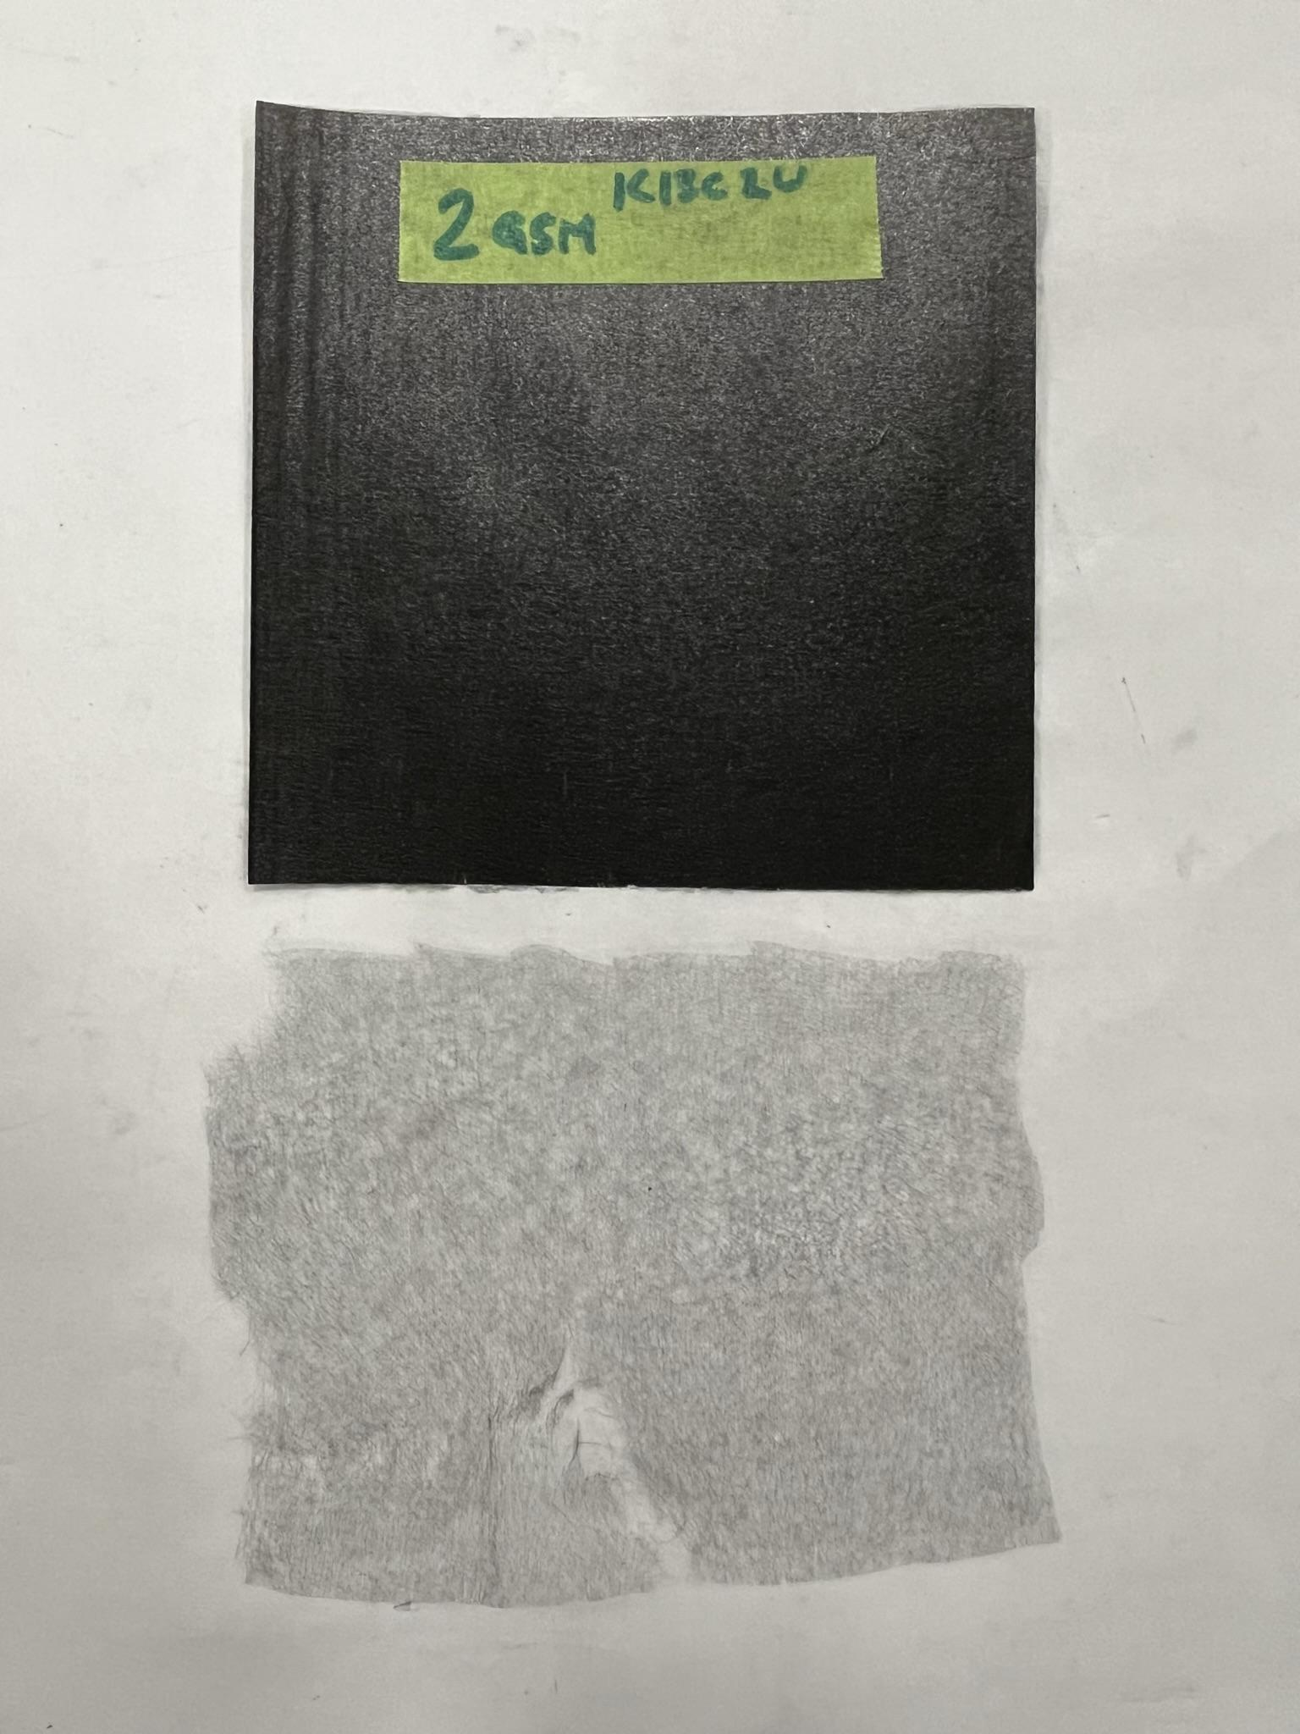
Materials
K13C2U Carbon Fiber
2gsm carbon veil

Slide 11
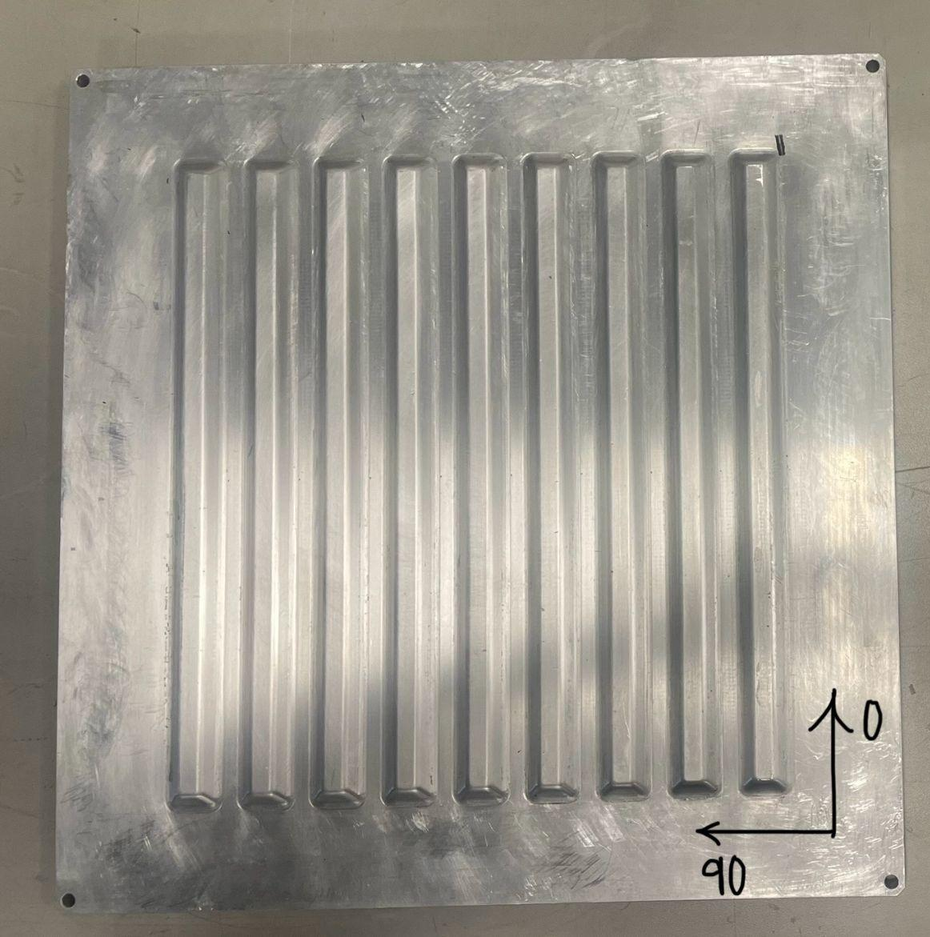
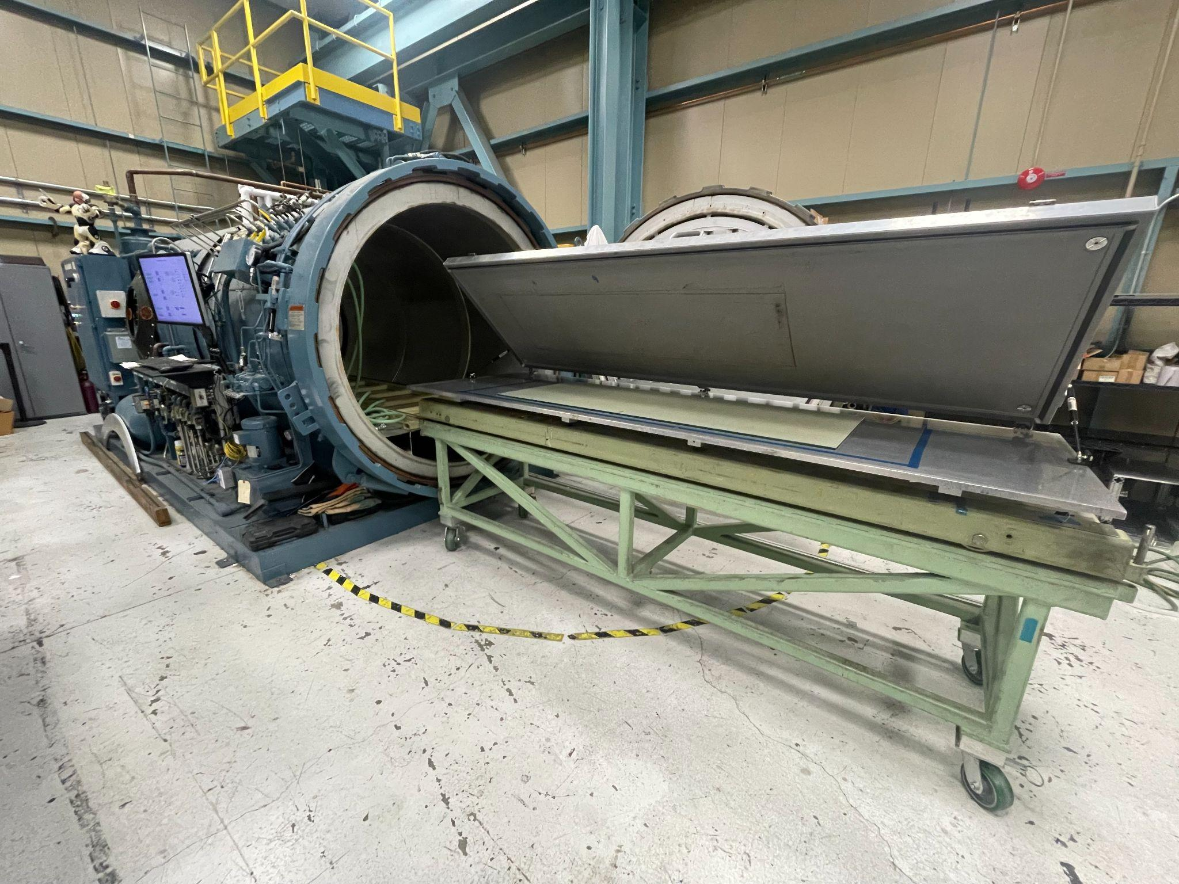
Tooling

Slide 12
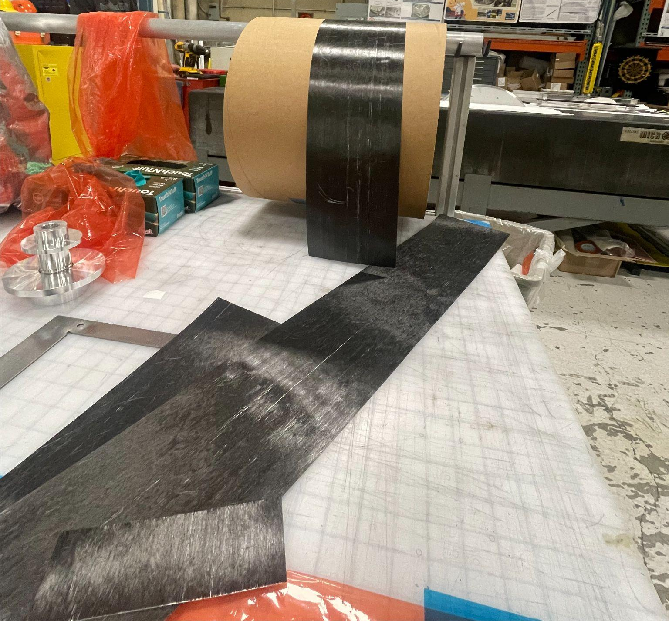
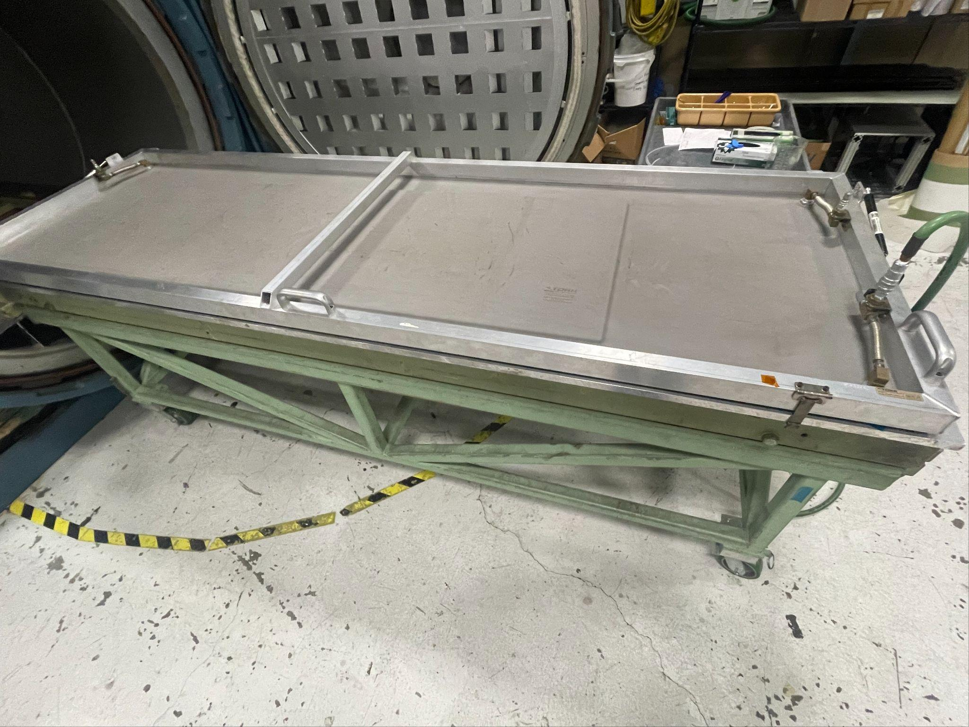
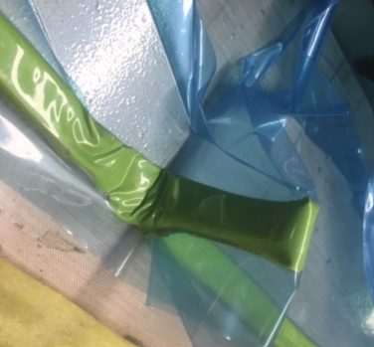
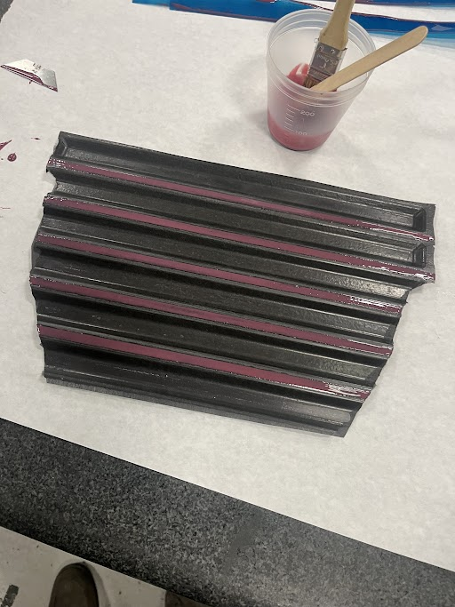
Procedure
Cut & prepare
Debulk
Vacuum bag
Glue
Cure

Slide 13
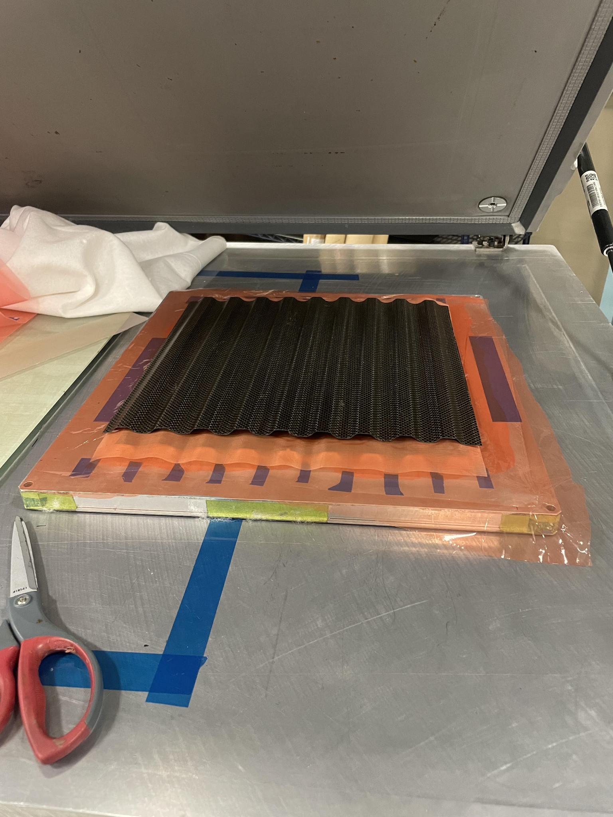
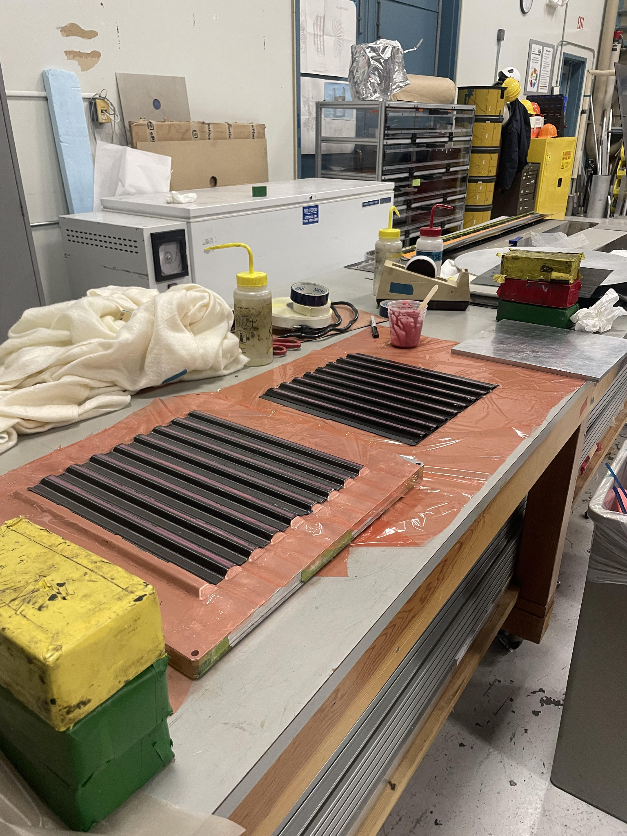
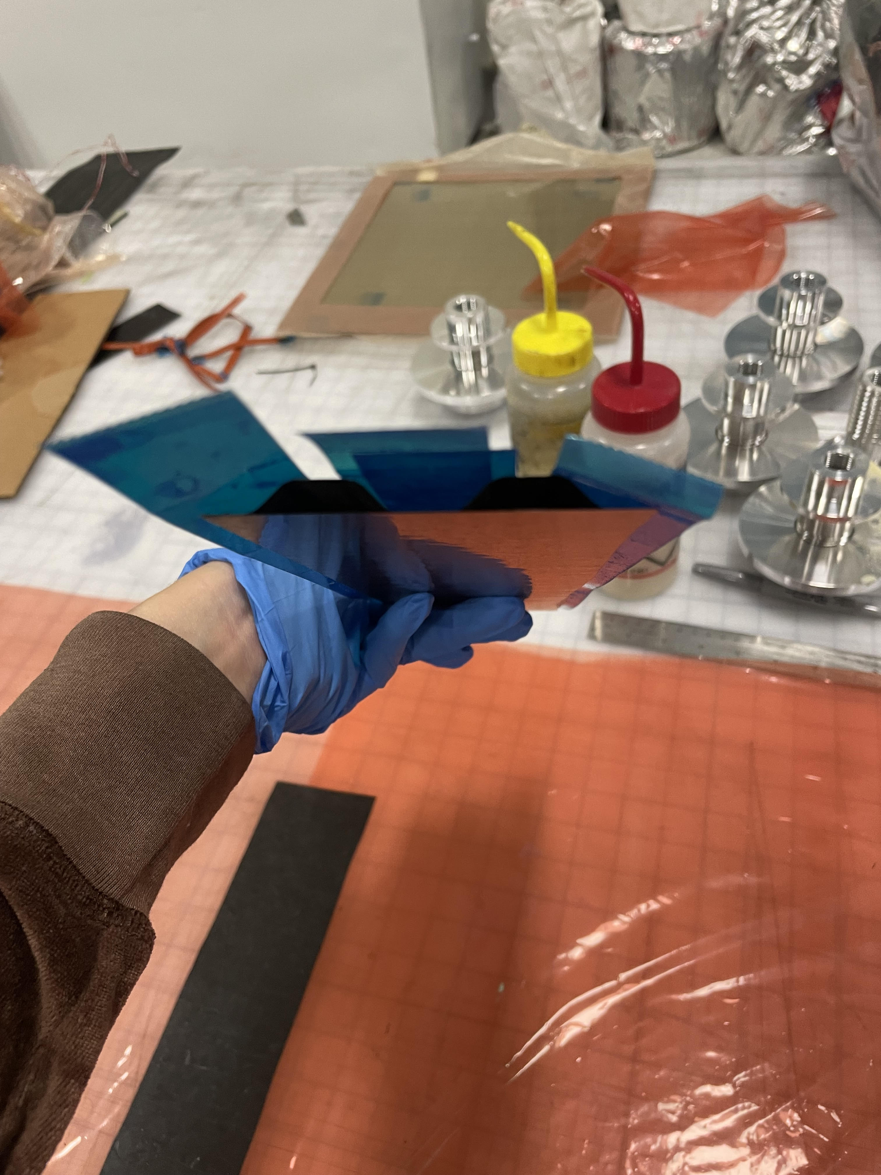
More Photos

Slide 14



Caul Plate
Issue
Approach
Impact
Struggle getting the k13 to stay flush to the mold, and hold shape.
Constructed a corrugated caul plate out of CN80 – a strong, heavy weave
The caul plate works as a pressure intensifier to distribute vacuum pressure equally and hold the K13 in place during debulking and cooking.

Slide 15
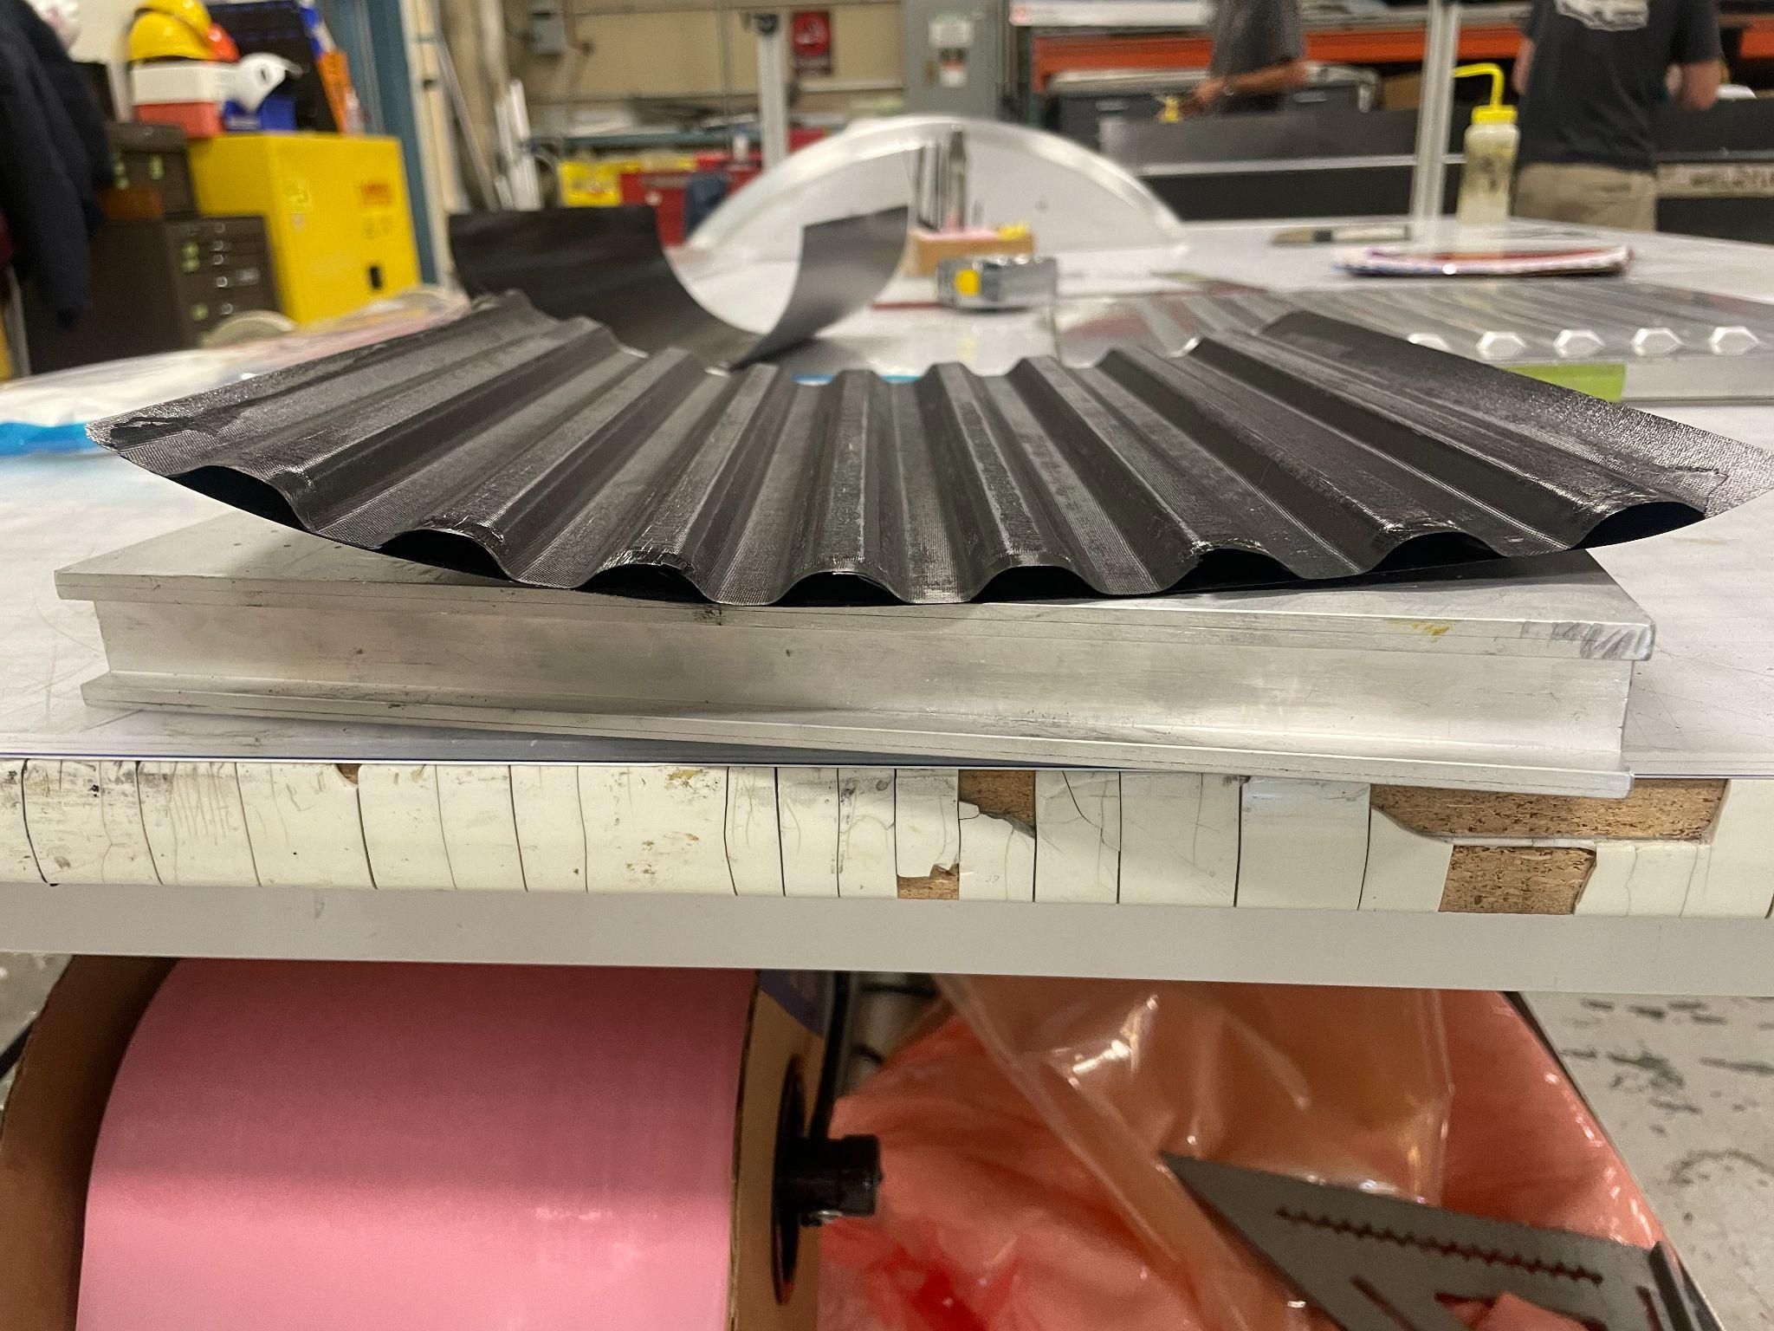
Early prototypes
I started off thin with 1 and then 2 layers
1 layer piece
2 layer piece
Pros
Extremely light
Good in density and strength
Cons
Quite weak in the direction orthogonal to the fibers as the only thing holding them together was the 2gsm veil
Warped, putting undue stress silicone sensors

Slide 16

Final laminate
We opted to go with the three ply laminate, which though heavier was strong and true to the mold. Testing continues on optimizing the orientation.

Slide 17
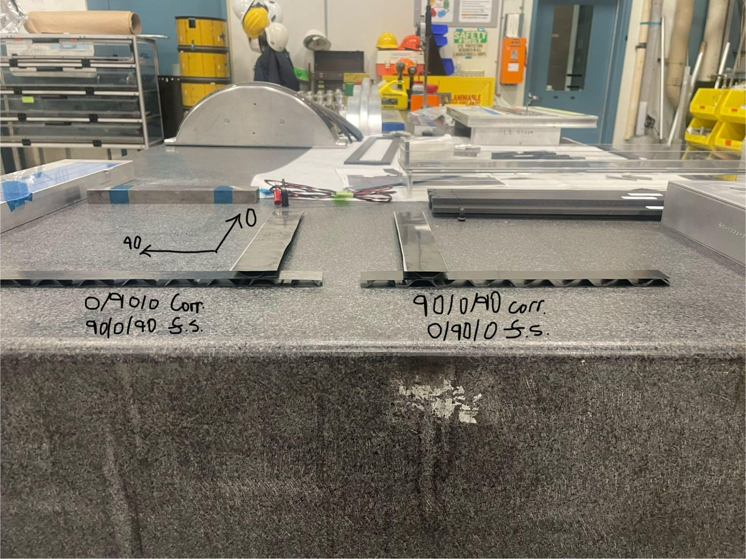
Corrugation layup orientation
0/90/0
  Face sheets are opposite (90/0/90)
90/0/90
  Face sheets are opposite (0/90/0)

Slide 18

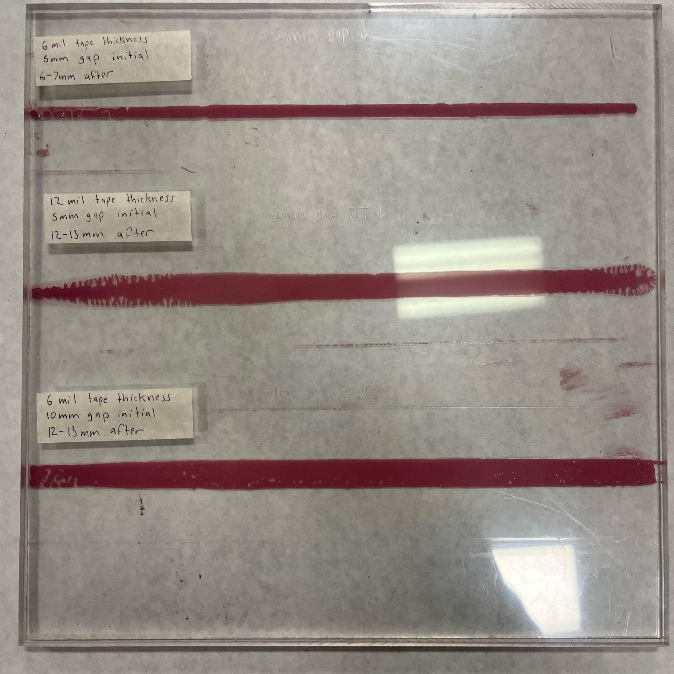
Gluing
Adhesion strategies
Adhesive tape
Boron (conductive)
Hysol 9309
Control taping
Key takeaway
The best option seems to be the Hysol 9309 in a 6 mil mm strip controlled by taping
Notes:
I have experimented with several different adhesion strategies: thin adhesive tape, heavy conductive boron glue, and hysol 9309. I have also experimented with amounts of glue and how to have a consistent glue amount. As of now, the best option seems to be the Hysol 9309 in a 6 mil mm strip controlled by taping. In some of the samples, I glued in pieces of conductive foam with the conductive boron glue as another heat sapping strategy. The air however cannot flow freely through the foam like it can the open corrugations so we may want to do a smaller piece of foam or no foam.

Slide 19
Densities
1 ply
2 ply
3 ply
Hysol 9309: 317.38 gsm
Adhesive Tape: 290.14 gsm
Boron Glue: 747.55 gsm
Adhesive Tape: 600.5 gsm
Hysol 9309 (6 mil tape 5mm width): 760.49 gsm
*Note: things that contribute to material budget include amount of prepreg K13, how much resin gets bled out with peel ply, glue type and amount. If foam is added, that will contribute as well.

Slide 20
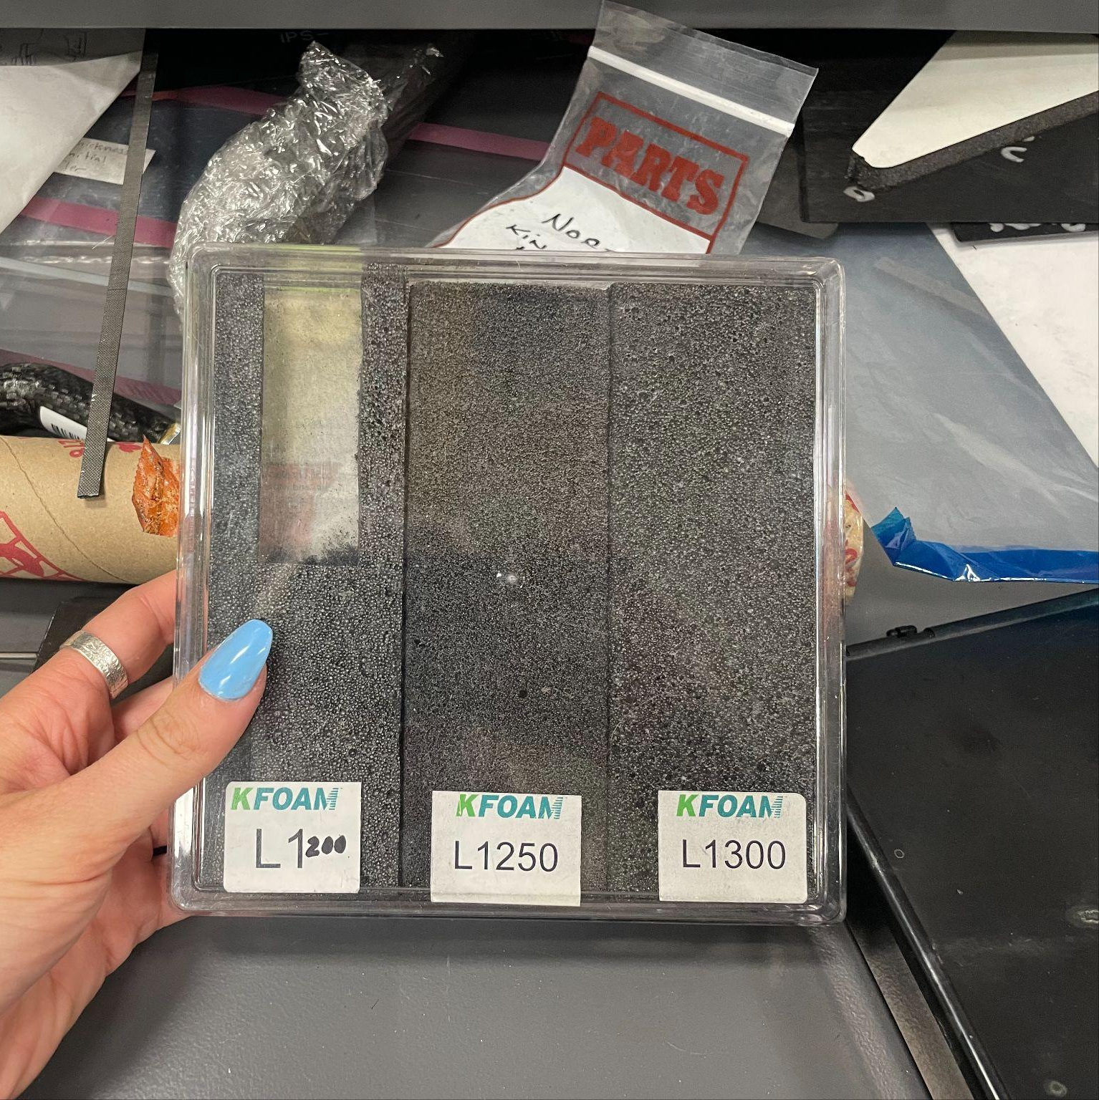
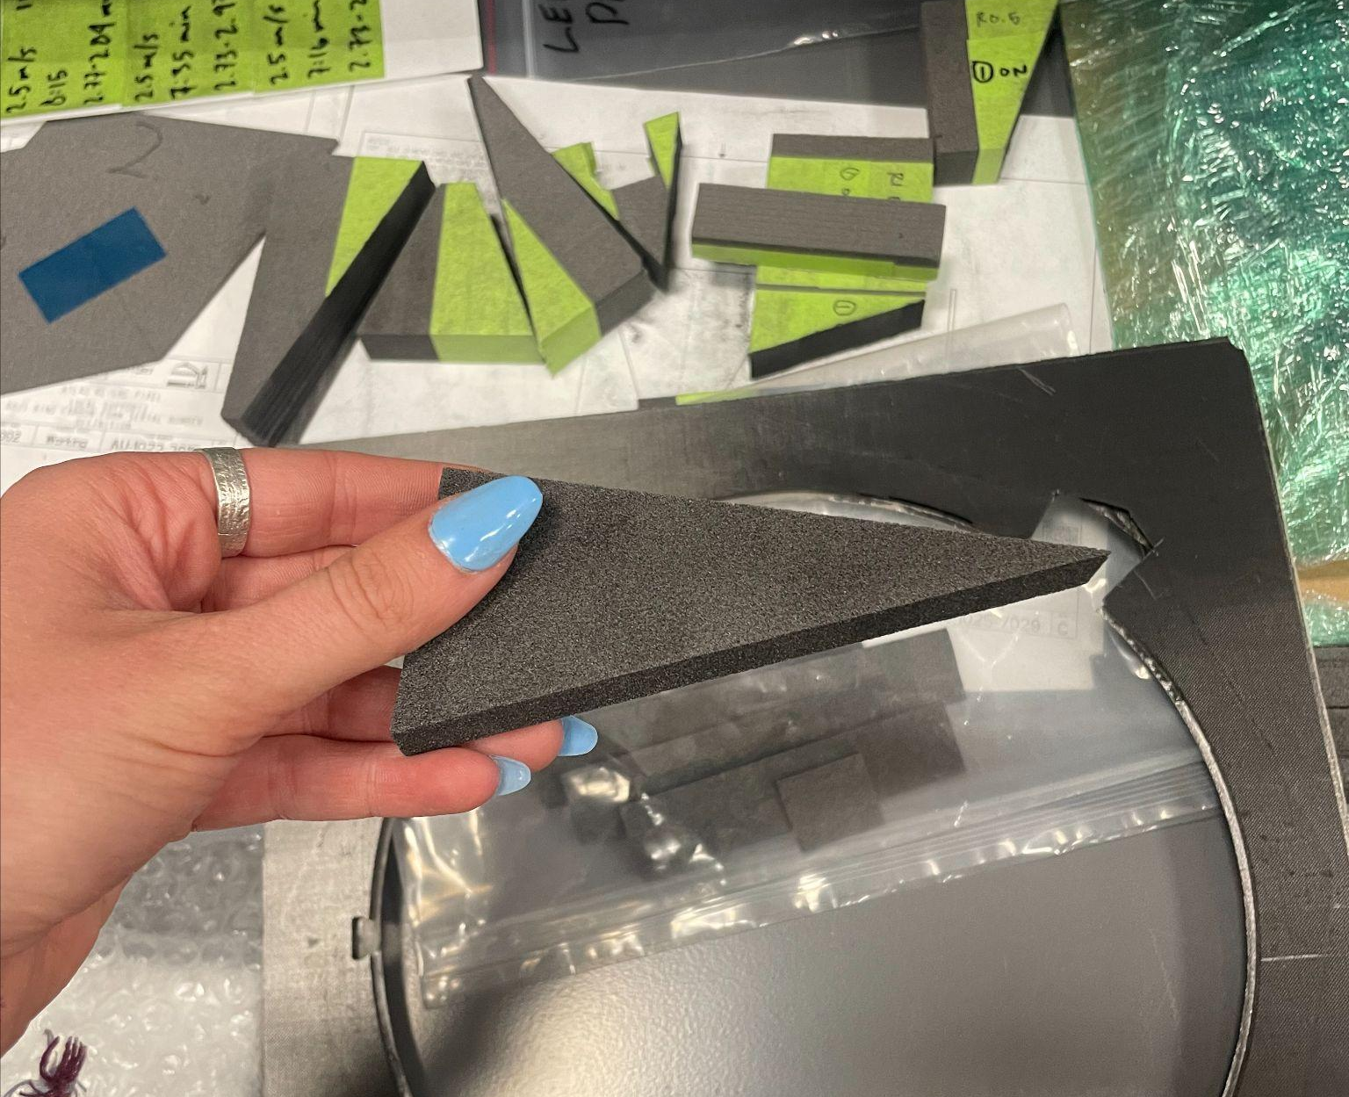
Conducting foam
Conducting carbon foam
Too dense to blow air through but saps heat very effectively
Potential next steps
Cut slots in the conducting carbon foam for air
Utilize a porous, less conductive foam
In some prototypes we put foam between the corrugations for cooling purposes

Slide 21
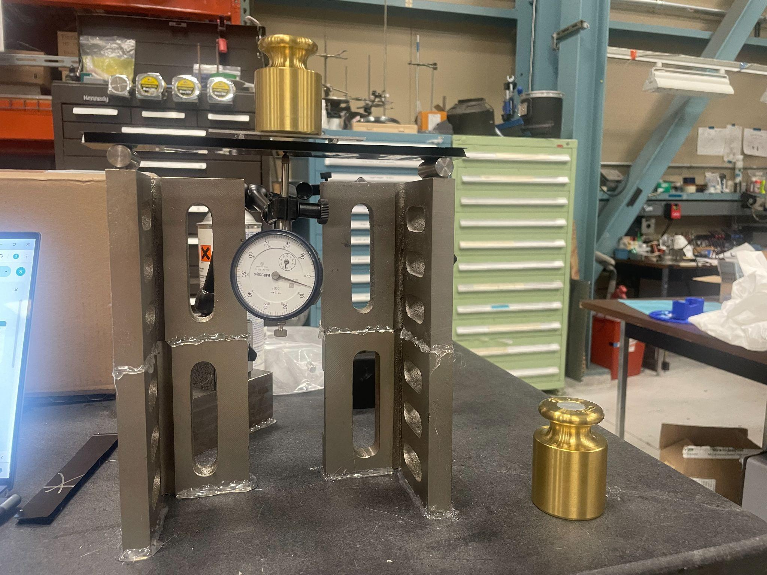

Four point bend test
*thermal tests being conducted by Nicole Apadula
Testing 4 pieces
With corrugation 90/0/90
Against Corrugation 90/0/90
With Corrugation 0/90/0
Against Corrugation 0/90/0

Slide 22

Summary
ePIC SVT needs a disc design that maximizes acceptance and minimizes material.
🡪 corrugated carbon fiber core
Currently making prototypes of different CF layups in different orientations to determine which ones satisfy all requirements (low material budget, strength, etc.)
🡪 3 ply final laminate 90/0/90 or 0/90/0

Slide 23
Next steps
Bend & thermal tests to confirm final laminate
Thermal tests with foam
Placing sensors on the carbon

Slide 24
Questions?

