Slide 1
The new Sit/Stand Desk

Slide 2
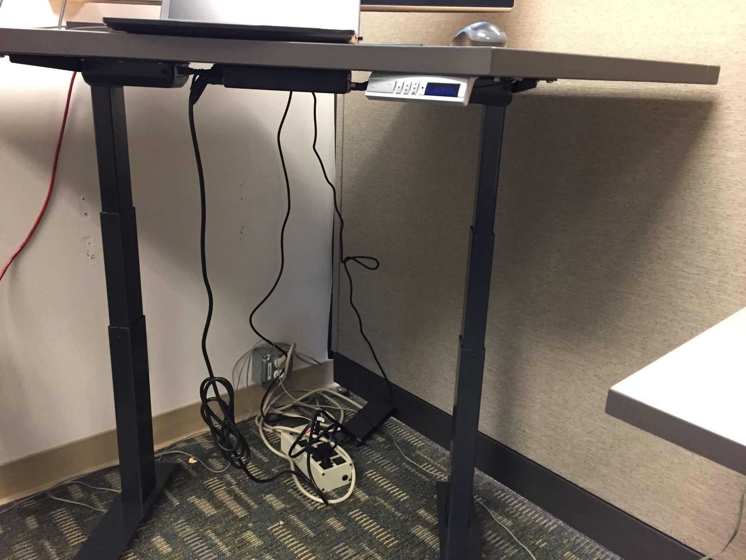
Hanging weight
Cable too close to legs
Rat’s nest

Slide 3
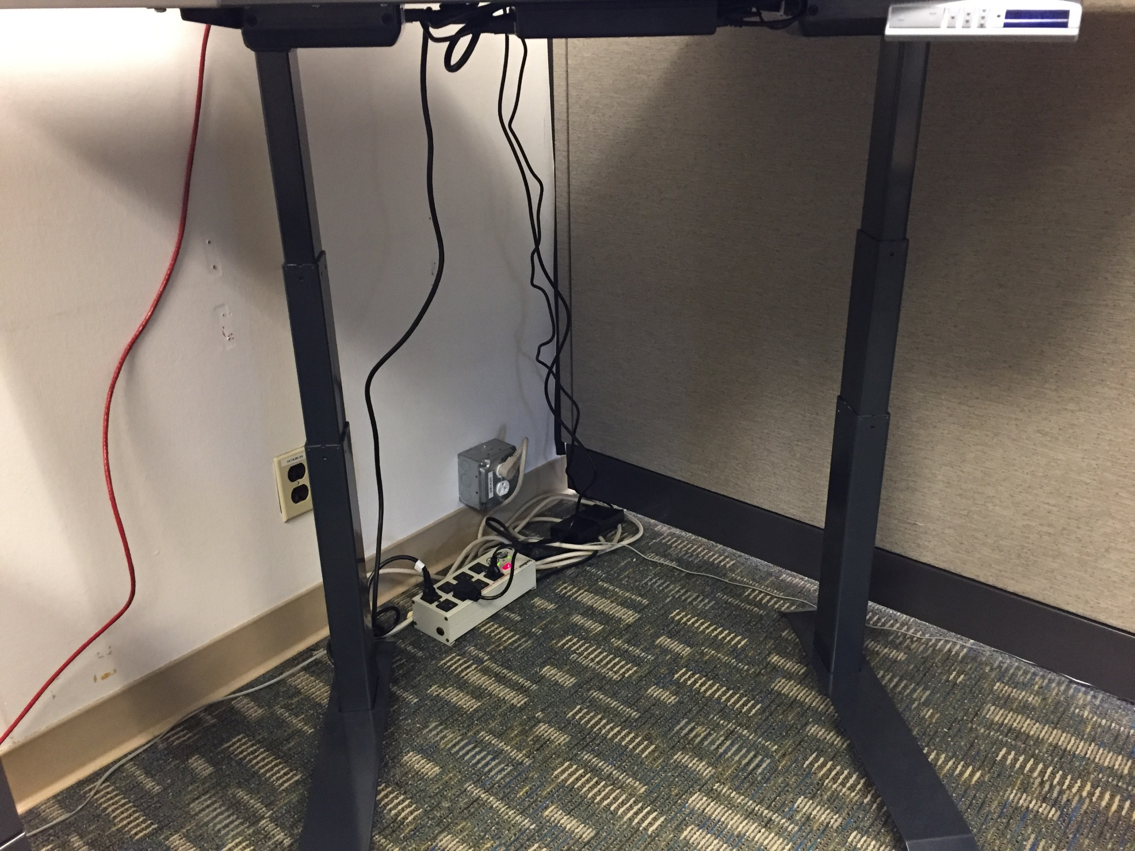

Slide 4
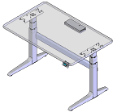


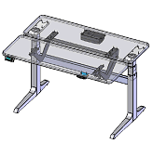


Safety Tips for Using Sit-Stand Electric Height Adjustable Desks
1 Minute
4 Safety
Electrical Safety
  All electrical cords and power strips should lay loosely on the floor, not strung tight, stretched or hanging
  Sit/stand desk should not pull on cords
  Make sure cords are cleared from any potential pinch points that can cause damage to the cord
Adjust Table Properly for You
  Adjust table to your proper sitting and/or standing heights
  Vary or change your position throughout the day
  Ask for assistance if you are unsure how to adjust your table
Avoid Hand Pinch Points
When making adjustments to your table avoid placing your hand(s) in locations that can get injured from any moving parts
For more information, contact the Ergo Team x6848 or ergo@lbl.gov
Visit Berkeley Lab EHS Ergo Website Table Adjustments and Tips for Standing and Moving at Work

