Slide 1
MDP Materials Meeting and Milestones Update
S. Krave,
US Magnet Development Program

Slide 2
Outline
Next Meeting
MDP Roadmap
Milestones
Naming Scheme
Database
Work at FNAL
Other

Slide 3
Next meeting
Is every other week an OK target?
Now is an OK slot for me, we have the REBCO Group on alternate Thursdays
Scheduling poll through outlook didn’t work, so I’ll look at a different poll option (doodle)

Slide 4
Goals of the Working Group
Develop Materials, and processes, and methods to inform better magnet designs
Characterize behavior that may lead to quenching as a result of modifiable material properties

Slide 5
Milestones currently in google doc…
Milestone # | Description | Target | Status * | Updated Target | Requestor | Comments
AIIIc-M1 | Demonstration of High Viscosity (Thermoplastic) Resin Systems for Superconducting Magnets | Jun-21 | Obsolete | Jun-24 | S. Krave | Initial attempts with thermoplastics proved challenging and require substantial additional resources. Negotiations are in progress with a partner to utilize injection molding equipment on subscale composites
AIIIc -M2 | Down-selection and Fabrication of CCT based on the above | Nov-21 | Obsolete |  | S. Krave | Listed as obsolete, can bring back based on the above if successful
AIIIc -M3 | Evaluation of de-sized glass | Dec-21 | Complete/in progress | Jun-23 | S. Krave | Samples have veen completed. Heat cleaned glass substantially outpreforms bare glass by 50%-100%. A followup task with re-sizing materials is added
AIIIc -M3b | Measurement of interlaminar Fracture toughness of Nb3Sn cable stacks and sensistivity to surface treatments |  | In Progress/Complete
AIIIc -M4 | Characterization of epoxy resin under gamma irradiation |  | Complete |  | T. Shen/ C. Reis
AIIIc -M5 | Evaluation of High Temperature compatible Mold Releases |  | Complete |  | S. Krave | Boron Nitride works OK. Nickel based plating (including nickel boron) is destroyed during heat treatment on stainless steel. Other substrates may be functional. Other resin systems may be compatible (release coatings are said to be comtatible with thermoplastics)
AIIIc-M6 | Evaluation of in-situ pre-impregnation silane treatment of de-sized cable | Mar-24 | Not Started |  | S.Krave
Potential Others:
Characterization of Filled Waxes
Thoughts on fillers?
Aluminum Nitride (high conductivity)
Low-Negative CTE materials
Develop and fabricate Multifunction cryo characterization probe
Like the Transverse Pressure Probe (TPI), but for generic applications (Slide later)
Does anyone other than me like the thermoplastic stuff? I have very little effort to dedicate to it
How do these fit in with conductor material properties
Do we send tested samples to LBNL for microscopy? How best do we manage this data?

Slide 6
Proposed milestones
Do conductor milestones get a different block?
I know there is much interest in properties of Bi2212, and REBCO Stacks
Compressive loading in 3 axis
CTE of composites
Modulus of 2212 cables at 4.2K

Slide 7
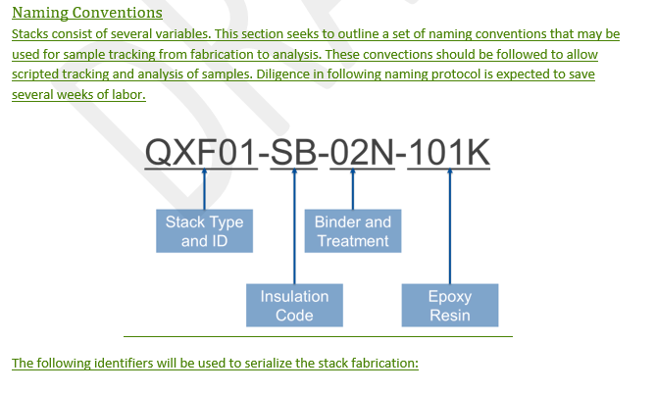
Naming Scheme
Does LBNL have an established naming scheme?
I tried locally establishing a scheme but did not have enforced data validation and ultimately failed.

Slide 8
Database
FNAL Database consists of several shared folders with no control.
Magnet data is stored in old sun database
Testing data for samples is scattered
For fusion materials in the FIRE proposal, a test database is desired, can we fulfill both:

Slide 9
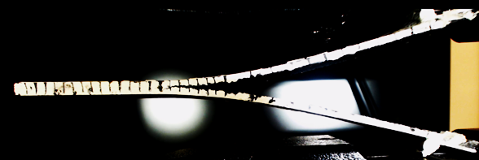
Interlaminar fracture toughness
Measurement System
Data is recorded by Instron and a webcam
What we are looking for
Results gained
Measured
Force (by Instron loadcell)
Displacement (by Instron)
Crack Elongation (by Webcam)
Time
Calculated
Strain Energy Release Rate (SERR)
Change in the measured results
A sample before testing starts
Sample during testing. Samples were painted white for contrast.

Slide 10
Measure debonding energy of cable/insulation systems.
Additional samples are in fabrication
Planning on the following so far:
CTD-101K, standard glass, no binder
CTD-101K, heat cleaned glass
CTD-101K, Heat cleaned, the post reaction sized glass
Post reaction re-sized glass

Slide 11
Measurement of CTE of material using Fiber Strain Sensing
Similar to measuring CTE of materials using conventional strain gages, it can be measured using distributed strain sensing fiber
https://docs.micro-measurements.com/?id=2414
A standard test block is being developed for fast and repeatable instrumentation that allows multiple samples to be measured simultaneously

Slide 12
General Purpose Low Temperature Pressure Probe
Lock nut for changing to tension mode
Load frame to react compression mode
Through Hole cylinder to apply ~200 MPa to 20mm x 50 mm (20 ton)
Teslatron mount plate
60 mm outer diameter (or VTI OD)
ID Pushrod sized to maximize buckling load and minimize total heat leak/mass
Instrument thin wall with strain gages and calibrate for force sensing
Interchangeable load head using Instron Style coupling if it fits
Fiber-optic interferometry for displacement and dilatometry (S. Holl, https://cds.cern.ch/record/2845427/files/CERN-THESIS-2022-274.pdf)
System is a large pushrod
Design for maximum buckling load or equal cross section (needs some optimization)
though pushrod can be used to stabilize bucking mode
Use through hole or dual acting cylinder to apply either tension or compression to sample
Use inner and outer leads as current leads
Wrap in HTS to reduce He Consumption
Where applicable, insert G-10 electrical and thermal brakes
20 Ton

Slide 13
Plots of properties for stainless steel
Example calculations of losses/resistivity/ stress etc for stainless
Something like bronze may be better for electrical conductivity, and soldering.
Stainless could be copper/silver plated as well
Heat leak will be large and need some optimization.
Maybe stick a roller screw at the bottom and generate force internally

